Slide 1
California EIC Consortium
Summer 2025 Meeting
Welcome to Cal Poly Physics
Jenn Klay
July 28, 2025

Slide 2
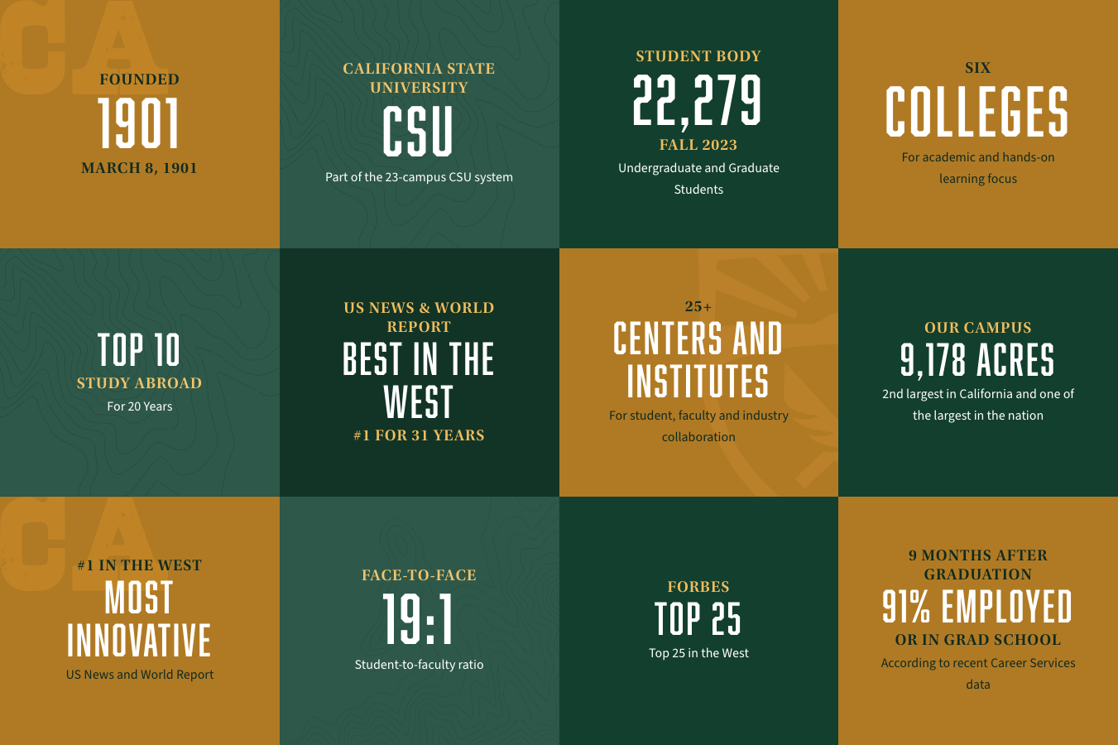
Welcome to Cal Poly
Big Sky Conference
(Homecoming game is Oct 4 against UC Davis)
John Madden, Weird Al Yankovic, Victor Glover are notable alumni
Notes:
Madden Center ($45 million) opening Winter 2026

Slide 3
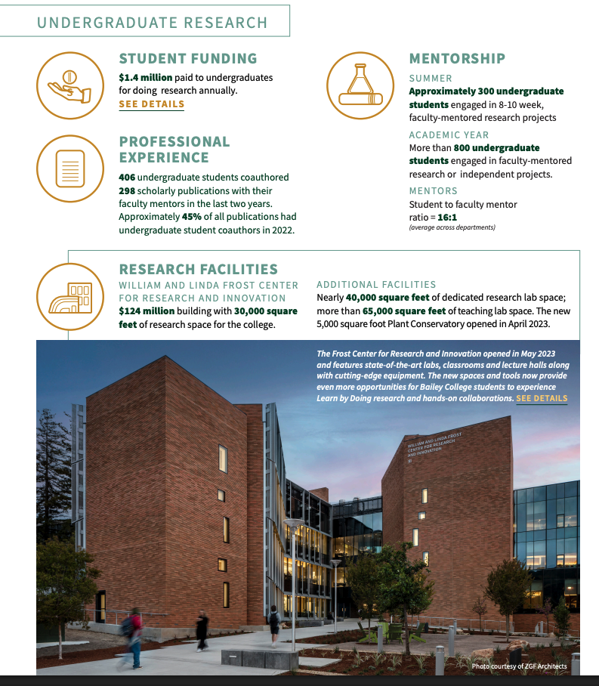
Bailey College of Science and Mathematics
Seven Departments, One School, Eleven Majors
Biological Sciences, Chemistry and Biochemistry, Kinesiology and Public Health, Liberal Studies, Mathematics, Physics, Statistics, School of Education

Slide 4
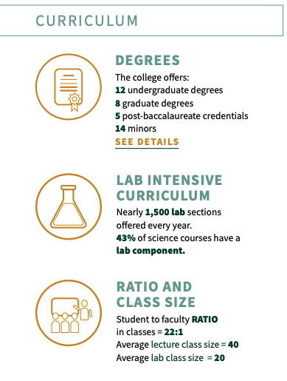
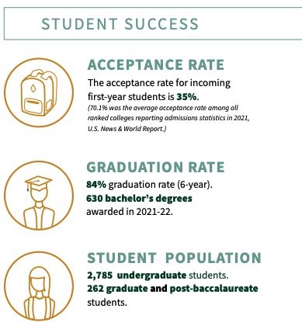
Bailey College

Slide 5
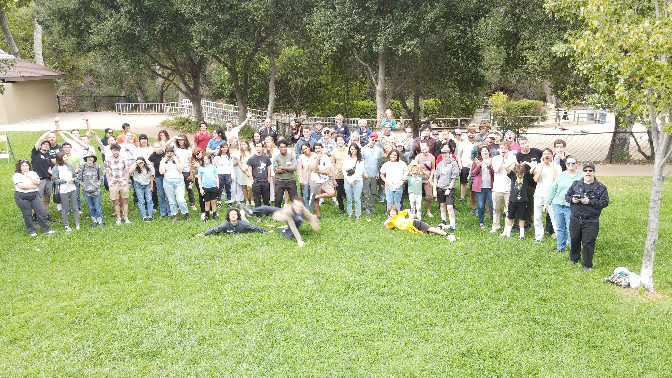
Cal Poly Physics: Who are we?
35 tenure-track faculty
15 full-time lecturers
5 staff members
~200 physics majors
4 student clubs
  Society of Physics Students
  Women in Physics
  Minorities in Physics
  Sigma Pi Sigma National Honor Society
Small class sizes, direct interaction with PhD faculty
Fall 2023 Department Picnic at Cuesta Canyon Park
Notes:
Astronomy Club – broader than our department
We want to build your sense of community from day 1 – you belong in our department and help make it what it is

Slide 6
Cal Poly News
We have merged with Cal Maritime Academy (Vallejo)
We are hiring!
We are switching to semesters in Fall 2026
Tenure-track search for assistant professor to be announced August 1, other positions likely in 2026-2027

Slide 7
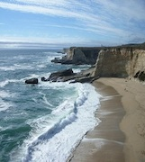
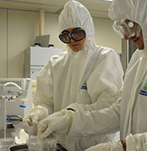
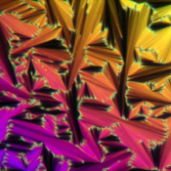
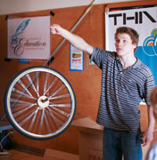
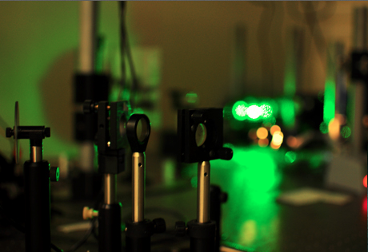
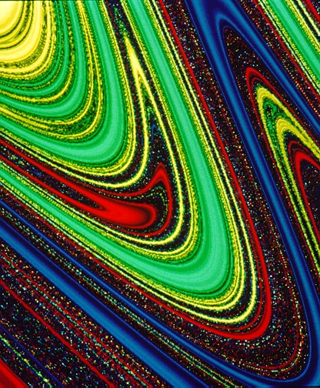
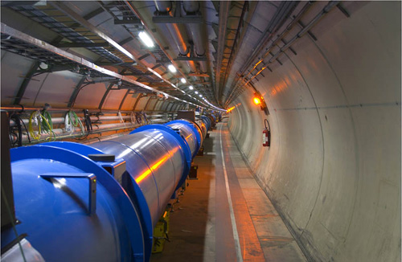
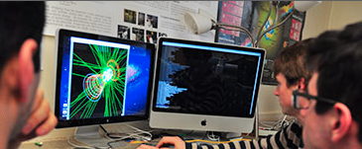
Research Areas in Cal Poly Physics
Accelerator Physics
Astronomy & Astrophysics
Atomic, Molecular, & Optical Physics
Computational Physics & Scientific Computing
Cosmic Evolution
Fluid Mechanics and Physical Oceanography
General Relativity, Gravitation, and Black Holes
Geology & Geophysics
Nonlinear Dynamics
Nuclear & Elementary Particle Physics
Physics, Astronomy, & Teacher Education
Renewable Energy, Appropriate Technologies, and Sustainability
Soft Condensed Matter Physics
Solid State Physics

Slide 8
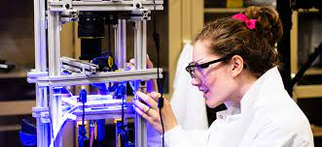
Many ways to get involved
PHYS 220: Introduction to Physics Research (Year 2 Fall)
Frost Summer Undergraduate Research Program
  Earn a stipend for working 8 weeks full-time with a faculty member on research
  End-of-summer symposium
  Weekly seminar, social events
Faculty-led research projects
(paid by federal grants)
Independent Study Classes
(PHYS/ASTR/GEOL 200, 400, 404)
Senior Project (PHYS 461/462) – individualized one-on-one experience

Slide 9







Career Exploration
Physics Majors are often hired into engineering roles
Many activities to prepare for careers in industry
  PHYS 100: Career exploration activities
  PHYS 220: Career Center visit
  Resume building/Statement of purpose workshops
  Industry alumni visits, colloquium, meet-and-greet
  Faculty advising, Career Facilitation Committee

Slide 10

American Physical Society Conference for Undergraduate Women and Gender Minorities in Physics (CU*iP)
Plenary speakers, research talks, networking events, workshops, career panels
Building community for women and gender minorities in physics

