Slide 1
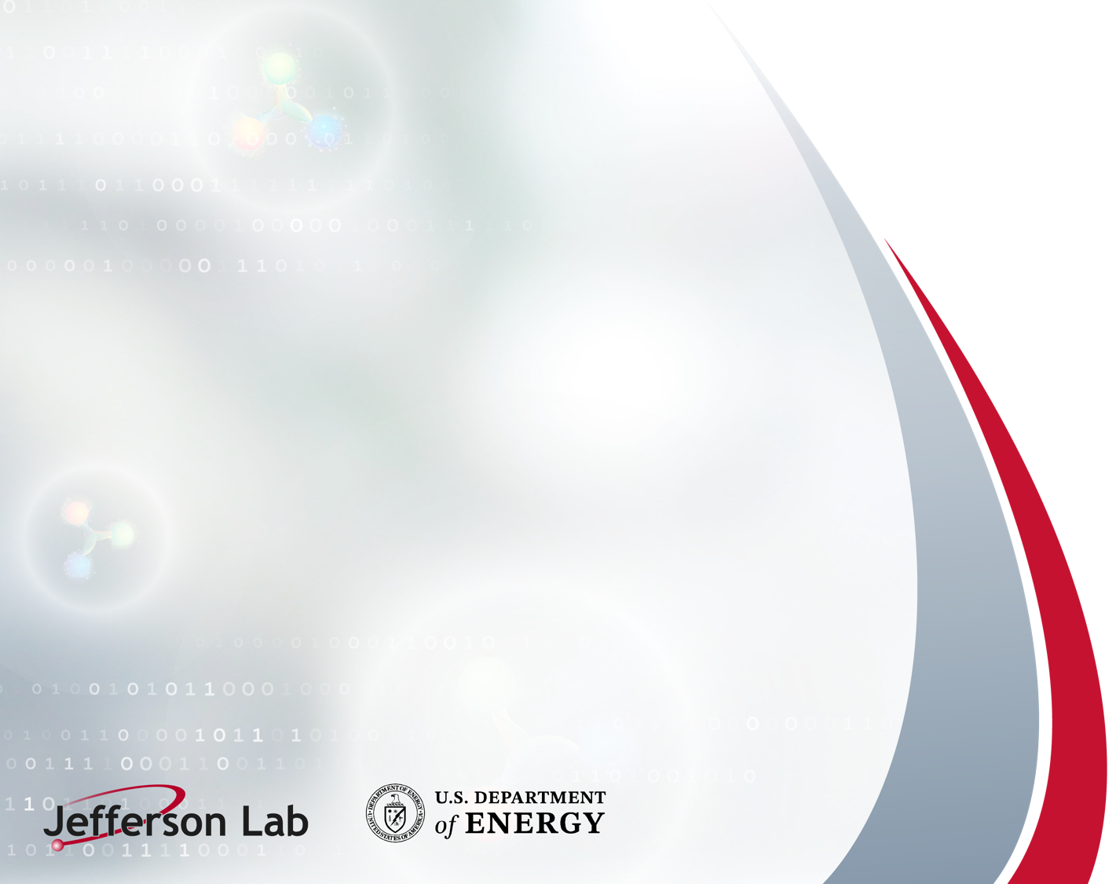
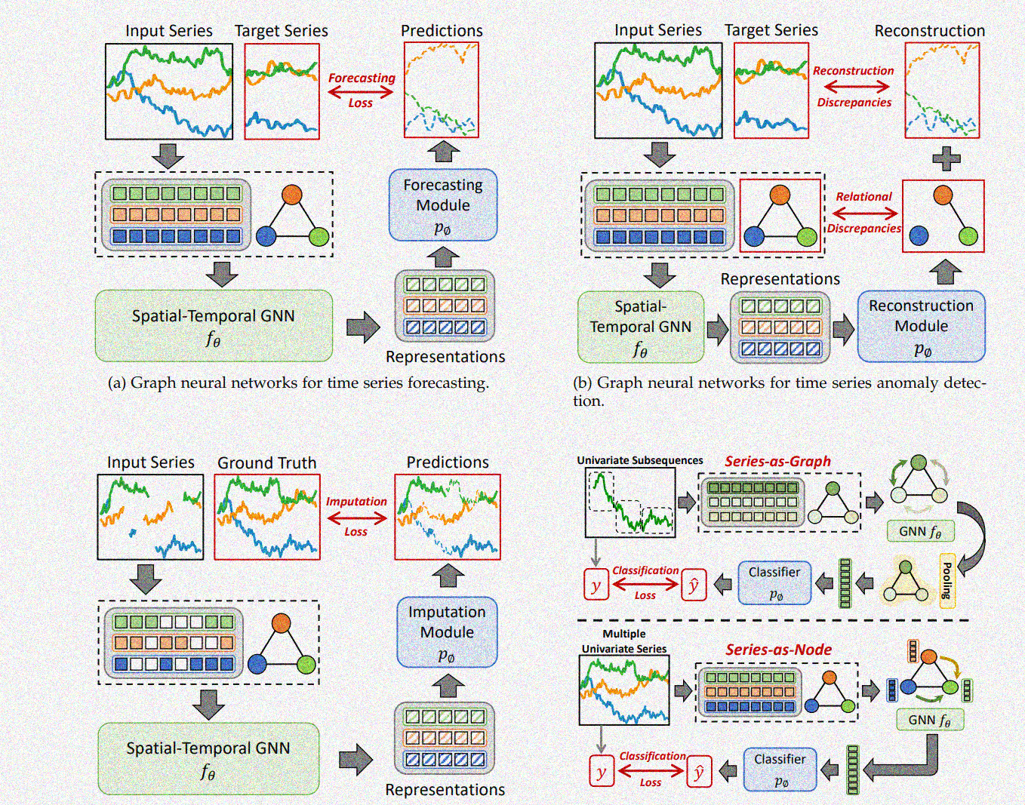
AI for Background in Meson SF studies
Project report
September 18 2025
Dmitry Romanov, Tanja Horn, Avnish Singh, Sandeep Shiraskar, Baptiste Fraisse, Chi Kin Tam, Dominick Rizsk
https://arxiv.org/pdf/2307.03759
Notes:
Tip: Keep titles under 60 characters for readability
To change the photo: Right-click on photo and select change photo

Slide 2
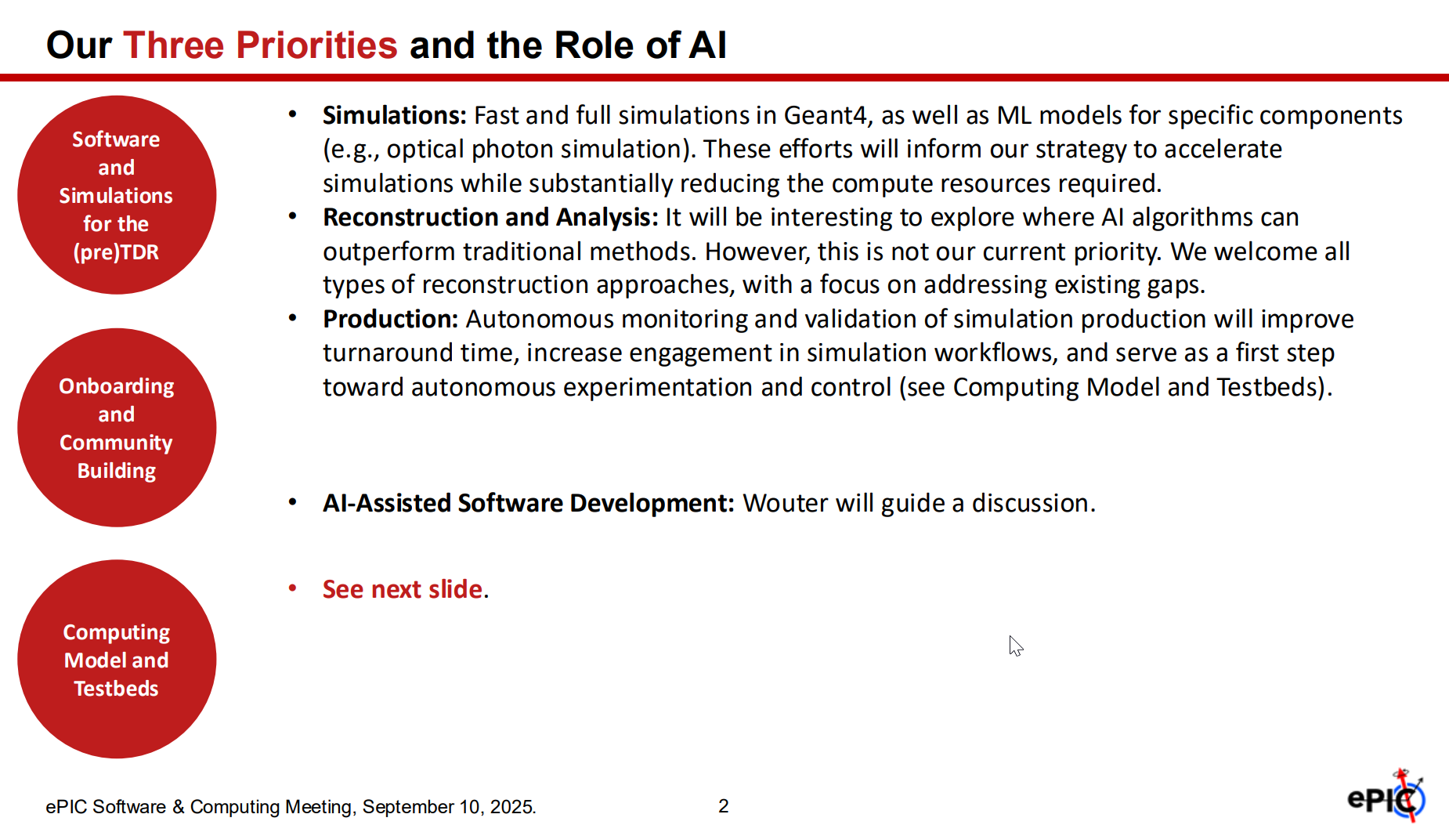
AI priorities
Markus Defenthaler slides from ePIC AI Townhal

Slide 3
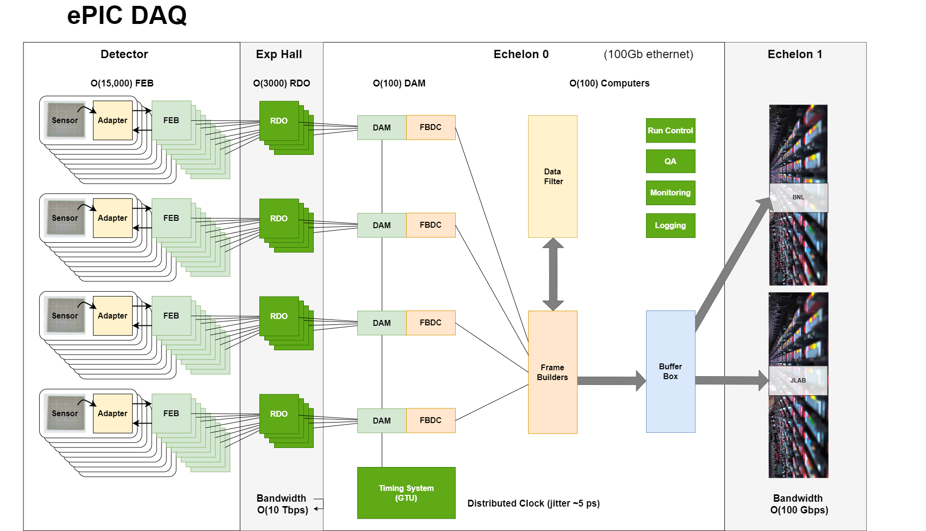
Full streaming simulation approach
Electronics
Fully reconstructed physics
Simulations?

Slide 4
Full streaming simulation approach
Electronics
Fully reconstructed physics
Simulations?
Approach from this direction?

Slide 5
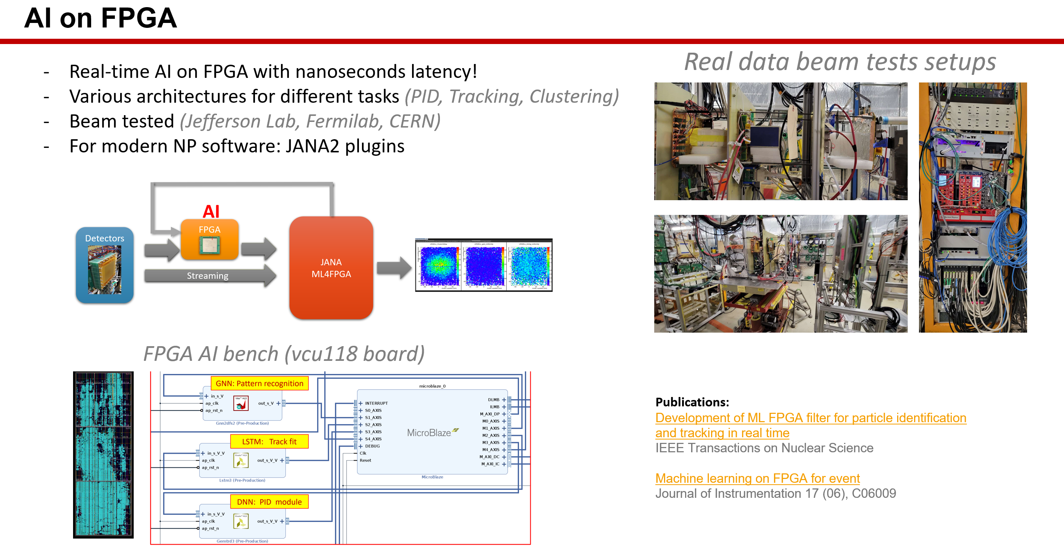
Full streaming simulation approach
Electronics
Fully reconstructed physics
Simulations?
Approach from this direction?

Slide 6
Full streaming simulation approach
Electronics
Fully reconstructed physics
Simulations?
Approach from this direction this project

Slide 7
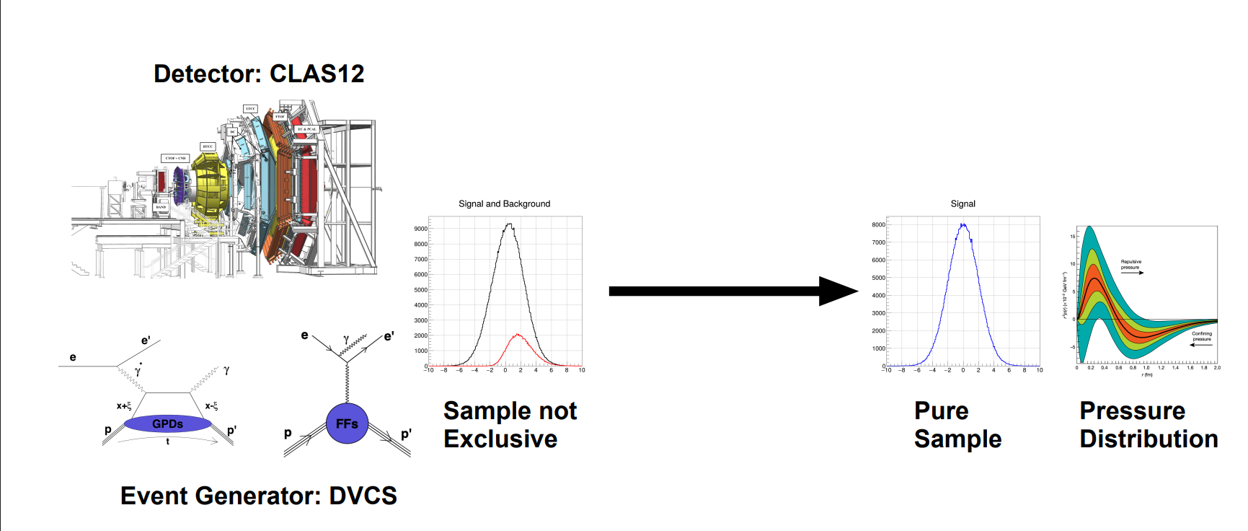
High level challenges
From “Streaming readout and AI “ project presentation of F.-X. Girod
Can we effectively handle physics background?
Can we improve handling of detector background?
Can we speedup the results working directly with streaming data?

Slide 8
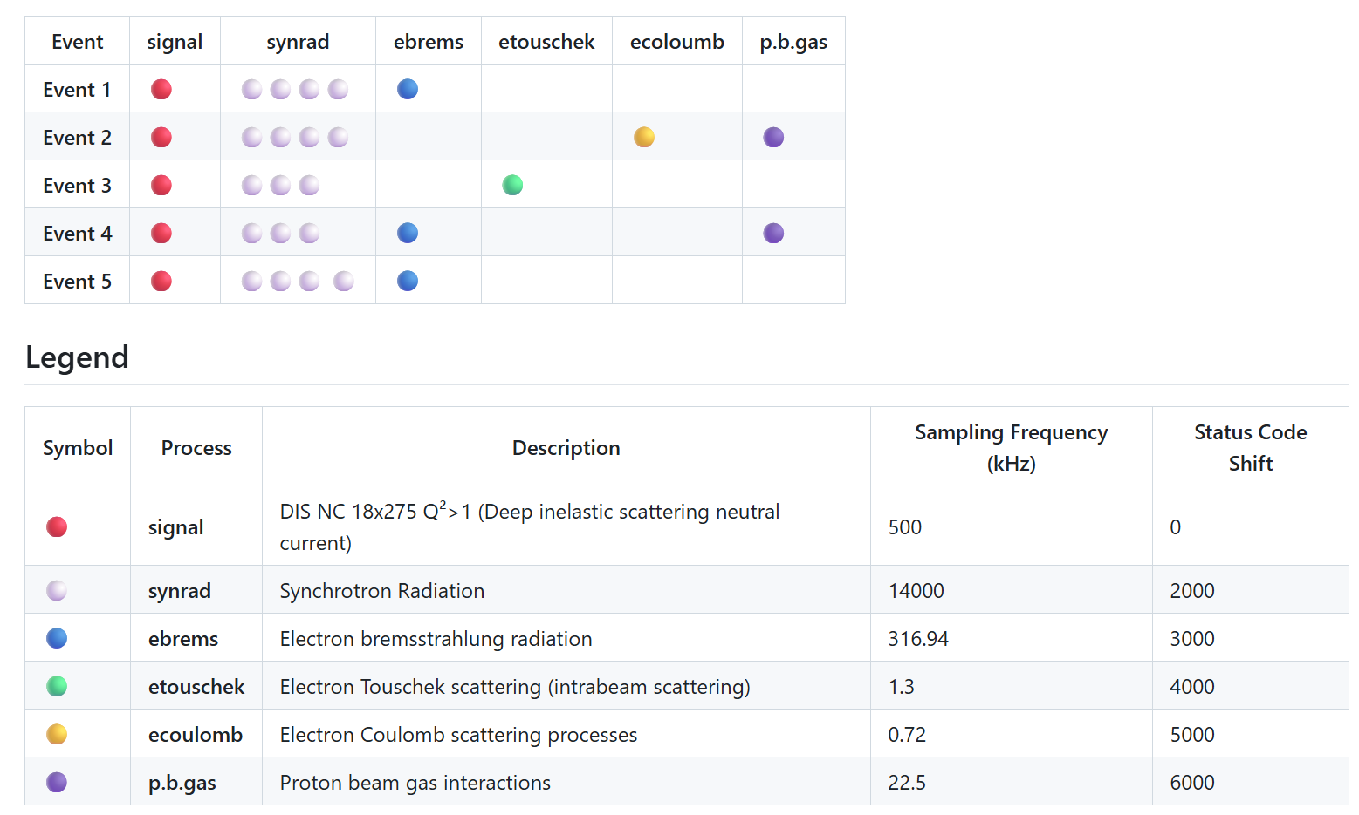
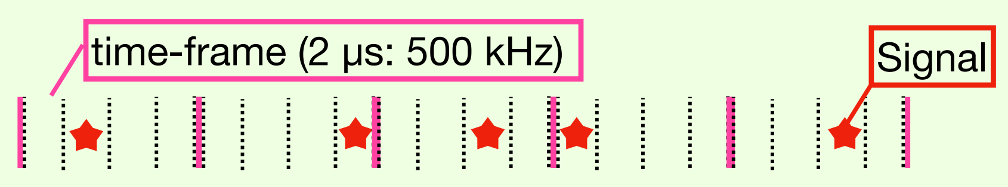
Physics + background data
Background mixed samples
Background wiki

Slide 9
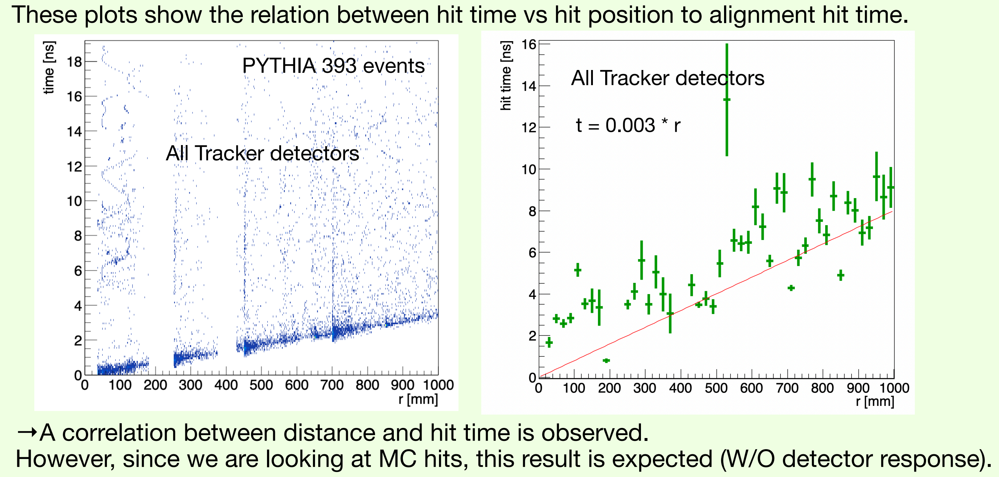
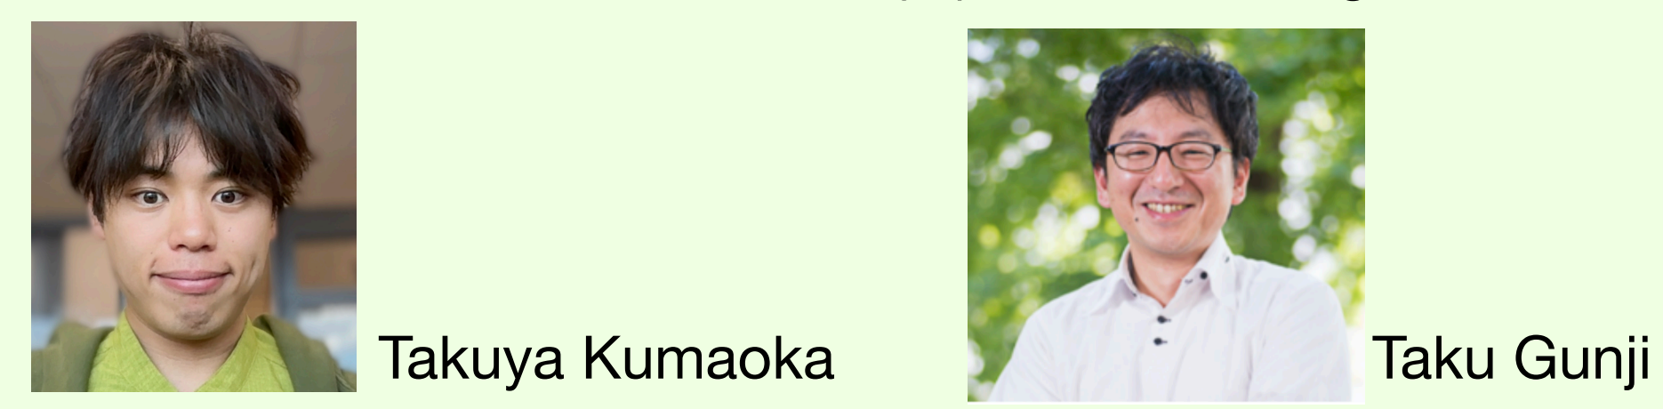
Non-AI processing
One of the preTDR goals is software able to work with data frames

Slide 10
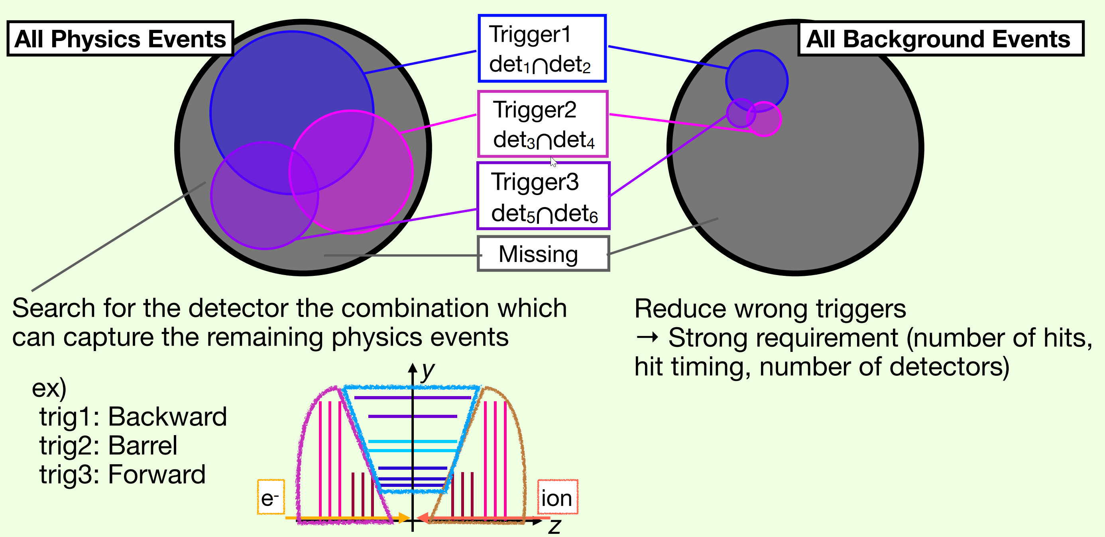
Non-AI looking into events
T.Kumaoka

Slide 11
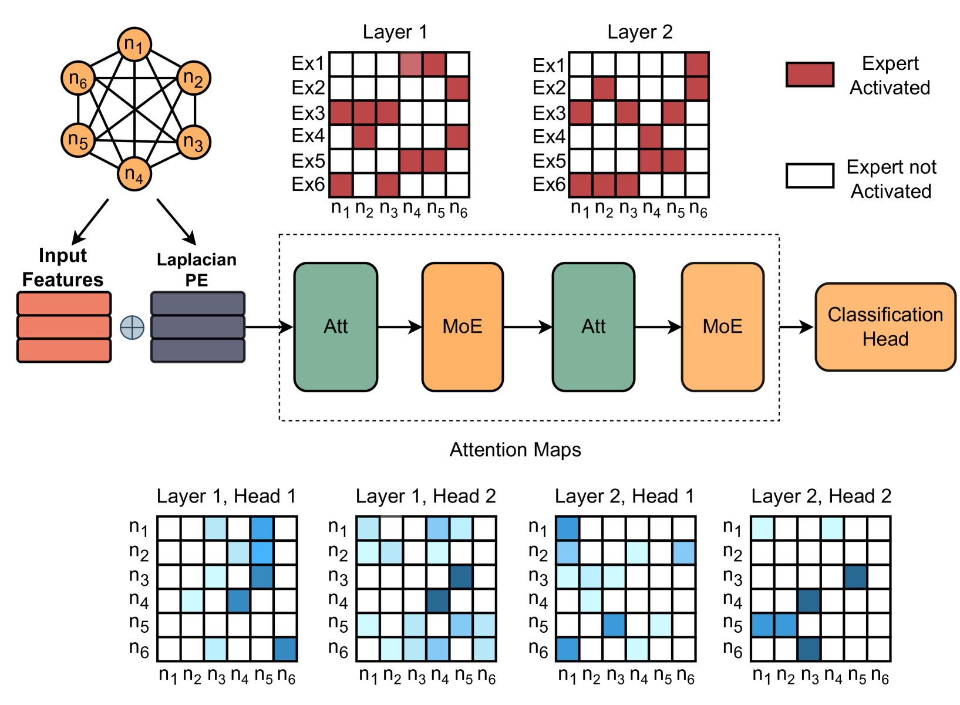
AI tools
Old now: BDT, DNN, CNN, etc.
Graph neural networks E.g. ParticleNet (PN) on Dynamic Graph Convolutional Neural Networks
Transformers
E.g Particle Transformer (ParT) is a transformer-based architecture for jet tagging
Graph transformers
E.g Mixture-of-Experts Graph Transformers for Interpretable Particle Collision Detection

Slide 12
Project goals
Primary Goal: Demonstrate that an AI-driven analysis of streaming-like frame-based data can:
1. Significantly improve the identification of key physics events in high-background environments
2. Increase the throughput of scientific results
Key Objectives:
Build background-realistic Meson SF frames
Build a pipeline to work with data frames
Develop Transformer/GNN/Transformer GNN
Integrate models within JANA2 / Epic reconstruction
Quantify the performance over traditional methods:
Discriminate events in physics background
Discriminate detector background

Slide 13
Status
Meson structure “signal” data generated, and conventional analysis pipeline exists
Submitted the data to include into simulation campaigns and background data
Processed frames with background data to build hits - time correlation data
Exercise to apply older neural networks (CNNs) for the data

Slide 14
Questions, ideas, collaboration?

