Slide 1

Luminosity Monitoring at the Electron-Ion Collider
Alex Smith
University of York
Dr. Nick Zachariou, Prof. Dan Watts
alex.smith3@york.ac.uk

Slide 2


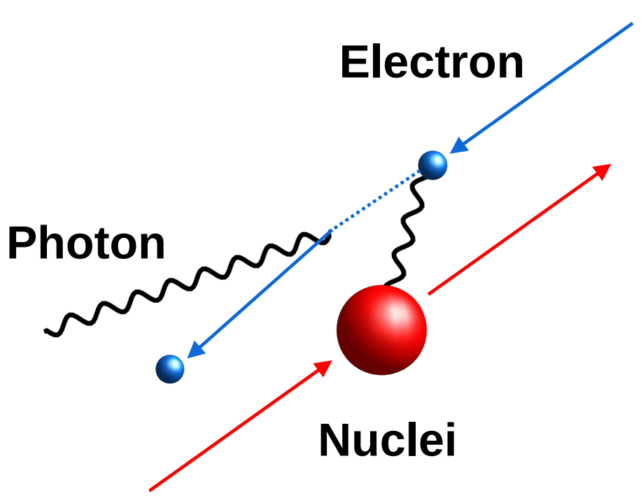
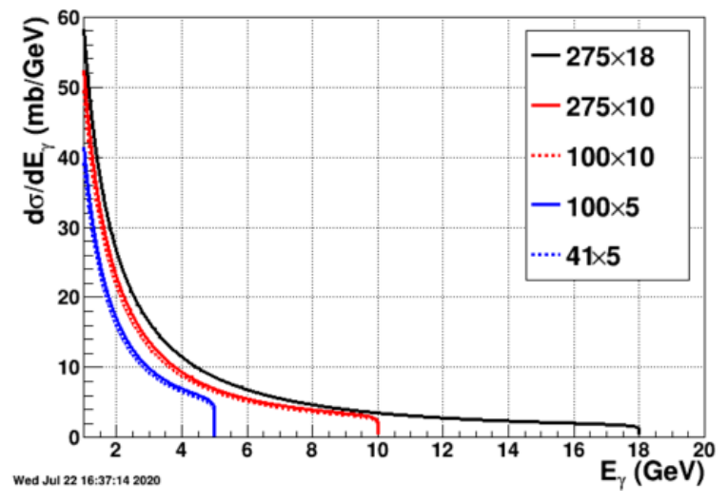
Bremsstrahlung
ep → epƔ, eA → eAƔ
Bremsstrahlung cross section known from QED (~0.5%).
σ_{eA} = Z_{A}² σ_{ep}.
From the rate of bremsstrahlung events and the energy of the photons, the luminosity can be found:
E_{p} x E_{e}
L = σ⁻¹ R
Figure - Dr. Dhevan Gangadharan, Houston; EIC yellow report.

Slide 3
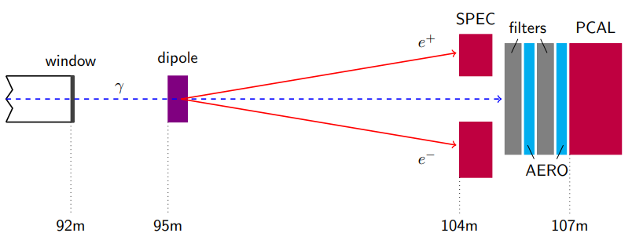
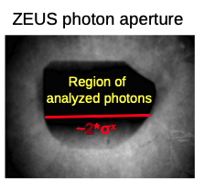
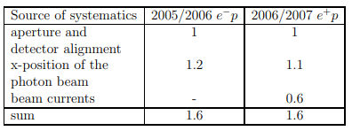
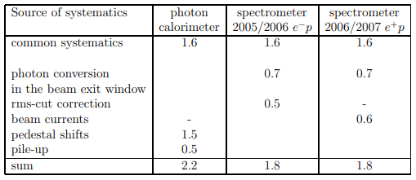
Lessons from the ZEUS Monitoring System
Dominated by poorly defined photon acceptance window.
Calibration of PCAL proved a significant issue.
Exit window thickness and material was not strictly controlled.
Thickness of exit window led to very high rates at pair spectrometer.
https://doi.org/10.1016/j.nima.2014.01.053

Slide 4
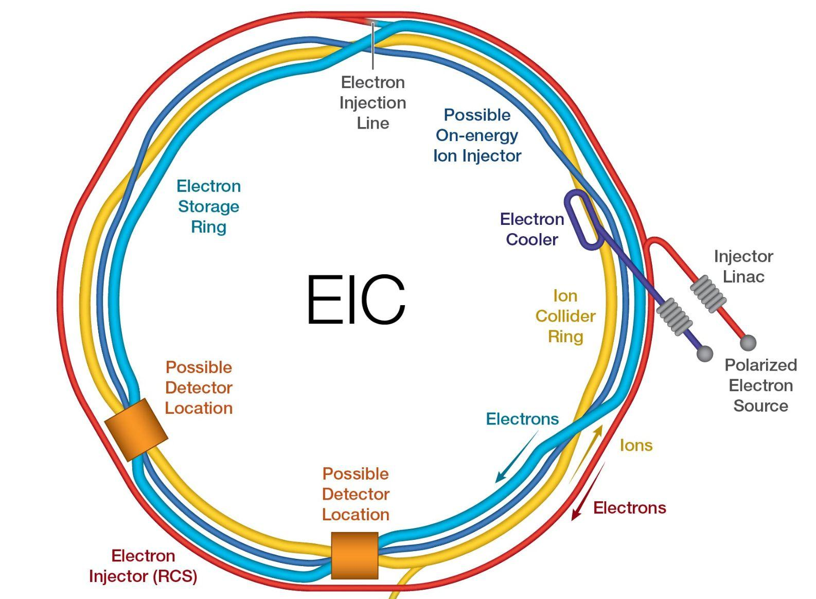
ePIC Requirements
EIC target luminosity 10³⁴ cm⁻²s⁻¹.
2 x 10³² cm⁻² s⁻¹ for early science.
Precise determination of absolute luminosity at 1% level.
Precise determination of relative luminosity at 10⁻⁴ level.
Complementarity and redundancy.
10³⁴ cm⁻²s⁻¹
EIC yellow report; https://agenda.infn.it/event/43344/contributions/250126/

Slide 5
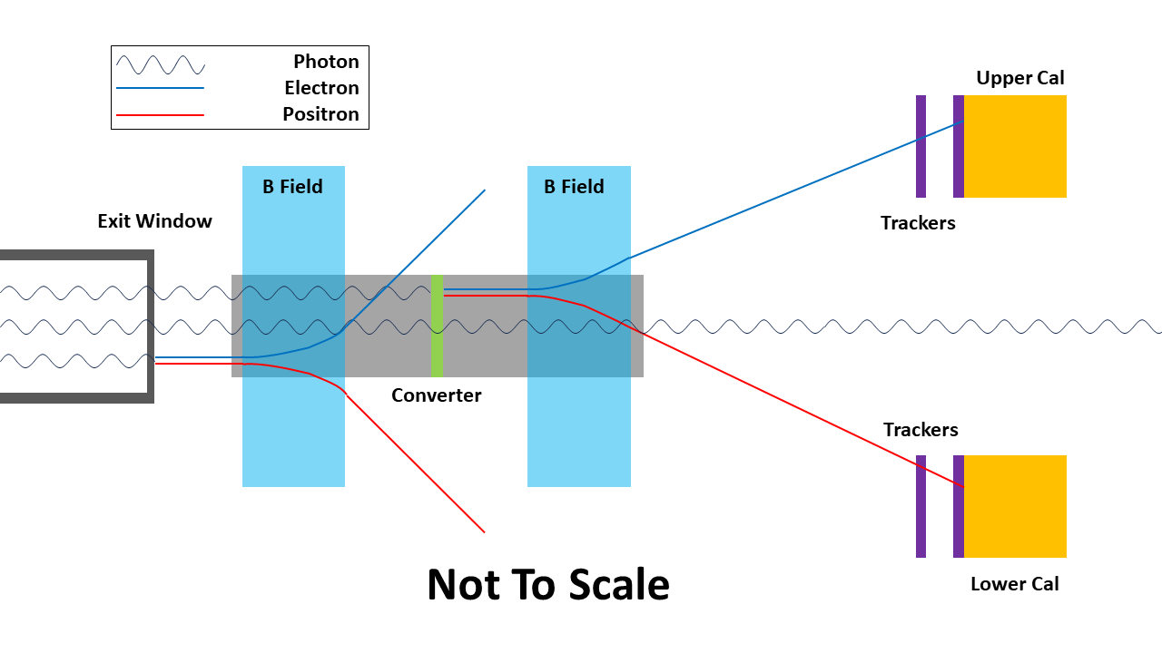
ePIC Monitoring System Layout
5 σ photon beam clearance.
Exit window:
Simple geometry with uniform thickness and well-known composition.
Conversion rate established via special runs with sweeper magnet off.
Sweeper magnet to remove pair conversions from the thick exit window.
Dedicated converter.
1% conversion rate (reduce pileup)
Placed in vacuum pipe minimise conversions in air within dipole magnets
Photon Cal

Slide 6
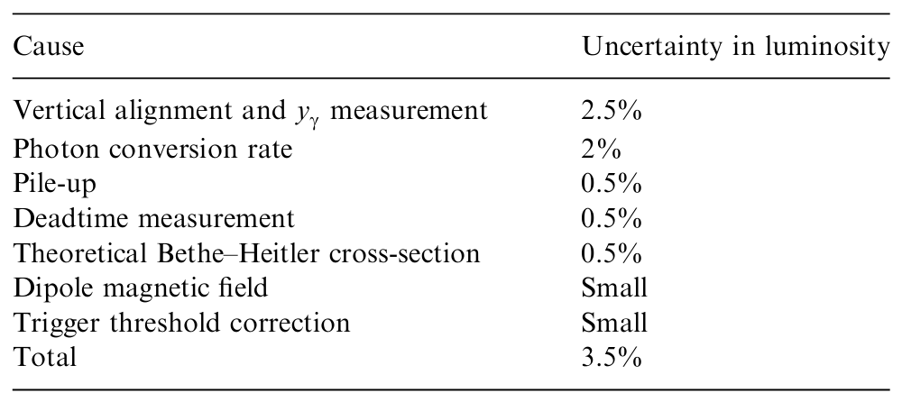
ZEUS vs ePIC PS Uncertainty Estimation
ePIC mitigations:
Tracker systems for precise position measurements and self calibration.
WSciFi calorimeters have < 10% /√E energy resolution and Position resolution ~ 2 mm.
Real time calorimeter calibration with low-Q² tagger.
https://doi.org/10.1016/j.nima.2006.06.049

Slide 7
ZEUS vs ePIC PS Uncertainty Estimation
ePIC mitigations:
Diamond exit window (~ 99% C).
Sweeper magnet to remove unwanted conversions.
Calibration runs with sweeper off to exactly determine rate.
Dedicated conversion foil with well known conversion rate, located in vacuum pipe.
https://doi.org/10.1016/j.nima.2006.06.049

Slide 8
ZEUS vs ePIC PS Uncertainty Estimation
ePIC mitigations:
1% of photons converted to reduce rate at the pair spectrometers.
Sweeper magnet to remove unwanted conversions.
Collimator to shield detectors from unnecessary radiation.
https://doi.org/10.1016/j.nima.2006.06.049

Slide 9
ePIC PS Uncertainty Estimation
Cause | Uncertainty contribution
Vertical alignment and y_{γ} measurement | 0.5 - 1 %
Photon conversion rate | 0.5 - 1 %
Pile-up | 0.0 - 0.2 %
Deadtime measurement | 0.5 % [kept same as ZEUS]
Theoretical Bethe-Heitler cross-section | 0.5 % [kept same as ZEUS]
Total (quadratic sum) | 1.0 - 1.6 %
Aranya Giri - Houston

Slide 10
ePIC PS Uncertainty Estimation
Cause | Uncertainty contribution
Vertical alignment and y_{γ} measurement | 0.5 - 1 %
Photon conversion rate | 0.5 - 1 %
Pile-up | 0.0 - 0.2 %
Deadtime measurement | 0.5 % [kept same as ZEUS]
Theoretical Bethe-Heitler cross-section | 0.5 % [kept same as ZEUS]
Total (quadratic sum) | 1.0 - 1.6 %
ZEUS uncertainty reduced over the run period.
There are good reasons to believe ePIC uncertainty will also decrease.
https://doi.org/10.1016/j.nima.2006.06.049; https://doi.org/10.1016/j.nima.2014.01.053

Slide 11
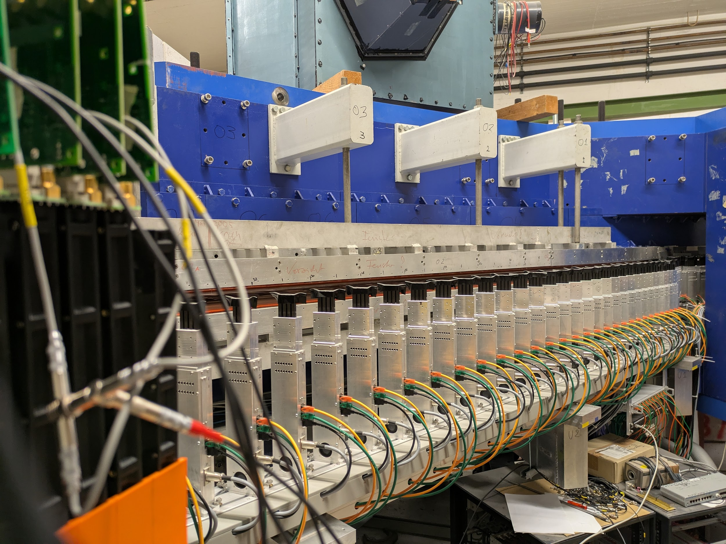
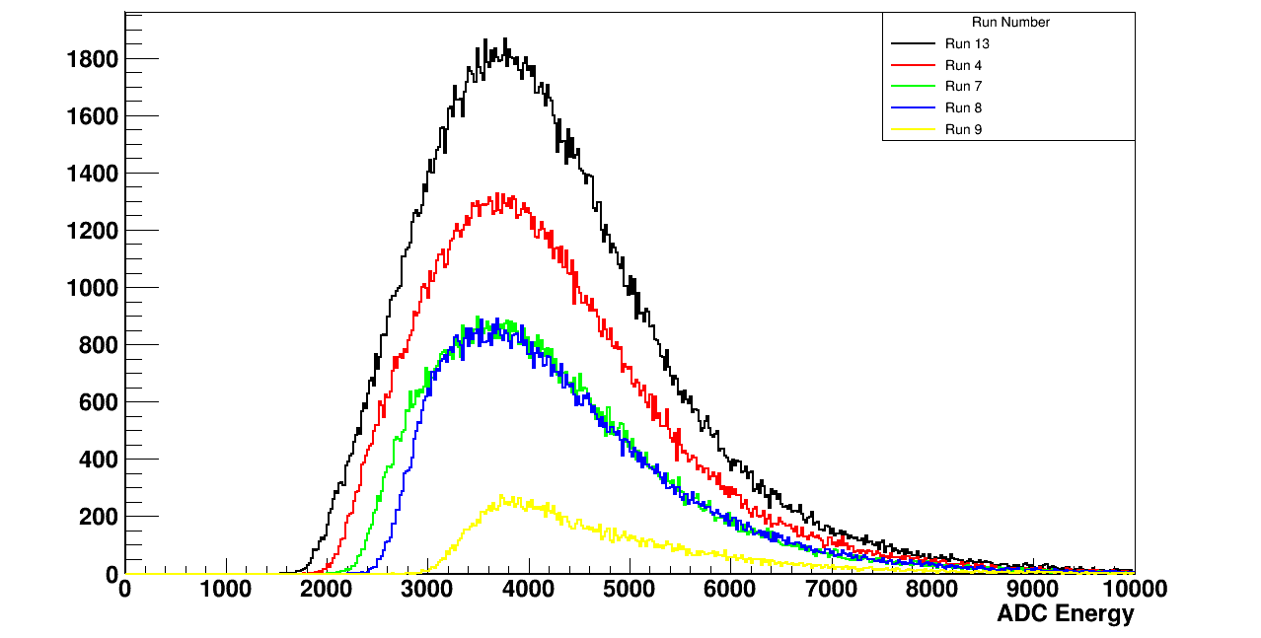
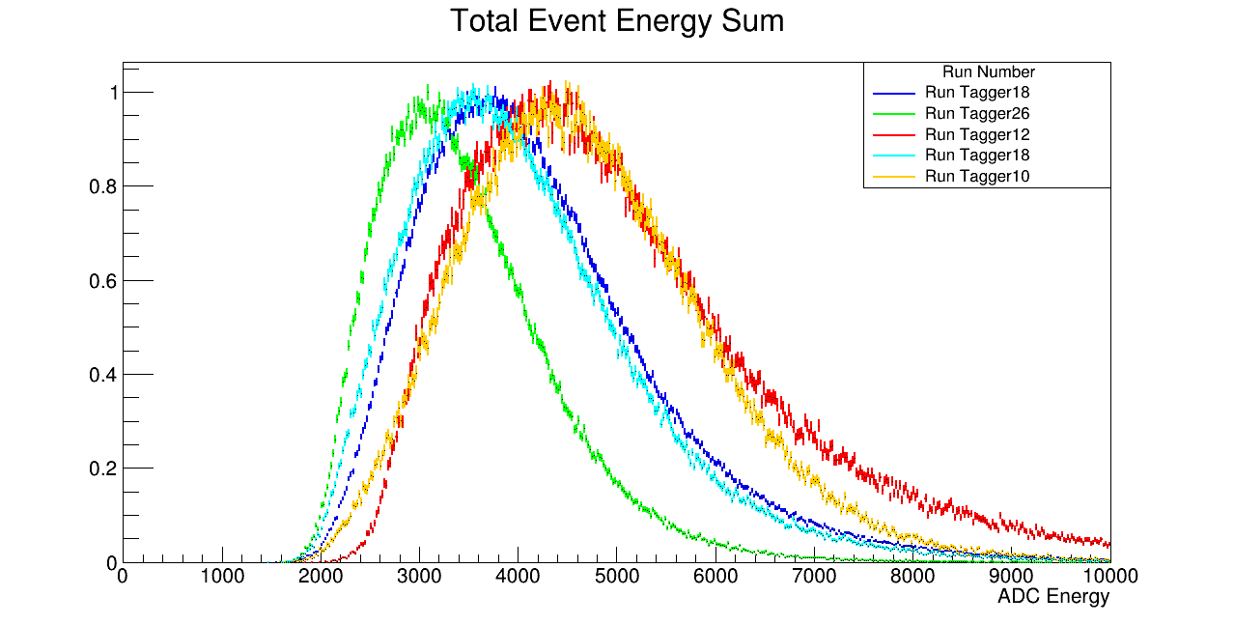
Conclusions
Luminosity system design is on track to meet requirements.
Many issues with ZEUS systematics are address by the new setup.
R&D on the new calorimeter design is progressing well.
Successful beam tests conducted at Mainz August 2025

