Slide 1

Atom Interferometry in Gravity: From Gravity Gradients to Gravitational Waves
Jeremiah Mitchell
19 January 2026
UK-APP

Slide 2
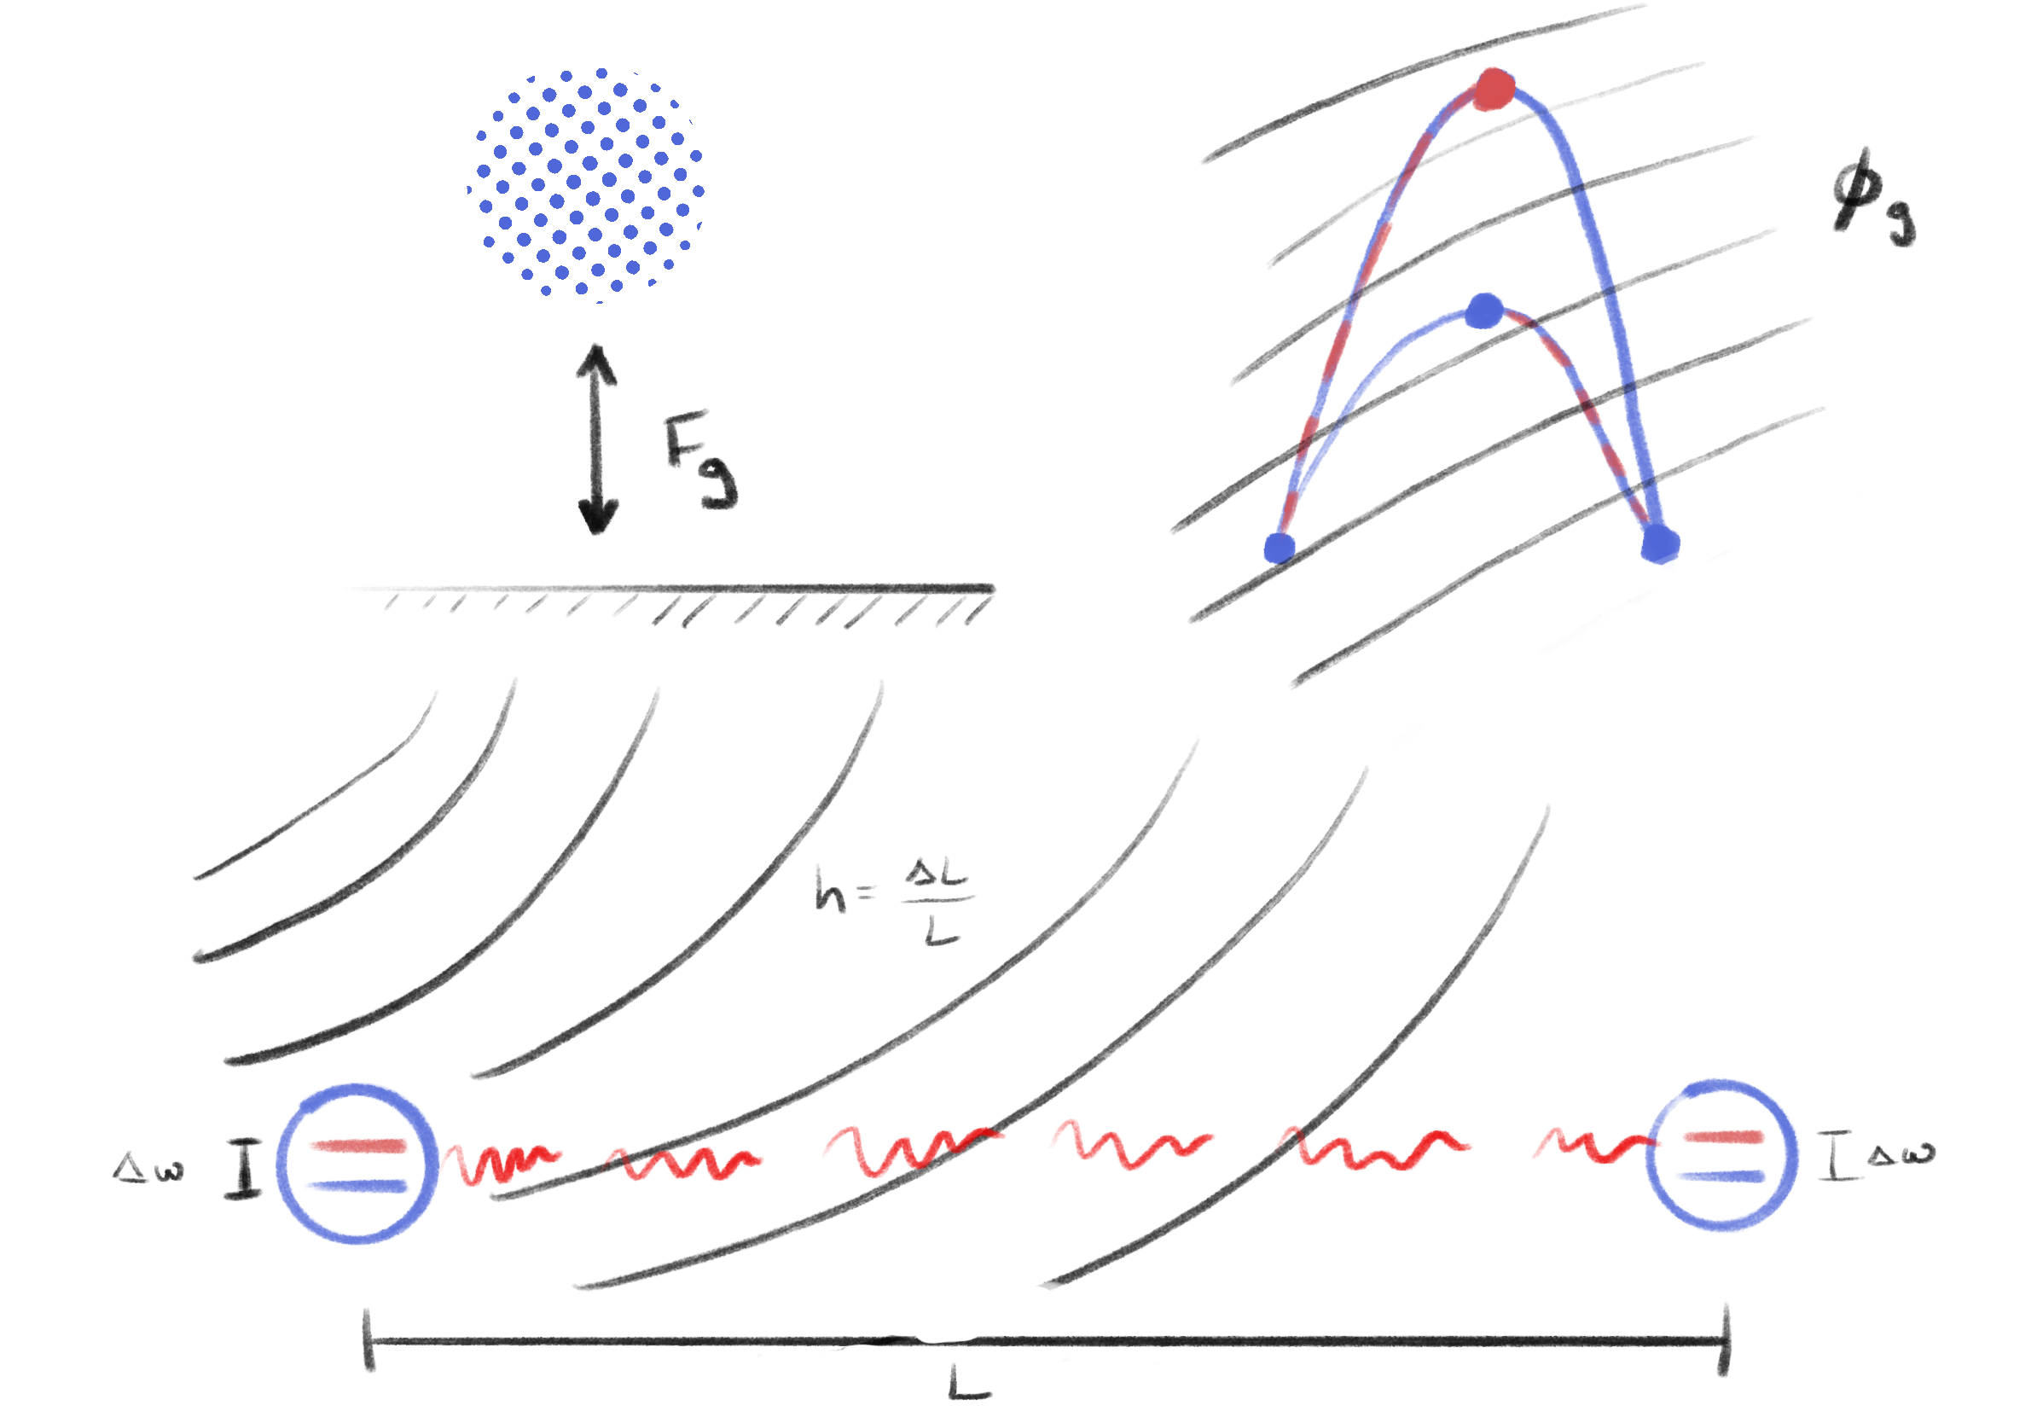
Overview
1) Atoms in gravity
2) Gravitational sensing with atoms
3) Searching for gravitational waves with atoms

Slide 3
Atom interferometry
Mach-Zehnder laser interferometer
Mach-Zehnder atom interferometer
delay
detector
beamsplitter
mirror
beamsplitter
mirror
beamsplitter
Atom interferometry tutorials:
J. M. Hogan et al., arXiv:0806.3261 [physics] (2008).
O. Buchmueller, J. Ellis, and U. Schneider, arXiv:2306.17726 (2023).

Slide 4
The phase shift
Phase Shift
Leading order phase shift

Slide 5
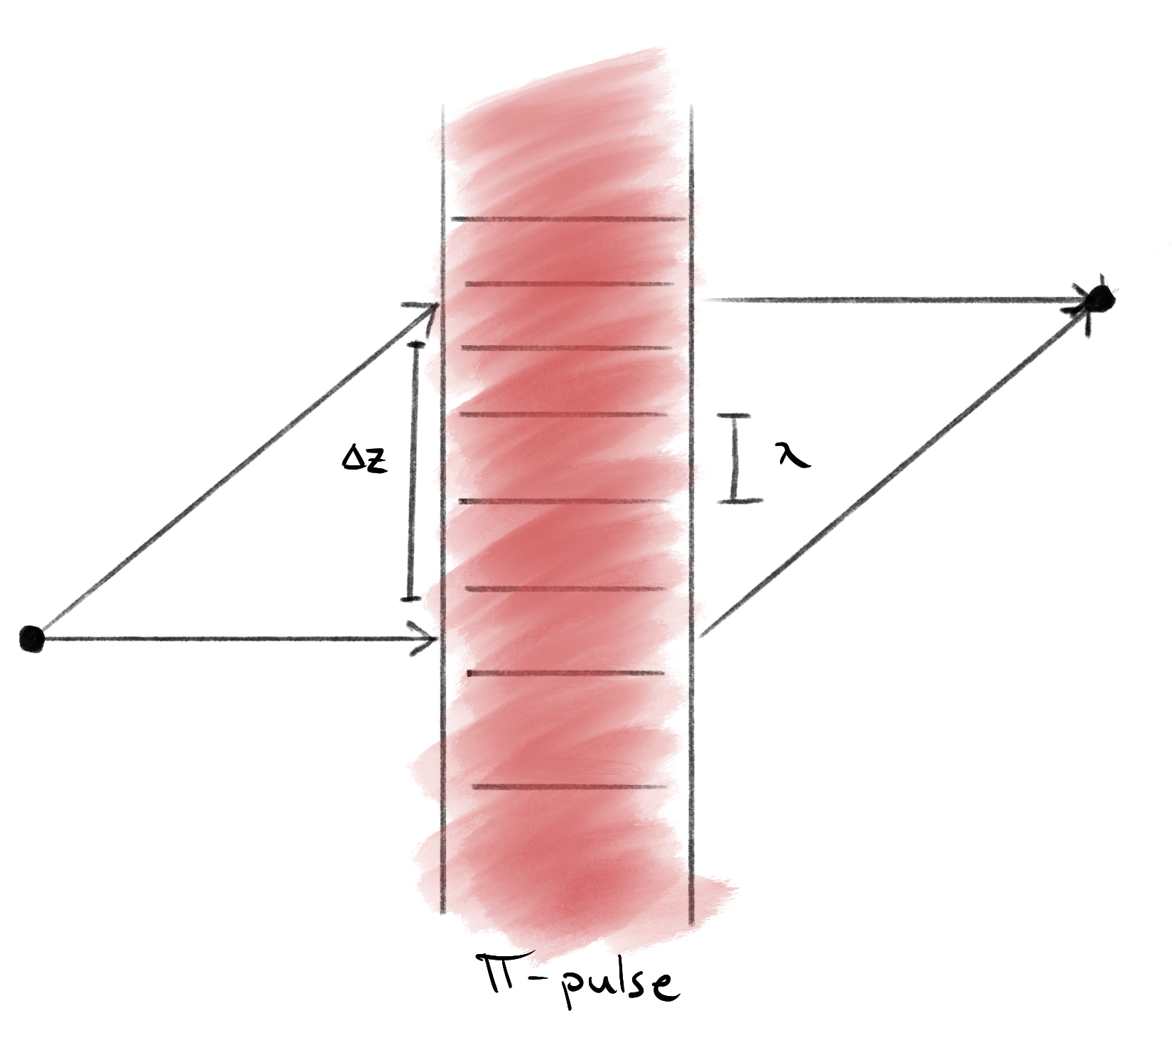
Interferometry + gravity

Slide 6
Non-relativistic and relativistic
Newtonian gravity
Gravitational potential expansion
Semi-classical atom-light interactions
Classical acceleration during atom free-fall
Relativistic gravity
Post-Newtonian expansion of weak gravity using Fermi-Walker coordinates
Metric affects trajectories of atom and light
Atom-light interactions modified
M. Werner et al., Phys. Rev. D 109, 022008 (2024).
S. Dimopoulos et al., Phys. Rev. Lett. 98, 111102 (2007).

Slide 7
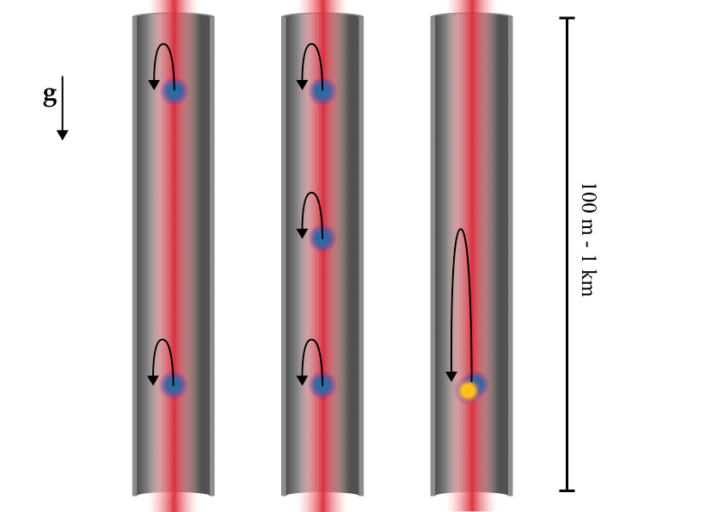
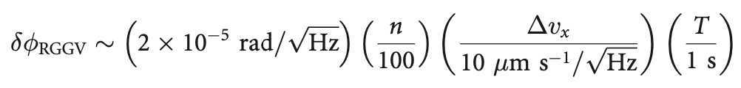

Gravity gradients
Lagrangian for center-of-mass trajectory
Phase Shifts
Atom shot noise = (10⁻³ – 10⁻⁴ rad/$√$Hz)
Mahiro Abe et al 2021 Quantum Sci. Technol. 6 044003

Slide 8
Gravity gradient noise
Utilize gradiometry to suppress common mode noise sources
Local vibration of optics
Laser frequency and phase noise
Gradients in potentials experienced by atoms may fluctuate in space and time

Slide 9
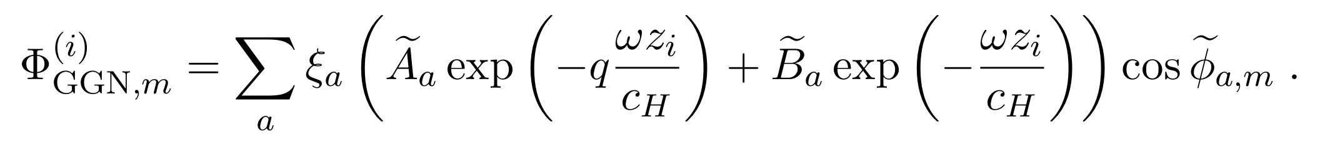
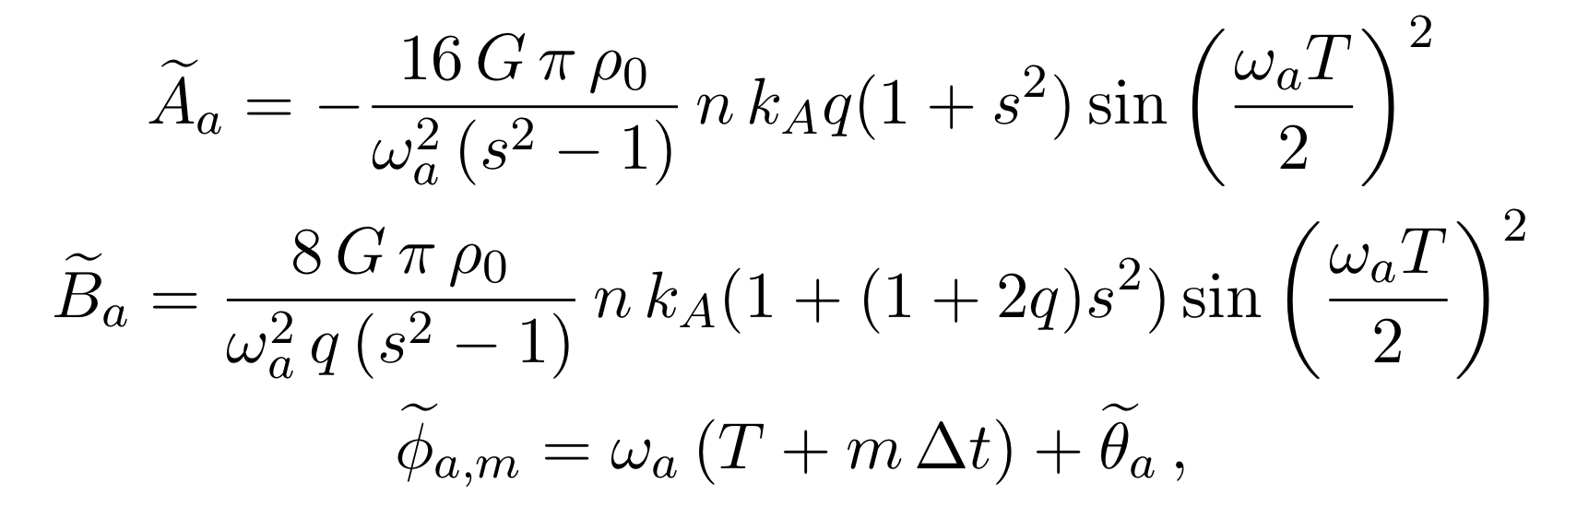
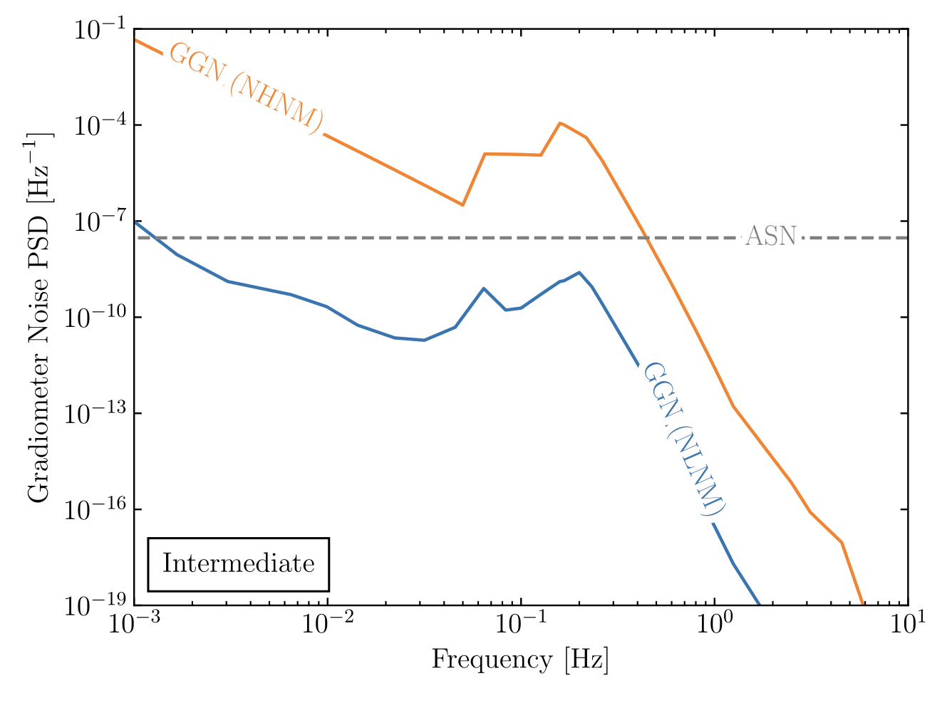
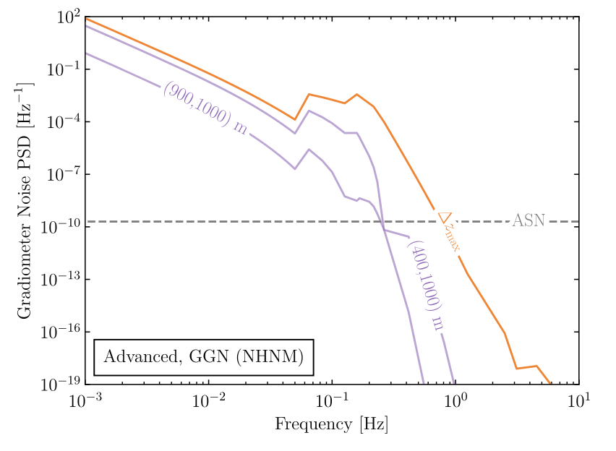
Seismic GGN
J. Mitchell et al., J. Inst., vol. 17, 01, 2022.
L. Badurina, J. Mitchell et al. Phys. Rev. D 107, 055002

Slide 10
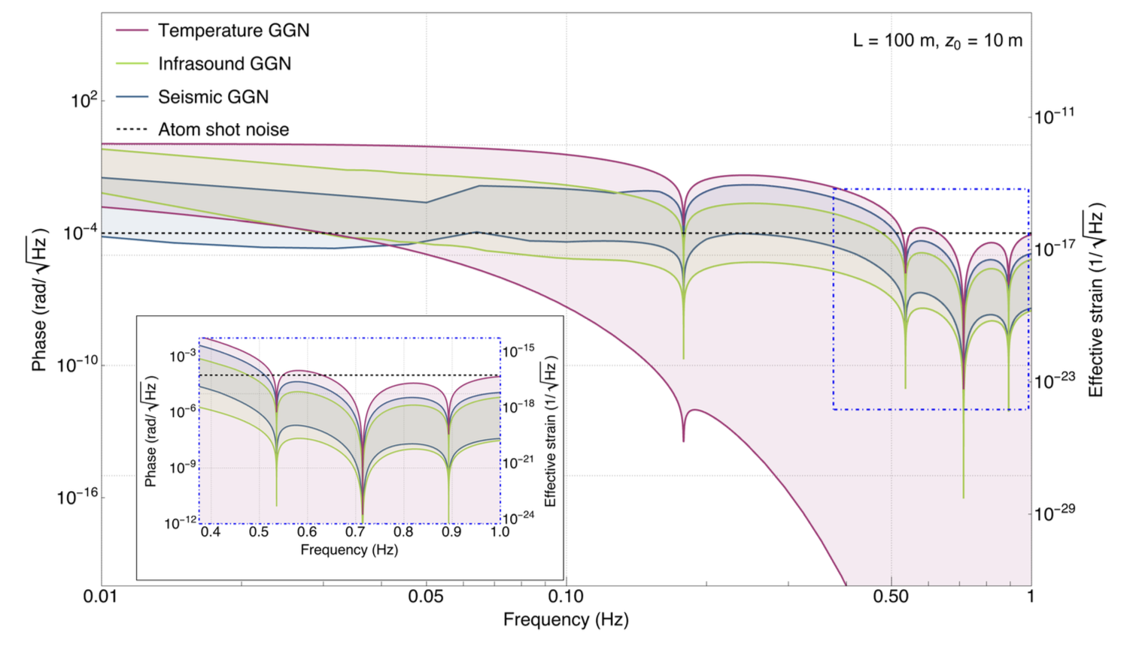
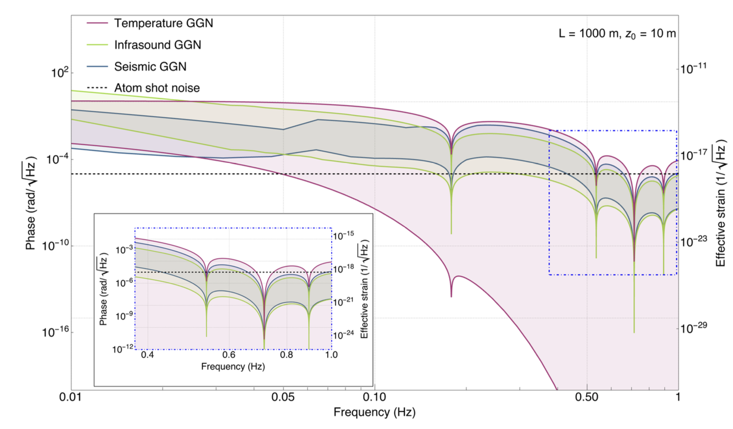
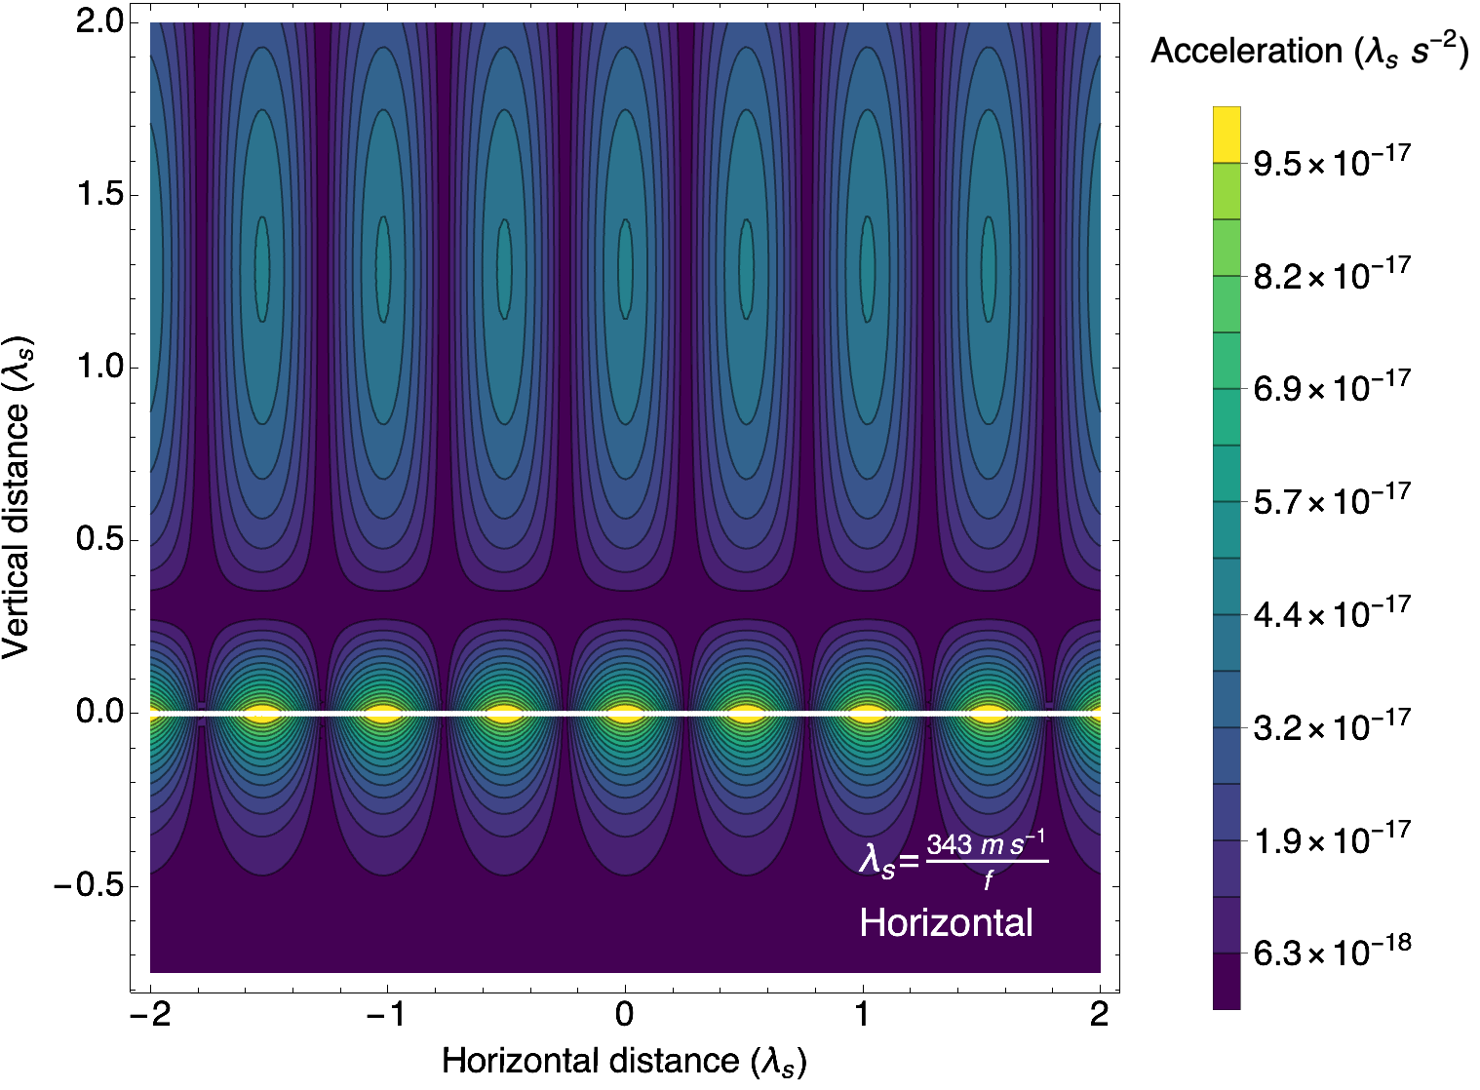
Atmospheric GGN
J. Carlton, J. Mitchell et al., Phys. Rev. D 111, 082003 (2025).

Slide 11
Gravitational waves

Slide 12
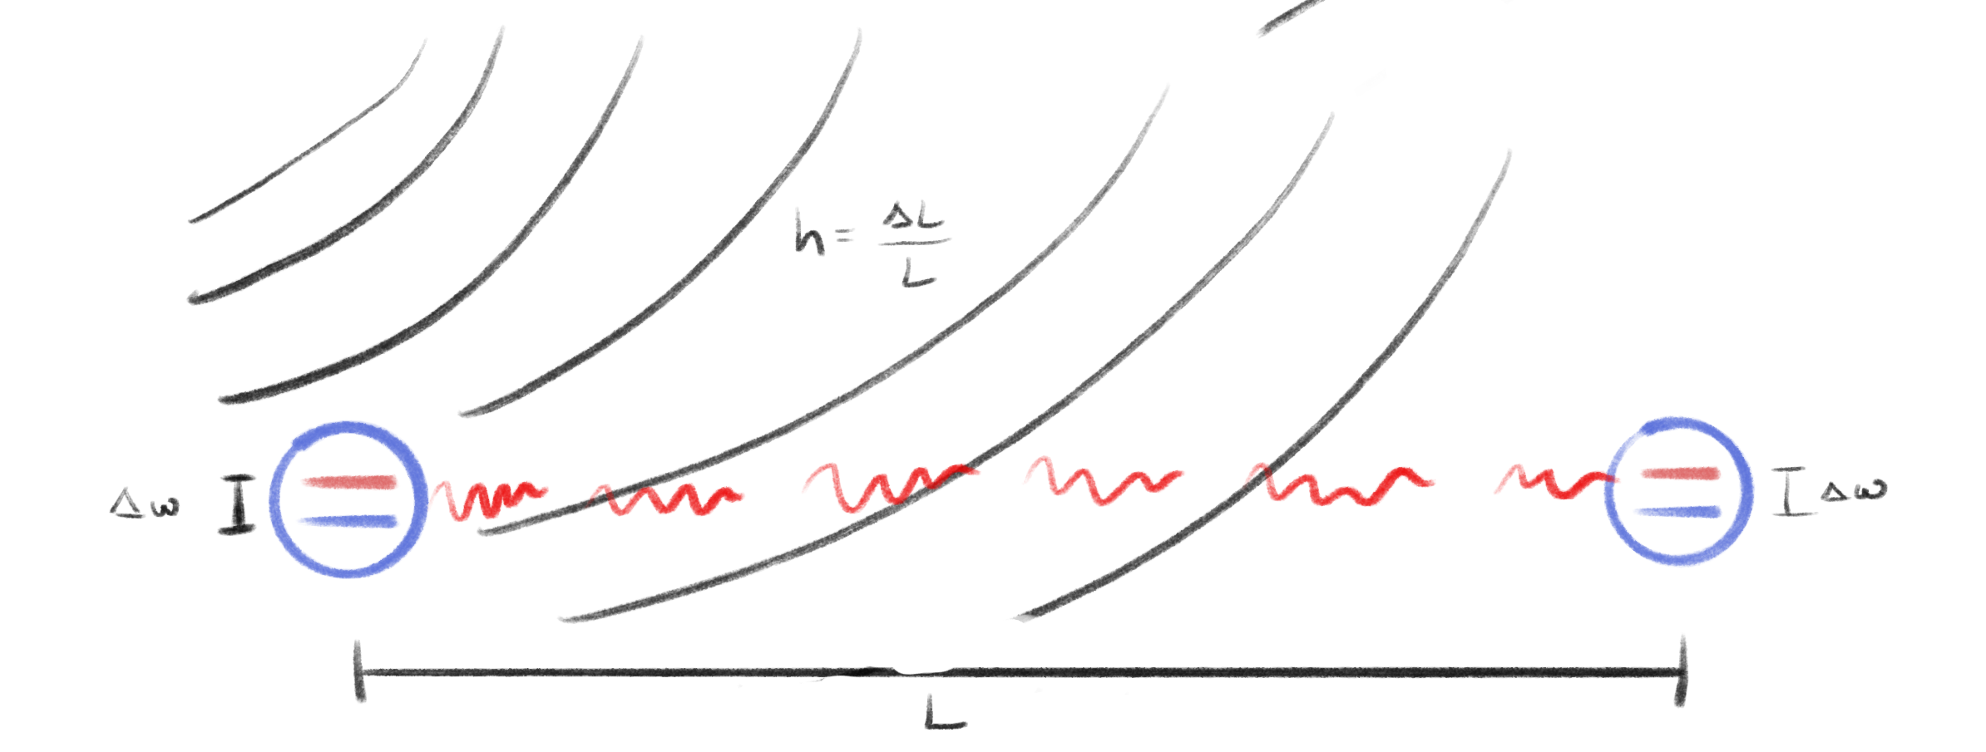
Measuring gravitational waves
Subtleties and pitfalls between laser and atom interferometry
Laser phase is not used as reference/clock atoms are inertial reference
Common noise between gradiometer through laser highly suppressed
Differential kinematics of gradiometer and laser wavefronts become dominant noise (and Newtonian Noise)
Leading phase shift for relativistic single photon
Gradiometer GW phase shift
P. W. Graham et. al., Phys. Rev. Lett. 110, 171102 (2013).

Slide 13
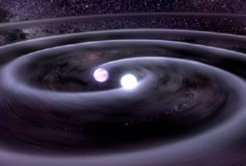
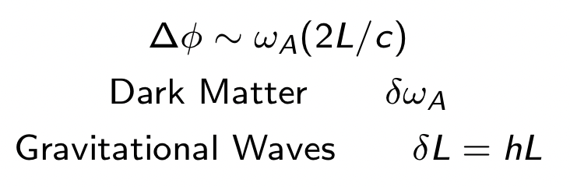
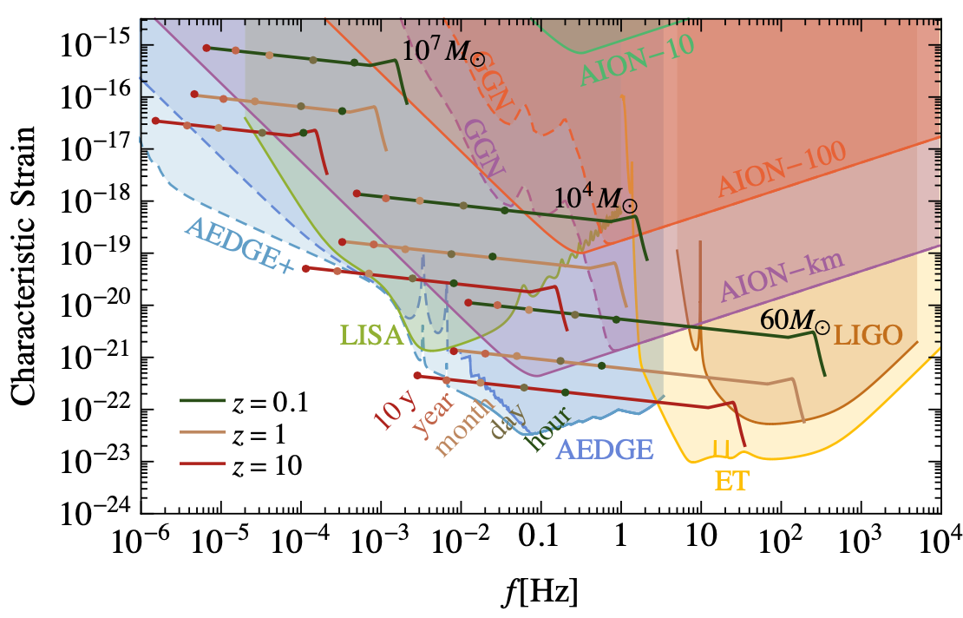


Gravitational waves
Gravitational waves
L. Badurina et al., JCAP 05 (2020) 011

Slide 14
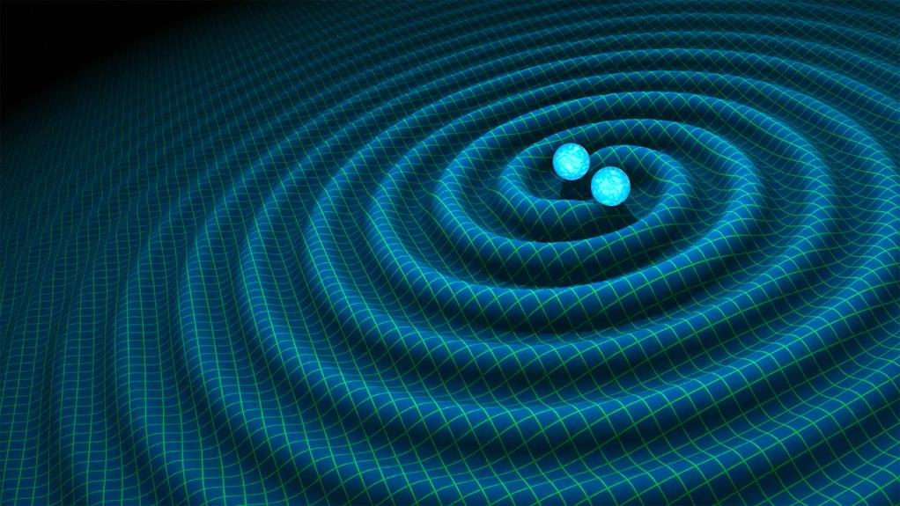
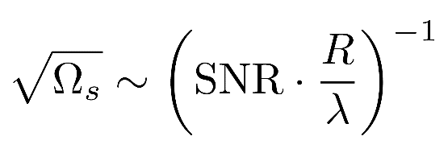
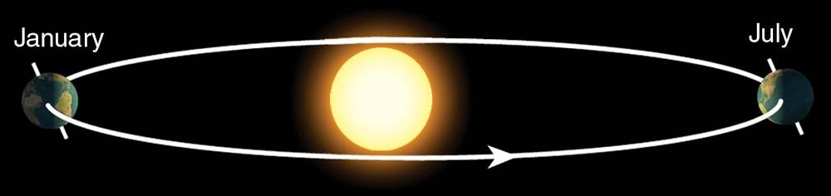
Sky localization
Sky localization precision:
Images: R. Hurt/Caltech-JPL; 2007 Thomson Higher Education
Mid-band advantages
- Small wavelength λ
- Long source lifetime (~months) maximizes effective R
λ
R
Ultimate sensitivity for terrestrial based detectors is achieved by operating 2 (or more)
Detectors in synchronisation mode
Courtesy of Jason Hogan!
P. W. Graham and S. Jung, Phys. Rev. D 97, 024052 (2018).
S. Baum, Z. Bogorad, and P. W. Graham, J. Cosmol. Astropart. Phys. 2024, 027 (2024).

Slide 15
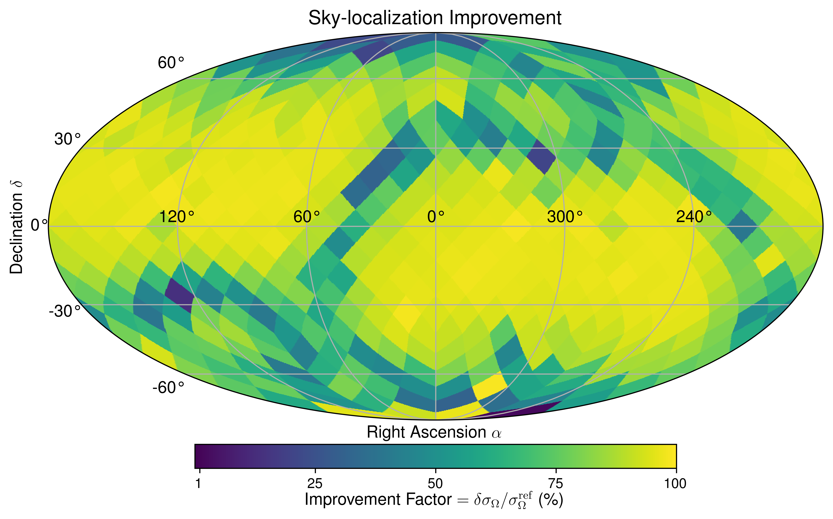
Siting considerations
Passive and active mitigation at site
Network enhancement to physics goals
SNR enhancement from multiple detectors
Gravitational wave sky-localization improvements from southern hemisphere
Preliminary
Tools from:
S. Baum, Z. Bogorad, and P. W. Graham, J. Cosmol. Astropart. Phys. 2024, 027 (2024).

Slide 16
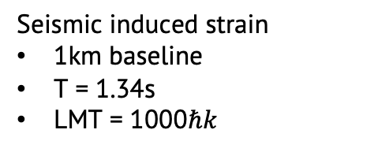
Terrestrial limits
Seismic induced strain
1km baseline
T = 1.34s
LMT = 1000$ℏk$
Site specific Newtonian noise leads to anomalous strain in long-baseline instruments
Further inland provides stronger dispersion of fundamental Raleigh mode surface waves
Preliminary

Slide 17
Other GW sources
Supernovae
Phase transitions
Cosmic Strings
Inflationary fluctuations and primordial black holes
L. Badurina et. al., Philosophical Transactions of the Royal Society A: Mathematical, Physical and Engineering Sciences 380, 20210060 (2021).
J. Ellis et. al., Prospects for Future Binary Black Hole GW Studies in Light of PTA Measurements, arXiv:2301.13854.

Slide 18
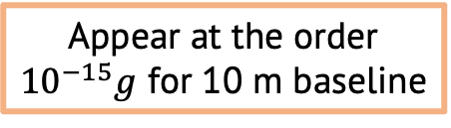
Tests of general relativity and dark energy
GR
Dark Energy
Atom acceleration in PPN Schwarzschild metric
Relativistic phase shift
Search for Chameleon field dark energy
Non-linear scalar interaction
Experimental setup requirements:
High density source mass
Perform atom interferometry near source mass in vacuum
Chameleon acceleration alters atom trajectories leading to phase shift
Test for Newtonian violations
Non-linear GR terms
Velocity dependent forces
Set limits on PPN parameters
Appear at the order
${10}^{−15}g$ for 10 m baseline
B. Elder et al., Phys. Rev. D 94, 044051 (2016).
S. Dimopoulos et al., Phys. Rev. Lett., 2007

Slide 19


Summary and outlook
Atom interferometry presents a unique way of testing gravity with quantum systems
Allows for searches of mid-band gravitational waves and serves as a platform to explore the interface of gravity and quantum mechanics
Enabling these searches requires understanding and control of terrestrial gravitational signals
Explore potential of testing: spacetime torsion, gravitational memory in many-body quantum systems, quantum-classical transition

Slide 20
Backups

Slide 21
Atom interferometry cont.
Atom interferometry ingredients
Quantum states that can be superposed
Coherent
Long-lived
Technical feasibility
Laser system
Extremely stable
Quickly and precisely address the quantum states
Controlled atom-light interactions
absorption
emission

Slide 22

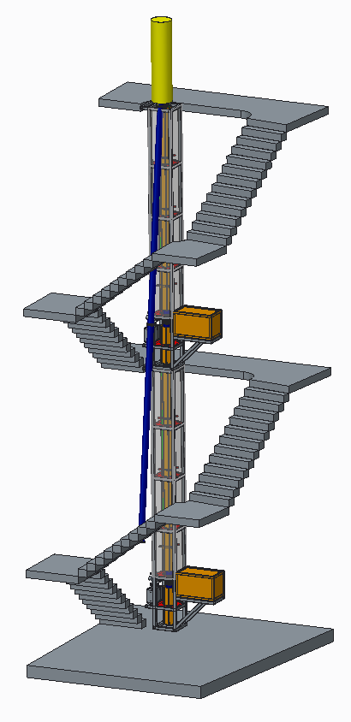
AION
Atom Interferometer Observatory and Network
UK consortium of 7 institutions
Multi-stage project
Develop 5 ultracold strontium UK laboratories for atom interferometry R&D
Design and deploy increased baseline atom interferometers 10m -> 100m -> 1km
Investigate technology development and network with MAGIS-100 for large-scale science goals
14.7m
Ground level
AI-10
10.0m
7.7m
Project executed in national partnership with UK National Quantum Technology Hub in Sensors and Timing, Birmingham, UK,
and international partnership with The MAGIS Collaboration
and The Fermi National Laboratory, US
5.0m
L. Badurina et al JCAP05(2020)011

Slide 23

MAGIS-100
Matter-wave Atomic Gradiometer Interferometric Sensor
Long-baseline atom interferometer being built at Fermilab US
3 strontium atom sources along vertical baseline
Test bed experiment for simultaneous atom interferometer control
Prototype 10m device at Stanford
Mahiro Abe et al 2021 Quantum Sci. Technol. 6 044003

Slide 24
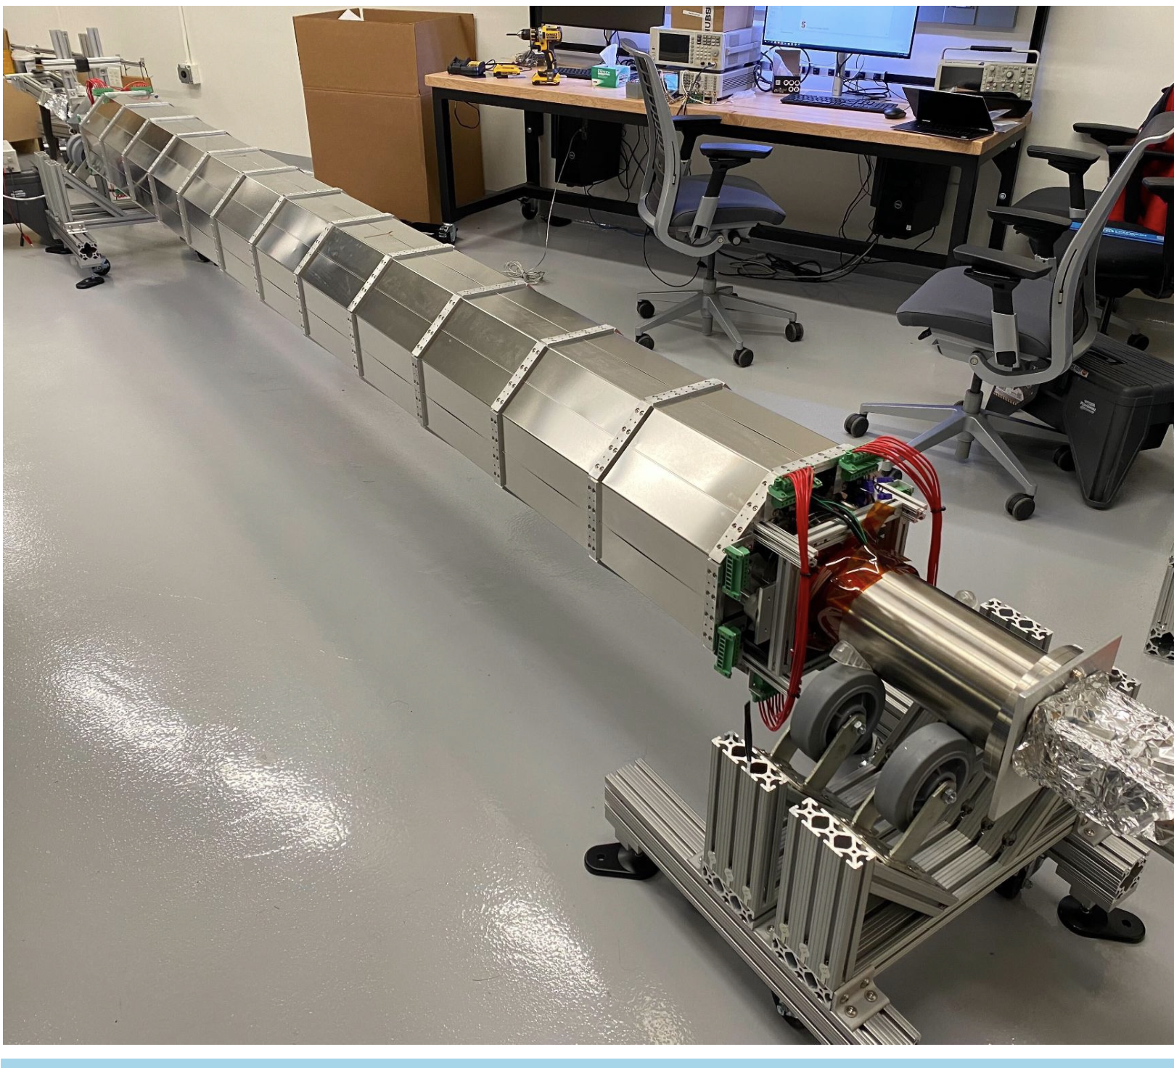
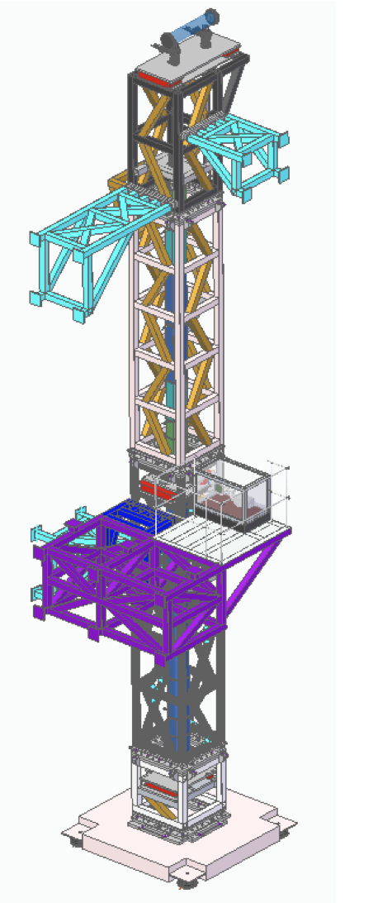
Long-baseline atom interferometer progress
MAGIS-100
AION
Design of Oxford
10 m Detector
Stanford 10 m tower assembly
Construction phase in progress
Surface laser lab and laser transport system started construction in 2023, completion and optical table install this year.
Civil construction waiting on contract to start summer 2025
Commissioning planned for early 2027
MAGIS-100 design is supported by development of Stanford 10 m Sr atom interferometer assembly started last summer.
5 ultracold Sr labs built in less than 24 months
Utilized cross-disciplinary large-scale Particle Physics production methods
All labs are commissioning R&D platforms
Finalized 10 m instrument design for Oxford
More than doubled the ultracold Sr R&D capacity in the UK and designed centralized ultra-high vacuum system production
AVS Quantum Sci. 6, 014409 (2024)

Slide 25
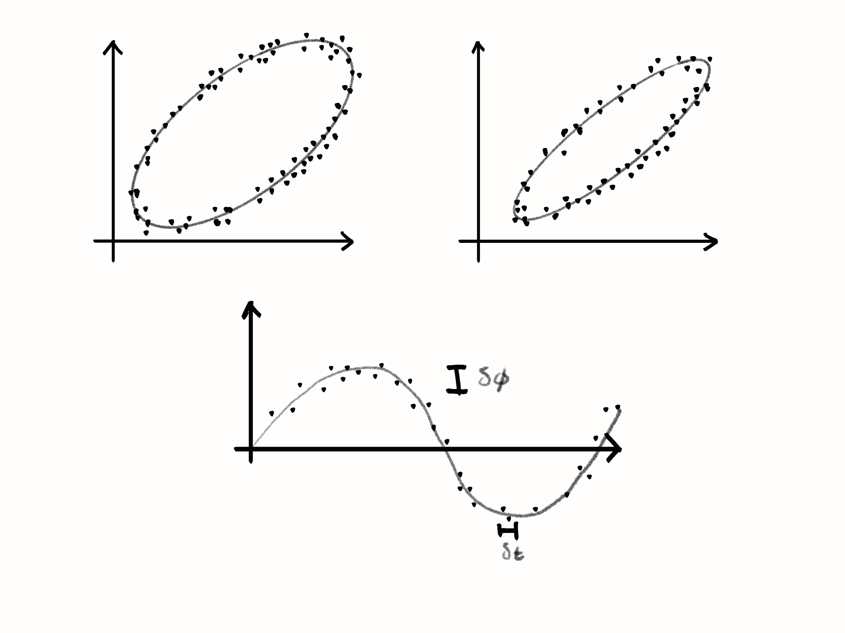
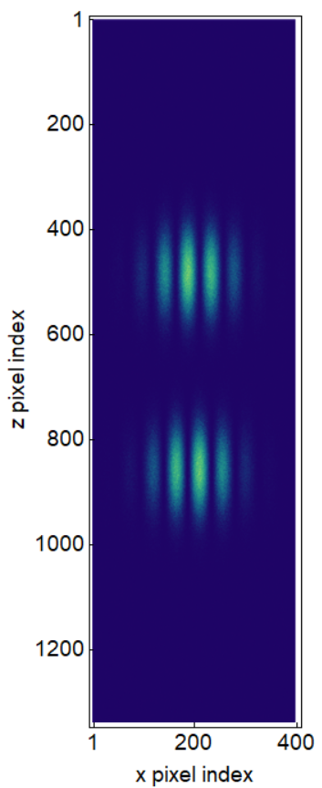
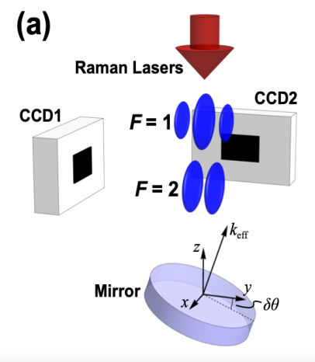
Signal extraction and challenges
Technical challenges require extreme precision for quantum control
Atom flux, kinematics, atom temperature and collimation
Laser frequency, phase, and pointing stability
Temperature, vacuum, stray magnetic fields, and vibrations
Gravitational static gradients and moving masses
Subsampling instrument, aliasing
Exquisite sensitivity to gravity results in environmental noise sources which are harder to mitigate
Seismic and atmospheric gravity gradient noise
Random anthropogenic and synanthropic noise
Excited state upper (%)
Excited state upper (%)
Excited state lower (%)
Excited state lower (%)
L. Badurina, A. Beniwal, and C. McCabe, Phys. Rev. D 108, 083016 (2023).
J. Carlton and C. McCabe, Phys. Rev. D 108, 123004 (2023).
G. T. Foster et. al., Opt. Lett., OL 27, 951 (2002).
A. Sugarbaker et. al., Phys. Rev. Lett. 111, 113002 (2013).

Slide 26
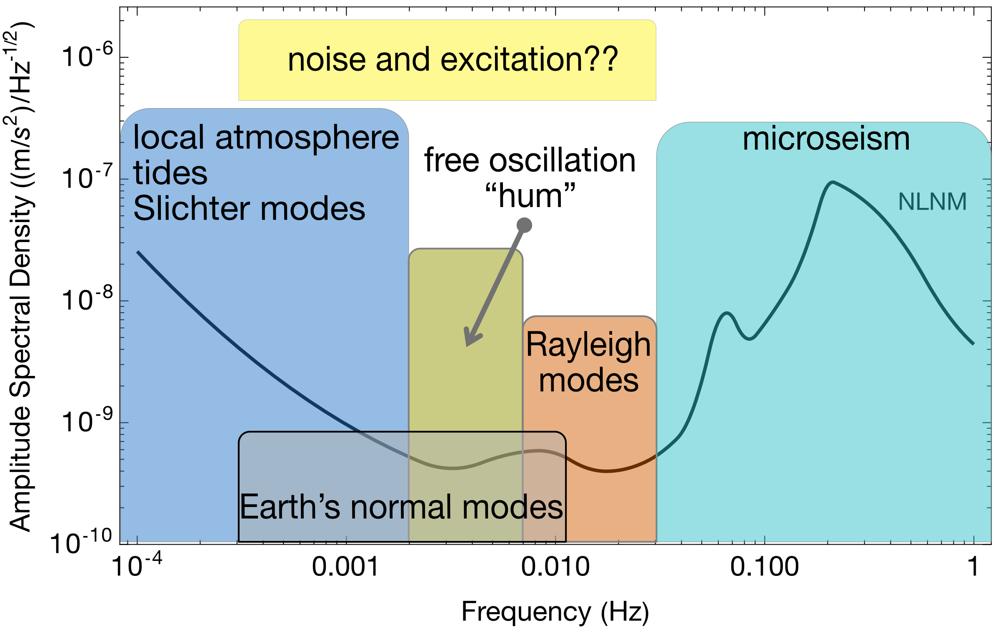
Earth Science applications
Rayleigh seismic waves source gravitational fluctuations
Terrestrial backgrounds cause gravity gradient noise limiting fundamental physics searches
AION can use gravitational signal channel to answer open questions in Earth science
Earth’s free oscillation and normal modes
Low-frequency Earth dynamics
Seismic Frequency Spectrum
Mitchell et al., J. Inst., vol. 17, 01, 2022.
Badurina, et al. Phys. Rev. D 107, 055002
Atmospheric infrasound and temperature gradient noise
Carlton et al., arXiv:2412.05379 (2024).

Slide 27
title

