Slide 1
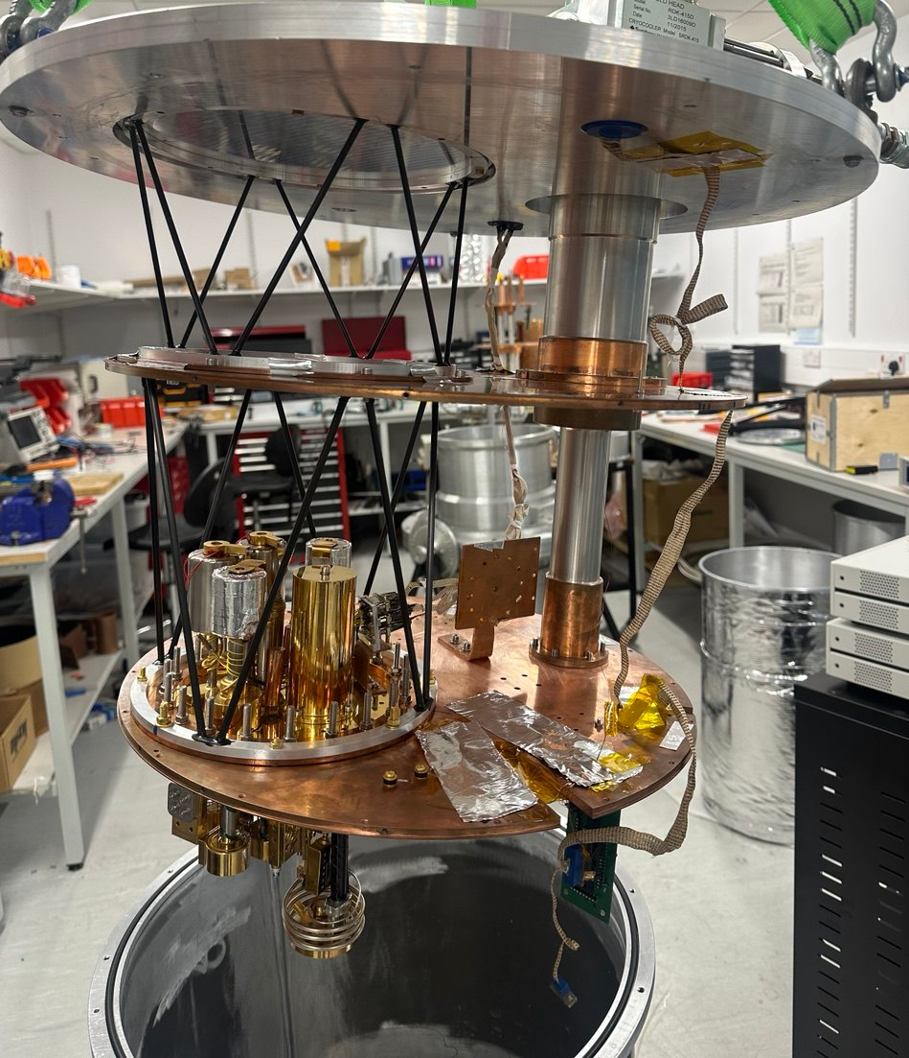
High-Frequency Axion Searches
Jamie McDonald
University of Manchester
On behalf of
Ades, Battye, Buck, Feasby, Gilles, Gramellini, Marchitelli, JM, McCulloch, Lancaster, Mohammadian, Piccirillo, Preston, Qureshi, Rhukadze, Upward, Wystemp.
New Windows on Fundamental Physics: from tabletop devices to large scale detectors
20 – 23 January 2026 | University of Manchester

Slide 2
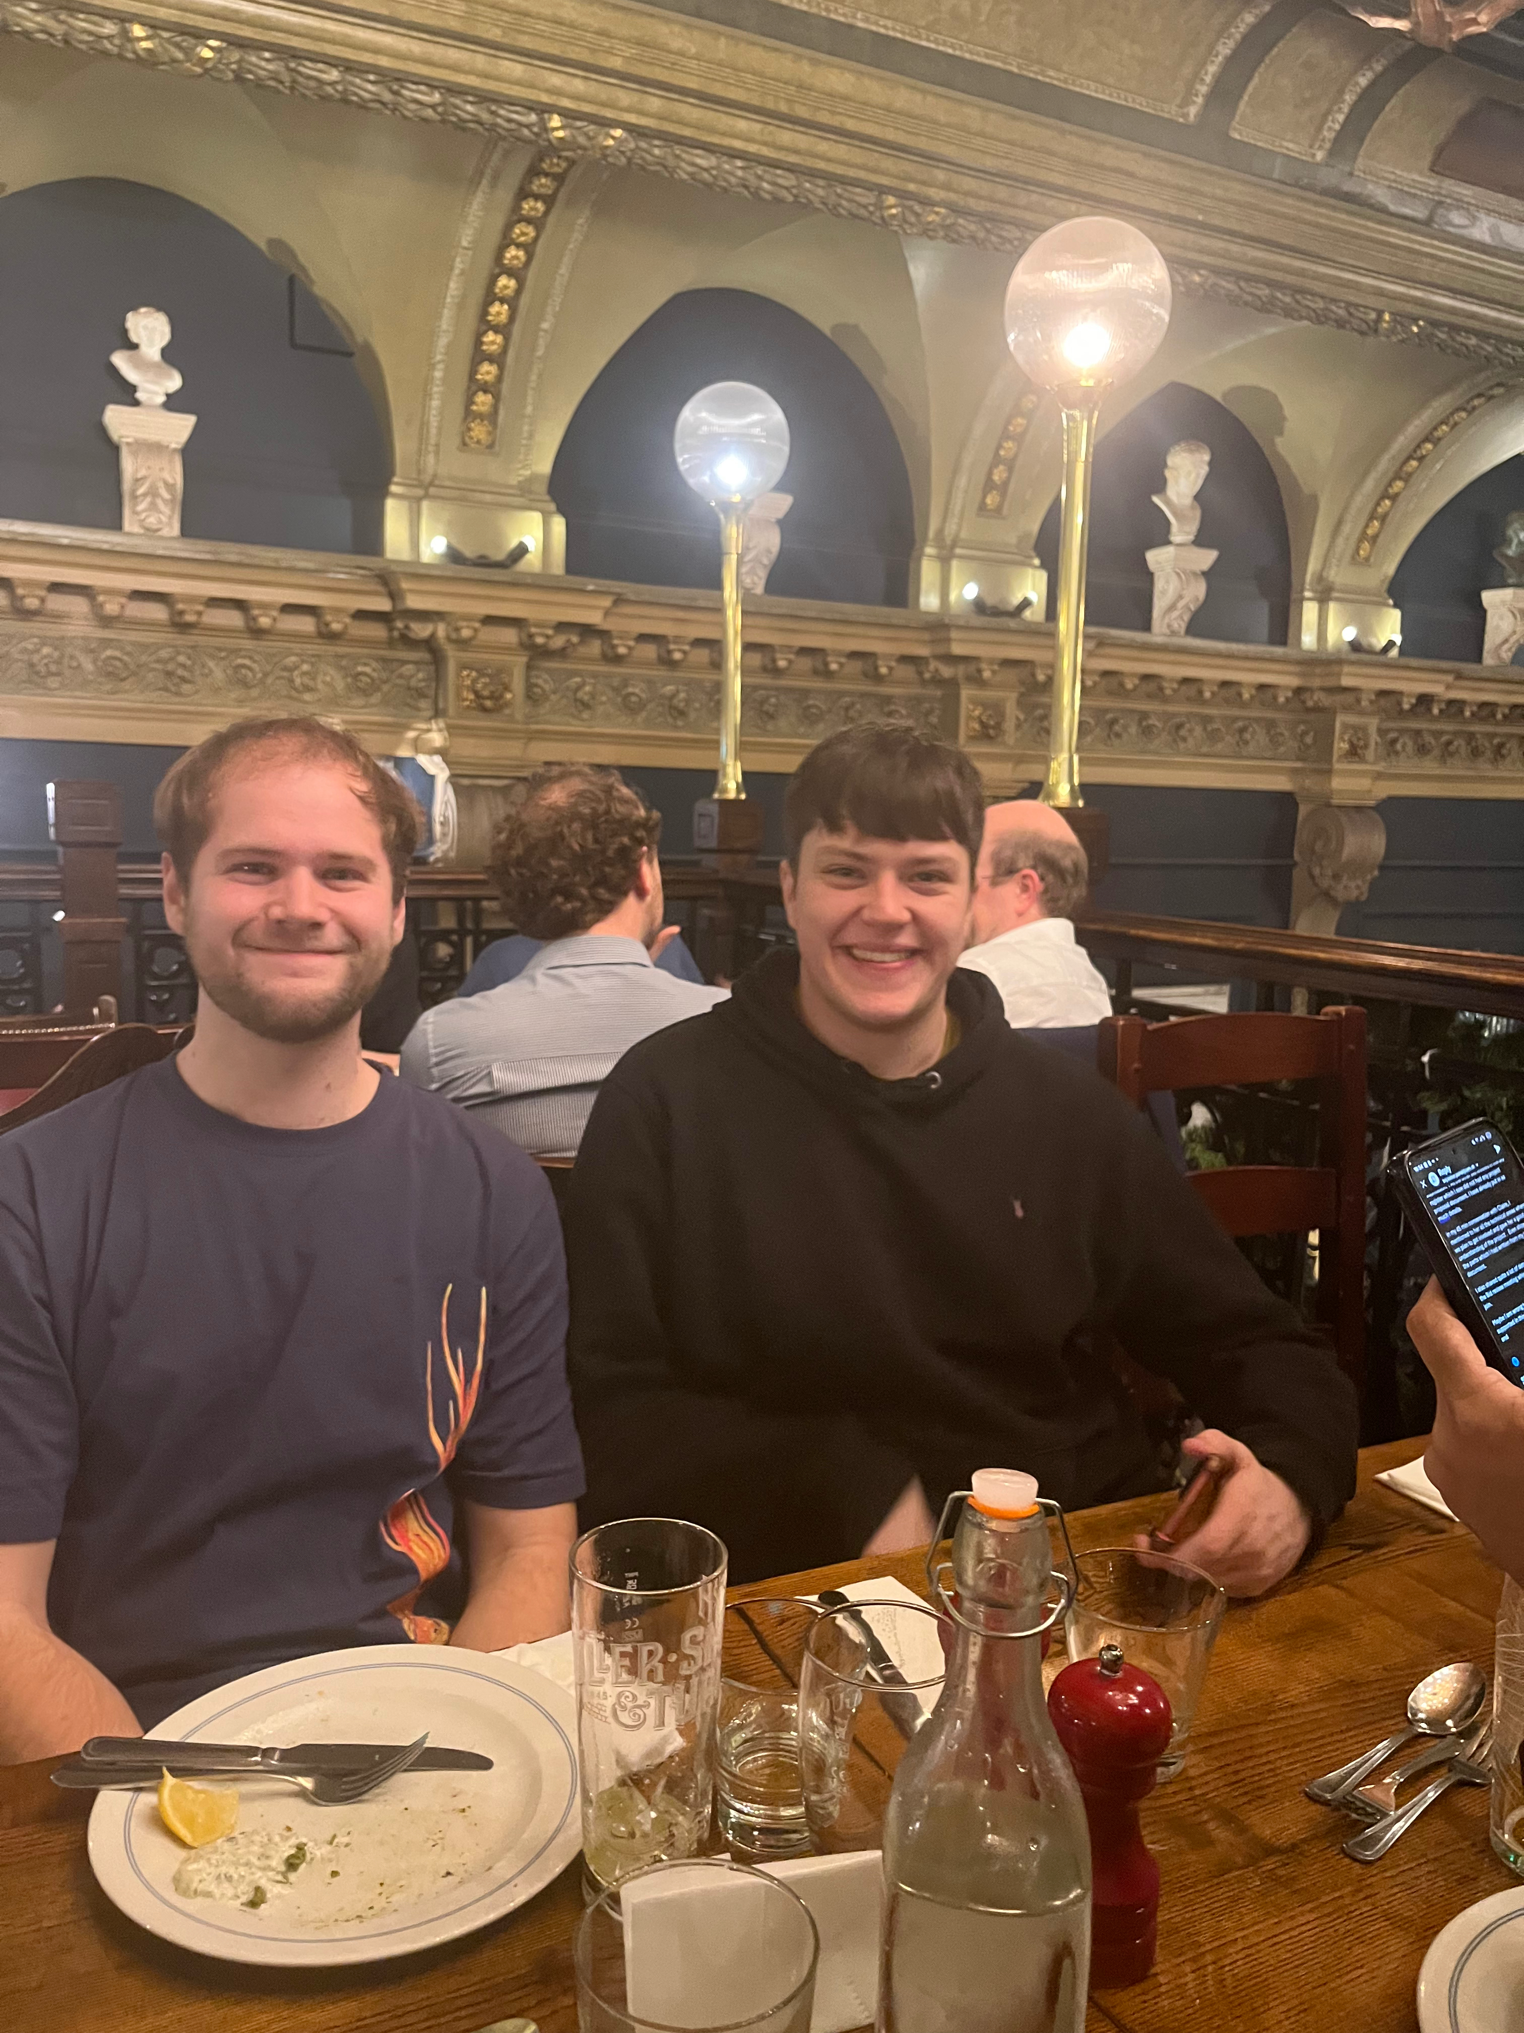

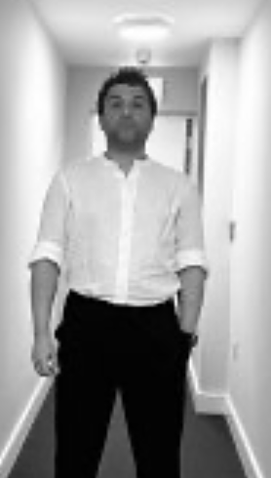
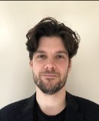
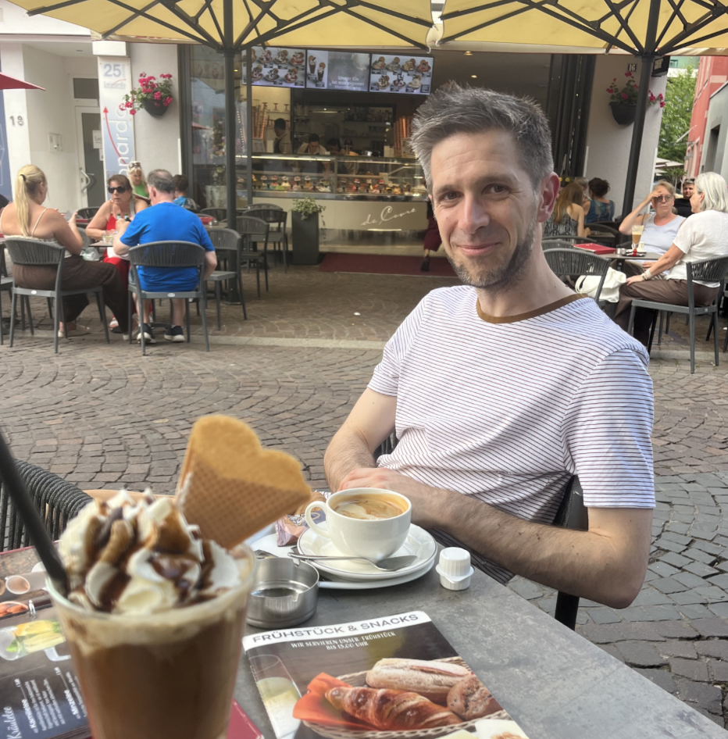


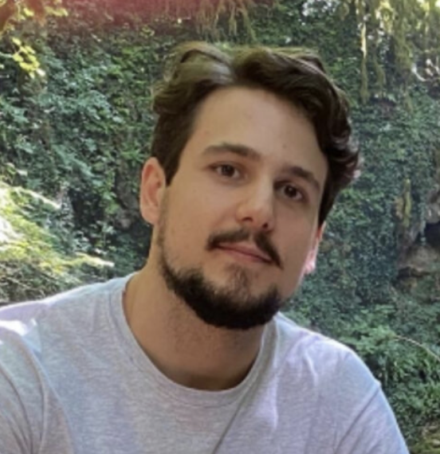
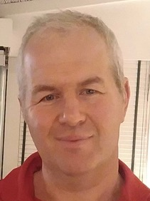
The Team
Ted Smith
Lucio Piccirillo
Babak Mohammadian
Matt Millns
JM
Mark McCulloch
Mark Lancaster
Elena Gramellini
Valerio Gilles
Richard Battye
Technical Staff: Daren Shepherd, Joshua Major, Noel Minzie
MPhys & MSc Students: Nodar Rhukadze, Oliver Ades

Slide 3
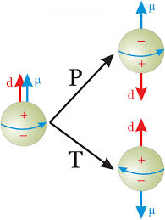
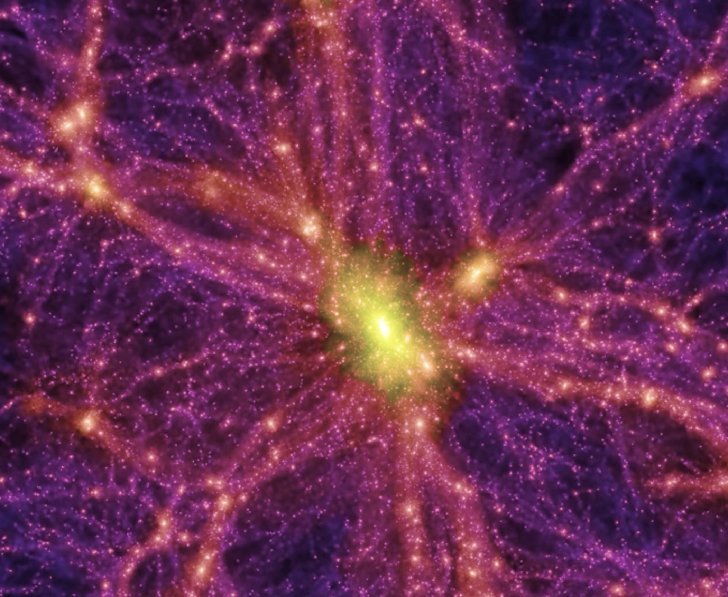
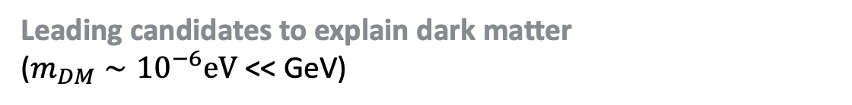
Axions
Solve strong CP problem in QCD
(why neutron EDM so small?)
Peccei & Quinn (1977)
Leading candidates to explain dark matter
($m_{DM}∼{10}^{−6}eV$ << GeV)
Dine & Fischler (1983), Abbott & Sikivie (1983), Preskill, Wise & Wilczek (1983).

Slide 4
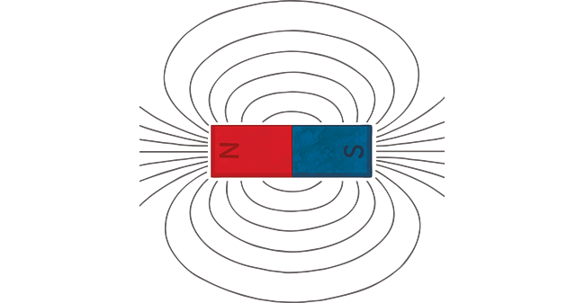
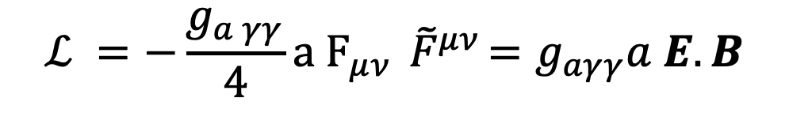
Axions
$$ℒ =−\frac{g_{a γγ}}{4}a F_{μν}{ \tilde{F}}^{μν}=g_{aγγ}a E.B$$
Axions
Photons

Slide 5
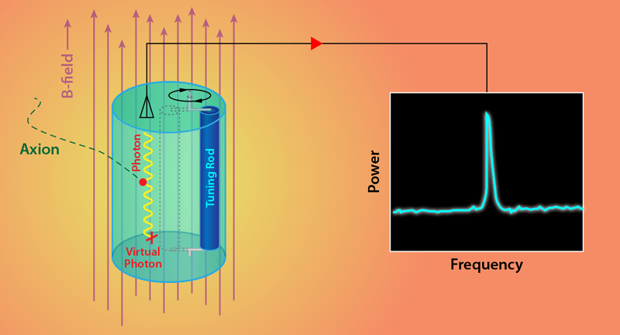


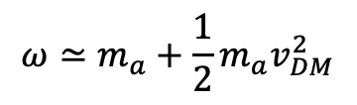



Axion Dark Matter
$$a$$
$$γ$$
$a∝e^{iωt}$
$$ω≃m_{a}+\frac{1}{2}{m_{a}v}_{DM}^{2}$$
$$B_{lab}$$
$$ω≃m_{a}$$
$$\frac{Δω}{ω}∼{10}^{−6}$$

Slide 6
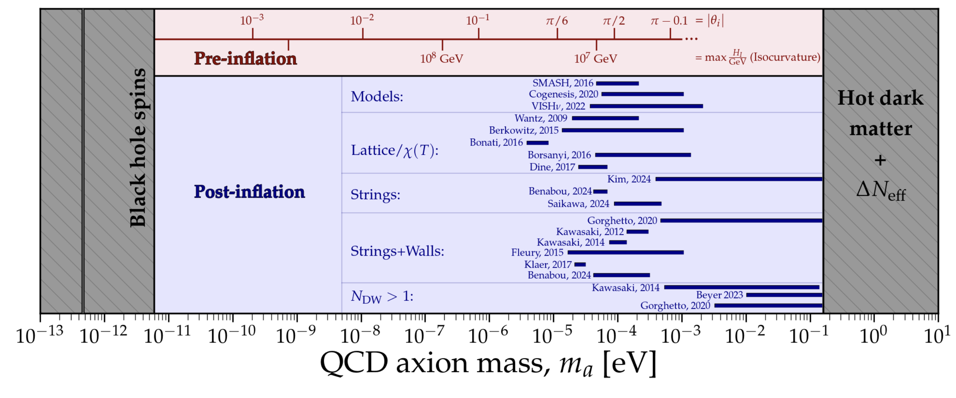
Theory predictions for axion mass
Plot Courtesy: Ciaran O’Hare

Slide 7
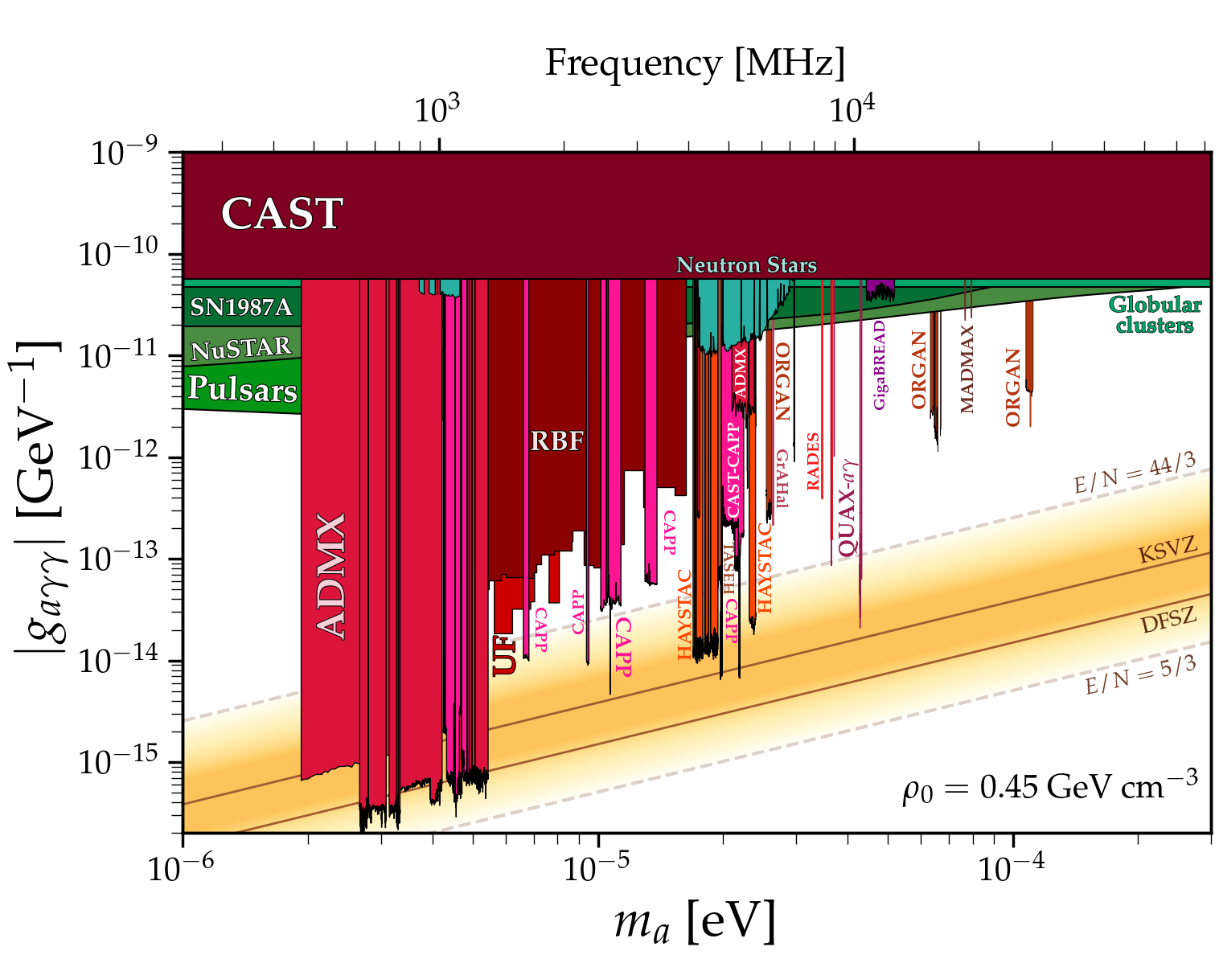
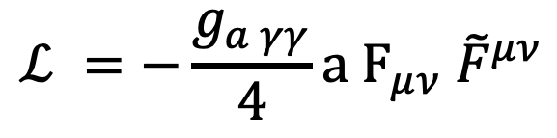
Axion Dark Matter
26 – 40 GHz
This Talk
$$ℒ =−\frac{g_{a γγ}}{4}a F_{μν}{ \tilde{F}}^{μν}$$
Photon Coupling
Dark Matter Mass

Slide 8
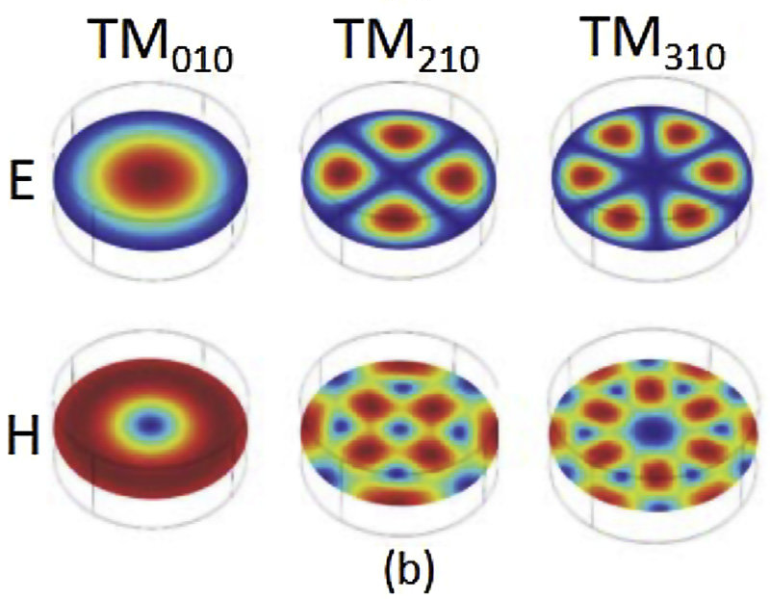
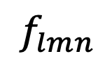

Cavity Searches for Axion Dark Matter
Cavity Modes
$r_{c}$
Cavity
$$f_{lmn}$$
(eigenfrequencies)

Slide 9
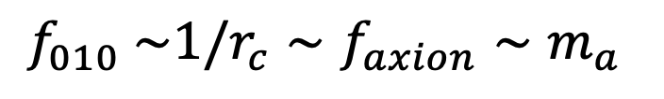



Cavity Searches for Axion Dark Matter
Cavity Modes
Magnet
axion
$r_{c}$
B
Cavity
$$a$$
$$γ$$
$$f_{010} \sim 1/r_{c}∼f_{axion}∼m_{a}$$
(eigenfrequencies)
$$B_{}$$

Slide 10
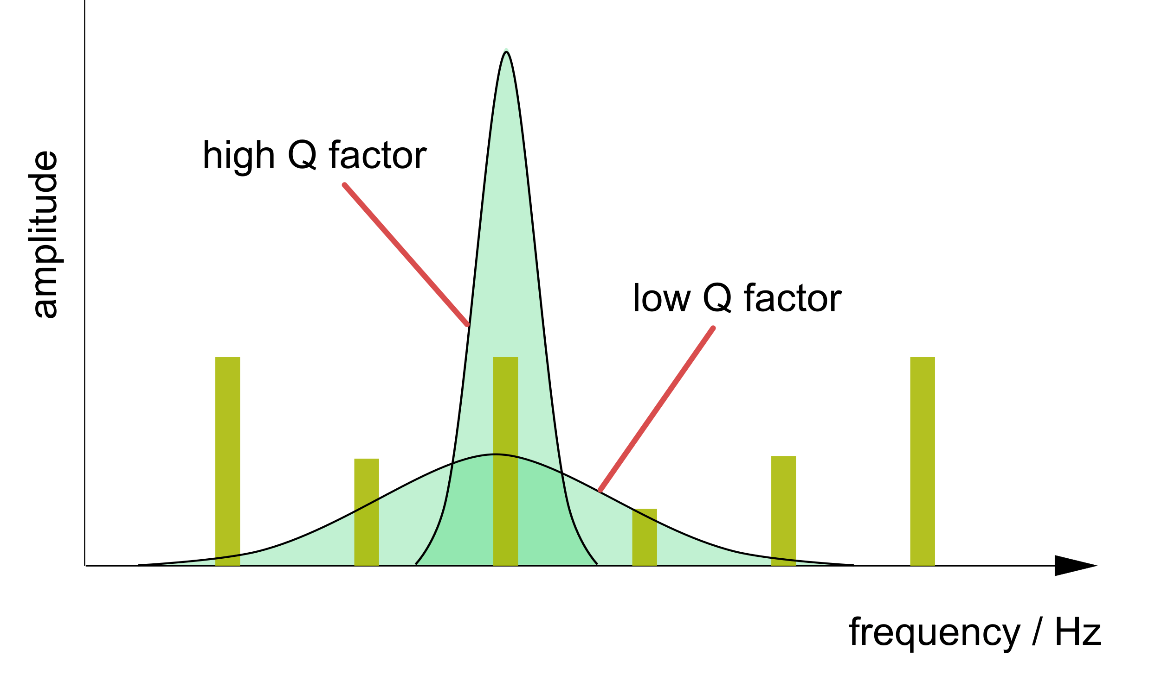

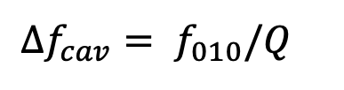
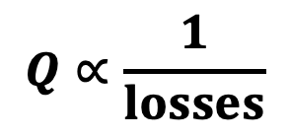
Cavity Searches for Axion Dark Matter
Cavity Modes
Magnet
$$Q∝\frac{1}{losses}$$
axion
$$Δf_{cav}= f_{010}/Q$$
$r_{c}$
B
Cavity
$$a$$
$$γ$$
Resonant Signal Power $∝g_{aγγ}^{2} B^{2}Q V C$
$$B_{}$$

Slide 11
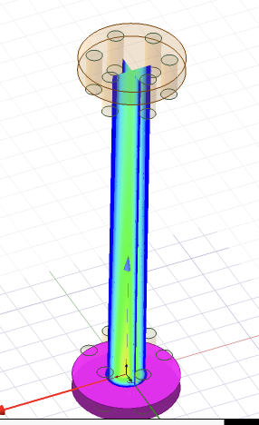
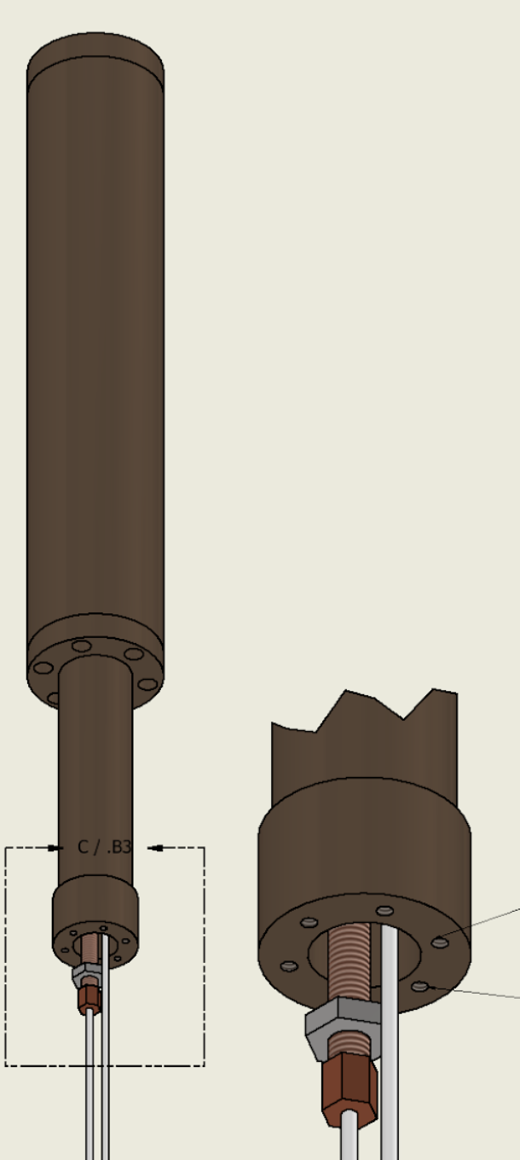
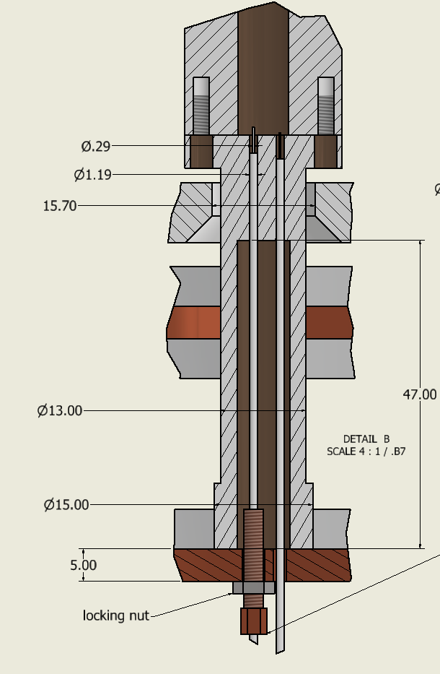
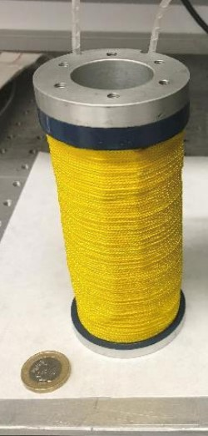
Cavity Searches for Axion Dark Matter
30 GHz Static Pillbox Cavity
3cm
12cm
3 Tesla
Cavities
Magnet

Slide 12
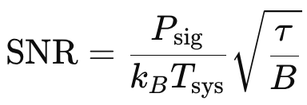
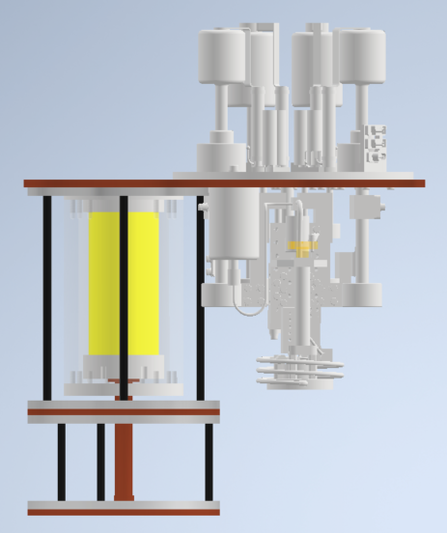

4 K
Cryo-Cooler
to 4 K
Miniature
Dilution
Fridge
magnet
300 mK
cavity
50 mK
${\text{@ 30 }\text{GHz}\text{: }T}_{Quant}$= 1.4 K

Slide 13
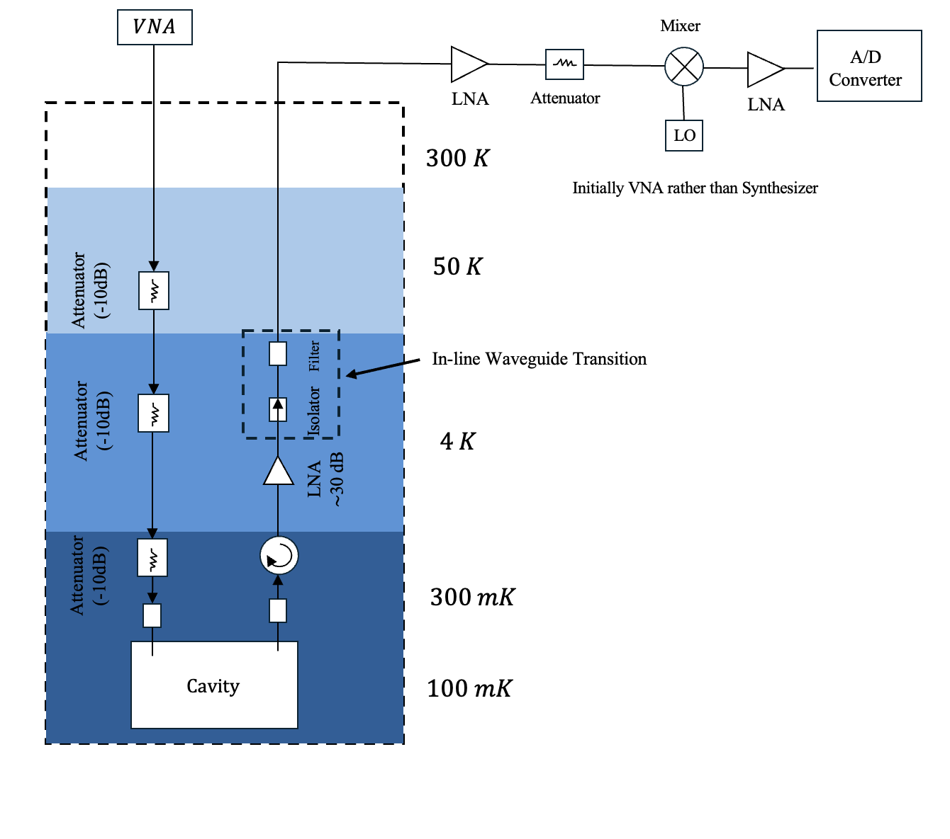
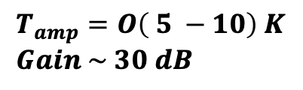
amplifier
$$T_{amp}=O\left( 5 −10\right) K \\ Gain \sim 30 dB$$
Cavity

Slide 14
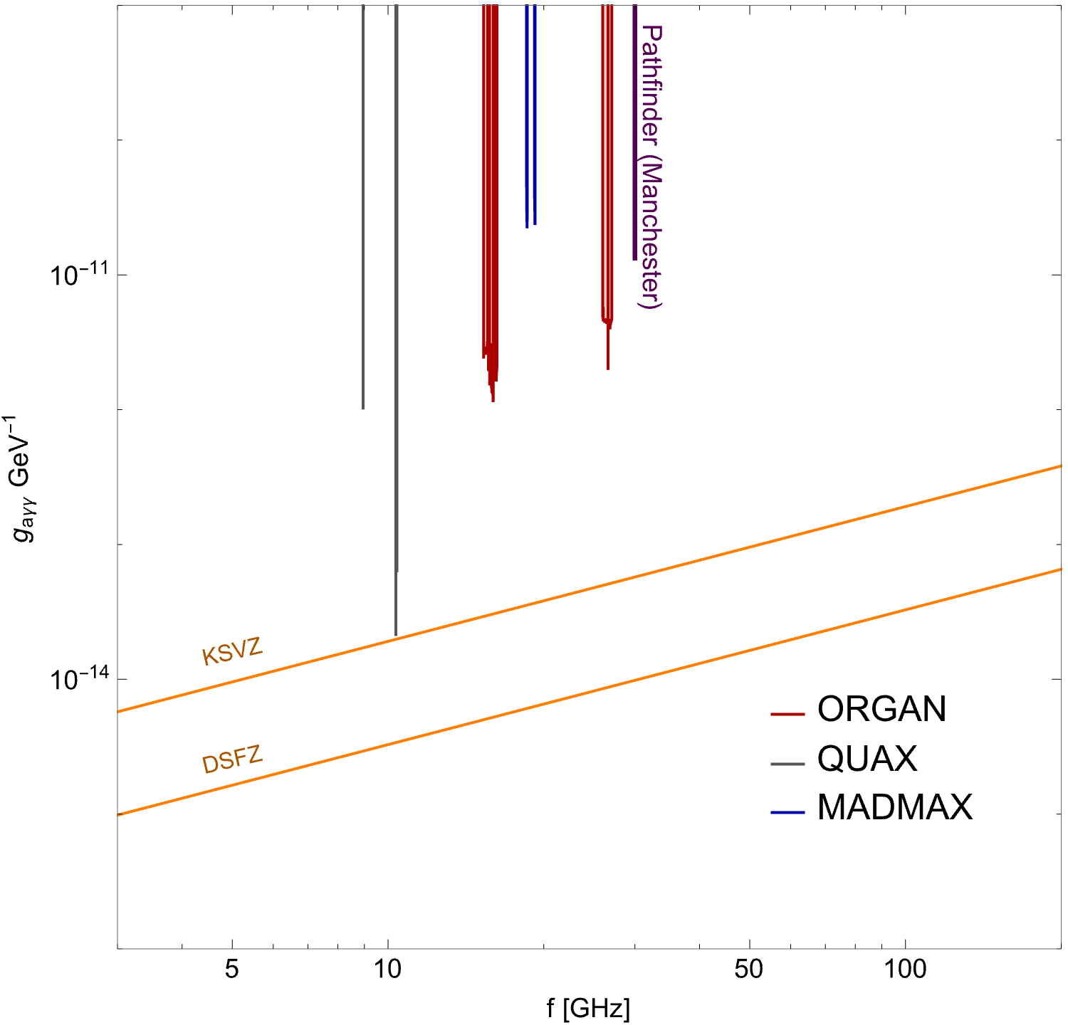
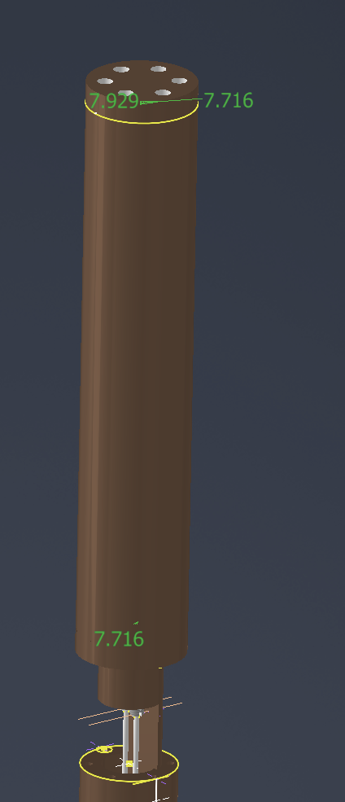
30GHz Pathfinder Underway
Pathfinder (Manchester)
Magnet
QCD Axions
Cryostat operating at 50mK (2025) ✅
Microwave Hardware Ordered (Sep 2025) ✅
Two new PhD students (Oct 2025) ✅ Machining (underway) ✅
Assembly + data taking planned for 2026

Slide 15
Scaling up the experiment: challenges and opportunities

Slide 16
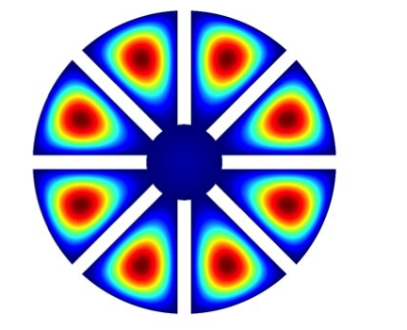
Scaling up the experiment: challenges and opportunities
*
Volume Challenge & multi-cavity arrays
Quantum sensors
Magnets
8T
3T
20 cm
12 cm
*PRL 125 (2020) 22, 221302
3cm
20cm

Slide 17
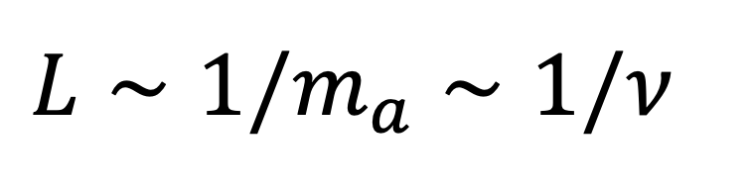
Volume Challenge
$$L∼1/m_{a}∼1/ν$$
1 GHz
Magnet
20 cm

Slide 18
Volume Challenge
$$L∼1/m_{a}∼1/ν$$
10 GHz
Magnet
20 cm

Slide 19
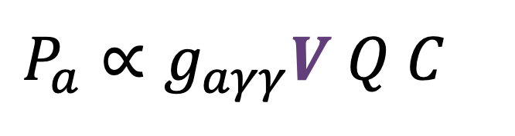
Volume Challenge
$$L∼1/m_{a}∼1/ν$$
30 GHz
$$P_{a}∝g_{aγγ}V Q C$$
Magnet
20 cm

Slide 20
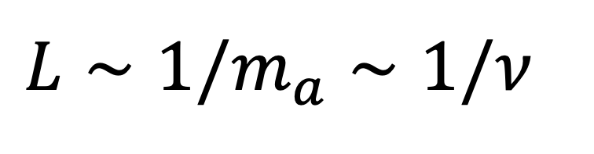
Volume Challenge
$$L∼1/m_{a}∼1/ν$$
$$L$$
Repeated Structures
Recover Larger Volume

Slide 21
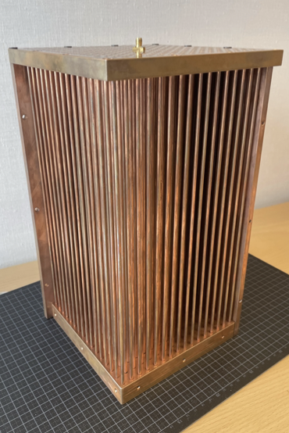
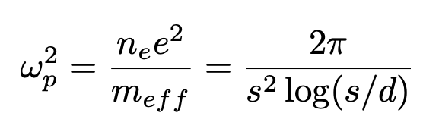



Volume Challenge
Repeated Structures
$$d$$
$$s$$
Resonant axion conversion
$$ω_{p}^{2}=m_{a}^{2}$$
Wires
Lawson et al PRL 123 (2019) 14, 141802
ALPHA Collaboration

Slide 22
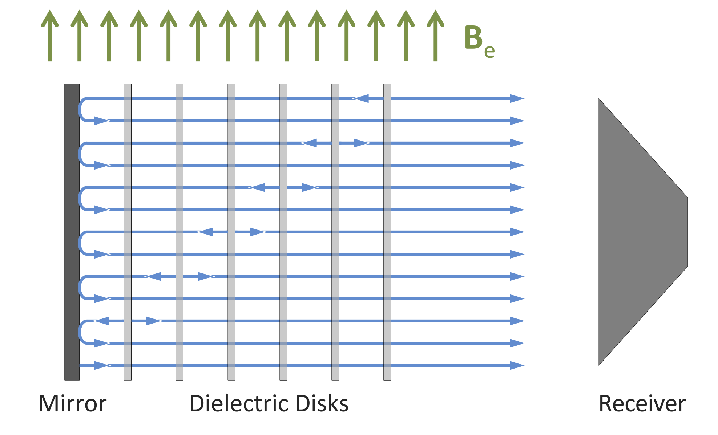
Volume Challenge
Repeated Structures
MADMAX – concept (Caldwell et al PRL 118, 091801 (2017))
ALPHA Collaboration

Slide 23
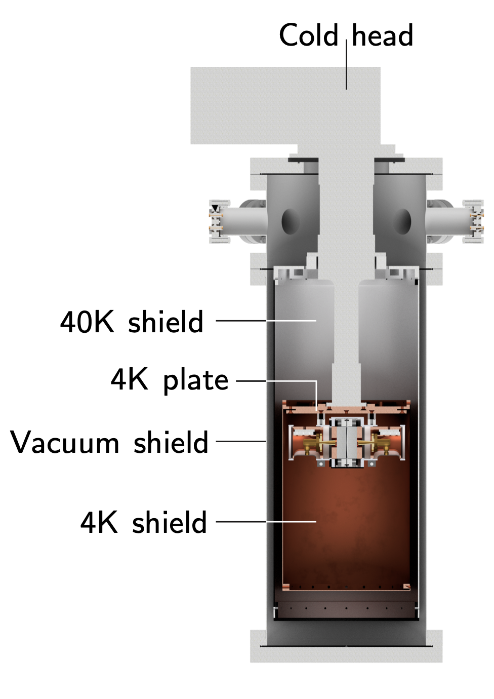
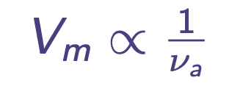
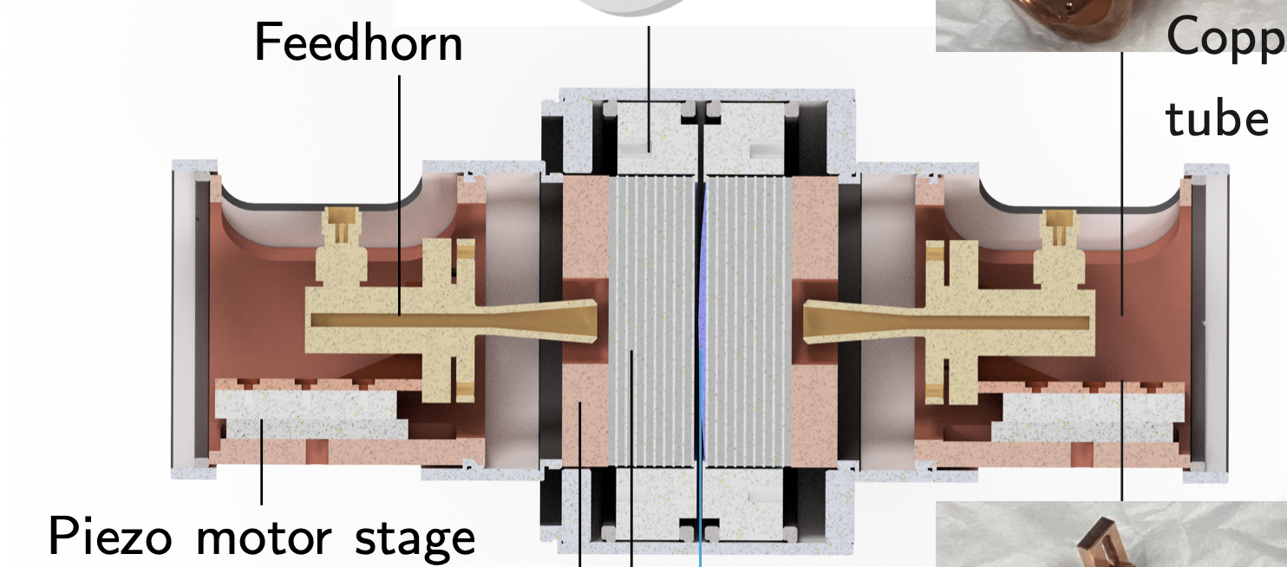
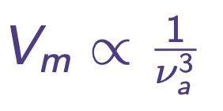
Volume Challenge
See Jiacheng Shi’s and Jack Devlin’s Talks &
Jon Gosling’s poster!
Naïve cavity Scaling
Fabry Perot

Slide 24
Volume Challenge
$$L∼1/m_{a}∼1/ν$$
Multi-Cavity Arrays
We have x 2 magnets
Magnet
See also: ORGAN, ADMX-ERF, CAPP
20 cm
cheap 2 cavity demonstrator

Slide 25
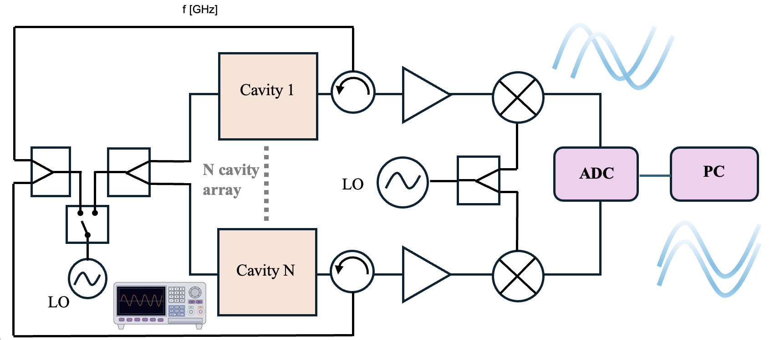
Volume Challenge
Multi-Cavity Arrays
Offline phase-matching
2 actuators per cavity (probe + tuning)

Slide 26
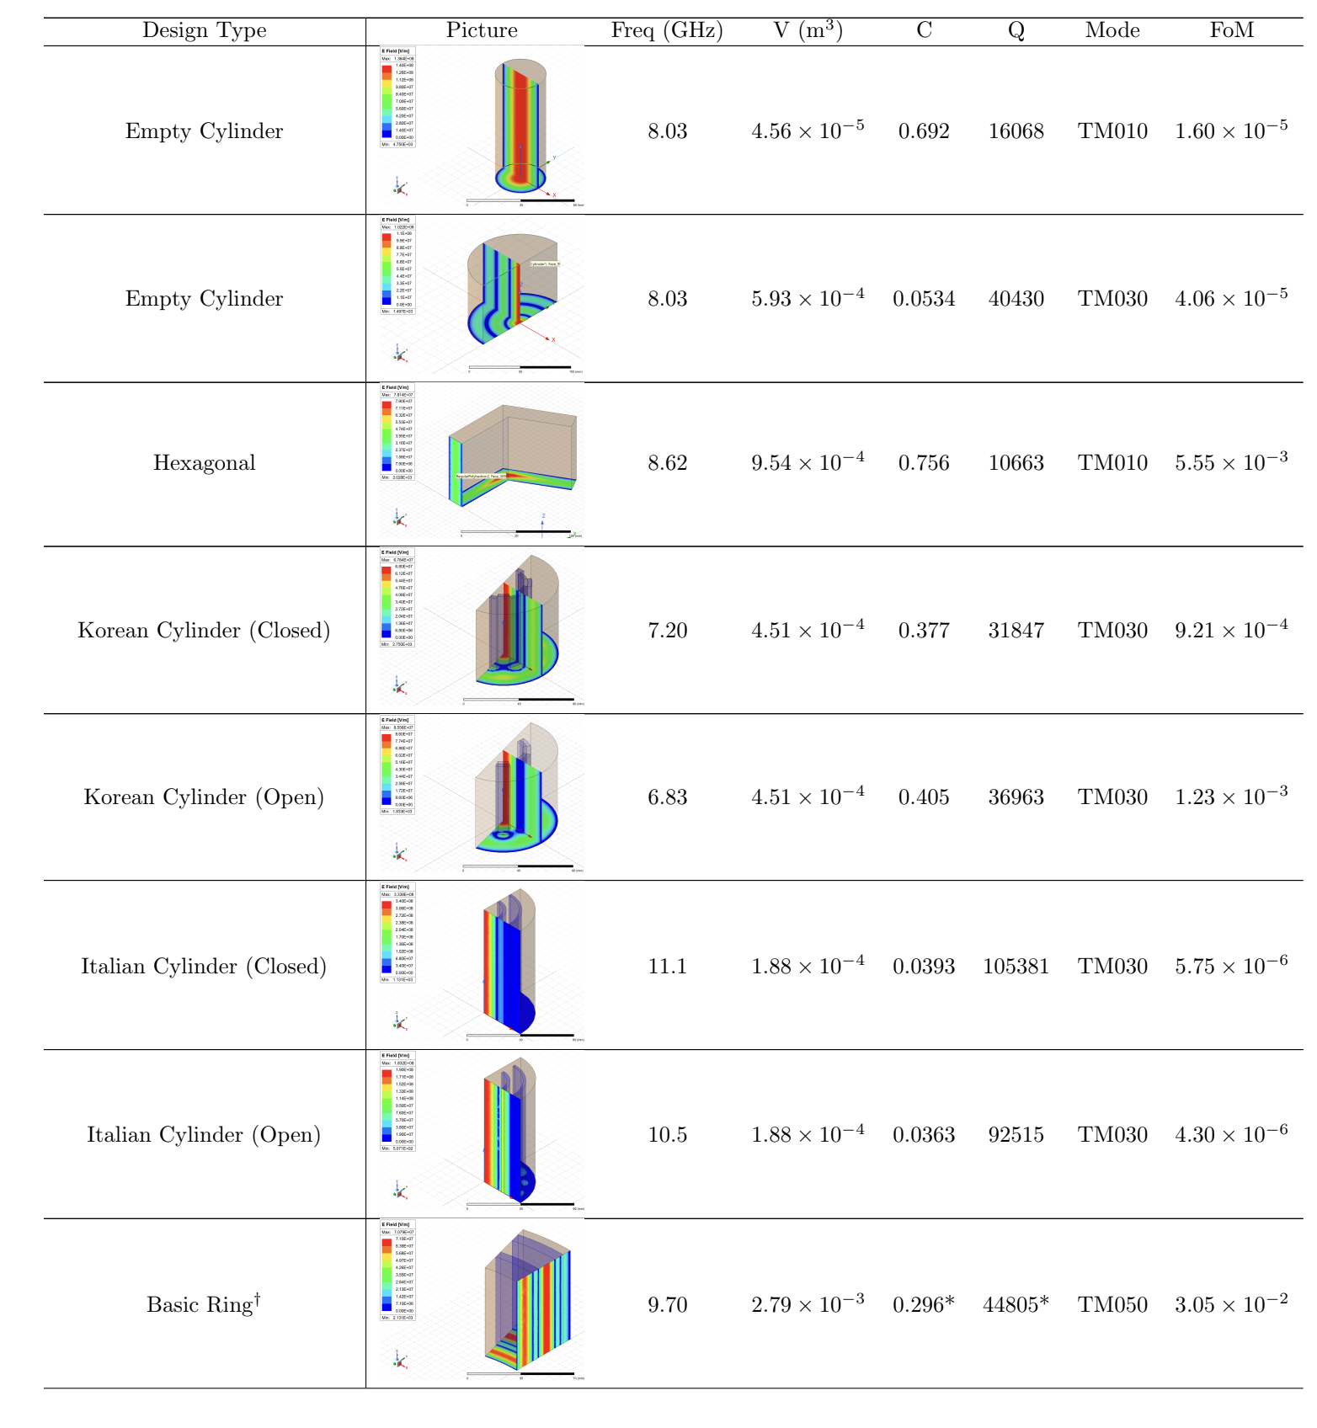
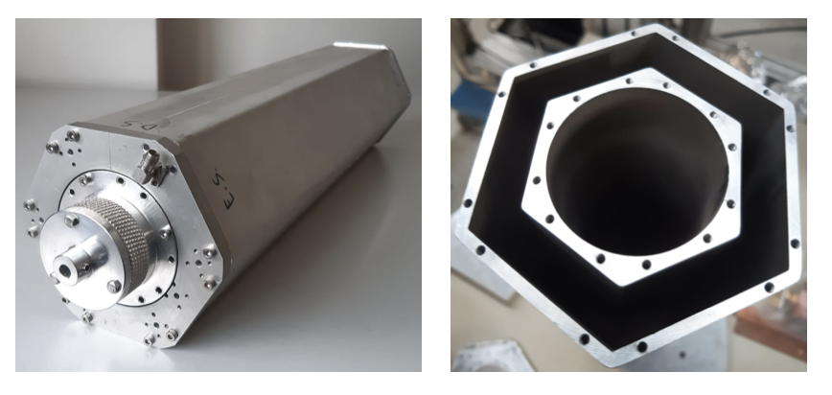
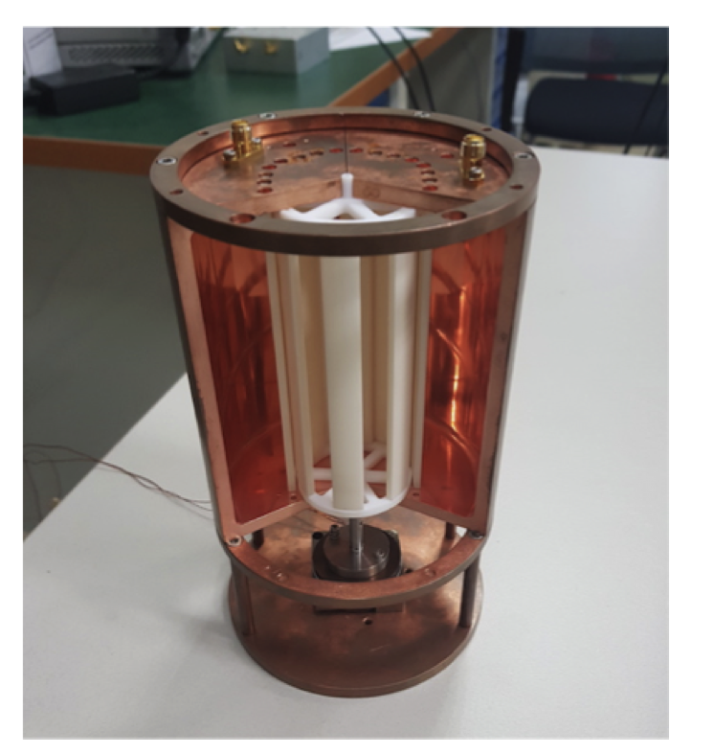
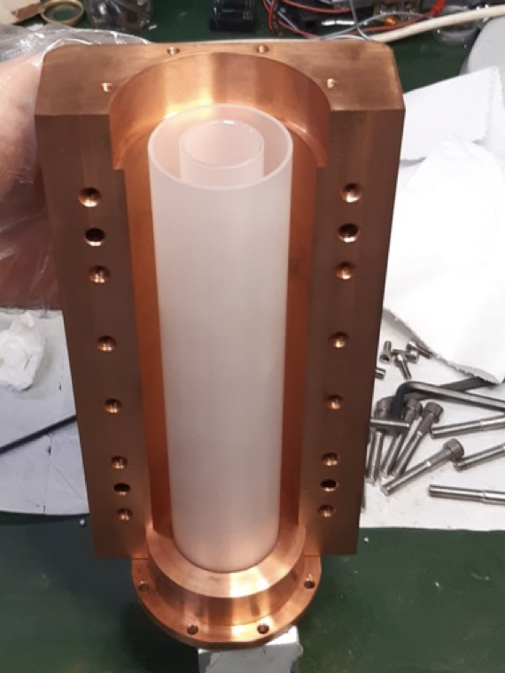



Improved Cavity
Designs
Scan Rate ($m^{3}$)
$$\frac{df}{dt}∝{\left(VC\right)}^{2}Q_{c}$$
Case Study
JM with masters student
Hong-Kai Tan

Slide 27




A multi-cavity case study
~ 10 GHz
30GHz
~ 10 GHz
$$L∼1/m_{a}$$
Band Gap Structures (Manchester Adaptation)
(JM et al (in progress) )
5 – 10 % tuning
R. Di Vora et al PRA 23, 034047 (2025)

Slide 28




Increased Q under high B
Q = 300,000 @ B = 8 T
Q =720,000
Q = 1,000,000 Q > 100,000
@ B = 6 Tesla. @ B = 6 Tesla
Superconducting Tapes
Sapphire Inserts
Superconducting Films
Posen et al
Phys. Rev. Applied
20, 034004 (2023)
Ahn, J., et al.
Phys. Rev. Applied 17, L061005 (2022)
Marconato et al
IEEE Trans. Appl. Supercond.
34(7) October 2024
D Alesini et al
Nucl. Instrum. Meth.
A 985 (2021) 164641

Slide 29




Increased Q under high B
Early stages collaboration with
Manchester & Daresbury National Lab
Andy Blackett-May
Superconducting coatings

Slide 30




Quantum Noise Limited Amplifiers
amplifier
GAIN
Noise
Cavity

Slide 31

A multi-cavity case study
Existing Pathfinder
A possible next phase experiment
(schematic)
8 Tesla
20 cm bore

Slide 32
Summary
Axion DM spans large mass range: high frequency scan
Pathfinder measurement in 2026.
Quantum Limited Amplifiers demonstrated in 2025.
Future improvements

Slide 33
Thank You

Slide 34

Backup slide
Jamie McDonald | University of Manchester | New Windows on Fundamental Physics | 19-20 Jan 2026

Slide 35


