Slide 1
A new search for dark matter axions using quantum technologies
New windows on Fundamental Physics
Jack Devlin
21/01/2026
J. A. Devlin et al., arXiv:2601.05472

Slide 2
Overview
1 | Introduction
2 | Linear amplification vs. single photon counting
3 | How to make a Penning trap single photon counter
4 | Progress so far

Slide 3
Overview
1 | Introduction
2 | Linear amplification vs. single photon counting
3 | How to make a Penning trap single photon counter
4 | Progress so far

Slide 4

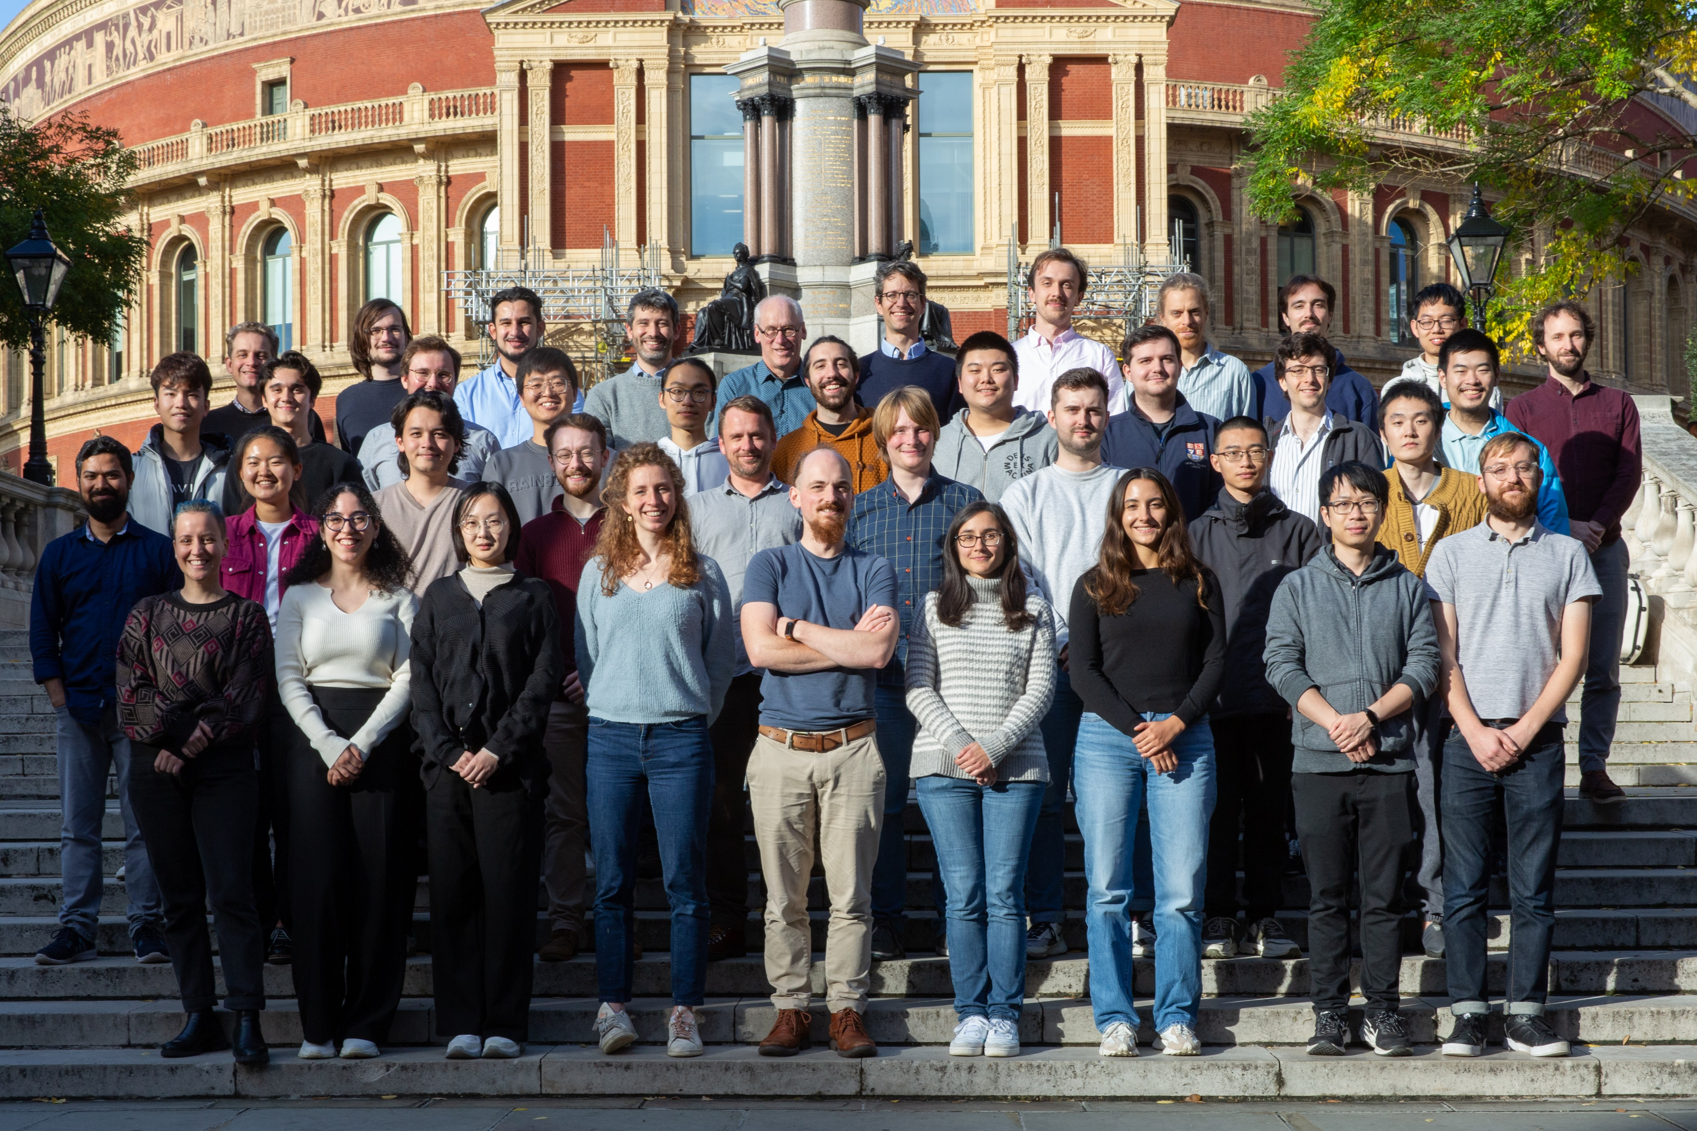
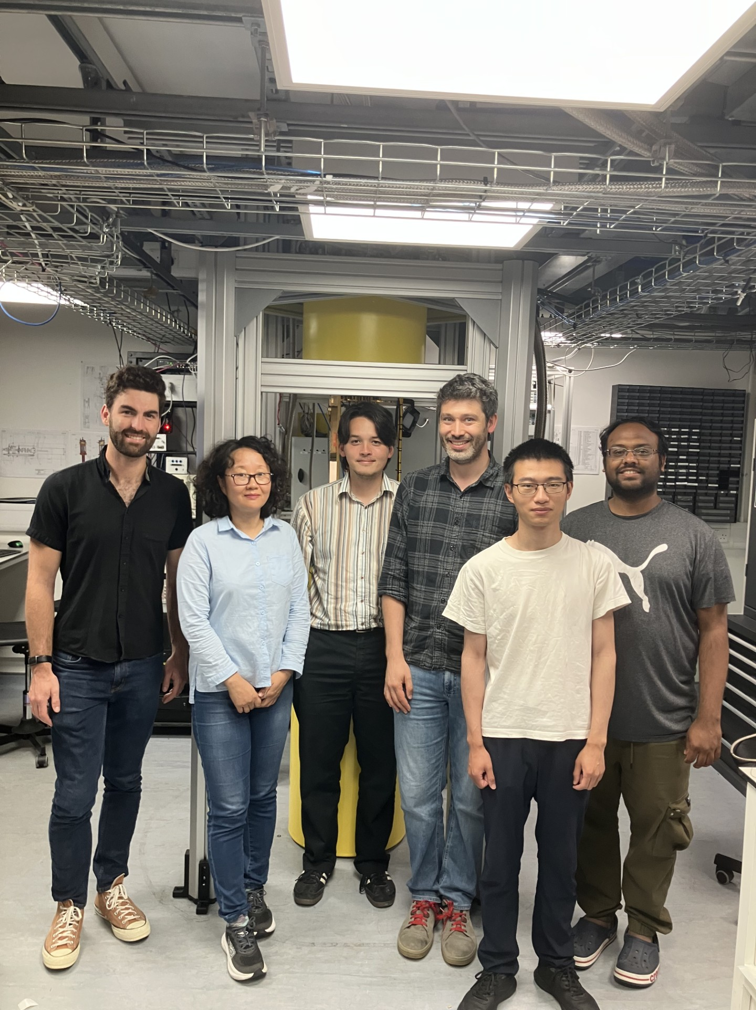


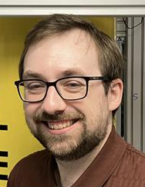
Who we are
Quantum Enhanced Particle Astrophysics Team
Centre for Cold Matter @ Imperial College
Richard
Thompson
Dr. Kanika
Jonathan Gosling
Toren Dofher
Marko Wojtkowiak
JAD
Shreyak Banhatti
The Centre for Cold Matter uses cold atoms, molecules and ions to test fundamental physics, measure tiny forces, control quantum systems and develop quantum technologies
He Zhang
Jiacheng Shi
+ Mike Tarbutt Marios Telemachou & Mingyao Xu, Maddie Fisher Horacio Septien-Gonzalez

Slide 5

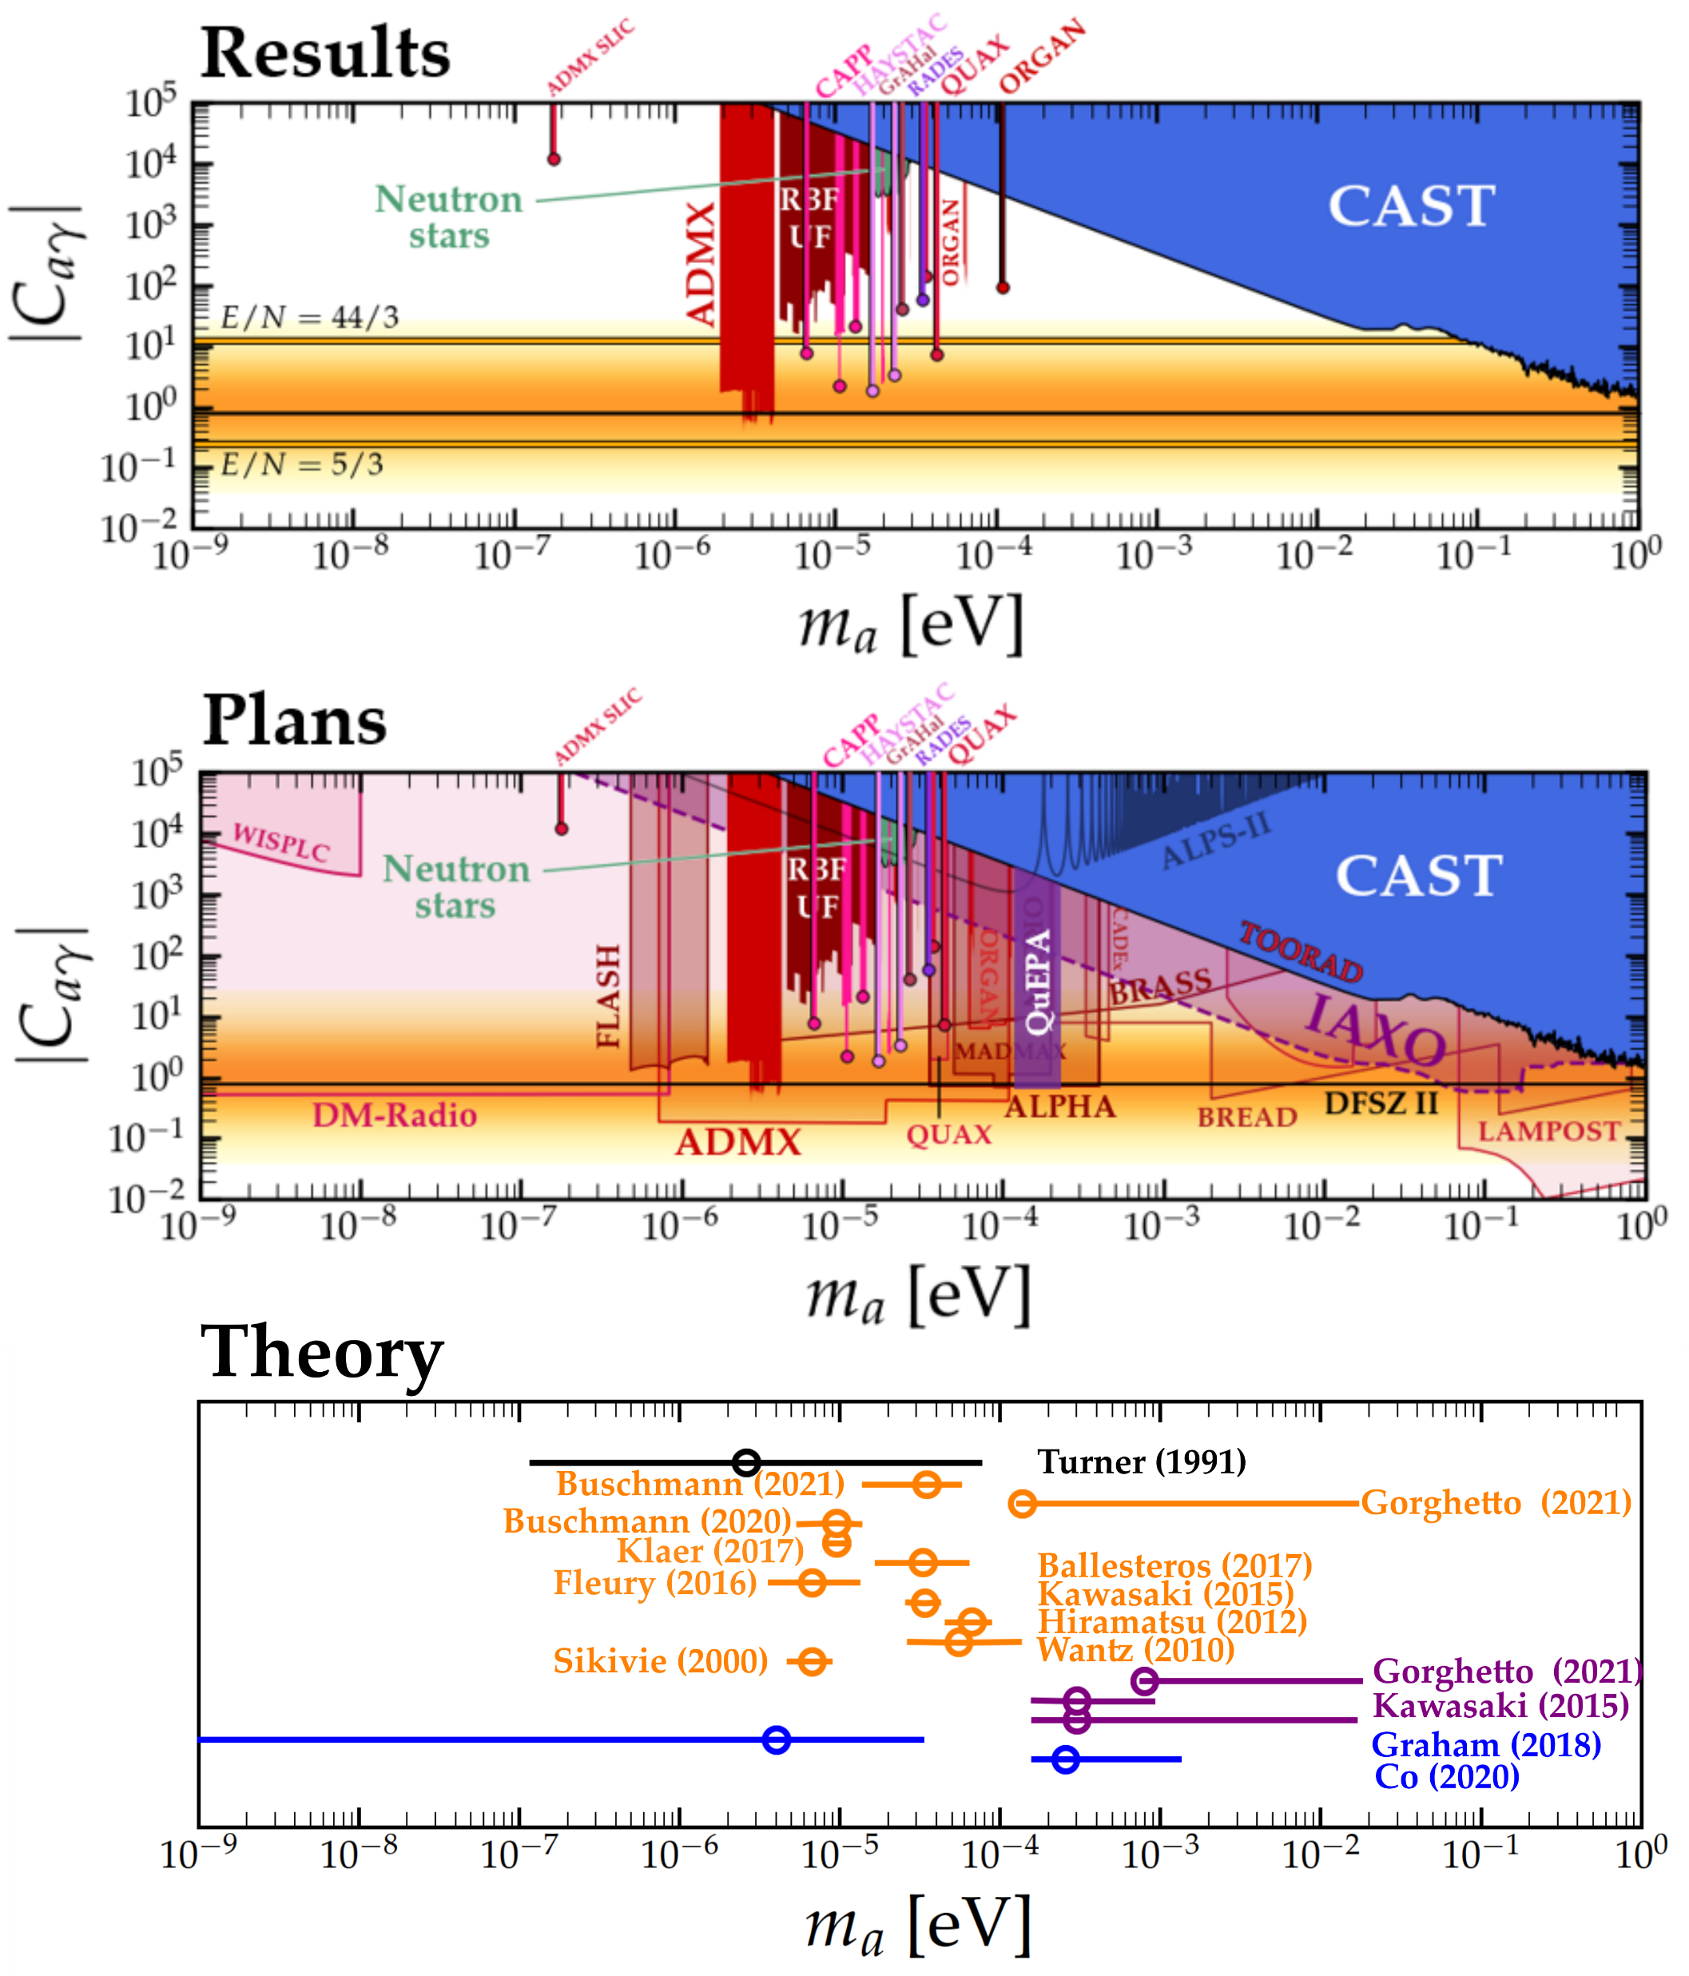
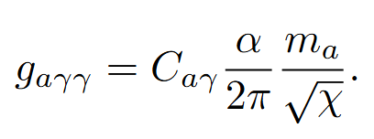
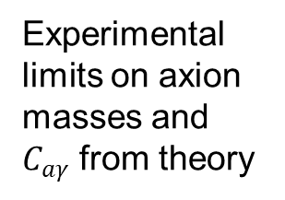
Axions
Experimental limits on axion masses and $C_{aγ}$ from theory
DFSZ
Model predictions
Axions formed pre-inflation
Axion masses consistent with Big Bang cosmology and DM density
Axions formed post-inflation with 1 domain wall
>1 domain wall
Other models
Huge range of viable axion masses to be explored
Goal: Search $m_{a}=\text{12}\text{4} \text{μeV}$ - $\text{248} \text{μeV}$ @ DFSZ sensitivity
Top: limits from cajohare.github.io/AxionLimits/docs/ap.html
Bottom: Theory plot adapted from Javier Redondo’s talk at TAUP 2021, reproduced with permission

Slide 6
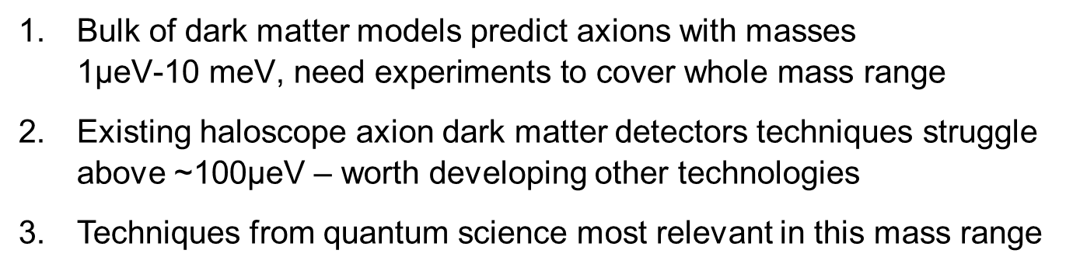
Why axions above $\text{12}\text{4 }\text{μeV}\text{?}$
Bulk of dark matter models predict axions with masses 1$\text{μeV}\text{-10 }\text{meV}\text{, }\text{need} \text{experiments} \text{to} \text{cover} \text{whole} \text{mass}$range
Existing haloscope axion dark matter detectors techniques struggle above ~100$\text{μeV}$ – worth developing other technologies
Techniques from quantum science most relevant in this mass range

Slide 7
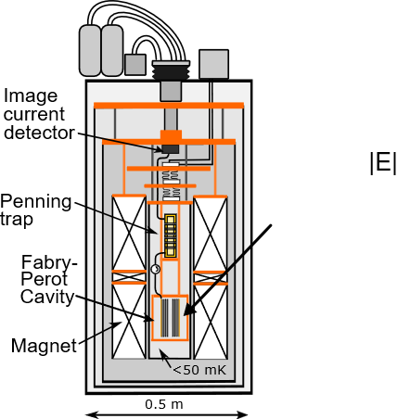
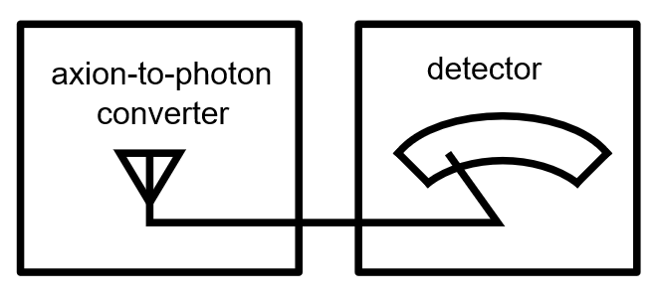
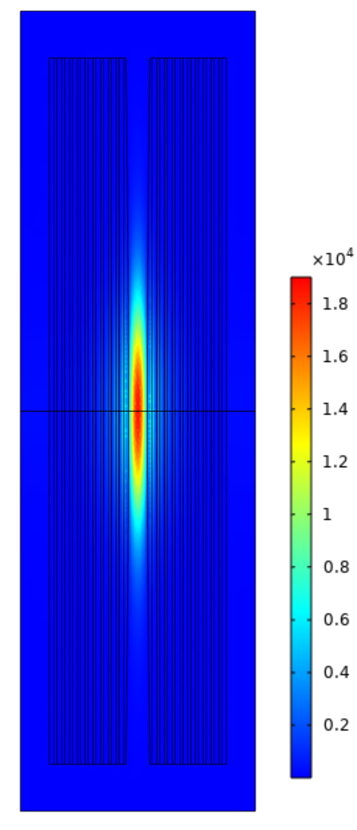

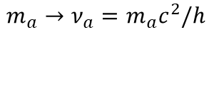
Experimental concept
Detector
$$m_{a}→ν_{a}=m_{a}c^{2}/h$$

Slide 8
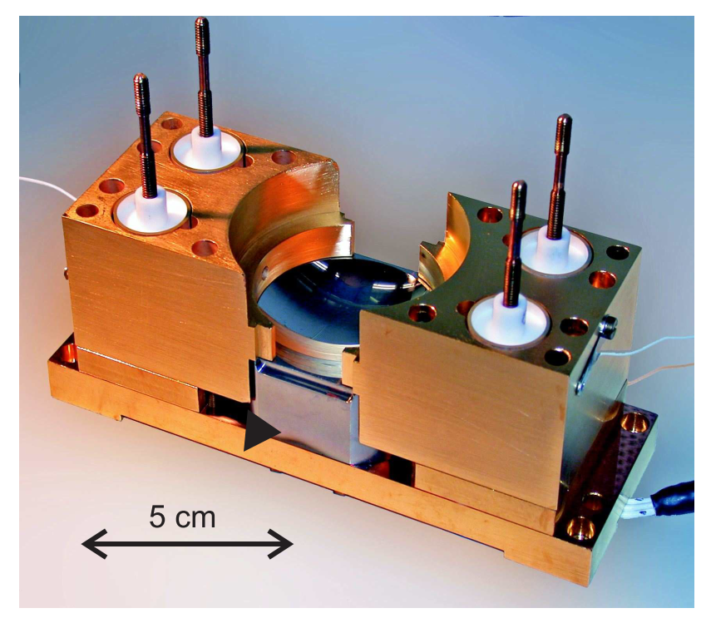
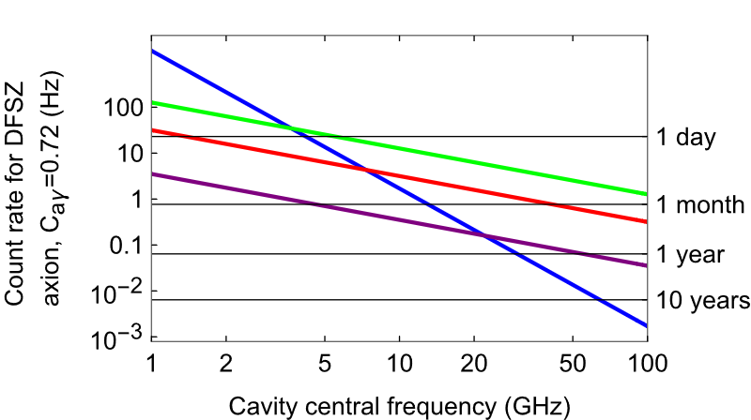







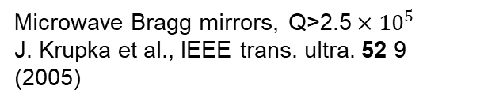

Fabry-Perot cavity axion-to-photon converter
Why?
$V_{m}∝$ cavity volume
If axions make up all dark matter, haloscope output is
$Q$cavity Q-factor
$$\text{Rate} [s^{−1}]={10}^{−3}κ{C_{aγγ}}^{2} ×V_{m}QB^{2}$$
$B$ magnetic field
1) Favourable $V_{m}$ scaling with $ν_{a}$
B
2) High Q possible in open geometry
Q=4.2x10¹⁰
At the optimum design frequency, $V_{m}=\frac{8}{π}\frac{c w^{2}}{ν_{a}}$
B=10T, Q=10⁶
$$λ_{a}/2$$
$w≫λ_{a}$/2
S. Kuhr et al., Appl. Phys. Lett. 90, 164101 (2007)
Measurement time to scan $m_{a}→2m_{a}$
3) High B-field compatible
Microwave Bragg mirrors, $\text{Q}\text{>2.5}×{10}^{5}$
J. Krupka et al., IEEE trans. ultra. 52 9 (2005)
Cylindrical cavity
FP $∅ 50$ mm
FP $∅ 150$ mm
FP $∅ 300$ mm
Other considerations: Frequency adjustment easy, compact, broad tuning range, easy to model and profile E field

Slide 9
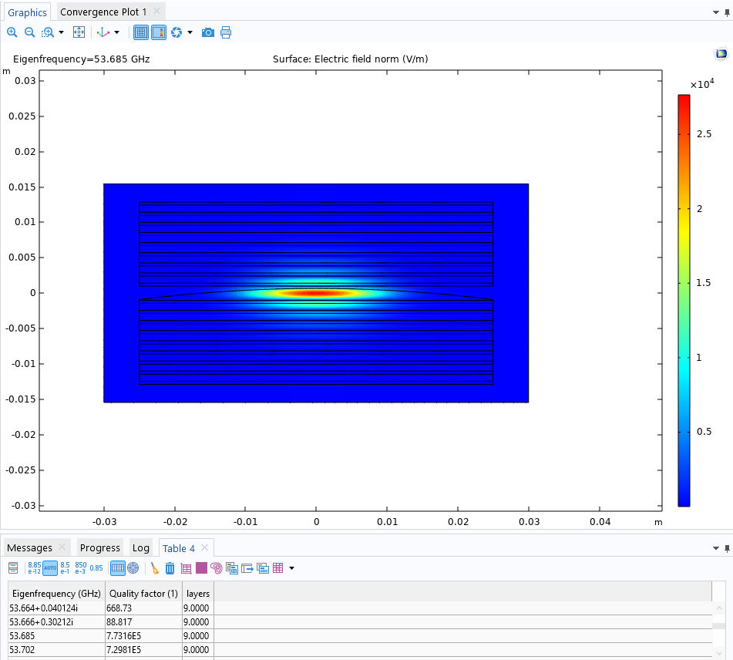
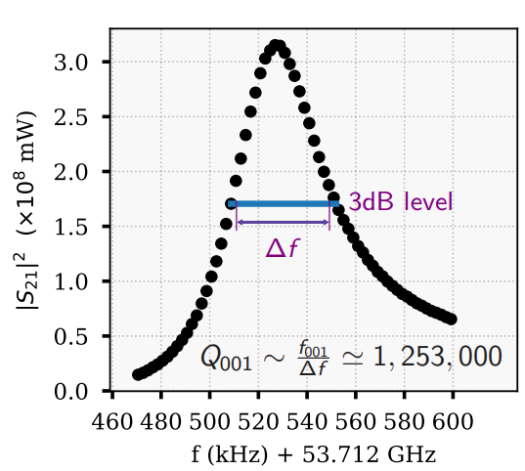
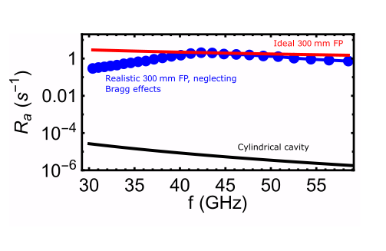
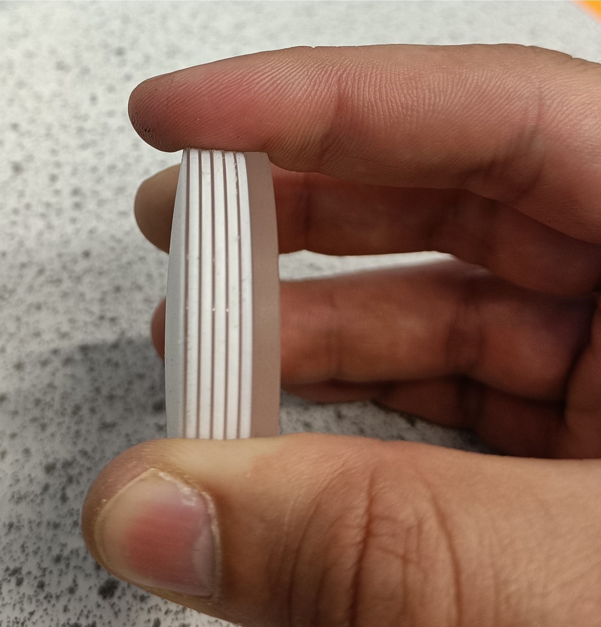
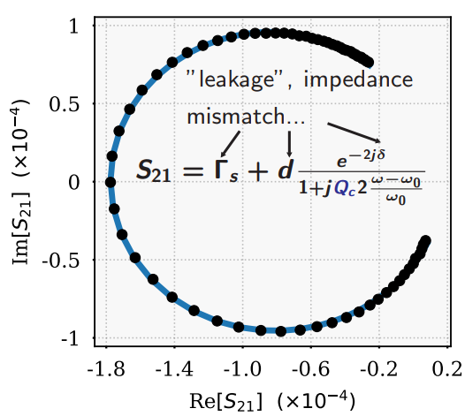




Fabry-Perot cavity axion-to-photon converter
Performance
Aim for a larger cavity:
50 mm diameter prototype works well,
tested at room temperature and 4K
|E|
Cylindrical cavity
FP $∅ 50$ mm
2.5
FP $∅ 150$ mm
2.0
FP $∅ 300$ mm
50 mm
1.5
1.0
0.5
$\text{Axion} \text{to} \text{photon} \text{conversion} \text{rate} \text{of} \sim 1 s^{−1}$ achievable

Slide 10
Overview
1 | Introduction
2 | Linear amplification vs. single photon counting
3 | How to make a Penning trap single photon counter
4 | Progress so far

Slide 11

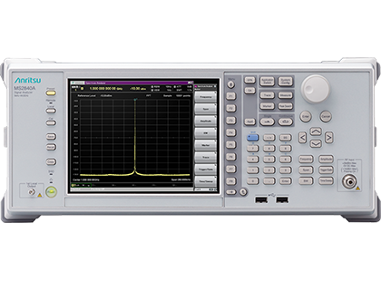

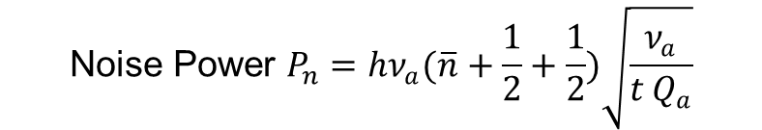


Detecting weak signals at microwave frequencies
Standard Quantum Noise limit
Classical readout: linearly amplify signal, use a signal analyzer
Implications for axion detection
Time to scan for 95% confidence limit
$$m_{a}=124 \text{μeV}→2m_{a}=248 \text{μeV}$$
(30 $→$60 GHz)
with $Q={10}^{6}$:
$$\frac{P_{a}}{P_{n}}=\frac{{hν_{a}R}_{a}}{P_{n}}=\text{SNR}$$
$$t_{scan}=8,600 \text{years}{×\left(\frac{1 s^{−1}}{R_{a}}\right)}^{2}{\left(\frac{\text{1 }}{\text{Efficiency}}\right)}^{2}$$
$$\text{Noise} \text{Power} P_{n}=hν_{a}(\overline{n}+\frac{1}{2}+\frac{1}{2})\sqrt{\frac{ν_{a}}{t Q_{a}}}$$
Zero-point noise from using a normal, Gaussian state of the cavity
Fundamental quantum amplification noise, related to zero-point noise of amplifier mode
Noise from finite temperature
Standard Quantum Limit (SQL)
Squeezed vacuum is an alternative…
S. K. Lamoreaux, et al., Phys. Rev. D 88, 035020 (2013)

Slide 12

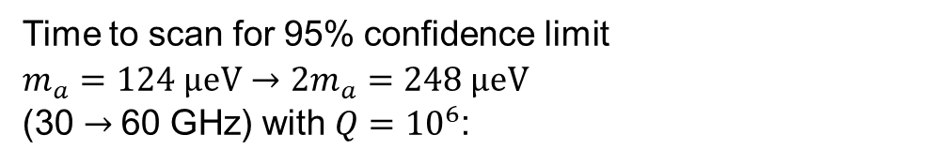
Detecting weak signals at microwave frequencies
Single photon counting
Detector
From axion to
photon converter
Time to scan for 95% confidence limit
Time to scan for 95% confidence limit
$$m_{a}=124 \text{μeV}→2m_{a}=248 \text{μeV}$$
(30 $→$60 GHz) with $Q={10}^{6}$:
$$t_{scan}=24 \text{days} ×\left(\frac{1s^{−1}}{R_{a}}\right)\left(\frac{1}{\text{e}\text{fficiency}}\right)$$

Slide 13
Overview
1 | Introduction
2 | Linear amplification vs. single photon counting
3 | How to make a Penning trap single photon counter
4 | Progress so far

Slide 14
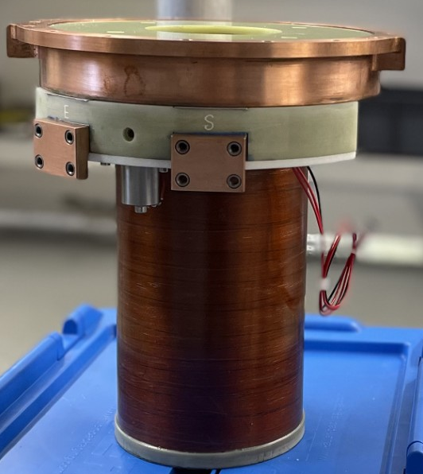
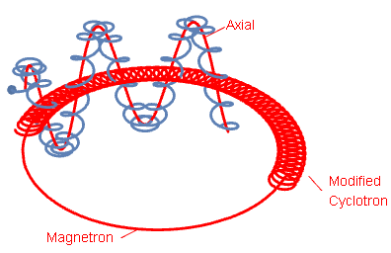
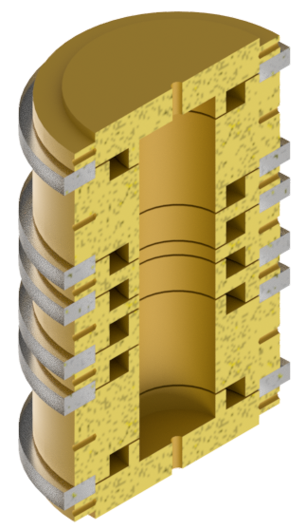
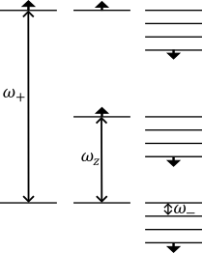
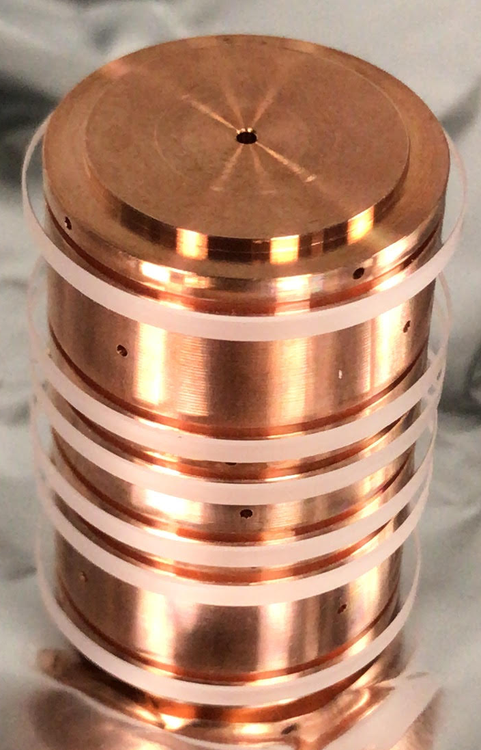
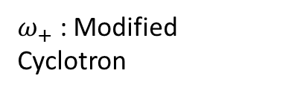






The Penning trap
What is it?
$$B_{0}$$
${ ω}_{z}$ : Axial
Strong
(~ Tesla) static magnetic field gives radial confinement
$ω_{+}$ : Modified
Cyclotron
V
$ω_{−}$: Magnetron
~10 cm
Spin not shown
$$V_{C}$$
$$V_{R}$$
Modified Cyclotron
~2 cm
$$V_{C}$$
Quadratic electric potential gives
axial confinement
Axial
Magnetron

Slide 15
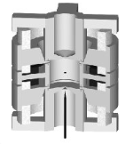
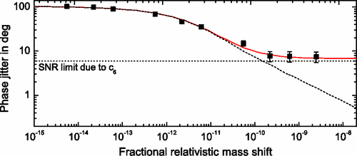
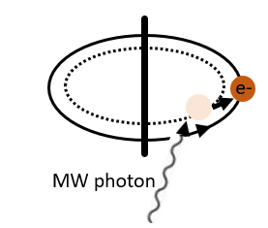
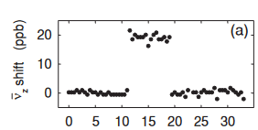



The Penning trap
Existing methods
Single cyclotron jump resolution
High precision axial frequency measurements via phase sensitive detection
B₂
Off resonant cavity
electron
$$Δν_{z}=\frac{hν_{+}B_{2}}{4π^{2}m_{e}ν_{z}B_{0}}Δn_{+}$$
electron
$Δ$n₊
$$Δν_{z}$$
1 degree phase resolution now standard for ions
cyclotron mode
time (s)
S. Peil and G. Gabrielse Phys. Rev. Lett. 83, 1287 (1999)
S. Sturm et al., Eur. Phys. J. Special Topics 227, 1425–1491 (2019)
D. Hanneke, S. Fogwell Hoogerheide, and G. Gabrielse, PRA 83, 052122 (2011)
S. Sturm et al., Phys. Rev. Lett. 107, 143003 (2011)

Slide 16
The Penning trap
Why use a Penning trap for single photon counting?
Penning traps do not require zero magnetic field
All electronic control
Very high up-time

Slide 17
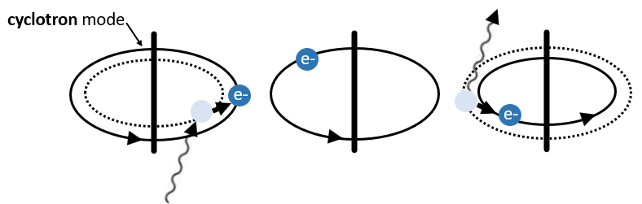
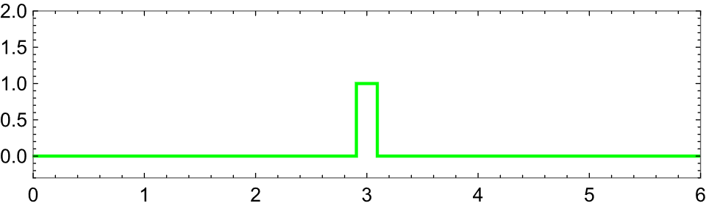
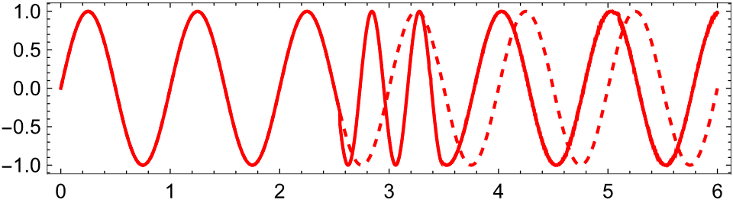
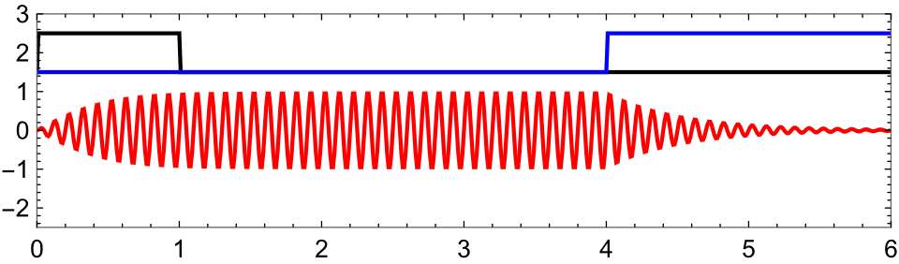
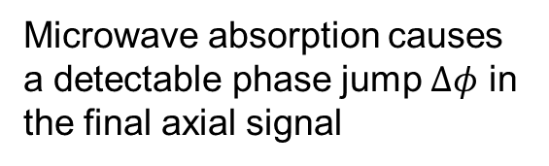



A Penning trap single photon counter
The basic operating principle
Microwave photon
Cyclotron state
$$Δφ$$
Excite axial motion
Detect axial motion
Microwave absorption causes a detectable phase jump $Δφ$ in the final axial signal
Axial Amplitude
Time
$$Δν_{z}=\frac{hν_{+}B_{2}}{4π^{2}m_{e}ν_{z}B_{0}}Δn_{+}$$
Details in J. A. Devlin et al., arXiv:2601.05472
See also similar ideas –
A. Cridland et al., Photonics 3, 59 (2016).
X. Fan et al., Physical Review D 111, 075022 (2025).
$$Δφ=2π{Δν}_{z}τ$$

Slide 18
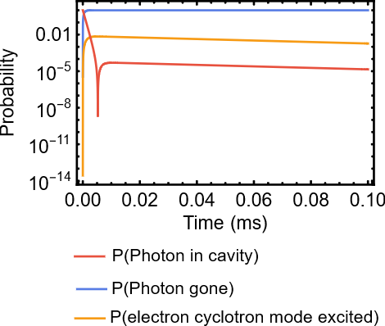
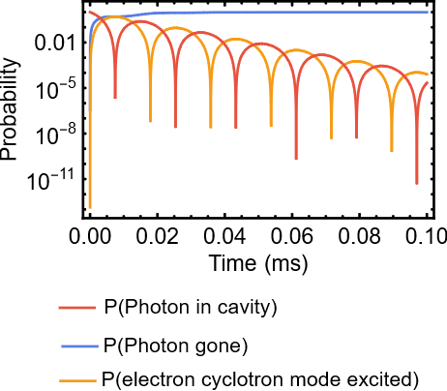
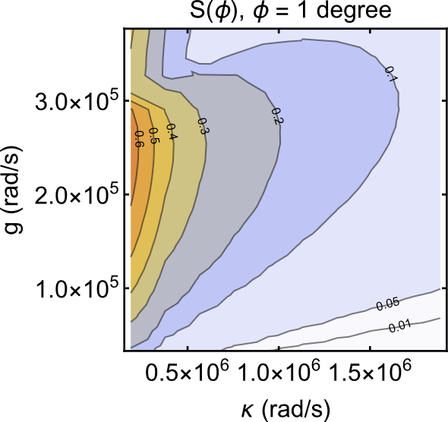
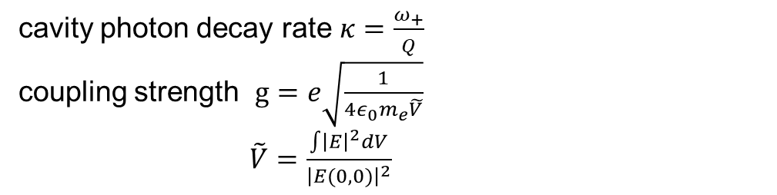
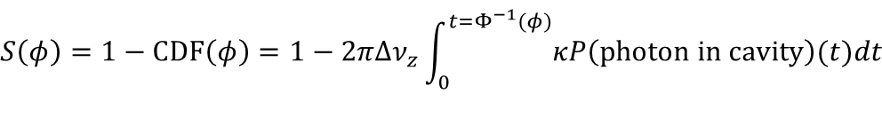

A Penning trap single photon counter
Electron-photon interaction
$$κ≫g$$
$$g≫κ$$
V
B₀
B₂
cQED model for coupled harmonic oscillators, parameterised by
cavity photon decay rate $κ=\frac{ω_{+}}{Q}$
coupling strength $g=e\sqrt{\frac{1}{4ε_{0}m_{e}\tilde{V}}}$
$\tilde{V}=\frac{\int{{\left|E\right|}^{2}}dV}{{\left|E(0,0)\right|}^{2}}$
What proportion of the time is the phase > $φ$?
$$S\left(φ\right)=1−\text{CDF}\left(φ\right)=1−2πΔν_{z}\int_{0}^{t=Φ^{−1}(φ)}{κP\left(\text{photon} \text{in} \text{cavity}\right)\text{(}t)dt}$$
ω₊ =2π × 30 GHz,
B₂ = 10⁵ T/m²
Axial phase advances of a few degrees when a photon is in the cavity

Slide 19
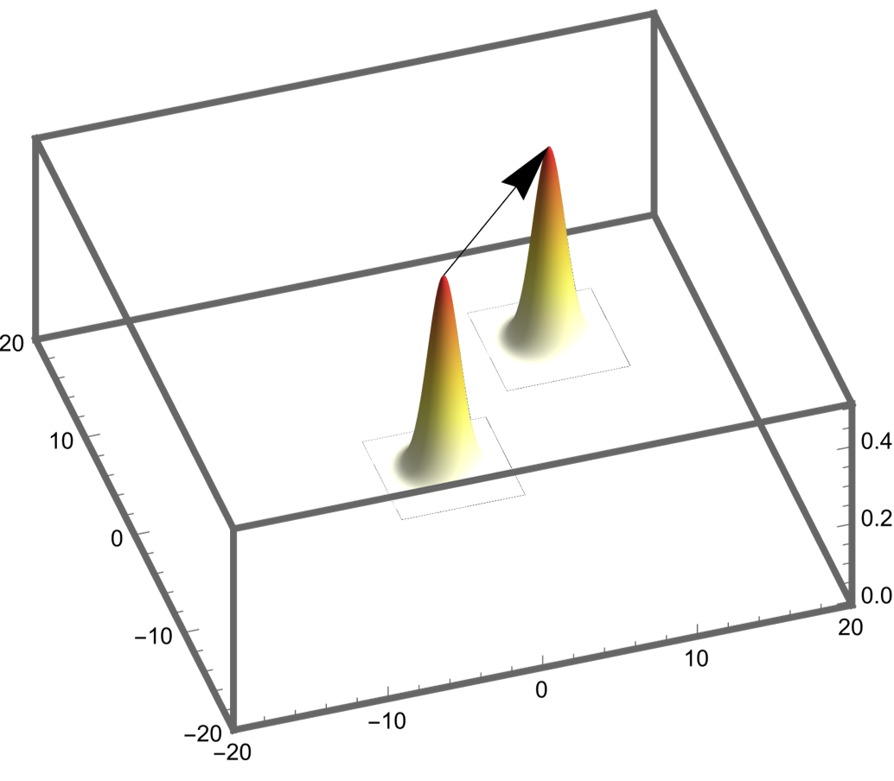



A Penning trap single photon counter
Resolving axial phase
$$φ$$
Resolving $φ$
PDF
Velocity/$ω_{z}$
Position

Slide 20
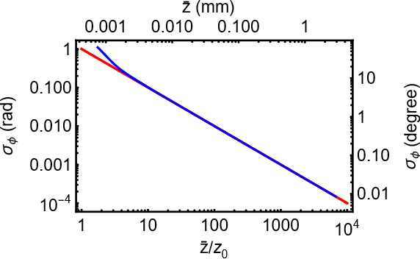
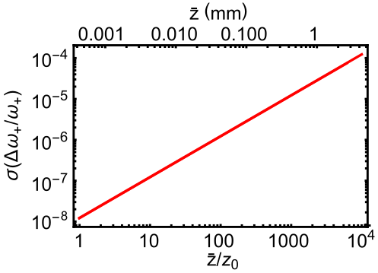
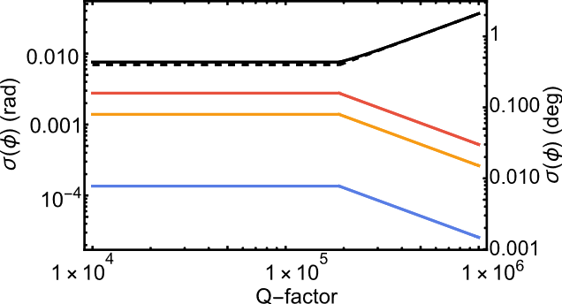
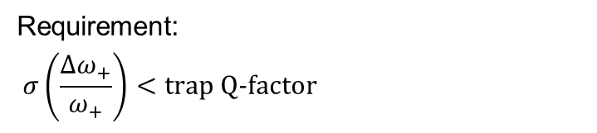
A Penning trap single photon counter
How well can we resolve an axial phase?
Increasing
Axial amplitude
Increasing
Axial amplitude
Requirement:
$$σ\left(\frac{Δω_{+}}{ω_{+}}\right)<\text{trap} \text{Q}\text{-}\text{factor}$$
B₂
B₂
Lower axial
phase noise
Increasing
broadening

Slide 21
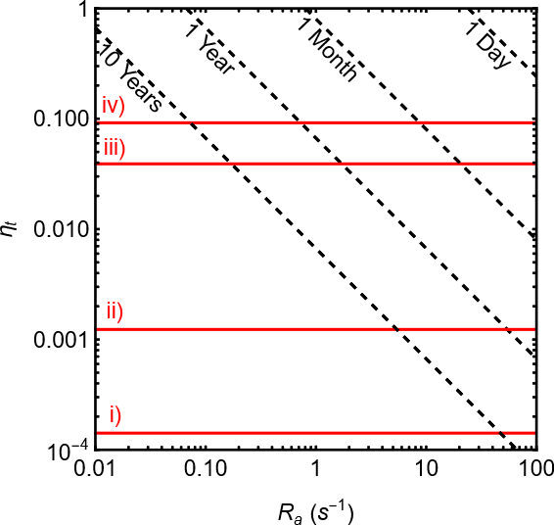






A Penning trap single photon counter
Detection and exclusion efficiency
$m_{a}→2m_{a}$ scan time
Detection efficiency
3%
Exclusion efficiency
Exclusion efficiency
19 %

Slide 22
Overview
1 | Introduction
2 | Linear amplification vs. single photon counting
3 | How to make a Penning trap single photon counter
4 | Progress so far

Slide 23




Penning trap experimental progress
Dilution refrigerator
With 2T applied, base temperature 0.047 ± 0.001K
Vibration measured via MEMS
accelerometers < 1µm rms at
magnet centre, should not affect
measurement

Slide 24




Experimental progress
Trap design and construction
Custom high
density feedthrough
Penning trap
electrodes
Trap can
Inductor
(one element
of image
current
detector)
Filters
Pinch off tube

Slide 25





Experimental progress
Electron trapping and excitation
Up to date images of small
cloud of electrons
resonator
Cooldown 10/10/25
Clear signs of trapping 23/10/25

Slide 26
Takeaway
1 | Microwave single photons counters dramatically speed up high mass axion searches
2 | An electron in a Penning trap can be used to make a photon counter
3 | We can now load and control small clouds of electrons, and are working towards single particle control

Slide 27



Thank you
A new search for dark matter axions using quantum technologies
21/01/2026

Slide 28




Detecting weak signals at microwave frequencies
Single photon counting technologies
Solid-state devices
Alternative AMO devices
At 100-300 GHz LCKIDs are used for astrophysics
(not single photon sensitivity)
CARRACK I & II Rydberg atoms
electron g-factor
Penning trapped electron
opto-electro-mechanical detector
Double Quantum Dot (resonant)
(photomultiplication)
Efficiency ~${10}^{−5}$
Double Quantum Dot (broadband)
Transition Edge Sensors
SIMP
Josephson junction detectors
Hot-electron bolometers
cQED QND
Good performance, ultimately effort was not sustained, new Rydberg efforts at Yale
A. V. Dixit, et al., Phys. Rev. Lett. 126 141302 (2021)
M. Tada et al., Physics Letters A 349 6 488 (2006)
A. Ghirri et al., Sensors 20(14), 4010 (2020)
E. Graham et al., Physical Review D 109, 032009 (2024)

Slide 29
Penning trap experimental progress
Short term goals
Load, trap and control electrons
Demonstrate the basic techniques needed for photon counting
Demonstrate photon counting

