Slide 1



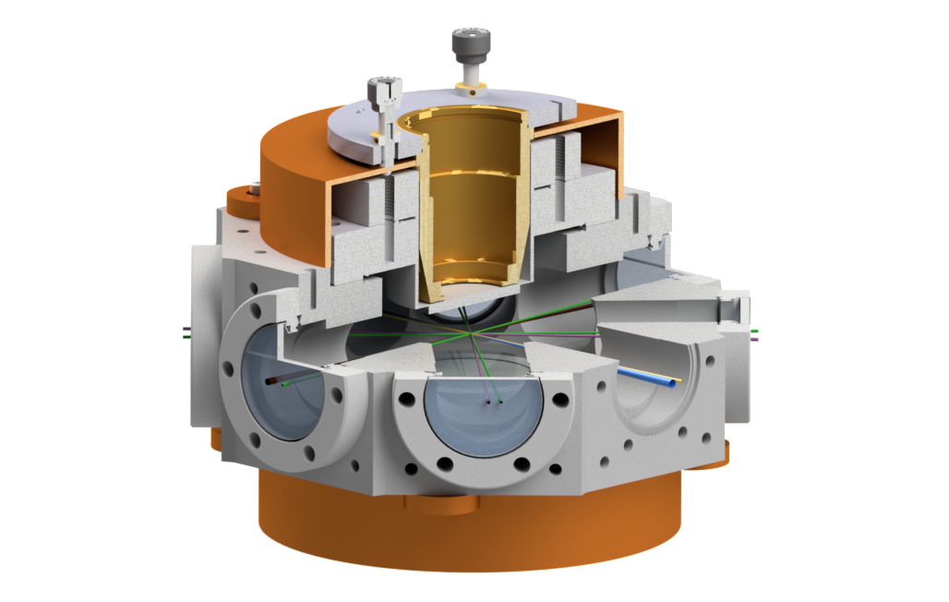
Configurable optical lattices: Quantum simulation and sensing for fundamental physics
Tiffany Harte
th558@cam.ac.uk
20th January 2026
New Windows on Fundamental Physics, University of Manchester

Slide 2
Part 1: Experimental toolkit

Slide 3
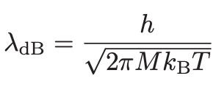

Ultracold atoms in optical lattices
Dilute clouds of atoms cooled to quantum degeneracy (typically hundreds of nK or lower)
Sensitive, manipulable quantum systems that are easily probed
$$λ_{dB} ≈d$$

Slide 4
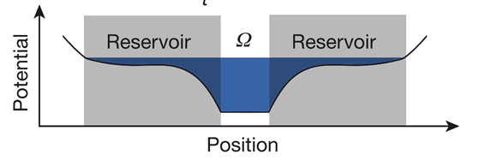
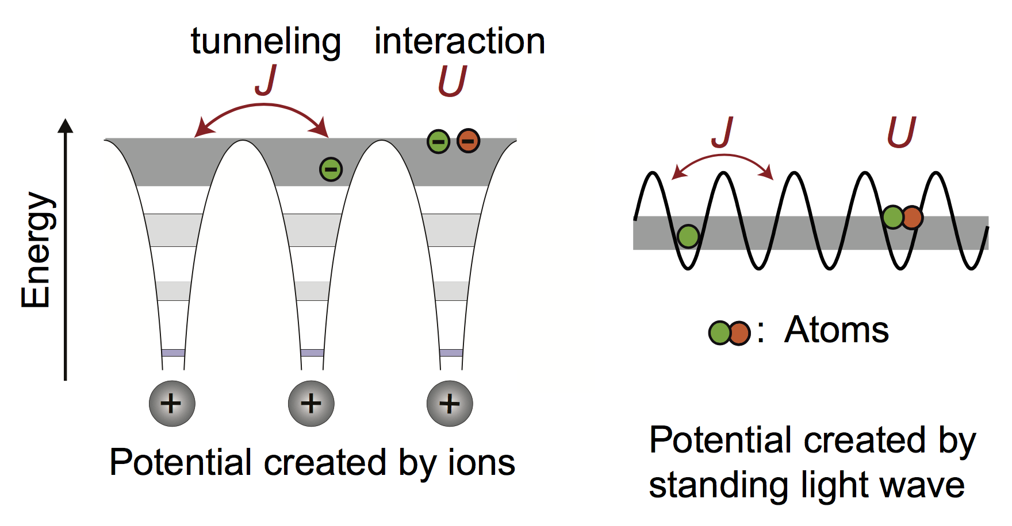
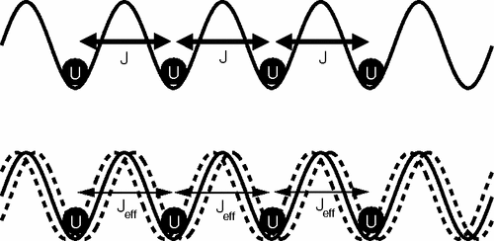
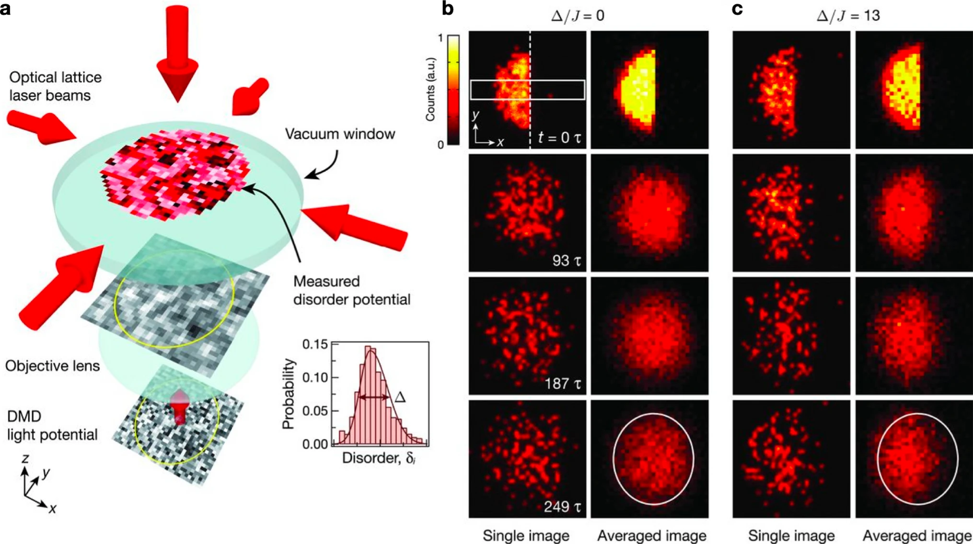
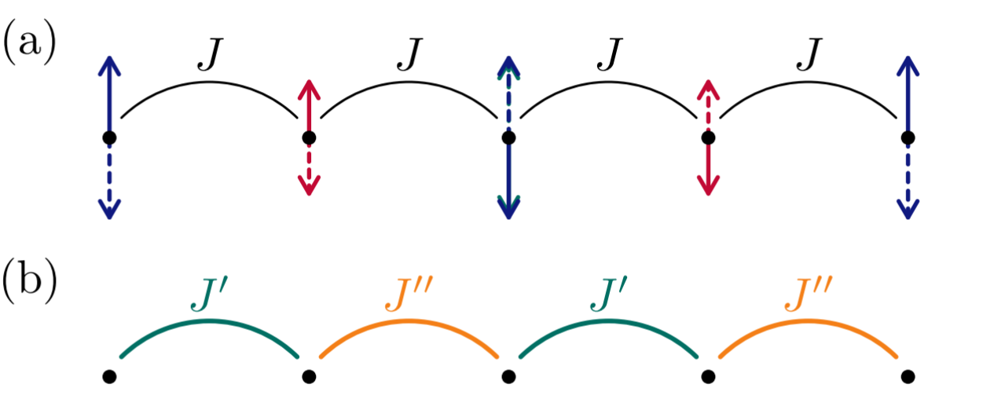
Ultracold atoms in optical lattices
Creating Hamiltonian of interest:
Geometry
Depth
Interactions and species
Floquet engineering
Projected potentials
Nature 545, 462-466 (2017).
Projected potential for entropy redistribution
PRL 99, 220403 (2007)
Suppressed tunnelling by strong shaking
Quantum Sci. Technol. 9 045030 (2024).
Locally driving on-site energies to generate the SSH model
Science 351, 1547 (2016).
Thermalisation with and without projected disorder

Slide 6
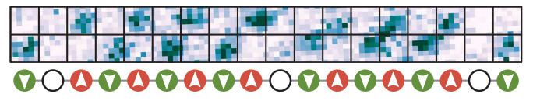
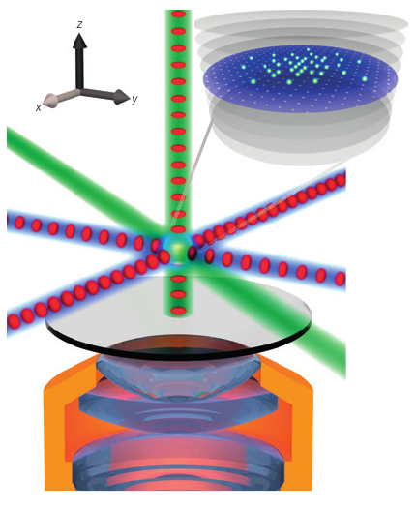
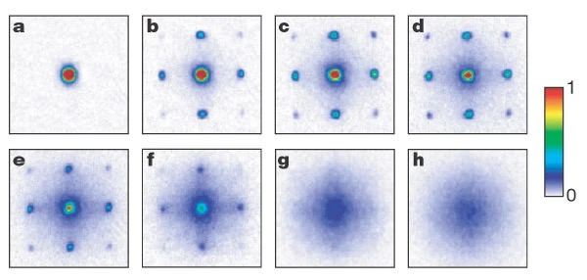
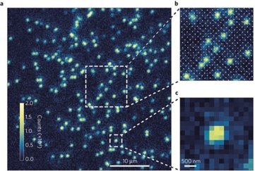
Ultracold atoms in optical lattices
Real-space…
Science 357, 484-487 (2017).
Spin-resolved imaging
… or momentum space imaging
Nature Physics 11, 738-742 (2015)
Single-site imaging in a quantum gas microscope
Nature 415, 39 (2002).
Superfluid-Mott insulator transition

Slide 7

Ultracold strontium
5sns ³S₁
5snd ³D₁
Isotopes: ⁸⁴Sr, ⁸⁶Sr, ⁸⁷Sr, ⁸⁸Sr
2-stage MOT: wide (blue, 461 nm) and narrow (red, 689 nm) cooling transitions
Metastable state(s) and clock transition
Atomic clocks and metrology
Nature 506, 71–75 (2014), PRL 110, 171102 (2013)
Quantum information and simulation
Quantum Inf. Process. 10, 865 (2011)
Magic wavelength 813 nm
Coupling to triplet Rydberg states
Long-range (controllable) interactions
J. Phys. B 44, 184010 (2011), Nature Phys. 16, 857-861 (2020)
Off-resonant dressing: squeezing and entanglement
PRL 131, 063401 (2023)
5s6s ³S₁
5s6s ³S₁
707 nm
317 nm
5s5p ¹P₁
679 nm
461 nm
2π x 30 MHz
J=2
J=1
689 nm
2π x 7.5 kHz
5s5p ³P_{J}
J=0
698 nm
mHz
5s² ¹S₀

Slide 8
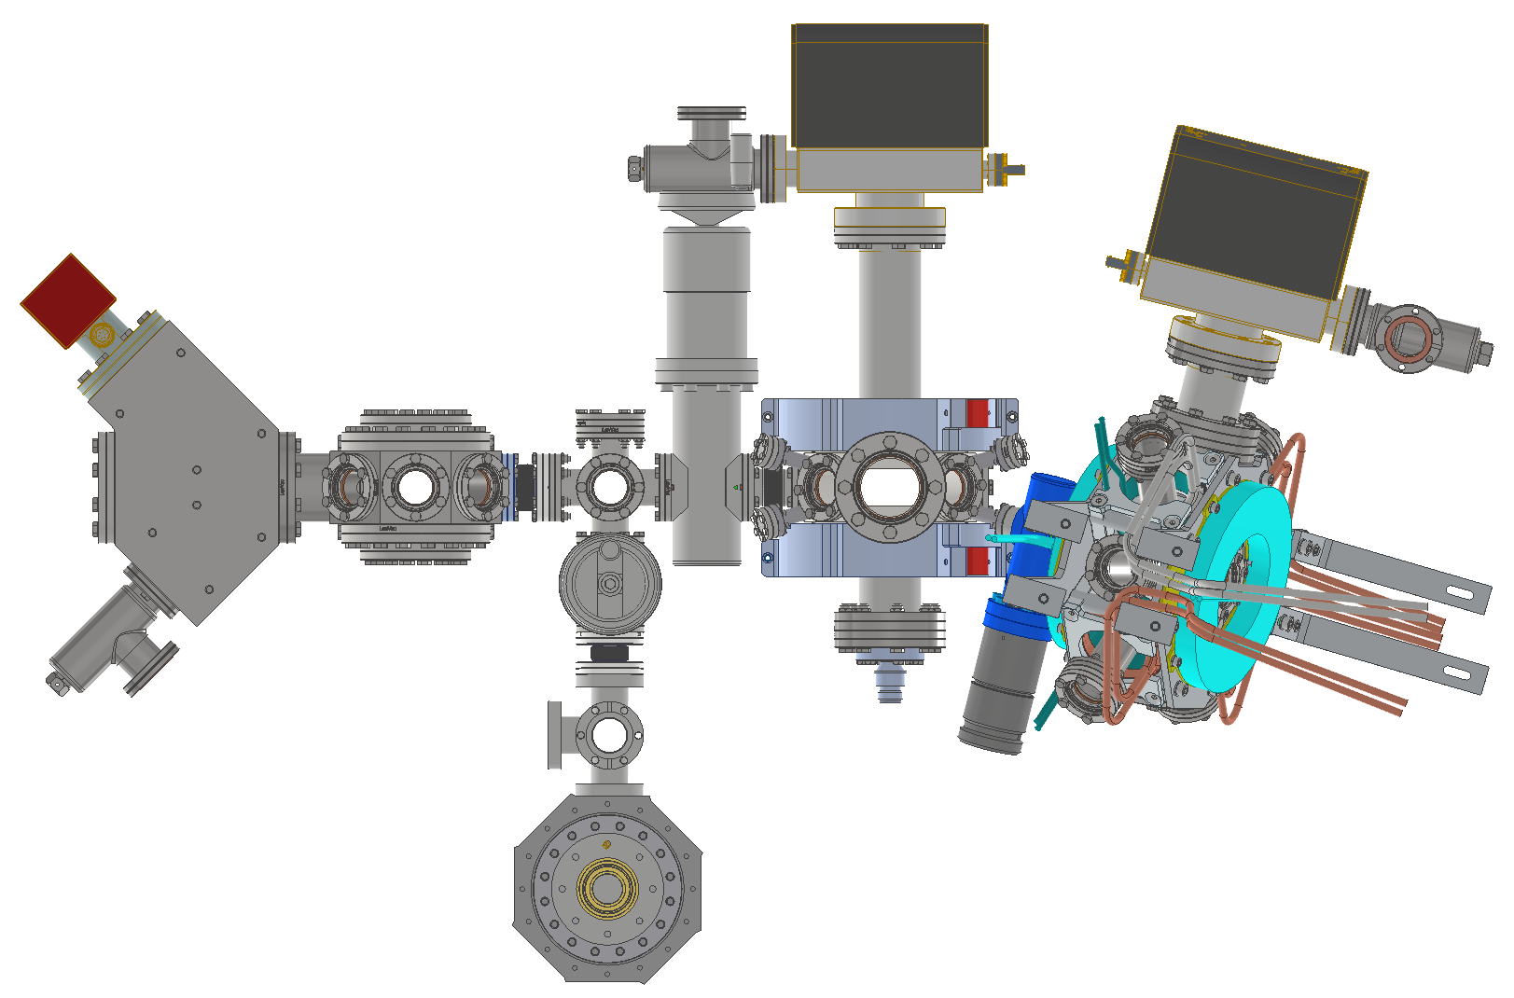
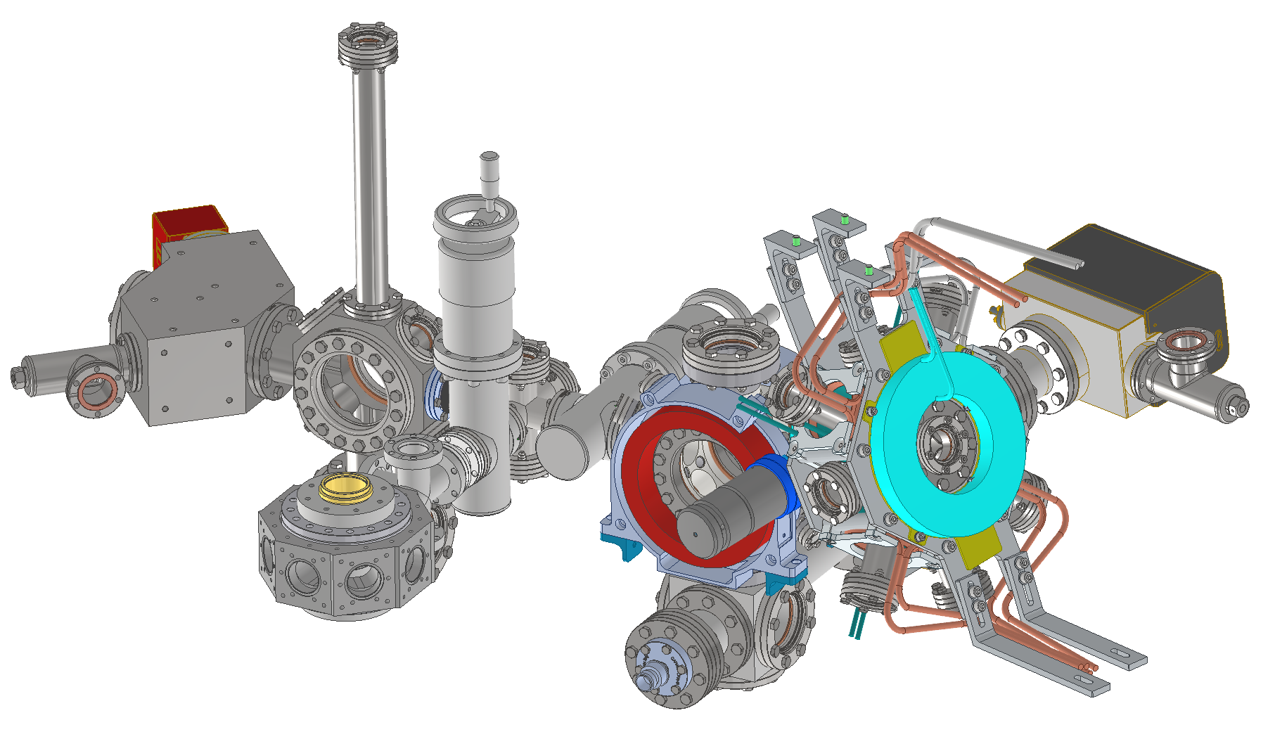
The strontium apparatus
Atom interferometry (AION)*
View from above
*Sr apparatus development a collaboration between AION and tweezer teams
J. Cosmol. Astropart. Phys. 5, 011 (2020)
See AION talk later today!
2D MOT
Tweezer/lattice chamber
Sr oven
(~400ºC)
3D blue MOT
3D red MOT
Optical dipole trap and transport

Slide 9
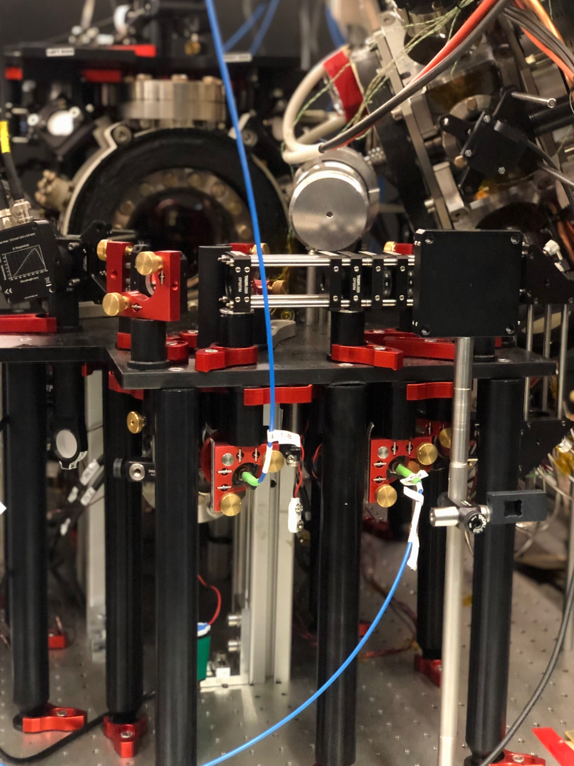
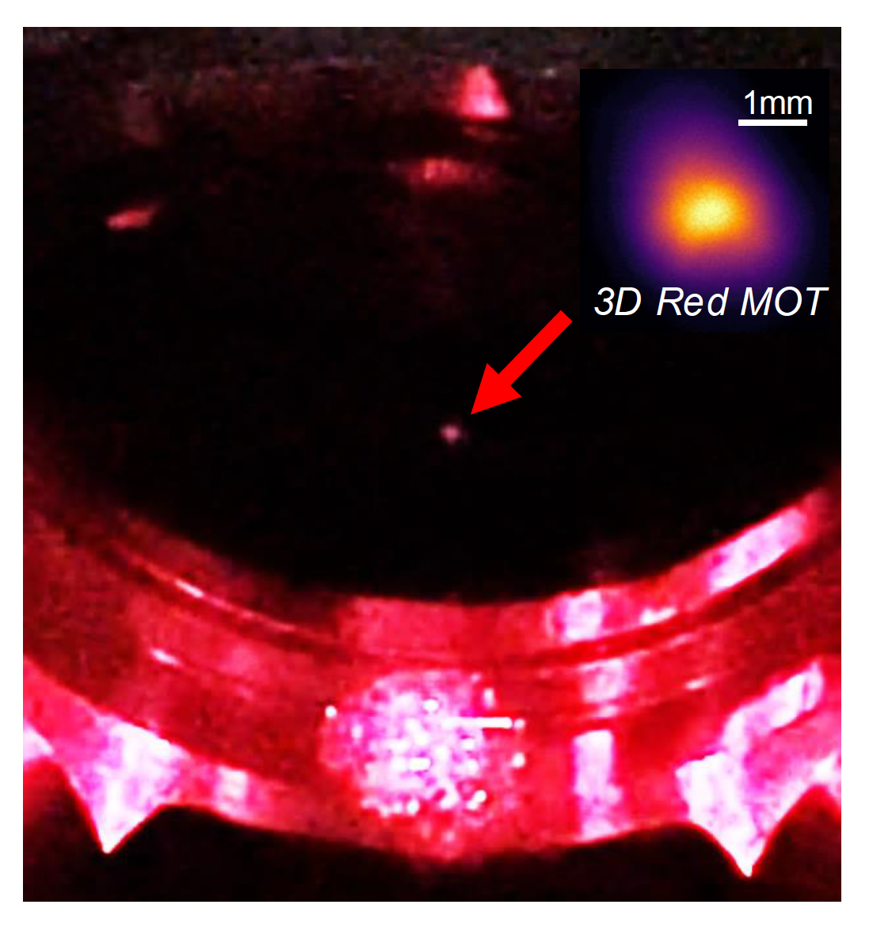
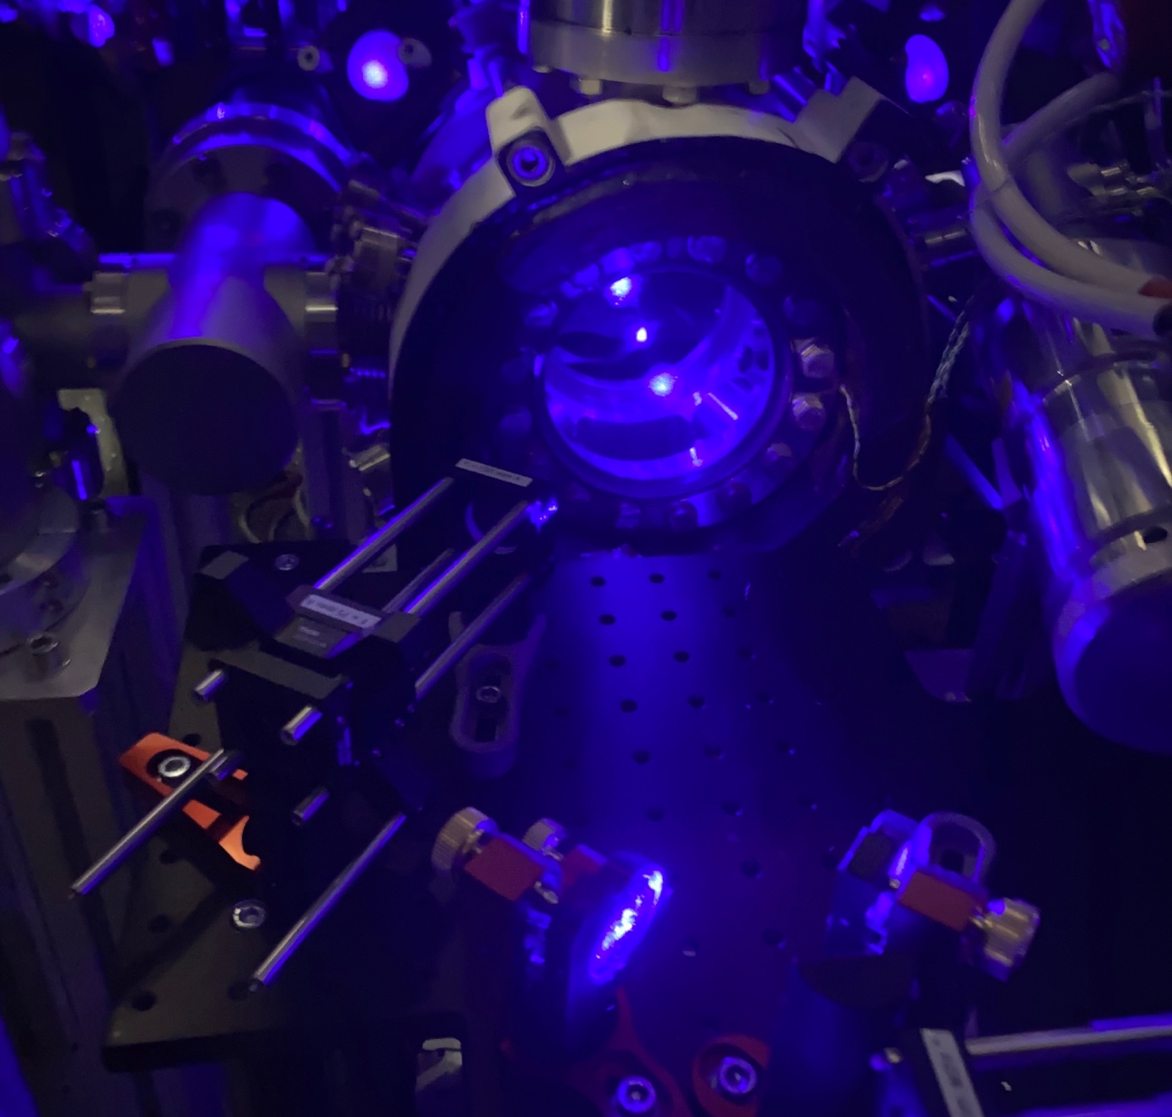
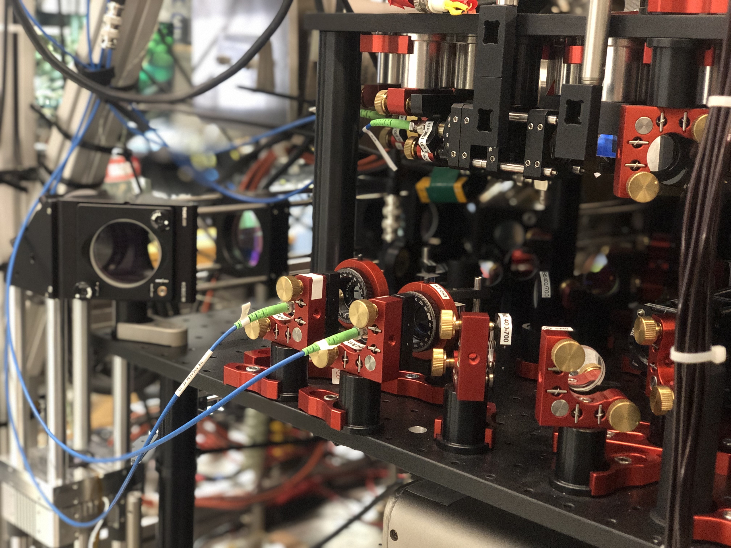
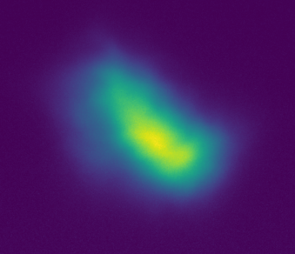
The strontium apparatus
3D blue MOT
Atoms at mK
3D red MOT
Atoms at 1.5 µK
1 mm

Slide 10
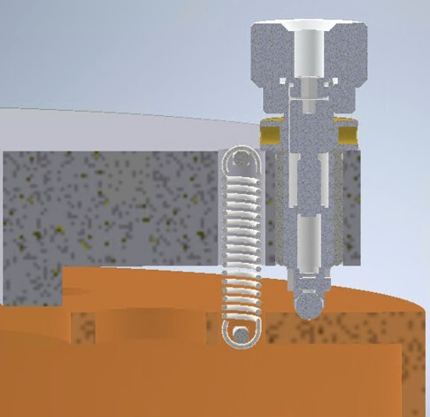
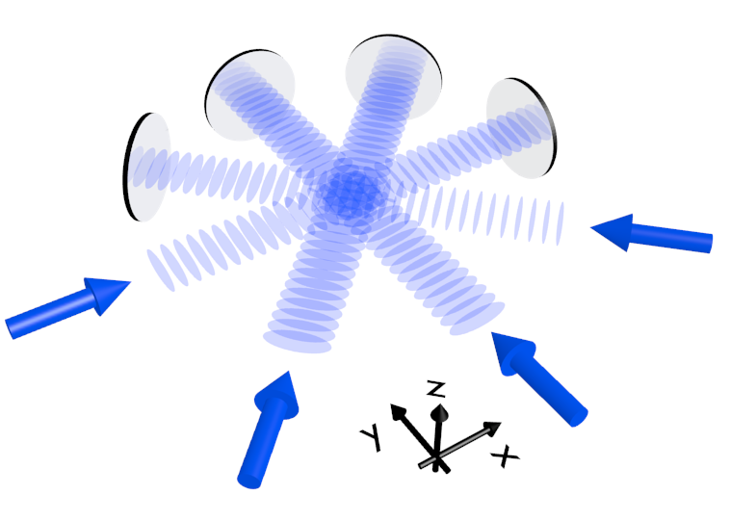
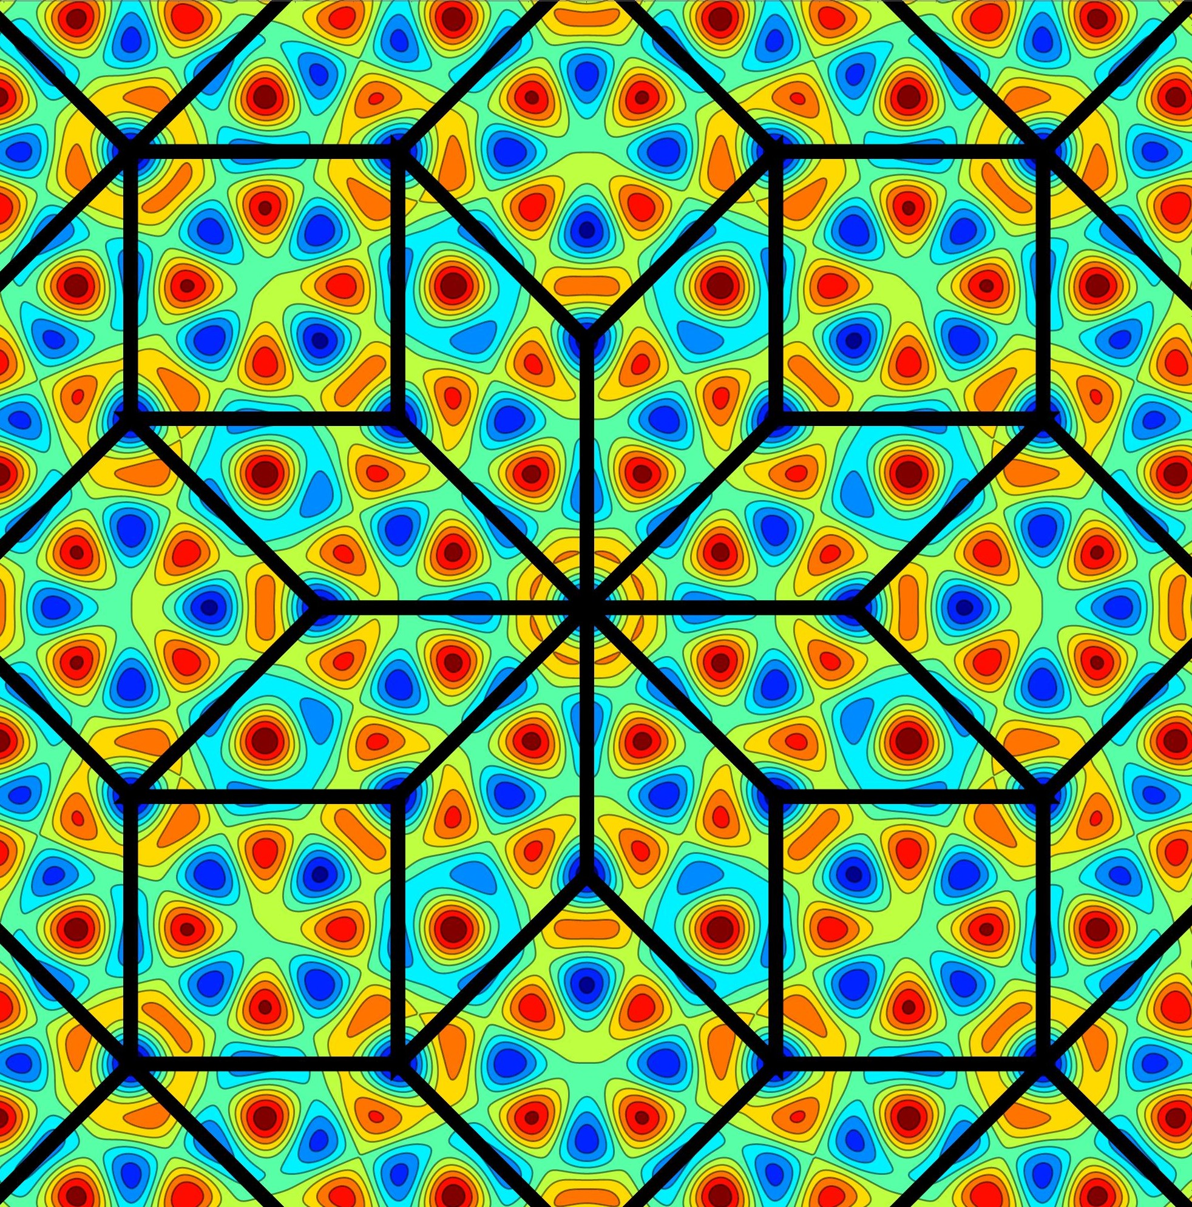
The lattice/tweezer platform
Vacuum construction in progress!
Objective tip/tilt and z translation
Adjuster screw 0.25 µm/rev
Fixtures and clearance for field plates
(for Rydberg physics, to add later)
Objective lens pair: imaging and projection NA 0.6
WD 15.5 mm
Wavelengths: (317), 461, 515, 689, 698, 813, 1064 nm
3 mm hole through centre of lenses
Images courtesy K. Viebahn and E. Carter
Vertical axis:
Tweezer projection
Imaging
Vertical lattice
Octagonal chamber:
Lattice beams, retroreflected (eightfold symmetric quasicrystal)
Crossed beam dipole trap
Optical transport
Rydberg beam
Square/quasicrystalline optical lattice with high resolution addressing and imaging

Slide 11

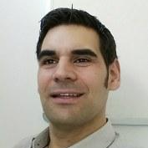

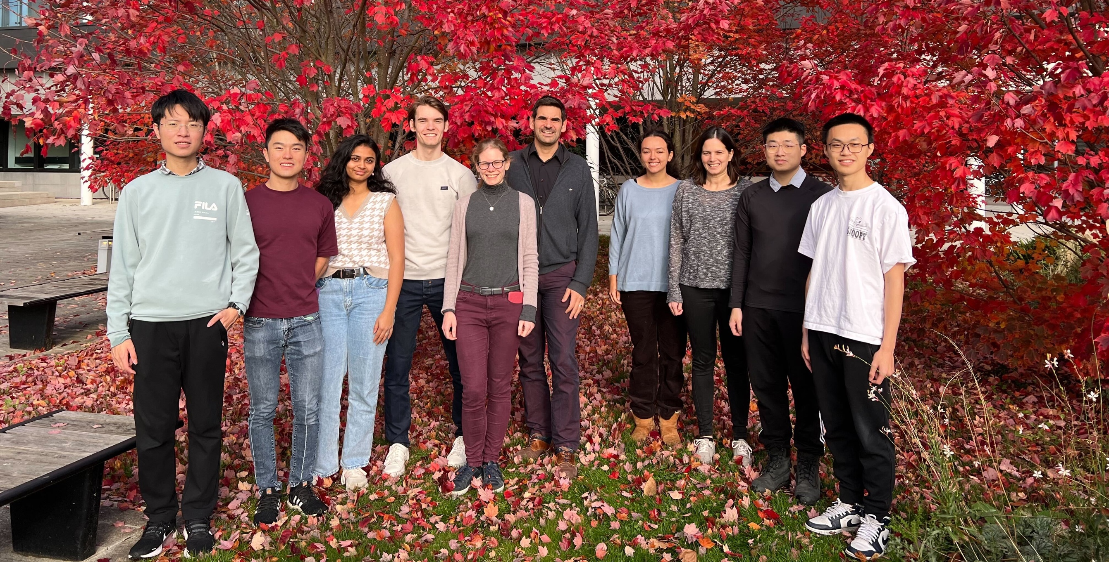



The strontium tweezers team
Dr Tiffany Harte
Prof. Ulrich Schneider
Dr Shengnan Zhang
Mariame Karzazi
Julian Scheper
Ben Millward
Isaac Nicol
Lucija Koledic
Cambridge AION team also includes: Dr Jeremiah Mitchell, Noam Mouelle, Yijun Tang, Jiajun Chen, Jinhuang (John) Chen

Slide 12
Part 2: The science

Slide 13





























Many-body effects
Environment monitoring
Quantum simulation
Quantum sensing
Phase transitions
Accelerometry, magnetometry,…
Fundamental physics
Out of equilibrium systems
Notes:
Introducing capabilities and current plans
Some design aspects, and also where we are experimentally

Slide 14
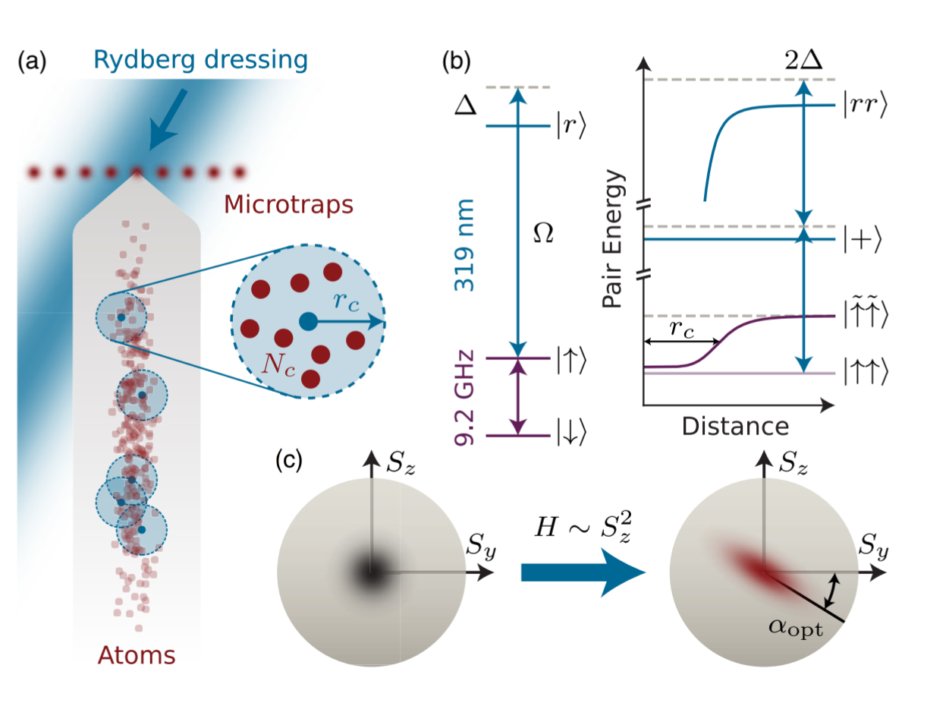
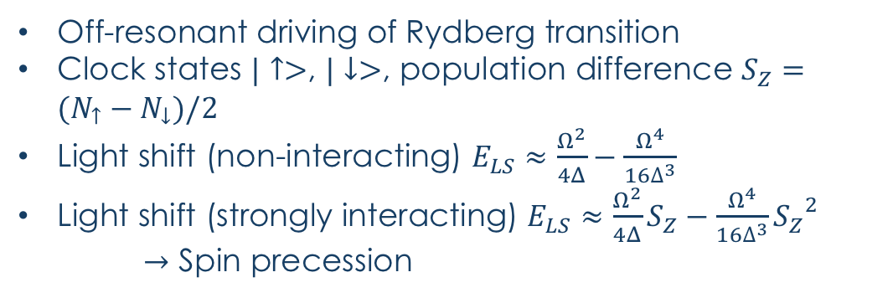
Rydberg dressing
Squeezing and entanglement creation using local interactions
Goal: continuum, tweezers and lattices
e.g. Schleier-Smith group (Cs)
Stroboscopic pulses minimise decoherence for N=200
Off-resonant driving of Rydberg transition
Clock states $|↑>$, $|↓>$, population difference $S_{Z}=(N_{↑}−N_{↓})/2$
Light shift (non-interacting) $E_{LS}≈\frac{Ω^{2}}{4Δ}−\frac{Ω^{4}}{16∆^{3}}$
Light shift (strongly interacting) $E_{LS}≈\frac{Ω^{2}}{4Δ}S_{Z}−\frac{Ω^{4}}{16∆^{3}}{S_{Z}}^{2}$
$→$ Spin precession
See also (smaller systems):
Nat. Phys. 12, 71 (2016), Nat. Phys. 12, 1095 (2016)
Phys. Rev. X 7, 041063 (2017), Phys. Rev. X 11, 021036 (2021)
J.A. Hines et al, PRL 131, 063401 (2023)
Notes:
Rydberg basics (if needed):
* Rydbergs – strong and long-range interactions
Consider pair state potentials – at large r, no interaction, short r (<~2um) rapid divergence
-> Rydberg blockade effect if using Rydberg states directly – prohibited resonant creation of >1 Rydberg excitation in closely packed (ground state) ensemble
-> or if driving off-resonantly (mod Delta >> Omega) – magnitude of effective detuning rapidly increases, suppression of AC stark (light) shift
-> r-dependent change in ground state energy
Here, states are superposition of hf clock states, spin down is F=3, mF=0, spin up is F=4, mF=0
One-axis twist intuition: imagine coherent state centred on Sz=0 – with light shift with Sz dependence, positive and engative will accumulate phase in opposite directions

Slide 15
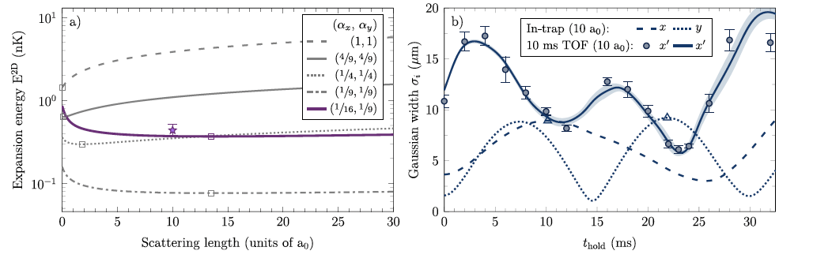
Many-body enhanced sensing
Quantum sensors with squeezed states
Developing ultracold sensors driven by many-body physics, e.g.
Bloch oscillations
SF/MI transition
Interaction-induced BEC collapse
Interaction-enhanced atom-optics
A. Herbst et al., Commun. Phys. 7 132 (2024)
Also matter-wave lensing of molecules:
Phys. Rev. Research 7 043015 (2025)
Carlton et al., arXiv:2412.05379 (2024).
Notes:
(different experimental platforms - all tailored differently and have different strengths)

Slide 16
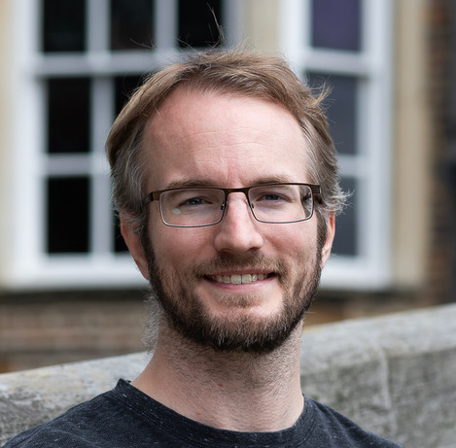
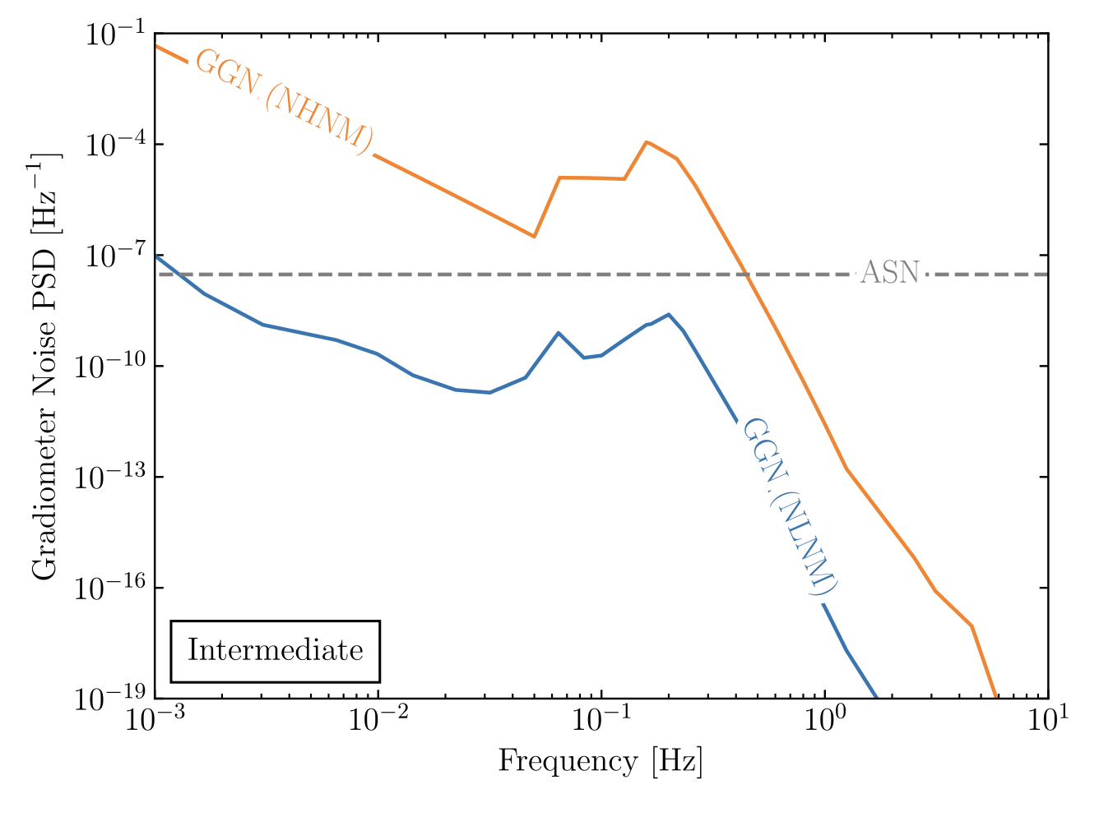
Sensing-enhanced simulation
Development of noise models: confidence in experiment interpretation
Gravitational effects (environmental sources)
Electric or magnetic fields
Fundamental physics sources (beyond standard model)
In-situ monitoring and verification
Jeremiah Mitchell (Cambridge)
Rayleigh seismic waves source gravitational fluctuations
Atmospheric infrasound and temperature gradient noise
Mitchell et al., J. Inst., 17, 01 (2022)
Carlton et al., arXiv:2412.05379 (2024)
Badurina et al. Phys. Rev. D 107, 055002 (2023)
Carlton et al., arXiv:2412.05379 (2024).
Notes:
Gravitational: seismic, atmospheric, anthropogenic, synanthropic

Slide 17
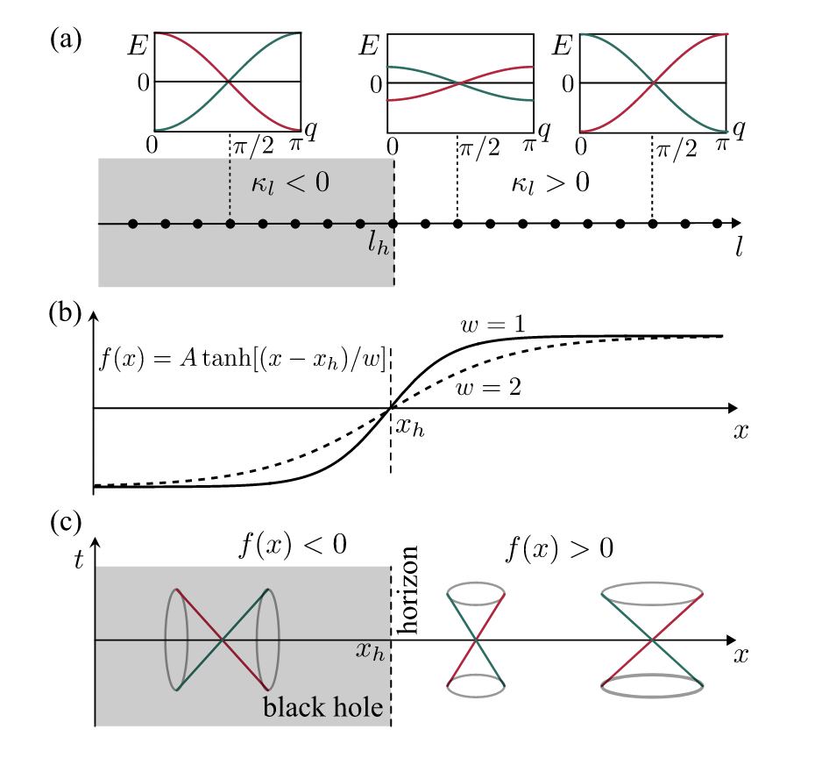
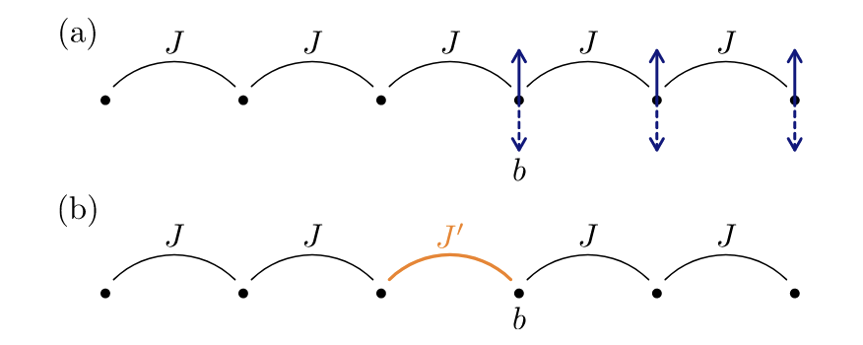
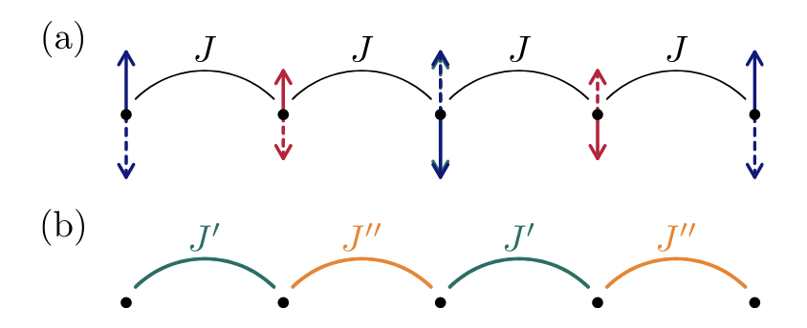
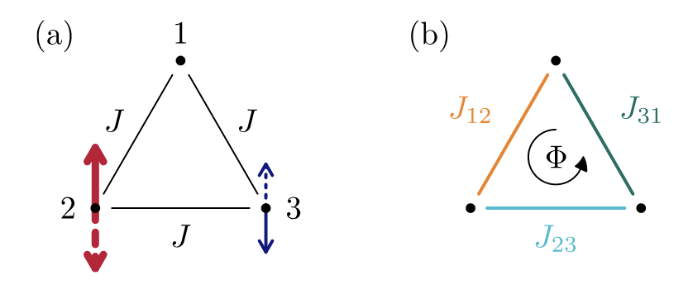
Local periodic driving
Tunable sequence of tunnelling amplitudes by driving individual lattice sites with different amplitudes
Quantum Sci. Technol. 9 045030 (2024)
Single modified tunneling element:
SSH model:
Effective flux:
Simulating curved geometry of black hole
arXiv:2312.14058v1 (2023)

Slide 18
Conclusion and outlook
Strontium lattice/tweezer platform: new avenues in quantum simulation and sensing, and exploring their intersection
New platform, new opportunities: get in touch!
New capabilities…
th558@cam.ac.uk

Slide 19

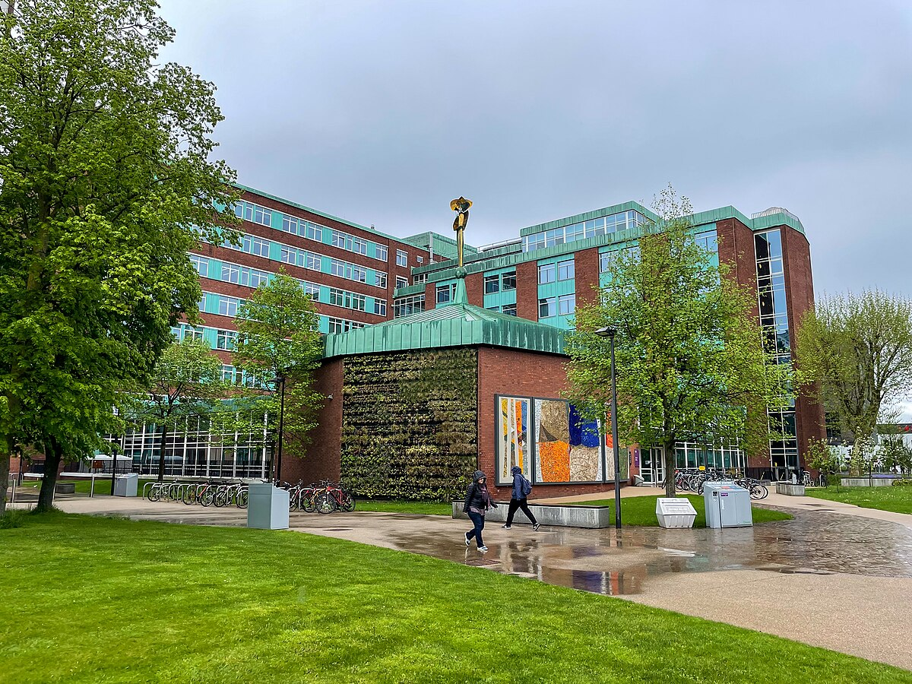
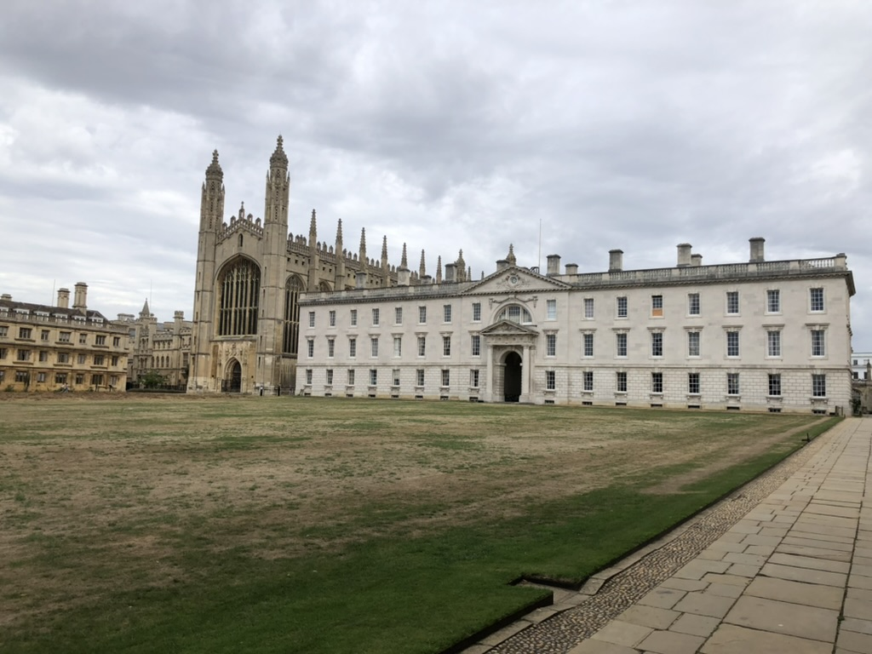
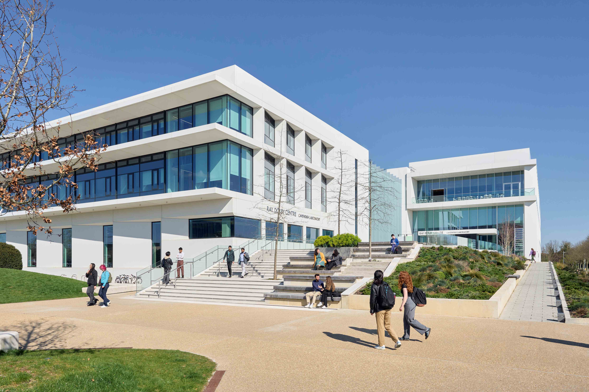
Contact th558@cam.ac.uk if you’d like to join my team!
University of Manchester
September 2026
Quantum sensing and simulation for fundamental physics:
Atom optics
Atom interferometry readout
Modulated lattices
University of Cambridge

