Slide 1



Dark energy and modified gravity with levitated cavity optomechanics
Sofia Qvarfort, Dennis Rätzel, Stephen Stopyra
Manchester 20th January 2026

Slide 2

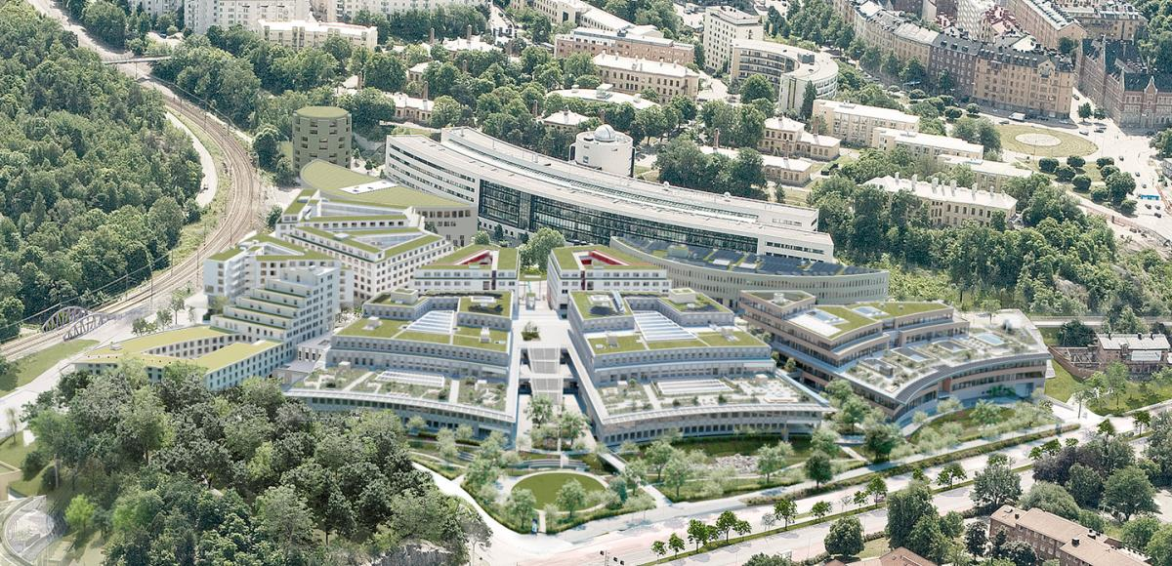
Campus Albano, Stockholm

Slide 3
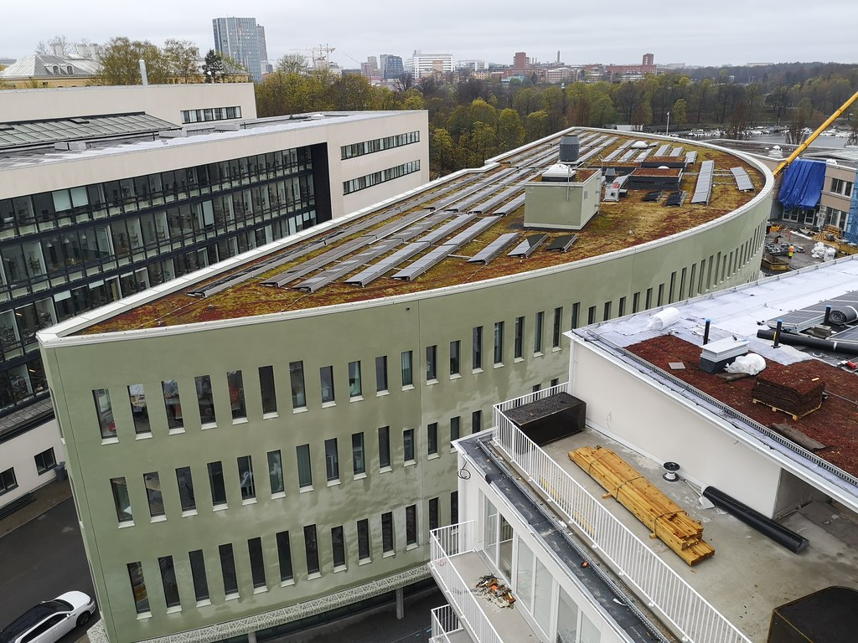
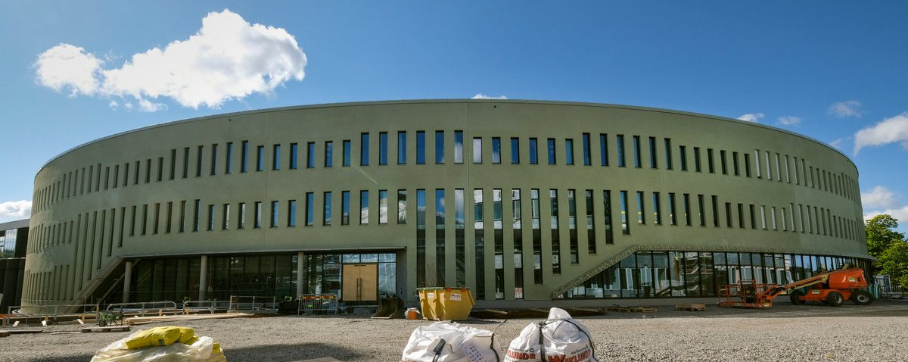
Nordic Institute for Theoretical Physics (Nordita)

Slide 4
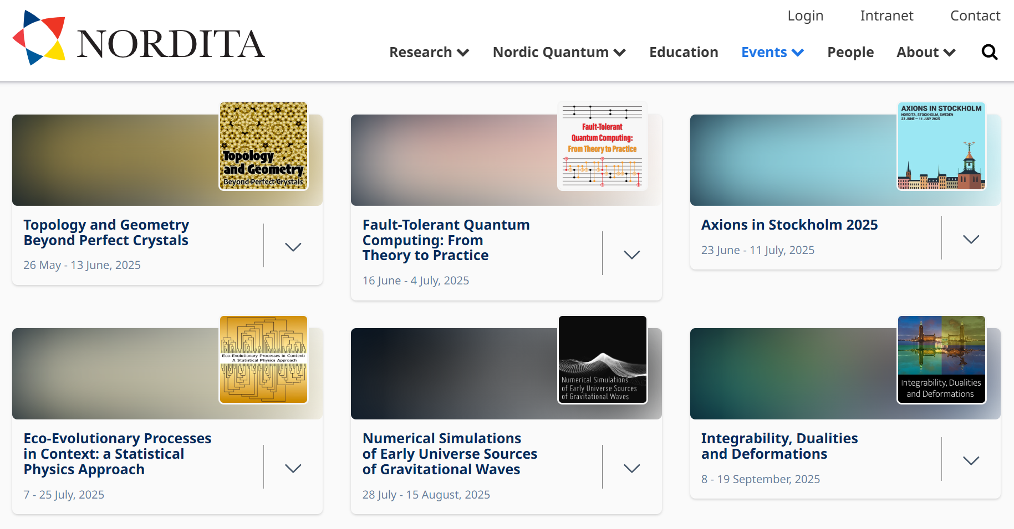

Slide 5


Slide 6



Our group – sensing with dynamical quantum systems
PhD students
Postdoc
Niklas Önne
Maximilian Goll

Slide 7
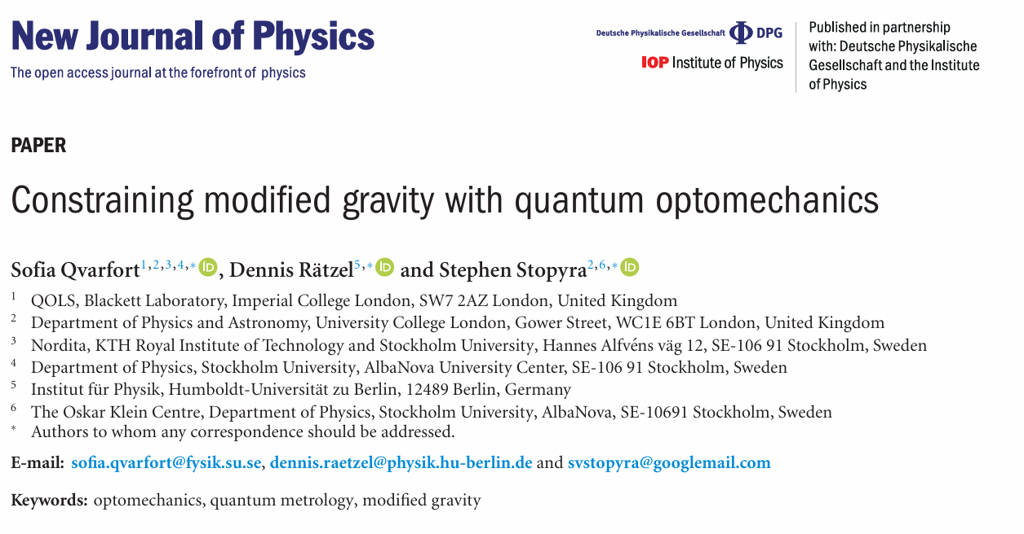


Paper reference
Dennis Rätzel (Vienna)
Stephen Stopyra (UCL)

Slide 8
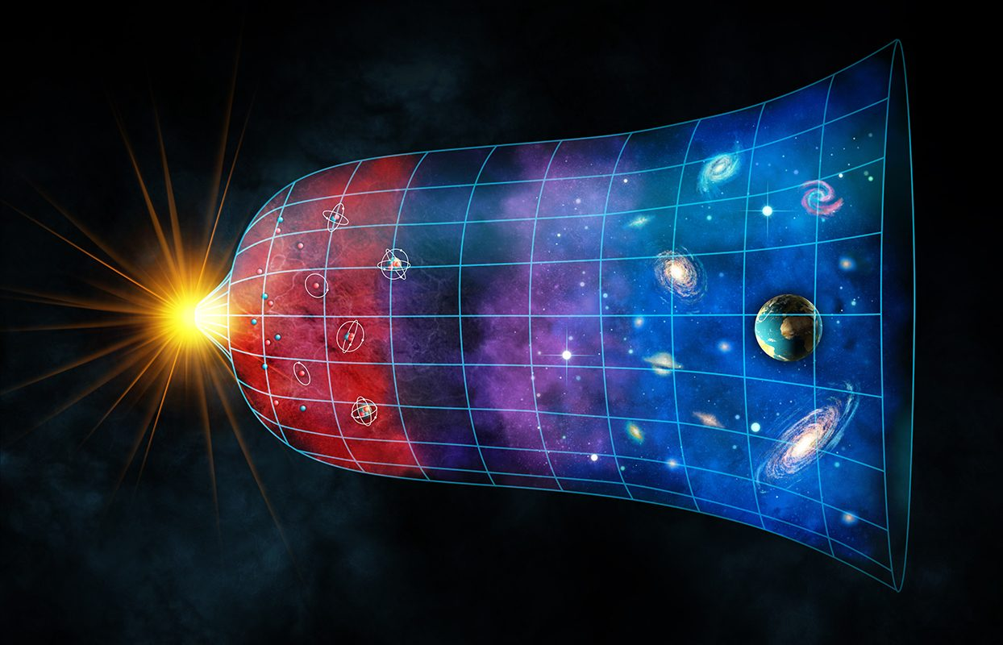
Searches for modified gravity
Image credit: BBC
The cosmological constant problem
  The Universe is expanding → weakly positive cosmological constant
  Predicted value of vacuum fluctuations is 120 orders of magnitude off
T. Clifton, et al. "Modified gravity and cosmology." Physics Reports 513.1-3 (2012): 1-189.

Slide 9
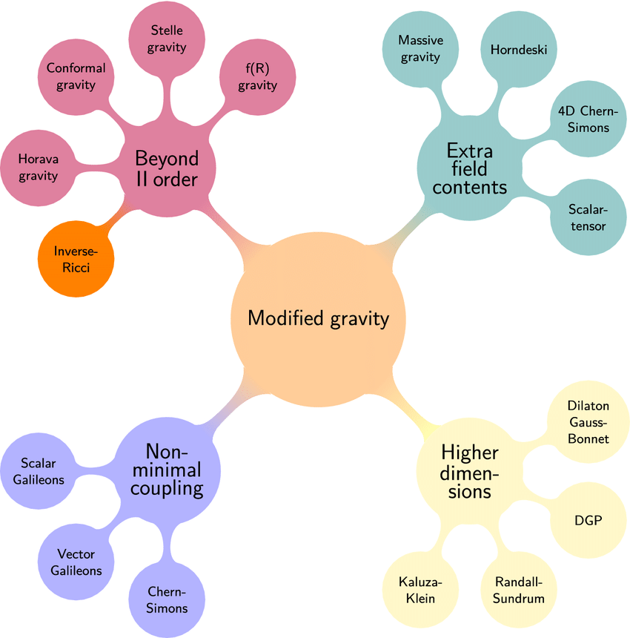
Modified gravity theories
S. Shankaranarayanan, and J. P. Johnson. "Modified theories of gravity: Why, how and what?." General Relativity and Gravitation 54.5 (2022): 1-35.

Slide 10
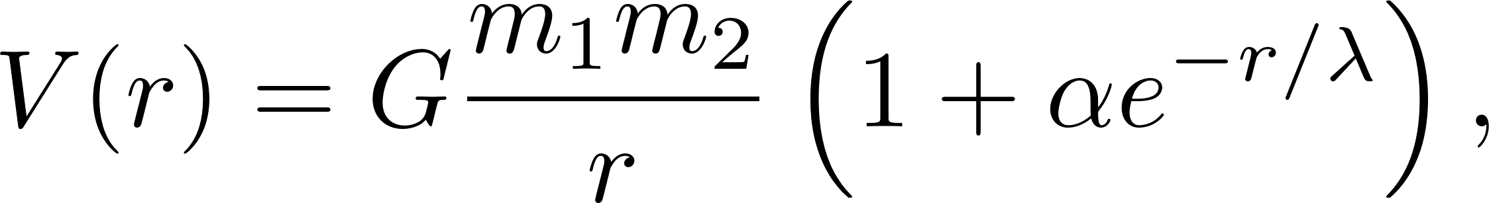


Yukawa-like modifications
The Newtonian potential can be parametrised as
where is the strength and is the range of the modification.

Slide 11
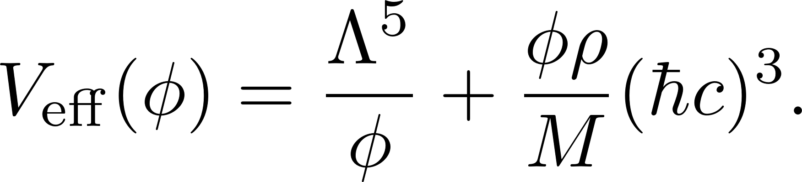
Chameleon-like modifications
The chameleon field
  …is screened by local matter
  …is difficult to detect in the laboratory
Test particle
Source
Khoury and Weltman. "Chameleon cosmology." Physical Review D 69.4 (2004): 044026.

Slide 12
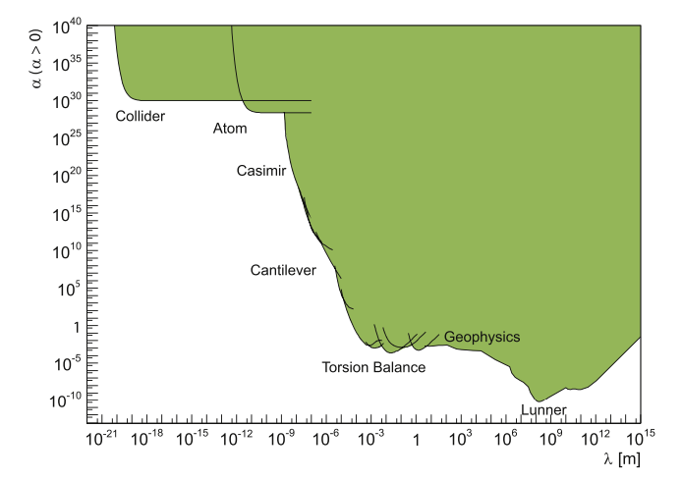
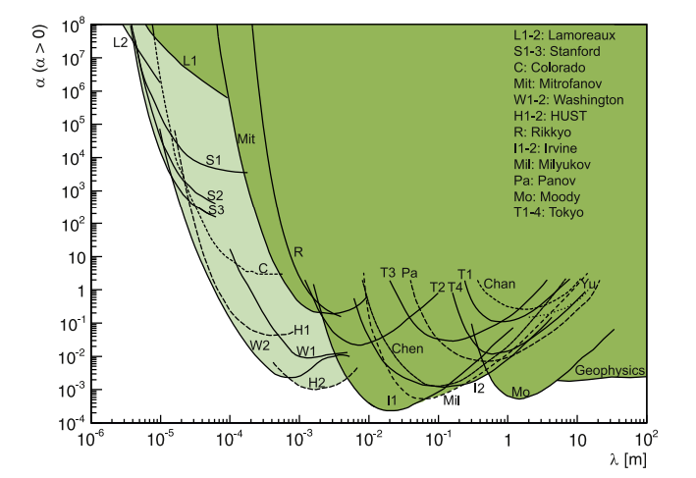
Current limits on modified gravity theories
All tests
Laboratory tests
J. Murata, and S. Tanaka. "A review of short-range gravity experiments in the LHC era." Classical and Quantum Gravity 32.3 (2015): 033001.

Slide 13
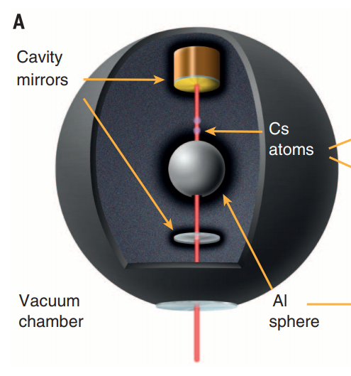
Cold atom interferometry searches
Burrage, Copeland, and Hinds. "Probing dark energy with atom interferometry." Journal of Cosmology and Astroparticle Physics 2015.03 (2015): 042.
Hamilton, et al. "Atom-interferometry constraints on dark energy." Science 349.6250 (2015): 849-851.

Slide 14
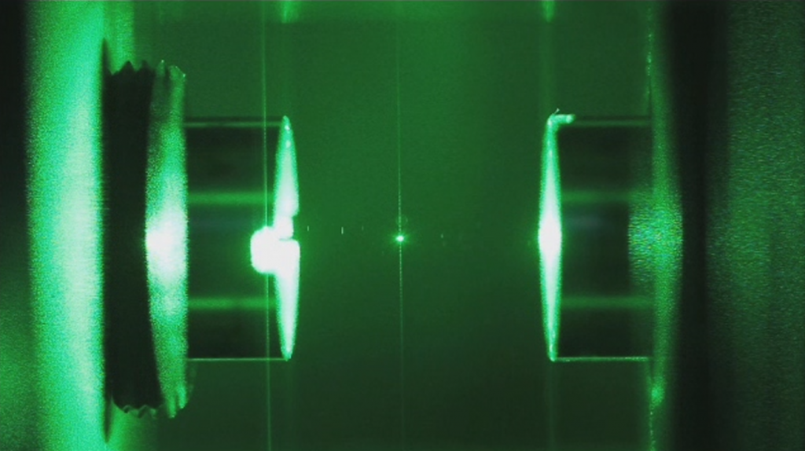

Slide 15
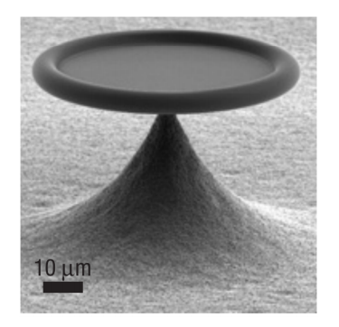
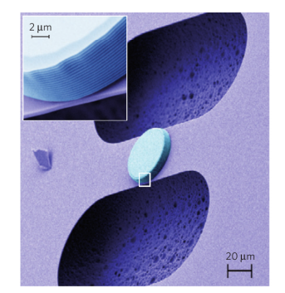
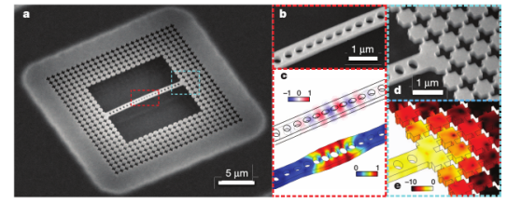
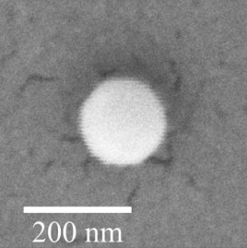
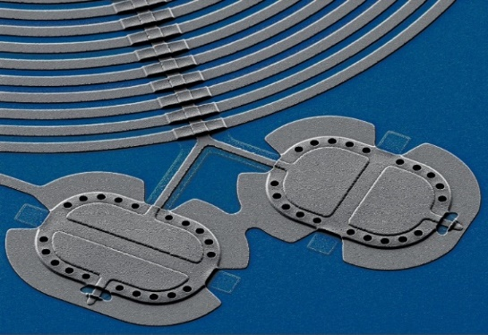
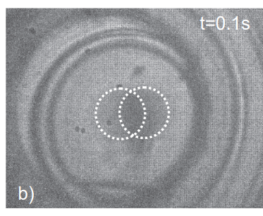
Optomechanical systems
Schliesser et al. Nature Physics 4.5 (2008).
Gröblacher, et al. Nature Physics 5.7 (2009).
Chan, et al. Nature 478.7367 (2011).
Delić, et al. Science 367.6480 (2020).
Kotler, et al. Science 372.6542 (2021).
Latorre et al. arXiv preprint arXiv:2109.15071 (2021).

Slide 16
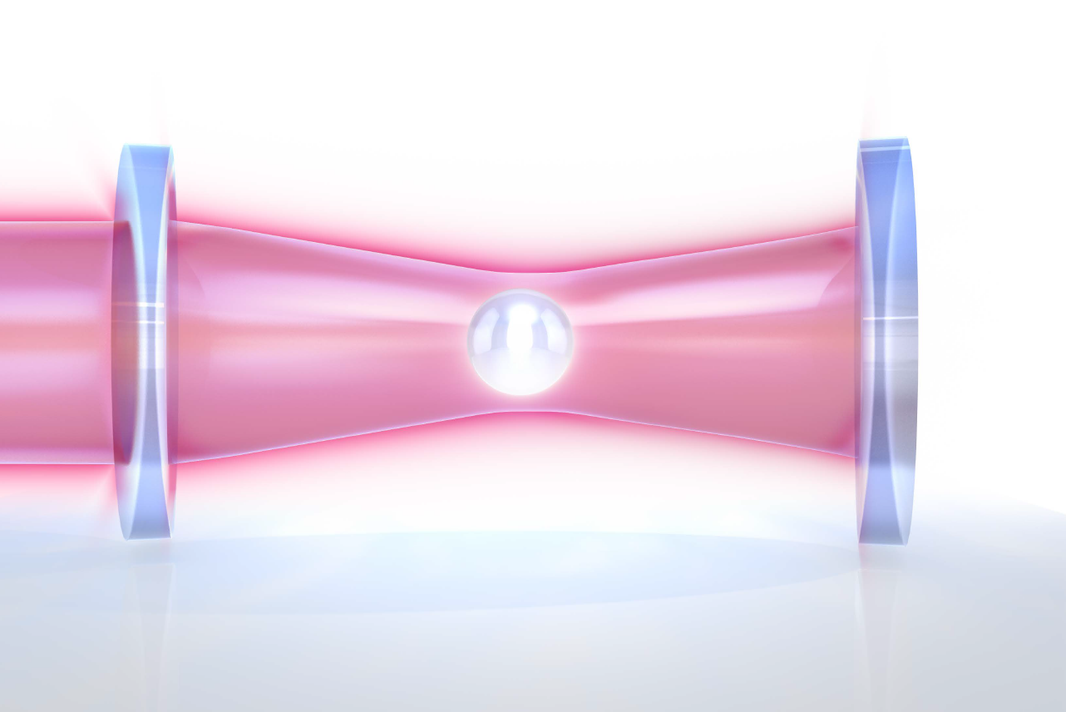


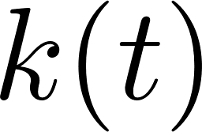
Optomechanical Hamiltonian
The standard optomechanical Hamiltonian is
where
is the optical frequency
is the mechanical frequency
is the optomechanical coupling

Slide 17
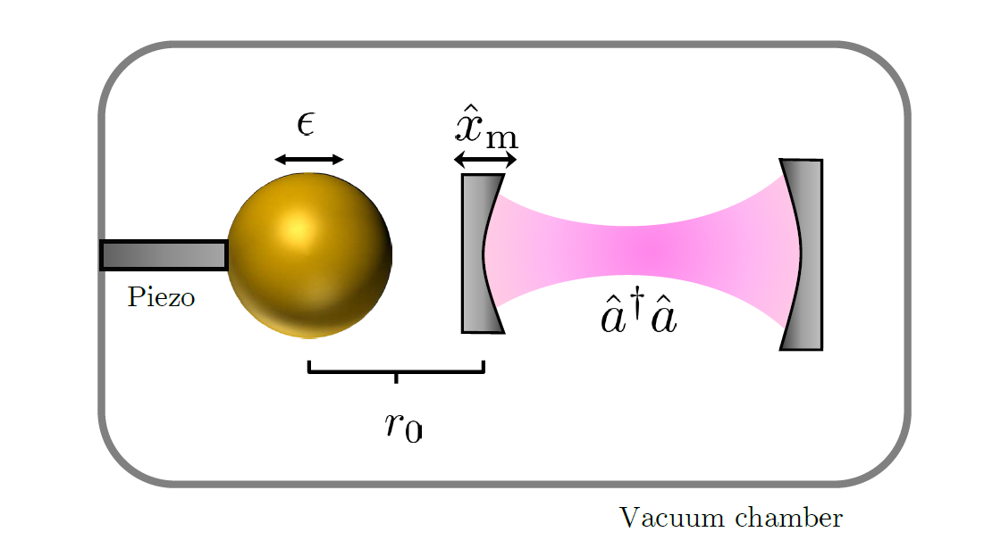

Sensing gravitational shifts
  Gravimetry through nonlinear optomechancis (SQ et al. Nat. Commun. 2018)
  Fundamental sensing limits to general dynamics (SQ, DR et al. PRA 2020)
  Detecting time-dependent gravitational fields, including gravitational waves (SQ, DR et al. PRR 2021)

Slide 18
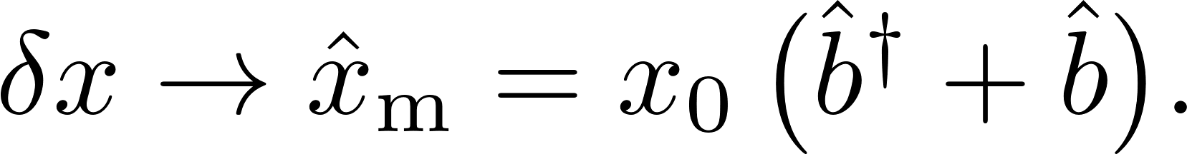
Linearising the gravitational potential
Expand the potential for small perturbations
Then promote the perturbation of the mechanical element to a quantum operator
The Hamiltonian becomes

Slide 19
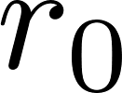

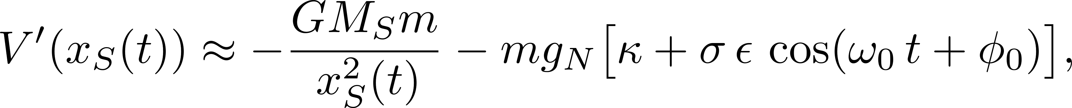
Linearising for small oscillations
Let the source mass oscillates around :
Linearising for small , the Hamiltonian prefactor becomes
where

Slide 20
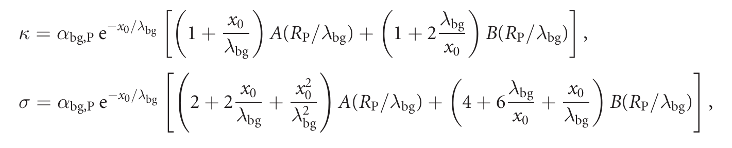
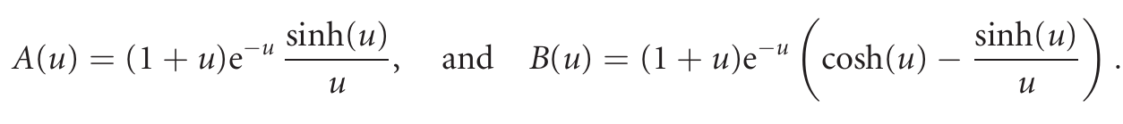
Linearising the chameleon force
The expressions now become
where we have defined

Slide 21
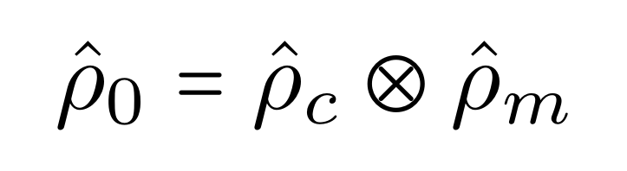
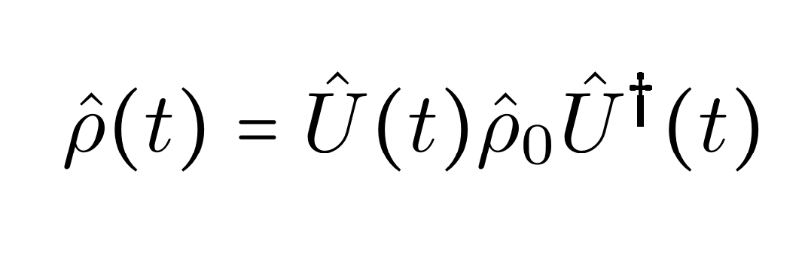
Full system Hamiltonian
The full Hamiltonian that models the cavity and mechanical element is
Given an initial state of the system
the final state becomes:

Slide 22
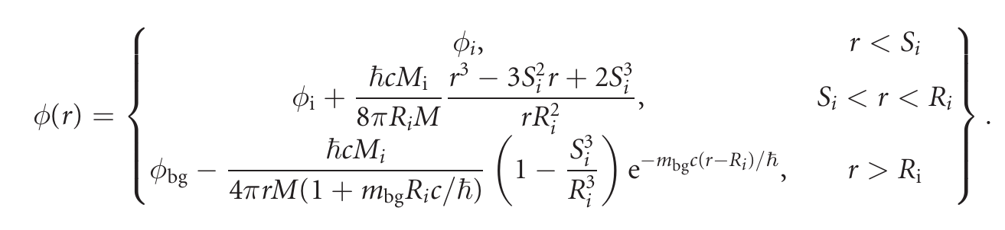
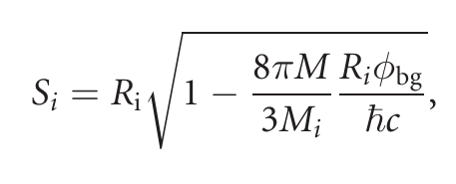
Chameleon screening
Consider the potential around a source or probe:
where
Burrage C, Copeland E J and Hinds E A 2015 J. Cosmol. Astropart. Phys. JCAP03(2015)042

Slide 23

Hilbert space trajectory
$$\hat{ρ}$$

Slide 24
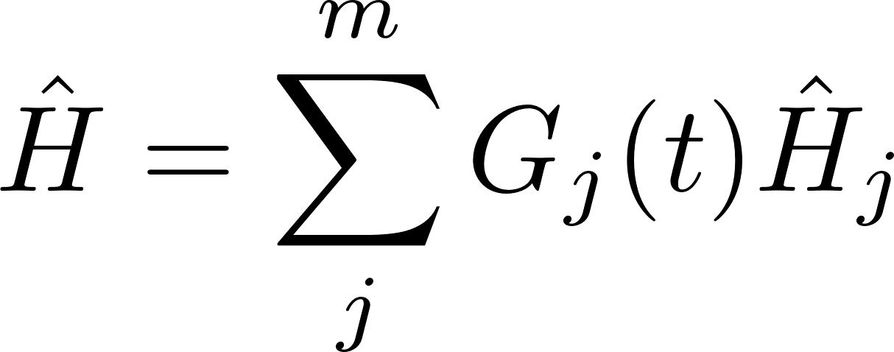
Lie algebra solution for quantum dynamics
Write down the Hamiltonian
Wei, James, and Edward Norman. "Lie algebraic solution of linear differential equations." Journal of Mathematical Physics 4.4 (1963): 575-581.

Slide 25
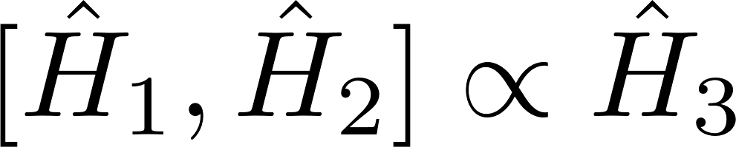
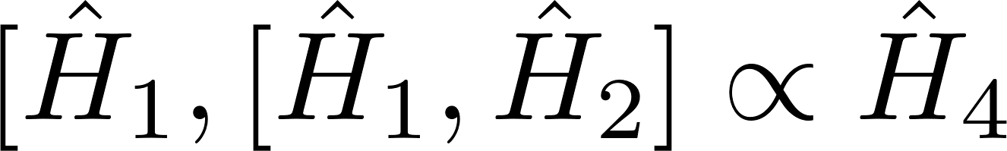
Lie algebra solution for quantum dynamics
2. Find all the terms of the Lie algebra by commuting the Hamiltonian terms
but also
There are now two alternatives:
  The Lie algebra is finite (true for all quadratic systems) = we can solve the dynamics
  The Lie algebra is infinite (many nonlinear systems) = unlikely to find simple expressions
Wei, James, and Edward Norman. "Lie algebraic solution of linear differential equations." Journal of Mathematical Physics 4.4 (1963): 575-581.

Slide 26
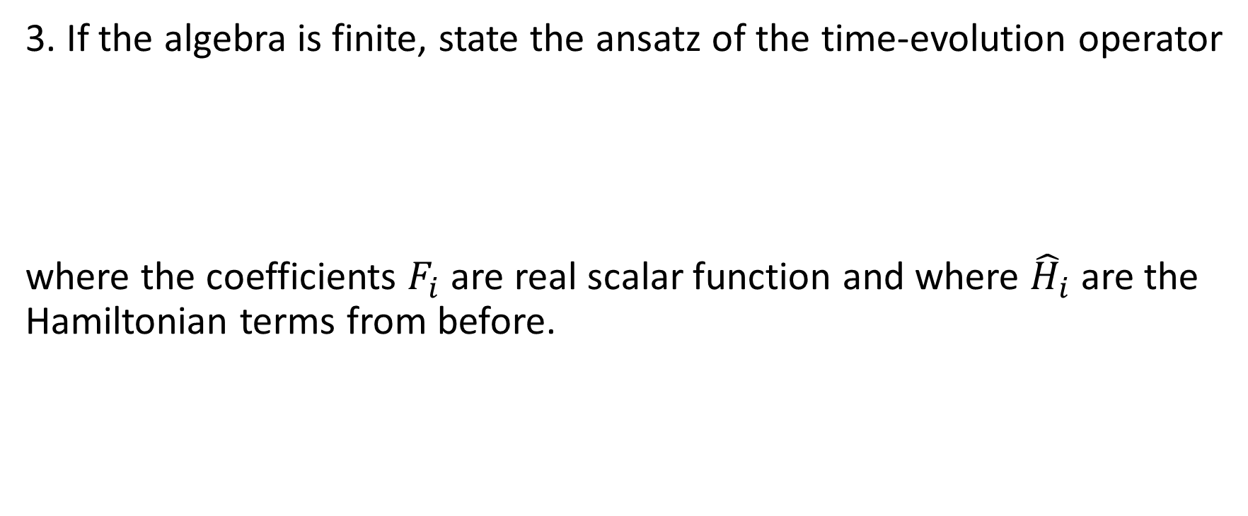
Lie algebra solution for quantum dynamics
3. If the algebra is finite, state the ansatz of the time-evolution operator
where the coefficients $F_{i}$ are real scalar function and where ${\hat{H}}_{i}$ are the Hamiltonian terms from before.
Wei, James, and Edward Norman. "Lie algebraic solution of linear differential equations." Journal of Mathematical Physics 4.4 (1963): 575-581.

Slide 27
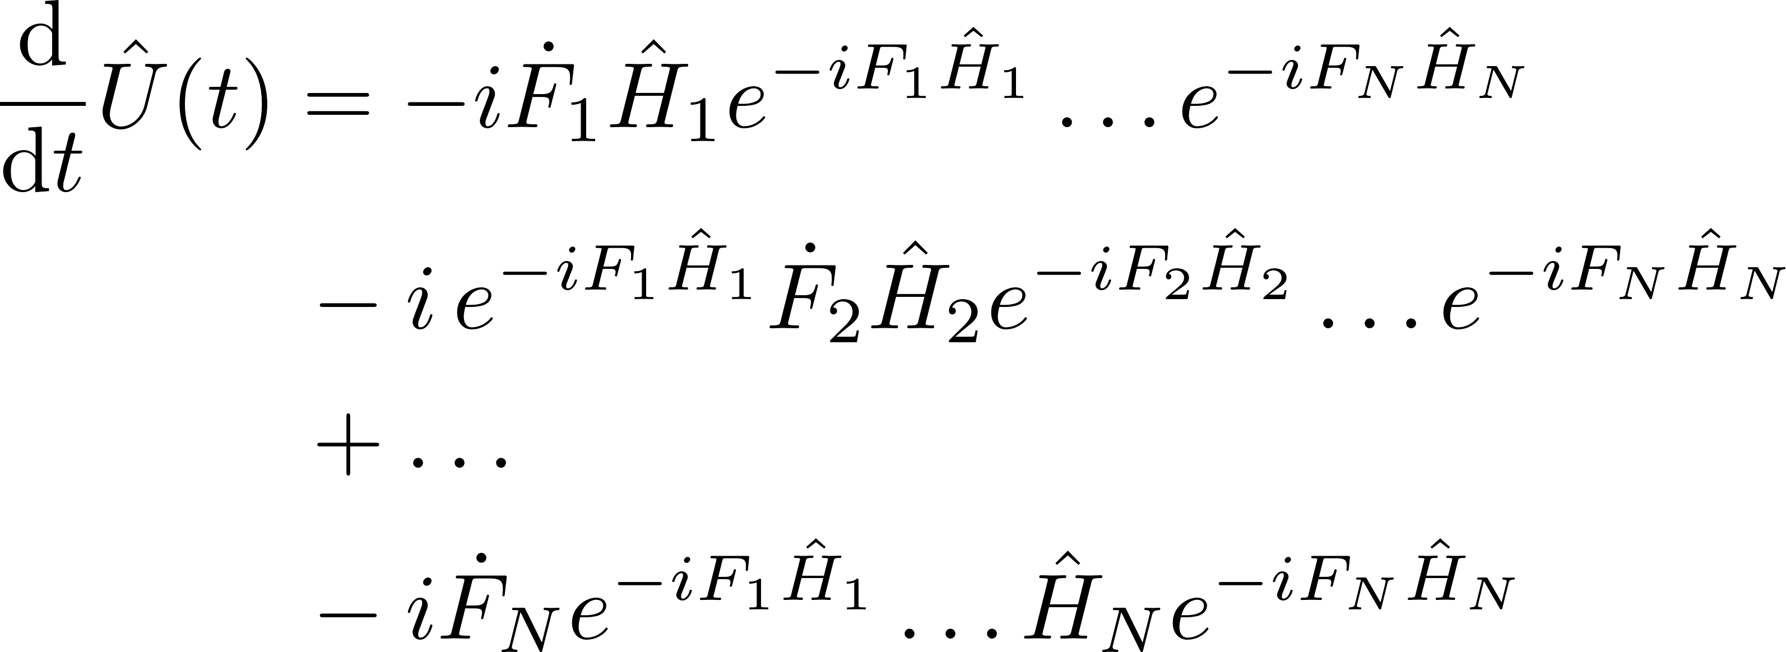
Lie algebra solution for quantum dynamics
4. Then, differentiate the ansatz:
Wei, James, and Edward Norman. "Lie algebraic solution of linear differential equations." Journal of Mathematical Physics 4.4 (1963): 575-581.

Slide 28
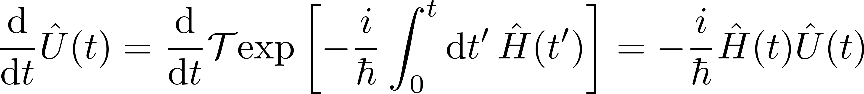
Lie algebra solution for quantum dynamics
4. But we could also differentiate the actual time-evolution operator:
The two expressions are equivalent:
Wei, James, and Edward Norman. "Lie algebraic solution of linear differential equations." Journal of Mathematical Physics 4.4 (1963): 575-581.

Slide 29
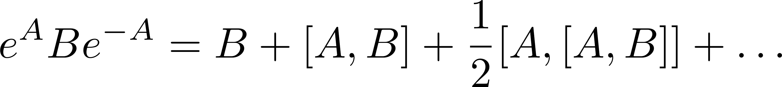
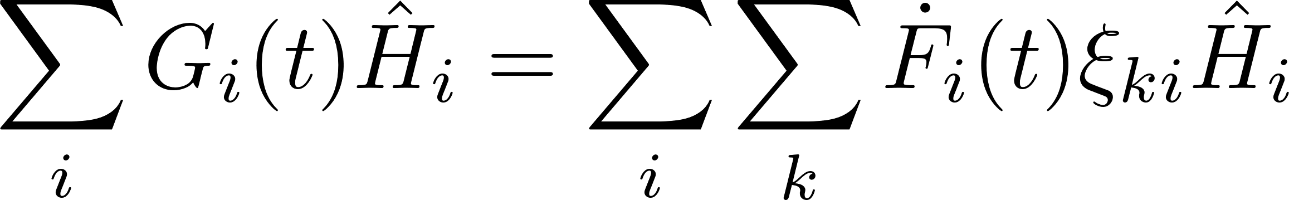

Lie algebra solution for quantum dynamics
4. Multiply by the inverse to find
Then, using the fact that the Lie algebra is closed
we write
where the $ξ_{ki}$ are functions of the $F_{i}$ coefficients.
Wei, James, and Edward Norman. "Lie algebraic solution of linear differential equations." Journal of Mathematical Physics 4.4 (1963): 575-581.

Slide 30
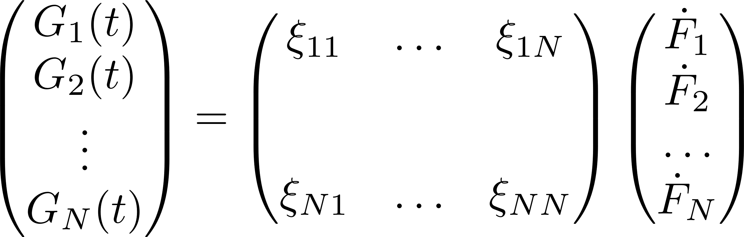
Lie algebra solution for quantum dynamics
5. Use the linear independence of the operators to identify a set of differential equations:
Invert the matrix to solve the differential equations.
Wei, James, and Edward Norman. "Lie algebraic solution of linear differential equations." Journal of Mathematical Physics 4.4 (1963): 575-581.

Slide 31
Lie algebra solution for quantum dynamics
Write down the Hamiltonian
Find all the terms of the Lie algebra by commuting the Hamiltonian terms
State the ansatz of the time-evolution operator
Differentiate the ansatz and set it equal to the Hamiltonian
Identify and (hopefully) solve the resulting differential equations
Tutorial article: SQ and I. Pikovski (PRX Quantum)
Wei, James, and Edward Norman. "Lie algebraic solution of linear differential equations." Journal of Mathematical Physics 4.4 (1963): 575-581.

Slide 32
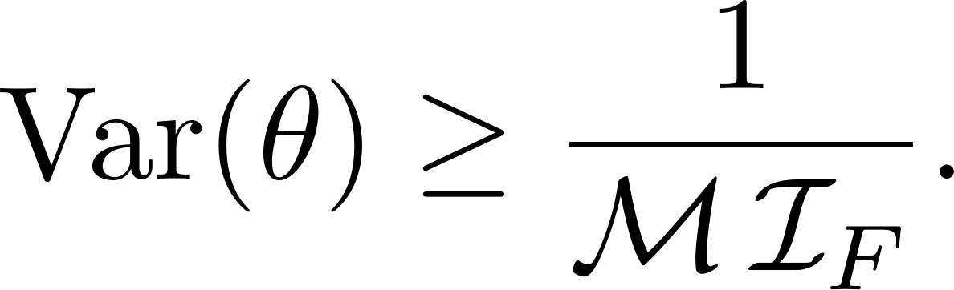
Quantum metrology
Quantum Fisher information: Quantifies the change in a quantum state due to an external effect. It is related to the variance of a parameter as
For a pure quantum state, the quantum Fisher information is given by

Slide 33
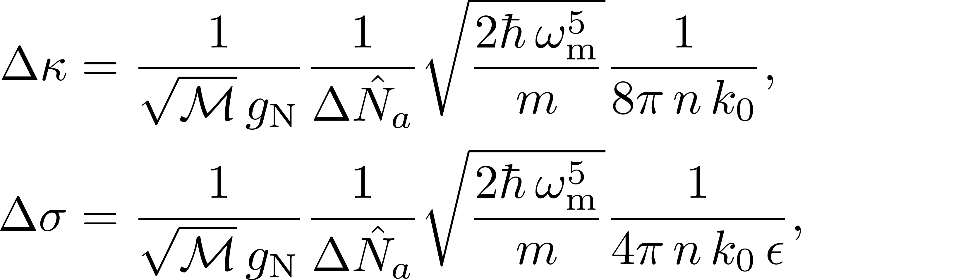
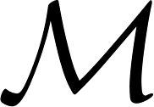
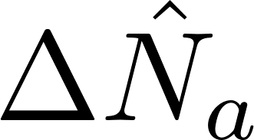

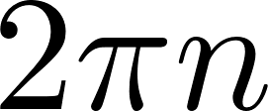
Results – sensitivity
Variances for constant optomechanical coupling
where
is the number of measurements
is the photon number standard deviation
denotes the measurement time as

Slide 34
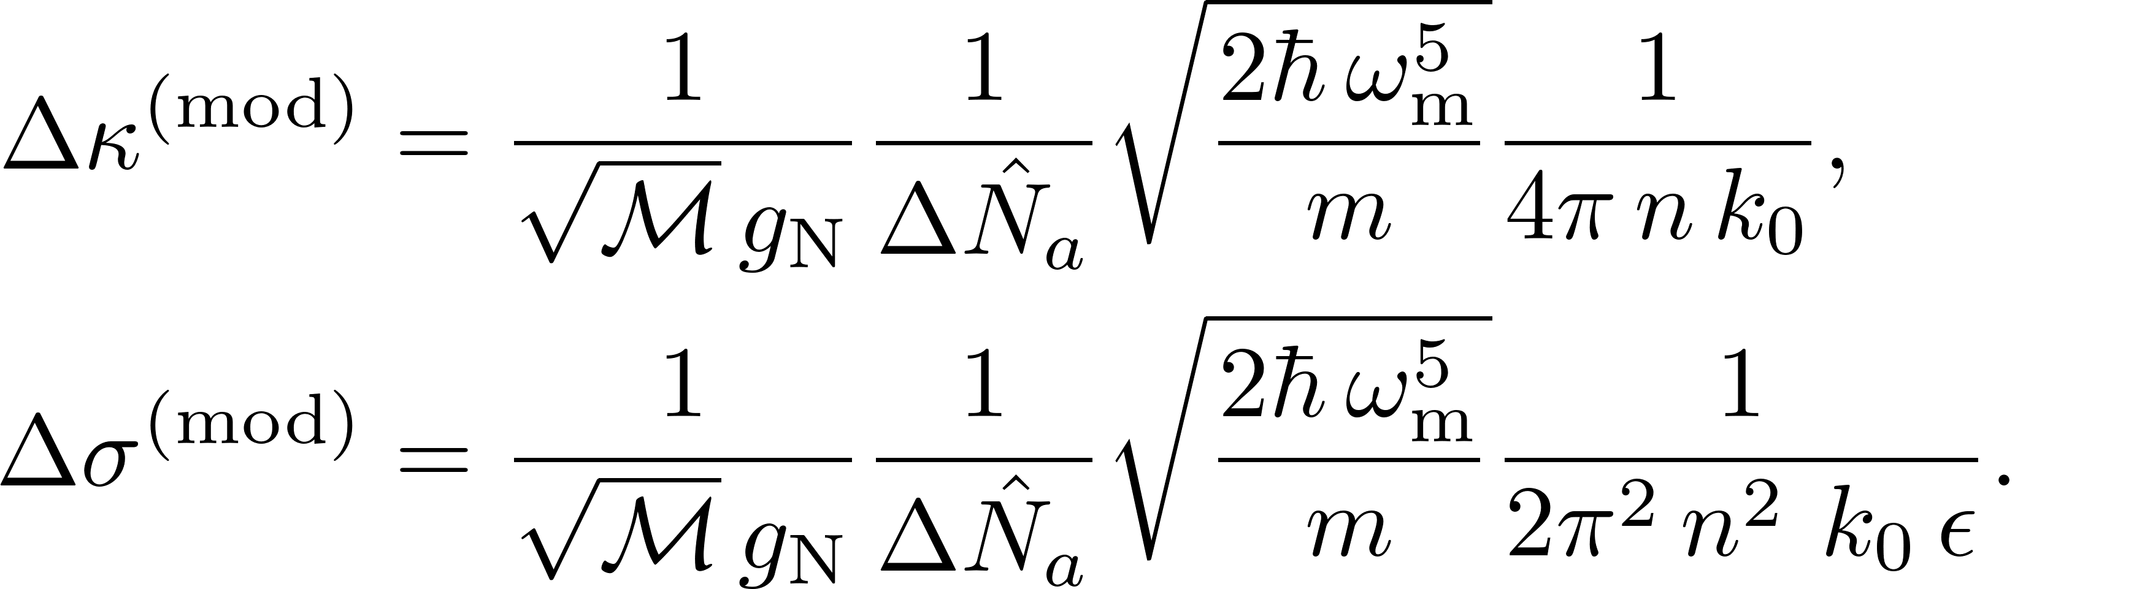
Results – sensitivity
Variances for a modulated optomechanical coupling

Slide 35
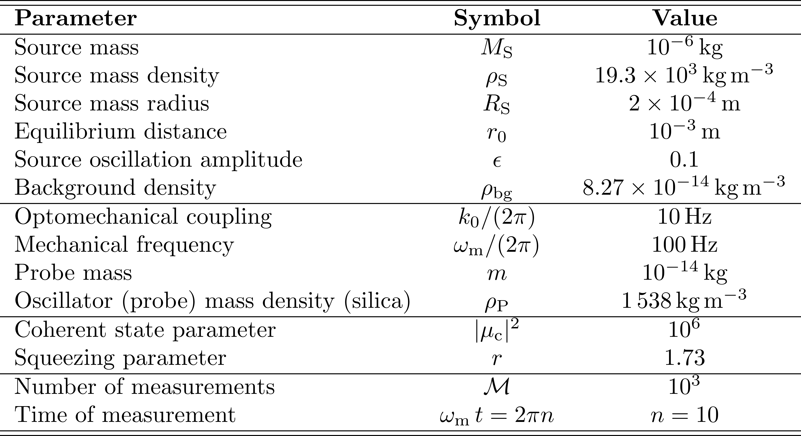
Results – parameters

Slide 36
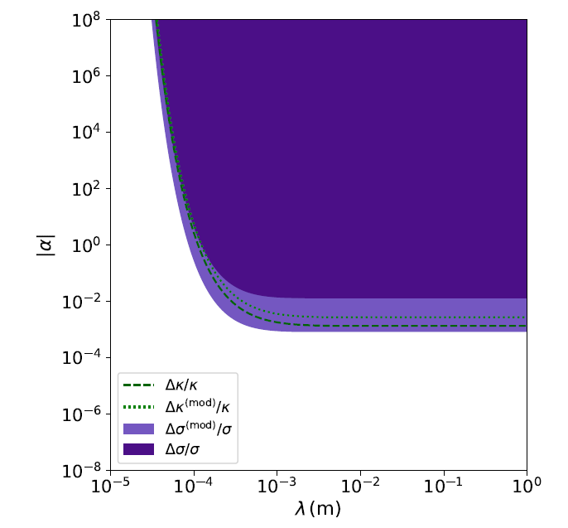
Results – Yukawa bounds

Slide 37
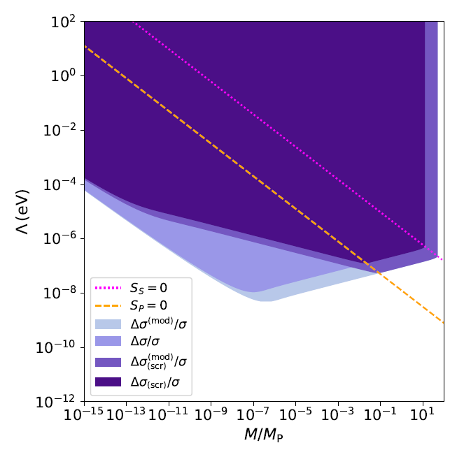
Results – Chameleon bounds

Slide 38


Comparison with known bounds

Slide 39

Next steps – closer to experiments
1. Assumptions made in this work:
  No optical noise
  No mechanical noise
  Access to the intra-cavity state
→ A full noise analysis is needed to determine actual limits.
Comparison with linearised optomechanics – is linearisation justified?
Could alternative shapes prove advantages for detecting chameleon forces?

Slide 40
Summary
Summary: We derived fundamental limits to detecting modifications
of Newtonian gravity with an optomechanical sensor
Conclusion: In high vacuum, optomechanical sensors could potentially further constrain modified gravity theories, especially
chameleon theories, but more work is needed to determine realistic limits.

Slide 41




Thank you for listening!
Paper reference: New Journal of Physics 24.3 (2022): 033009.

Slide 42

Lie algebra solution for quantum dynamics
We identify a Lie algebra that generates the dynamics
F. Schneiter, SQ, DR, et al. PRA 101.3 (2020): 033834.

Slide 43

Lie algebra solution for cavity optomehanics
We then make the ansatz:
F. Schneiter, SQ, DR, et al. PRA 101.3 (2020): 033834.

Slide 44
Lie algebra solution for cavity optomehanics
We then make the ansatz:
Evidence of nonlinearity
F. Schneiter, SQ, DR, et al. PRA 101.3 (2020): 033834.

Slide 45
Lie algebra solution for cavity optomehanics
We then make the ansatz:
Evidence of nonlinearity
Optomechanical interactions
F. Schneiter, SQ, DR, et al. PRA 101.3 (2020): 033834.

Slide 46
Lie algebra solution for cavity optomehanics
We then make the ansatz:
Evidence of nonlinearity
Optomechanical interactions
Displacements from gravity
F. Schneiter, SQ, DR, et al. PRA 101.3 (2020): 033834.

