Slide 1
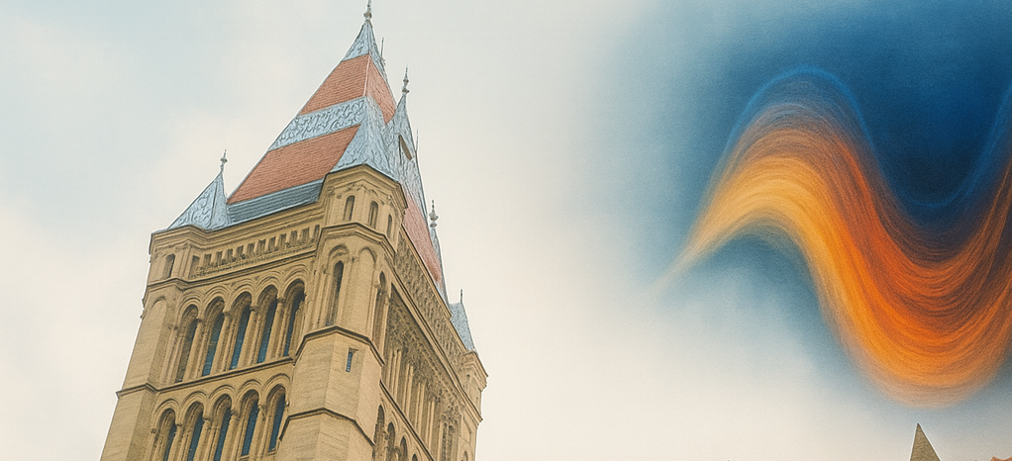
New Window on Fundamental Physics
From Tabletop Devices to Large Scale Detectors
20-23 January 2026

Slide 2
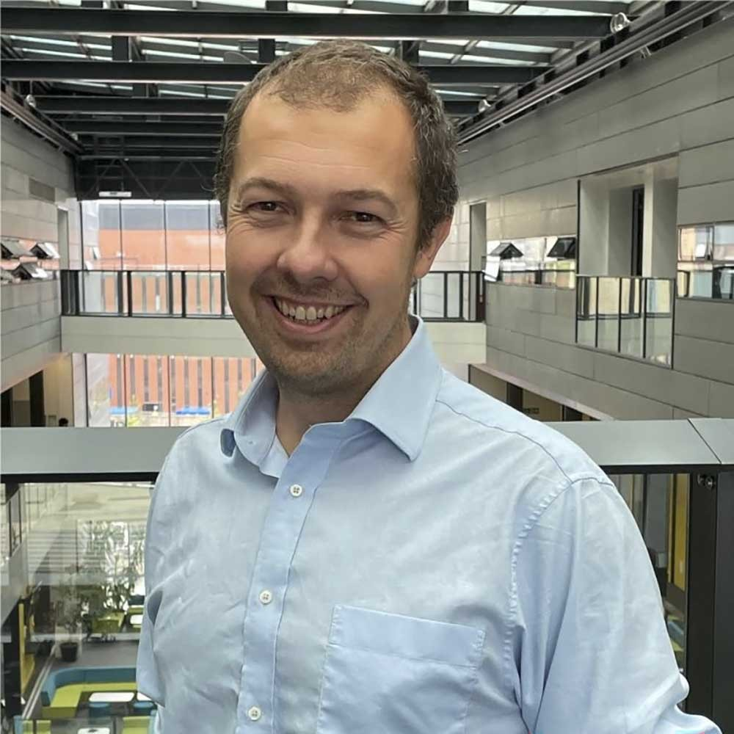
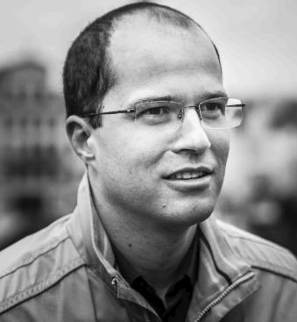
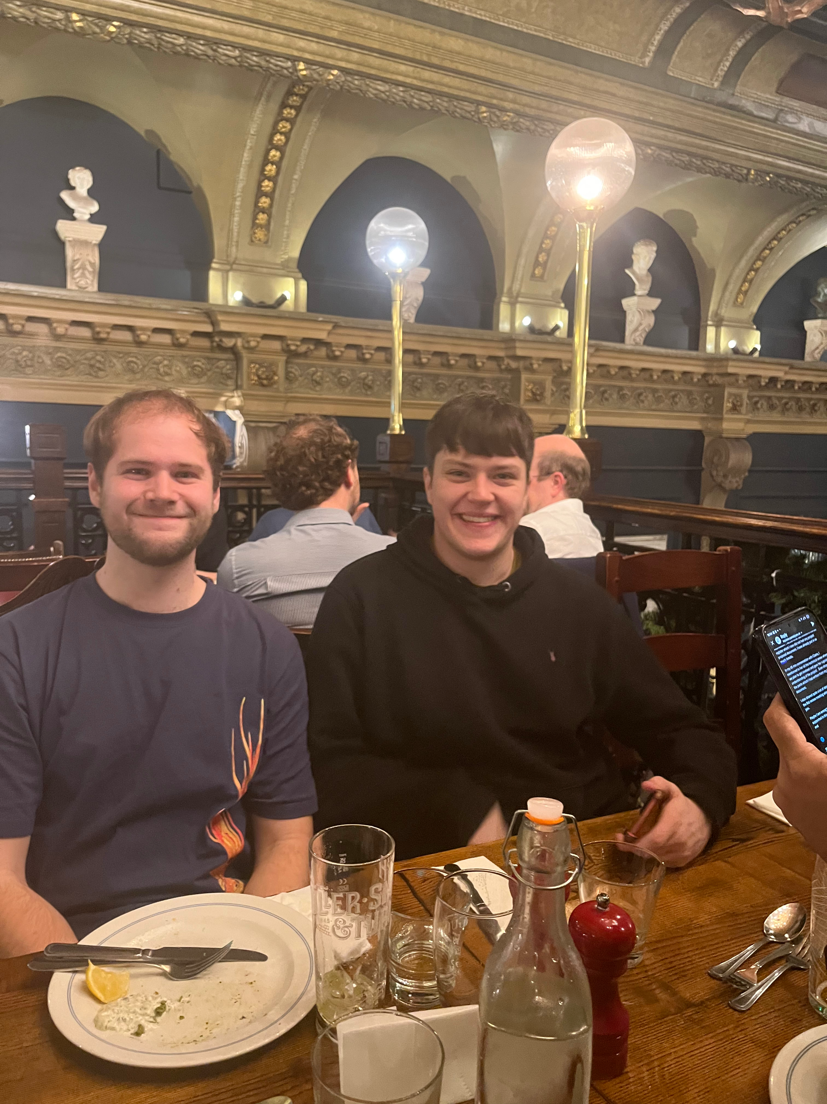
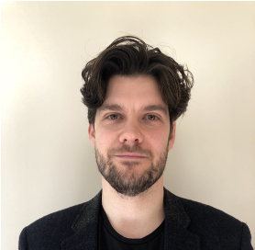
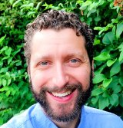
Kieran Flanagan
Lucien Heurtier
Matt Millns
+ Physics
Operations
Team
Jamie McDonald
Pete Millington
Ted Smith

Slide 3


Slide 4

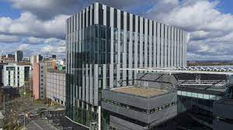
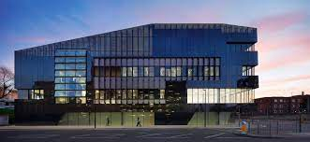
Centre for Quantum Science and Engineering
The Centre was launched in 2024 to promote, co-ordinate, and lead quantum science and engineering at Manchester:
Over 50 research groups focussing on quantum science, spanning physics, chemistry, materials, maths, computer science, electrical and electronic engineering
Facilities spanning three institutes – Advanced Materials, Photonics, and 2D Materials
3 tenure-track Dame Kathleen Ollerenshaw Fellowships
Royce Institute for Advanced Materials
Photon Science Institute
The National Graphene Institute

Slide 5

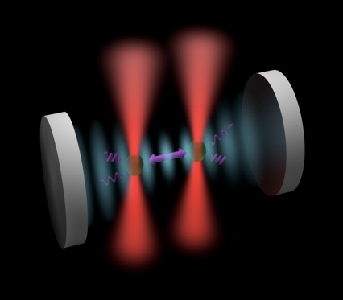
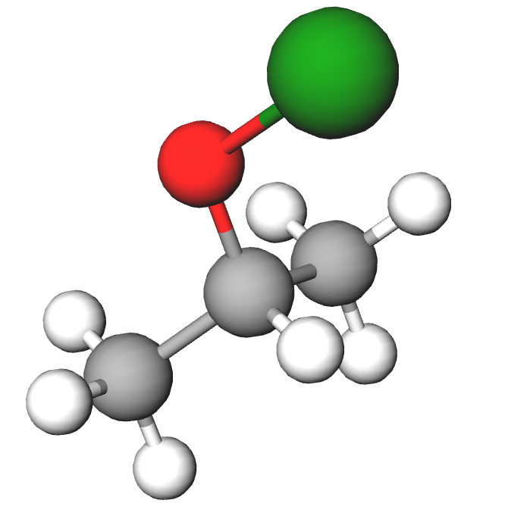
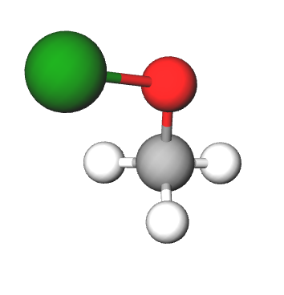
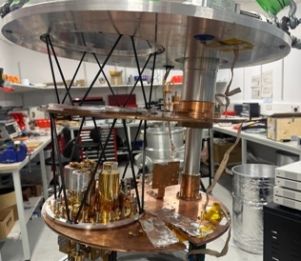
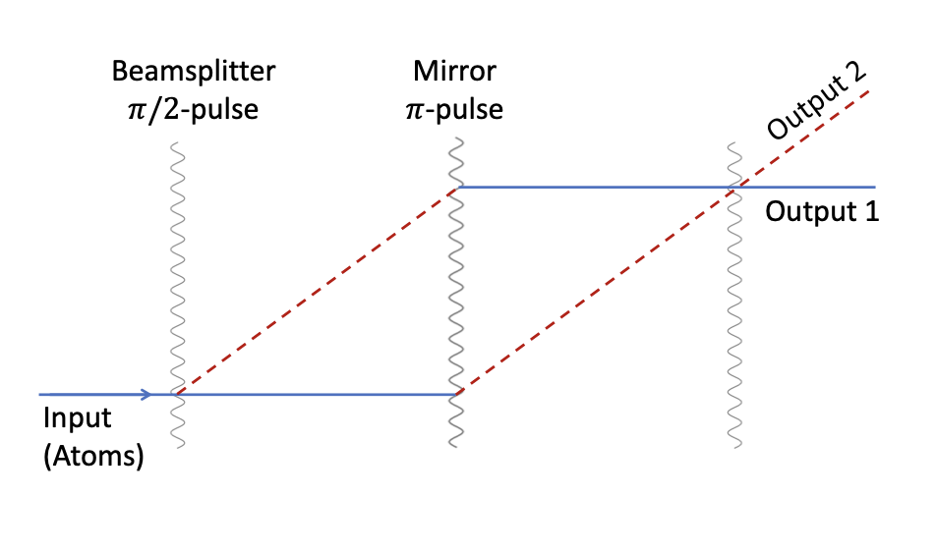
Centre for Quantum Science and Engineering
6 Themes
THEME 1
Information, Computation and Physical Foundations
Lead: Thomas Elliott (PHYS)
Optomechanical Sensors
THEME 2
2D Materials & Condensed Matter
Lead: Artem Mishchenko (PHYS)
THEME 3
Spins & qubits
Lead: Alice Bowen (CHEM)
Actinide Molecules for Fundamental Physics
THEME 4
Quantum photonics
Lead: Jayadev Vijayan (EEE)
ERC Advanced Grant
THEME 5
Materials for quantum
Lead: Maddison Coke (TECH)
Axion Dark Matter Searches
(Thursday’s talk)
VLBAI
THEME 6
Quantum Technologies for
fundamental physics
Lead: Jamie McDonald (PHYS)

Slide 6
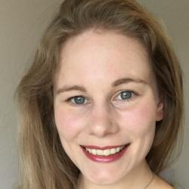
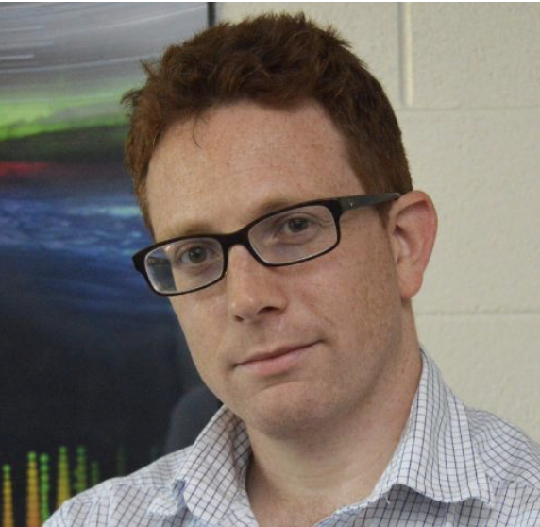
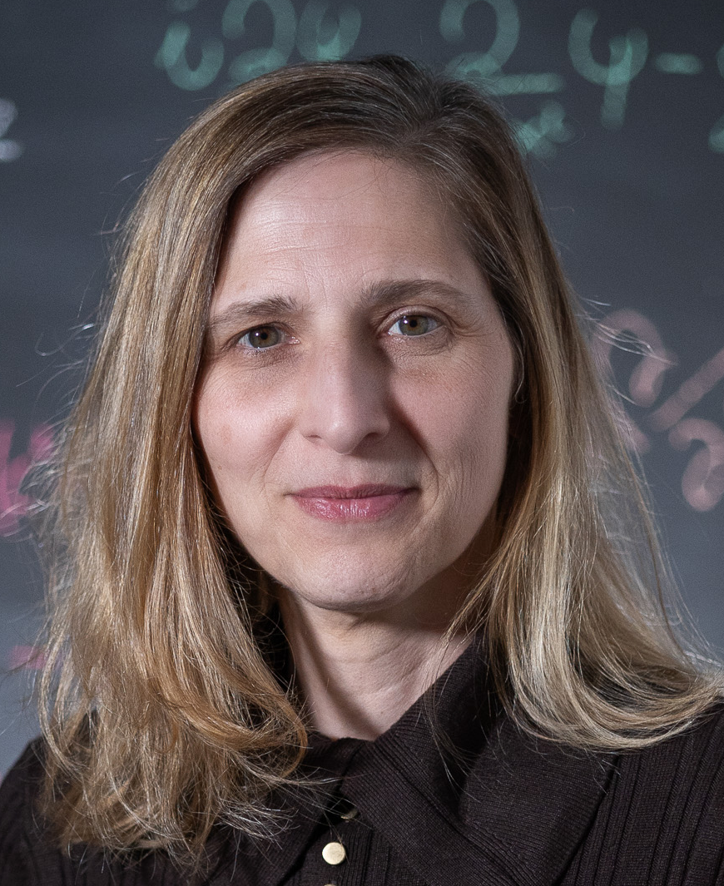
Centre for Quantum Science and Engineering
6 Themes
THEME 1
Information, Computation and Physical Foundations
Lead: Thomas Elliott (PHYS)
Three new academic hires starting in 2026
in applied quantum technologies
(strong focus in QTFP)
THEME 2
2D Materials & Condensed Matter
Lead: Artem Mishchenko (PHYS)
THEME 3
Spins & qubits
Lead: Alice Bowen (CHEM)
THEME 4
Quantum photonics
Lead: Jayadev Vijayan (EEE)
THEME 5
Materials for quantum
Lead: Maddison Coke (TECH)
THEME 6
Quantum Technologies for
fundamental physics
Lead: Jamie McDonald (PHYS)
Dr Tiffany Harte
(Cambridge UK)
Prof Ben Jones
(UTA USA)
Prof Silke Weinfurtner
(Nottingham UK)

Slide 7
Centre for Quantum Science and Engineering
6 Themes
THEME 1
Information, Computation and Physical Foundations
Lead: Thomas Elliott (PHYS)
First cohort of 5 Quantum-specific
PhD students recruited in 2024/5
THEME 2
2D Materials & Condensed Matter
Lead: Artem Mishchenko (PHYS)
THEME 3
Spins & qubits
Lead: Alice Bowen (CHEM)
THEME 4
Quantum photonics
Lead: Jayadev Vijayan (EEE)
THEME 5
Materials for quantum
Lead: Maddison Coke (TECH)
Matt Millns (2025)
(axion experiment + organizing committee)
THEME 6
Quantum Technologies for
fundamental physics
Lead: Jamie McDonald (PHYS)

Slide 8
Housekeeping
Code of conduct
Export controls
Photography
Fire safety

Slide 9

Lunches

Slide 10
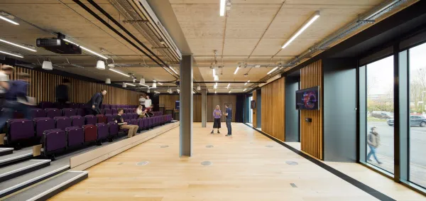
Talks : 25 Minutes + 5 minutes discussion

Slide 11
Enjoy!
Breakout Rooms

