Slide 1

AION Atom Interferometer Observatory and Network
Jeremiah Mitchell
On behalf of the AION collaboration
New Windows on Fundamental Physics
20 January 2026

Slide 2
Overview
Atom interferometry refresher
Fundamental physics
AION and the international landscape

Slide 3
Atom interferometry
Mach-Zehnder laser interferometer
Mach-Zehnder atom interferometer
delay
detector
beamsplitter
mirror
beamsplitter
mirror
beamsplitter
Atom interferometry tutorials:
J. M. Hogan et al., arXiv:0806.3261 [physics] (2008).
O. Buchmueller, J. Ellis, and U. Schneider, arXiv:2306.17726 (2023).

Slide 4
The phase shift
Phase Shift
Leading order phase shift

Slide 5
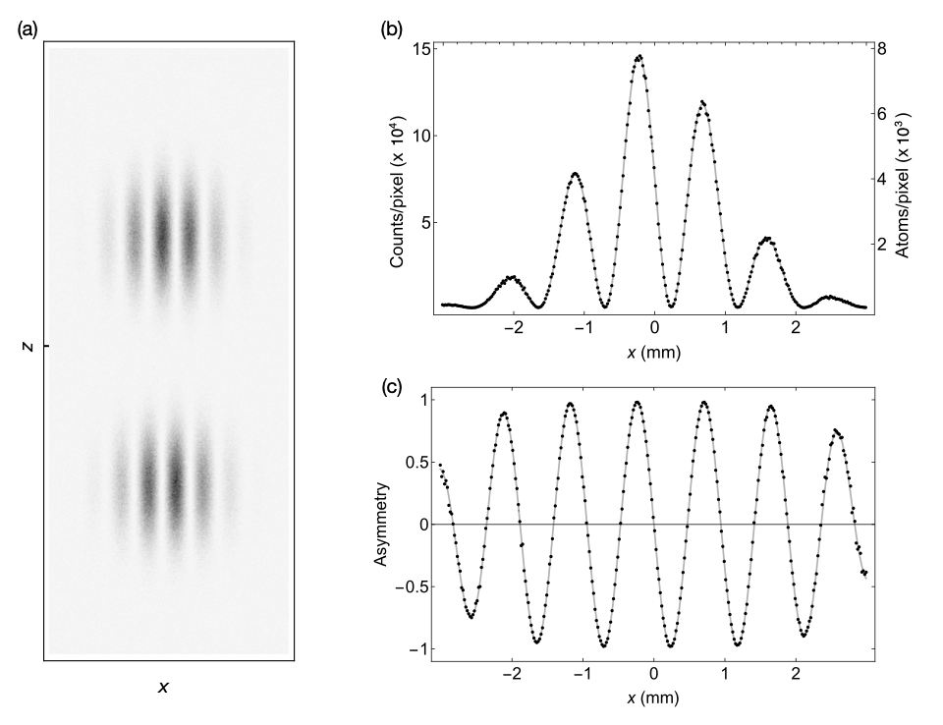
Atom interferometry readout
Measurement relies on two key components
Phase shift between quantum states (energy levels)
Contrast
Simulation (MAGIS-100)
M. Abe et al, Quantum Sci. Technol. 6 044003 (2021)

Slide 6
Gradiometry
Utilize gradiometry to suppress common mode noise sources
Local vibration of optics
Laser frequency and phase noise
Gradients in potentials experienced by atoms may fluctuate in space and time

Slide 7
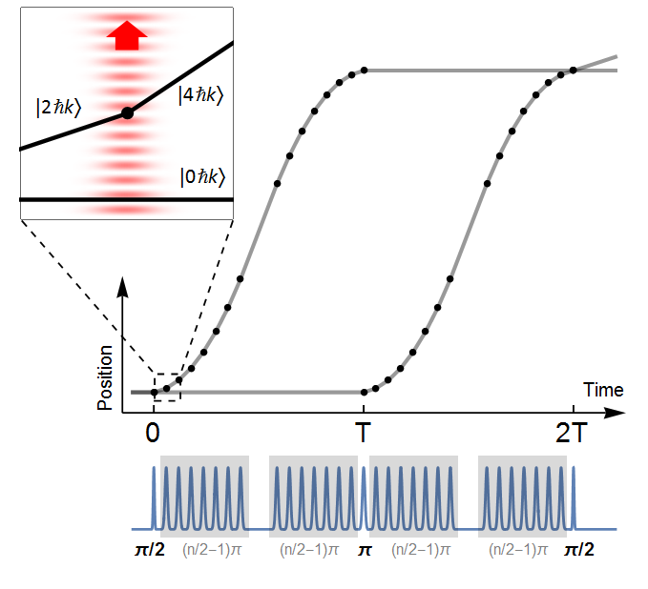
Large momentum transfer and resonant sequences
TK, P. Asenbaum et al., Nature (2015)
P. Asenbaum, C. Overstreet et al., PRL (2017)
J. Rudolph et al., Phys. Rev. Lett. 124, 083604 (2020).
J.-N. Siemß et al., (2022).
P. Cladé et al., Phys. Rev. Lett. 102, 240402 (2009).

Slide 8
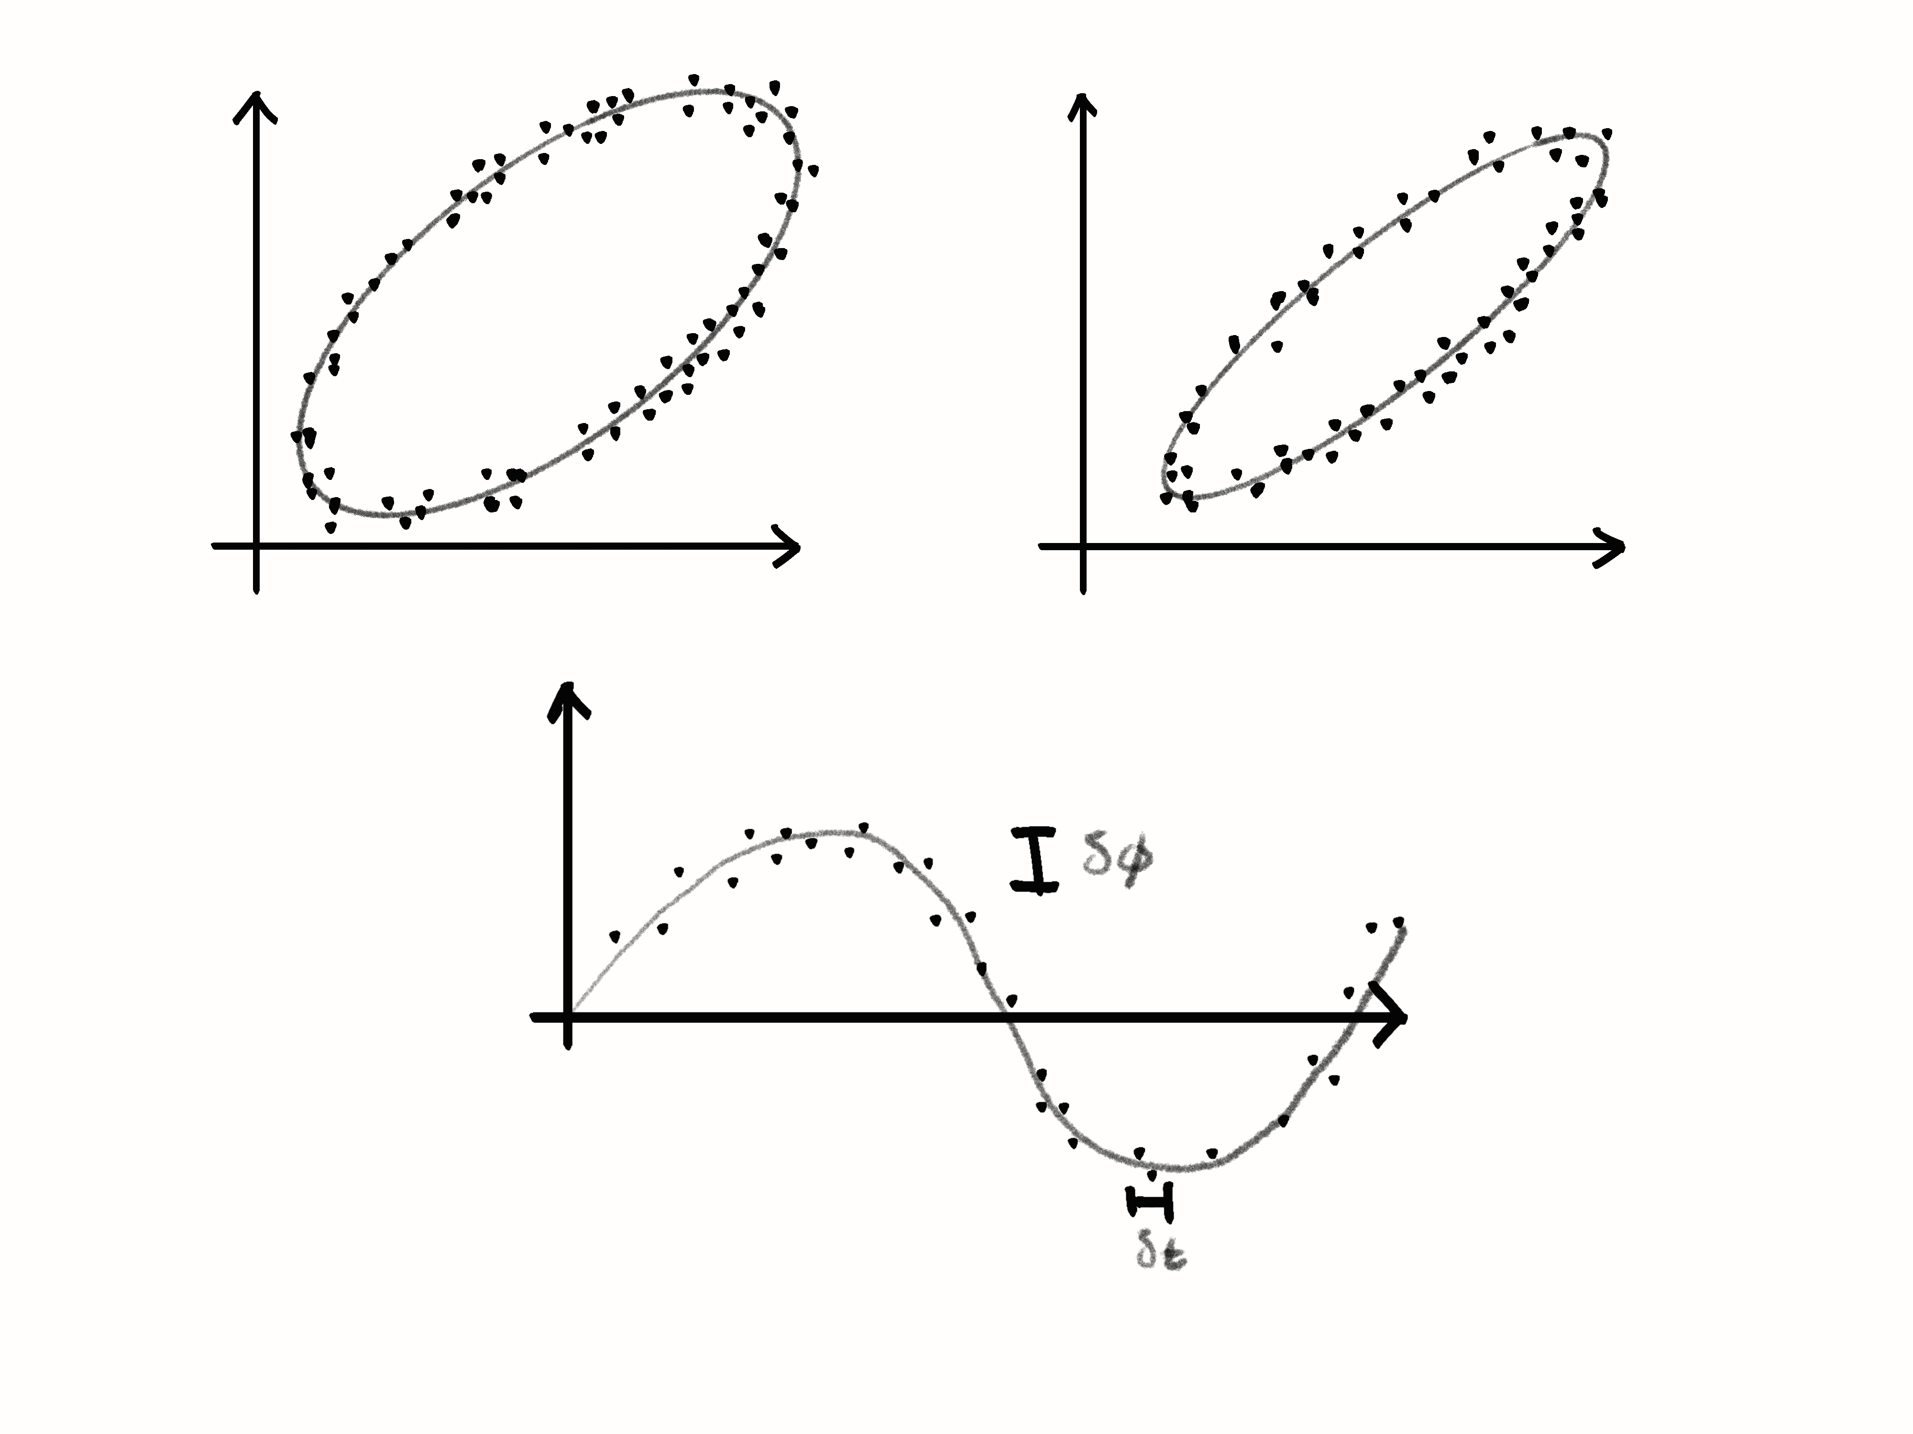
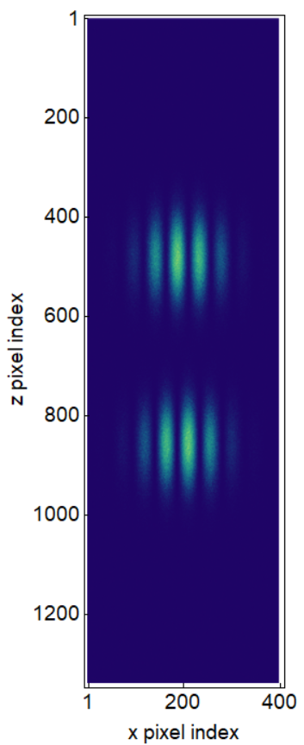
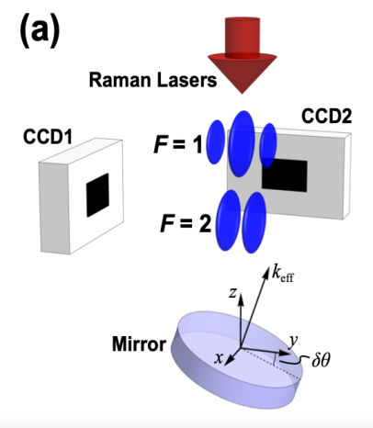
Signal extraction and challenges
Technical challenges require extreme precision for quantum control
Atom flux, kinematics, atom temperature and collimation
Laser frequency, phase, and pointing stability
Temperature, vacuum, stray magnetic fields, and vibrations
Gravitational static gradients and moving masses
Subsampling instrument, aliasing
Exquisite sensitivity to gravity results in environmental noise sources which are harder to mitigate
Seismic and atmospheric gravity gradient noise
Random anthropogenic and synanthropic noise
Excited state upper (%)
Excited state upper (%)
Excited state lower (%)
Excited state lower (%)
L. Badurina, A. Beniwal, and C. McCabe, Phys. Rev. D 108, 083016 (2023).
J. Carlton and C. McCabe, Phys. Rev. D 108, 123004 (2023).
G. T. Foster et. al., Opt. Lett., OL 27, 951 (2002).
A. Sugarbaker et. al., Phys. Rev. Lett. 111, 113002 (2013).

Slide 9
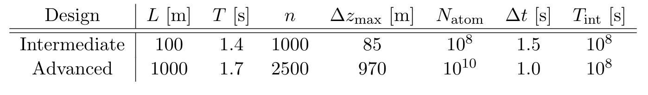
Science opportunities
Macroscopic tests of quantum mechanics
Searches for dark matter and gravitational waves
Tests of general relativity
Earth Science applications

Slide 10
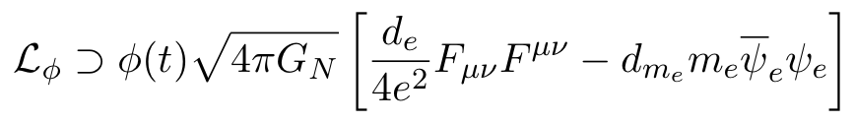
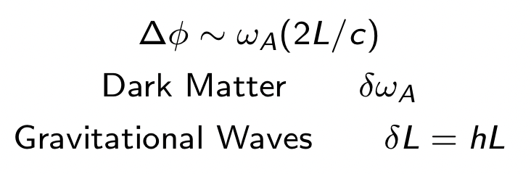
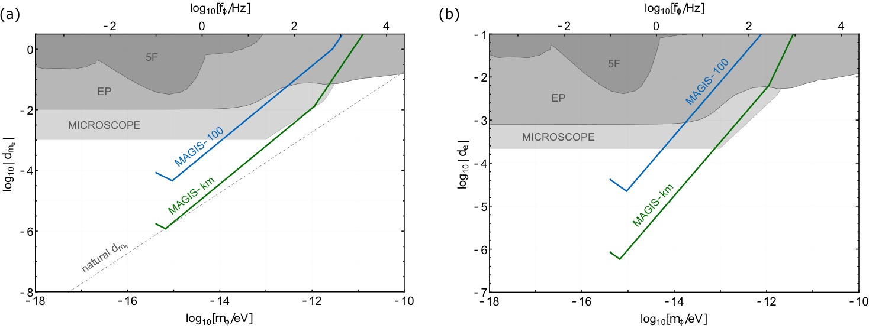
Dark matter
Ultralight dark matter
Ultralight scalar dark matter → high density, wave-like characteristics
Photon Couplings
Electron Mass Couplings
10⁻²² eV
10⁻¹⁷ eV
10⁻¹² eV
10⁻⁷ eV
Mahiro Abe et al 2021 Quantum Sci. Technol. 6 044003
Phys. Rev. D 97, 075020 (2018).

Slide 11
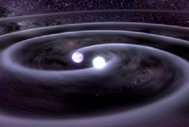
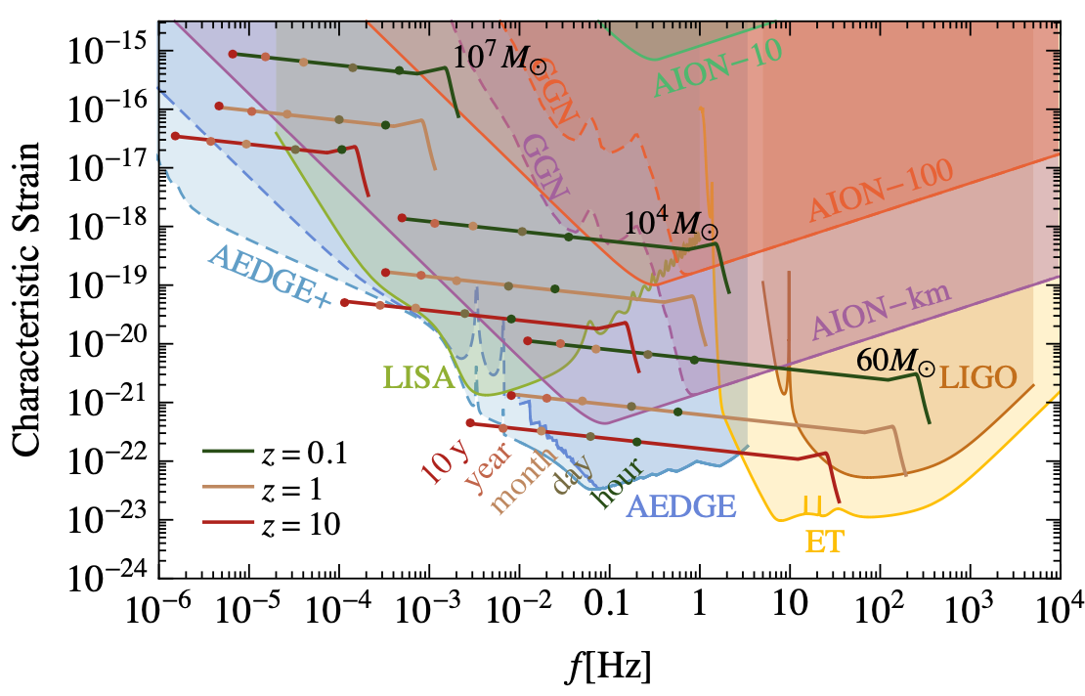


Gravitational waves
Gravitational waves
L. Badurina et al., JCAP 05 (2020) 011
Phys. Rev. Lett. 110, 171102 (2013).

Slide 12
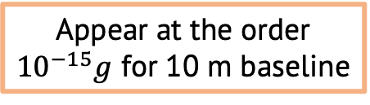
Tests of general relativity and dark energy
GR
Dark Energy
Atom acceleration in PPN Schwarzschild metric
Relativistic phase shift
Search for Chameleon field dark energy
Non-linear scalar interaction
Experimental setup requirements:
High density source mass
Perform atom interferometry near source mass in vacuum
Chameleon acceleration alters atom trajectories leading to phase shift
Test for Newtonian violations
Non-linear GR terms
Velocity dependent forces
Set limits on PPN parameters
Appear at the order
${10}^{−15}g$ for 10 m baseline
B. Elder et al., Phys. Rev. D 94, 044051 (2016).
S. Dimopoulos et al., Phys. Rev. Lett., 2007

Slide 13
International efforts

Slide 14

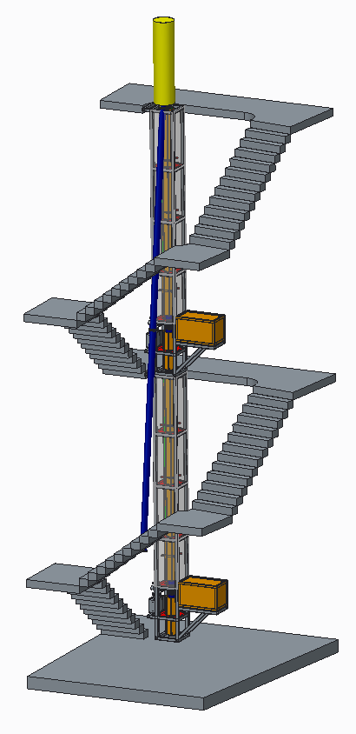
AION
Atom Interferometer Observatory and Network
UK consortium of 7 institutions
Multi-stage project
Develop 5 ultracold strontium UK laboratories for atom interferometry R&D
Design and deploy increased baseline atom interferometers 10m -> 100m -> 1km
Investigate technology development and network with MAGIS-100 for large-scale science goals
14.7m
Ground level
AI-10
10.0m
7.7m
Project executed in national partnership with UK National Quantum Technology Hub in Sensors and Timing, Birmingham, UK,
and international partnership with The MAGIS Collaboration
and The Fermi National Laboratory, US
5.0m
L. Badurina et al JCAP05(2020)011

Slide 15
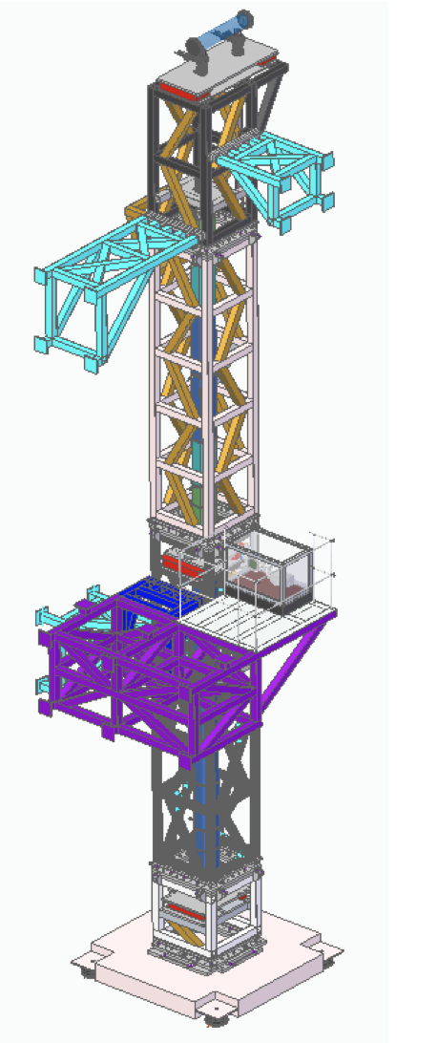
Status
Centralized design of Ultrahigh vacuum systems
10 m atom interferometer blueprint (AION-10)
Differential atom interferometry on strontium 87 clock transition
Exploring 100 m sites and potential smaller scale spinoff instruments (Boulby, CERN)
B. Stray et al., Centralized design and production of the ultra-high vacuum and laser-stabilization systems for the AION ultra-cold strontium laboratories, AVS Quantum Science 6, 014409 (2024).
AION Collaboration et al., AION-10: Technical Design Report for a 10m Atom Interferometer in Oxford, arXiv:2508.03491.
C. F. A. Baynham et al., A Prototype Atom Interferometer to Detect Dark Matter and Gravitational Waves, arXiv:2504.09158.

Slide 16

MAGIS-100
Matter-wave Atomic Gradiometer Interferometric Sensor
Long-baseline atom interferometer being built at Fermilab US
3 strontium atom sources along vertical baseline
Test bed experiment for simultaneous atom interferometer control
Prototype 10m device at Stanford
Mahiro Abe et al 2021 Quantum Sci. Technol. 6 044003

Slide 17
TVLBAI
Proto-collaboration formed to bring together atom interferometry community
55 institutions from 21 countries

Slide 18



Summary and Thanks
Quantum technologies have the potential to unlock unprecedented sensitivity for key scientific questions in fundamental physics, particle physics, and quantum mechanics
A network of long-baseline atom interferometers provides the key to noise rejection and enhanced science reach for ultralight dark matter searches and decihertz gravitational waves
RAL

Slide 19
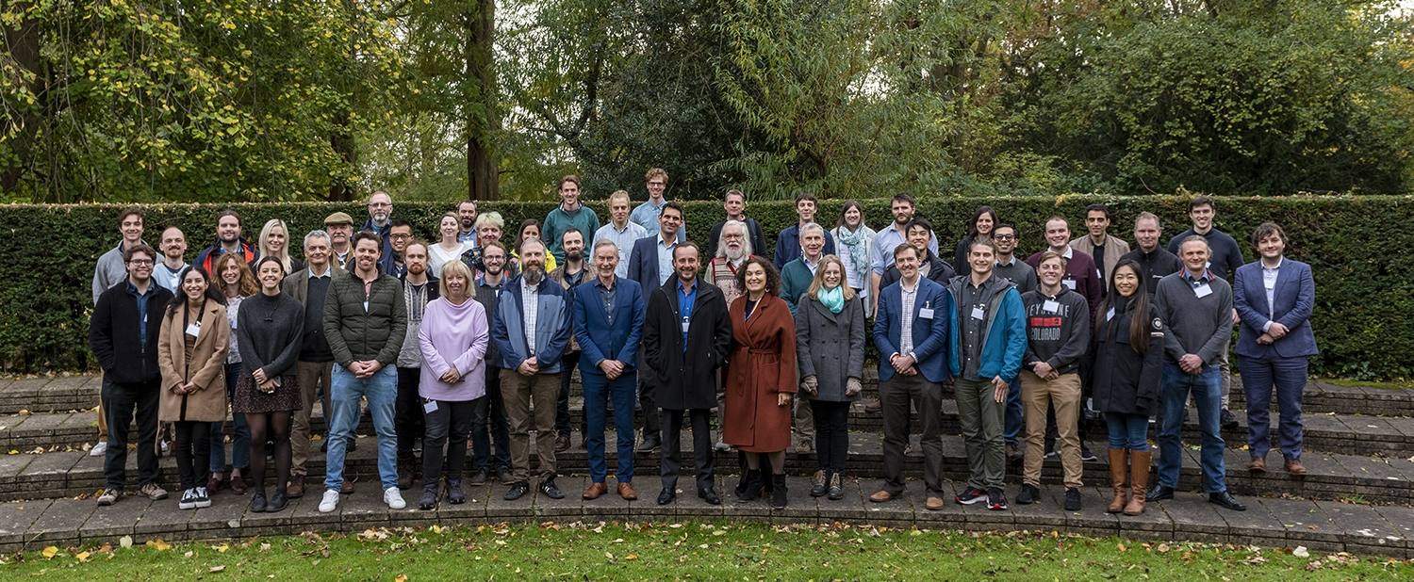


@AION_Science
Follow our progress!
aion_science

Slide 20
Backups

Slide 21
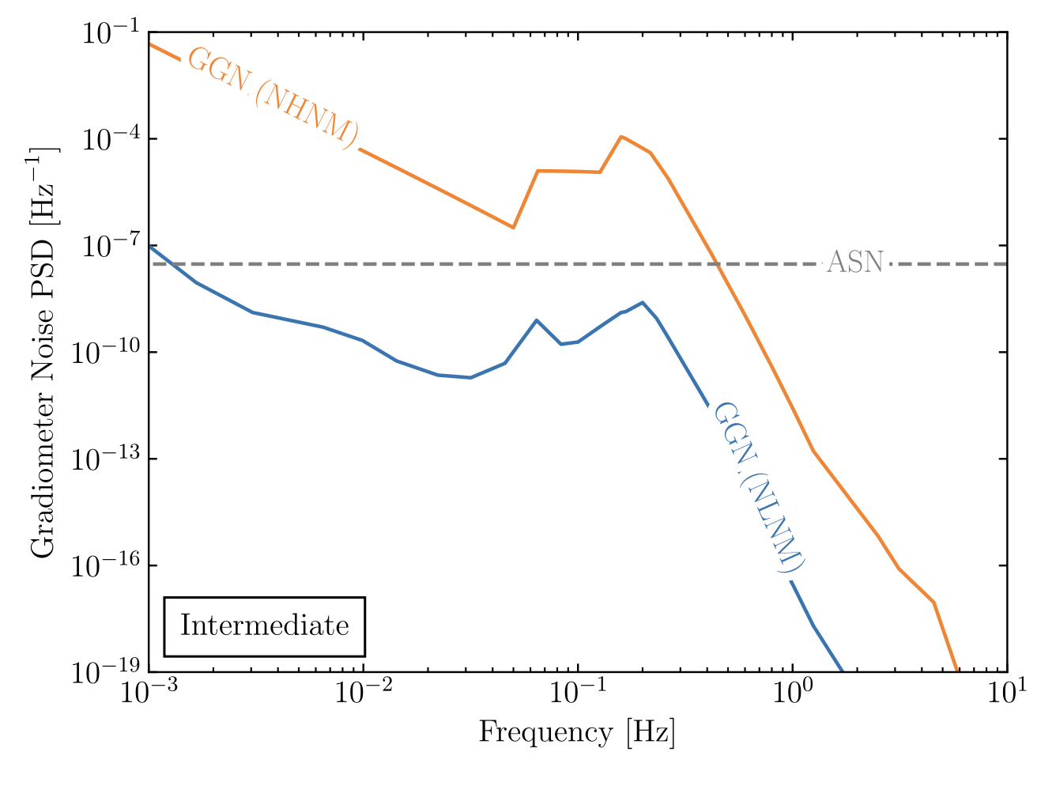
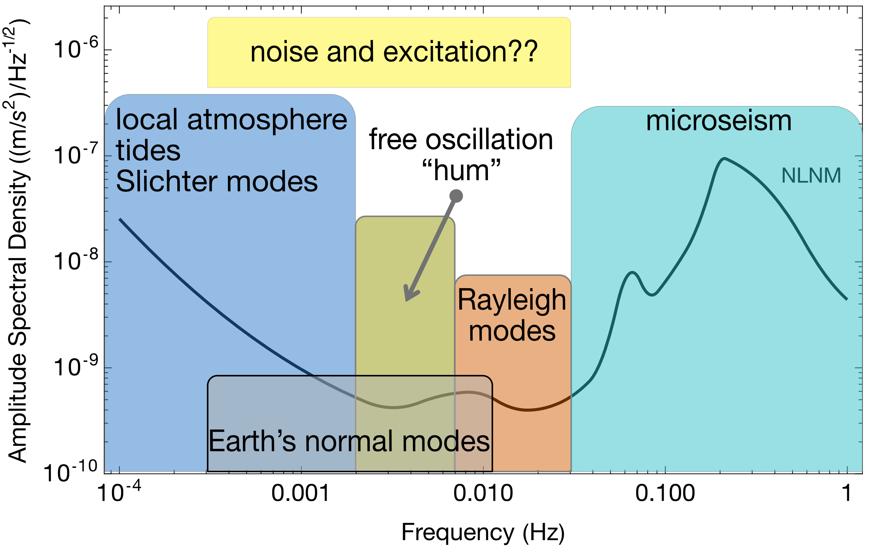
Earth Science applications
Rayleigh seismic waves source gravitational fluctuations
Terrestrial backgrounds cause gravity gradient noise limiting fundamental physics searches
AION can use gravitational signal channel to answer open questions in Earth science
Earth’s free oscillation and normal modes
Low-frequency Earth dynamics
Seismic Frequency Spectrum
Mitchell et al., J. Inst., vol. 17, 01, 2022.
Badurina, et al. Phys. Rev. D 107, 055002
Atmospheric infrasound and temperature gradient noise
Carlton et al., arXiv:2412.05379 (2024).

Slide 22
title

Slide 23
title

