Slide 1
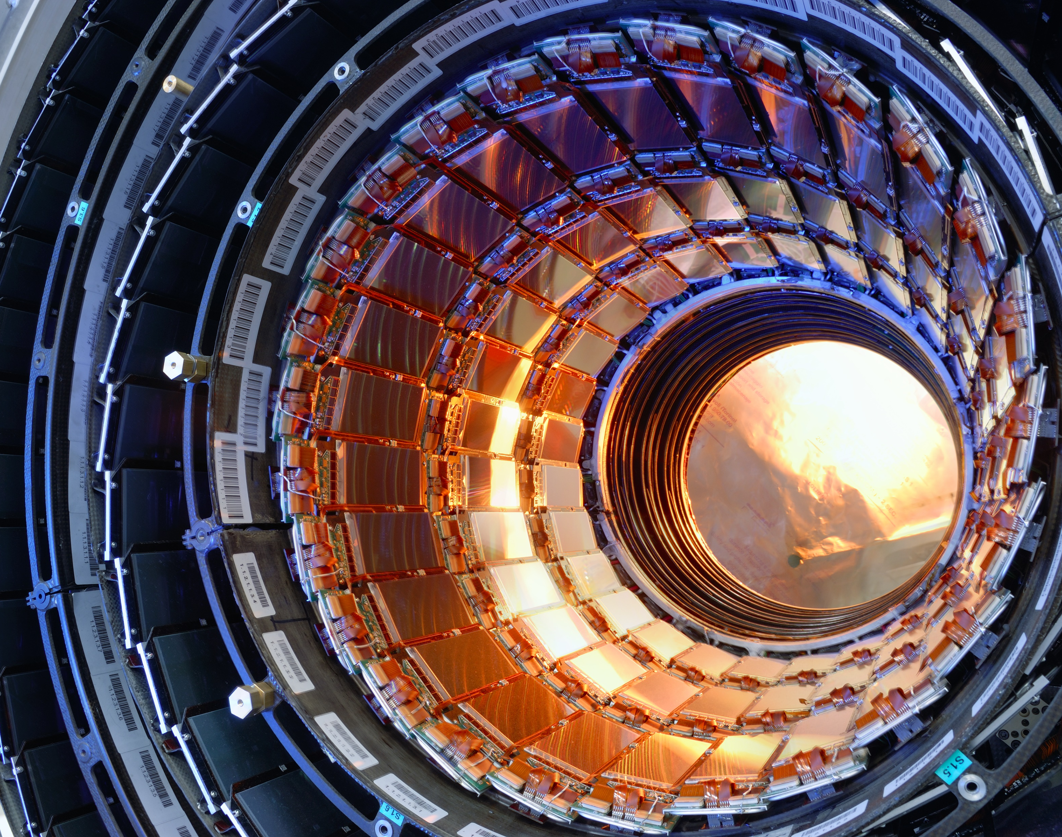
Marietta Blau Institute for Particle Physics
Jochen Schieck
Vienna, 14.IX.2026

Slide 2
Welcome to the M4JETS Conference 2026 in Vienna

Slide 3
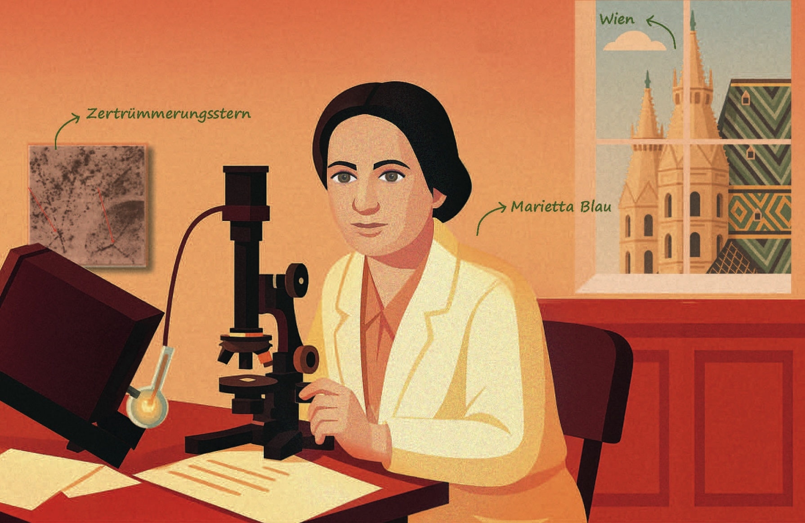
Marietta Blau
Austrian Physicist (1894-1970)
Working at Institut für Radiumforschung (founded 1910)
Key contribution to visualization of particle Tracks
Emigration to Mexico in 1938
Proposed several times for Nobel Prize

Slide 4
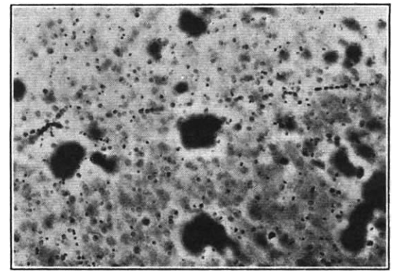
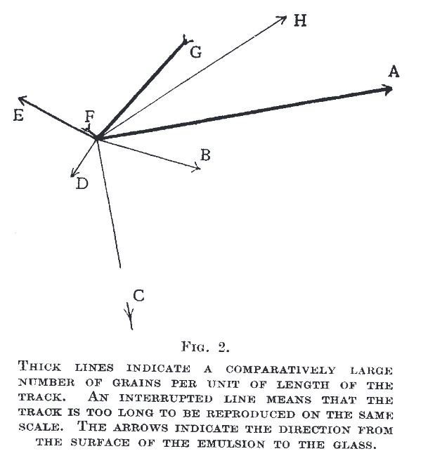
Marietta Blau
Nature Volume 140, page 585 (1937)
Visualization of Spallation process induced by cosmic radiation on photographic plate

Slide 5
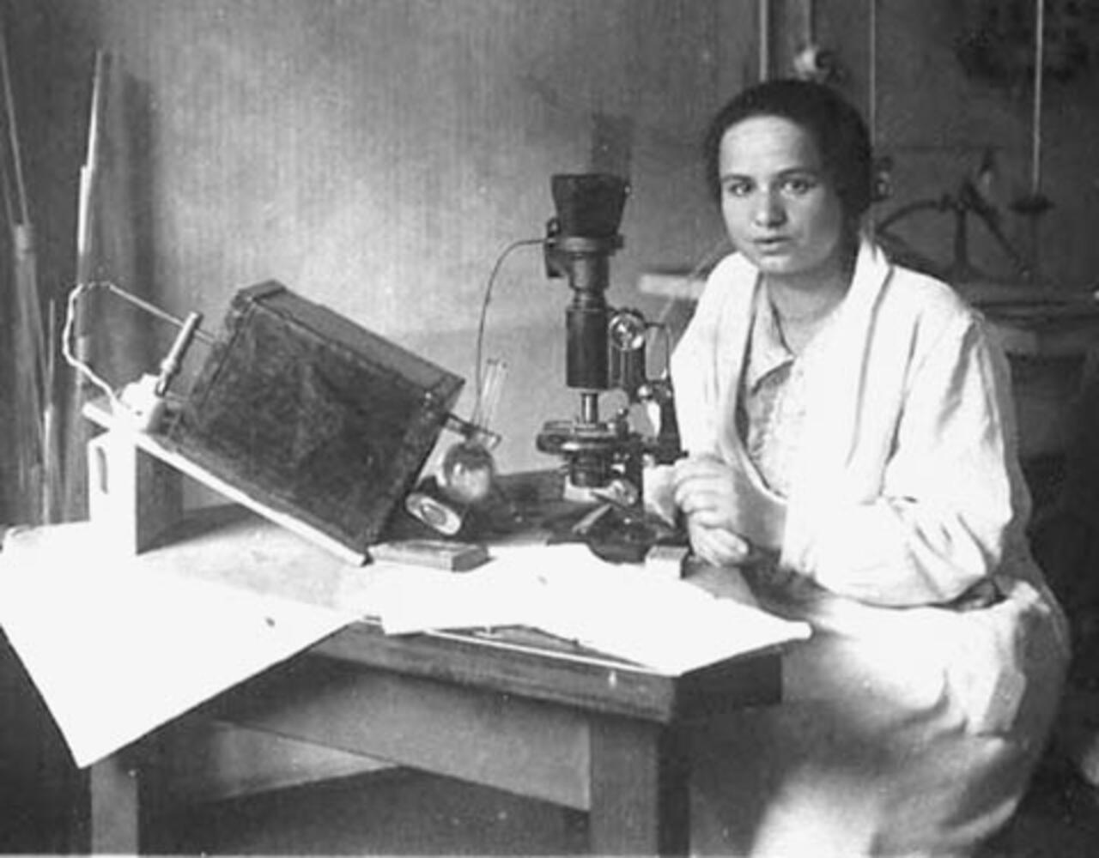
Marietta Blau
Pioneering visualization of particle tracks using Nuclear Emulsion
Groundbreaking work for particle detection
  Nobel Prize for Cecil Powell for the detection of Pions (and Myons) in cosmic rays
Essential experimental technique to study fundamental particles

Slide 6
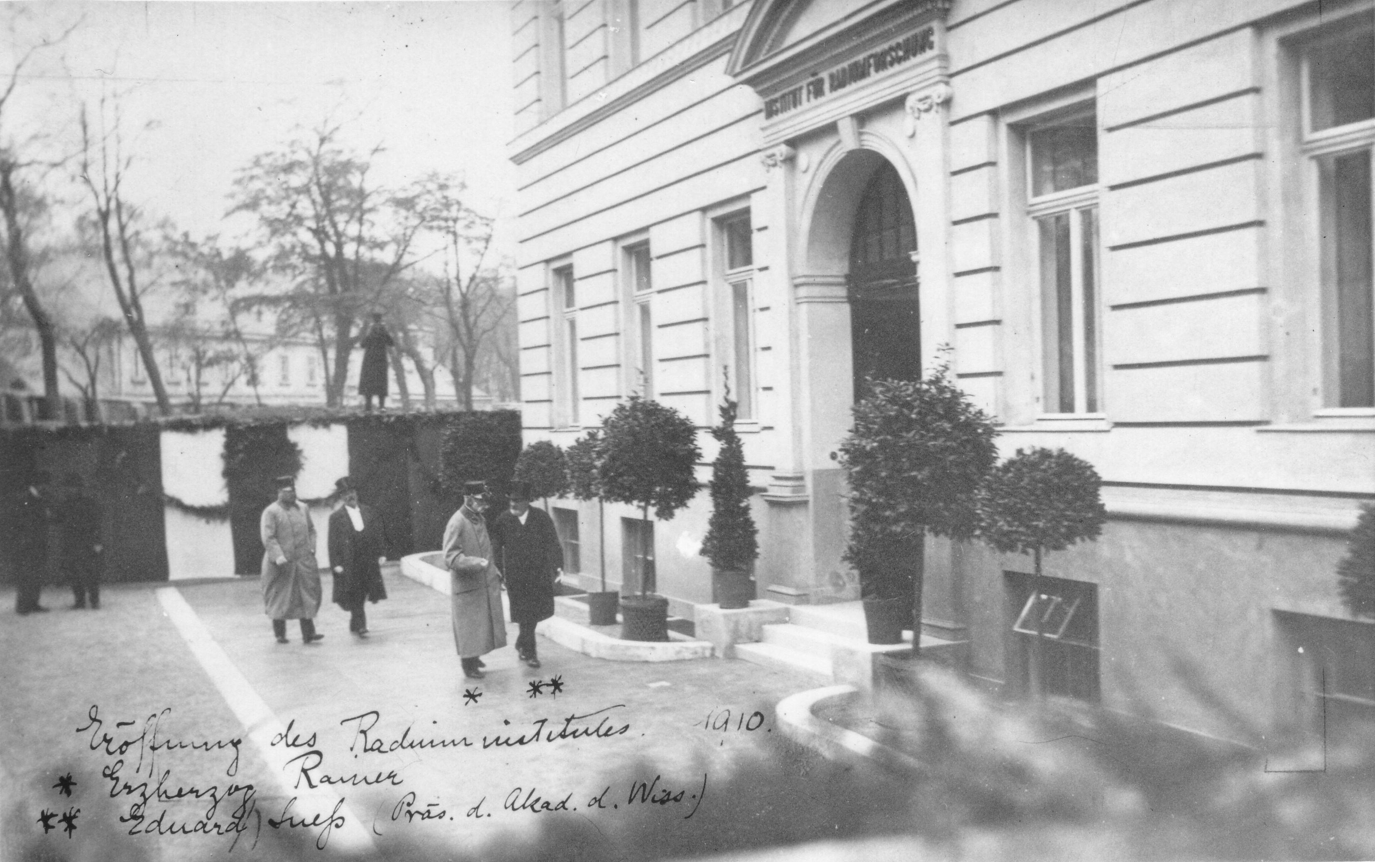
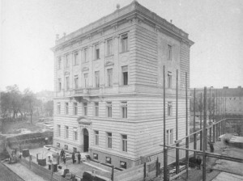
Institut für Radiumforschung
First dedicated Institute for research on radioactivity
Institute of the Kaiserliche Akademie der Wissenschaften (now ÖAW)
Marietta Blau performed her key research at this institute
Hosts now the Institute for Quantum Optices and Quantum Information (IQOQI)

Slide 7

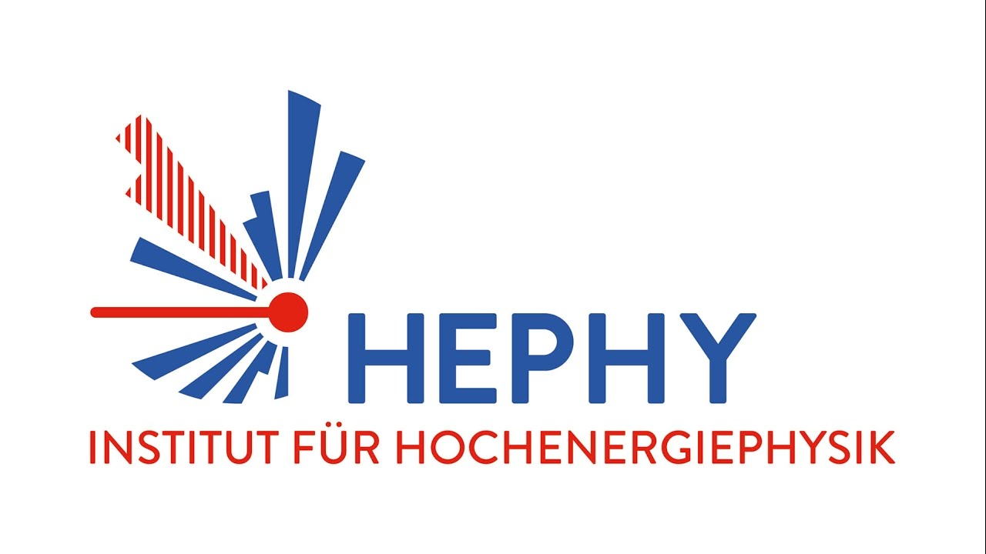

Marietta Blau Institute for Particle Physics (MBI)
MBI was founded in 2025
Merger of two former ÖAW institutes with closely related scientific disciplines
  Stefan Meyer Institute for subatomic Physics (SMI)
  Institute for High Energy Physics (HEPHY)
About 120 people (head count),
including 25-30 PhD

Slide 8
Marietta Blau Institute for Particle Physics
Austria’s largest non-university research institute focusing on experimental and theoretical particle physics
Largest Austrian Participant in experimental program at CERN
significant contribution to the development, conception, construction and testing of experiments and subsequent data analysis
Involvement in scientific program at KEK (Japan) and LNGS (CRESST and COSINUS)
Cooperation with TU Wien and Universität Wien

Slide 9
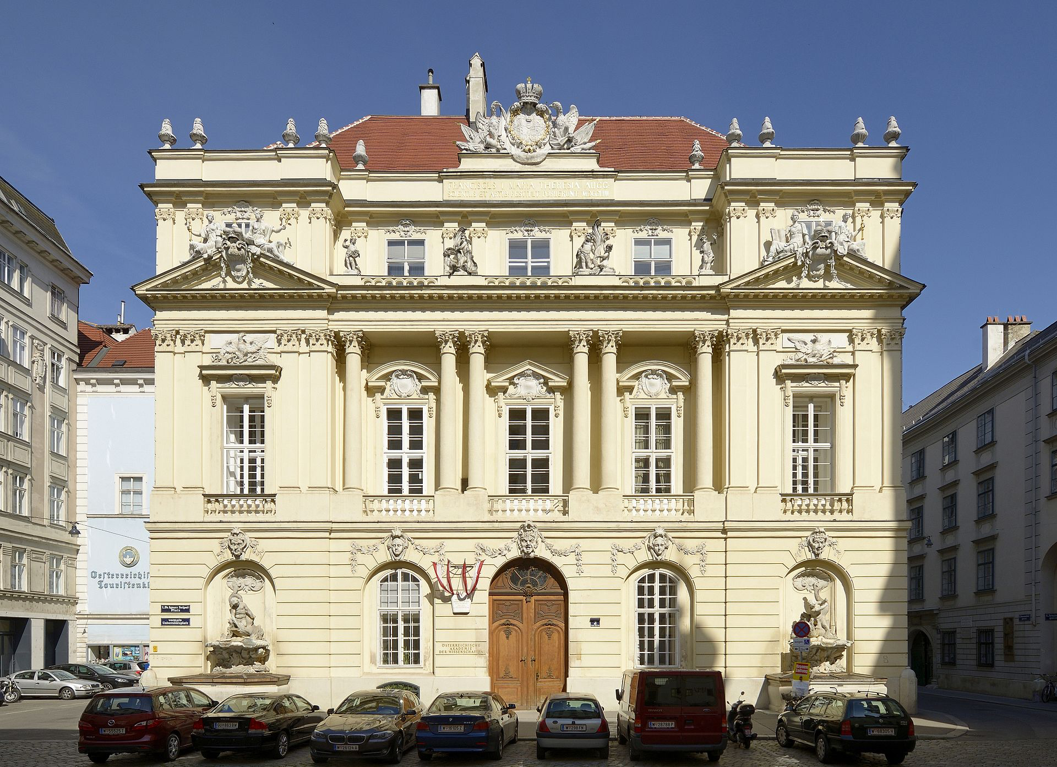
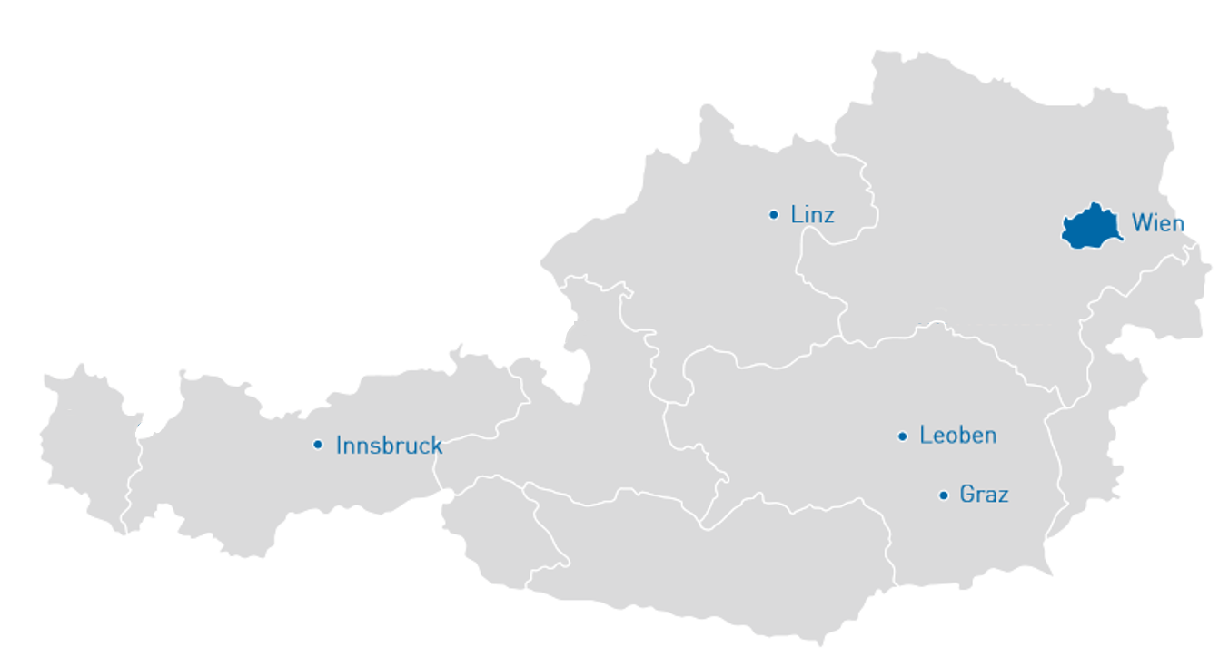
Austrian Academy of Sciences
Austria‘s central non-university research and science institution
established in 1847
ÖAW operates 25 research institutes with broad scientific orientation
About 1800 employees
3 year budget of 529 M€ (2024-2026)

