Slide 1
ML4JETS
Classification-Generative
Supervised Fine-Tuning
for Hierarchical Tagging of ML4HEP Literature
Ziyue Chen | IHEP UCAS
Collaborators
Claudius Krause, PhD | MBI Vienna (ÖAW)
Ke Li | Chinese Academy of Sciences (CN)
Ramon Winterhalder | Università degli Studi di Milano
Yulei Zhang | University of Washington (US)

Slide 2
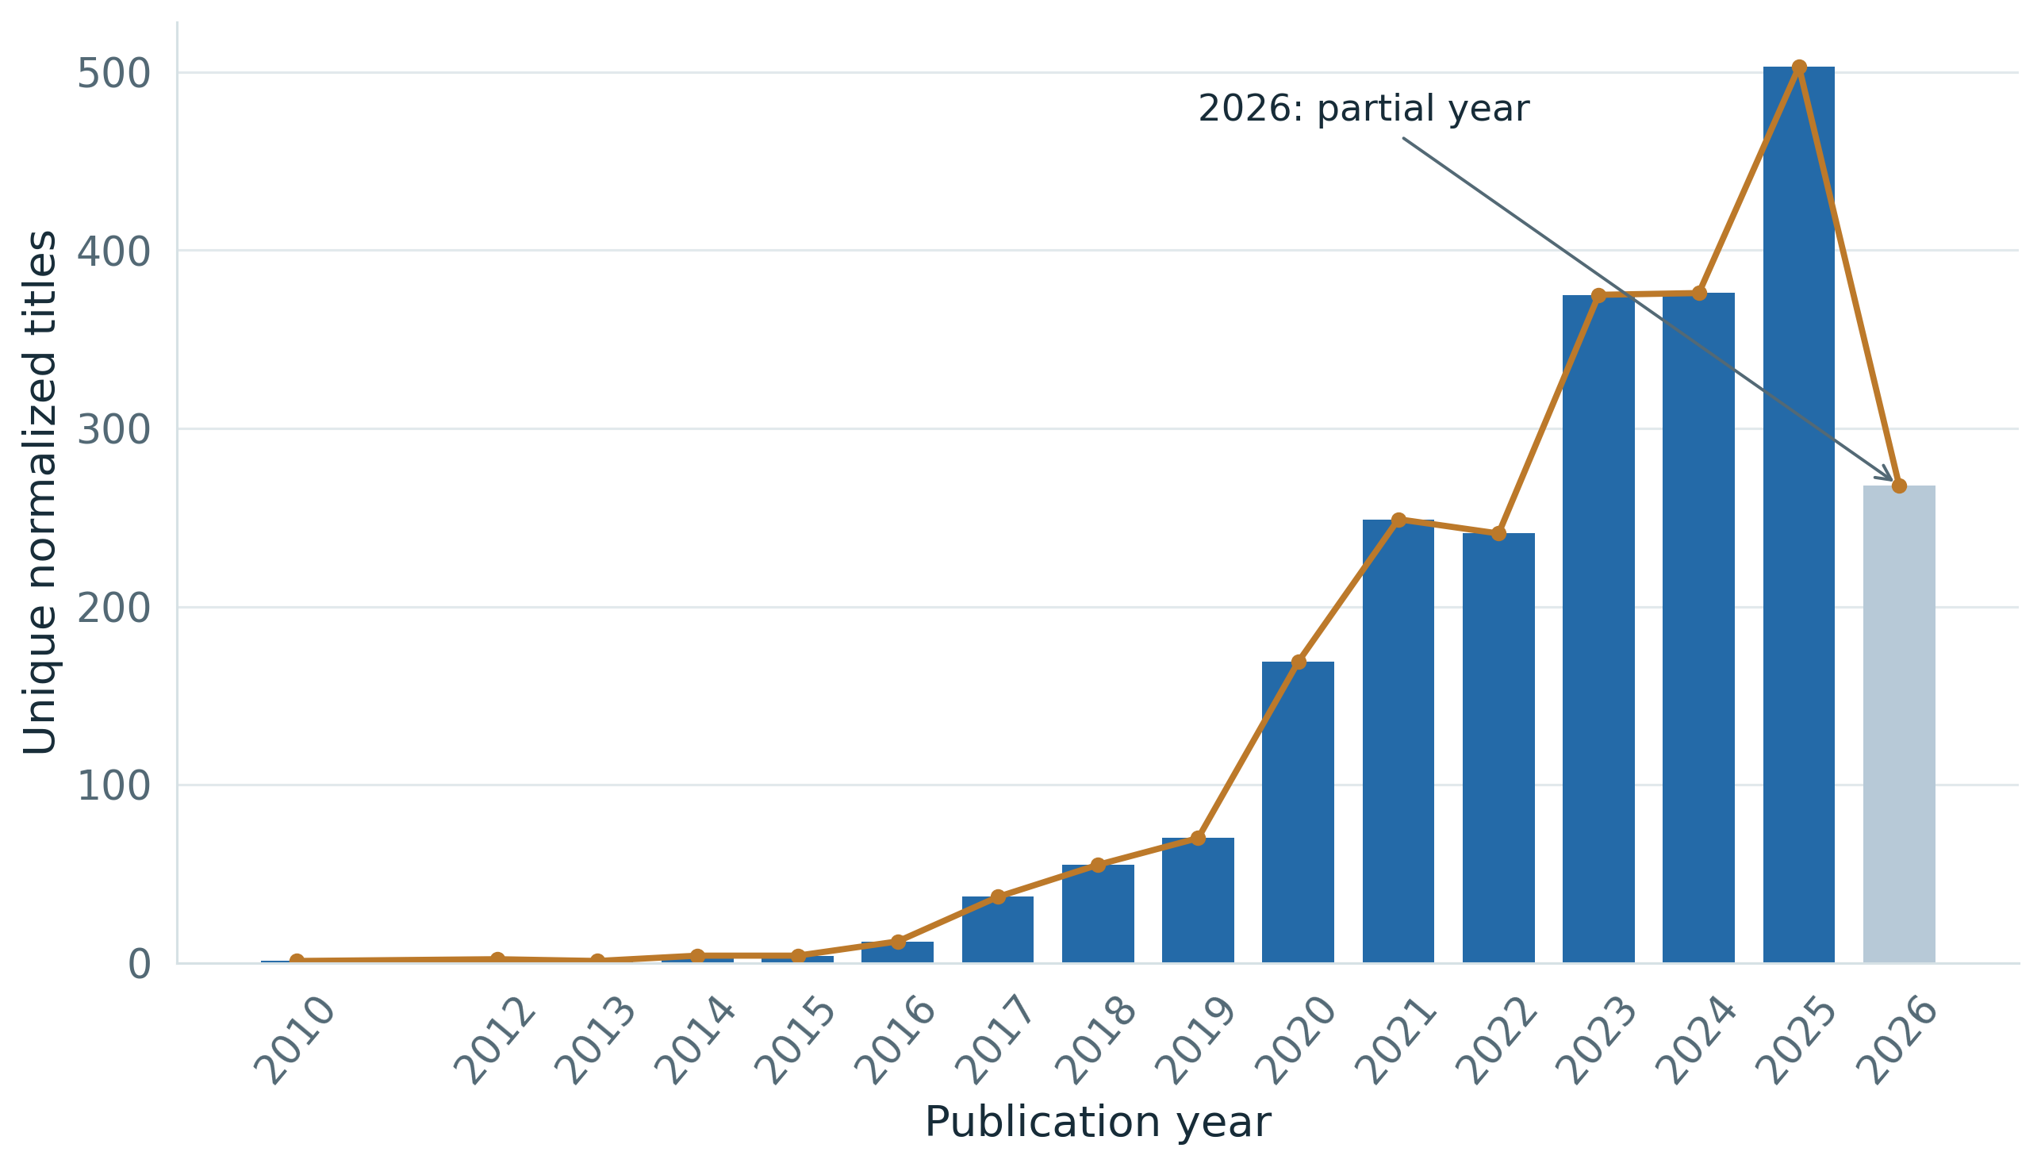
INTRODUCTION / MOTIVATION
A growing literature makes manual tagging a recurring bottleneck
ML4HEP literature is growing in volume, topical breadth, and overlap.
One paper may span methods, datasets, applications, and parent topics.
Manual tagging repeats these decisions paper by paper.
Human curation becomes time consuming as the corpus grows.
REPORT OUTLINE
Part 1 — CG-SFT: fine-tune an LLM to assign labels to established HEP/ML papers.
Part 2 — knowledge base + HEPML Agent: organize the curated literature for domain research.
Source: iml-wg.github.io/HEPML-LivingReview/
ML4Jets | Ziyue Chen, IHEP
CG-SFT 02 / 14

Slide 3
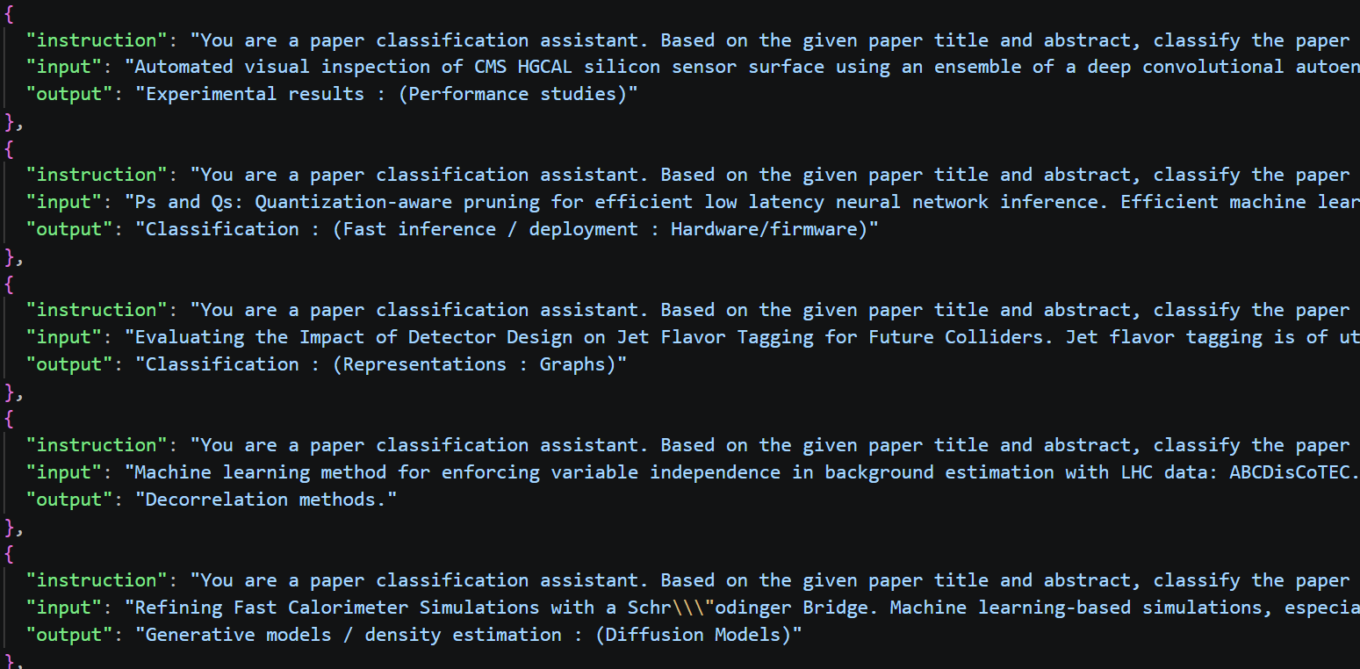
RESEARCH PURPOSE
Research purpose: Classify literature using LLM and further organize it into a knowledge base
Input: paper title + abstract
Output: 91 labels in a fixed order
Multi-label: several positive labels per paper.
Hierarchical: parent–child relations add structure.
Example: one paper can cover graph representations and jet tagging.
One controlled <yes>/<no> decision per label.
Fixed order → checkable vector.
No formatting ambiguity.
91 labels · 77 parent–child relations · 1,819 records · 186 held-out test papers
ML4Jets | Ziyue Chen, IHEP
CG-SFT 03 / 14

Slide 4
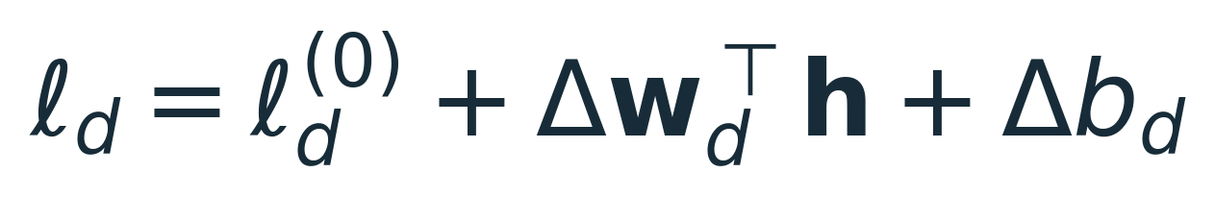

RESEARCH METHOD / ARCHITECTURE
One generative network, specialized at the decision interface
Shared Qwen states feed the native LM head; LoRA and optional decision-row adapters support task adaptation.
Token embeddings
Qwen decoder
h at t - 1
Native LM head
Decision rows
Paper + ordered template
Causal attention + MLP
All vocabulary rows
<yes> <no>
Attention projection: frozen path + low-rank update
Optional decision-row adapters
W0
A
B
u
+
Frozen
Rank r
d = <yes> or <no>
Input embeddings also receive two learned row deltas.
scaled by alpha / r
ML4Jets | Ziyue Chen, IHEP
CG-SFT 04 / 14

Slide 5
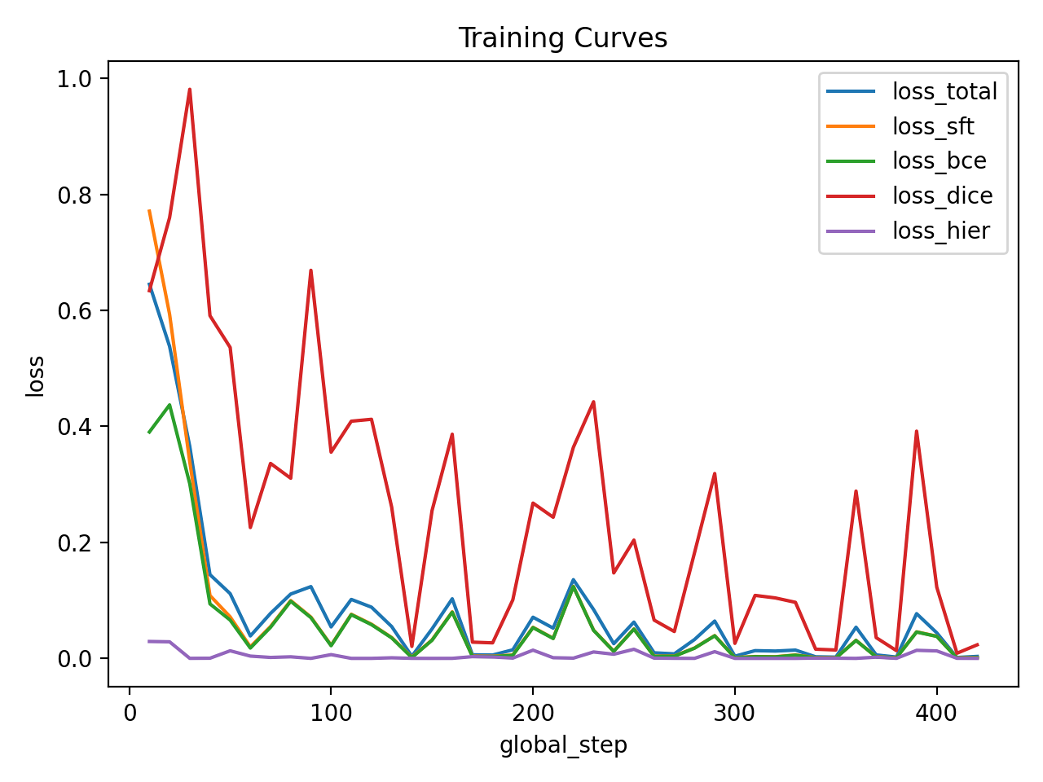
RESEARCH METHOD / OBJECTIVE
Joint supervision links token generation, binary decisions, and hierarchy
At position t, the causal logits are read at t − 1.
Selective SFT: supervise only the 91 decision positions.
Binary cross-entropy: separate <yes> from <no>.
Dice loss: address sparse positive labels.
Hierarchy term: softly penalize p_child > p_parent.
Training curves from the reported run
ML4Jets | Ziyue Chen, IHEP
CG-SFT 05 / 14

Slide 6
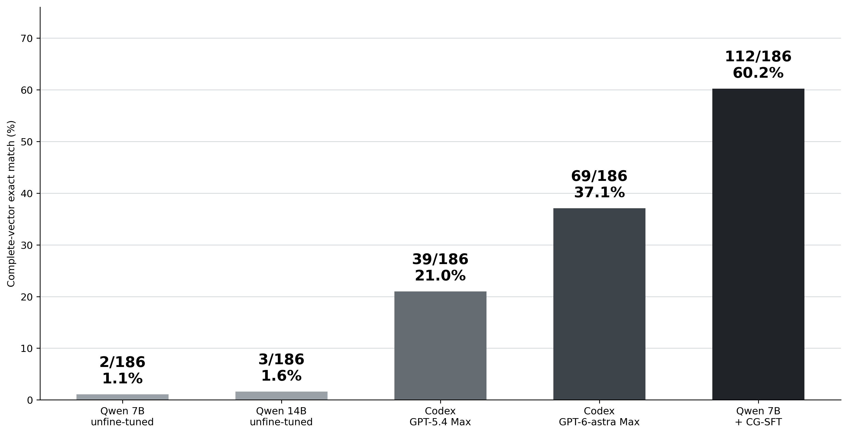
RESEARCH RESULT / EVALUATION
A strict and reproducible comparison
Same 186 held-out papers and title-and-abstract inputs.
Same 91-label taxonomy and fixed order.
Complete-vector exact match: all 91 decisions must agree.
All 91 decisions must agree for one paper to count as correct.
ML4Jets | Ziyue Chen, IHEP
CG-SFT 06 / 14

Slide 7
RESEARCH RESULT / MAIN RESULT
What the five-way comparison tells us
TASK COMPLEXITY
This is a difficult text-classification task:
Each paper can receive many labels
The labels form a complex parent–child structure
The model must map paper meaning to a 91-label taxonomy.
WHAT THE RESULTS SHOW
Before fine-tuning, the small models almost never classify correctly: 2/186 and 3/186 exact matches. CG-SFT raises the 7B model to 112/186. Even GPT-6-astra Max reaches only 69/186, below the fine-tuned small model.
ML4Jets | Ziyue Chen, IHEP
CG-SFT 07 / 14

Slide 8
CONCLUSION / CG-SFT
CG-SFT is meaningful because it matches the task, not just the model size
Results show that CG-SFT is highly effective for fast, domain-specific paper classification.
Large gain on the difficult 91-label task.
Fixed decision interface makes outputs machine-readable.
Main limitation: performance depends on human labeling quality.
Noisy or incomplete labels can be learned and repeated at scale.
NEXT Curated papers → knowledge base → HEPML Agent
CG-SFT 08 / 14

Slide 9
AGENT / OVERVIEW
A dedicated HEPML Agent for end-to-end research support
A domain Agent can automate the main research loop:
Retrieve
Plan
Code
Run
Iterate
precedents
and evidence
→
problem analysis
and experiment spec
→
write or modify
research scripts
→
→
analyze metrics
and decide next step
local or Slurm
execution
Not reached
Reached target
Summary and report
Knowledge base from the CG-SFT literature; precedent retrieval + persistent experiment records.
ML4Jets | Ziyue Chen, IHEP
CG-SFT 09 / 14
CG-SFT 09 / 14

Slide 10
AGENT / KNOWLEDGE BASE
Knowledge base: separate provenance, explicit retrieval, quality boundaries
Shared literature
Project literature
Research memory
Methods: representations, datasets, reported results.
Newly extracted papers remain local; local versions take precedence.
Agent decisions and experiments, each linked to artifacts.
Retrieval axes · literal terms · relevance · transfer conditions.
Bounded excerpts with paper ID, source, section, path, and line references.
Retrieval is evidence, not scientific validation.
ML4Jets | Ziyue Chen, IHEP
CG-SFT 10 / 14

Slide 11
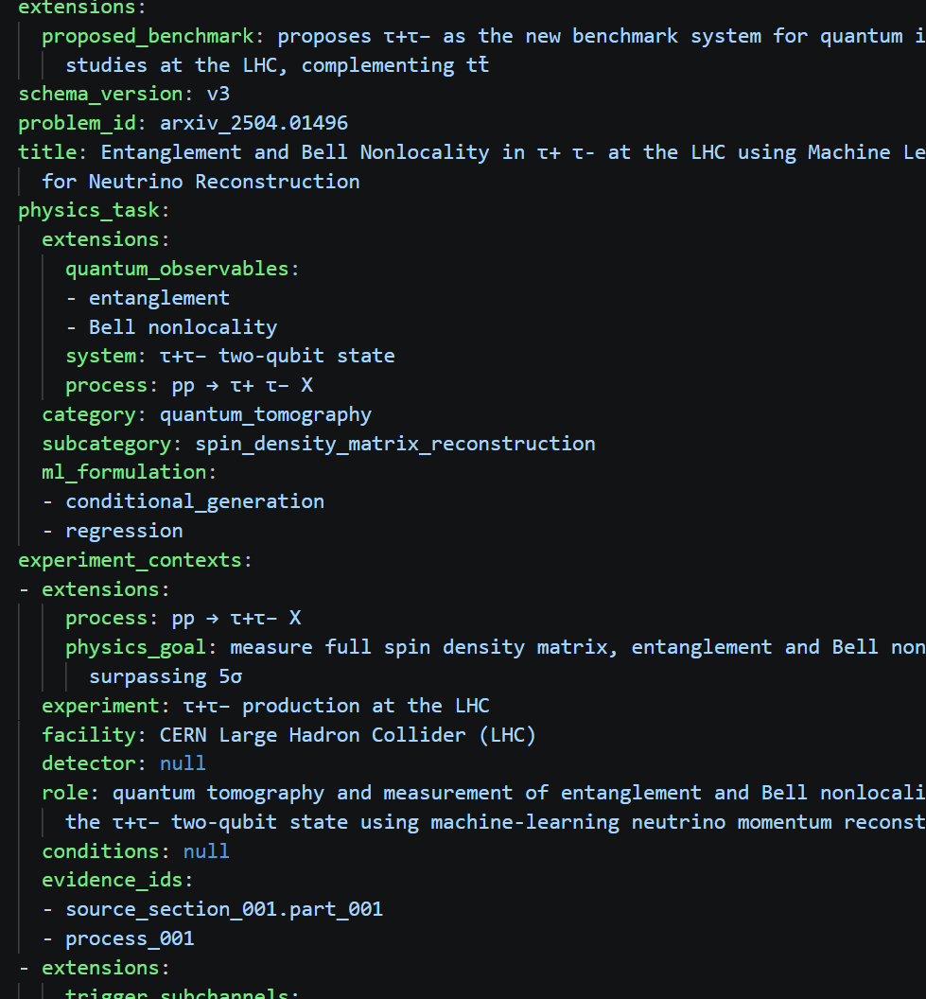
AGENT / EVIDENCE EXAMPLE
Real knowledge-base record: arXiv:2504.01496
The Agent stores a paper as three linked cards, with source and quality information.
Problem
Result
Two undetected neutrinos → underconstrained LHC event.
Goal: spin-density matrix, entanglement, and Bell nonlocality.
~17% average momentum resolution.
6–8% ττ mass resolution; Bell nonlocality above 5σ.
The extracted record concerns entanglement and Bell nonlocality in τ⁺τ⁻ production at the LHC, enabled by machine-learning neutrino reconstruction.
Solution
PET transformer body + diffusion generation head.
DDIM reconstructs the three-momenta of two effective neutrinos.
ML4Jets | Ziyue Chen, IHEP
CG-SFT 11 / 14
CG-SFT 11 / 14

Slide 12
AGENT / REAL PROJECT
A real application: JUNO vertex and energy reconstruction
An Agent-led reconstruction study using MC positron events.
Retrieve
Plan + code
Read prior decisions and baselines.
Inspect PMT hit time, charge, and position.
Write reconstruction scripts.
Run + analyze
Iterate
Submit Slurm jobs.
Compare vertex and energy metrics.
Choose the next direction.
Store decisions and artifacts.
Recorded outcome: about 167 mm position resolution with a classic residual head.
Decision, artifacts, and source paths remain linked.
Research loop: retrieve → plan → code → run → analyze → iterate.
ML4Jets | Ziyue Chen, IHEP
CG-SFT 12 / 14

Slide 13
CONCLUSION / AGENT
Agent conclusion: a closed loop for HEPML research
The Agent keeps the whole research chain connected:
Retrieve → analyze → code → run → metrics → iterate → memory
External evidence
Research memory
The arXiv record preserves problem, method, result, source, and quality state.
The JUNO record preserves what was tried, what worked, what failed, and the next decision.
Research state becomes easier to recover, inspect, and reuse.
Scientific review remains necessary.
ML4Jets | Ziyue Chen, IHEP
CG-SFT 13 / 14

Slide 14
CONCLUSION / OVERALL
Overall conclusion and outlook
CG-SFT
HEPML Agent
CG-SFT is highly effective.
It greatly improves LLM classification in a specific domain.
HEP + ML knowledge base built from curated literature.
Self-iterating HEPML Agent developed.
Next: stronger label-quality checks, broader evaluation, better evidence retrieval, and transfer to more HEPML tasks.
Thank you · Questions and discussion
ML4Jets | Ziyue Chen, IHEP
CG-SFT 14 / 14

