Slide 1
Variational Quantum Classification Heads for Particle Transformer-Based in Jet Tagging
Nadia Ahmed Sharna*
Bursa Technical University, Turkiye
Dr. Izzet F. Senturk
Bursa Technical University, Turkiye

Slide 2
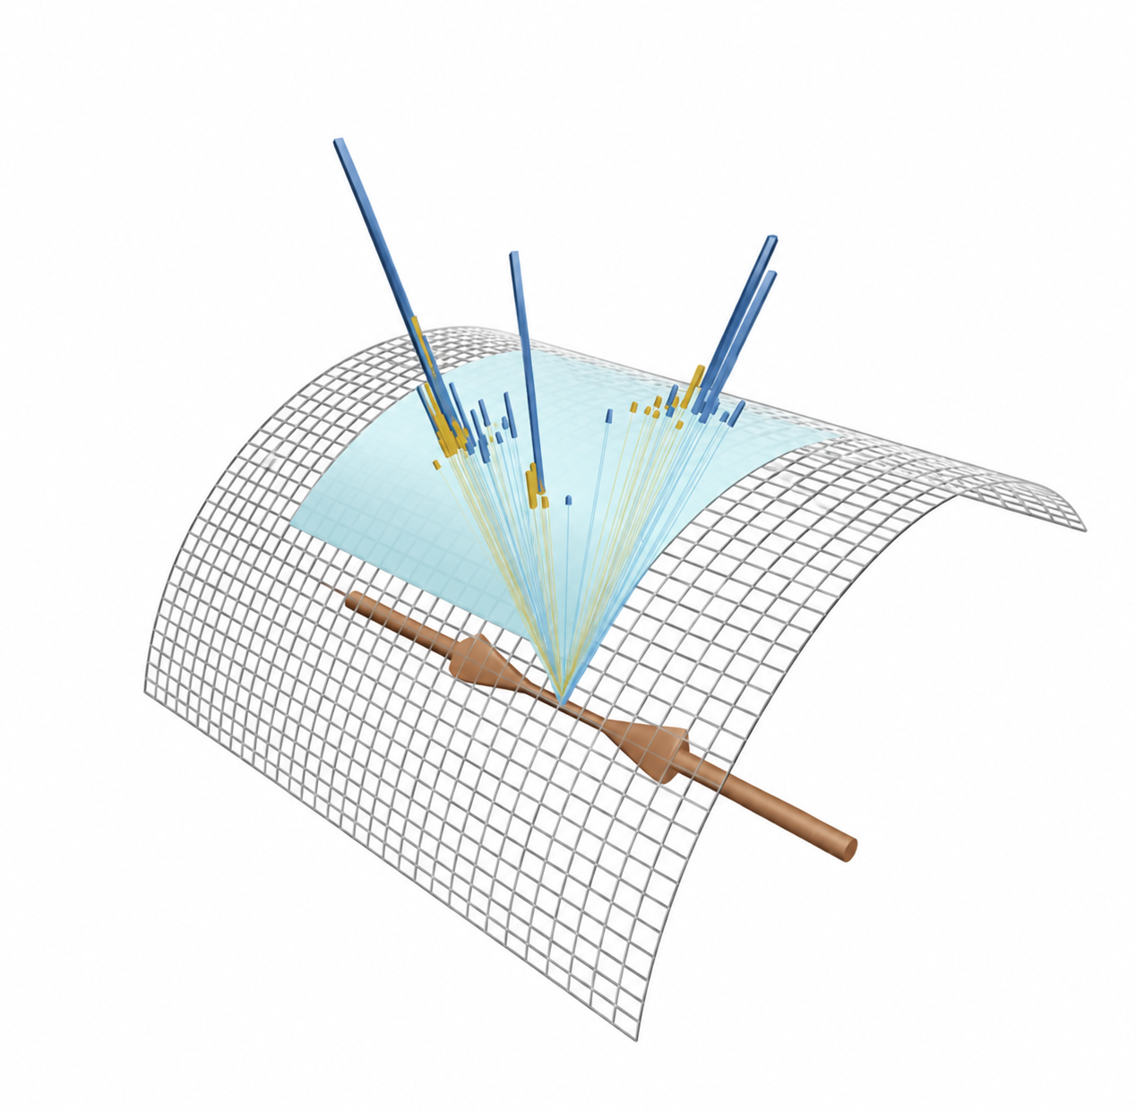
Can a small Variational Quantum Circuit act as a useful classification head on top of Particle Transformer representations?
Main distinction to preserve:
Classifier-head performance vs. information lost by compressing 128 ParT features to only 4–8 dimensions/qubit

Slide 3
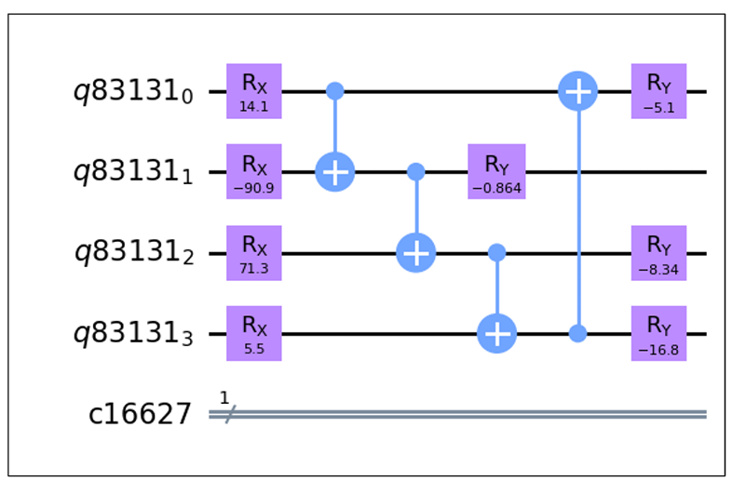
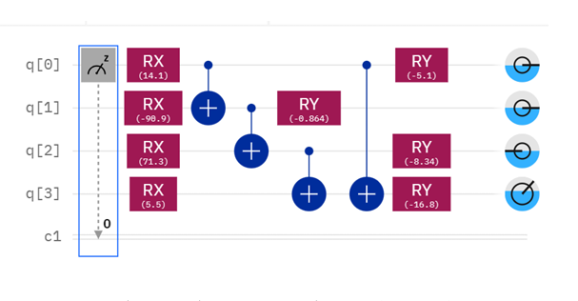
Quantum Variational Circuit
Quantum gates have adjustable parameters
Initial State / Data Encoding
The Ansatz (quantum circuit architecture containing tunable gates)
Measurement & Cost Function
Classical Optimizers
Fig 1.1 Typical variation circuit diagram
Fig 1.2 The circuit diagram generated in IBM Quantum Composer

Slide 4
Question for every reconstructed jet:
what produced this spray of particles?
Why JetTagging?
Jets encode the initiating particle or process.
Substructure carries correlations among constituents
Collider searches require robust signal–background separation
QCD
background-like jets
Hbb / Wqq / Tbqq
selected signal-like categories
Notes:
A variational circuit (also known as a parameterized quantum circuit) is a quantum circuit where some of the gates have adjustable parameters, such as rotation angles. It forms the backbone of modern hybrid quantum-classical algorithms.Instead of relying on a fixed set of operations, it acts like a trainable neural network, blending quantum processing with classical computing to solve problems

Slide 5
JETCLASS DATASET
JetClass is a new large-scale dataset that consists of 100M jets. The dataset contains 10 classes of jets.
Tasks
Binary | Multiclass
QCD vs Hbb | QCD Hbb Wqq Tbqq
CONTROLLED EVENT SELECTION
Constructed a fixed master pool using the global reproducibility seed.
We assigned fixed train, validation, test roles before downstream model comparisons

Slide 6
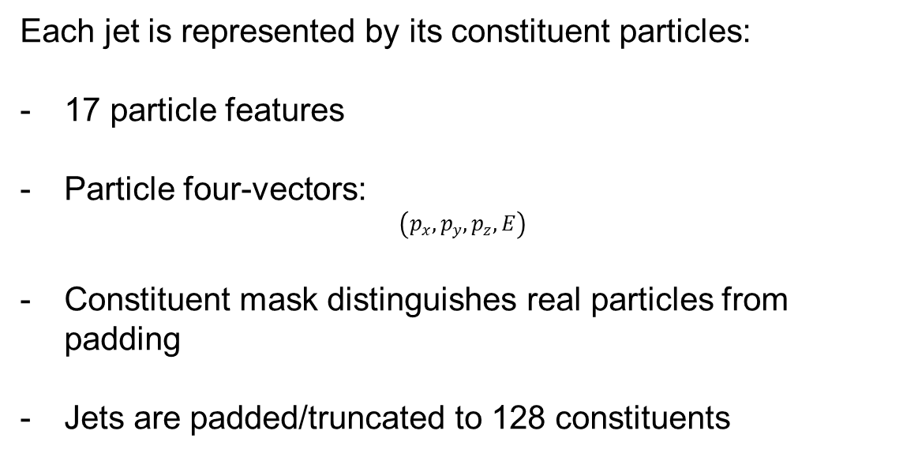
From a Jet to Particle-Level Model Inputs
Each jet is represented by its constituent particles:
17 particle features
Particle four-vectors:
$$\left(p_{x} , p_{y} , p_{z} , E\right)$$
Constituent mask distinguishes real particles from padding
Jets are padded/truncated to 128 constituents

Slide 7
Particle Transformer as a Frozen Feature Extractor
Load pretrained Particle Transformer (ParT)
Original pretrained weights retained
Original classification layer removed
Replace final classifier with Identity
Set model to evaluation mode
Disable gradients for all ParT parameters
Pretrained ParT
Particle inputs
Transformer blocks
Learned jet representation
Original classifier

Slide 8
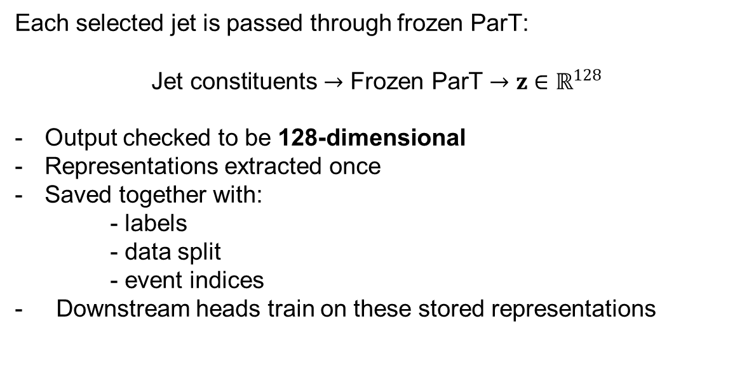
Frozen Feature Extraction
Each selected jet is passed through frozen ParT:
$$\text{Jet constituents}→\text{Frozen ParT}→z∈ℝ^{128}$$
Output checked to be 128-dimensional
Representations extracted once
Saved together with:
  - labels
  - data split
  - event indices
- Downstream heads train on these stored representations

Slide 9
Two Representation Branches
COMPRESSED REPRESENTATION
Start from 128-D ParT vector
Fit PCA on TRAINING data only
128-D → d-dimensional bottleneck
d ∈ {4,5,6,7,8}
99th-percentile angle scaling
Clip to [-1,1]
Multiply by π
Final range ≈ [-π, π]
UNCOMPRESSED CONTROL
Start from original 128-D vector
Standardize using TRAINING data only
Keep all 128 features
Purpose: measure how much performance is lost due to compression

Slide 10
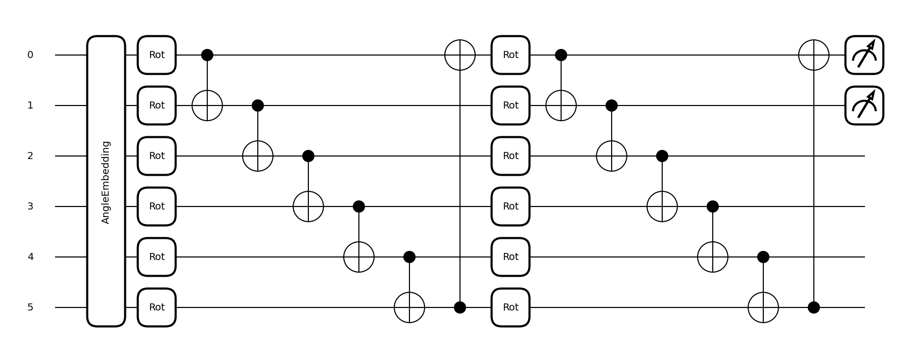
Variational Quantum Classification Head
Fig 2.1 Core variational circuit diagram
Notes:
Our implementation uses Y-angle embedding, trainable Rot gates, CNOT-based entanglement and Pauli-Z expectation measurements

Slide 11
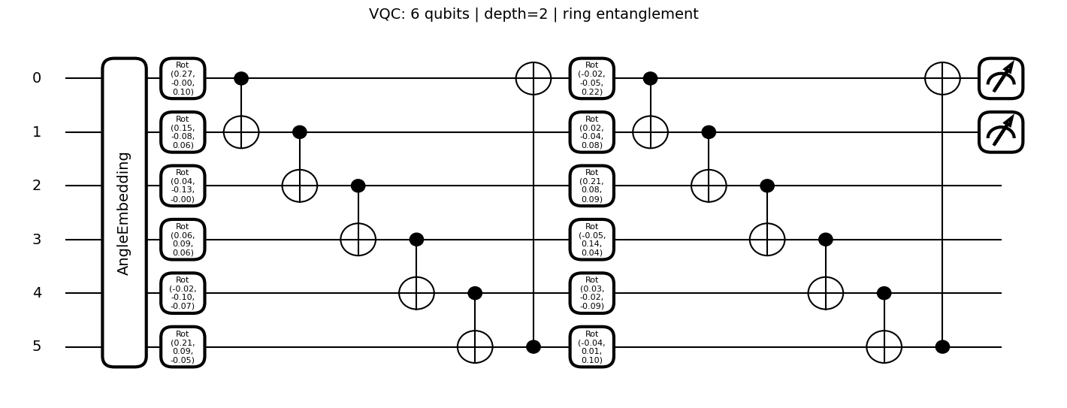
Quantum Model Configuration
Baseline
6 qubits
Circuit depth = 2
Ring entanglement
Analytic statevector simulation
PennyLane default.qubit
shots=None
Backpropagation through
the simulator
Trainable parameters
Each qubit has 3 trainable rotation parameters per layer:
𝑁_𝜃=3𝑛𝐿
Fig 2.2 Our actual 6-qubit / two-layer circuit

Slide 12
Model Training Procedure
Initialize model
Cross-entropy classification loss
Adam optimizer
Mini-batch training
Validation loss monitored after each epoch
Early stopping prevents unnecessary training
Best validation model restored before test evaluation
Train
Validate
Select best state
Select best state

Slide 13
Evaluation Metrics
Classification
Accuracy
ROC-AUC
Multiclass macro one-vs-rest ROC-AUC
Probability quality
Reliability diagrams
Expected Calibration Error
Brier score
Collider-oriented discrimination
Background rejection at:
50% signal efficiency
80% signal efficiency
Robustness and complexity
Stability across seeds
Trainable parameter count
Training/inference time

Slide 14
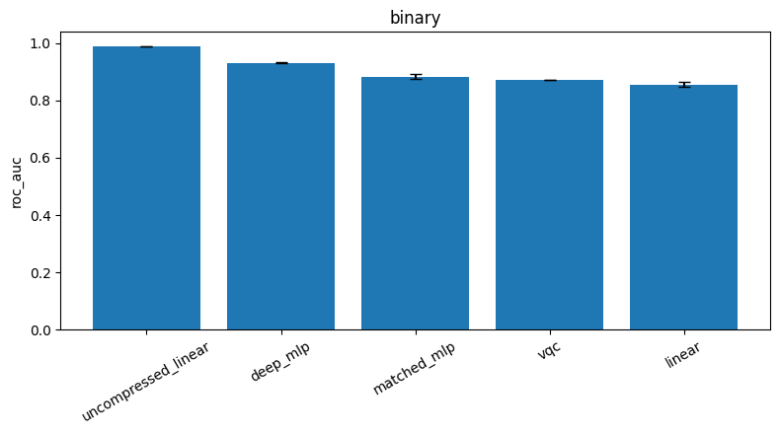
Results
Fig 3.1 Binary ROC-AUC

Slide 15
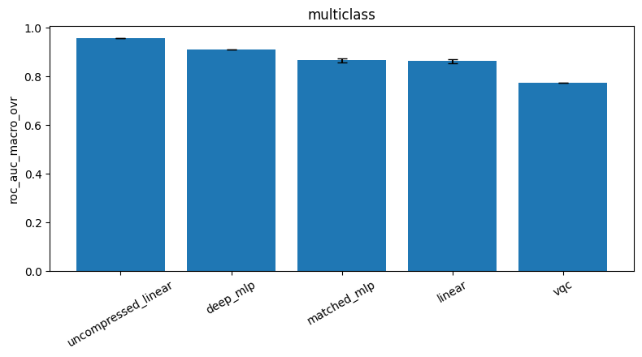
Results
Fig 3.1 Multiclass Macro ROC-AUC

Slide 16
Results
Head | Accuracy | ROC-AUC | ECE | Params
VQC | 0.8038 | 0.8715 | 0.1019 | 36
Compressed linear | 0.7788 | 0.8563 | 0.0609 | 14
Matched MLP | 0.8030 | 0.8838 | 0.0719 | 38
Deep MLP | 0.8562 | 0.9319 | 0.0222 | 2594
Uncompressed linear | 0.9484 | 0.9899 | 0.0325 | 258
Fig 3.3 Accuracy

Slide 17
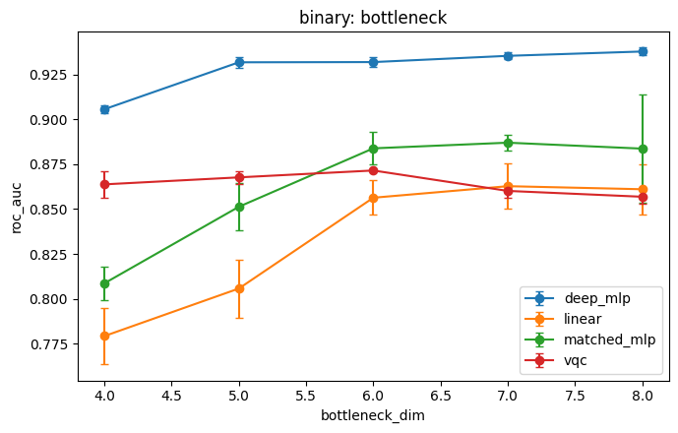
Controlled sweeps

Slide 18
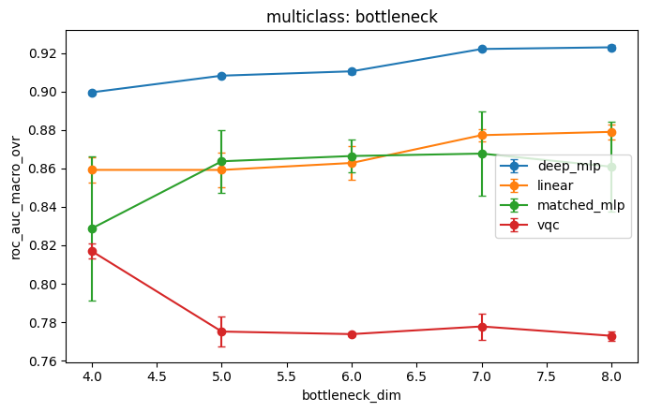
Performance

Slide 19
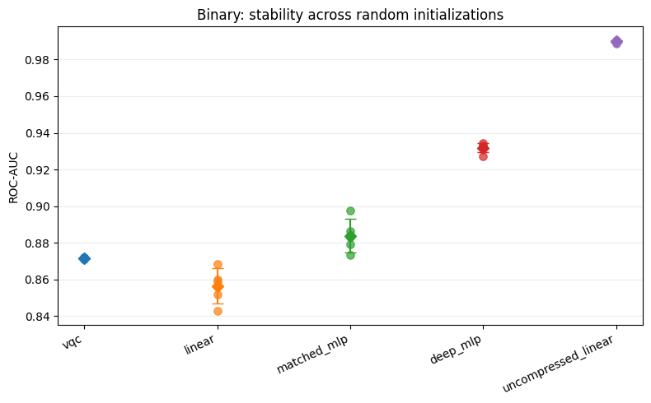
Performance

Slide 20
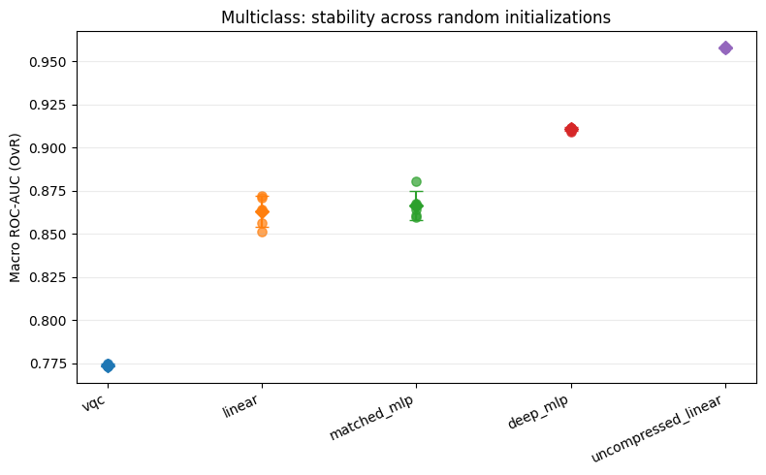
Performance

Slide 21
Takeaway
The aim is not to ask:
“Did the quantum model win?”
Instead, the study asks:
Where is the VQC competitive with classical heads?
Where do classical models retain a clear advantage?
How much performance is limited by representation compression?
Do more qubits, greater depth, or denser entanglement help?
How sensitive are results to random initialization?
What computational cost accompanies greater VQC complexity?

Slide 22
THANK YOU.

Slide 23
Backup

Slide 24
Backup

Slide 25
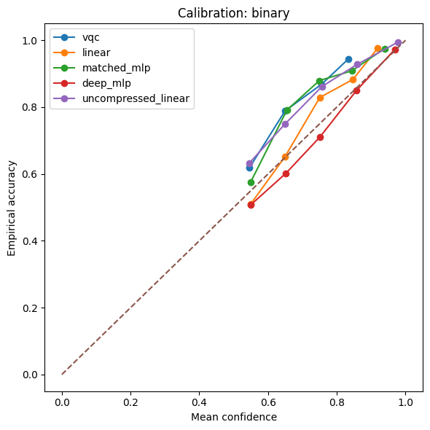
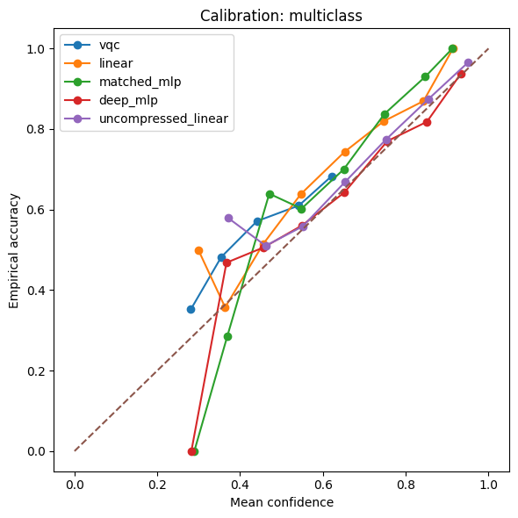
Backup

Slide 26
Backup

Slide 27
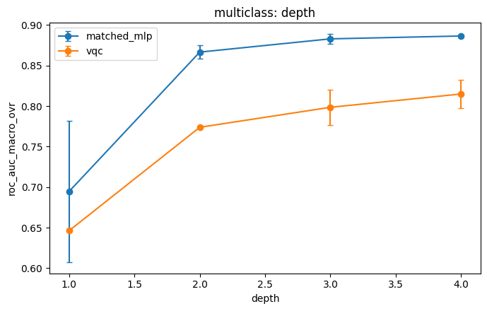
Backup

