Slide 1



MadAgents
Daniel Schiller
16.09.2026, ML4Jets, Vienna
Based on arXiv:2601.21015 and arXiv:2607.22813
With Sascha Diefenbacher, Tilman Plehn and Nikita Schmal

Slide 2

MadGraph
Software:
Usage:
MadAgents:
Advanced capabilities
Documentation
Tool for research
Multi-Agent system as the
smart interface for MadGraph
Collaborators
Limited documentation and user interface
Many unknown settings, even user mistakes
Community support

Slide 3
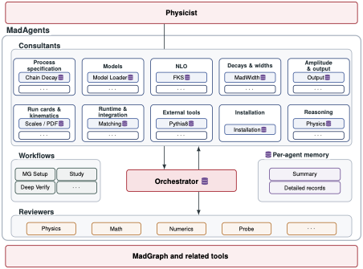
Claude Code, Codex and OpenCode implementation!
MadAgents
Flexibility
Task-dependent orchestration
Reliability
Topic specific experts
Source-code grounding
Efficiency
Agents store learned knowledge
Summary always in context
Details loaded on demand
Guidance
High-level predefined workflows
Verification
Independent domain specific reviews

Slide 4
From intent to a simulation setup
/mg-setup skill for creating a MadGraph setup
1
Frame
2
Classify
3
Build
4
Reconcile
→
→
→
What is the physics request?
What is the physics regime?
Orchestrator invokes consultants and assembles the setup
Compare the physics request to the simulation setup
Physics request
≟
Simulation setup
No error messages ⇏ correct simulation setup

Slide 5
Efficiency and reliability
1 MEMORY
2 WIKI
pointers
Always loaded
Opened on demand
Single file
→
Files with detailed records
Summaries of detailed memories
Avoid past mistakes and retain knowledge
EXAMPLE · A SUB-THRESHOLD DECAY CHAIN
USER TASK
MEMORY ENTRY
WIKI FILE
Set up H → W W*
with a chained decay
→
bw-cutoff-sizing-derivation
→
bwcutoff ≥ (mₚₒₗₑ − m_floor) / Γ_eff
Derive and adjust bwcutoff
Re-read myamp.f and the generated card

Slide 6
Silent Failure Tests
Agents excel at fixing error messages
Incorrect simulation settings may produce no error message
Qwen3.5 27B | w/ MadAgents | w/ trained memory
6/10 | 9/10 | 9/10
0/10 | 2/10 | 5/10
I'm running generate p p > t t~, t > b w+. What are the matrix-element-level final-state particles of each event?
b w+ t~
I'm setting up the LO signal calculation
$$b\overline{b}→A, A→Z h, Z→ℓ^{+}ℓ^{−}, h→b\overline{b}$$
in 2HDM type-II with $m_{A}=170$GeV and the SM-like Higgs is at $m_{h}=125$ GeV. How do I simulate this?
Decay chain + widen bwcutoff

Slide 7




Use cases
Installation
Teaching
inexperienced
users
Advanced
user-support
Autonomous
execution

Slide 8
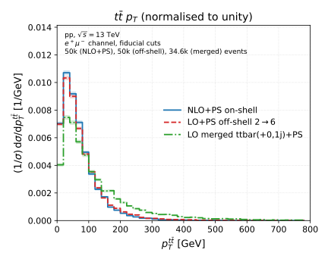
Provide Expert Physics Insight
Advanced user-support
Experienced user has a dataset
Task: precision improvements
Outcome: MadAgents discusses three improvements
Create a plot to visualize the effects

Slide 9
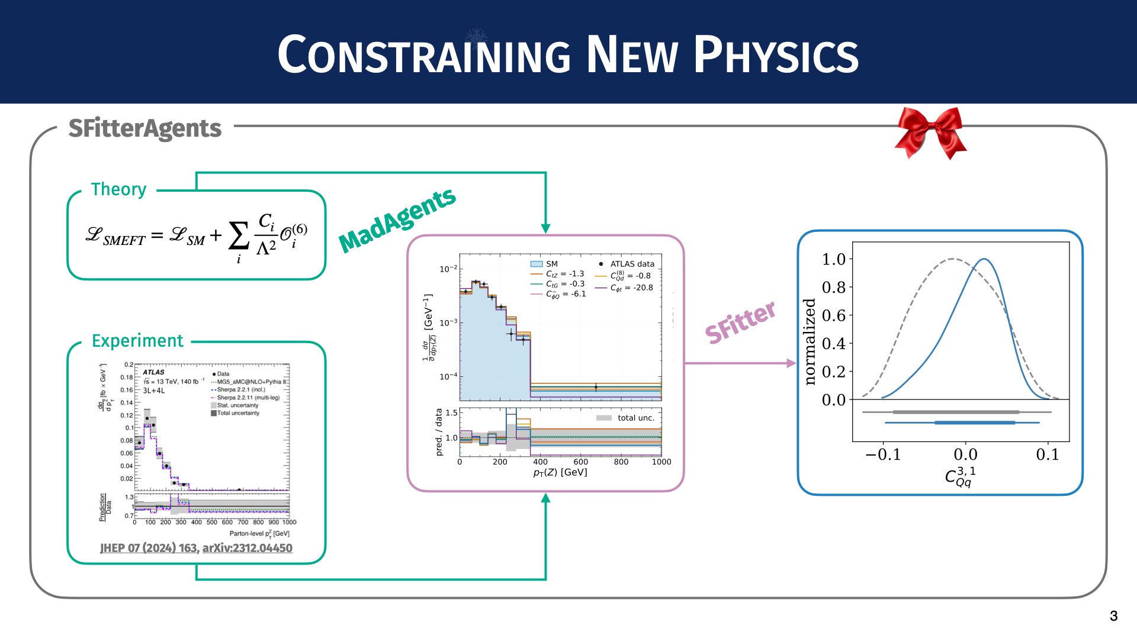
MadAgents in SFitterAgents
Autonomous execution
[Credit: Nikita Schmal]

Slide 10
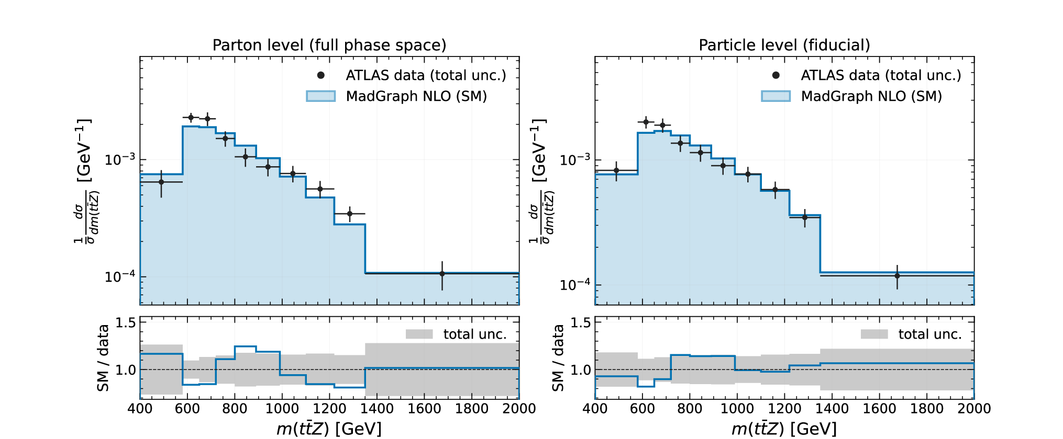
SM regeneration
Physicist in the loop!
Published measurements
→
MadGraph
→
SM baseline

Slide 11
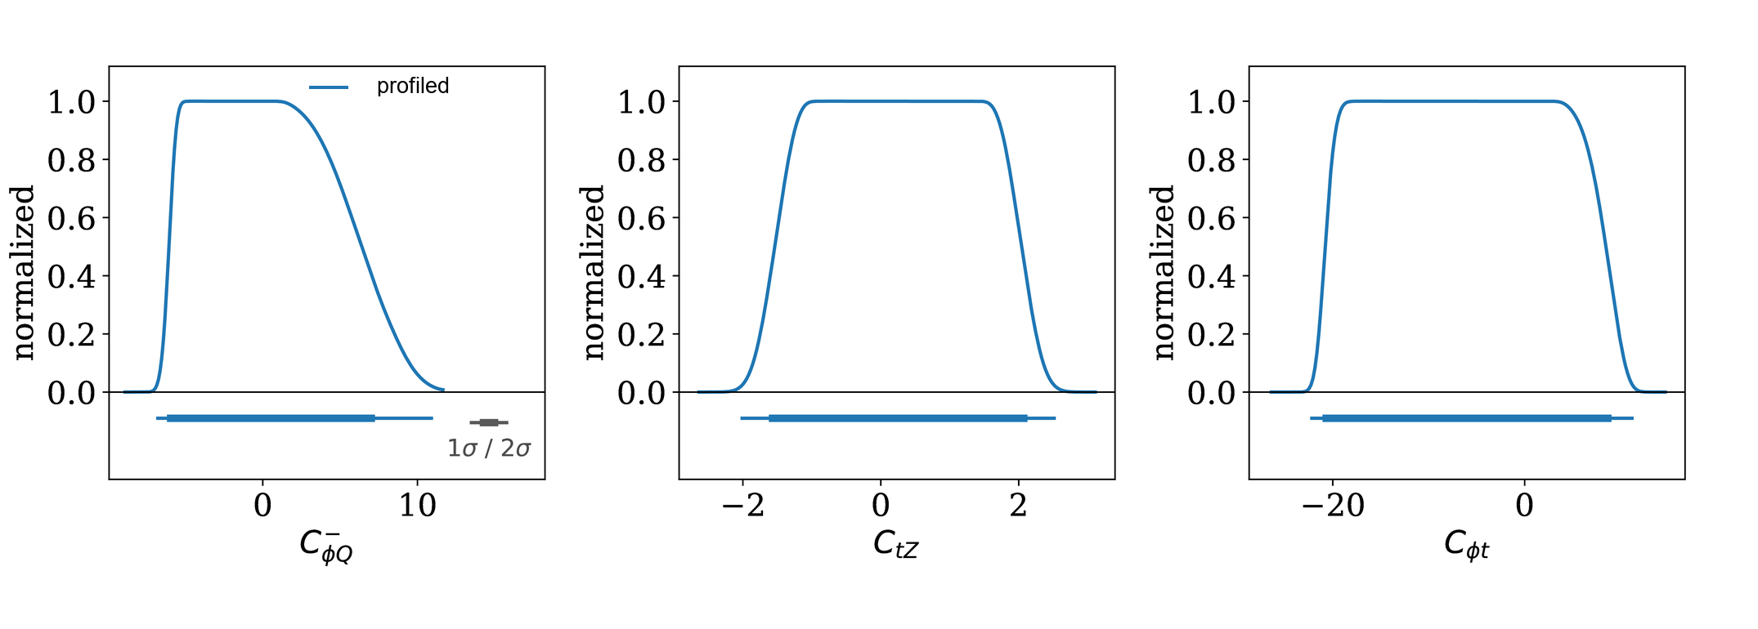
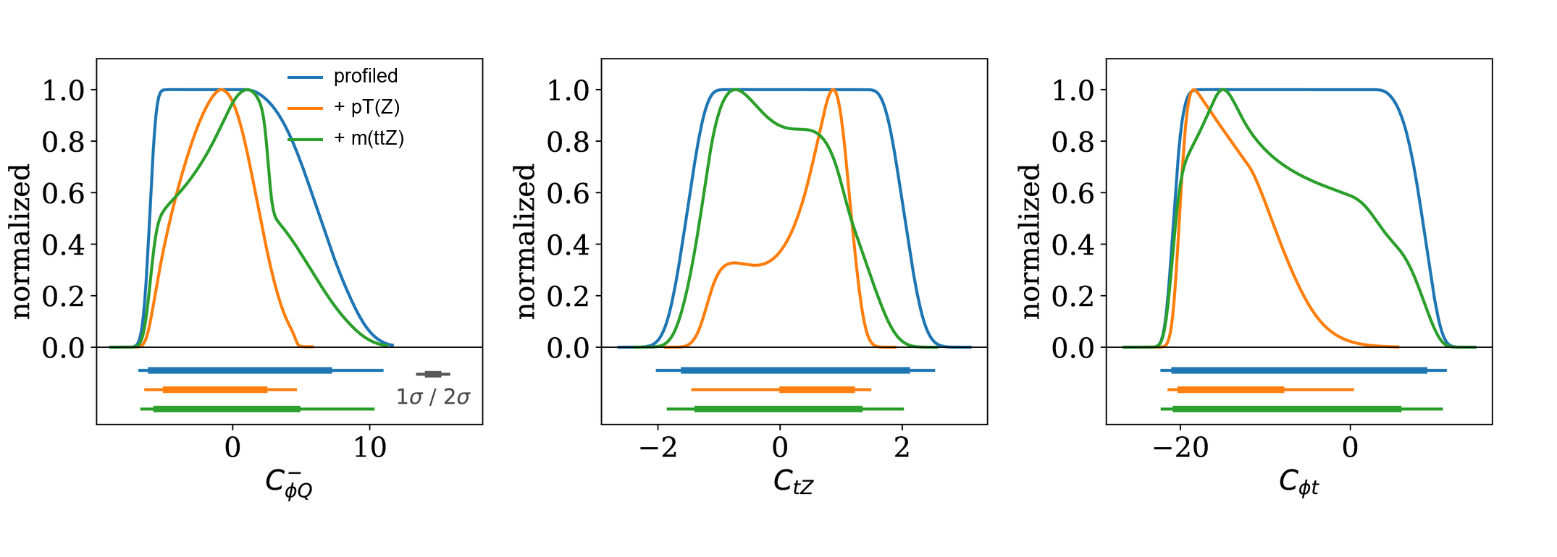
SFitter inference
SMEFT simulation
→
SFitter
→
Wilson coeff. constraints
new measurements

Slide 12
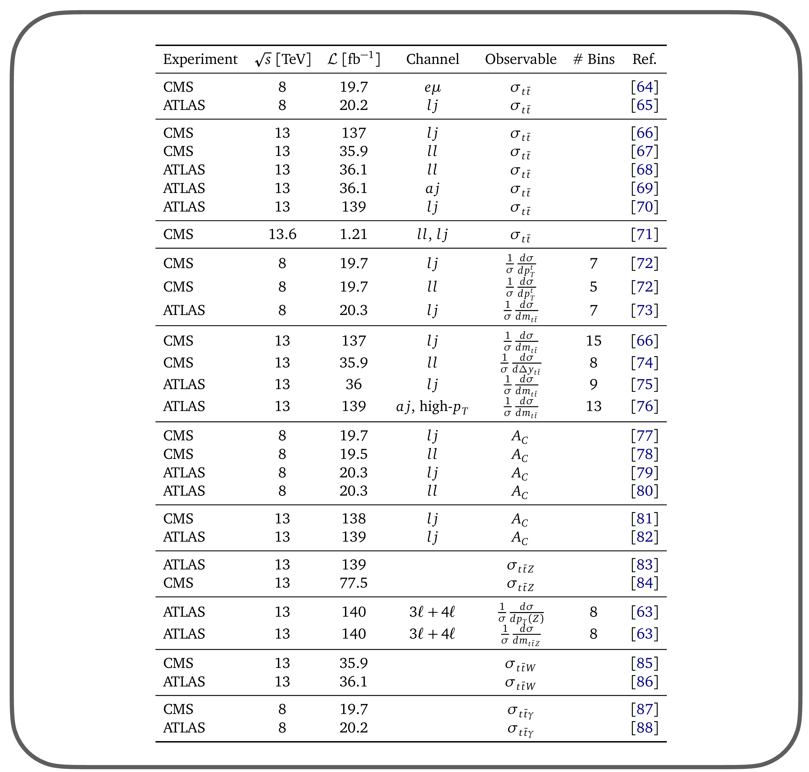
Combining all measurements
From many measurements
to global fits
Agents can easily handle published measurements and likelihoods

Slide 13


Conclusion
MadAgents: smart interface for MadGraph
Teaching
Workflow acceleration
MadAgents
SFitterAgents
Expert-level support
Extends to global analyses
Increase the speed of scientific progress
Papers: arXiv:2601.21015, arXiv:2607.22813
Code Repo: github.com/MadGraphTeam/MadAgents
Claude Code, Codex and OpenCode implementations exist!

