Slide 1
Student Symposium
Rethinking Medical English Education in Japan:
Bridging Educational Gaps through
Student-Expert Collaboration
Alex Seiji Anderson^{※1, 2}, Yuki Kobayashi^{※1, 3}, Akihiro Ono^{※1, 4},
Mayumi Rossi^{1, 5}, Masayuki Nogi^{6, 7}, Hiroto Kitahara^{1, 8}, Takayuki Oshimi⁹
※ Alex Seiji Anderson, Yuki Kobayashi and Akihiro Ono contributed equally to this work.
Team WADA (Non-Profit Organization)
Asahikawa Medical University School of Medicine, JPN
Tohoku University School of Medicine, JPN
Mie University School of Medicine, JPN
University College London Hospitals NHS Foundation Trust, UK
Kameda Medical Center, JPN
Queen’s Medical Center, USA
The University of Chicago Medicine, USA
International University of Health and Welfare, JPN

Slide 2
COI Disclosure
The 29th JASMEE Academic Meeting Disclosure of Conflicts of Interest
Name of Presenters:
Alex Seiji Anderson, Yuki Kobayashi and Akihiro Ono
We have nothing to disclose.

Slide 3
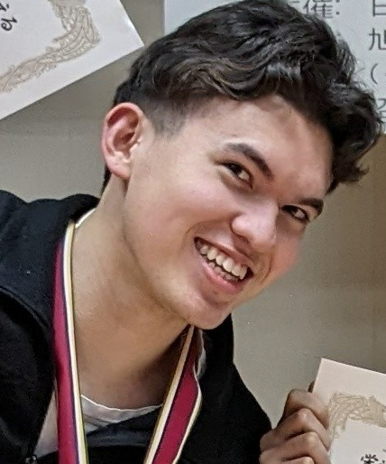
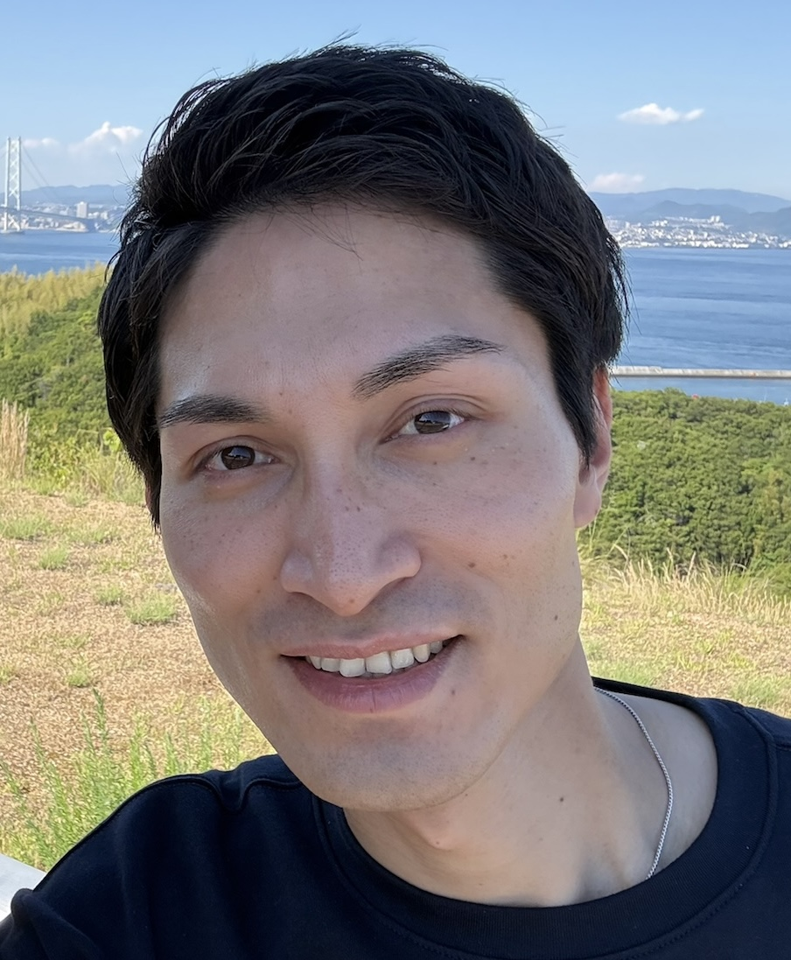
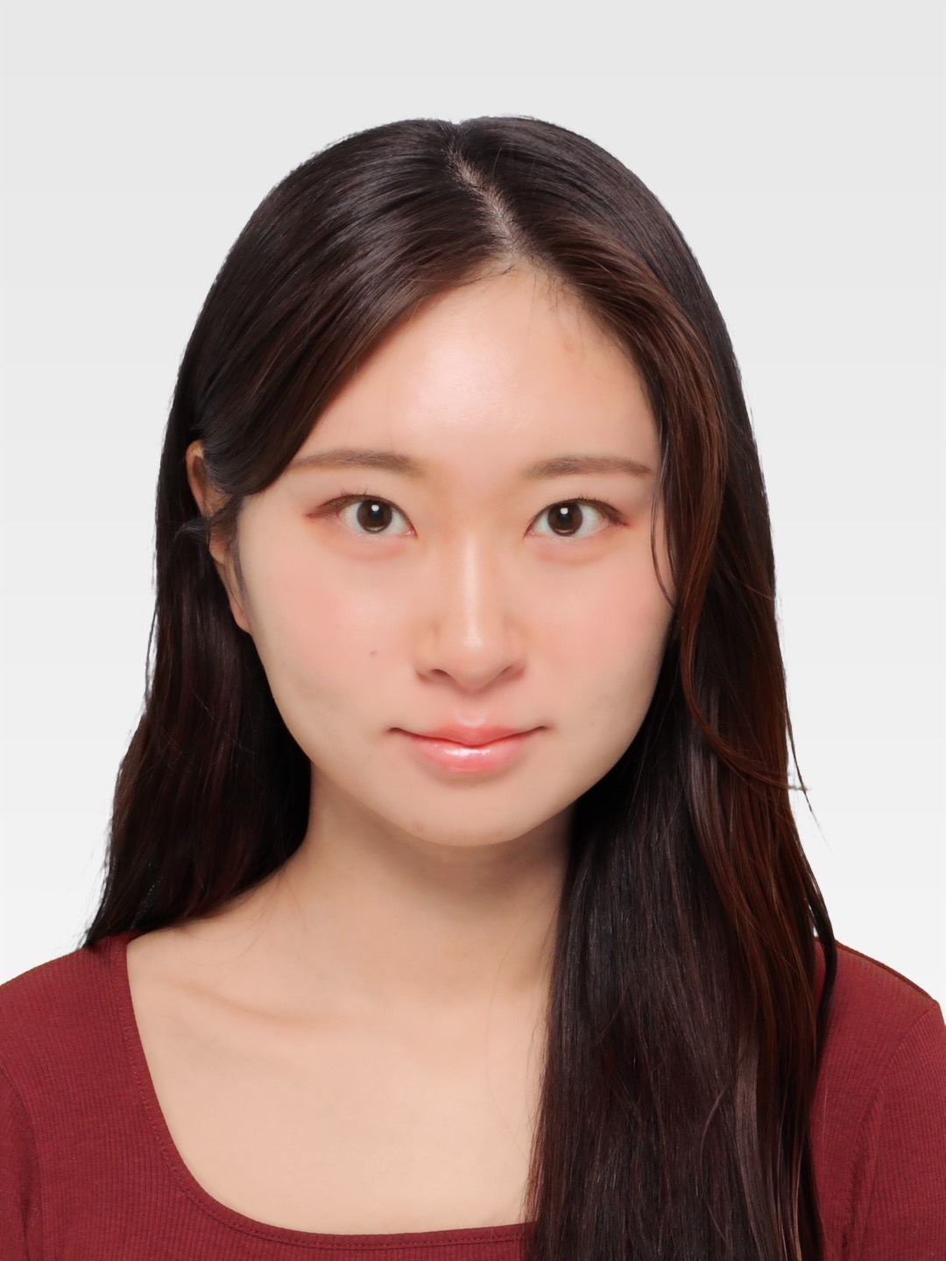
Today’s Agenda
01
02
03
How Team WADA can bridge educational gaps for medical English
Clinical reasoning training
at Clinical Dojo
Current status and future potential of Medical English Education
Alex Seiji Anderson
Akihiro Ono
Yuki Kobayashi

Slide 4
01
How Team WADA can bridge
educational gaps for medical English
Notes:
By sharing student perspectives and survey findings, we hope to stimulate discussion among medical English educators regarding current challenges and potential strategies for improving medical English education in Japan.

Slide 5
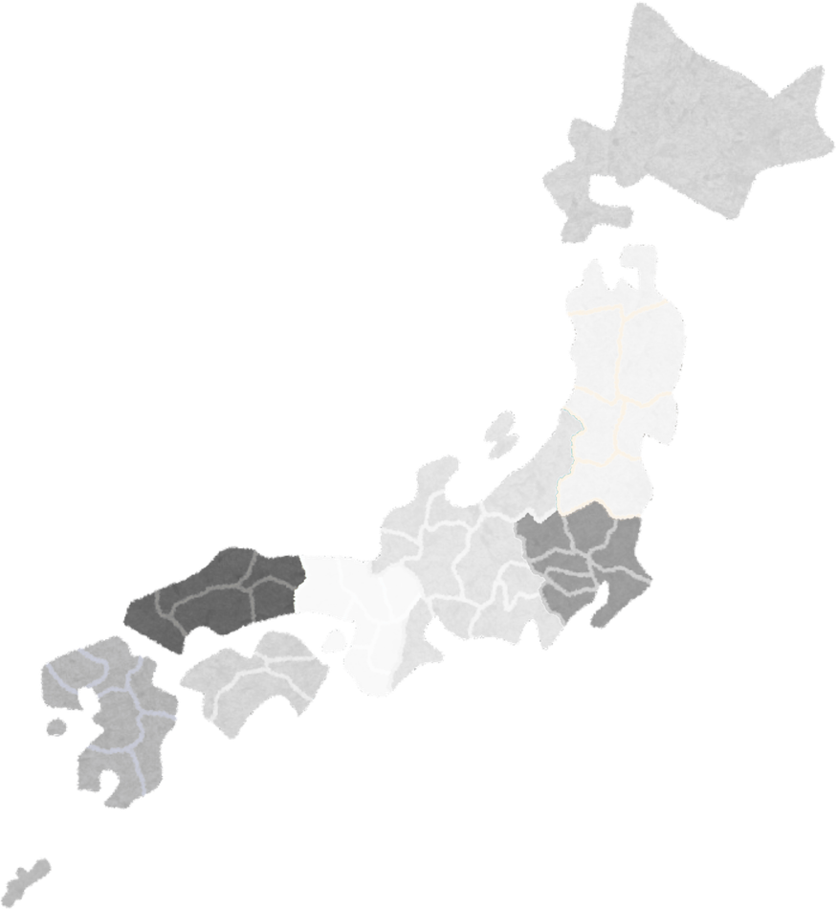
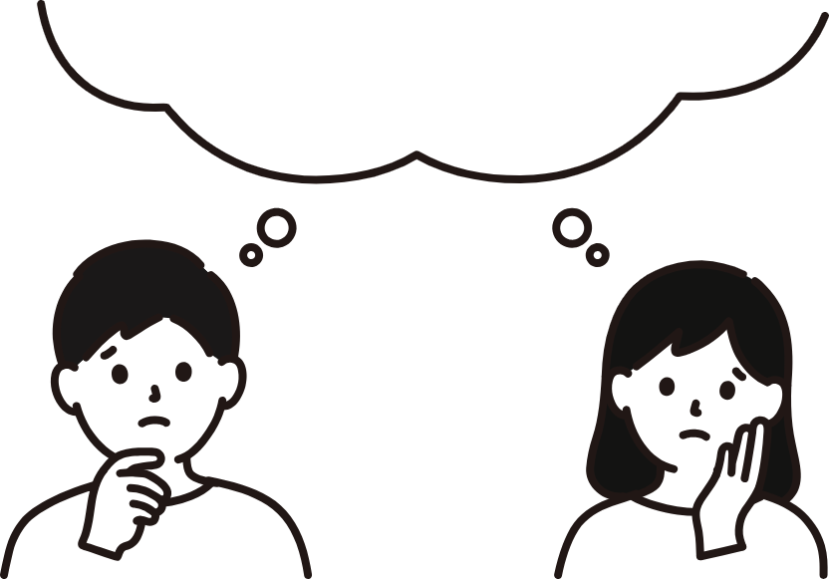
Different curriculum in Medical English Education
Medical English education in Japan varies considerably across institutions, reflecting differences in curricular priorities and available faculty expertise.
While many universities provide introductory instruction, opportunities for more advanced or internationally oriented training may be limited in some settings.
As a result, some highly motivated students seek additional learning opportunities outside their formal curricula.
日本医学英語教育学会. 医学教育分野別評価基準日本版（グローバルスタンダード）に対応するための医学英語教育ガイドライン. 2015

Slide 6
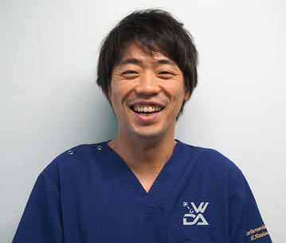

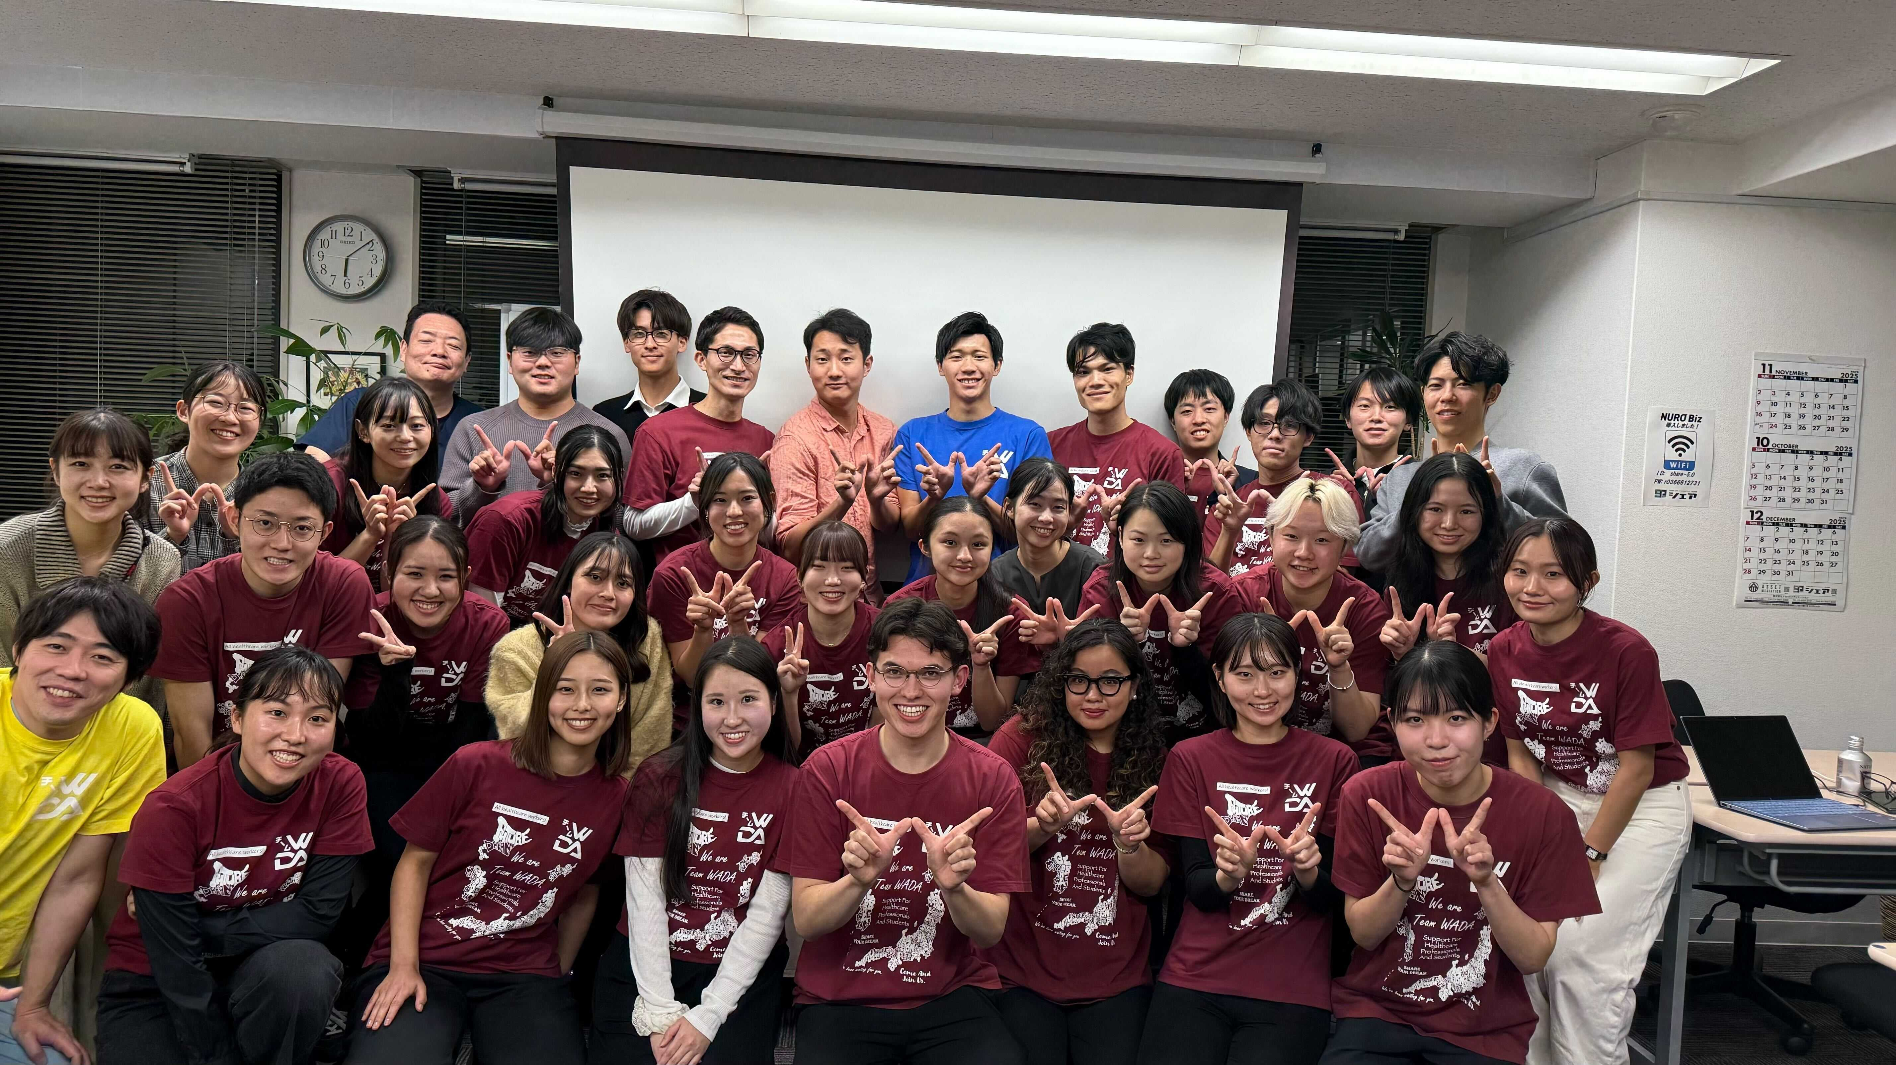
Team WADA
A community for Japanese healthcare professionals and students who aspire to work internationally
Members:
Around 170 students from more than 60 schools
Led by Dr. Hiroto Kitahara,
a cardiac surgeon at the University of Chicago.
Also known as a social media influencer
333,000 subscribers
1247 videos
378,481,661 views

Slide 7

Team WADA 3 pillars
Providing real-time information on studying and working abroad
Creating opportunities for networking and community exchange
Promoting medical English education
Notes:
lower the psychological barriers to studying abroad and mastering medical English. By providing an environment where members can learn from real-world, international insights and grow alongside like-minded peers, we strive to broaden the global perspectives of Japanese healthcare professionals and students, fully supporting each individual’s career advancement.
We are driven by the belief that the global stage should not be reserved for a select few, but should be accessible to anyone with the ambition to challenge themselves. To realize this future, we remain committed to delivering the latest information and resources every day.

Slide 8
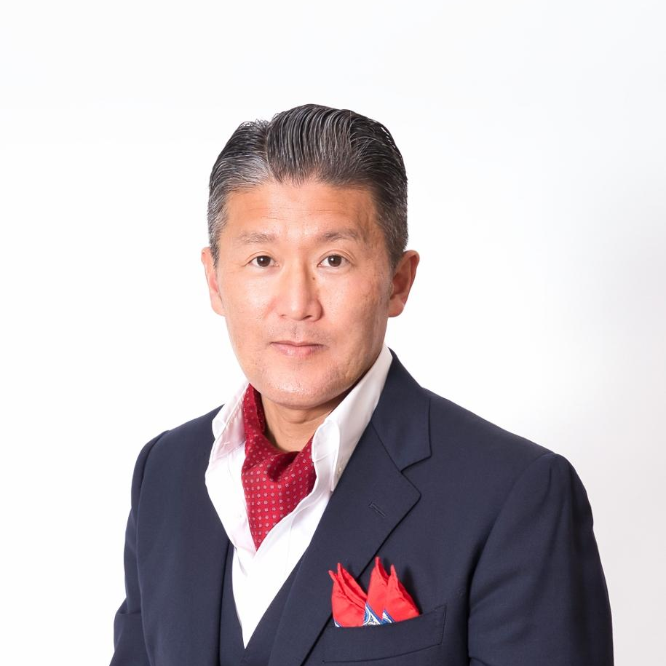
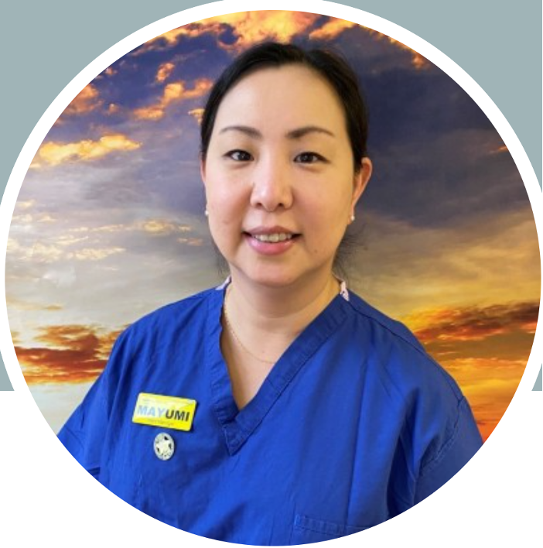
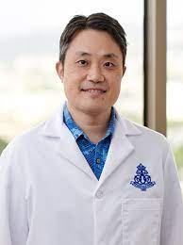
Collaboration with medical experts
Clinical Dojo
Team WADA MEDS
Study with Ns. Rossi
Takayuki Oshimi, MD
International University of Health & Welfare
Ns. Mayumi Rossi
University College
London Hospitals NHS
Masayuki Nogi, MD
Kameda Medical Center
Queen’s Medical Center

Slide 9

Roadmap for Medical English Education
Dr. Nogi
Clinical Dojo
Clinical Reasoning
Ns. Rossi
Study with Ns. Rossi
Dr. Oshimi
Medical Interview
Team WADA MEDS
Learn essential medical English

Slide 10
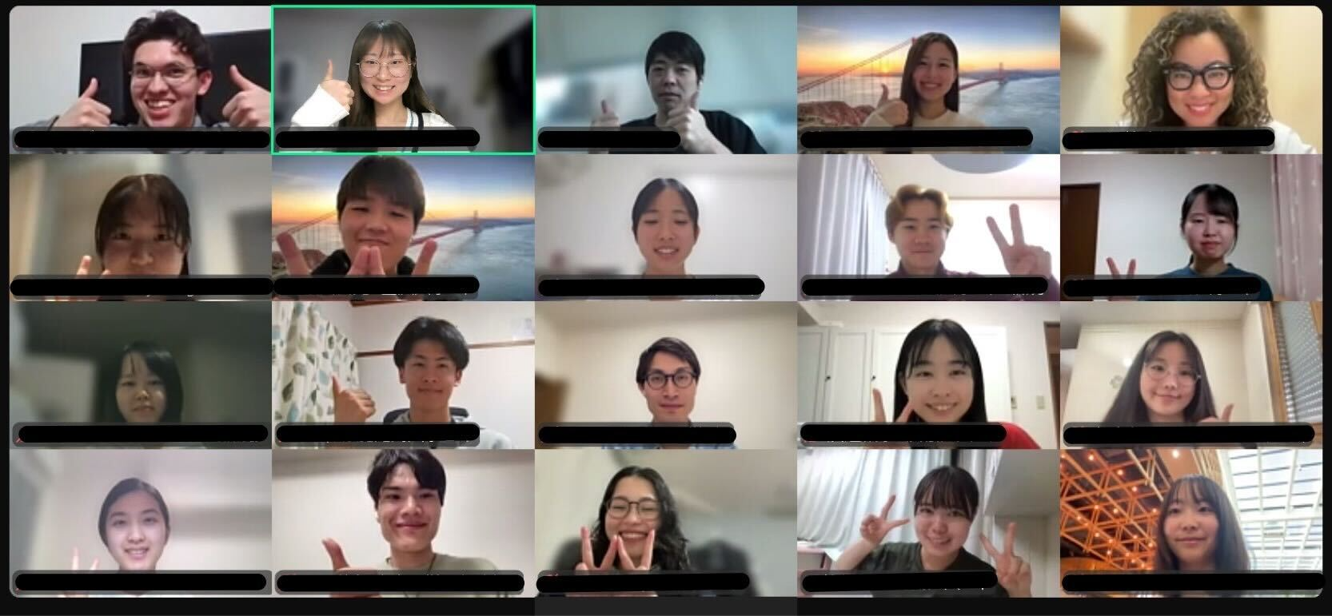
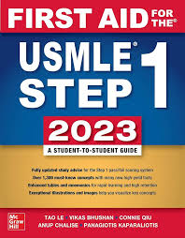

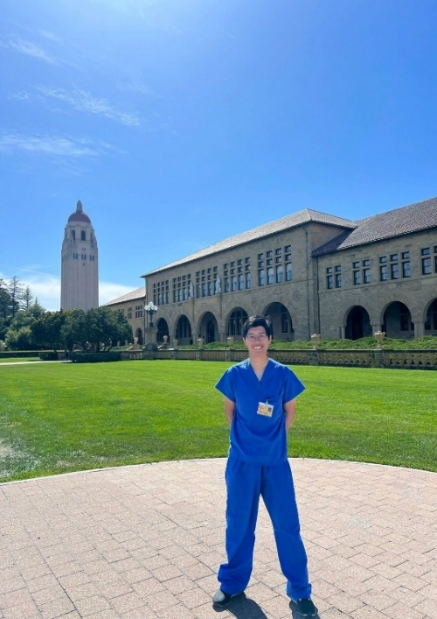

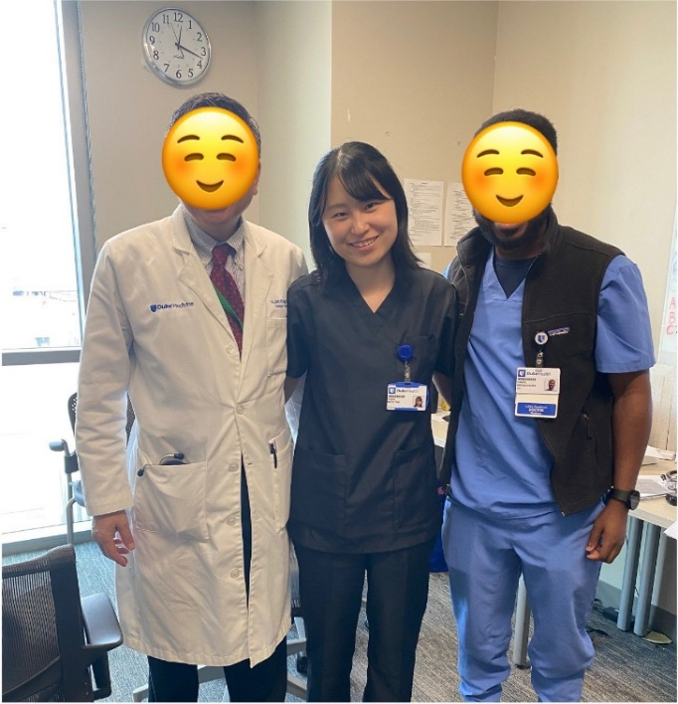
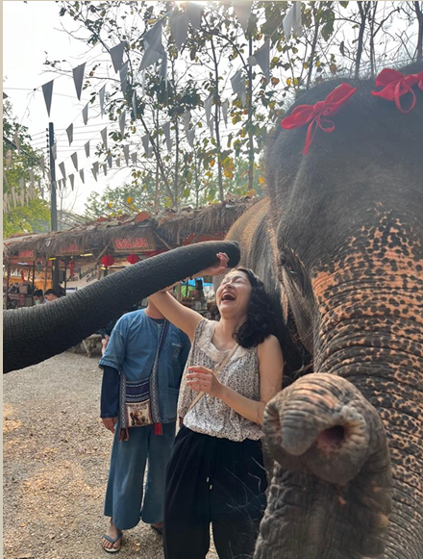
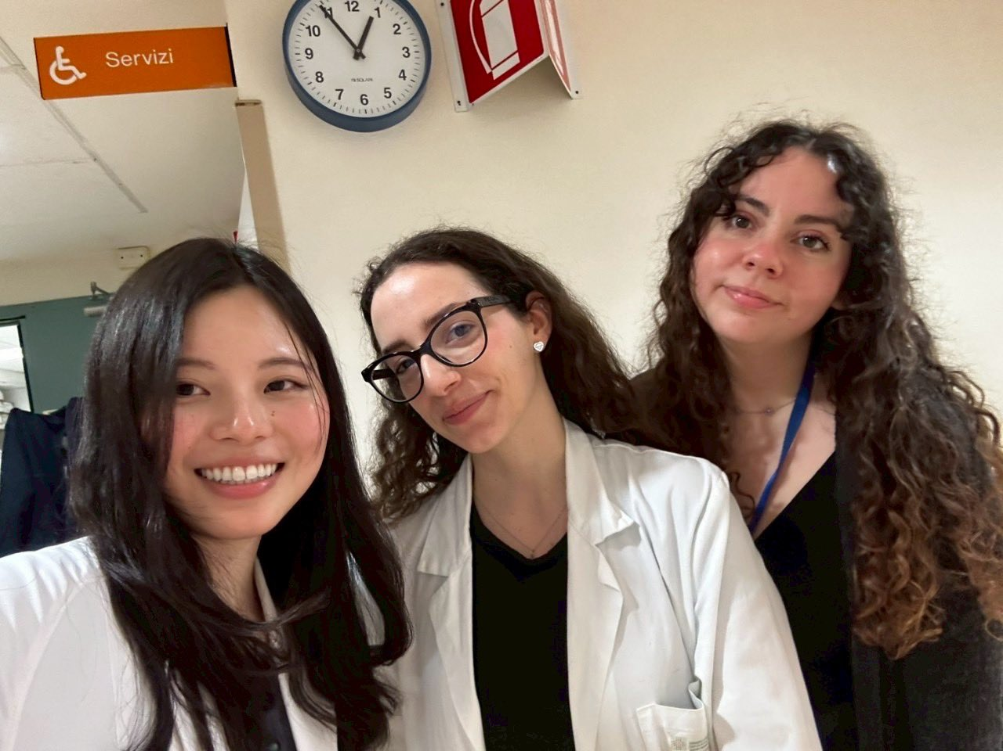
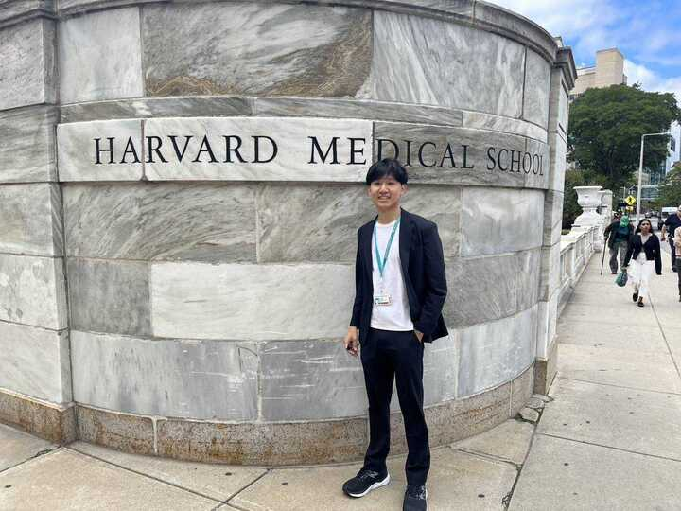
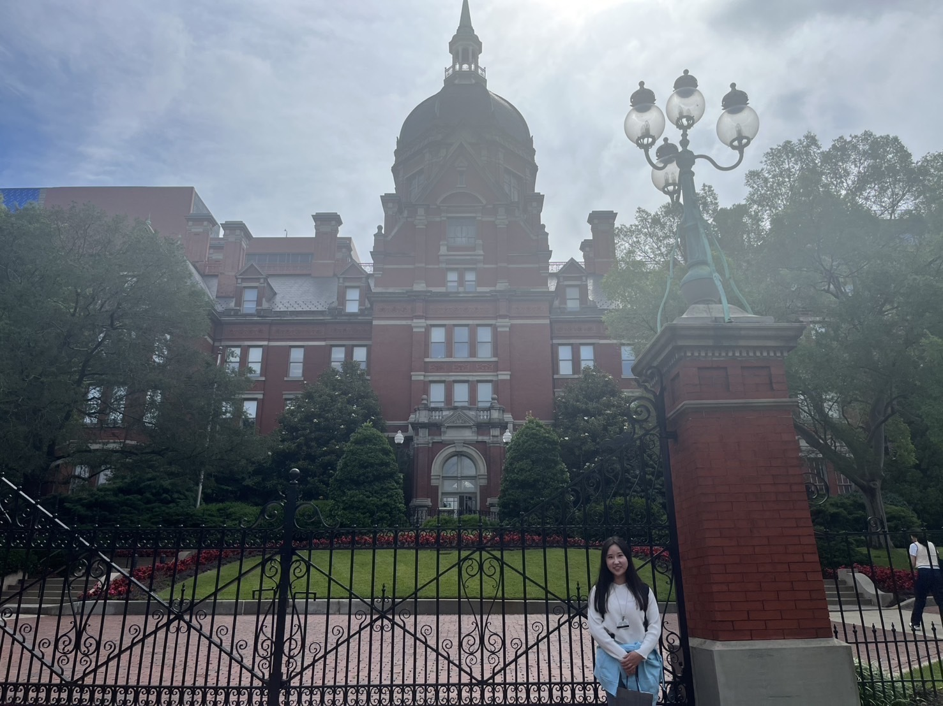
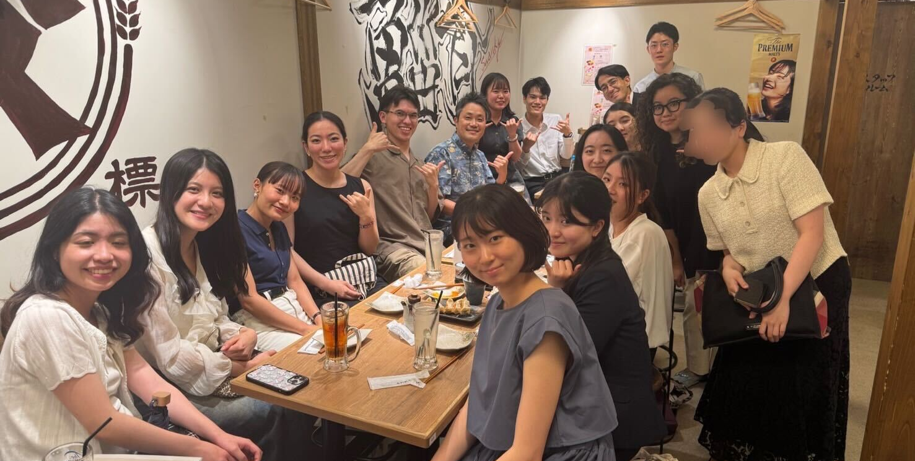
Student-led Activities
Present monthly reports on
study-abroad experiences.
Student members organize
USMLE study group.
Promoting peer learning
and networking across
institutions.

Slide 11
Summary
① Online Community:
Online activities allow students to engage from various regions and universities.
② Continuous Member Inflow
Dr. Kitahara’s active presence on SNS and YouTube attracts a steady influx of new students.
③ Student-Expert Collaboration
Functions as a systemic solution to bridge institutional gaps and elevate the national standard of medical education in Japan.
Team WADA has the potential to empower
the next generation of global clinicians.

Slide 12
02
Medical English Training at Clinical Dojo
Notes:
By sharing student perspectives and survey findings, we hope to stimulate discussion among medical English educators regarding current challenges and potential strategies for improving medical English education in Japan.

Slide 13
Clinical Dojo: A Personalized Extracurricular Learning Opportunity to Complement Standardized Formal Curricula
Akihiro Ono^{1, 2}, Hibiki Yamazaki^{1, 3}, Yui Okamura^{1, 4}, Kana Kaburagi^{1,5}, Kota Tokunaga⁶, Masayuki Nogi^{7, 8}
Team WADA (Non-Profit Organization)
Mie University School of Medicine, JPN
Juntendo University Faculty of Medicine, JPN
University of Tsukuba School of Medicine and Health Sciences, JPN
Jikei University School of Medicine, JPN
Fujita Health University Hospital, JPN
Kameda Medical Center, JPN
Queen’s Medical Center, USA

Slide 14
Clinical Dojo supports clinical reasoning and English clinical communication.
Clinical reasoning and clinical communication are essential competencies for medical students. (Cooper et al., 2021; AAMC, 2014)
English for Medical Purposes has become an important component of undergraduate medical education. (Muthukumar et al., 2025)
Extracurricular activities provide additional educational opportunities beyond the formal curriculum. (Kim et al., 2023)
↓
Clinical Dojo
A student-led extracurricular program for learning clinical reasoning and English clinical communication

Slide 15
Clinical Dojo combines student preparation with expert-supervised case discussion.
Program features
Student-led
Real patient cases
Supervised by a U.S. board-certified hospitalist
Interactive feedback
Learning process
Before the session
Chief complaint shared in advance
Student-led preparation session
↓
During the session
History taking / physical examination
Clinical reasoning
Case presentation
↓
After the session
Expert feedback

Slide 16
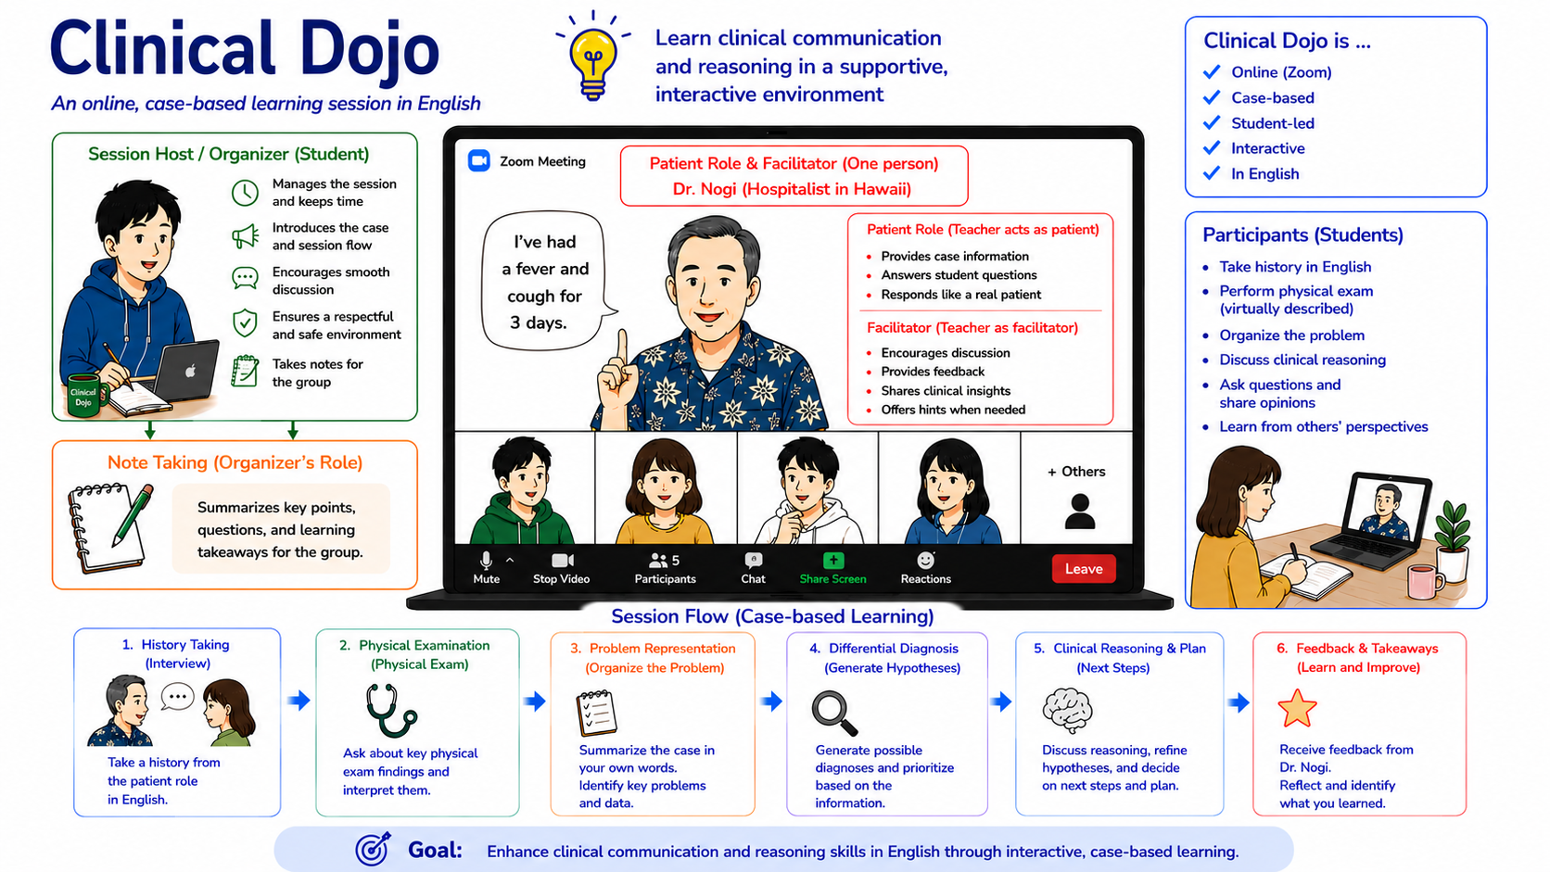

Slide 17
We evaluated participants' perceptions using a questionnaire survey.
Design: Anonymous post-participation online questionnaire
Target population: Clinical Dojo participants (January 2024 – May 2026)
Eligible participants: n = 102
Responses: n = 32 (Response rate: 31.4%)
Scale: 5-point Likert scale
1 = Strongly disagree, 2 = Disagree, 3 = Neutral, 4 = Agree, 5 = Strongly agree
Domains:
  1. History taking (four questions)
  2. Physical examination (four questions)
  3. Problem representation (three questions)
  4. Clinical reasoning (five questions)
  5. Confidence / Self-Efficacy (five questions)
  6. Educational effectiveness (five questions)
Free-text comments

Slide 18
Clinical Dojo attracted learners from diverse educational backgrounds.
Participant Characteristics (n = 32)
Training level
Participation style
Overseas clinical electives

Slide 19
Participants perceived improvements across multiple educational domains.
Mean scores were at least 4.0 across all domains (5-point Likert scale).
Question format
Q1–16: "Participation in Clinical Dojo has improved..."
Q17–19: "Participation in Clinical Dojo has increased my confidence...“
All responses were collected after participation in Clinical Dojo.
Domain | Mean ± SD
History Taking | 4.2 ± 0.6
Physical Examination | 4.0 ± 0.7
Problem Representation | 4.0 ± 0.7
Clinical Reasoning | 4.1 ± 0.6
Confidence / Self-Efficacy | 4.0 ± 0.6

Slide 20
Clinical Dojo was highly valued by participants.
Representative comments (fifth-year medical students)
"Clinical Dojo allowed me to experience the entire process from history taking to diagnosis, helping me develop stronger clinical reasoning skills."
"Clinical Dojo helped me develop a habit of clinical reasoning and conduct more focused and efficient history taking."

Slide 21
Clinical Dojo supported preparation for overseas clinical electives.
Preparation for overseas clinical electives
84%
reported that Clinical Dojo was useful for overseas elective preparation.
Active participation during overseas electives
78%
reported that Clinical Dojo facilitated active participation during overseas electives.
*Answered only by participants who completed an overseas clinical elective after Clinical Dojo (n = 9).
Representative comment (sixth-year medical student)
"Learning a structured approach to case presentations through Clinical Dojo was extremely helpful during my overseas clinical elective."

Slide 22
Clinical Dojo may complement formal curricula.
Discussion
Participants perceived positive educational impacts across multiple domains.
Clinical Dojo provided personalized learning beyond the formal curriculum.
Clinical Dojo may facilitate preparation for overseas clinical electives.
Limitations
Small sample size
Self-reported outcomes
───────────────
Take-home message
Clinical Dojo may complement standardized formal curricula by providing personalized opportunities to develop clinical reasoning and English clinical communication skills.

Slide 23
References
Cooper N, et al. Consensus statement on the content of clinical reasoning curricula in undergraduate medical education. Medical Teacher. 2021.
Association of American Medical Colleges. Core Entrustable Professional Activities for Entering Residency. 2014.
Muthukumar R, et al. Preclinical Medical Students' Perspectives and Experiences With Structured Web-Based English for Medical Purposes Courses: Cross-Sectional Study. JMIR Medical Education. 2025.
Kim S, et al. Extracurricular activities in medical education: an integrative literature review. BMC Medical Education. 2023.

Slide 24
03
Current status and future potential of Medical English Education
Notes:
By sharing student perspectives and survey findings, we hope to stimulate discussion among medical English educators regarding current challenges and potential strategies for improving medical English education in Japan.

Slide 25



Medical English Education by Team WADA
What Members
Expected
Benefits of Participation
Suggestions for Improvement
Notes:
To better understand the impact of Team WADA‘s medical English education program, we conducted a questionnaire survey among student members. The survey focused on three main areas. First, we asked what motivated students to join Team WADA and what they expected from the program. Finally, we asked for suggestions on how the program could be improved to better meet the needs of future participants. The following slides summarize the results of this survey.

Slide 26


What Members Expected from Team WADA
・海外での臨床や研究活動に関する情報を探し、将来同じ夢を持つ医学生と交流したいと考え、入会させていただきました。
・将来アメリカで働くための必要な情報を諦めるため
・国際的な実習の機会の情報を得ること
・海外の医療に関する情報収集
・留学の情報
・留学に関する情報、留学を志す方との交流、臨床推論など留学に向けた準備、英語学習のモチベーション
・同じように頑張っている人たちの場に入って刺激を受けることと、情報を得ることです。
・海外での臨床に興味を持っている学生と関わりを持つ、情報を得るため
・国際意識の高い方との交流
・国際的な視野を持ち、自分と似た志向を持つ医療系学生との繋がりが欲しかったから。
・海外志向や医学学習に意欲のある全国/世界の学生と出会えて勉強やキャリアについての相談などをさせていただけることを期待して加入しました
・国際意識の高い方との交流
・留学情報を共有できるコミュニティ
・医学英語に関するイベントに参加したかったから、日本だけでなく世界に目を向けている方から刺激を受けたかったから。
・将来、海外で医師として働いて日本以外の症例や働き方、患者さんのかかわり方などを学びたいという思いがあり、色々な情報を得られ、勉強会に参加させていただける環境が今の私にとって理想的だと思って入会しました。
・「留学」や「海外で働く」といった将来の可能性・選択肢を広げたいと思い、入会しました。
N=22
USMLE Preparation and English Proficiency
・Opportunities to improve English and learn medical English
・Information on study abroad and USMLE
・Sharing with USMLE peers
Study Abroad Information and Networking
・Study abroad & international career information
・Networking with globally minded peers
・Medical English & international learning opportunities
・Expanding future career opportunities
Notes:
The first question asked students what they expected from Team WADA when they joined. Based on the responses from the 22 students, two major themes emerged. The first was USMLE preparation and improving medical English skills. Many students wanted to improve their English proficiency, learn medical English, and obtain practical information about the USMLE and studying abroad. Some participants also mentioned that they wanted to meet peers preparing for the USMLE so that they could exchange information and motivate each other. The second theme was study abroad information and networking. Many students hoped to learn about research opportunities and medical careers overseas. Several participants specifically wrote that they wanted to interact with internationally minded students and physicians because there were few such opportunities at their own universities. Others expressed a desire to broaden their career options by hearing firsthand experiences from people who had studied or worked abroad. Overall, these findings suggest that students viewed Team WADA not only as a place to improve their English, but also as a community where they could gain practical information, find role models, and build a network of peers with similar international aspirations.

Slide 27




Benefits of Participation in Team WADA
Motivated Peers
Study Abroad Information
Medical English Skills
Notes:
Next, we asked participants about the benefits they gained from joining Team WADA. Based on the survey responses, the benefits could be categorized into three main themes: study abroad information, motivated peers, and improved medical English skills.

Slide 28
Benefits of Participation in Team WADA
・志向の似た学生と出会えて、悩みや将来像を共有できること、また勉強会にもたくさん参加できて嬉しく思っています。
・英語を流暢に話している医学生の方の刺激を受け、自分自身の英語の勉強に対するモチベーションも上がっています。
・同じく海外志向のある学生と関わりながらモチベーションにつなげたり、実際に将来有用な情報を共有してもらうことができているのが良かったです。
・モチベーション
・一緒に合格を目指す仲間
・意識の高い学生の方々と交流できたこと
・大学では知り合えなかった人たちと関われること
・勉強会はためになりますし、全国の志高い医学生が集まるのでモチベーションを維持する上で最適です
・様々なバックグラウンドや経歴を持つ面白い友達ができたこと。
N=22
Motivated Peers
・ Building a network of like-minded students
・Maintaining motivation through peer learning
・Connecting with students beyond one’s own university
・Sharing information on study abroad and international Careers
Notes:
One of the most frequently reported benefits was meeting motivated peers. Many participants appreciated having the opportunity to connect with students who shared similar goals and interests. Several respondents mentioned that interacting with highly motivated students inspired them to continue studying English. Others valued the opportunity to discuss study abroad and future career plans, exchange practical information, and build friendships with students from different universities.

Slide 29
Benefits of Participation in Team WADA
N=22
Study Abroad
Information
・Practical insights from students with study abroad experience
・Career development through networking with globally minded peers
・Increased motivation for study abroad, USMLE, and medical English
・Preparation for international training through clinical reasoning and English learning
・留学情報や実際に留学した方からのお話を聞くことができたこと。
・将来国際的に活躍しようと具体的なプランを立てている同級生や後輩の医学生と出会い、刺激をもらえた。成功者からより多くの情報をいただくで、自分のキャリアプランがより具体的になったり、資格試験の勉強などに実際役立てることができた。
・留学に関する情報、留学を志す方との交流、臨床推論など留学に向けた準備、英語学習のモチベーション
Notes:
Another major benefit was access to study abroad information. Many participants appreciated hearing firsthand experiences from students who had studied abroad, which helped them better understand the preparation process and life overseas. Several respondents also mentioned that these experiences increased their motivation to pursue study abroad, the USMLE, and medical English. In addition, networking with internationally minded peers helped them gain practical information and think more concretely about their future careers.

Slide 30
Benefits of Participation in Team WADA
・楽しい会話形式のセミナー
・Clinical Dojoで英語で医療面接、身体診察、臨床推論ができ、大変勉強になりました。
・医学英語に何度か参加させていただき、医学単語や論文の読み方などのテクニックを教わりました。
・実践的な医学英語の勉強を行えたこと。
・一番は、医学／医学英語は楽しく勉強できるという事です。今までClinical DojoやTeamWADA MEDSに参加してきましたが、知識を総動員して考えて、ディスカッションを重ねるのが毎回楽しいです。さらに、全国の医療系学生とのつながりを作ることが出来るのが私がこのTeam WADAに入って満足している点です。遠方なので時々にはなりますが、オフ会で顔の見える関係性になった時、自分のいる環境以外の人の経験を聴く事が出来て、将来の解像度があがったり、モチベーション向上にもつながっています。特にコアメンバーの皆さんの姿が私にとっての第一目標です。
・1人では取り組みにくかった医学英語を分かりやすく指導してもらえていることです。また、他大学で留学を目指している方々がどの程度の英語力を持っているのかを知ることができ、自分自身の英語学習への取り組み方や意識が大きく変わった点がとてもよかったです。
N=22
・Hands-on medical English training
・Interactive learning through Clinical dojo
・Nationwide peer networking
・Enhanced motivation for English learning
・Career development through mentorship and role models
Medical English Skills
Notes:
The third major benefit was the improvement of medical English skills. Participants valued the hands-on learning opportunities, such as Clinical Dojo, where they could practice clinical reasoning and medical discussions in English. Several respondents commented that learning from experienced physicians and role models made medical English more accessible and increased their motivation to continue studying. Many also appreciated the nationwide network, which allowed them to learn from students with diverse backgrounds and experiences.

Slide 31

Suggestions for Improving Team WADA Activities
N=22
・オンライン形式なので難しい面もありますが、メンバー同士がより仲良くなれるような交流をもっとしたいです。
・発言する機会がもう少しあったら交流が増えるのではないかと思いました。
・アンケートに回答したはずなのに勉強会グループ等に招待されていない気がします。
・月一の勉強会以外は意外と関わりがなかったこと
・対面で集まれる機会が少ないこと
・発言する機会がもう少しあったら交流が増えるのではないかと思いました。
・強いて挙げるとすれば活動に主体性が求められるため、自ら希望して行動に移さない限り望んだ活動ができないこと。
・対面ではない分参加しやすいのもメリットですが、同時に優先順位が後回しになりがちになってしまうので自分でモチベーションを維持しながらコミットしていく力が必要になってくると感じました。
・物足りないな、と思うことはないのですが、今後自分がUSMLEやOETを本格的に勉強するとなった時に、同じ試験を目指す人たちでオンライン勉強会や（既に存在していて稼働していたら申し訳ないですが…）が開催されていたらもっと勉強が頑張れそうと思いました！（usmle-studyのチャンネルの活性化とも言えるかもしれません）
The Need for Active Participation
・Facilitating active participation
・Strengthening the USMLE/OET learning community
・Supporting long-term motivation
Networking Opportunities
・More opportunities for member networking
・More in-person networking opportunities
・Ongoing connections beyond study sessions
Notes:
Finally, we asked participants for suggestions to improve Team WADA's activities. Two main themes emerged. The first was the need to encourage more active participation by creating opportunities for discussion and supporting long-term motivation. The second was expanding networking opportunities. Participants hoped for more interaction among members, including in-person events and communities that continue beyond regular study sessions.

Slide 32



Limitations of the Current Team WADA Online Model
Inherent reliance on learner initiative
Benefits for highly
self-directed learners
Disadvantage for less
self-directed learners
Notes:
One limitation of the current Team WADA model is its online format. Because Team WADA consists of members from across Japan, opportunities for face-to-face interaction are limited. As a result, participation largely depends on each learner's own initiative. While this environment works well for highly self-directed learners, it may make it more difficult for less self-directed students to participate actively and benefit fully from the program.
This may explain why many participants requested more opportunities for interaction and community building.

Slide 33



Medical English Education by University
What additional classes or support would you like to see in your university's medical English education?
N=61
Cultural &
Social Backgrounds
  Medical Interviews &
  Speaking Skills
Expansion of Medical English Courses
Notes:
We then asked the following question: "What additional classes or support would you like to see in your university's medical English education?" We received responses from 61 participants. Their responses were categorized into three major themes, which I will explain in the following slides.

Slide 34
Need for Expanded Medical English Education
More Medical English Courses
Regular & longitudinal education
Weekly learning opportunities
Practical Clinical English
Medical interviews
Clinical reasoning
Improved Accessibility
Standardized opportunities across universities
Curriculum Integration
English lectures
Continuous exposure throughout medical school
Notes:
The first theme was the need for expanded medical English education. The responses were categorized into four main areas.The first was the need for longitudinal medical English education. Many participants commented that medical English classes disappeared once clinical clerkships began and expressed a desire for continuous learning opportunities, such as weekly medical English classes.The second was the need for practical clinical English training. Rather than simply memorizing medical terminology, students wanted opportunities to learn English that could be applied in real clinical settings, such as medical interviews and clinical reasoning.The third was improving accessibility to medical English education. Several respondents pointed out that little or no medical English education was offered at their universities, highlighting the need to reduce disparities in educational opportunities across institutions.The fourth was curriculum integration. Students expressed a desire for medical English education to be incorporated throughout the six-year medical curriculum, including more lectures delivered in English.

Slide 35
Medical Interviews and Speaking Skills
Practical medical
interview training
English history taking
Medical interviews
Clinical communication
Clinical reasoning in English
・Clinical reasoning using English
・Integrating diagnosis ＆
communication
・Case-based discussions
  More speaking opportunities
Speaking-focused classes
Interactive communication
Less emphasis on reading alone
Integration into
clinical education
・English OSCE
・English clinical clerkships
・Medical English education comparable to Japanese clinical
education
Feedback on
communication skills
・Direct feedback after simulations
・Opportunities to improve
communication performance
Notes:
The second theme was the need for practical training in medical interviews and speaking skills. The responses were categorized into four main areas. The first was practical medical interview training. Many students wanted opportunities to practice English history taking, medical interviews, and clinical communication in realistic clinical settings. The second was clinical reasoning in English. Several respondents emphasized the need to go beyond communication practice and incorporate case-based discussions and clinical reasoning in English. The third was more opportunities for speaking with feedback. Students requested interactive speaking-focused classes and direct feedback after simulations to improve their communication skills. Finally, participants highlighted the importance of integrating medical English into clinical education. They suggested incorporating English into OSCEs, clinical clerkships, and other practical components of the medical curriculum.

Slide 36
Current challenges on each side
Team WADA - based
University - based
Over-reliance on student initiative creates a barrier for less self-directed learners.
Difficult to meet the needs of motivated students
Formal curricula in University-based education are necessary.
Introducing Team WADA to students or joining as a lecturer.
We can bridge the educational gap through Student-Expert Collaboration.
Notes:
Taken together, our findings highlight challenges on both sides. From the Team WADA perspective, its online community successfully supports highly motivated students. However, because participation relies heavily on learner initiative, it may be difficult for less self-directed learners to fully engage. This suggests that more structured medical English education should be incorporated into university curricula. From the university perspective, existing medical English education often does not meet the needs of highly motivated students who seek more practical and advanced learning opportunities. One possible solution is to introduce organizations such as Team WADA to students or involve Team WADA members as educators within university programs. By combining the strengths of both approaches, we believe that student–expert collaboration can help bridge the current educational gap in medical English education.

Slide 37

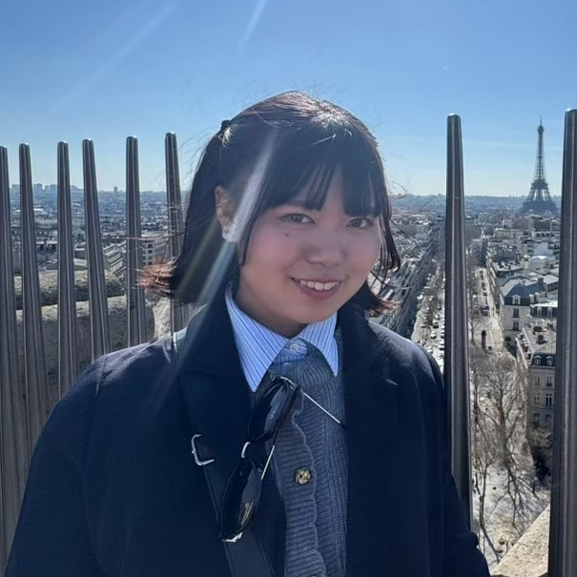

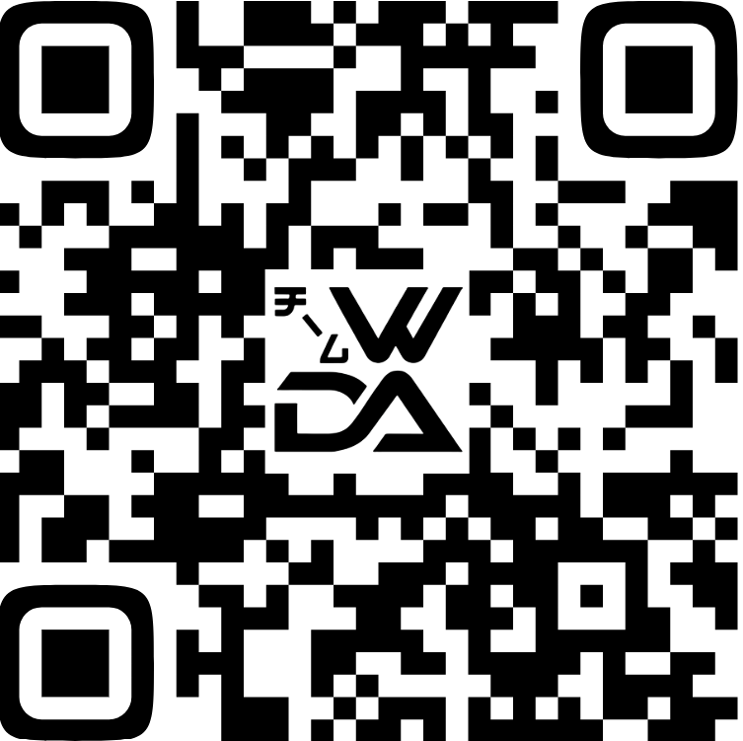

Thank you for listening!
Scan the QR code to learn more and join us!
Student Representative
Representative
Kanae Sasai
Hiroto Kitahara
luv.06.kana@gmail.com

