Slide 1

Personalizing EMP for Acupuncturists:
Bridging the Gap in Communicating Eastern Medical Concepts to Cross-Cultural Patients
Issei Miyaguchi
Kansai Medical University
Notes:
Good morning, everyone. Thank you very much for coming to my presentation today. My name is Issei Miyaguchi. I am from Kansai Medical University. It is a great honor to be here. Today, I would like to talk about English education for acupuncturists. The title of my presentation is "Personalizing EMP for Acupuncturists: Bridging the Gap in Communicating Eastern Medical Concepts to Cross-Cultural Patients. I will share how we can help acupuncturists explain Eastern medicine to foreign patients easily.

Slide 2

Conflict of Interest (COI) Disclosure
Presenter: Issei Miyaguchi
Employment/Leadership Position: CEO, Therapist English Co., Ltd.
Financial Interests: The specialized clinical English course evaluated in this study ("Therapist English") is a commercial service provided by my company.
There are no other conflicts of interest to disclose regarding this presentation.
Notes:
Before I begin my talk, I need to share my Conflict of Interest, or COI. I am the CEO of a company called Therapist English Co., Ltd. In this study, I will talk about a special English course. This course is a commercial service provided by my company. There are no other conflicts of interest to share with you today. Now, let's move on to the main topic.

Slide 3

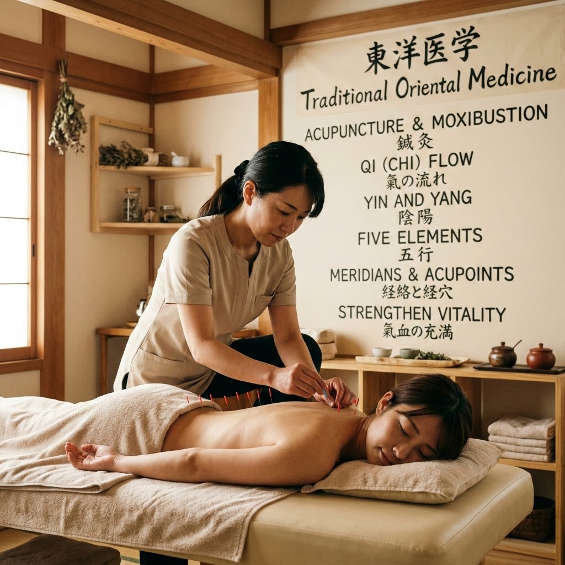
Background: The EMP Gap
Western Focus: Most English for Medical Purposes (EMP) courses focus heavily on Western medicine.
Missing Curriculum: Lack of specialized training for alternative/complementary medicine practitioners.
Notes:
Let's start with the background. As you may know, most medical English courses focus on Western medicine. For example, they teach words for hospitals, surgeries, or modern drugs. However, this is a big problem for acupuncturists and other therapists. They do not use these hospital words every day. Because of this, they are often left without the right language training. They do not have a good place to learn the English they really need for their jobs.

Slide 4


Specific Needs of Acupuncturists
Explaining unique Eastern concepts to cross-cultural patients:
○
Qi (Energy flow)
○
Meridians (Energy pathways)
○
De Qi (Acupuncture sensation)
Goal: Ensure safety, reduce anxiety, and build trust.
Notes:
Acupuncturists face a very special challenge. They have to explain Eastern medical ideas to foreign patients. These patients often have different cultures and do not know anything about Eastern medicine. For example, therapists must explain concepts like "Qi" or energy flow, "Meridians" or energy lines, and "De Qi" or the heavy feeling from the needle. If therapists cannot explain these ideas simply, patients might feel scared or confused. So, learning how to explain these concepts is very important. It ensures safety, reduces anxiety, and builds strong trust with patients.

Slide 5
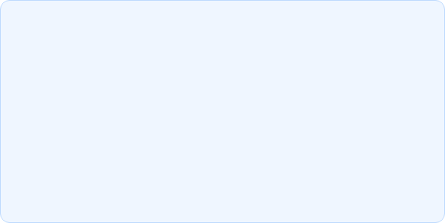
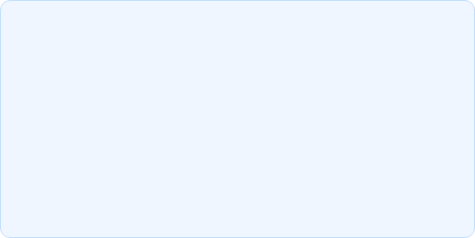


Objective of the Study
Investigate
Evaluate
To investigate the specific EMP needs of Japanese acupuncturists.
To evaluate the effectiveness of a specialized, 1-on-1 clinical English course based on role-playing.
Notes:
Therefore, the objective of this study is twofold. First, we wanted to find out exactly what kind of English Japanese acupuncturists need. What words do they want to learn? Second, we wanted to see if our special English course works well for them. This course is a one-on-one clinical English course. It focuses very much on role-playing between the teacher and the student. We wanted to check if this training style is truly helpful.

Slide 6
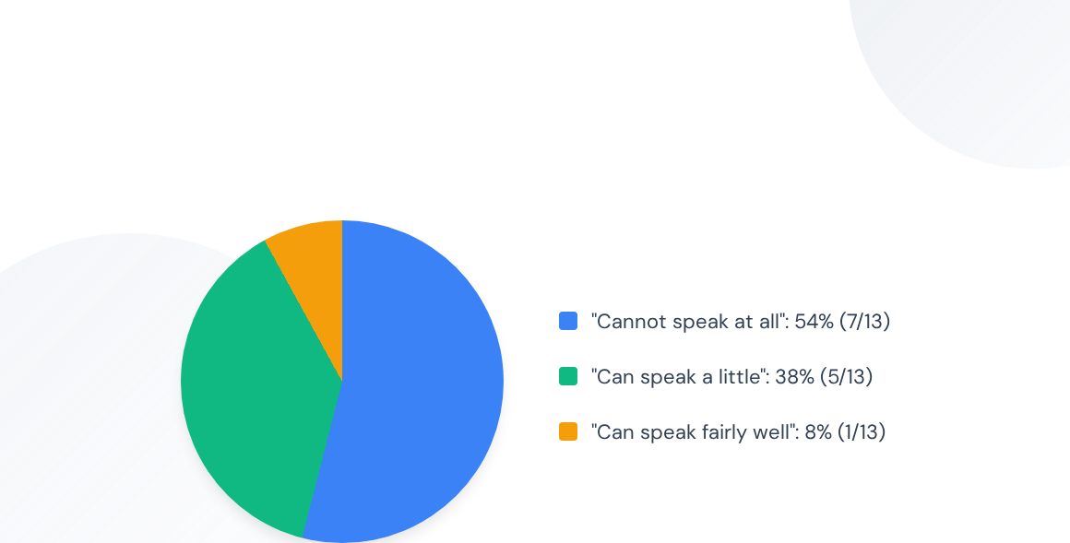
Participants & Methodology
Target: Japanese acupuncturists and massage therapists.
Surveys: Pre-course (n=13) and Post-course (n=11).
Initial English Speaking Level
Notes:
Next, let me explain our methods. We did surveys before the course started and after the course ended. Our participants were Japanese acupuncturists and massage therapists. We received 13 answers before the course, and 11 answers after the course. Interestingly, their initial English speaking levels were very low. In fact, 54 percent of them said, "I cannot speak English at all." Another 38 percent said they could only speak a little. This shows that most of the participants felt a high level of anxiety about speaking English before they joined the course.

Slide 7
Course Design: "Therapist English"
Format: 1-on-1 online sessions.
Volume: 45 minutes/lesson, twice a week (Total: 30 lessons).
Structure of a single lesson:
○
First 15-20 min: Input of practical medical phrases.
○
Remaining time: Intensive role-playing (Therapist & Patient). 2 to 3 clinical cases per lesson.
Notes:
To help these therapists, we designed a special course. It consists of 30 one-on-one online sessions. Each session lasts 45 minutes, and students took two lessons a week. The structure of each lesson is very simple and practical. For the first 15 to 20 minutes, students learn specific, useful English phrases for their clinics. Then, the rest of the time is used for intensive role-playing. The teacher acts as a foreign patient, and the student acts as the therapist. They practice 2 to 3 clinical situations in every lesson. They get feedback right away.

Slide 8
Examples of "Cultural Translation"
Concept (Japanese) | Translated Phrase Used in Class
tongue diagnosis (舌診) | "Please stick out your tongue for me."
De Qi (響き) | "Do you feel a heavy or dull sensation?
Moxa (お灸) | "I also suggest Moxa heat therapy to warm you."
Notes:
A very important part of our course is "cultural translation." This means explaining Eastern ideas in simple, everyday English. We do not use difficult medical terms. For example, when checking the tongue, we teach them to say, "Please stick out your tongue for me." When explaining the needle sensation, or "De Qi", we practice asking, "Do you feel a heavy or dull sensation? That is a good reaction." Using these simple, friendly phrases makes foreign patients feel safe and relaxed. It bridges the cultural gap very easily.

Slide 9



Phrase 2
Therapist Phrase
Please stick out your tongue for me.
舌を（私のために）出してください。
類似フレーズ / Similar Expressions
1
Show me your tongue, please.
舌を見せてください。
2
Open your mouth wide.
口を大きく開けてください。
3
Relax your tongue and let it hang out.
舌の力を抜いて、だらんと出してください。
©Therapist English

Slide 10
Phrase 3
Therapist Phrase
Please lift your tongue. I need to check the underside.
舌を持ち上げてください。裏側を確認する必要があります。
類似フレーズ / Similar Expressions
1
Touch the roof of your mouth with your tongue.
舌で口の天井（上あご）を触ってください。
2
Roll your tongue up.
舌を巻き上げてください。
3
Can you move your tongue up?
舌を上に動かせますか？
©Therapist English

Slide 11
Phrase 7
Therapist Phrase
I will use points on your hands and legs.
手や足にあるツボ（ポイント）を使います。
類似フレーズ / Similar Expressions
1
I will put needles in your arms and feet.
腕と足に鍼をします。
2
I use points far from the pain.
痛みから離れた場所にあるツボを使います。
3
These are special points for your neck.
これらは、あなたの首のための特別なツボです。
©Therapist English

Slide 12
Pre-Course Needs Assessment
Key focus areas identified by participants:
assignment
forum
health_and_safety
Patient Histories
Taking accurate patient histories smoothly and professionally in English.
Mechanism & Effects
Explaining the complex mechanisms and physiological effects of acupuncture treatment.
Patient Reassurance
Reassuring patients about unfamiliar reactions, such as healing crises or post-treatment sensations.
©Therapist English
Notes:
Let's look at the results of the pre-course survey. What did they want to learn? First, participants urgently wanted to learn how to ask questions and take patient histories smoothly. Second, they wanted to explain how acupuncture works and its effects. Finally, they strongly needed to reassure foreign patients. Foreign patients often feel surprised by unfamiliar reactions, like a "healing crisis." The therapists wanted the right English words to calm their patients down.

Slide 13
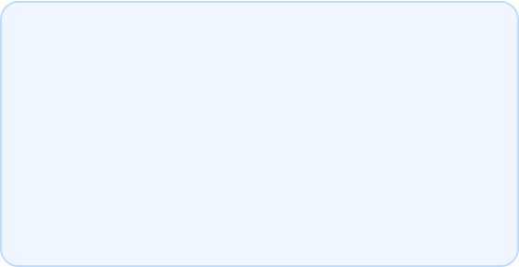
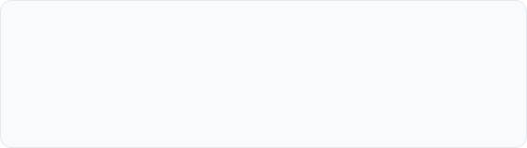
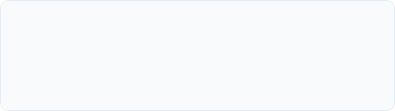
Course Outcomes (Post-course)
4.7x
Quantitative Improvement
Participants reported a significant increase in their English proficiency, scoring an average of 4.7 compared to a baseline of 1 before the course.
Improvement in Self-Rated English Proficiency
Qualitative Feedback
"Role-playing in every lesson allowed me to output what I learned, which deepened my understanding and gave me confidence."
"Learning English specialized for the medical field helped me visualize working overseas."
Notes:
Now, let's look at the outcomes after the 30 lessons. The results were highly positive. For the numbers, we asked them to rate their English skills. We set their starting level as 1. After the course, their self-rated score went up to 4.7 on average. Their skills improved almost 5 times! We also received wonderful comments. One student said, "Role-playing in every lesson allowed me to practice speaking. It deepened my understanding and gave me confidence." Another student said, "Learning English just for my job helped me imagine working overseas."

Slide 14
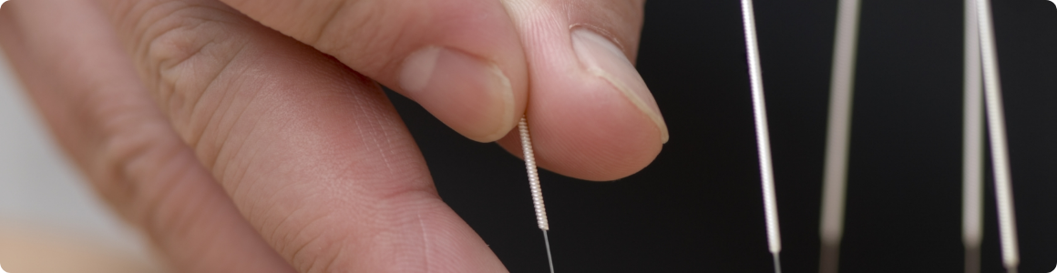
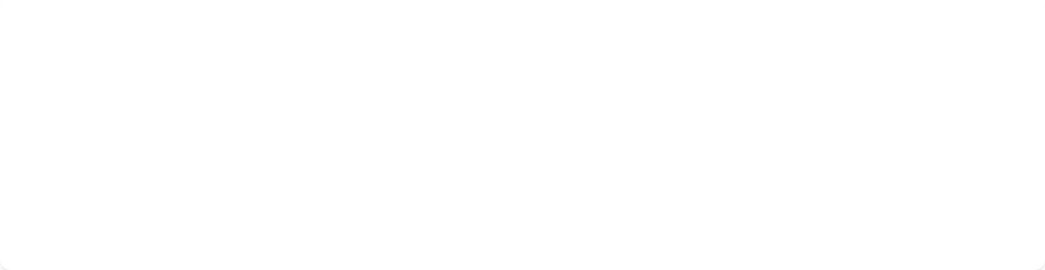
Why was this approach effective?
Overcoming the Language Barrier: Intensive, repetitive role-play shifted knowledge from "passive" to "active."
Cultural Bridging: Providing ready-to-use templates for difficult concepts (e.g., Qi, Meridians) drastically reduced therapist hesitation.
Relationship Building: Being able to explain the "why" and "how" without an interpreter fostered deeper patient trust.
Notes:
Why was this course so successful? We think there are three main reasons. First, the repeating role-plays changed their English from "passive listening" to "active speaking." Second, we gave them easy templates, or set phrases, for difficult Eastern concepts. This cultural bridging stopped them from hesitating or pausing. Third, they learned how to explain the treatment directly. Because they did not need an interpreter, they could build a much deeper and stronger trust with their patients.

Slide 15
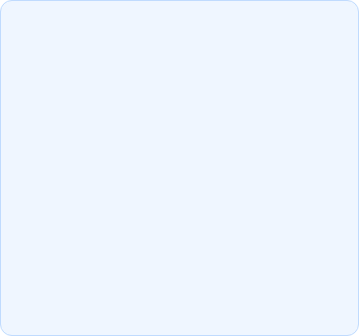
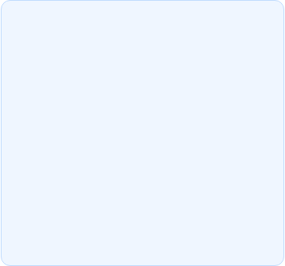
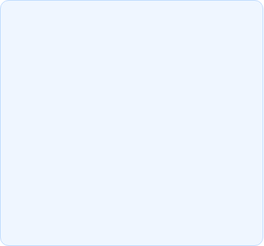



Conclusion
Confident Communicators
Reduced Anxiety
Future Implication
Role-playing clinical scenarios is highly effective for reducing language anxiety.
EMP education must evolve to include diverse medical paradigms beyond Western medicine.
When EMP is tailored to Eastern medicine, acupuncturists become confident communicators.
Notes:
To conclude my presentation, I want to say that EMP must fit the user's needs. When medical English is customized for Eastern medicine, acupuncturists can become confident speakers. Also, practicing with clinical role-plays is a fantastic way to reduce anxiety. The most important message today is this: EMP education needs to grow. It should not only focus on Western hospitals. It must expand to support different types of medical care, including Eastern medicine.

Slide 16
Thank You for Your Attention!
Any questions?
Notes:
That brings me to the end of my presentation. Thank you very much for your kind attention today.

