Slide 1



Slide 2

After Six Weeks
Confidence
2.49 3.85
+ 55%
Anxiety
3.46 3.23
-7%
Matched pre–post responses (5-point Likert scale)
n = 215 paired responses

Slide 3
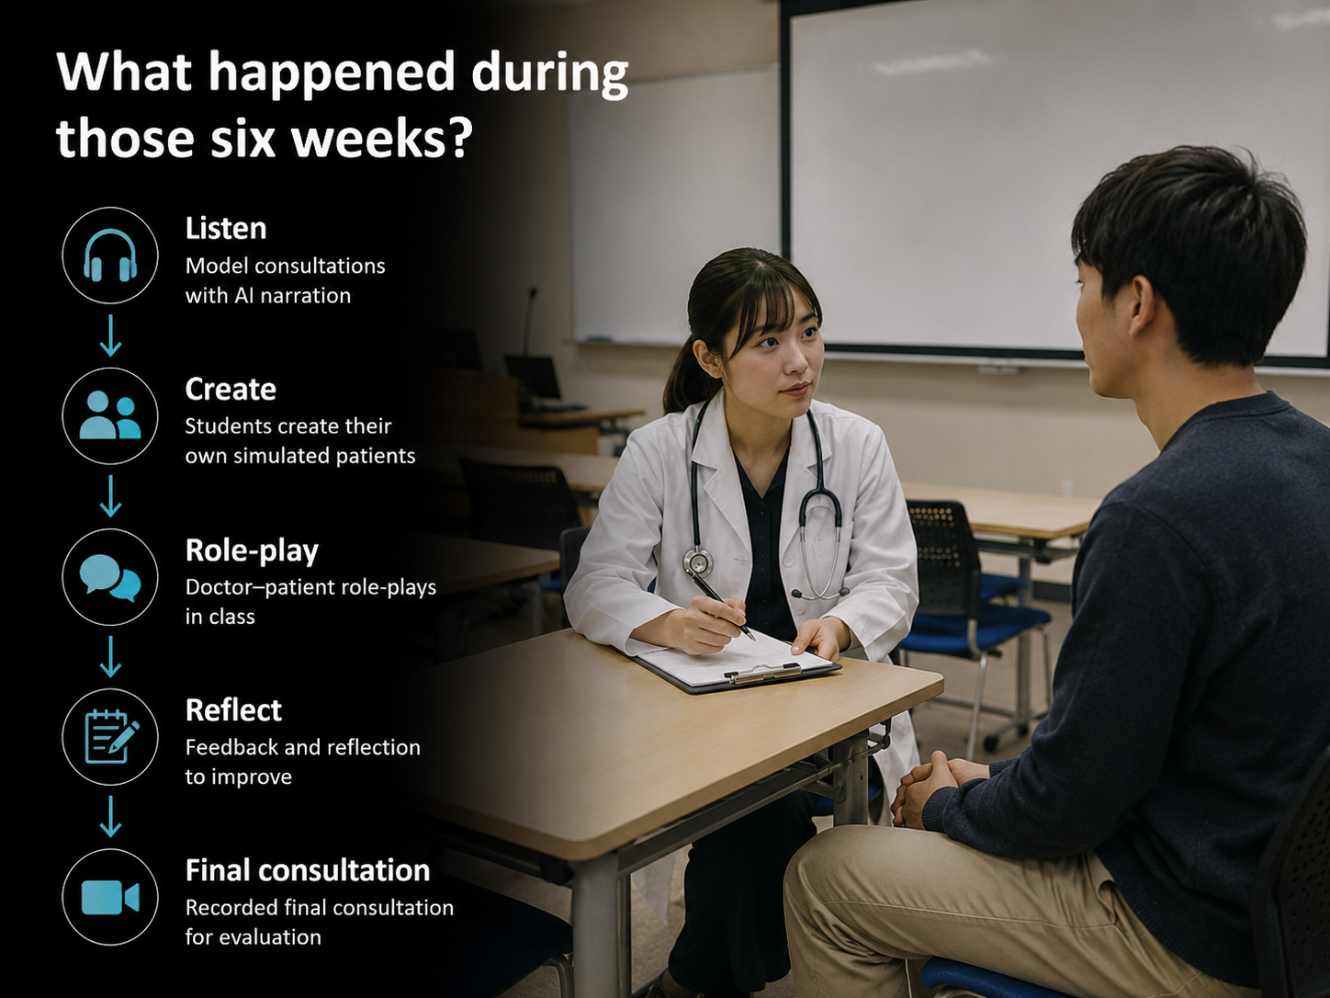

Slide 4
Our Assumption
More Confidence
Less Anxiety
=

Slide 5
More Confidence
Less Anxiety
≠
Maybe I was asking the wrong question...

Slide 6
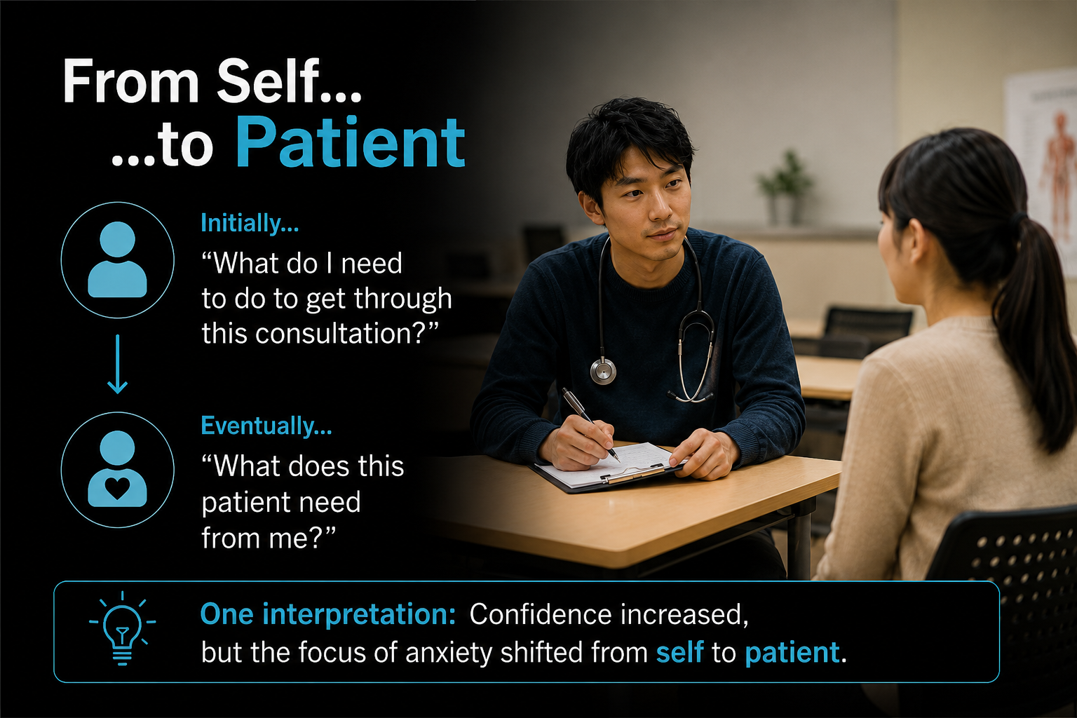
..then what changed?

Slide 7
Students' reflections...
患者がどうしたいか、どうしてほしいかが重要である。
“I realised that what matters is what the patient wants and needs.”
患者が1番医師に伝えたいことは何か、医師はどこに注意して聞かなければならないか理解でき、患者の背景について知る重要性を理解した。
"I learned to focus on what the patient most wanted the doctor to understand, and the importance of understanding the patient's background.“
共感は「優しくすること」だけでなく、「よく聞いて理解すること」だと分かった。
"I learned that empathy isn't just about being kind. It's about listening carefully and understanding the patient.“
"I learned that patients want to know about their symptoms, of course, but they also want empathy and helpfulness just as much.
ただ質問を淡々と繰り返すのではなく、患者さんの話をきちんと聞いているという姿勢を示すことが非常に重要であることを改めて認識した。
"I realised that it isn't enough simply to ask questions. It is equally important to show patients that you are truly listening."

Slide 8
One interpretation...
Confidence
Greater capability
Greater responsibility
Continuing anxiety
Damasio • Kierkegaard • Narrative Medicine

Slide 9
Confidence
and
Anxiety
may coexist throughout professional growth.

Slide 10
Perhaps the goal of medical education is not to eliminate anxiety...
...but to transform what students are anxious about.

Slide 11
Thank you
Questions?
──────────────────────────────────
Timothy P. Williams
Assistant Professor
Nihon University School of Medicine
✉ williams.timothy@nihon-u.ac.jp

