Slide 1
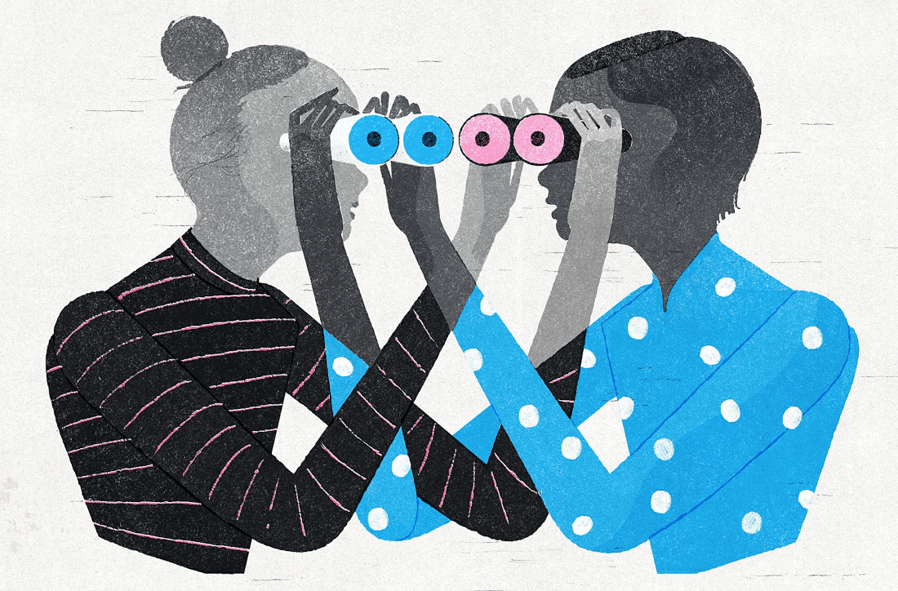
What is EMP without EMPathy?
Ian Willey (Ph.D.)
Kagawa University
29th JASMEE Conference
July 11, 2026, 13:20 (Rm. B)
Kansai Medical University
Osaka, Japan
Notes:
Hello everyone. It’s great to be here today. I’m Ian Willey and I’m at Kagawa University. I’ll be talking about the role of empathy in EMP.

Slide 2
EMPATHY
Notes:
OK, let’s begin by thinking about this word, empathy. We hear it all the time, but what does it mean?

Slide 3
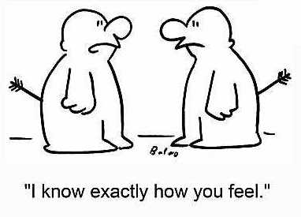
Notes:
Simply put, empathy is the ability or capacity to put yourself in other people’s shoes, to understand how they feel, and perhaps feel the same thing yourself.

Slide 4
For doctors, having empathy…
Improves doctor-patient relationship (Mercer & Reynolds, 2002)
Increases diagnostic accuracy (Neumann et al., 2012)
Reduces severity of symptoms (Rakel et al., 2009)
Reduces malpractice claims (Huntington & Kuhn, 2003)
Notes:
For doctors, having empathy is considered a good thing! There’s evidence that it improves doctor-patient relationships; it may increase diagnostic accuracy and even reduce the severity of patients’ symptoms. There’s even evidence that it reduces malpractice claims. That’s good!

Slide 5
For EFL learners, empathy…
Enables language learning (Brown, 1973)
Fosters communicative competence (Gudykunst, 2002)
Benefits pronunciation and grammatical sensitivity (Guiora et al., 1972)
Aids in memorizing vocabulary (Rota & Reiterer, 2009)
Notes:
For those of us teaching English, how is empathy important to EFL? Well, it has long been called a key variable in L2 learning as well as communicative competence. Not only that, but empathy may benefit pronunciation, grammatical sensitivity, and vocabulary acquisition.

Slide 6
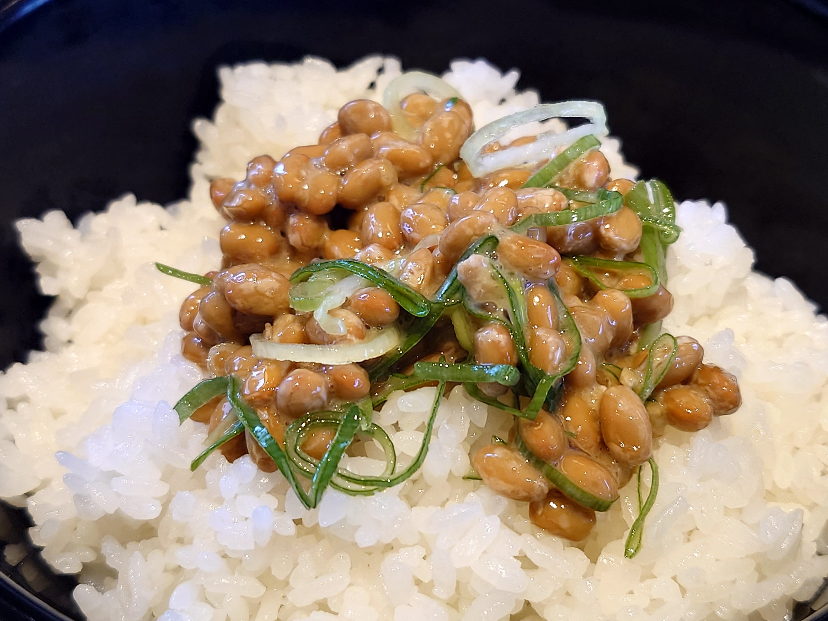
Notes:
So, empathy is a bit like natto. You just can’t get enough of it!

Slide 7
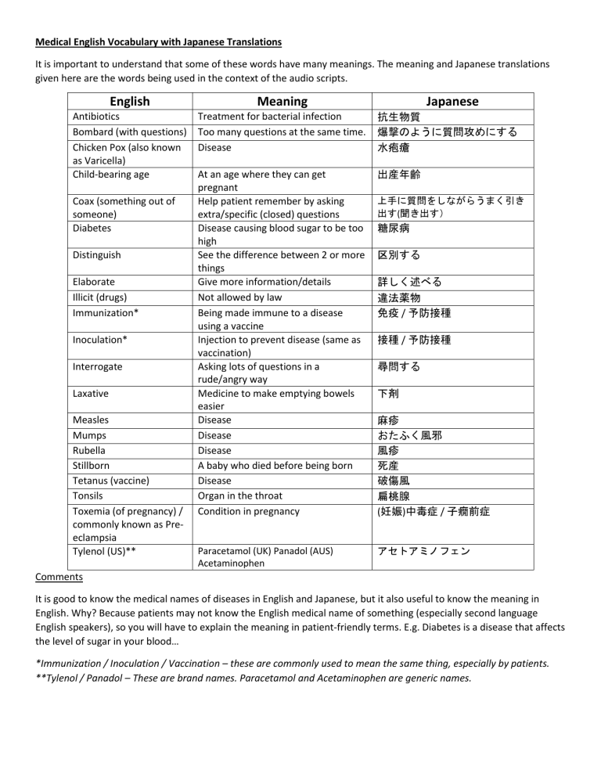
Notes:
Yet, having been involved in EMP education for many years, my feeling is that most EMP textbooks continue to focus on vocabulary or expressions, as though this is what defines medical English. Little space is allotted for empathy-building activities. To me this seems like a shame. There’s a strong possibility that the only communication course in many medical curricula in Japan are our own EMP courses.

Slide 8
But empathy is also…
Hard to define
Multi-dimensional
(cognitive, affective)
A double-edged sword?
Notes:
Perhaps this is because there are reasons to shy away from empathy. It’s hard to define. It’s complex, involving multiple dimensions including cognitive and affective dimensions. Also, it could be a double-edged sword.

Slide 9
But empathy is also…
Hard to define
Multi-dimensional
(cognitive, affective)
Empathy fatigue
A double-edged sword?
Notes:
Too much empathy can lead to empathy fatigue in medical professionals and teachers.

Slide 10
But empathy is also…
Hard to define
Multi-dimensional
(cognitive, affective)
Empathy fatigue
A double-edged sword?
Burnout
Notes:
Even burnout, and dropping out of the workforce.

Slide 11
But empathy is also…
Hard to define
Multi-dimensional
(cognitive, affective)
Empathy fatigue
A double-edged sword?
Burnout
Discrimination
Notes:
It can also become the basis of discrimination—our group is better than yours!—as well as emotional manipulation and bullying.

Slide 12
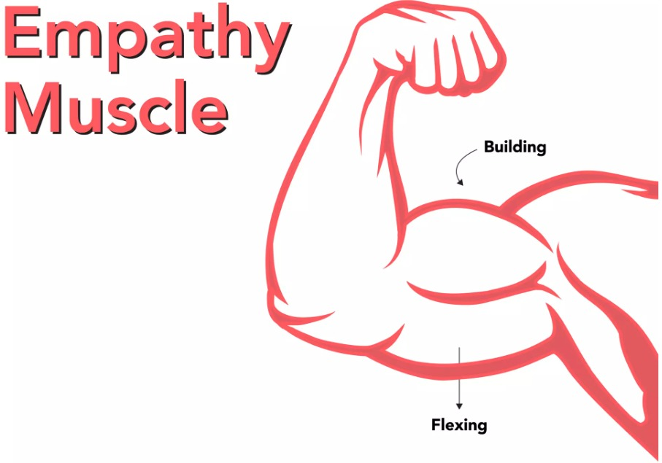
Still…
Notes:
Still, few would deny that possessing a degree of empathy is a good thing. Probably most of us here have been with a doctor or teacher with low empathy. Such experiences can be frustrating and painful. They could even lead to medical emergencies.

Slide 13
Poetry & Empathy (Schoonover et al., 2019)
Two studies found poetry to increase empathy using validated surveys
Limited evidence that poetry reduces professional burnout
Empathy-building haiku workshops spreading
Notes:
Now, for the past few years we’ve been researching the link between poetry and empathy. Studies have found that poetry increases empathy using various surveys. There’s also some evidence that reading poetry reduces professional burnout. One genre of poetry, the haiku, has been touted as especially useful in empathy building. Haiku are short, easy to read, and often packed with deep meaning, like little empathy multivitamins.

Slide 14

Our previous study found students believed reading medical haiku was good for empathy development (Willey & Suzuki, 2025)
Yet, after one semester of such tasks, cognitive empathy scores went down. Why?
We wanted to try it again with a more rigorous design.
Notes:
Our previous study found that students believed that reading medical haiku was good for empathy development. Yet, after one semester of such tasks, cognitive empathy scores went down. We wondered why. We wanted to try it again, with a more rigorous design.

Slide 15
Research questions:
What effect does weekly reflection on medically-themed English haiku have on students’ cognitive empathy levels (perspective-taking and fantasy) after one semester?
What happens to students’ cognitive empathy levels six months after completion of the course?
How does gender relate to 1 and 2.
Notes:
Our research questions were these: what effect does weekly reflection on medically themed English haiku have on students’ cognitive empathy levels, especially in the dimensions of perspective-taking and fantasy, after one semester? And, what happens to students’ cognitive empathy levels six months after completion of the course? And finally, how does gender relate to 1 and 2?

Slide 16
Study method (1)
Time: 2025 academic year
Participants: 67 (3rd year Medicine majors) enrolled in required Medical English courses
Intervention: 5-10 minute discussion of English haiku at the beginning and end of class (for 15 weeks) + optional writing task on Moodle
Control: Focus on activities in the textbook; no empathy-building
Notes:
This study took place in 2025. Participants were, in the end, 67 3rd year medical students enrolled in required Medical English courses. In the intervention group (which was one class), students engaged in 5-10 minute discussions centered on English haiku at the beginning and end of each class over the course of a 15-week semester. Students could also write about the haiku on Moodle. In the control group, there was a focus on activities in the textbook, with no explicit empathy-building activities.

Slide 17
Study method (2)
Assessment: Online surveys of the Multidimensional Empathy Scale (MES; Suzuki & Kino, 2008) in Japanese at three time points.
Analysis: In SPSS using T-tests
Week 1
Week 15
6 months post-course
Notes:
The intervention was assessed using online administrations of the Multidimensional empathy scale, a survey in Japanese. The survey was given to students at three time points: in the first week of classes, the last week of classes, and 6 months after the course was completed.

Slide 18
Perspective Taking
“Even when I disagree with someone, I try to understand that person’s point of view.”
Notes:
We focused on two item groups which were found to be important in previous studies on the link between poetry and empathy: first, perspective-taking, which is exemplified by this item.

Slide 19
Fantasy
“While reading an interesting story or novel, I feel as though the things happening in the story are happening to me.”
Notes:
And Fantasy. Here is a fantasy item.

Slide 20
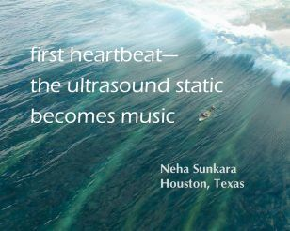
Notes:
And here is an example of the sort of haiku we used. Have a read! … Isn’t it lovely? Can you feel how the author feels?

Slide 21
Let's think about this haiku in terms of the following questions.
1) What’s the situation? Who might the author be?
2) How does the author feel about the situation?
3) How does the haiku make you feel?
The Task
Notes:
And for the task itself, students were directed to reflect upon each haiku in terms of the following questions.

Slide 22
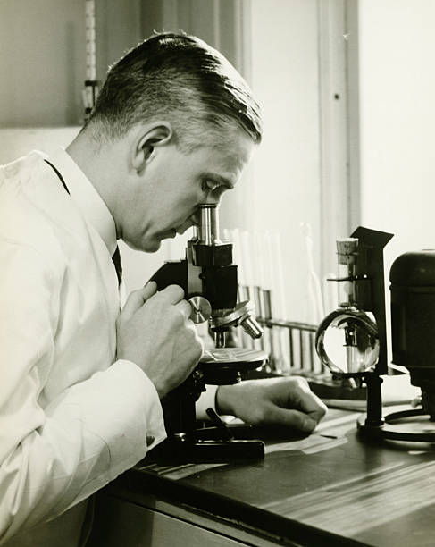
Findings
Notes:
Now for the findings.

Slide 23
Empathy changes (?)
* Significance at p < 0.05
 |  | Time 1 | Time 2 | Time 3 | p (C1-C2) | p (C2-C3)
Intervention (37) | PT | 3.96 | 4.11 | 4.13 | 0.06 | 0.10
 | FA | 3.81 | 3.86 | 3.85 | 0.6 | 0.76
Control (30) | PT | 3.96 | 3.93 | 3.98 | 0.84 | 0.83
 | FA | 3.56 | 3.62 | 3.73 | 0.60 | 0.17
Notes:
Well, did we see significant gains in empathy across the three time points? Not exactly significant, but there were increases across the perspective-taking dimension, and a tendency for significance between the beginning and end of the semester. Fantasy also increased, but not significantly. There were no significant changes in the control group, either.

Slide 24
Gender differences (?)
* Significance at p < 0.05
 |  | Time 1 | Time 2 | Time 3 | p (C1) | p (C2) | p (C3)
Female (37) | PT | 4.08 | 4.18 | 4.21 | 0.04* | 0.02* | 0.04*
Male (29) |  | 3.77 | 3.8 | 3.86
Female (37) | FA | 3.77 | 3.93 | 3.77 | 0.34 | 0.03* | 0.9
Male (29) |  | 3.56 | 3.49 | 3.79
Notes:
Were there differences between genders? The answer here is, you bet! Female students had significantly higher perspective-taking scores at all three collection points. For fantasy, though, female students were higher at only one time point, the end of the semester. Otherwise, there were no significant differences. These findings largely support previous studies which found that women tended to have higher empathy than men. Anyone surprised?

Slide 25
Feedback (1)
In Medical English I, we studied and discussed English haiku. We didn’t write haiku ourselves, but we analyzed their meanings and emotions.
It was difficult to understand such short poems, but we can enjoy talking about what poets wanted to express.
I was impressed by how much emotions and meanings could be packed into just a few words.
This experience showed me a new way to connect language and emotion.
Notes:
Here is some feedback from students on the haiku task, collected at Mid-term. This comment is positive. I’ll let you have a read. … This is exactly the sort of feedback an instructor would hope for.

Slide 26
Feedback (2)
Haiku in English is interesting for me. The reason why I think it is interesting is I couldn’t feel and understand what Haiku says.
I could read the English and imagine the situation, however I couldn’t imagine what the writer feels.
Haiku is too short to find any proves for deciding logically what writer feels. I want you to explain them more clearly. I don’t mind even if the explanation is not logical.
Notes:
And this one isn’t. Have a read. … Because of this, I started giving my own interpretation of haiku, after students had time to think about them. I wrote this on Moodle. This comment shows how challenging it can be to identify emotions. It also reinforces my belief in the importance of this practice. They’re not getting it elsewhere.

Slide 27
Conclusions
Reflecting on English haiku may positively impact perspective-taking but not fantasy; this impact is sustained over time.
Female students score significantly higher in perspective-taking and sometimes fantasy.
More room in EMP education for empathy-building activities.

Slide 28

Notes:
So, how does this make you feel? Ah, almost done.

Slide 29
Images used in this presentation
Slide 1: https://www.drmitchkeil.com/uncategorized/what-is-empathy/
Slide 3: https://chinkeetan.com/mahita-chinkee-tan-wealth-coach/empathy-cartoon/
Slide 6: https://en.wikipedia.org/wiki/Natt%C5%8D
Slide 7: https://studylib.net/doc/25587817/medical-english-vocabulary-with-japanese-translations
Slide 12: https://sidlaurea.com/2023/09/30/21666/
Slide 14: https://www.istockphoto.com/jp
Slide 20, 30, 31, 32: https://pulsevoices.org/haiku/
Slide 22: https://www.istockphoto.com/jp
Slide 28: https://stockcake.com/ja/i/mountain-top-triumph_702150_874017

Slide 30
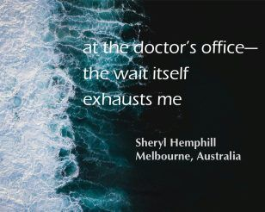

Slide 31
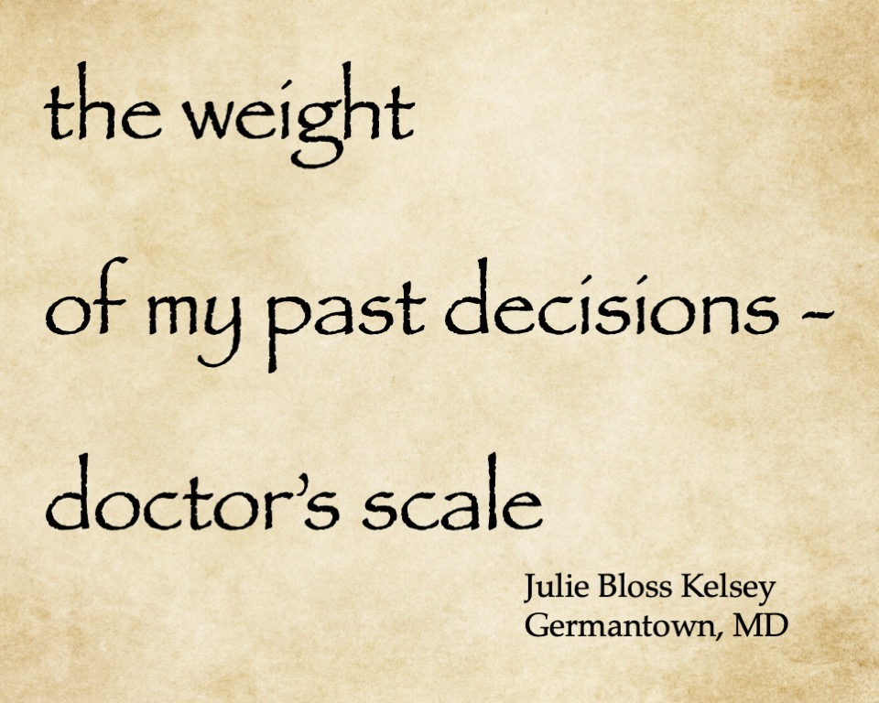

Slide 32
