Slide 1
International Activities for Cultural Competence and Intercultural Communication
Adam Crosby
Kobe City College of Nursing

Slide 2


National Taipei University of Nursing and Health Science
University of Da Nang

Slide 3
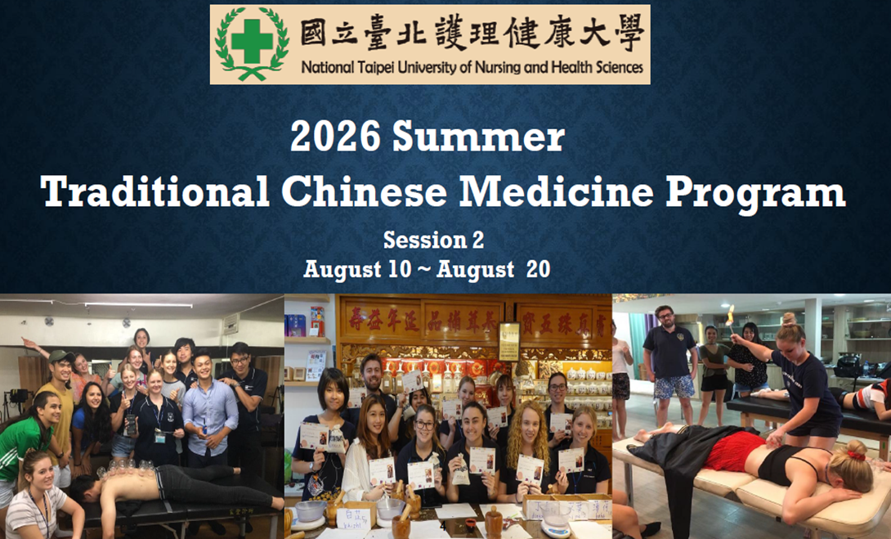

Slide 4
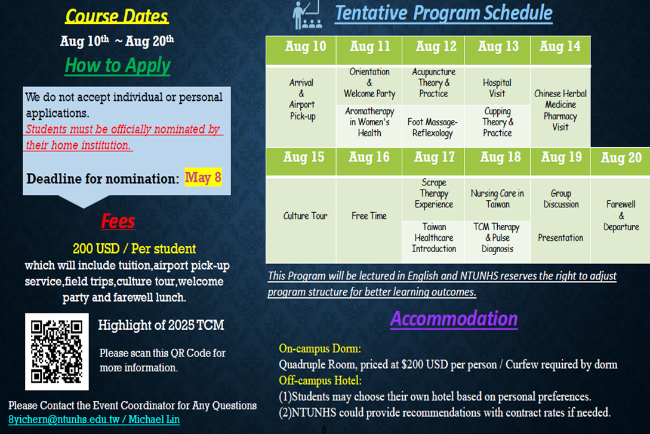

Slide 5
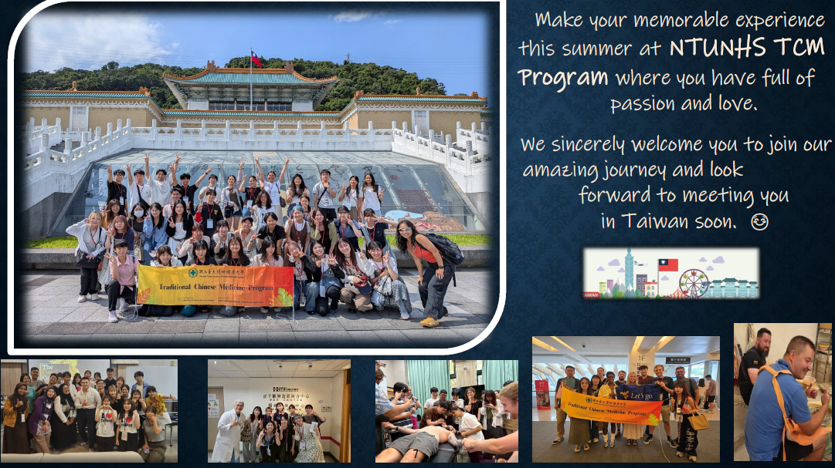

Slide 6
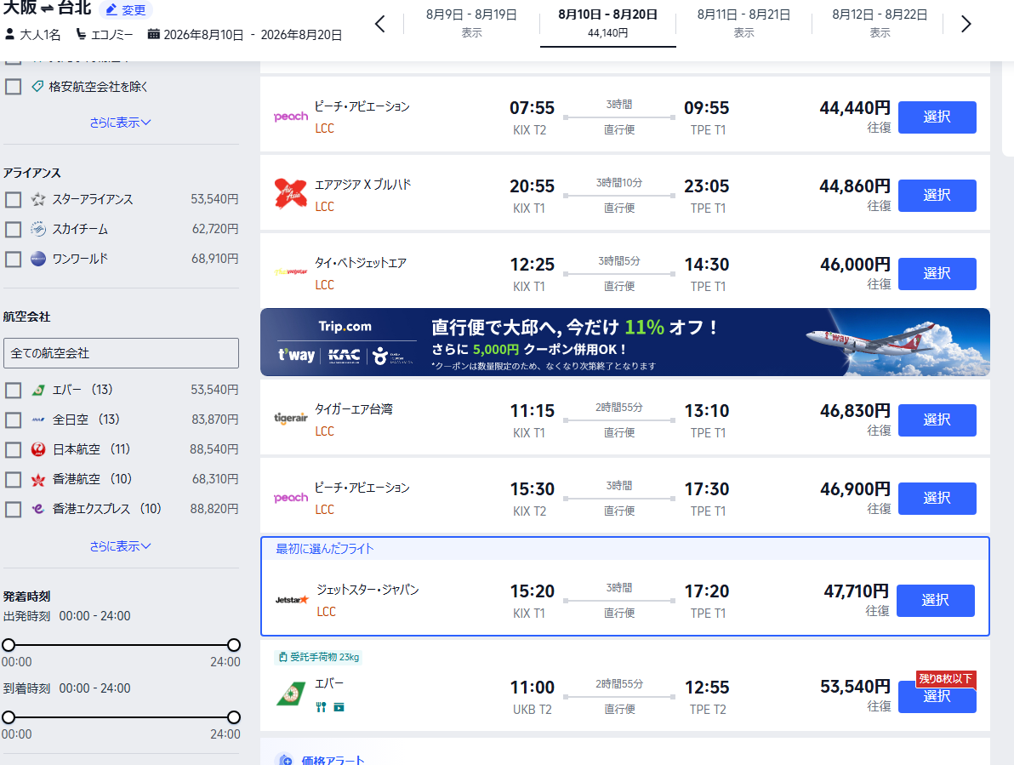
Participants have to:
Buy a plane ticket
Buy their own food
Choose accommodation

Slide 7
University of Da Nang
2022
Online
Two Faculty Presentations
Four Student Presentations
Attendance 130

Slide 8
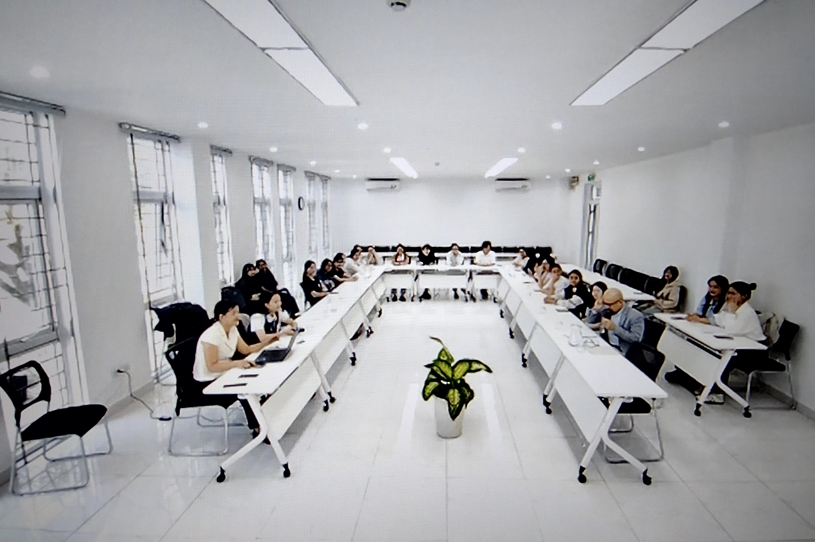
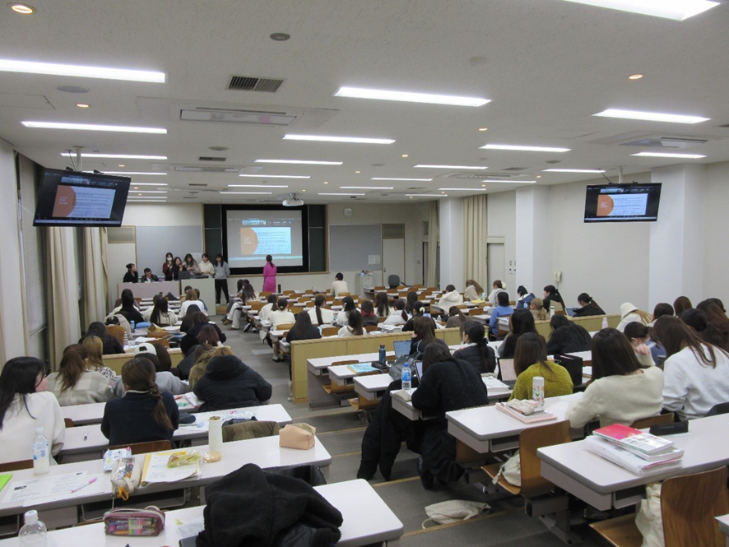
University of Da Nang

Slide 9
Key Point
Online
Reasonably priced
Intercultural communication

