Slide 1

Vacuum decay in theories with no instanton solutions
Kinga Gawrych
Based on 2510.21922 with Ben Elder and Arttu Rajantie
UK-QFT XIV, University of Nottingham
26.11.2025

Slide 2
Introduction – vacuum decay the standard way
K. Gawrych – Vacuum decay in theories with no instanton solutions UK QFT XIV, 26.11.2025, University of Nottingham

Slide 3
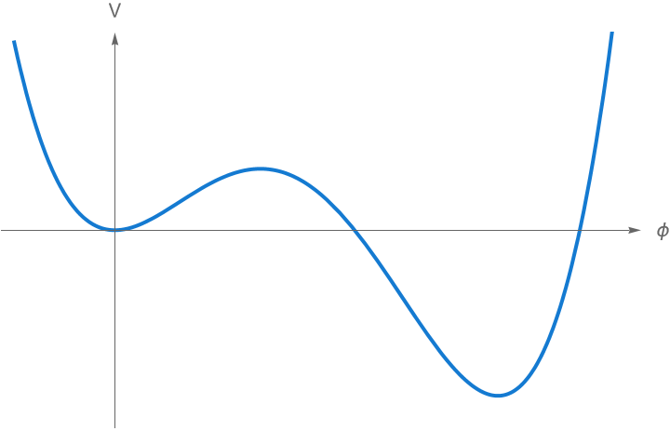
Introduction – vacuum decay the standard way
K. Gawrych – Vacuum decay in theories with no instanton solutions UK QFT XIV, 26.11.2025, University of Nottingham

Slide 4
Introduction – vacuum decay the standard way
“false vacuum”
K. Gawrych – Vacuum decay in theories with no instanton solutions UK QFT XIV, 26.11.2025, University of Nottingham

Slide 5
Introduction – vacuum decay the standard way
“false vacuum”
“true vacuum”
K. Gawrych – Vacuum decay in theories with no instanton solutions UK QFT XIV, 26.11.2025, University of Nottingham

Slide 6
Introduction – vacuum decay the standard way
“false vacuum”
“true vacuum”
K. Gawrych – Vacuum decay in theories with no instanton solutions UK QFT XIV, 26.11.2025, University of Nottingham

Slide 7
Introduction – vacuum decay the standard way
“false vacuum”
“true vacuum”
K. Gawrych – Vacuum decay in theories with no instanton solutions UK QFT XIV, 26.11.2025, University of Nottingham

Slide 8
Introduction – vacuum decay the standard way
“false vacuum”
“true vacuum”
K. Gawrych – Vacuum decay in theories with no instanton solutions UK QFT XIV, 26.11.2025, University of Nottingham

Slide 9
Introduction – vacuum decay the standard way
K. Gawrych – Vacuum decay in theories with no instanton solutions UK QFT XIV, 26.11.2025, University of Nottingham

Slide 10
Introduction – vacuum decay the standard way
Vacuum decay rate
K. Gawrych – Vacuum decay in theories with no instanton solutions UK QFT XIV, 26.11.2025, University of Nottingham

Slide 11

Introduction – vacuum decay the standard way
Vacuum decay rate
K. Gawrych – Vacuum decay in theories with no instanton solutions UK QFT XIV, 26.11.2025, University of Nottingham

Slide 12
Introduction – vacuum decay the standard way
Vacuum decay rate
K. Gawrych – Vacuum decay in theories with no instanton solutions UK QFT XIV, 26.11.2025, University of Nottingham

Slide 13
Introduction – vacuum decay the standard way
Vacuum decay rate
Standard method:
saddle point approximation
K. Gawrych – Vacuum decay in theories with no instanton solutions UK QFT XIV, 26.11.2025, University of Nottingham

Slide 14
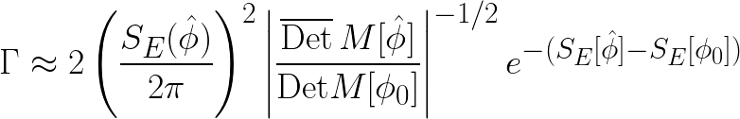
Introduction – vacuum decay the standard way
Vacuum decay rate
K. Gawrych – Vacuum decay in theories with no instanton solutions UK QFT XIV, 26.11.2025, University of Nottingham

Slide 15
Introduction – vacuum decay the standard way
Instanton
Vacuum decay rate
K. Gawrych – Vacuum decay in theories with no instanton solutions UK QFT XIV, 26.11.2025, University of Nottingham

Slide 16
Introduction – vacuum decay the standard way
Instanton
Vacuum decay rate
False vacuum
K. Gawrych – Vacuum decay in theories with no instanton solutions UK QFT XIV, 26.11.2025, University of Nottingham

Slide 17
Introduction – vacuum decay the standard way
Instanton
Vacuum decay rate
False vacuum
Fluctuation operator
K. Gawrych – Vacuum decay in theories with no instanton solutions UK QFT XIV, 26.11.2025, University of Nottingham

Slide 18
Introduction – vacuum decay the standard way
Vacuum decay rate
K. Gawrych – Vacuum decay in theories with no instanton solutions UK QFT XIV, 26.11.2025, University of Nottingham

Slide 19
Introduction – vacuum decay the standard way
Vacuum decay rate
Problem:
No saddle points!
K. Gawrych – Vacuum decay in theories with no instanton solutions UK QFT XIV, 26.11.2025, University of Nottingham

Slide 20
Idea – constrained instantons
K. Gawrych – Vacuum decay in theories with no instanton solutions UK QFT XIV, 26.11.2025, University of Nottingham

Slide 21
Idea – constrained instantons
First proposal [Affleck, ‘81] – constrained instantons (interesting, but has problems)
K. Gawrych – Vacuum decay in theories with no instanton solutions UK QFT XIV, 26.11.2025, University of Nottingham

Slide 22
Idea – constrained instantons
First proposal [Affleck, ‘81] – constrained instantons (interesting, but has problems)
Our work – same basic idea, improved method
K. Gawrych – Vacuum decay in theories with no instanton solutions UK QFT XIV, 26.11.2025, University of Nottingham

Slide 23
Idea – constrained instantons
First proposal [Affleck, ‘81] – constrained instantons (interesting, but has problems)
Our work – same basic idea, improved method
PROBLEM
No saddle points of the action in the space of all functions
K. Gawrych – Vacuum decay in theories with no instanton solutions UK QFT XIV, 26.11.2025, University of Nottingham

Slide 24
Idea – constrained instantons
First proposal [Affleck, ‘81] – constrained instantons (interesting, but has problems)
Our work – same basic idea, improved method
PROBLEM
No saddle points of the action in the space of all functions
SOLUTION
Split the space of functions into sectors, such that in a given sector a saddle point exists + sum over the sectors
K. Gawrych – Vacuum decay in theories with no instanton solutions UK QFT XIV, 26.11.2025, University of Nottingham

Slide 25

Idea – constrained instantons
K. Gawrych – Vacuum decay in theories with no instanton solutions UK QFT XIV, 26.11.2025, University of Nottingham

Slide 26
Idea – constrained instantons
K. Gawrych – Vacuum decay in theories with no instanton solutions UK QFT XIV, 26.11.2025, University of Nottingham

Slide 27

Idea – constrained instantons
K. Gawrych – Vacuum decay in theories with no instanton solutions UK QFT XIV, 26.11.2025, University of Nottingham

Slide 28
Idea – constrained instantons
K. Gawrych – Vacuum decay in theories with no instanton solutions UK QFT XIV, 26.11.2025, University of Nottingham

Slide 29

Idea – constrained instantons
Integral only over functions with $ξ\left[φ\right]=\overline{ξ}$
K. Gawrych – Vacuum decay in theories with no instanton solutions UK QFT XIV, 26.11.2025, University of Nottingham

Slide 30
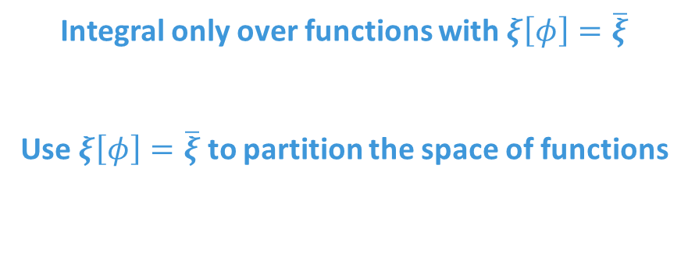
Idea – constrained instantons
Integral only over functions with $ξ\left[φ\right]=\overline{ξ}$
Use $ξ\left[φ\right]=\overline{ξ}$ to partition the space of functions
K. Gawrych – Vacuum decay in theories with no instanton solutions UK QFT XIV, 26.11.2025, University of Nottingham

Slide 31
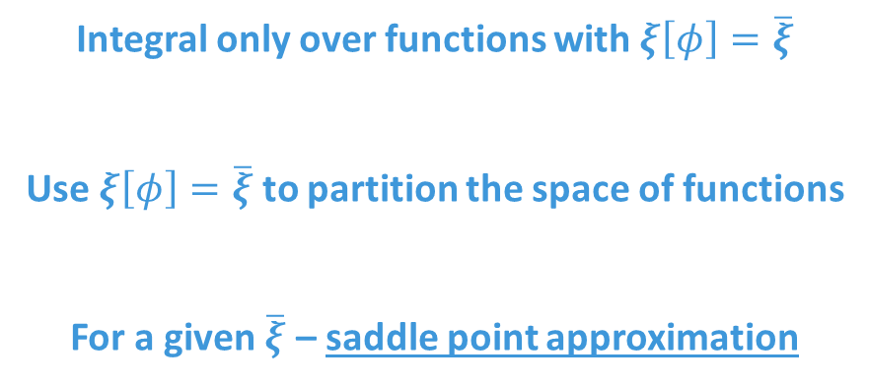
Idea – constrained instantons
Integral only over functions with $ξ\left[φ\right]=\overline{ξ}$
Use $ξ\left[φ\right]=\overline{ξ}$ to partition the space of functions
For a given $\overline{ξ}$ – saddle point approximation
K. Gawrych – Vacuum decay in theories with no instanton solutions UK QFT XIV, 26.11.2025, University of Nottingham

Slide 32
Idea – constrained instantons
Integral only over functions with $ξ\left[φ\right]=\overline{ξ}$
Use $ξ\left[φ\right]=\overline{ξ}$ to partition the space of functions
For a given $\overline{ξ}$ – saddle point approximation
“Sum” over sectors
K. Gawrych – Vacuum decay in theories with no instanton solutions UK QFT XIV, 26.11.2025, University of Nottingham

Slide 33
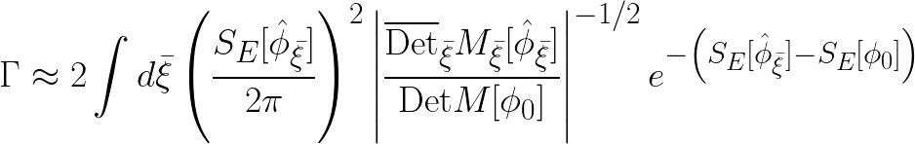
Idea – constrained instantons
K. Gawrych – Vacuum decay in theories with no instanton solutions UK QFT XIV, 26.11.2025, University of Nottingham

Slide 34
Idea – constrained instantons
Constrained instanton
K. Gawrych – Vacuum decay in theories with no instanton solutions UK QFT XIV, 26.11.2025, University of Nottingham

Slide 35
Idea – constrained instantons
Constrained instanton
K. Gawrych – Vacuum decay in theories with no instanton solutions UK QFT XIV, 26.11.2025, University of Nottingham

Slide 36

Idea – constrained instantons
Constrained instanton
K. Gawrych – Vacuum decay in theories with no instanton solutions UK QFT XIV, 26.11.2025, University of Nottingham

Slide 37

Idea – constrained instantons
Constrained instanton
K. Gawrych – Vacuum decay in theories with no instanton solutions UK QFT XIV, 26.11.2025, University of Nottingham

Slide 38
Idea – constrained instantons
Constrained instanton
K. Gawrych – Vacuum decay in theories with no instanton solutions UK QFT XIV, 26.11.2025, University of Nottingham

Slide 39
Idea – constrained instantons
Constrained instanton
K. Gawrych – Vacuum decay in theories with no instanton solutions UK QFT XIV, 26.11.2025, University of Nottingham

Slide 40
Idea – constrained instantons
Question: How do we find the saddle points for fixed $ξ\left[φ\right]=\overline{ξ}$ ?
K. Gawrych – Vacuum decay in theories with no instanton solutions UK QFT XIV, 26.11.2025, University of Nottingham

Slide 41
Idea – constrained instantons
Question: How do we find the saddle points for fixed $ξ\left[φ\right]=\overline{ξ}$ ?
Answer: Lagrange multipliers!
K. Gawrych – Vacuum decay in theories with no instanton solutions UK QFT XIV, 26.11.2025, University of Nottingham

Slide 42

Idea – constrained instantons
Question: How do we find the saddle points for fixed $ξ\left[φ\right]=\overline{ξ}$ ?
Answer: Lagrange multipliers!
Modified action
K. Gawrych – Vacuum decay in theories with no instanton solutions UK QFT XIV, 26.11.2025, University of Nottingham

Slide 43
Idea – constrained instantons
Question: How do we find the saddle points for fixed $ξ\left[φ\right]=\overline{ξ}$ ?
Answer: Lagrange multipliers!
Constant Lagrange multiplier
Modified action
K. Gawrych – Vacuum decay in theories with no instanton solutions UK QFT XIV, 26.11.2025, University of Nottingham

Slide 44
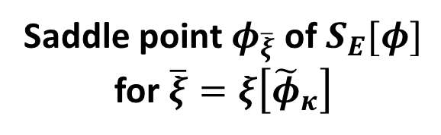

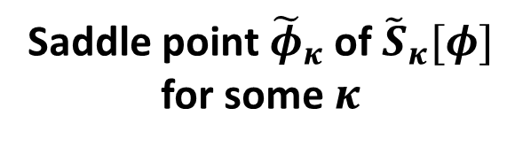
Idea – constrained instantons
Question: How do we find the saddle points for fixed $ξ\left[φ\right]=\overline{ξ}$ ?
Answer: Lagrange multipliers!
Constant Lagrange multiplier
Modified action
Saddle point ${\tilde{φ}}_{κ}$ of ${\tilde{S}}_{κ}[φ]$ for some $κ$
$$=$$
Saddle point $φ_{\overline{ξ}}$ of $S_{E}[φ]$ for $\overline{ξ}=ξ\left[{\tilde{φ}}_{κ}\right]$
K. Gawrych – Vacuum decay in theories with no instanton solutions UK QFT XIV, 26.11.2025, University of Nottingham

Slide 45
Idea – constrained instantons
Question: How do we find the saddle points for fixed $ξ\left[φ\right]=\overline{ξ}$ ?
Answer: Lagrange multipliers!
Constant Lagrange multiplier
Modified action
Solve EOM
Saddle point ${\tilde{φ}}_{κ}$ of ${\tilde{S}}_{κ}[φ]$ for some $κ$
$$=$$
Saddle point $φ_{\overline{ξ}}$ of $S_{E}[φ]$ for $\overline{ξ}=ξ\left[{\tilde{φ}}_{κ}\right]$
K. Gawrych – Vacuum decay in theories with no instanton solutions UK QFT XIV, 26.11.2025, University of Nottingham

Slide 46
Example – massive $φ^{4}$
K. Gawrych – Vacuum decay in theories with no instanton solutions UK QFT XIV, 26.11.2025, University of Nottingham

Slide 47

Example – massive $φ^{4}$
K. Gawrych – Vacuum decay in theories with no instanton solutions UK QFT XIV, 26.11.2025, University of Nottingham

Slide 48
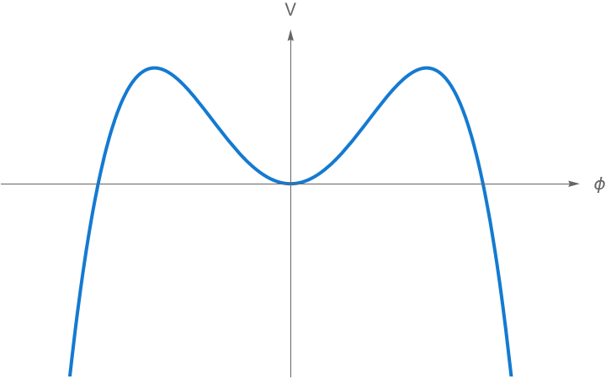
Example – massive $φ^{4}$
K. Gawrych – Vacuum decay in theories with no instanton solutions UK QFT XIV, 26.11.2025, University of Nottingham

Slide 49
Example – massive $φ^{4}$
K. Gawrych – Vacuum decay in theories with no instanton solutions UK QFT XIV, 26.11.2025, University of Nottingham

Slide 50


Example – massive $φ^{4}$
K. Gawrych – Vacuum decay in theories with no instanton solutions UK QFT XIV, 26.11.2025, University of Nottingham

Slide 51
Example – massive $φ^{4}$
K. Gawrych – Vacuum decay in theories with no instanton solutions UK QFT XIV, 26.11.2025, University of Nottingham

Slide 52

Example – massive $φ^{4}$
Culprit
K. Gawrych – Vacuum decay in theories with no instanton solutions UK QFT XIV, 26.11.2025, University of Nottingham

Slide 53
Example – massive $φ^{4}$
K. Gawrych – Vacuum decay in theories with no instanton solutions UK QFT XIV, 26.11.2025, University of Nottingham

Slide 54
Example – massive $φ^{4}$
K. Gawrych – Vacuum decay in theories with no instanton solutions UK QFT XIV, 26.11.2025, University of Nottingham

Slide 55
Example – massive $φ^{4}$
Make a choice
K. Gawrych – Vacuum decay in theories with no instanton solutions UK QFT XIV, 26.11.2025, University of Nottingham

Slide 56

Example – massive $φ^{4}$
K. Gawrych – Vacuum decay in theories with no instanton solutions UK QFT XIV, 26.11.2025, University of Nottingham

Slide 57

Example – massive $φ^{4}$
K. Gawrych – Vacuum decay in theories with no instanton solutions UK QFT XIV, 26.11.2025, University of Nottingham

Slide 58

Example – massive $φ^{4}$
K. Gawrych – Vacuum decay in theories with no instanton solutions UK QFT XIV, 26.11.2025, University of Nottingham

Slide 59

Example – massive $φ^{4}$
O(4) symmmetry
K. Gawrych – Vacuum decay in theories with no instanton solutions UK QFT XIV, 26.11.2025, University of Nottingham

Slide 60


Example – massive $φ^{4}$
O(4) symmmetry
+ Boundary conditions
K. Gawrych – Vacuum decay in theories with no instanton solutions UK QFT XIV, 26.11.2025, University of Nottingham

Slide 61
Example – massive $φ^{4}$
O(4) symmmetry
Solve numerically in a finite simulation box
+ Boundary conditions
K. Gawrych – Vacuum decay in theories with no instanton solutions UK QFT XIV, 26.11.2025, University of Nottingham

Slide 62
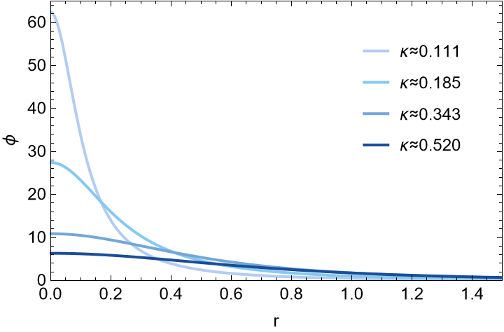
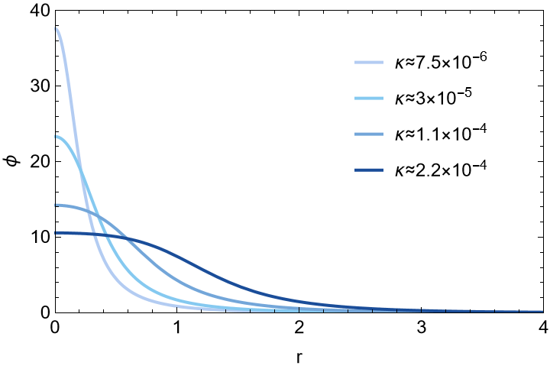


Results – field profiles
$$ϕ^{3}$$
$$ϕ^{6}$$
K. Gawrych – Vacuum decay in theories with no instanton solutions UK QFT XIV, 26.11.2025, University of Nottingham

Slide 63
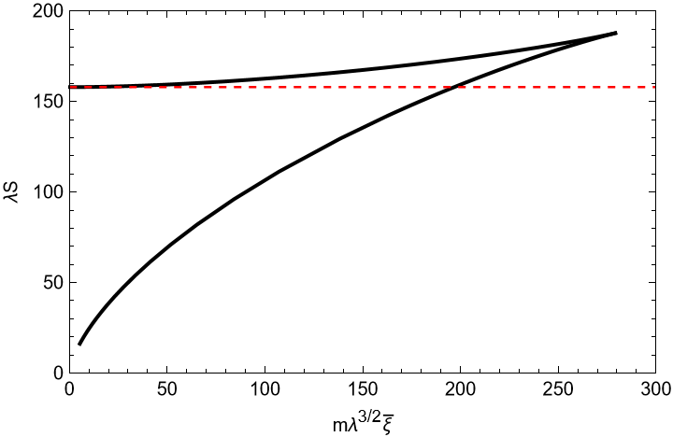
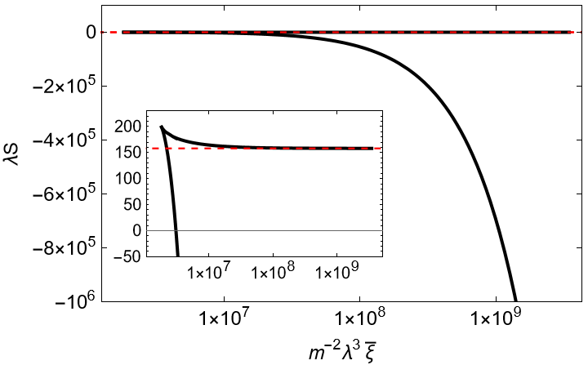


Results – action
$$ϕ^{3}$$
$$ϕ^{6}$$
K. Gawrych – Vacuum decay in theories with no instanton solutions UK QFT XIV, 26.11.2025, University of Nottingham

Slide 64
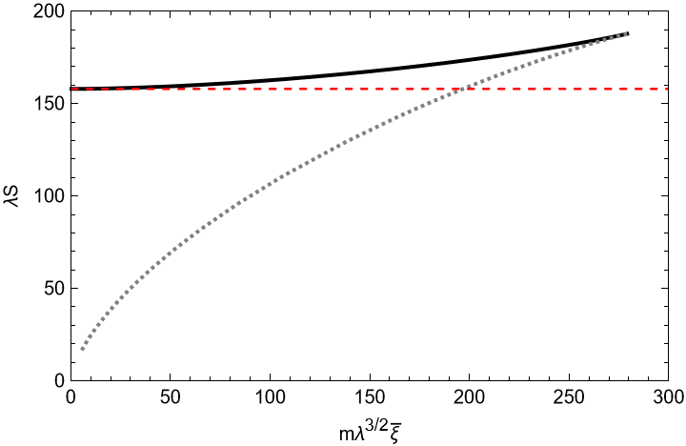
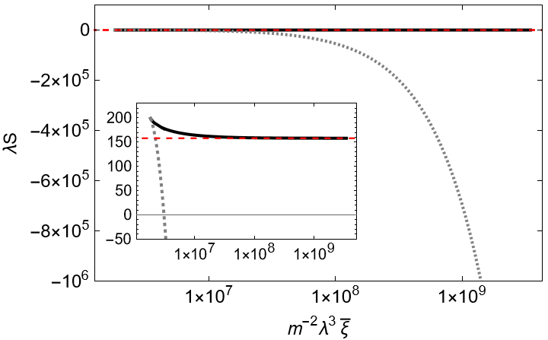
Results – action
$$ϕ^{3}$$
$$ϕ^{6}$$
K. Gawrych – Vacuum decay in theories with no instanton solutions UK QFT XIV, 26.11.2025, University of Nottingham

Slide 65
Results – field profiles yet again
$$ϕ^{3}$$
$$ϕ^{6}$$
K. Gawrych – Vacuum decay in theories with no instanton solutions UK QFT XIV, 26.11.2025, University of Nottingham

Slide 66
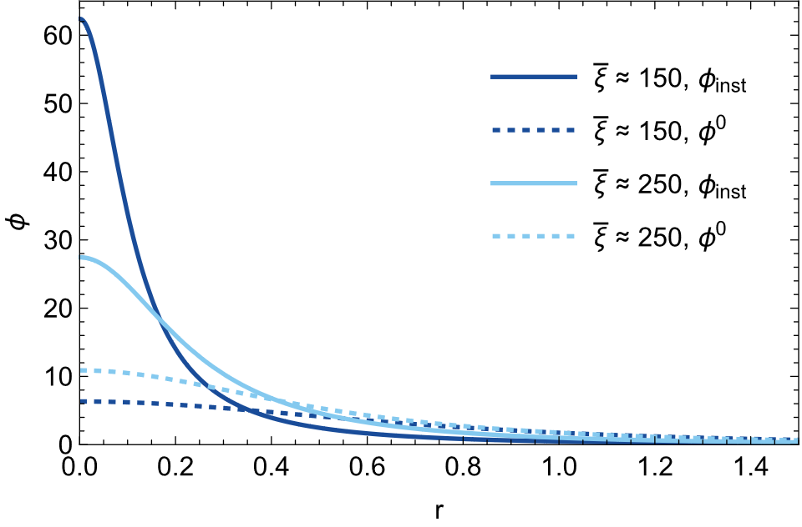
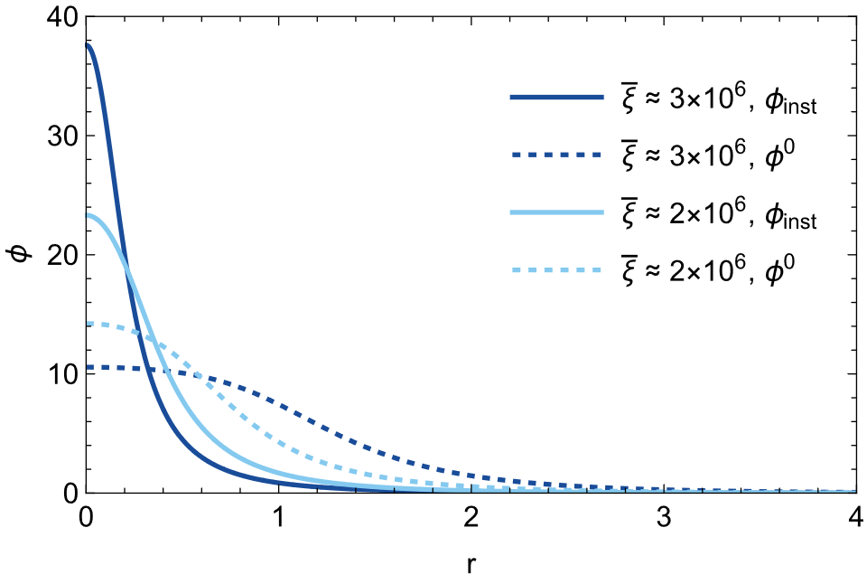
Results – field profiles yet again
$$ϕ^{3}$$
$$ϕ^{6}$$
K. Gawrych – Vacuum decay in theories with no instanton solutions UK QFT XIV, 26.11.2025, University of Nottingham

Slide 67
Summary and further research
K. Gawrych – Vacuum decay in theories with no instanton solutions UK QFT XIV, 26.11.2025, University of Nottingham

Slide 68
Summary and further research
SUMMARY
K. Gawrych – Vacuum decay in theories with no instanton solutions UK QFT XIV, 26.11.2025, University of Nottingham

Slide 69
Summary and further research
SUMMARY
Introduced a method for computing vacuum decay rates in theories with no explicit instanton solutions
K. Gawrych – Vacuum decay in theories with no instanton solutions UK QFT XIV, 26.11.2025, University of Nottingham

Slide 70
Summary and further research
SUMMARY
Introduced a method for computing vacuum decay rates in theories with no explicit instanton solutions
Showed how to use this method to find constrained instantons in a simple scalar model
K. Gawrych – Vacuum decay in theories with no instanton solutions UK QFT XIV, 26.11.2025, University of Nottingham

Slide 71
Summary and further research
SUMMARY
Introduced a method for computing vacuum decay rates in theories with no explicit instanton solutions
Showed how to use this method to find constrained instantons in a simple scalar model
Omitted a lot of technical details – these can be found in the paper
K. Gawrych – Vacuum decay in theories with no instanton solutions UK QFT XIV, 26.11.2025, University of Nottingham

Slide 72
Summary and further research
SUMMARY
Introduced a method for computing vacuum decay rates in theories with no explicit instanton solutions
Showed how to use this method to find constrained instantons in a simple scalar model
Omitted a lot of technical details – these can be found in the paper
or just ask me!
K. Gawrych – Vacuum decay in theories with no instanton solutions UK QFT XIV, 26.11.2025, University of Nottingham

Slide 73
Summary and further research
SUMMARY
Introduced a method for computing vacuum decay rates in theories with no explicit instanton solutions
Showed how to use this method to find constrained instantons in a simple scalar model
Omitted a lot of technical details – these can be found in the paper
FURTHER RESEARCH
or just ask me!
K. Gawrych – Vacuum decay in theories with no instanton solutions UK QFT XIV, 26.11.2025, University of Nottingham

Slide 74
Summary and further research
SUMMARY
Introduced a method for computing vacuum decay rates in theories with no explicit instanton solutions
Showed how to use this method to find constrained instantons in a simple scalar model
Omitted a lot of technical details – these can be found in the paper
FURTHER RESEARCH
Computation of the fluctuation determinant (work in progress)
or just ask me!
K. Gawrych – Vacuum decay in theories with no instanton solutions UK QFT XIV, 26.11.2025, University of Nottingham

Slide 75
Summary and further research
SUMMARY
Introduced a method for computing vacuum decay rates in theories with no explicit instanton solutions
Showed how to use this method to find constrained instantons in a simple scalar model
Omitted a lot of technical details – these can be found in the paper
FURTHER RESEARCH
Computation of the fluctuation determinant (work in progress)
Comparison of the results (full rate) for different constraint operators
or just ask me!
K. Gawrych – Vacuum decay in theories with no instanton solutions UK QFT XIV, 26.11.2025, University of Nottingham

Slide 76
Summary and further research
SUMMARY
Introduced a method for computing vacuum decay rates in theories with no explicit instanton solutions
Showed how to use this method to find constrained instantons in a simple scalar model
Omitted a lot of technical details – these can be found in the paper
FURTHER RESEARCH
Computation of the fluctuation determinant (work in progress)
Comparison of the results (full rate) for different constraint operators
Analytic construction of constrained instantons for extreme values of κ (work in progress)
or just ask me!
K. Gawrych – Vacuum decay in theories with no instanton solutions UK QFT XIV, 26.11.2025, University of Nottingham

Slide 77
Summary and further research
SUMMARY
Introduced a method for computing vacuum decay rates in theories with no explicit instanton solutions
Showed how to use this method to find constrained instantons in a simple scalar model
Omitted a lot of technical details – these can be found in the paper
FURTHER RESEARCH
Computation of the fluctuation determinant (work in progress)
Comparison of the results (full rate) for different constraint operators
Analytic construction of constrained instantons for extreme values of κ (work in progress)
Extension of the method to theories with gauge fields (partial results) and application to the electroweak sector of the Standard Model
or just ask me!
K. Gawrych – Vacuum decay in theories with no instanton solutions UK QFT XIV, 26.11.2025, University of Nottingham

Slide 78
Thank you
K. Gawrych – Vacuum decay in theories with no instanton solutions UK QFT XIV, 26.11.2025, University of Nottingham

