Slide 1


Matter Sourced Bubble Nucleation in the Asymmetron Scalar-Tensor Theory
Usama Syed Aqeel
Clare Burrage, Oliver Gould & Paul Saffin
UK-QFT XIV
arXiv:2510.25499
Notes:
Hello, My name's usama and I'm going to talk with you about a recent paper my collaborators (Clare, Oli and Paul) and I released a few weeks ago called "matter sourced bubble nucleation in the asymmetron scalar-tensor theory". You can find it on the arxiv here.

Slide 2
Introduction
Scalar fields are ubiquitous in early Universe physics.
Some applications: cosmological phase transitions, inflation, cosmic structure and vacuum stability.
Scalar fields with metastable states can spontaneously tunnel – resulting in a bubble of true vacuum!
The Symmetron is a scalar-tensor theory of gravity with spontaneous symmetry-breaking (SSB) coupled to local matter density.
Notes:
To start off with, some words on the big picture of the talk.
Scalar fields are ubiquitous in models of the early universe.
Their applications include, cosmological phase transitions, inflation, the origins of cosmic structure and vacuum stability.
In some models, scalar fields can be endowed with metastable states as well as truly stable states vacua. From the metastable state the scalar can spontaneously tunnel to the true vacuum – resulting in a bubble of this stable phase.
[A Question would be good here].

Slide 3



The Symmetron Mechanism I
The symmetron – originally a model for dynamical dark energy in Refs. [1, 2]
The metrics are related by a Weyl transformation:
EOM:
For a pressureless fluid, in the Einstein frame, make this choice:
1. Hinterbichler and Khoury (2010)
2. Hinterbichler, Khoury, Levy and Matas (2011)
Notes:
The symmetron is an example of a scalar tensor theory – proposed as a model for dynamical dark energy by Hinterbichler and Khoury in 2010.
The action of the symmetron is split into two parts, the first part looks like a scalar field minimally coupled to gravity in the Einstein frame.
The second term is the standard model matter action coupled to gravity in the Jordan frame.
The metrics in the two frames are related to each other by a Weyl transformation – where g_tilde is the Jordan frame metric and g is the Einstein frame metric.
The equation of motion shown on the right looks familiar, however we have an explicit term that includes the Weyl factor and its derivatives.
T_tilde is the energy momentum tensor of matter in the jordan frame.
We can choose the matter to be a pressureless fluid in the Einstein frame, by making the following assignment.

Slide 4


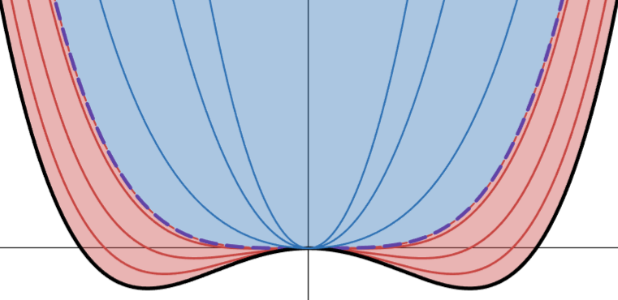





The Symmetron Mechanism II
EOM can be written,
Effective potential:
1. Hinterbichler and Khoury (2010)
2. Hinterbichler, Khoury, Levy and Matas (2011)
3. Clements, Elder, Hackermuller, Fromhold, Burrage (2023)
Notes:
The equation of motion can be written in terms of the bare potential, V and Weyl factor, A – components of an effective potential.
For the symmetron, we choose the bare potential to be the mexican hat potential
And we choose A to be an even function in the field – the simplest case is a quadratic function,
where M is introduced as an energy scale for the symmetron, such that φ << M
Thus the effective potential is given by the following.
We introduce \rho_* = \mu^2M^2 - a critical density of the potential.
For matter densities < \rho_*:
The scalar breaks the Z_2 symmetry spontaneously – we have fifth forces.
For matter densities > \rho_*:
The symmetry is restored, the scalar field has 1 minimum at φ~0 and is locked in place. Weyl factor A=1, and we recover GR from the action earlier. (no fifth forces)
(Optional): Why this choice?
The matter coupling vanishes when symmetry is restored! \phi ~ 0
The matter coupling must turn on when the symmetry breaks! - A'(phi_0) =/= 0
It retains the Z_2 symmetry in the effective potential – linear terms allow constant fifth forces in screened limit. Quadratic ones don't
F_5 = dlnA/dφ
The point is that it prevents fifth forces in high-density environments like the solar system.

Slide 5
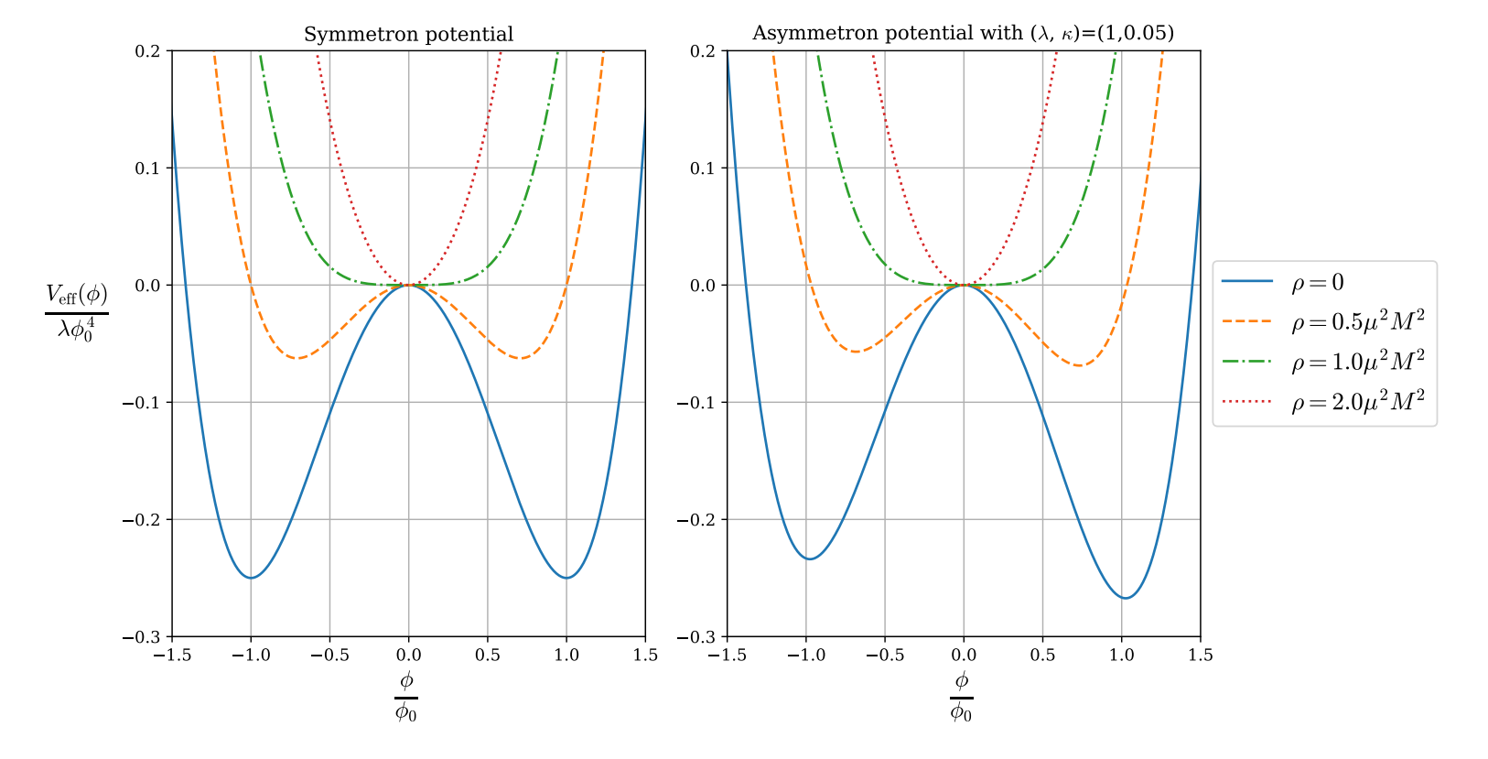


The Asymmetron Mechanism
Asymmetron – different V(ϕ):
Yielding the effective potential
4. Perivolaropolous and Skara (2022)
5. Christiansen, Hassani and Mota (2024)
Notes:
Now, there exists a modification of the symmetron known as the asymmetron.

Slide 6
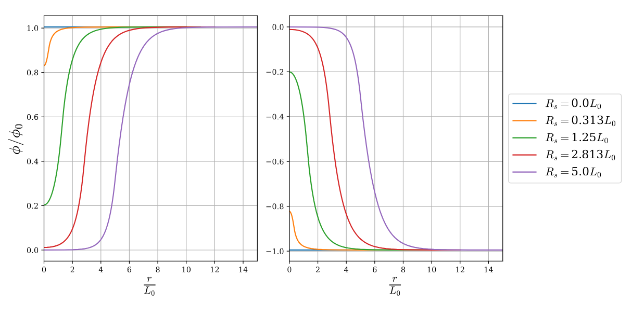

Asymmetron around inhomogeneous density distributions
Symmetron around spherical object, R_{s}, solved in Ref. [2].
Object with density, ρ_{s}>>ρ*=μ²M², surrounded by vacuum
Large R_{s}>>L₀, thin-wall, planar limit.
2. Hinterbichler, Khoury, Levy and Matas (2011)

Slide 7



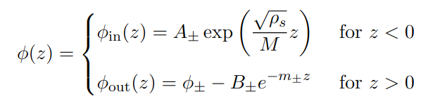
Trivial Profiles Around Dense Planar Object
In the planar limit, EOM is written as:
Boundary conditions, ϕ(∞) = ϕ±, ϕ'(-∞) = 0:

Slide 8
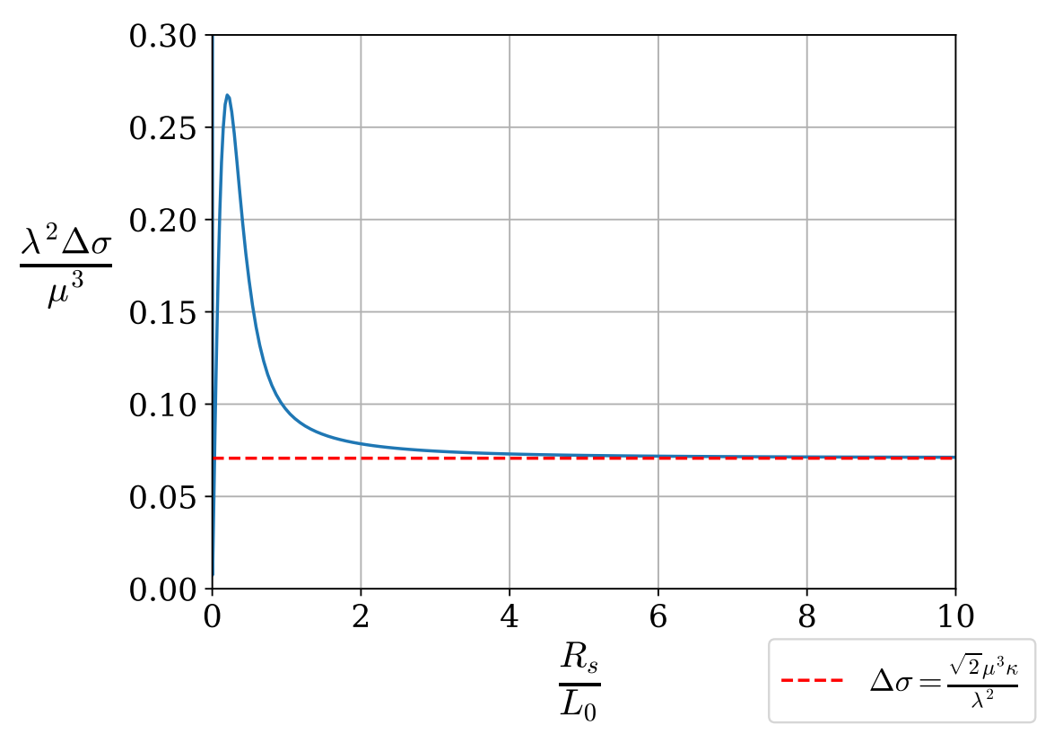
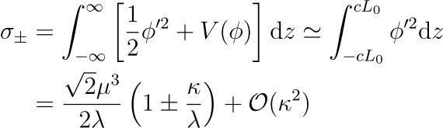

Surface Energy Density at Planar Wall
Surface Energy density
Difference in surface tensions,

Slide 9

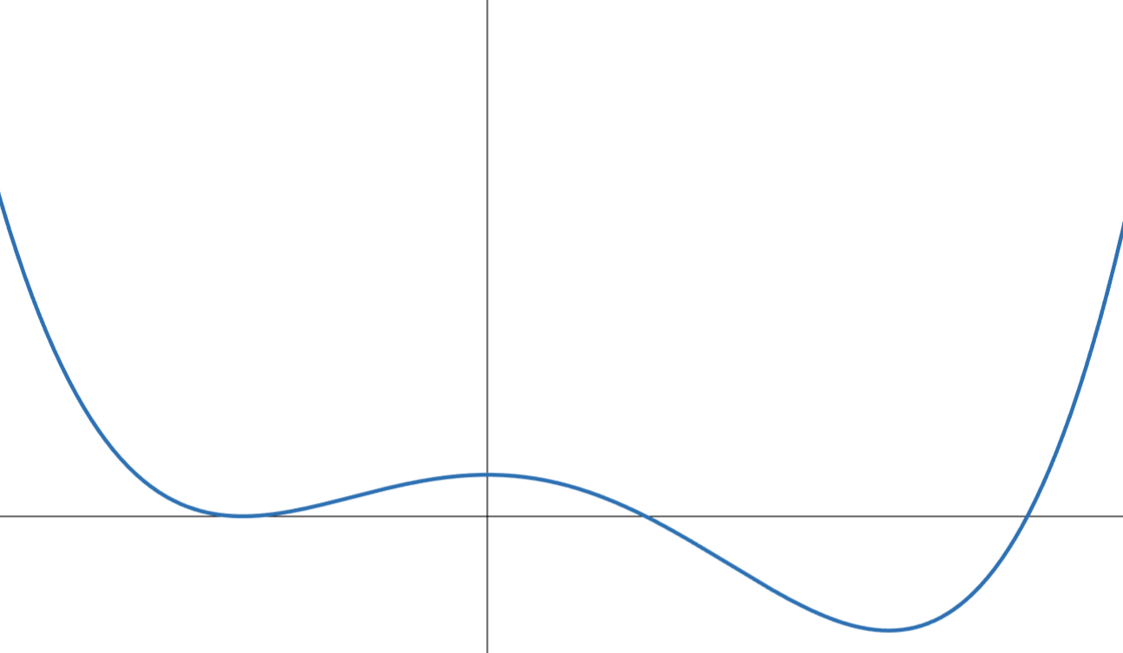




Vacuum Decay and Instantons I
Consider a scalar field, ϕ, endowed with a false (ϕ₋) and true vacuum (ϕ₊).
False vacuum metastable under quantum fluctuations
The decay rate of the false vacuum:
Tree-Level Amplitude
Negative
Eigenvalue
Positive
Fluctuation Spectrum
Zero
Mode
Contribution
6. Langer (1969)
7. Coleman (1977)
8. Coleman and Callan (1977)
Notes:
The classical saddle configuration is called the bounce – the boundary conditions include paths that bounce off the turning point (shown to the right) and return to ϕ₋.

Slide 10

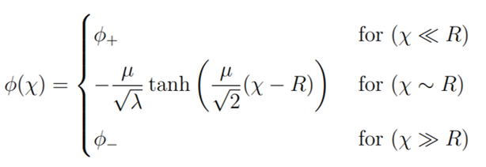

Vacuum Decay and Instantons II
Bounce: O(4) symmetry of ϕ
The Euclidean action,
EOM with boundary conditions ϕ(∞) = ϕ₋, ϕ'(0)= 0.
Thin wall approximation: Valid when R >>L₀ (another scale hierarchy)!
7. Coleman (1977)
Notes:
The Euclidean action of an O(4) symmetric system is given by...
Where chi is the Euclidean radial coordinate in R^4.
We want a solution that is regular at chi=0, but the first derivative term has a 1/chi singular point, thus phi'(0)=0
The want the scalar to be in the false vacuum at infinity.

Slide 11





Thin-Wall Bubbles
The Euclidean action in the thin-wall approximation is,
Describes a bubble with surface area, A, and volume, V.
For a three-sphere, the bubble is,
The critical bubble has stationary Euclidean action:
R₀
ε
σ
7. Coleman (1977)
Notes:
In the thin-wall approximation, the action of the bubble is described purely in terms of geometric quantities, the areas and volumes.
This action looks like the free energy of a macroscopic bubble.
From the exponential suppression, in Gamma, we see that when more than one instanton is compatible with the boundary conditions,
The one with the smallest Euclidean action is preferred!

Slide 12
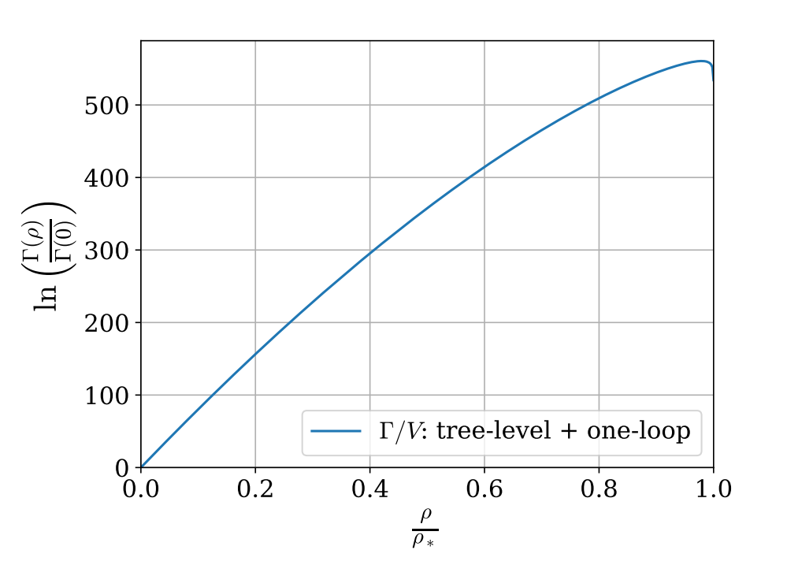



O(4) bubble with Asymmetron Mechanism
Bulk O(4) case (symmetron modification)
We can calculate the semiclassical decay rate:
Notes:
Let's look at the bulk O(4) bubble inside a region with a matter density, rho<\rho_*.
The Euclidean action is the same as the Coleman Callan bubble, however, with an additional factor accounting for the density of the source.
Comparing the decay rate of this process with the same process in vacuum, we can see that for densities less than \rho_*, the decay rate increases

Slide 13


Classical Bubbles I
The scalar field profile being described by a bubble/droplet is a cute.
The asymmetron couples to boundaries of dense objects.
Can we extend the analysis to accommodate bubbles forming on these boundaries?

Slide 14
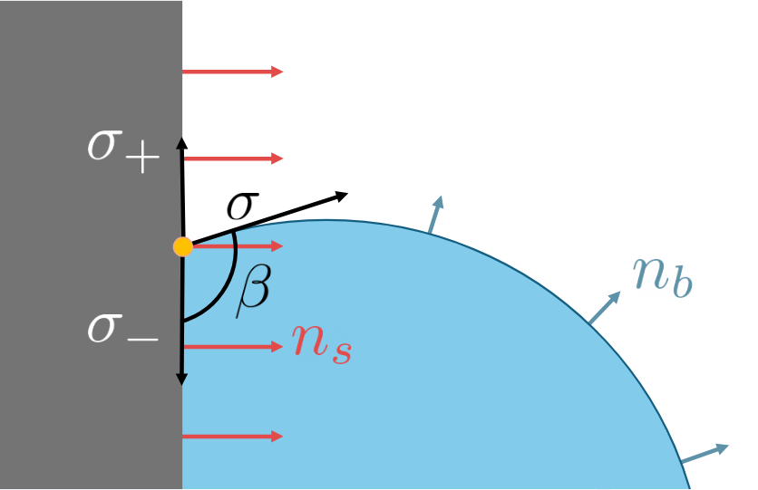

Classical Bubbles II
Bubble-Substrate System (water droplet on a table).
The three-phase contact angle, β, is given by,
gas
Previously, we found for the asymmetron,
liquid
solid

Slide 15
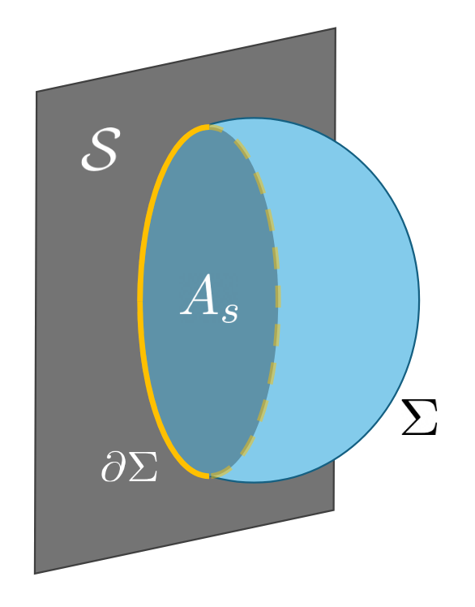




Classical Bubbles III
Boundaries modify the Euclidean action:
Bubble is codimension-1 in R⁴:
g_{μν} - background metric
γ_{ab} - induced metric on the bubble
Canaletti and Moss (2024).
Brown, Moss, and Billam (2025).
Jenkins, Peiris, and Pontzen (2025).

Slide 16

The Instantons
Planar Substrates, with contact angle β:

Slide 17
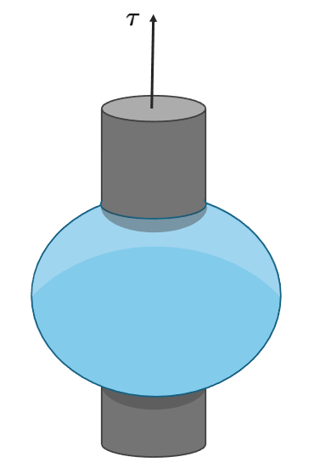
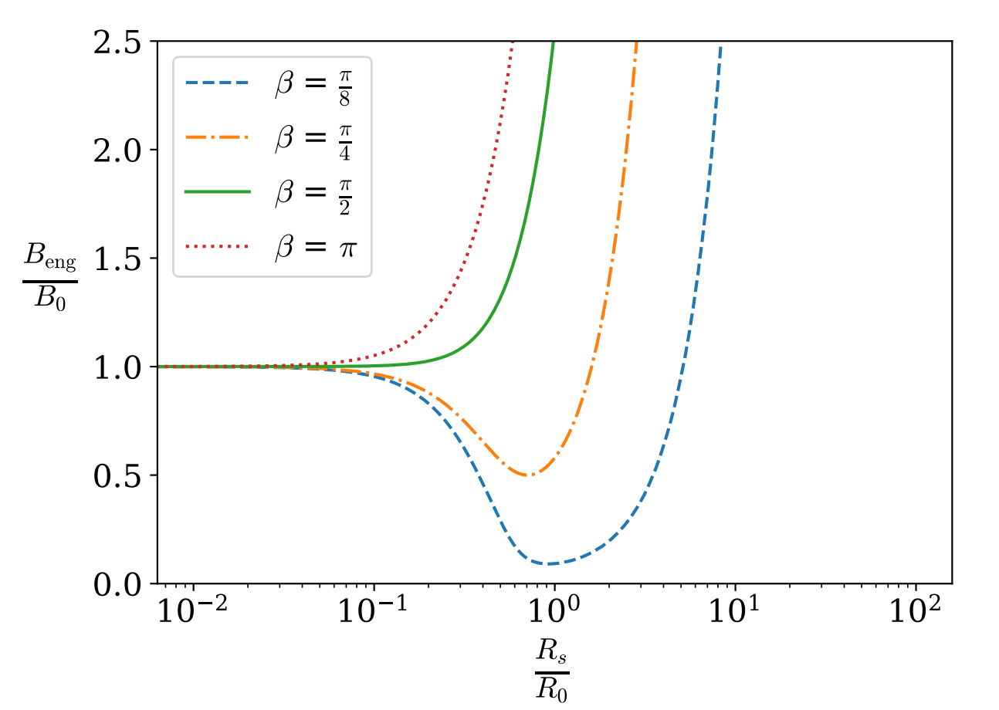



The Instantons II
Spherical Substrates:
Engulfing Instanton, with contact angle β:

Slide 18


The Instantons III
Edge Spherical Cases:
Perturbation on planar case: L₀<<R₀<<R_{s} – a hierarchy in scales.
Convex Surface
+: convex surface
-: concave surface
Concave Surface
Soleimani, Hill and van de Ven (2013)
Canaletti and Moss (2024)

Slide 19
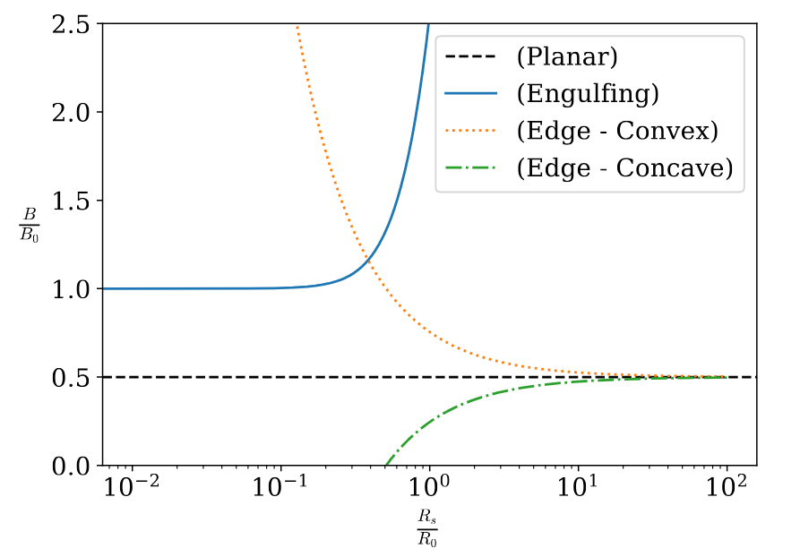
Preferred Instanton
The preferred instanton has the lowest Euclidean action:
Thus, the bubble preferentially forms on a concave surface.
Concave Surface

Slide 20




Is bulk nucleation ever preferred?
Bubble nucleation near concave cylindrical boundary, R_{s}.
Upper bound on edge nucleation,
If R_{s} > Λ, then bulk nucleation is preferred.
Unless ρ-ρ*<<ρ* : Λ becomes O(R₀)- bubble cannot fit in this concavity – must be bulk nucleation.

Slide 21


Fun with numbers: Vacuum Chambers
Estimated values of the symmetron parameters in vacuum chambers (for ρ=0) in Ref. [3],
And my predicted value of Λ is,
The radius of the observable Universe is this many:
Bulk nucleation is never preferred.
3. Clements, Elder, Hackermuller, Fromhold, Burrage (2023)

Slide 22


Fun with numbers: Cosmic Voids
Symmetron parameters at the cosmological scale (for ρ=0)
And my predicted value of Λ is,
The radius of the observable Universe is this many:
So bulk nucleation is not preferred.
5. Christiansen, Hassani and Mota (2024)

Slide 23
Conclusion
We sourced surface tensions in the asymmetron from the screening mechanism inside dense sources.
We have shown that the preferred boundary for nucleation is a concave spherical surface.
In the presence of a source with a density less than but close to the critical density, the bulk nucleation is preferred.

Slide 24
Thank you for listening!
Any questions?

Slide 25




For Topological Defect Enjoyers...
The spontaneously broken Z₂ symmetry of the symmetron effective potential allows for topological defects known as domain walls to form.
Static, planar domain wall profile (normal to the xy-plane) is a minimum of the energy functional,
From Bogomolnyi's method, we can write a one-dimensional planar domain wall solution
With surface energy density (surface tension) given by,
Key: The argument of the tanh function becomes imaginary – domain walls are no longer permitted when rho>rho_*, because the symmetry of the potential is fully restored and there is only one minimum at phi=0.

