Slide 1
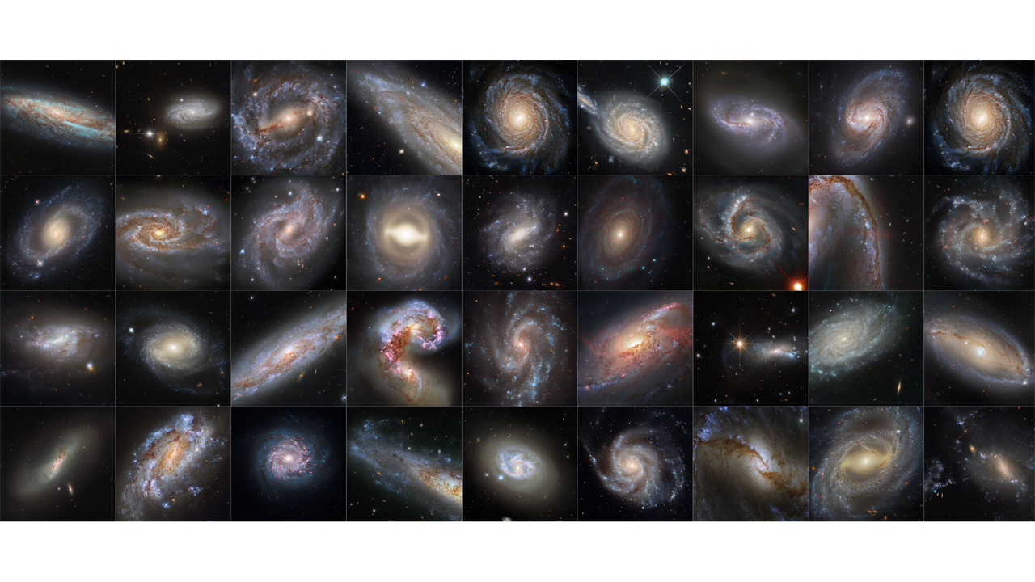



Characterisation of Type Ibn Supernovae using Zwicky Transient Facility data
Anjasha Gangopadhyay
Postdoctoral Fellow
Oskar Klein Center
Stockholm University
Sweden
In collaboration with Jesper Sollerman et al., On behalf of the ZTF collaboration
A dazzling collection of supernova host galaxies! Courtesy : STSCI

Slide 2
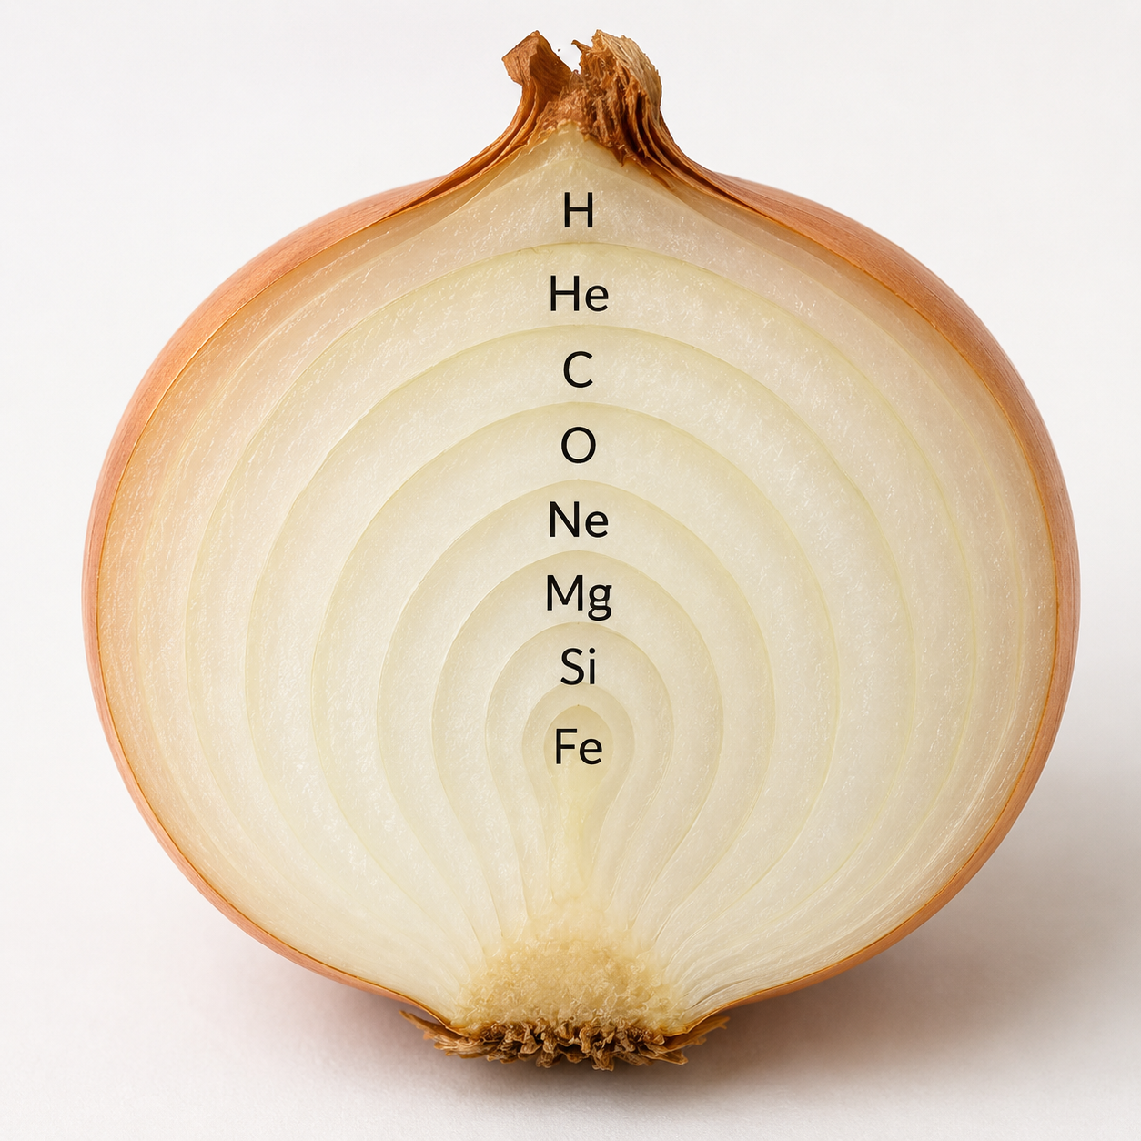
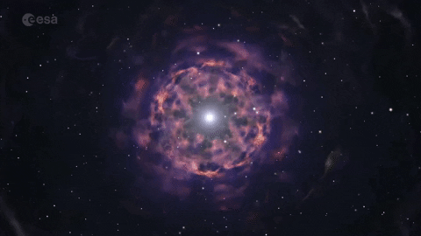
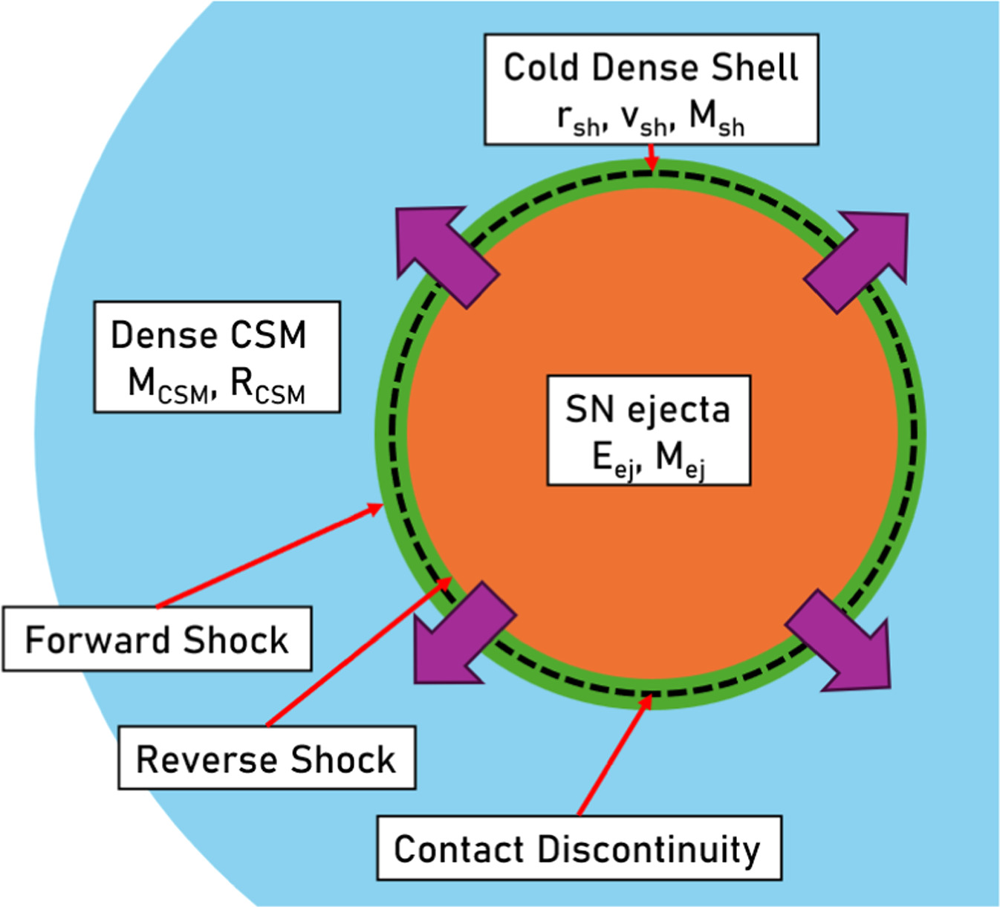
Supernovae:
A supernova is the violent and luminous death of a star, in which stellar material is expelled into space at enormous velocities, enriching the surrounding medium with freshly synthesized elements and shaping the chemical and dynamical evolution of galaxies.
Chiba et al. 2025

Slide 3
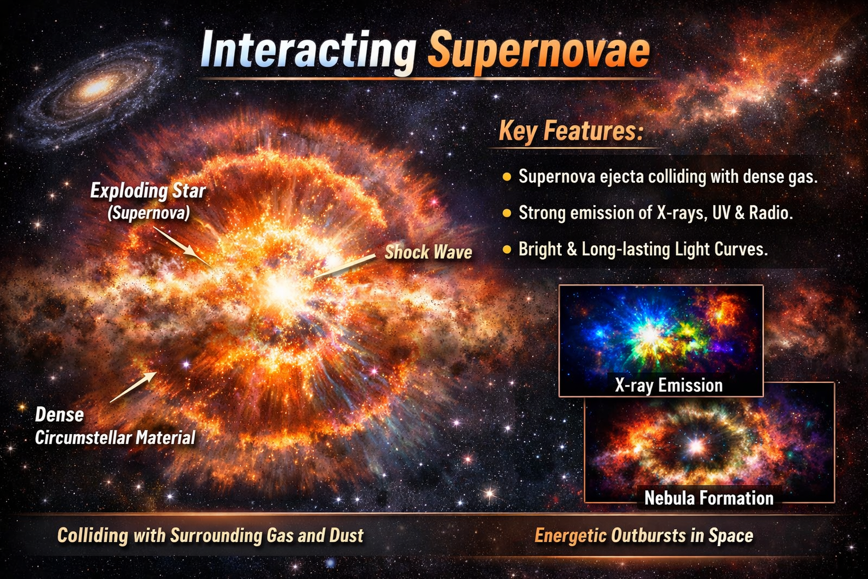
Strong stellar explosions
Huge energies!
Interact with dense circumstellar medium!
Unknown progenitor systems!
Pic -chatgpt

Slide 4
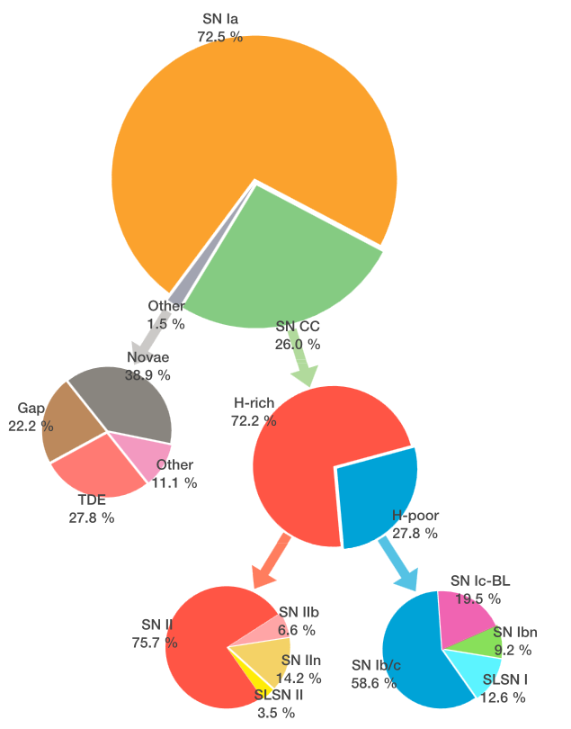
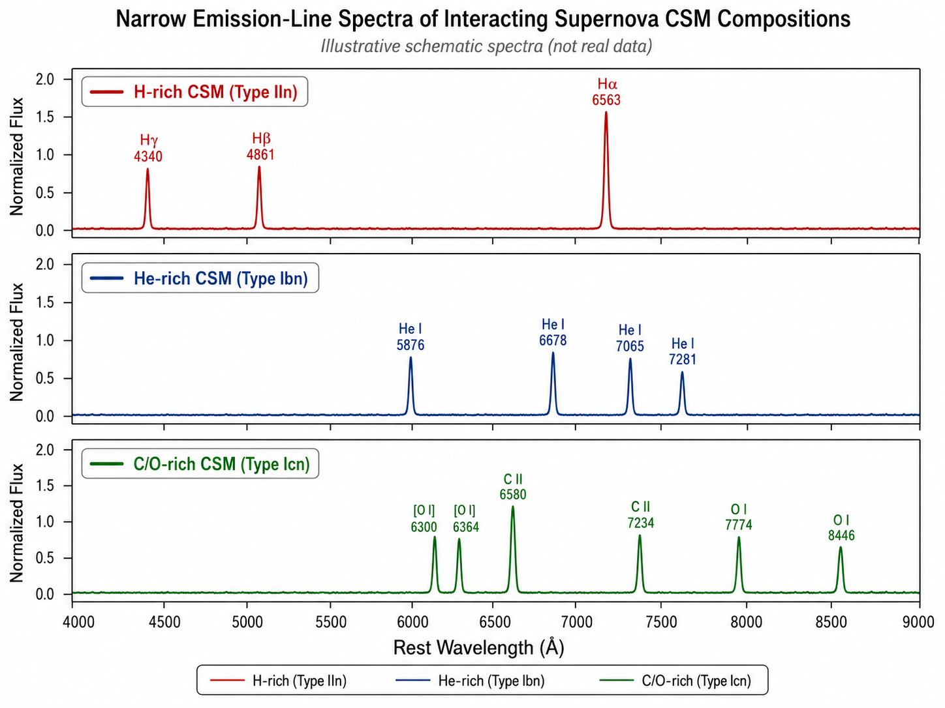
The extragalactic transient space:
Perley et al. 2020
Icn - narrow C/O

Slide 5
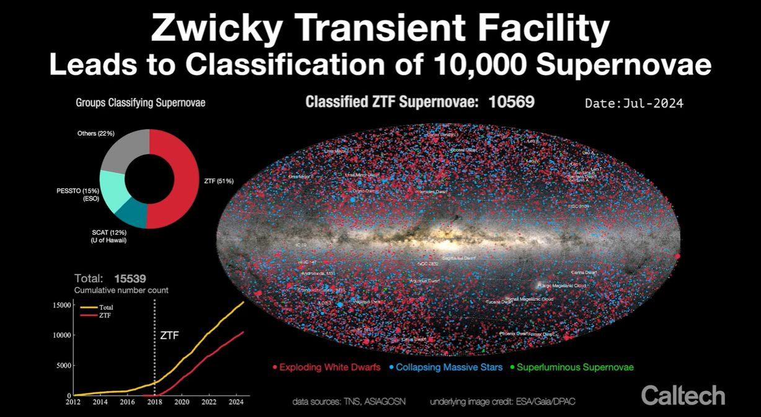
Only 40 SNe Ibn

Slide 6
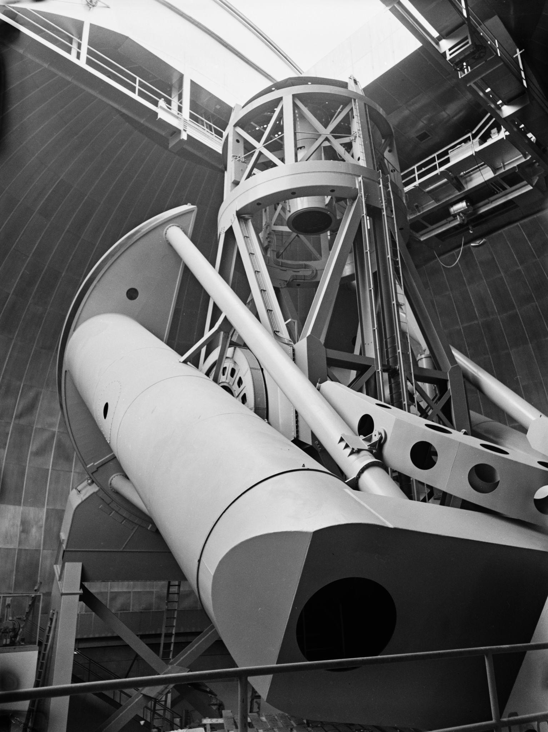
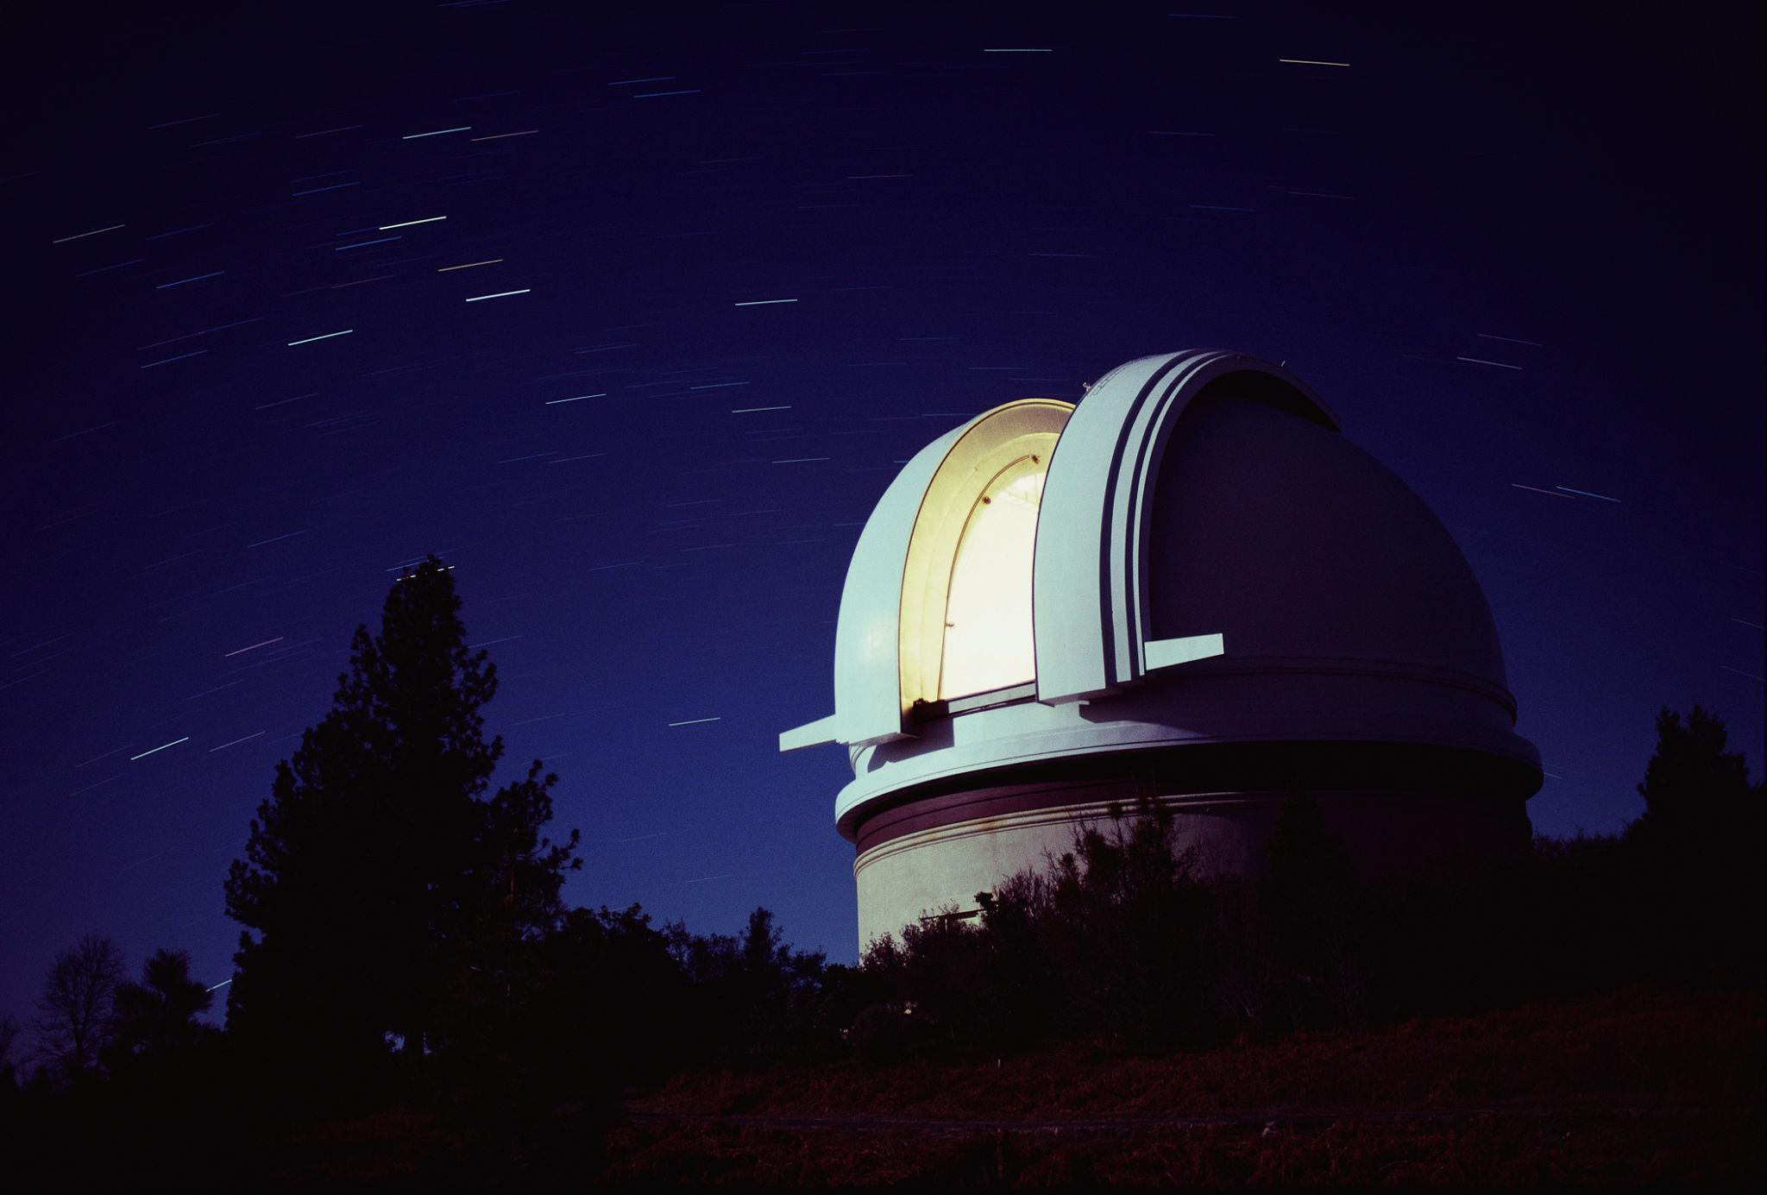
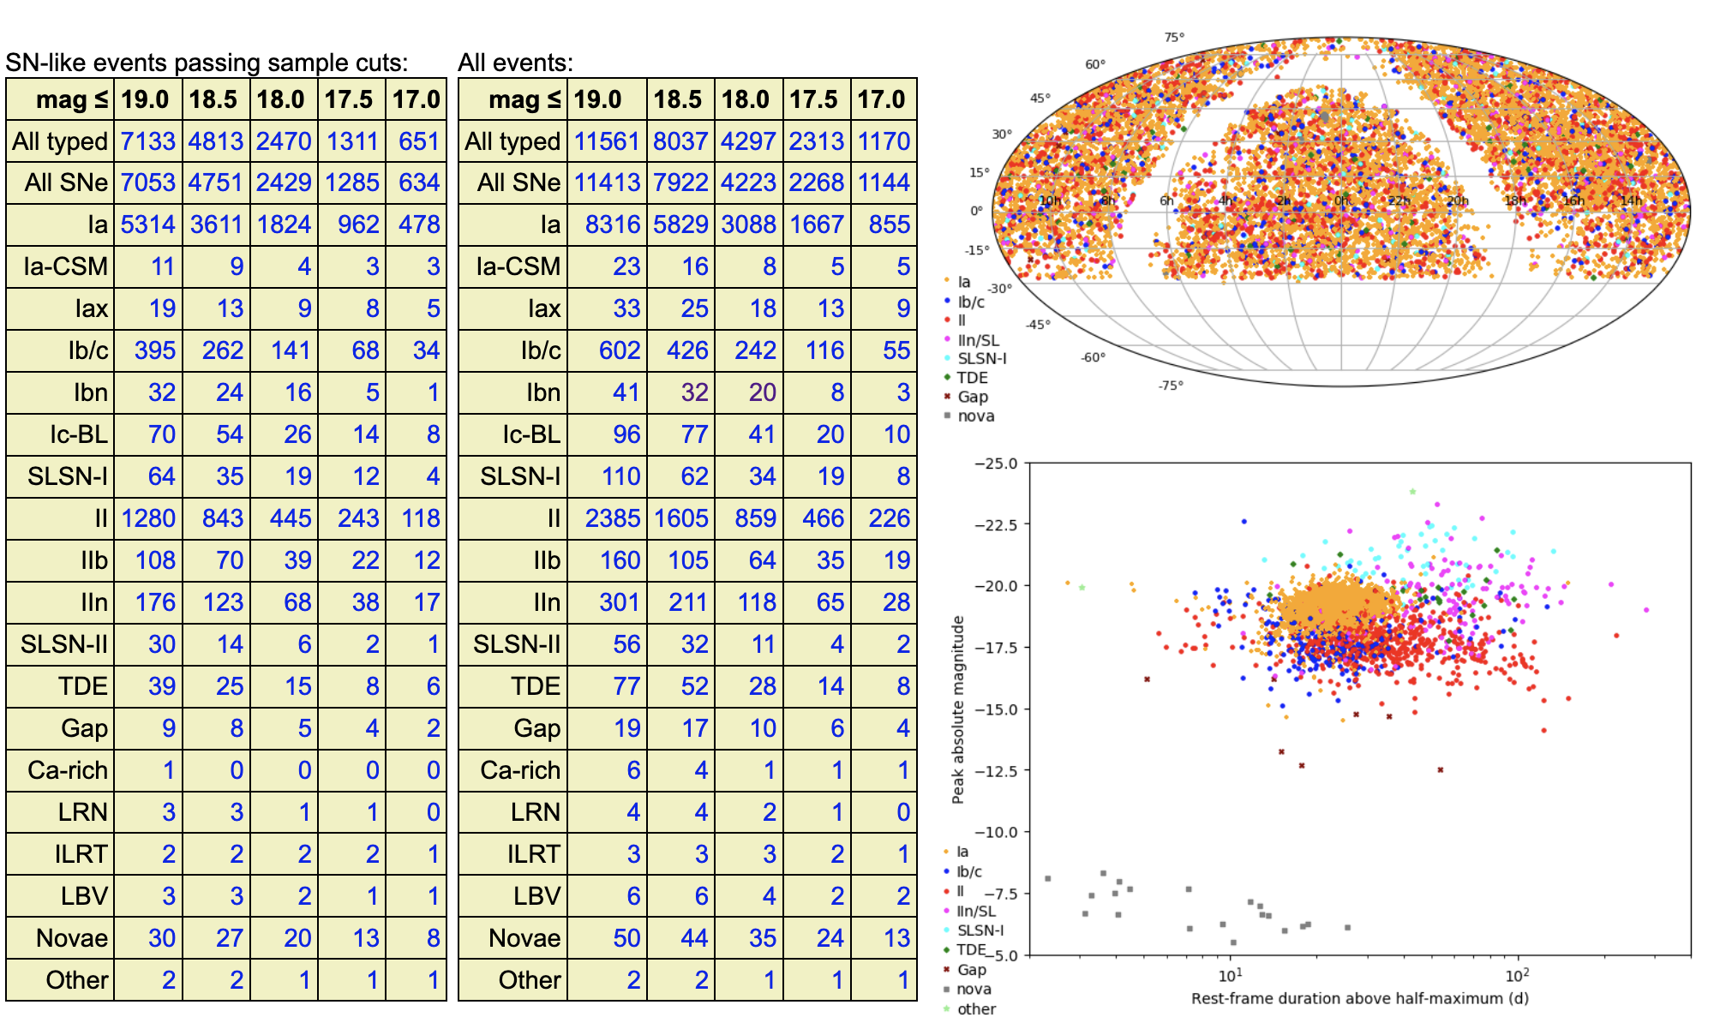
Telescopes in Palomar
Telescopes
which i use:
1.Palomar Telescopes, USA
2. Nordic Optical Telescope
3. Keck Telescope
4. Liverpool Telscope

Slide 7
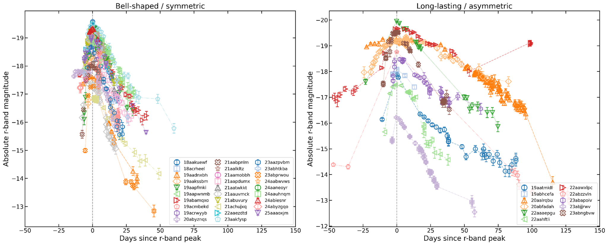
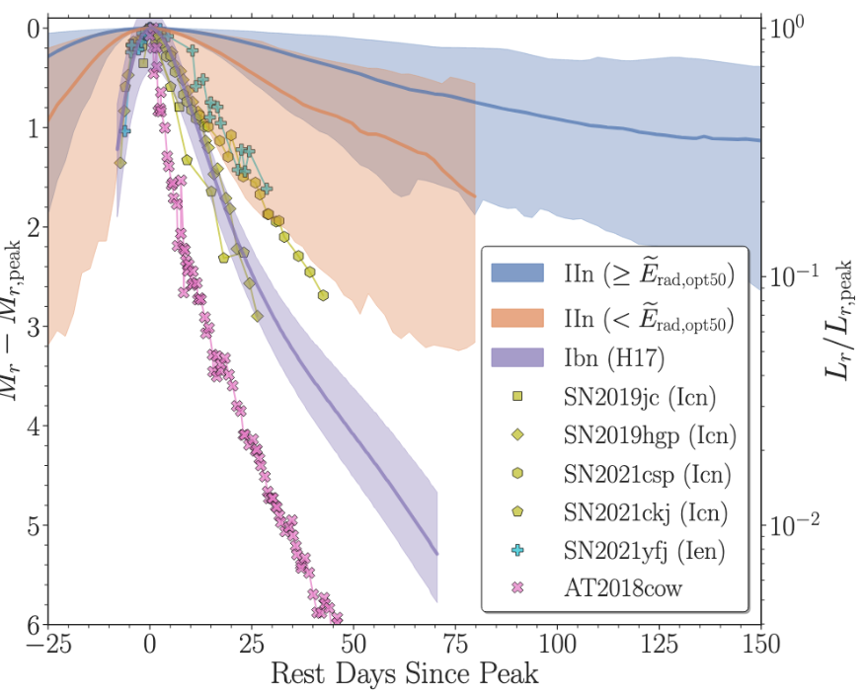
Diversity in the lightcurves:
Hosseinzadeh et al. 2024
< 10 d
> 10 d
Two populations: Diverse CSM configuration!!!
Gangopadhyay,A; Sollerman, J et al. 2026
Risetime

Slide 8
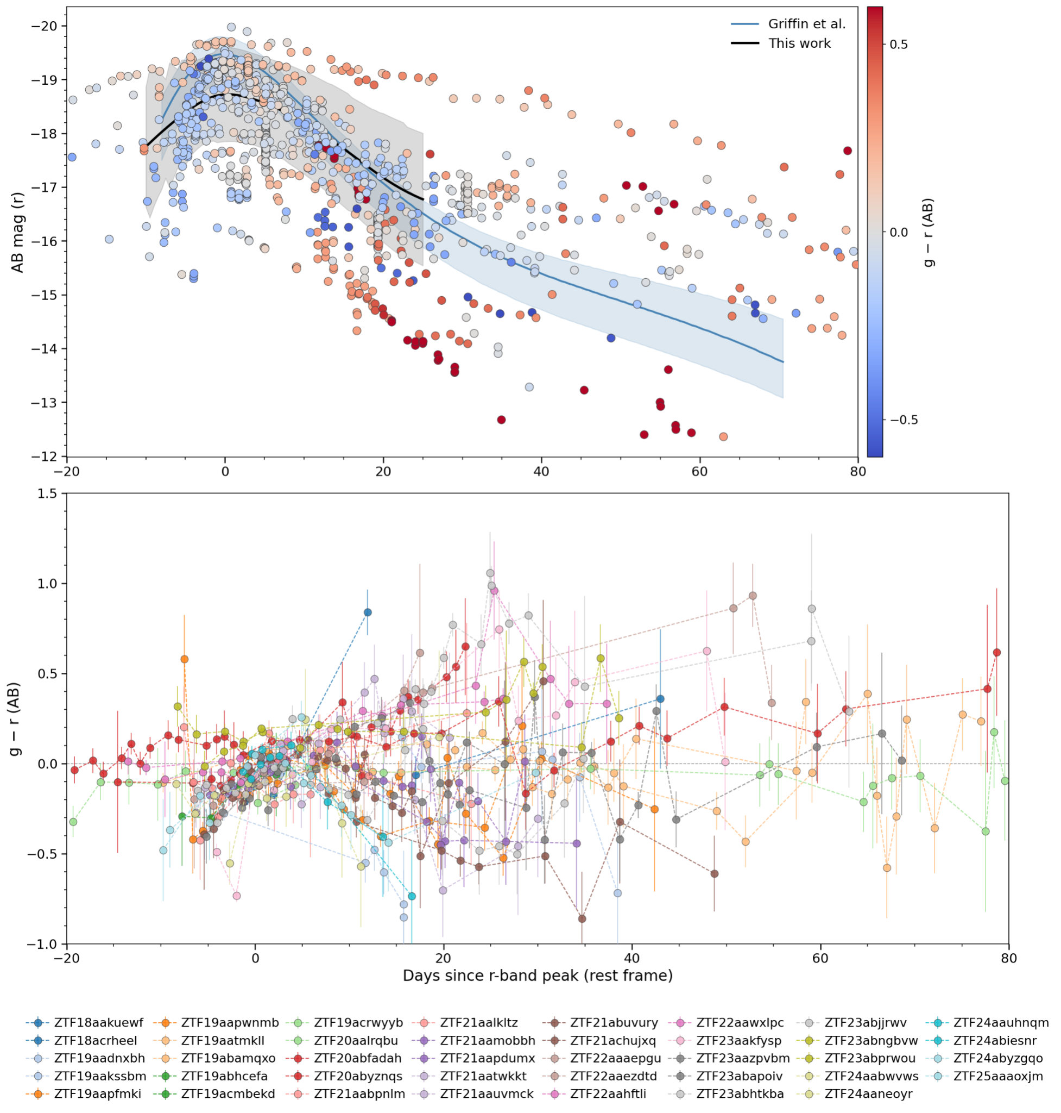
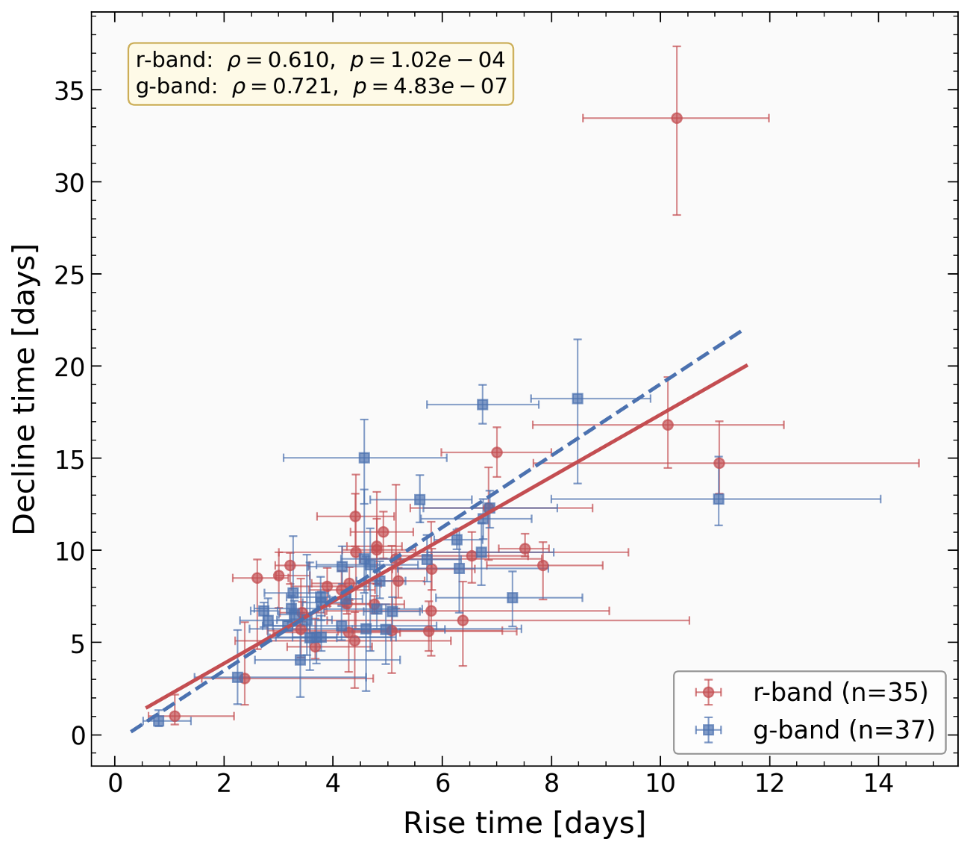
Diversity in lightcurves:
Homogeneous only around peak, strongly correlated.
Brighter are not bluer.

Slide 9
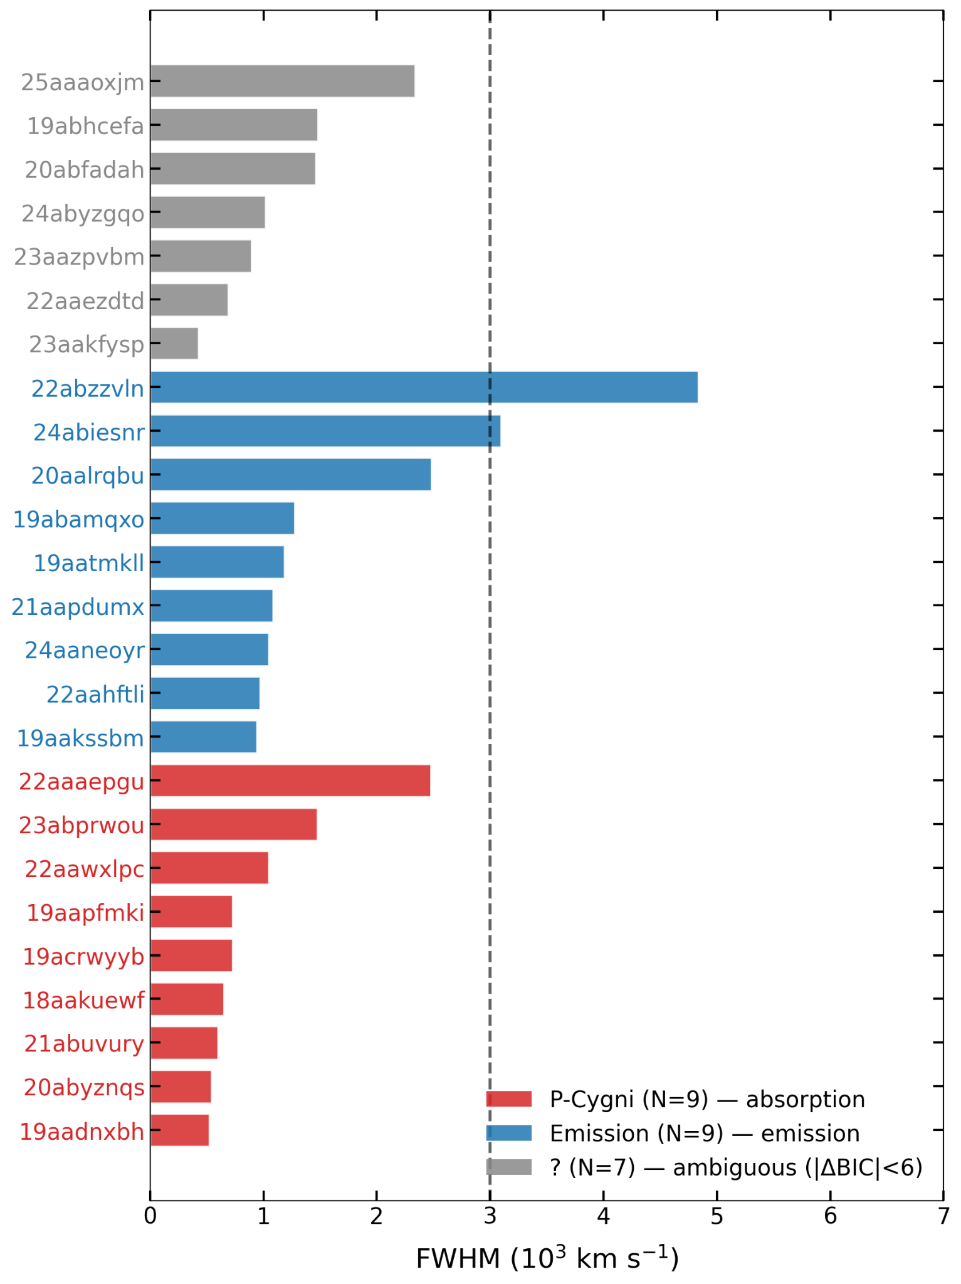
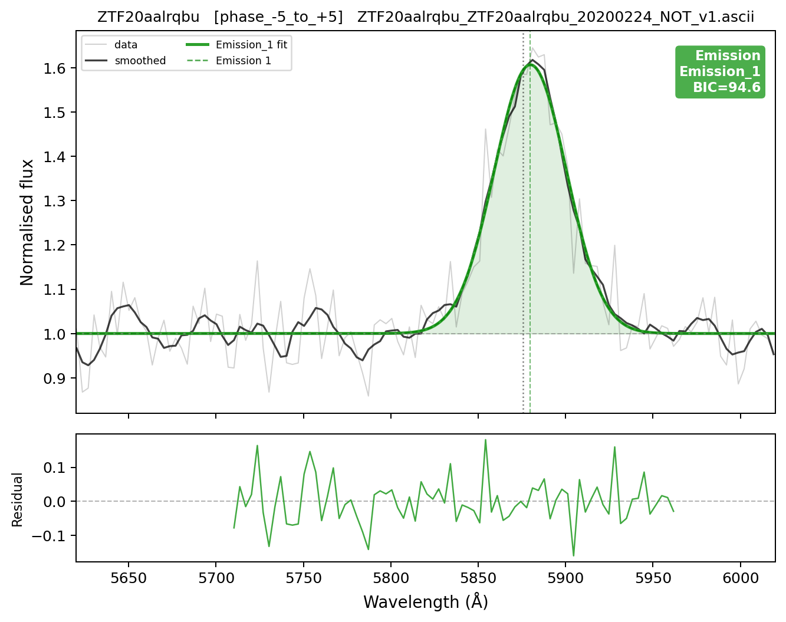
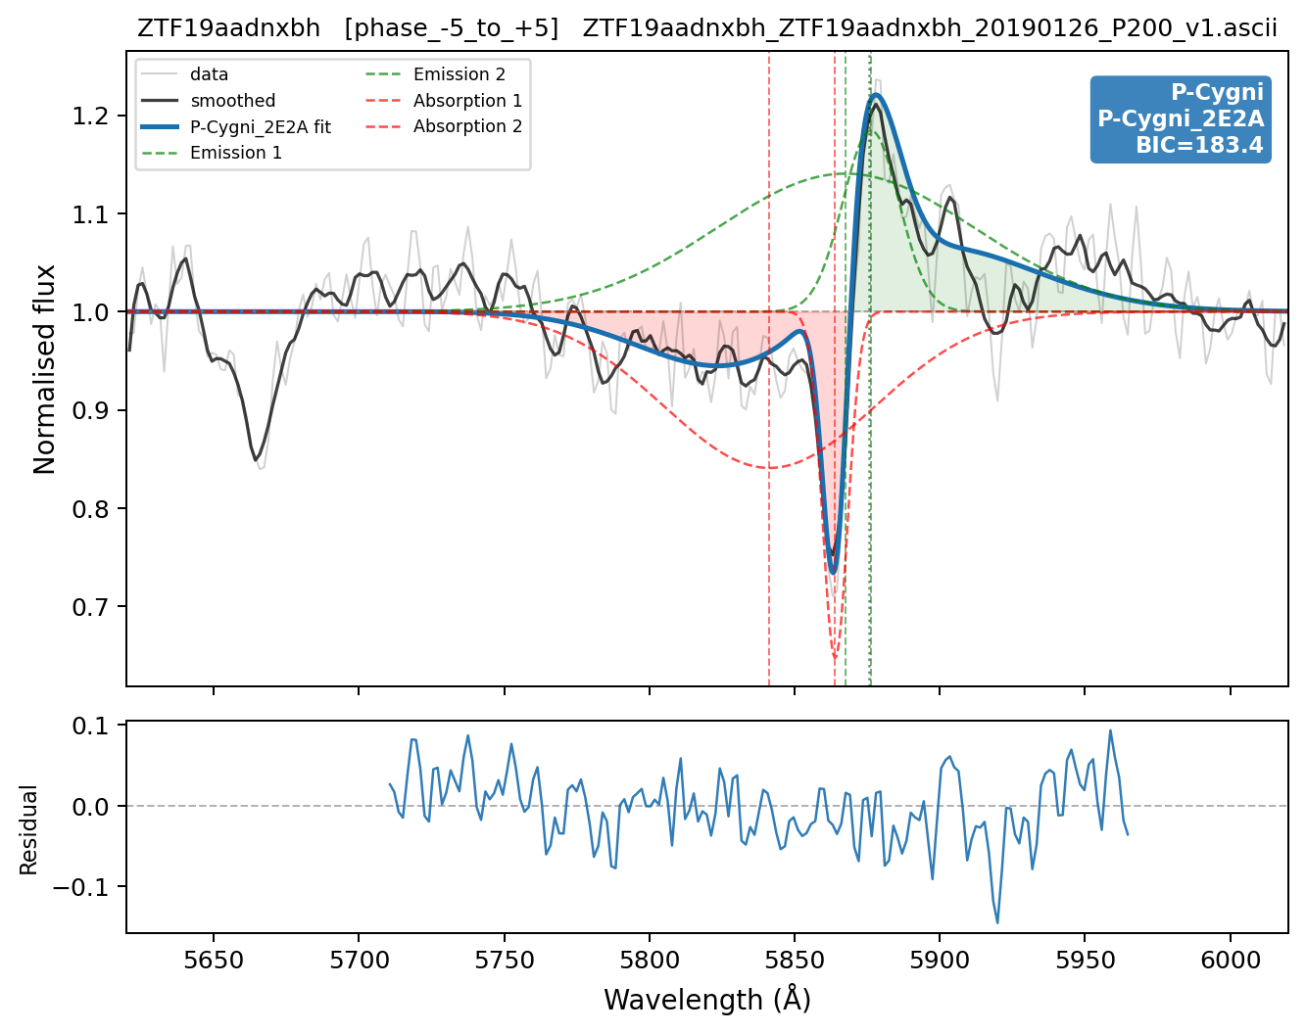
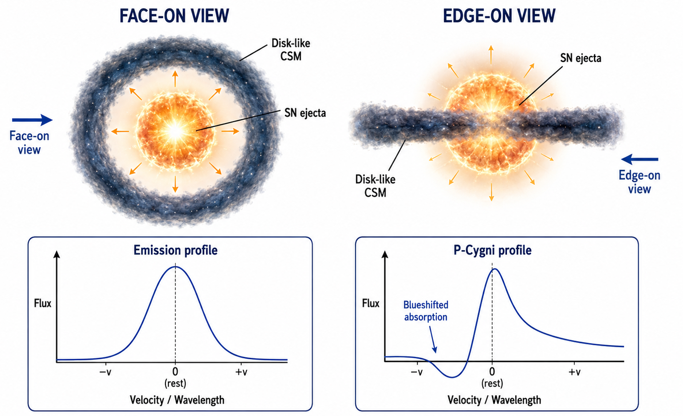
Spectroscopic Diversity:
Or could be an optical depth effect?

Slide 10
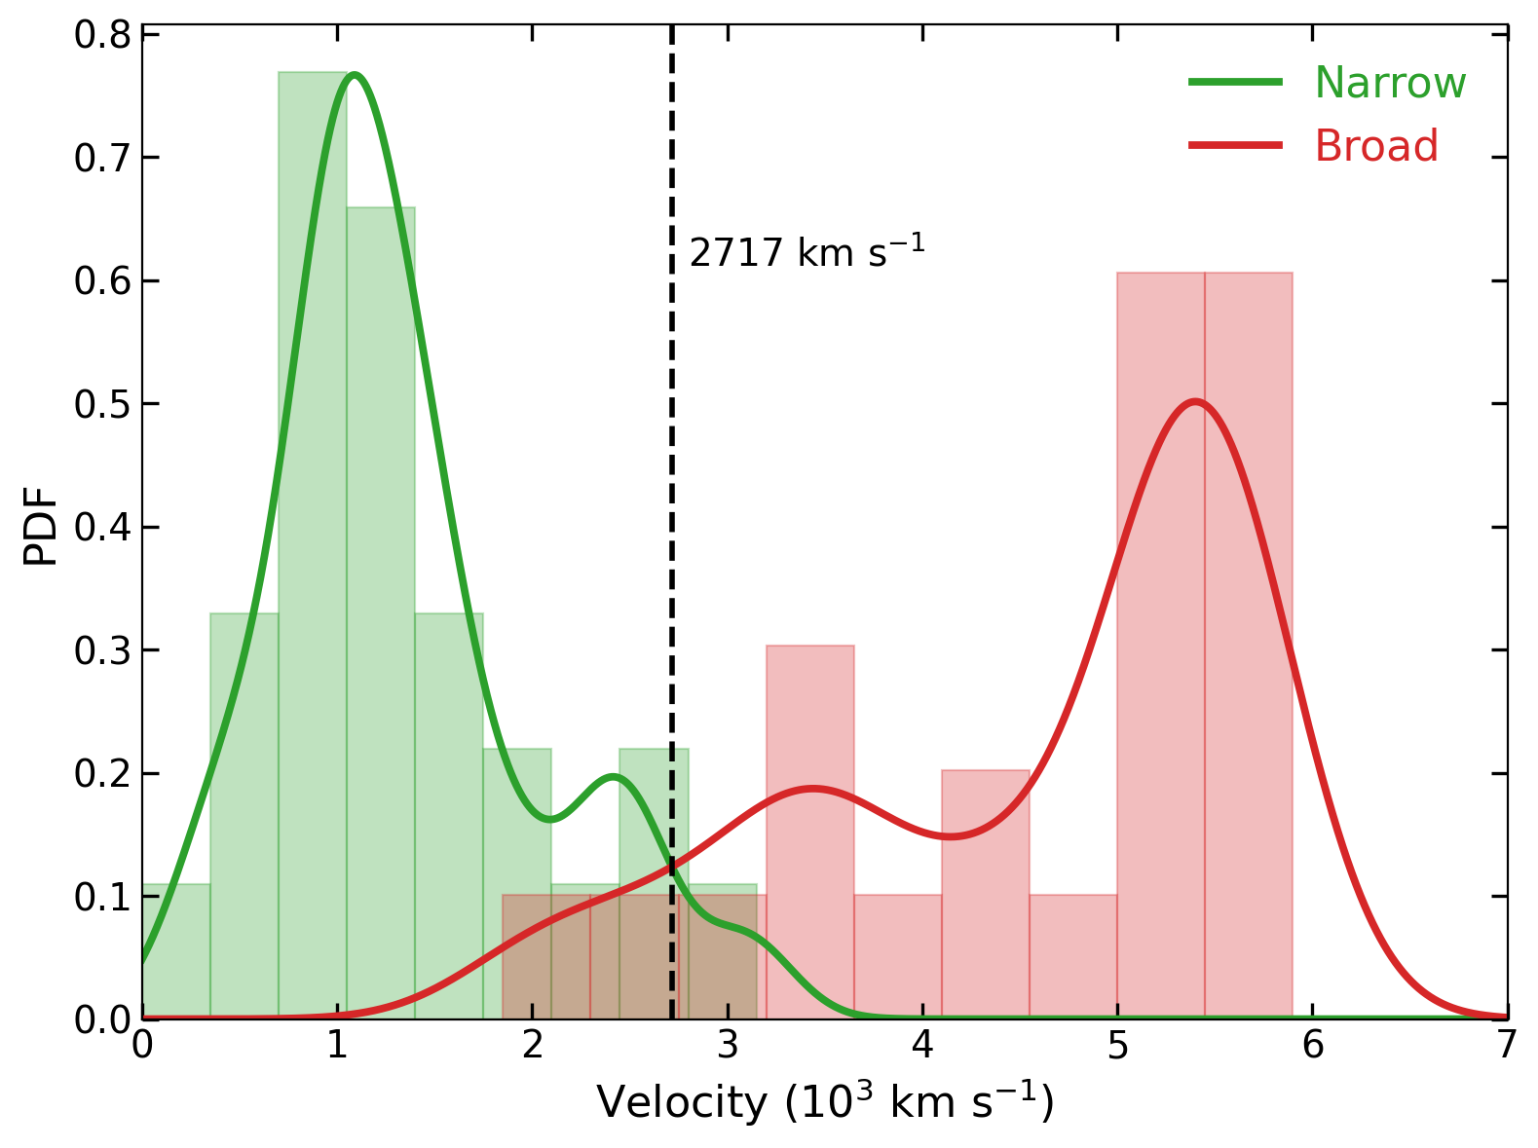
Classification as a SNe Ibn?:
- Narrow component: median FWHM = 1174 km/s (+818 / −281) → slow, dense CSM
- Broad component: median FWHM = 5191 km/s (+343 / −1890) → fast ejecta /high-velocity CSM
-Dashed line at 2717 km/s = KDE crossover boundary separating the two populations, a SN~Ibn!!!

Slide 11
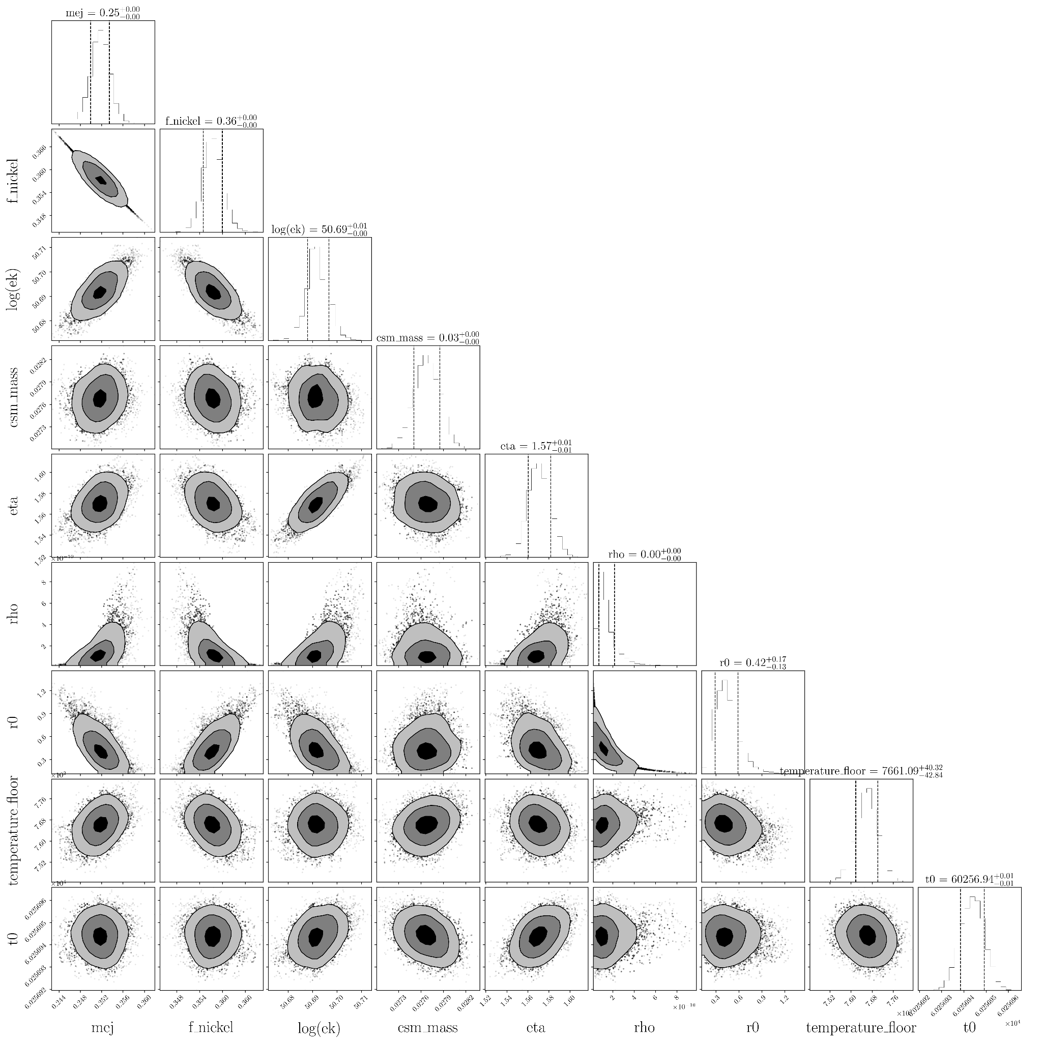
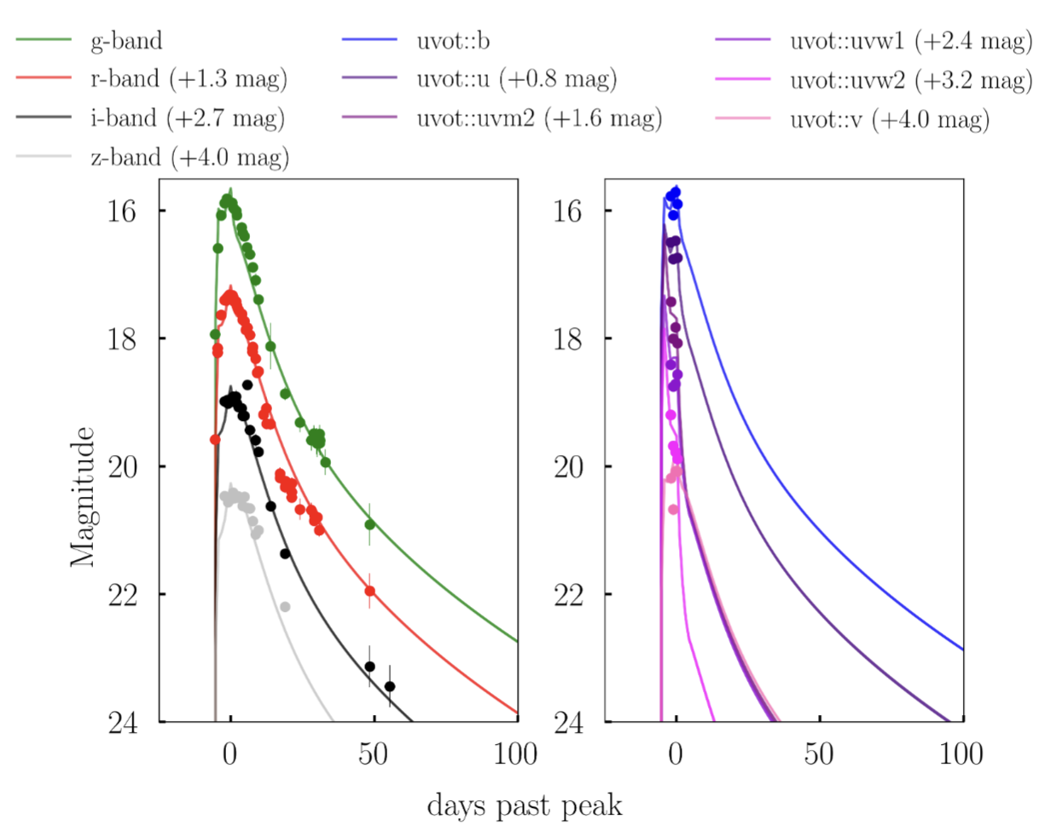
Modelling the data:
Very low Ni mass, low ejecta masses and low circumstellar material masses as well… then what are the stars which give rise to this??

Slide 12
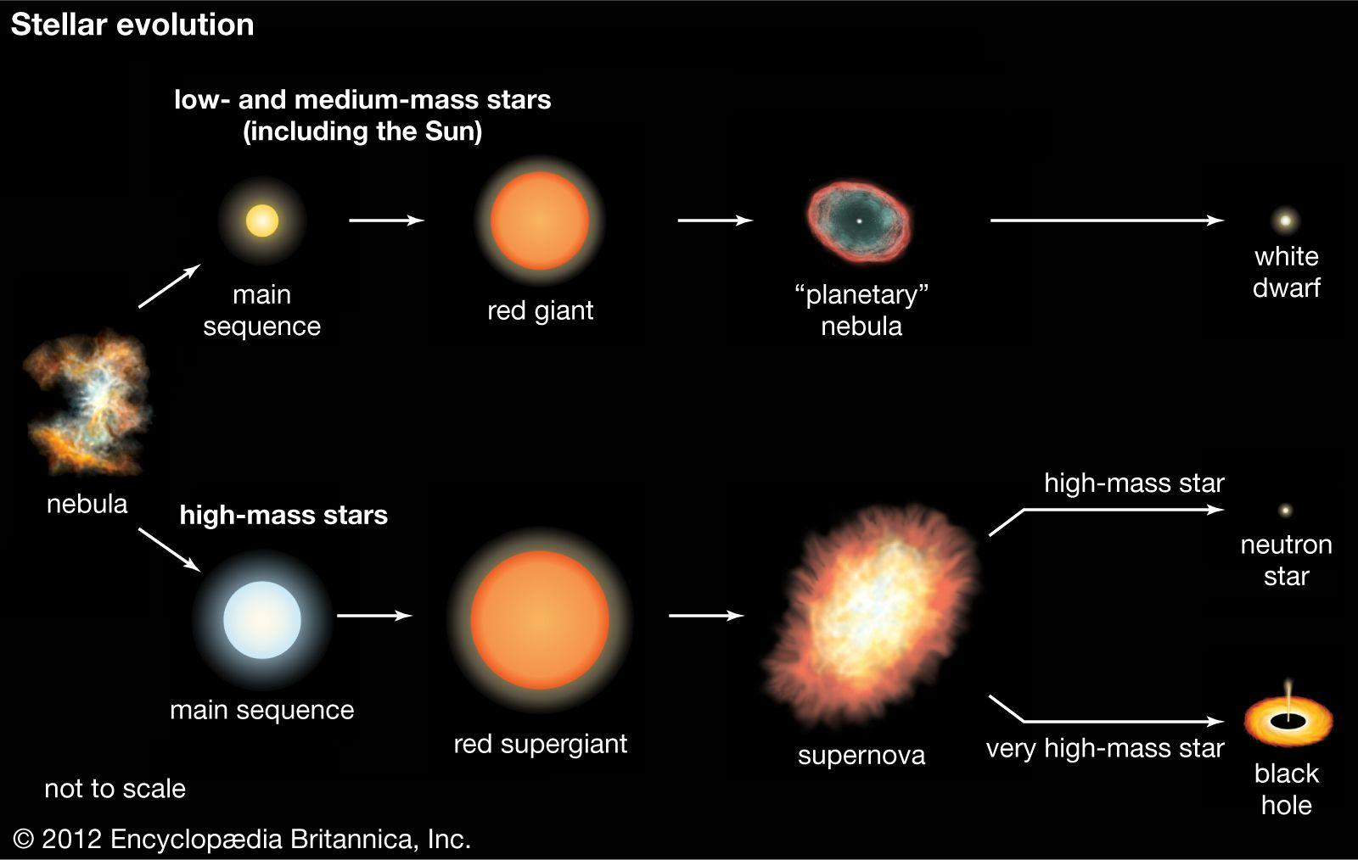
Progenitor stars?
Wolf-Rayet stars

Slide 13
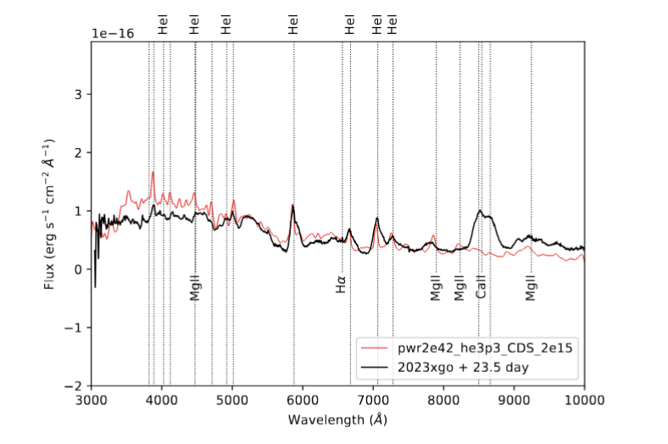
Spectral Ibn models on SN 2023xgo:
Matched the nebular phase spectrum. Non-LTE radiative transfer calculations from HERACLES.
Low mass He stars in binary companionship
Low mass He stars in binary companion as possible progenitors!
Gangopadhyay, Sollerman et al. 2026, MNRAS
See also Wang, Goel, Dessert et al. 2024

Slide 14
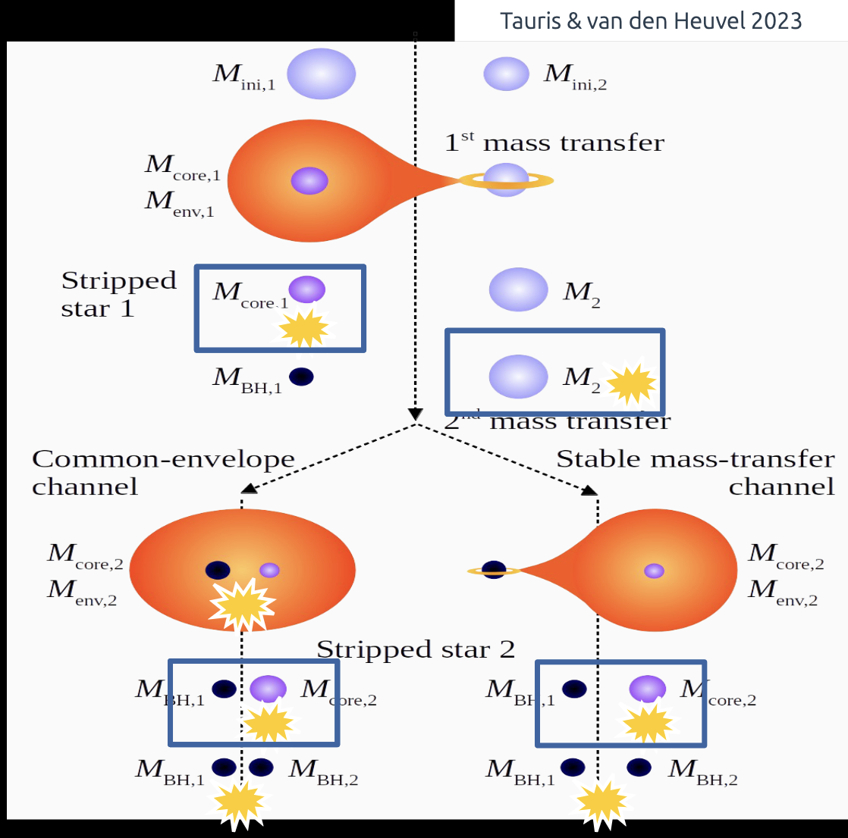
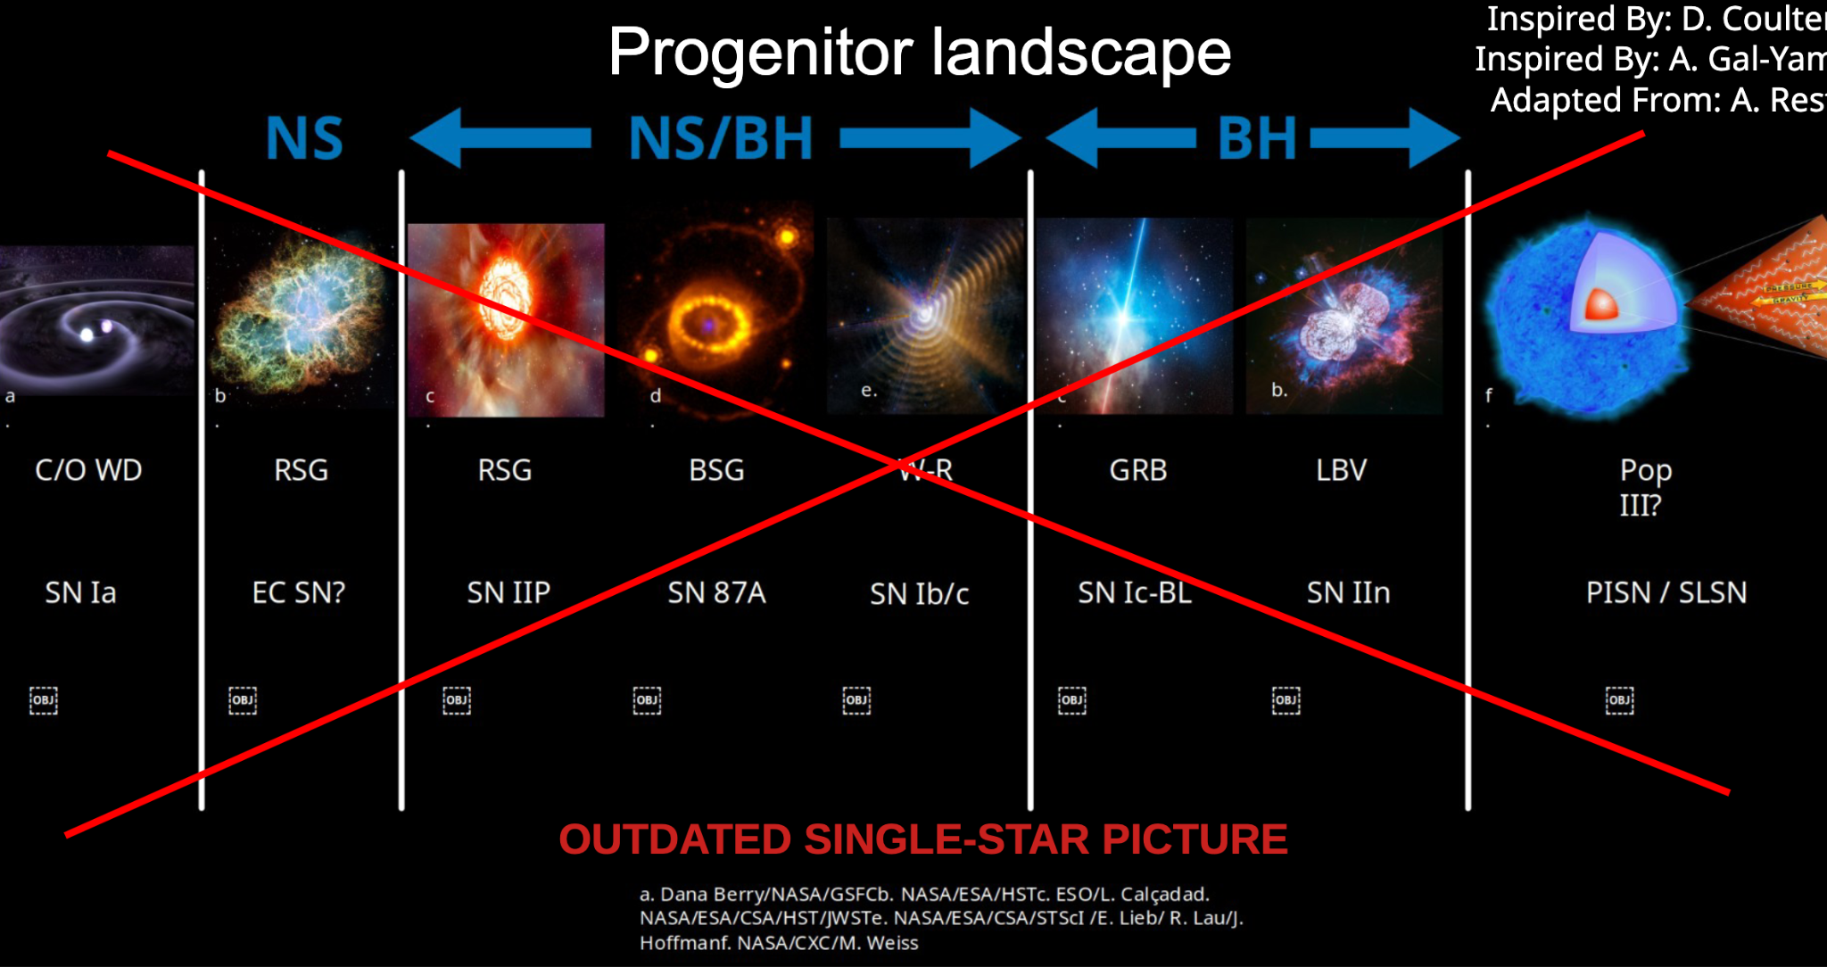
Adapted from Eva Laplace’s previous conference talk
Ibn/Icn

Slide 15
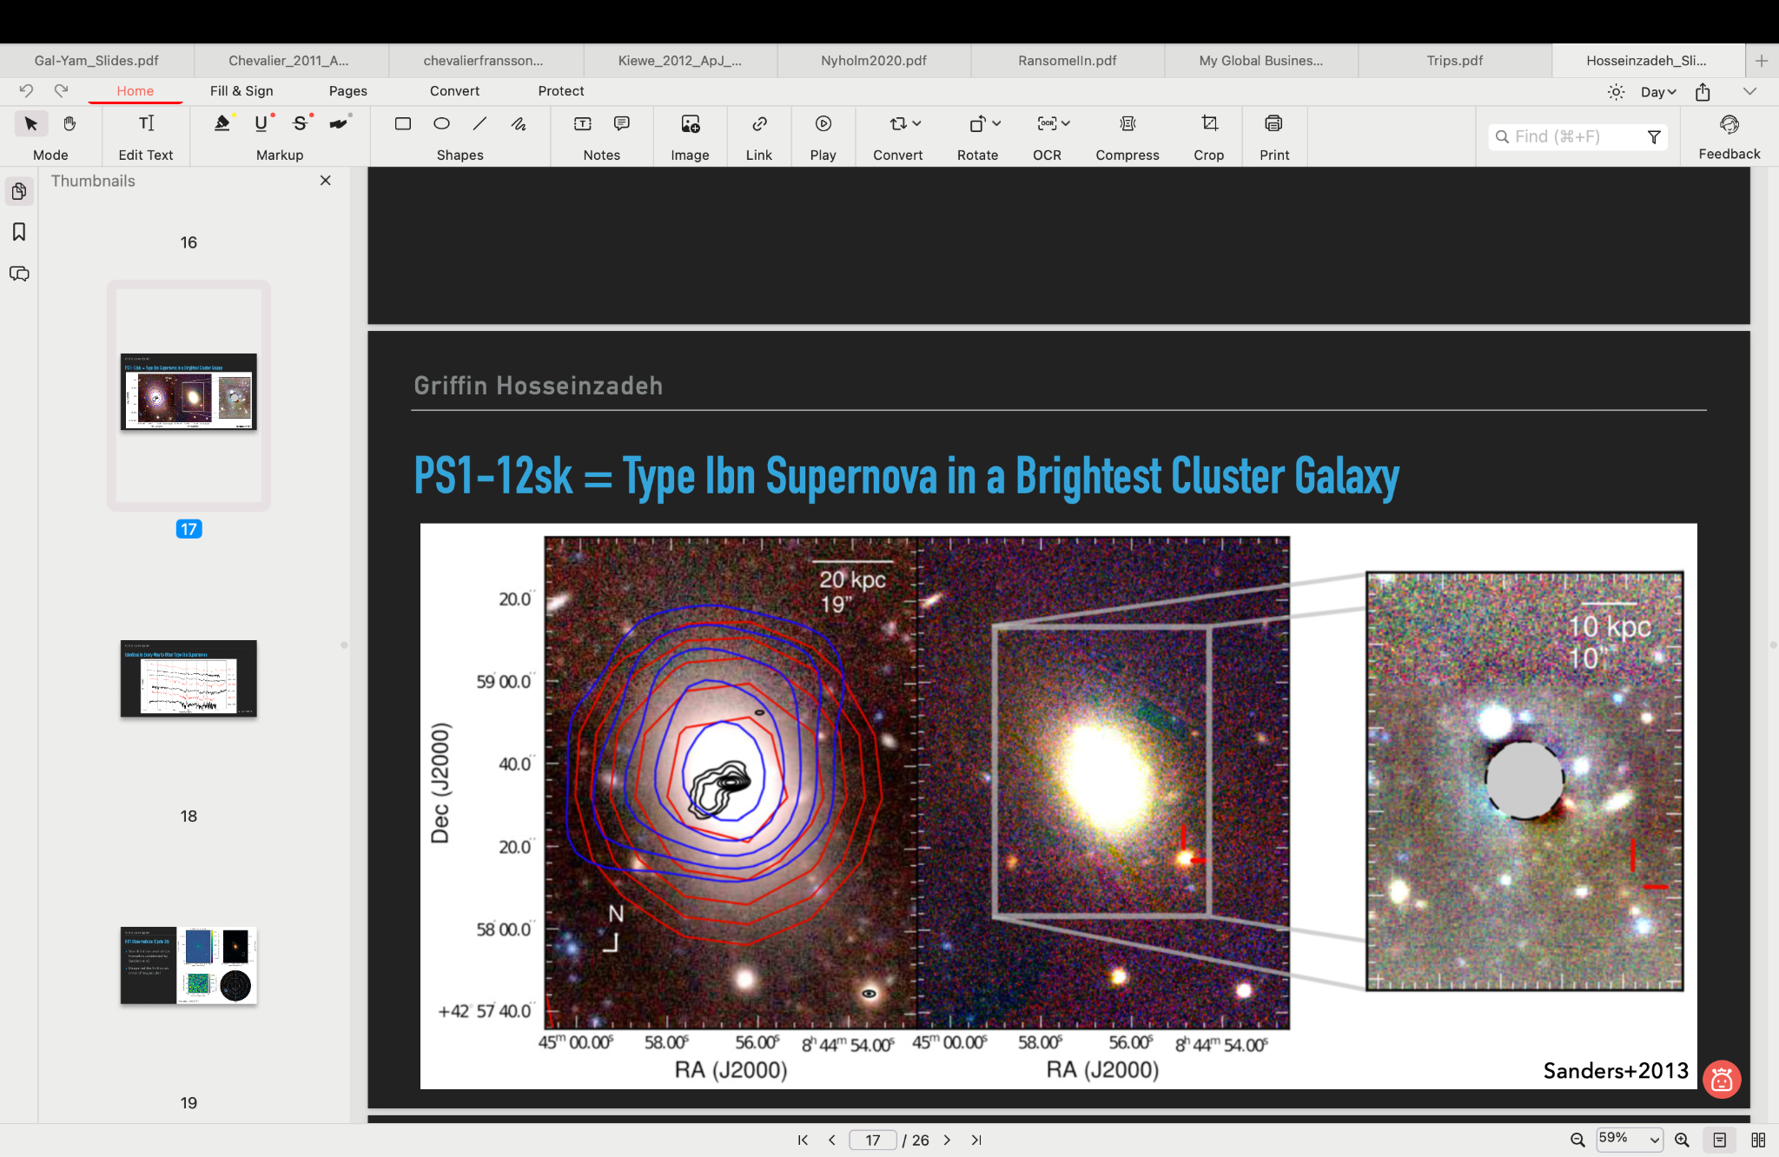
SN Ibn: PS1-12sk occurring in a elliptical brightest cluster galaxy
Search for low-level of star formation undetected by Sanders et al. (HST triggered).
White dwarf binary systems as a possible progenitor channel for SNe Ibn.

Slide 16
Summary of SNe Ibn:
✔ Fast-Evolving Light Curves: Rapid rise and decay compared to other supernovae.
✔ Circumstellar Interaction: Strong interaction with a helium-rich environment.
✔ Progenitor Candidates: Likely linked to Wolf-Rayet stars but not confirmed. Low mass He stars in binary companion.
✔ Spectral Signatures: Dominated by helium emission with minimal hydrogen features.
✔ Rare & Diverse: Constitute a small fraction of core-collapse SNe but show a wide range of properties.
Open Questions:
❓ Progenitor Uncertainty: Are all Ibn progenitors Wolf-Rayet stars, or are other channels possible?
❓ Diversity in Light Curves: What drives the variation in rise times and peak luminosities?
❓ CSM Properties: What determines the density, structure, and extent of the circumstellar material?
❓ Explosion Mechanism: How do these SNe relate to other interacting transients like SNe IIn?
❓ Connection to Other Transients: Could some rapidly evolving transients be extreme cases of SNe Ibn?
Supernovae Ibn are a window into the late stages of massive star evolution, but many mysteries remain—solving them will advance our understanding of stellar death and transient astrophysics.

