Slide 1
Detection of Ellerman bombs in SST observations
Rebecca Nguyen
Nordic-Baltic Astronomy Days 2026

Slide 2
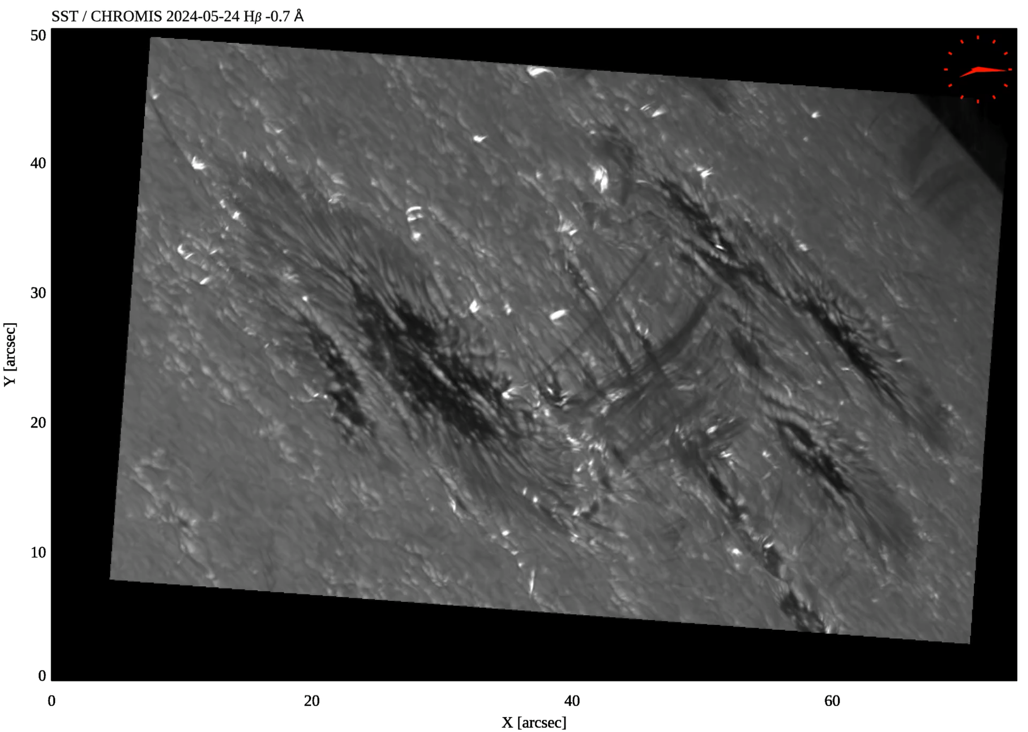
Ellerman bombs (EBs)
Credit: SST/RoCS/UiO

Slide 3
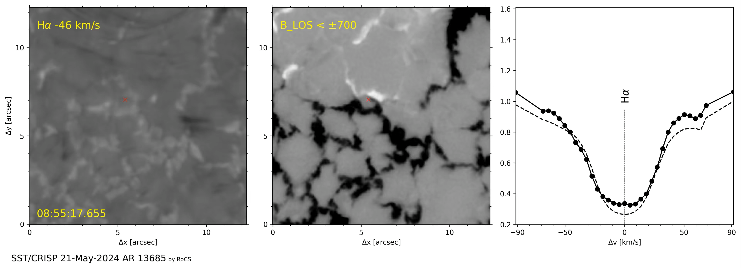
Ellerman bombs (EBs)
Courtesy of Ignasi Josep Solar Poquet

Slide 4
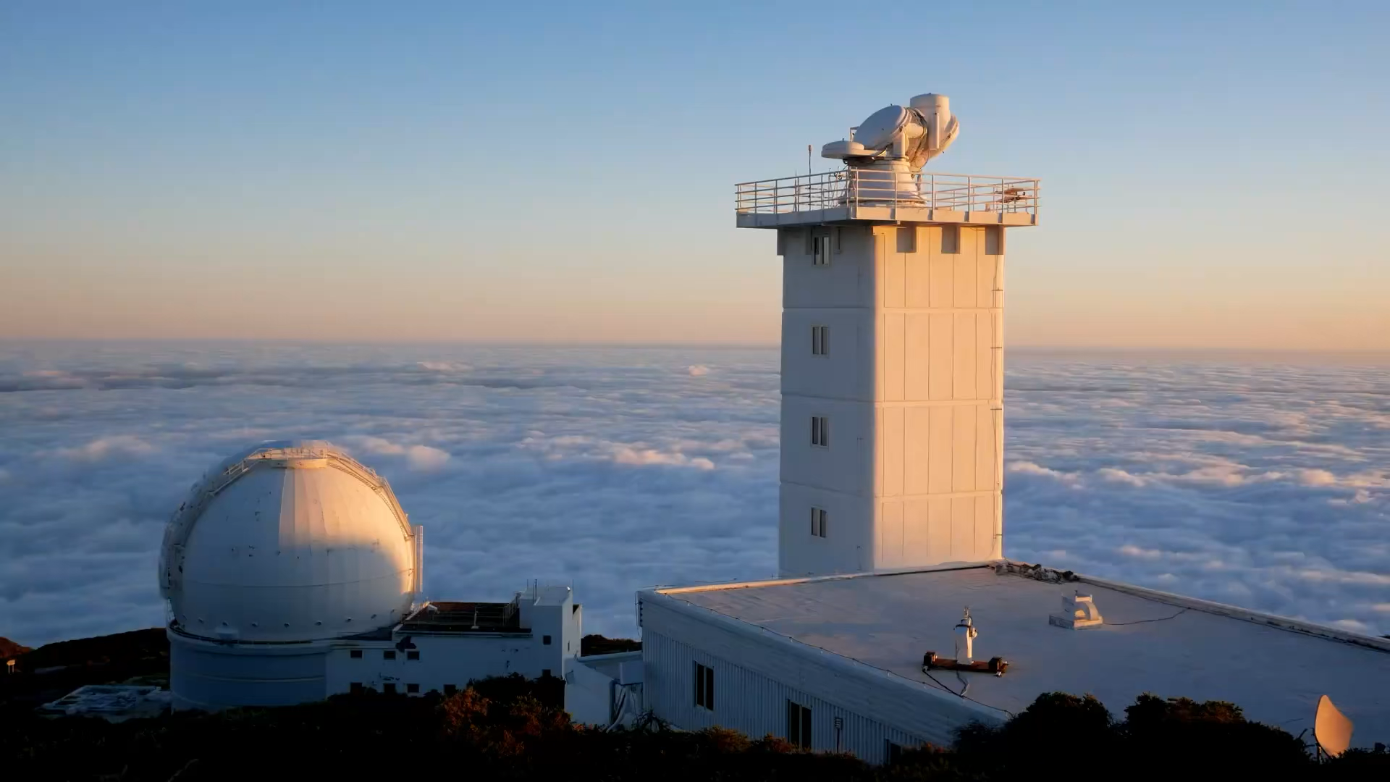
Swedish 1-m Solar Telescope
Credit: Tiago Pereira

Slide 5
Motivation
Develop a detection and tracking algorithm for EBs, in order to characterize their properties and magnetic field configuration.

Slide 6
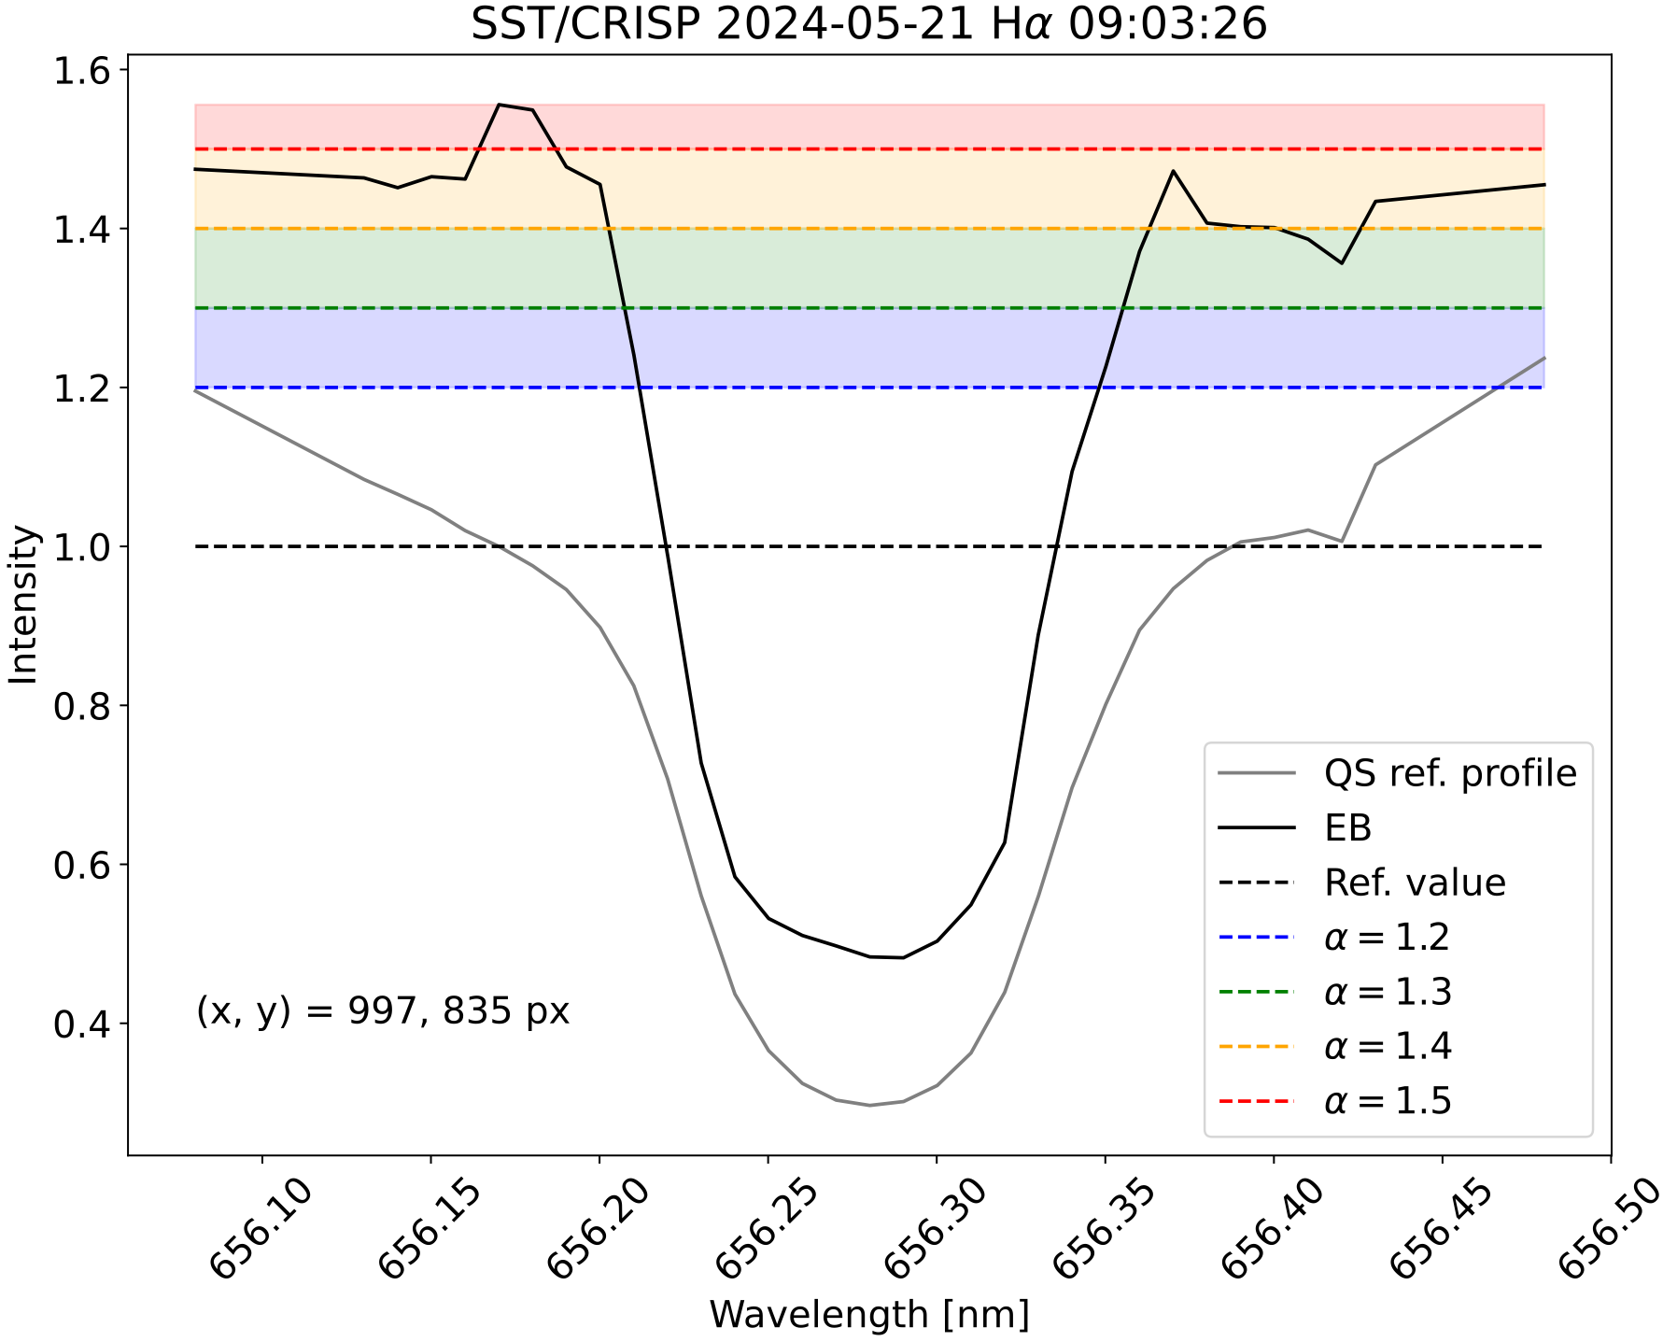
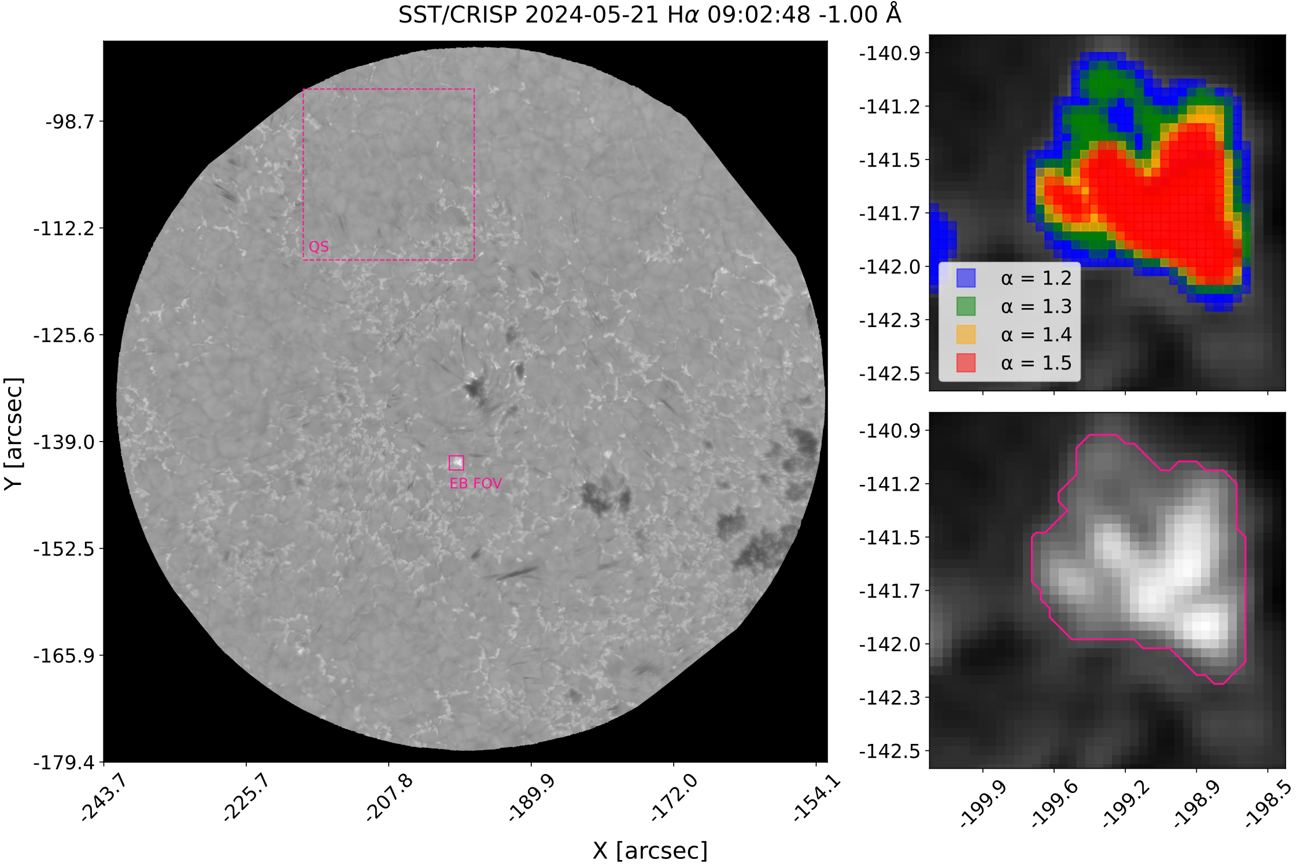
Detection of EBs

Slide 7
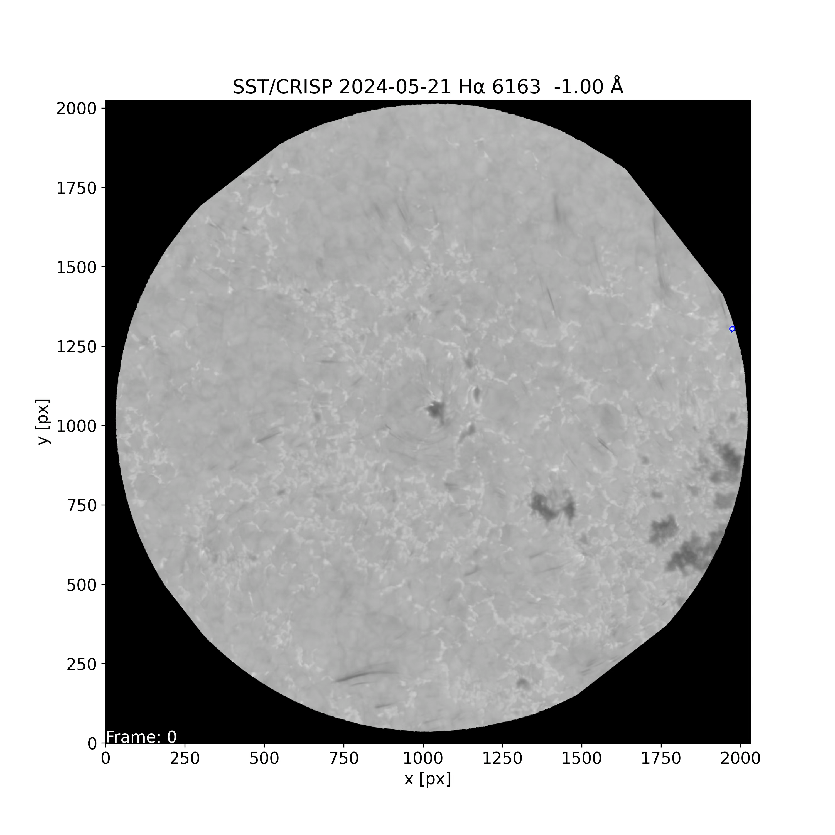
Tracking of EBs
Minimum area:
0.035 ${\text{arcsec}}^{2}$
Minimum lifetime:
74 s (2 frames)

Slide 8
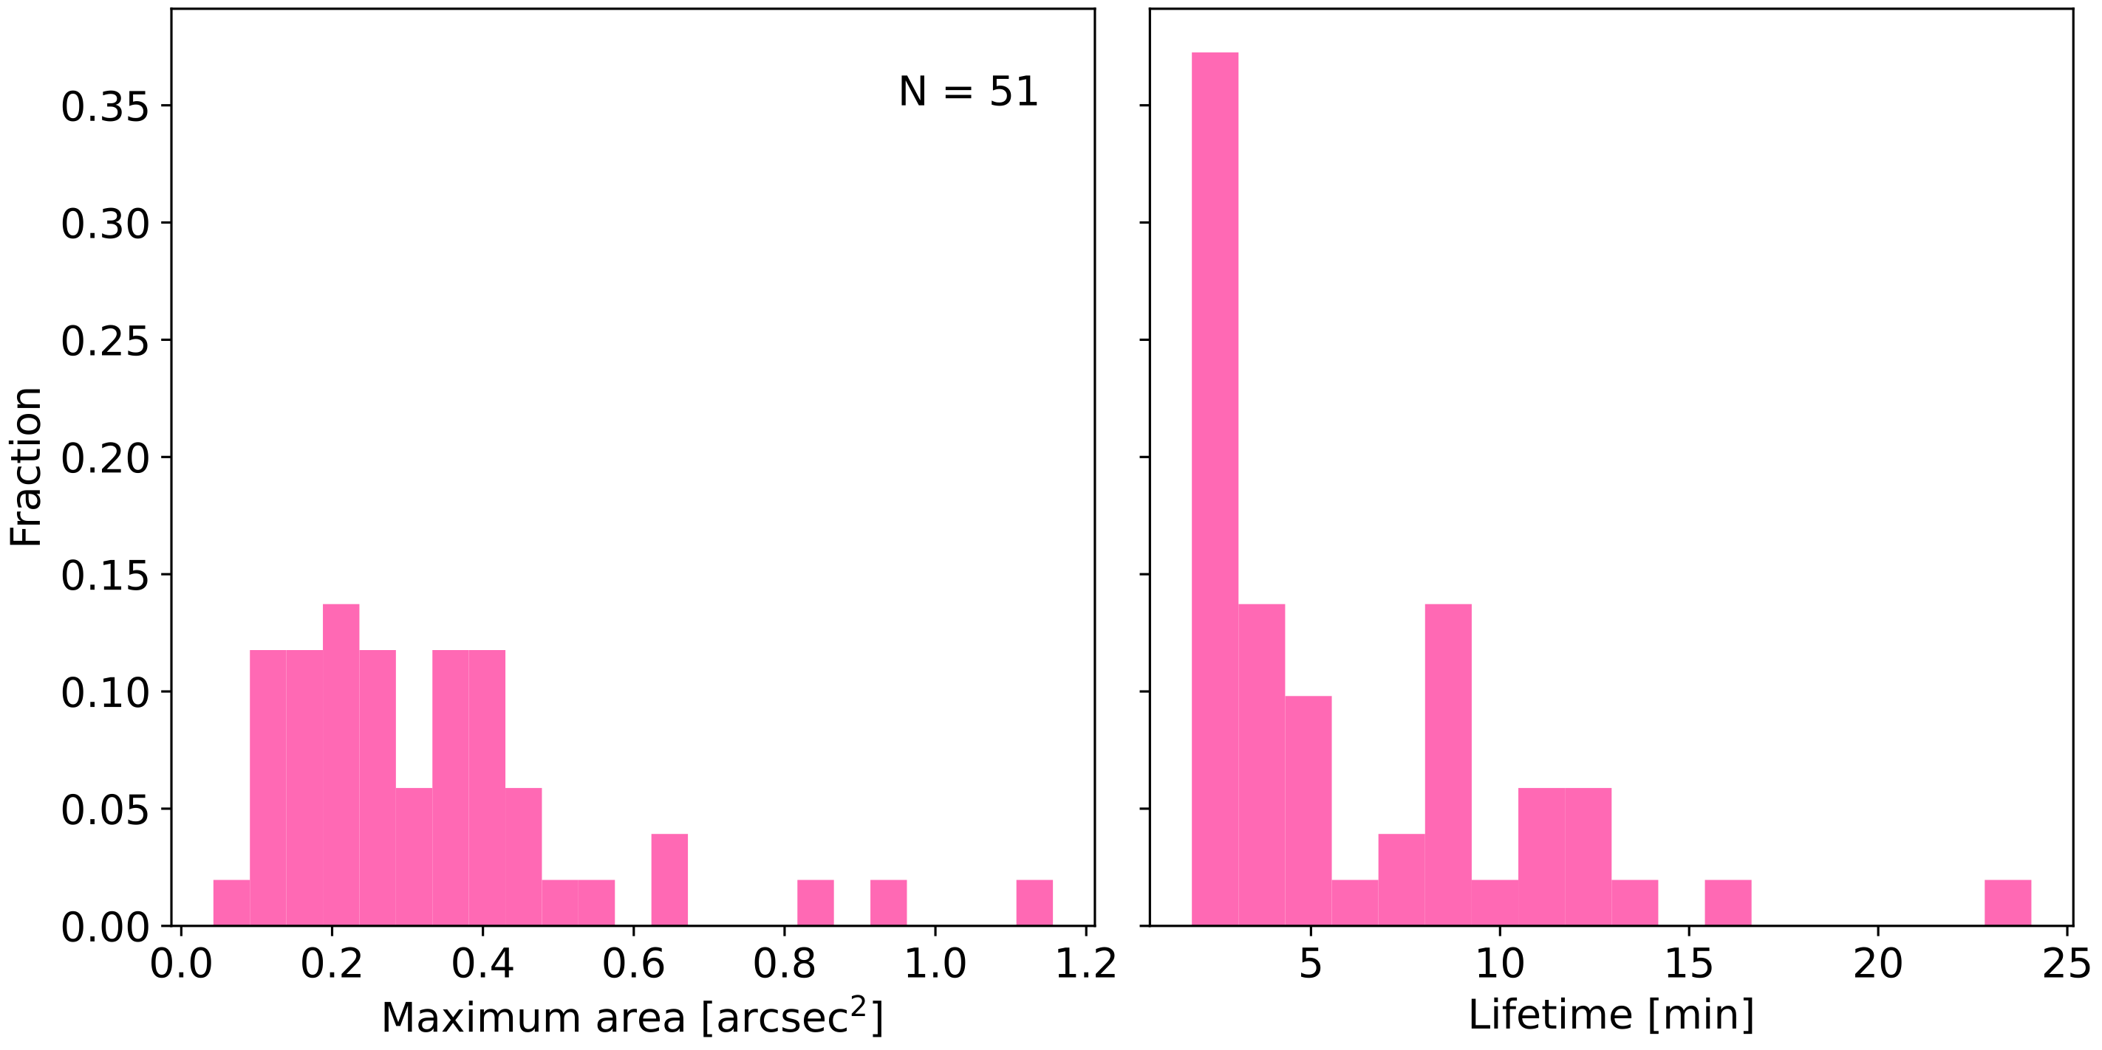
General EB statistics
Median maximum area:
0.275 ${\text{arcsec}}^{2}$
Median lifetime:
3.0 min

Slide 9
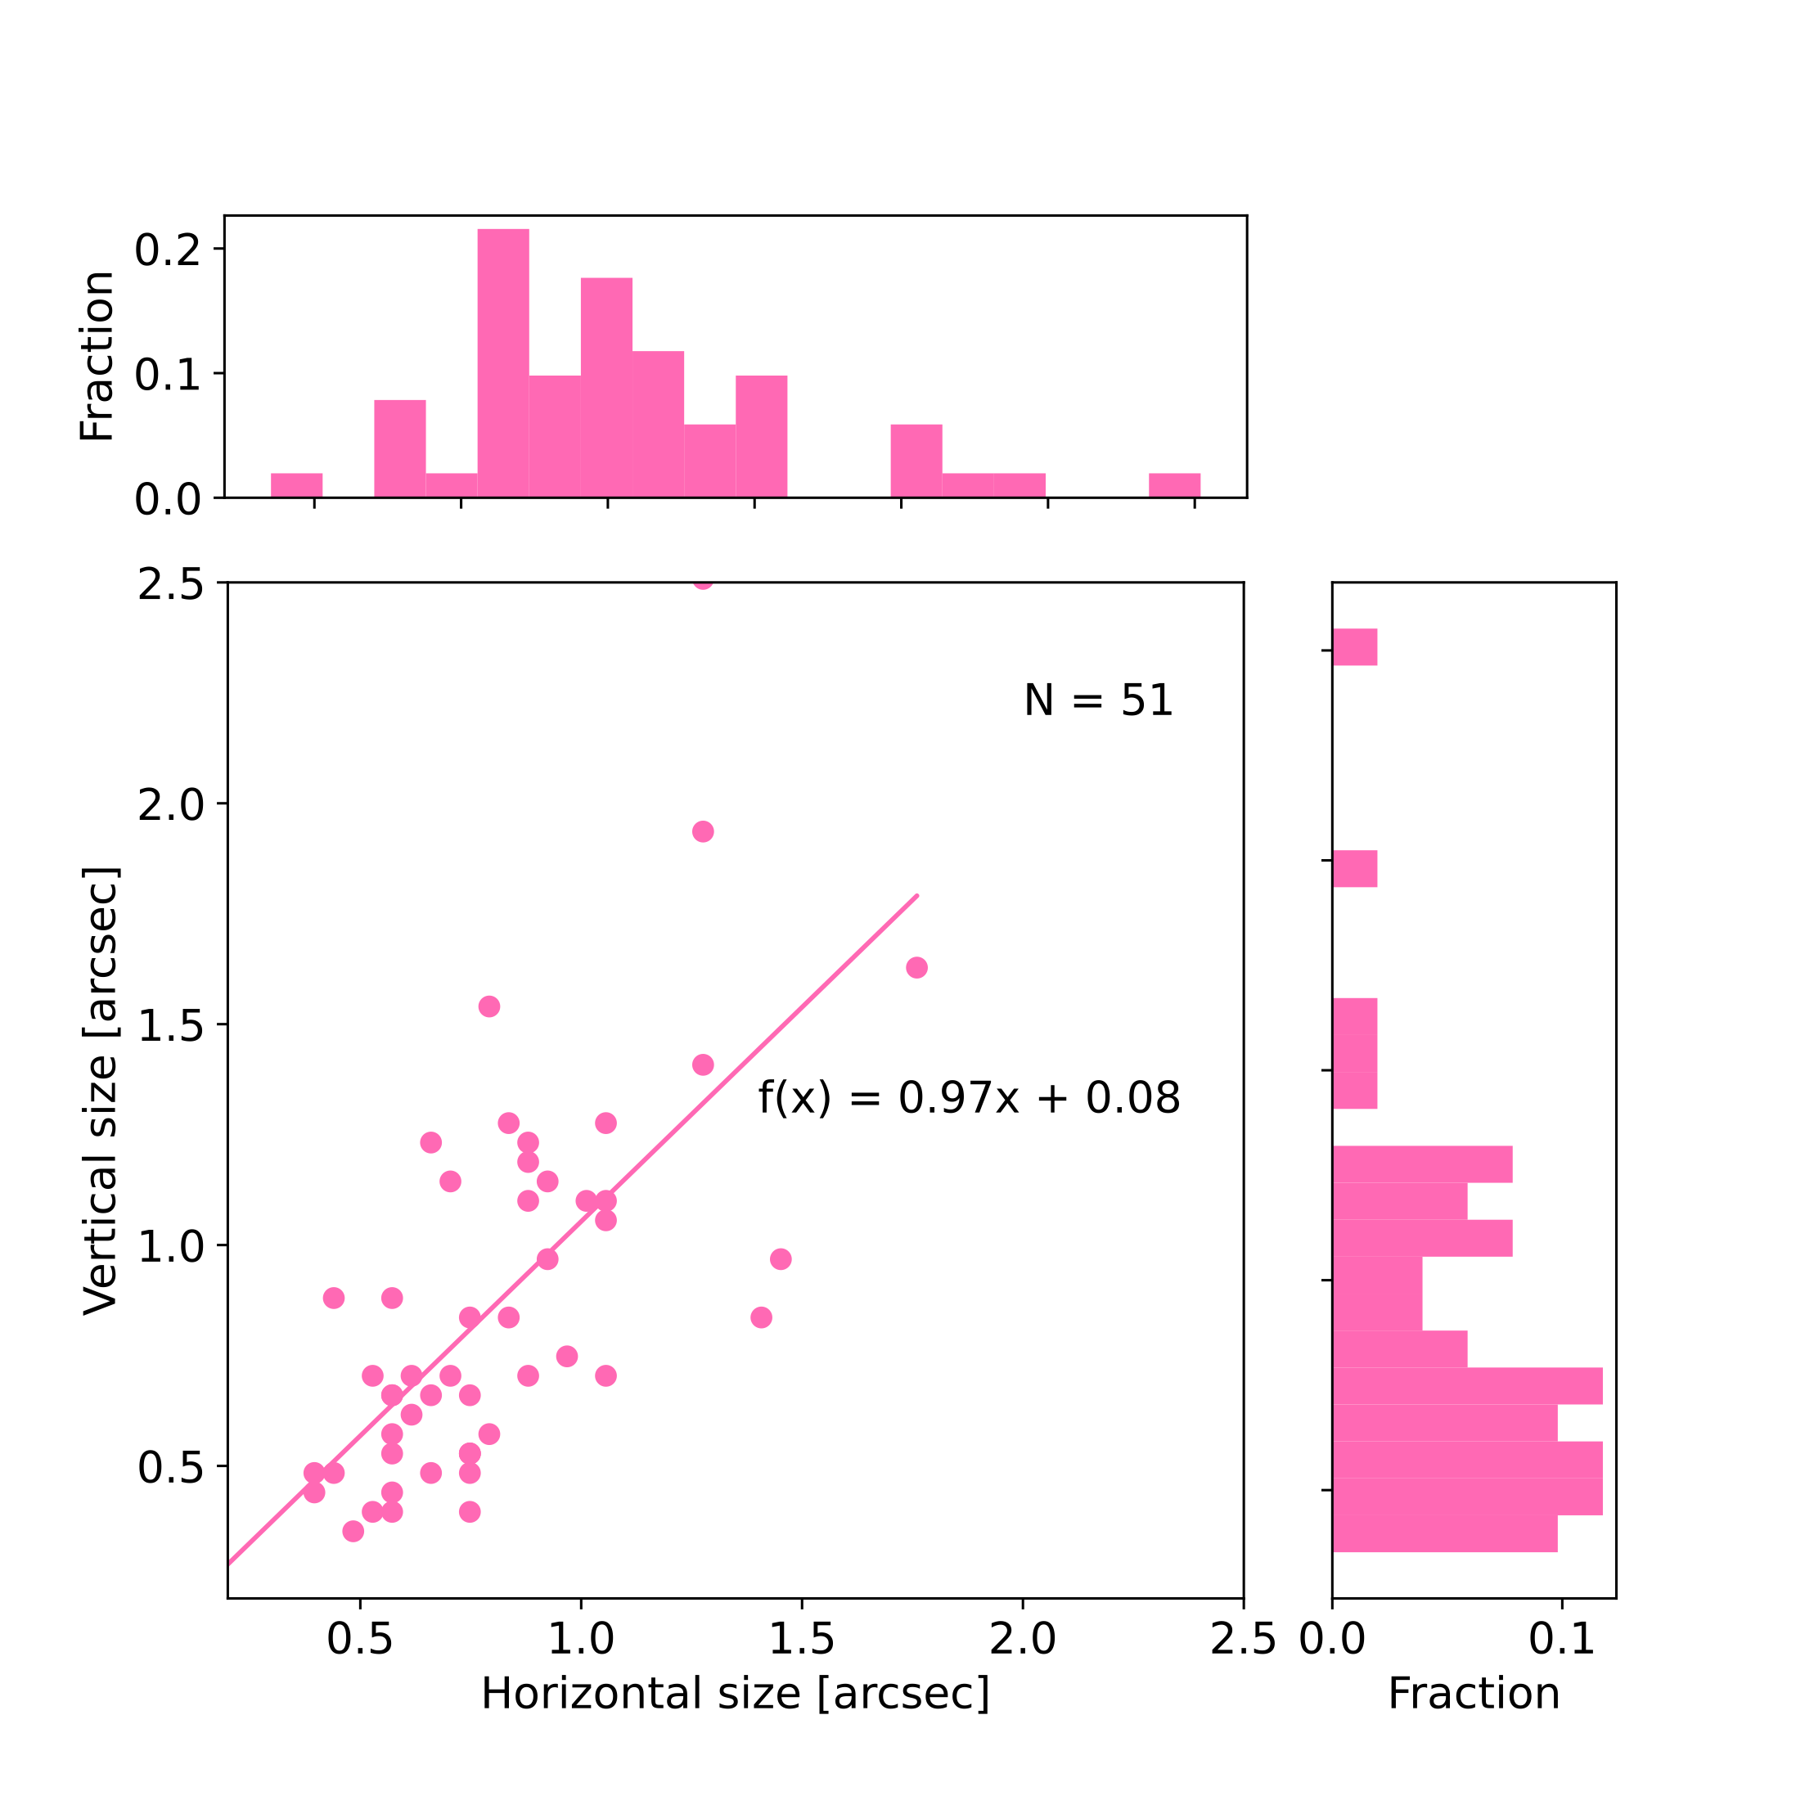
General EB statistics
Median maximum vertical extent:
0.704 arcsec
Median maximum horizontal extent:
0.748 arcsec

Slide 10

Classification of magnetic field configuration
Group A
Group B
Group C
+
-
+
-
+
-
PIL
Dipolar EBs
Unipolar EBs
Noise level of ${\text{B}}_{\text{LOS}}$: $σ=9.5\text{G}$

Slide 11
Classification of magnetic field configuration
Group A
Group B
Group C
18 EBs
26 EBs
7 EBs

Slide 12
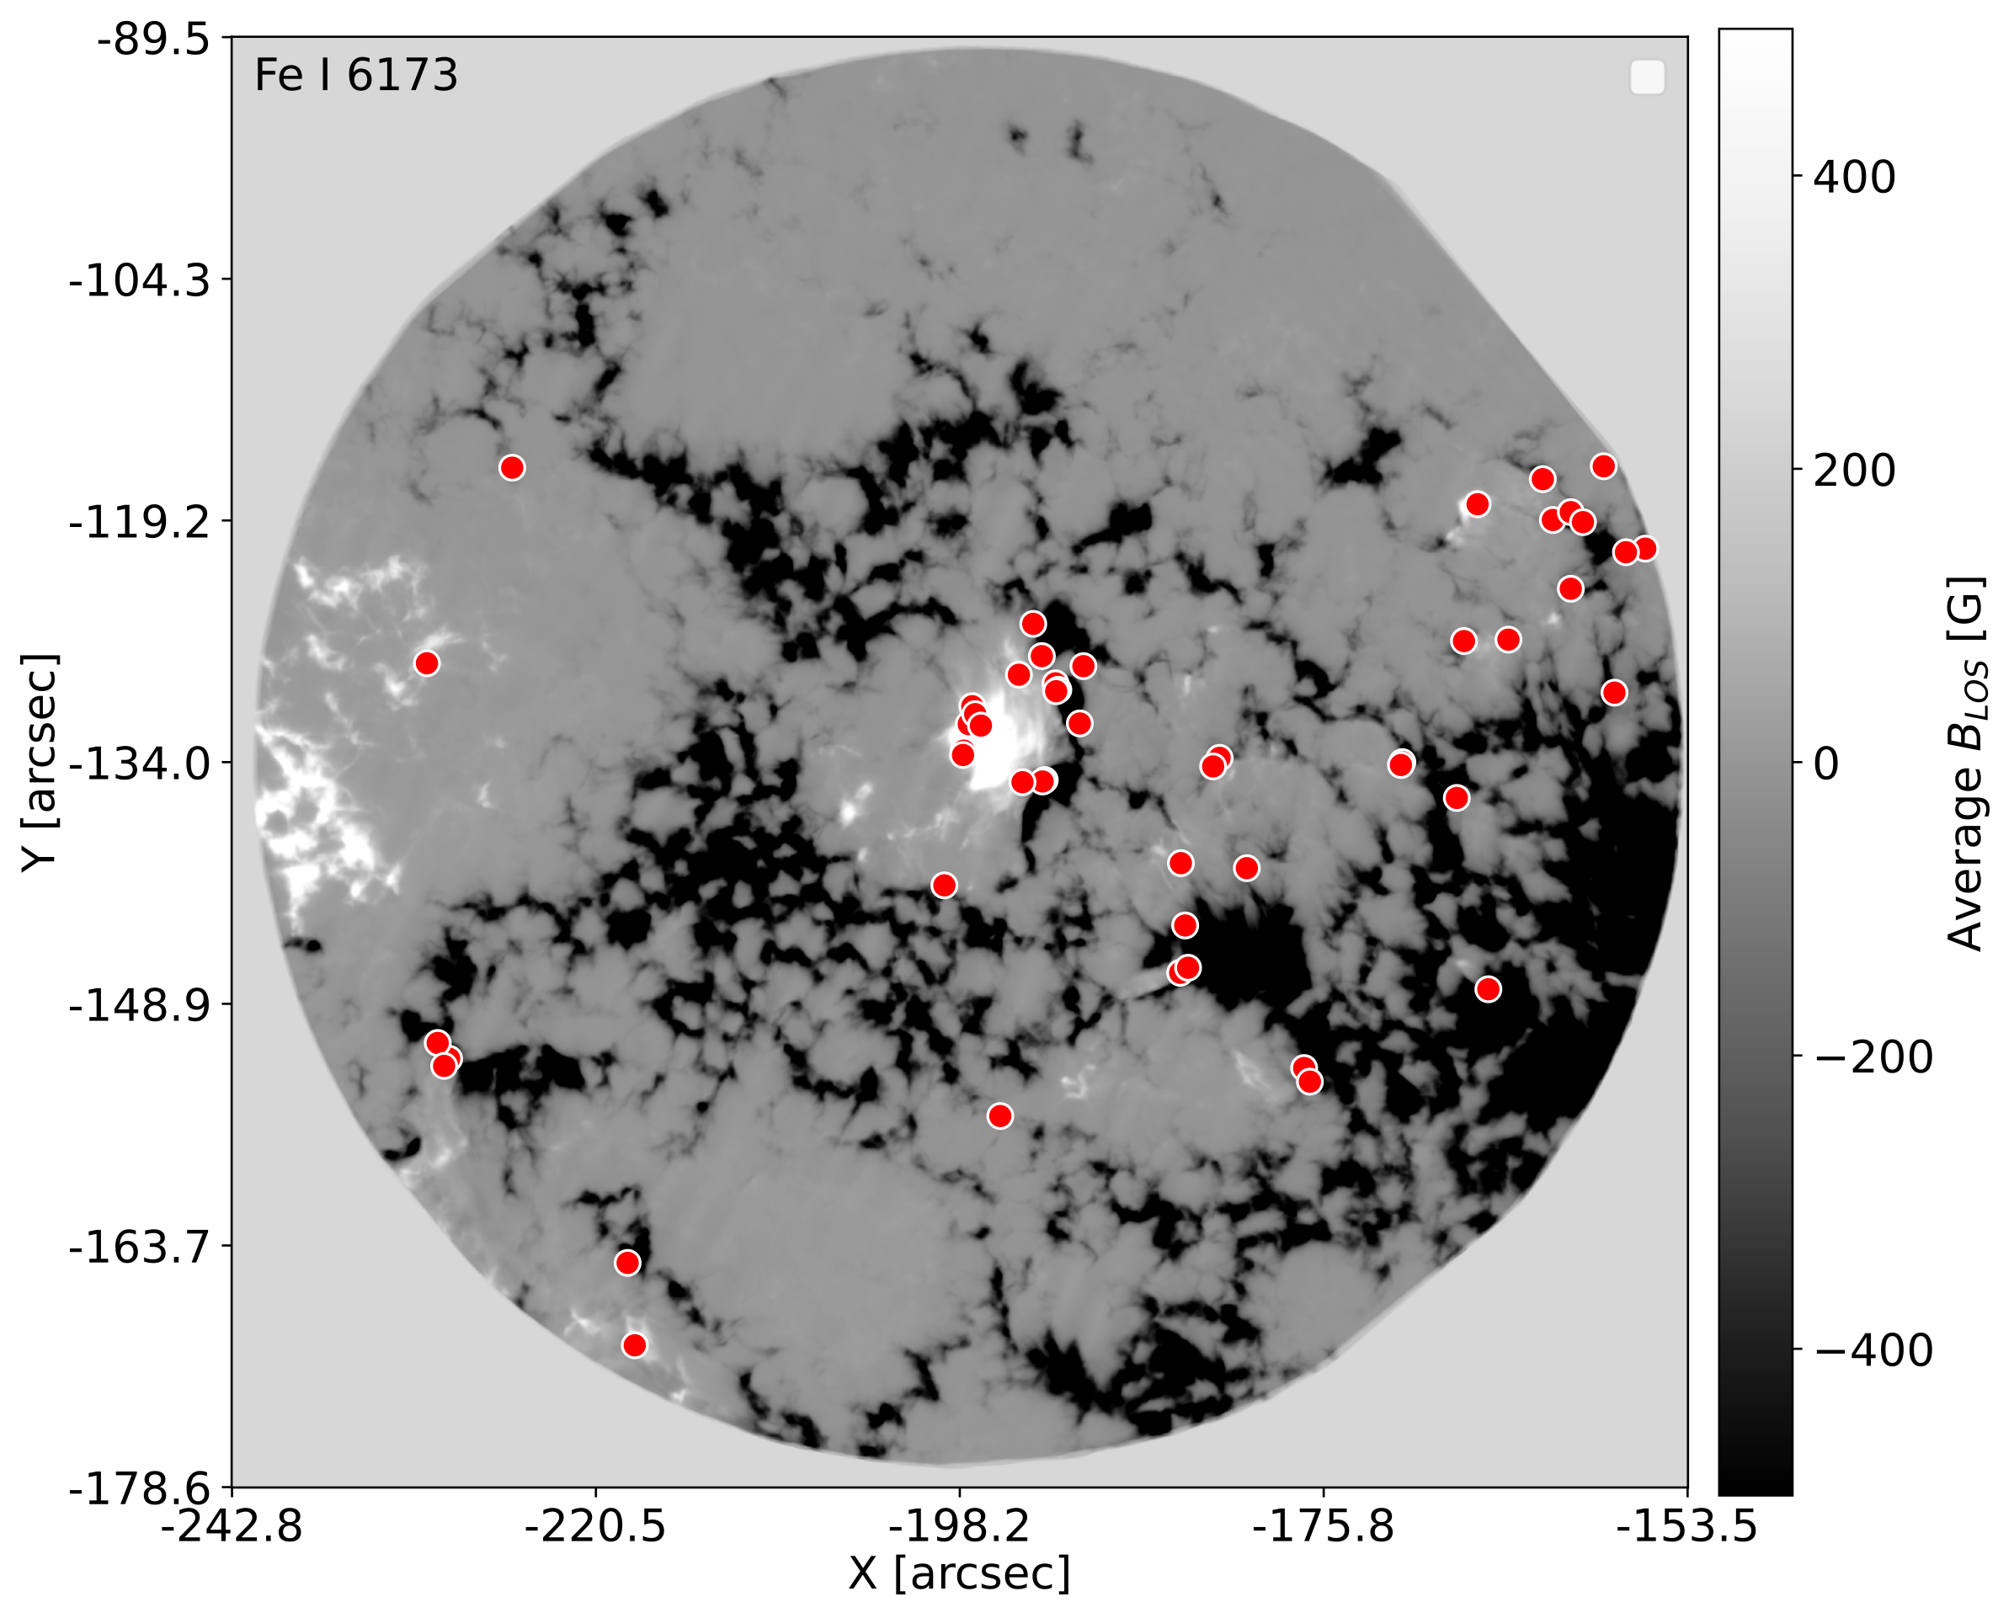
Spatial distribution of EBs

Slide 13
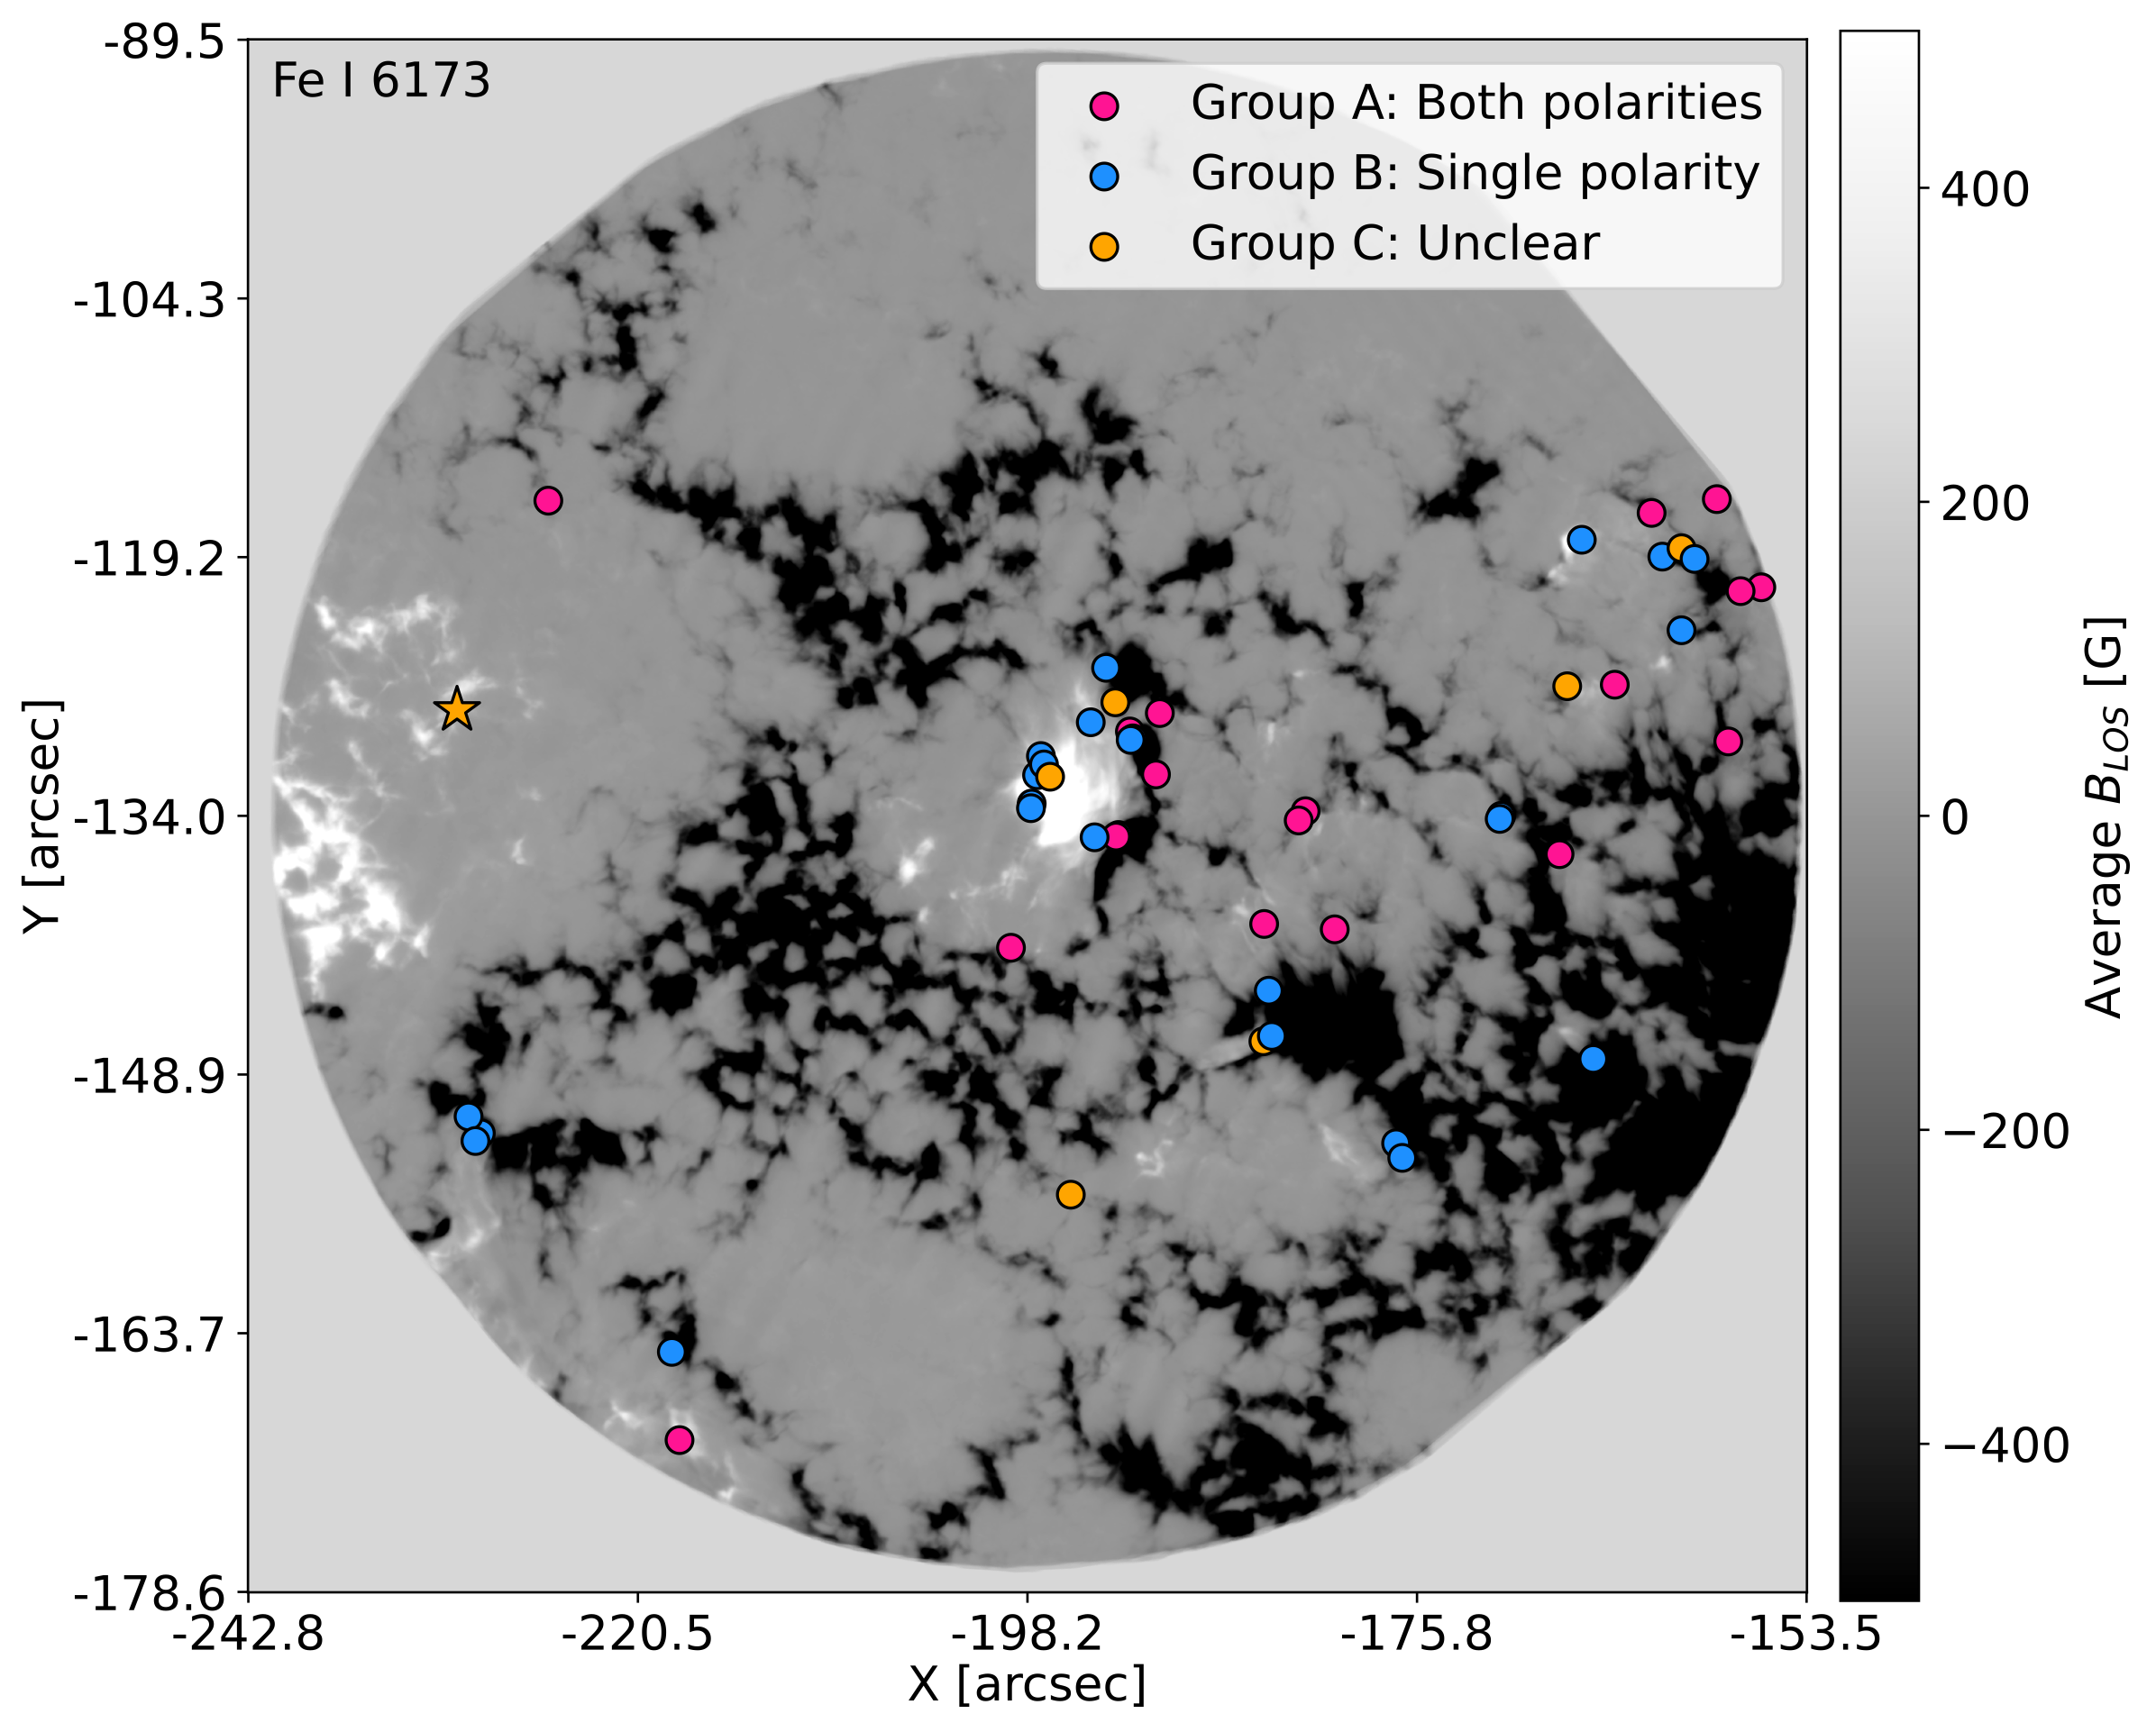
Spatial distribution of EBs

Slide 14
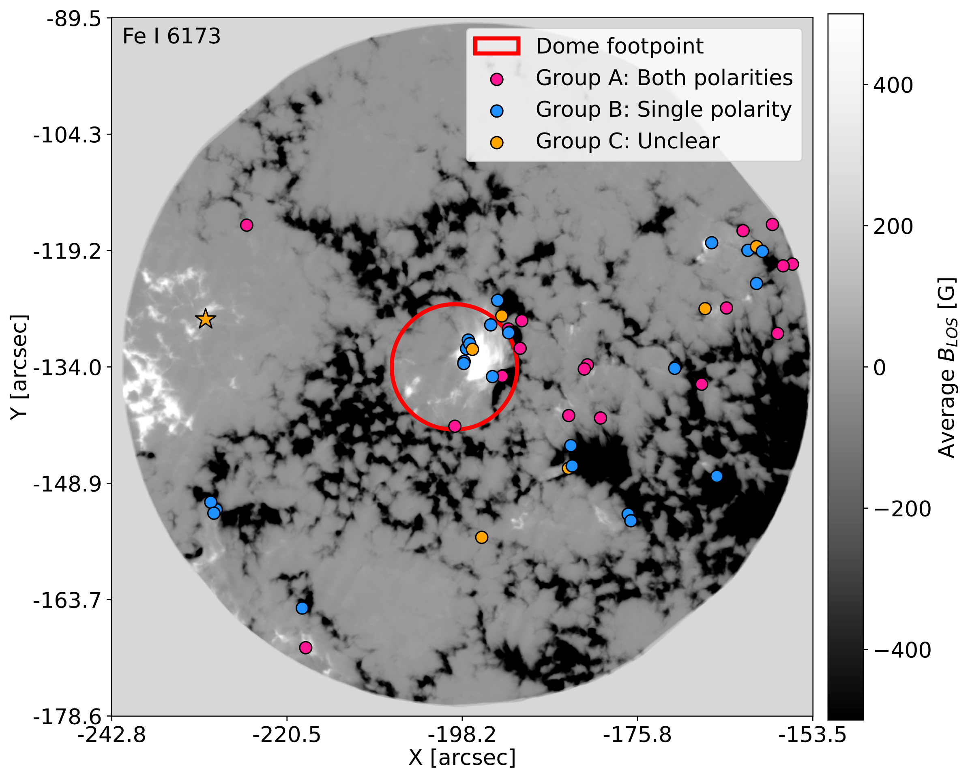
Spatial distribution of EBs

Slide 15
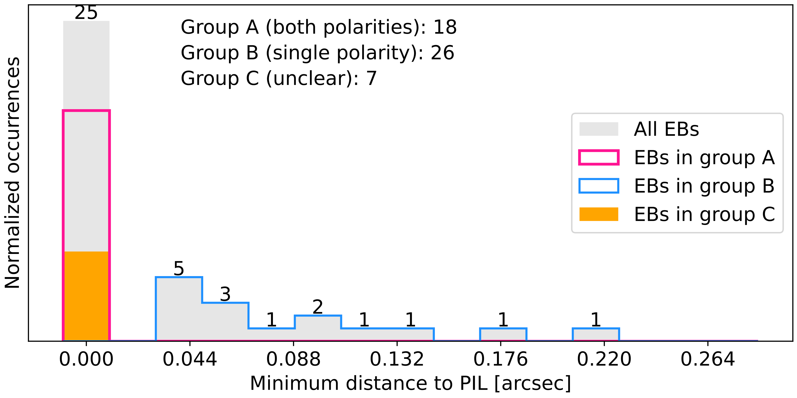
Minimum distance to PIL

Slide 16
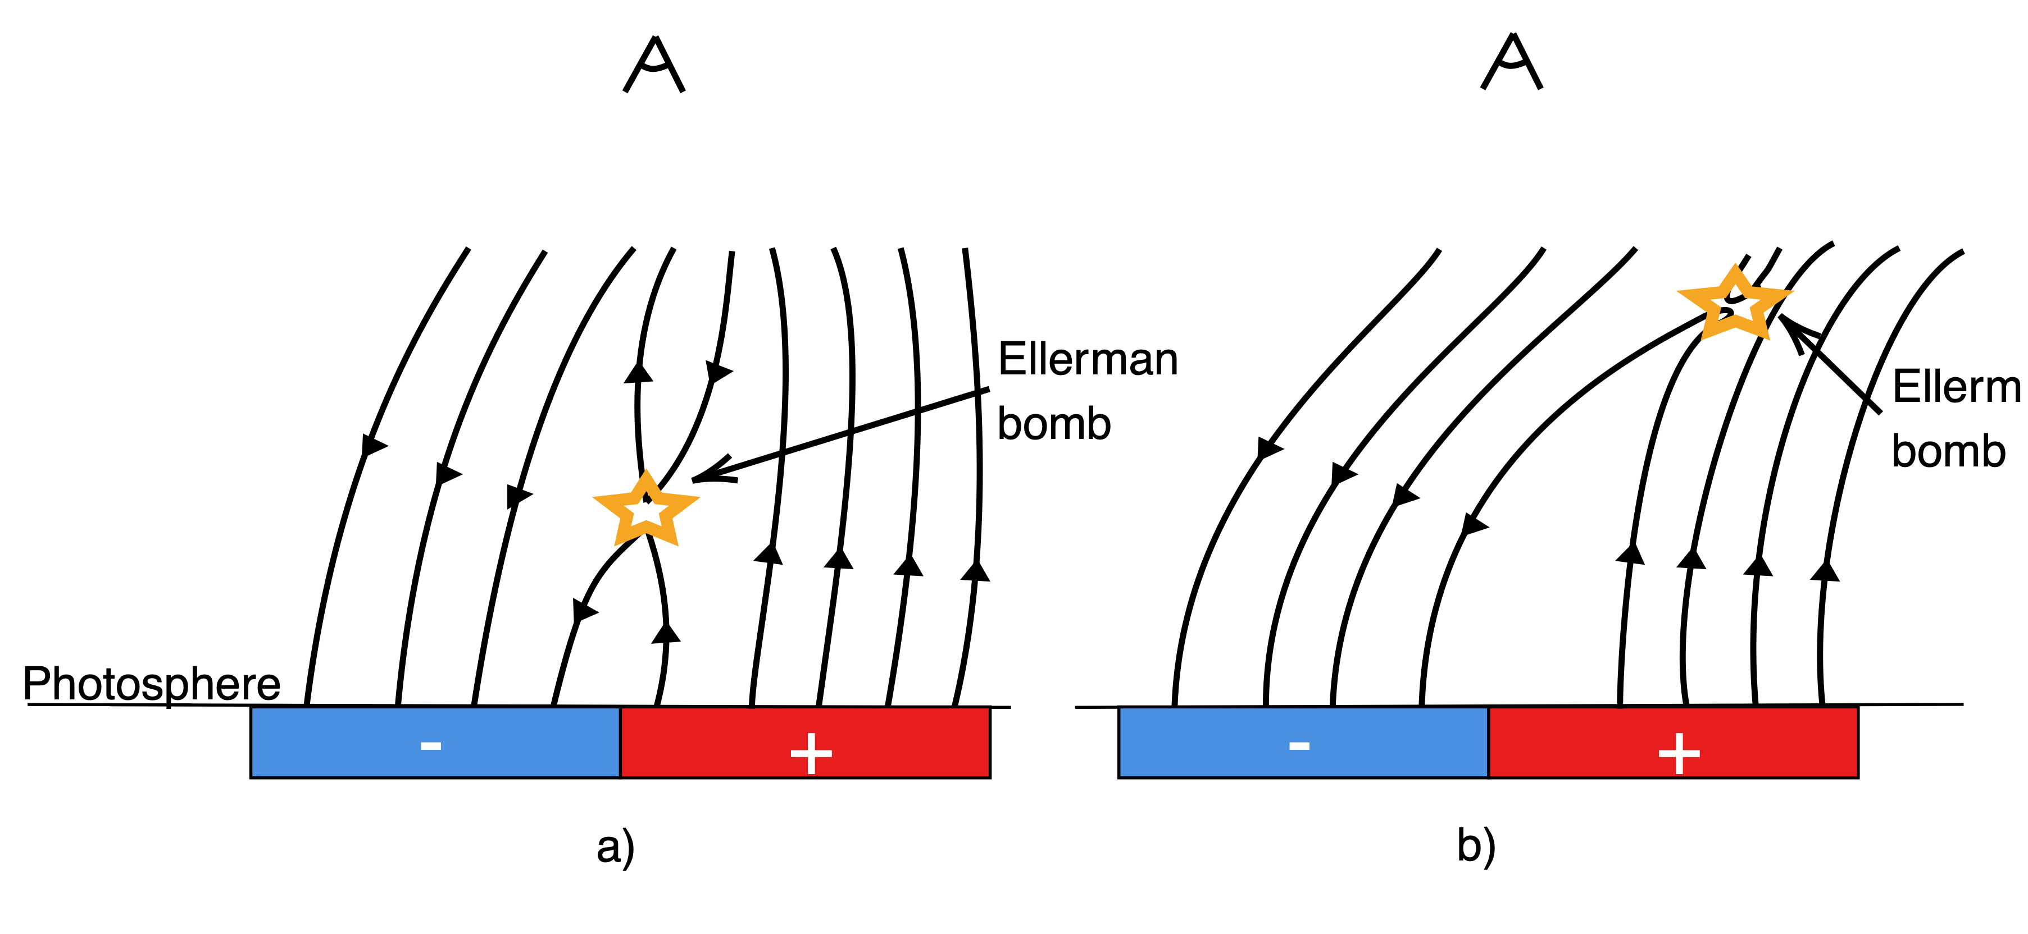
Possible magnetic topologies

Slide 17
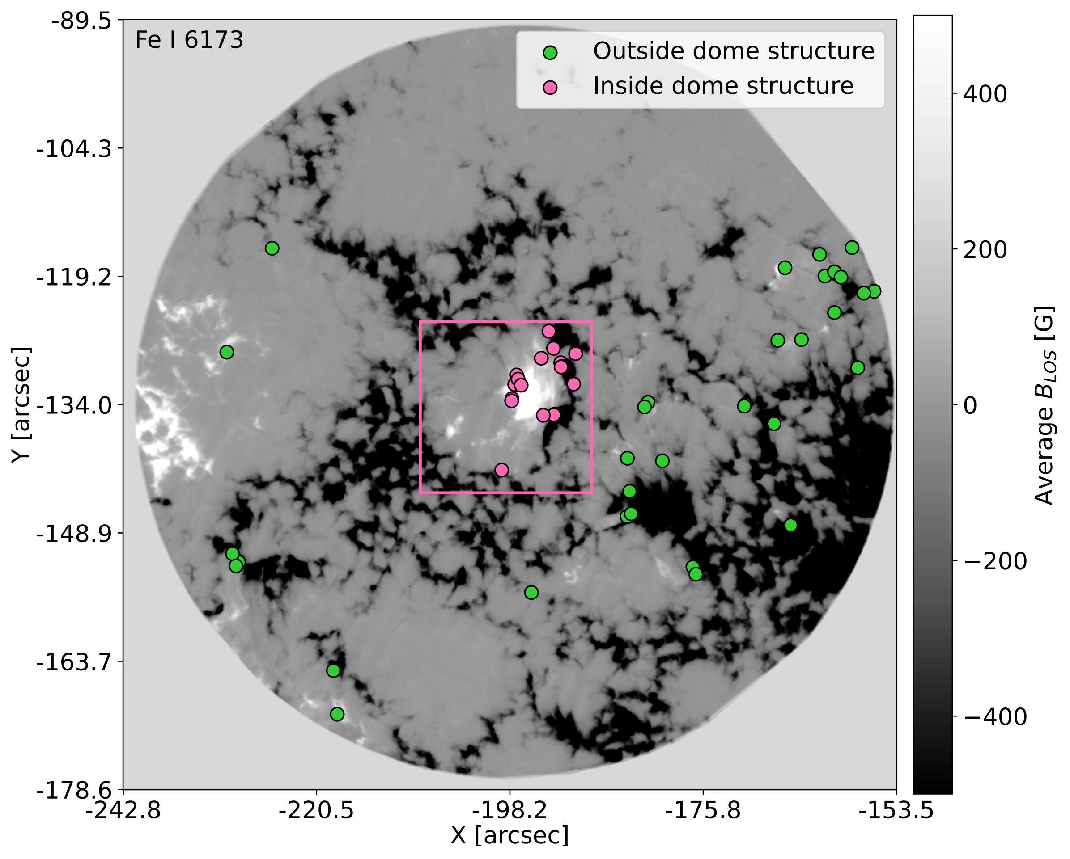
Separate EBs inside and outside dome

Slide 18
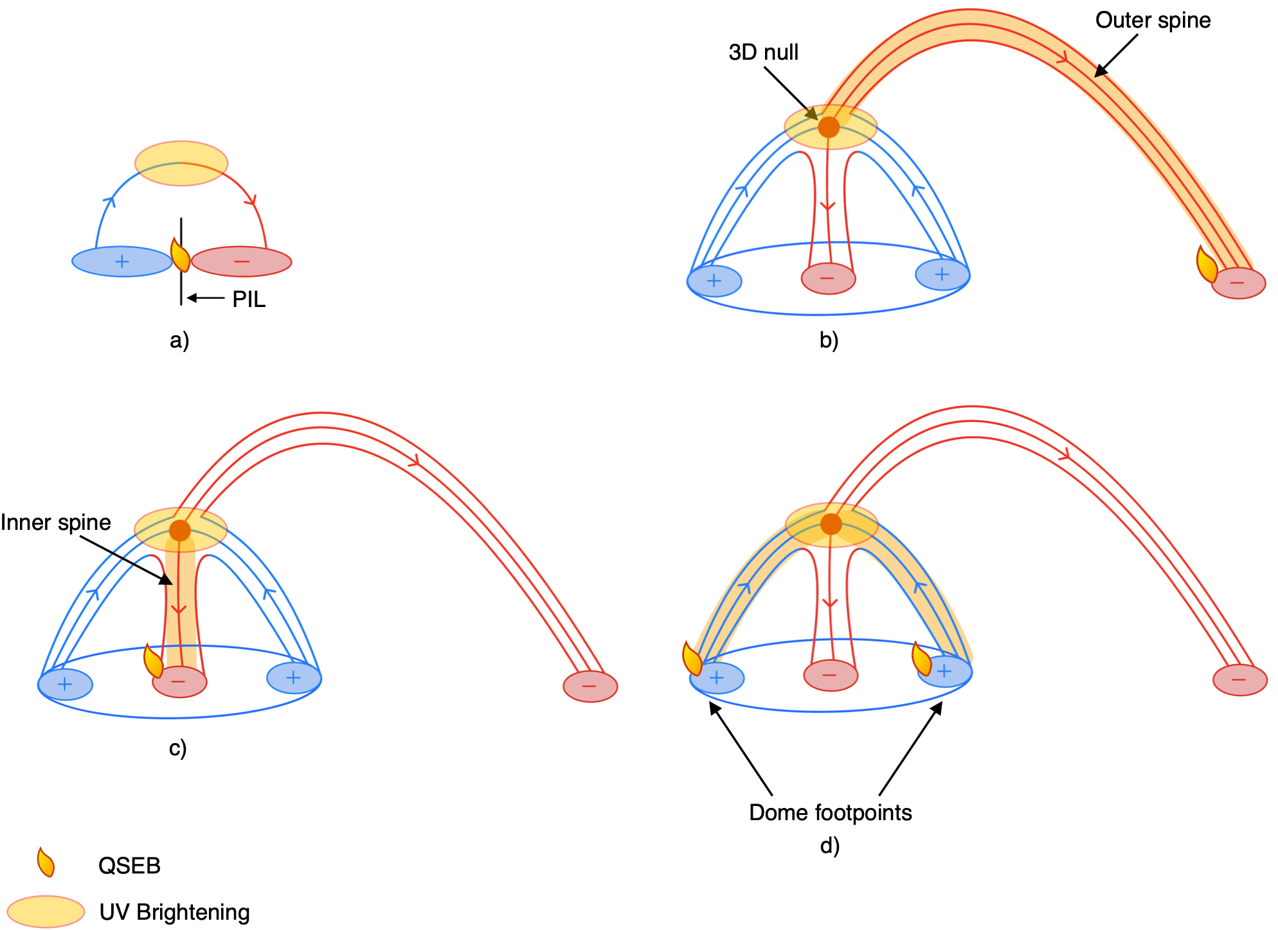
Fan-Spine Topology
Bhatnagar et al. 2025

Slide 19
Conclusions
We apply a 4-level intensity threshold to $Hα$ wings to detect EBs.
We find median maximum area of 0.275 ${\text{arcsec}}^{2}$ and median lifetime of 3 min.
18 dipolar EBs, 26 unipolar EBs, 7 EBs are unclear.
Unipolar EBs are most likely due to a reconnection site located higher in the atmosphere.

