Slide 1
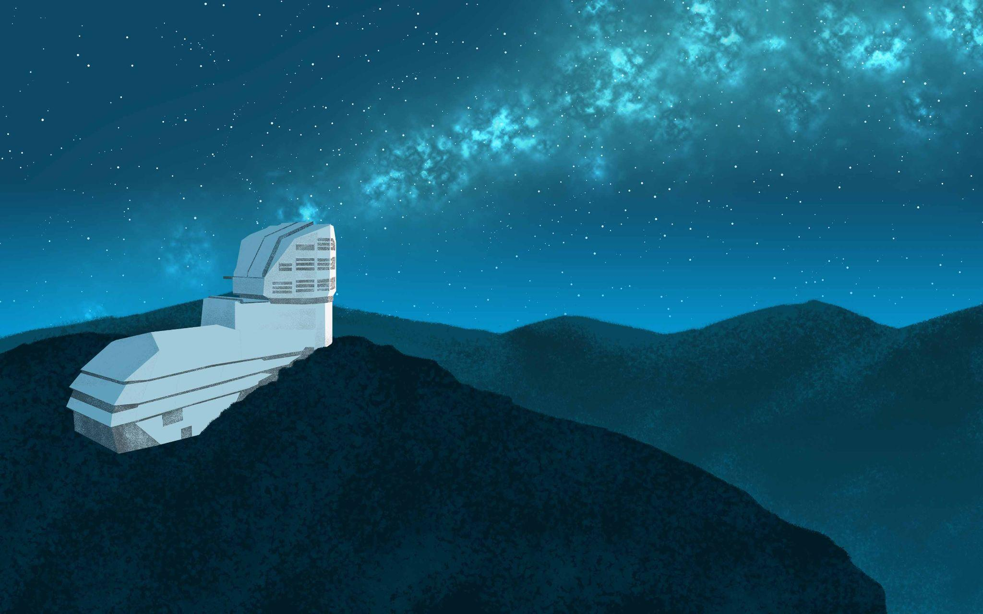
Debiasing the
LEGACY SURVEY OF SPACE AND TIME
for Solar System Objects
Rosemary Dorsey¹ & Mikael Granvik¹²
¹University of Helsinki
²Luleå University of Technology
Image credit:
Rubin Observatory/NSF/AURA

Slide 2

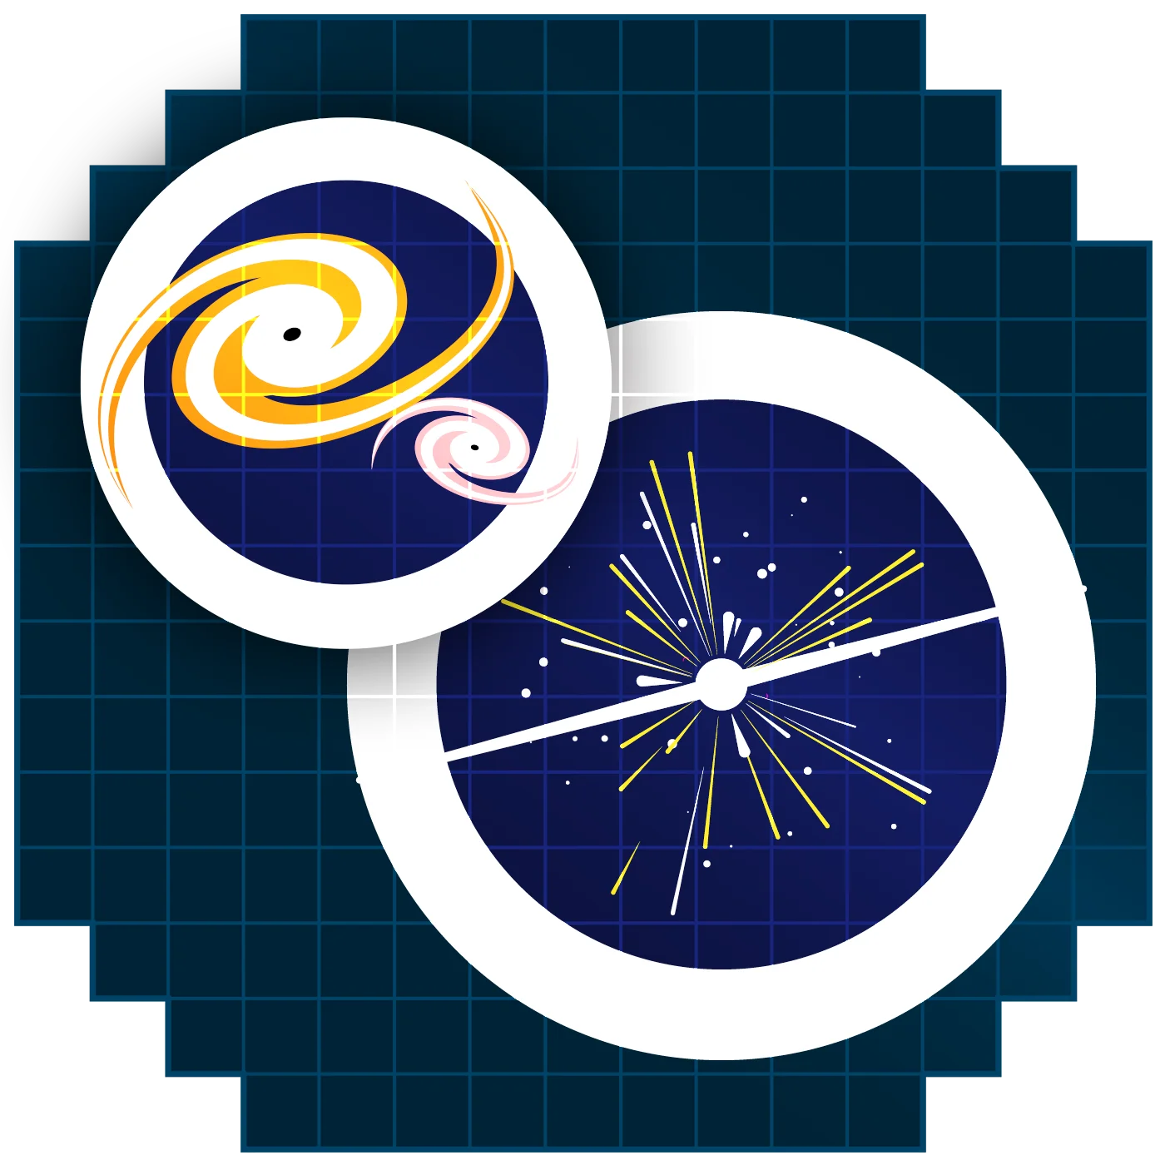
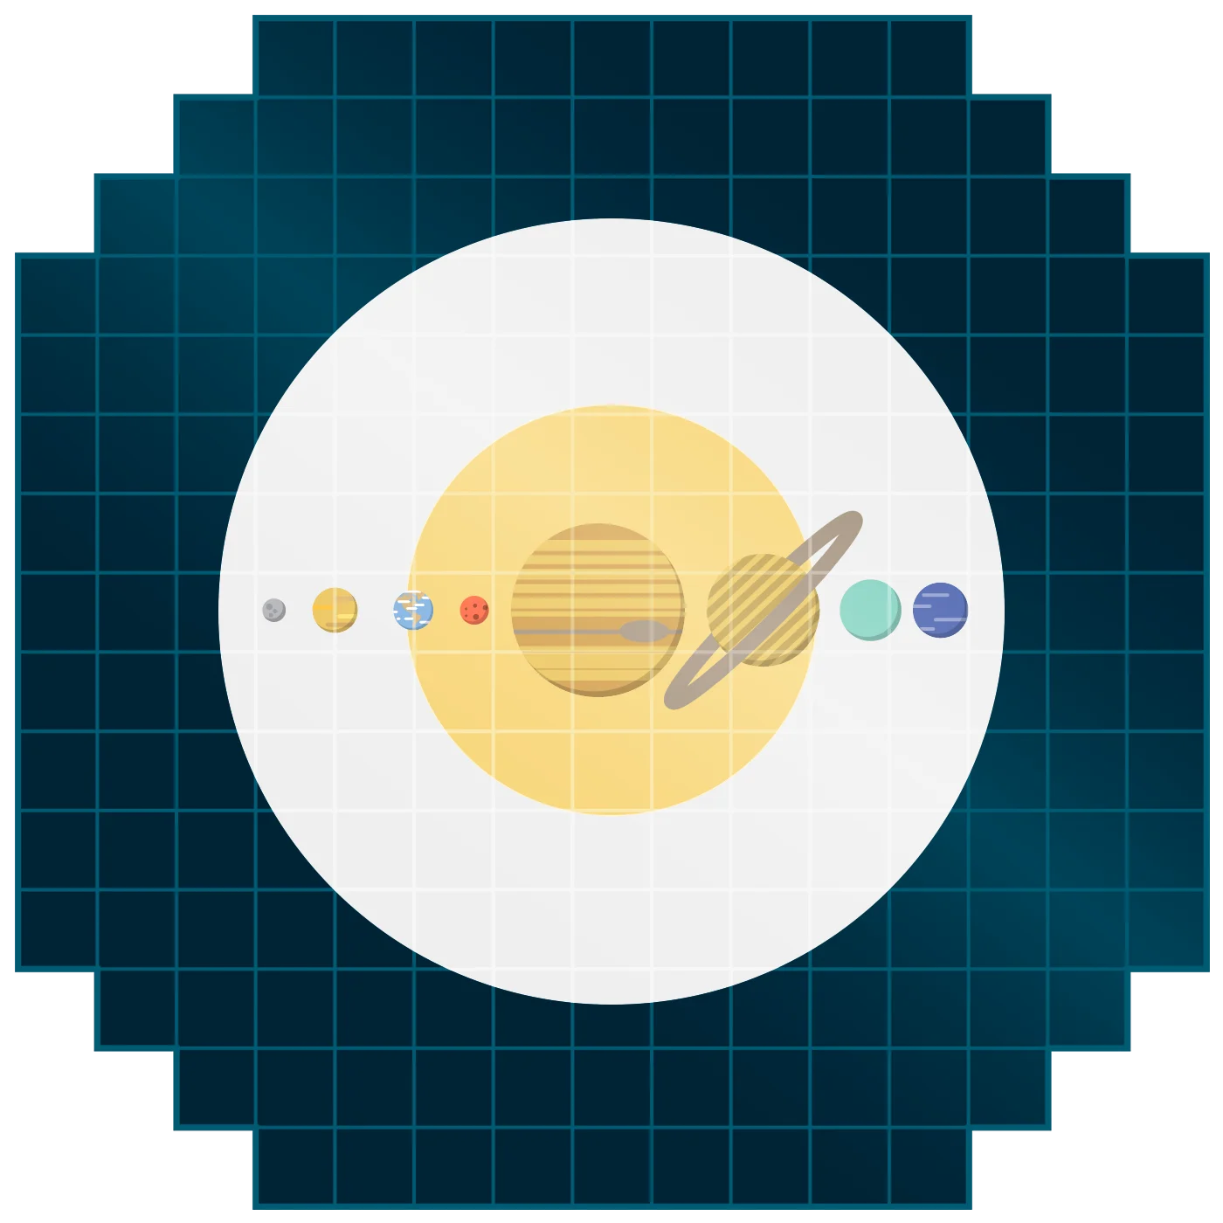

Four Science Goals
Image credit: Rubin Observatory/NSF/AURA

Slide 3
Four Science Goals
Taking an Inventory of the Solar System
5 million asteroids
~5x currently known
6-50 interstellar objects
≥2x currently known
40,000 trans-Neptunian objects
~7x currently known
130,000 near-Earth objects
>4x currently known
Kurlander et al. (2025), Dorsey et al. (2025)

Slide 4
Near-Earth Discoveries
5 million asteroids
~5x currently known
6-50 interstellar objects
≥2x currently known
Near-Earth objects
Interstellar objects
40,000 trans-Neptunian objects
~7x currently known
130,000 near-Earth objects
>4x currently known
Kurlander et al. (2025), Dorsey et al. (2025)

Slide 5
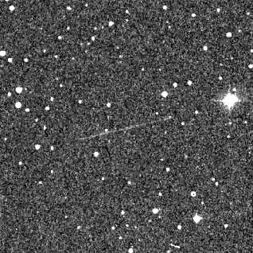
Near-Earth Discoveries
Near-Earth objects
q ≤ 1.3 au
Evolved from the main belt
~40,000 currently known
Interstellar objects
e > 1, v∞ > 0
Ejected from extrasolar systems
3 currently known
small & fast ⇒ trailing losses

Slide 6
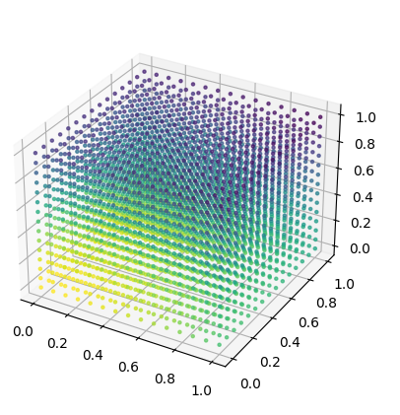
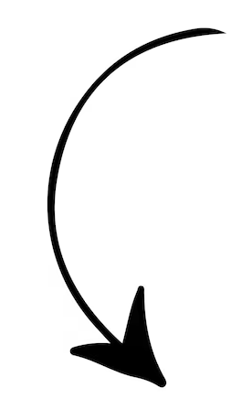
Near-Earth objects
q ≤ 1.3 au
Evolved from the main belt
~40,000 currently known
Absolute magnitude (~size)
Inclination
To understand survey discoveries:
debias the survey efficiency
Eccentricity
Semi-major axis
 Model agnostic
✗ Huge computational cost

Slide 7
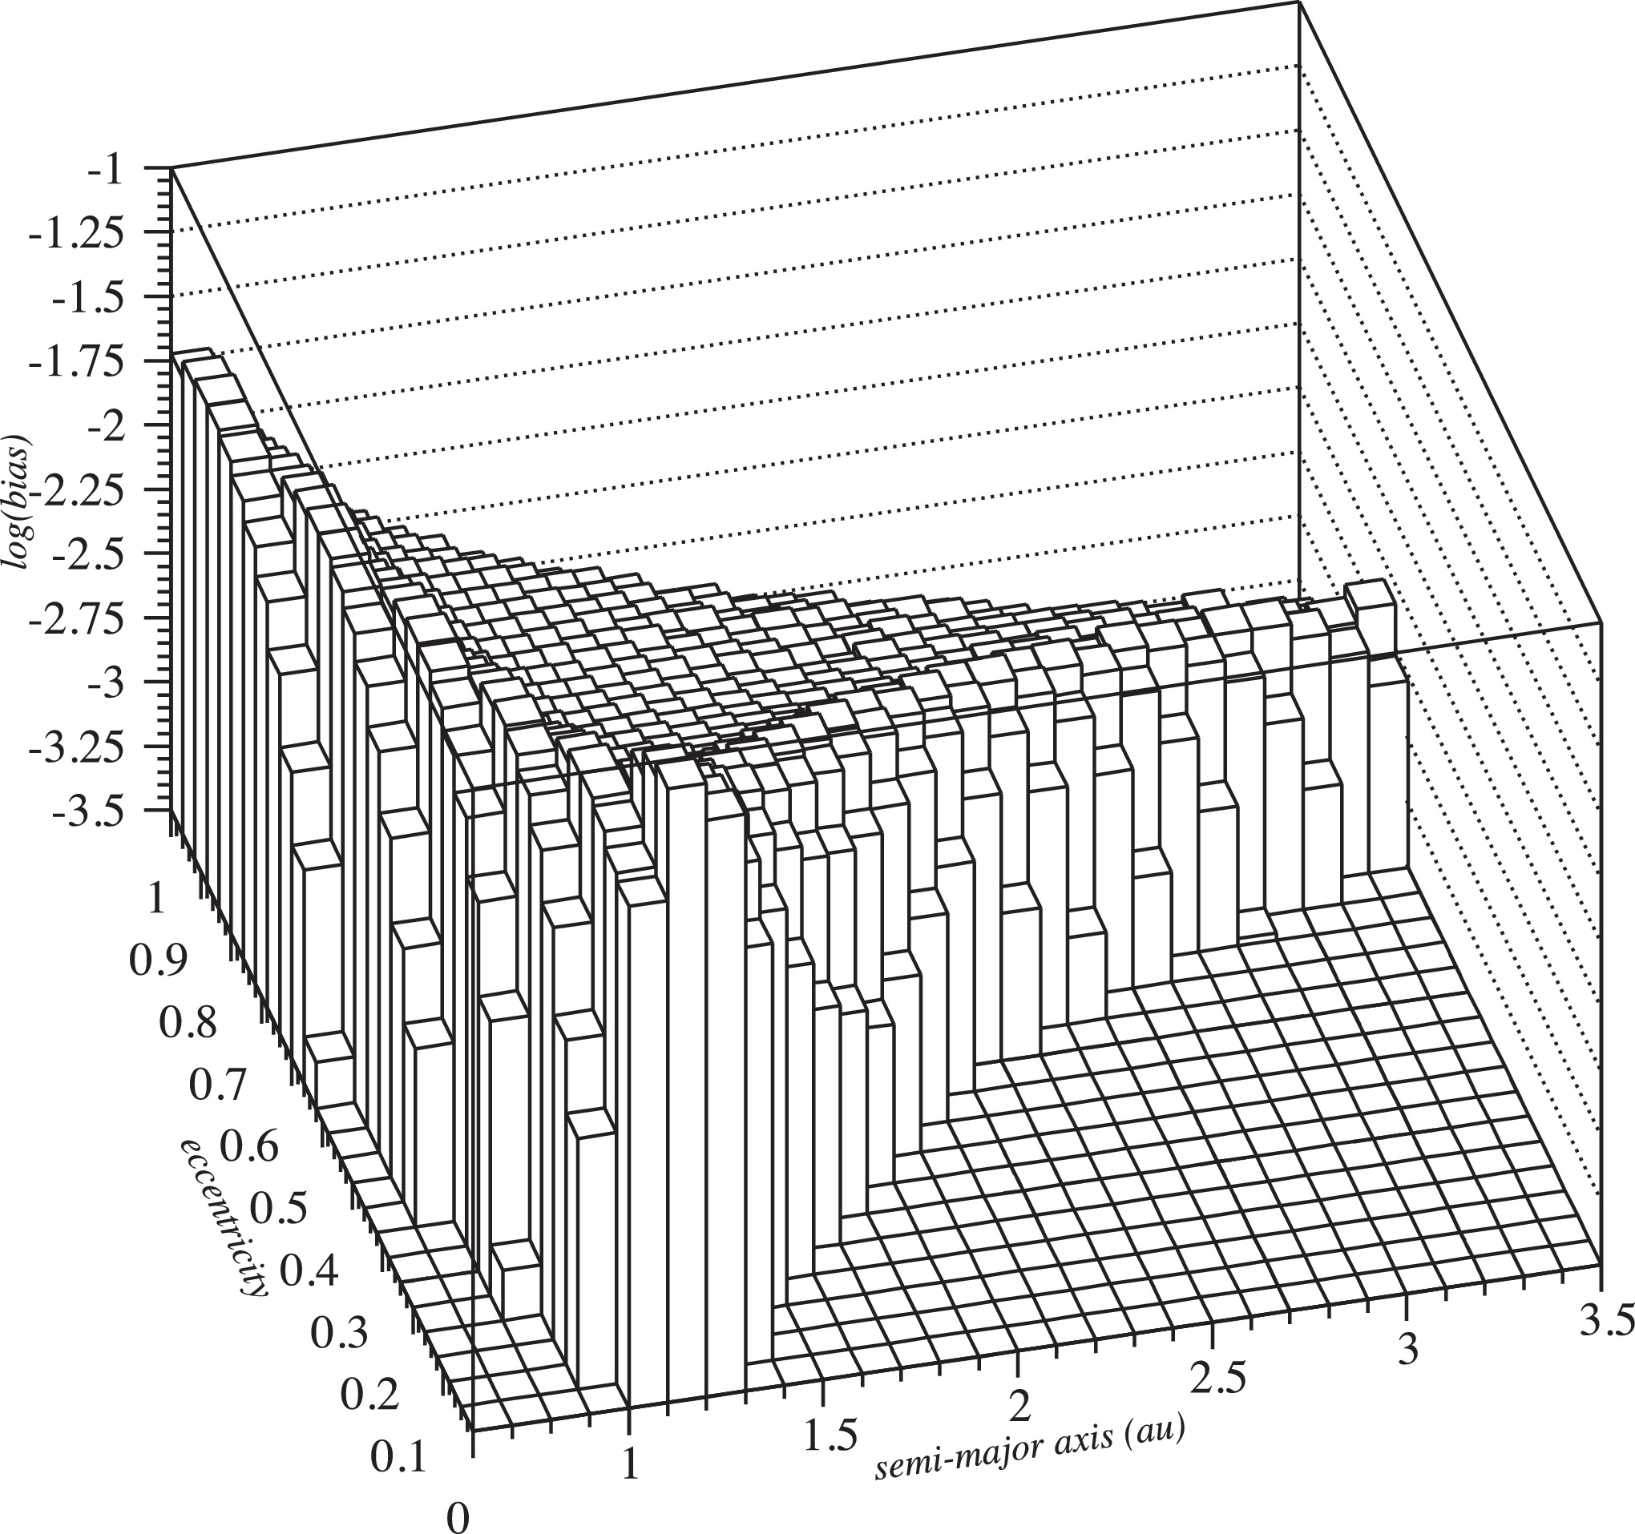
Near-Earth objects
q ≤ 1.3 au
Evolved from the main belt
~40,000 currently known
2D slice of a 4D detection efficiency
Granvik et al. (2018)
 | Min | Max | Cell width | N
a (au) | 0.0 | 4.2 | 0.05 | ~10²
e | 0.0 | 1.0 | 0.02 | ~10¹
i (°) | 0 | 180 | 2 | ~10²
H (mag) | 17 | 25 | 0.25 | ~10¹
 |  |  |  | ~10⁶

Slide 8
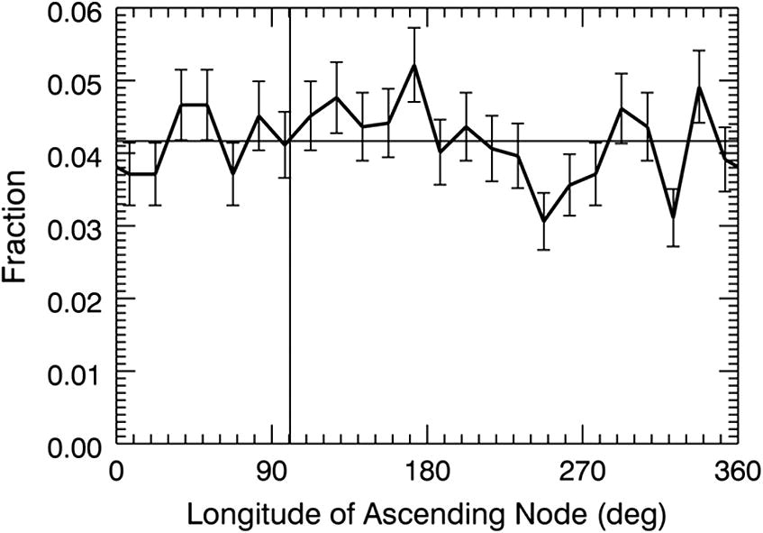
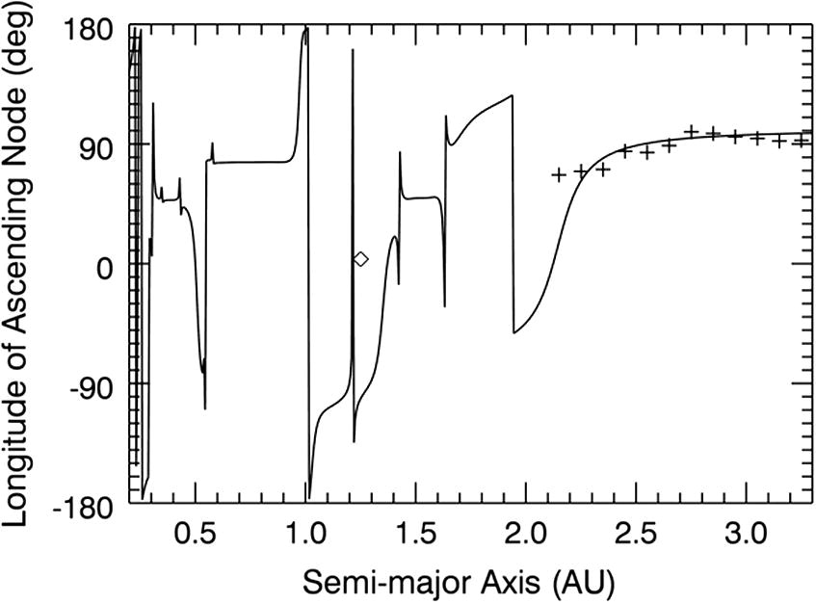
Near-Earth objects
q ≤ 1.3 au
Evolved from the main belt
~40,000 currently known
JeongAhn & Malhotra (2014)
NEOs may have non-uniform Ω
a-dependent & forced by Jupiter
But...

Slide 9
Near-Earth objects
q ≤ 1.3 au
Evolved from the main belt
~40,000 currently known
JeongAhn & Malhotra (2014)
NEOs may have non-uniform Ω
a-dependent & forced by Jupiter
But...
~2,000 NEOs (H<19) → p=0.053

Slide 10
Near-Earth objects
q ≤ 1.3 au
Evolved from the main belt
~40,000 currently known
many objects per cell
&
2 million LSST pointings
 | Min | Max | Cell width | N
a (au) | 0.0 | 4.2 | 0.05 | ~10²
e | 0.0 | 1.0 | 0.02 | ~10¹
i (°) | 0 | 180 | 2 | ~10²
H (mag) | 17 | 25 | 0.25 | ~10¹
Ω | 0 | 360 | 5 | ~10²
ω | 0 | 360 | 5 | ~10²
 |  |  |  | ~10⁶ ~10¹⁰

Slide 11

Near-Earth objects
q ≤ 1.3 au
Evolved from the main belt
~40,000 currently known
 | Min | Max | Cell width | N
a (au) | 0.0 | 4.2 | 0.05 | ~10²
e | 0.0 | 1.0 | 0.02 | ~10¹
i (°) | 0 | 180 | 2 | ~10²
H (mag) | 17 | 25 | 0.25 | ~10¹
Ω | 0 | 360 | 5 | ~10²
ω | 0 | 360 | 5 | ~10²
 |  |  |  | ~10⁶ ~10¹⁰

Slide 12
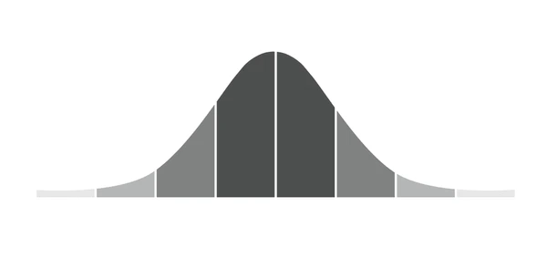
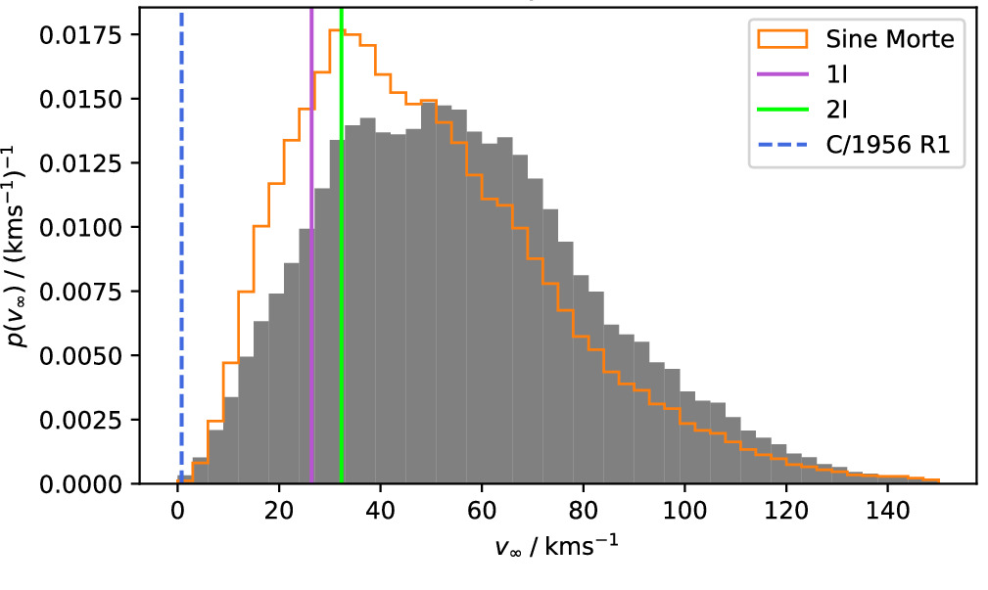
Interstellar objects
e > 1, v∞ > 0
Ejected from extrasolar systems
3 currently known
Historically
v∞
One data-driven model
(with lots of assumptions)
New model Hopkins et al. (2025)
After LSST, how will we know if the model is correct?

Slide 13
Interstellar objects
e > 1, v∞ > 0
Ejected from extrasolar systems
3 currently known
Historically
v∞
One data-driven model
(with lots of assumptions)
New model Hopkins et al. (2025)
! Model agnostic debiasing is critical
✗ Huge phase space

Slide 14
Debiasing LSST
LSST will find 2-4× more NEOs and ISOs
It is critical to understand their discovery efficiency
Main challenge:
Huge parameter space = huge computational cost
Reward:
More detailed understanding of the most accessible small bodies (from across the Galaxy)
Image credit:
Rubin Observatory/NSF/AURA

