Slide 1

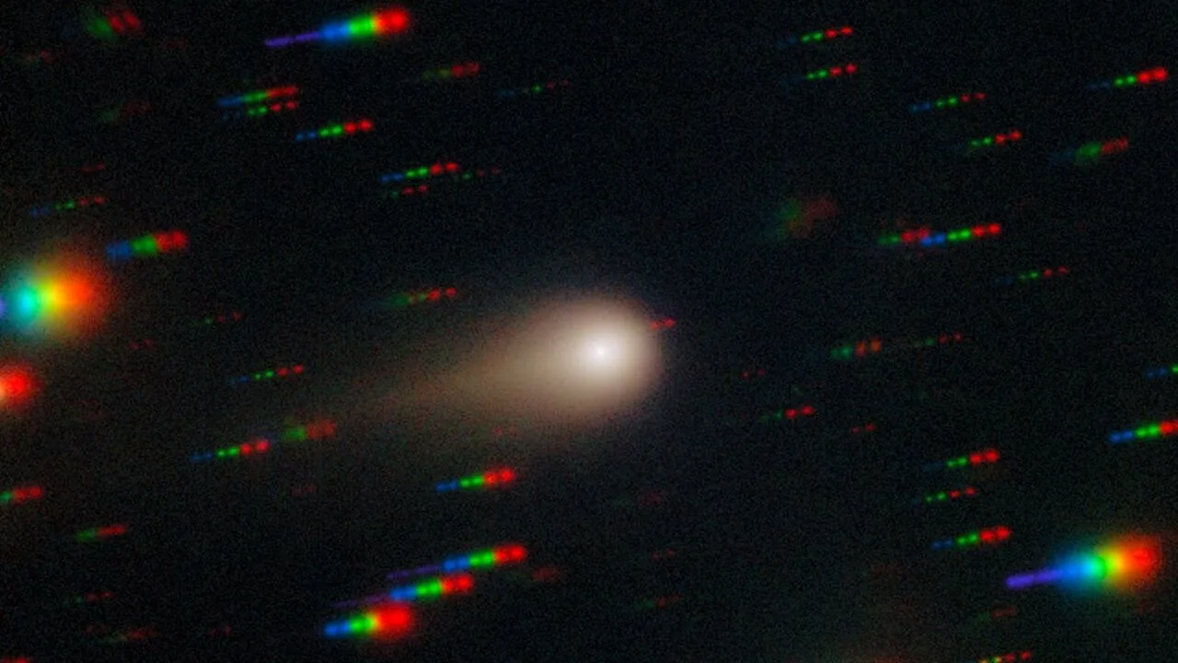
Interstellar comet 3I/ATLAS
Gemini South telescope, Chile.
Extreme Negative Polarisation of new interstellar comet 3I/ATLAS
Nordic-Baltic Astronomy Days 2026. May 28th, Turku, Finland.
Zuri Gray (zuri.gray@helsinki.fi), Stefano Bagnulo, Galin Borisov, Yuna G. Kwon, Alberto Cellino, Ludmilla Kolokolova, Rosemary C. Dorsey, Grigori Fedorets, Mikael Granvik, Eric MacLennan, Olga Muñoz, Philippe Bendjoya, Maxime Devogèle, Simone Ieva, Antti Penttilä, and Karri Muinonen

Slide 2
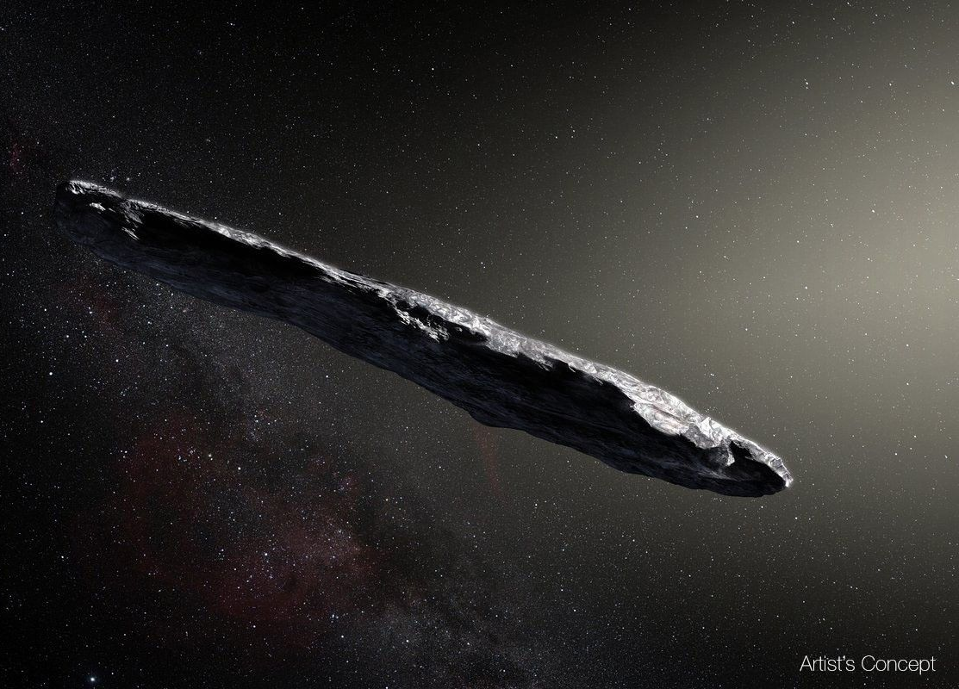
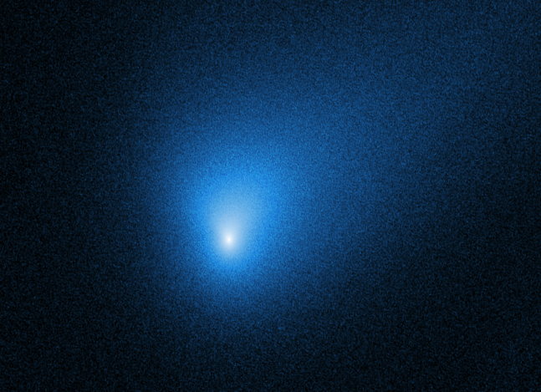
3I/ATLAS:
1I/’Oumuamua
Discovery: 19 Oct 2017
(Artist’s impression, ESO)
2I/Borisov
Discovery: 29 Aug 2019
(Hubble Space Telescope)
3I/ATLAS
Discovery: 1 July 2025
(International Gemini Observatory)

Slide 3
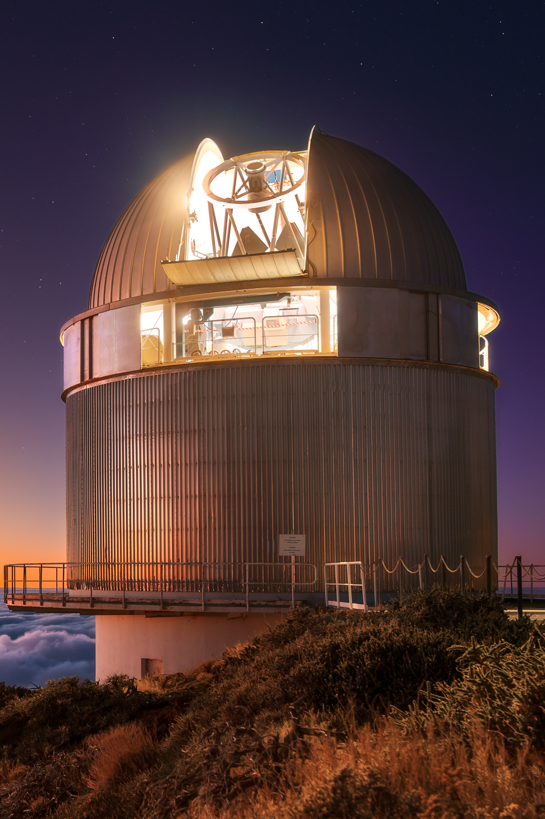
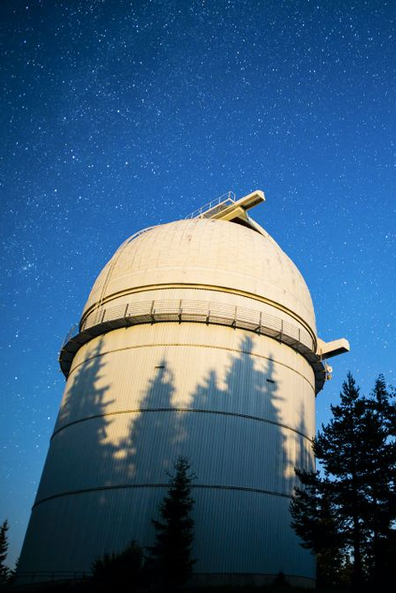
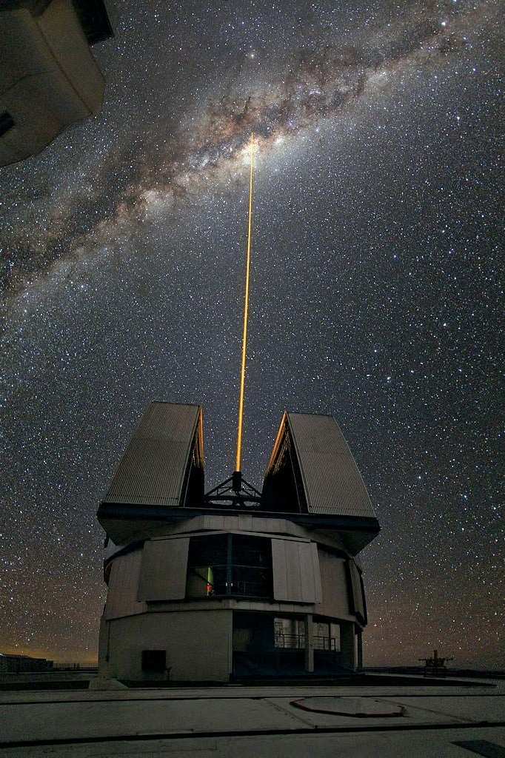



3I/ATLAS: Observations
FORS2
8.2m Very Large Telescope (VLT)
ESO Paranal, Chile
ALFOSC
2.5m Nordic Optical Telescope (NOT)
La Palma, Spain
FeReRo2
2m Ritchey-Chrétien-Coude
Rozhen, Bulgaria

Slide 4
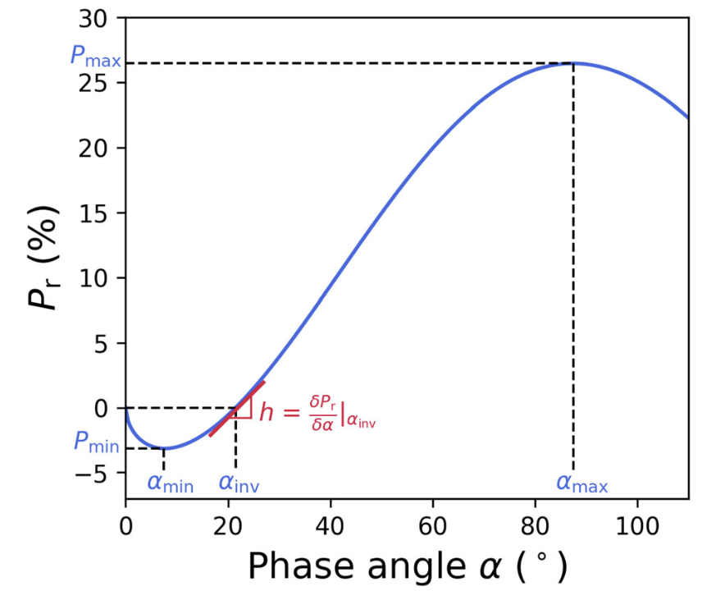
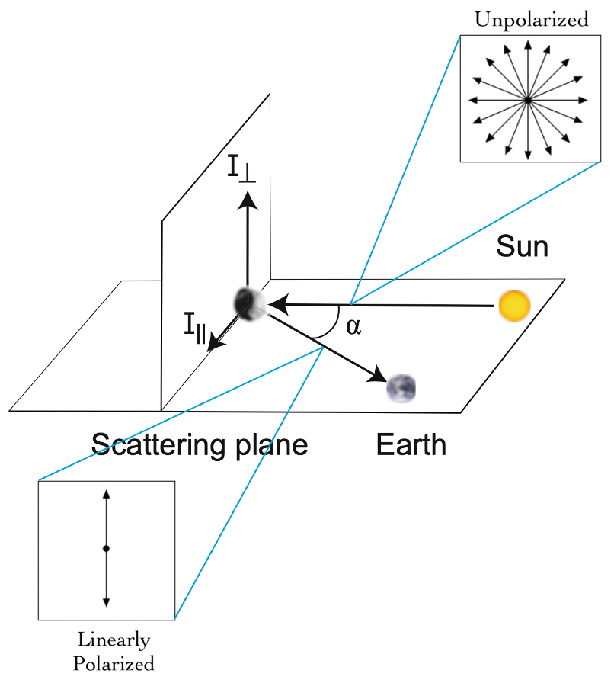
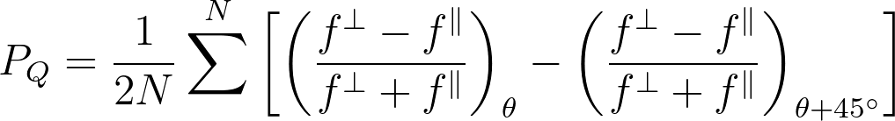
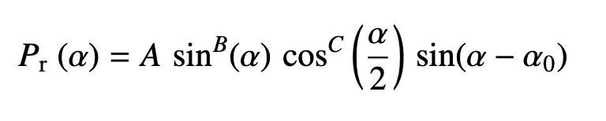
Introduction
Lumme & Muinonen (1993)

Slide 5
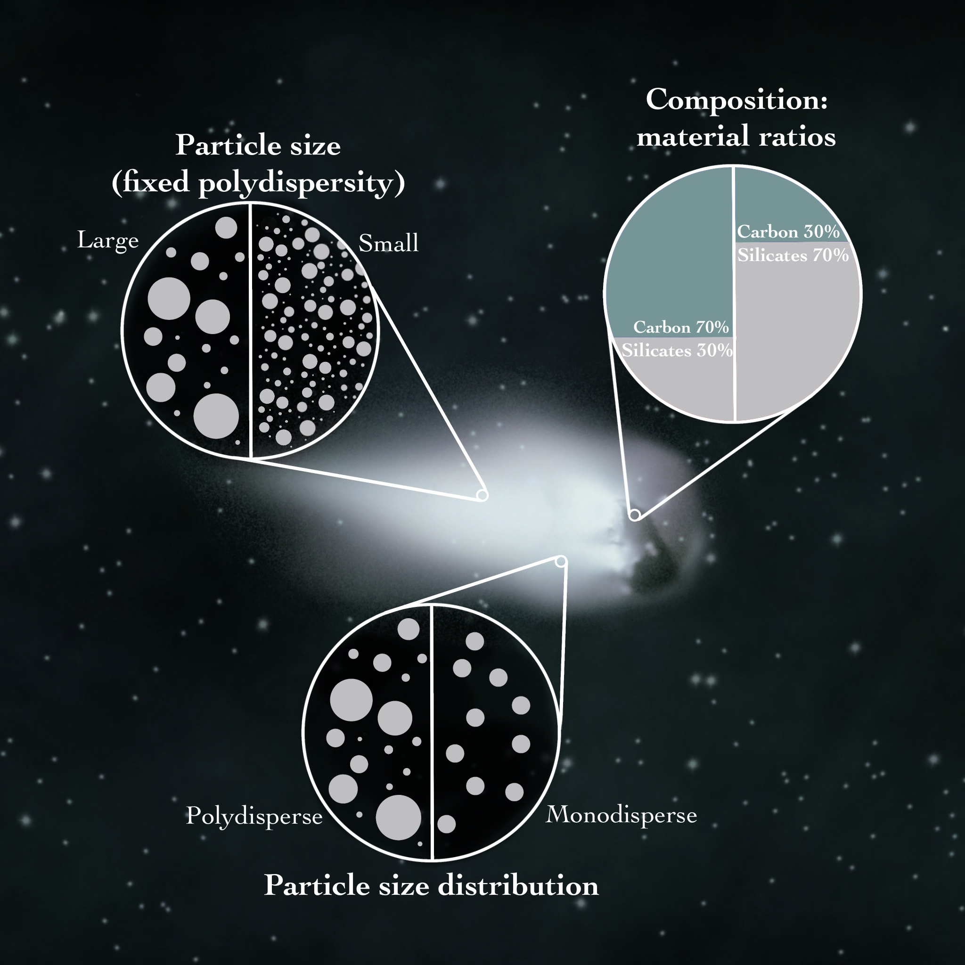
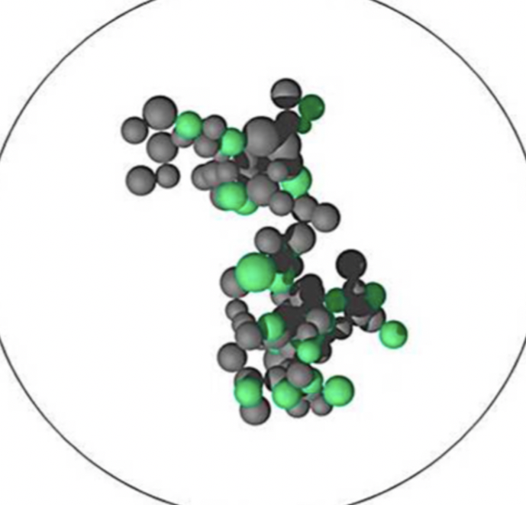
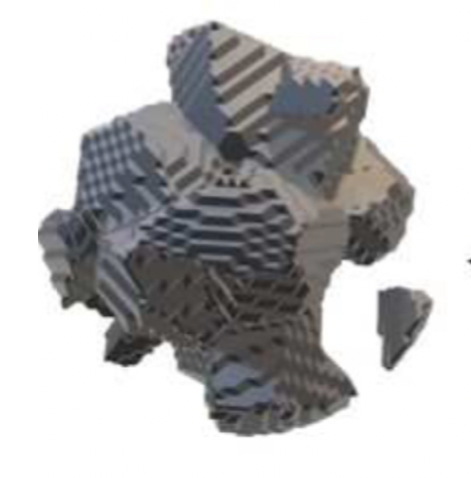
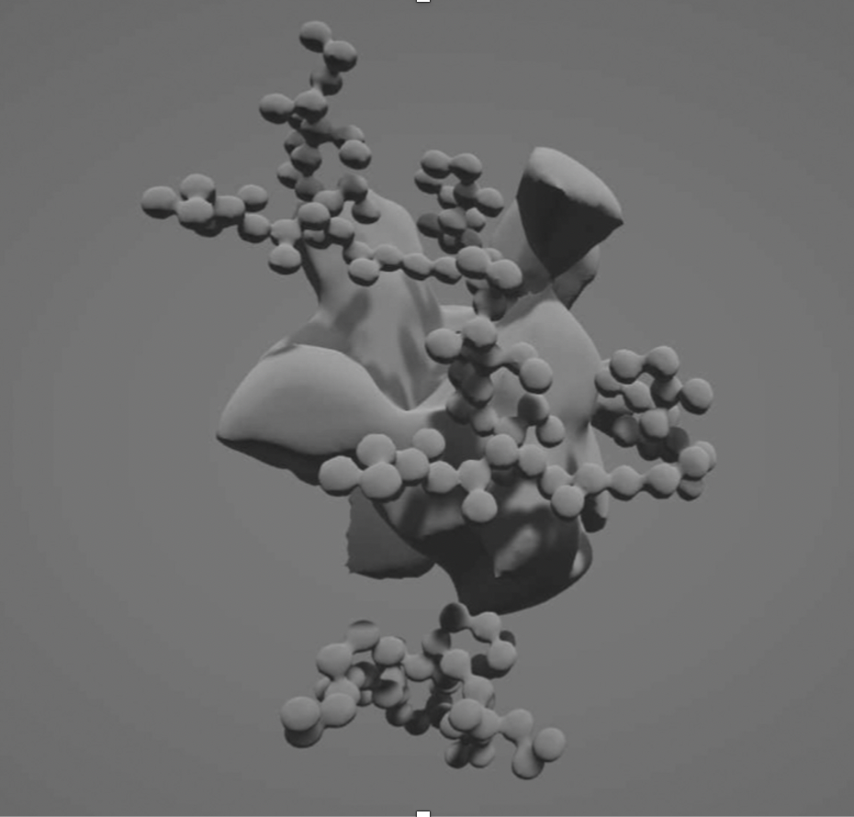
3I/ATLAS: Introduction
Aggregates
(high porosity)
Solids
(low porosity)
“Fluffy” solids
(moderate porosity)

Slide 6
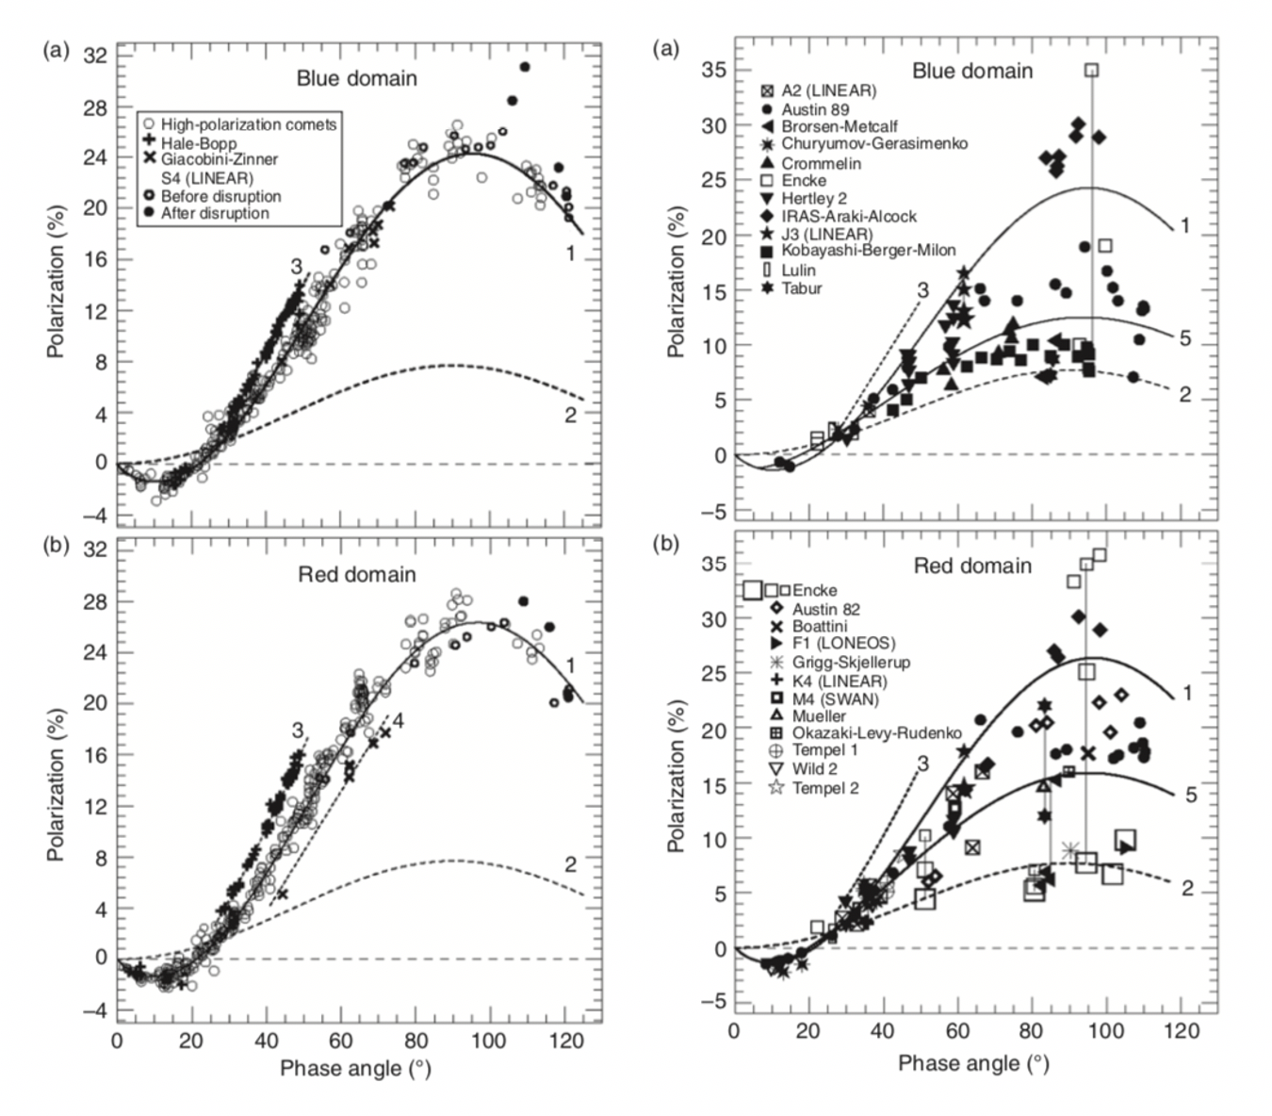
3I/ATLAS: Introduction
High-Pmax
(~25-30%)
Low-Pmax
(~5-15%)
Aggregates
(high porosity)
Solids
(low porosity)
“Fluffy” solids
(moderate porosity)

Slide 7
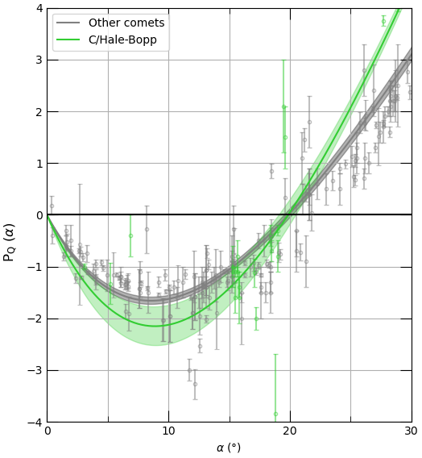
3I/ATLAS: Introduction

Slide 8
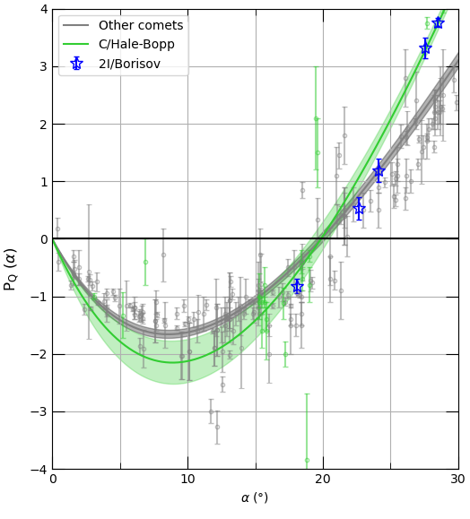
3I/ATLAS: 2I/Borisov
Bagnulo et al. (2021), Unusual polarimetric properties for interstellar
comet 2I/Borisov
2I/Borisov
Observed 2 weeks to 3 months post-perihelion
(Dec 2019 – Mar 2020)
r ~ 2-3 au
Phase angle ~ 18-28°

Slide 9
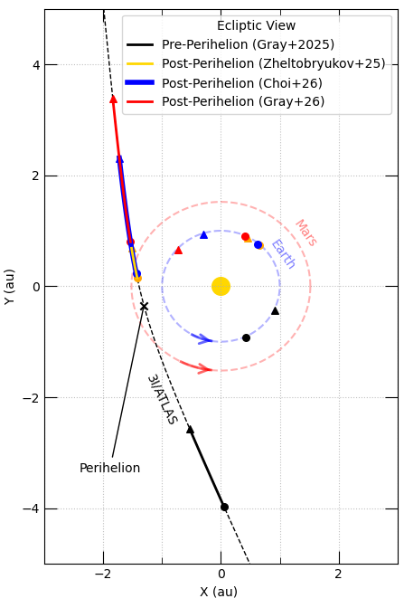
3I/ATLAS: Results
3I/ATLAS
Observed ~3 to 2 months pre-perihelion
(July – August 2025)
r ~ 4-2.6 au
Phase angle ~ 7-22°

Slide 10
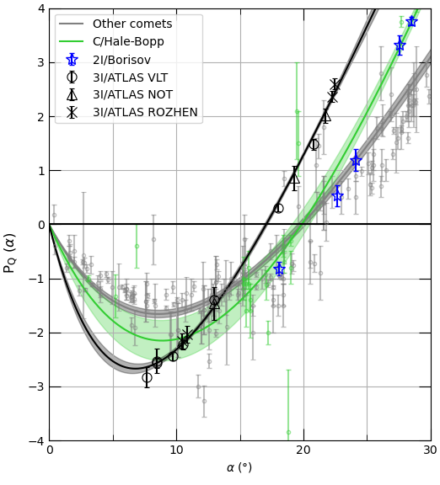
3I/ATLAS: Results
3I/ATLAS
Observed ~3 to 2 months pre-perihelion
(July – August 2025)
r ~ 4-2.6 au
Phase angle ~ 7-22°
Pmin = -2.7 %

Slide 11
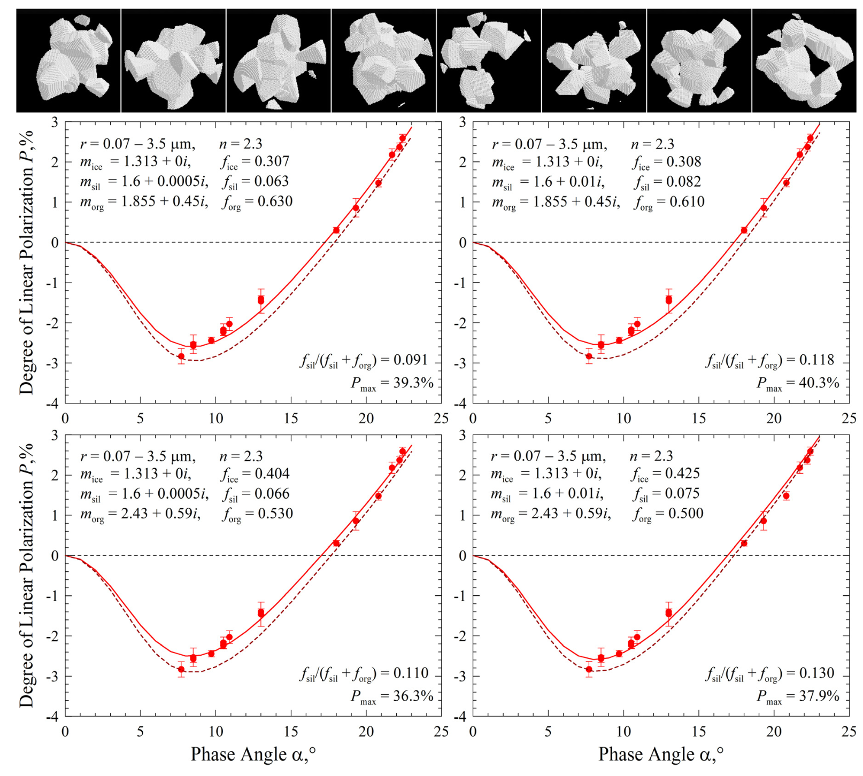
3I/ATLAS: Discussion
Zubko et al. (2025): deep polarisation minima can be produced by a coma made of 40% water ice particles, and 60% silicate and organic particles.

Slide 12
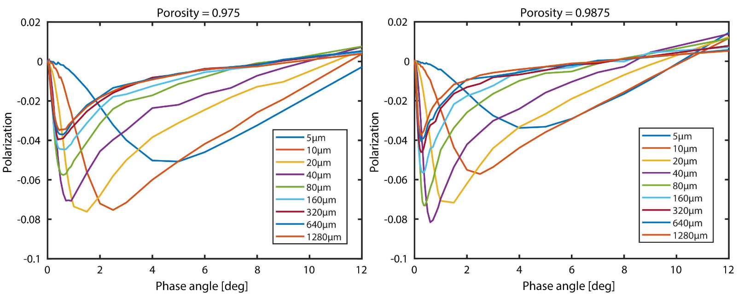
3I/ATLAS: Discussion
Ivanova et al. (2023): a deep polarisation minima can be produced using large, porous particles made of silicate-organic + water- and CO2-ice particles. They demonstrate that particle size and porosity play key roles!

Slide 13

3I/ATLAS: Conclusions
(i) 3I/ATLAS is characterised by an extremely deep and narrow negative polarisation branch.
(ii) 3I/ATLAS represents a new/unique polarimetric class of comet.
(iii) 3I/ATLAS may be dominated by large, porous particles consisting of a mix of bright and dark particles.
Extreme Negative Polarization
of New Interstellar Comet 3I/ATLAS
(Zuri Gray et al. 2025)
Pmin = -2.7 %

Slide 14
3I/ATLAS: New Observations
Post-Perihelion
Solar conjunction
Pre-Perihelion

Slide 15
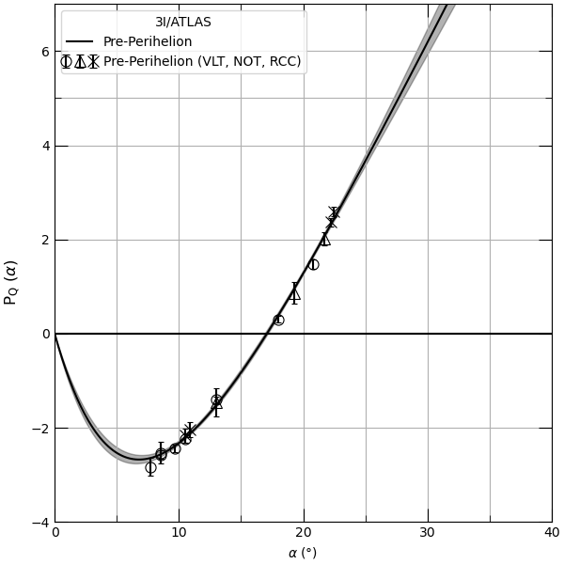

3I/ATLAS: New Observations
Pre-Perihelion (18 Jul – 28 Aug):
r ~ 4 – 2.6 au
α ~ 8 – 22° (increasing)
Pmin = -2.7 %

Slide 16
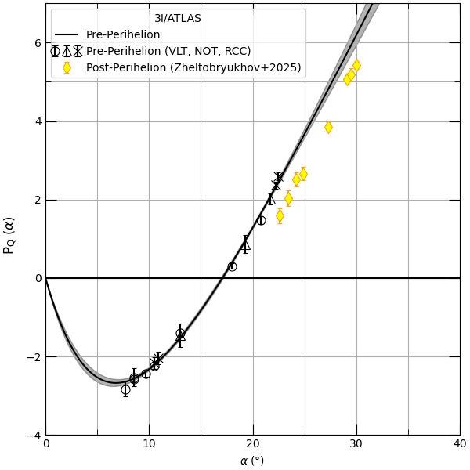

3I/ATLAS: New Observations
Pre-Perihelion (18 Jul – 28 Aug):
r ~ 4 – 2.6 au
α ~ 8 – 22° (increasing)
Post-Perihelion (11 Nov – 25 Nov):
r ~ 1.4 – 1.7 au
α ~ 23 – 30° (increasing)
Pmin = -2.7 %

Slide 17
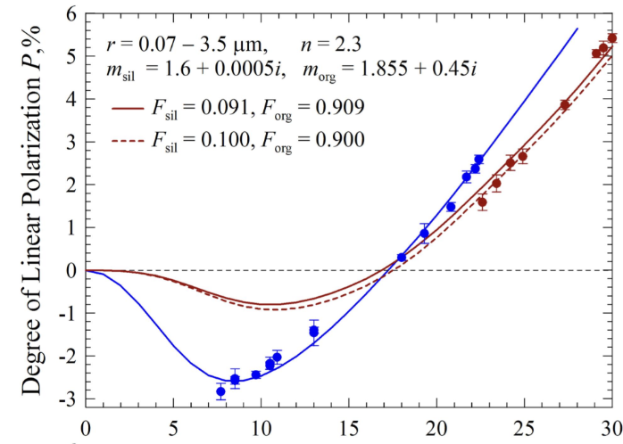
3I/ATLAS: New Observations
Pre-Perihelion (18 Jul – 28 Aug):
r ~ 4 – 2.6 au
α ~ 8 – 22° (increasing)
Post-Perihelion (11 Nov – 25 Nov):
r ~ 1.4 – 1.7 au
α ~ 23 – 30° (increasing)
Pmin = -2.7 %

Slide 18
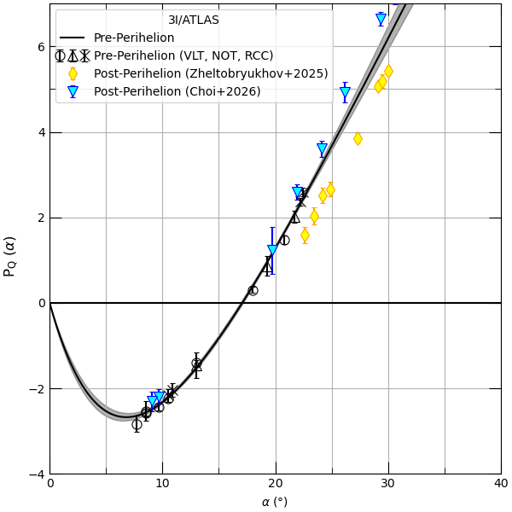

3I/ATLAS: New Observations
Pre-Perihelion (18 Jul – 28 Aug):
r ~ 4 – 2.6 au
α ~ 8 – 22° (increasing)
Post-Perihelion (11 Nov – 25 Nov):
r ~ 1.4 – 1.7 au
α ~ 23 – 30° (increasing)
Post-Perihelion (13 Nov – 08 Jan):
r ~ 1.5 – 2.9 au
α ~ 31 – 9° (increasing, then decreasing)
Pmin = -2.7 %

Slide 19
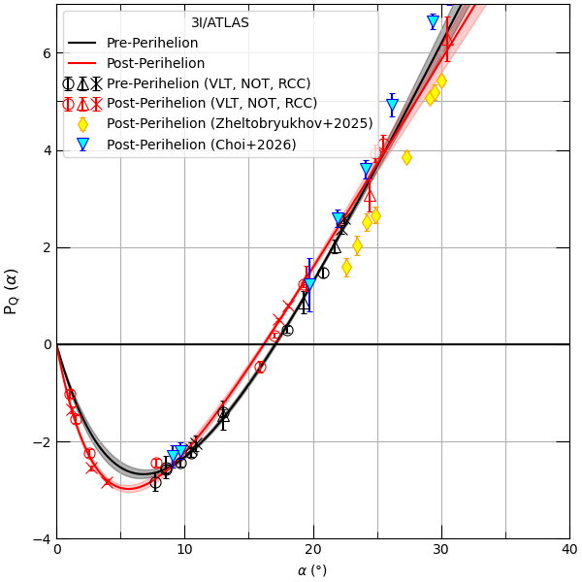

3I/ATLAS: New Observations
Pre-Perihelion (18 Jul – 28 Aug):
r ~ 4 – 2.6 au
α ~ 8 – 22° (increasing)
Post-Perihelion (11 Nov – 25 Nov):
r ~ 1.4 – 1.7 au
α ~ 23 – 30° (increasing)
Post-Perihelion (13 Nov – 08 Jan):
r ~ 1.5 – 2.9 au
α ~ 31 – 9° (increasing, then decreasing)
Post-Perihelion (28 Nov – 21 Jan):
r ~ 1.7 – 3.3 au
α ~ 30 – 1° (decreasing)
Pmin = -2.7 %
Pmin = -3 %

Slide 20
3I/ATLAS: Conclusions
(i) 3I/ATLAS is characterised by an extremely deep and narrow negative polarisation branch, which remains stable despite the perihelion and snowline passage.
(ii) 3I/ATLAS represents a new/unique polarimetric class of comet.
(iii) 3I/ATLAS may be dominated by large, porous particles consisting of a mix of bright and dark particles.
Unusual polarimetric signature may be due to intrinsic properties of dust particles.
Why exactly? We’re still figuring it out ;)
Pmin = -2.7 %
Pmin = -3 %

Slide 21
Interstellar comet 3I/ATLAS
Gemini South telescope in Chile.
Thank you for listening!

