Slide 1


Imaging simulation tool for small solar system objects
Antti Penttilä
University of Helsinki
With contributions by Meri Kolehmainen, Anne Keski-Vakkuri, Leonardo Negri, Noora Halla-aho, Joel Jääskeläinen, Mario F. Palos, Tomas Kohout (UTU), Antti Näsilä (VTT), Richard Cole (VTT)
Nordic-Baltic Astronomy Days 2026, Turku

Slide 2
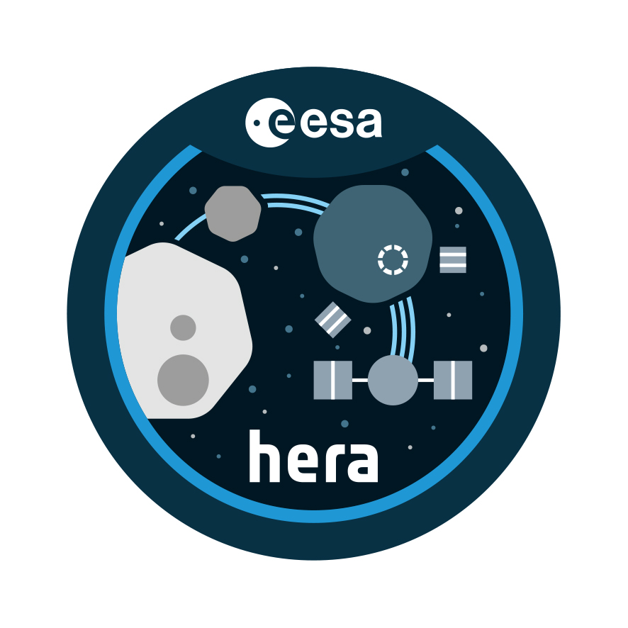
Motivation
Space mission operations need to be planned beforehand
This invokes questions like:
  What do we see with camera XXX in mission phase YYY when observing geometry is ZZZ?
  What is the quality of the images with detector XXX in geometry YYY and with integration time ZZZ
  What is the quality of scientific products from the image with certain detector/geometry/integration etc.
We are especially interested in these questions in relation with VTT Fabry-Perót interferometric hyperspectral camera on ESA space missions
  Hera/MILANI smallsat, ASPECT instrument targeting Didymos binary asteroid system
  Comet Interceptor MIRMIS instrument with yet undecided target, hopefully new long-period comet

Slide 3
Goals for the tool on what the instrument is seeing
Physically “correct” and traceable imaging simulations of surfaces (asteroid, comet nucleus) and particle and gas volumes (cometary coma)
Correct physical units such as radiance
Description of surface scattering with photometric functions and their parameters typical for planetary science
  Disk functions: Lommel-Seeliger, Lambert
  Phase functions: polynomial (ROLO), exponential, linear-magnitude
Description of particle/gas volumes by particle or molecule density, particle size, particle refractive index or molecule absorption spectra
3D shape models for the targets
(Simple) coma density models
Accurate observing geometries from SPICE kernels

Slide 4
Goals for the tool on what the instrument is outputting
Physically correct models for instrument optics transmissions and detector noise components
Correct units in noise modeling
  Irradiance goes in
  Photons transform into electric charges in the detector
  Detector noise components in unit charges
  Detector transforms charge counts into digital numbers with some bit depth
Instrument output is binary stream of digital numbers

Slide 5
Design choices for the tool
The 3D imaging simulation at one wavelength is done in Blender open-source 3D modeling software
Image simulation part implemented as a Python module working inside Blender’s Python console
Disk and phase functions implemented as Blender shader nodes
The GUI tools from Blender available, as well as Python command line using the Python module functionality
Shape models as Blender targets
SPICE kernel functionality embedded in the Blender Python console for observation geometry

Slide 6
…design choices for the tool
Instrument simulation as stand-alone Python module outside Blender
Uses generated images from Blender with additional information to convert image digital numbers into
  radiance factor, then
  irradiance at instrument lens
  flux to detector pixel
  charges at detector pixel
  pixel readout digital number
  instrument binary output data stream
With spectral instruments, if the phase function of the surface photometric model can be assumed wavelength-independent, then single image can be expanded into spectral datacube by multiplying by target reflectance spectrum
For wavelength-dependent cases (comet with gas and dust coma), different wavelengths need to be individually rendered in Blender

Slide 7
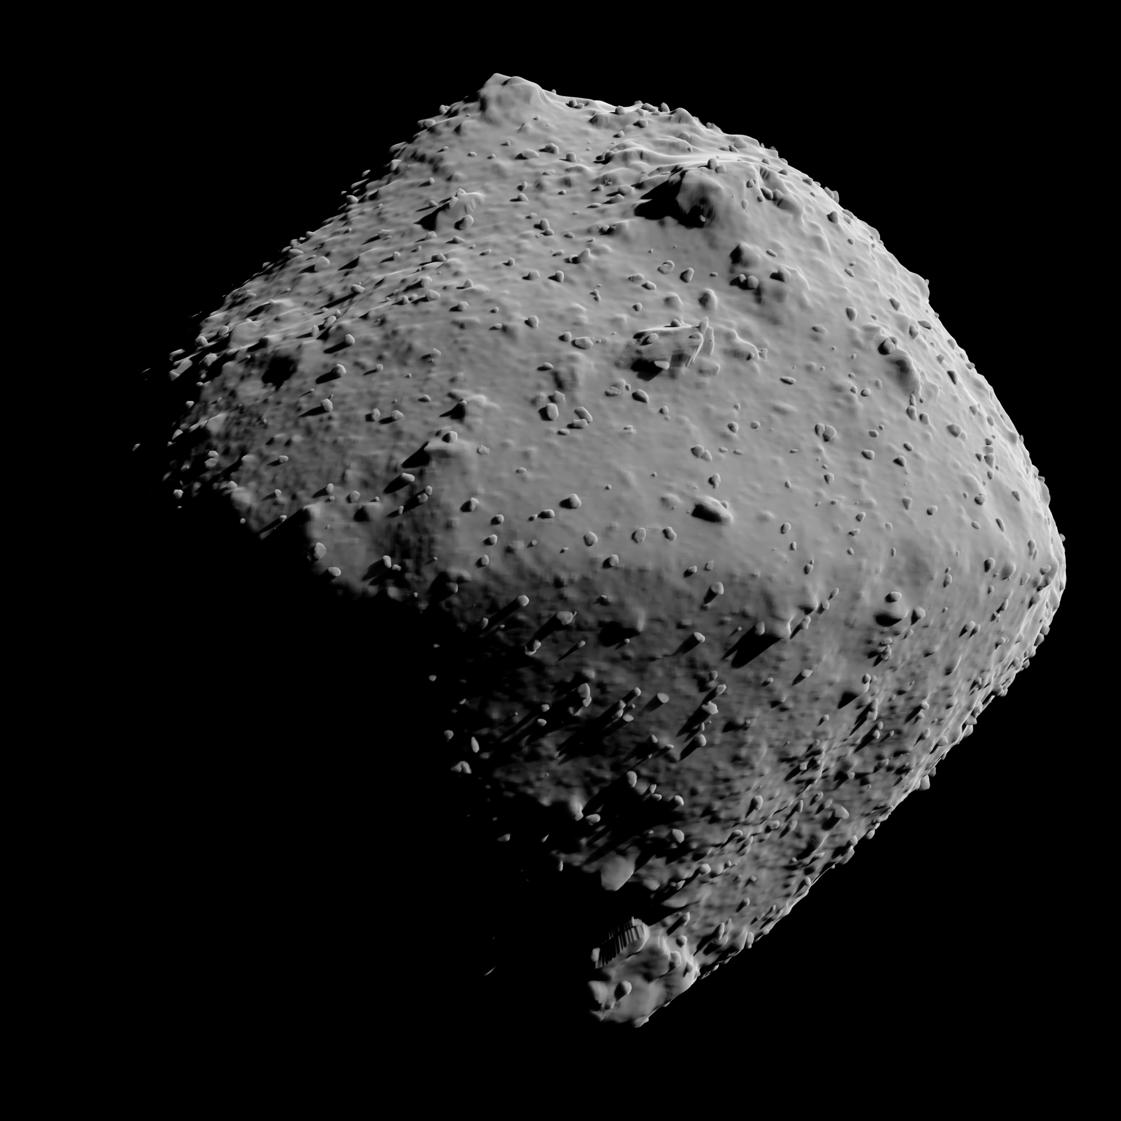
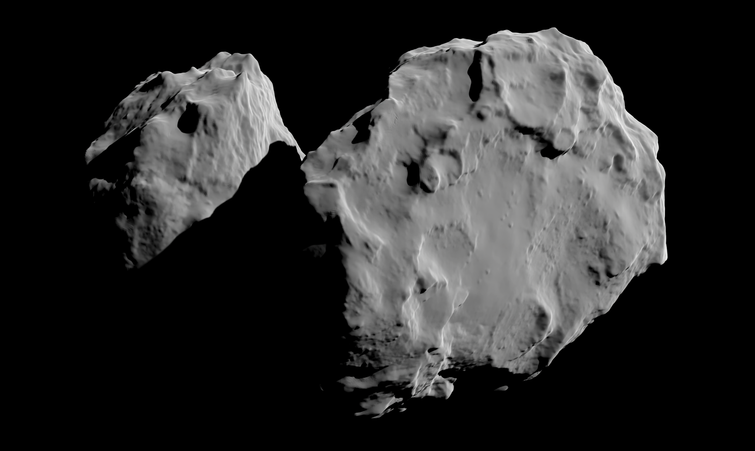
Showcase of results with current version of the tool
67P/C-G, McEwen photometric function
Ryugu with added boulders, McEwen photometric function

Slide 8
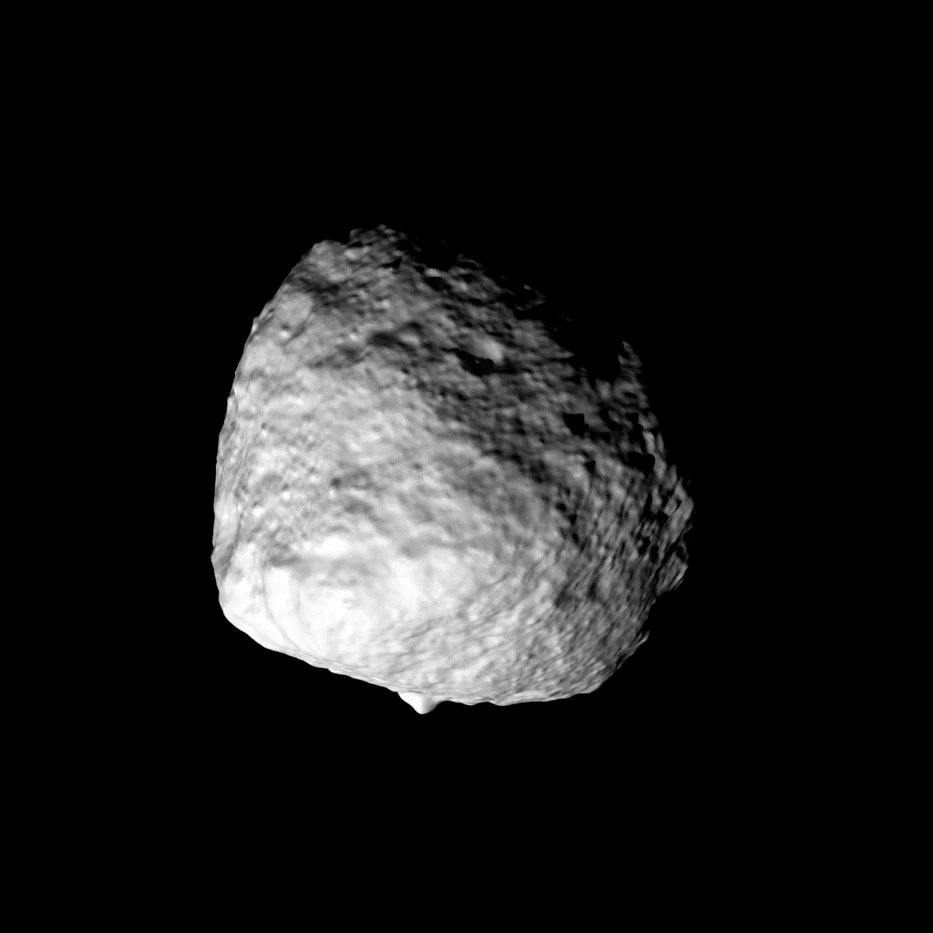
Instrument orbiting an asteroid

Slide 9
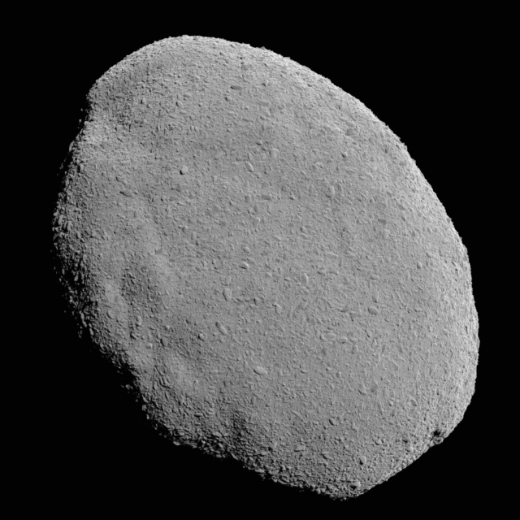
…result showcase
Didymos imaged with ASPECT camera from 5 km distance (left), and zooms on one surface patch (right) either without noise (up), or with added instrument noise (down)

Slide 10
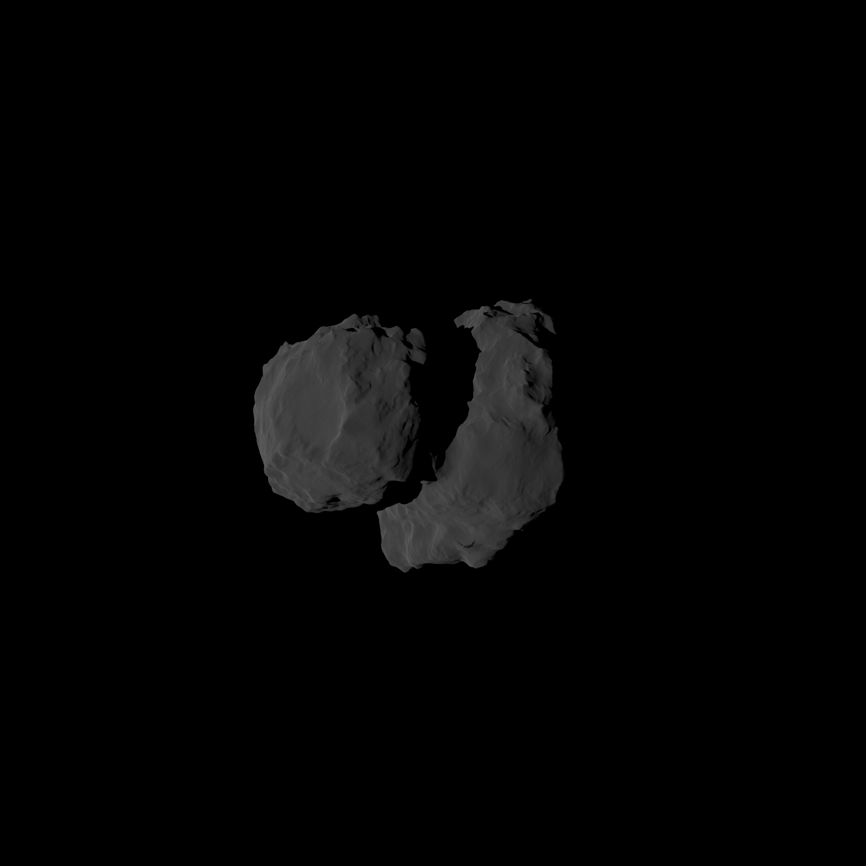
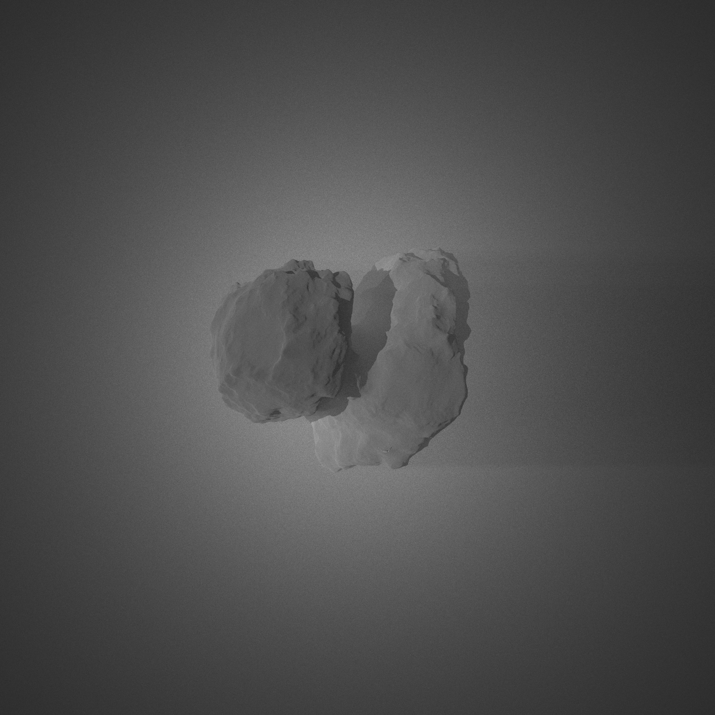
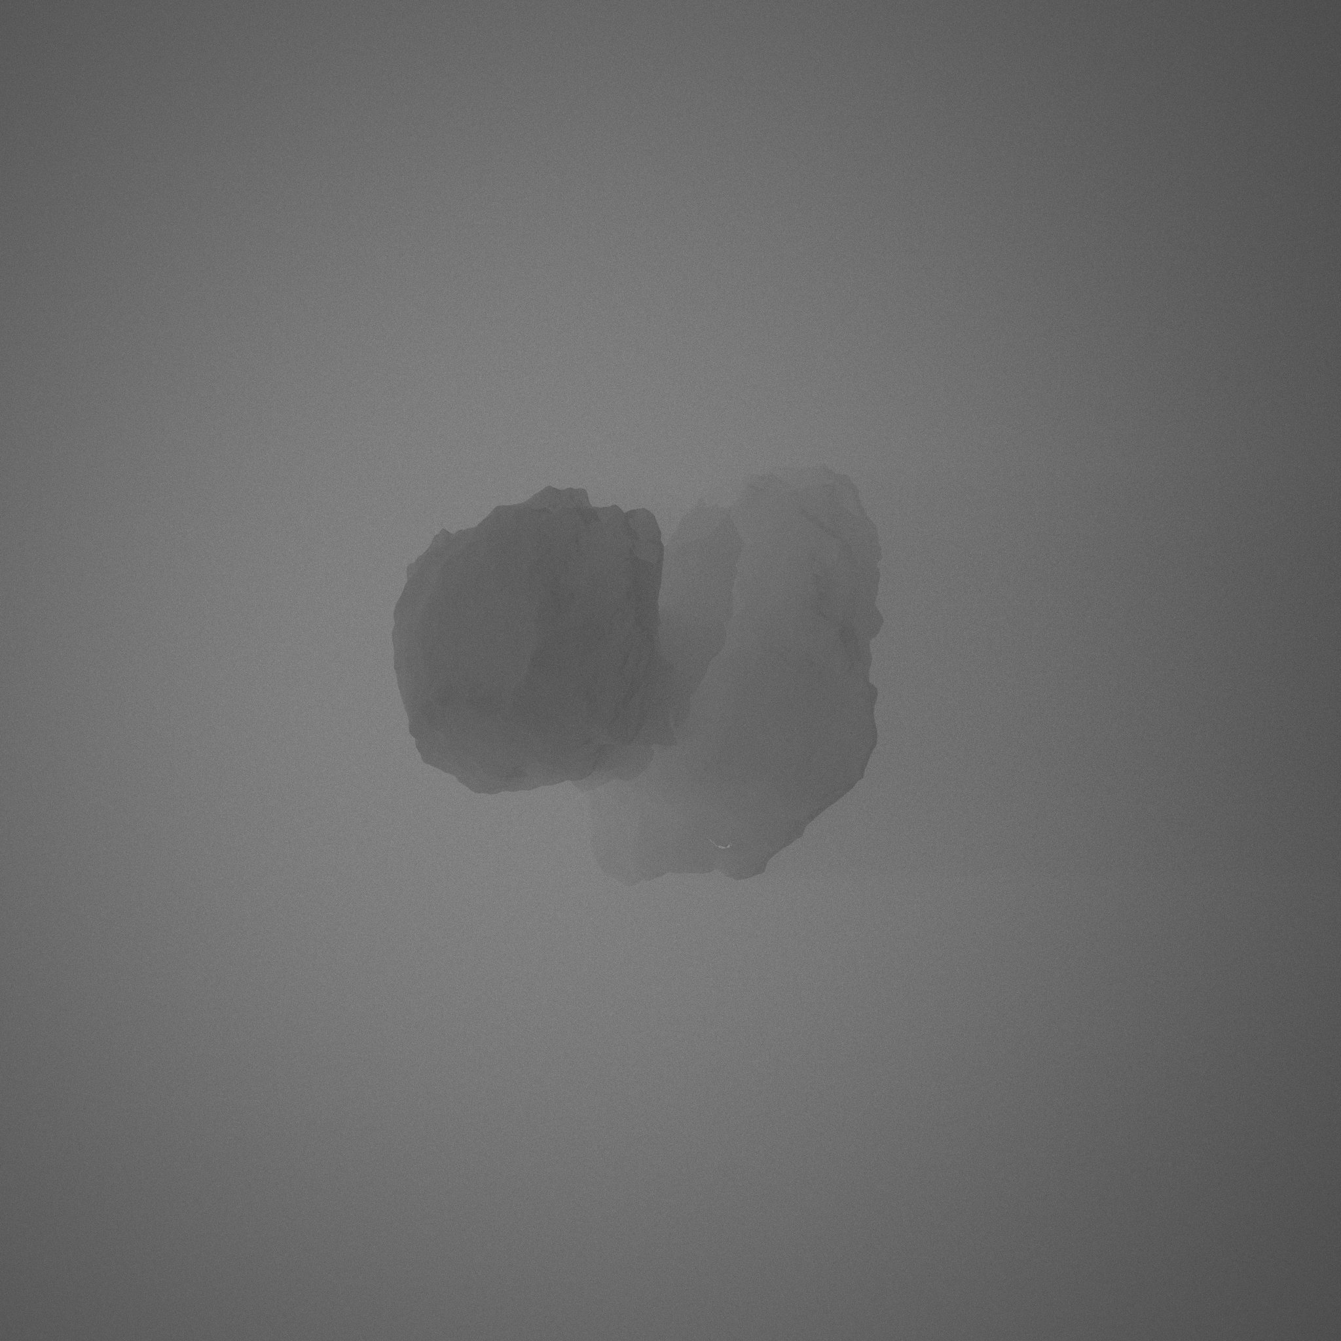
…result showcase
Different levels of dust around a comet nucleus

Slide 11
Current state

