Slide 1
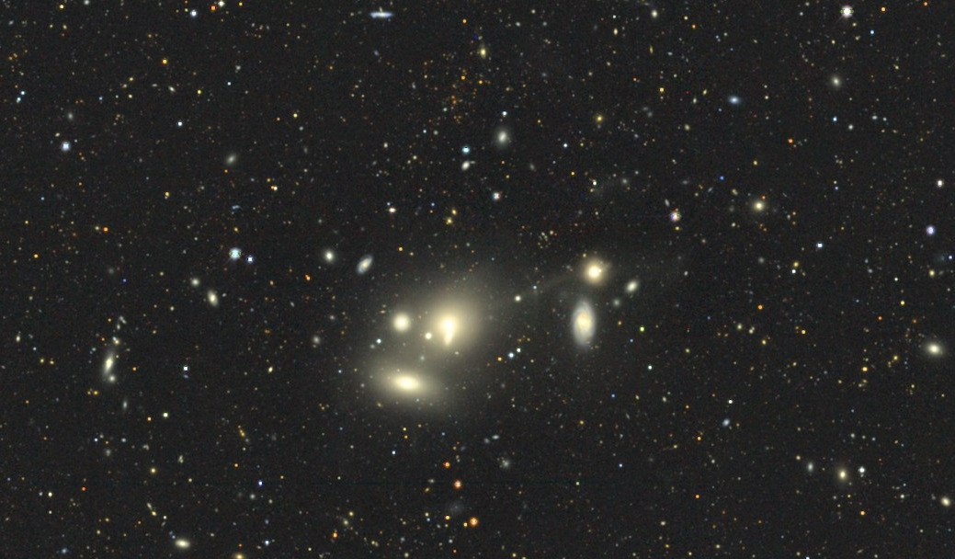
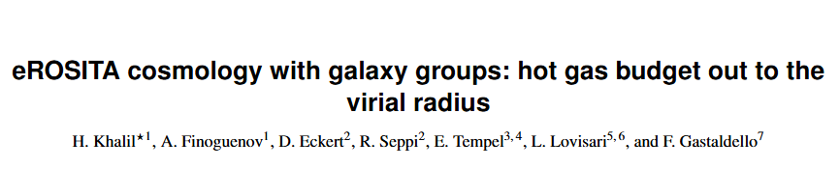

Tracing the hot gas budget at the outskirts of galaxy groups with eROSITA
Hossam Khalil
(170.61º, 24.30º)
AXES_ID: 3718
Source: LS DR10

Slide 2
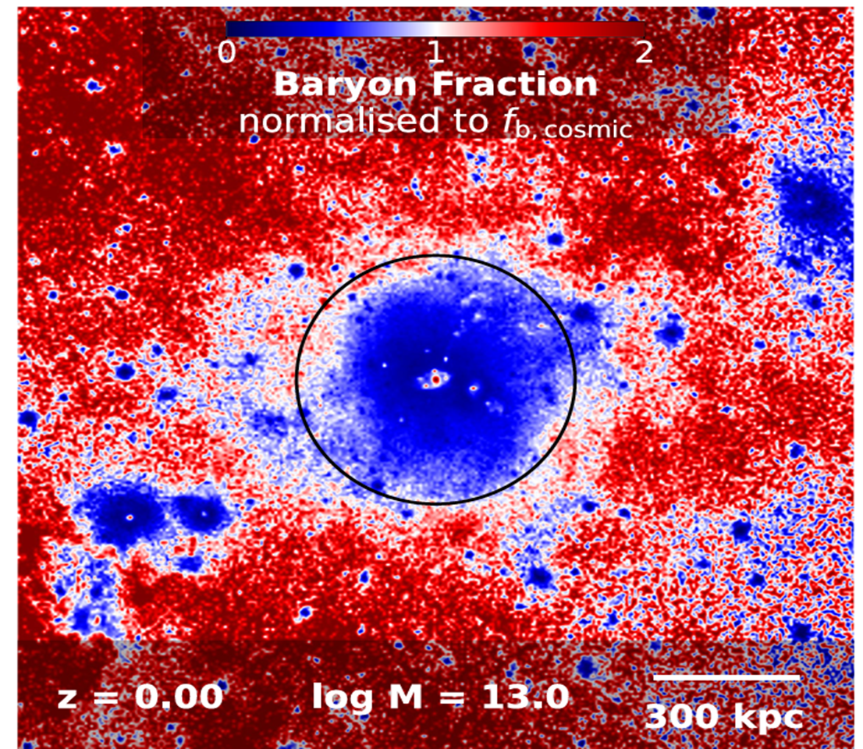
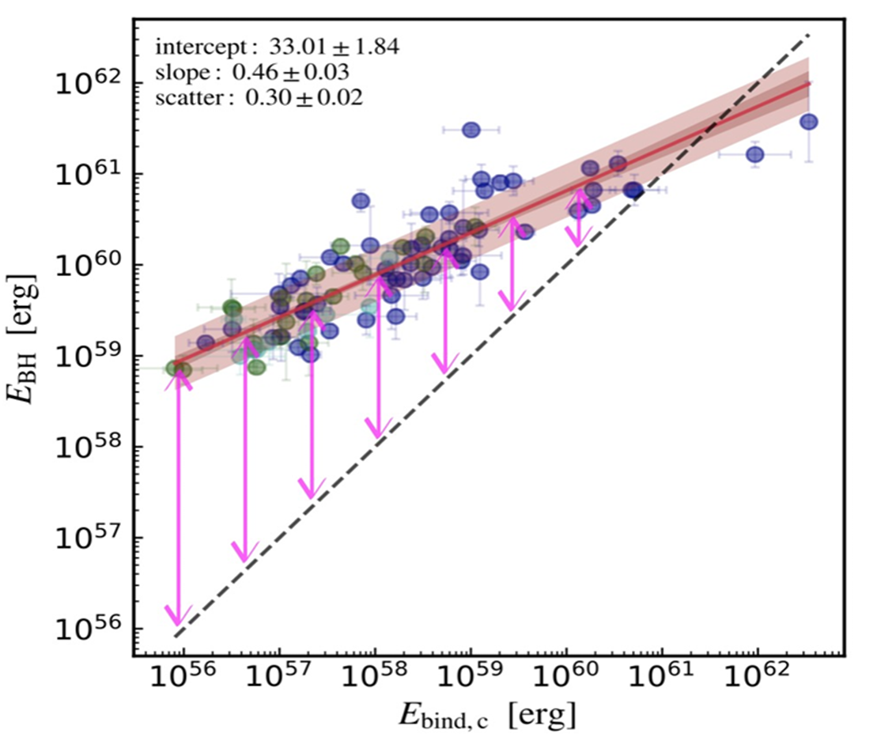
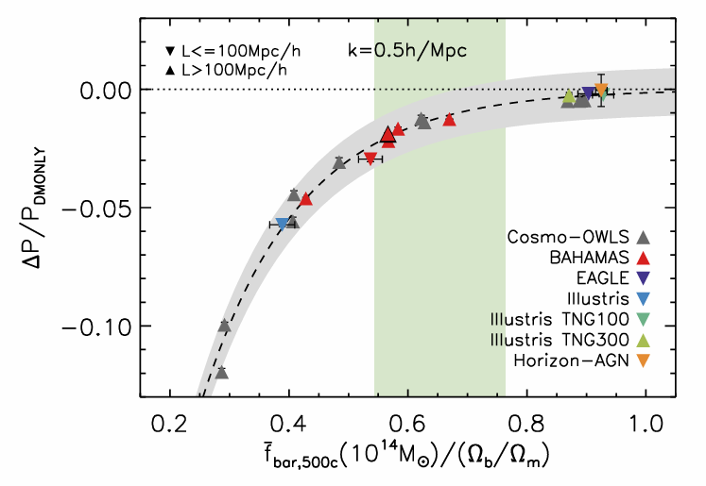
AGN Feedback in galaxy groups
Baryon distribution in a TNG100 group halo ​
Feedback vs. gravitational binding energy
Large-scale effect on the matter power spectrum
Ayromlou et al. 2023
Gaspari et al. 2019
van Daalen et al. 2020
Notes:
On small scales, sims have different implmentations, we are interested in the effects of the AGN feedback prescription on the matter distribution on Mpc scales
Looking at the available energy from the BH growth➔ much energy is available for groups than clusters
Ppl use hydro-sims to model this AGN feedback
They found a link between that aGN feedback process of lifting of gas to large-scales and the MPS suppression
The better we constrain the green bar → the better we can constrain the suppression of the MPS

Slide 3
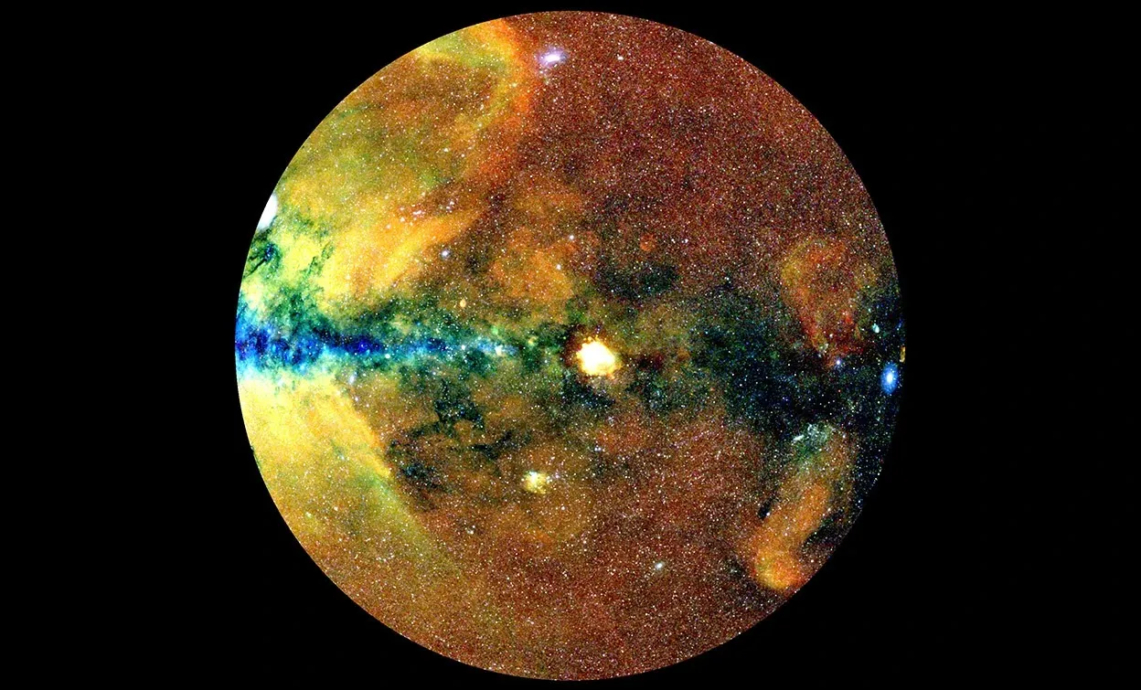
What is the gas fraction of nearby galaxy groups from eROSITA?
Which hydro simulation best reproduces the observed gas masses?
What is the implication of our result on the suppression of the MPS?
MPE, J. Sanders for the eROSITA consortium

Slide 4
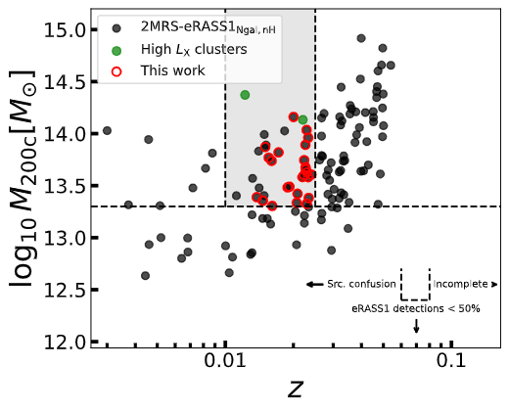
2MRS-eRASS1
Main catalogue
We create a catalogue of extended X-ray emitting sources from the eRASS1 survey using wavelet decomposition.
We then link these X-ray sources to the 2MRS groups (catalogue paper in Finoguenov et al., Subm)
Notes:
MHD associates the X-ray contours to the projected positions of the galaxies in galaxy groups using a distance metric (MHD) and a certain threshold of the median distances of 50% of contour points.
Dynamical virial masses [logM = 13-14]→ galaxy groups. Above that ➔ clusters
Some groups are located in areas of enhanced bkg., some of them are outside the DE consortium.,, etc

Slide 5
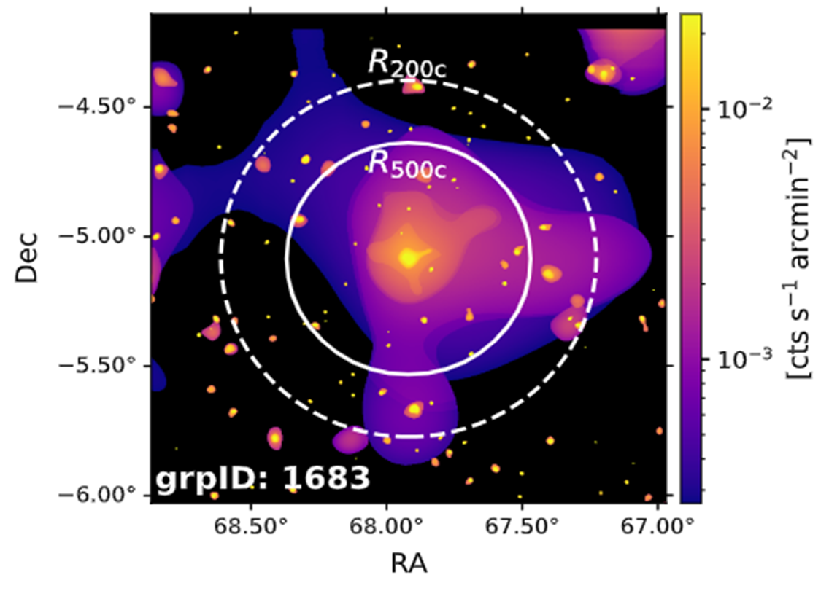
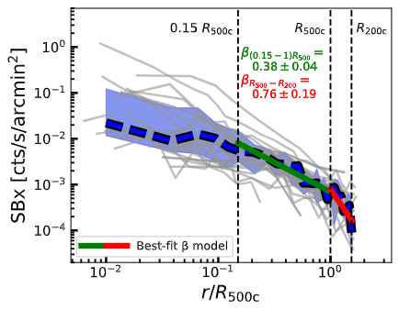
2MRS-eRASS1
Surface brightness profiles
X-ray bkg subtraction
Instrumental bkg subtraction (FWC)
PSF modelling
Example [0.6-2.3] keV wavelet image
Notes:
We see a large-scale component of the emission and also point sources which are mostly AGNs, and we exclude in the extraction.
Our noise is your main data

Slide 6
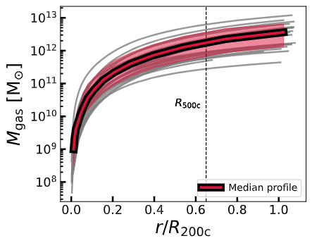
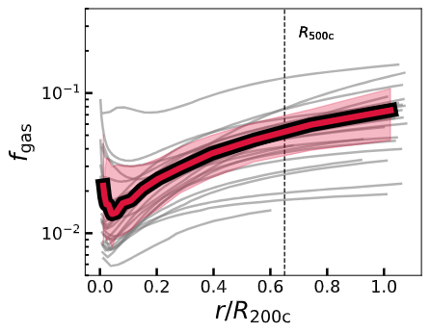

2MRS-eRASS1
Gas mass fraction
Cosmic $f_{gas}$

Slide 7
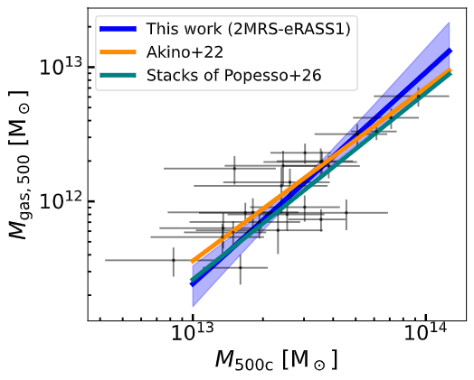
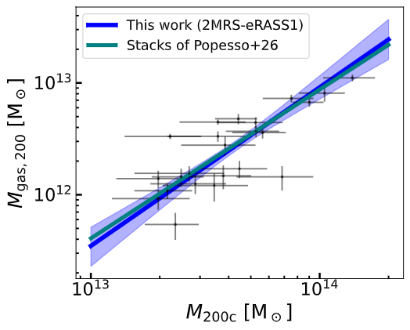

Scaling relations
$$M_{gas}−M$$

Slide 8
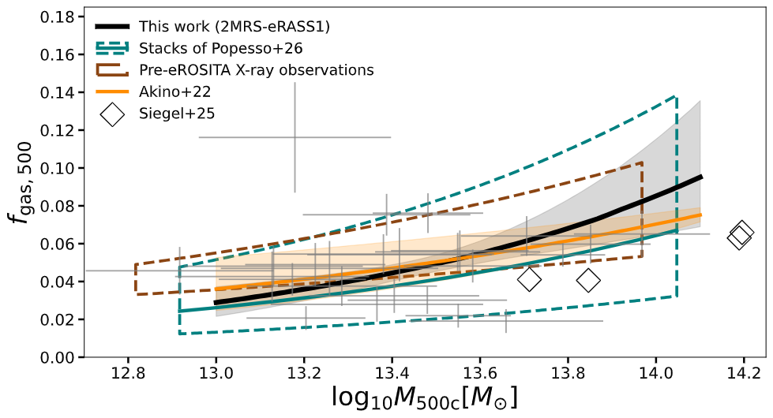

Scaling relations
$$f_{gas}−M_{500}$$

Slide 9
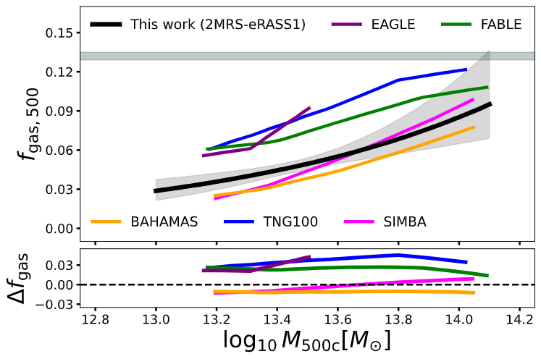
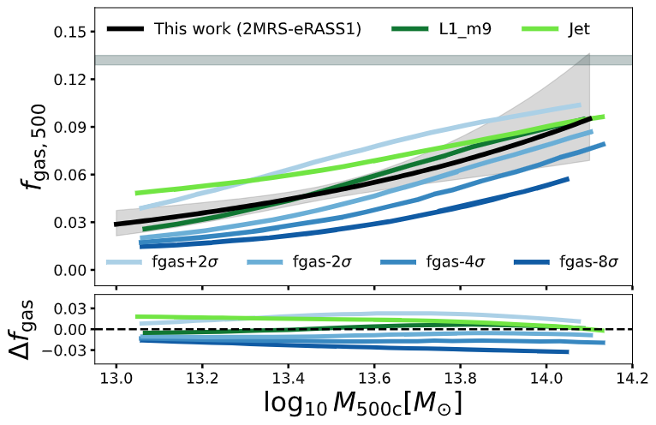
Scaling relations
$$f_{gas}−M_{500}$$
Fiducial FLAMINGO, SIMBA, and BAHAMAS provide the closest match to our relation, with strong feedback models significantly deviating.

Slide 10
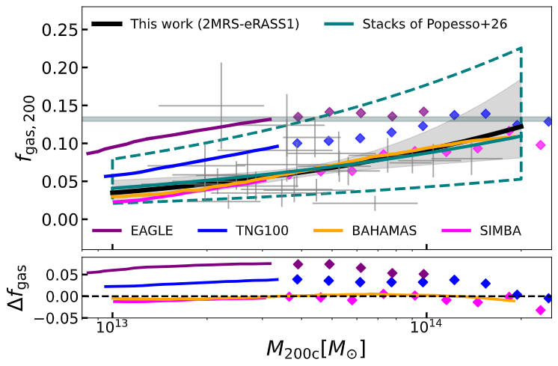

Scaling relations
$$f_{gas}−M_{200}$$

Slide 11
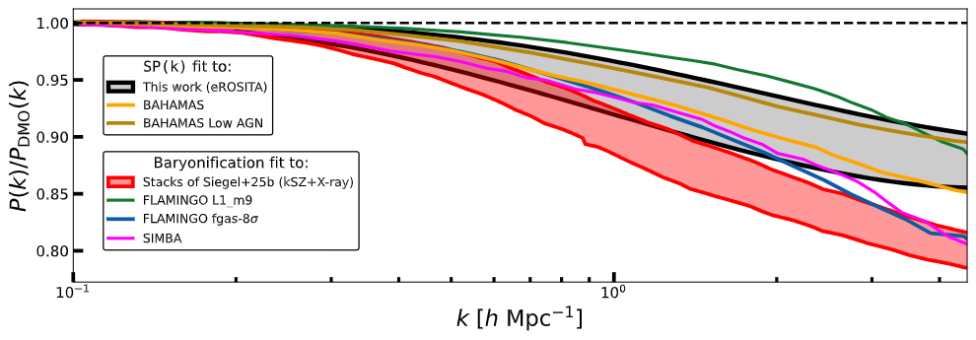
Matter power spectrum suppression
We complement our gas fractions with stellar fractions from from Leauthaud+12 COSMOS stellar fractions and construct
f_{b} = f_{gas} + f*
We then use the SP(K) model (Salcido et al. 2023)
to predict the power suppression from the power-law fitted parameters of the f_{b} – M relation

Slide 12
Conclusions
Galaxy groups density profiles steepens outside of R500
Strong feedback models do not reproduce the observed galaxy group gas masses
We detect a 10-15% suppression of the matter power spectrum on scales of 5h Mpc^-1
Thank you!

Slide 13
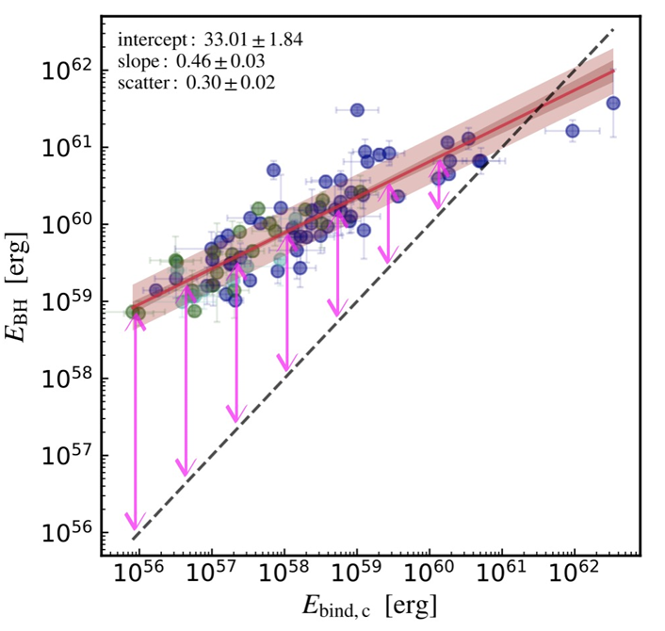
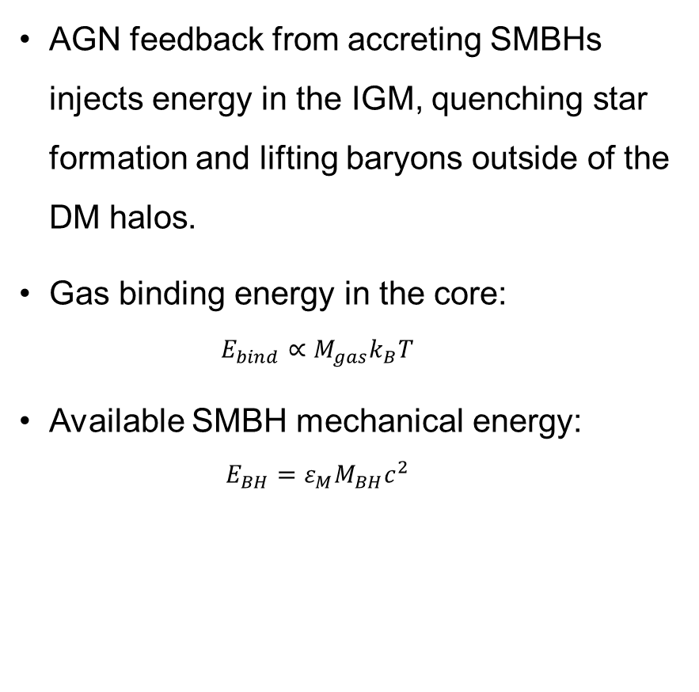
AGN Feedback
AGN feedback from accreting SMBHs injects energy in the IGM, quenching star formation and lifting baryons outside of the DM halos.
Gas binding energy in the core:
  $$E_{bind}∝M_{gas}k_{B}T$$
Available SMBH mechanical energy:
  $$E_{BH}=ε_{M}M_{BH}c^{2}$$
Strongest in low-mass (temperature) group-scale halos
(Eckert et al. 2024)
Notes:
In forming BHs, some of the energy is released to the surrounding media, and it’s paratmertized with epsilon (effiency parameter)

Slide 14


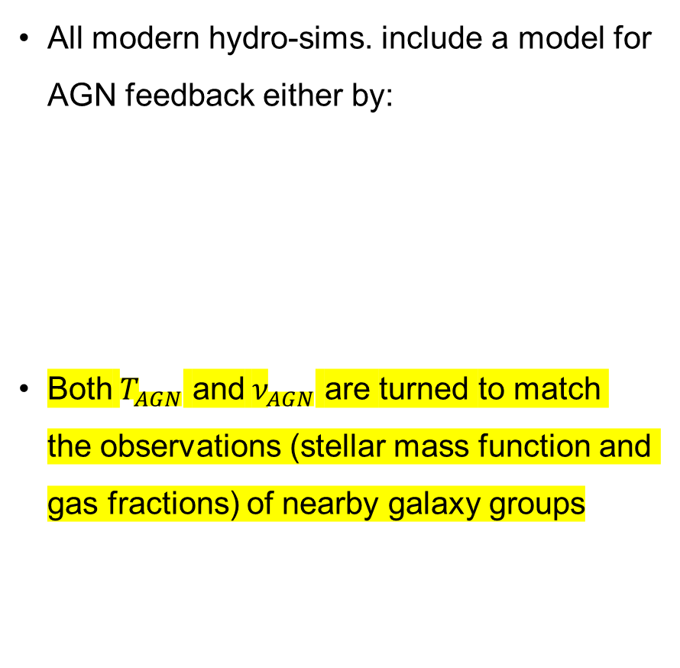
AGN Feedback
All modern hydro-sims. include a model for AGN feedback either by:
Both $T_{AGN}$ and ${\text{ν}}_{AGN}$ are turned to match the observations (stellar mass function and gas fractions) of nearby galaxy groups
Thermal heating OR Kinetic injection
($T_{AGN})$ (${\text{ν}}_{AGN}$)
Baryon fraction in TNG100 (Ayromlou et al. 2023)
Notes:
On small scales, sims have different implmentations, we are interested in the effects of the AGN feedback prescription on the matter distribution on Mpc scales
Fraction of the feedback is coupled to the baryons through kinteitc, or thermal injection.
Important is that this coupling is linked to the MPS suppression on large scales (virial radii) [obne relevant to cosmological analysis with euclid]
A relation is found between the gas displacement and MPS suppression

Slide 15
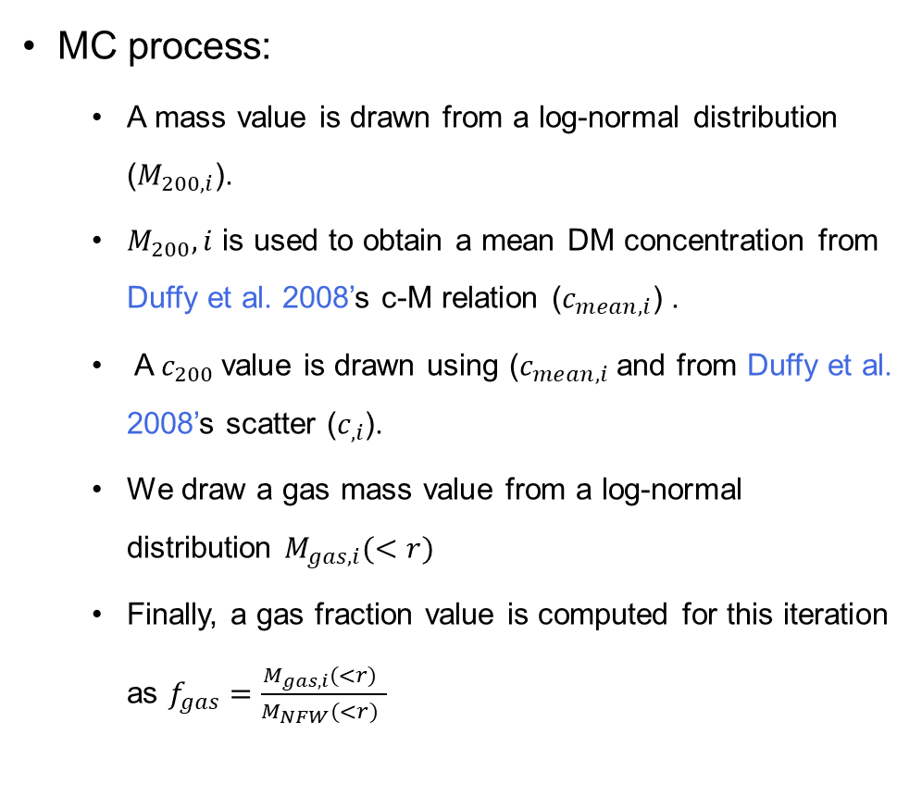
2MRS-eRASS1
Gas mass fraction
MC process:
  A mass value is drawn from a log-normal distribution ($M_{200,i}$).
  $M_{200},i$ is used to obtain a mean DM concentration from Duffy et al. 2008’s c-M relation ($c_{mean,i}$) .
  A $c_{200}$value is drawn using ($c_{mean,i}$and from Duffy et al. 2008’s scatter ($c_{,i}$).
  We draw a gas mass value from a log-normal distribution $M_{gas,i}(<r)$
  Finally, a gas fraction value is computed for this iteration as $f_{gas}=\frac{M_{gas,i}(<r) }{M_{NFW}(<r) }$
Notes:
First explain the figure
Plot f_Gas_cosmic

Slide 16
2MRS-eRASS1
Gas mass fraction
Notes:
First explain the figure
Plot f_Gas_cosmic
Values are well below the cosmic mean expectation → signiature of AGN feedback→ we are tracing it now to R200, people usually published up to only R500 + we have many more groups

Slide 17
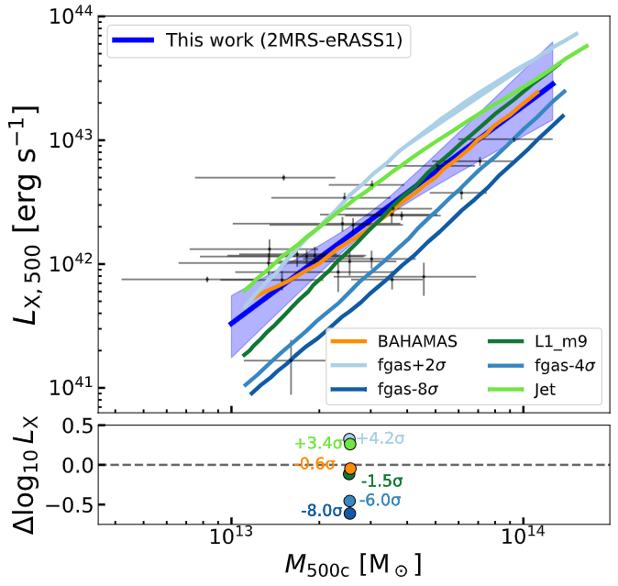


Scaling relations
$$L_{X}−M_{500}$$
$$M_{gas}−M_{500}$$

Slide 18
Outline
AGN feedback and the baryon budget in galaxy groups
Hot gas budget in 2MRS-eRASS1
Scaling relations
Implications on the matter distribution (MPS suppression)
Summary
MPE, J. Sanders for the eROSITA consortium

Slide 19
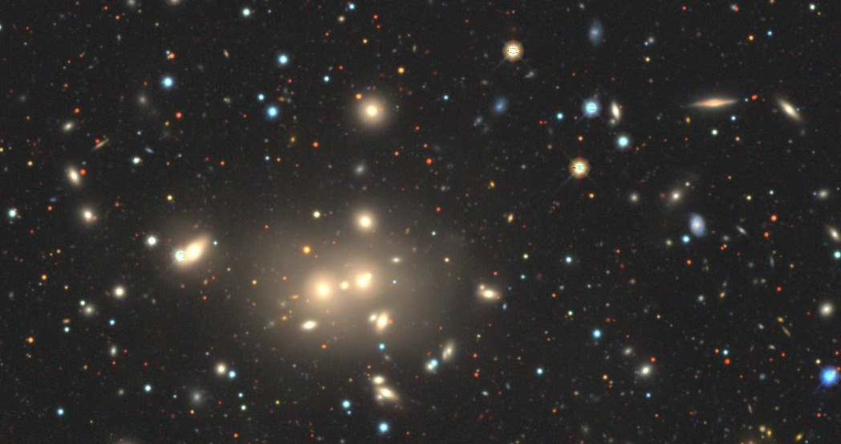
Outline
Motivation
2MRS-eRASS1
Hot gas budget
Scaling relations
Suppression of the matter power spectrum
(86.37º, -25.94º)
AXES_ID: 2009
Source: LS DR10
Notes:
So, this is the outline of my talk today. Firstly, I’m going to talk about how galaxy groups can provide unique insights into many physical processes and phenomena in our Universe.
Then I’m going to introduce AXES-2MRS, which consists of two parts.
After that, AXES-2MRS is a relatively large catalog with more than 500 galaxy groups, of which, we have selected a smaller subsample observed by XMM-Newton, and studied its detailed properties such as:
Then I’m going to show the scaling relations that I constructed between the optical Vdisp and the X-ray properties
Finally, I’ll present a primer on AXES-2MRS-eROSITA, which is a subsample of AXES-2MRS observed by eROSITA, and talk about the perspectives of studying the baryon lifting with it.

Slide 20
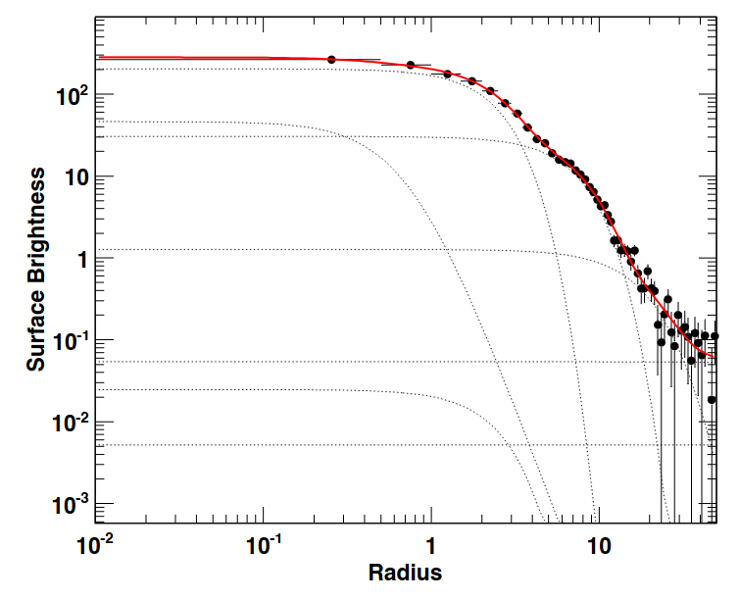
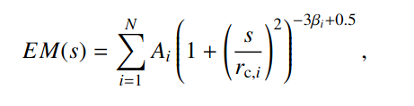
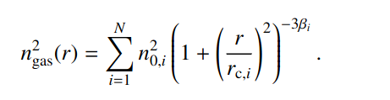
Multiscale deprojection
Emission measure profile components
Deprojected electron density components

Slide 21
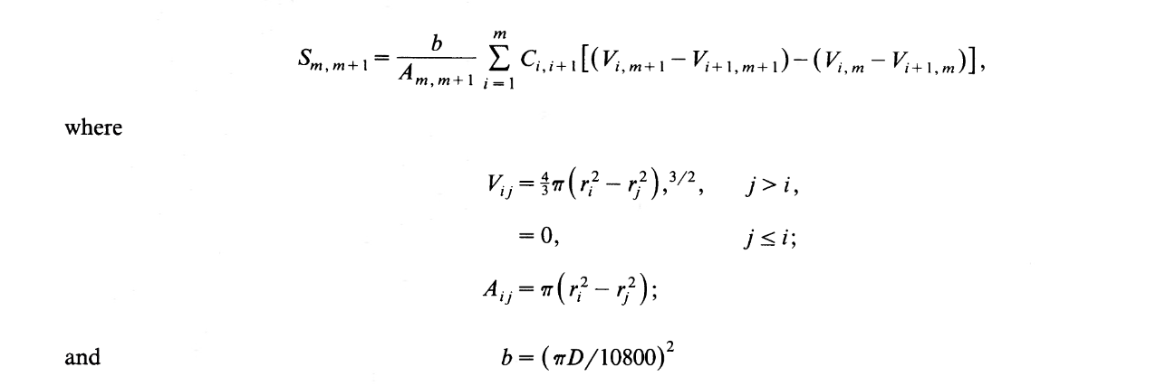
Deprojection
2D
3D
(Kriss et al. 1983)

Slide 22
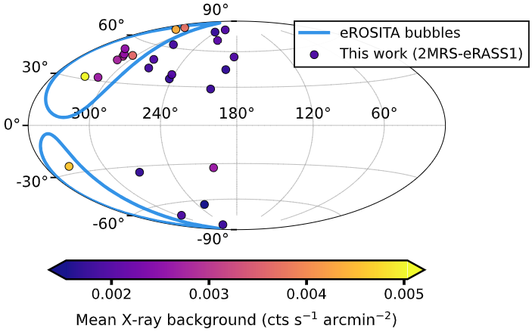
2MRS-eRASS1

Slide 23
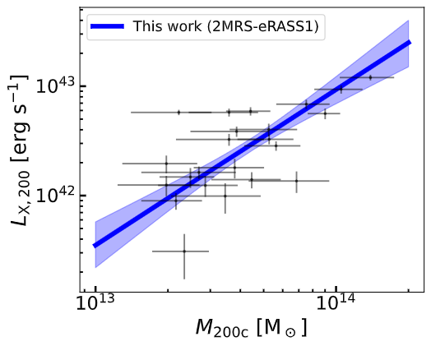

Scaling relations
$$L_{X}−M_{200}$$

Slide 24

Scaling relations
$$M_{gas}−M_{200}$$

Slide 25
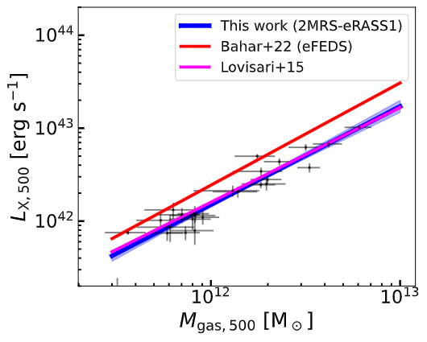

Scaling relations
$$L_{X}−M_{gas,500}$$

Slide 26
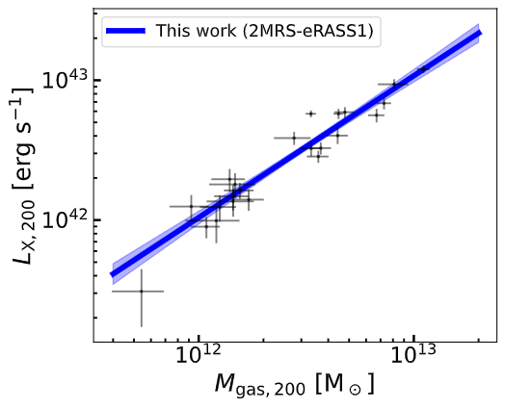

Scaling relations
$$L_{X}−M_{gas,200}$$

