Slide 1
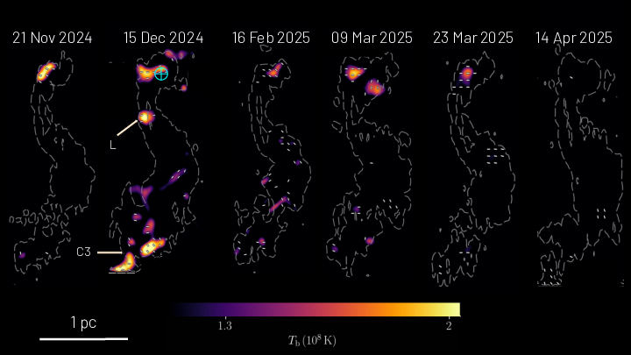




Shocks, polarisation, and high-energy emission: Probing black hole jets
from VLBI to IXPE
Georgios Filippos Paraschos
May 28 2026
FINCA - University of Turku / MRO / MPIfR
Main collaborators: L. C. Debbrecht, J. A. Hodgson, M. Janßen, J.-Y. Kim, J.-A. Kramer, T. P. Krichbaum,
I. Liodakis, N. R. MacDonald, D. Nair, J. Röder, E. Ros, T. Savolainen, E. Traianou, M. Wielgus, J. A. Zensus
‹#›
Notes:
Shocks, polarisation, and high-energy emission: Probing black hole jets from VLBI to IXPE
Jets launched by accreting supermassive black holes (SMBHs) are key to understanding how energy is extracted from compact objects and fed into their environments. How these jets form and where high-energy γ-rays are produced, in the so-called blazar zone, remain open questions. Competing scenarios place the γ-ray emission either close to the SMBH, within the broad-line region, or further downstream at parsec scales. Pinpointing the blazar zone is essential to link jet energetics to the accretion process and to establish conditions for multimessenger emission. Very long baseline interferometry (VLBI) offers a unique window into these inner-most jet regions, providing milliarcsecond resolution capable of tracing shocks, polarisation changes, and structural evolution. When combined with optical and X-ray polarimetry (utilising the Imaging X-ray Polarimetry Explorer; IXPE), γ-ray monitoring, and neutrino observations, VLBI enables directly connecting jet dynamics to high-energy phenomena. I will discuss such synergistic observations between VLBI, neutrinos, and multiwavelength polarisation of selected blazars, which exhibited multimessenger flares and polarisation angle rotations. Our results unveil shock–shock interactions, the conditions suitable for hadronic emission, as well as the location of the γ-ray emission being at parsec scales away from the central engine. I will place these results in the broader context of our forthcoming Event Horizon Telescope studies, which will further probe high-energy emission from relativistic jets from supermassive black holes.

Slide 2
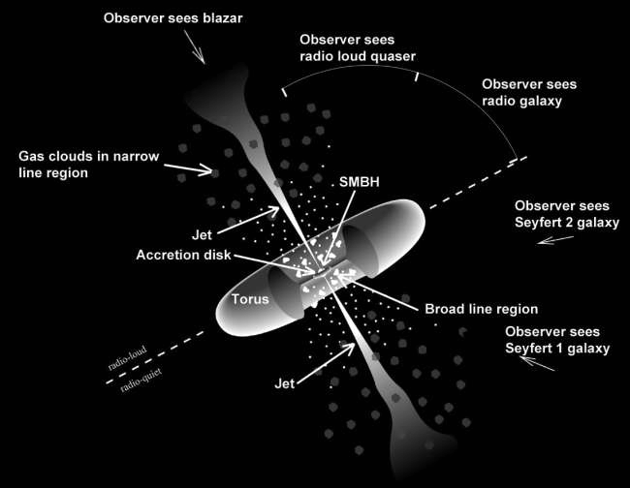
Active galactic nuclei (AGN) can launch jets
The radiation in AGN stems from:
synchrotron processes (jet, non-thermal)
inverse Compton emission (jet, non-thermal)
free-free emission (dust, thermal)
Beckmann+2012
Radio telescopes are measuring this synchrotron emission.
‹#›
Notes:
TERMS: AGN

Slide 3

A couple of unanswered jet questions
How are jets accelerated and collimated?
  Magnetic field?
  Disc wind?
Where is the acceleration zone?
  Upstream (close to SMBH)
  Downstream (parsecs away)
Flares related to shocks and probed through polarimetry
(P, ψ) can reveal the physical mechanisms at play
© W. Steffen
Notes:
Near blazar zone scenario (γ-rays produced within sub‑parsec scales, often inside the Broad-Line Region)
Location: Within the BLR, typically at distances
≲0.1−1pc from the SMBH.
↳ Supported by rapid variability (timescales of hours–days) implying compact emission regions
(e.g. Ghisellini & Tavecchio 2008, MNRAS, 386, L28).
Seed photons for inverse Compton: Dominated by optical/UV emission from the accretion disk and BLR clouds → external Compton on BLR photon fields (EC/BLR).
(Sikora et al. 1994, ApJ, 421, 153; Hayashida et al. 2015, ApJ, 807, 79).
Advantages:
High photon energy density → high γ-ray luminosity via EC.
Co-spatiality with optical synchrotron flares and fast, large-amplitude polarization swings.
Correlation with optical/γ-ray light curves observed in many FSRQs.
Challenges:
Potential γ–γ pair production opacity above a few tens of GeV if inside BLR
→ tension with detection of >100 GeV photons from some blazars.
(e.g. Liu & Bai 2006, ApJ, 653, 1089; Poutanen & Stern 2010, ApJ, 717, L118).
Far blazar zone scenario (γ-rays produced downstream at parsec scales, co-spatial with VLBI radio core or knots)
Location: Several pc from SMBH, often at the VLBI 43 GHz core or in moving superluminal knots observed to flare contemporaneously with γ-rays
(Jorstad et al. 2001, ApJS, 134, 181; Agudo et al. 2011, ApJ, 726, L13).
Seed photons for inverse Compton:
IR radiation from dusty torus (EC/Torus).
Synchrotron photons from the jet itself (SSC) and/or slower sheath layer (EC/Sheath).
(Błażejowski et al. 2000, ApJ, 545, 107; Sikora et al. 2008, ApJ, 675, 71).
Advantages:
Lower γ–γ opacity → allows VHE (>100 GeV) photons to escape.
γ-ray flares can be directly linked to VLBI component ejections and polarization signatures far out in the jet.
Challenges:
Photon energy densities from external fields are lower → requires higher electron energies or efficient SSC.
Sometimes tension with very fast variability (< hrs) if region size is constrained by VLBI geometry
(Nalewajko et al. 2014, MNRAS, 443, 1801).
Key discriminants in the near vs. far zone debate:
Variability timescale: sub-hour to day timescales favour near zone, multi-day to multi-week can fit far zone.
Spectral cut-offs (due to γ–γ absorption) → presence/absence can indicate photon fields (BLR vs torus).
VLBI correlations: γ-ray flare timing with radio core brightening or component ejection → far zone link.
Polarization behaviour: rapid PA rotations often linked to moving shocks downstream.

Slide 4
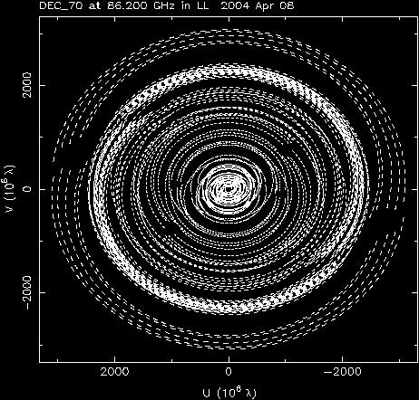
mm-VLBI offers a number of advantages
With mm-VLBI we can:
  peer through self-absorbed regions
  explore the physics of the central engine
  study the origin of jets
  zoom into the hearts of jets, typical spatial scales are <0.1pc / ~ 1000-10000R_{s}
Synergy:
  Spectral studies (e.g. 7mm, 3mm, 1mm)
  Broadband MWL campaigns (e.g. IXPE, Fermi)
9000 km
‹#›

Slide 5
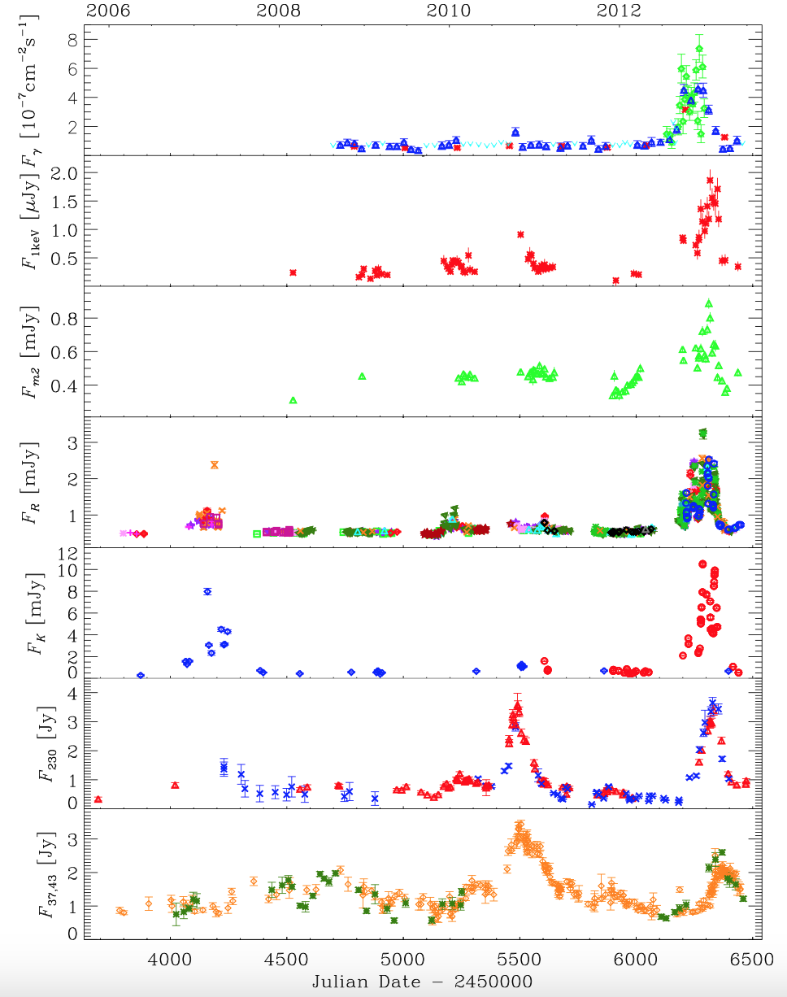
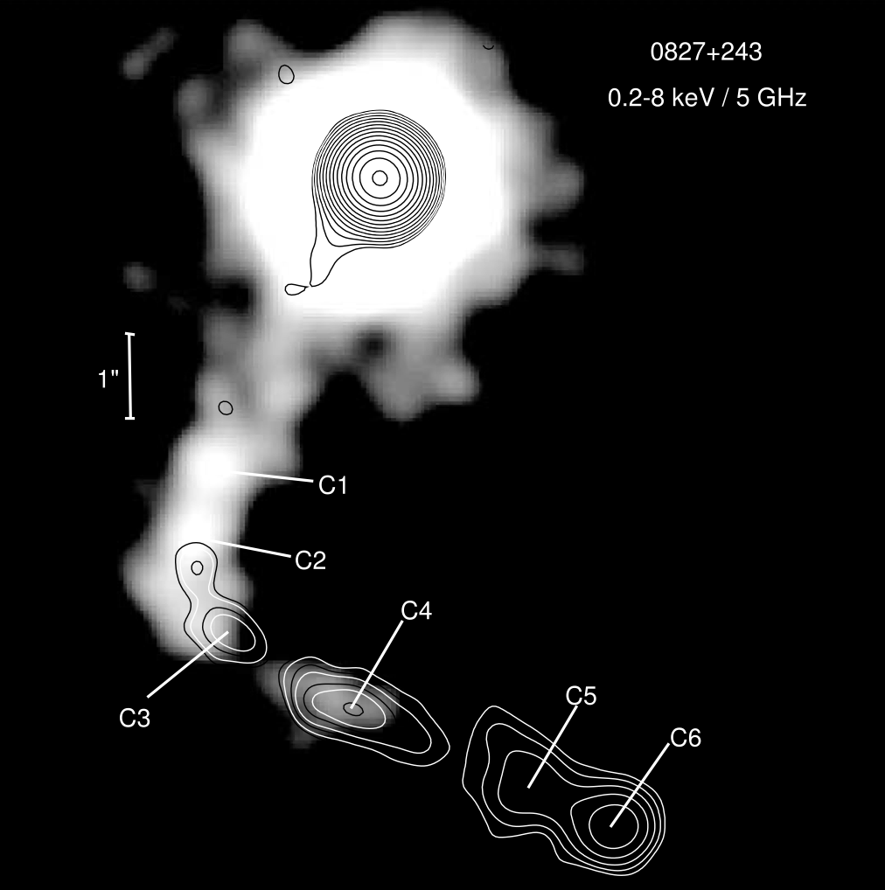
The case of blazar OJ 248
Carnerero et al. 2015
FSRQ, blazar
Has been monitored for years at multiple bands
Shows bent jet morphology at larger scales
Exhibited a well-defined multi-frequency flare
‹#›
Jorstad & Marscher 2004

Slide 6
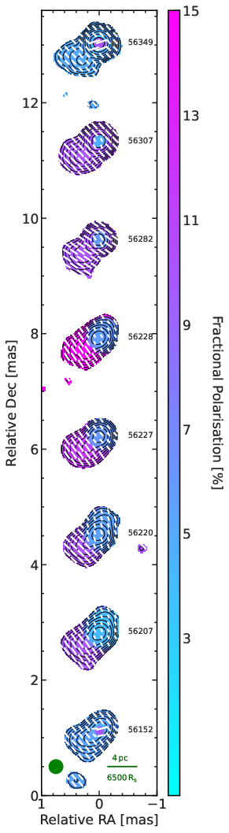
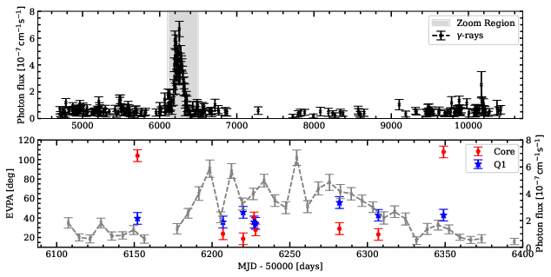
Paraschos 2025a
The case of OJ 248
Paraschos 2025a
Shock-shock interaction explains the flare and ψ rotation
‹#›
Notes:
Spine-Sheath structures in other sources and their connection to flares in the optical and gamma-rays is a topic that I’m currently great interested in.

Slide 7
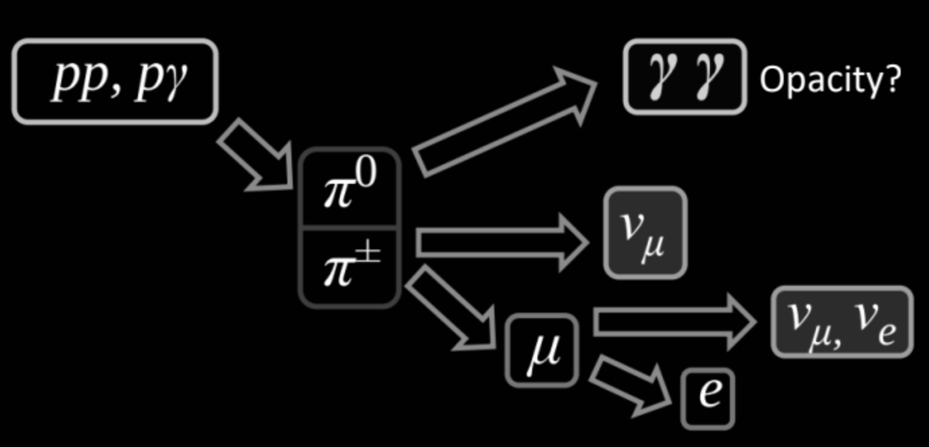
Origin of high energy neutrinos remains elusive
Blazars can be one of sources, but so far no robust spatial association
Open question if they are related to jet beaming or not
Credit: Y. Kovalev
With flares and shocks in mind, let’s pivot to multi-messenger astronomy

Slide 8
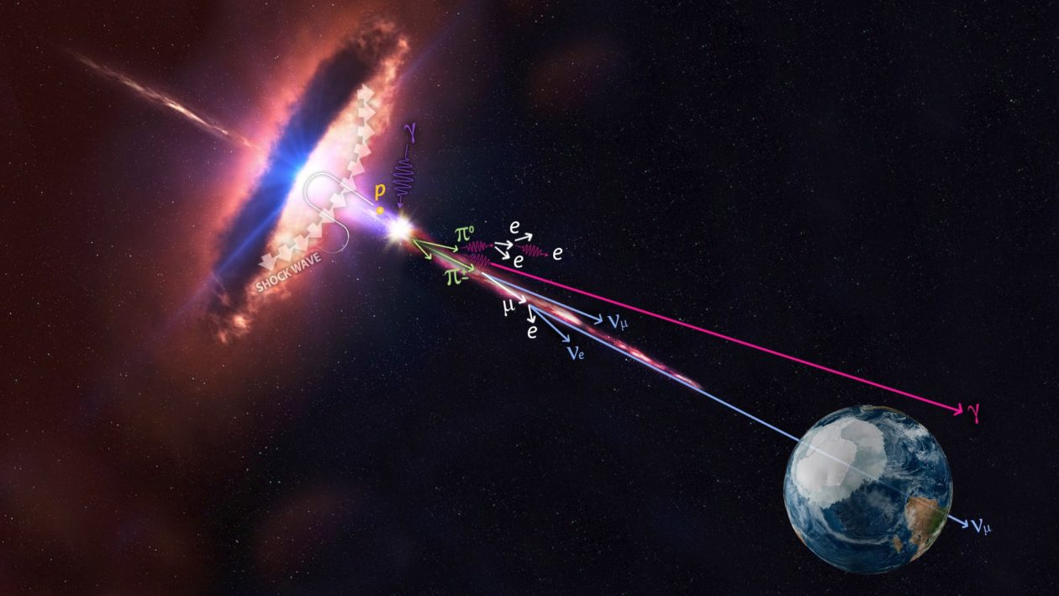
Neutrino emission in blazars requires:
Mild shocks (e.g. quasi-stationary components)
Target photon field for
p-γ interactions
Credit: Icecube/NASA

Slide 9
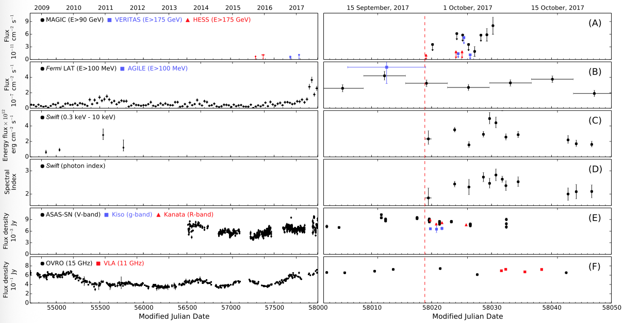
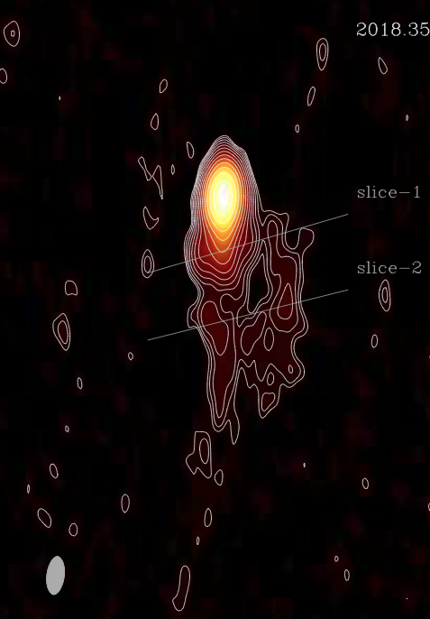
Ros+19
IceCube+18
The prototypical case of a blazar-neutrino coincidence: TXS 0506+056

Slide 10


Blazar PKS 0735+178 oscillates between periods of activity
(bent jet, fast moving components) and
quiescence (straight jet, quasi-stationary components),
perhaps influenced by interplay of rotating jet and ambient medium
Britzen+10

Slide 11
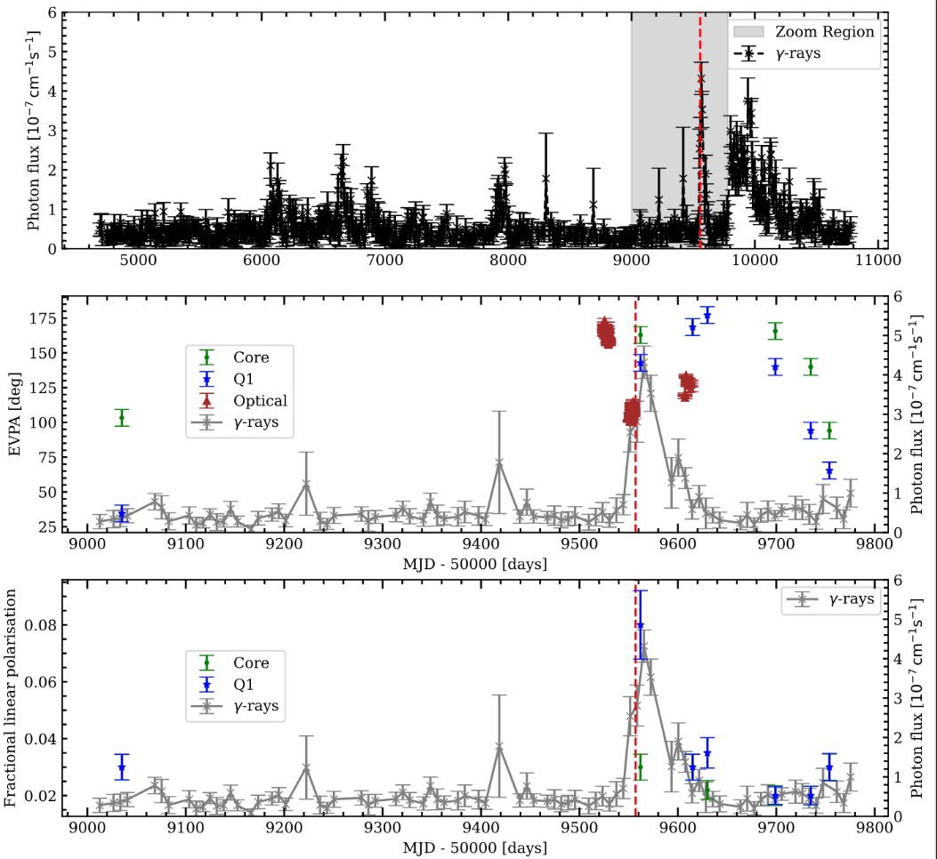
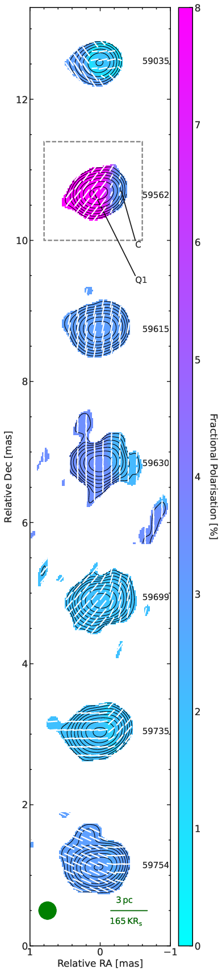
PKS 0735+178 also shows
a flare and ψ rotations,
with the neutrino
arrival as a bonus!
Travelling shock creates
flare and turns the ψ
and interacts with ambient
medium photon field → ν
Paraschos 2025c

Slide 12
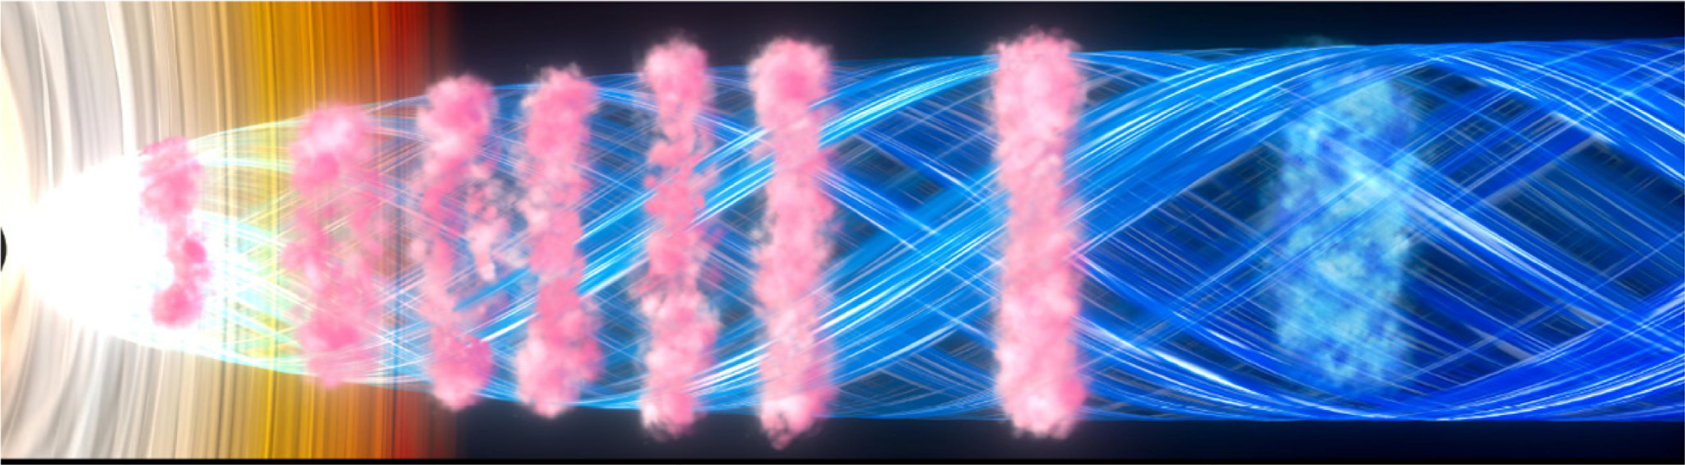
A unifying scenario
Blinov et al. 2021
In the examples mentioned here (+ in literature, e.g. 3C454.3) blazar zone located in “far site” → photons could be originating from sheath
This case presents an exciting scenario, in which the blazar zone is co-spatial with potential neutrino emitting regions
‹#›

Slide 13
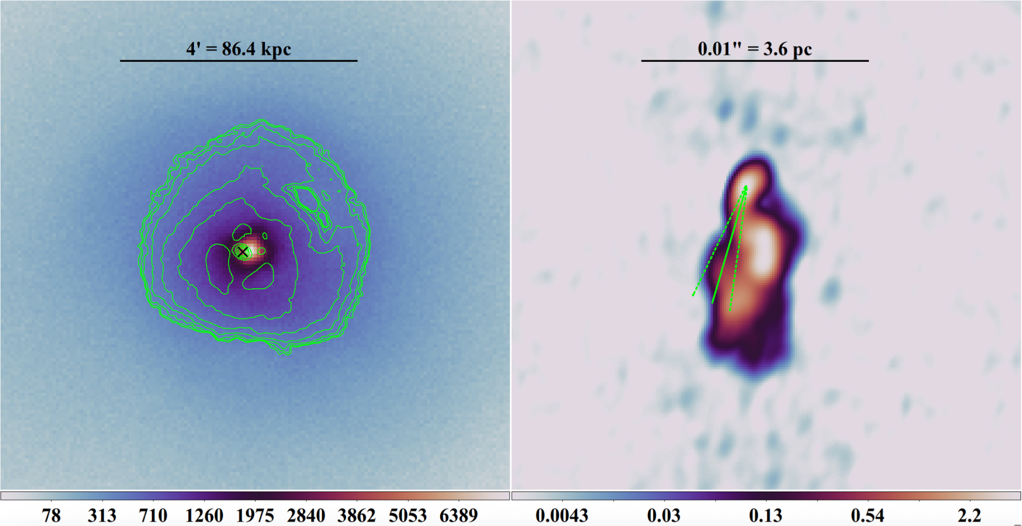
Blazars are great, but what about radio galaxies?
3C84
Liodakis+25

Slide 14
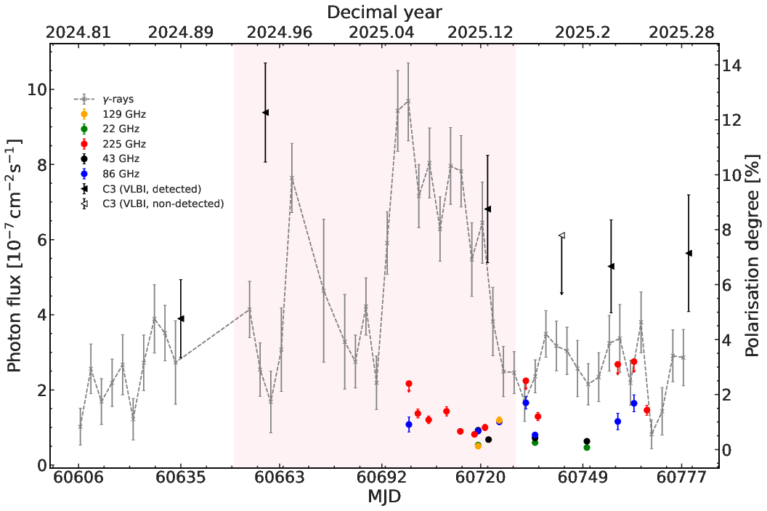
In a fortunate turn of events, a γ-ray flare coincided with IXPE
The single dish and VLBI polarisation degree measurements are consistent with the γ-ray trend of enhancement (Jan. 2025) and then decay (Mar. 2025)
Paraschos+26
‹#›

Slide 15
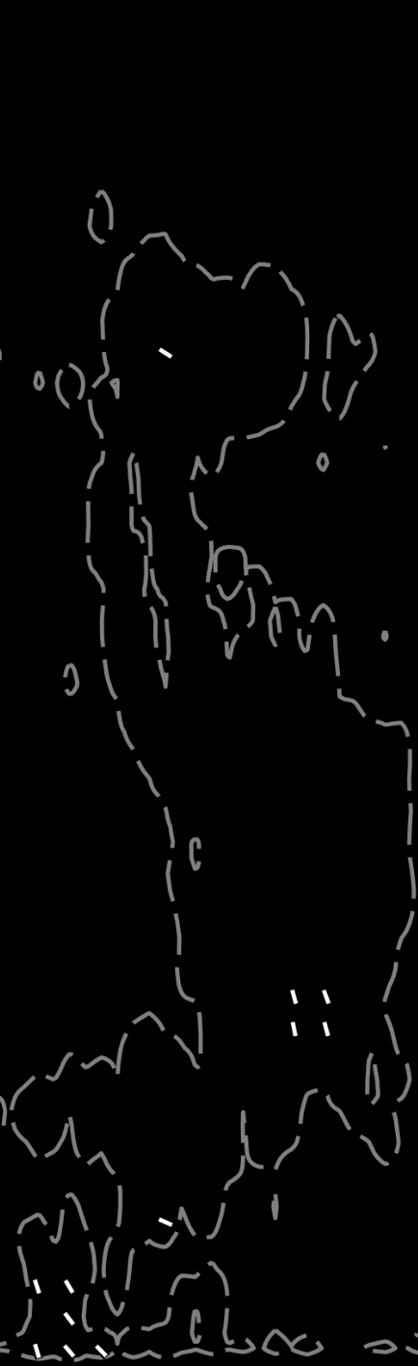
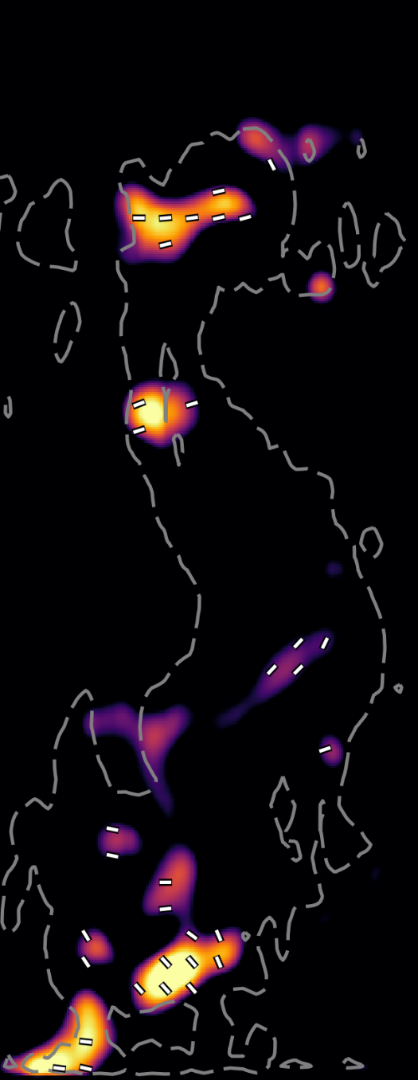
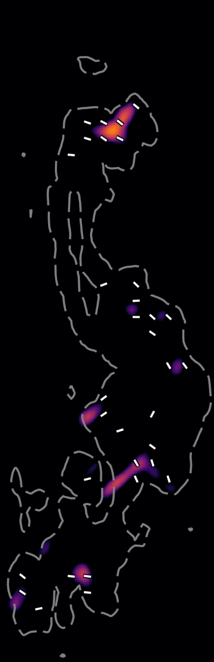
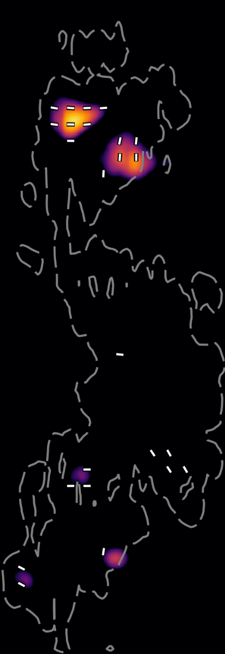
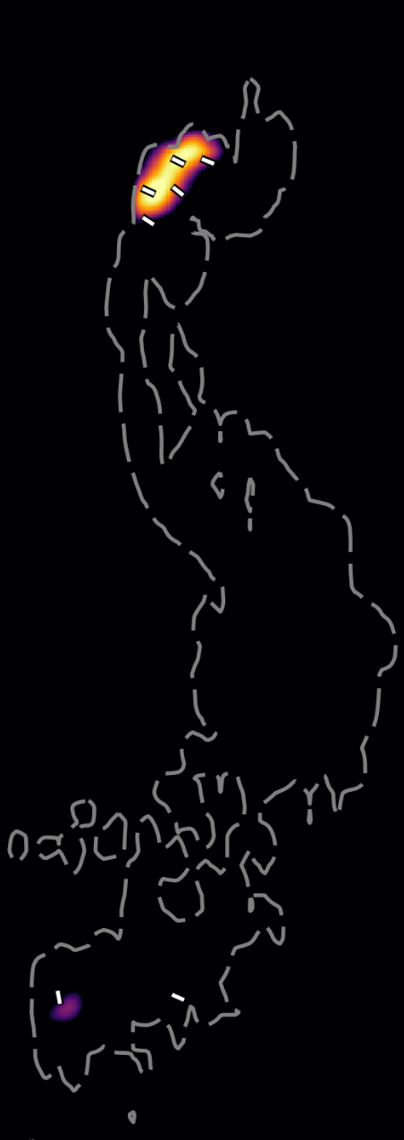

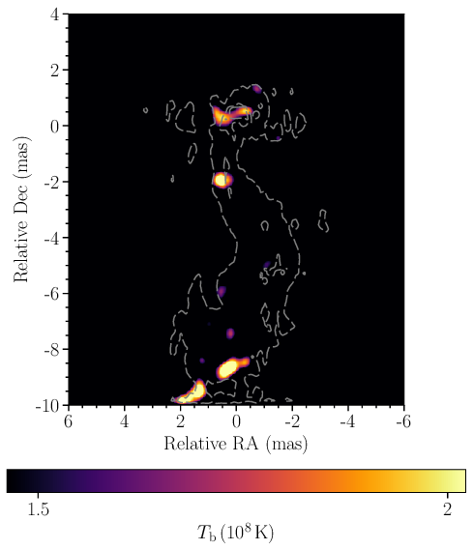
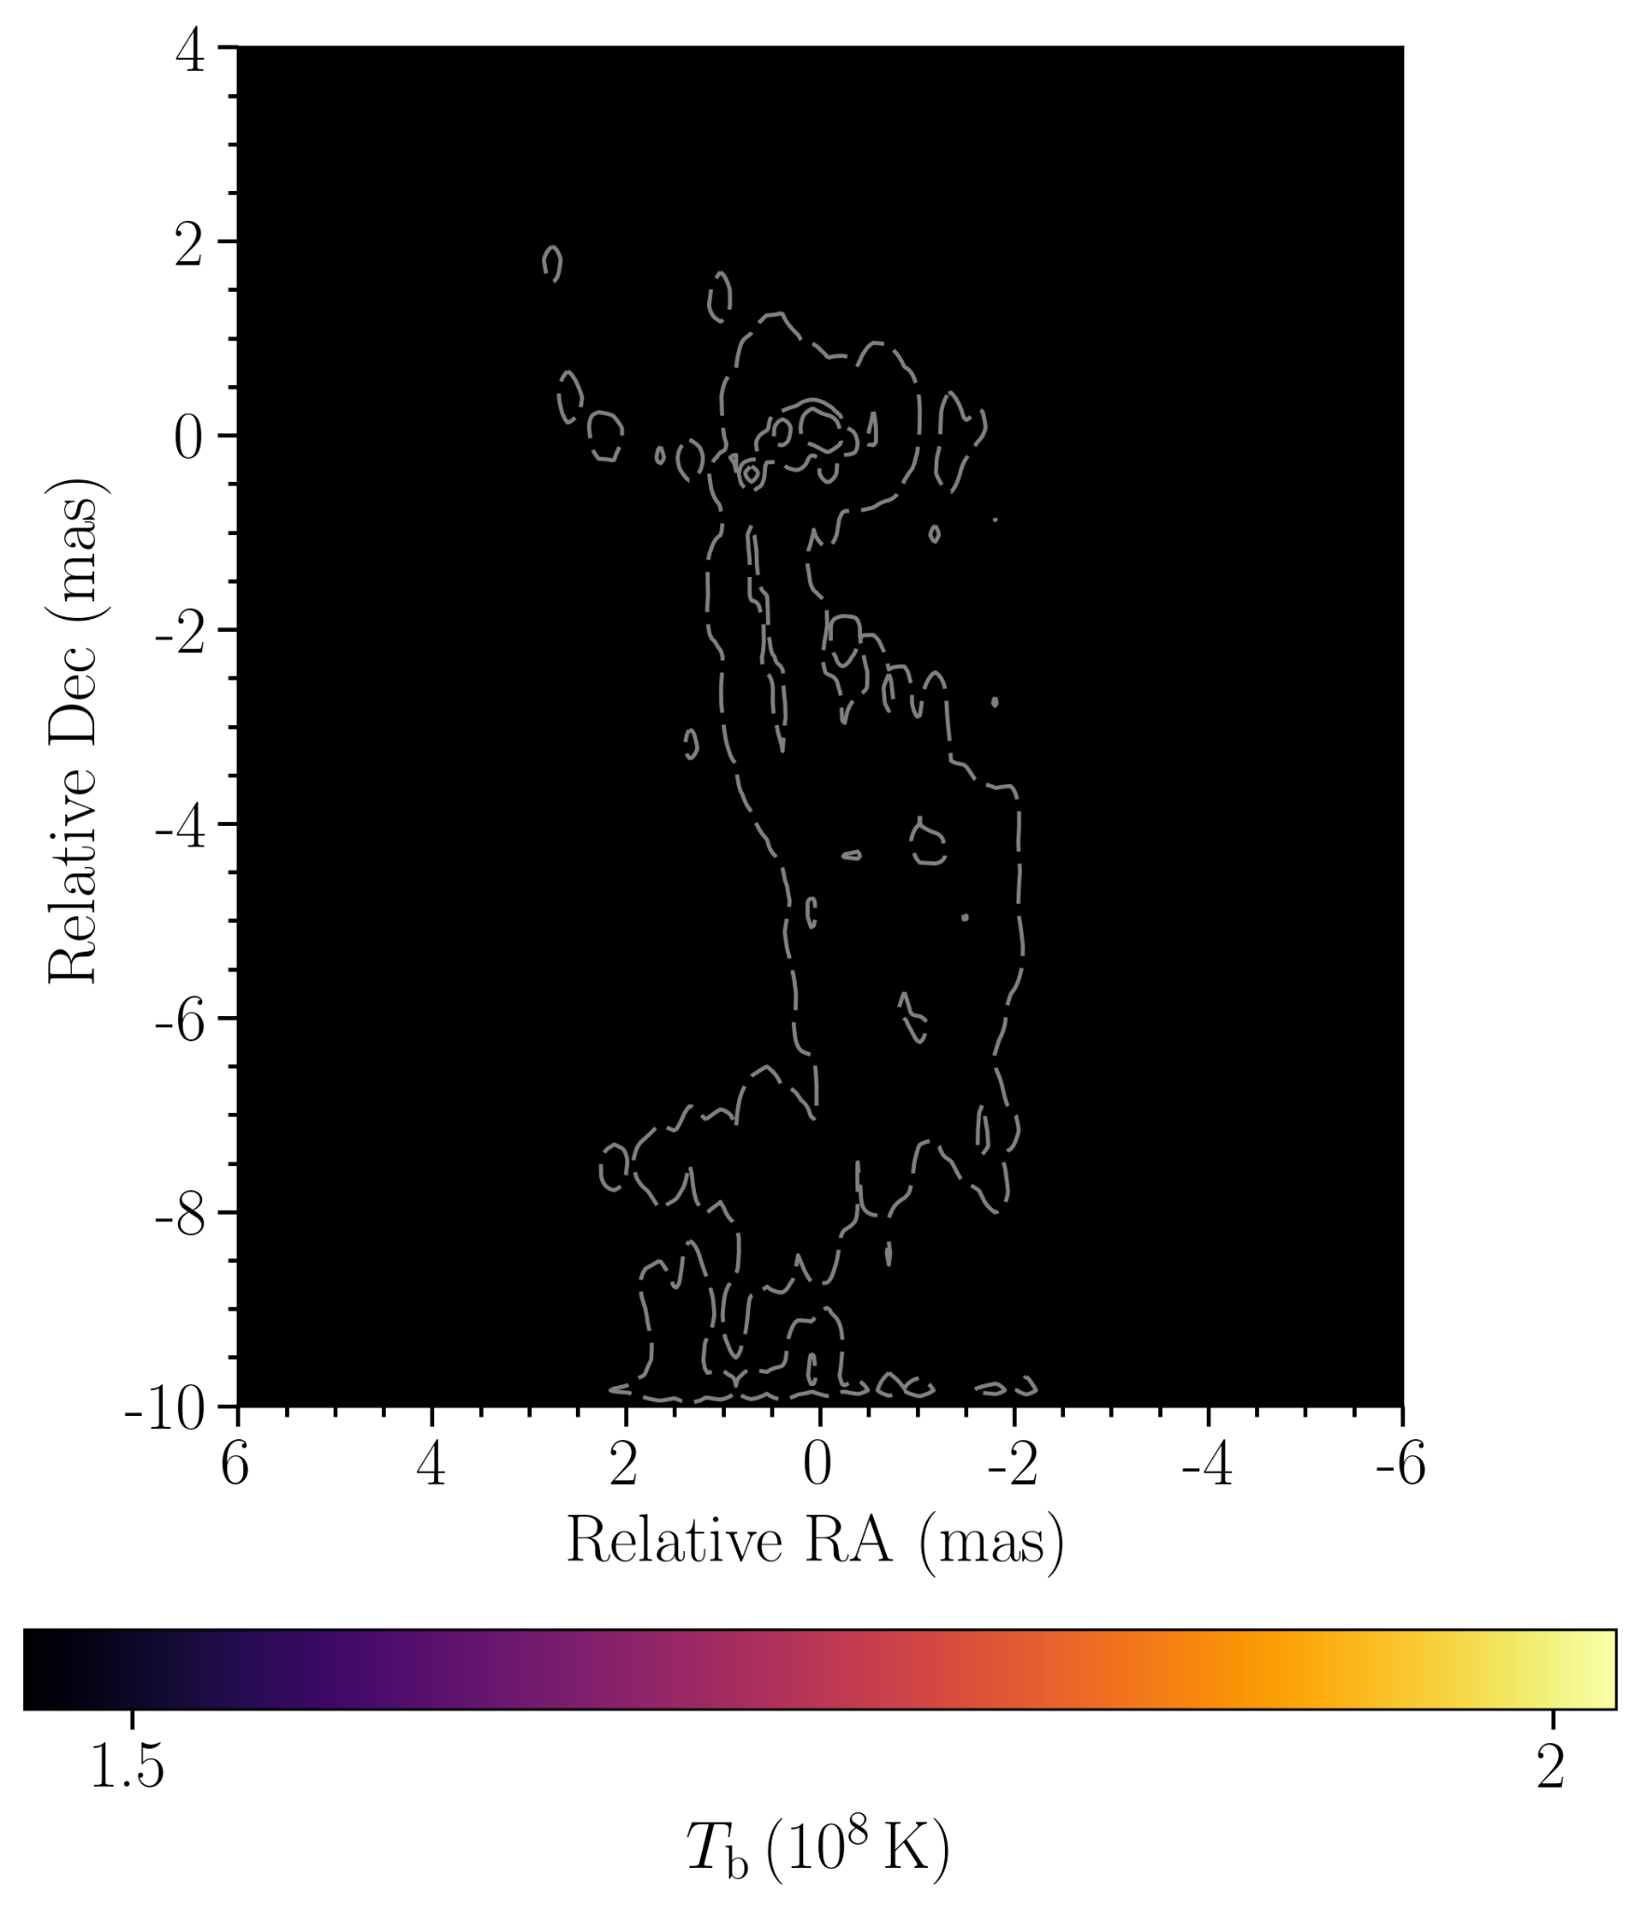
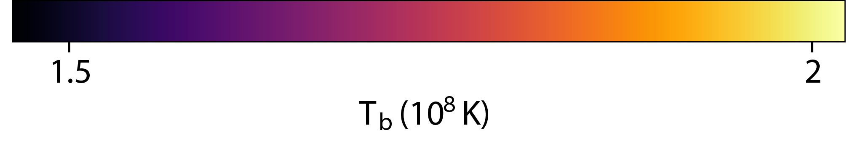
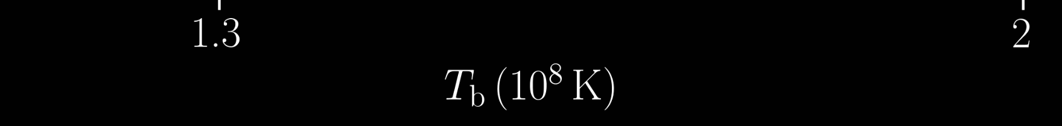
21 Nov 2024
15 Dec 2024
16 Feb 2025
09 Mar 2025
23 Mar 2025
14 Apr 2025
C3
1 pc
Paraschos+26

Slide 16
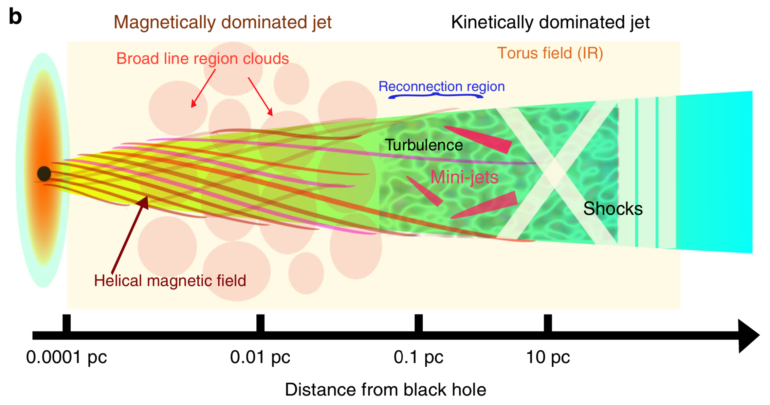
A possible interpretation
Shukla+20
‹#›

Slide 17
Take home messages
‹#›

Slide 18
We have demonstrated the synergetic capability of mm-VLBI
with optical and X-ray measurements to investigate the acceleration within jets in a multi-messenger context
How?
shock - shock interaction
Where?
Downstream
Type?
Both RGs and blazars
Implication?
P as a probe of ν
‹#›
Notes:
Here we report the detection of a highly coherent, strong magnetic field around234
its central, supermassive black hole. The brightness temperature analysis suggests that the system is in equipartition.235
We test models of jet formation, propagation, and Faraday rotation. Large Faraday rotation measure values imply236
depolarisation in the accretion flow. Our investigation of different flow geometries and black hole spins supports an237
advection-dominated accretion flow in a magnetically arrested state around a rapidly rotating supermassive black hole238
as a model of the jet launching system in the core of 3C 84

Slide 19

‹#›

Slide 20
Appendix
‹#›

Slide 21
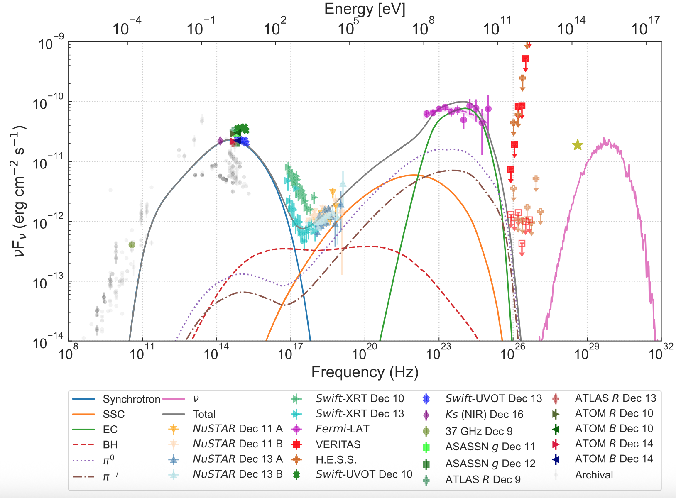
SED modelling reveals that an external photon field is necessary for the best fit, providing a target photon field
Acharyya+23

Slide 22
We have demonstrated the synergetic capability of mm-VLBI
with optical and X-ray measurements to investigate the location of the particle acceleration zone within jets
Our case study of selected blazars favour a far site acceleration zone
Similarly, in the radio galaxy 3C84 the downstream polarisation enhancement agrees with the proposed SSC origin of a γ-ray flare, that accompanied an X-ray polarisation detection
We found evidence favouring shock-shock interactions as a particle acceleration mechanism
The accompanying polarisation enhancement and EVPA rotation can be a potential tracer of neutrino emission
‹#›
Notes:
Here we report the detection of a highly coherent, strong magnetic field around234
its central, supermassive black hole. The brightness temperature analysis suggests that the system is in equipartition.235
We test models of jet formation, propagation, and Faraday rotation. Large Faraday rotation measure values imply236
depolarisation in the accretion flow. Our investigation of different flow geometries and black hole spins supports an237
advection-dominated accretion flow in a magnetically arrested state around a rapidly rotating supermassive black hole238
as a model of the jet launching system in the core of 3C 84

