Slide 1


Modelling the mergers and gravitational wave recoils of supermassive black holes
Peter Johansson
Department of Physics, University of Helsinki
Nordic Baltic Astronomy Days 2026
Turku, Finland, May 28th, 2026
In Helsinki with Atte Keitaanranta, Bastián Reinoso, Max Mattero, Till Sawala, Gábor Rácz
Jenni Häkkinen, Toni Tuominen, Alexander Rawlings (now at MPA),
Ruby Wright (now at UWA, Perth), Shihong Liao (now at NAOC, Beijing), Matias Mannerkoski
and at MPA with Antti Rantala (now in Cambridge), Thorsten Naab, Natalia Lahén,
Christian Partmann (now at CCA, Flatiron) , Volker Springel

Slide 2
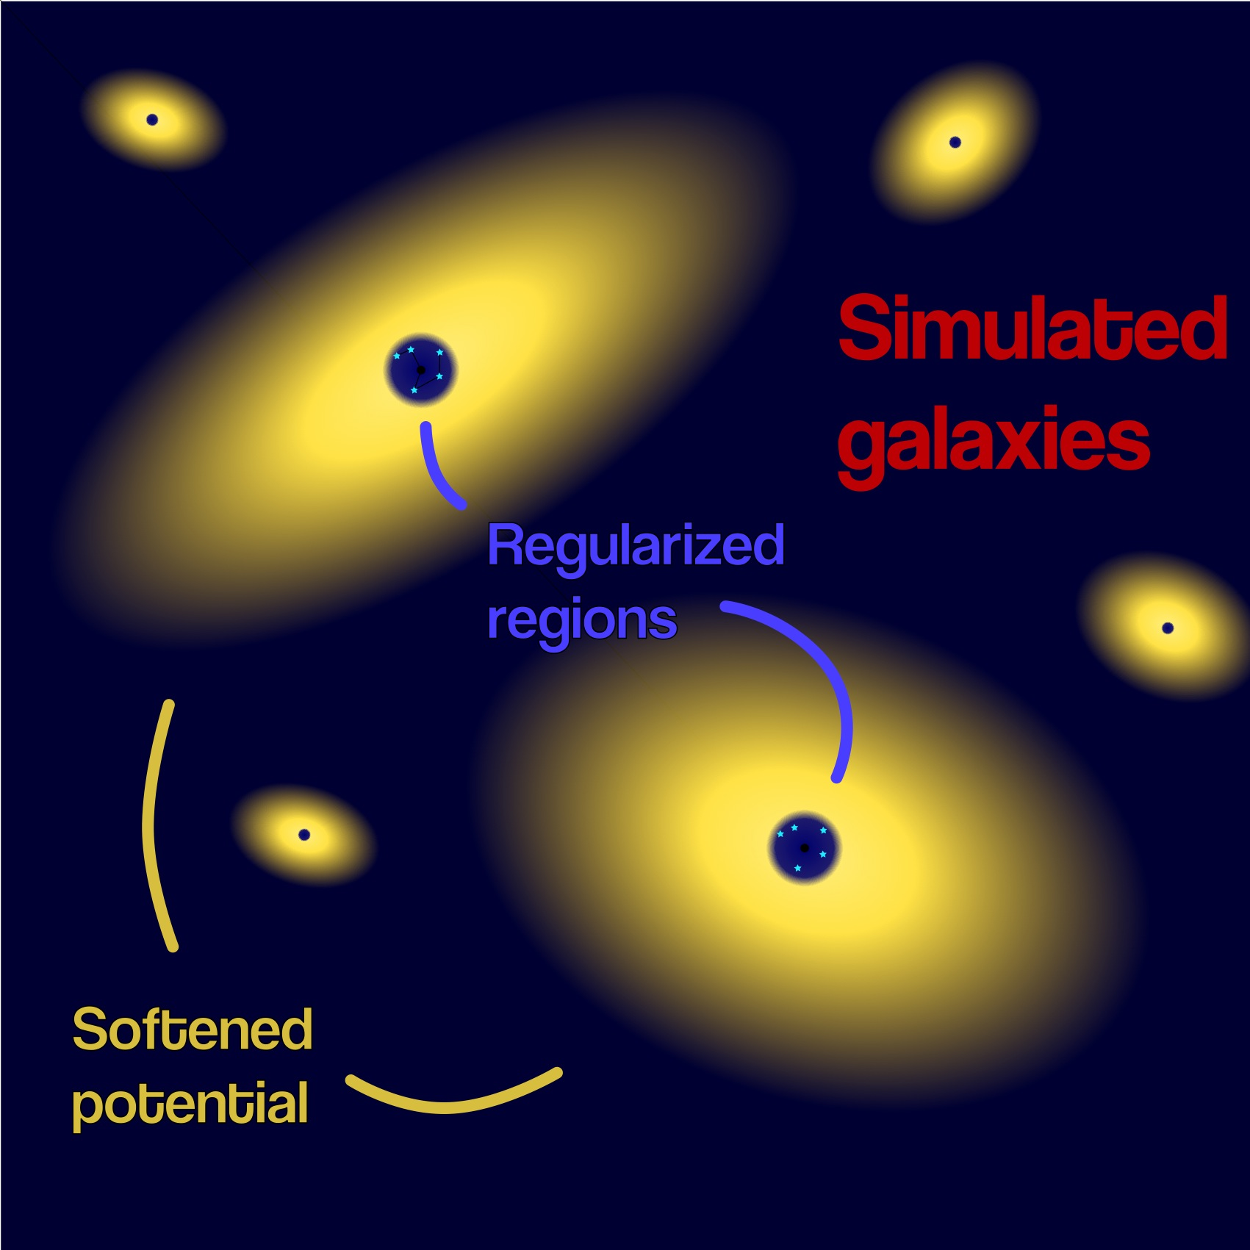
1. Current state-of-the-art
The dynamics of black holes have been traditionally studied with global hydrodynamical ~100-1000 million particle softened simulations (i.e. Gadget-3/4, GIZMO, AREPO, SWIFT, RAMSES).
An alternative is to use a collisional direct N-body simulation, which are typically restricted to
~1 million particles (i.e. Nbody-7) and typically do not include gas.
In addition, there are hybrid methods, such as for example the KETJU code that combines a global tree code with direct N-body.
BHs are point mass particles!

Slide 3
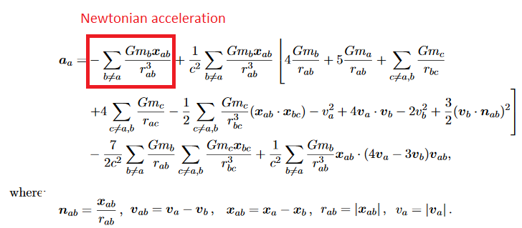
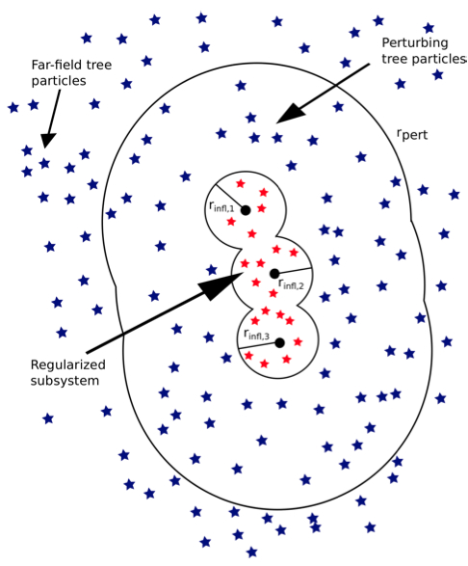
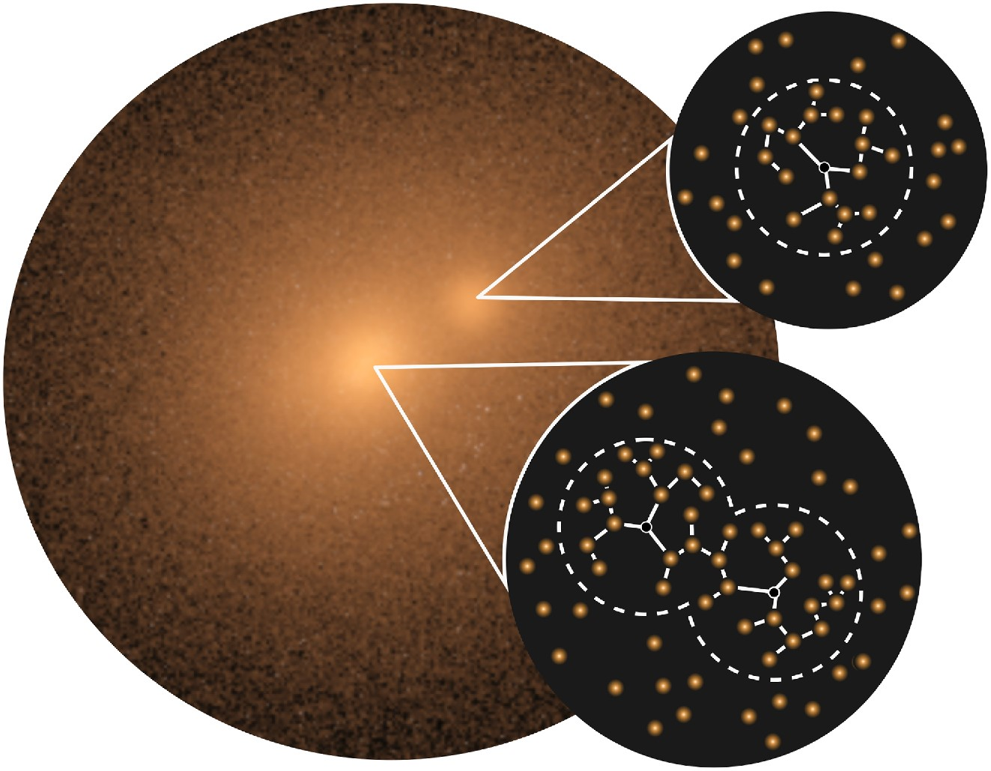
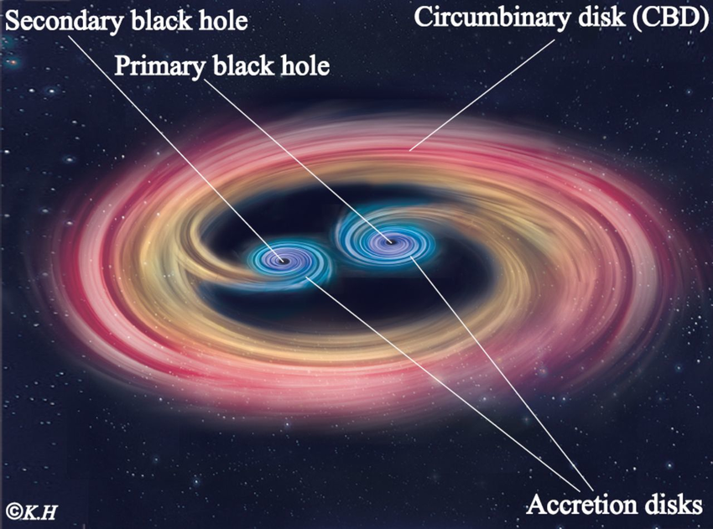
2. Hybrid N-body+hydrodynamics (KETJU model)
KETJU (chain in Finnish): Built originally on the GADGET-3 code. Includes algorithmically regularised chain regions
around every black hole.
The dynamics close to the black holes is accurately resolved. GADGET is used for the long- distance force.
Includes Post-Newtonian correc-tions up to order 3.5 PN, valid down to ~10 Schwarzschild radii.
The main novelty is that KETJU enables accurate BH dynamics simultaneously with gas physics.
Rantala, Pihajoki, PHJ et al. 2017, ApJ
Mannerkoski, Rawlings, PHJ et al. 2023, MNRAS
PN 1.0

Slide 4
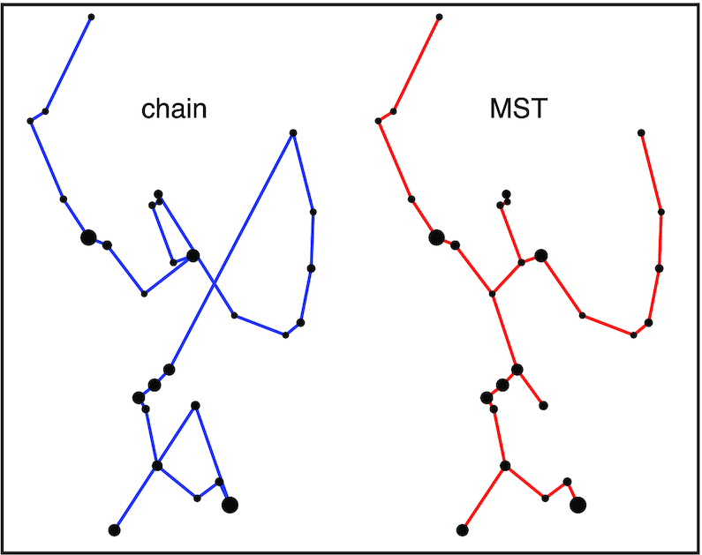
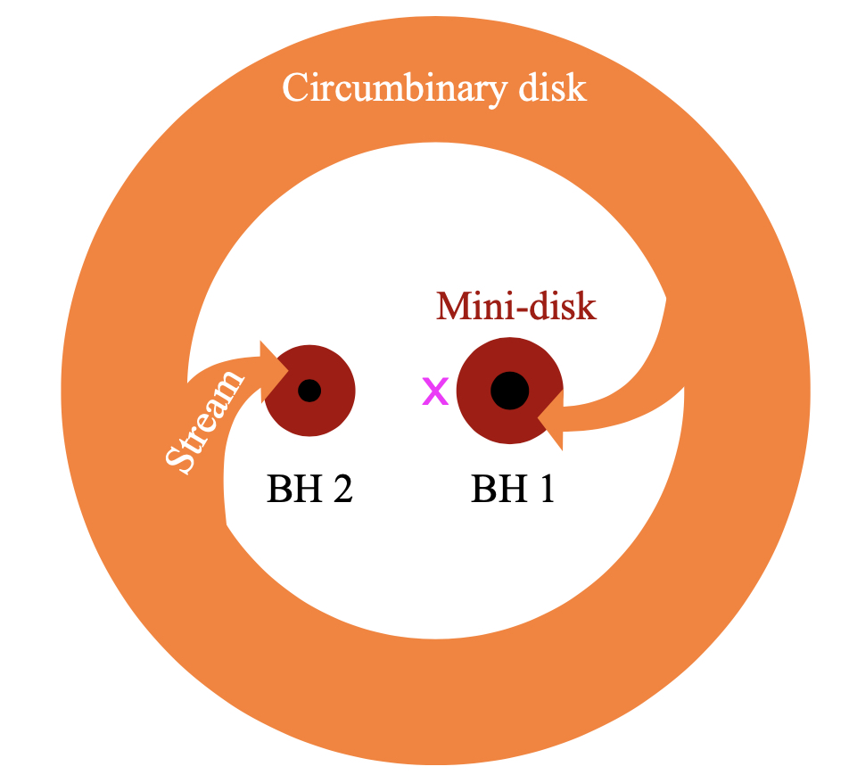
Proprietary KETJU-GADGET3 version – Code features
The MSTASR integrator snables simulations with ~5 000s particles in the “regularised region”. The next version of the code ‘fastKETJU’ is in preparation (Rantala et al. 2026).
Includes a parametrised model to account for BH spins and kicks (Zlochower & Lousto 2015).
Feedback model includes metal-dependent cooling. Stochastic star formation and the feedback and metal enrichment from type II, type Ia supernovae and AGB stars.
Includes a new binary BH accretion model (Liao et al. 2023) and a subgrid model to account for dynamical friction for low-mass BHs (Keitaanranta et al. 2026).
Rantala et al. 2020, MNRAS
Liao et al. 2023, MNRAS

Slide 5
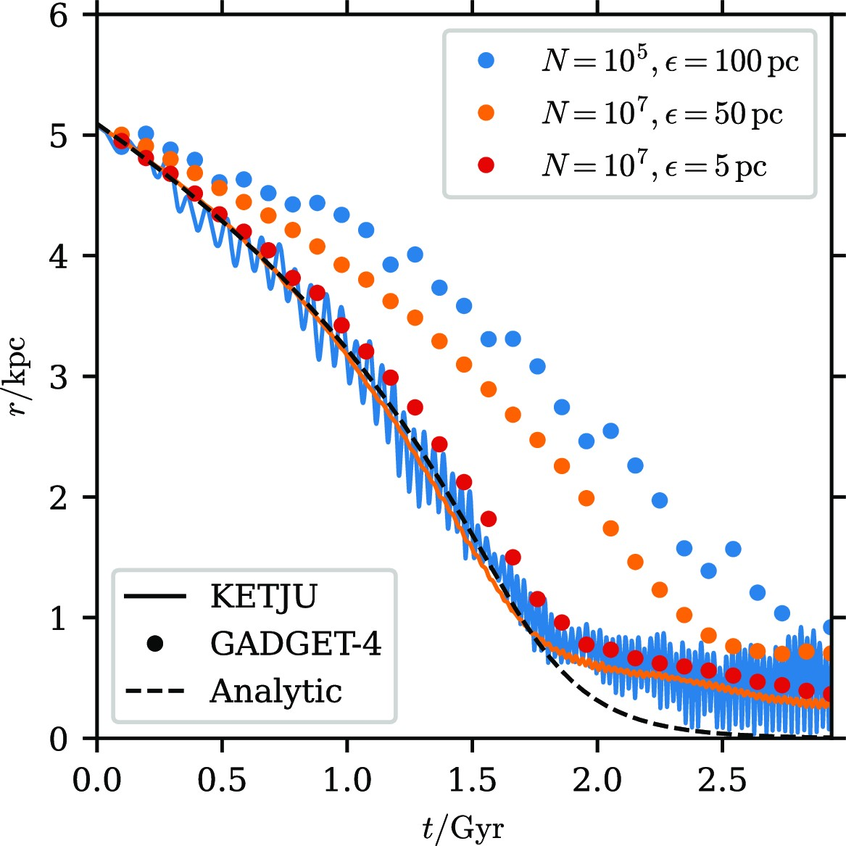
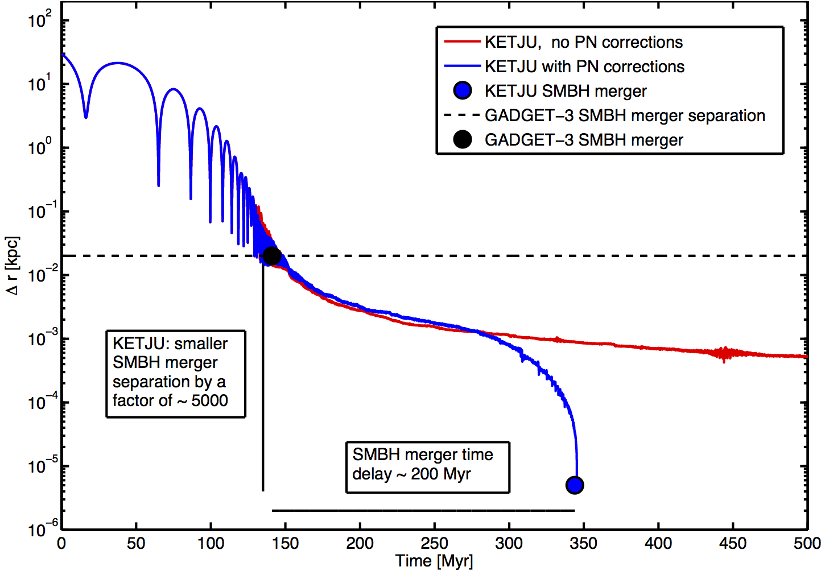
KETJU applications
Mannerkoski et al. 2023, MNRAS
KETJU can be used to accurately resolve the dynamical friction in simulations
and the hard three-body scattering phase, however a sufficiently high
mass ratio of m_{BH}/m*>100 is required for macroparticles (e.g. ~10⁴ - 10⁵ M⊙).
KETJU can accurately resolve the dynamics of binary supermassive black holes
down to separations of ~10 Schwarzschild radii. Enables a more physically
motivated merger criterion.

Slide 6
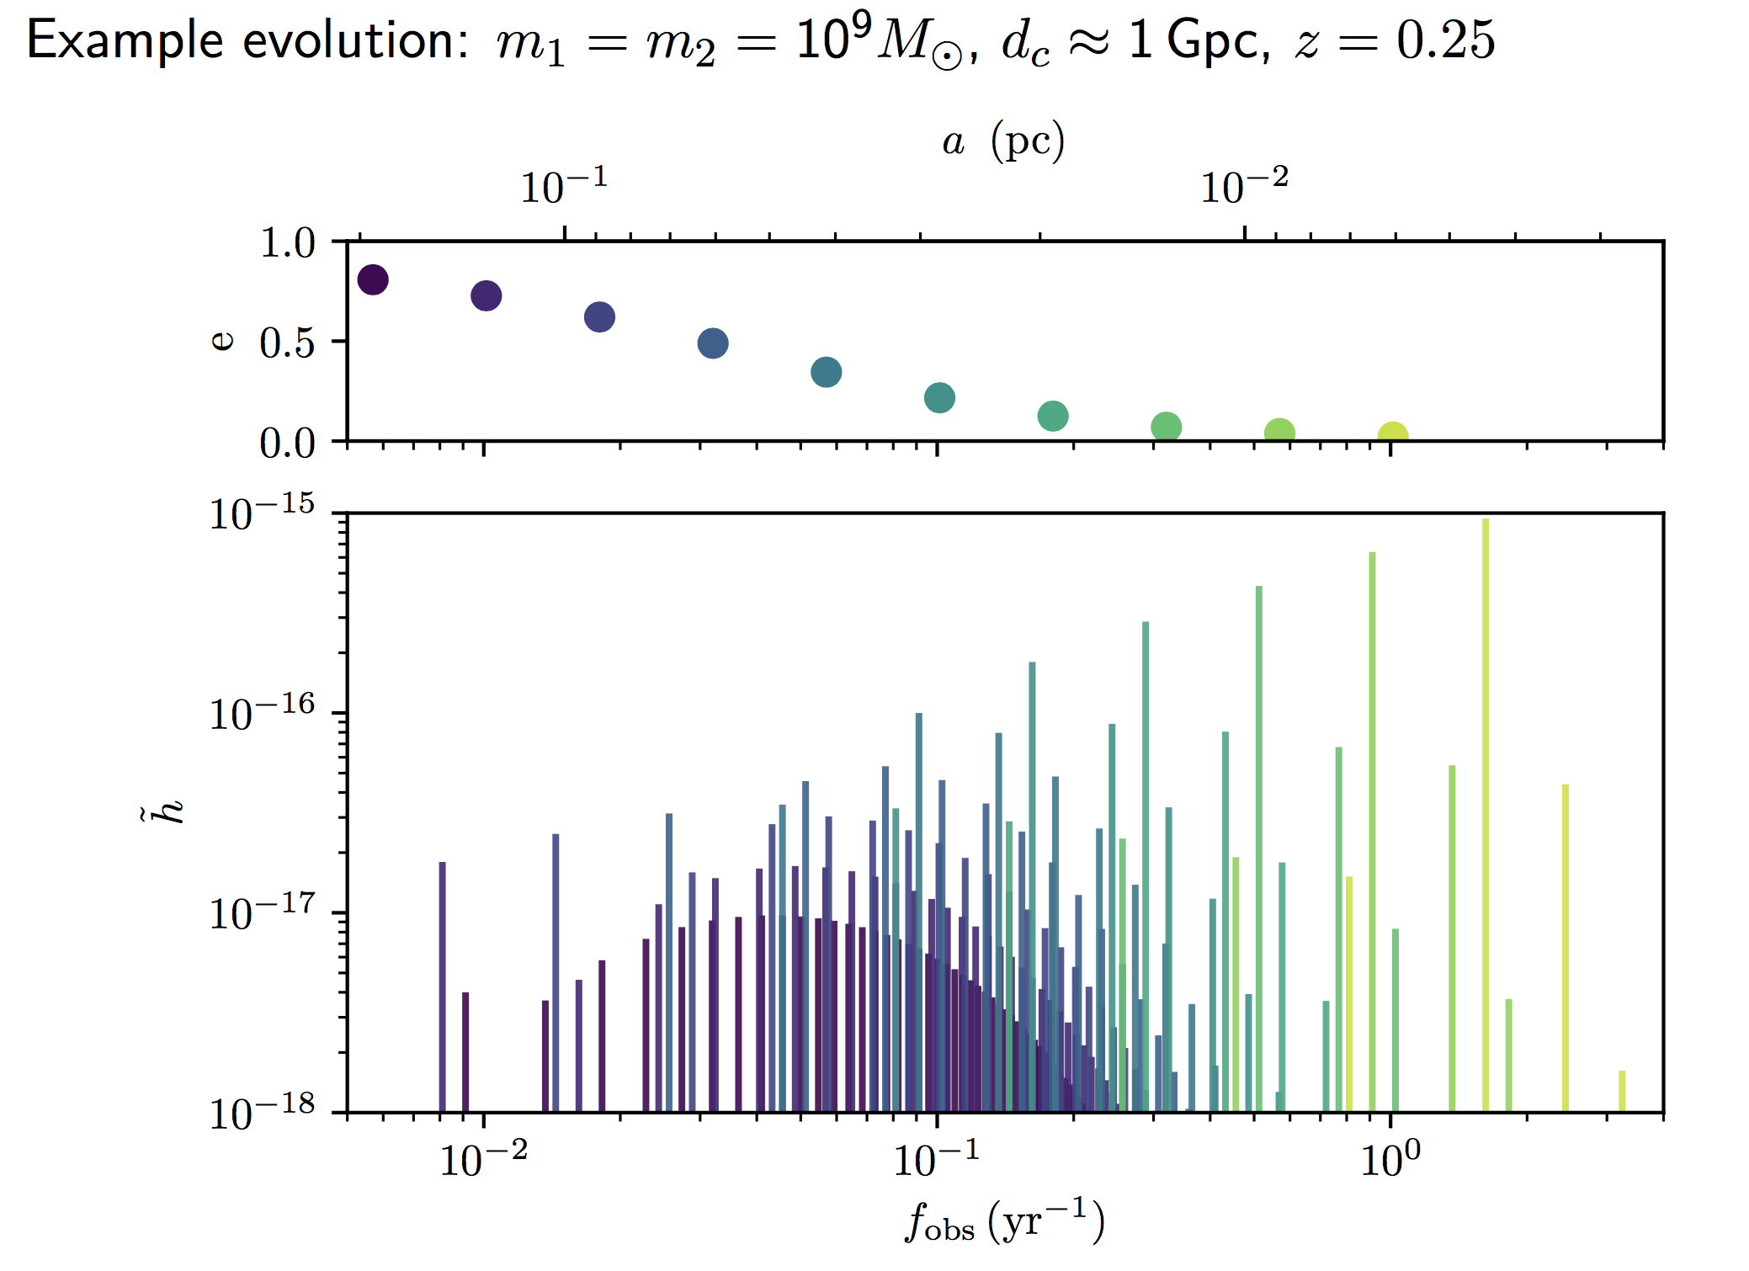
3. Gravitational wave background
A circular binary (e=0)
emits GWs only at the n=2 harmonic (2xorbital frequency).
With higher eccentricity, the GW signal (h=strain) is emitted over
many harmonics.
Many SMBH binaries in different stages of evolution emitting GWs. GW signals sum to an unresolved background (GWB).
Amplitude and shape affected by:
1) Density of binary mergers,
2) Masses, eccentricities and
3) Environment (stellar scattering etc.)

Slide 7
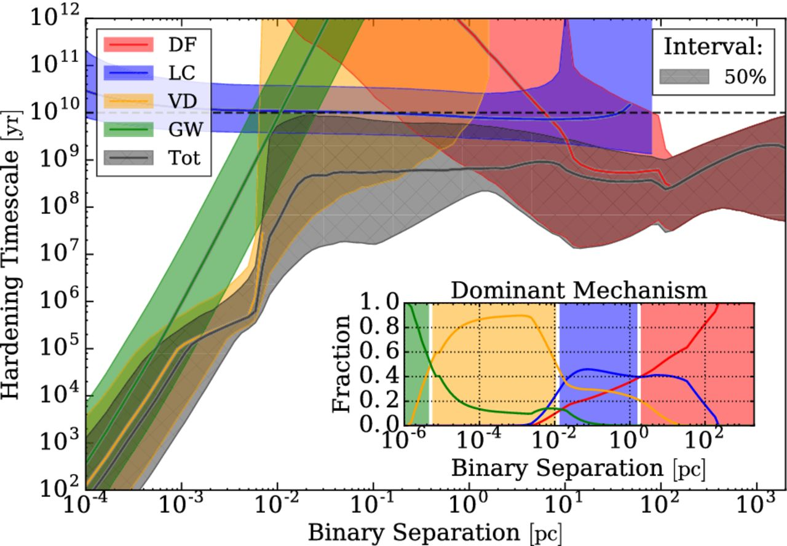
GW background calculation in large boxes
Large cosmological simulations, such as the ~100 Mpc box Illustris (Vogelsberger et al. 2014) simulation can be used to study the BH population.
The softening length of baryons is ~0.7 kpc, black holes thus merge at ~1 kpc separation in the simulation.
Use Analytic subgrid models and eccentricity as an input:
Dynamical friction (~kpc scales)
Stellar loss-cone scattering
(~1-10 pc scales)
Gas drag from a circumbinary, viscous disc (~10⁻³-5 pc)
GW emission (~10⁻⁵-5 pc)
Kelley et al. 2017

Slide 8
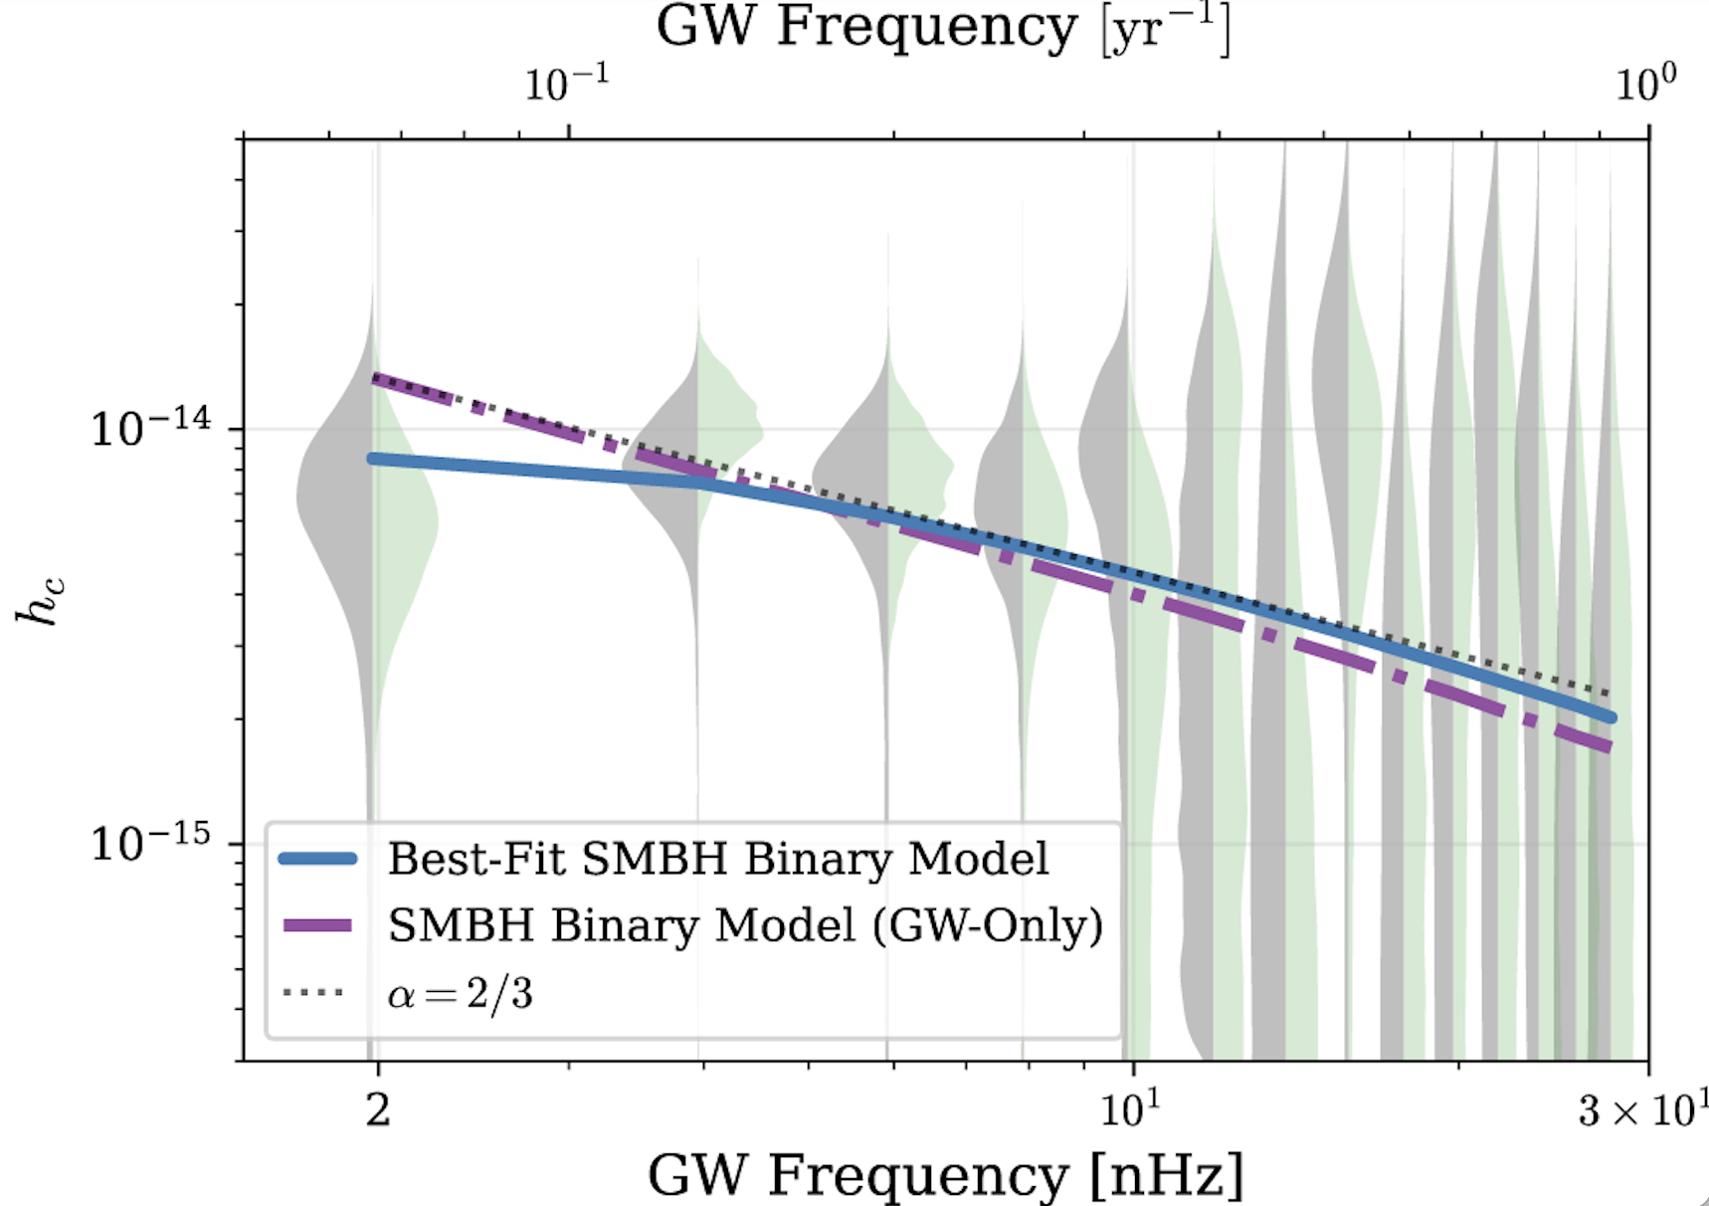
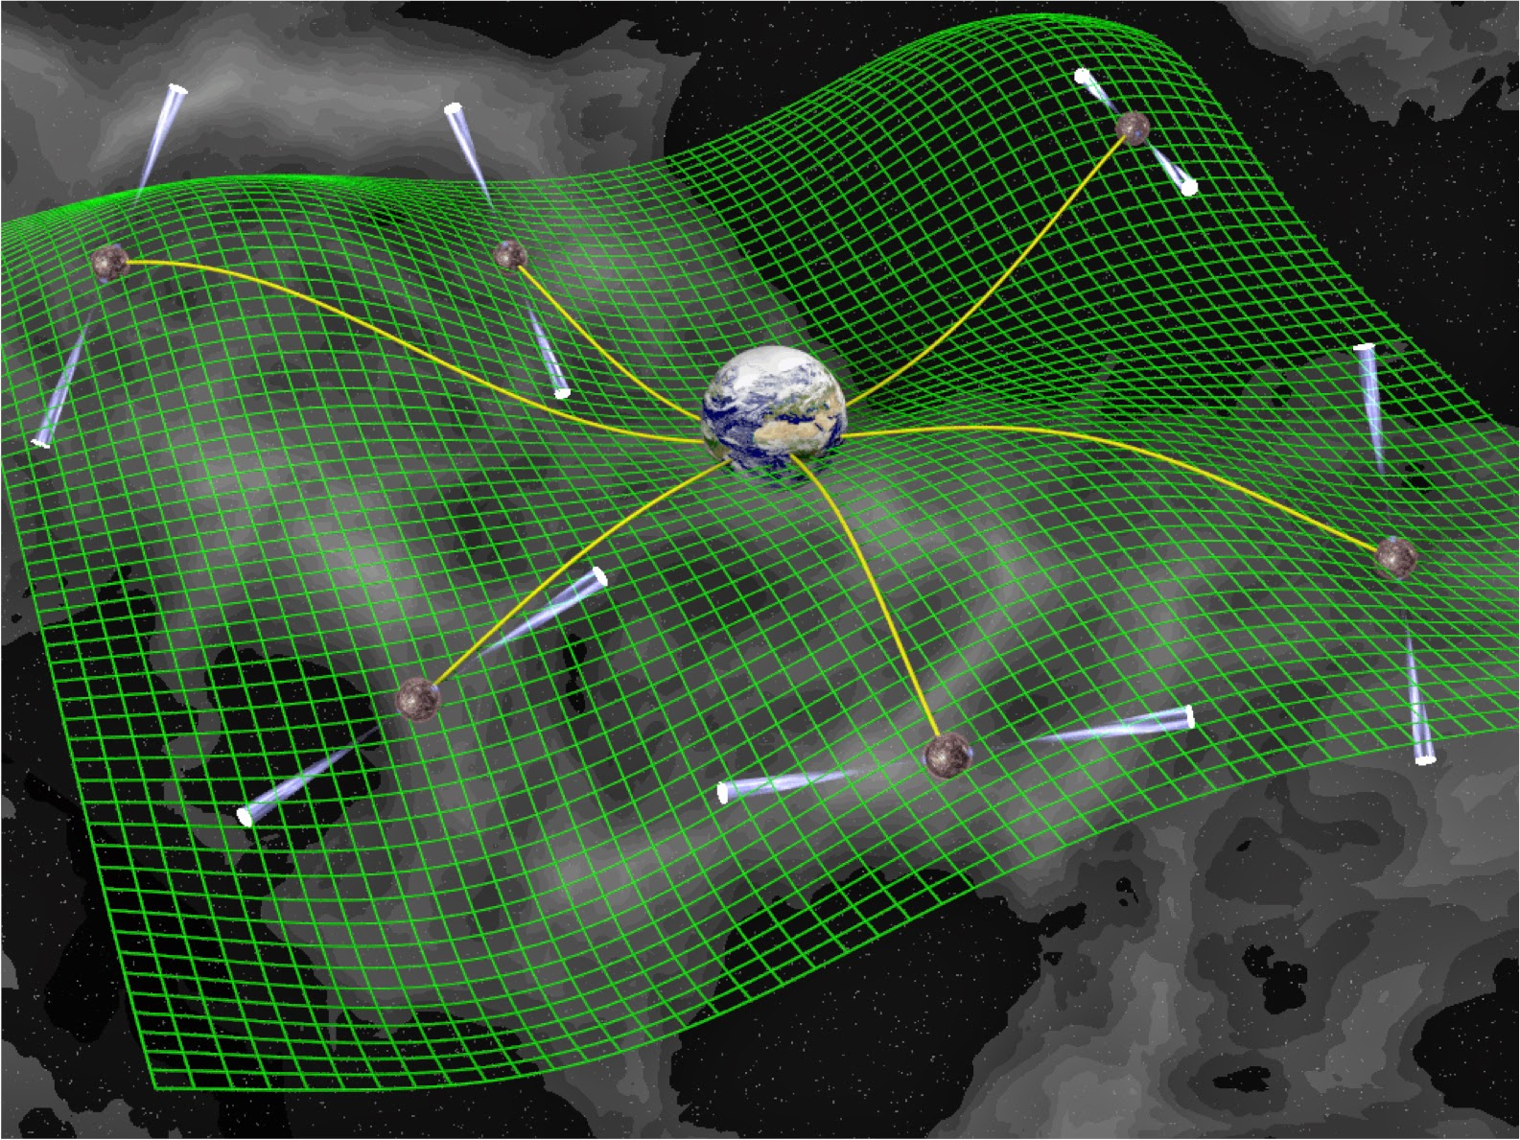
Pulsar timing array observations
Agazie et al. 2023b
PTA observations
The recovered GWB signal has a higher amplitude (log A~-14.5 at f₀=1yr⁻¹) and is also flatter than expected (γ~2.7, for α=-2/3, γ=13/3 expected).
The high amplitude indicates efficient evolution of massive merging SMBHs in the local (z<1) Universe and the flattening may indicate
the presence of significant eccentricity in the binary population.

Slide 9
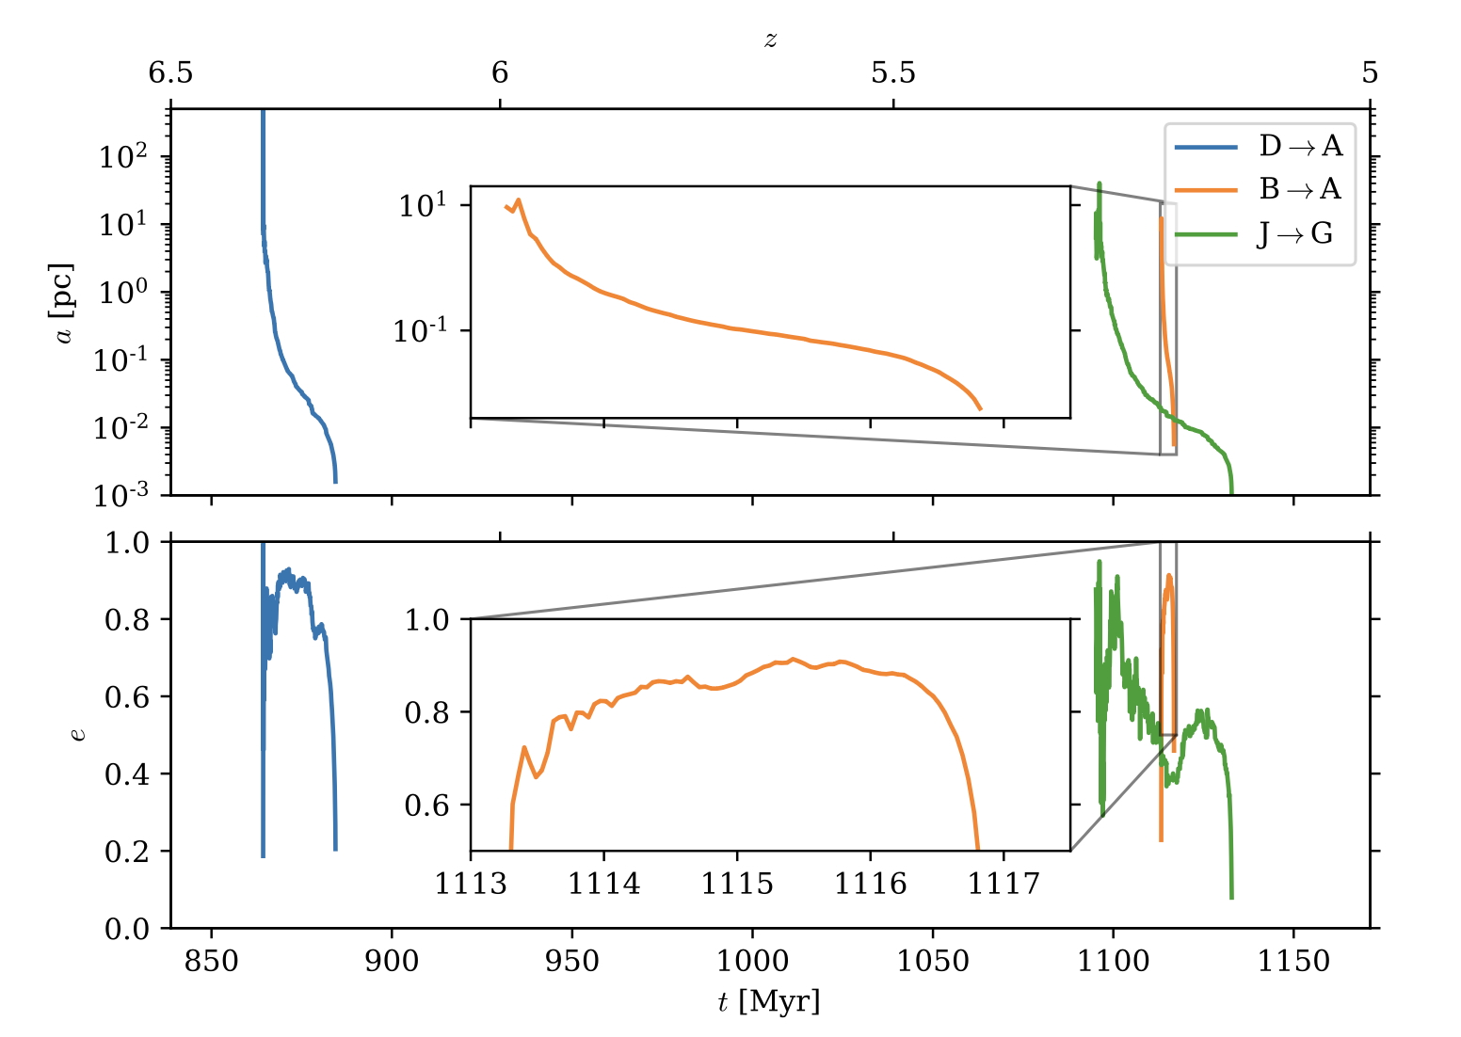
4. Cosmological KETJU zoom-in simulations at high-z
Work led by PhD
student Atte Keitaanranta.
Keitaanranta,
PHJ et al. 2026, in press
Combining KETJU with an analytic dynamical friction model. BHs seeded at 10⁶ h⁻¹ M ⊙ and become KETJU BHs at 10⁷ h⁻¹ M ⊙, when m_{BH}/m*>100.
BH mergers at high-z are very rapid, due to very high central stellar densities and in general high BH eccentricities.

Slide 10
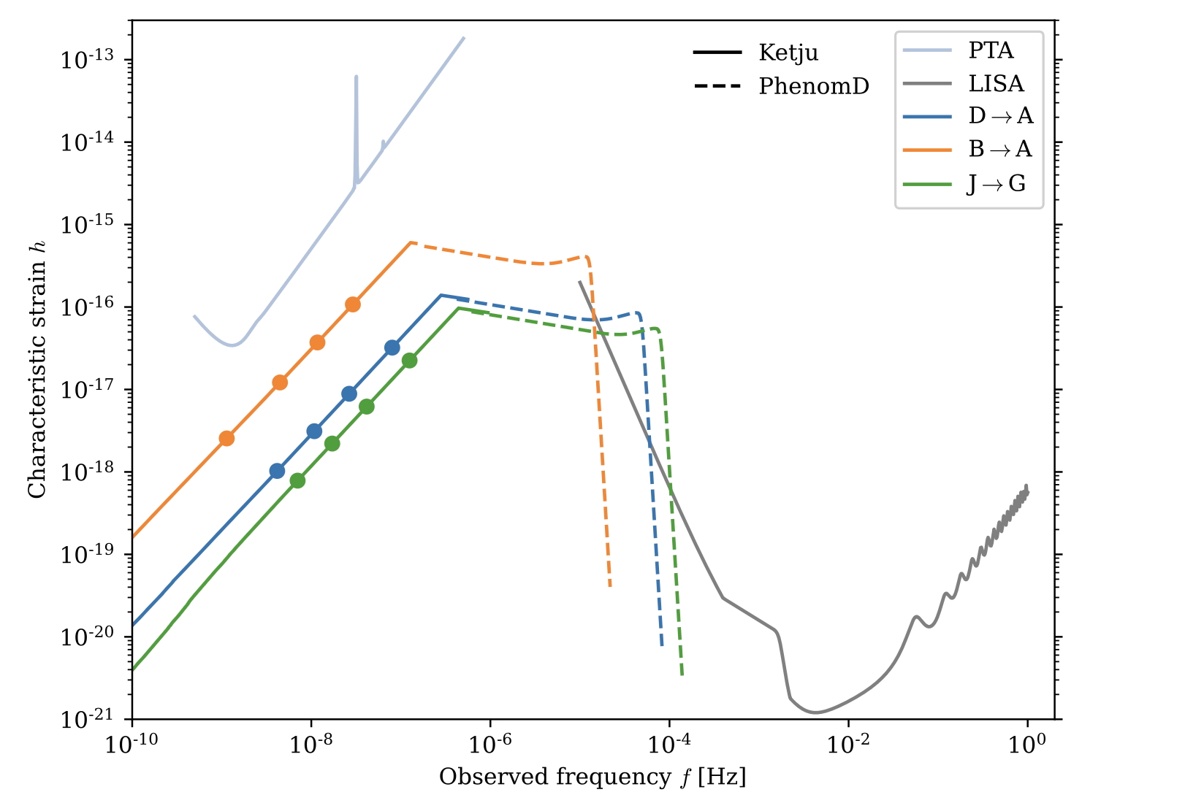
Gravitational waves from merging SMBHs at high-z
Keitaanranta,
PHJ et al. 2026, in press
Assume an observation time of 30 yrs.
10² yrs
10⁵ yrs
The GW signal from BH mergers with m_{BH}> 10⁷ h⁻¹ M ⊙ can be resolved from the KETJU simulation. The dots indicate the time before BH coalescence.
At even higher redshifts, where lower mass BHs (m_{BH}~10⁴-10⁶ M ⊙) are expected, the KETJU resolved evolution of the BH binaries would be in the LISA band.

Slide 11
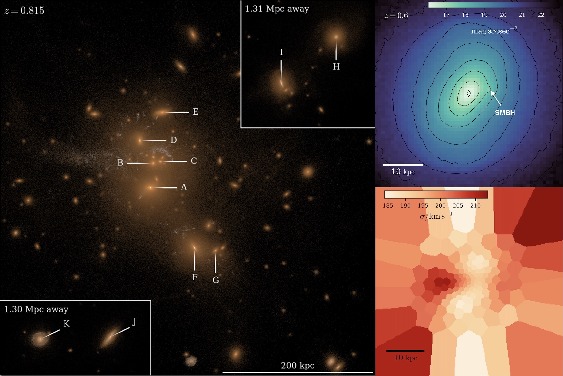
5. Observing recoiling supermassive black holes
Work led by former PhD student
Alex Rawlings (now MPA).
Rawlings,
PHJ et al. 2025, ApJ
Gravitational wave recoil kicks can eject supermassive black holes with M_{BH}>10⁹ M⊙ which can carry with them a retinue of bound stellar material.
These Black Hole Recoil Clusters (BRCs) with masses of 10⁶ ≤ M_{BRC} ≤10⁷ M⊙ can be detected both photometrically and kinematically.

Slide 12
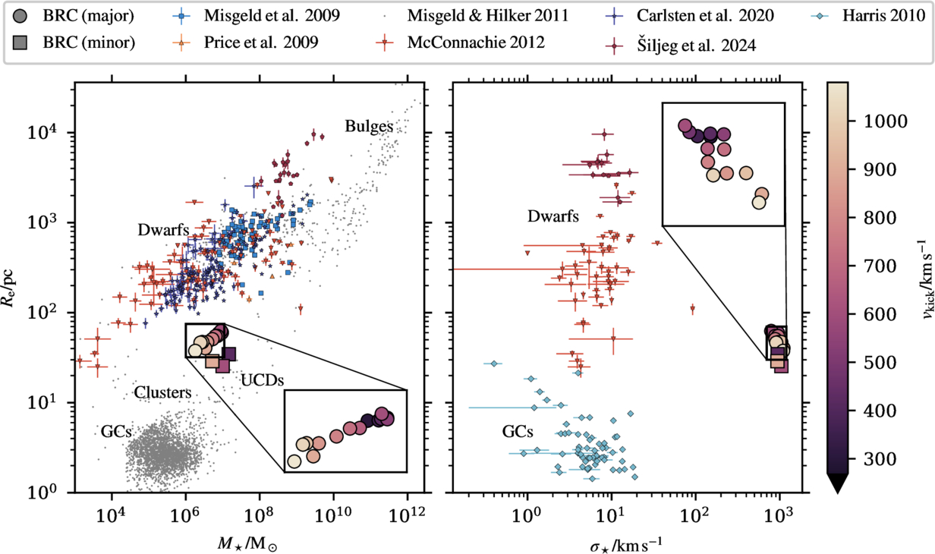
Catching Black hole recoil clusters
The Black Hole Recoil clusters are clearly distinguishable by their compact sizes (~10s of pc) and very high velocity dispersions in excess of σ≥600 km/s.
Thousands of BRC candidates should be detectable with Euclid below z<0.6. BRC status can be spectroscopically confirmed with the ELT.

Slide 13
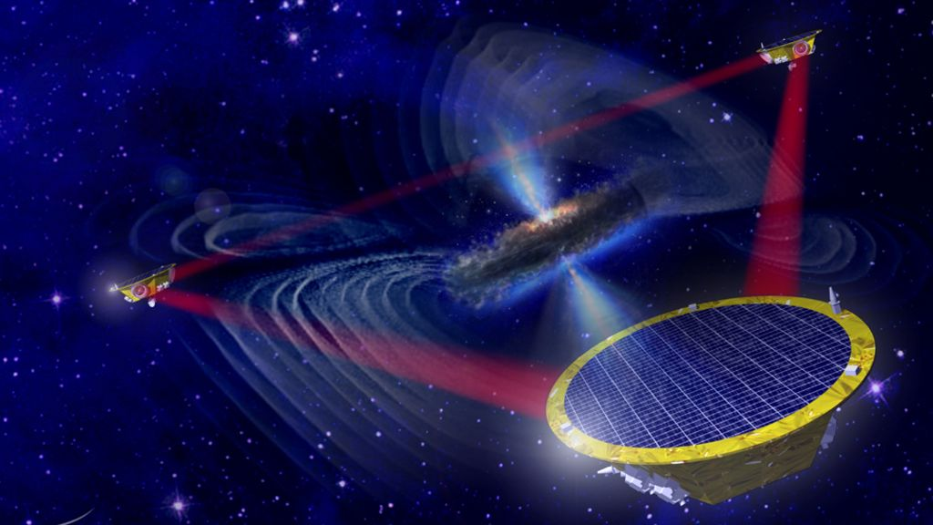
6. Summary & Outlook
The KETJU code includes an algorithmically regularised region around each SMBH, enabling accurate small-scale dynamics.
In large-scale simulations, the dynamics below the softening length must
be modelled using analytic subgrid models that induce BH merger delays.
This will impact the predictions for the stochastic GW background signal, which has now been tentatively detected by PTAs.
Gravitational wave recoil kicks can eject SMBHs, which carry with them Black Hole Recoil Clusters (BRCs) with masses of M_{BRC}~10⁶ -10⁷ M⊙ and very high velocity dispersions σ≥600 km/s.
LISA will be most sensitive to GW signals
from SMBHs with masses in range
10⁵-10⁷ M⊙. Modelling the accurate
small-scale dynamics simultaneously
with the gas physics will be important.
Download the public KETJU-GADGET4 code:
https://www.mv.helsinki.fi/home/phjohans/group-website/research/ketju/

