Slide 1






COSMOS-Web: estimating physical parameters of galaxies using Self-Organizing Maps
Fatemeh Abedini, Ghassem Gozaliasl,
Akram Hasani Zonoozi, Atousa Kalantari, Maarit Korpi-Lagg, Olivier Ilbert,
and COSMOS team
Notes:
Today I would like to present a paper that was recently accepted by Monthly Notices of the Royal Astronomical Society. I did this work with my supervisors, Ghassem and Akram, and my colleague Atousa at my university in Iran, in collaboration with the COSMOS team.
In this work, I apply Self-Organizing Maps to COSMOS-Web data, which is observational data, to estimate physical parameters.

Slide 2
Our Goal
Estimate physical parameter of galaxies like:
Redshift: Change in the observed wavelength relative to the rest frame of an object
Stellar mass: Total mass of stars in a galaxy
Star Formation Rate (SFR): Rate at which a galaxy forms new stars
Specific Star Formation Rate: Star formation rate per unit stellar mass
Age and luminosity
Notes:
So first, let me explain what this presentation is about.
This talk has four main parts.
First, I will explain why we use machine learning in galaxy studies.
In galaxy studies, we often want to estimate physical parameters such as redshift, stellar mass, star formation rate (SFR), specific star formation rate (sSFR), and galaxy age.
These parameters help us understand how galaxies form and evolve over cosmic time.
However, new surveys like Euclid produce huge amounts of data. So analyzing without using Machine learning… basically difficult. Unless we want to work for the next 300 years.
Second, I will introduce the data.
I use both simulated data and observational data.
Many previous studies have used similar datasets. However, one advantage of this work is that we include JWST filters.
Third, I will briefly explain the method, which is Self-Organizing Maps.
SOM is an unsupervised machine learning method.
In supervised learning, we give the model both features and labels. A common example is regression, where we train the model to predict a known value.
But in unsupervised learning, we do not provide labels. Instead, the algorithm tries to find patterns and structure in the data by itself.
This is often used for clustering and classification.
At this point, a question appears:
If SOM is unsupervised, how can we use it to predict physical parameters like redshift or stellar mass?
I am going to answer this in our work.
And finally, I will show some results and ongoing work.
I will not go into all the technical details today. But I will explain the general idea and show the results.

Slide 3
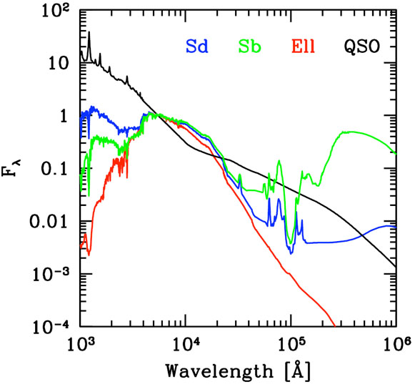
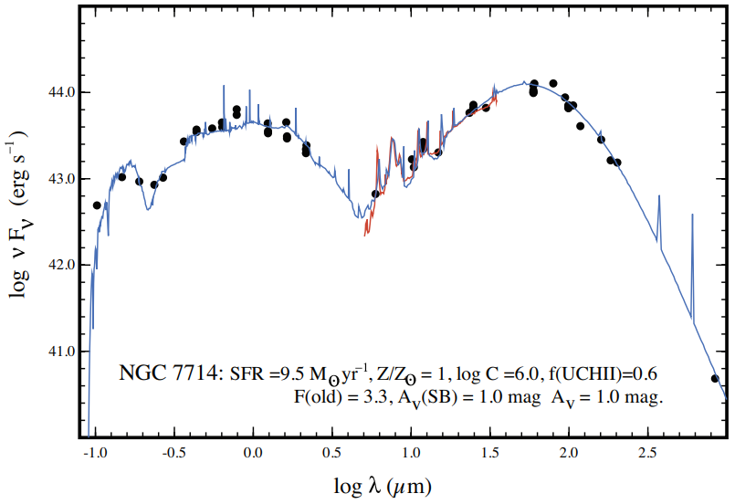


Method: Spectral Energy Distribution (SED) Fitting
Observational Data
Templates
Redshift
Stellar Mass
Star Formation Rate (SFR)
sSFR
Age, etc
Walcher et al. 2010
Notes:
So first, let me explain what this presentation is about.
This talk has four main parts.
First, I will explain why we use machine learning in galaxy studies.
In galaxy studies, we often want to estimate physical parameters such as redshift, stellar mass, star formation rate (SFR), specific star formation rate (sSFR), and galaxy age.
These parameters help us understand how galaxies form and evolve over cosmic time.
However, new surveys like Euclid produce huge amounts of data. So analyzing without using Machine learning… basically difficult. Unless we want to work for the next 300 years.
Second, I will introduce the data.
I use both simulated data and observational data.
Many previous studies have used similar datasets. However, one advantage of this work is that we include JWST filters.
Third, I will briefly explain the method, which is Self-Organizing Maps.
SOM is an unsupervised machine learning method.
In supervised learning, we give the model both features and labels. A common example is regression, where we train the model to predict a known value.
But in unsupervised learning, we do not provide labels. Instead, the algorithm tries to find patterns and structure in the data by itself.
This is often used for clustering and classification.
At this point, a question appears:
If SOM is unsupervised, how can we use it to predict physical parameters like redshift or stellar mass?
I am going to answer this in our work.
And finally, I will show some results and ongoing work.
I will not go into all the technical details today. But I will explain the general idea and show the results.

Slide 4
Challenges
 | SED Fitting Method | Machine learning Method
Era of the Large data galaxies
Computationally Expensive
Model or Data
Inefficient for big data
😰
Built for big data
🤩
Time-consuming
🐢
Fast prediction
🐇
Model-dependent
🤯
Data-dependent
🧐
Notes:
Now, let’s return to our question: why do we use machine learning?
We are currently in the era of large-scale galaxy surveys. In this plot, we see several major astronomical surveys, including Palomar Digital Sky Survey (DPOSS), Two Micron All-Sky Survey (2MASS), Galaxy Evolution Explorer (GALEX), Sloan Digital Sky Survey (SDSS), SkyMapper Southern Sky Survey, Pan-STARRS, the Large Synoptic Survey Telescope (LSST), and the Square Kilometre Array (SKA).
As we can see, surveys such as LSST and SKA will produce enormous amounts of data. For example, the expected data volume is around ten to the power of six terabyte, which is extremely large.
We also expect even more data in the near future from missions such as Euclid and the Roman Space Telescope.
Data Volume Growth
Traditional SED fitting struggles to scale to millions of galaxies, while machine learning methods are designed to handle large datasets efficiently.
Computational Cost
SED fitting requires intensive model evaluation for each galaxy.
Machine learning shifts the cost to training, enabling fast predictions afterward. 1 billion galaxy it takes 27 hours to do the SED fitting for the lephare, but for the SOM is one minute (for the prediction)
Model Dependence
SED fitting relies heavily on assumed physical models and templates.
Machine learning is more flexible but depends on the quality and representativeness of training data.

Slide 5

Supervised vs Unsupervised learning
Feature: The input data that the model uses to learn.
Label: The correct answer associated with each input data.

Slide 6
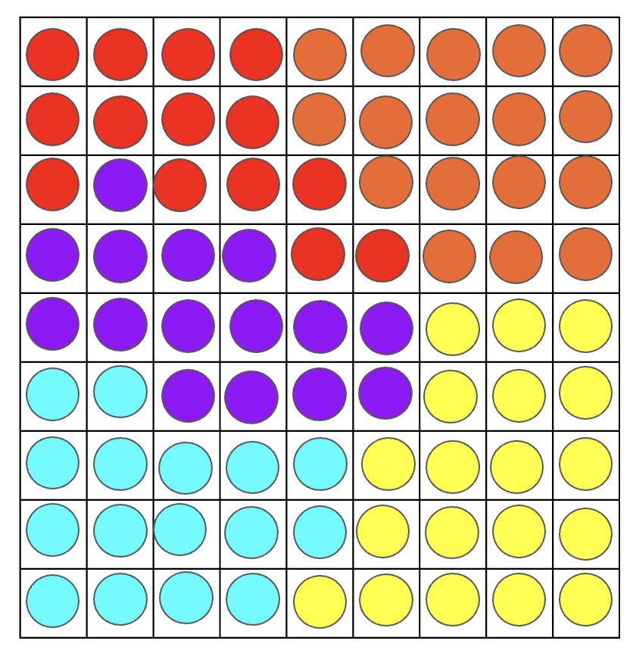
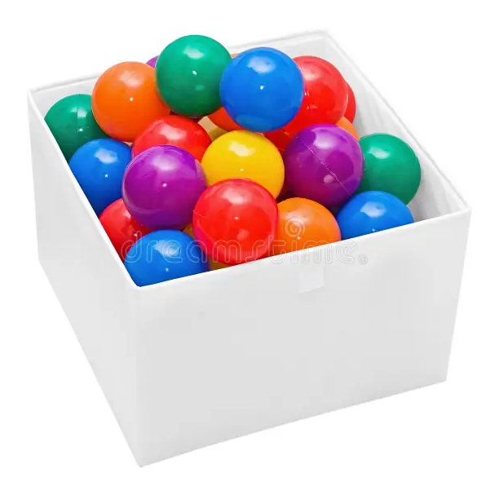
Self Organizing Maps
An unsupervised learning method
Developed by Teuvo Kohonen (Helsinki University of Technology)
Projects high-dimensional data → 2D map
Preserving data topology
Input data
Final SOM
Notes:
In this part, I want to focus on the method that I used. The method is the Self-Organizing Map (SOM). As I mentioned before, it is an unsupervised machine learning method used for data reduction.
For example, if we have data with 10 features, SOM can map it onto a two-dimensional grid while preserving the topology of the data. In this way, we can visualize high-dimensional data, and similar data points will be clustered in the same region of the map.
Now I want to show how SOM works. Let’s assume we have balls with different colors. In this simple example, we have only one feature, which is the color. We want to cluster them onto a two-dimensional map.
The first step is to define the 2D map and choose the grid size. For example, here we use a 9 × 9 grid, which means we have 81 cells or neurons.
Each neuron is assigned initial weights. In our work, we initialize the weights using Principal Component Analysis (PCA), which ensures that the initial weights follow the distribution of the data.
kohonen1981hierarchical
SOM is an unsupervised method, so it does not use labels.
But here, our goal is to estimate quantities like redshift, stellar mass, and SFR, which are exactly labels.
So the question is: how can an unsupervised method help us predict them?
I’ll answer this in a moment.

Slide 7
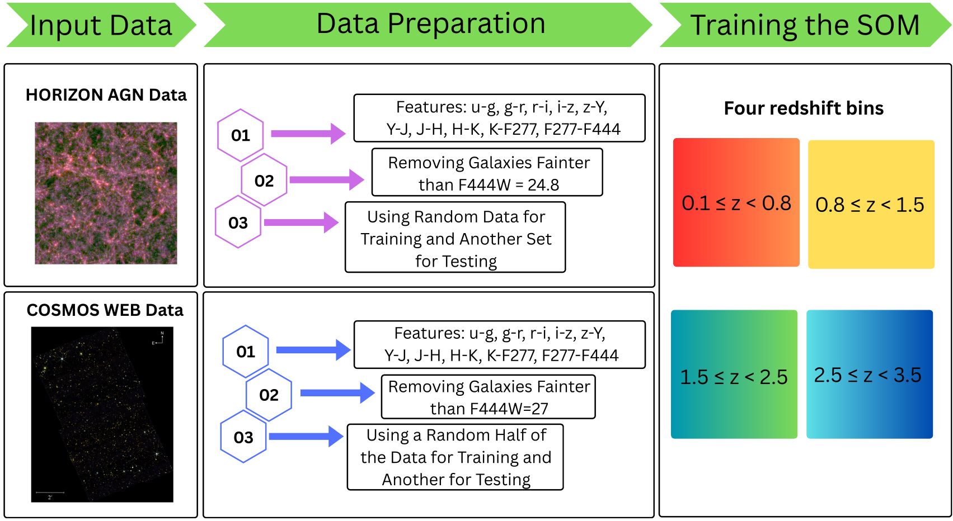
Workflow
Notes:
So, now I would like to discuss my work. We used two datasets, as I mentioned earlier: HORIZON-AGN as the simulation dataset and COSMOS-Web (CW) as the observational dataset.
We use the simulation data because the physical parameters, such as redshift and stellar mass, are known with high confidence. These parameters are part of the initial conditions of the simulation. We also use observational data because our final goal is to test whether the SOM can be applied to estimate stellar mass.
t is the magnitude limit where, if we look at the histogram, the number of galaxies starts to drop because we begin missing the fainter ones.
To determine this limit, we plotted a histogram of the magnitudes. From the magnitude where the number of galaxies starts to decrease significantly, we selected the magnitude limit. Since we apply this magnitude limit to the observational data, we also apply the same limit to the simulation data to keep the datasets consistent.
We also define the training and test datasets. For training the SOM, we train four SOMs in different redshift bins. Training in separate redshift bins helps us understand how the prediction accuracy changes in low, medium, and high redshift ranges.
In addition, we found that when the SOM is trained on the entire dataset, the redshift prediction is not very accurate. Therefore, we decided to train the SOM in separate redshift bins. So we used both the simulation and observational as the training data for the SOM. On time train with simulation in different separate redshift bins and one time for the observational data.

Slide 8
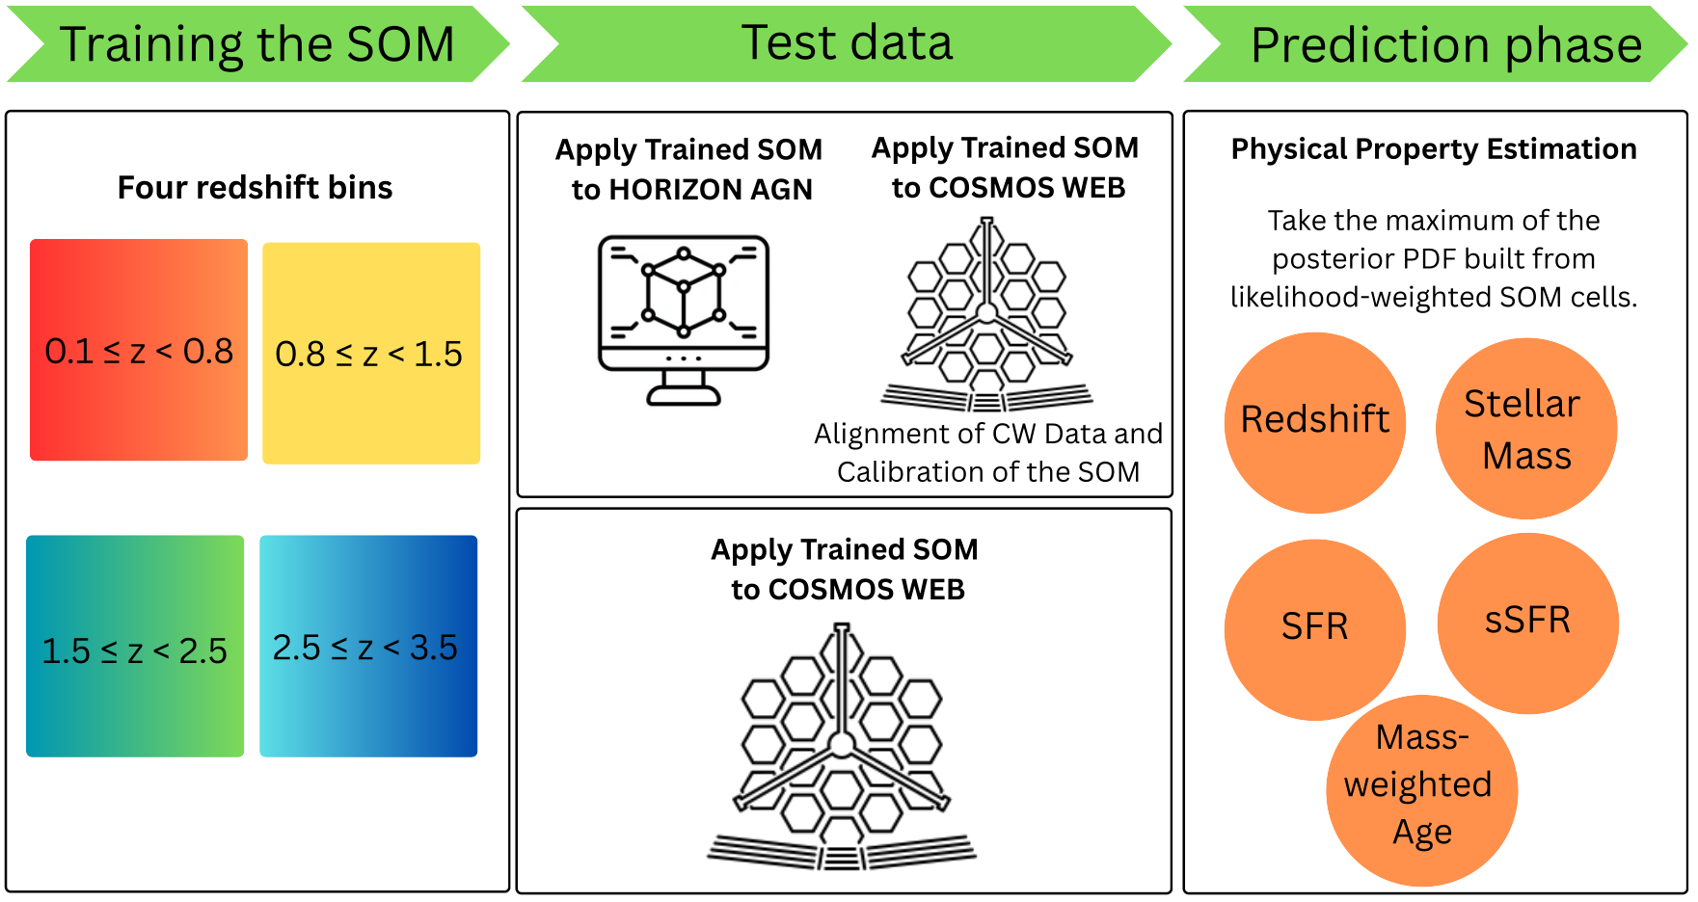
Workflow
σNMAD → Measures prediction precision
Lower is better
Outlier Fraction → Percentage of failed predictions
Lower is better
RMSE → Average prediction error
Lower is better
σ₀ → Error after removing outliers
Lower is better
Bias → Systematic offset between prediction and true value
Closer to zero is better
Pearson Correlation (r) → Strength of correlation between prediction and reference values
Closer to 1 is better
Notes:
We trained SOMs using both the Horizon AGN data and the CW data. For the SOM trained on the Horizon AGN data, we used both HZ-AGN and CW as test datasets. For the SOM trained on the CW data, we only used the CW data for testing.
In most studies, test data are mapped onto the SOM by finding the best matching unit, which corresponds to the minimum Euclidean distance between the test data and the SOM weights.
However, in this work we use the method proposed in the La Torre et al. paper. Instead of selecting only the best matching unit, we calculate the likelihood of each test galaxy across the SOM, taking into account the color errors of the data. From this likelihood, we compute a PDF and use the peak of the PDF as the predicted parameter.
This approach accounts for color errors and reduces the effect of color degeneracy, where galaxies may have similar colors but different physical parameters.
Finally, we derive redshift, stellar mass, SFR, sSFR, and mass-weighted age, and compare them with the true values to evaluate the performance of the SOM.

Slide 9
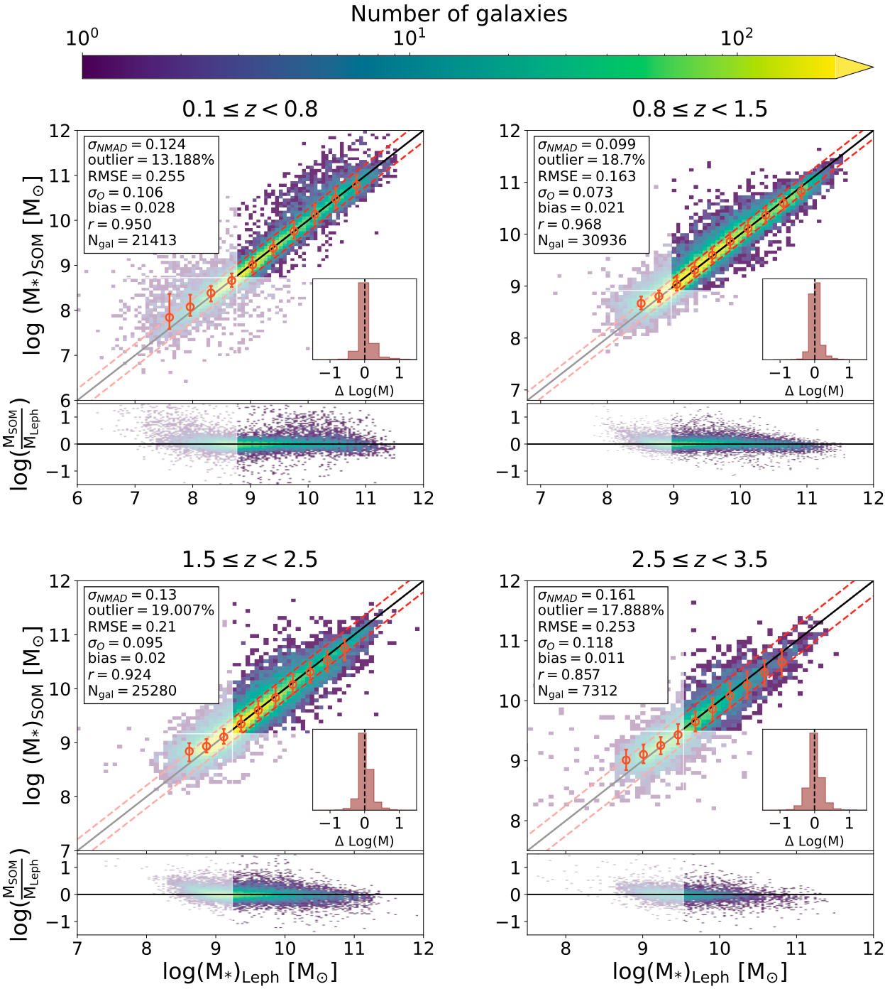



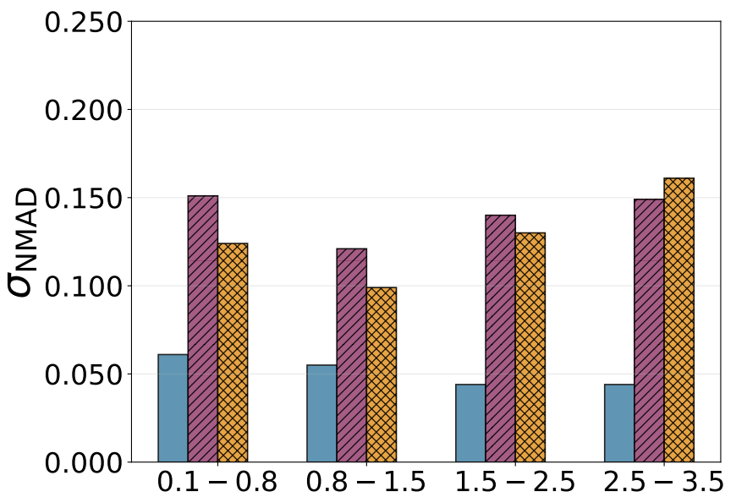

Stellar Mass Prediction (Trained on Horizon-AGN ->Tested on COSMOS-Web)
Trained on Horizon-AGN ->Tested on Horizon-AGN
Trained on COSMOS-Web ->Tested on COSMOS-Web
Trained on Horizon-AGN ->Tested on COSMOS-Web
Notes:
In here I showed the prediction of the redshift and stellar mass, for the SOM trained on HZ and HZ is applied on it. We see the prediction is good. But some scatters seen. Actually for the redshift prediction in the 1.5-2.5 redshift. We defined some metrics that shows how the SOM can predict.
First, NMAD measures the typical scatter between the predicted and true values. In simple terms, it tells us how large the usual differences are, while being less sensitive to extreme values.
Second, the outlier fraction shows the percentage of galaxies where the prediction is significantly wrong compared to the expected scatter.
Third, RMSE measures the overall prediction error. It gives more weight to large errors, so it is sensitive to cases where the prediction is very far from the true value.
Fourth, σₒ is similar to RMSE, but it is calculated after removing the outliers. This helps us understand the typical error for the majority of the galaxies.
Fifth, the bias measures whether the predictions are systematically higher or lower than the true values. If the bias is close to zero, it means the predictions are not systematically shifted.
Finally, the Pearson correlation coefficient measures how well the predicted values follow the same trend as the true values. If this value is close to one, it means the predictions and true values are strongly correlated.

Slide 10
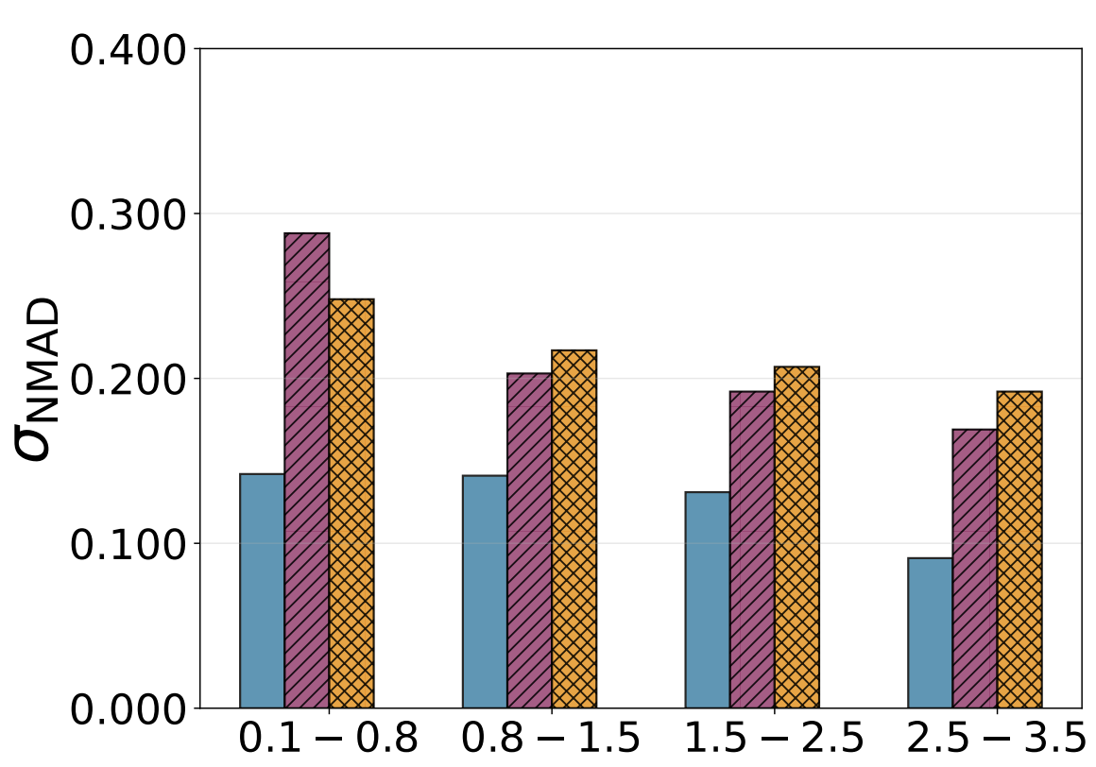
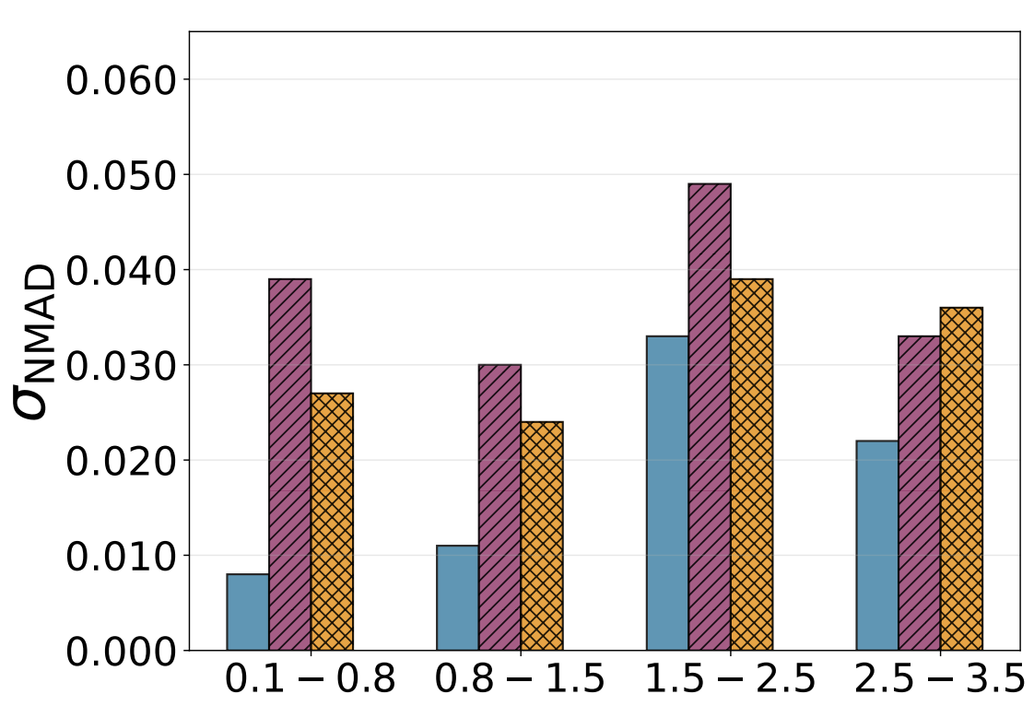
Star Formation Rate (SFR) Prediction and Redshift
Trained on Horizon-AGN ->Tested on Horizon-AGN
Trained on COSMOS-Web ->Tested on COSMOS-Web
Trained on Horizon-AGN ->Tested on COSMOS-Web
Notes:
In here I showed the prediction of the redshift and stellar mass, for the SOM trained on HZ and HZ is applied on it. We see the prediction is good. But some scatters seen. Actually for the redshift prediction in the 1.5-2.5 redshift. We defined some metrics that shows how the SOM can predict.
First, NMAD measures the typical scatter between the predicted and true values. In simple terms, it tells us how large the usual differences are, while being less sensitive to extreme values.
Second, the outlier fraction shows the percentage of galaxies where the prediction is significantly wrong compared to the expected scatter.
Third, RMSE measures the overall prediction error. It gives more weight to large errors, so it is sensitive to cases where the prediction is very far from the true value.
Fourth, σₒ is similar to RMSE, but it is calculated after removing the outliers. This helps us understand the typical error for the majority of the galaxies.
Fifth, the bias measures whether the predictions are systematically higher or lower than the true values. If the bias is close to zero, it means the predictions are not systematically shifted.
Finally, the Pearson correlation coefficient measures how well the predicted values follow the same trend as the true values. If this value is close to one, it means the predictions and true values are strongly correlated.

Slide 11
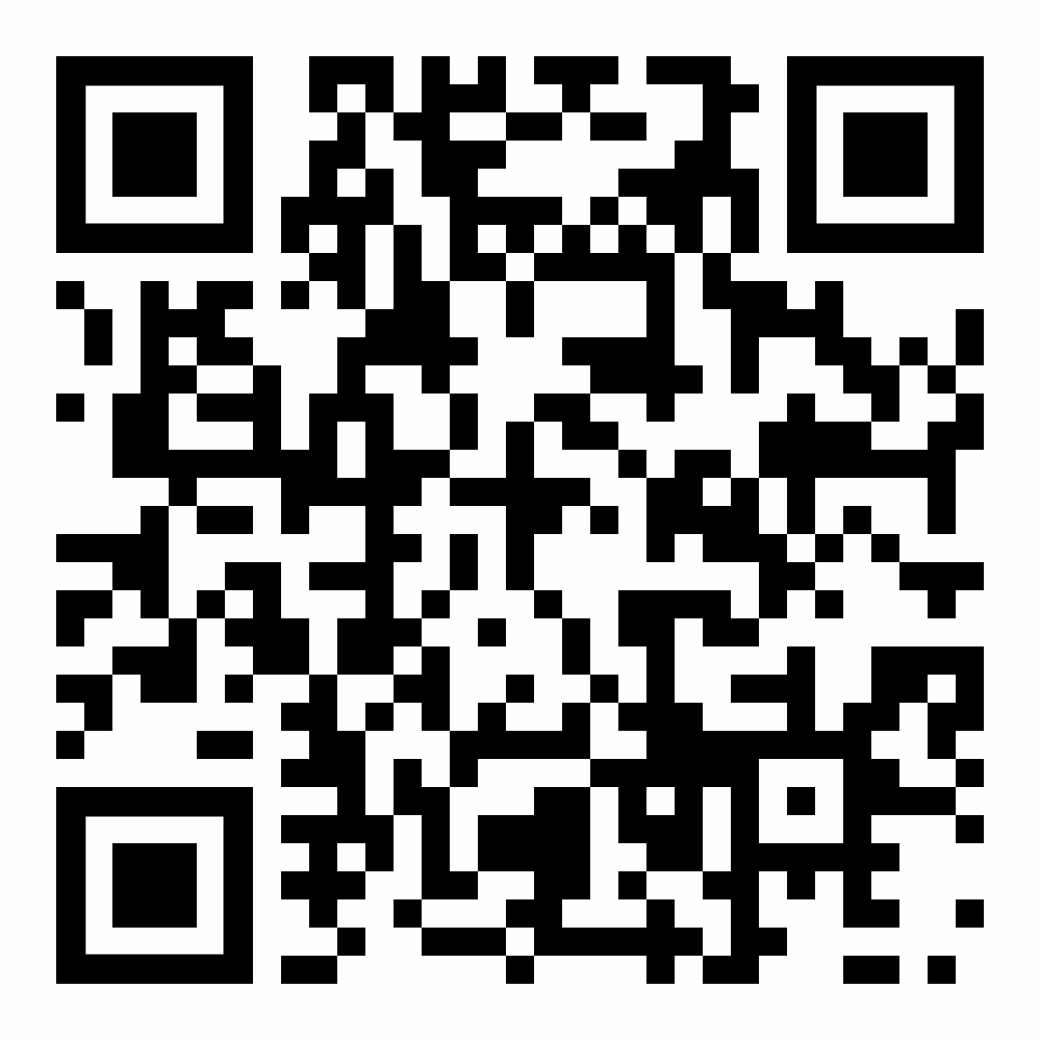
Summary
SOM works well
The results are acceptable when compared with the simulation and LePhare physical parameters.
Comparison with previous studies
The results show improvements relative to these studies.
And my time is up
You can scan this QR code to see more details
Work in progress
SED fitting for galaxy groups
Applying SOM for strong lensing objects
And I’m looking for postdoc position …

Slide 12
Extra Slides

Slide 13
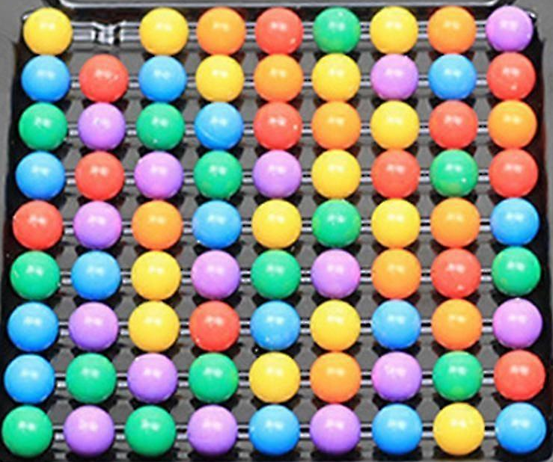


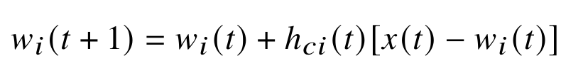
Training Process
Input data
Initial Weights
Updating Weights
Notes:
After this step, we repeat the procedure for each ball. For example, if we take the red ball, the algorithm searches for the cell that best matches it.
We calculate the Euclidean distance, and the cell with the smallest distance is considered the Best Matching Unit (BMU).
After selecting this cell, its weight is updated. In this formula, h represents the neighborhood function, which means that within a defined radius, the neighboring cells around the BMU are also updated.
As a result, nearby cells tend to take similar values, so cells close to each other become similar in color. In this example, the cells in one corner become red.
The same process is repeated for the blue and yellow balls, and they eventually form clusters in different corners of the map.

Slide 14
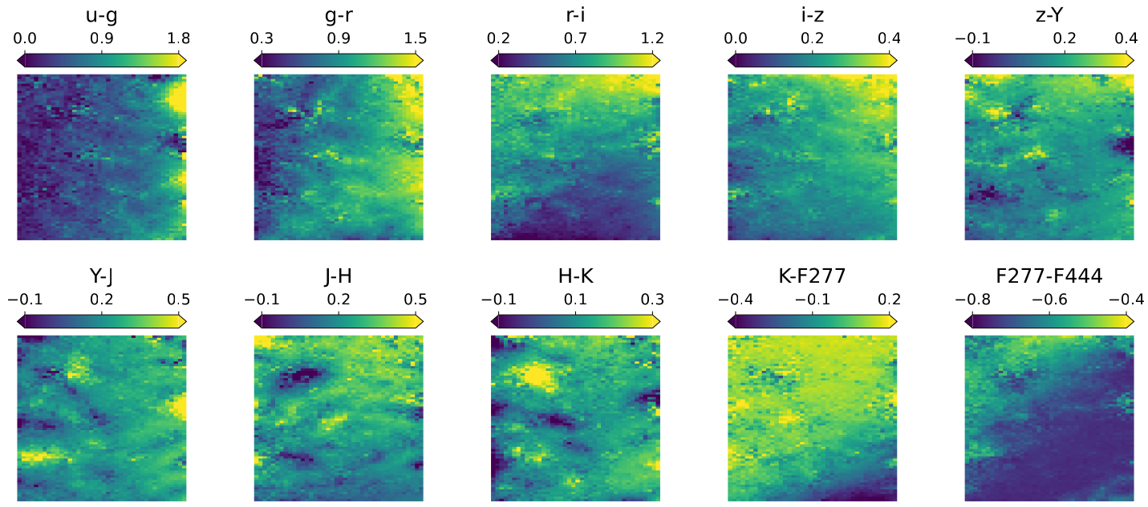
10 Features on SOM (Trained on Horizon-AGN data in 0.1<z<0.8)
Notes:
After training the SOM, the next step is to understand how the features are distributed on the map.
In this SOM, trained for the redshift bin 0.1 to 0.8, we see that galaxies with similar colors are mostly clustered in the same regions. Although in some areas galaxies with low color values appear in different regions, overall the SOM clusters the data well.
The next step is to label the SOM. With these labels, we can predict the physical parameters of galaxies. For each cell, we know which galaxies are mapped to it, and we also know their redshift, stellar mass, and star formation rate, or SFR. Therefore, we assign the median value of these parameters as the label of each cell.
Here we show the SFR distribution for different redshift bins. In the SOM trained on the Horizon AGN data, we see that lower redshift bins generally have lower SFR values, while higher redshift bins show higher SFR.
When we train the SOM using the CW data, we observe a similar pattern. However, in the redshift bin 2.5 to 3.5, we see galaxies with relatively low SFR, which needs further investigation.
We also project the CW observational calibration data onto the SOM trained with Horizon AGN data. As shown in this plot, we observe a similar pattern to the one seen when both training and projection use the Horizon AGN data.
Another important question is whether galaxies in the same cell actually have similar physical parameters. To test this, we calculate the 84th to 16th percentile range per cell.
For SFR, the spread is larger in the low redshift range, between 0.1 and 0.8. This is because in the local universe we observe galaxies with a wider range of physical properties. We see a similar pattern for stellar age.
However, for redshift the spread becomes larger at higher redshift. This is mainly due to the stronger color–redshift degeneracy in high-redshift galaxies.
So once the SOM is labeled, we can use it to predict the physical parameters of galaxies.

Slide 15
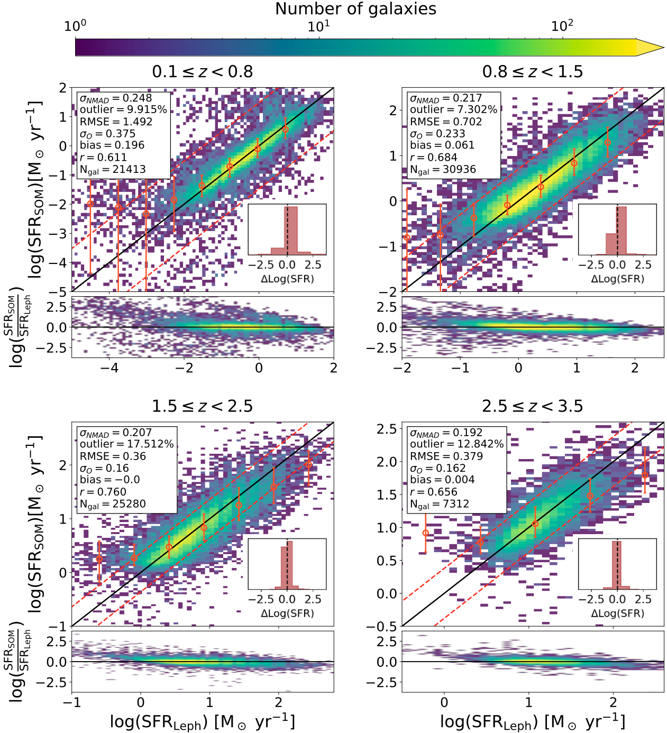
Star Formation Rate (SFR) Prediction
Trained on Horizon-AGN ->Tested on Horizon-AGN
Trained on COSMOS-Web ->Tested on COSMOS-Web
Trained on Horizon-AGN ->Tested on COSMOS-Web
Notes:
In here I showed the prediction of the redshift and stellar mass, for the SOM trained on HZ and HZ is applied on it. We see the prediction is good. But some scatters seen. Actually for the redshift prediction in the 1.5-2.5 redshift. We defined some metrics that shows how the SOM can predict.
First, NMAD measures the typical scatter between the predicted and true values. In simple terms, it tells us how large the usual differences are, while being less sensitive to extreme values.
Second, the outlier fraction shows the percentage of galaxies where the prediction is significantly wrong compared to the expected scatter.
Third, RMSE measures the overall prediction error. It gives more weight to large errors, so it is sensitive to cases where the prediction is very far from the true value.
Fourth, σₒ is similar to RMSE, but it is calculated after removing the outliers. This helps us understand the typical error for the majority of the galaxies.
Fifth, the bias measures whether the predictions are systematically higher or lower than the true values. If the bias is close to zero, it means the predictions are not systematically shifted.
Finally, the Pearson correlation coefficient measures how well the predicted values follow the same trend as the true values. If this value is close to one, it means the predictions and true values are strongly correlated.

Slide 16
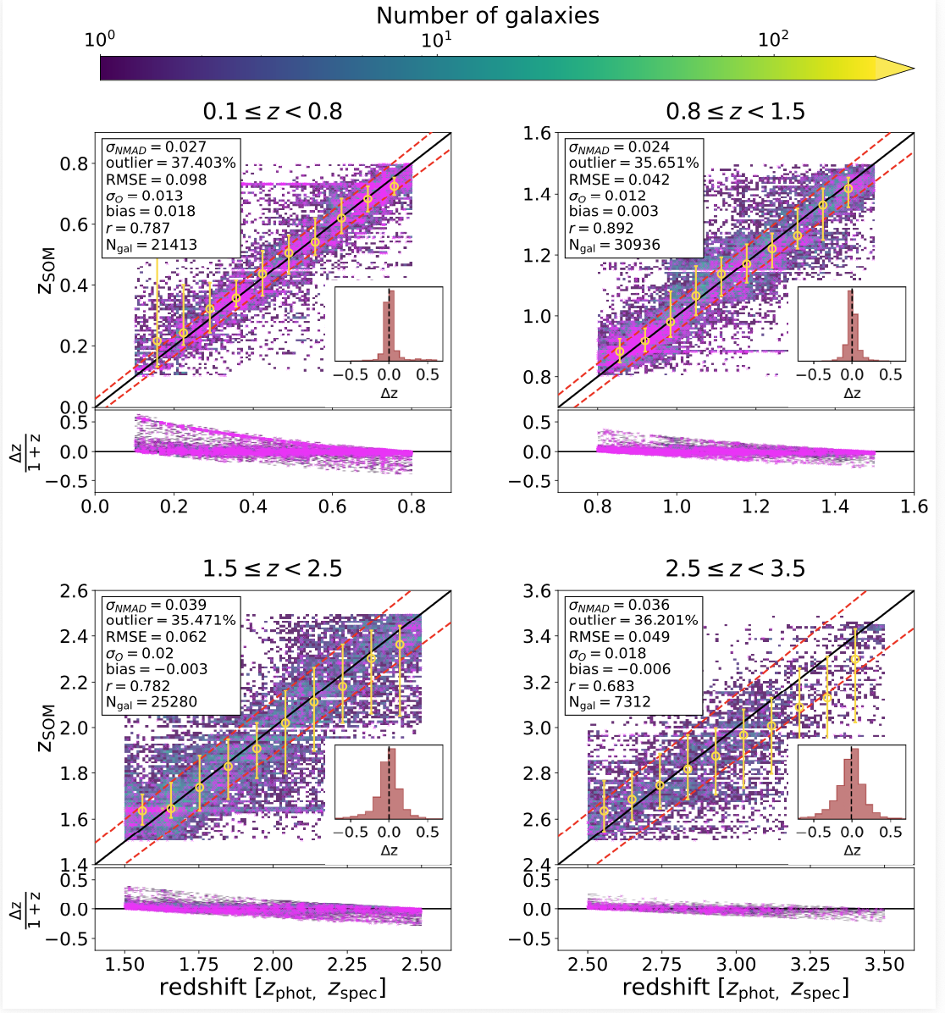
Redshift Prediction
Trained on Horizon-AGN ->Tested on Horizon-AGN
Trained on COSMOS-Web ->Tested on COSMOS-Web
Trained on Horizon-AGN ->Tested on COSMOS-Web
Notes:
In here I showed the prediction of the redshift and stellar mass, for the SOM trained on HZ and HZ is applied on it. We see the prediction is good. But some scatters seen. Actually for the redshift prediction in the 1.5-2.5 redshift. We defined some metrics that shows how the SOM can predict.
First, NMAD measures the typical scatter between the predicted and true values. In simple terms, it tells us how large the usual differences are, while being less sensitive to extreme values.
Second, the outlier fraction shows the percentage of galaxies where the prediction is significantly wrong compared to the expected scatter.
Third, RMSE measures the overall prediction error. It gives more weight to large errors, so it is sensitive to cases where the prediction is very far from the true value.
Fourth, σₒ is similar to RMSE, but it is calculated after removing the outliers. This helps us understand the typical error for the majority of the galaxies.
Fifth, the bias measures whether the predictions are systematically higher or lower than the true values. If the bias is close to zero, it means the predictions are not systematically shifted.
Finally, the Pearson correlation coefficient measures how well the predicted values follow the same trend as the true values. If this value is close to one, it means the predictions and true values are strongly correlated.

Slide 17
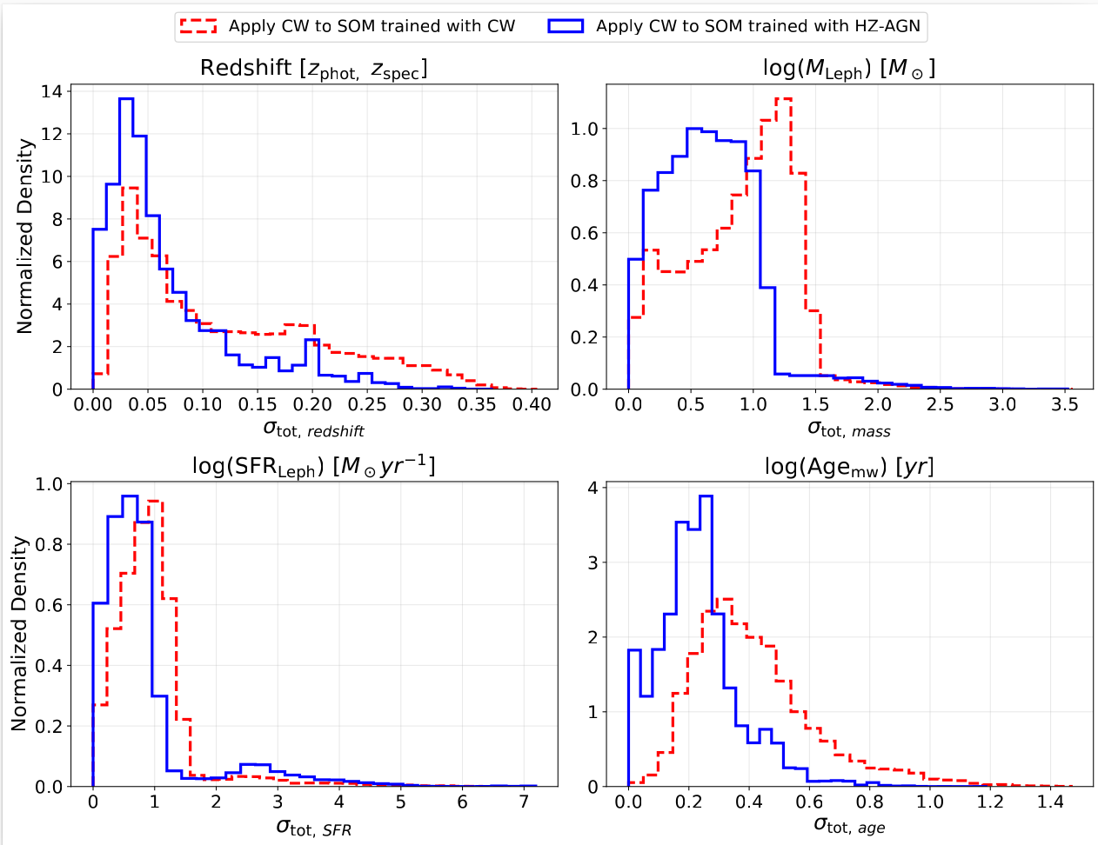
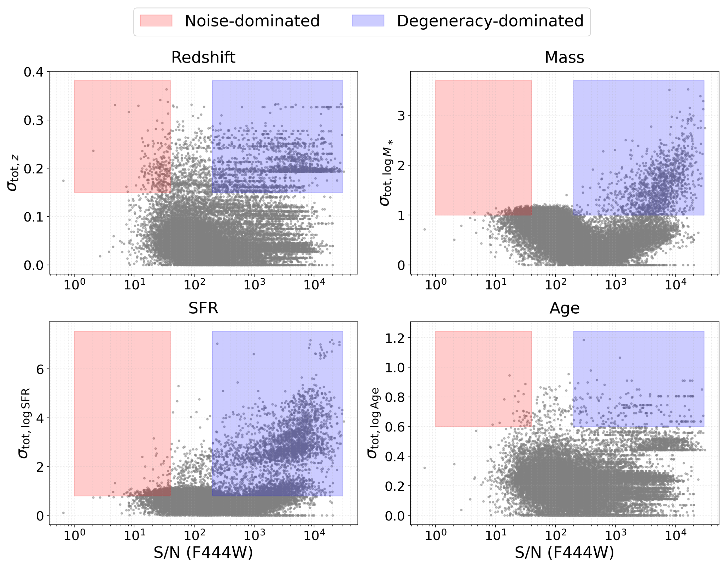

How Much Comes from Noise and How Much from Degeneracy
(La Torre et al. 2024)
Notes:
To better understand the uncertainties in our predictions, we define a total uncertainty for each physical parameter. This total uncertainty combines two components.
The first component is the statistical uncertainty, which comes from the width of the likelihood distribution and reflects the. photometric errors and color degeneracies in the data.
The second component is the systematic uncertainty, which is related to the spread of physical parameters of galaxies located in the same SOM cell This also traces color–template degeneracies.
Figure 28 shows the distribution of this total uncertainty for redshift, stellar mass, SFR, and mass-weighted age in the redshift bin 0.1–0.8.
For redshift, the uncertainties are generally small and acceptable. When the CW data are applied to the SOM trained on CW data, the uncertainties are slightly lower than when they are applied to the SOM trained on Horizon AGN data.
For stellar mass and SFR, the distributions show longer tails, meaning that some galaxies have larger uncertainties. This is consistent with the scattered points we saw in the prediction plots and is likely caused by color–template degeneracies.
For mass-weighted age, the uncertainties are generally smaller, although a small tail still exists.
Overall, we find that applying the CW data to the SOM trained on Horizon AGN simulations gives slightly better uncertainty behavior compared to training only on the observational data. This suggests that combining simulation data with observational calibration can improve the performance of the SOM.
To better understand the origin of the uncertainties, we also examine the signal-to-noise ratio in the F444 band. We check whether large uncertainties occur at low or high signal-to-noise values.
Figure 29 shows the total uncertainty as a function of the signal-to-noise ratio for the CW data projected onto the SOM trained with Horizon AGN data.
The pink region corresponds to low signal-to-noise. In this region, the uncertainties are mainly caused by photometric errors.
The blue region corresponds to high signal-to-noise. In this case, the large uncertainties are not due to measurement noise, but are mainly caused by model or color degeneracies, where different physical models can produce similar colors.
This analysis helps us distinguish whether the uncertainty comes from data quality or from degeneracies in the models.

Slide 18
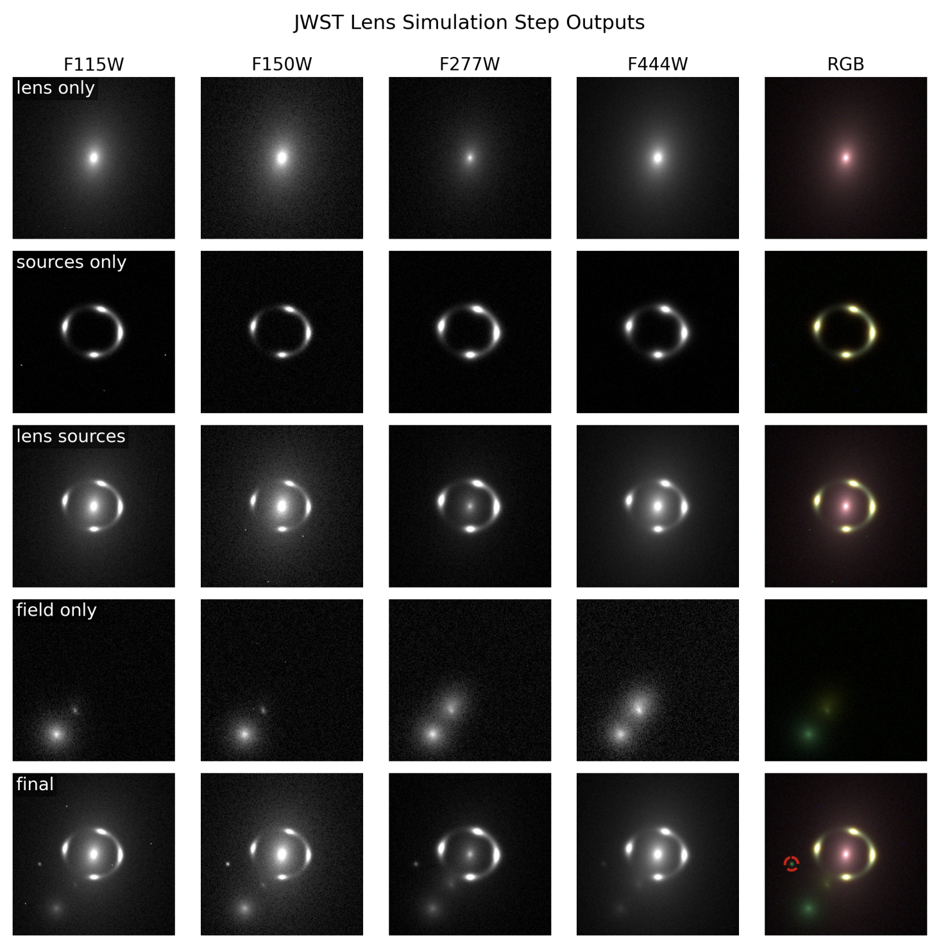
PRISM (Physically Realistic Infrared Strong-lensing Models)
Empirically calibrated on 436 COWLS lenses (COSMOS-Web)
Ultra-realistic high-z morphologies + redshift-dependent mass–size relations
True JWST realism: Real NIRCam PSFs + empirical noise
Multi-band mocks: F115W, F150W, F277W, F444W
Gozaliasl in prep

Slide 19
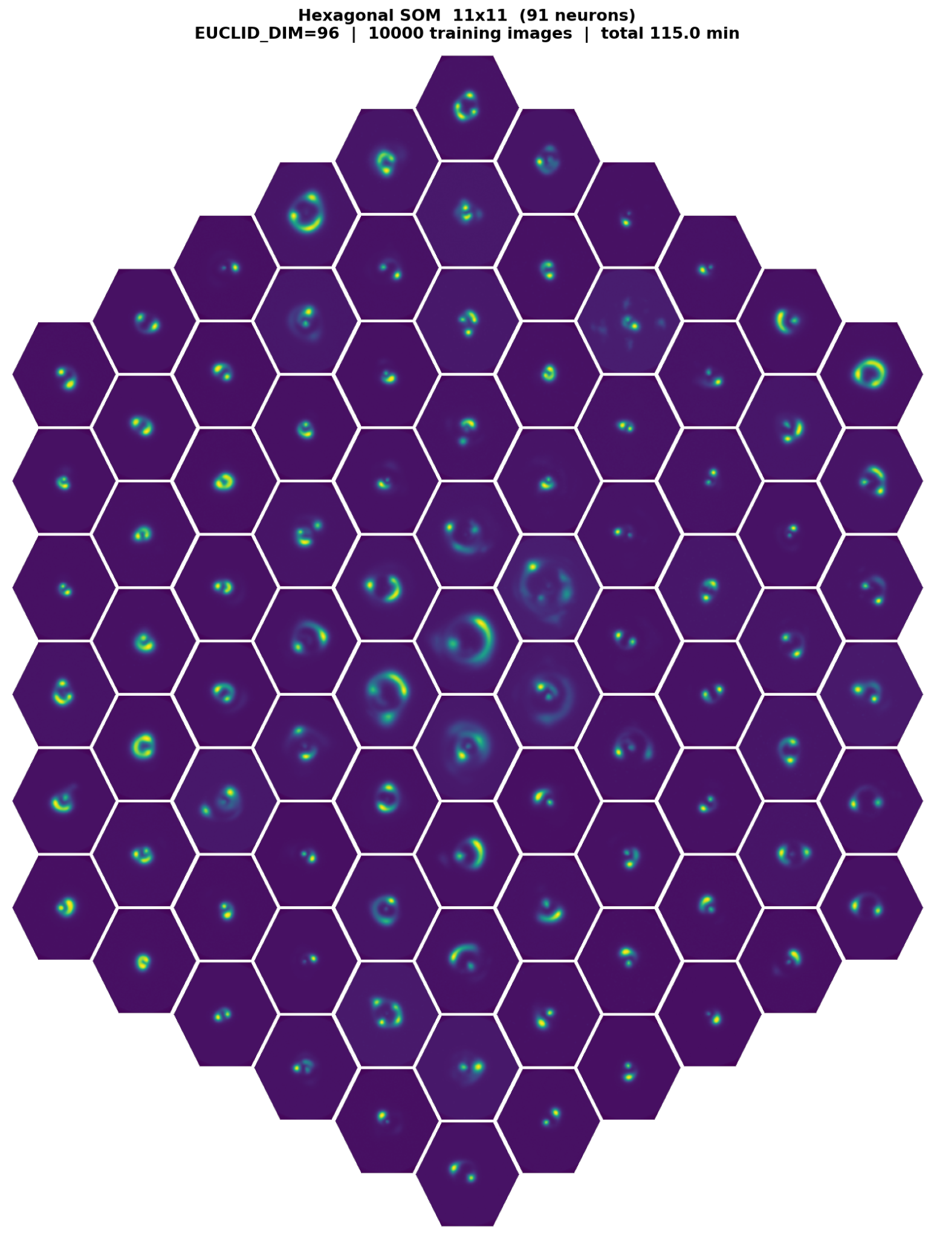
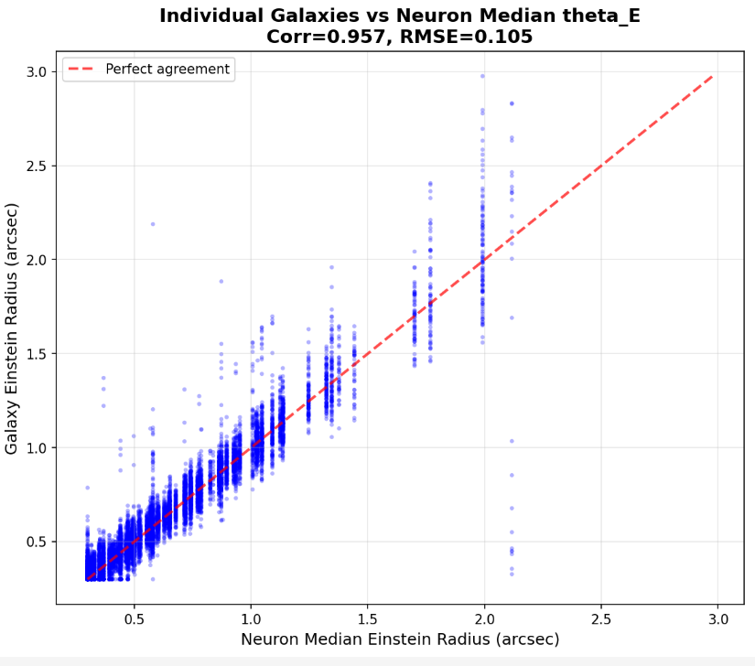
Applying the SOM to Strong Lensing Objects

