Slide 1
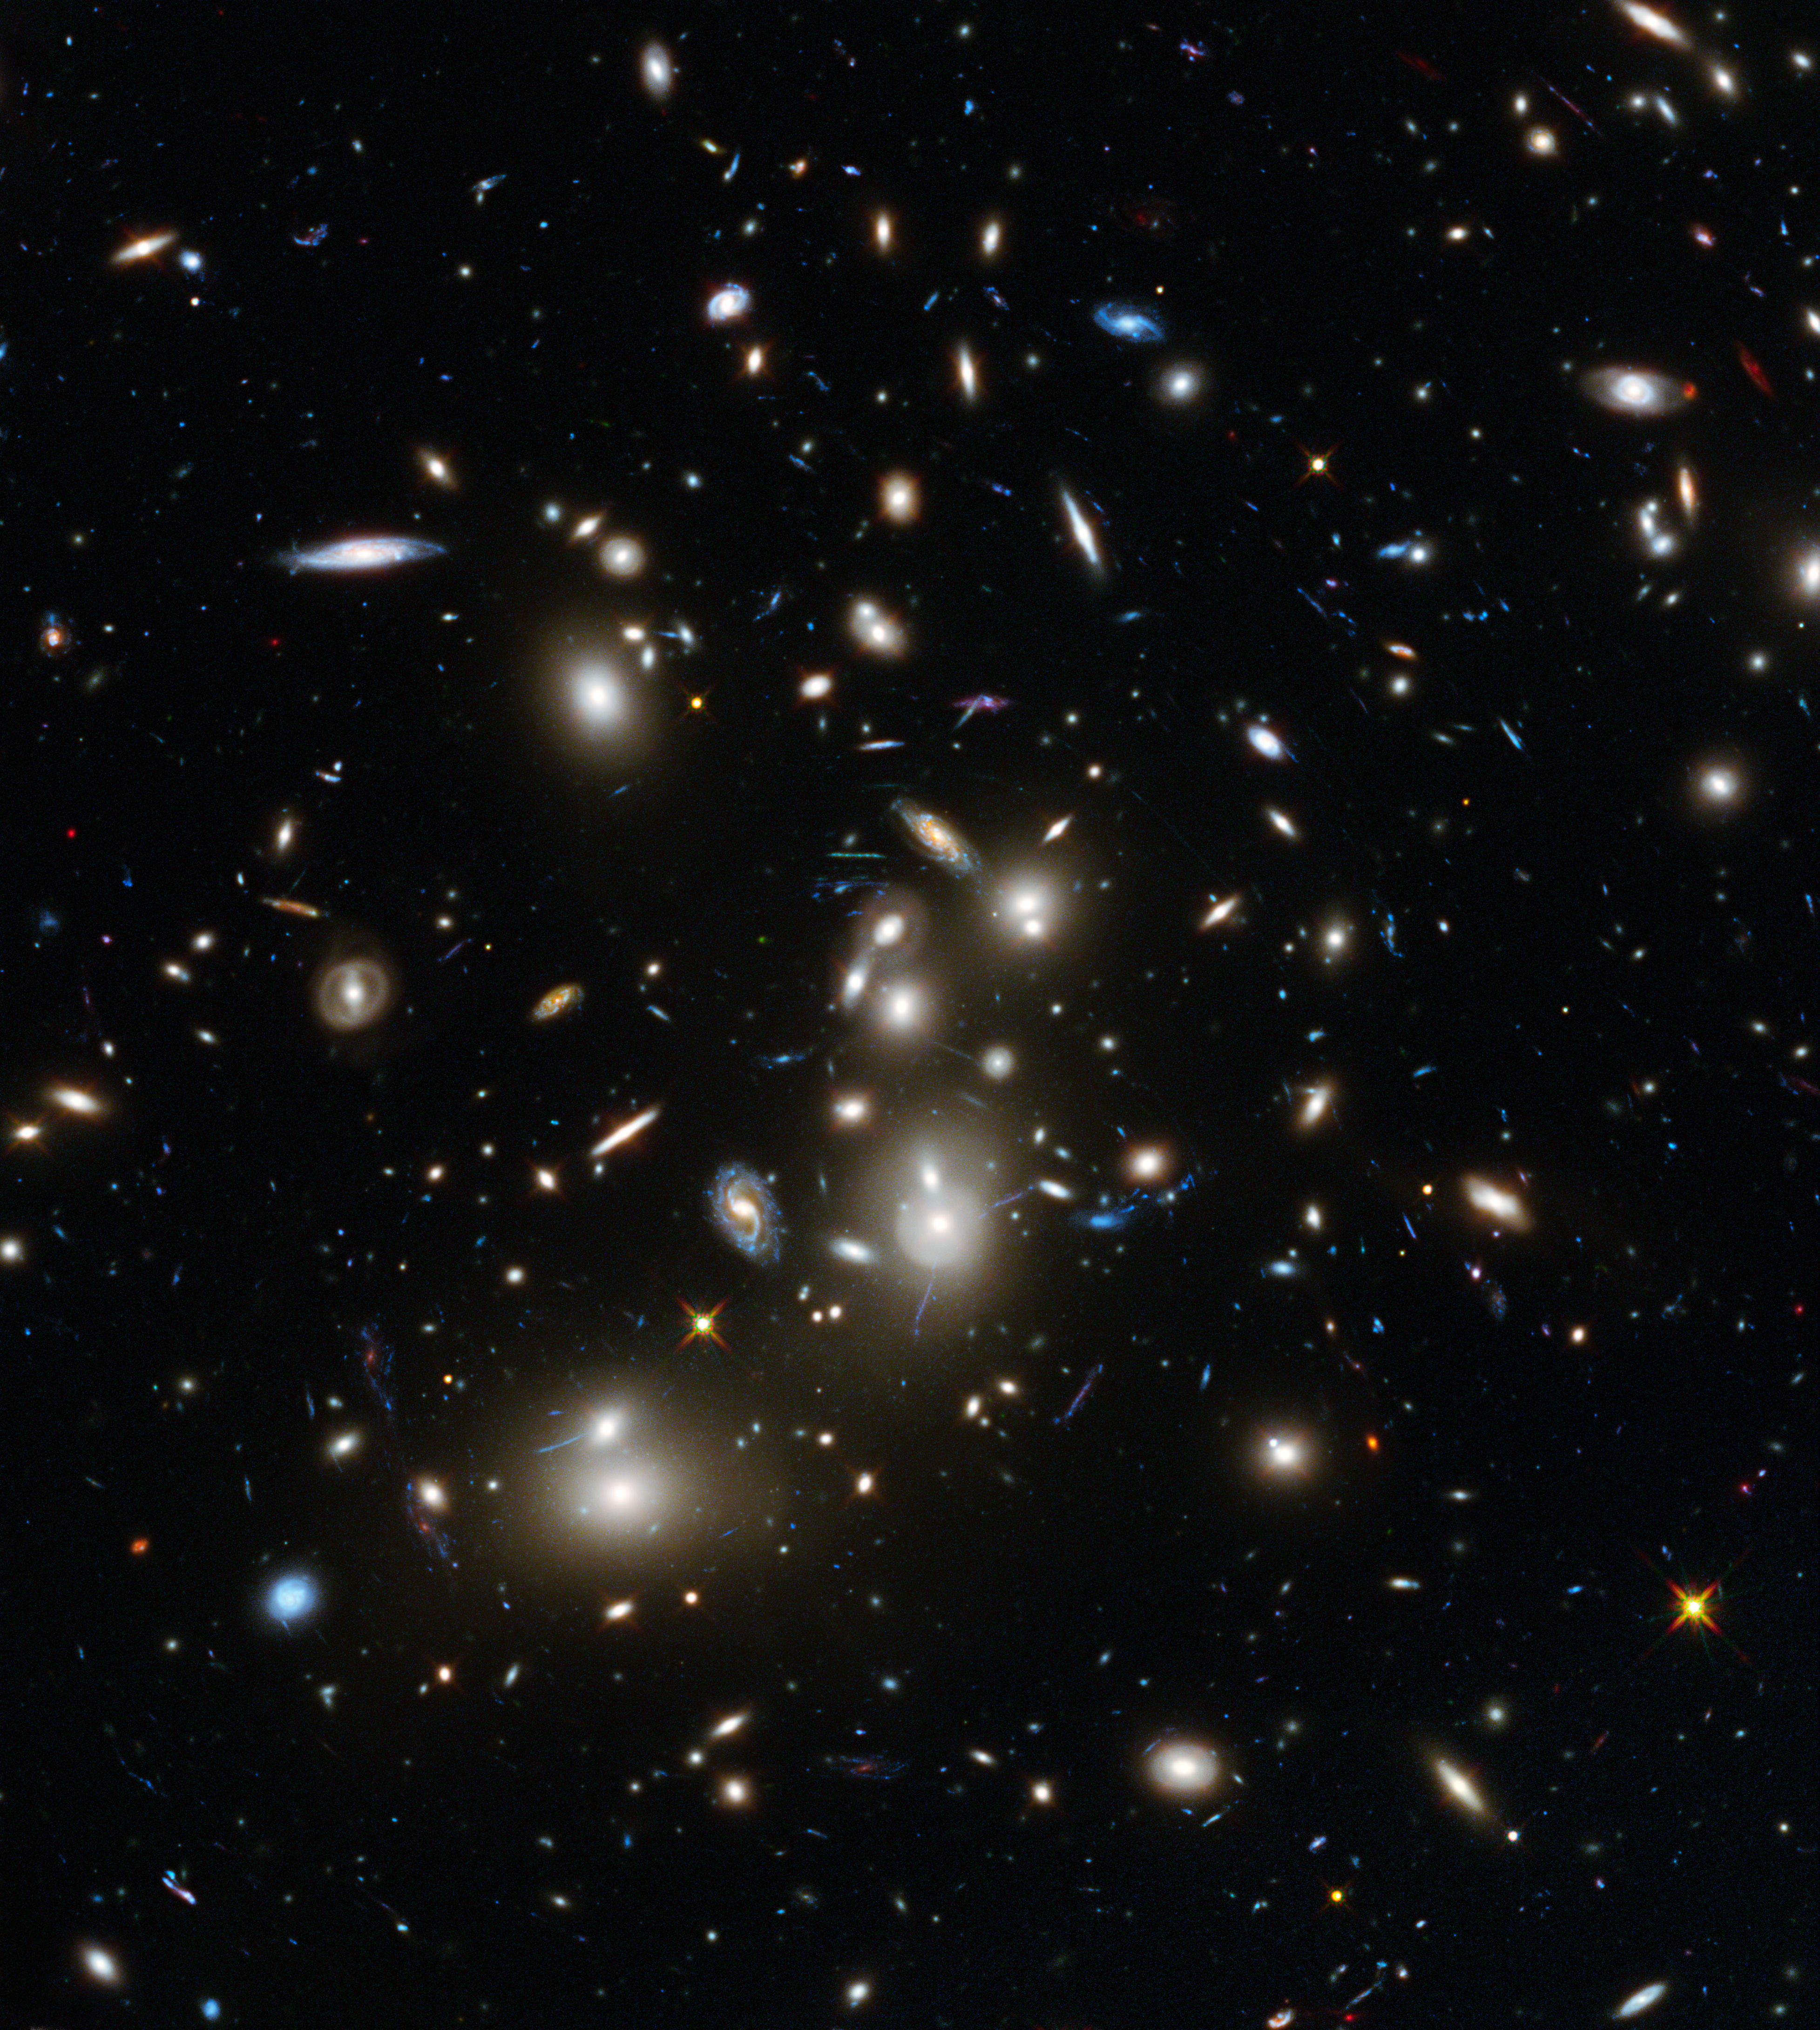



Characterising the impact of the environment on starburst galaxies in over-densities
Miranda Andersen
Nordic-Baltic Astronomy Days
Supervisors: B. Gullberg (DTU), T. Greve (DTU) J.Wardlow (LU)

Slide 2
galaxy clusters
Among the largest structure of the universe
Consists of up to a thousand of galaxies
Does the overdensities impact how the galaxies evolve?

Slide 3

galaxy clusters
Does the overdensities impact how the galaxies evolve?
Protoclusters: high $z$ progenitors of todays galaxy clusters
Found around radio-loud galaxies
Simulations show largest mass build-up around $z\sim 2$ (Chiang et al. 2017)

Slide 4
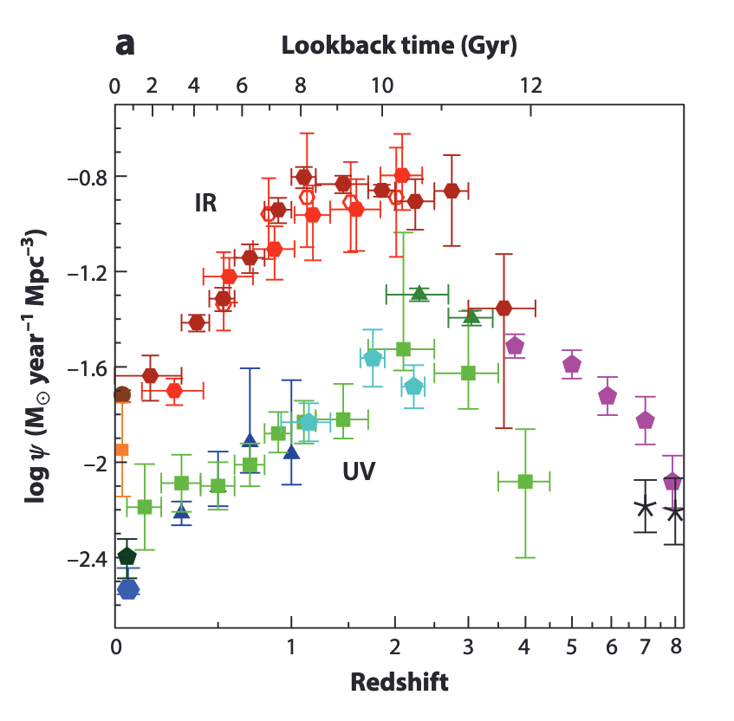
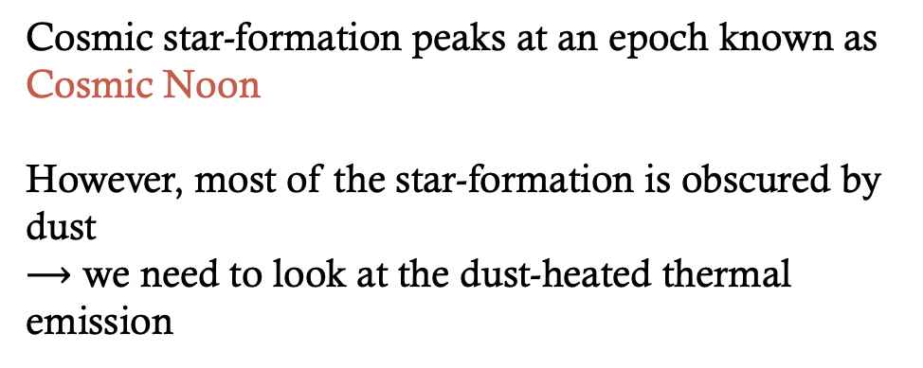
Cosmic star-formation history
Cosmic star-formation peaks at an epoch known as Cosmic Noon
However, most of the star-formation is obscured by dust
$⟶$ we need to look at the dust-heated thermal emission
Madau and Dickinson (2014)

Slide 5
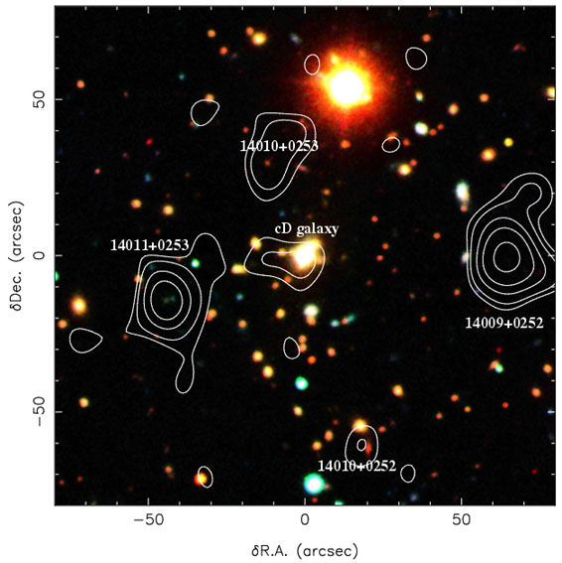
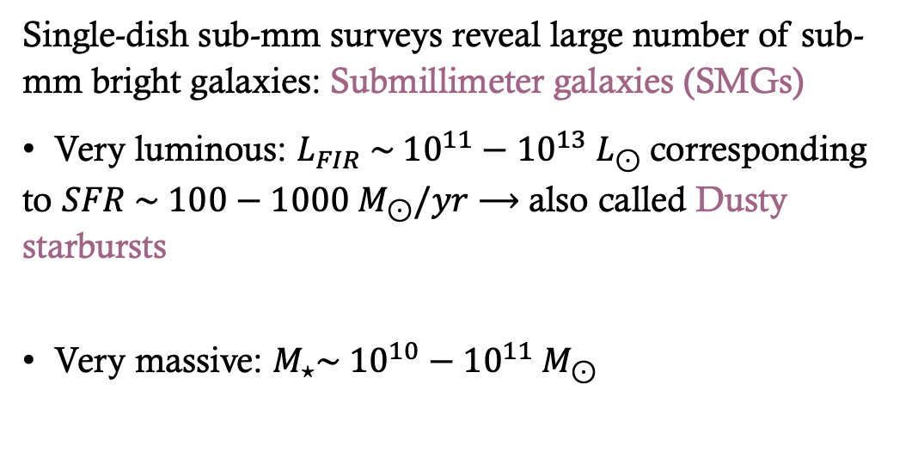
Submillimeter galaxies
Single-dish sub-mm surveys reveal large number of sub-mm bright galaxies: Submillimeter galaxies (SMGs)
Very luminous: $L_{FIR} \sim {10}^{11}−{10}^{13} L_{⊙}$corresponding to $SFR \sim 100−1000 M_{⊙}/yr$ $⟶$also called Dusty starbursts
Very massive: $M_{⋆}\sim {10}^{10}−{10}^{11} M_{⊙}$
Believed to be progenitors of giant elliptical galaxies
Blain et al. (2002)
Notes:
Abell 1835 optical image with SCUBA contours overlayed

Slide 6
Submillimeter galaxies
Believed to be progenitors of giant elliptical galaxies
However, most studies on SMGs have been blank field studies
We need to analyse SMGs in overdense environments!

Slide 7
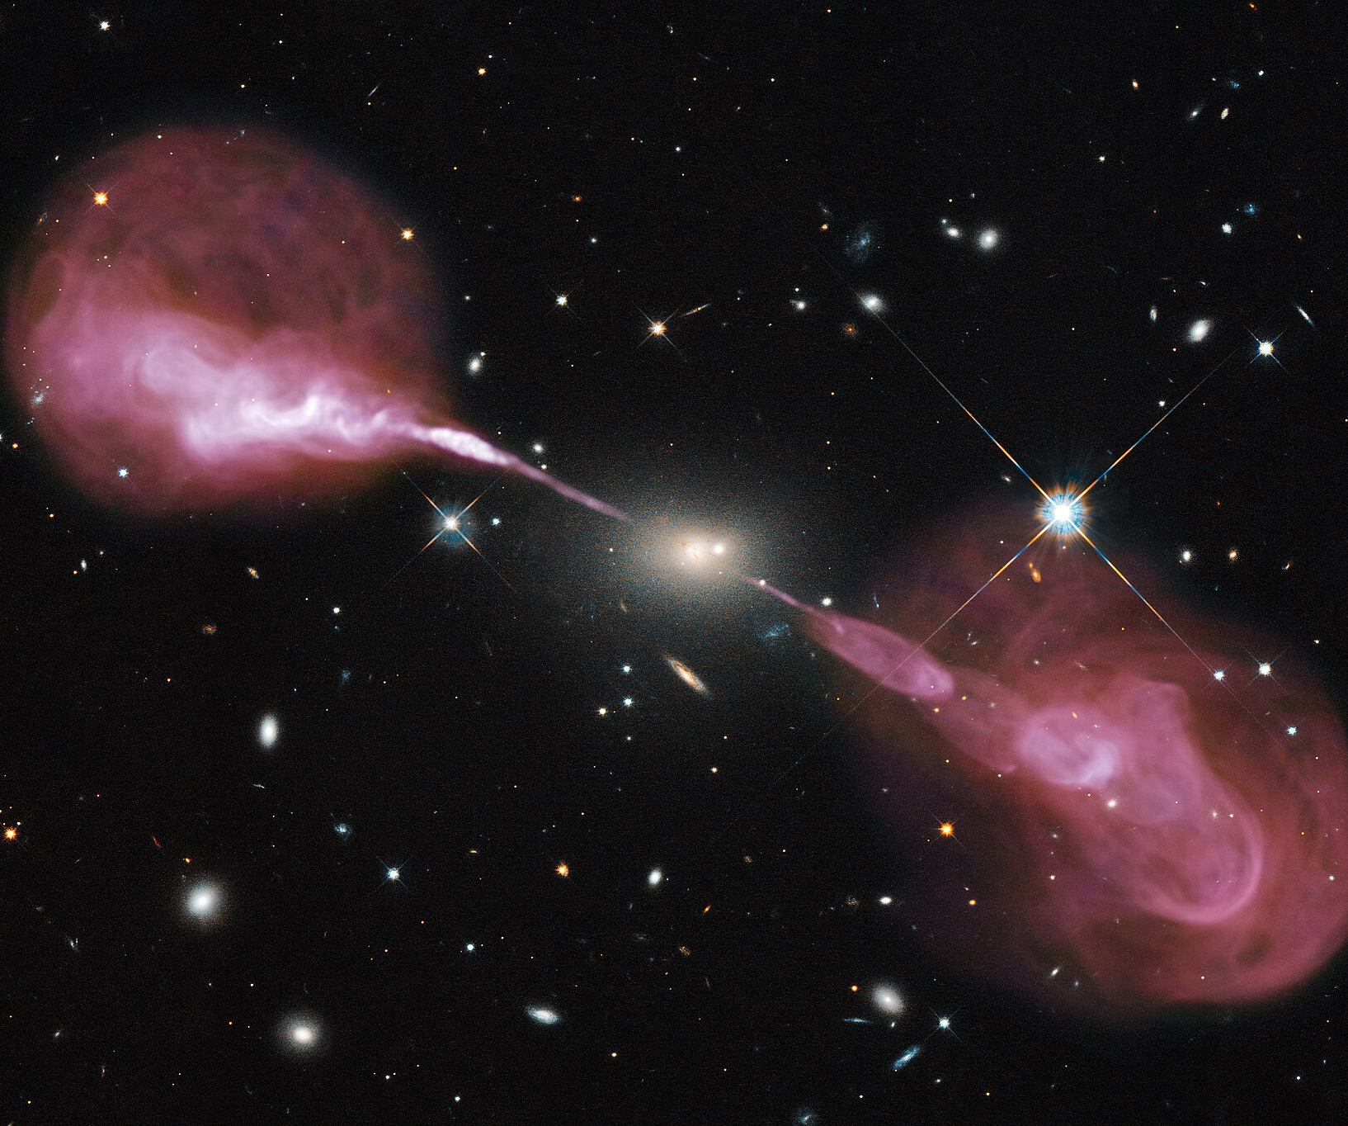

ragers
The RAdio Galaxy Environment Reference Survey
JCMT/SCUBA-2 large program
Environment around H$z$RGs $⟶$ progenitors of massive galaxy clusters
Notes:
James clark maxwell

Slide 8
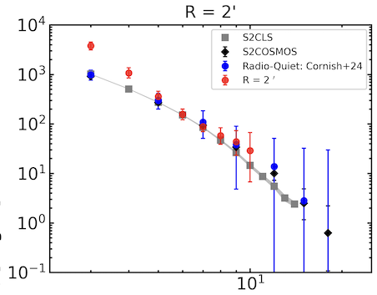

ragers
The RAdio Galaxy Environment Reference Survey
33 RAGERS fields
$1≤z ≤3.5$
H$z$RG $L_{500 MHz}≥{10}^{27} W/Hz$
Henstridge et al. in prep.

Slide 9
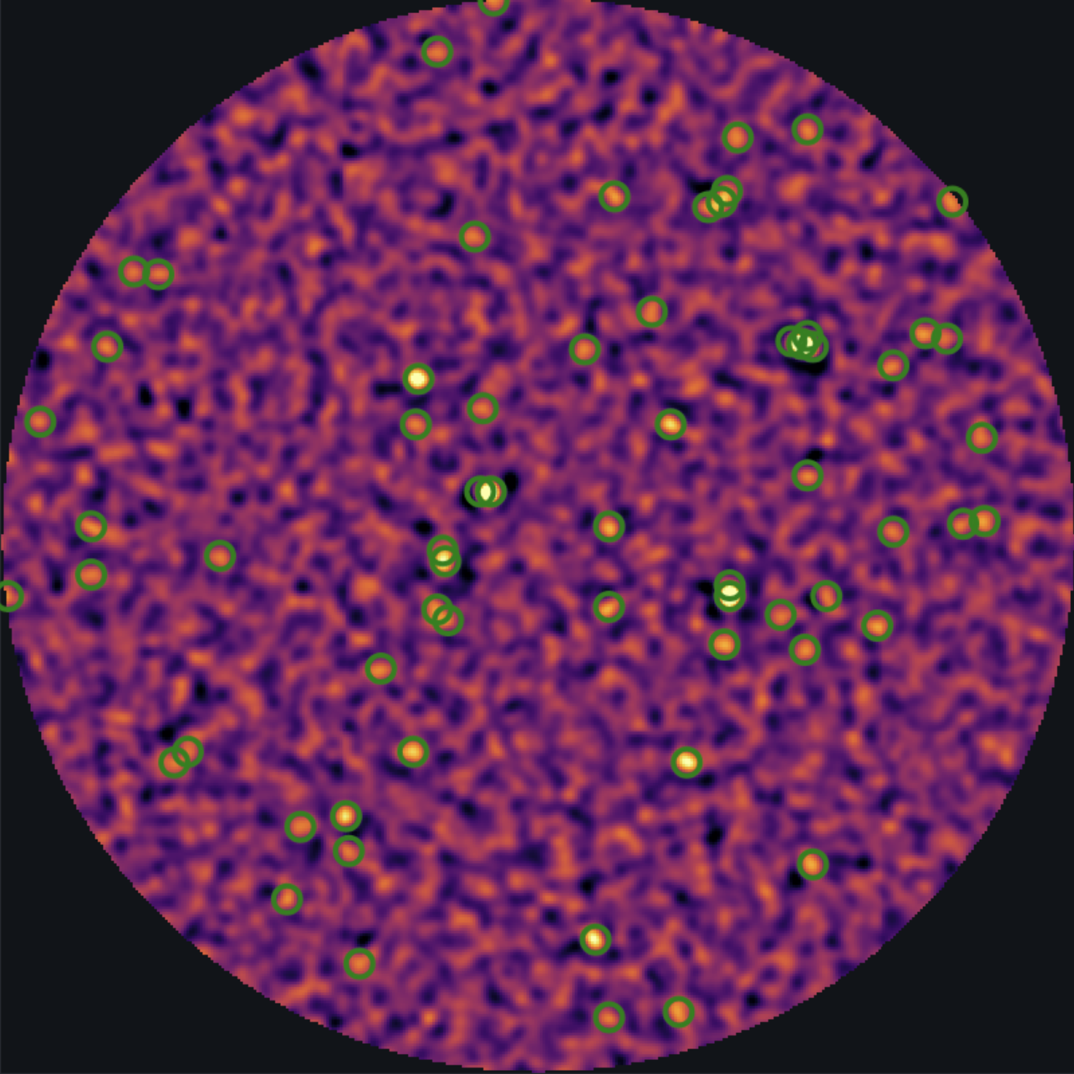
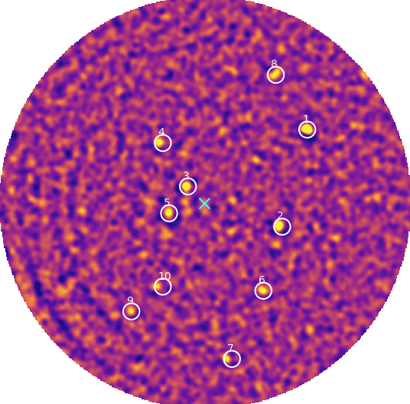

My project
ALMA follow-up observations
10 HzRGs fields across cosmic noon
Ten brightest SMGs observed in SCUBA-2
Targeting CO (7-6) and [CI] (2-1) $→$ robust redshift
Henstridge et al. in prep.

Slide 10
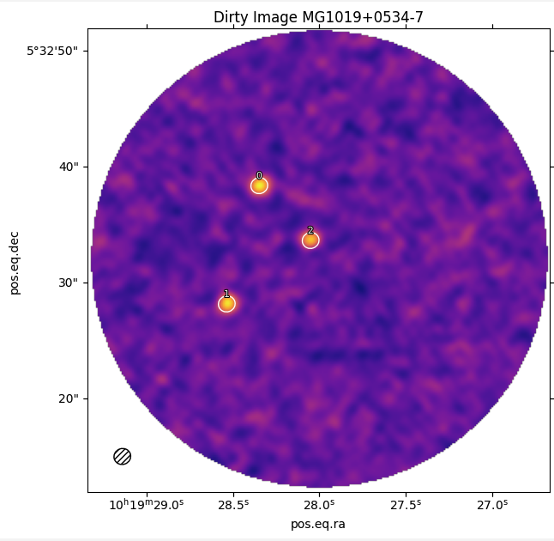
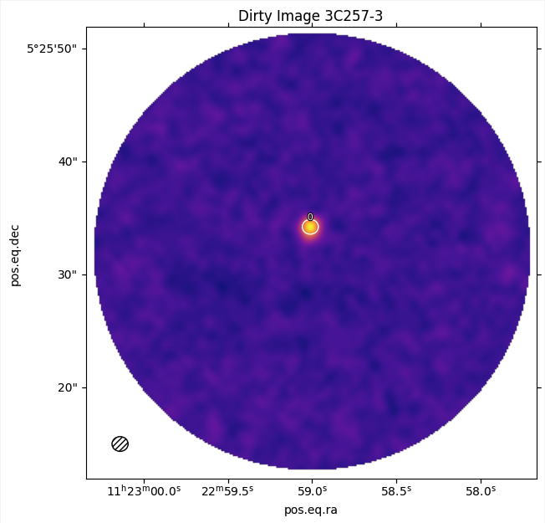
ALMA follow-up observations

Slide 11
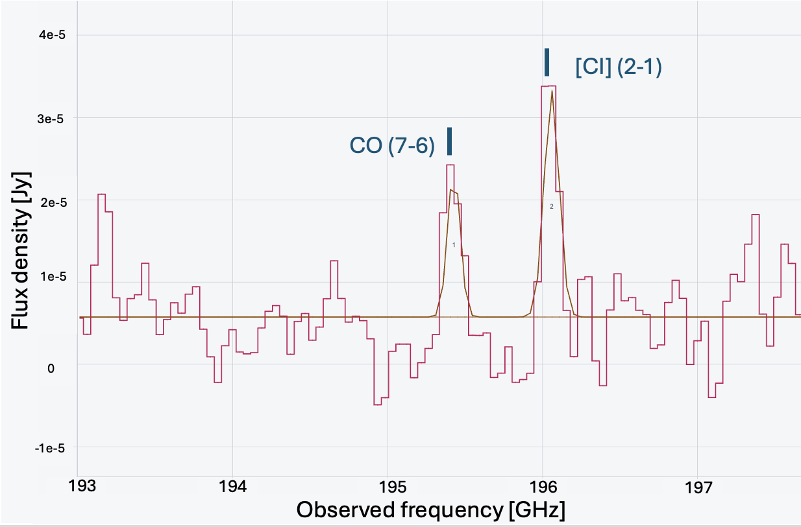
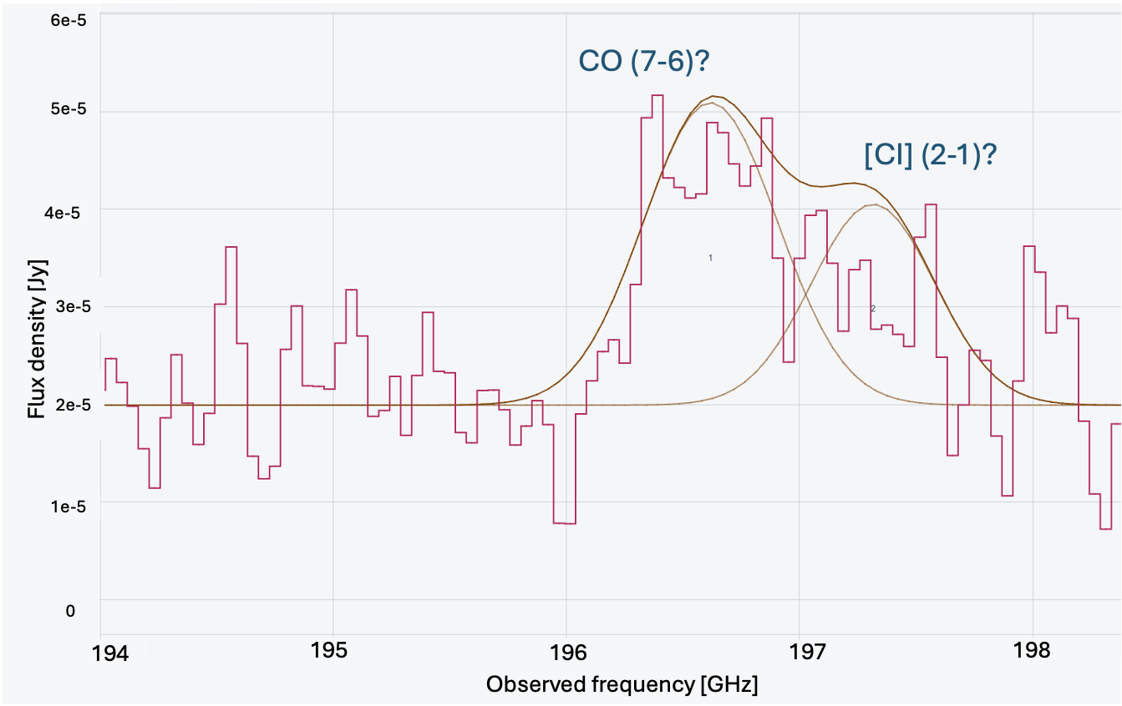
Some line detections

Slide 12
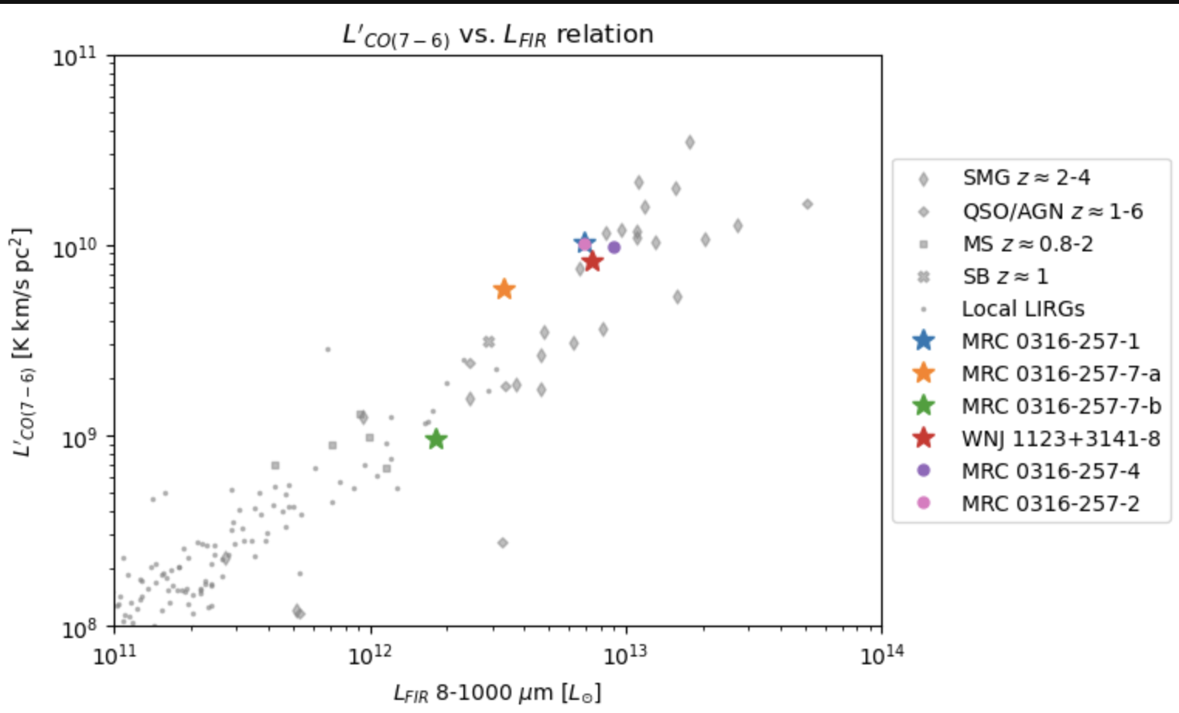
Preliminary results
Compared to the sample from Valentino et al. 2020
Notes:
Our smgs seem to resemble the blank field smgs

Slide 13
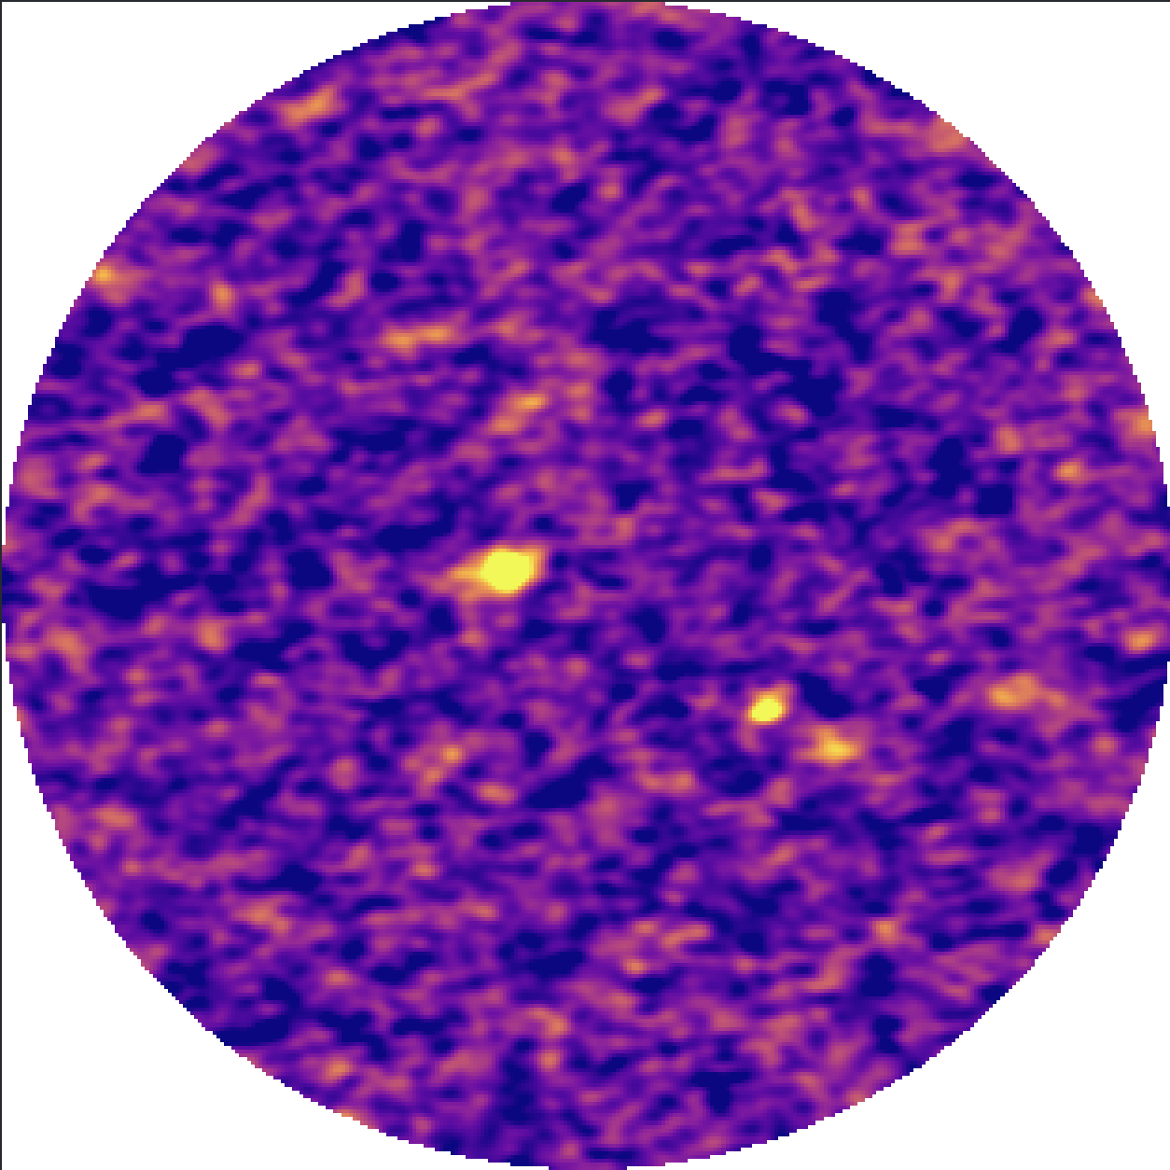
Preliminary results
a
b
Notes:
Our smgs seem to resemble the blank field smgs

Slide 14

Summery
To study the evolution of galaxies in overdensities, we need to look at the high z progenitors
Early universe is very dusty $→$ we need SMGs!!
Overdensities in SCUBA-2, but without redshift, we don’t know if the galaxies are cluster members $→$ ALMA follow-up observations

