Slide 1
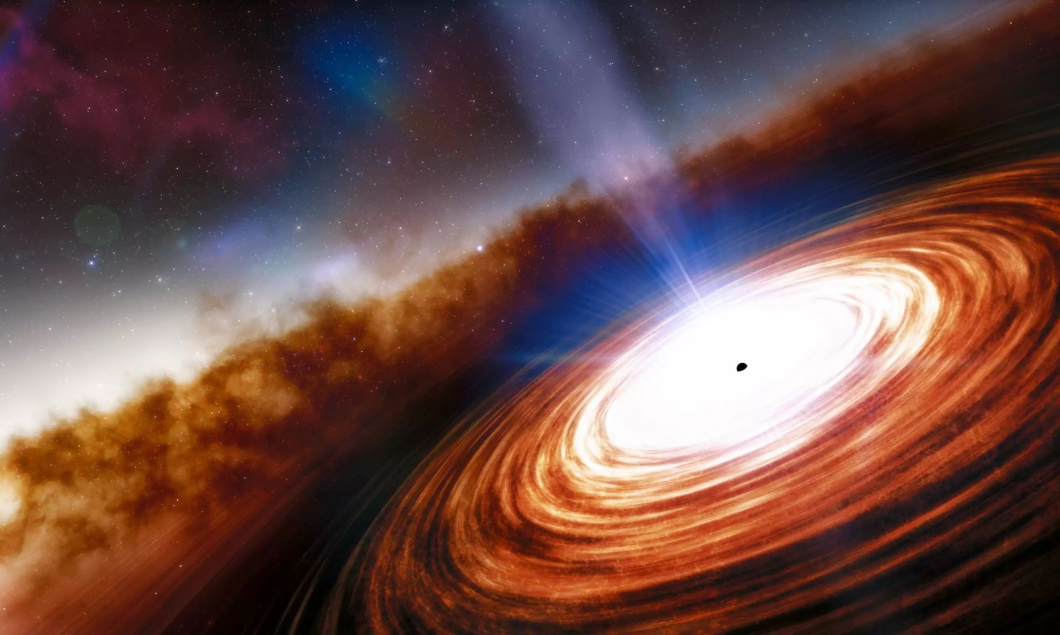
Understanding the Structure and Variability of AGN
Scott Hagen
Main collaborators:
Chris Done, Rick Edelson, Ed Cackett, and more
IFPU Post-Doctoral Fellow
IFPU / SISSA / INAF-OATs – Trieste
shagen@sissa.it
Nordic-Baltic Astronomy Days
Turku 28.05.2026

Slide 2

Overview – AGN SEDs
Throughout will focus on the inner accretion flow. Consider a radially stratified flow for the SED (Kubota & Done 2018), consisting of a standard disc (optical-UV), a warm Comptonised disc (UV-soft X-ray), and an inner hot corona (soft to hard X-ray)
Energy x Flux
~few 100 R_{G}
~r_{isco}
EUV
UV
Optical
X-ray
Specifically, will be focusing on the relationship between the inner disc and hot X-ray corona
kT_{e}
Energy

Slide 3
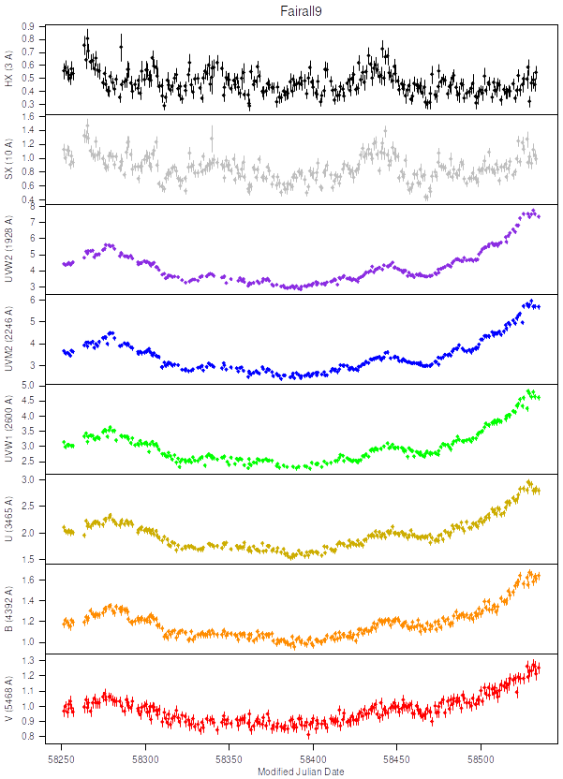
The Variability: A window into the inner flow
Variability gives a unique window into the physical structure of the inner accretion flow
Variability time-scales depend strongly on the physical conditions within the flow (e.g viscosity)
The relation between variability in different energy bands gives the causal connection between emitting structures
Time-lags between energy bands could ‘map’ the geometry of the flow
Light curves from:
Hernández-Santisteban et al. 2020

Slide 4

Reverberation
3. Absorbed X-rays heat the disc, modulating the optical/UV emission
2. Variable X-rays illuminate the disc, a fraction of which are absorbed.
e.g Blandford & McKee 1982; Welsh & Horne 1991
Viscous time-scales in Shakura-Sunyaev disc models are (many) orders of magnitude larger than observed variability time-scales.
Instead attribute UV/optical variability to the X-rays!
1. Large scale-height, low density, flow. Easy to generate turbulence, leading to variable X-rays
See talks by: Roberta Vieliute
and Vito Tuhtan

Slide 5
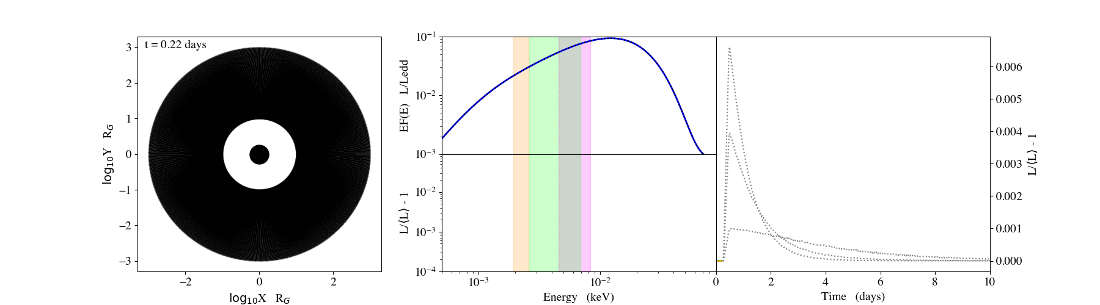
Reverberation
Directly modelling expected reverberation signal (for the full SED) allows for a point by point comparison to the observed light-curves
Hagen & Done 2023a
X-ray flash propagating across an accretion disc on the light-travel time
Disc SED responding to heating from X-rays
Response from individual bandpasses

Slide 6
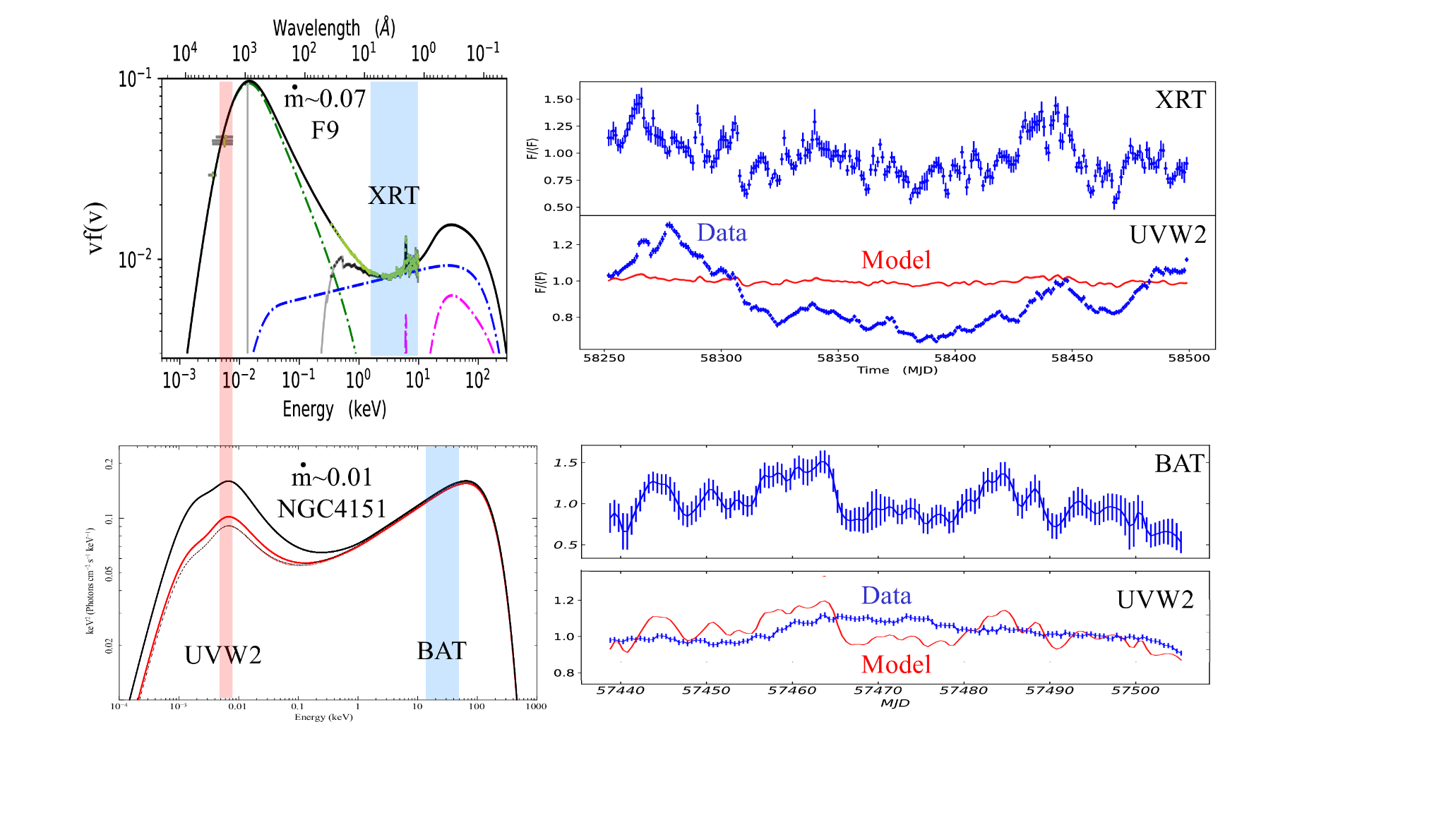
Fairall 9 - Hagen & Done 2023a
NGC 4151 – Mahmoud & Done 2020

Slide 7


Fairall 9: UV disc dominates the SED
=> X-rays are too weak to make a significant impact to the optical/UV emission
L/L_{Edd}
~0.07
~0.02
NGC 4151: Comparable power in the UV and X-ray
=>X-ray reprocessing now makes a significant impact

Slide 8
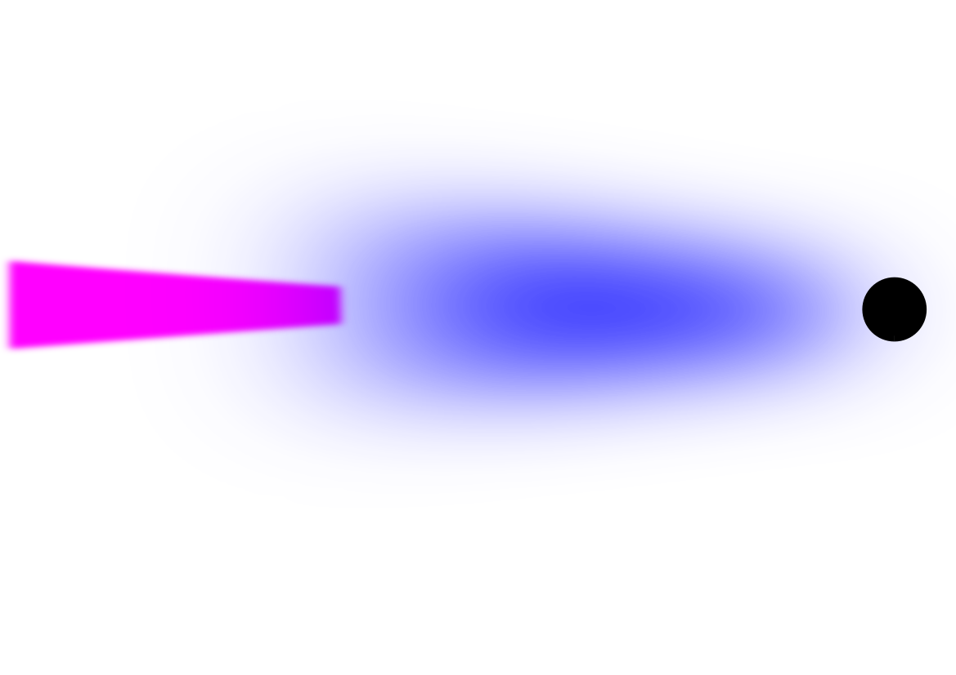
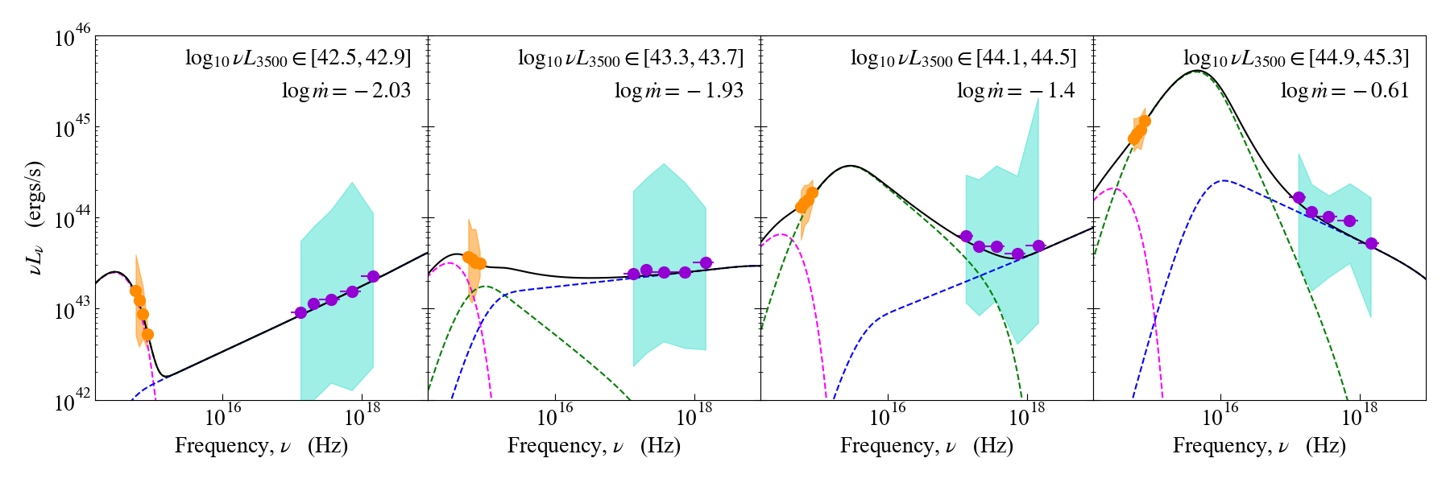
The SED and Accretion States
AGN display a wide range of SEDs (with corresponding accretion states), as seen here with Hyper SuPrime Cam and eROSITA; Hagen, Done, Silverman et al. 2024
AGN variability needs to be understood in the context of their accretion states!
Increasing (Eddington-scaled) mass-accretion rate

Slide 9
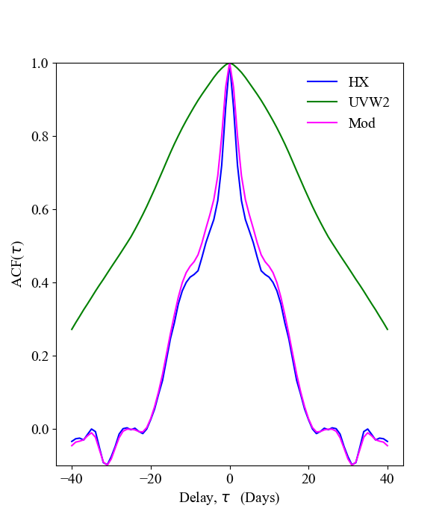
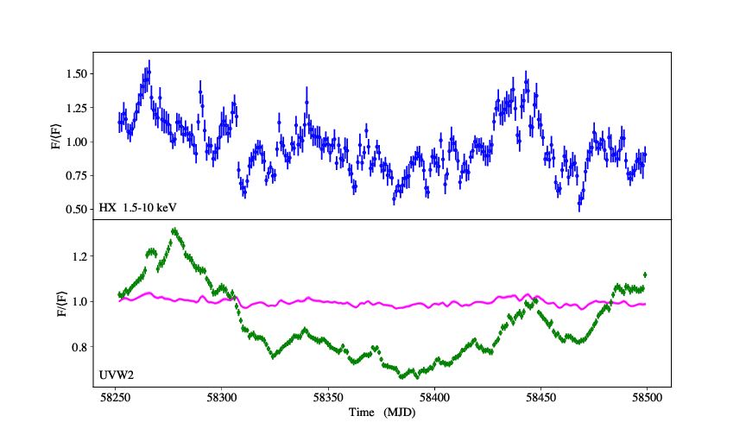
Fairall 9 – multiple time-scales in the data
Reverberation predicts near identical variability properties between the X-ray and UV.
Observations show a disconnect in time-scale. Suggests separate variability sources
X-ray dominated by fast variability (narrow ACF)
HX (1.5-10 keV)
UVW2
Model
UV dominated by slow variability (broad ACF)

Slide 10

A full model for AGN variability
Taking inspiration from black hole binary systems (Lyubarskii 1997; Arévalo & Uttley 2006; Ingram & Done 2011)
See: Hagen, Done & Edelson 2024
Fast variability generated within the X-ray corona
Reverberation imprints a weak but fast signal in the optical/UV
Slow variability generated through intrinsically turbulent disc
Propagation + UV seed photons imprint a slow signal in the X-ray

Slide 11
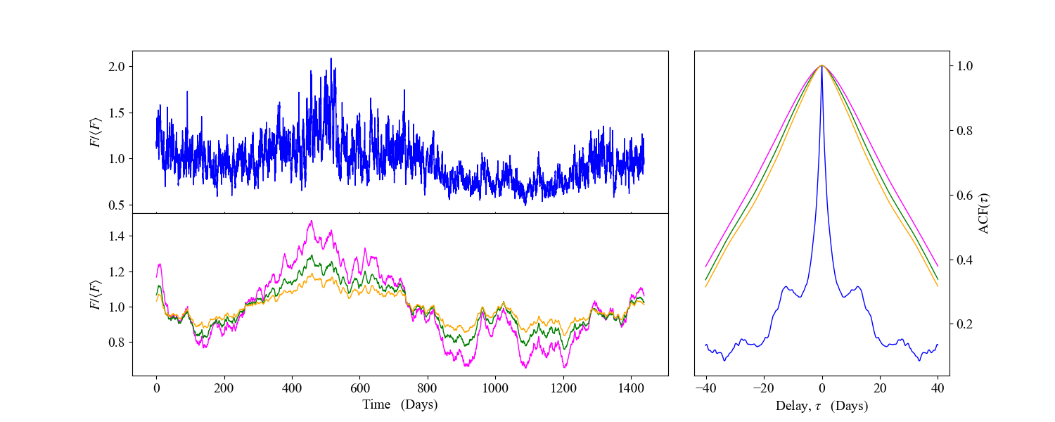
Simulating AGN variability
Hagen, Done & Edelson 2024
Narrow core from raid variability intrinsic to the corona
X-ray (1.5-10 keV)
UVW2, B, V
Intrinsically slow variations in the disc naturally give broad ACFs in the optical/UV
Broad base from UV disc modulations

Slide 12
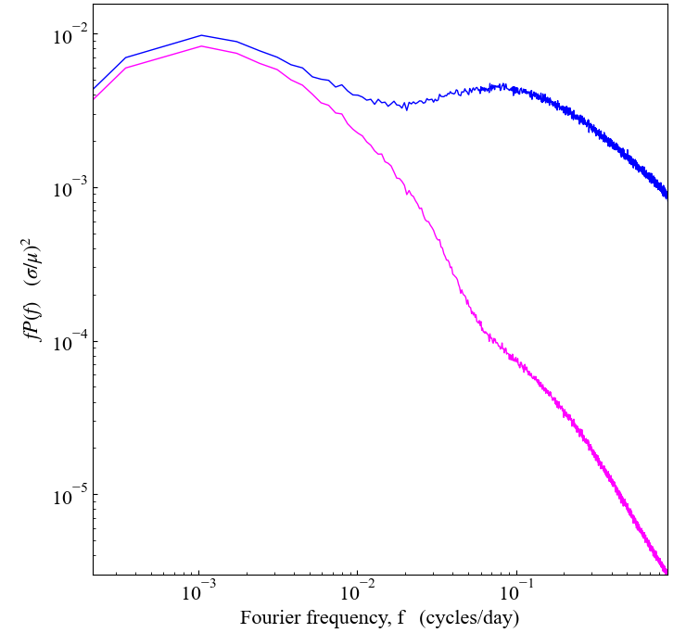
Simulating AGN variability
Hagen, Done & Edelson 2024
Intrinsic coronal variability giving high frequency bump in HX
Low frequency disc variability dominating UVW and also modulating HX
Reverberation gives weak high frequency bump in UVW2
HX
UVW2

Slide 13
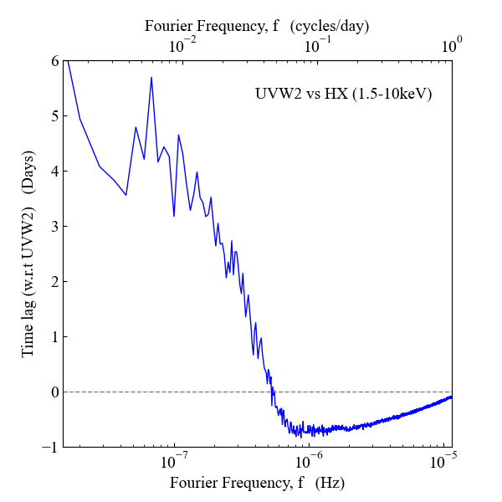
Simulating AGN variability - Predictions
Hagen, Done & Edelson 2024
Low frequency disc moving inwards (seed photons + propagation) gives UVW2 leading HX
Fast X-ray variability reverberating outwards gives HX leading UVW2

Slide 14
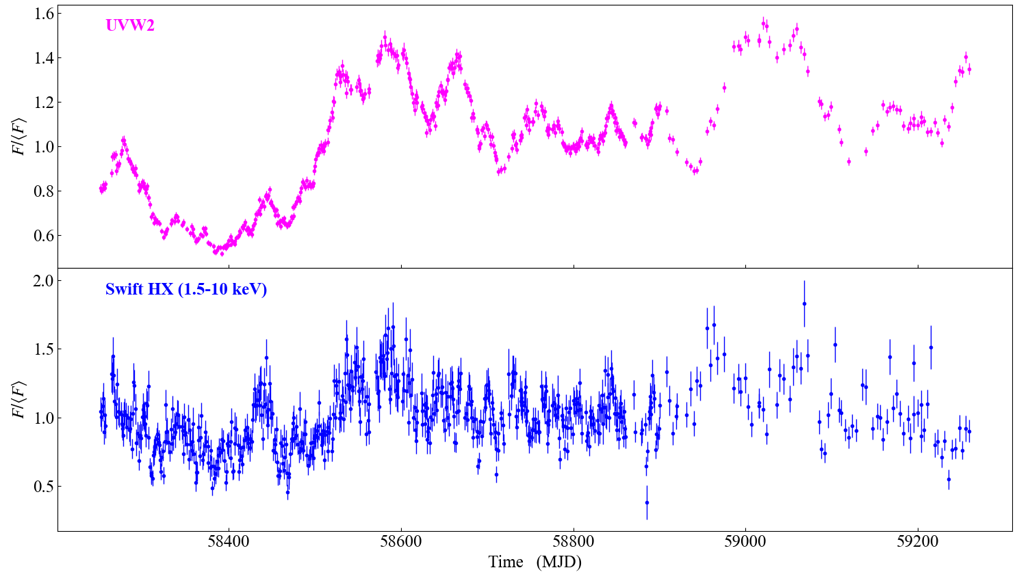
Fairall 9 – Full Campaign
Data from: Edelson et al. 2024

Slide 15
Fairall 9 – Full Campaign
Data from: Edelson et al. 2024

Slide 16
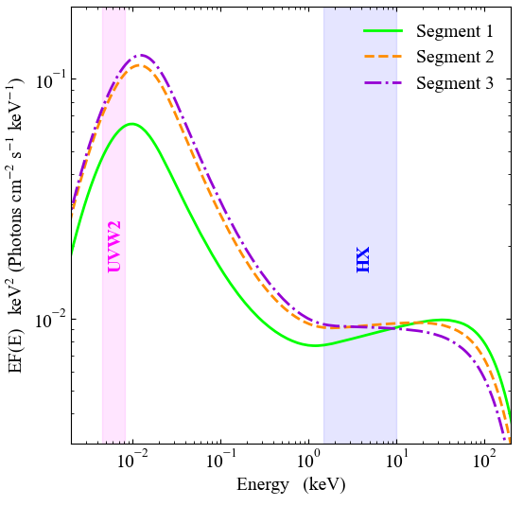
Fairall 9 – SED evolution
Clear evolution in the SED between segment 1 and 2/3
Likely due to an increase in mass-accretion rate, but predominantly affecting the disc component
Softening in the X-ray consistent with increased Compton cooling, due to increased disc seed photons
Hagen et al. 2025
Segment 1
Segment 2
Segment 3

Slide 17

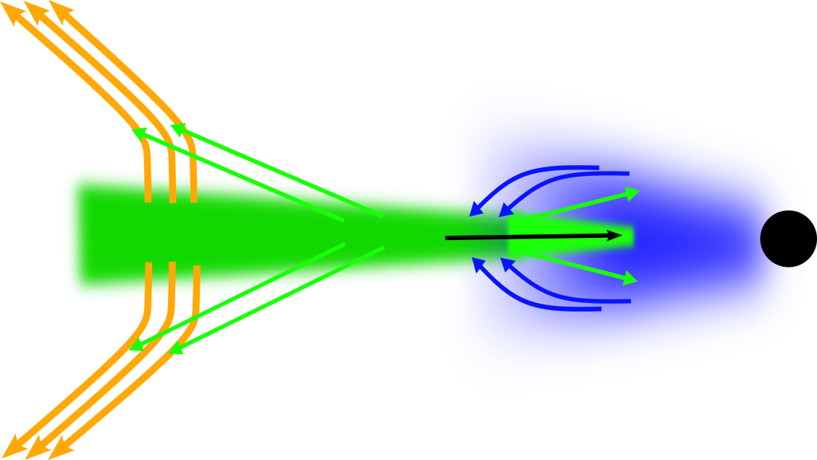
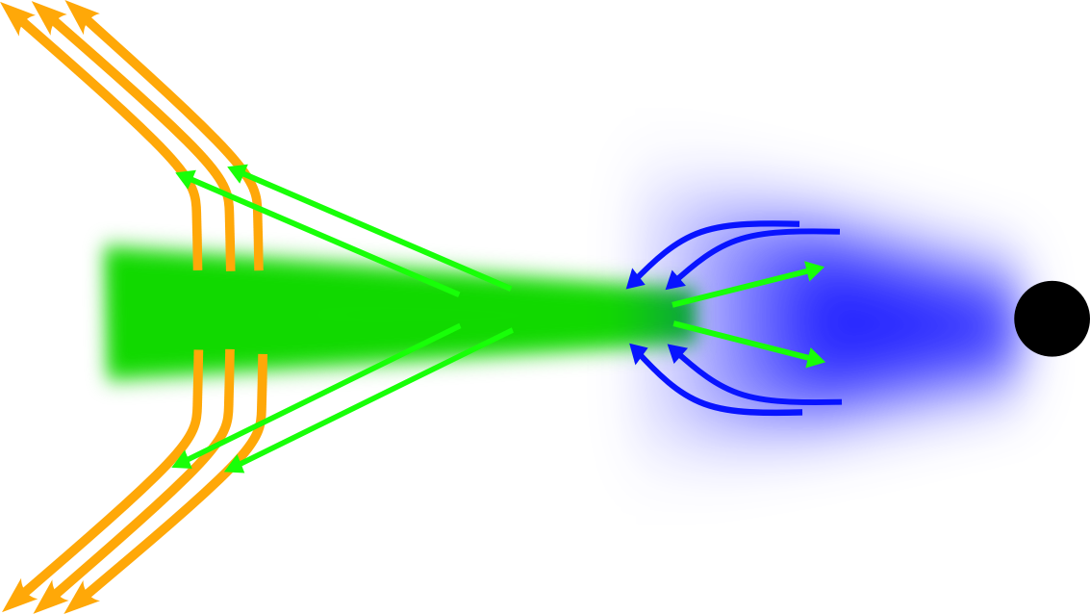
Fairall 9 – SED evolution
Clear evolution in the SED between segment 1 and 2/3
Likely due to an increase in mass-accretion rate, but predominantly affecting the disc component
Softening in the X-ray consistent with increased Compton cooling, due to increased disc seed photons
Hagen et al. 2025
Time

Slide 18
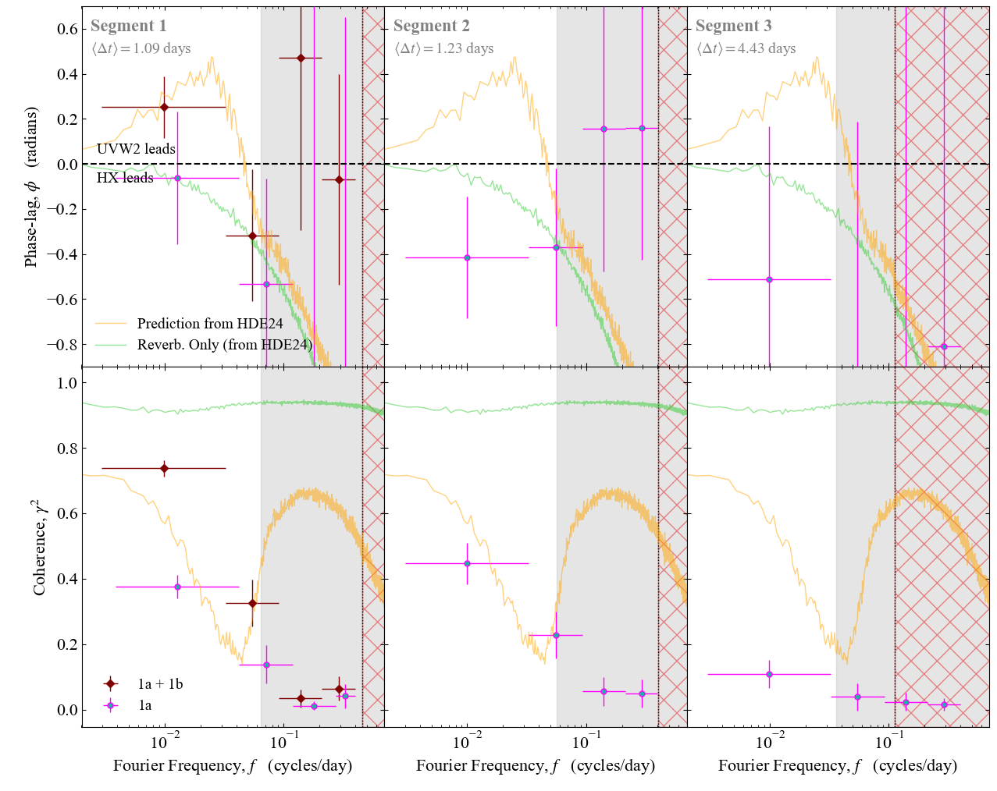
Timing properties
Lag (top) and coherence (bottom) between UVW2 and HX
Hagen et al. 2025
Generally moderate to low coherence throughout!
Exception if the sharp rise is included
Difficult to reconcile with the disc and corona having separate distinct time-scales while also modulating one another
Note: Grey shaded region in plot should be ignored due to GP regression introducing artificial incoherent signals in the cross-spectrum when interpolating the light-curve
Prop + Reverb. Prediction
Hagen, Done & Edelson 2024

Slide 19

Analytic toy model for exploring timing properties
Detailed full variability models are slow! Instead use an approximate analytic version (by picking simple response functions) to explore the impact of each component on the overall variability
Disc variability modulating X-ray (seed photons and propagation), governed by:
Wind responding to disc emission, governed by:
$$ψ_{w}(t)$$
$$ψ_{w}(t)$$
Intrinsically variable corona, with
$$L_{c}\left(t\right)$$
Intrinsically variable disc with:
$$L_{d}\left(t\right)$$
Disc reprocessing X-rays, governed by:
$$ψ_{r}(t)$$
Observed light-curves a linear combination of disc and coronal variability
$$L_{X}(t)=L_{c}\left(t\right)+(L_{d}⨂ψ_{s})(t)$$
$$L_{UV}\left(t\right)=L_{d}\left(t\right)+\left(L_{d}⨂ψ_{w}\right)\left(t\right)+(L_{c}⨂ψ_{r})(t)$$

Slide 20
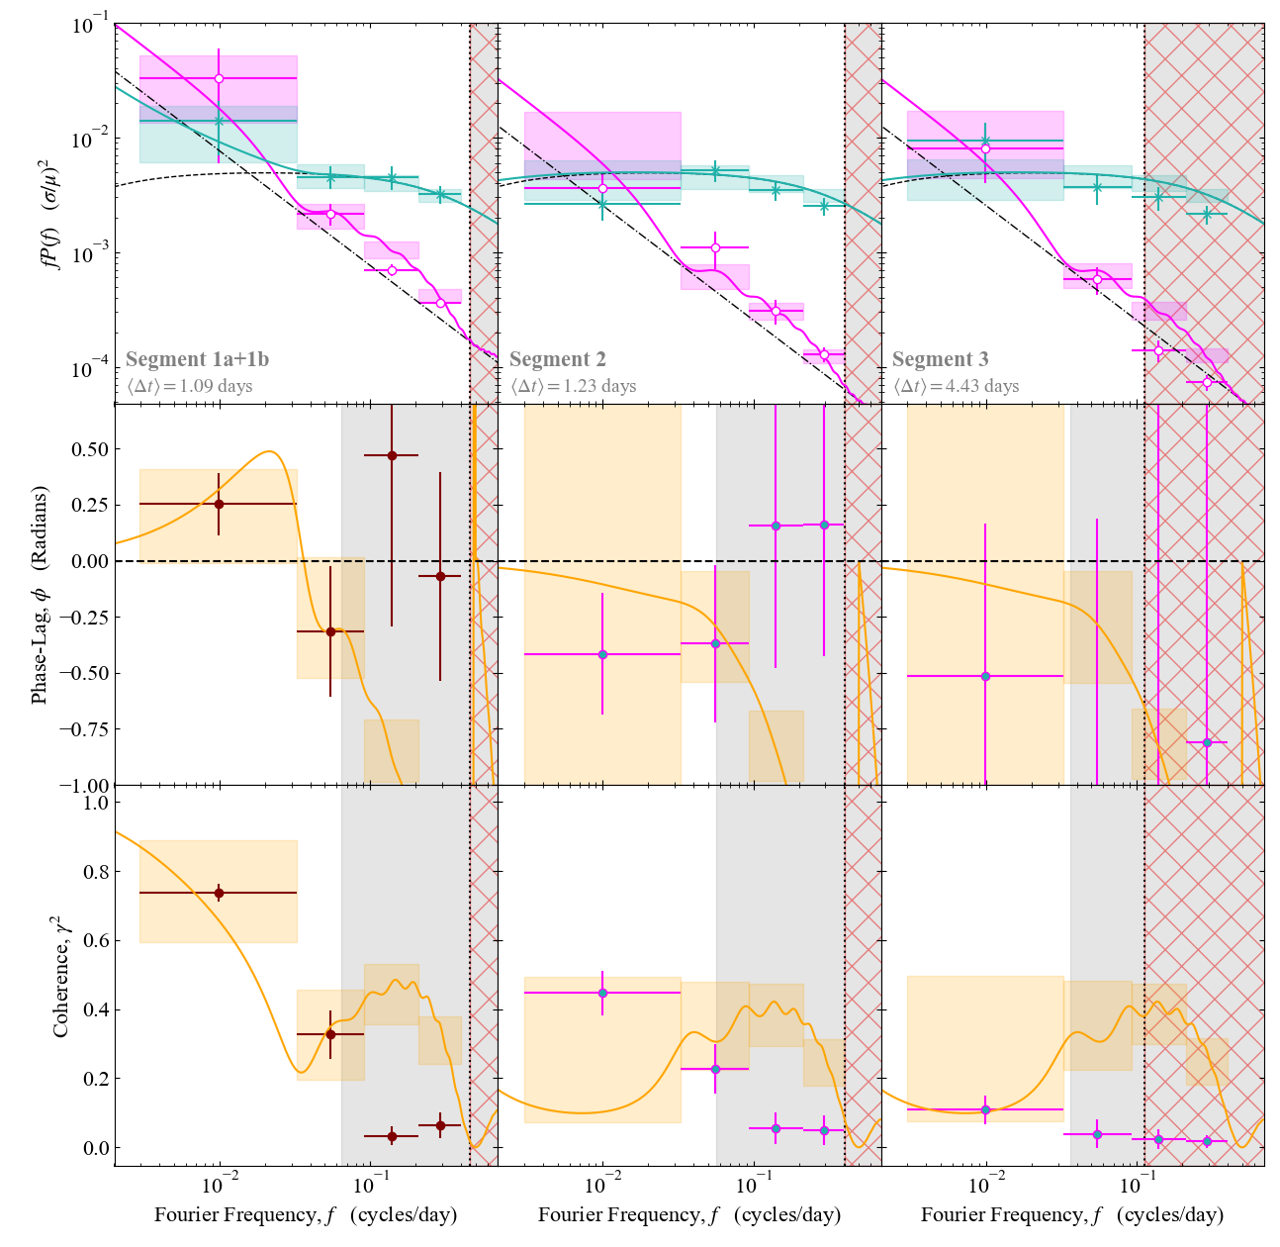
Toy model application
Key take aways from the model:
Intrinsic coronal PSD needs to extend to lower(ish) frequencies to give the low to moderate low-frequency coherence
Works because it introduces interference between the UV and X-ray at low-frequency
Need a long inwards lag and larger amplitude disc-corona transfer function to give the increased low-frequency coherence and +ve phase lag in the year 1 data
Likely due to the rise in mdot seen in the SED
Currently being expanded to a sample of objects by Pablo Saavedra
Hagen et al. 2025

Slide 21



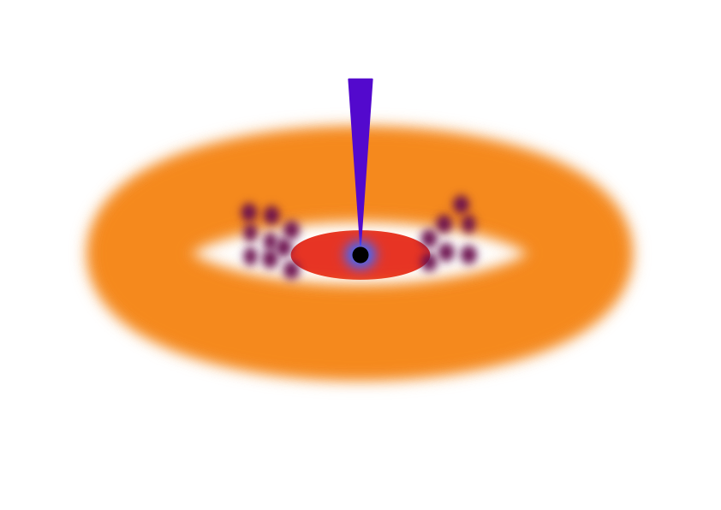



Upcoming…
A panchromatic legacy experiment
Spectroscopic monitoring led by HST
Near-IR to FUV
P.I. J. V. Hernández-Santisteban
Simultaneous XMM and NuSTAR snapshots for a detailed broad band X-ray spectrum
P.I. S. Hagen
Ground based high cadence photometry in the optical with LCO
P.I. J. V. Hernández-Santisteban
High-resolution X-ray spectrum with XRISM
P.I. S. Hagen
X-ray monitoring with Einstein Probe
P.I. J. Hu

Slide 22
Summary
Variability in F9 SEDs suggest an evolution in the inner accretion structure on short (~100 day) time-scales
  Driven by an increase in mdot, leading to a more ‘discy’ SED.
  Much like Changing-state AGN, but less dramatic
Elsewise the disc and corona are only marginally connected via UV seed-photon propagation + X-ray reverberation
Does require intrinsically variable disc + corona.
  Overlapping time-scales reduces coherence (extended corona?)
Intrinsically variable disc and corona
UV seed-photons + disc reverberation drives marginal connection between UV and X-ray
EUV reprocessing from a wind/BLR gives rise to the long optical/UV lags
See e.g:
Hagen, Done, Silverman et al. (2024): Accretion states in AGN populations
Hagen, Done & Edelson (2024): Physical model for AGN variability
Hagen et al. (2025): Characterisation of AGN variability and inner structure (evolution) in Fairall 9
Hagen et al. (2026): Analytic prescription for winds in AGN

Slide 23
Back-up slides

Slide 24
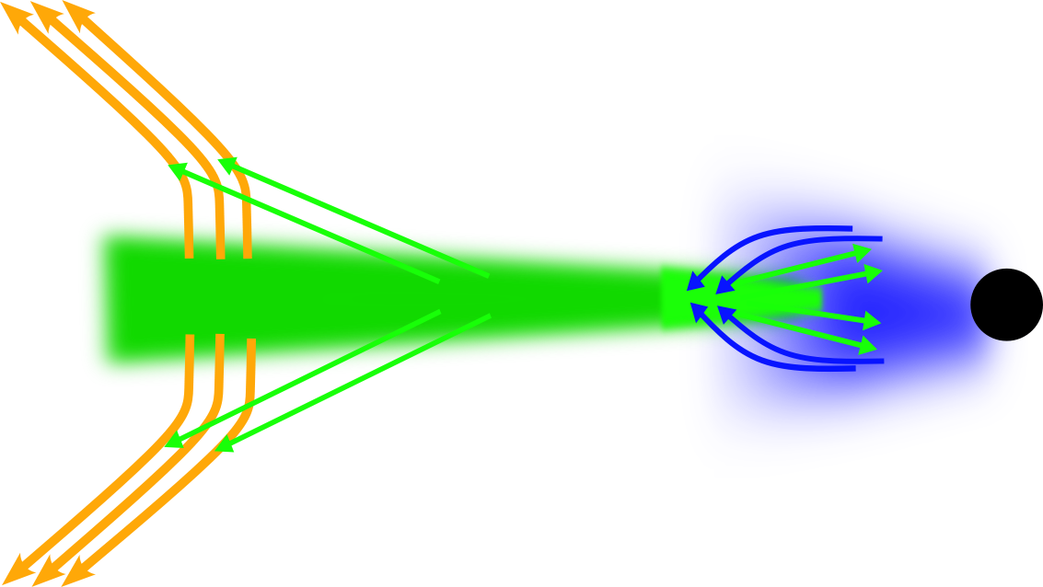
2. Rising phase
Increase in ṁ going from outside in. System becomes increasingly disc dominated
3. Final two years
UV-X-ray connection back to weak signals from reverberation + UV seed photons. Now also overall softer X-ray spectrum due to increased seed-photon power arising from stronger disc
1. Beginning of campaign
UV-X-ray connection mainly driven by weak signals from X-ray reverberation + UV seed-photon
Time

Slide 25
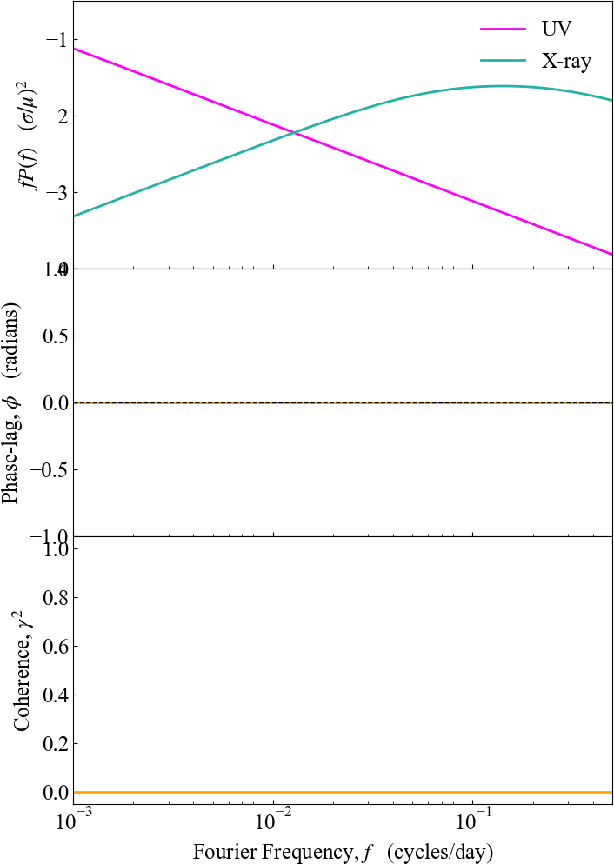






Interference - example
Note:
$$\tilde{L}\left(f\right)=ℱ[L\left(t\right)](f)$$
$$L_{d}(t)$$
$$L_{c}(t)$$
$${\tilde{L}}_{x}(f)={\tilde{L}}_{c} (f)$$
$${\tilde{L}}_{UV}(f)={\tilde{L}}_{d} (f)$$
$$P\left(f\right)={\tilde{L}}^{∗}\left(f\right)\tilde{L}\left(f\right)=|\tilde{L}\left(f\right)|^{2}$$
$$C\left(f\right)={\tilde{L}}_{UV}^{∗}\left(f\right){\tilde{L}}_{x}\left(f\right)=\left|{\tilde{L}}_{UV}\left(f\right)\right|\left|{\tilde{L}}_{x}\left(f\right)\right|e^{iφ}$$

Slide 26
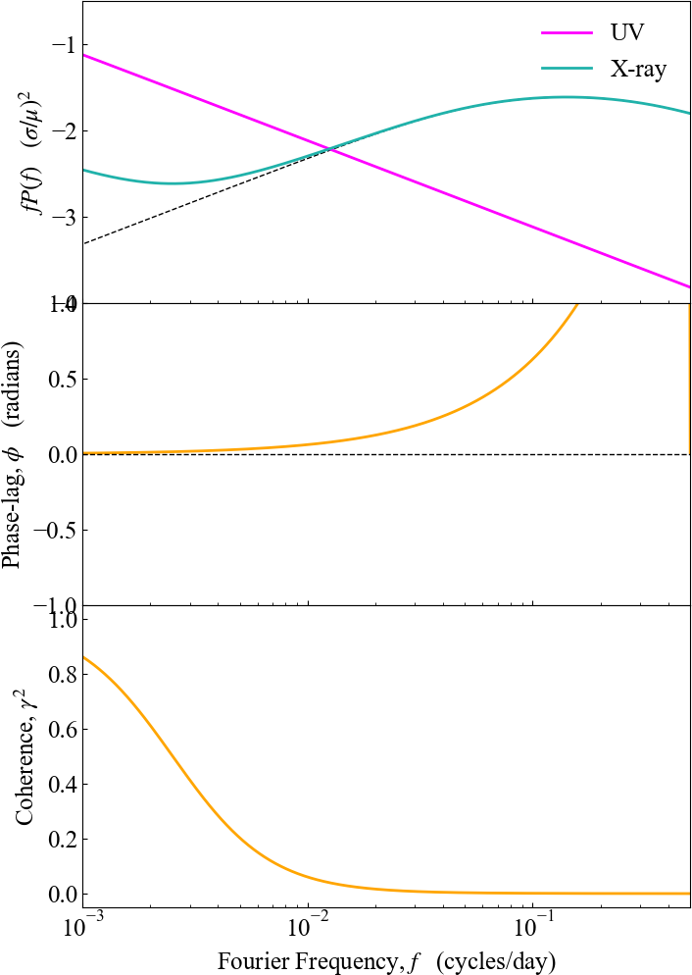


Interference - example
Note:
$$\tilde{L}\left(f\right)=ℱ[L\left(t\right)](f)$$
$$L_{d}(t)$$
$$L_{c}(t)$$
$${\tilde{L}}_{x}\left(f\right)={\tilde{L}}_{c} \left(f\right)+{\tilde{L}}_{d}(f){\tilde{ψ}}_{s}(f)$$
$${\tilde{L}}_{UV}(f)={\tilde{L}}_{d} (f)$$
$$P\left(f\right)={\tilde{L}}^{∗}\left(f\right)\tilde{L}\left(f\right)=|\tilde{L}\left(f\right)|^{2}$$
$$C\left(f\right)={\tilde{L}}_{UV}^{∗}\left(f\right){\tilde{L}}_{x}\left(f\right)=\left|{\tilde{L}}_{UV}\left(f\right)\right|\left|{\tilde{L}}_{x}\left(f\right)\right|e^{iφ}$$

Slide 27
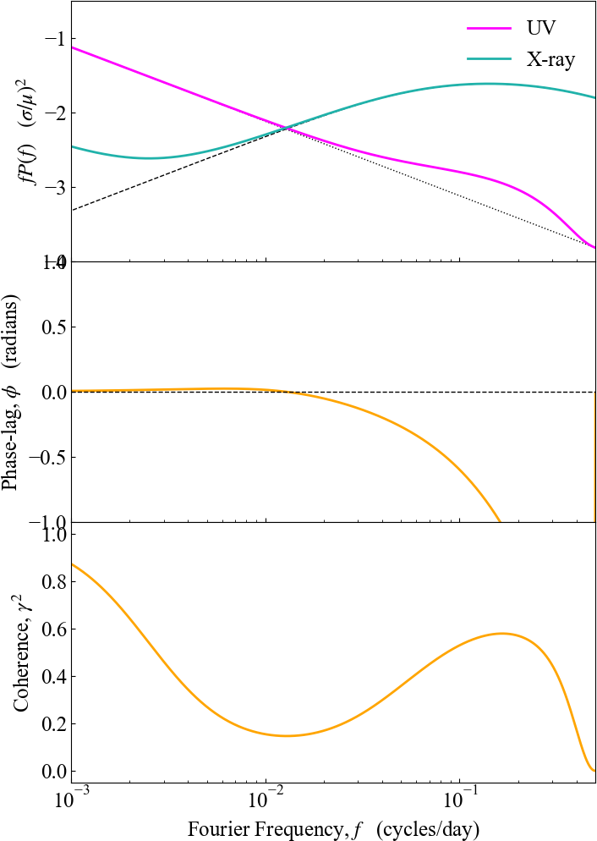

Interference - example
Note:
$$\tilde{L}\left(f\right)=ℱ[L\left(t\right)](f)$$
$$L_{d}(t)$$
$$L_{c}(t)$$
$${\tilde{L}}_{x}\left(f\right)={\tilde{L}}_{c} \left(f\right)+{\tilde{L}}_{d}(f){\tilde{ψ}}_{s}(f)$$
$${\tilde{L}}_{UV}\left(f\right)={\tilde{L}}_{d} \left(f\right)+{\tilde{L}}_{c}(f){\tilde{ψ}}_{r}(f)$$
$$P\left(f\right)={\tilde{L}}^{∗}\left(f\right)\tilde{L}\left(f\right)=|\tilde{L}\left(f\right)|^{2}$$
$$C\left(f\right)={\tilde{L}}_{UV}^{∗}\left(f\right){\tilde{L}}_{x}\left(f\right)=\left|{\tilde{L}}_{UV}\left(f\right)\right|\left|{\tilde{L}}_{x}\left(f\right)\right|e^{iφ}$$

Slide 28
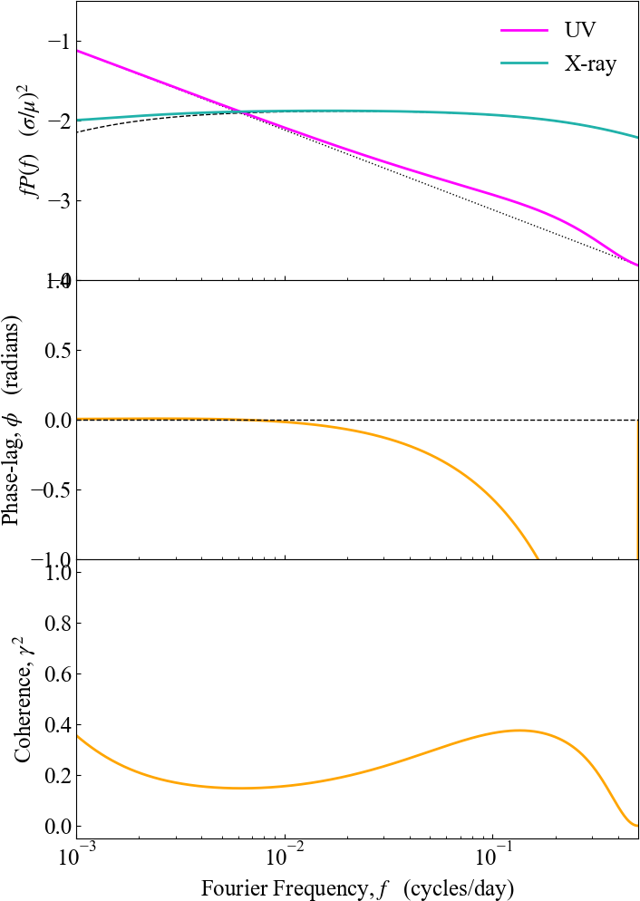
Interference - example
Note:
$$\tilde{L}\left(f\right)=ℱ[L\left(t\right)](f)$$
Extend intrinsic coronal PSD to lower frequency
$$L_{d}(t)$$
$$L_{c}(t)$$
$${\tilde{L}}_{x}\left(f\right)={\tilde{L}}_{c} \left(f\right)+{\tilde{L}}_{d}(f){\tilde{ψ}}_{s}(f)$$
Intrinsic variability in disc and corona on similar time-scales reduces coherence
$${\tilde{L}}_{UV}\left(f\right)={\tilde{L}}_{d} \left(f\right)+{\tilde{L}}_{c}(f){\tilde{ψ}}_{r}(f)$$
$$P\left(f\right)={\tilde{L}}^{∗}\left(f\right)\tilde{L}\left(f\right)=|\tilde{L}\left(f\right)|^{2}$$
$$C\left(f\right)={\tilde{L}}_{UV}^{∗}\left(f\right){\tilde{L}}_{x}\left(f\right)=\left|{\tilde{L}}_{UV}\left(f\right)\right|\left|{\tilde{L}}_{x}\left(f\right)\right|e^{iφ}$$

Slide 29
What about winds/the BLR? (e.g. Dehghanian et al. 2019b; Kara et al. 2021)
Large scale height material (BLR/winds) will subtend a large solid angle as seen from the disc
Variable EUV disc emission should then be absorbed and re-emitted as lines and free-bound continuum
(e.g. Korista & Goad 2001; 2019)

Slide 30
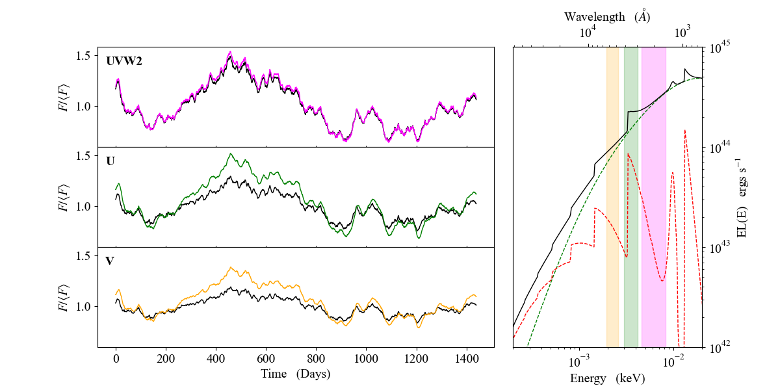
Effect of diffuse continuum on AGN variability
Hagen, Done & Edelson 2024
Diffuse continuum from BLR/wind

Slide 31
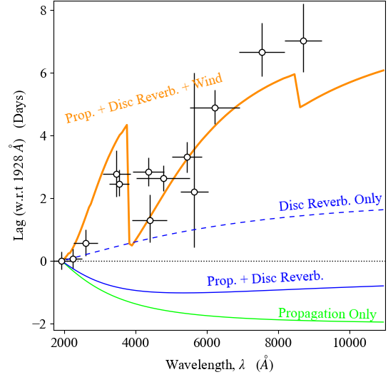
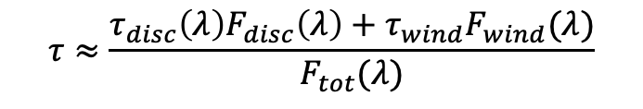
Wind re-processing as origin the AGN time-lags?
Hagen, Done & Edelson 2024
Data from Hernández-Santisteban et al. 2020
Addition of a wind gives a strong increase in the measured time-lags due to the increased light-travel time
Works because the free-bound continuum generally increases in contribution (relative to the disc continuum) to the total SED with increasing wavelength, which increases the winds contribution to the total lag
$$τ≈\frac{τ_{disc}\left(λ\right)F_{disc}\left(λ\right)+τ_{wind}F_{wind}(λ)}{F_{tot}(λ)}$$

Slide 32

Building an AGN SED
Infalling material forms a dense, optically thick, accretion disc
Viscous torques heat it, giving a radial temperature gradient
(Shakura & Sunyaev 1973)
Energy x Flux
EUV
UV
Optical
If the disc thermalizes, each radius will emit a black-body spectrum of temperature T(R)
Integrating over the disc gives and SED formed of multiple black-body components peaking in the UV/EUV
Energy

Slide 33
Building an AGN SED
Observations show ubiquitous X-ray emission (Elvis et al. 1994; Lusso & Risaliti 2016)
Generally understood as originating from a low-density, optically thin, hot (~100 keV) plasma (Haardt & Maraschi 1993; Haardt et al. 1994)
Energy x Flux
EUV
UV
Optical
‘Low-energy’ photons from the disc enter the corona and Compton up-scatter off free electrons
Repeated scatterings leads to the build up of a high energy tail in the SED
X-ray
kT_{e}
Energy

Slide 34
Building an AGN SED
Observations also show an up-turn in the soft X-rays (≲1keV) that appear to point back to the UV/EUV (Laor et al. 1997; Gierlinski & Done 2004; Porquet et al. 2004)
Energy x Flux
EUV
UV
Optical
X-ray
kT_{e}
Energy

Slide 35
Building an AGN SED
Observations also show an up-turn in the soft X-rays (≲1keV) that appear to point back to the UV/EUV (Laor et al. 1997; Gierlinski & Done 2004; Porquet et al. 2004)
Energy x Flux
If the disc fails to thermalize, then emission no longer black-body
Instead, populations of free-electrons in the photosphere will lead to a Comptonised shape
Can give a spectral shape linking the soft X-ray excess and the UV
Mehdipour et al. (2011, 2015); Done et al. (2012); Petrucci et al. (2013, 2018)
EUV
UV
Optical
X-ray
kT_{e}
Energy

Slide 36
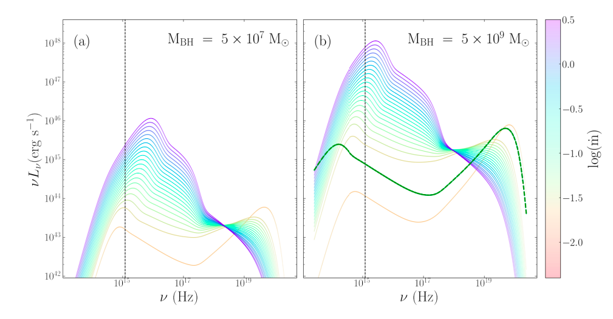
AGN SEDs – Fundamental Properties
Overall emitted power fundamentally depends on Black hole mass, M and Mass-accretion rate, $\dot{M}$
Figure from: Mitchell..SH.. et al. (2023)

Slide 37
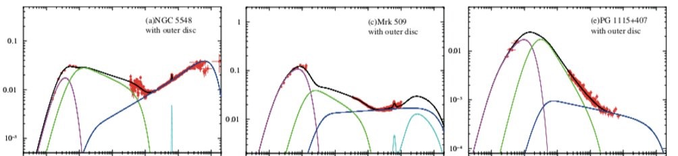
AGN SEDs – Fundamental Properties
If we know the total available power (i.e M and $\dot{M}$) we can use the SED to estimate the size scale of each emitting component from the energy balance (Kubota & Done 2018)
r_{h}
r_{h}
r_{h}
NGC 5548
$\dot{m}$~ 0.03
r_{h} ~ 50
Mrk 509
$\dot{m}$~ 0.1
r_{h} ~ 20
PG 1115
$\dot{m}$~ 0.4
r_{h} ~ 10
Energy
Energy
Energy
SED figure from: Kubota & Done 2018

