Slide 1
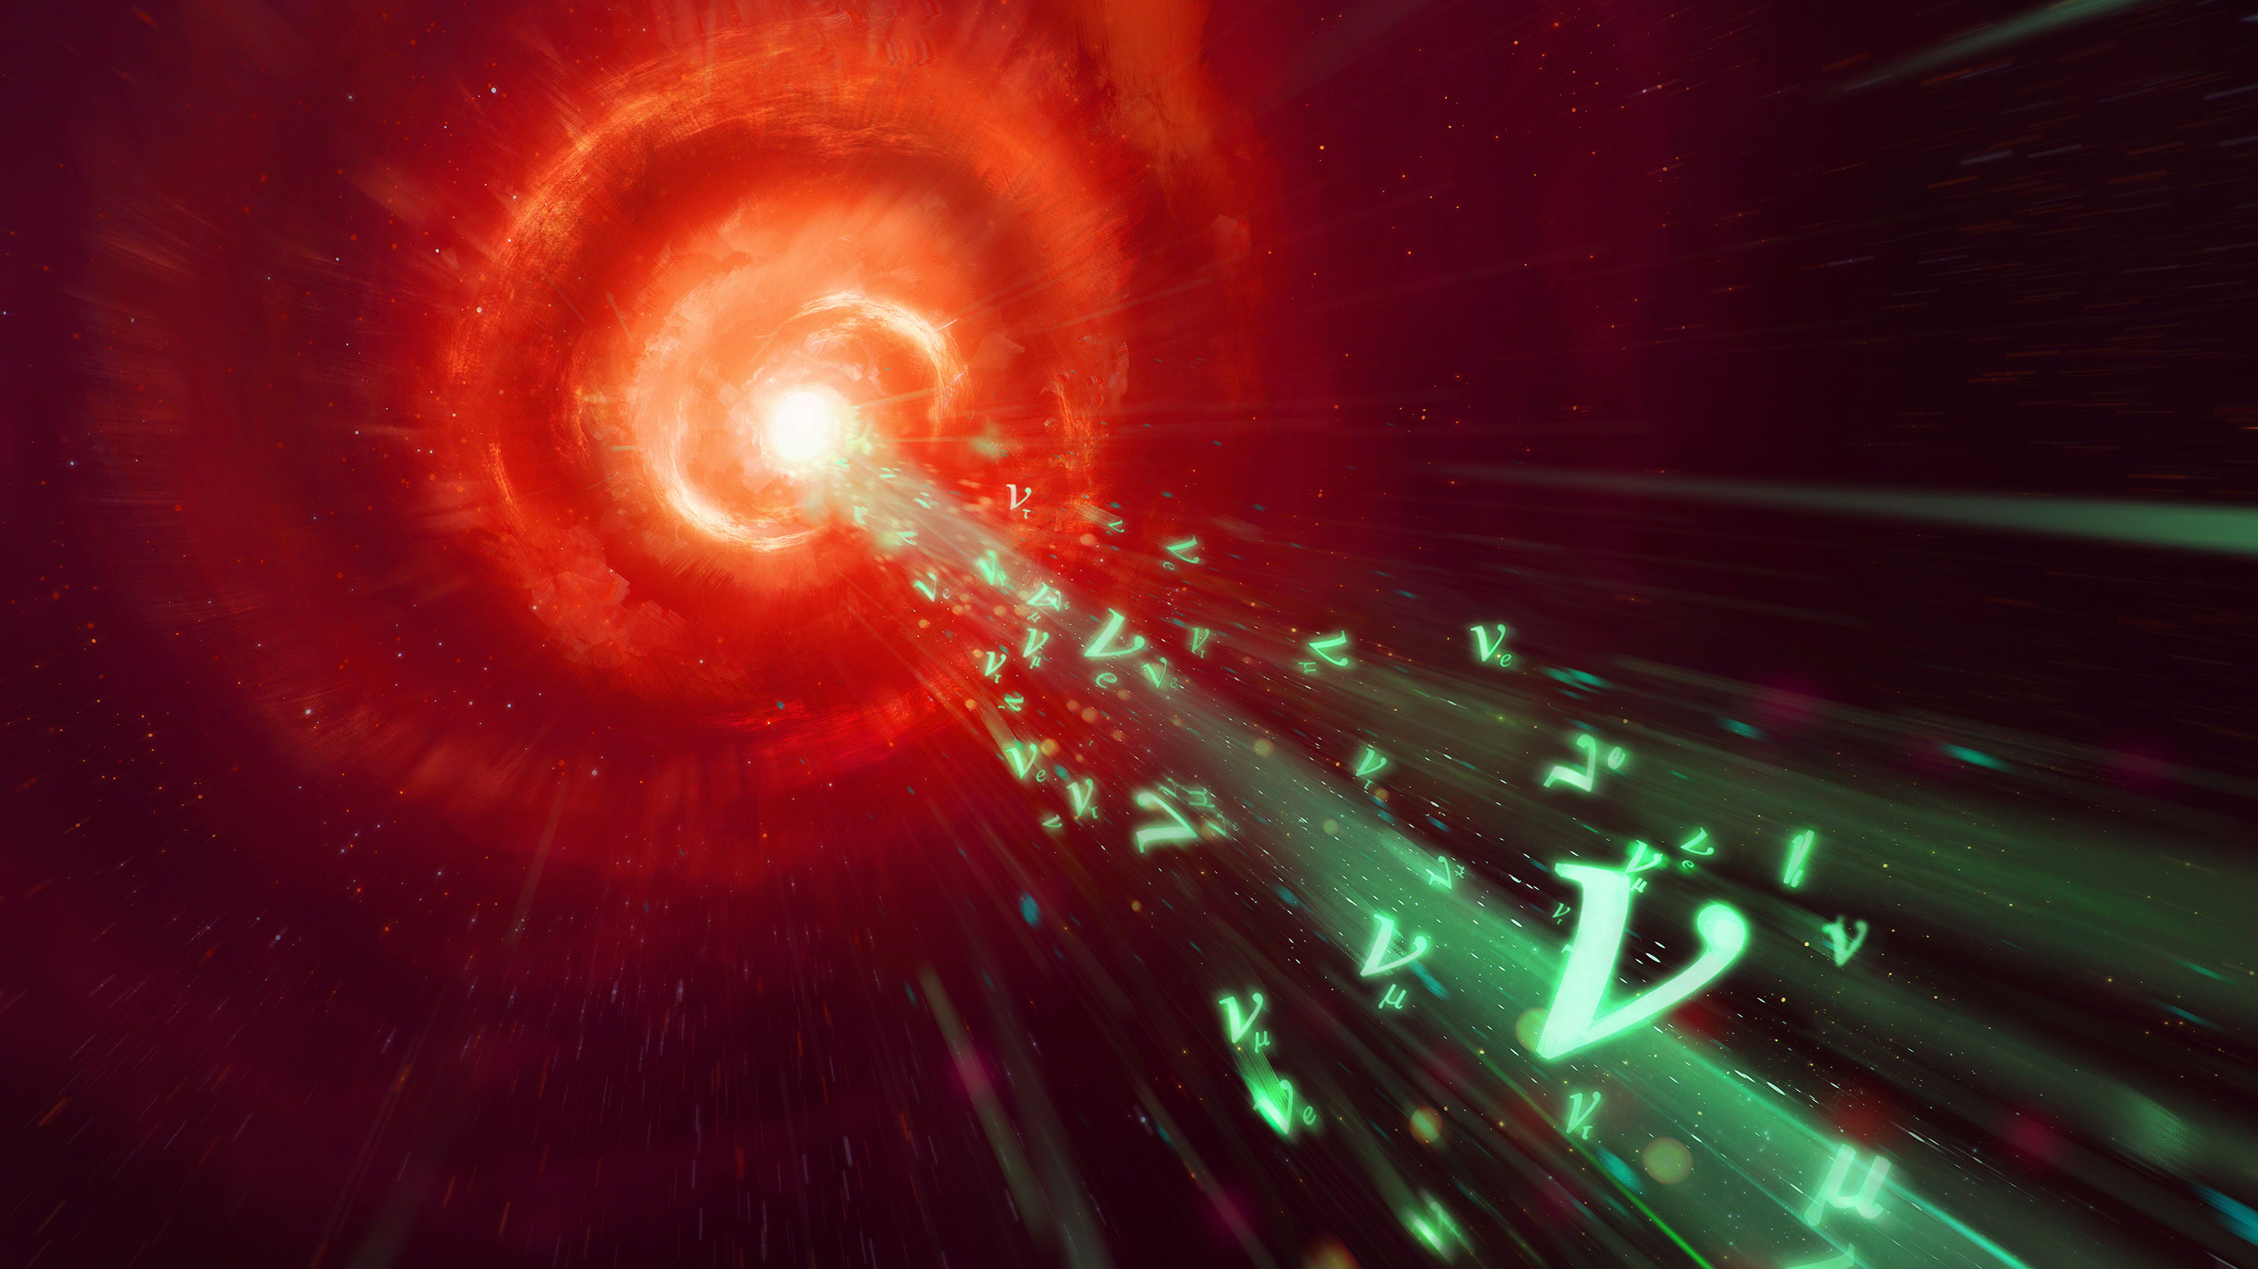


Are AGN jets emitting
high-energy neutrinos?
Nordic-Baltic Astronomy Days 2026
Turku, Finland
Pouya M. Kouch
Collaborators:
  Elina Lindfors,
  Talvikki Hovatta,
  Ioannis Liodakis,
  Karri Koljonen,
  et al.
Image credit: Quanta Magazine

Slide 2
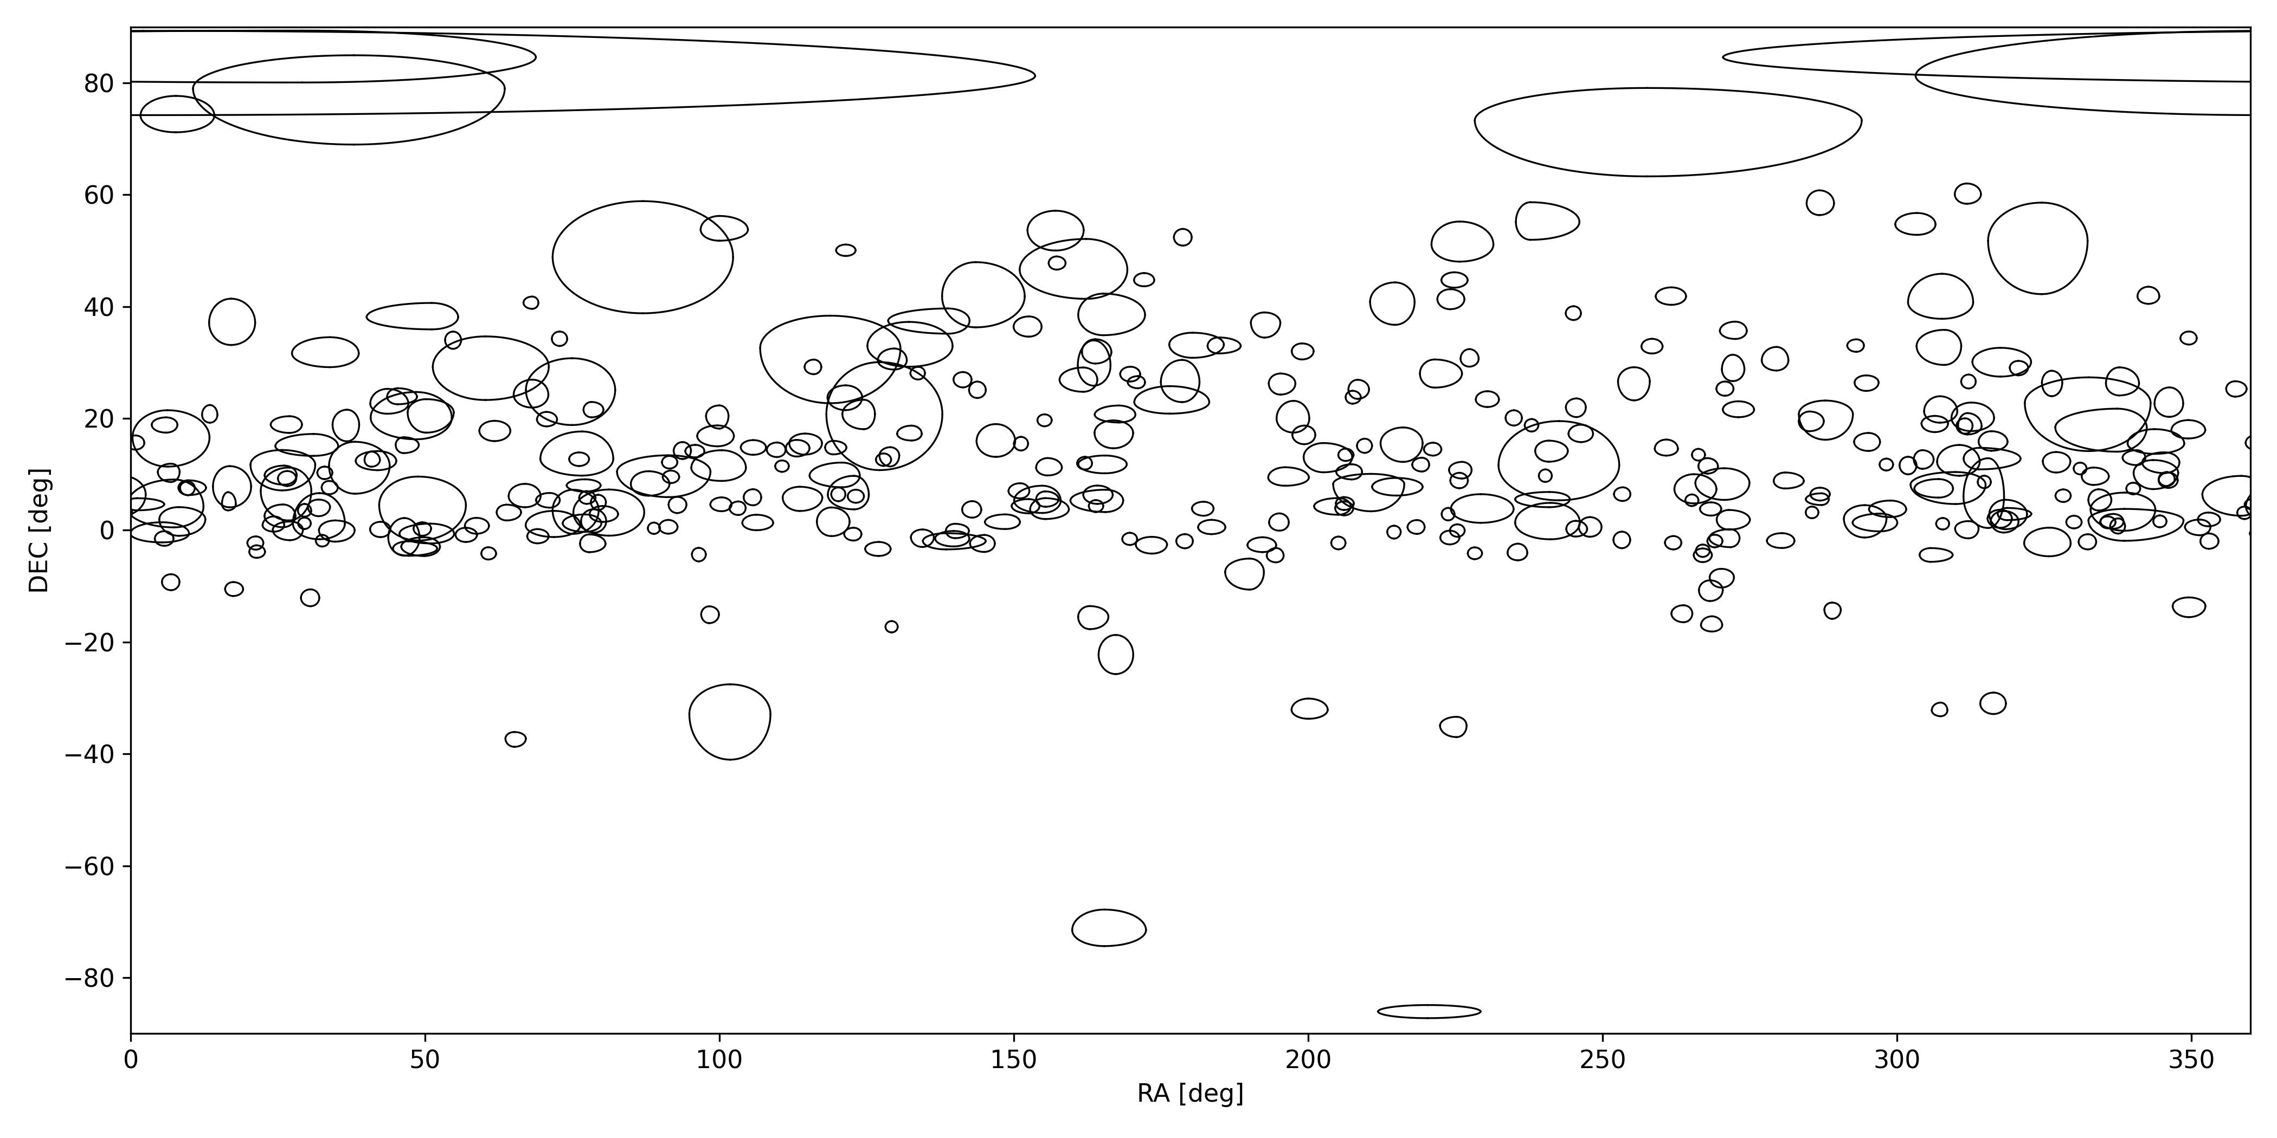


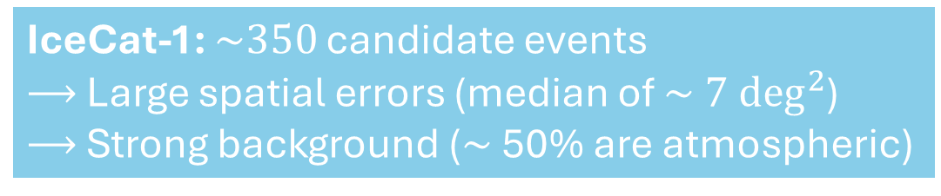
Mystery of cosmic high-energy neutrinos
Detected by IceCube at a rate of $\sim 15 {yr}^{−1}$
Emitted by unknown cosmic sources
Emission must involve $≳$PeV hadrons
(e.g., protons)
Sky map
$E \sim 100−1000$ TeV
Abbasi et al. (2023)
IceCat-1: $\sim 350$ candidate events
$⟶$ Large spatial errors (median of $\sim 7 \deg^{2}$)
$⟶$ Strong background ($\sim$ 50% are atmospheric)
2
Notes:
HE: from ~100 TeV to ~PeV (i.e., 10**14 to 10**15 eV)
Observational limitations:
Poor spatial resolution of the neutrinos
Poor significance of detection of each event
Model dependence (a lot of the parameters depend on the assume astrophysical spectrum which is not well constrained)

Slide 3
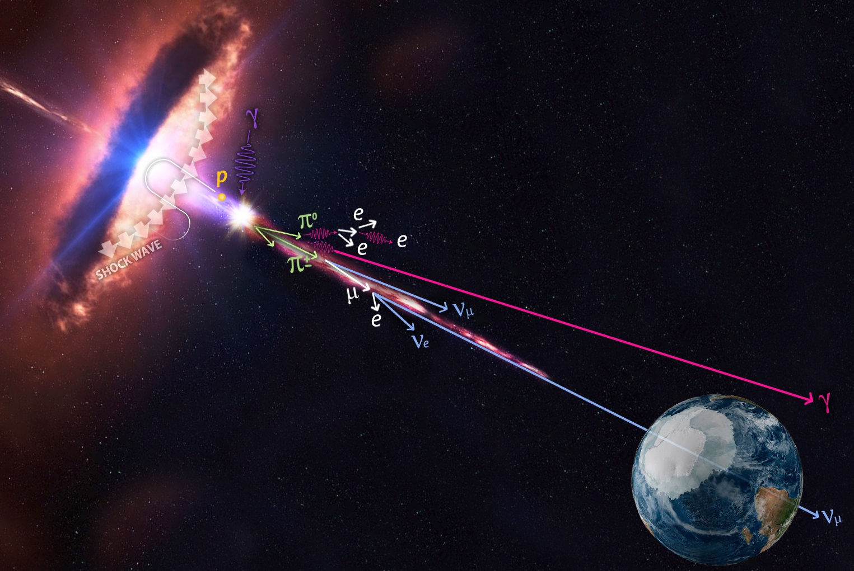

SMBH-powered jets are a source candidate...
Blazars are AGN jets pointed to Earth
Bright in all bands of the EM spectrum
Radio$−$X-rays:
$→$ Leptonic synchrotron emission
X-rays$−$TeV-$γ$-rays:
$→$ Mainly leptonic inverse-Compton
$→$ Possibly some hadronic emission
Hadronic emissions $⟹$ Neutrinos !
Image credit: IceCube/NASA
3
Notes:
Their emission Doppler boosted as the particles in the jet are moving at relativistic speeds toward us

Slide 4
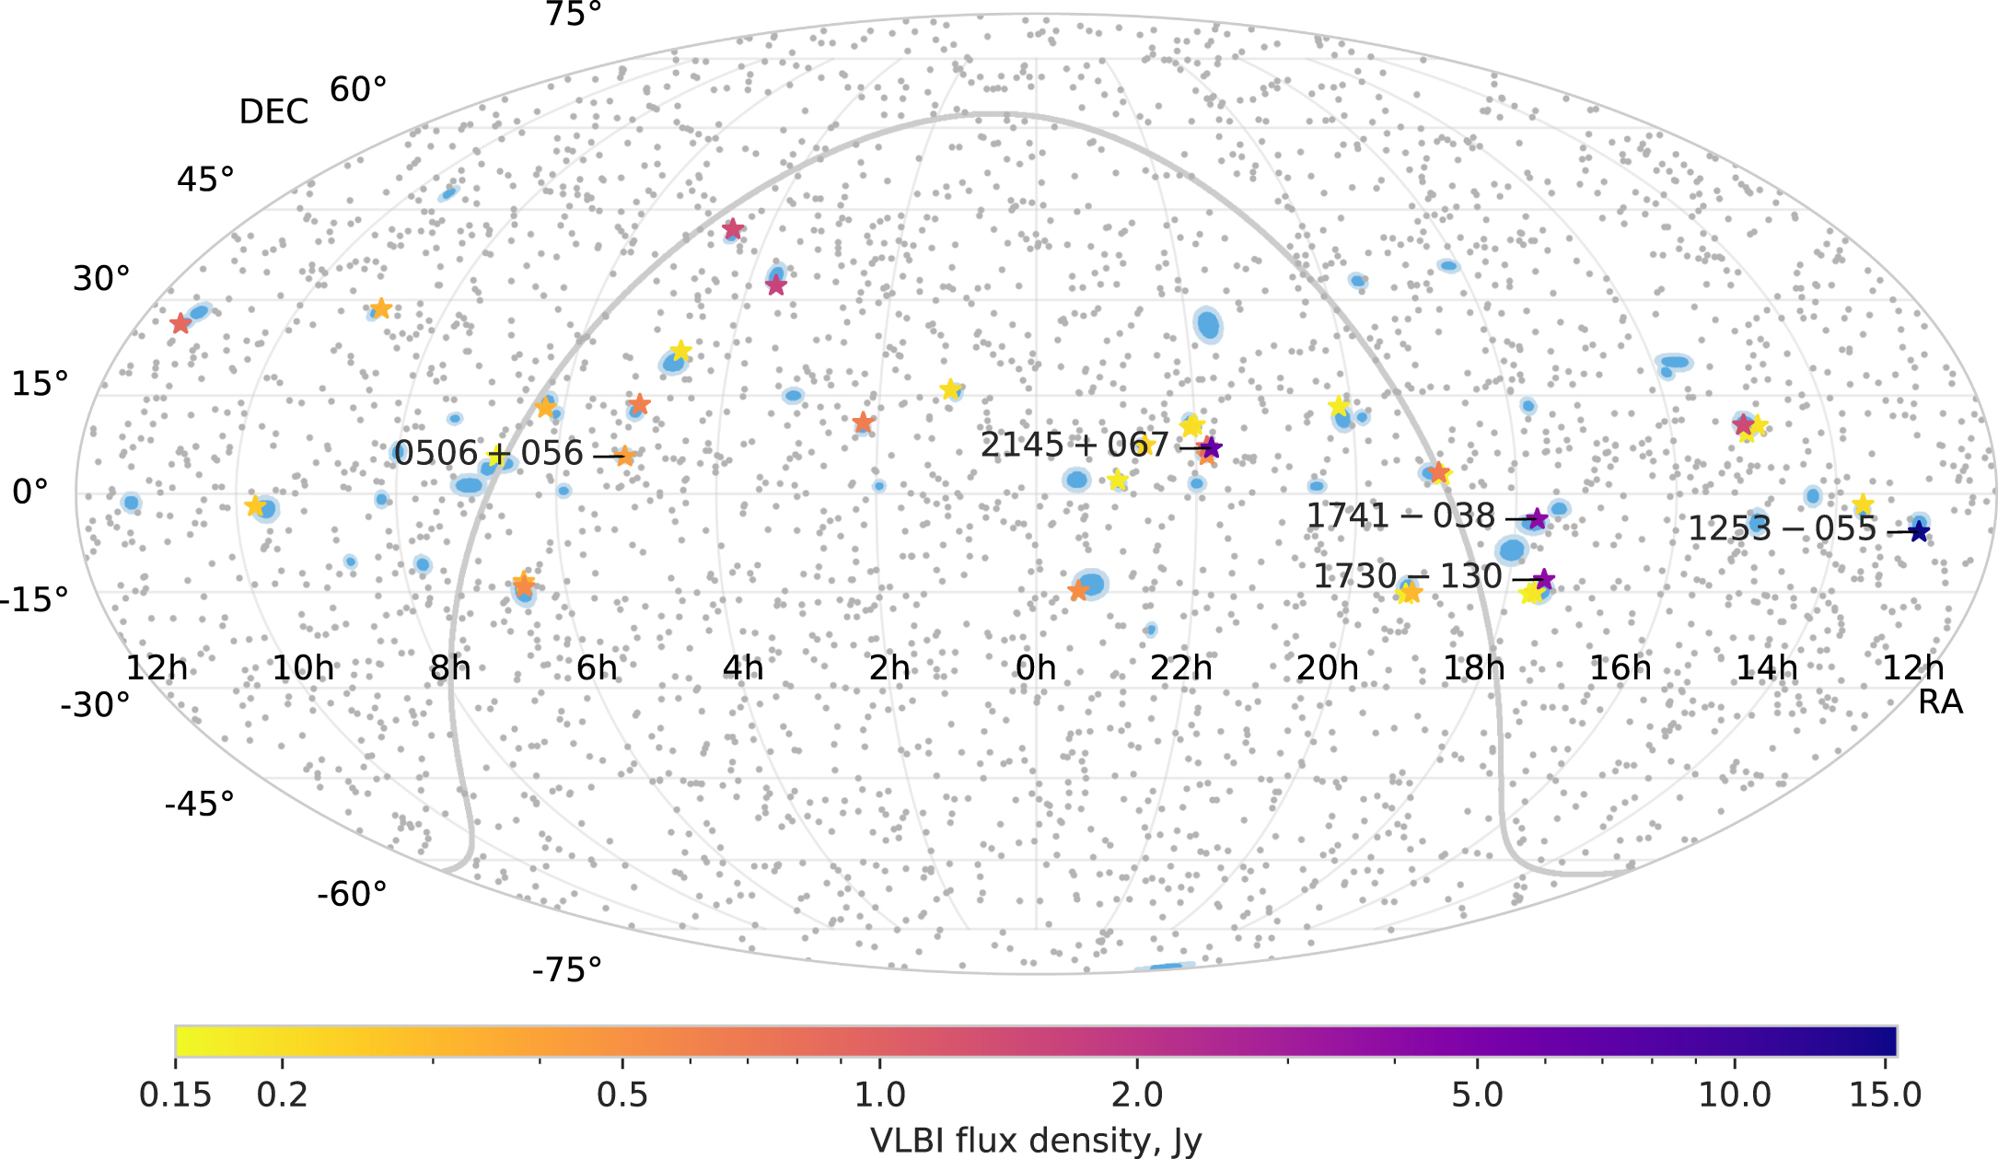

Spatial association of blazars & neutrinos
Spatial association of blazars and HE neutrinos
Plavin et al. (2020)
Spatial associations are rather weak (only $\sim 2σ−3σ$)
Likely due to the observational limitations of the neutrino data
Neutrino arrival times are key for boosting detection power
4
Notes:
Observational limitations of the neutrino data are:
Large error regions
Low signalness
Model dependence

Slide 5
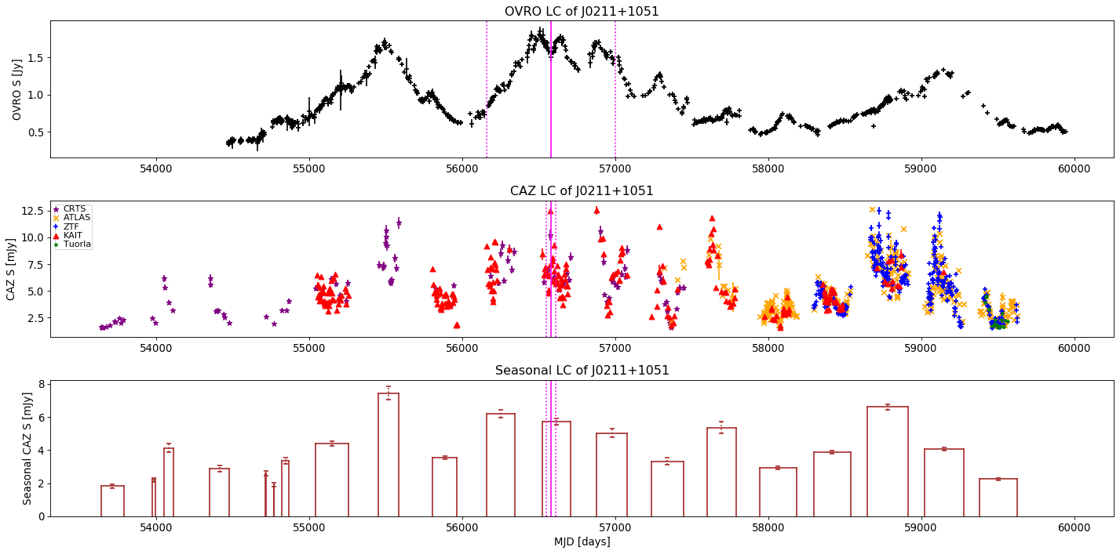

Spatio-temporal assoc. of blazars & neutrinos
J0211+1051
Assume: EM flare $⟺$ Neutrino flare
Studies from our group:
  Hovatta et al. (2021)
    56 neutrinos VS ~1200 blazars in radio
    $\sim$2$σ$ correlation
  Kouch et al. (2024)
    283 neutrinos (IceCat-1) VS
    ~1200 blazars in radio and optical
    $\sim$2.2$σ$ correlation
Kouch et al. (2024)
RADIO
OPTICAL
LONG TERM OPTICAL
Spatio-temporal correlations are also weak...
5
Notes:
** make sure to explain the assumption by referring to the figure **

Slide 6
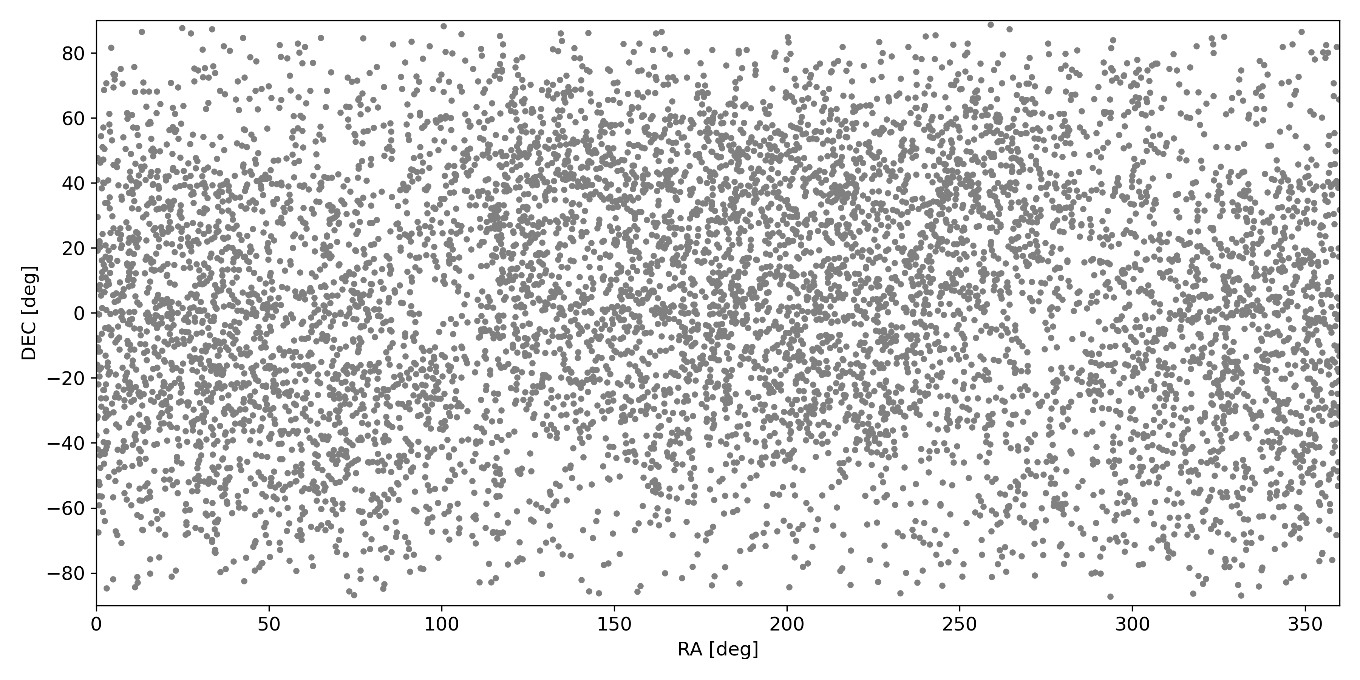
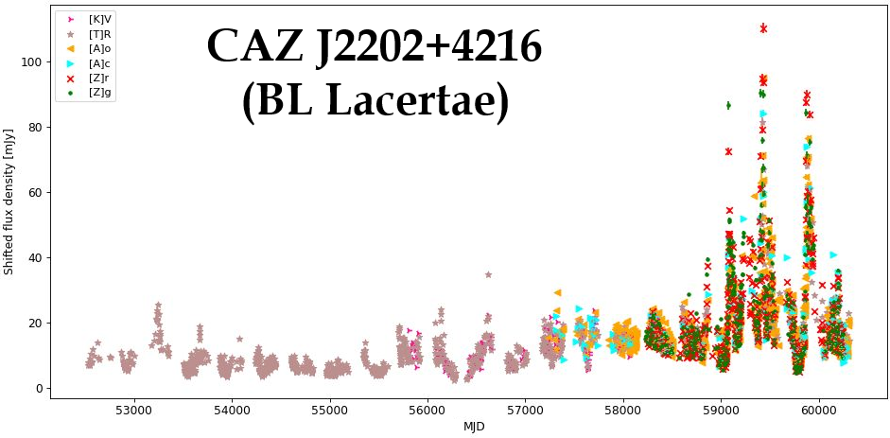
Pushing the detection power to the limit!
7918 sources - Kouch et al. (2026a)
(we focus on the optical band)
More blazars
  Compiled the largest blazar catalog to date: CAZ catalog
Longer & denser light curves
  Collected all-sky survey data
Optimized search statistics
  Performed extensive Monte Carlo simulations in Kouch et al. (2025)
Example CAZ optical light curve
6
Notes:
The CAZ catalog is 88.8% blazars (the rest are non-blazar AGN)
We used all-sky surveys to extract the light curves at the coordinates of the CAZ catalog sources (CRTS+ATLAS+ZTF; from 2005 to 2023)
With the optical strategy 4$σ$ corr. expected, even if only 20% of cosmic neutrinos are from blazars

Slide 7
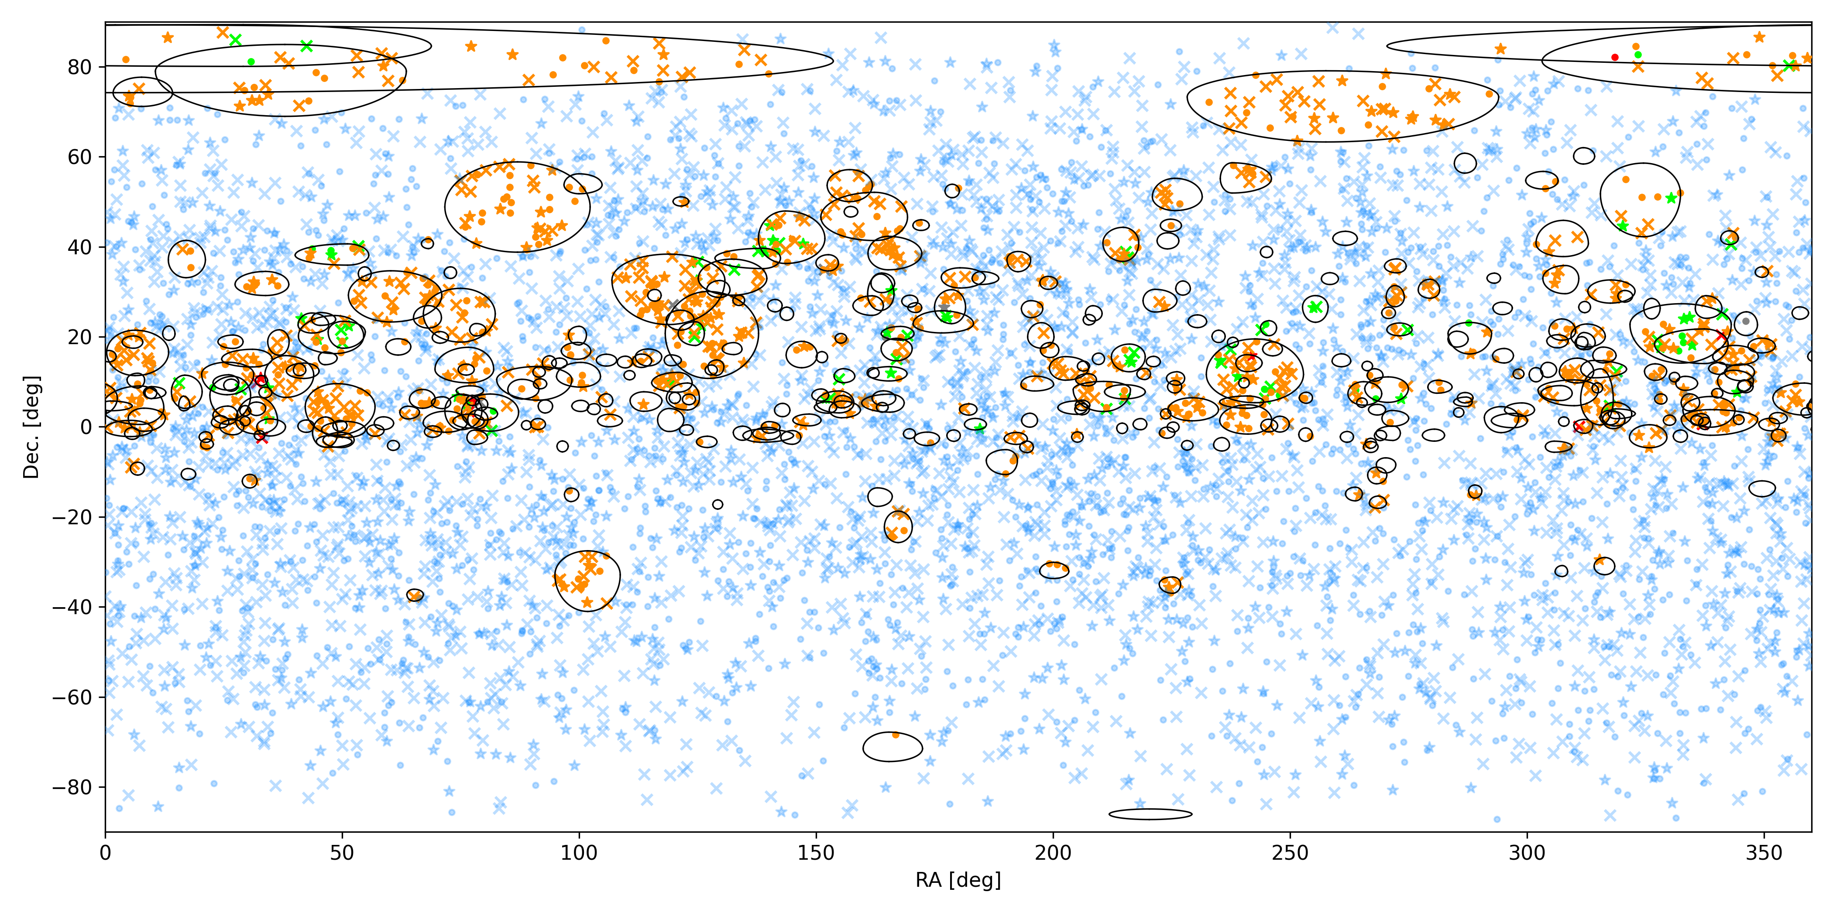

IceCat-1 neutrinos vs CAZ blazar light curves
Kouch et al. (2026b)
Blazars:
  Radio-selected (RFC):
  3225 sources
  $γ$-ray-selected (4LAC):
  3814 sources
Neutrinos:
  Updated IceCat1+:
  356 events
We count the spatial associations coinciding with major optical flares
7
Notes:
The counts are weighted based on the error region size and signalness of the neutrino events

Slide 8
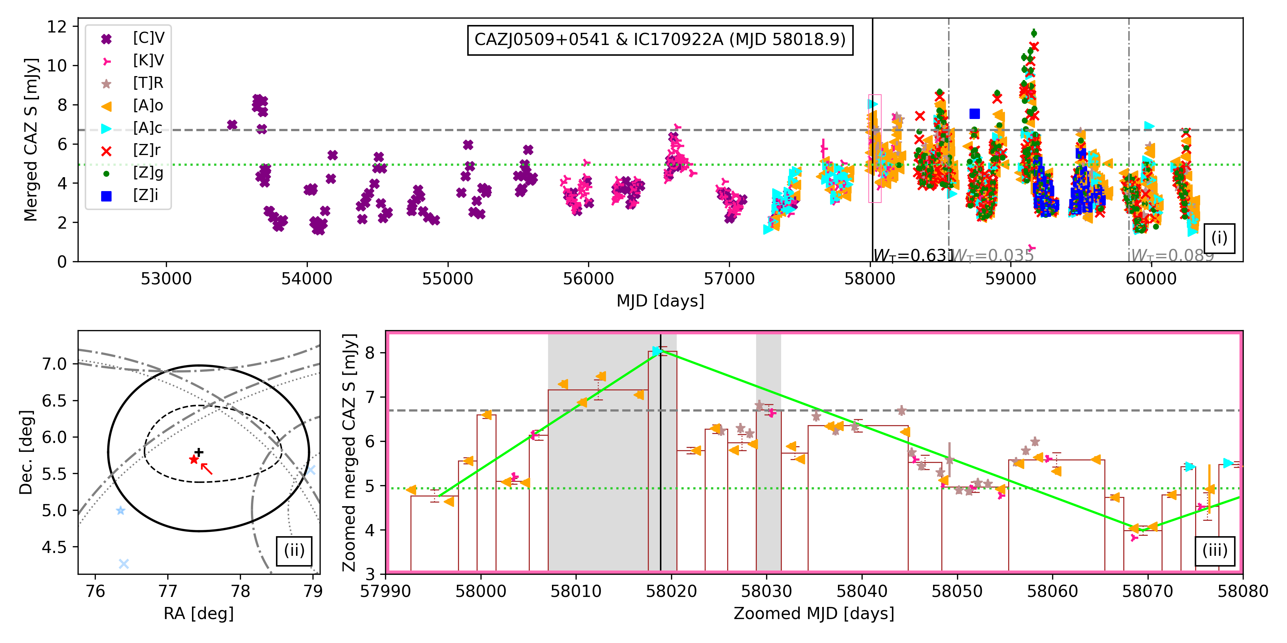
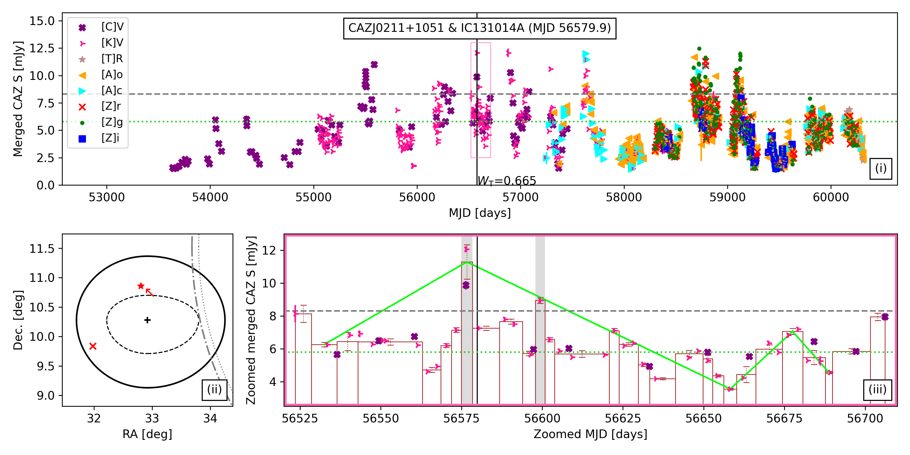

Results...
Overall significance remains rather weak ($2.64σ$; post-trial)
Driven by two associations:
TXS 0506+056 and J0211+1051
TXS 0506+056
J0211+1051
8
Notes:
Still few associations...
Despite a substantial increase in the data size, the significance is still low... This likely means that few blazars are making these neutrinos
The low number of associations is also partly due to the light curves having long and frequent observational gaps
Both of these strong associations are also associated via MAJOR radio flares
A general blazar-neutrino correlation is highly unlikely...

Slide 9
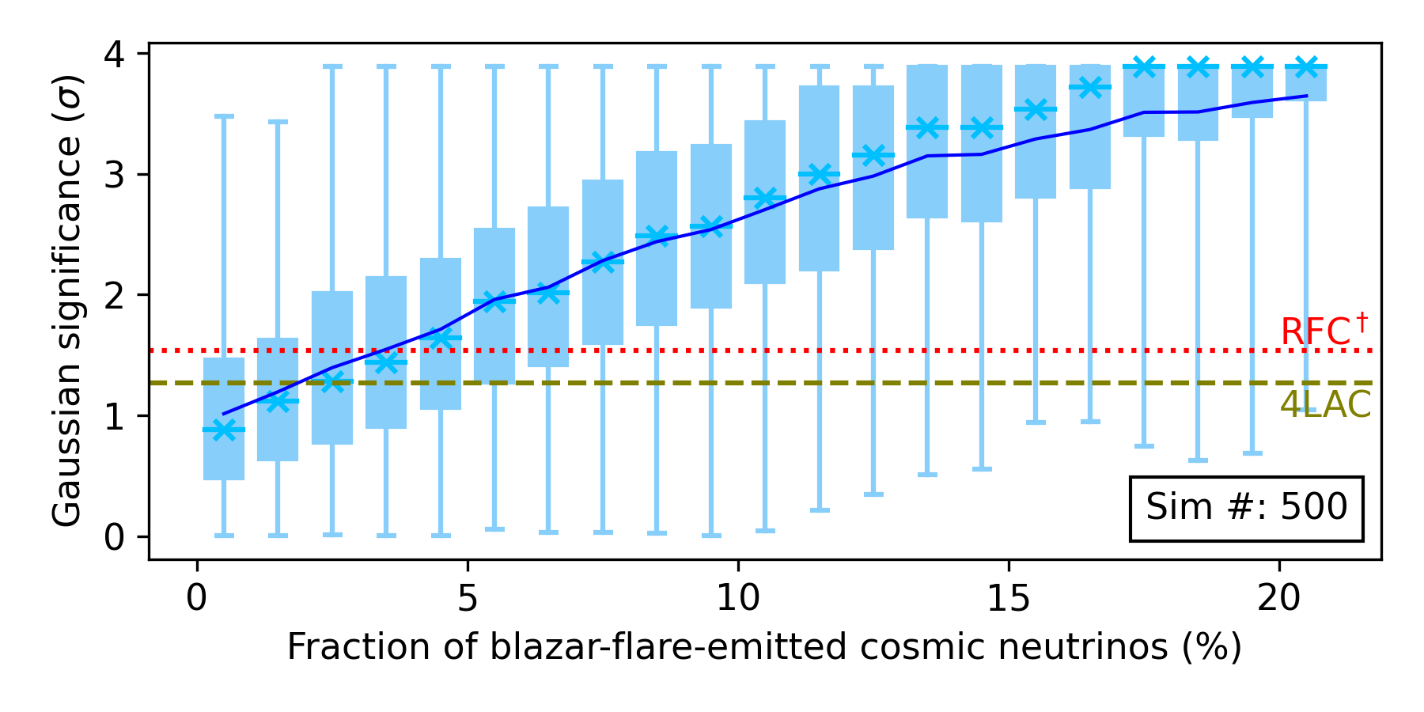
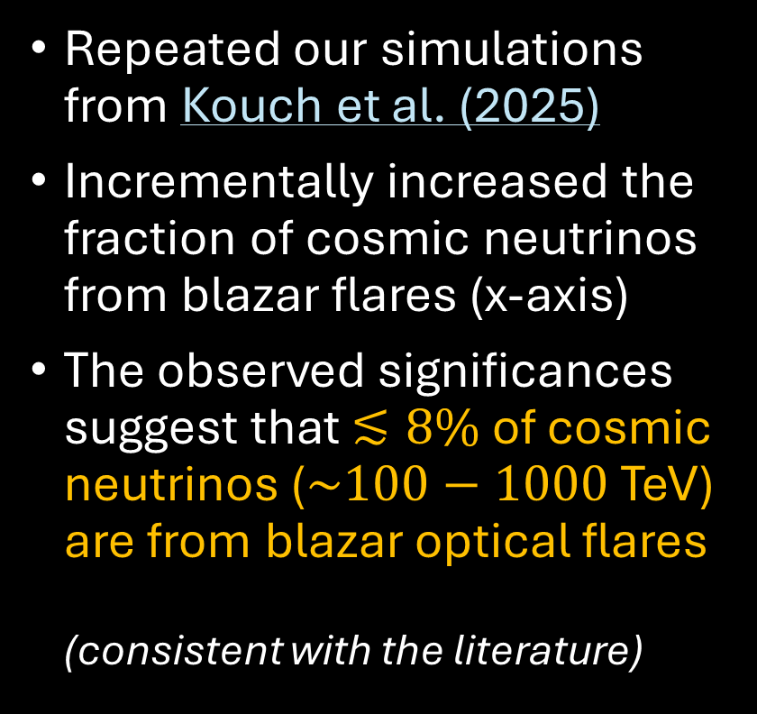
Fraction of neutrinos from blazar flares
Repeated our simulations from Kouch et al. (2025)
Incrementally increased the fraction of cosmic neutrinos from blazar flares (x-axis)
The observed significances suggest that $≲8\%$ of cosmic neutrinos ($\sim 100−1000$ TeV) are from blazar optical flares
(consistent with the literature)
9
Notes:
Around 50% of spatially associated neutrinos fall in a gap and are excluded from the analysis
Gaps are taken into consideration when repeating our simulations
- The estimate of <10% of neutrinos coming from blazars is consistent with the literature

Slide 10
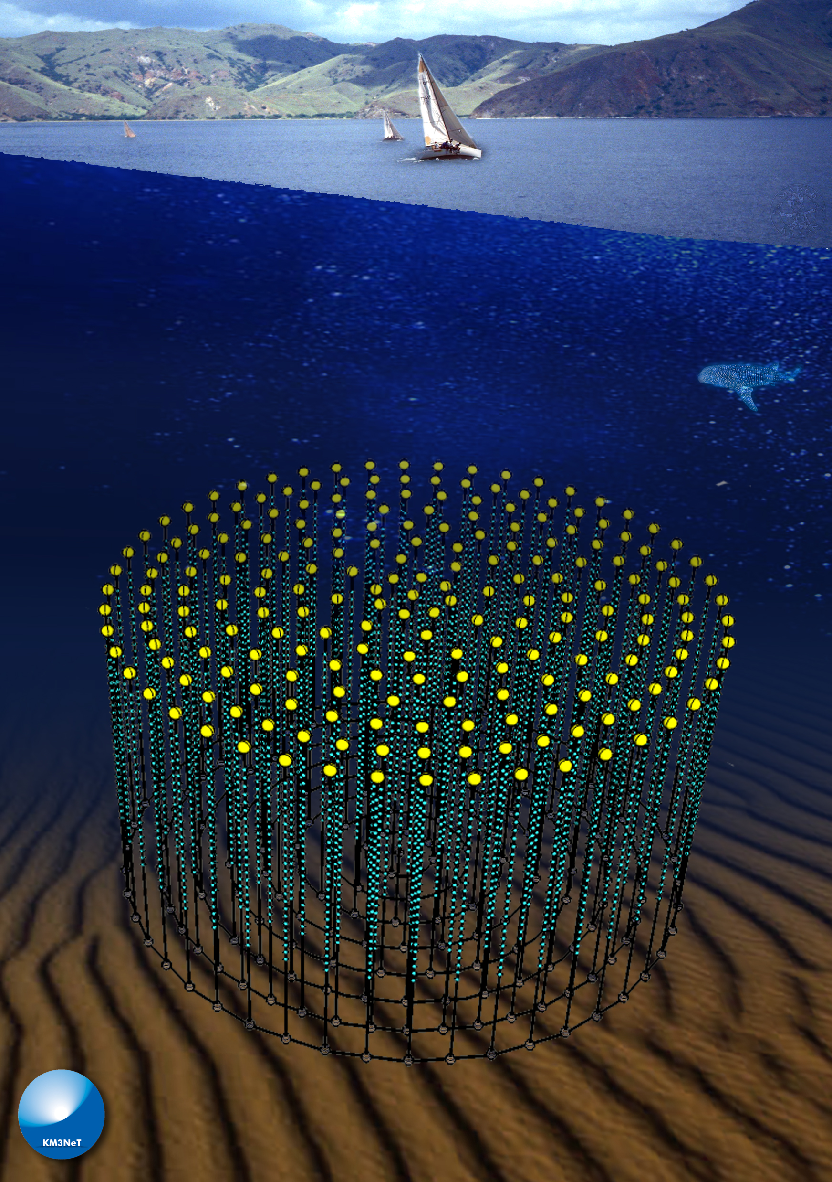
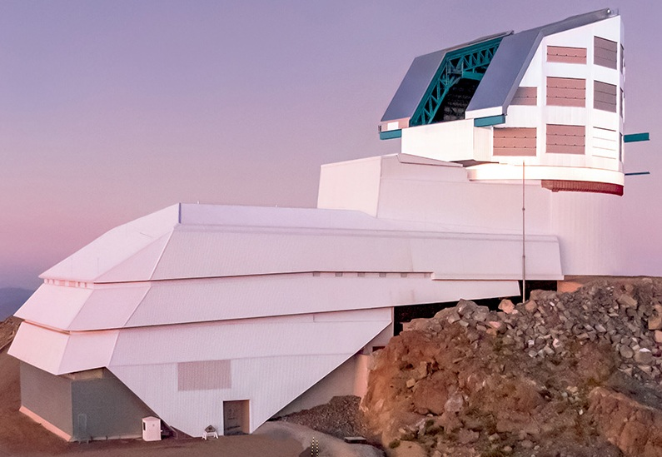

Conclusions
Very few blazar-neutrino spatio-temp. associations (even with more data)...
  $⟹$ Origin of most HE neutrinos still remains a mystery
In the future, we plan to apply our methods to next-generation data (with a focus on the southern sky), e.g.:
  Neutrinos: KM3NeT ($\sim$10$×$ smaller spatial errors)
  Optical: Vera Rubin’s LSST (more LCs)
Image credit: INFN
Kouch et al. (in prep.)
Image credit: RubinObservatory/NOIRLab/NSF/AURA/Y.AlSayyad
10

Slide 11
Conclusions
Link to the relevant papers from our group:
Hovatta et al. (2021, A&A, 650, A83)
Liodakis et al. (2022, A&A, 666, A36)
Kouch et al. (2024, A&A, 690, A111)
Kouch et al. (2025, A&A, 696, A73)
Kouch et al. (2026a, A&A, 708, A382)
Kouch et al. (2026b, A&A, 708, A383)
Very few blazar-neutrino spatio-temp. associations (even with more data)...
  $⟹$ Origin of most HE neutrinos still remains a mystery
In the future, we plan to apply our methods to next-generation data (with a focus on the southern sky), e.g.:
  Neutrinos: KM3NeT ($\sim$10$×$ smaller spatial errors)
  Optical: Vera Rubin’s LSST (more LCs)
Thank you for listening!
Kouch et al. (in prep.)
11

Slide 12
Back up slides
12

Slide 13
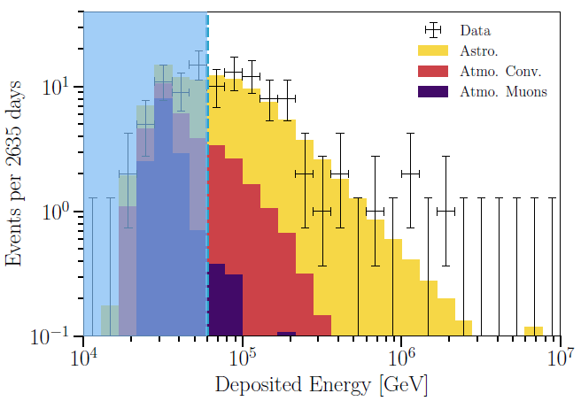

Neutrino spectrum as detected by IceCube
$>60$ TeV
13
Abbasi et al. (2021)

Slide 14
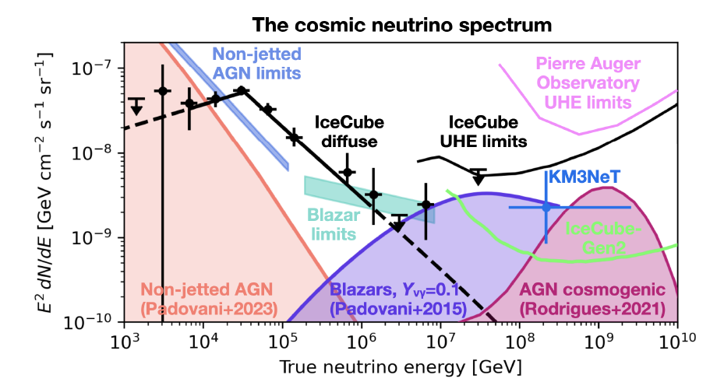
Rodrigues (2026)
14
Notes:
The shaded curves/areas show model predictions
The black line shows the observed data

Slide 15
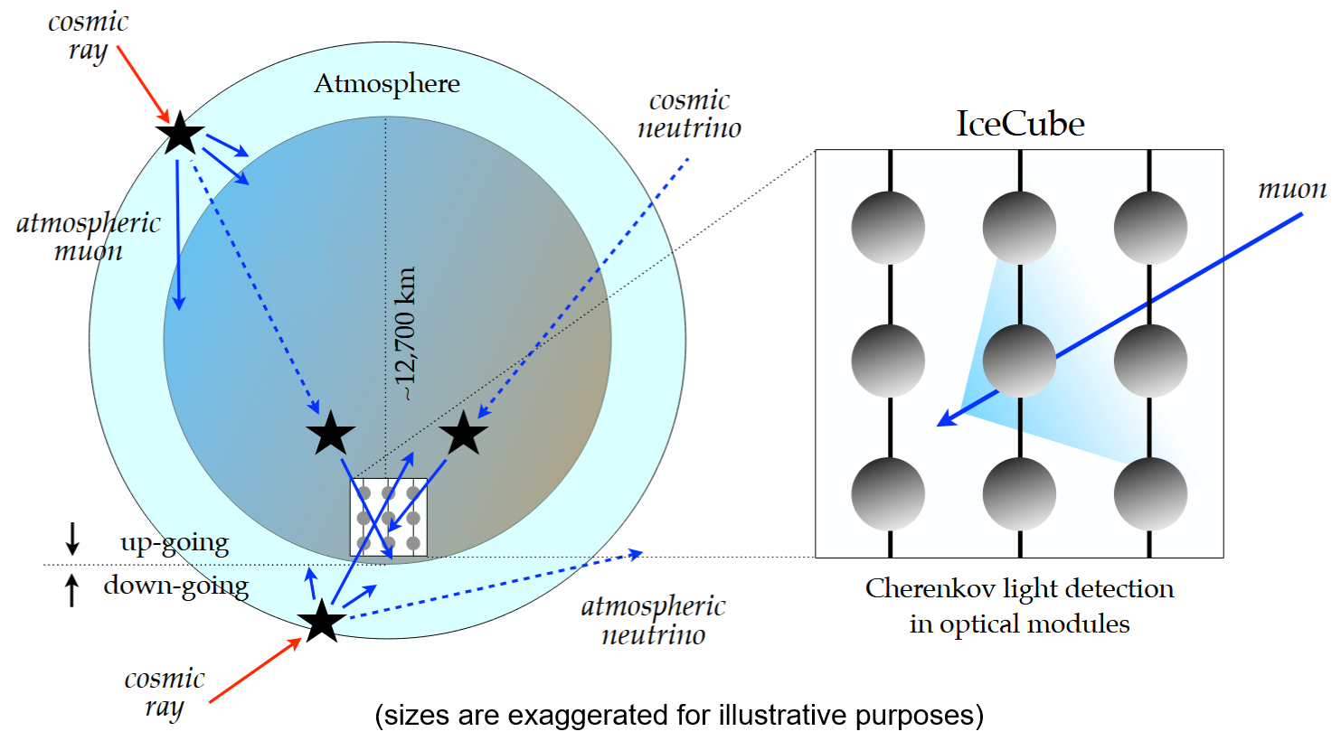
Sketch of IceCube and muon-tracks
Halzen & Kheirandish (2022)
15

Slide 16
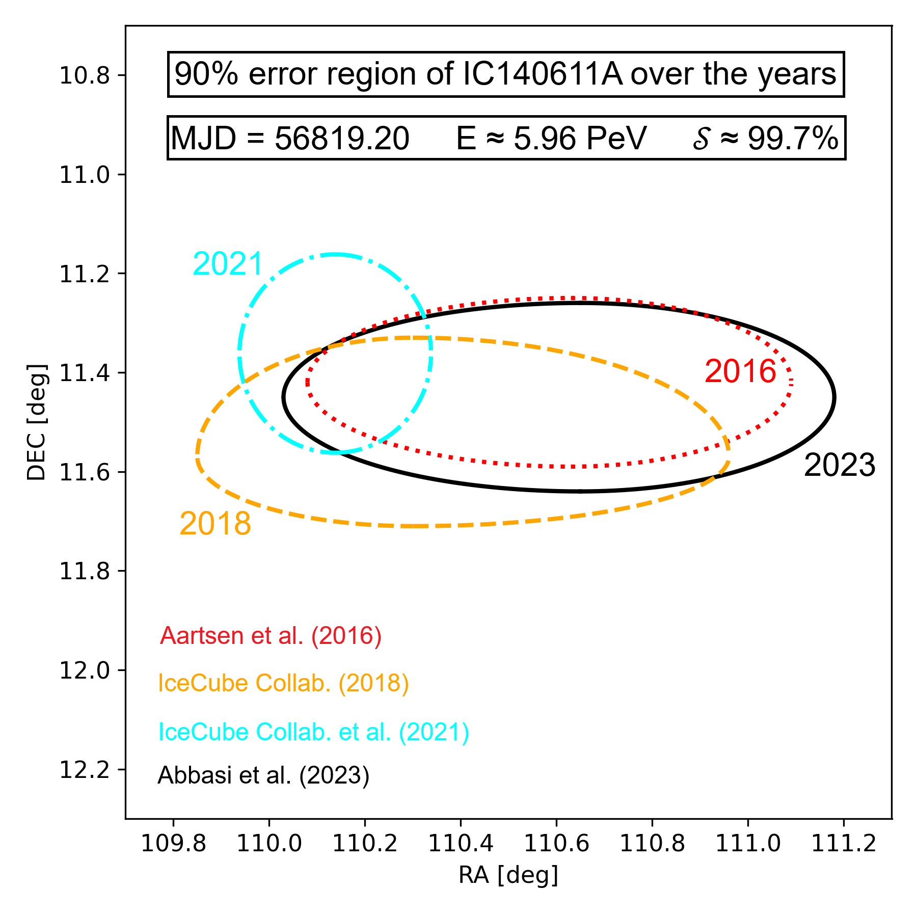
Example of potential systematic errors...
16

Slide 17
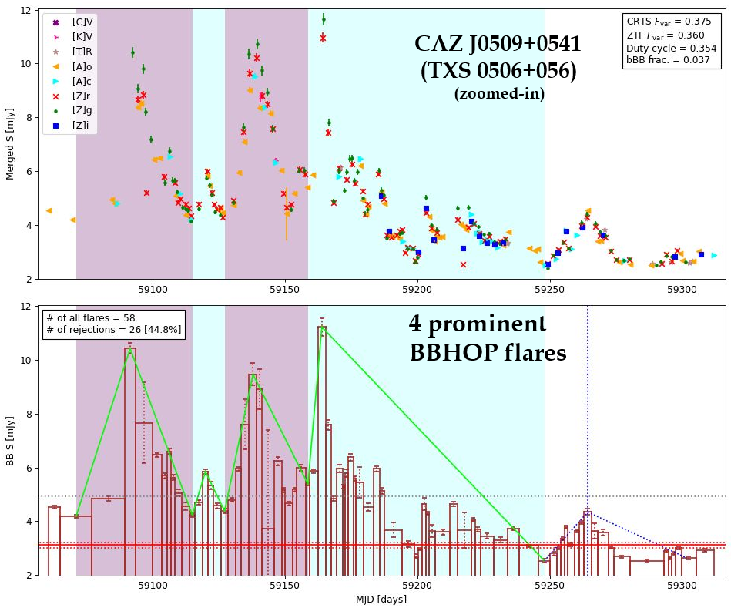
Example CAZ light curve and flares
17

Slide 18
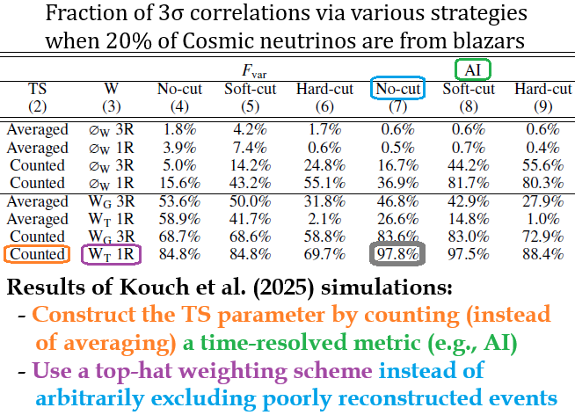

The need for an optimal test strategy
Some test strategies offer higher detection power
We performed extensive Monte Carlo simulations in Kouch et al. (2025) to determine the most optimal test strategy
Even if only 20% of cosmic neutrinos are from blazars, $\sim$4$σ$ detections are expected
18

Slide 19
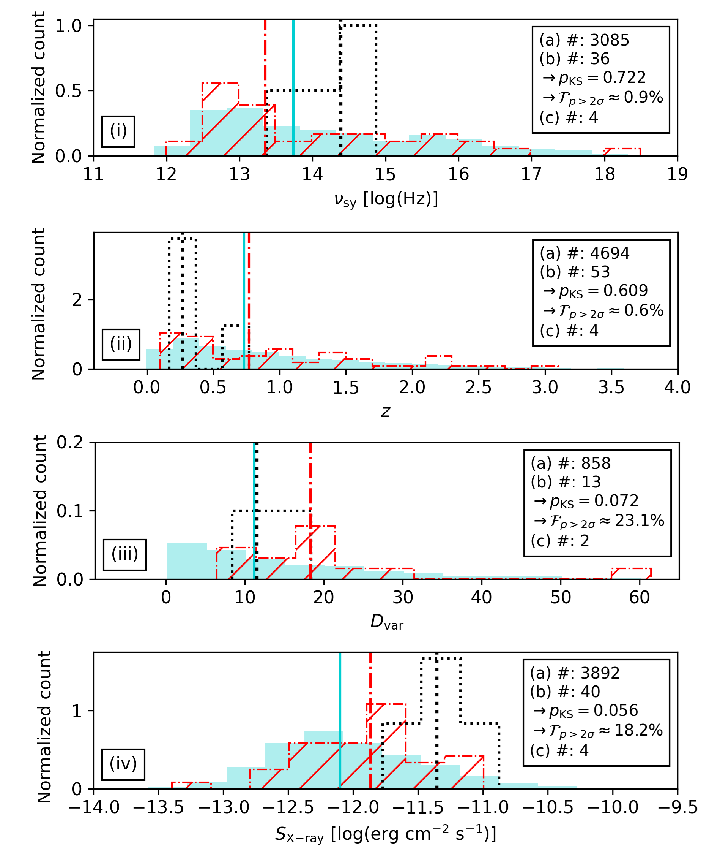

Physical properties of neutrino-assoc. blazars
Sync. peak freq.
Physical properties of
neutrino-assoc. blazars
in comparison to
all blazars
Neutrino-associated blazars show:
  No clear preference in terms of $υ_{sy}$ and $z$
  A hint of higher than average Doppler factor
  A hint of higher than average X-ray flux
Redshift
Doppler factor
X-ray flux
19
Notes:
Around 50% of spatially associated neutrinos fall in a gap and are excluded from the analysis
Statistical significance of these trends are weak...

