Slide 1


MUSE IFU investigation of nearby (U)LIRGs
From Birth to Death - studying the evolution of Massive Stars
Linking Star Formation, Transients, and Galaxy Evolution
Suman Sahu
Supervisors: Seppo Mattila, Petri Väisänen
Department of Physics and Astronomy, Faculty of Sciences

Slide 2

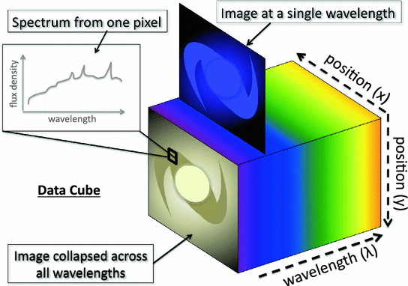
Introduction
Introduction
(U)LIRGs: Emit >10¹¹ solar luminosities in the infrared.
Characterized by intense, dust-obscured star formation.
Often the result of galactic mergers.
The Power of MUSE: Multi-Unit Spectroscopic Explorer on the VLT.
An Integral Field Unit (IFU): Captures a full spectrum for every single pixel in the image.
This creates a 3D "data cube" (X, Y, and wavelength).
Allows us to create 2D maps of:
Gas and star velocity, Dust extinction, Star Formation Rate (SFR), Metallicity,

Slide 3


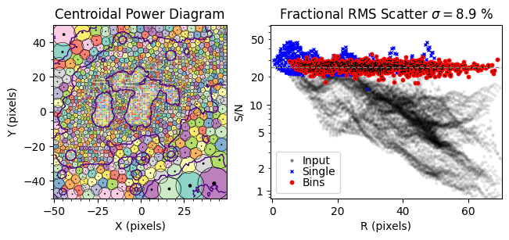
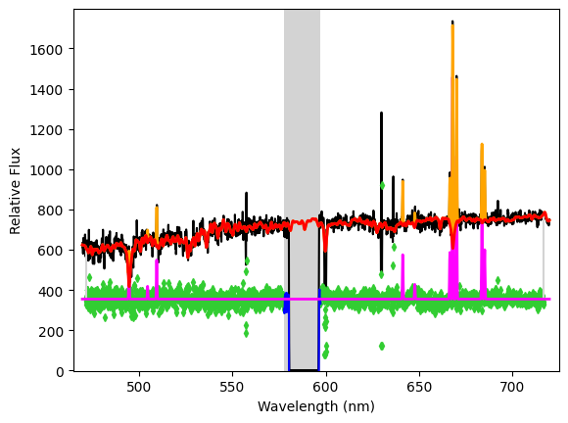
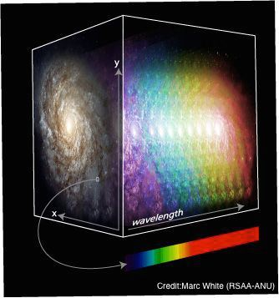
Semi Automated pipeline for Spectral Fitting:
PowerBin: Fast Adaptive Data Binning by Cappellari (2025)
pPXF: Penalized PiXel-Fitting method by Cappellari (2017)
Various Spectral and Spatial properties
(2D property Maps)

Slide 4
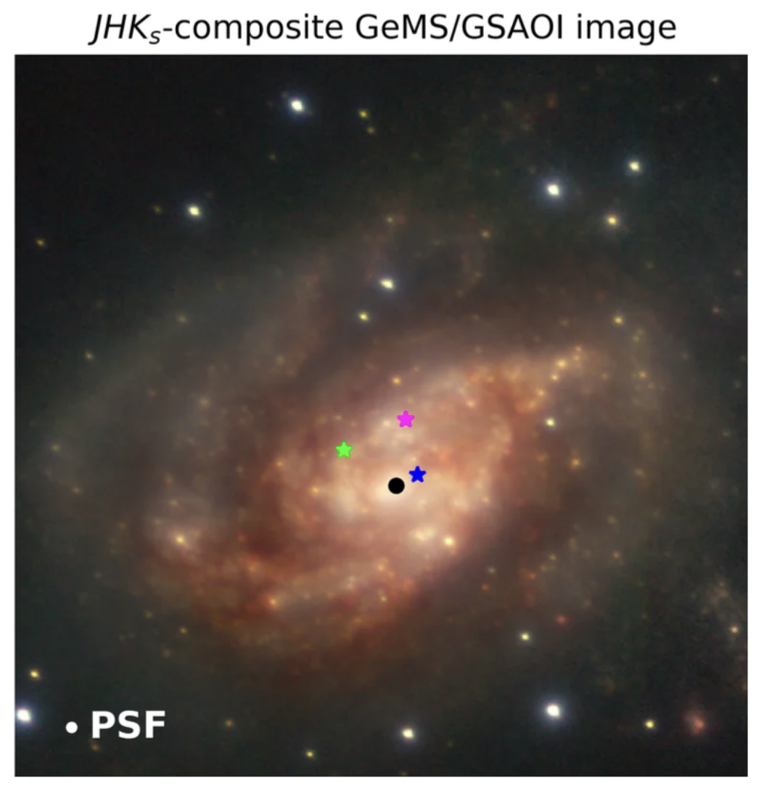
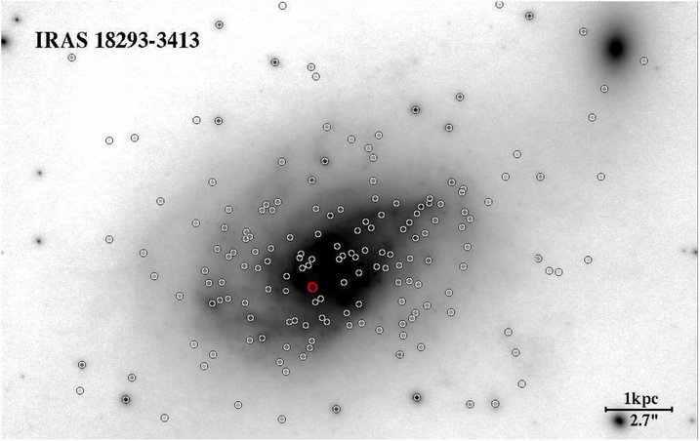
Introduction
The case of IRAS 18293-3413:
Known to have hosted many (~204) Young Massive Clusters and core-collapse supernovae (CCSNe): SN 2004ip, SN 2012iz, and SN 2013if.
Young Massive Cluster sites in IRAS 18293-3413
SNe sites in IRAS 18293-3413

Slide 5
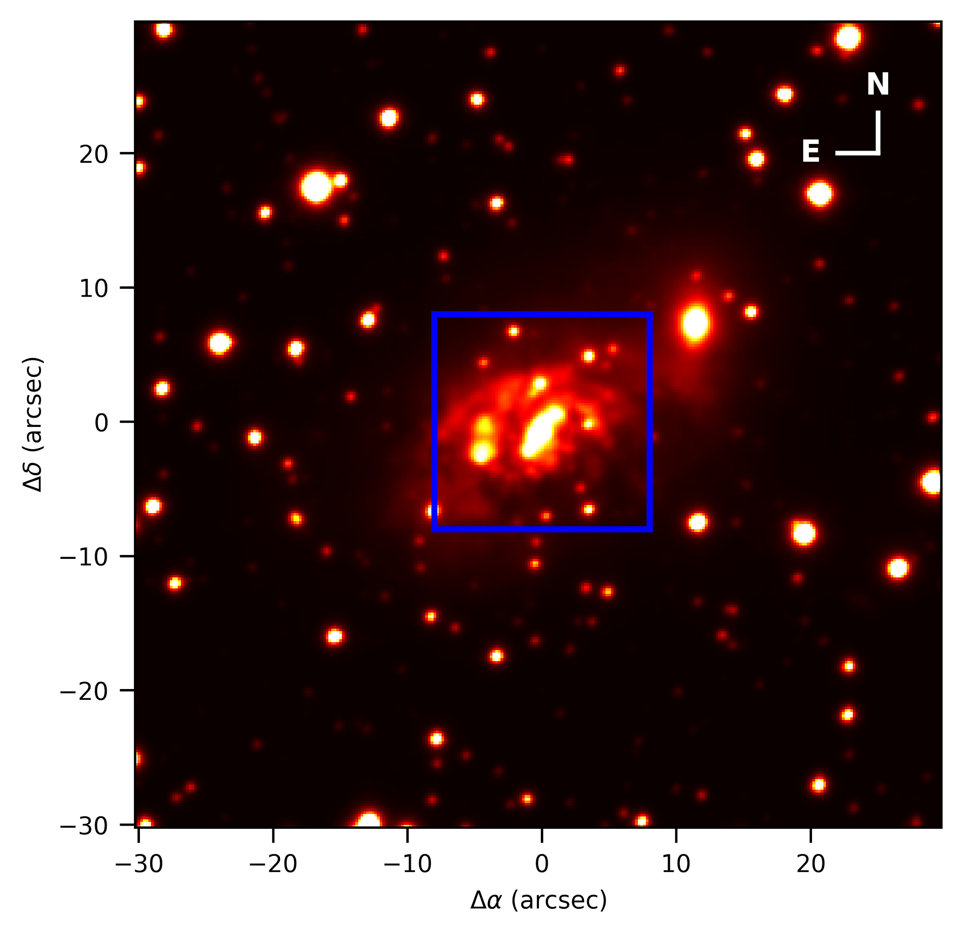
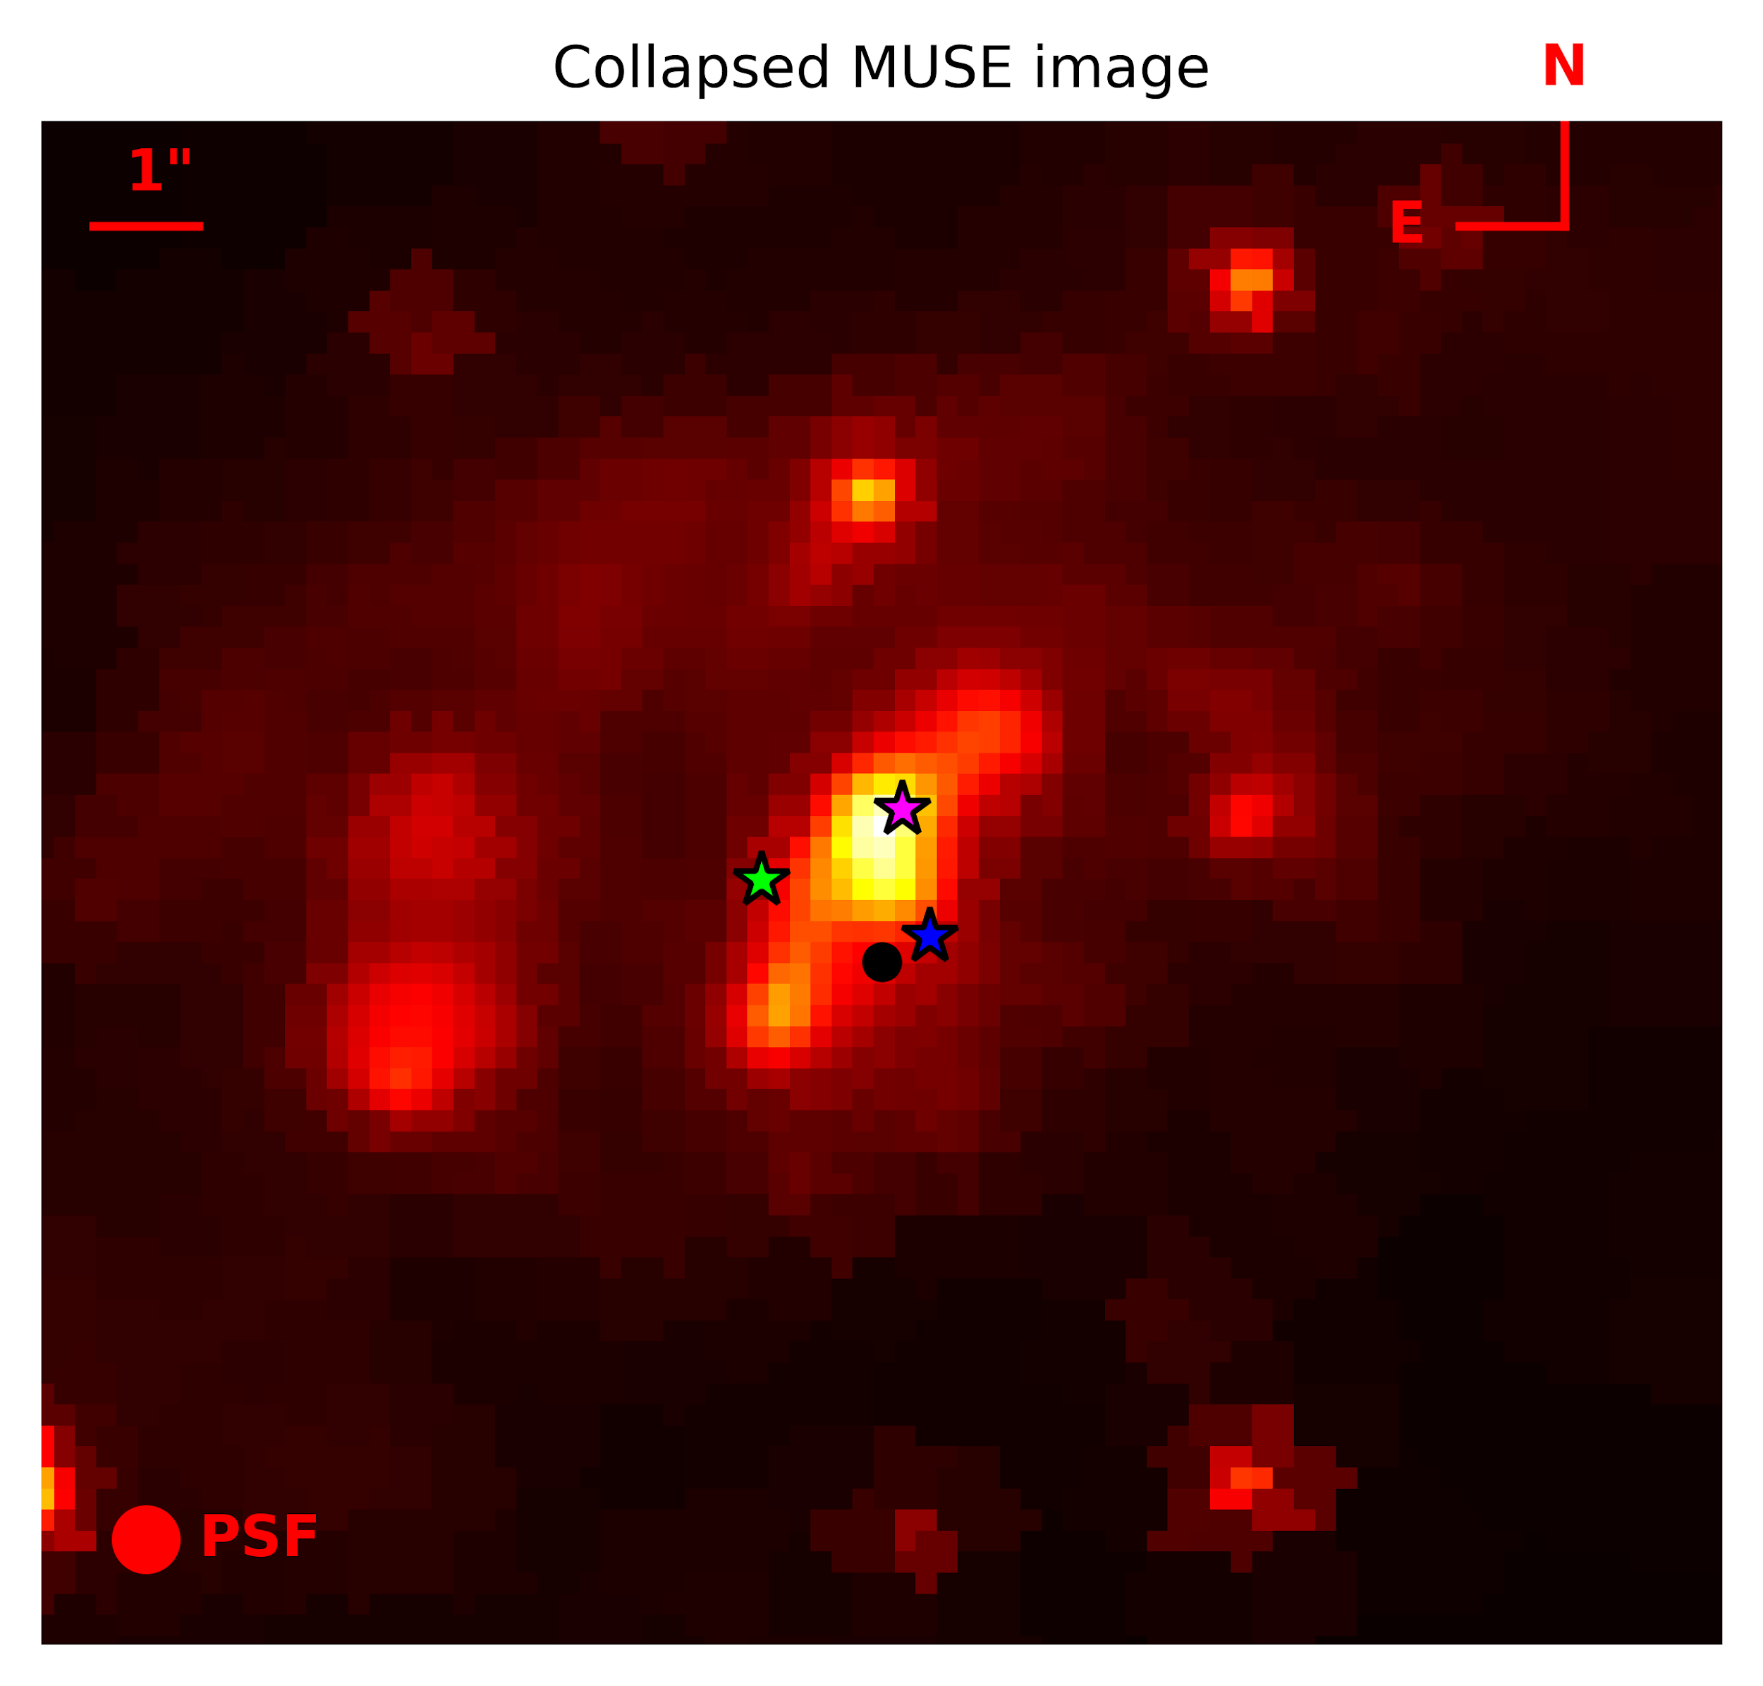
Introduction
The case of IRAS 18293-3413:
Known to have hosted many Young Massive Clusters and core-collapse supernovae (CCSNe):
  SN 2004ip, SN 2012iz, and SN 2013if.

Slide 6
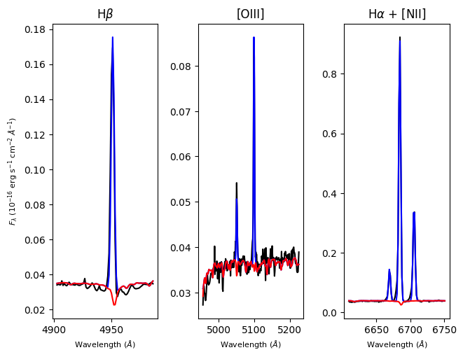
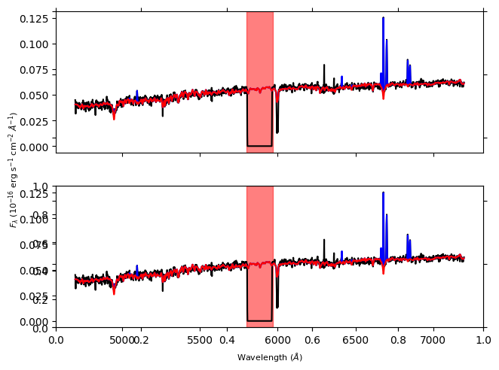
Spectral Fitting with pPXF - Emission Lines
Fig. : Spectral fitting results of the spectrum (in observed wavelengths) of a bin in the outer regions, composed of 26 spaxels, showcasing both absorption and emission features, and its fitted emission lines. Spectrum in observed wavelengths is shown in black, the continuum fit in red and the superimposed emission line fits in blue. Note the masked region between 5800- 5970 Å due to the NaD laser

Slide 7
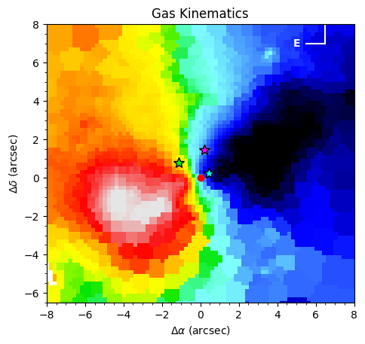
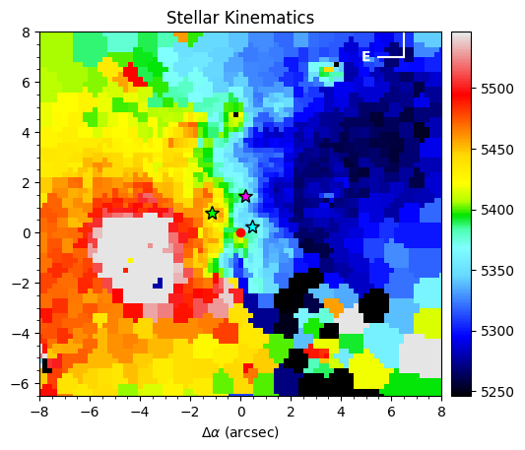
Galaxy Kinematics
Gas Velocity: Shows a surprisingly smooth, rotating disk.
Stellar Velocity: Follows the gas but is more disturbed.
Despite its patchy appearance, the galaxy has an underlying ordered rotation.

Slide 8
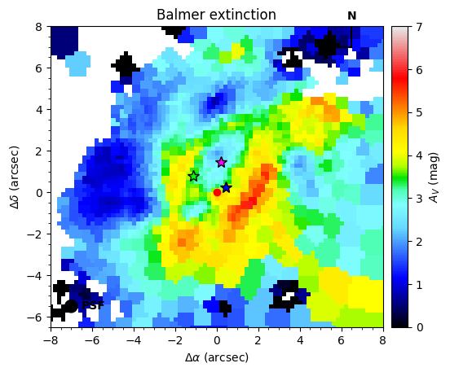
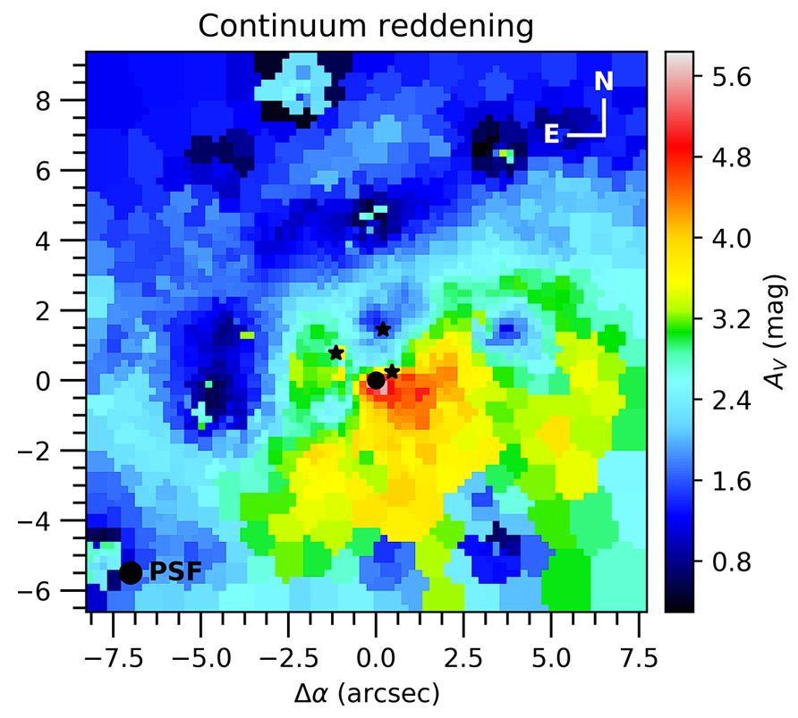
Introduction
Mapping the Dust
The regions of active star formation are even more dust-obscured (up to 6 magnitudes of extinction in V-band) than the galaxy as a whole. The true nucleus is completely hidden in the optical.
Balmer Extinction (Left): Dust mixed in with the star-forming regions. Peaks in a thick band south of the nucleus.
Continuum Reddening (Right):
Dust affecting the general starlight. Peaks at the true nucleus.

Slide 9
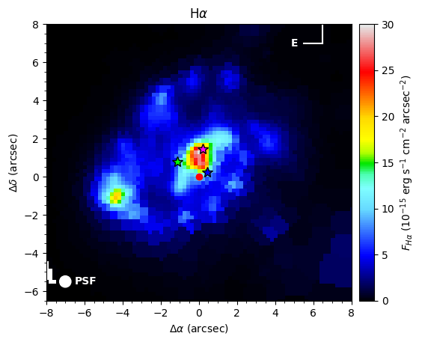
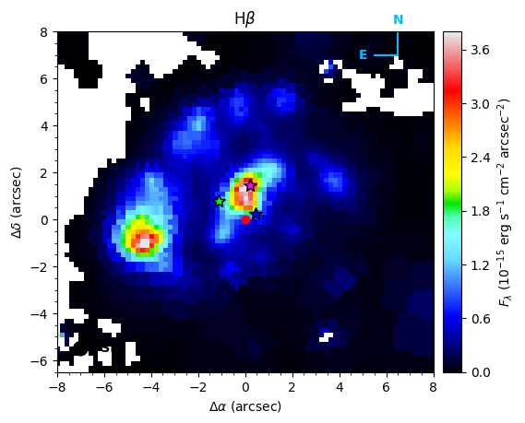
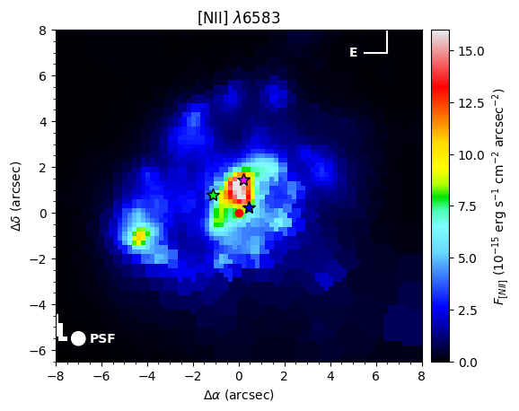
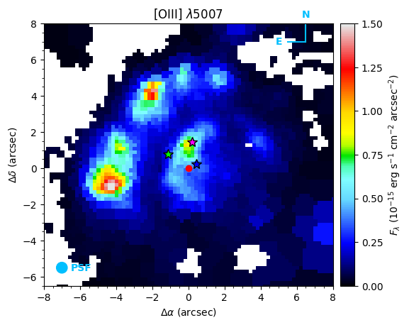
Emission Line Maps:
Observed emission line fluxes of H (top left), H (top right), [NII] (bottom left) and [OIII] (bottom right), corrected for Galactic foreground extinction.
Some spaxels have been masked based on AoN. The AO corrected PSF is shown, as are the SN sites indicated by black stars and the near-IR nucleus indicated by the red circle.

Slide 10
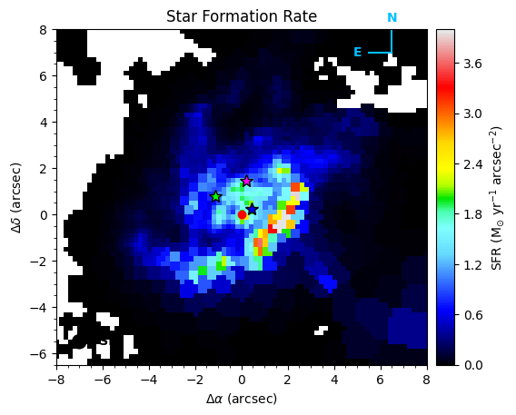
Introduction
The Star Formation Rate
  Used the H-alpha emission line to trace ongoing star formation.
  Corrected the H-alpha flux using our Balmer extinction map.
Results:
Total uncorrected SFR = 2.9 M☉/yr.
Total dust-corrected SFR = 55 M☉/yr!
Star formation is concentrated in the dusty spiral arm, not at the nucleus.

Slide 11
Introduction
The Big Question: Do Supernovae Trace Star Formation?
Expectation:
Core-collapse supernovae come from massive, short-lived stars, so they should occur where star formation is most intense.
Observation:
The three SNe are NOT located in the peak star-forming spiral arm. They are in regions of moderately high SFR, but not the highest.
Why? The answer is observational bias.
The regions with the highest SFR are also the most heavily obscured by dust. It's incredibly difficult to see a supernova explode there, even in the near-infrared.

Slide 12
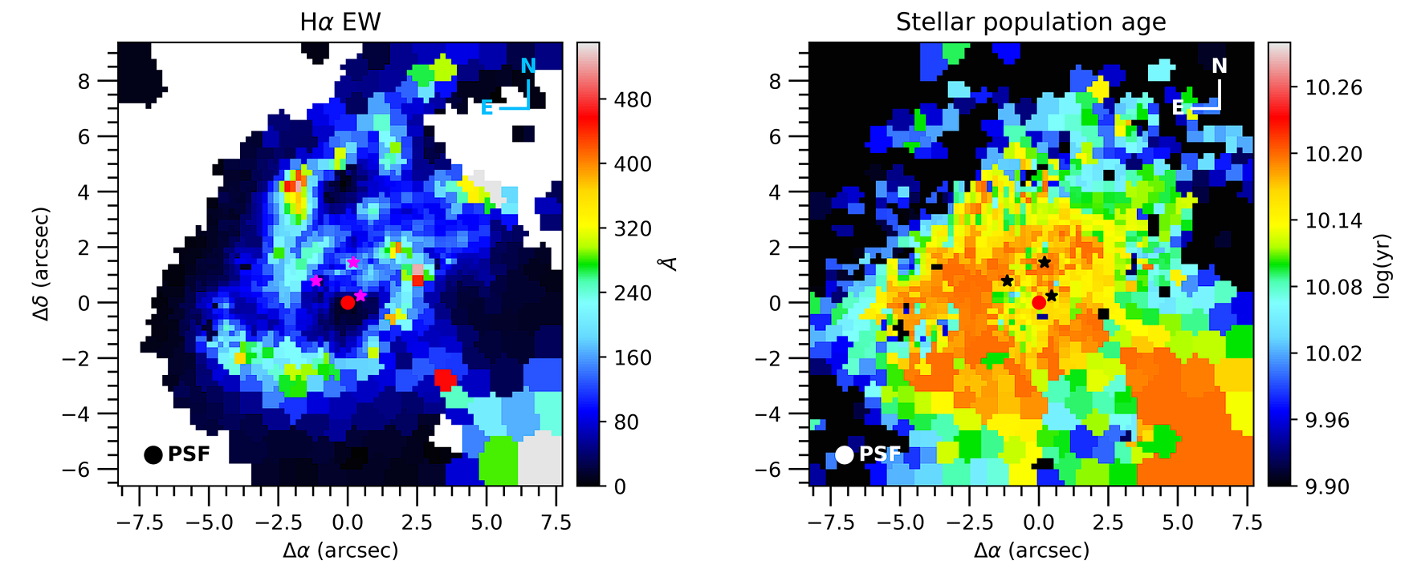
Introduction
EW and Age
Fig: Ha EW corrected for dust extinction and continuum reddening on the left. Continuum fitted stellar population MW age on the right

Slide 13
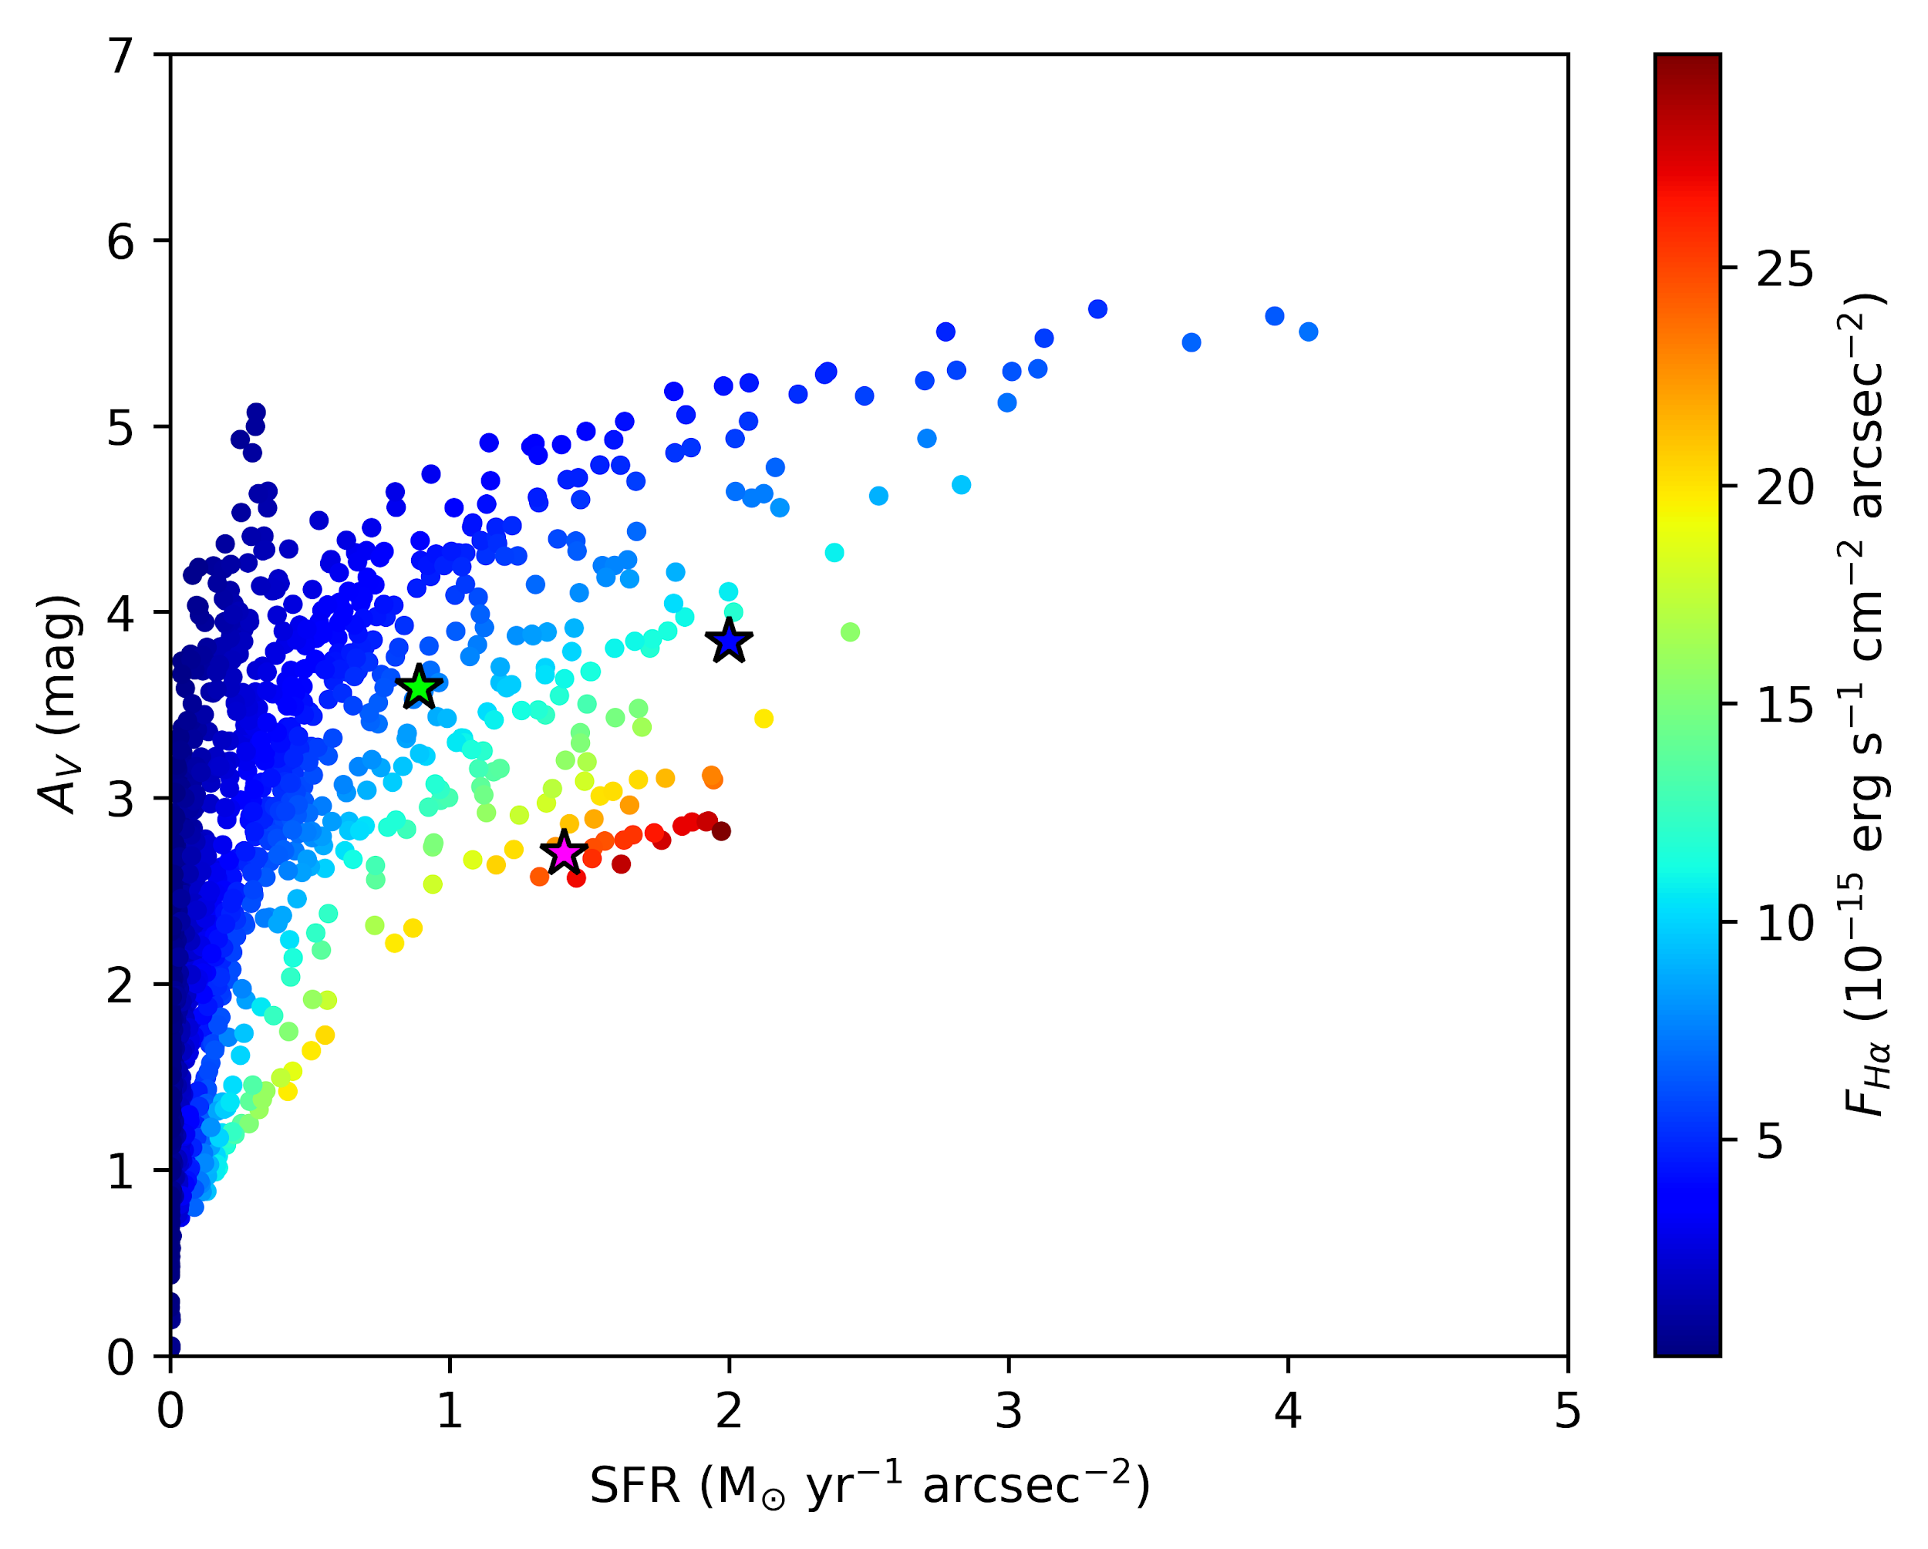
Introduction
Observed H-alpha: Tracer for SN Discovery?
What happens if we look at the observed H-alpha map without dust correction?
This map effectively shows a combination of two factors: where star formation is high AND where extinction is moderately low.
Result: The three supernovae cluster neatly around the peak of the observed, uncorrected H-alpha map.
Conclusion: SN discoveries in LIRGs don't trace the true SFR, but rather a combination of SFR and visibility.
But it is too less of sample size to tell anything, it is mostly observational bias

Slide 14
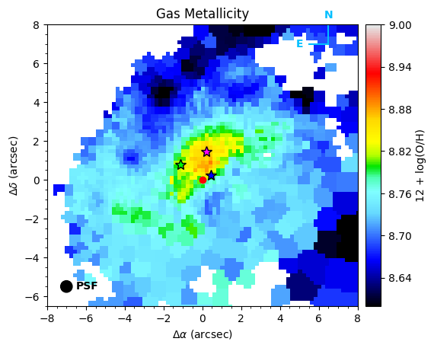
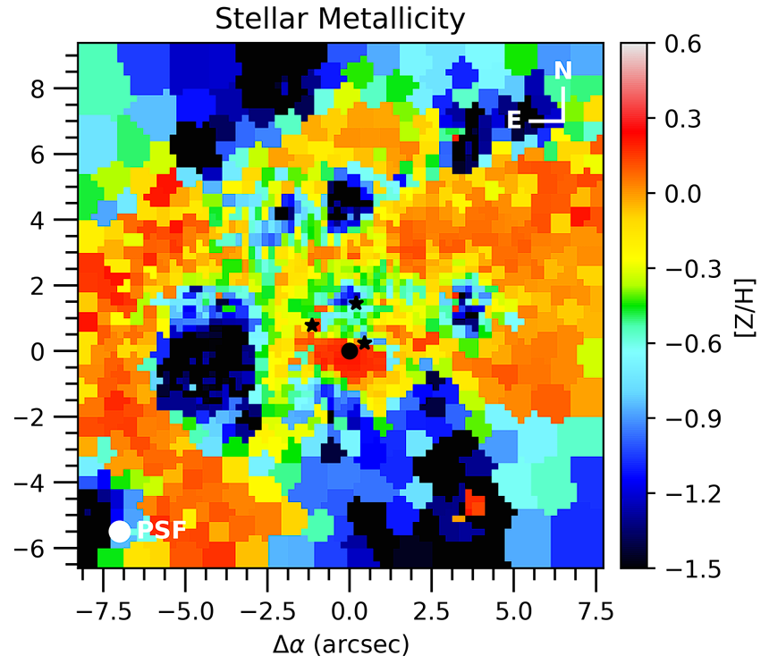
Introduction
Metallicities

Slide 15
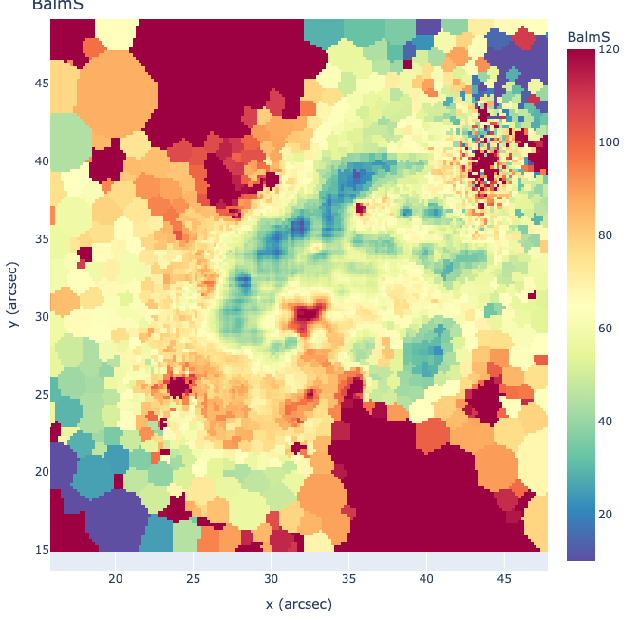
Introduction
Velocity Dispersion

Slide 16
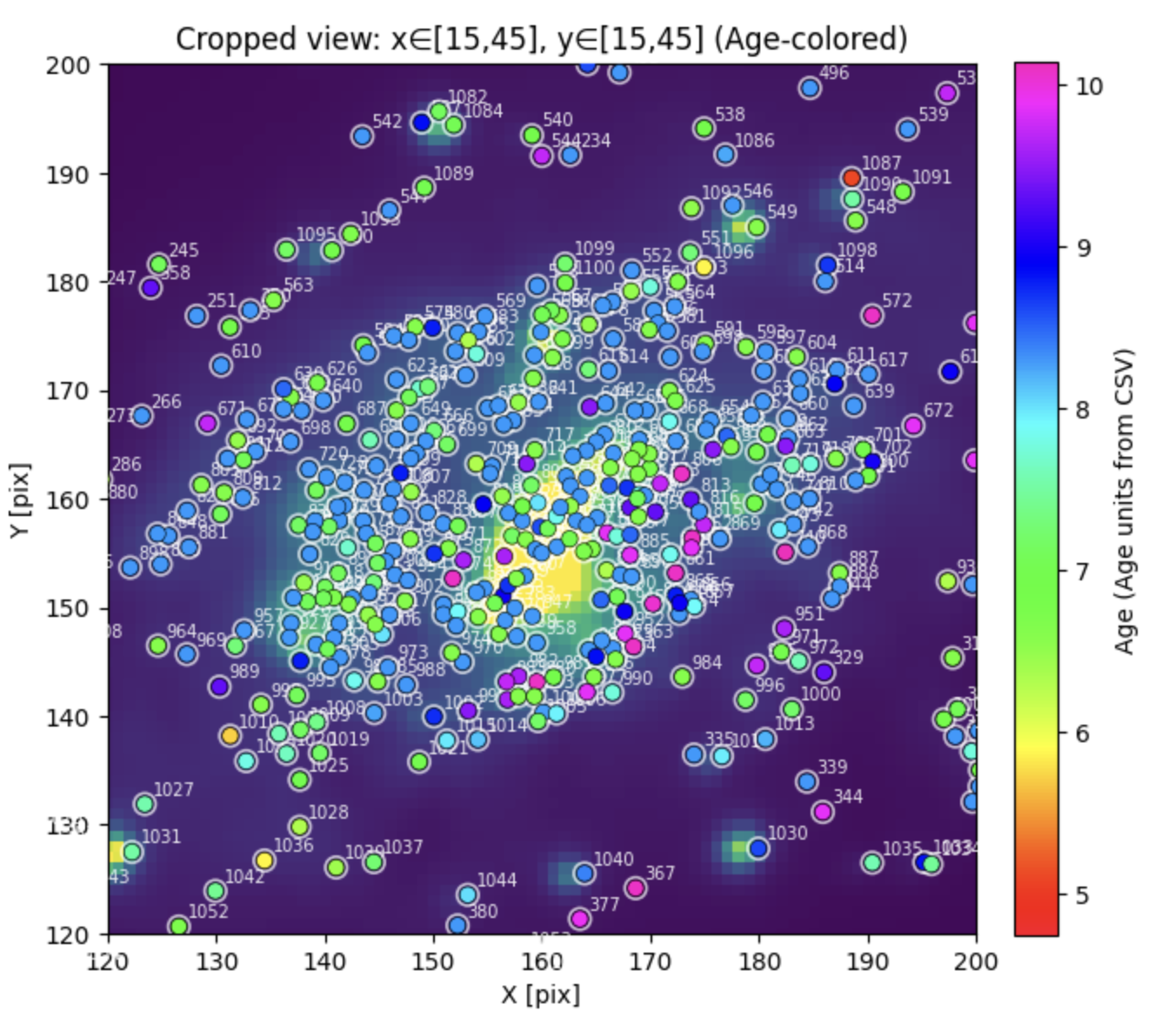
Introduction
YMC Age Dist.

Slide 17
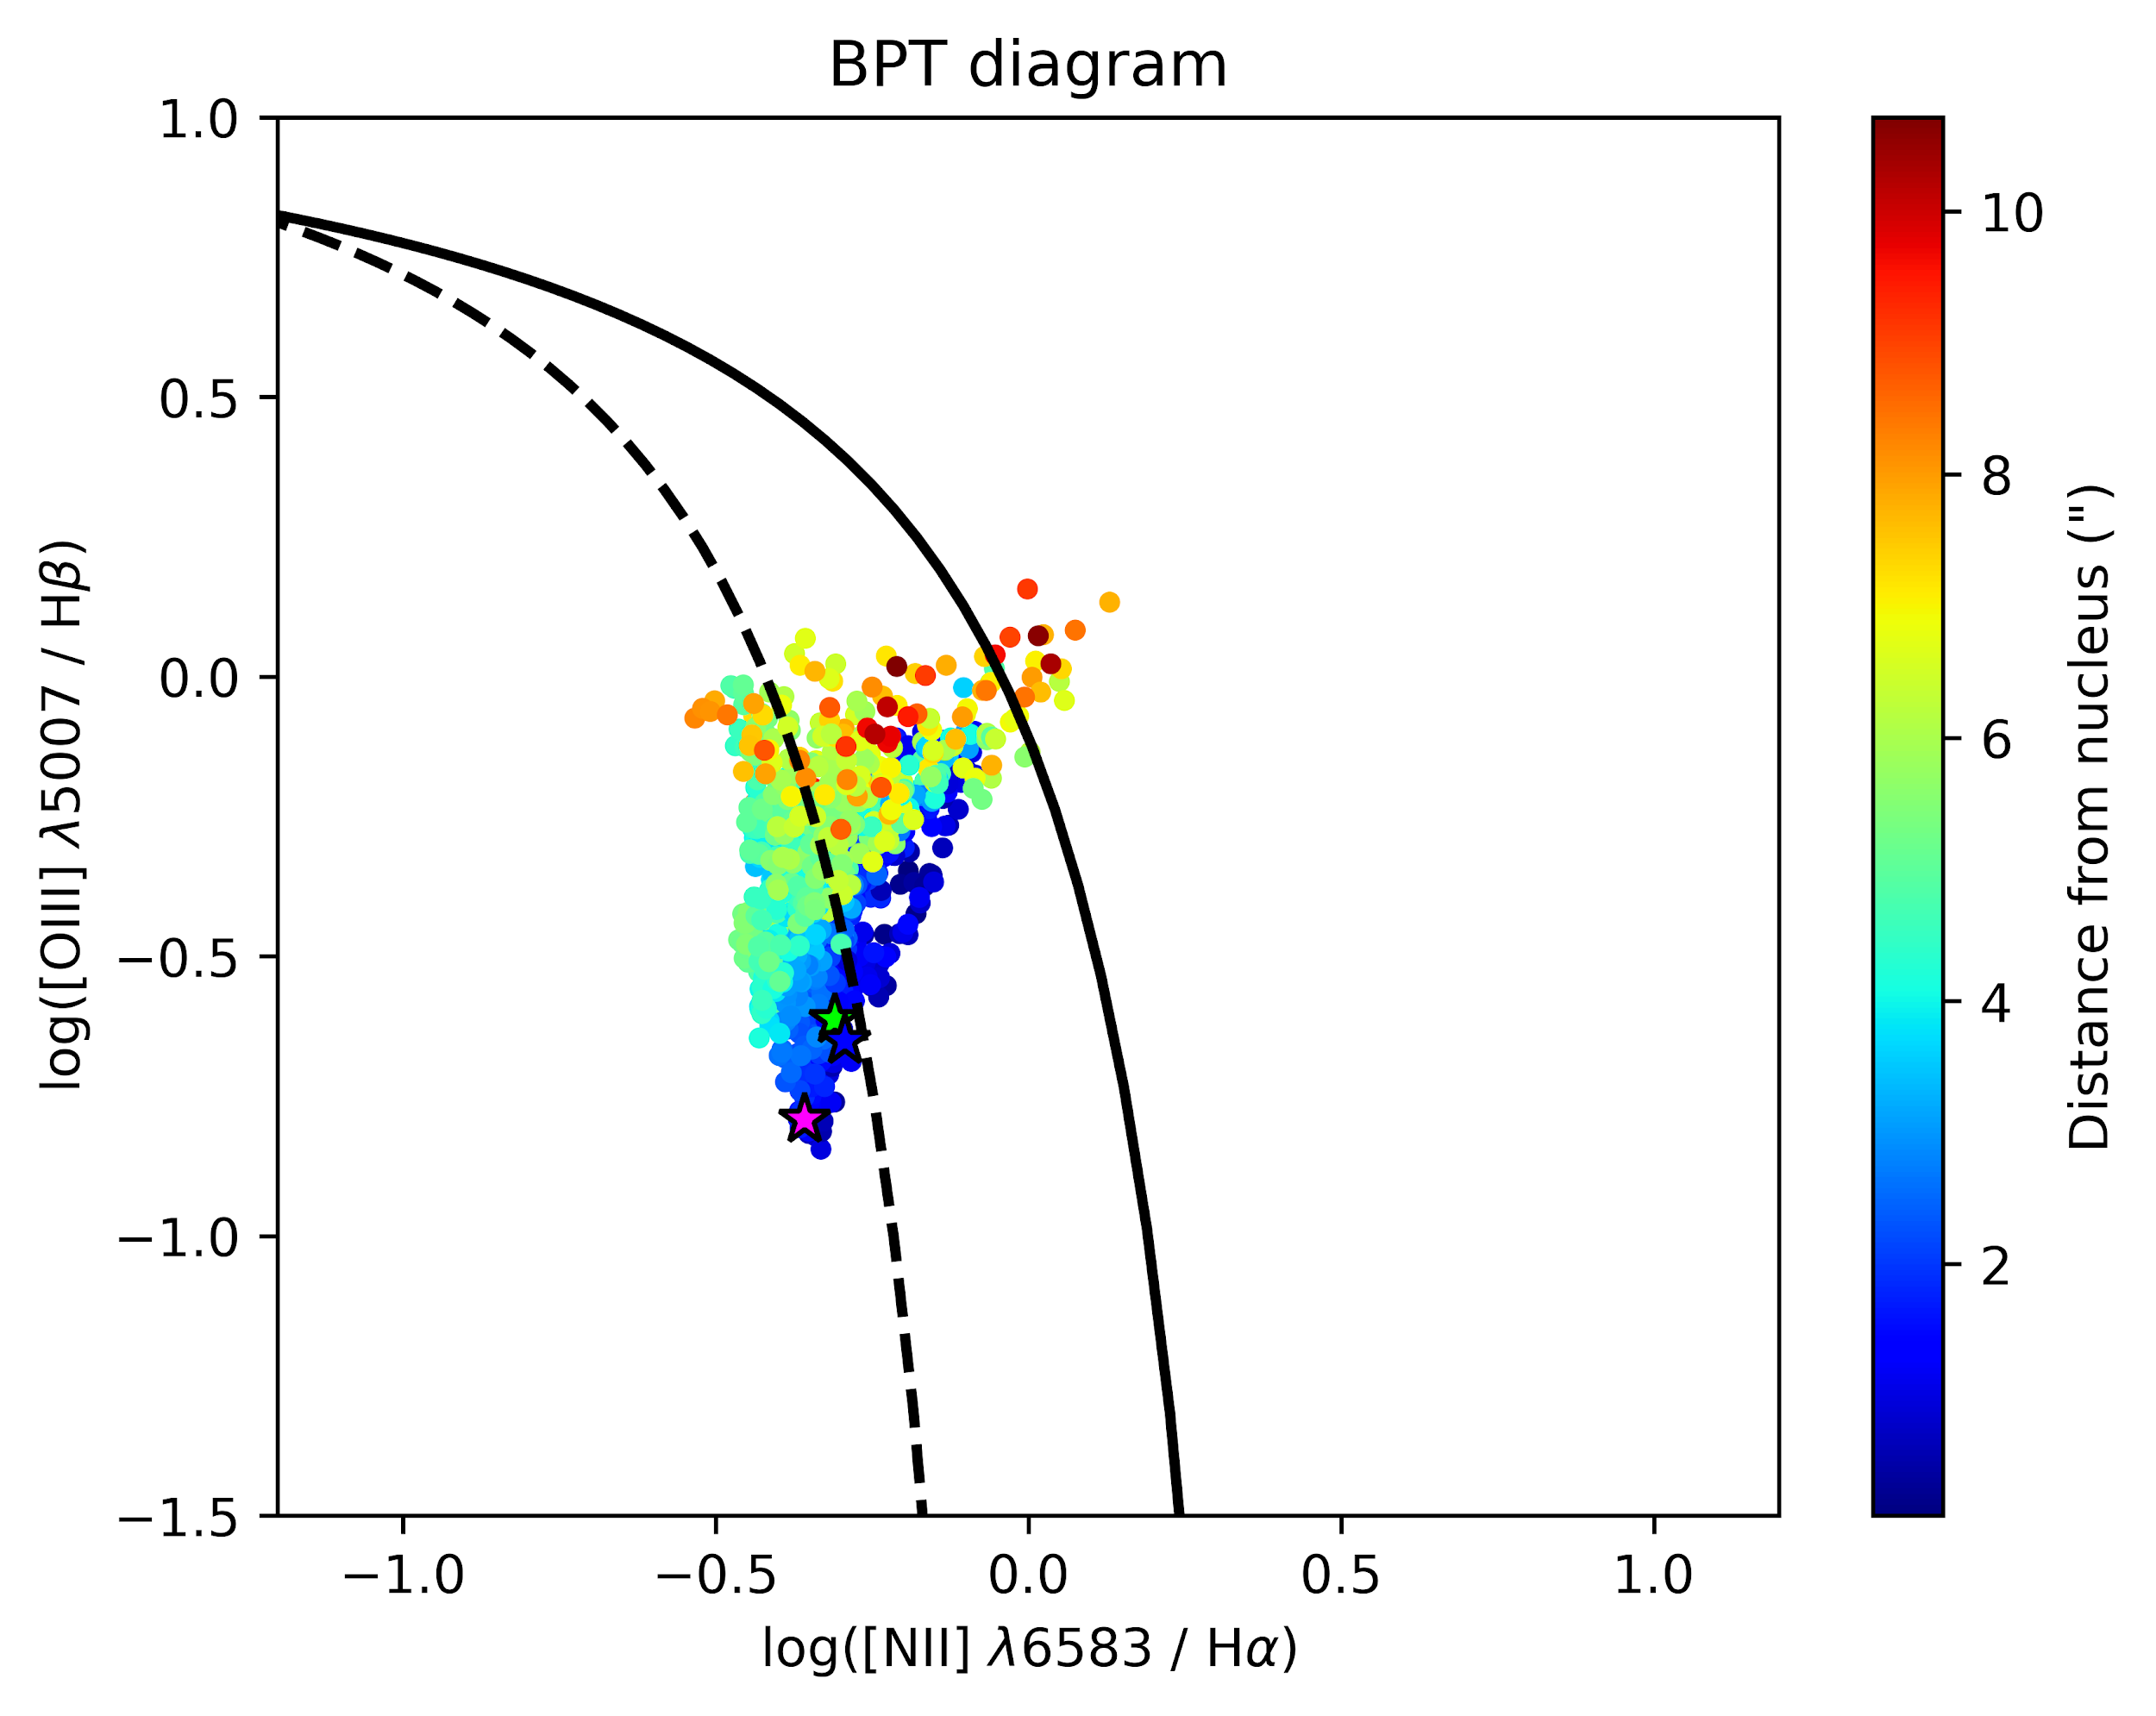
Introduction
BPT Diagnostic Plots

Slide 18
Introduction
Objective of the Project
Investigate how extragalactic transients influence galaxy evolution, specifically within dusty, high-star-formation environments.
Objectives include:
Quantify cluster formation efficiency (Γ)
Resolve the “missing” supernova problem
Connect YMCs and transient sites and the role of AGN towards triggering them
Characterize gas inflows/outflows
Perform SED & radiative transfer modeling
Birth Sites: Young Massive Clusters (YMCs)
High cluster formation efficiency (Γ)
Death Sites: Core-collapse SNe and transients
Goal: Connect YMC populations to transient locations to trace the full stellar life cycle.
Theoretical and Simulation Work:
Model feedback processes between transients, AGN, and YMCs, by utilizing various statistical methods

Slide 19
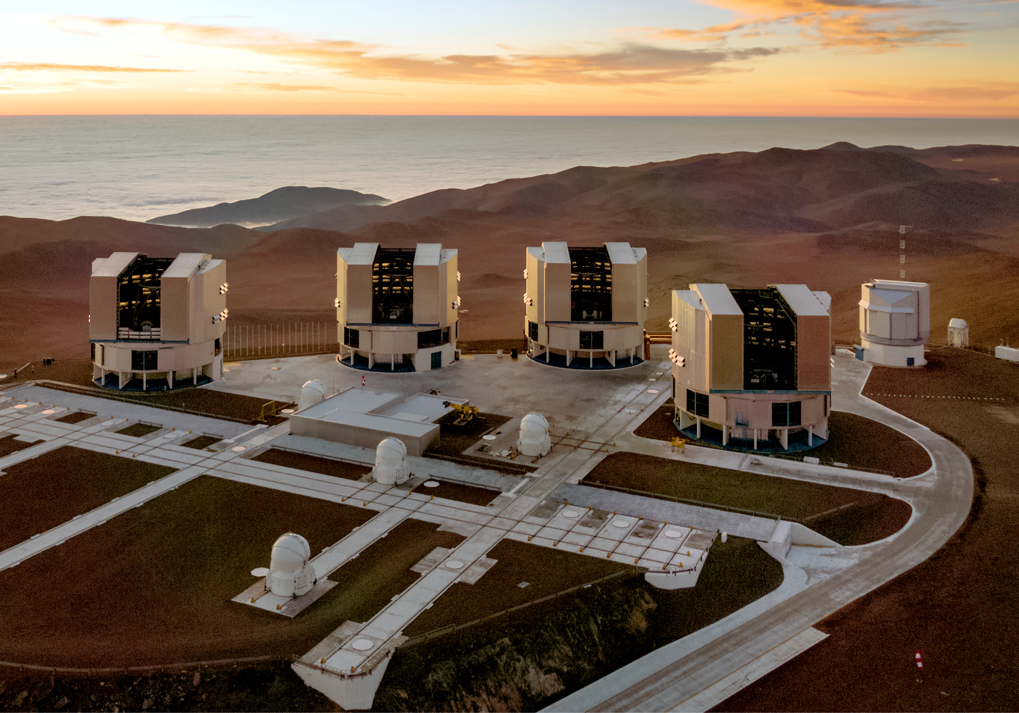
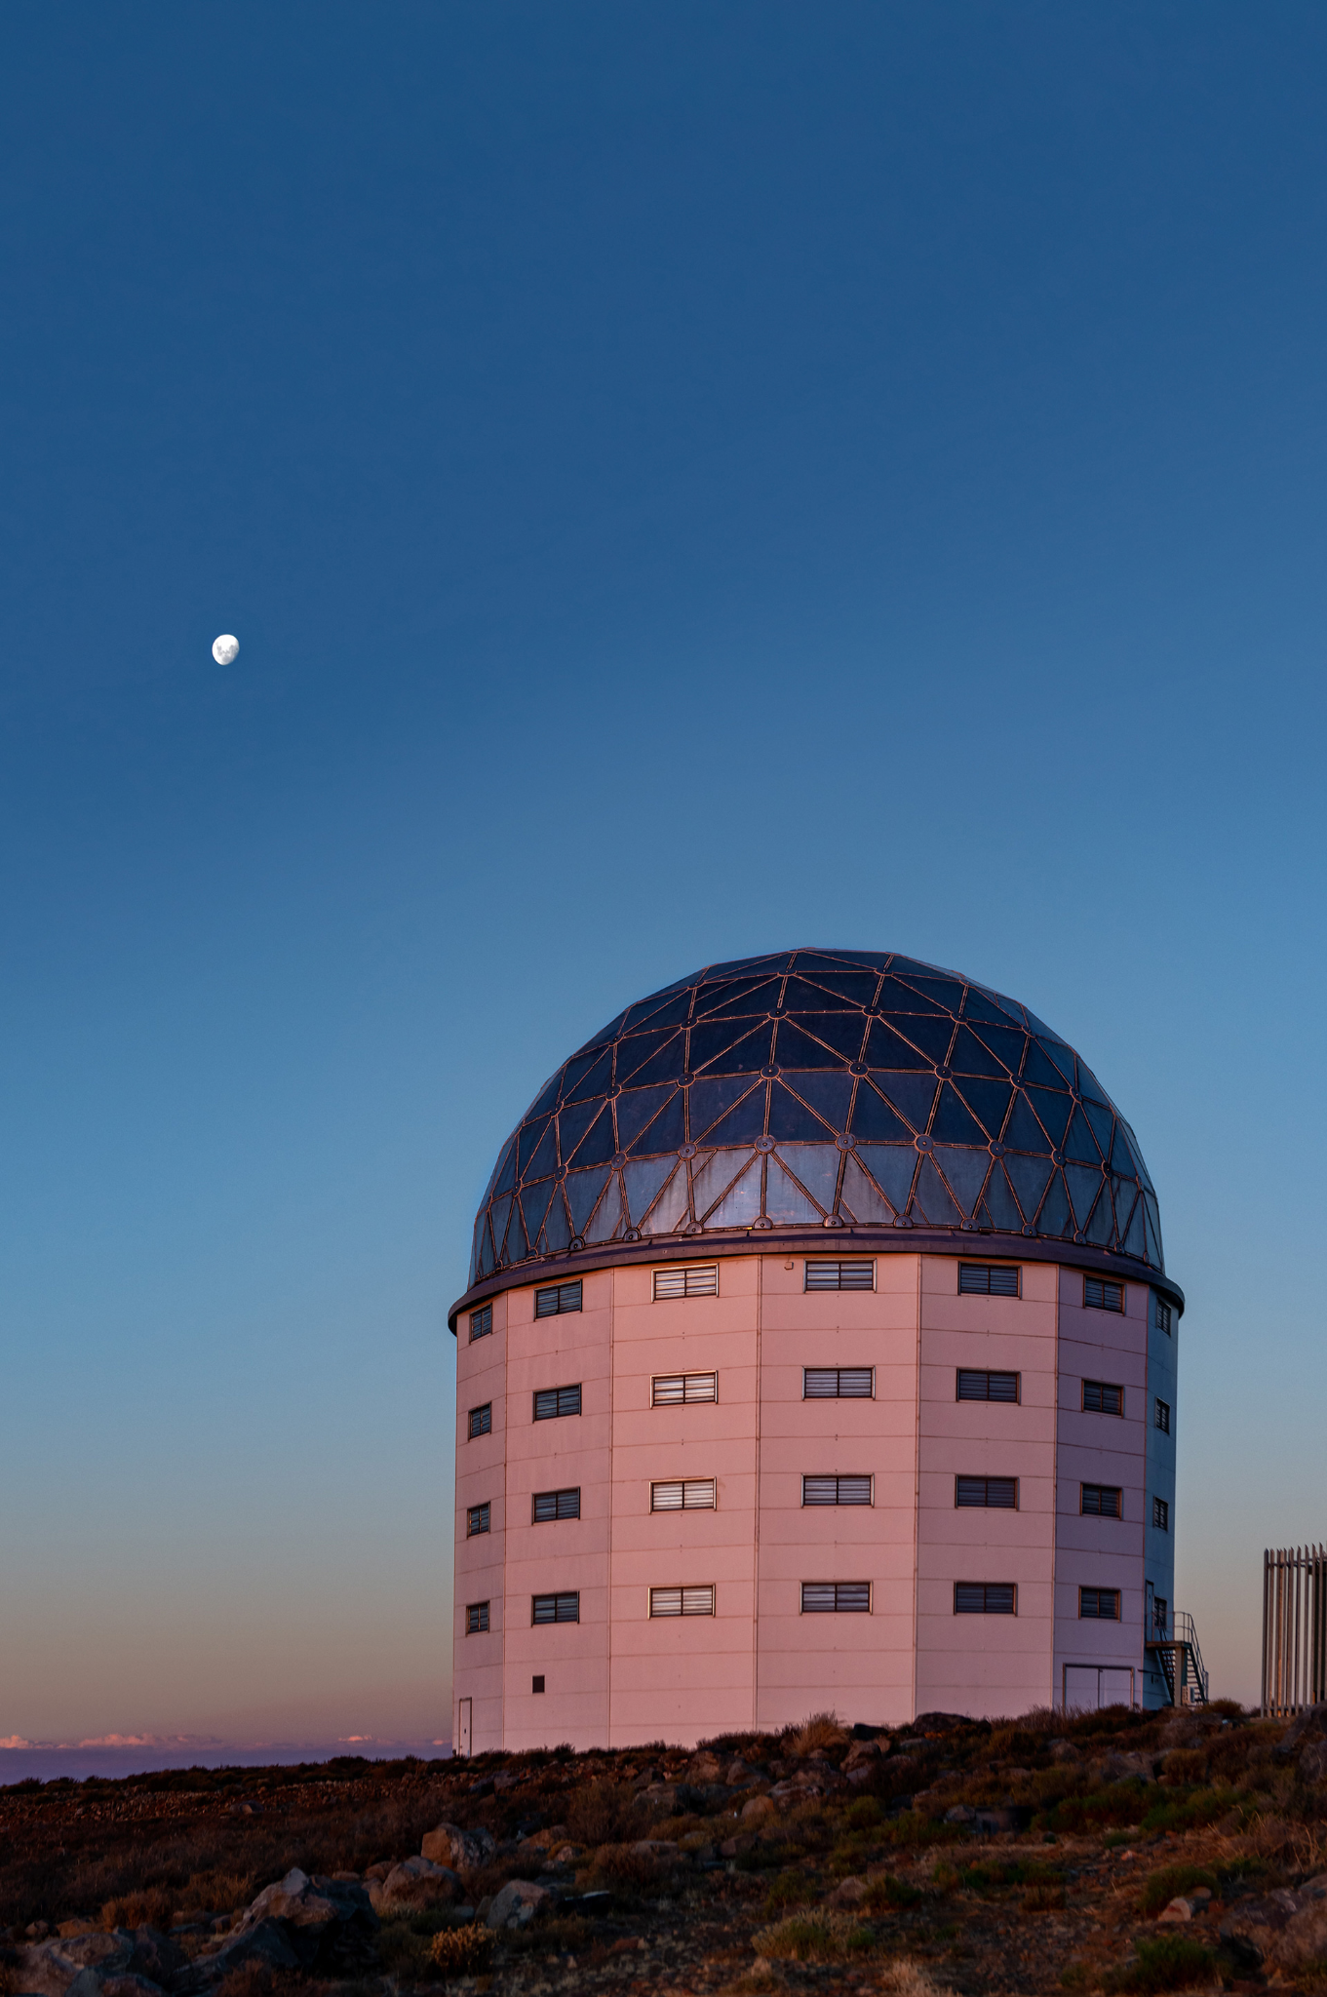
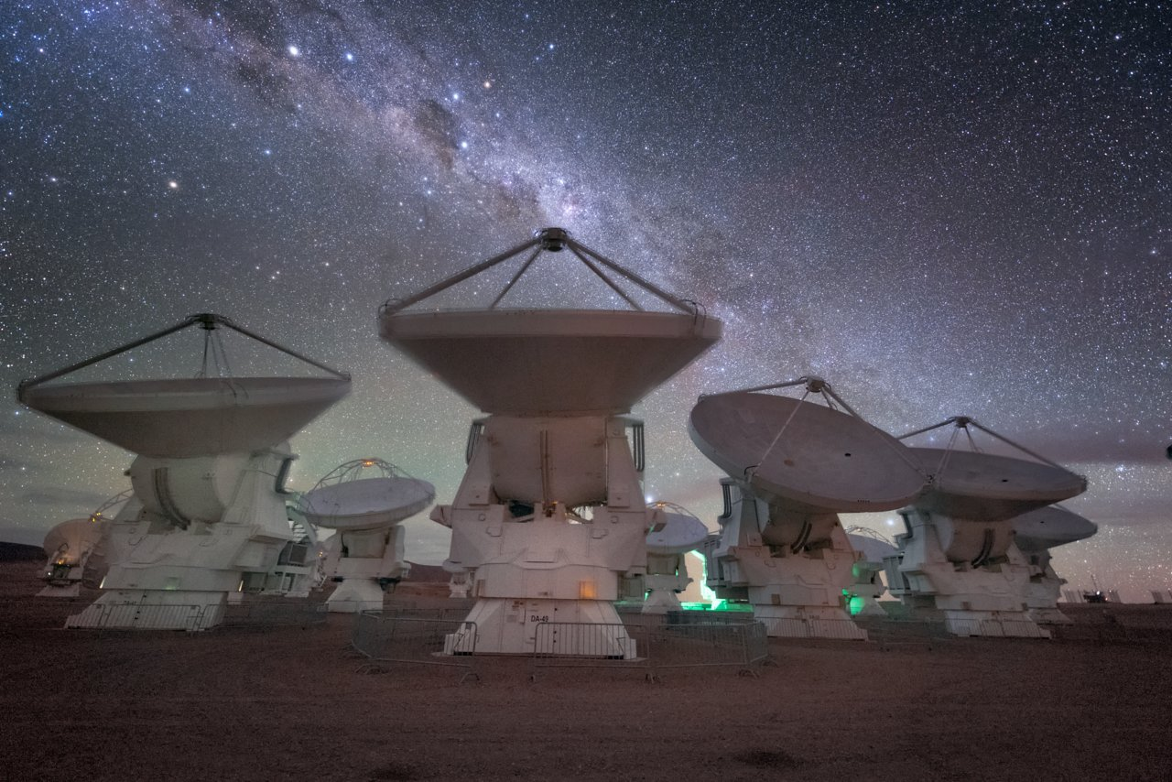
Introduction
Objective (cont.)
Multiwavelength Approach- Observational Strategy (alao SUNBIRD samples)
Optical IFU: VLT/MUSE, SALT
Ionized gas, BPT diagnostics, kinematics
NIR IFU: VLT/ERIS, SALT
Penetrate dust (Brγ, [Fe II], H₂)
Sub-mm: ALMA
Cold molecular gas reservoirs, Inflows/outflows
AO imaging for hidden SNe detection
Data Analysis Techniques:
Integral Field Unit (IFU) spectroscopy for detailed spatial resolution.
Spectral Energy Distribution (SED) fitting using radiative transfer models to derive galaxy parameters (e.g., star formation rates, dust temperatures).

Slide 20
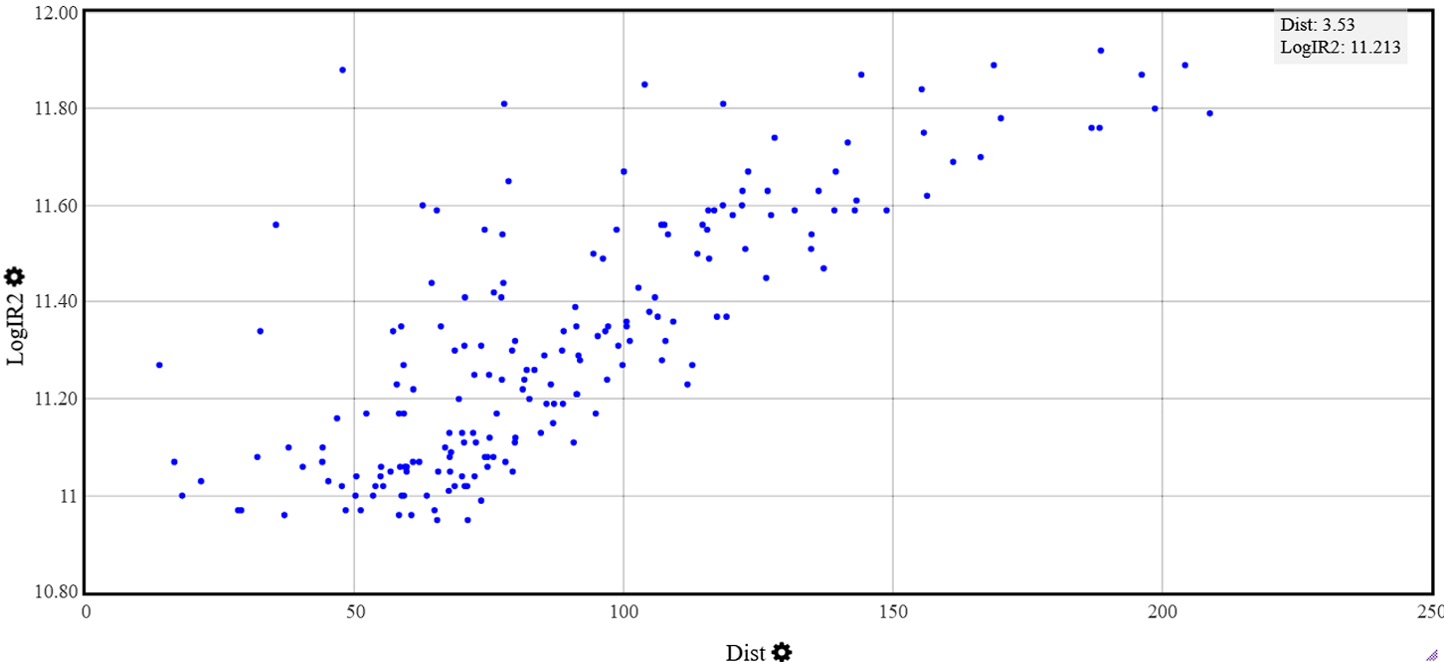
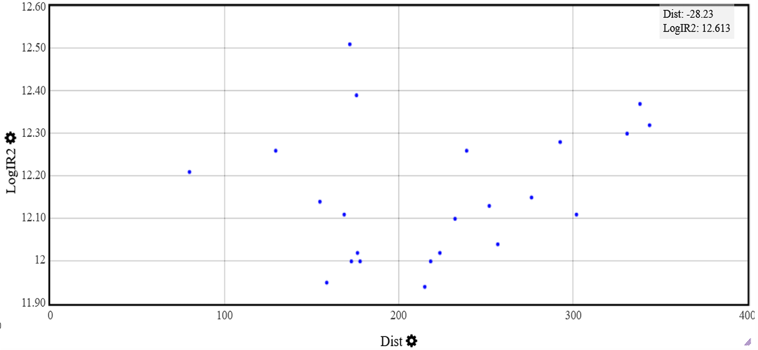
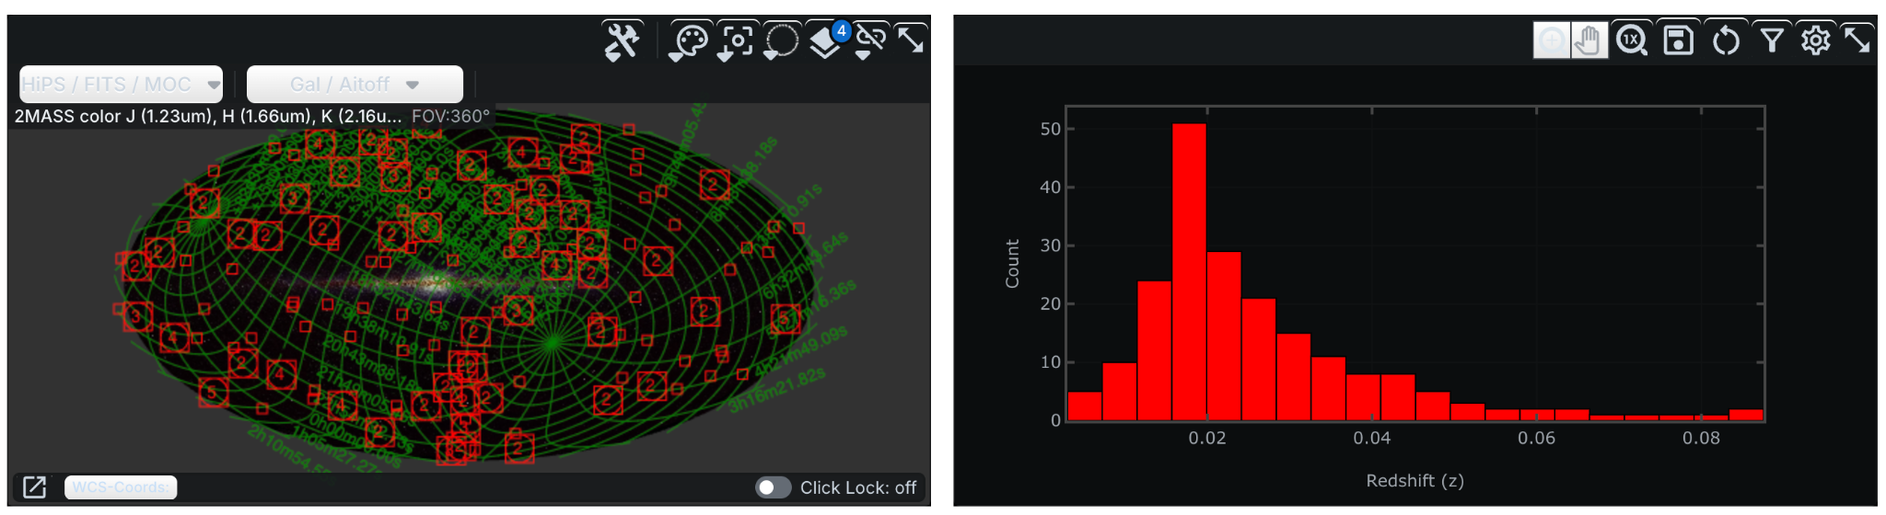
Introduction
Total Sample
IRAS Revised Bright Galaxy Sample of Sanders et al.
LIRGs: 173 Targets
ULIRGs: 42 Targets

Slide 21
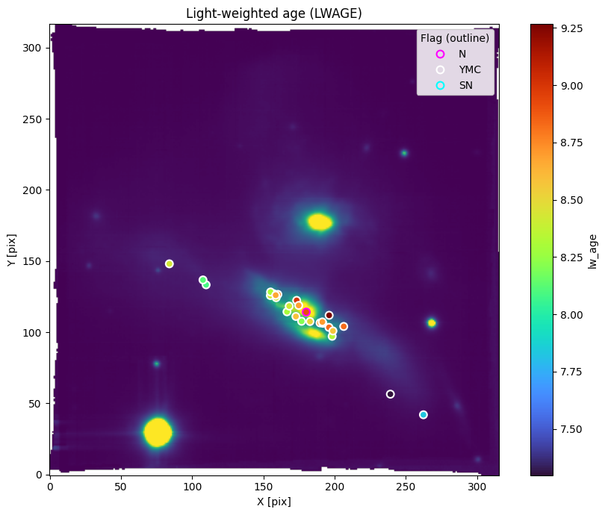
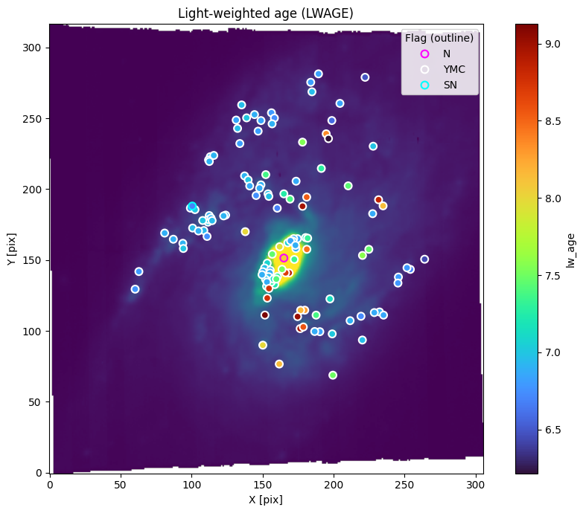
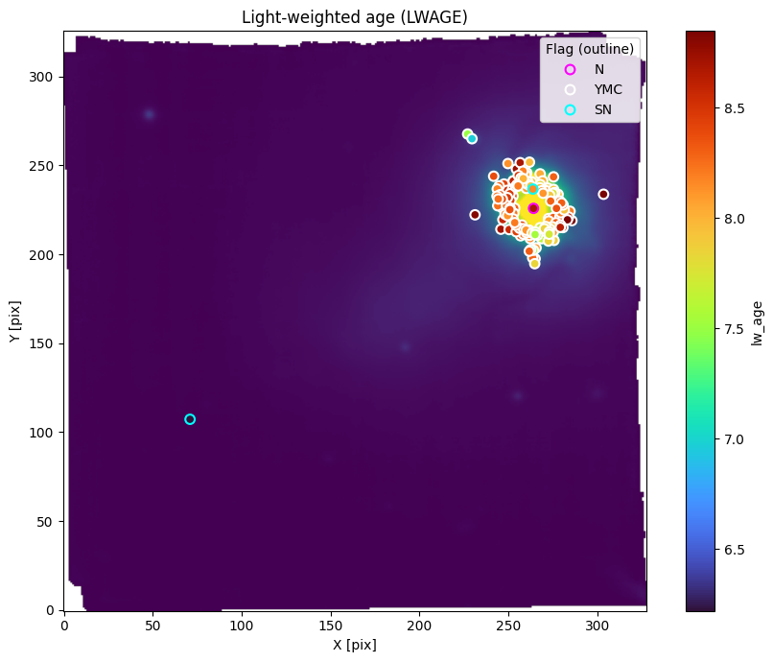
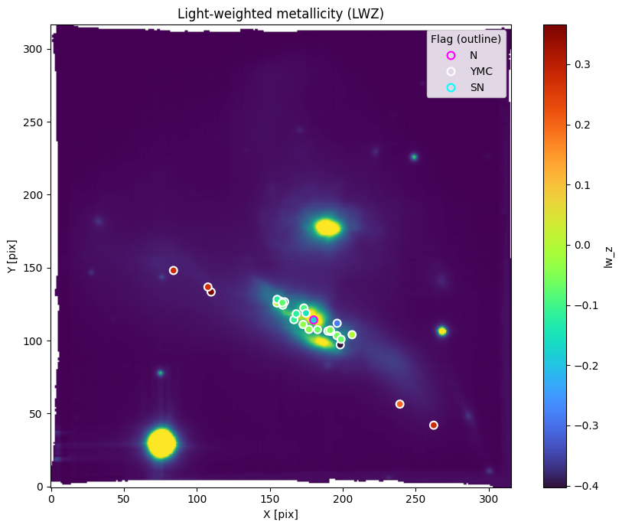
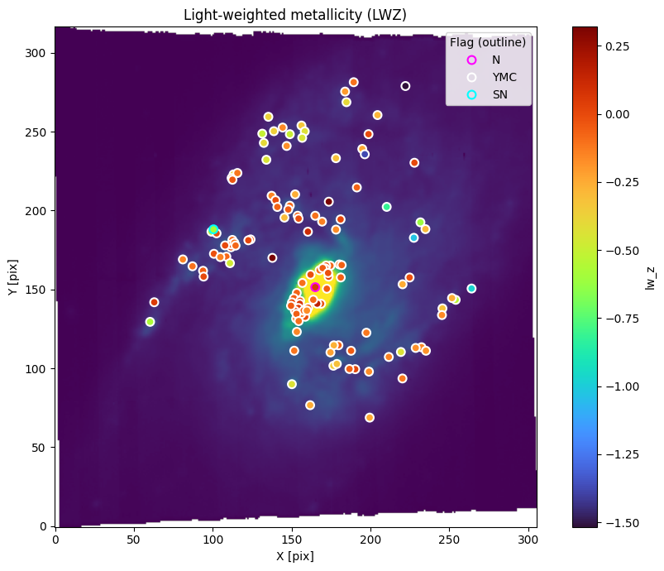
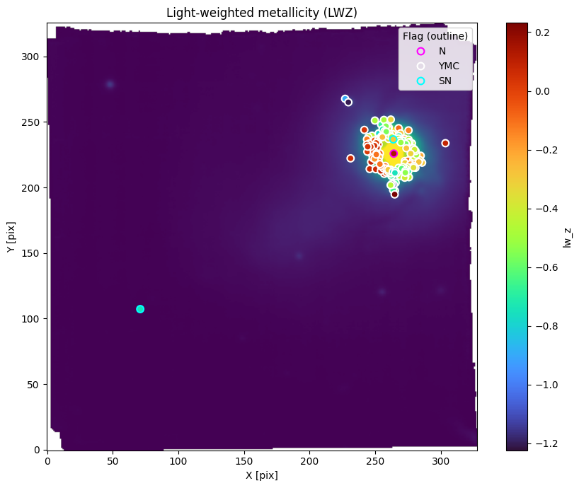
ESO 440-IG058
NGC1134
NGC1819

Slide 22
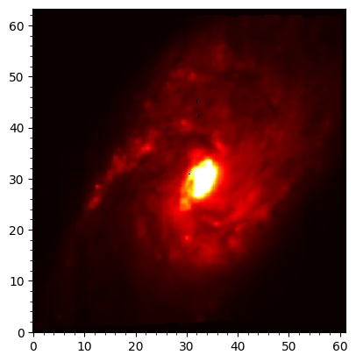
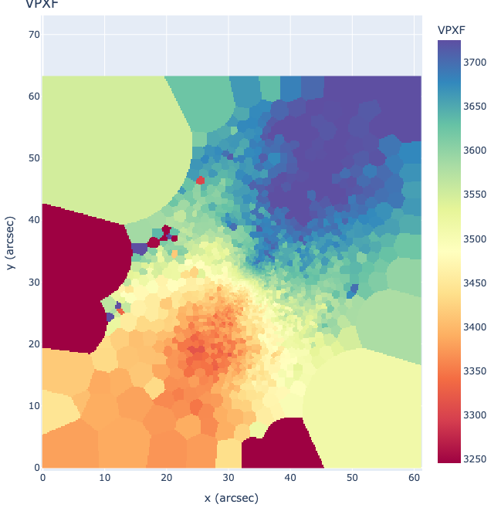
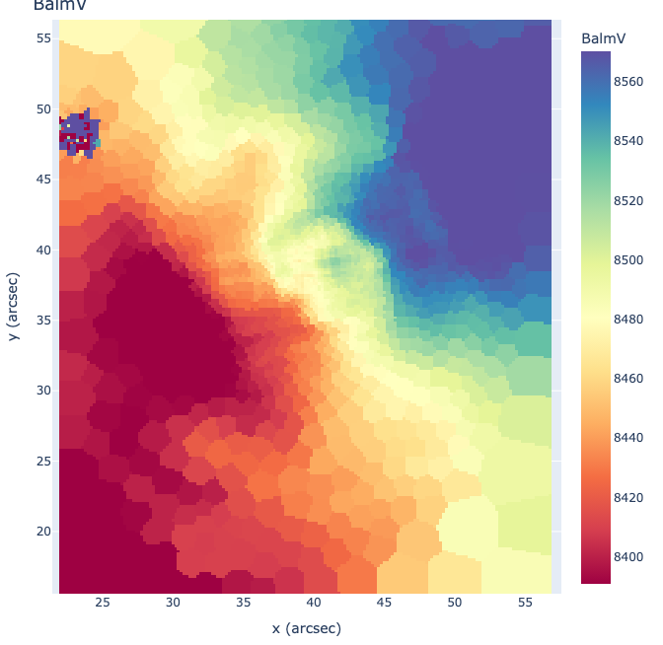
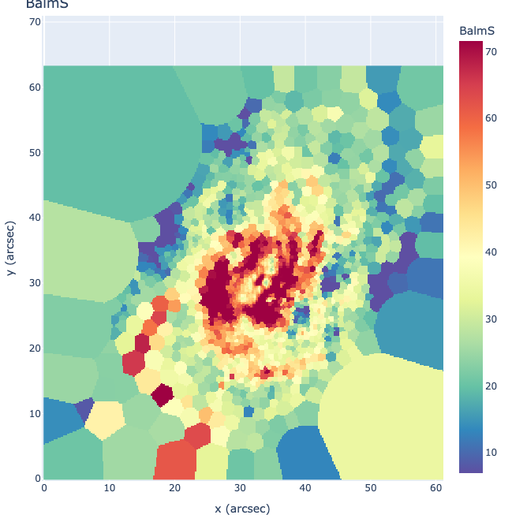
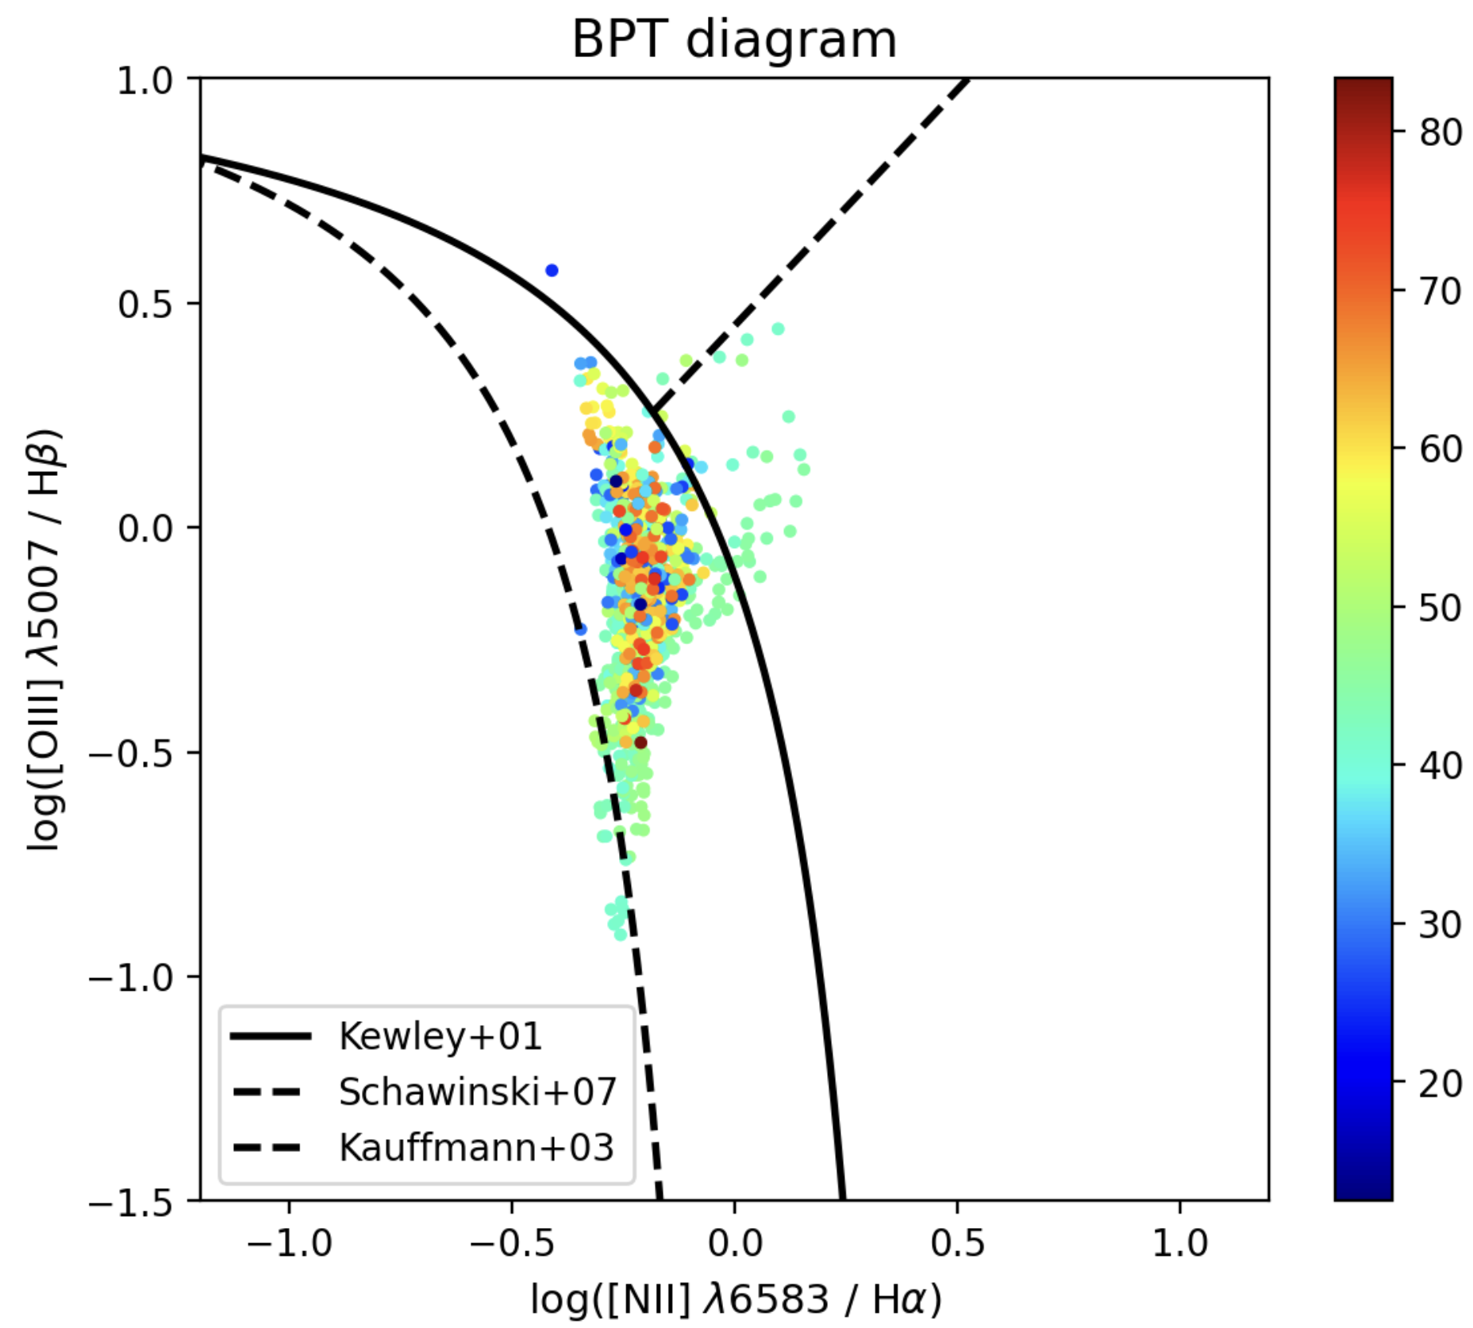
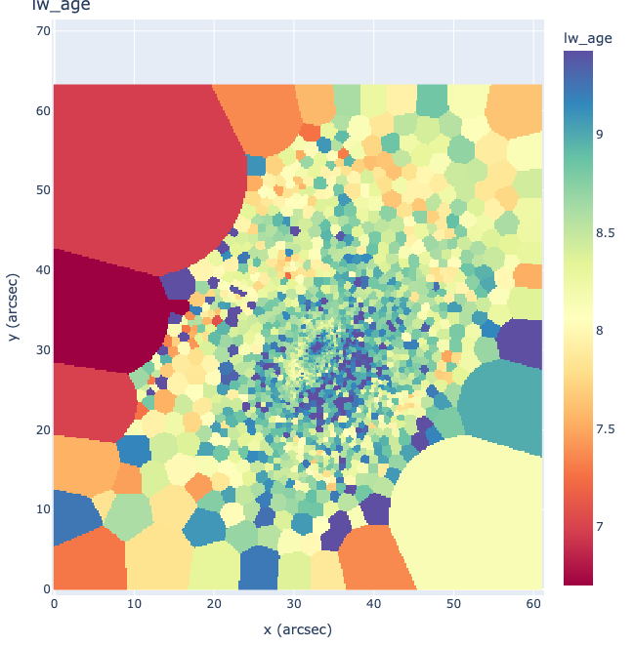
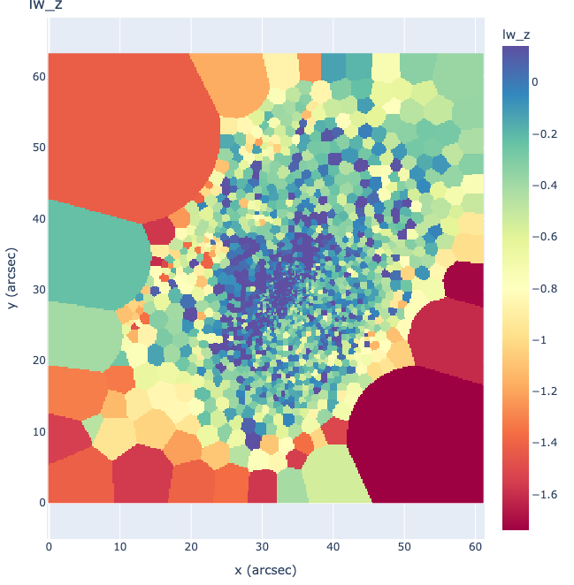
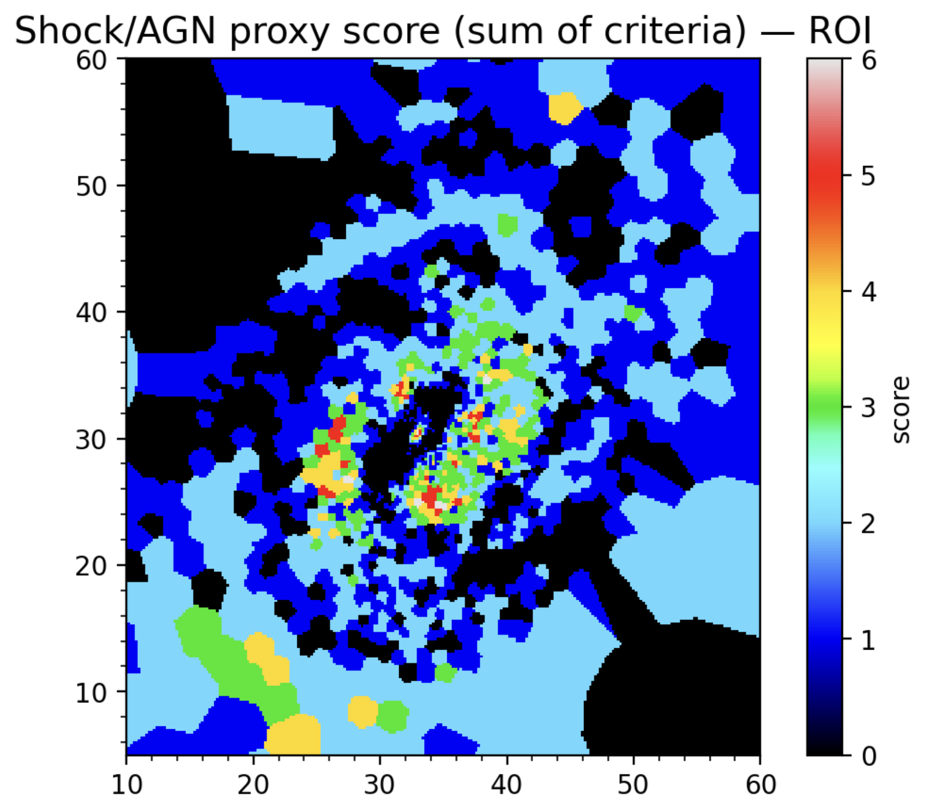
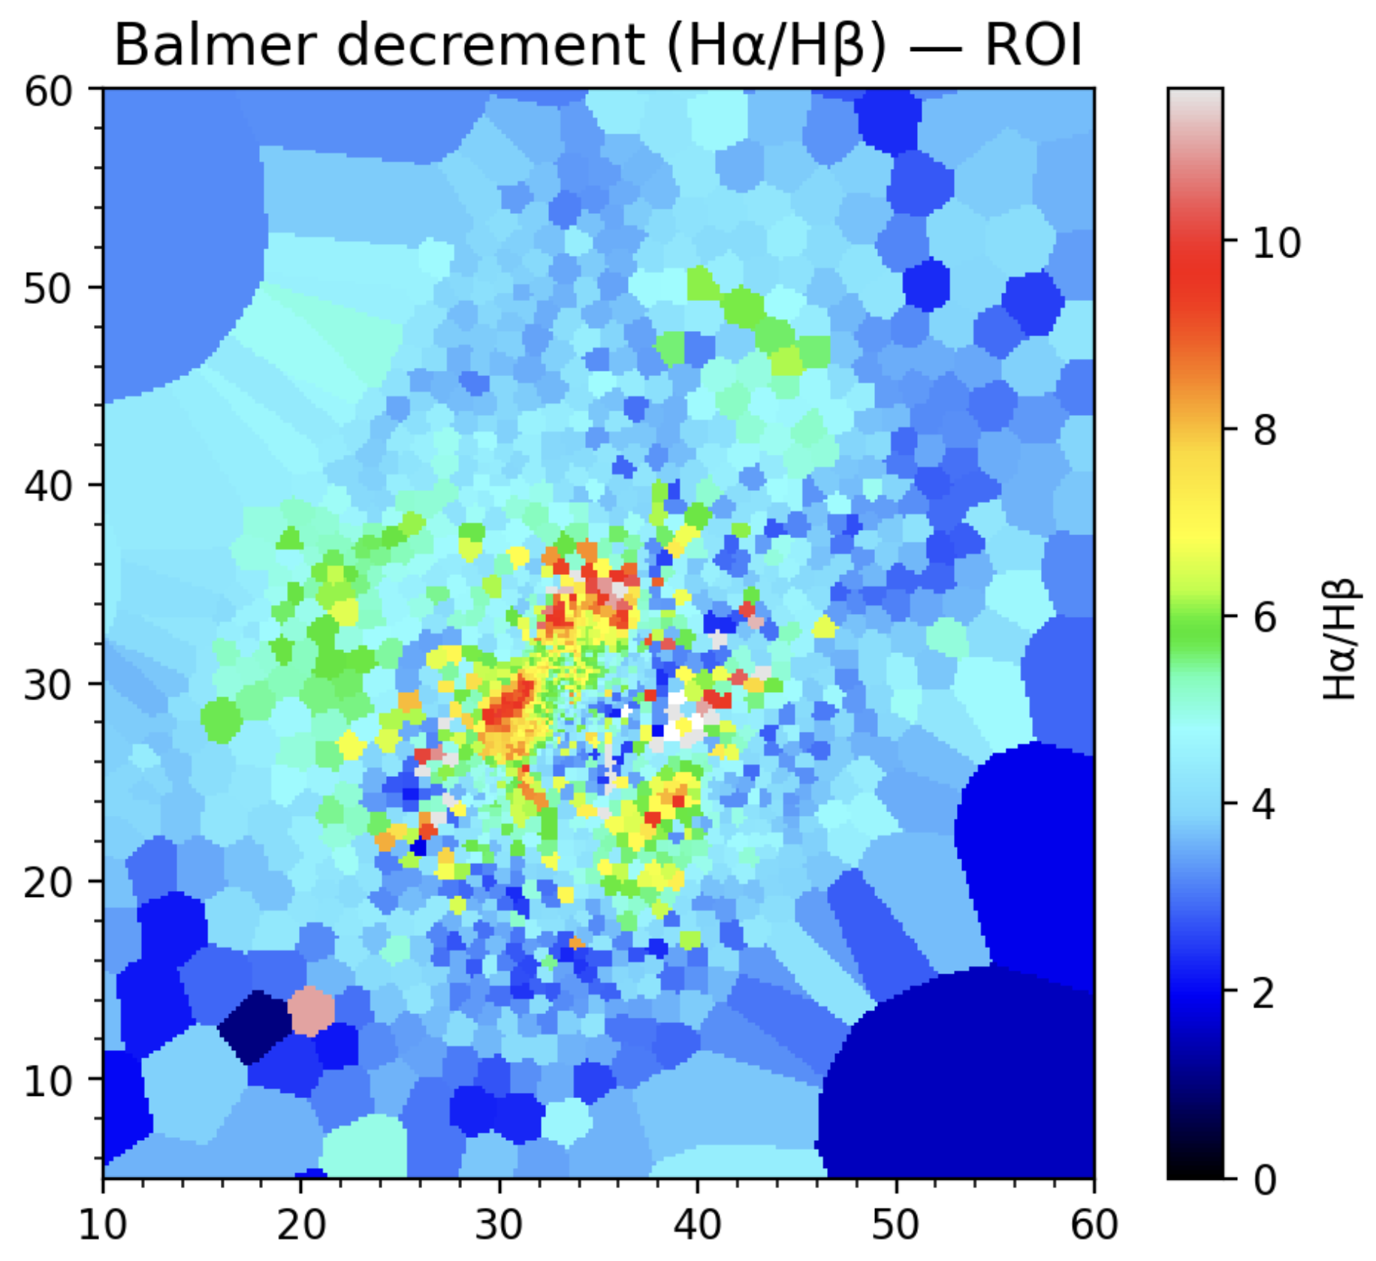
Introduction
NGC 1134 (Arp 200)
Stellar Velocity
Gas Velocity
Gas Velocity Dispersion
Light Weighted Age
Light weighted Metallicity

Slide 23
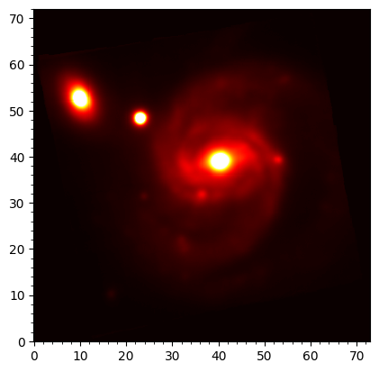
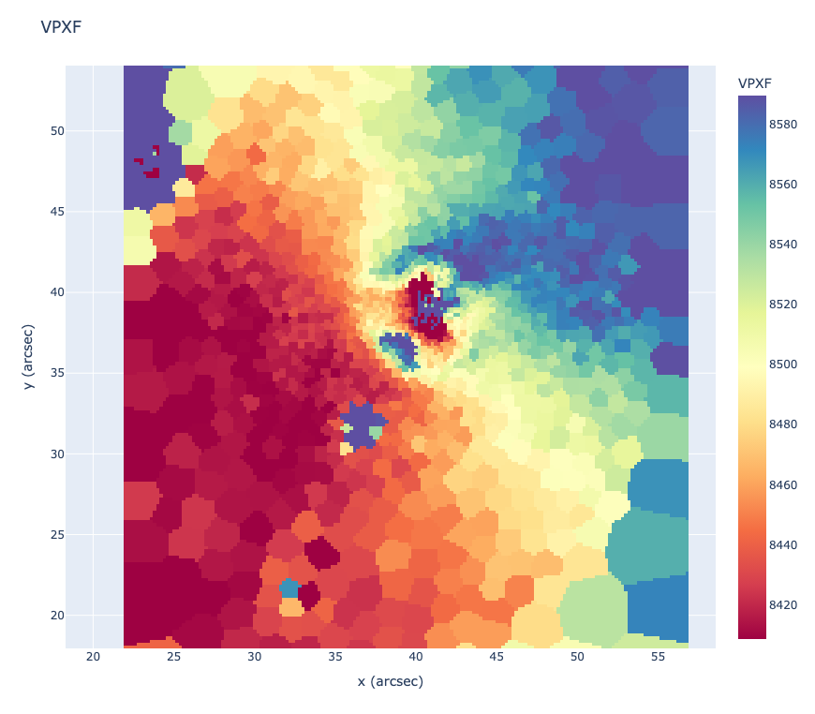
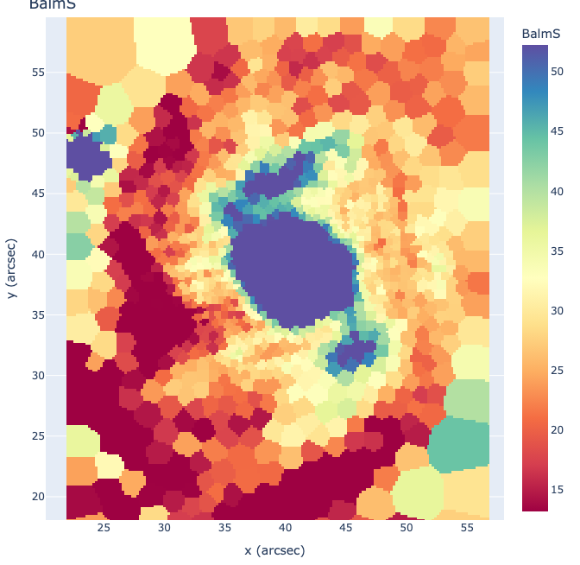





Introduction
NGC 7674
Stellar Velocity
Gas Velocity
Gas Velocity Dispersion
Light Weighted Age
Light weighted Metallicity
Mass Weighted Age

Slide 24







NGC 5331
Stellar Velocity
Gas Velocity Dispersion
Light Weighted Age
Gas Velocity

Slide 25




Introduction
II ZW 096 B

Slide 26









Introduction
Arp 256

Slide 27
Introduction
Summary & Conclusions for IRAS 18293-3413
high H α surface brightness and correspondingly elevated SFR surface density;
large EW(H α) at two sites (especially SN 2012iz), consistent with younger star-forming regions;
near-solar gas-phase metallicity (O3N2-based 12 + log(O/H) ≈ 8.8–8.9);
strong dust attenuation, where the Balmer decrement and continuum reddening provide mutually consistent (but not identical) estimates.
—----
Thank You!
Questions/Suggestions?

Slide 29
MUSE IFU investigation to the Birth and Death of Massive Stars in Nearby (U)LIRGs
Balmer Extinction: Dust mixed in with the star-forming regions. Peaks in a thick band south of the nucleus.
SFR: The three SNe are NOT located in the peak star-forming spiral arm - moderately high SFR, but not the highest.
LIRG, IRAS 18293-3413
  Used the H-alpha emission line to trace ongoing star formation.
  Corrected the H-alpha flux using our Balmer extinction map.
Results:
Total uncorrected SFR = 2.9 M☉/yr.
Total dust-corrected SFR = 55 M☉/yr!
Star formation is concentrated in the dusty spiral arm, not at the nucleus.
SN discoveries in LIRGs don't trace the true SFR, but rather a combination of SFR and visibility
Various Spectral and Spatial properties
(2D property Maps)
PowerBin: Fast Adaptive Data Binning by Cappellari (2025)
pPXF: Penalized PiXel-Fitting method by Cappellari (2017)
Emission Line Maps

