Slide 1




Portrait of a Milky Way-like galaxy
on FIRE
Is the α-bimodality a natural consequence of inside-out disc growth in a hierarchical formation scenario?
Benito et al. 2026 [2512.14897]
Nordic-Baltic Astronomy days 2026

Slide 2
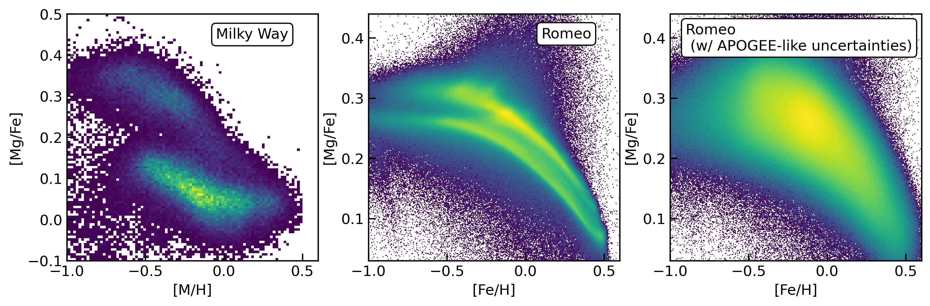
Benito et al. 2026 [2512.14897]
Bimodal distribution in the stellar disc
Simulated galaxy
María Benito

Slide 3
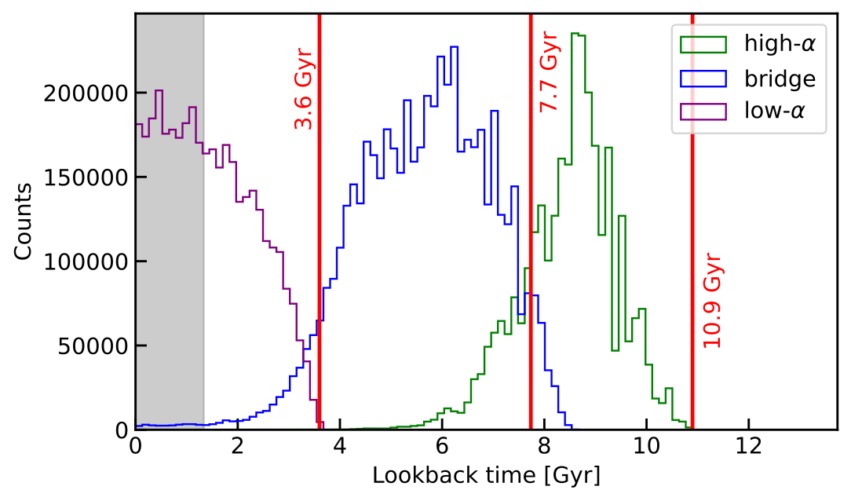
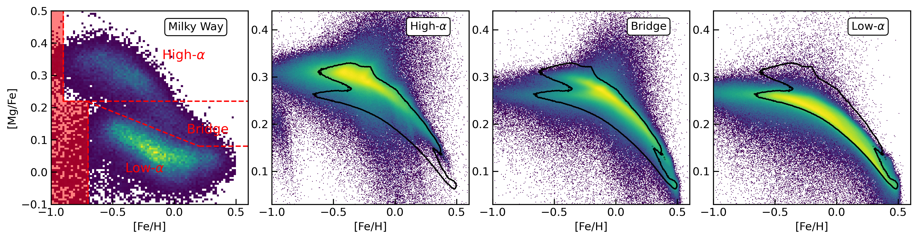
Benito et al. 2026 [2512.14897]
Three phases of stellar disc assembly
Simulated galaxy
María Benito

Slide 4
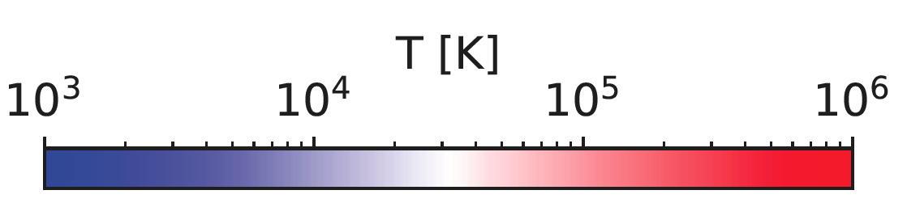
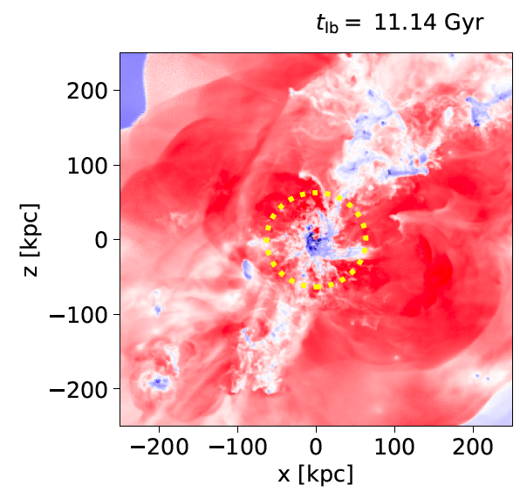
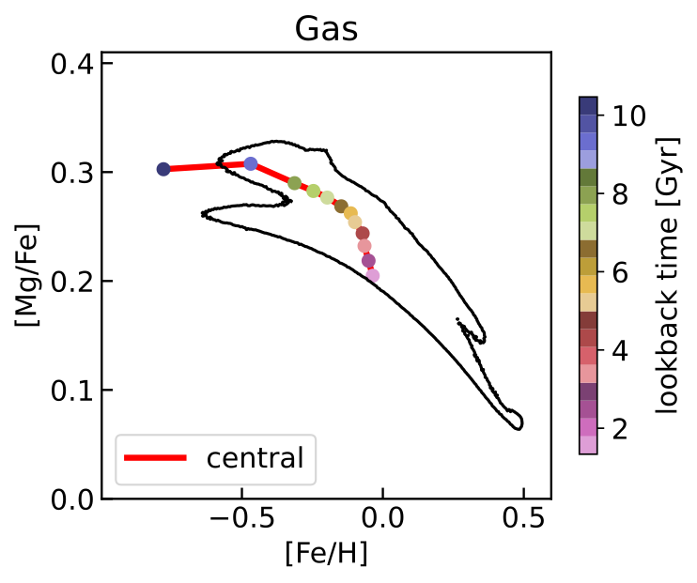
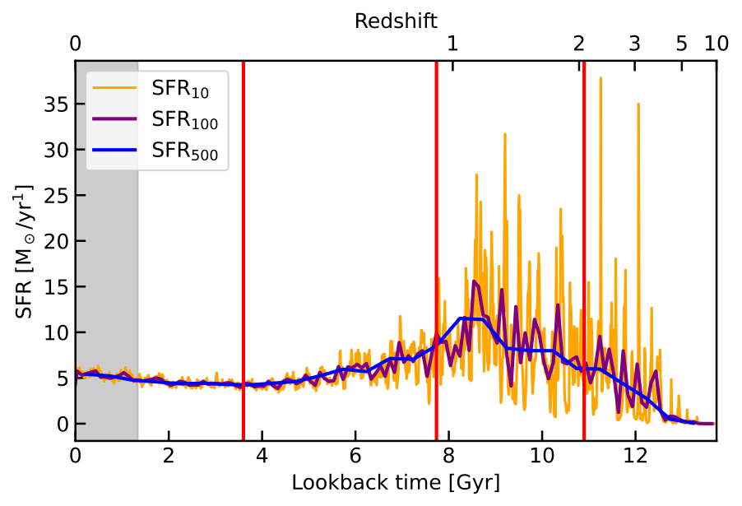
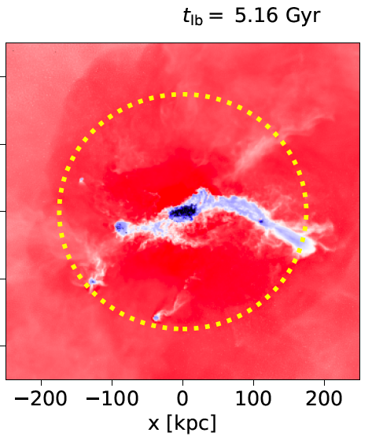
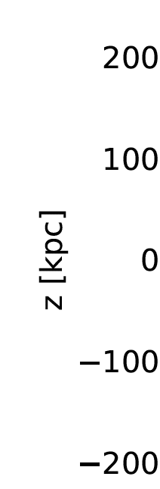
Benito et al. 2026 [2512.14897]
Disc assembly & evolution
(Minor) mergers
Gas flows
virial radius
María Benito

Slide 5
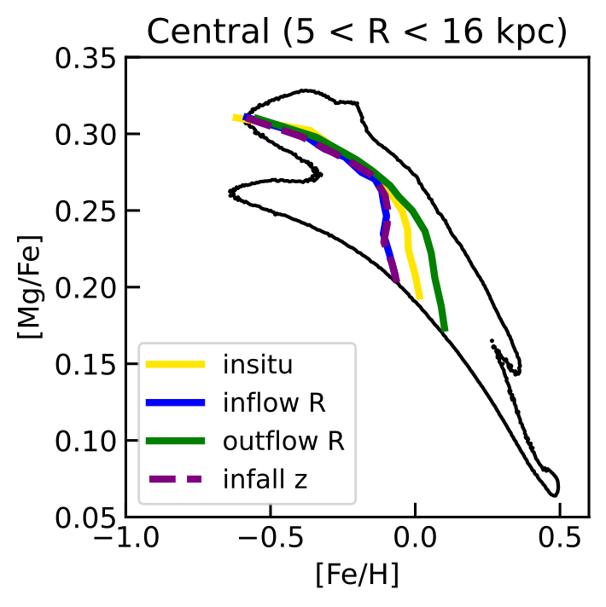
Benito et al. 2026 [2512.14897]
Take away & open questions
Is there a correlation of α-bimodality w presence of bar nor position in Cosmic Web?
α-bimodality formed without invoking major mergers nor radial migration, but simply as a natural consequence of inside-out disc growth driven by the hierarchical assembly of gas-rich minor mergers.
No need to invoke radial stellar migration to explain the spread of metallicities at given position of stars with same age, radial gas flows do the job!
Can we explain the shape of the MDF(R) by gas migration?
Problems w/ element yields (subgrid physics)?
María Benito

Slide 6

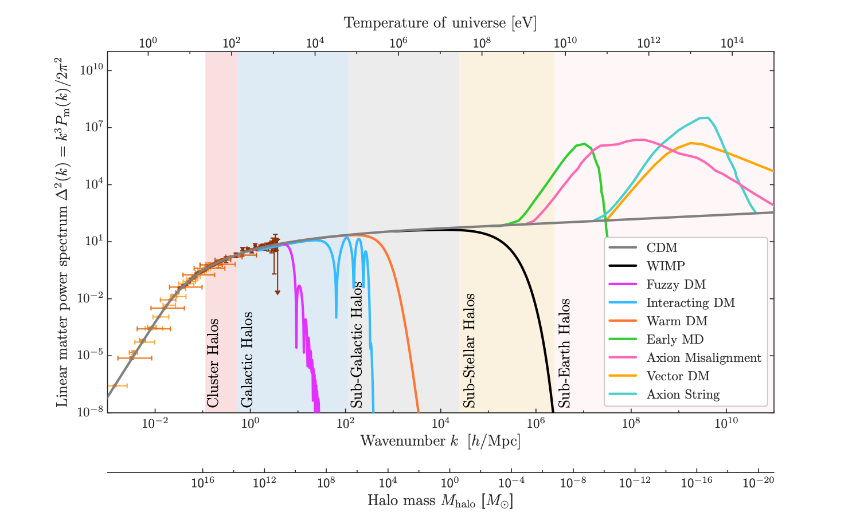
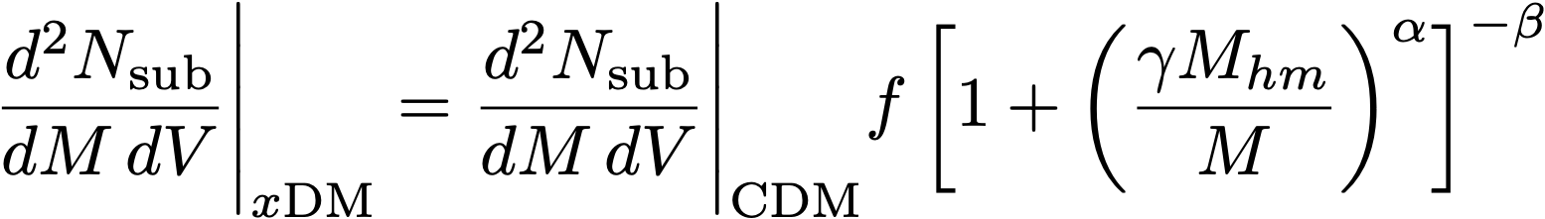

Data-driven DM particle searches
Only approach in a “nightmare” scenario
DM particle physics
Bechtol + [2203.07354]
Non-linear structure
Benito + [2001.11013]
Nadler + [2401.10318]
Observables
María Benito
Notes:
\frac{d^2N_{\rm sub}}{dM\,dV}\Bigg|_{x\rm DM}= \frac{d^2N_{\rm sub}}{dM\,dV}\Bigg|_{\rm CDM} f \left[1 + \left(\frac{\gamma M_{hm}}{M}\right)^{\alpha}\right]^{-\beta}

Slide 7
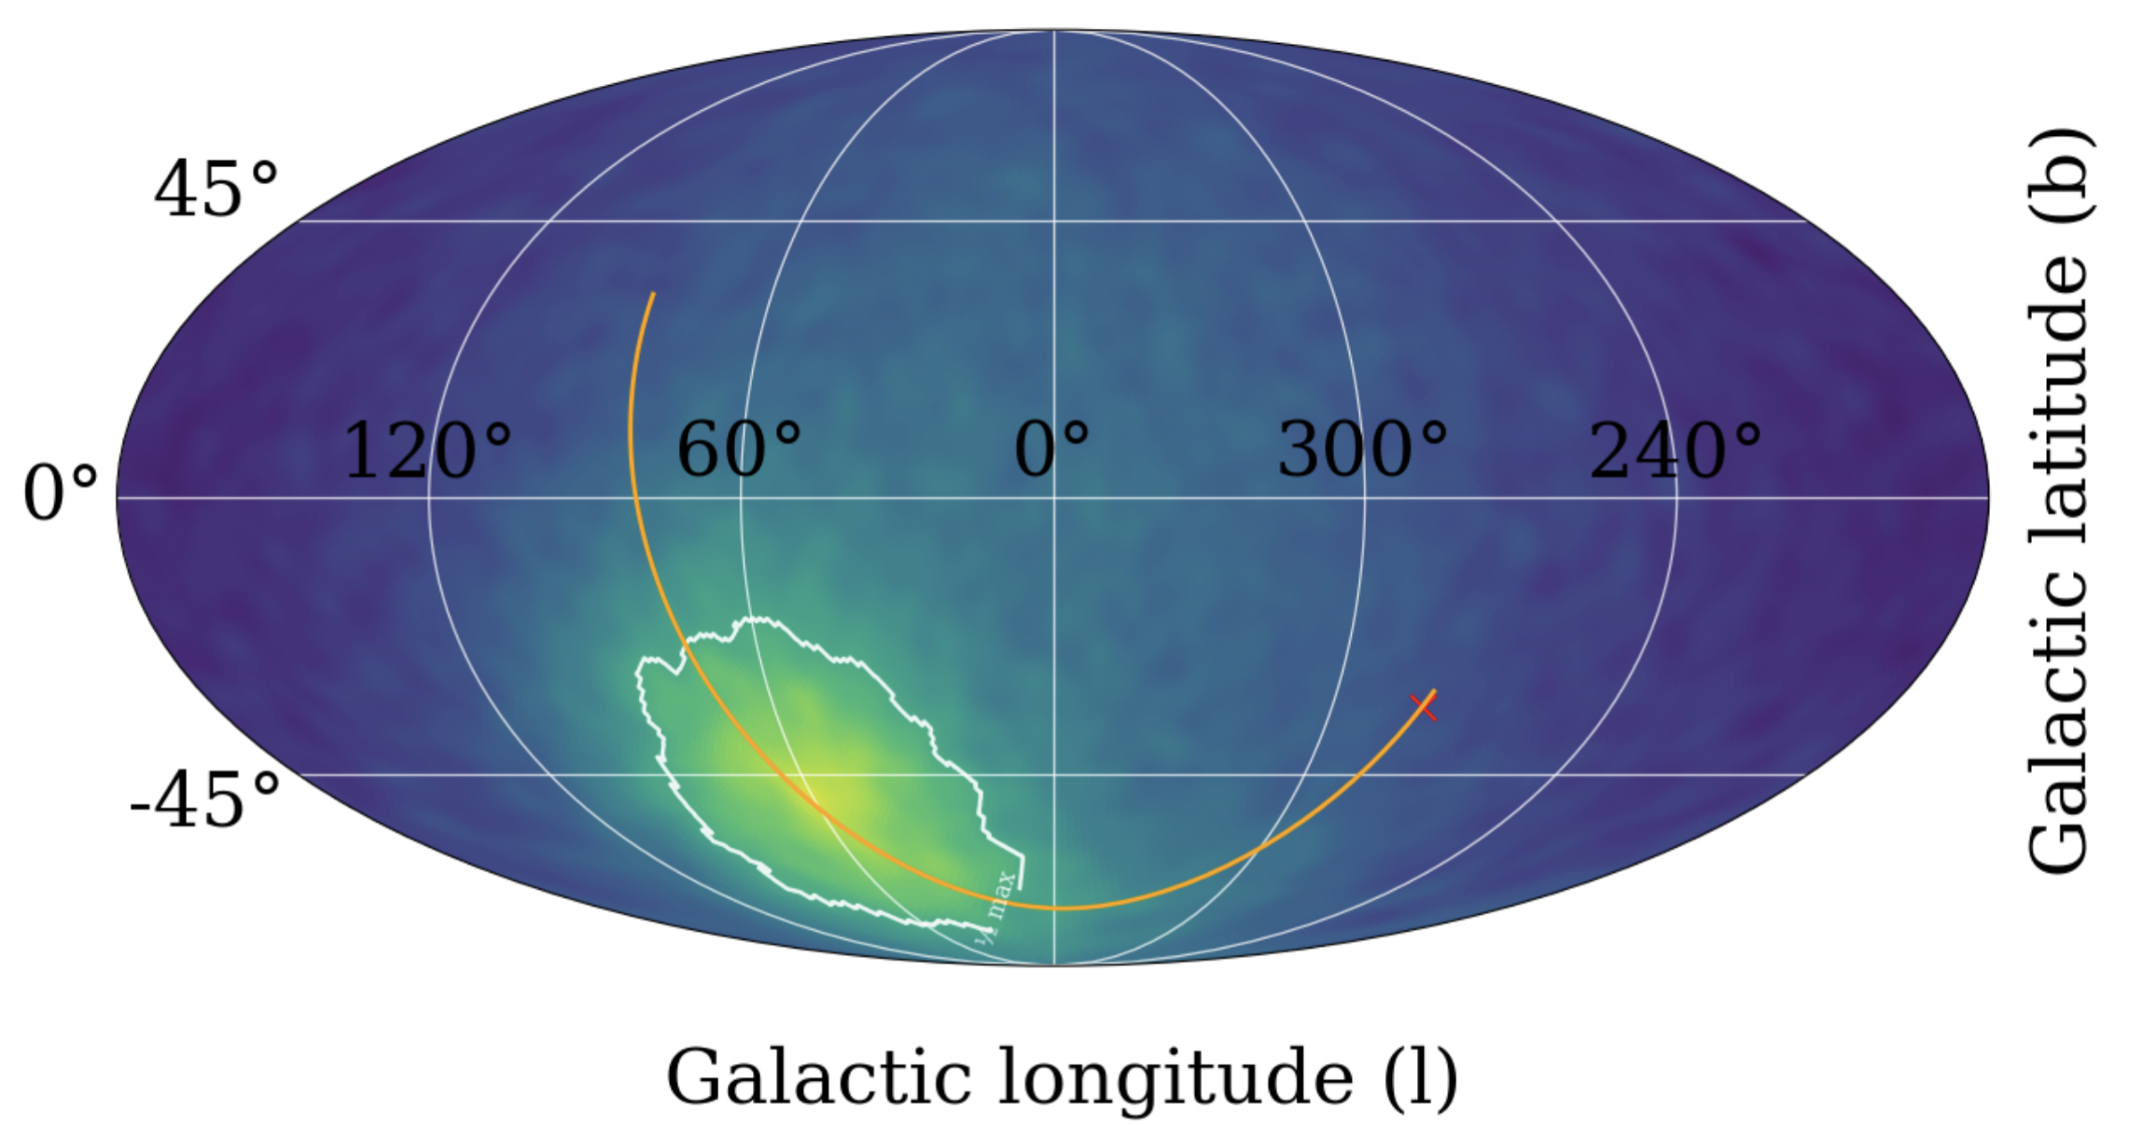
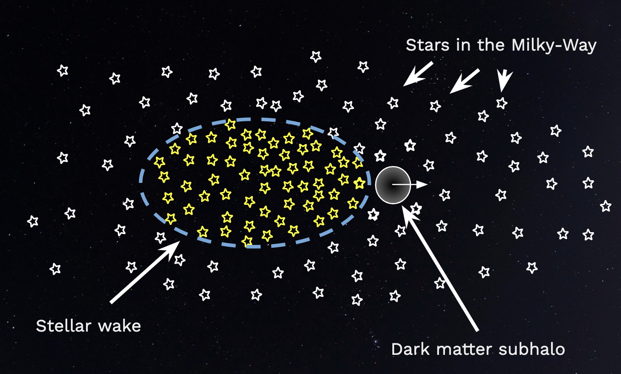
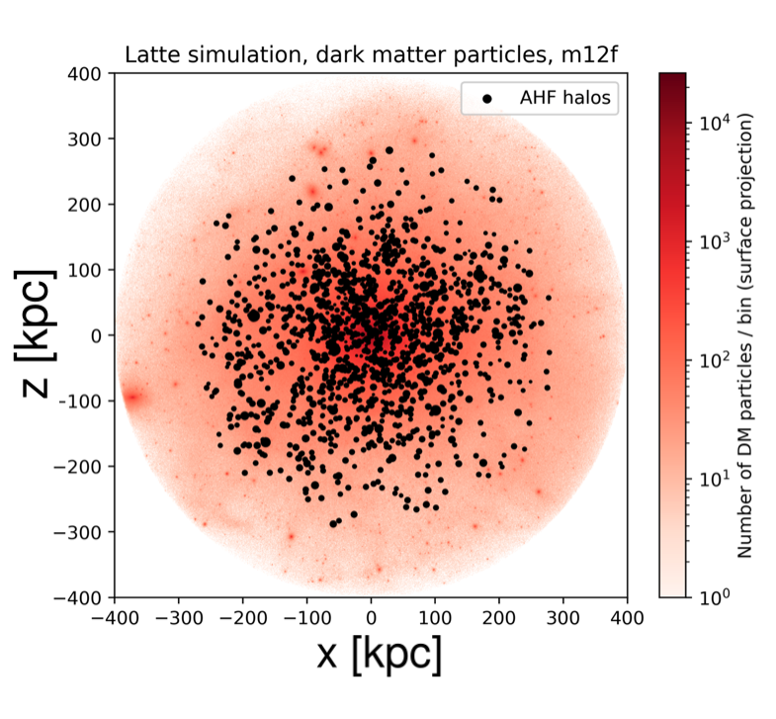
Data-driven DM particle searches
Low-surface brightness Milky Way
See also
Garavito-Camargo et al ’19
Foote et al ’23
Fushimi et al ’24
MB et al’ in preparation
stellar wakes
Luminous satellites
Dark satellites
Credit: Sven Põder
See also
Buschmann et al ’17
Petač ’19
Bazarov, MB et al ’22
Põder, Pata, MB et al ‘25
María Benito

Slide 8
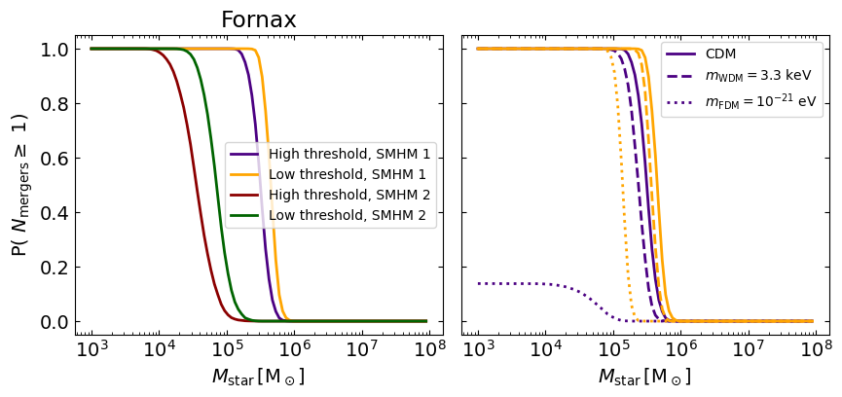
Data-driven DM particle searches
Chemo-dynamical signatures of mergers in dwarf galaxies
Probability that @ least one merger w/ stellar mass above Mstar has happened in Fornax:
Varying galaxy formation model
Varying DM particle microphysics
HRMOS white paper (including MB), soon on arXiv
María Benito

Slide 9
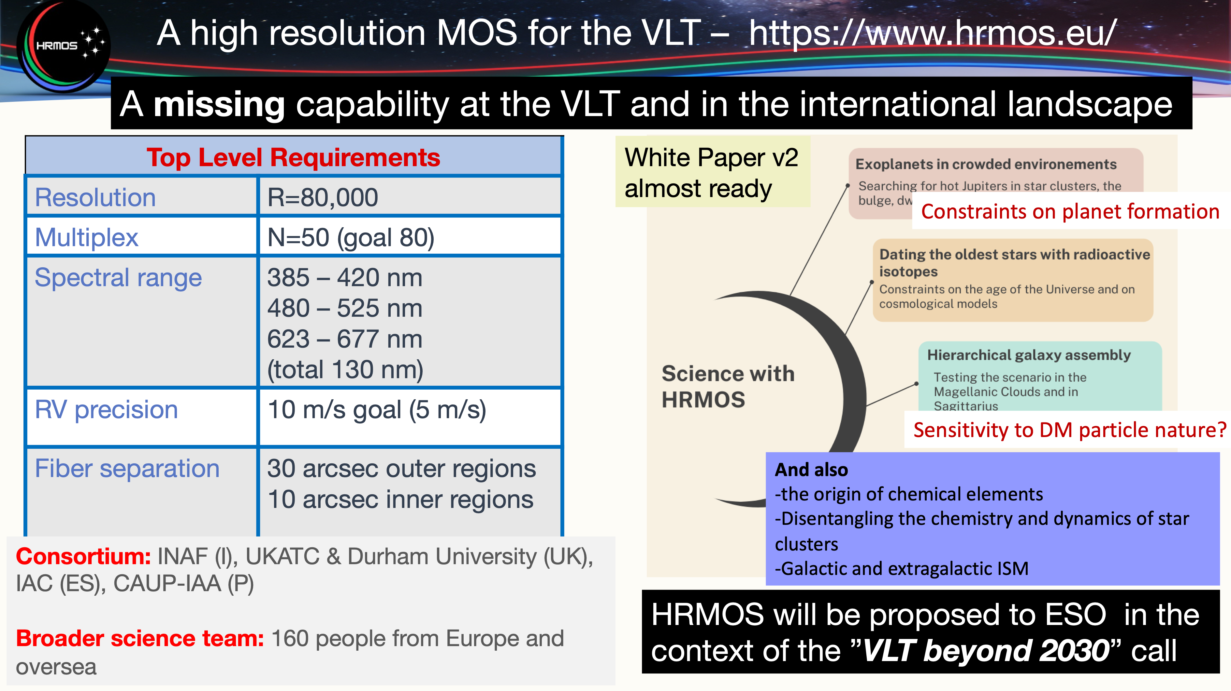
Credit: Sofia Randich

Slide 10
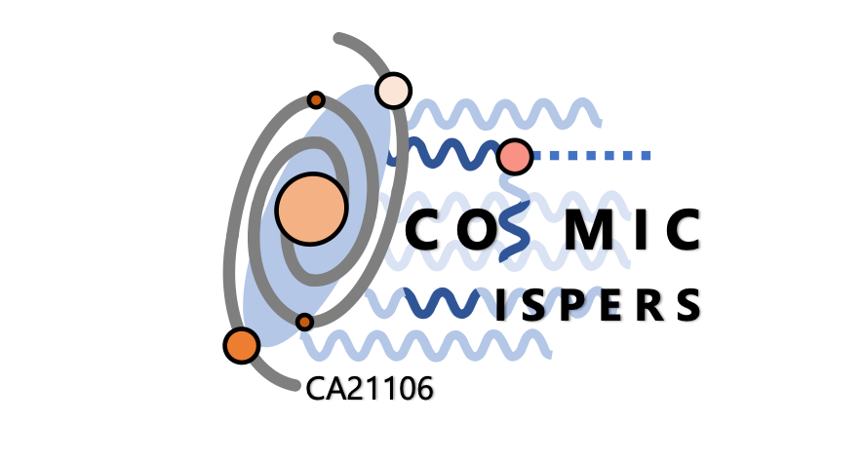


What are the microphysical properties of DM?
galaxy formation
DM particle microphysics
Non-linear structure @ galactic and sub-galactic scales
Wakes in Milky Way stellar halo
Chemo-dynamical data in LG dwarf galaxies
María Benito (mariabenitocst@gmail.com)
Notes:
\frac{d^2N_{\rm sub}}{dM\,dV}\Bigg|_{x\rm DM}= \frac{d^2N_{\rm sub}}{dM\,dV}\Bigg|_{\rm CDM} f \left[1 + \left(\frac{\gamma M_{hm}}{M}\right)^{\alpha}\right]^{-\beta}

