Slide 1
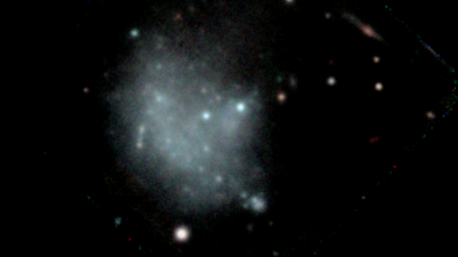


Kinematics and Globular Clusters of VCC 1249
Tuomas Hämäläinen (FINCA, University of Turku)
With Johanna Hartke, Petri Väisänen
tuiham@utu.fi Nordic-Baltic Astronomy Days 28.5.2026

Slide 2
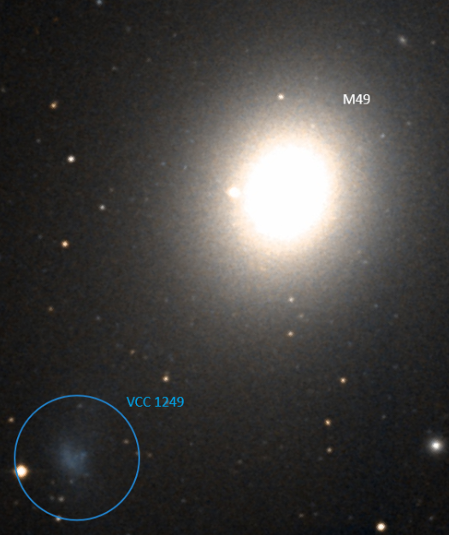
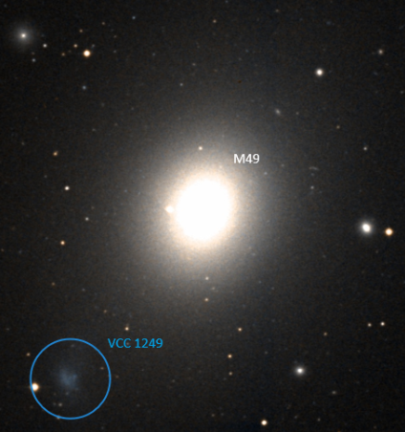
VCC 1249 and M49
VCC 1249:
  Dwarf irregular galaxy in the halo of M49
  Losing mass to M49
Messier 49 (M49):
  Brightest galaxy in the Virgo galaxy cluster
  Large globular cluster (GC) population
Understanding interactions like these can improve our understanding of galaxy formation and their life cycles
Aladin Sky Atlas, DSS
Notes:
Distance is roughly 26.2 kpc (5.’’4) between VCC 1249 and M49 (=NGC 4472) (Taylor et al. 2021)
It has been previously shown that VCC 1249 is losing mass via tidal and ram pressure stripping

Slide 3
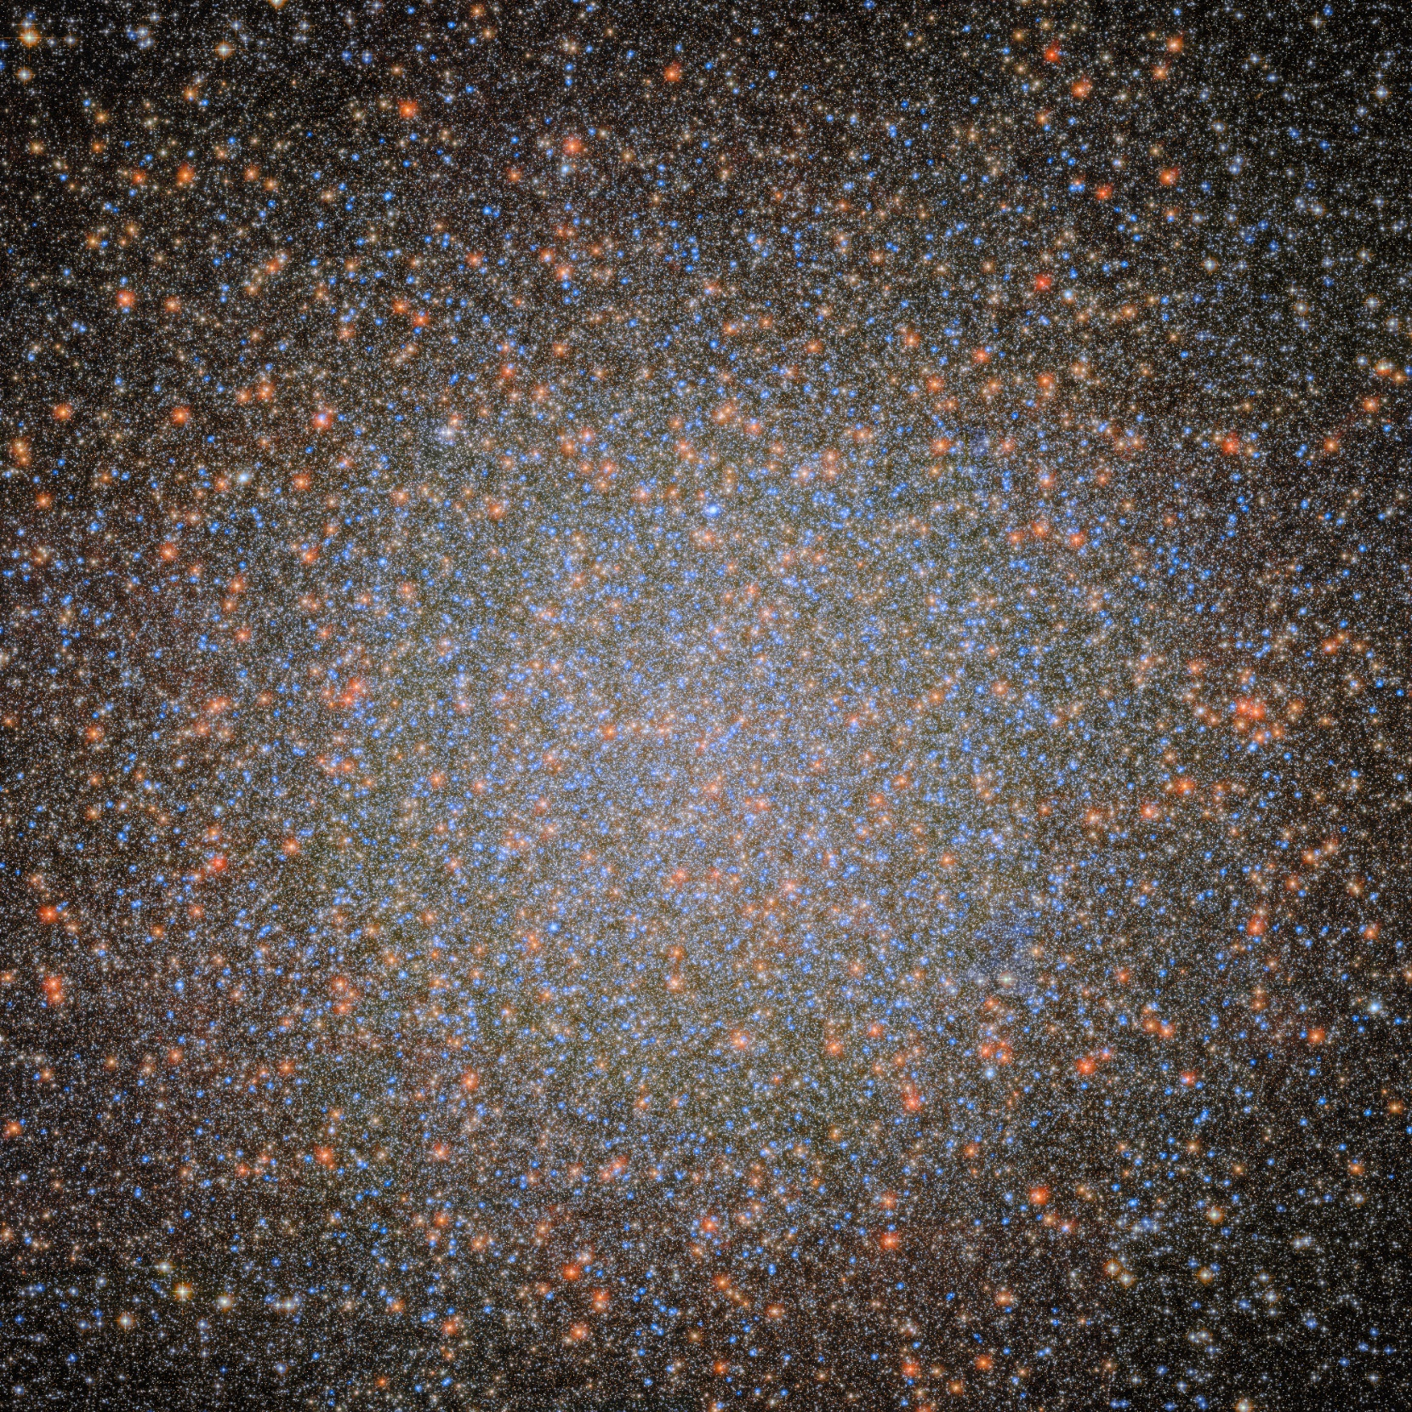

Globular Clusters
Dense, spherical groups of hundreds of thousands or millions of stars
Typically, composed of very old stars
At the distance of VCC 1249 (~16,7 Mpc) appear as unresolved, point-like, bright targets
Can be used as tracers of kinematics for the diffuse regions of host galaxies
Omega Centauri, HST/NASA

Slide 4
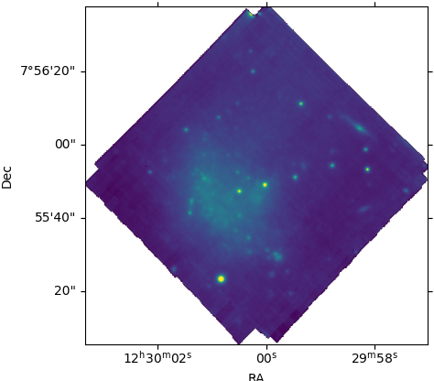
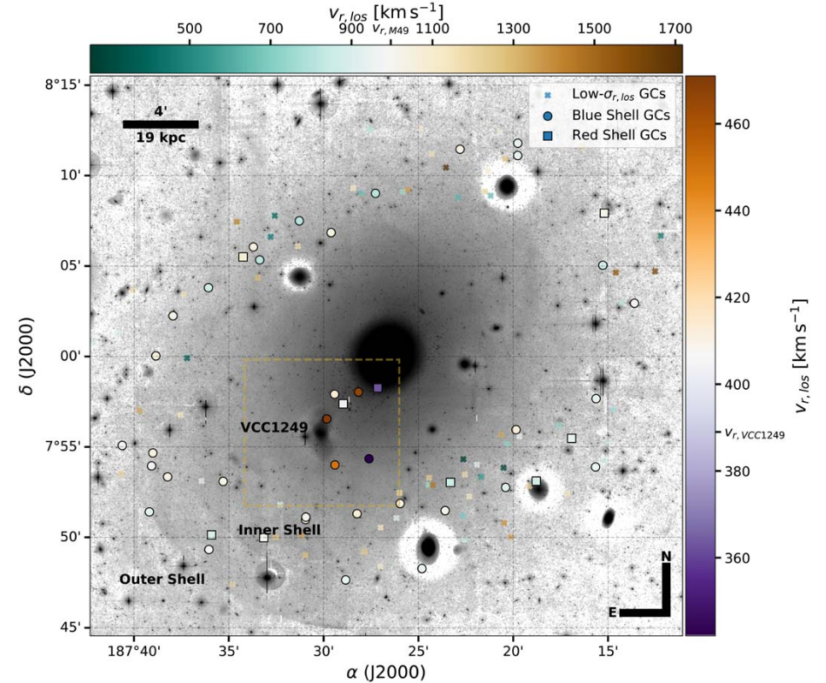
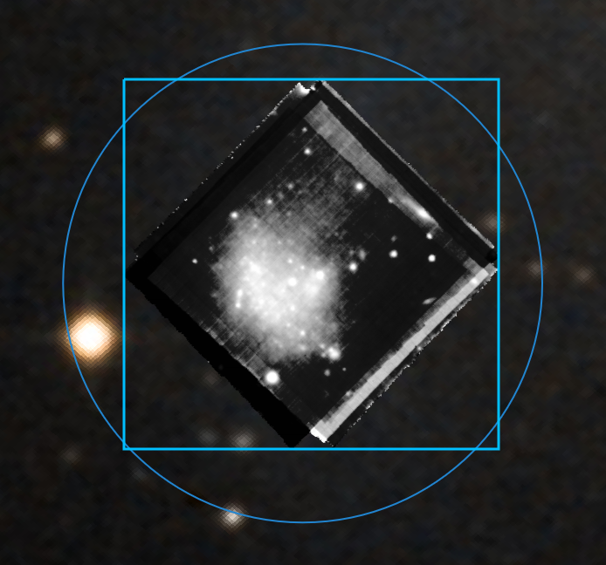

What is known about VCC 1249’s GCs? Not much…
Côté et al. 2003
  Only four GCs identified in the area of our data
Taylor et al. 2021
  Showed GCs near VCC 1249 are tracing the accreting matter
  Didn’t find GCs in the area of our data
Our data are IFS data from MUSE at the VLT
Taylor et al.

Slide 5
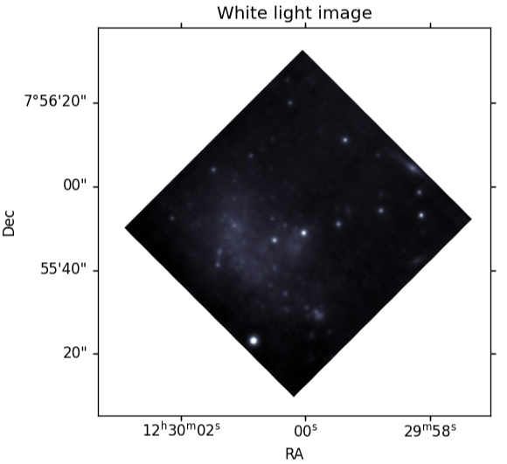
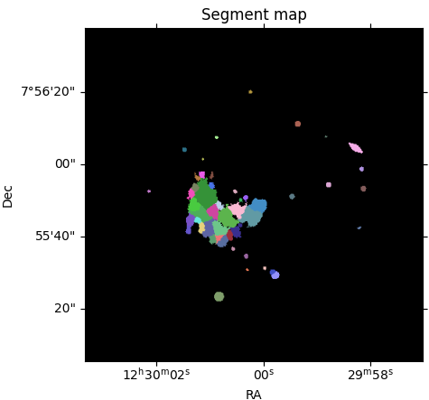
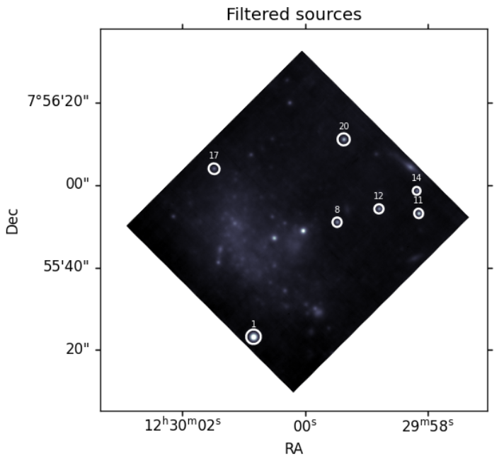
Finding New GCs
Identifying possible GCs from a white light image with a filter to produce only the bright unresolved sources
Seven targets as tracers
Segment map
Fitting isophotes
Filtering all isophotes with high ellipticity or area

Slide 6
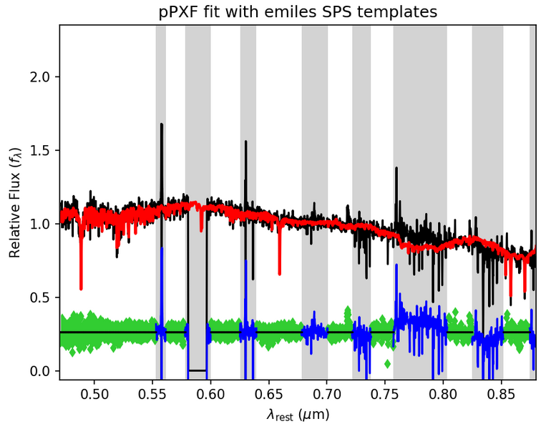

Kinematic and Stellar Population Properties
Python implementation of the Penalized Pixel-Fitting (pPXF) method (Cappellari & Emsellem, 2004) on the spectra
Spatially determining VCC 1249’s properties for:
  The line-of-sight velocity
  Velocity dispersion (σ)
  Age (Gyrs)
  Metallicity [M/H]
Only 7 tracers!
Low-surface brightness of VCC 1249
  Binning the integrated light of the galaxy
Binning not possible for point-like GCs
​
Notes:
(Annular summing of GC pixels and background subtraction could still be performed)
pPXF was used with the E-MILES spectral stellar population template library/models.

Slide 7
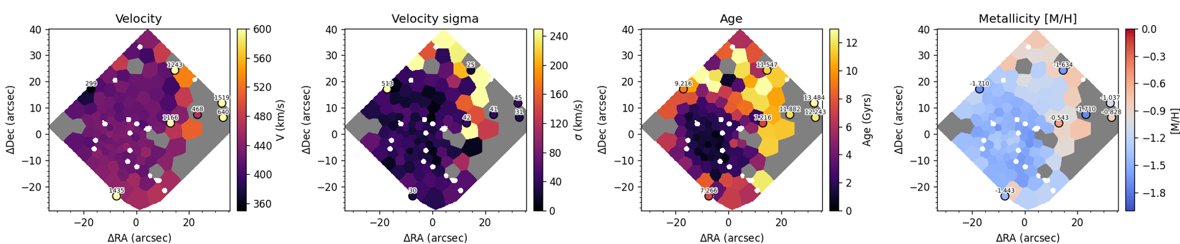
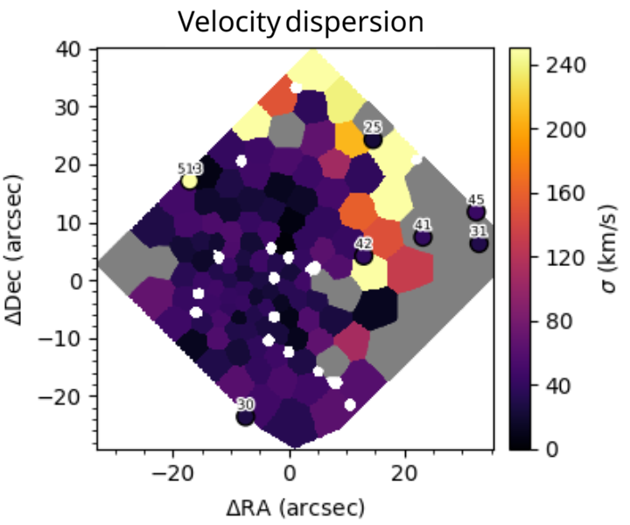
Results
Each property shows a transition from the integrated light of VCC 1249 into the halo of M49
Grey bins were discarded due to bad fitting
VCC 1249 velocity is uniform around ~450 km/s
Three of the putative GCs share similar velocities. Other four are higher, closer to M49 velocity
VCC 1249 is much younger than M49
The putative GCs are significantly older
Generally, low σ around VCC 1249
Only one putative GC with very high σ
Likely not a GC
VCC 1249 has low metallicity
The GCs are mostly low metallicity as well, with a few metal-richer GCs

Slide 8
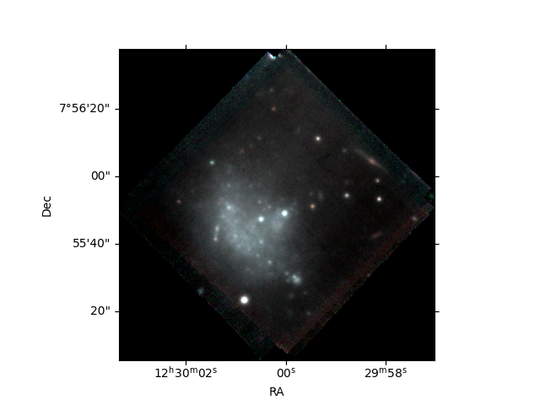
Conclusions & Outlook
Two new putative GCs that aren’t recorded in the literature were discovered in the region of VCC 1249.
The transition from the region of VCC 1249 to the intracluster light and the halo of M49 is visible in the measured properties.
Multiple GCs show velocity values roughly between the estimated velocities of VCC 1249 and M49, indicating they are likely in the process of being accreted to the halo of M49.
Future outlook:
Comparing the results gained from other tracers:
  PNe: Penger (2025), Hartke et al. (2018).
  Stripped gas kinematics: Arrigoni Battaia et al. (2012)
Notes:
Arrigoni Battaia et al. (2012) star-forming regions (HII regions)

Slide 9
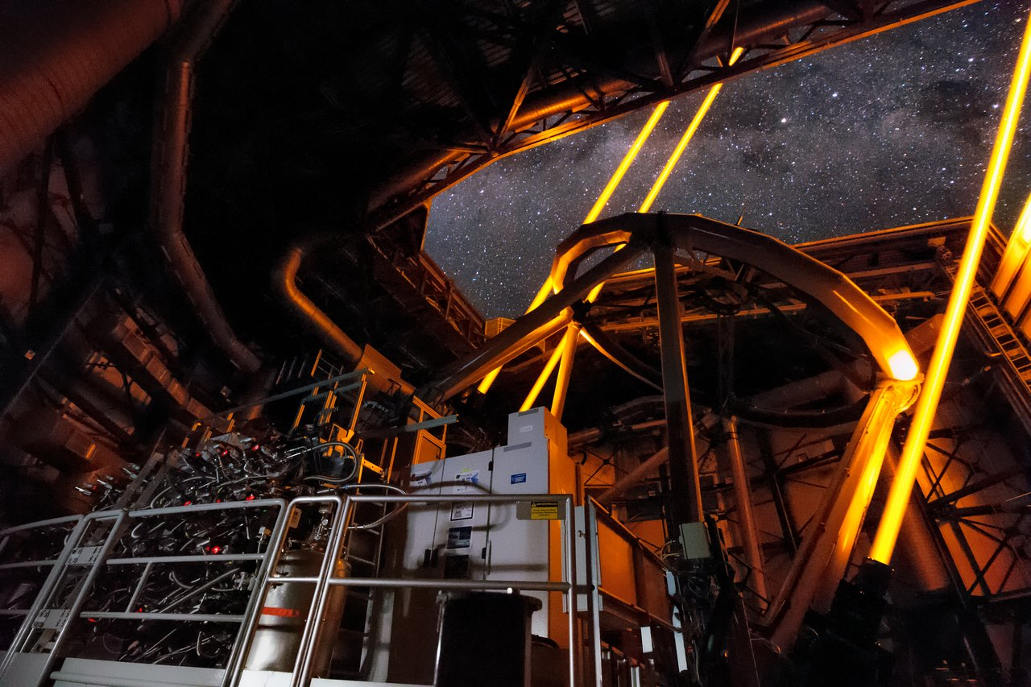
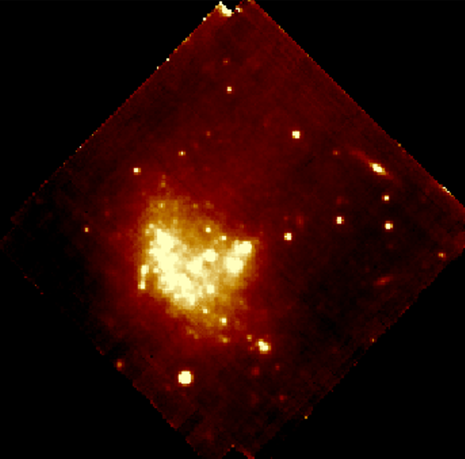
MUSE data
Bonus slides:
Data produced by the Multi Unit Spectroscopic Explorer (MUSE) instrument at the Very Large Telescope (VLT) at the Paranal Observatory.
MUSE measures the flux:
  On the spectral axis with a range from 4700 Å to 9350 Å.
  With a field of 1'x1' on the spatial axes
Data cube is produced by combining multiple measurements (pointings) using Integral Field Spectrography (IFS).
ESO MUSE data processing pipeline

Slide 10
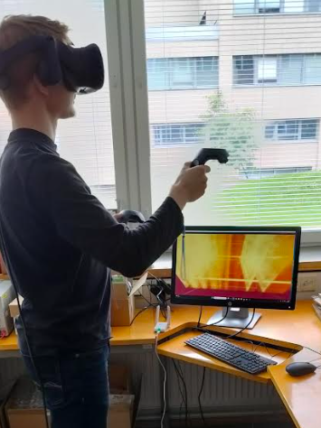
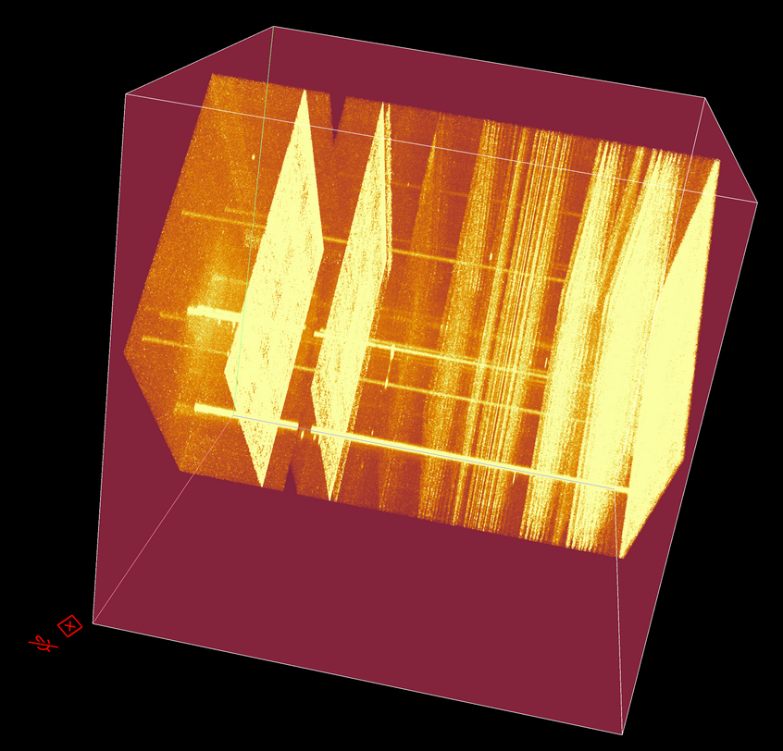
Data visualization in VR
Bonus slides:
Three dimensions difficult to visualize in two dimensions
Using iDaVIE to render MUSE data in virtual reality with three dimensions.

Slide 11
Bonus slides:
…But are you sure they are GCs? Not really…
What could they be if not GCs?
Milky Way foreground stars?
  Velocities are too high
Ultra-compact dwarf galaxy?
  Typically, would appear as larger and brighter than GCs
  The first target could be...
    Further investigation would be needed (GC luminosity function based on distance)
Other compact galaxies, star-forming regions?
  Would have distinct spectral features that are not visible

Slide 12
Bonus slides:
How confident can we be in the results?
Unpublished results
No real error/confidence measurements
Could be measured using Monte Carlo simulations for probability distribution for each bin and target
Typical errors for this kind of data and targets:
Kinematics: ~5-15 km/s
Metallicity: ~0.1 dex
Log(Age): ~0.5 dex

Slide 13
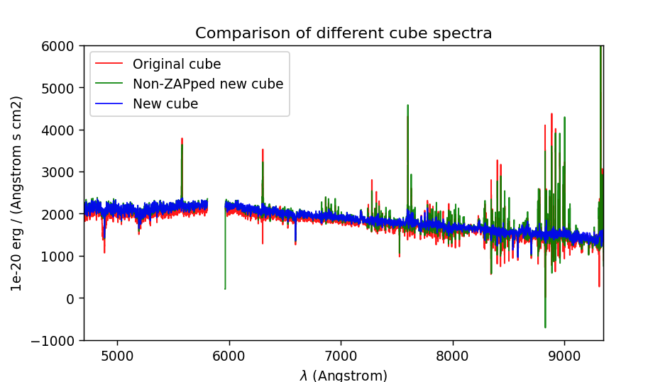
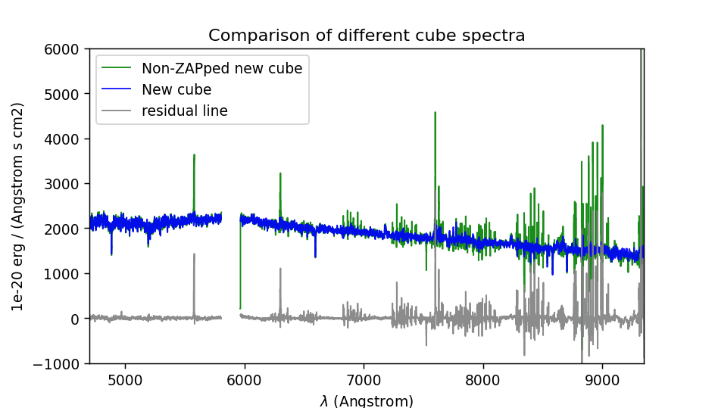
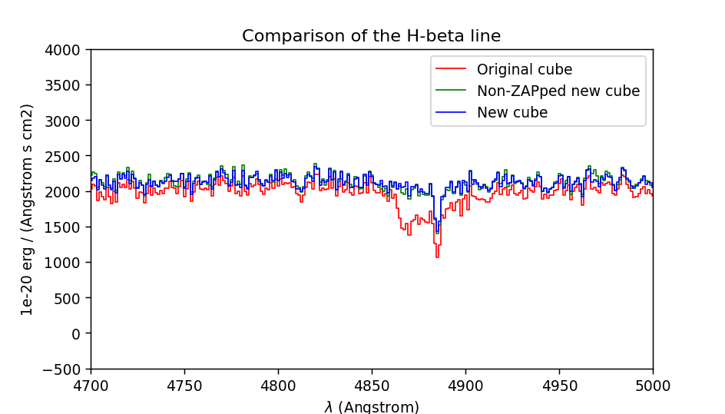
Bonus slides:
ZAPping the cube

Slide 14
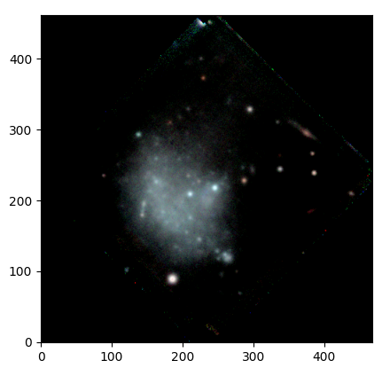
Color Images From an IFS
Bonus slides:

Slide 15
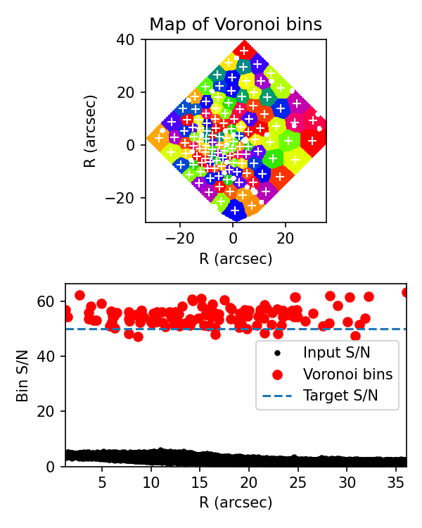
Voronoi bins
Bonus slides:

Slide 16
Thank you!

Slide 17
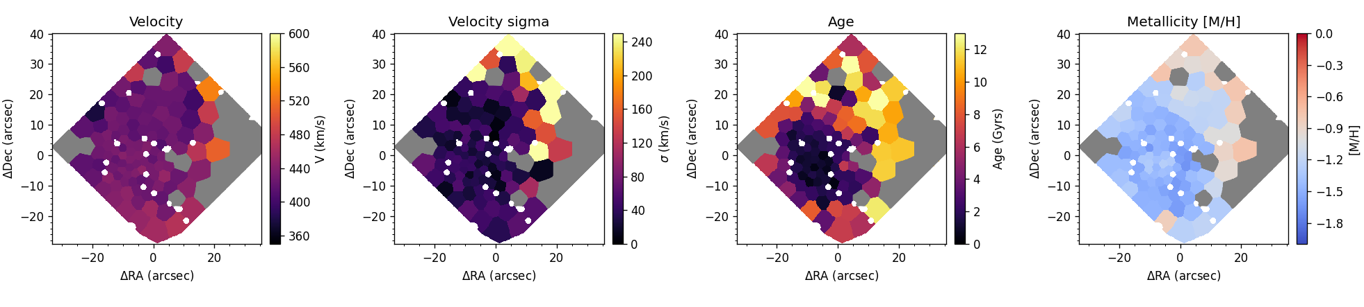
Kinematic and Stellar Population Properties

