Slide 1

First detection of X-ray polarization from the long-period X-ray pulsar 4U 1954+319
Alexander Salganik, Lingda Kong, Sofia V. Forsblom,
Menglei Zhou, Honghui Liu, QingChang Zhao, Sergey S. Tsygankov, Andrea Santangelo, Juri Poutanen
email: alsalganik@gmail.com arXiv: 2512.08195

Slide 2
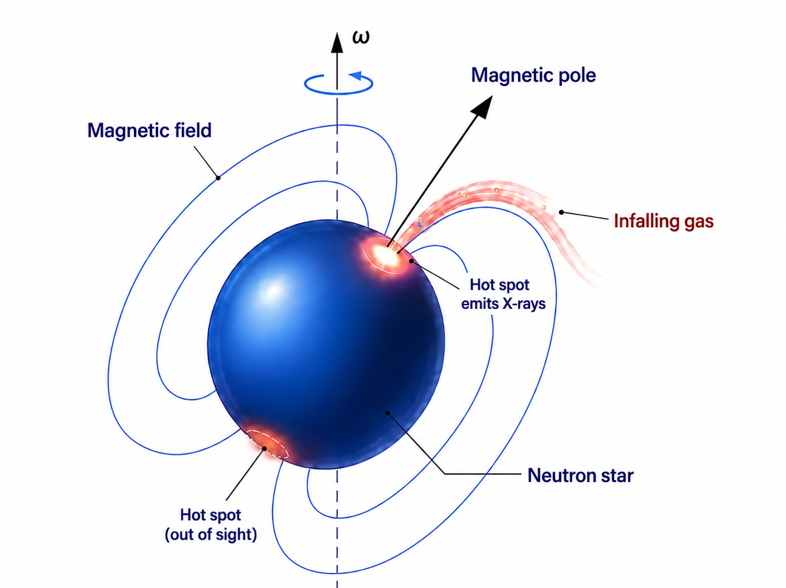
Accreting X-ray pulsars
A neutron star powered by accretion
Neutron star accreting matter from a companion.
Magnetic field channels the flow onto the poles.
Hot polar regions produce X-ray beams.
Rotation turns the beam into periodic pulsations.

Slide 3
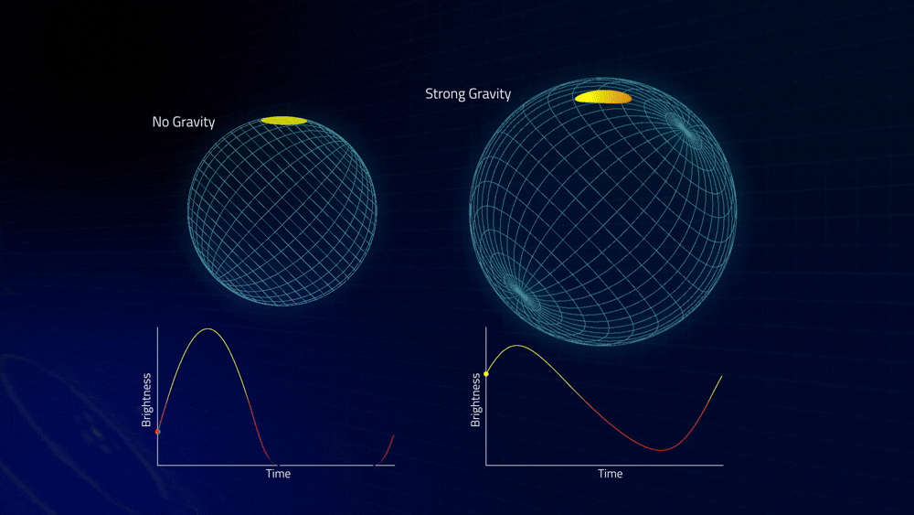
Pulsar’s pulse profile. Credit: NASA-GSFC

Slide 4
Why X-ray polarimetry?
What defines observed pulse profiles?
Beam Pattern
angular X-ray emission
depends on B-field
and accretion geometry
Degeneracy
pulse shape mixes geometry and emission physics
i_{p}, θ, beam pattern
Pulsar geometry
observer inclination
and magnetic obliquity
shape the pulse profile
Phase-resolved polarization allows us to infer the geometry of a pulsar and resolve the degeneracy!

Slide 5
Stokes Parameters: q, u, PD, and PA
u
Definitions
• q, u: normalized linear Stokes parameters
• PD: polarization degree (fractional linear polarization)
• PA: polarization angle projected on the sky
PD
2PA
q
Formulas
$$PD=\sqrt{q^{2}+u^{2}}$$
$$PA=\frac{1}{2}atan2(u,q)$$
Main idea
The point (q, u) is a vector in the Stokes plane: its length is PD, while its polar angle is 2PA.
$$q=PDcos(2PA)u=PDsin(2PA)$$

Slide 6
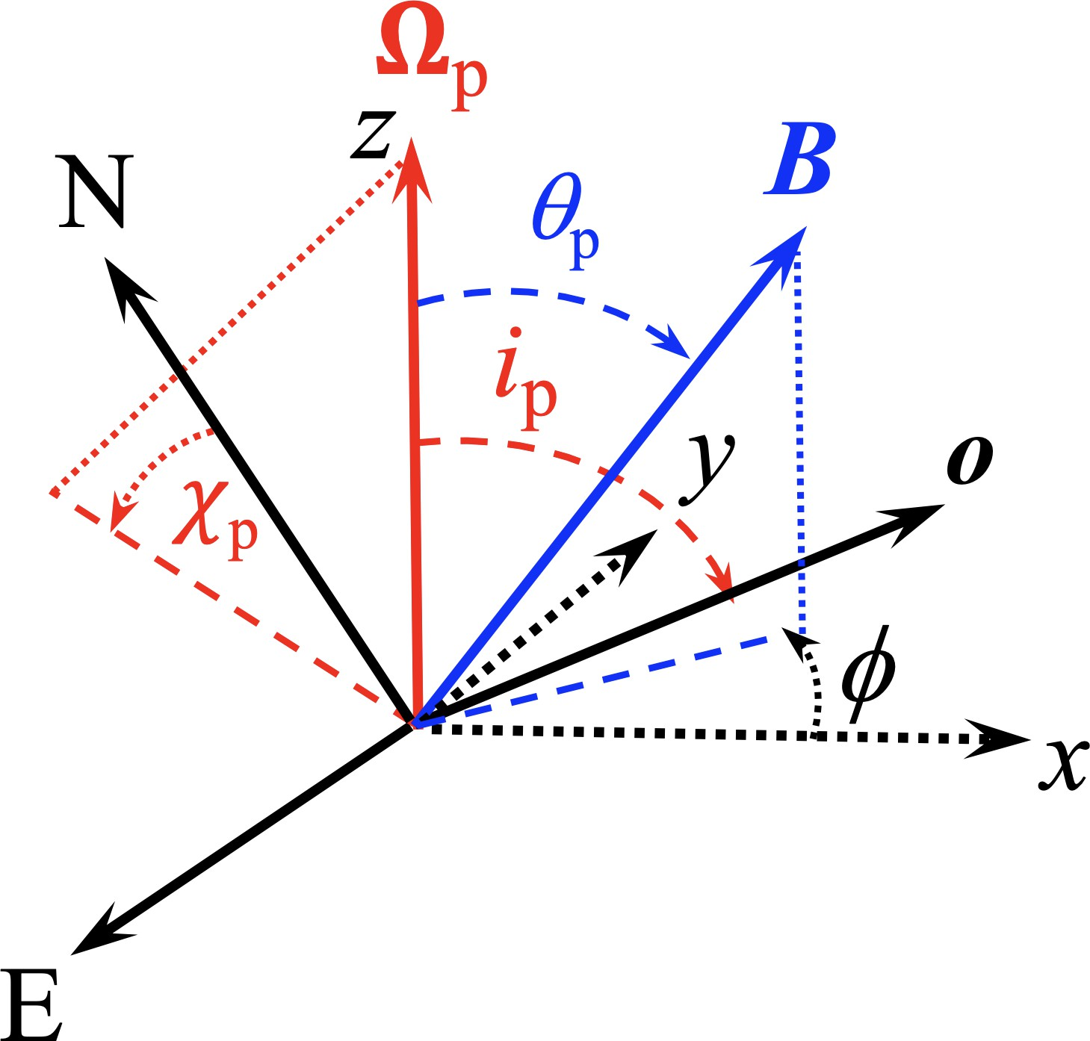
Rotating Vector Model (RVM): Geometry
Geometry
ip : spin-axis inclination
$θ$: magnetic obliquity
ϕ: rotational phase
χp : sky reference angle
Main idea
As the pulsar spins, the magnetic-field direction appears to move across the sky, causing the observed PA to change with phase.
RVM maps geometry into a phase-dependent PA curve.
$$tan(PA-χ_{p})=\frac{-sinθ_{p}sin(ϕ-ϕ_{0})}{sini_{p}cosθ_{p}-cosi_{p}sinθ_{p}cos(ϕ-ϕ_{0})}$$

Slide 7
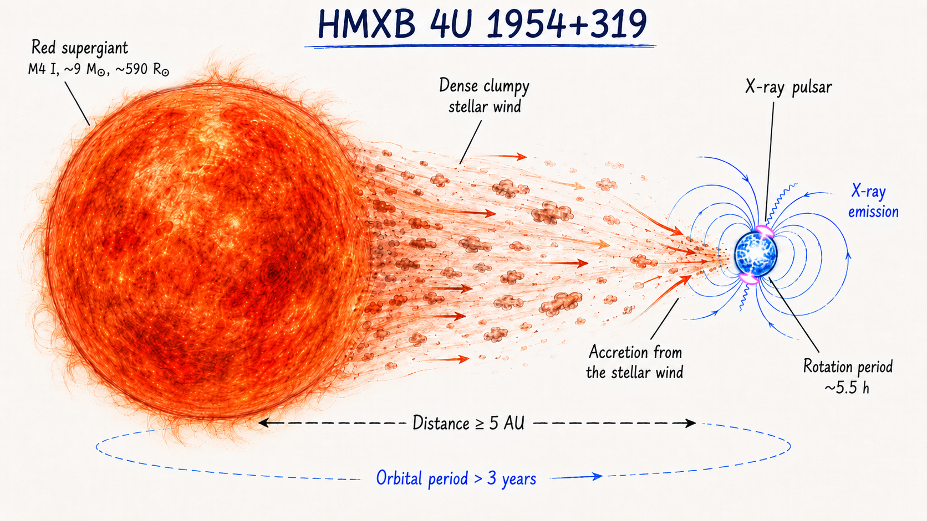
4U 1954+319: an unusual X-ray pulsar

Slide 8
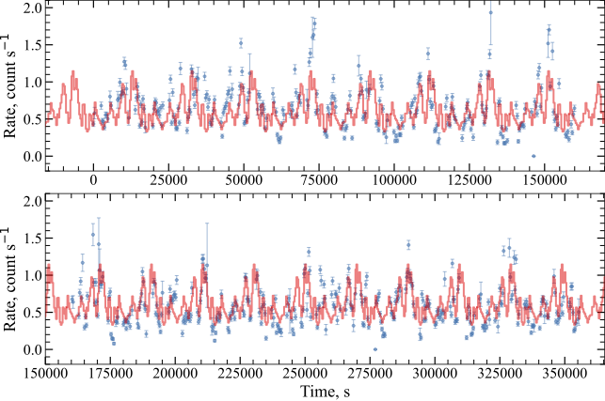
4U 1954+319: an unusual X-ray pulsar
$P_{spin}$= 5.49 ± 0.05 s

Slide 9
Main result
Polarization is hidden in the phase average but appears when the pulse is resolved
Phase-averaged:
no significant detection
${MDP}_{99}=4.9\%$ in 2–8 keV
9

Slide 10
Main result
Polarization is hidden in the phase average but appears when the pulse is resolved
Phase-averaged:
no significant detection
${MDP}_{99}=4.9\%$ in 2–8 keV
Phase-resolved analysis:
measure polarization separately at different pulse phases
$PD={10.3}_{-3.0}^{+3.1}\%$detected at pulse maximum
9

Slide 11
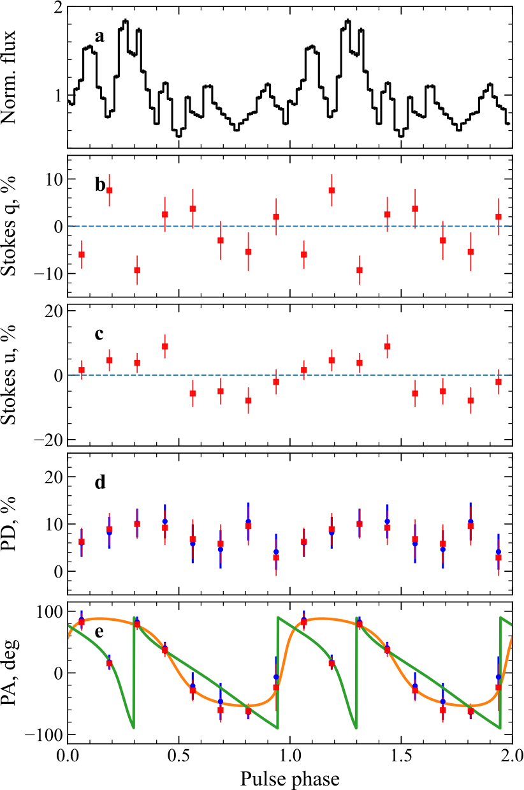
Phase-resolved polarization
Pulse maximum PD exceeds MDP₉₉
PA rotation
smooth swing by
$$≈{150}^{∘}$$
Polarization changes with pulse phase.
10

Slide 12
Why does phase-averaging miss the signal?
PA rotation can cancel the net polarization vector!
rotation
ϕ₃
ϕ₂
Phase average
different PA directions cancel each other out
⇒ net PD becomes small
ϕ₁
ϕ₄
ϕ₆
ϕ₅
Phase-resolved analysis
preserves the PA swing
⇒ polarization is recovered.
Different pulse phases contribute different polarization directions.
The PA swing can then be fitted with the rotating vector model.
11

Slide 13
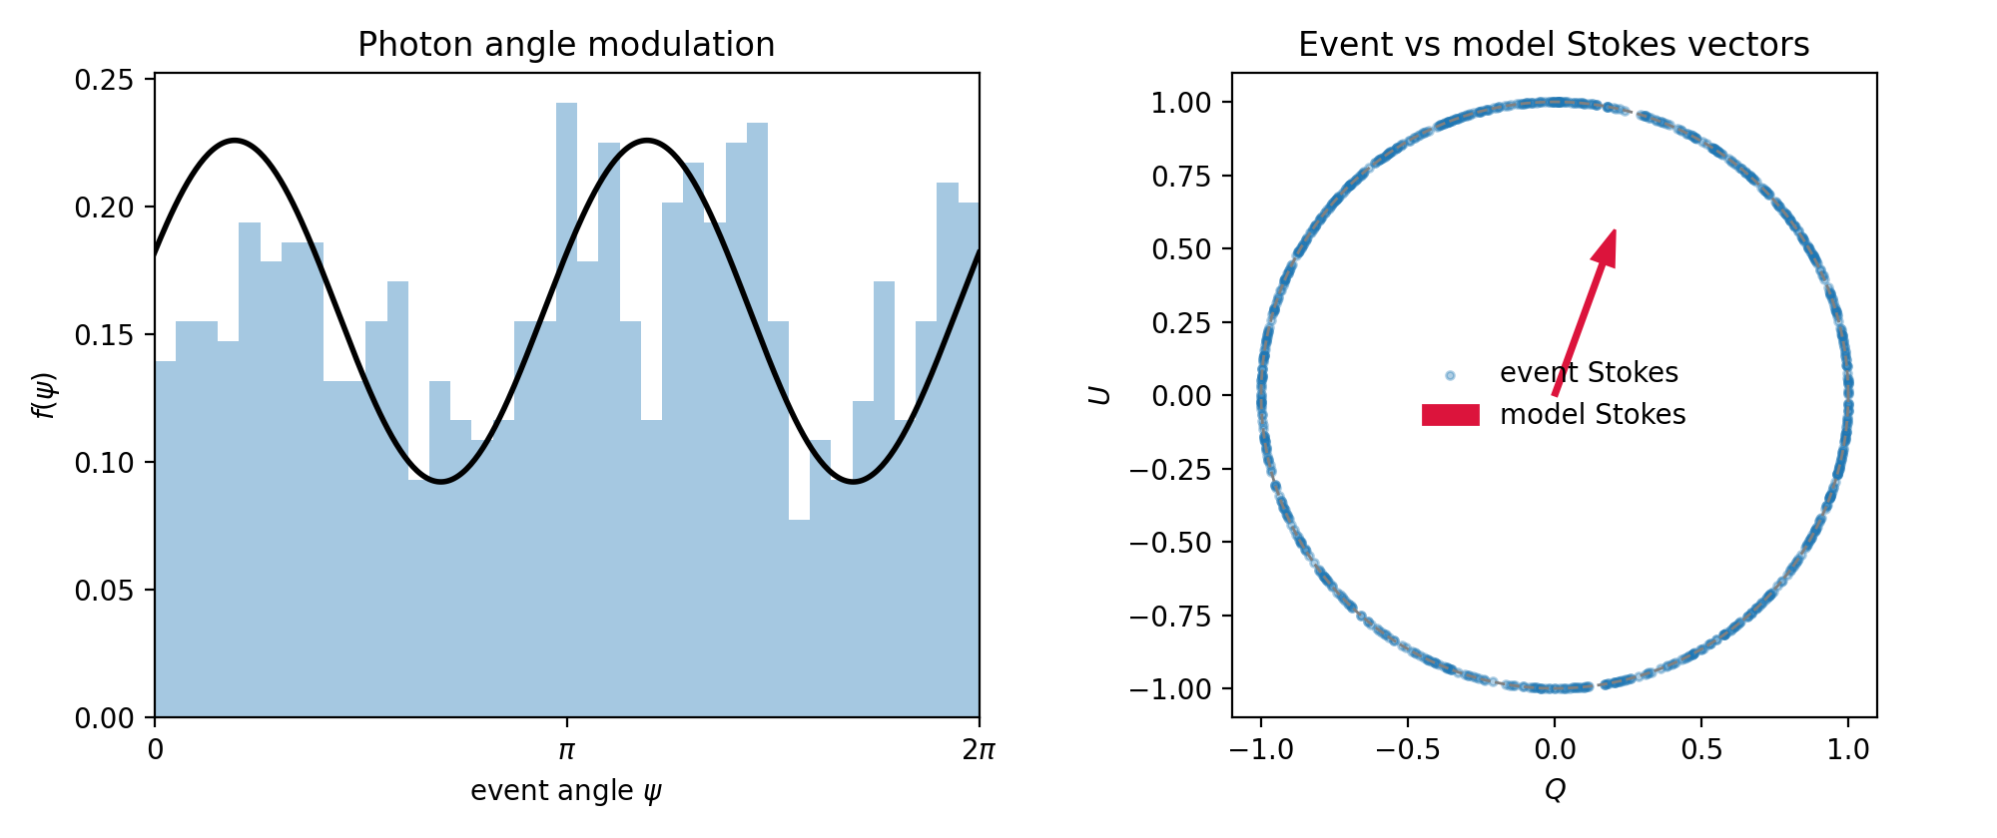
Event vs model Stokes: geometric picture
Each photon has a measured photoelectron angle $ψ_{k}$
Event stokes: $(Q_{k}^{γ},U_{k}^{γ})=(cos2ψ_{k},sin2ψ_{k})$ (a point on the circle)
Model stokes: $(Q^{m},U^{m})=p_{0}(cos2ψ_{0},sin2ψ_{0})$ (preferred direction)
$ψ_{0}$ — model PA, $p_{0}$ — model PD (assuming $p_{0}(ψ)≡p_{0}$)

Slide 14
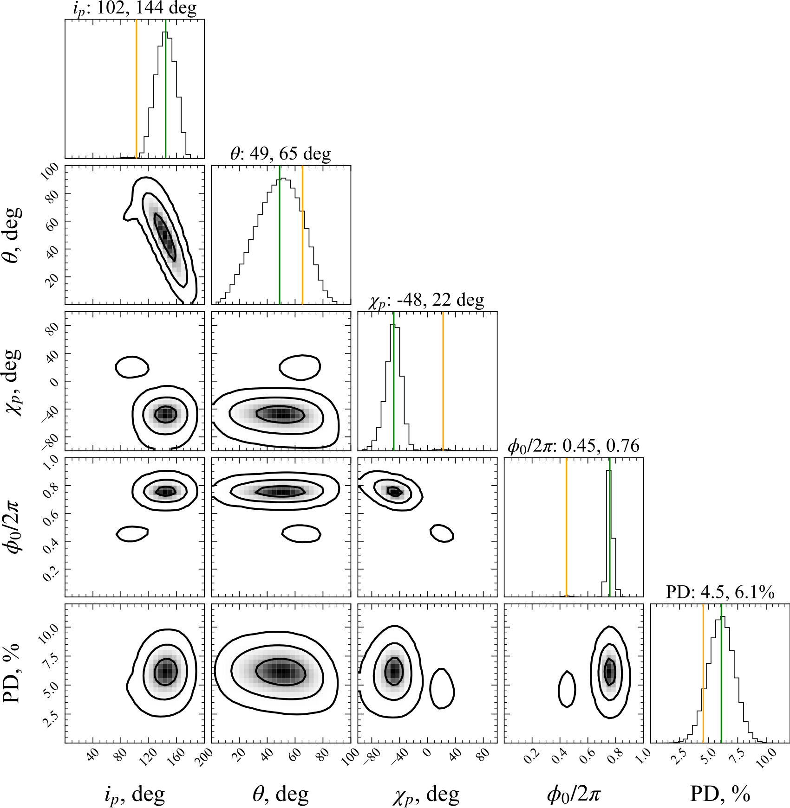
Pulsar geometry from the PA swing
Unbinned RVM analysis:
event-by-event fit of photon
Stokes q,u using the RVM
Best-fit geometry:
$$(i_{p},θ,χ_{p},ϕ_{0})$$
$$\left({144}_{-15}^{+14}{}^{∘},{49}_{-18}^{+16}{}^{∘},{138}_{-12}^{+10}{}^{∘},0.76±0.02\right)$$
Phase-independent PD: $6.1±1.1\%$
Intermediate viewing geometry

Slide 15
Summary
First X-ray polarization detection from 4U 1954+319
Phase-resolved detection
At pulse maximum, ϕ = 0.250–0.375:
$$PD={10.2}_{-3.0}^{+3.1}\%,PA={83}^{∘}±9^{∘}$$
PA swing
The polarization angle rotates smoothly across the pulse by ≈ 150◦.
Preferred RVM geometry:
$$i_{p}={144}_{-15}^{+14∘},θ={49}_{-18}^{+16∘}$$
Phase-independent polarization
Accounting for PA rotation gives PD = 6.1 ± 1.1%.
13

Slide 16
THANK YOU!

Slide 17
EXTRA SLIDES

Slide 18
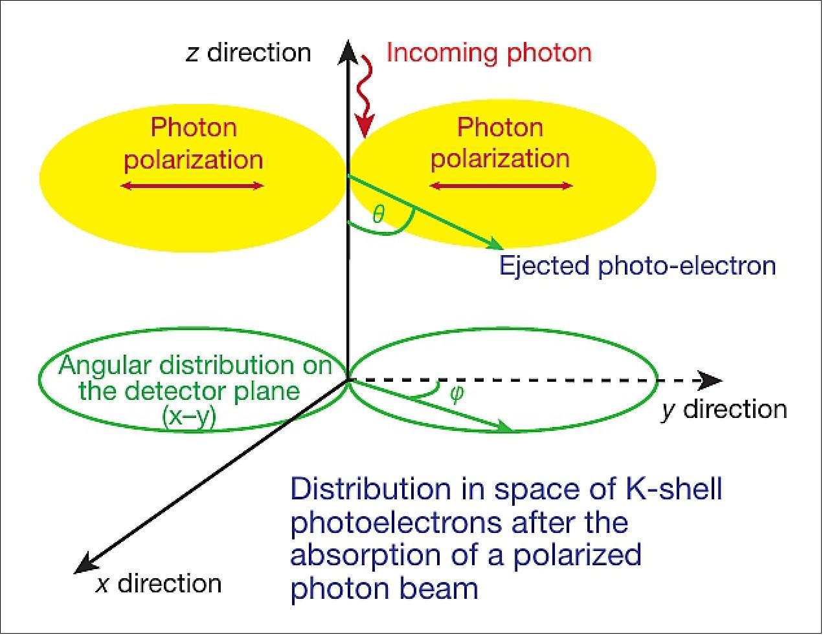
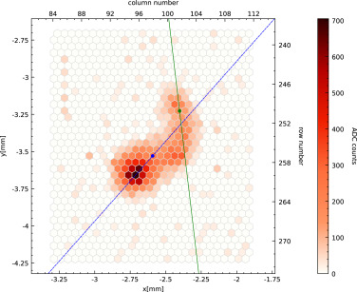
Polarization direction

Slide 19
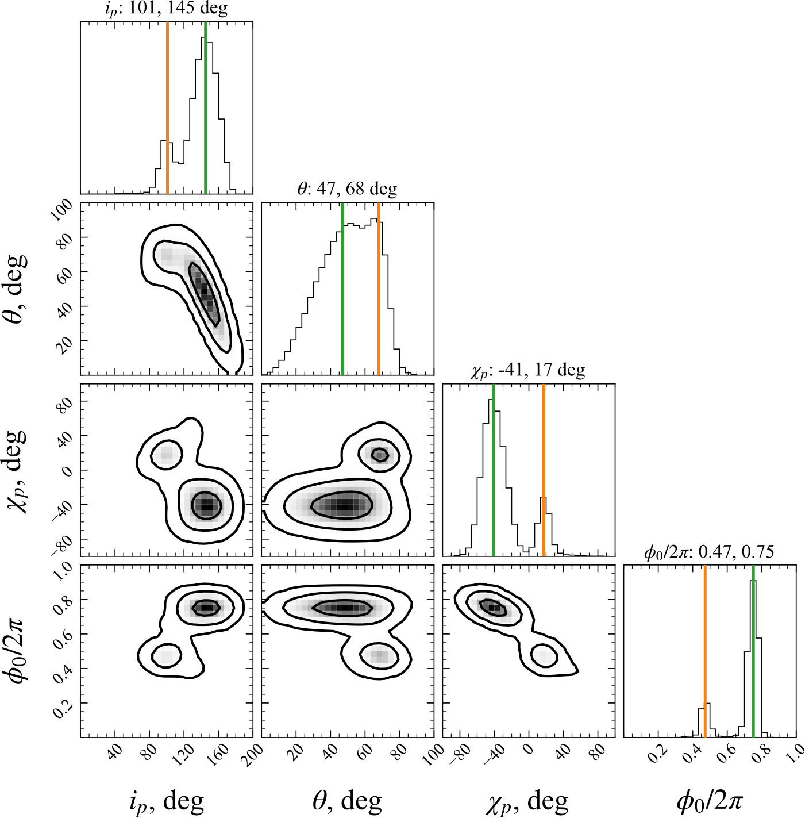

Slide 20
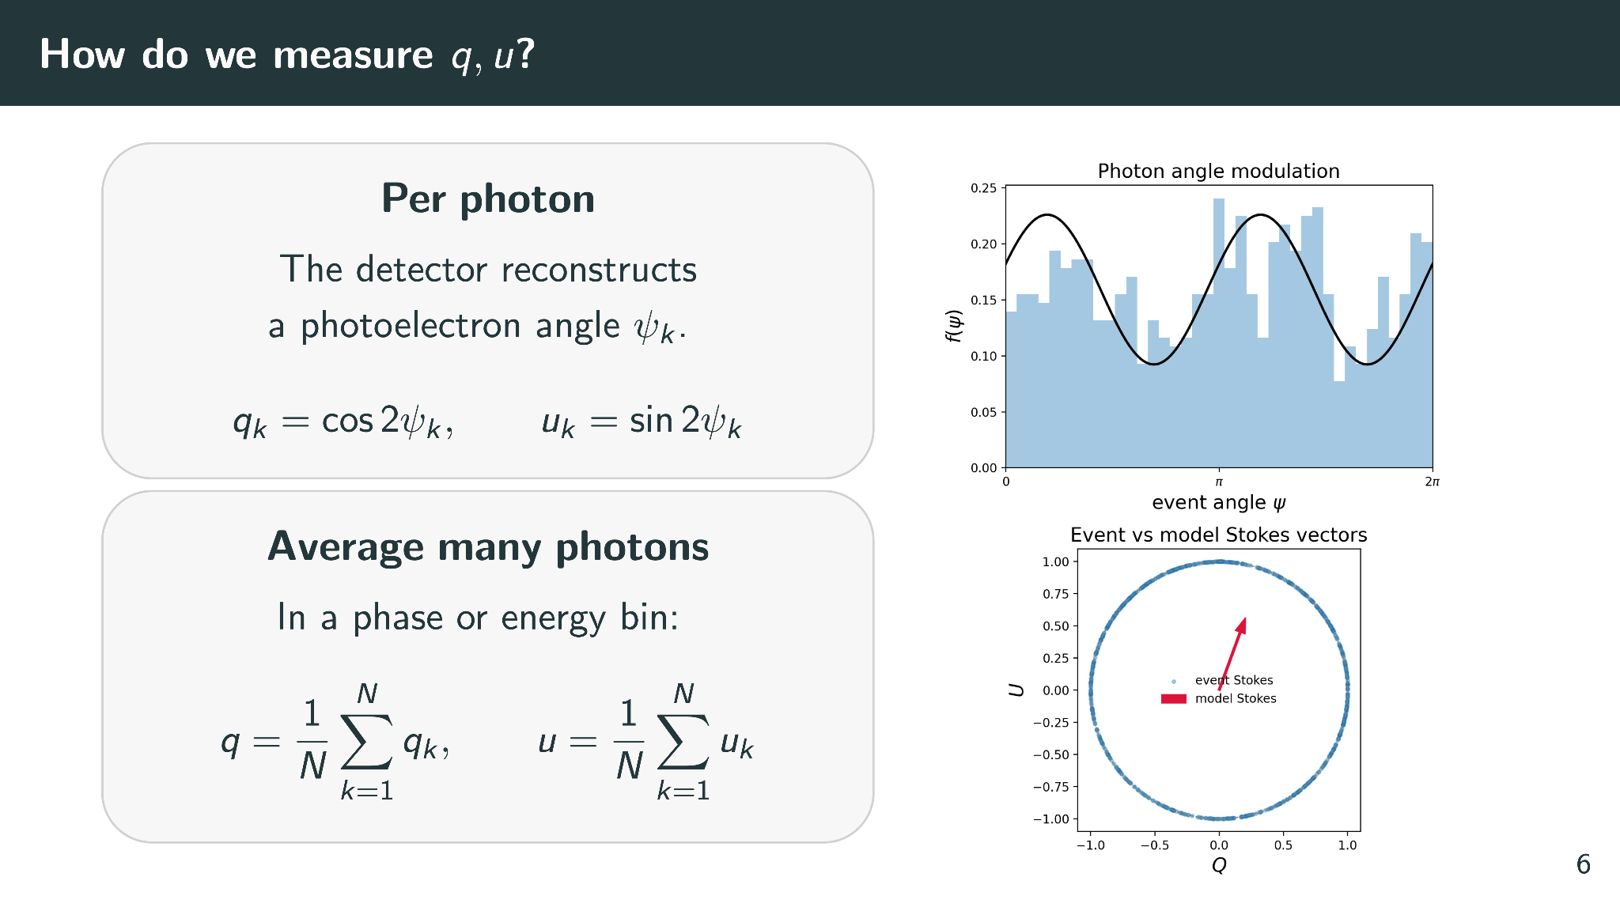

Slide 21
