Slide 1
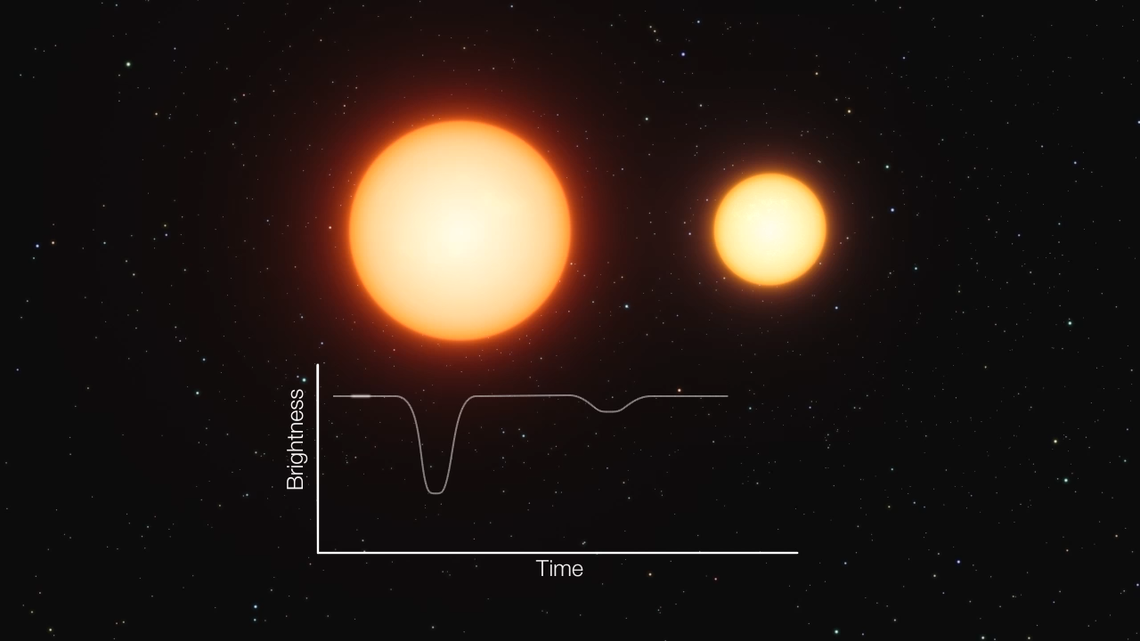

Starspots on eclipsing giant stars
András Haris, Mikko Tuomi, Thomas Hackman, Bálint Seli, Katalin Oláh
Nordic-Baltic Astronomy Days 2026
UNIVERSITY OF HELSINKI
Notes:
0. slide
**animation starts after first click**
Andras Haris,
Doctoral researcher
University of Helsinki, Stellar Astrophysics Research Group

Slide 2
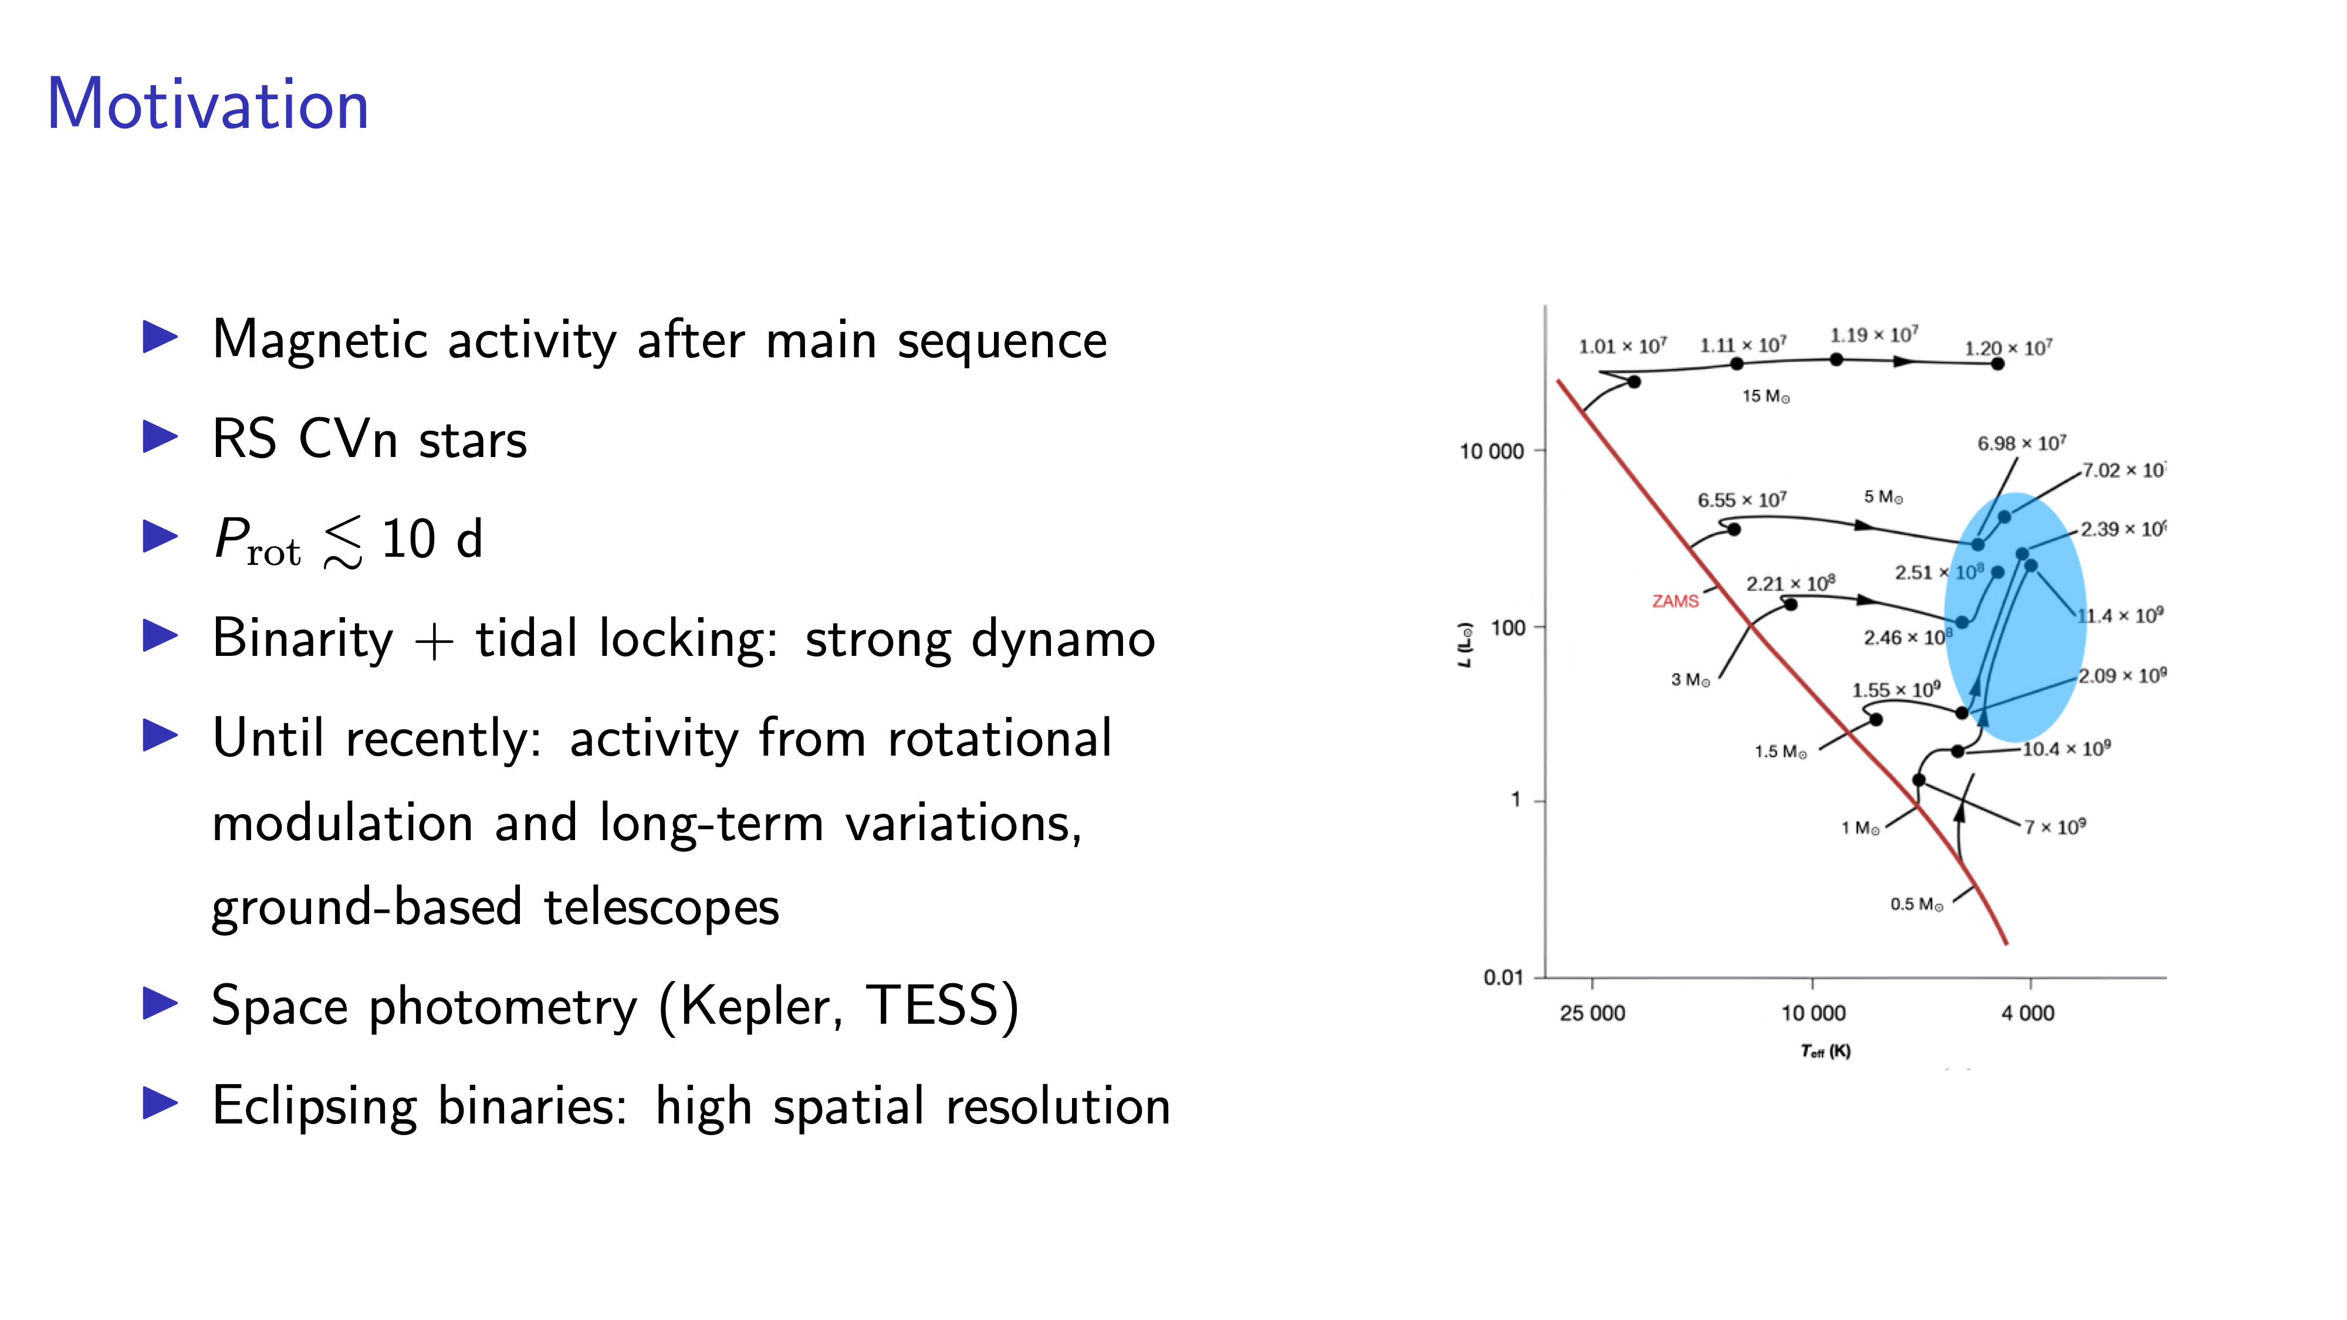
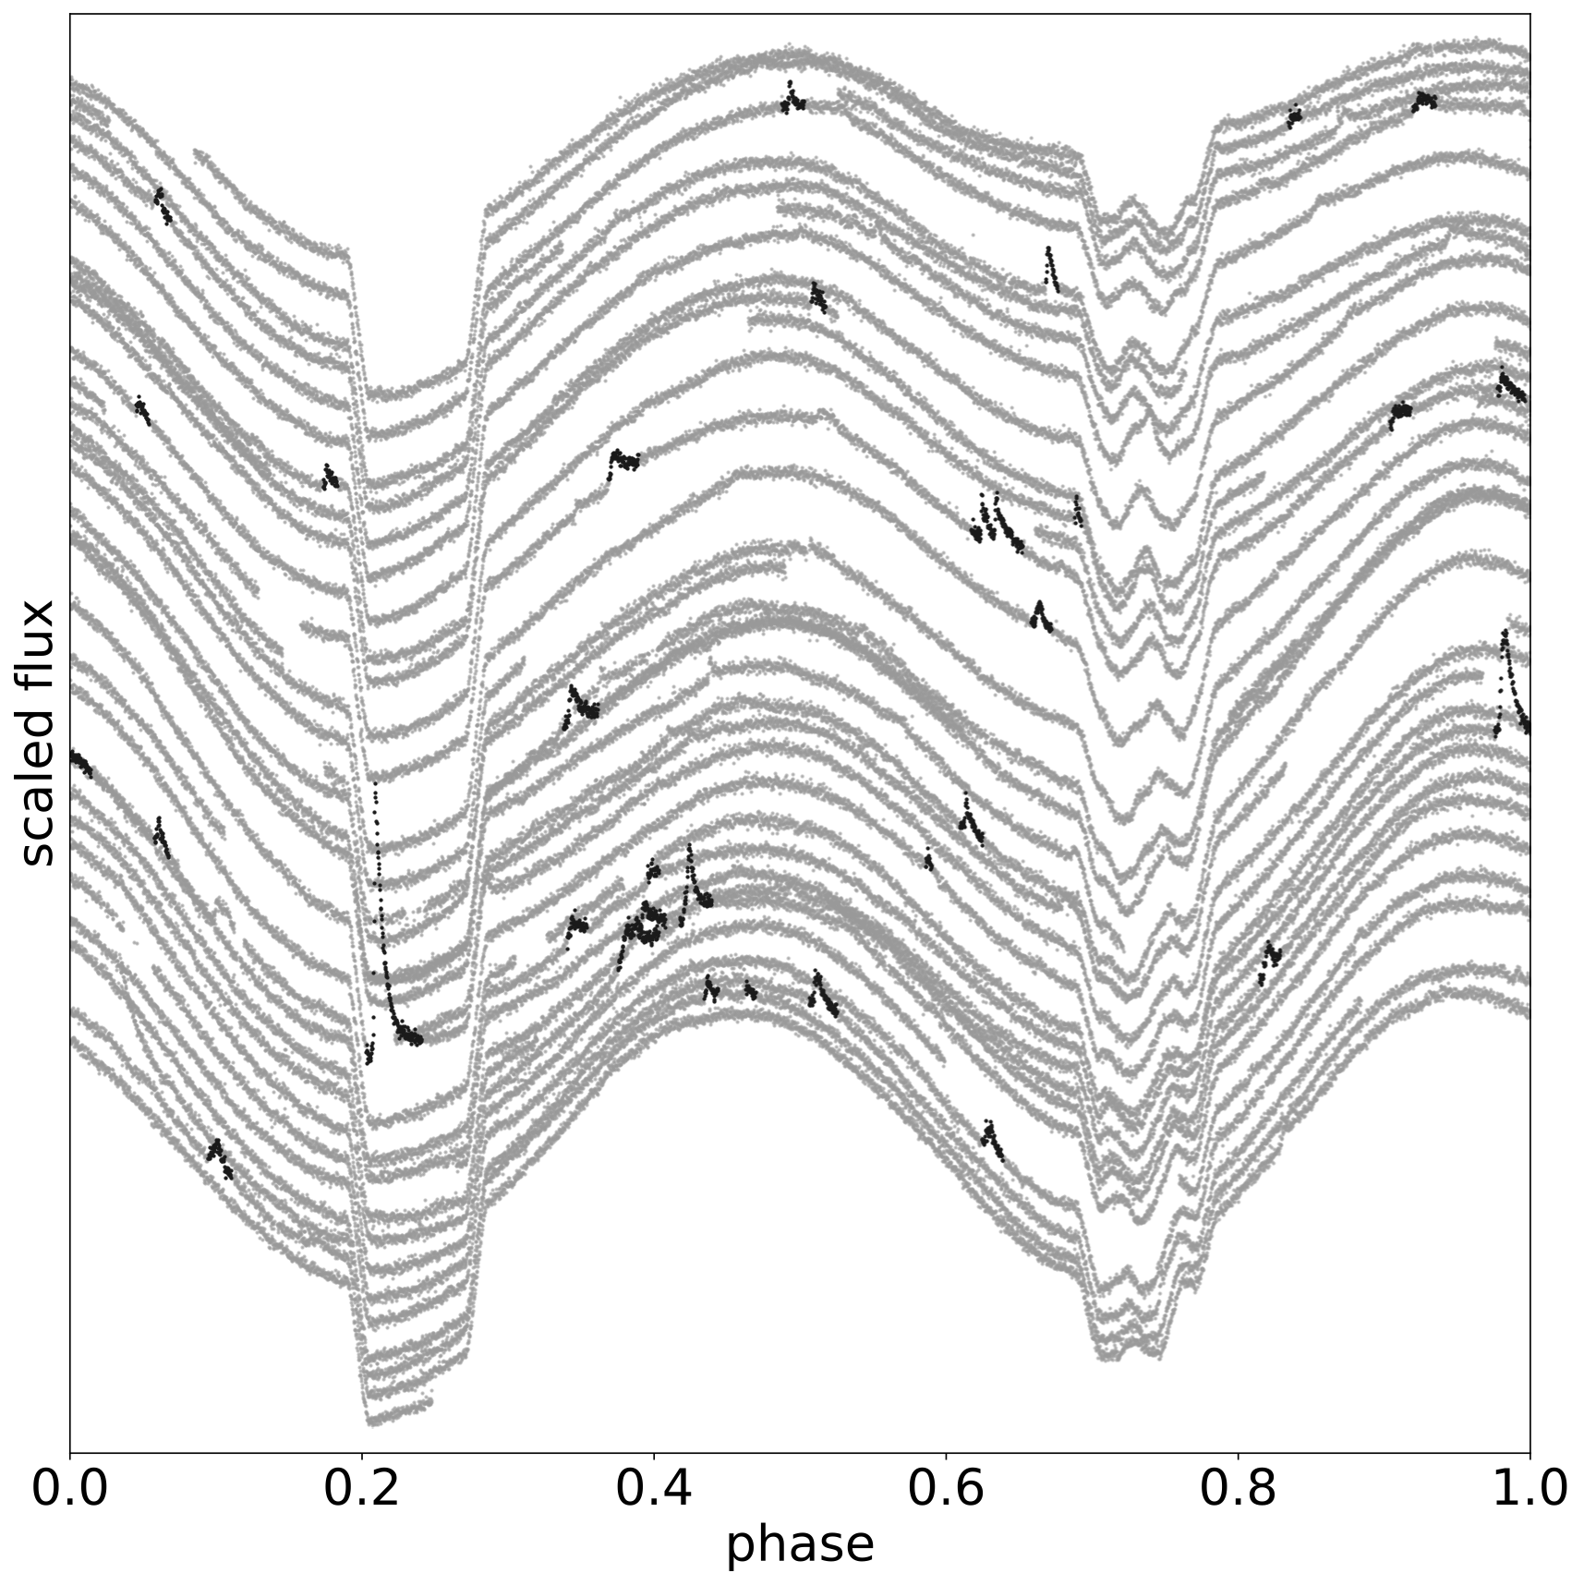
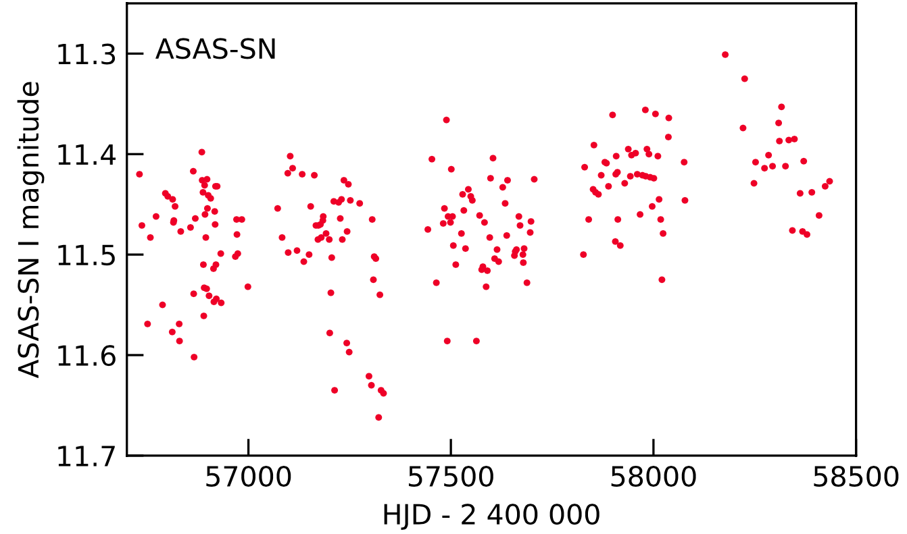
Notes:
Detached binaries.
Primary component F—G, V—IV (later extended to III).
Secondary can also be magnetically active.
Period: 1 d < P < 30 d.
Strong Ca II H&K emission.
Hall (1976)
To our knowledge, all previous attempts to characterize starspots using transits of planets or stellar companions were done on main-sequence stars. The reason behind this could be the long-lasting (several hours to days) and very shallow eclipses of the rare binaries with giant components, which are hard to observe from the ground.

Slide 3
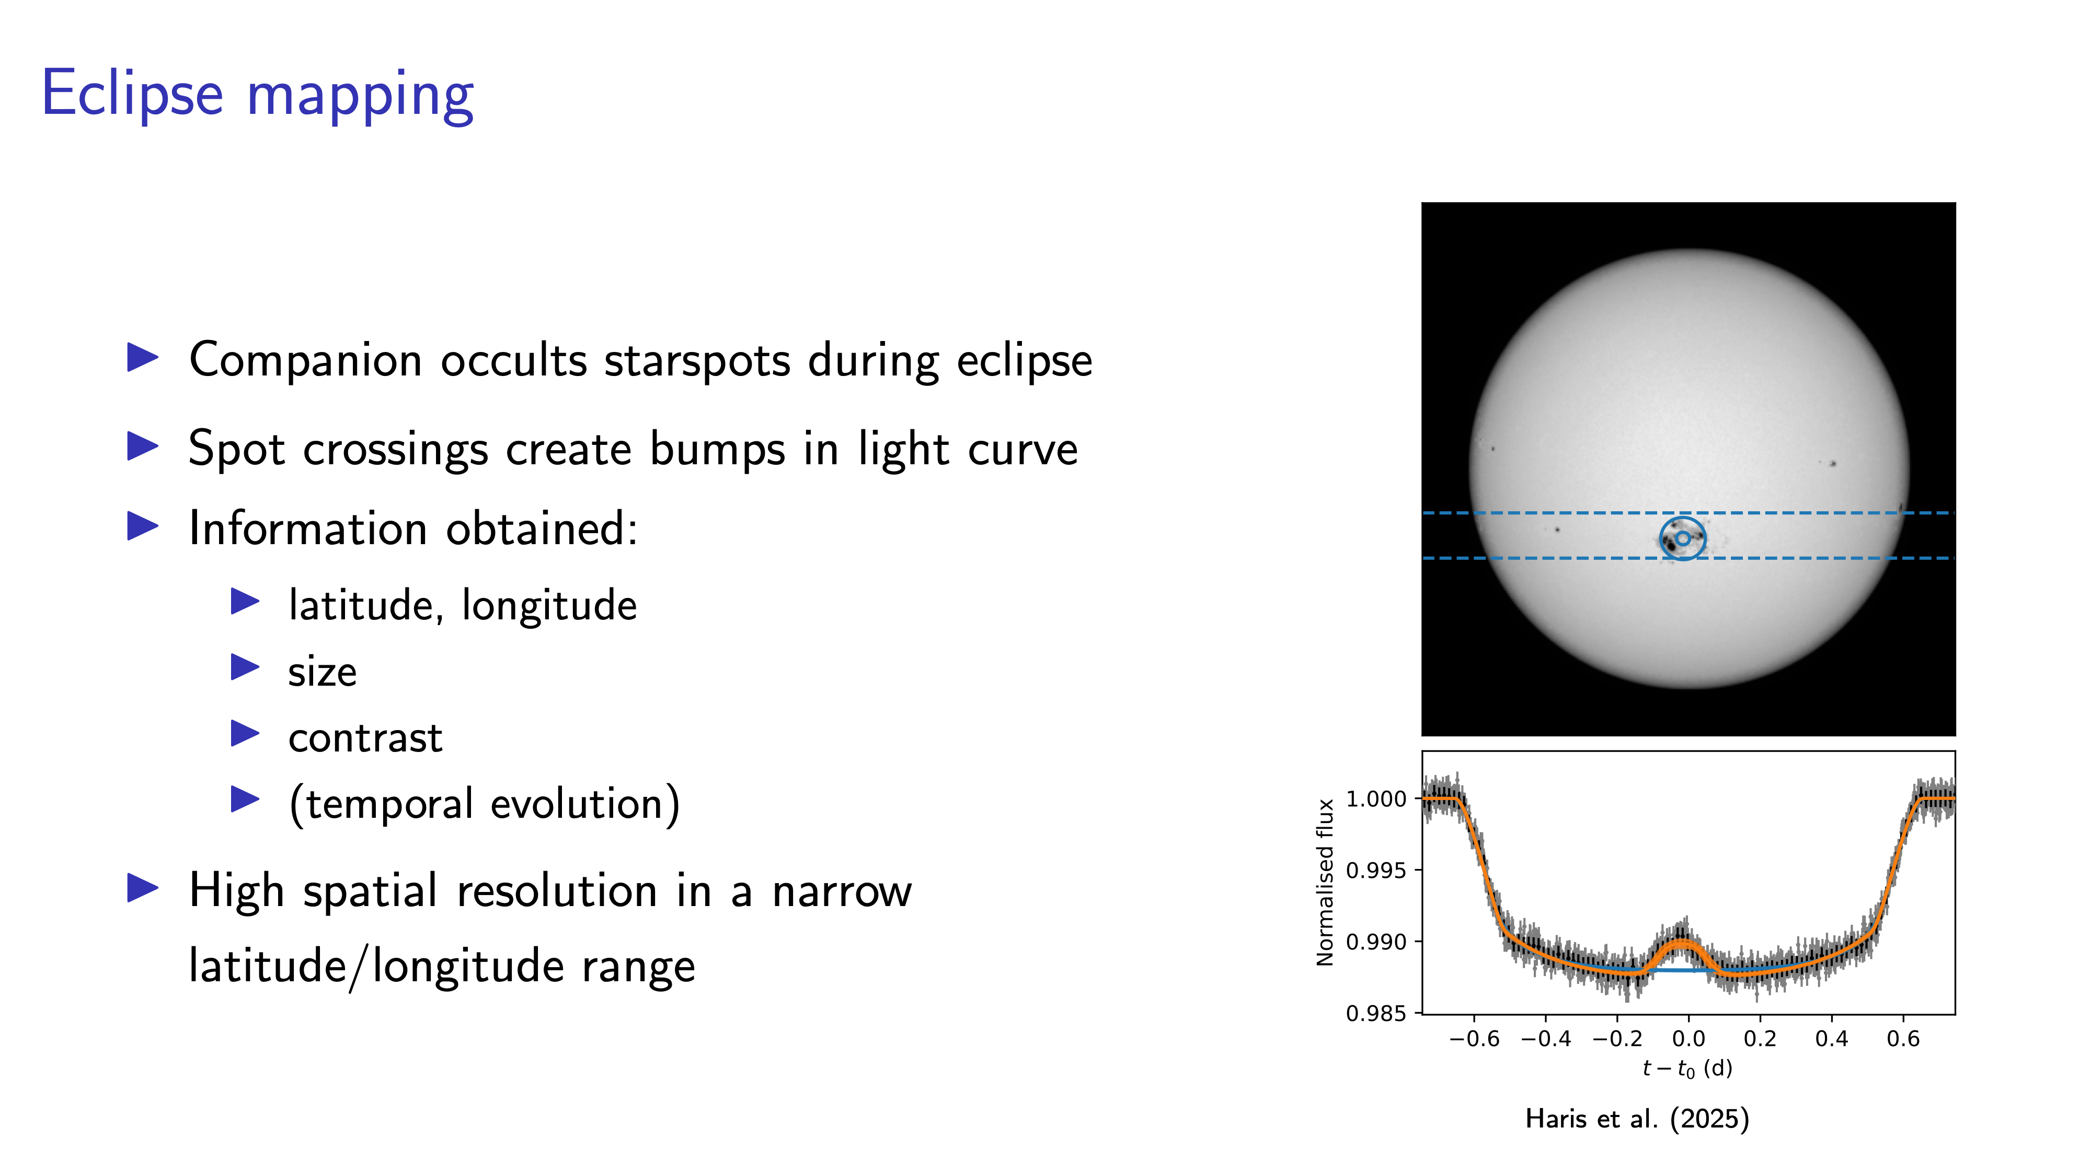
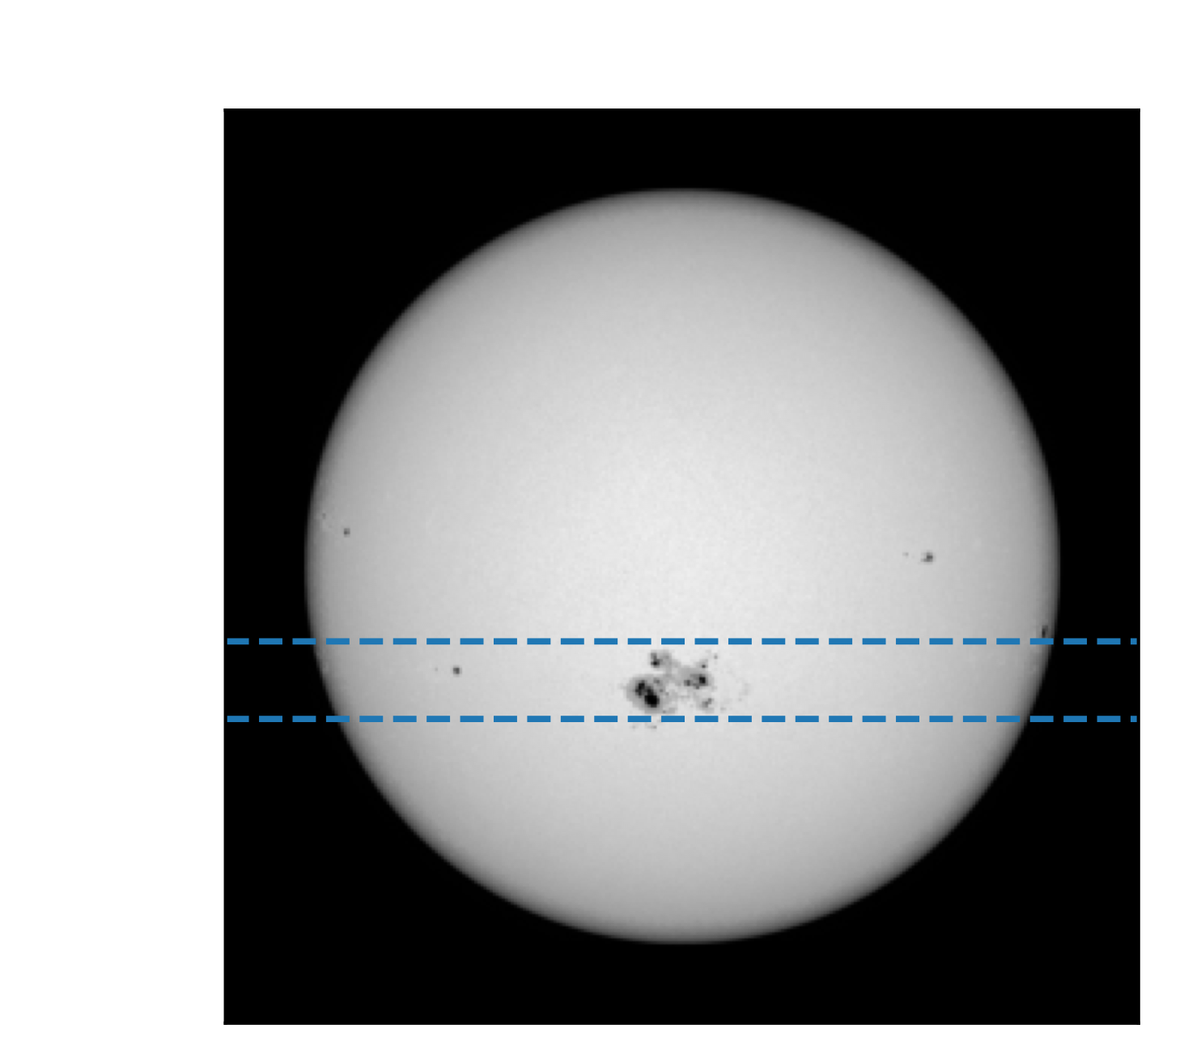
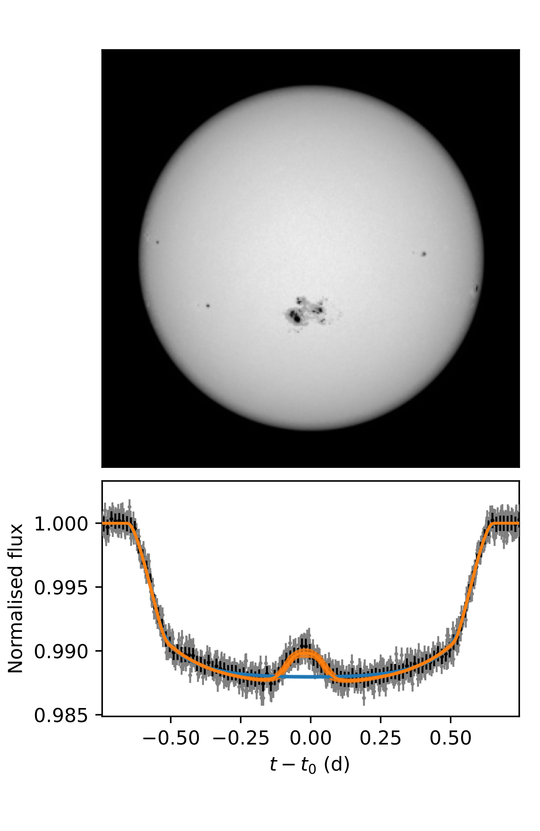

Slide 4
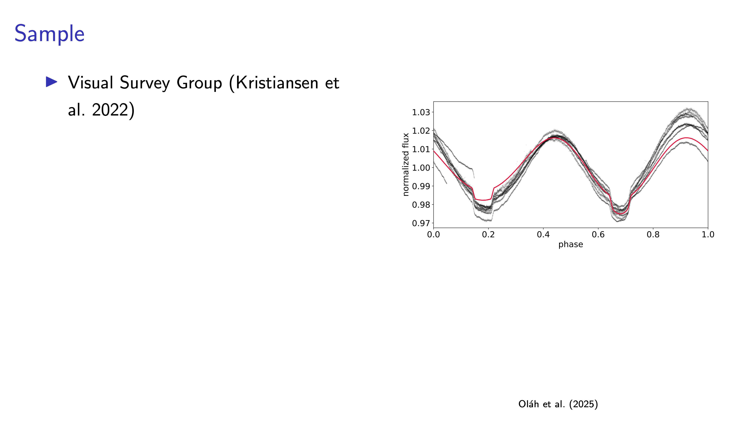

Slide 5
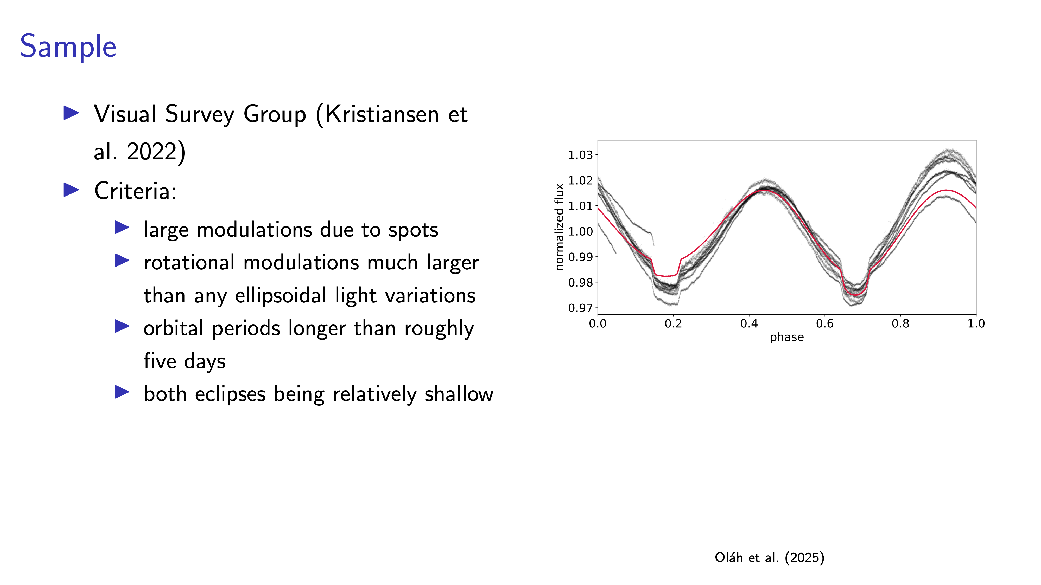

Slide 6
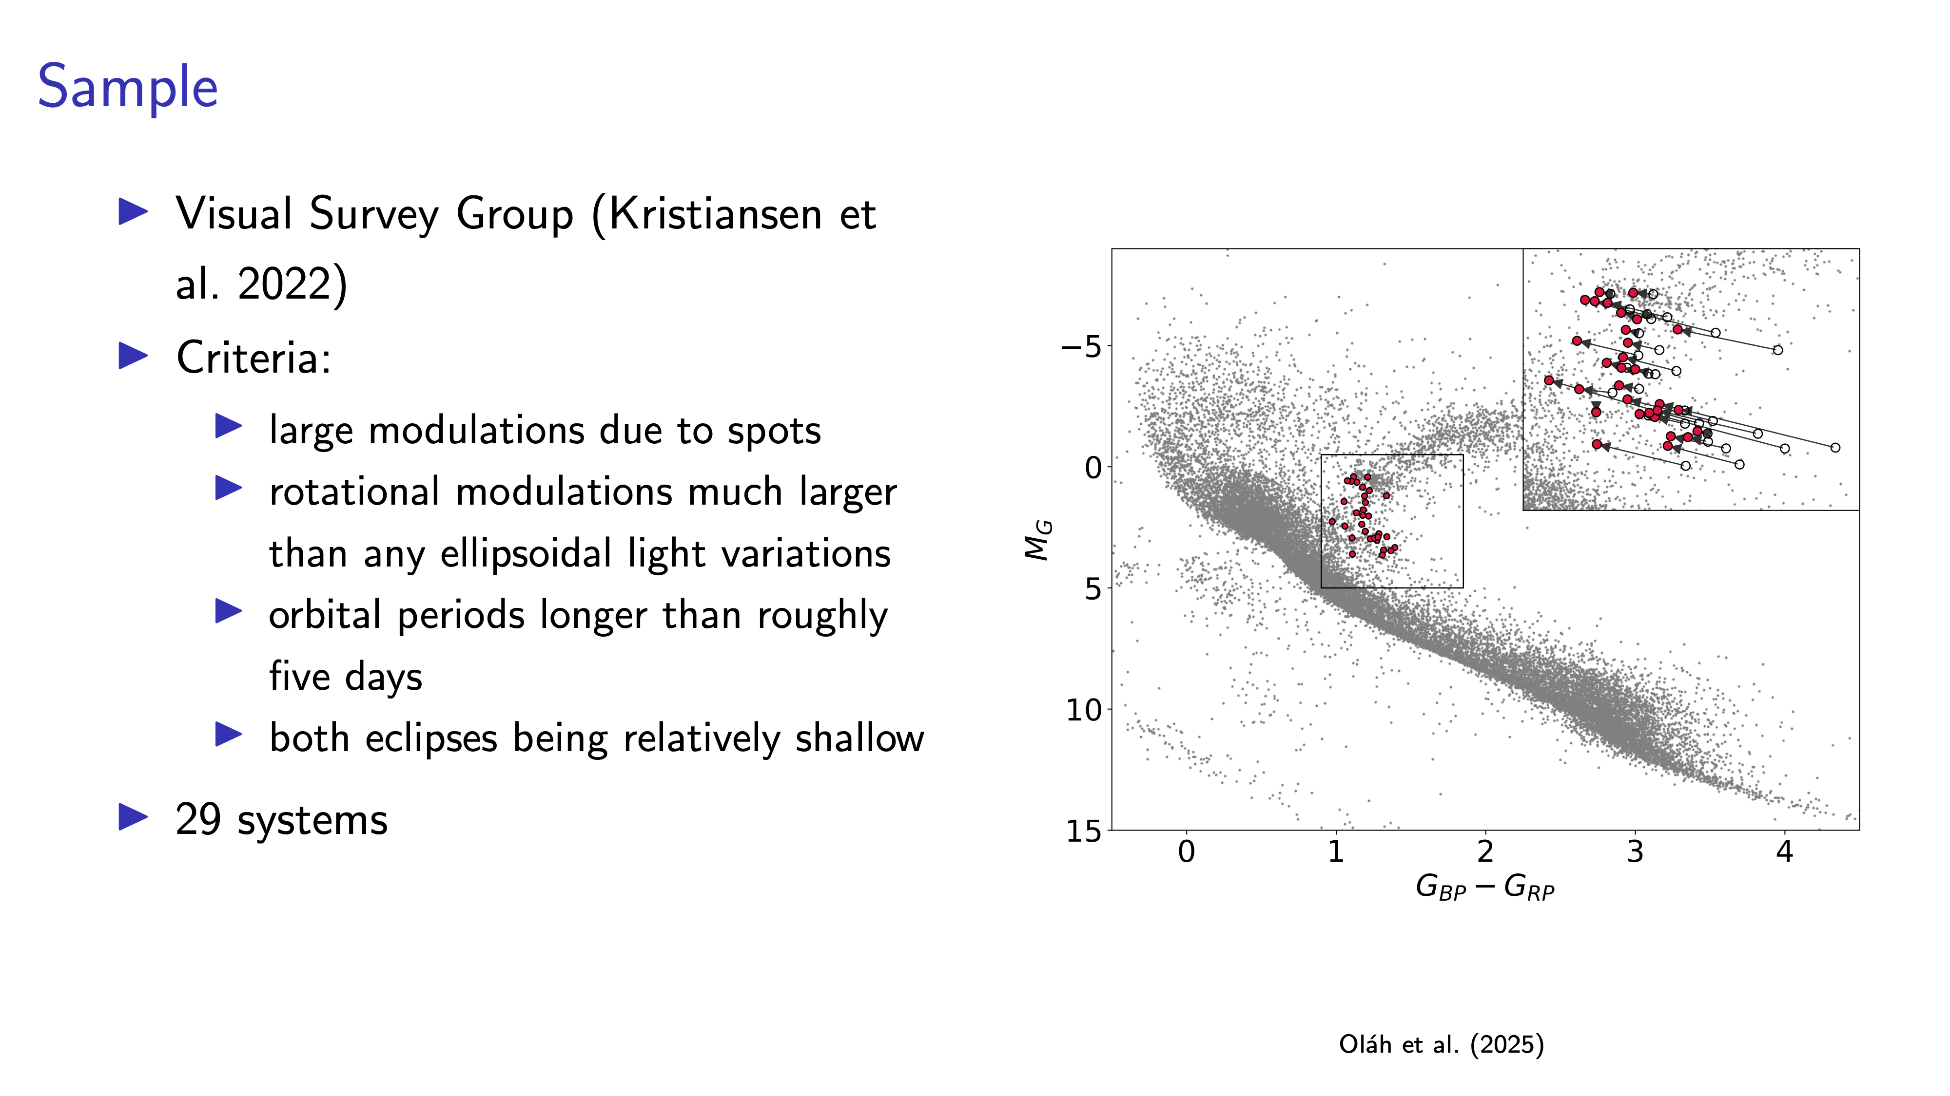

Slide 7
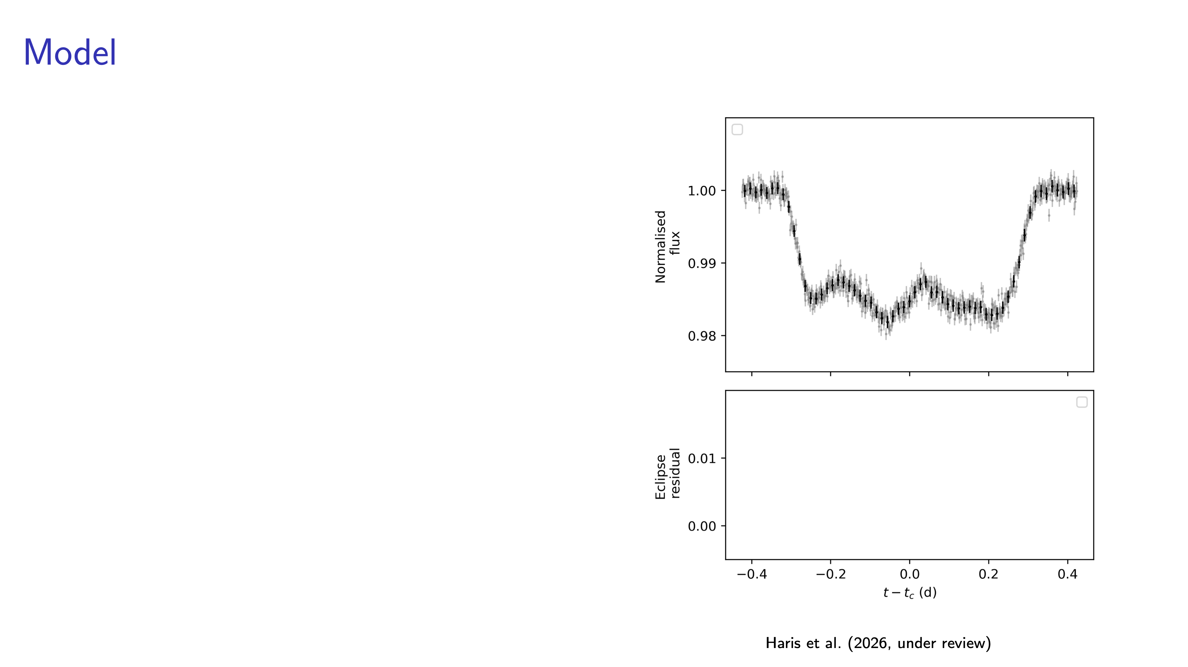

Slide 8
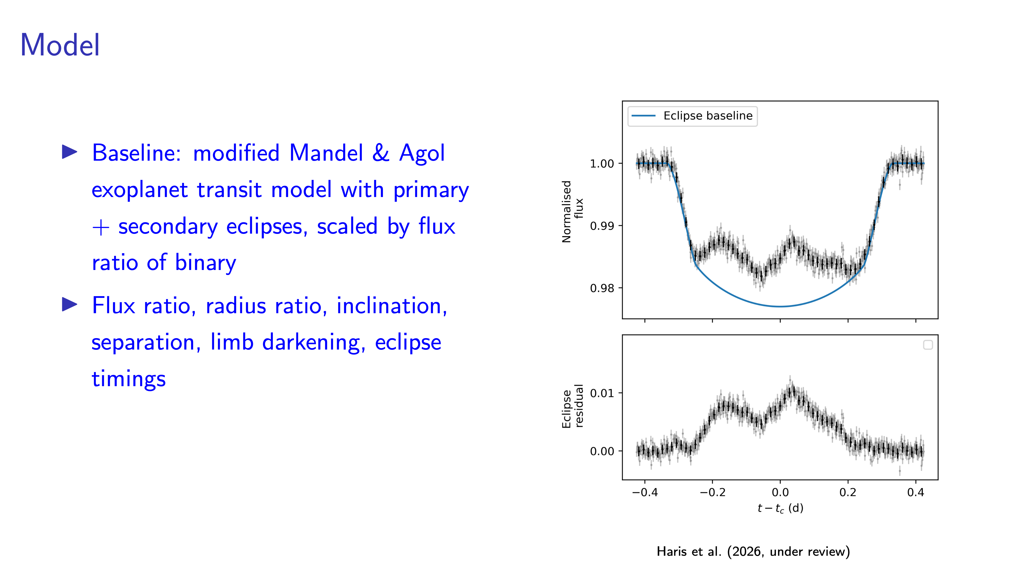

Slide 9
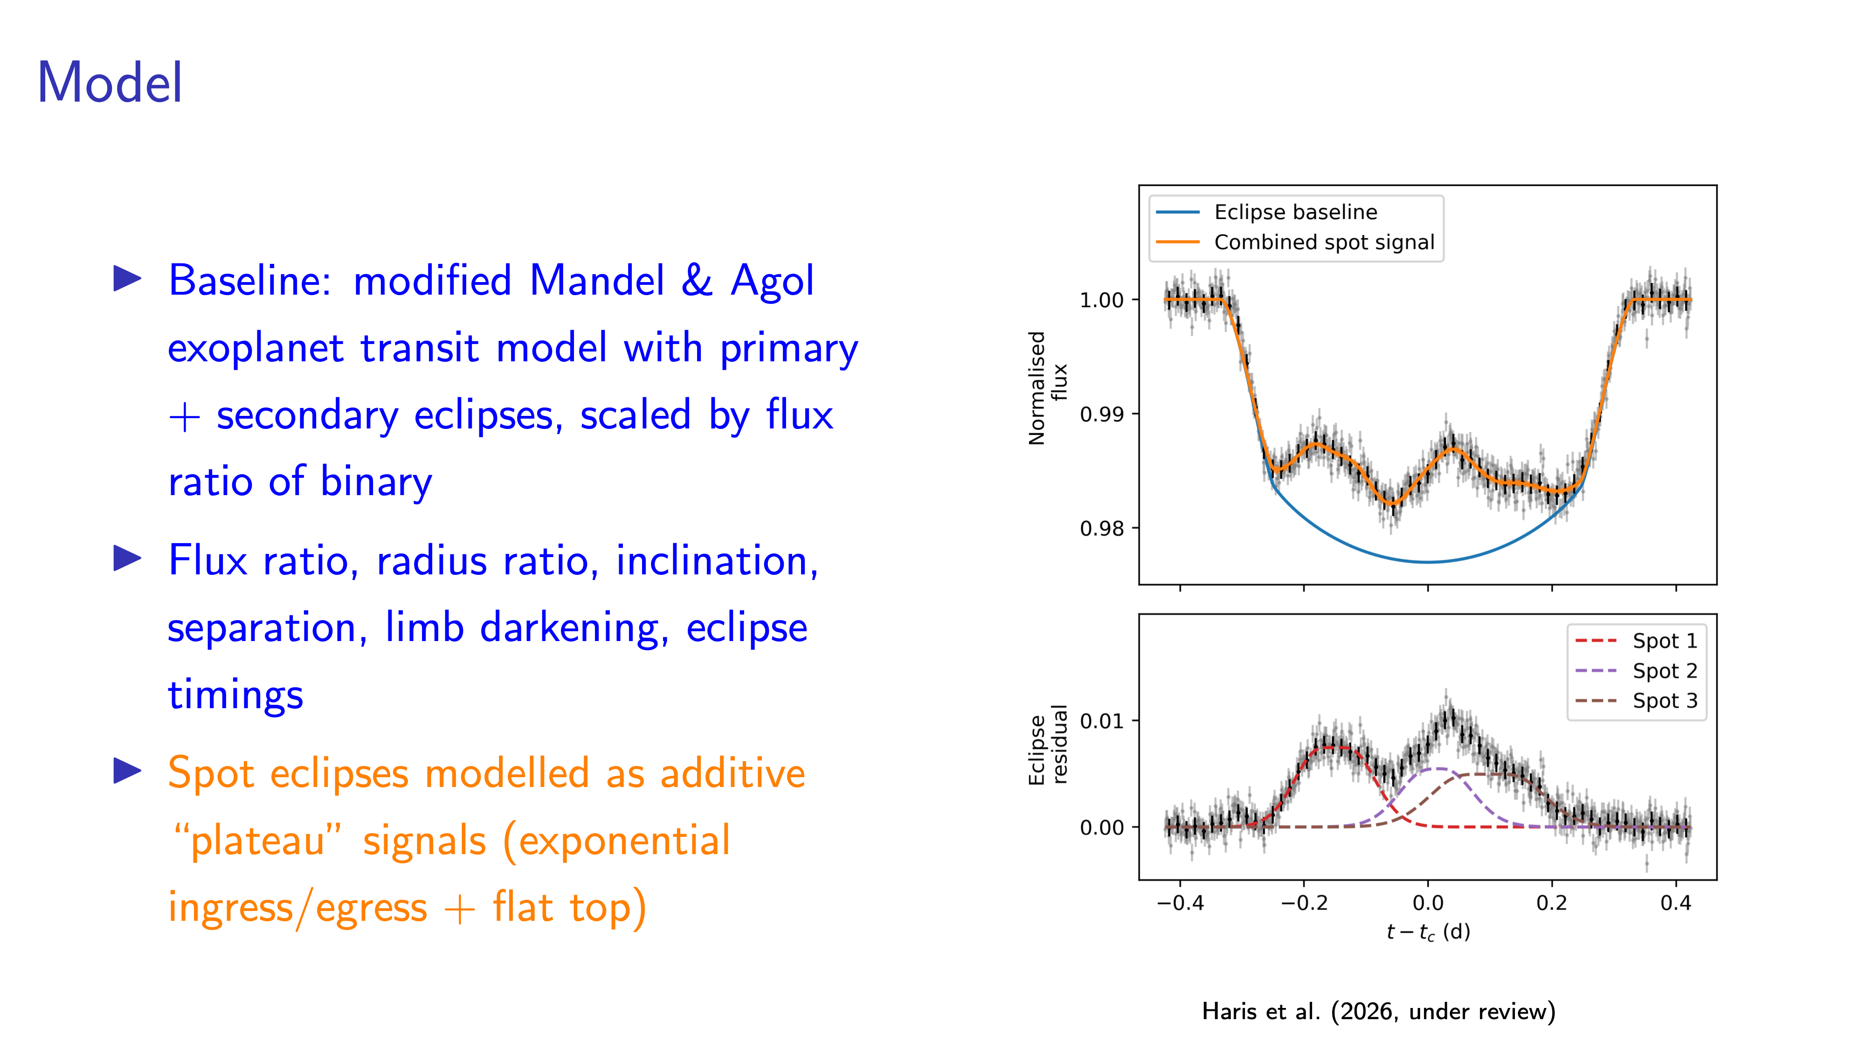

Slide 10
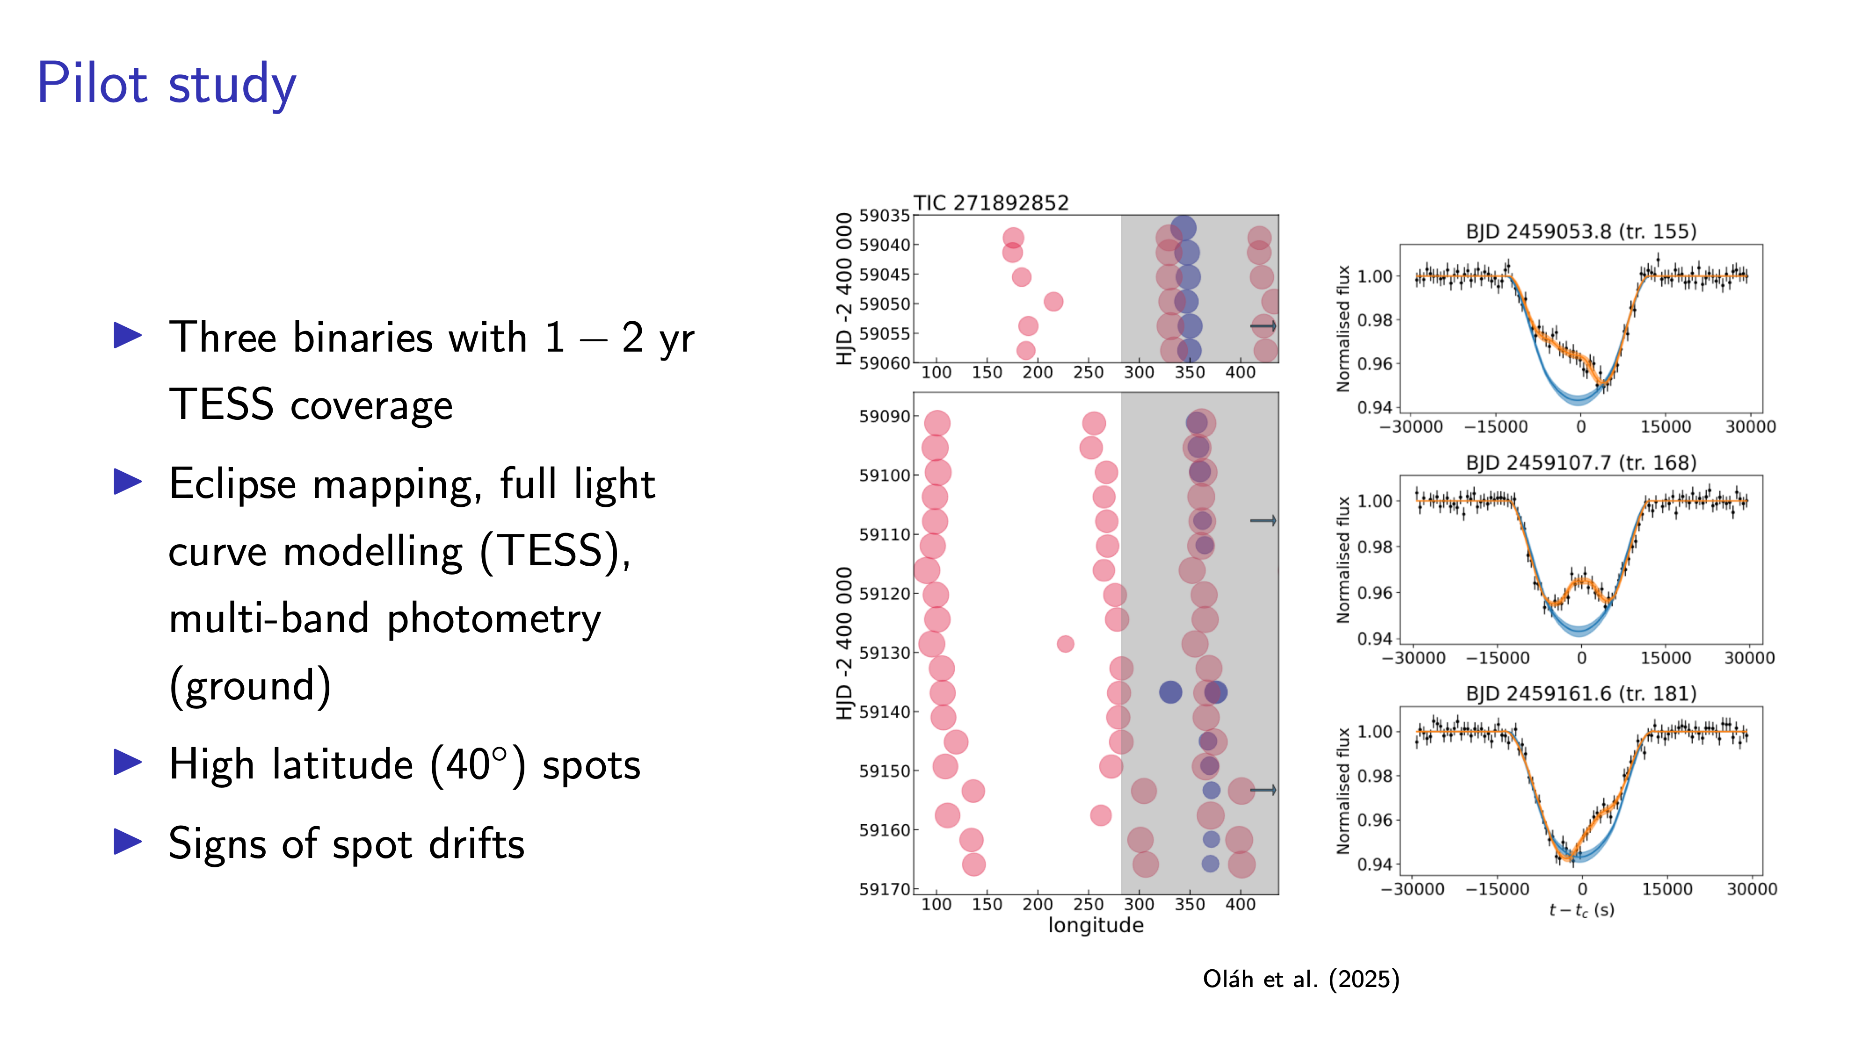

Slide 11
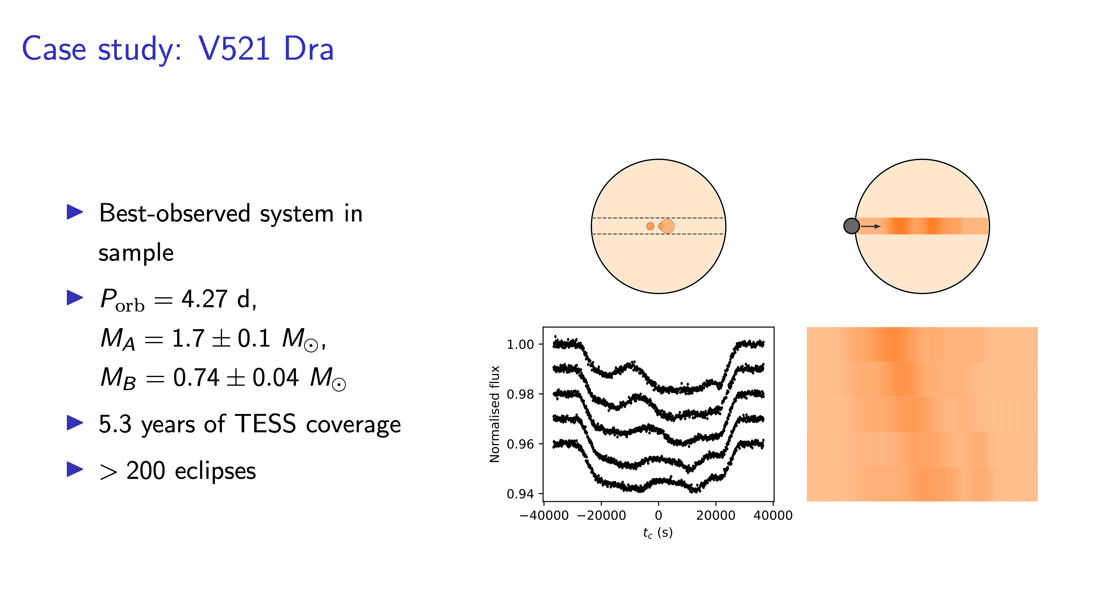
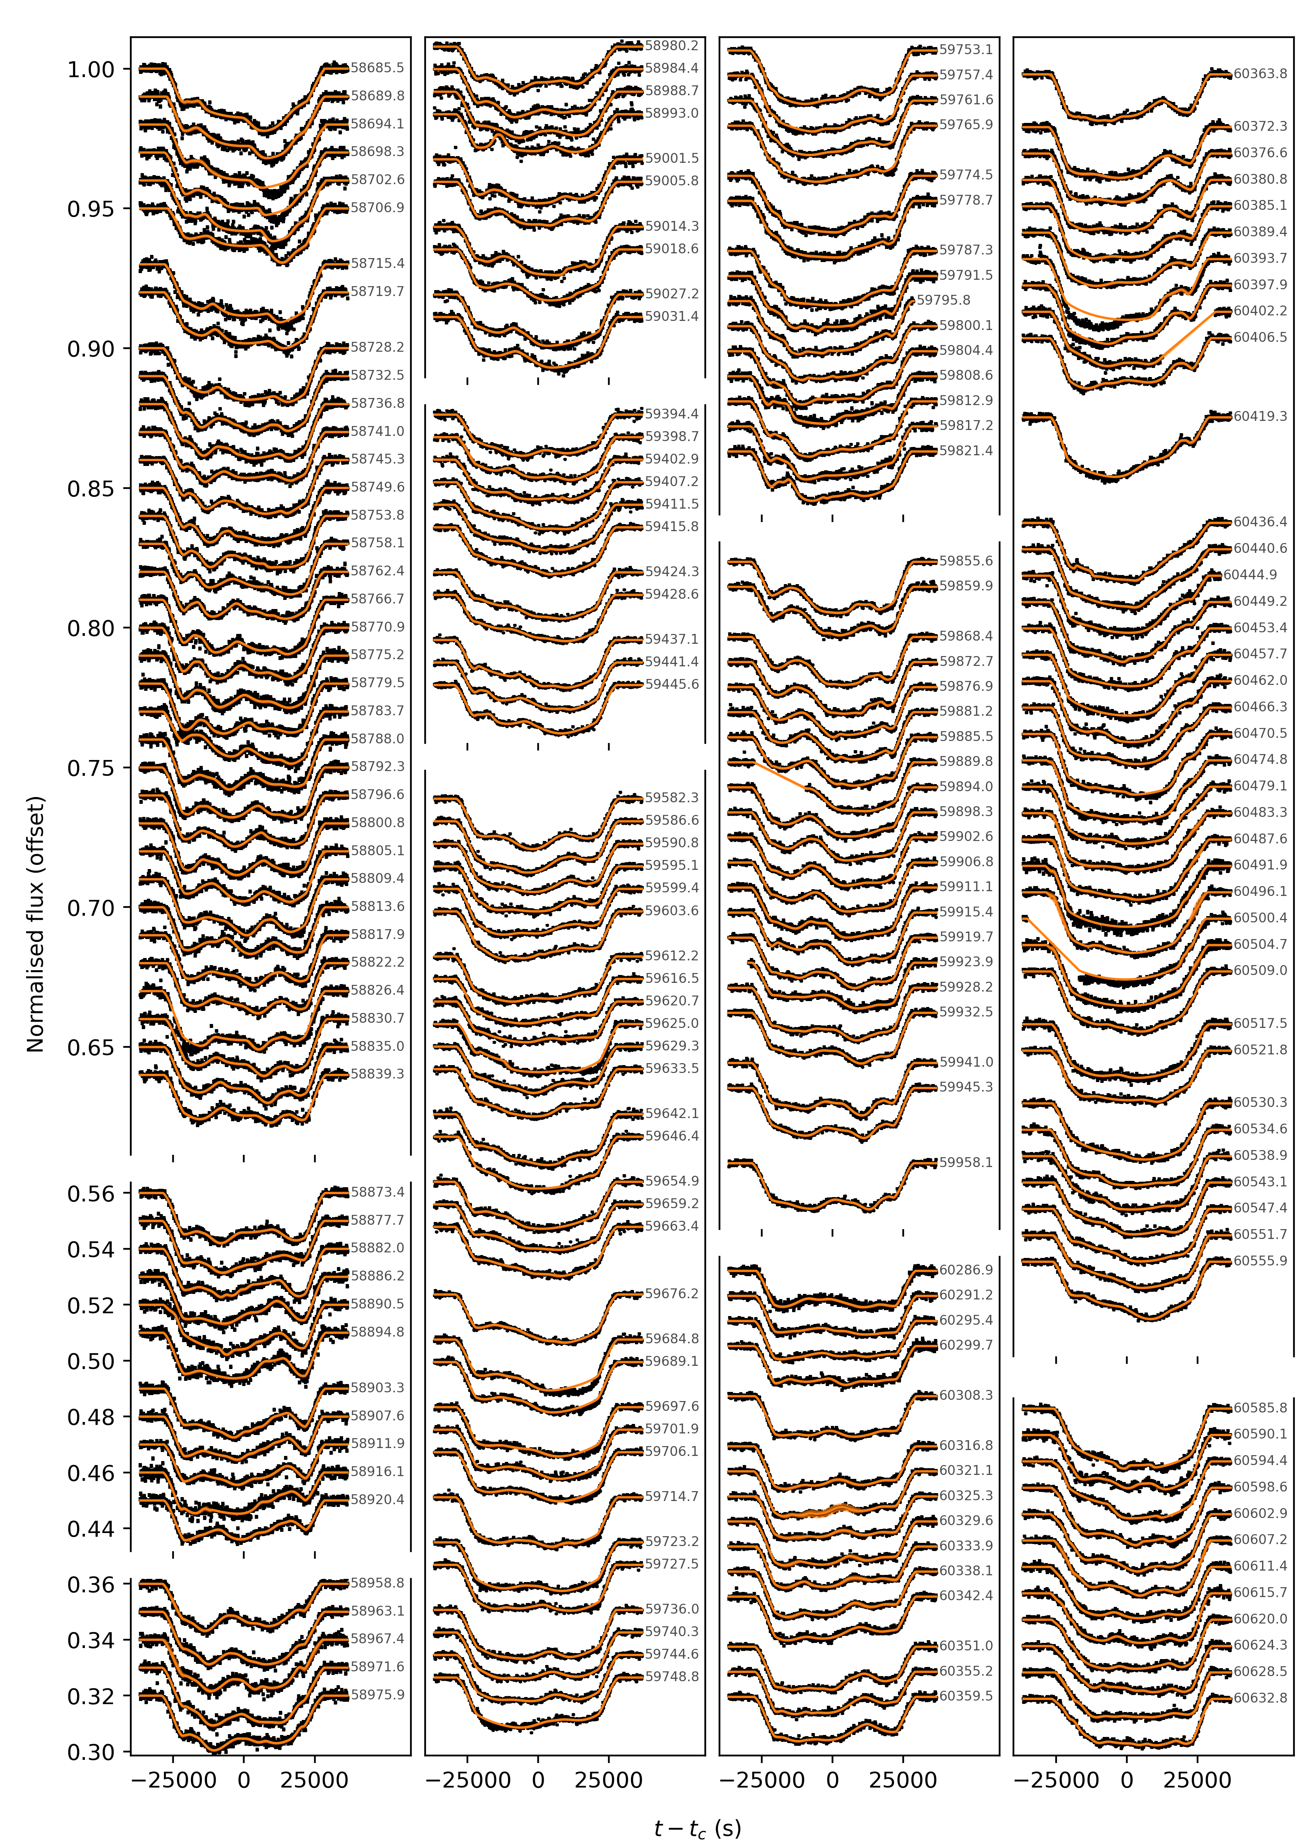

Slide 12
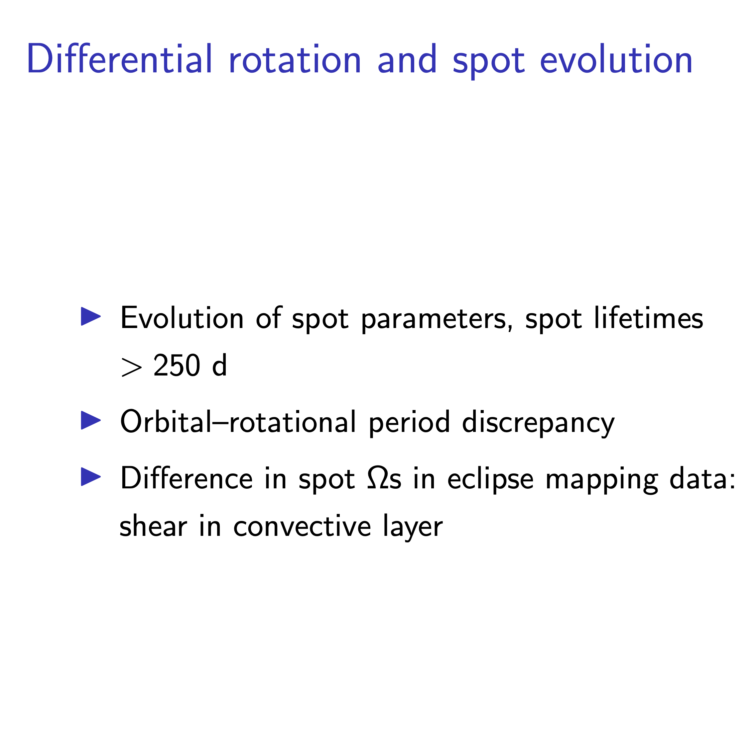
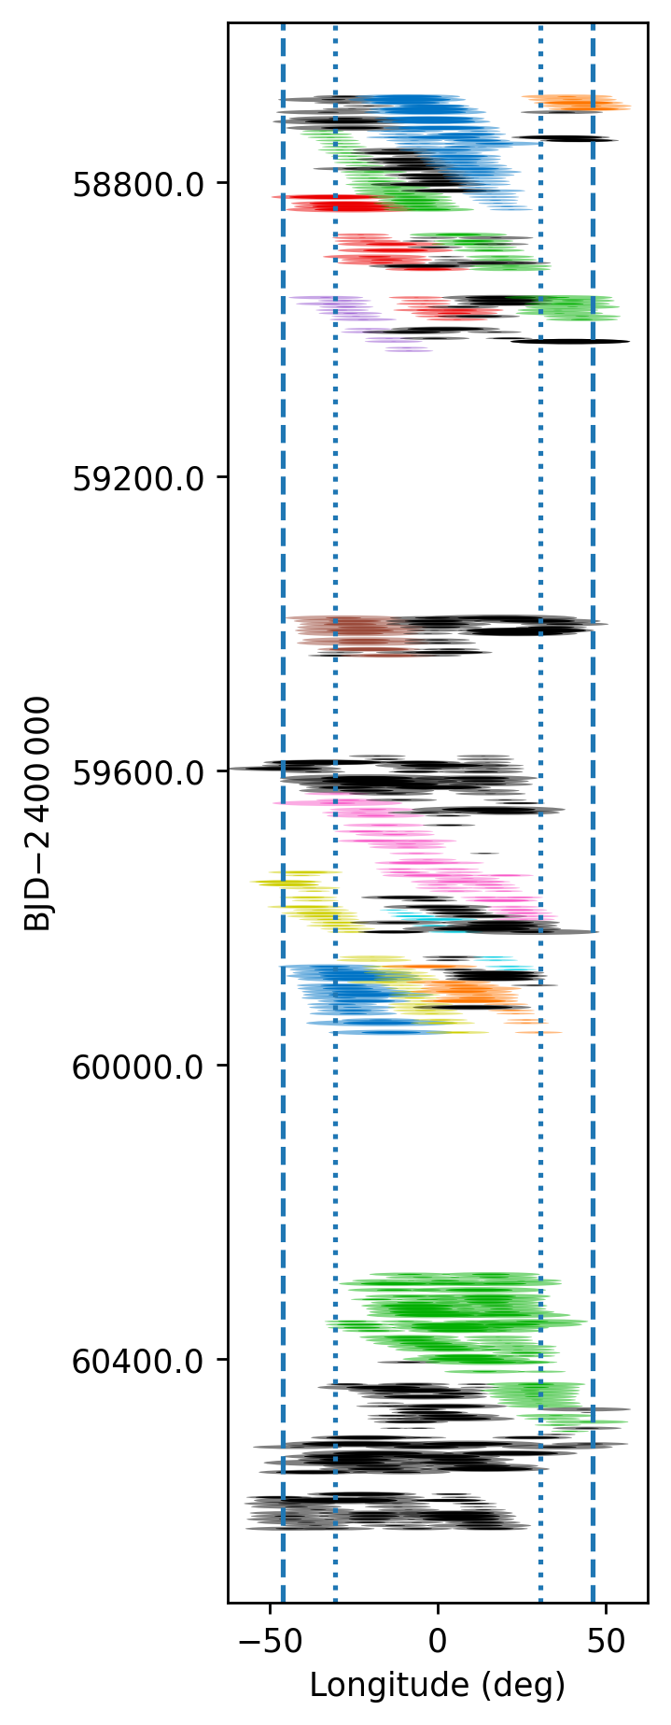
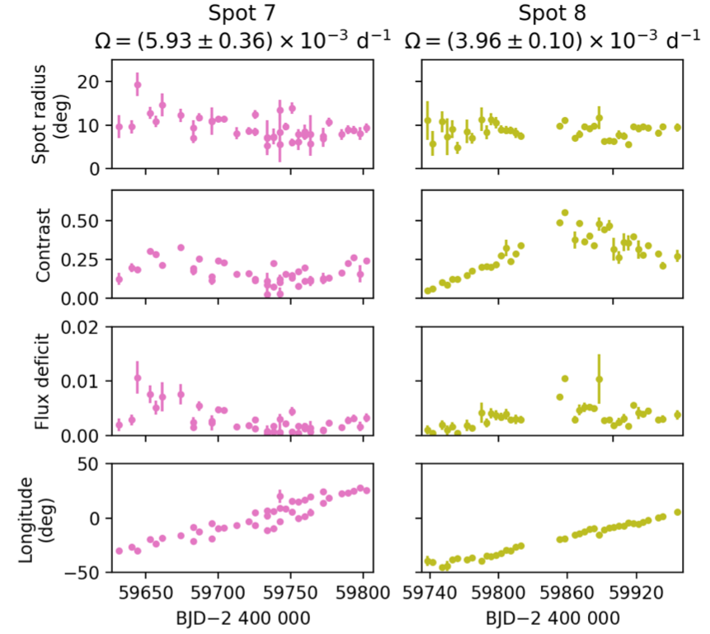

Slide 13
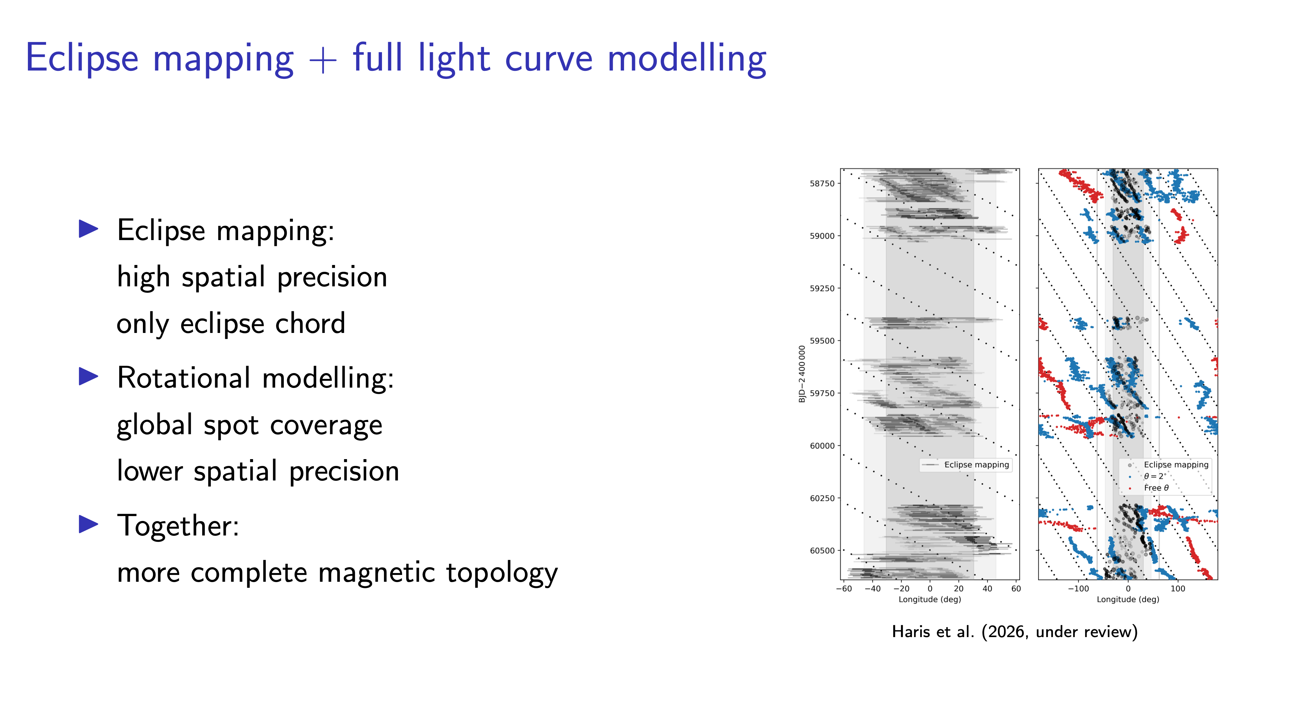
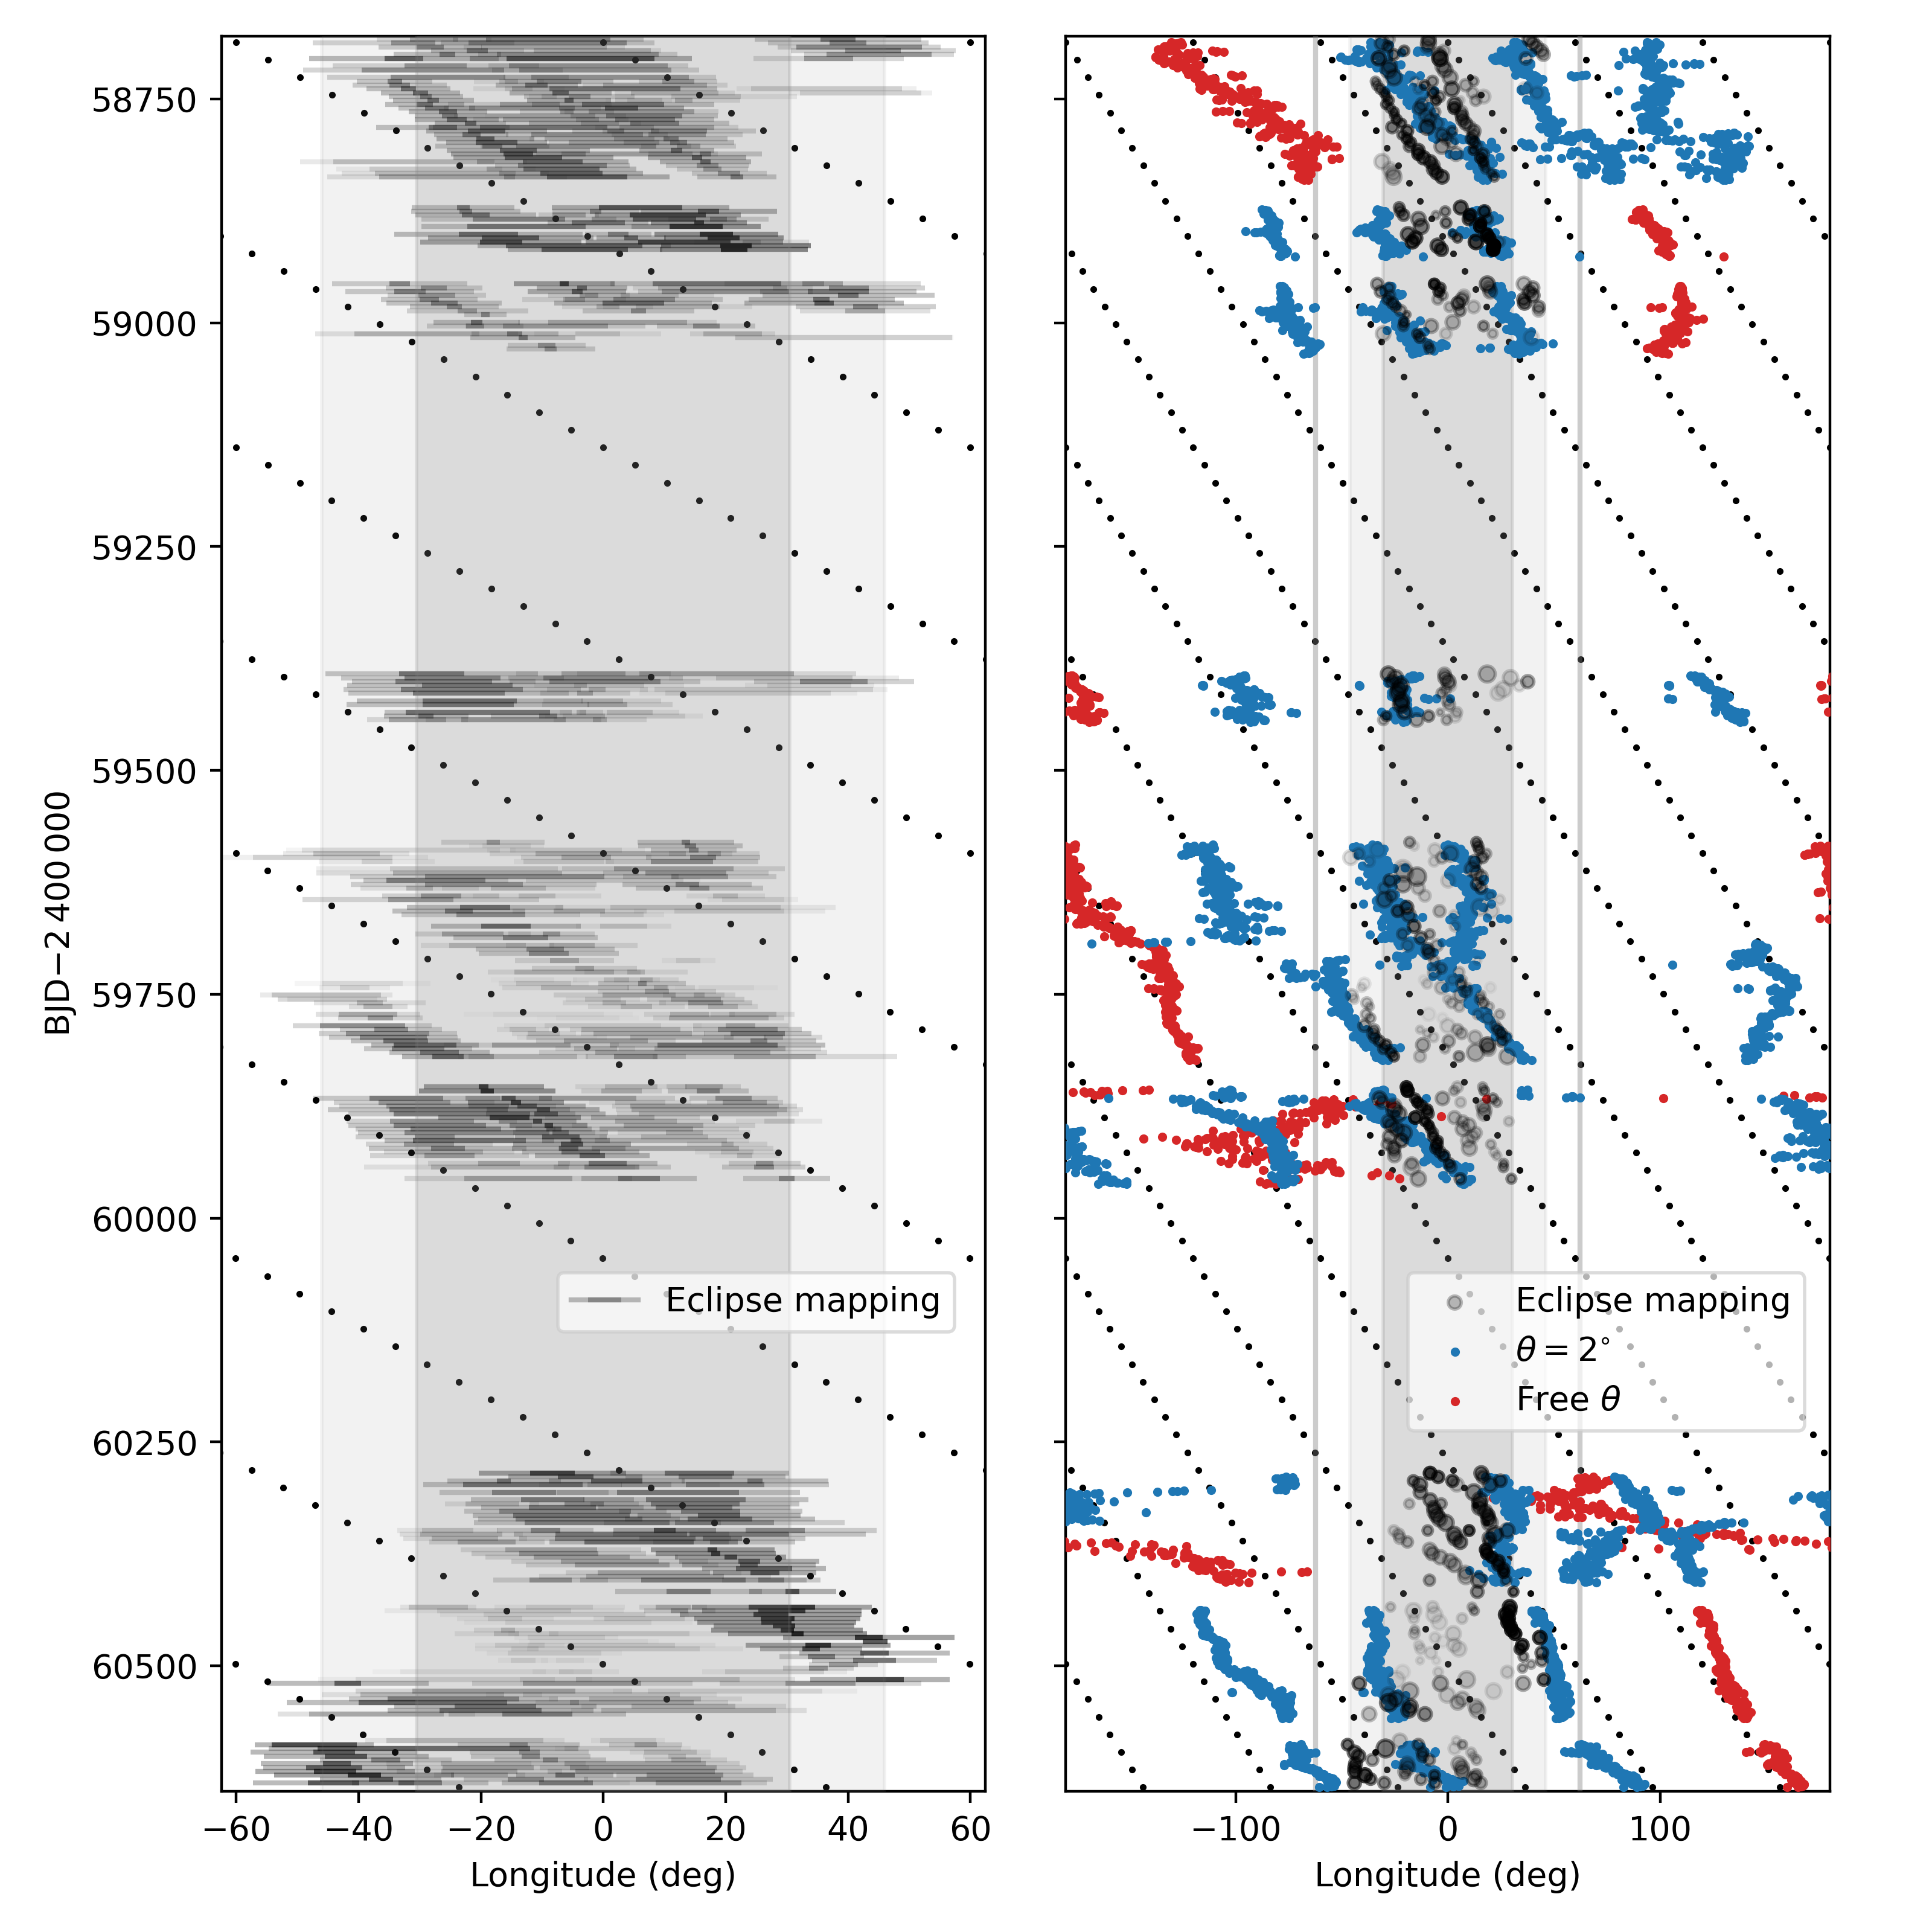

Slide 14
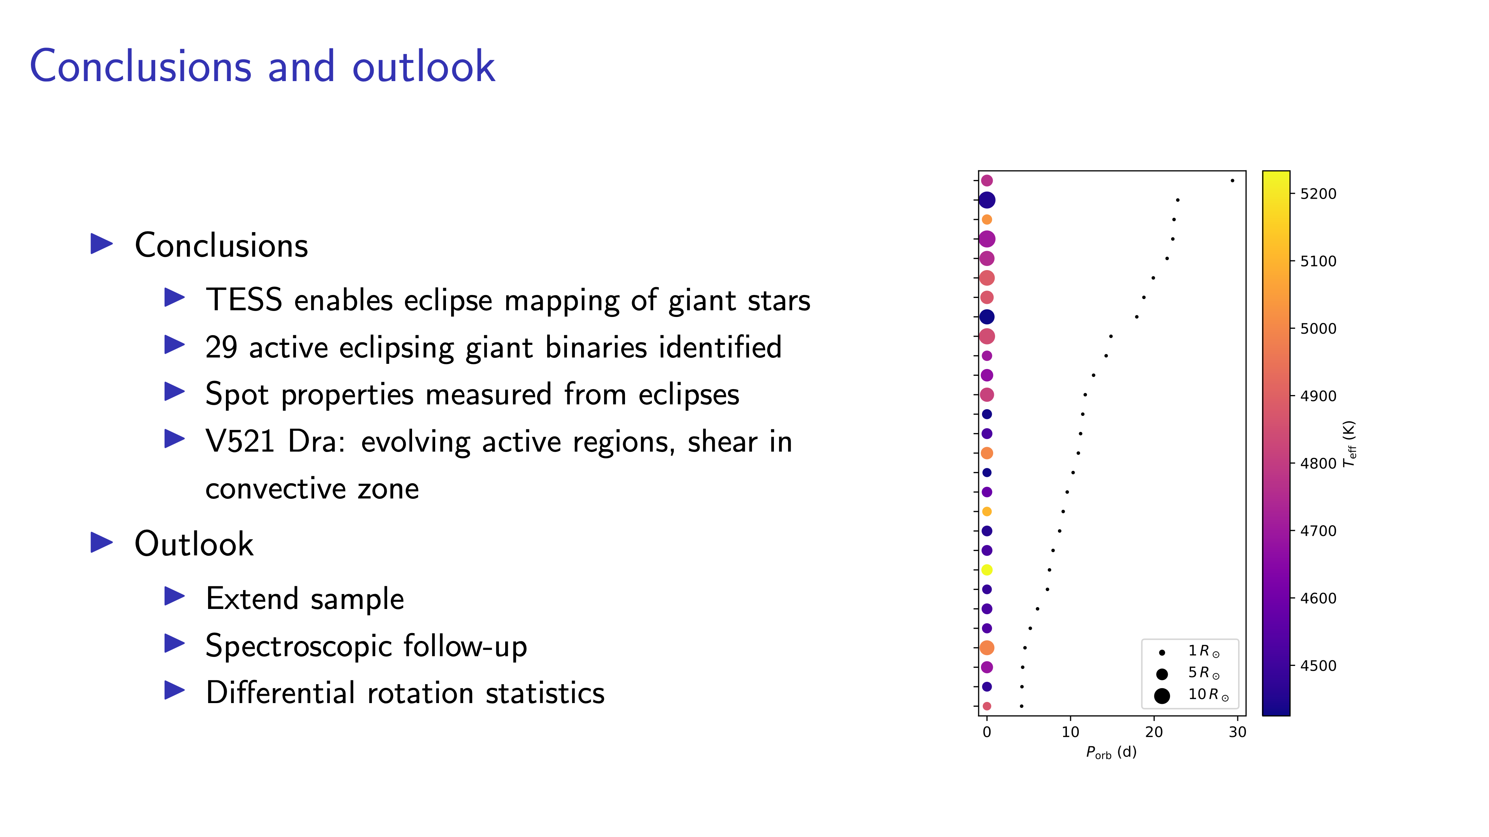
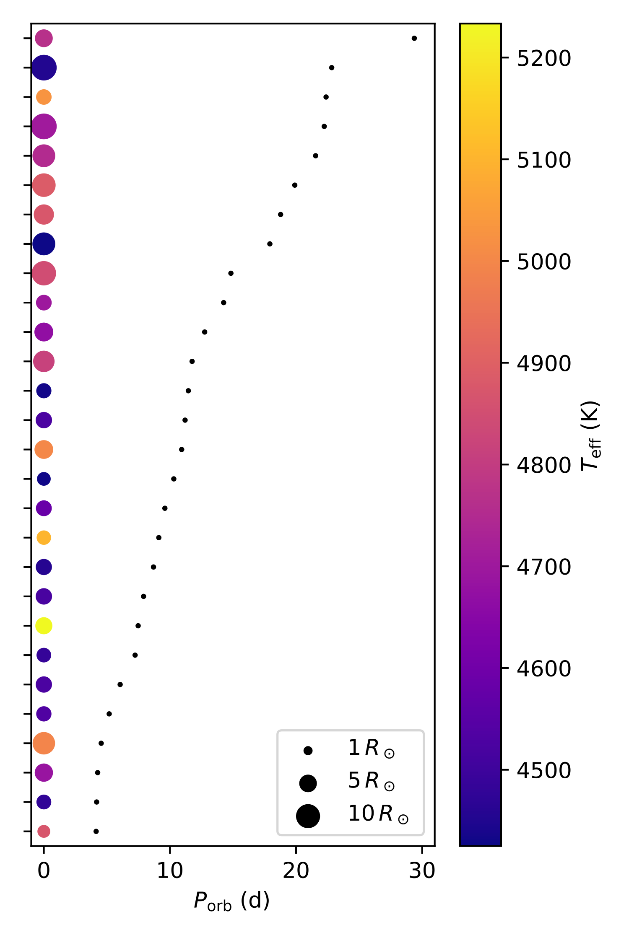

Slide 16
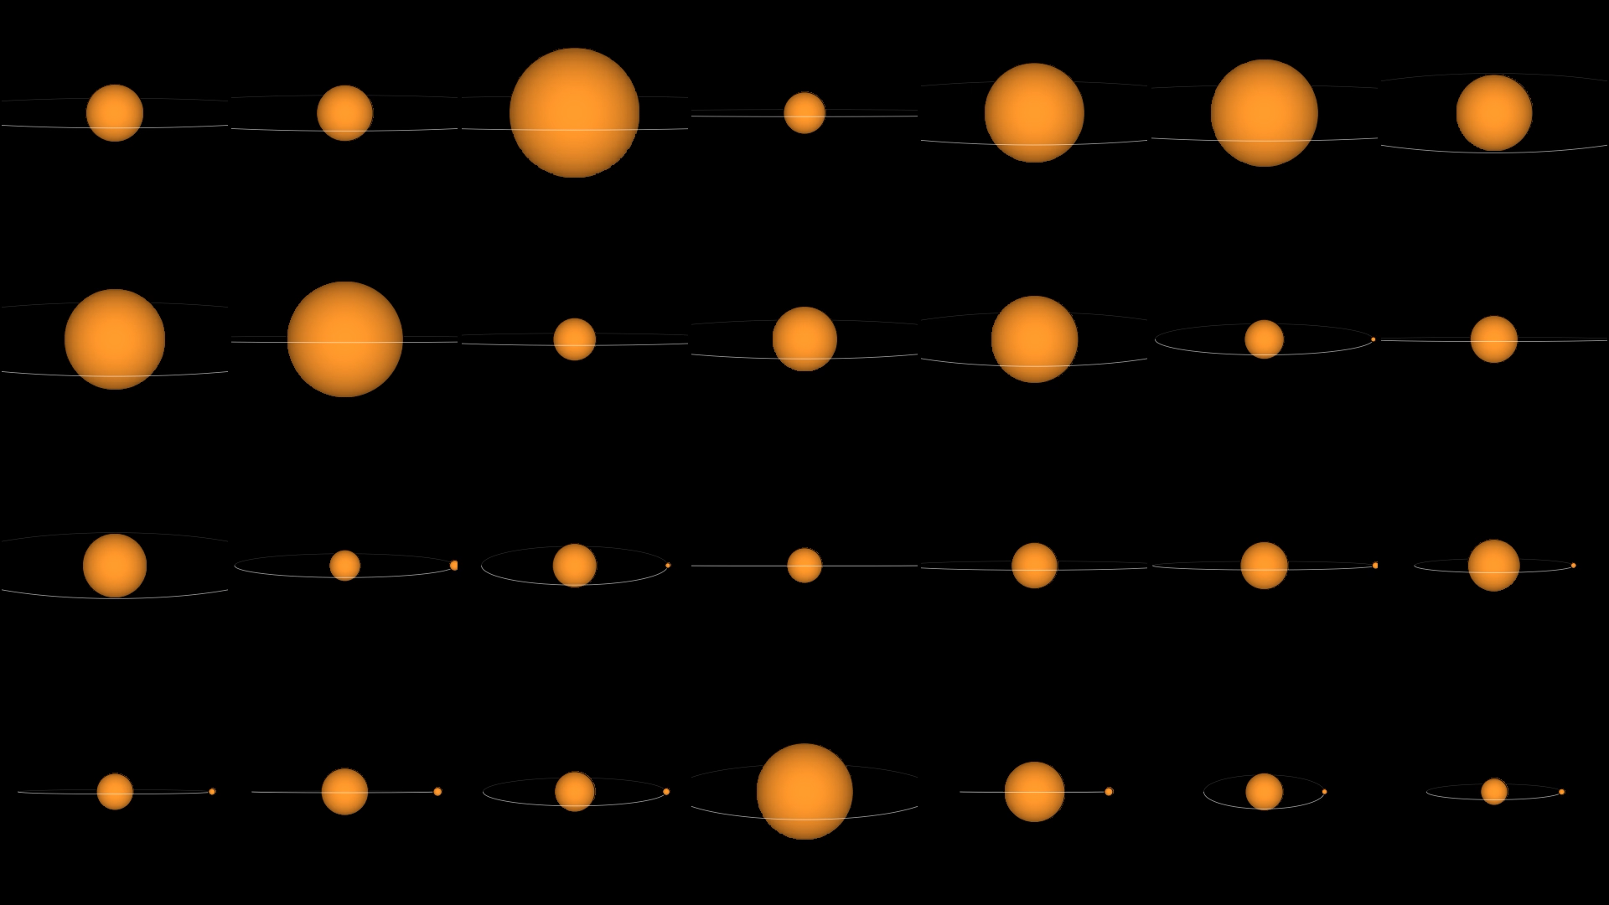
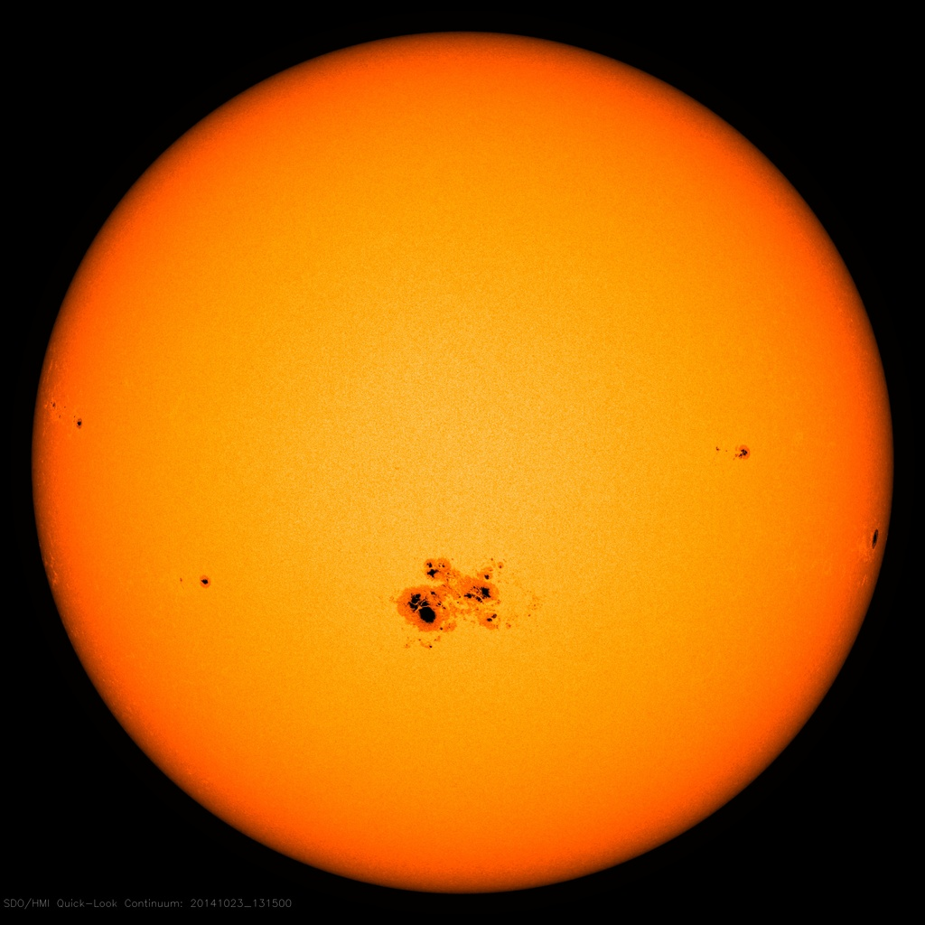
Notes:
n. slide

Slide 17
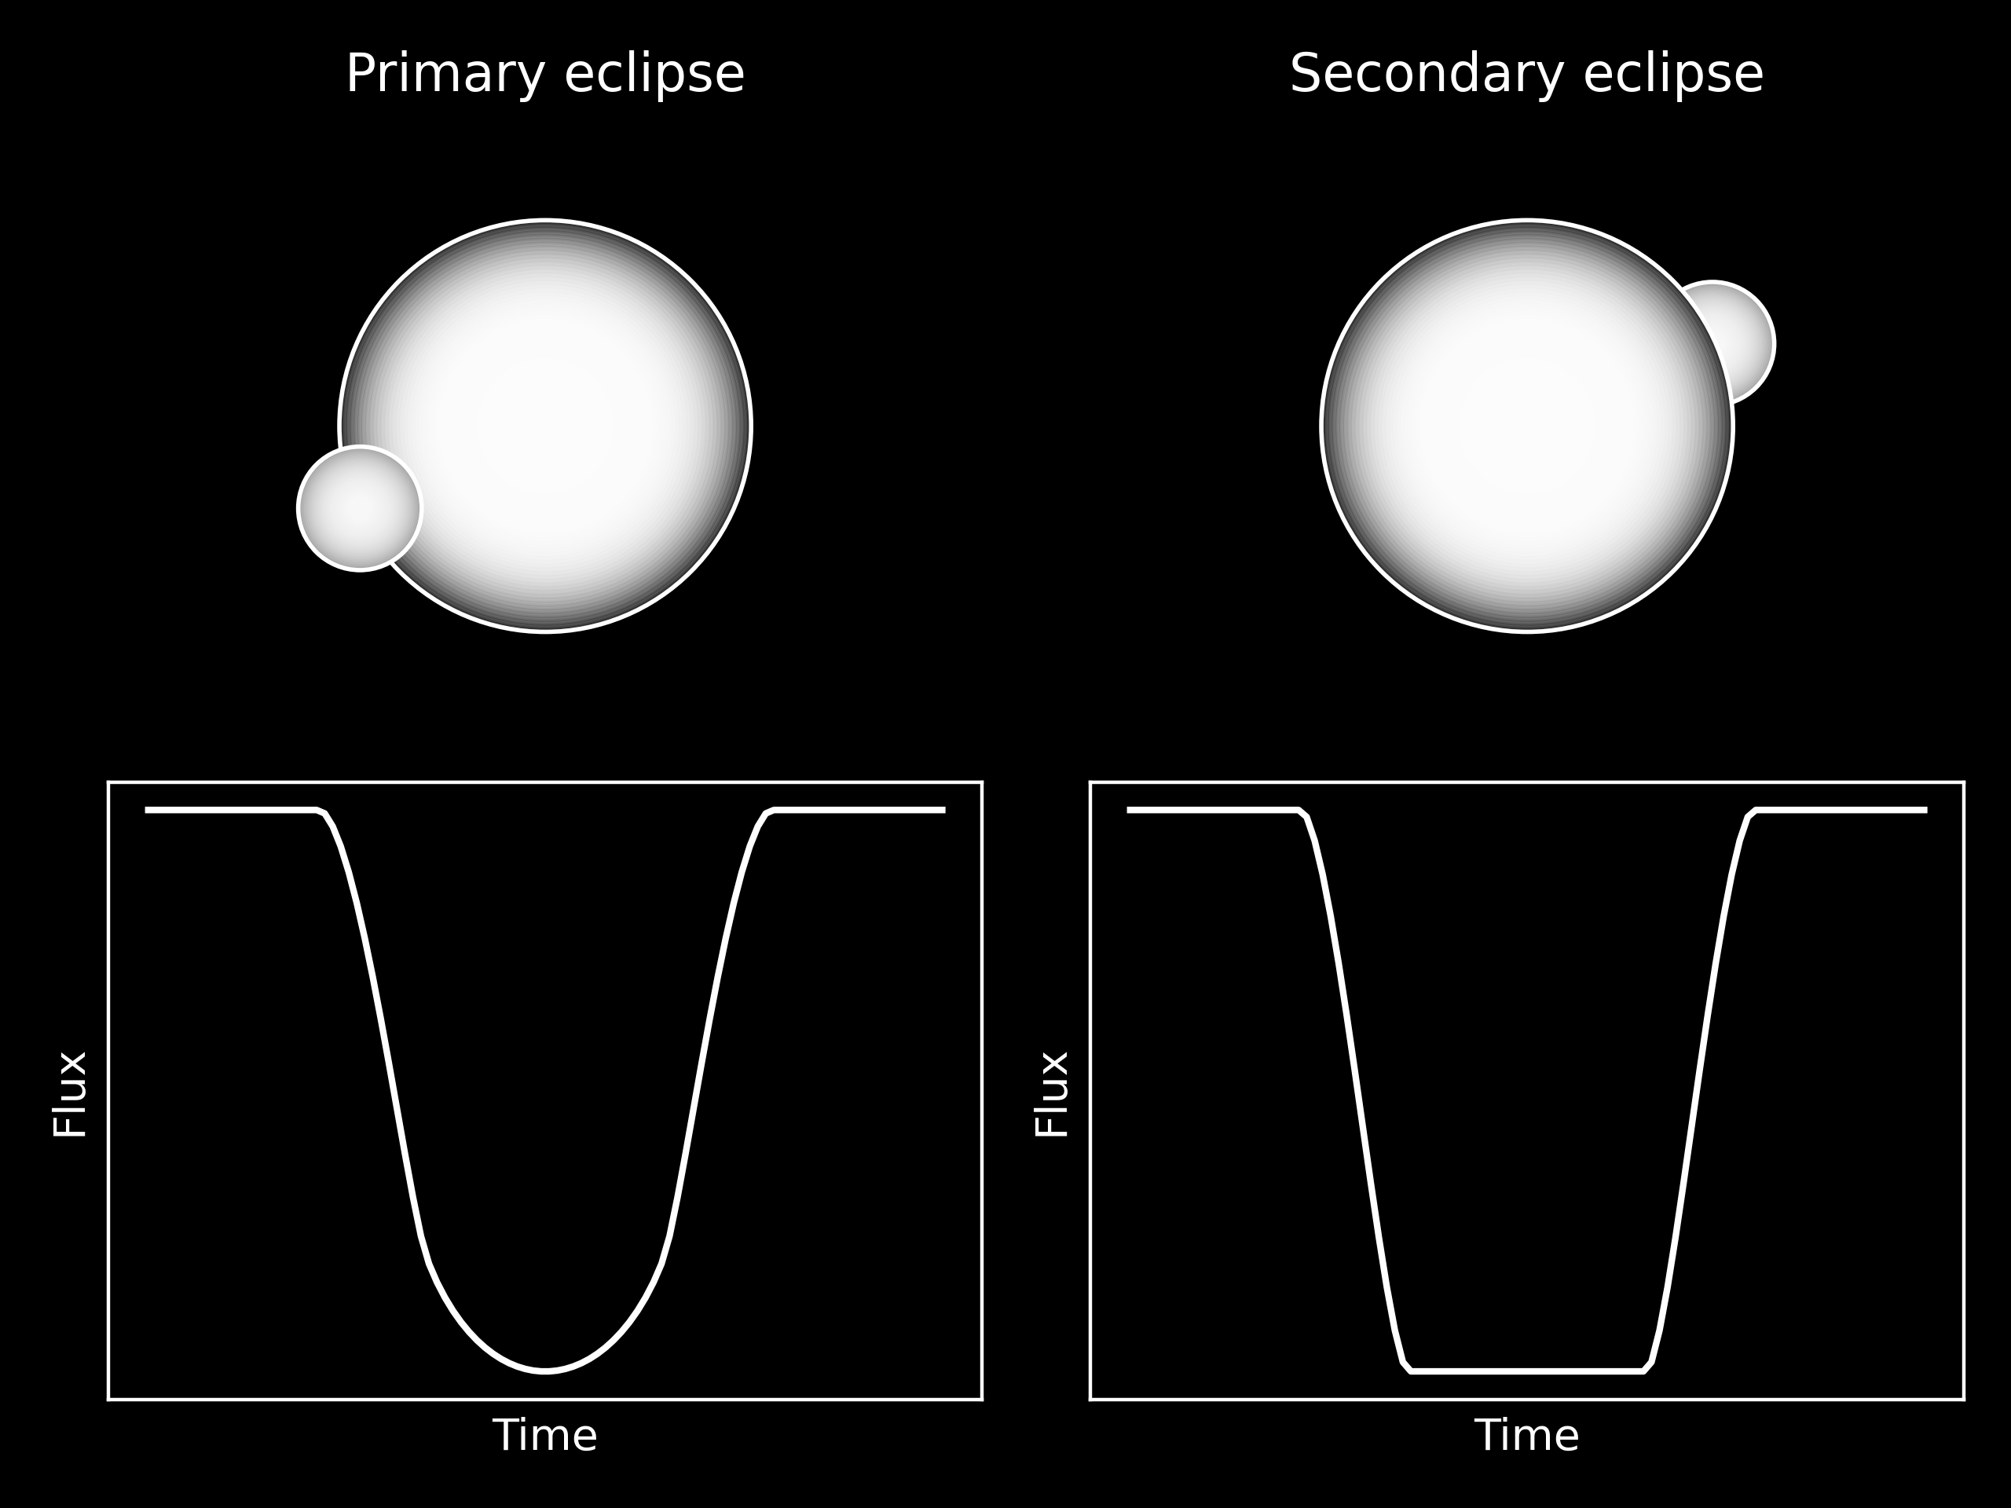
Eclipse model
$$f(t_{i})=\frac{1}{f_{p}+f_{s}}F_{phase}(t_{i})$$
$$F_{phase}(t_{i})=\{\begin{matrix}f_{p}F(t_{i})+f_{s}, & \text{primary transit} \\ f_{s}F(t_{i})+f_{p}, & \text{secondary transit} \\ f_{s}+f_{p}, & \text{out-of-transit}\end{matrix}$$

Slide 18
Model comparison
Comparison of 0- and 1-spot models for each transit
BIC-approximation, Bayes factor (B)
$$BIC=-2logP(D|M)=-2logl_{max}+klogN$$
$$B_{i,j}=\frac{P(D|M_{1})}{P(D|M_{2})}$$
P(D|M): probability of model M given data D, log lmax: maximum likelihood of model, k: no. of parameters, N: no. of observations
Bi,j | Evidence in favour of the ith model
1—3 | Not worth mentioning
3—20 | Positive
20—150 | Strong
>150 | Decisive
Kass and Raftery (1995)

Slide 19
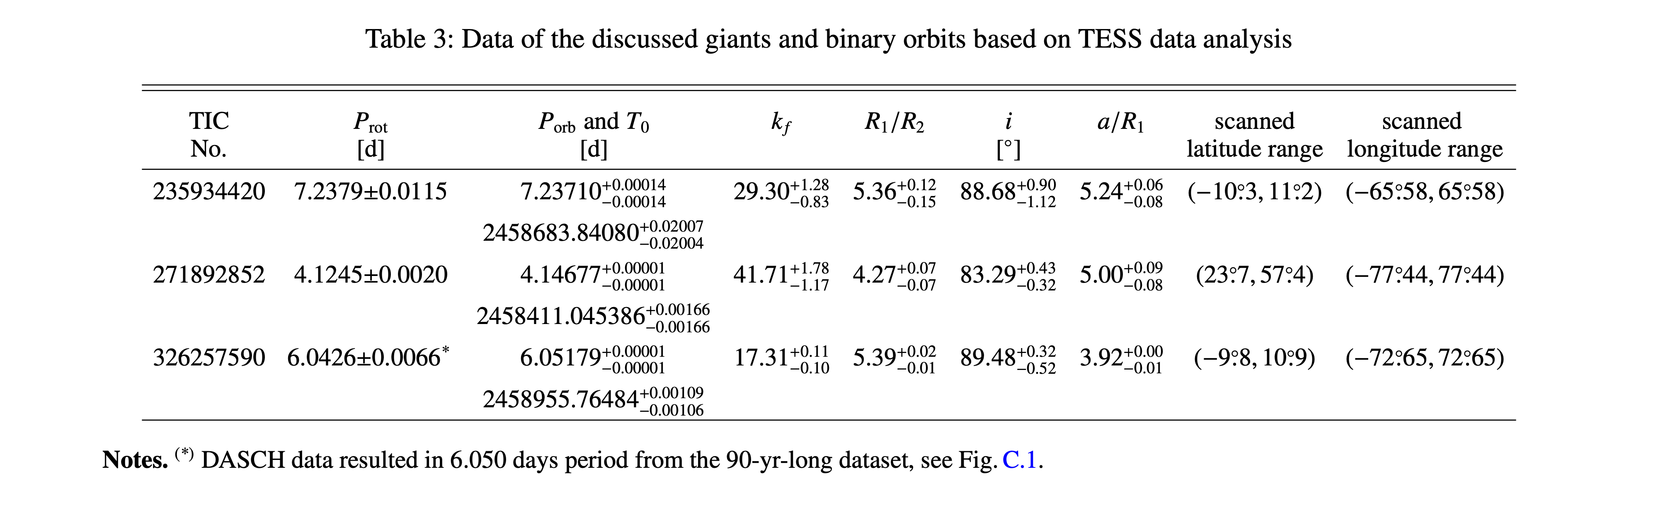

Slide 20
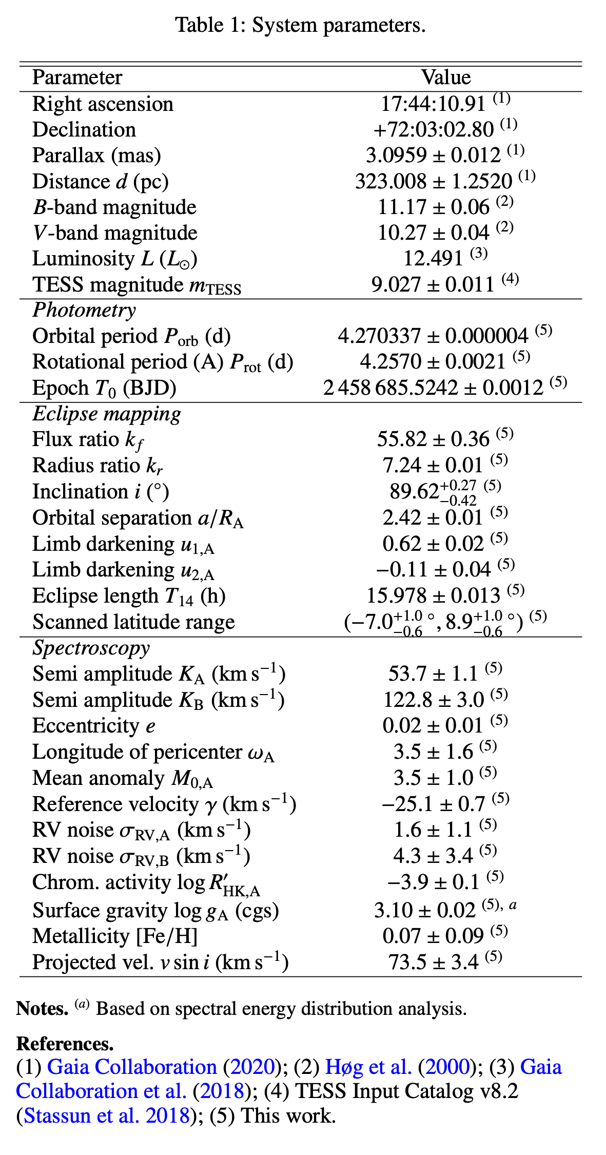

Slide 21
