Slide 1

Testing the reliability of magnetic field measurements for M dwarfs
Nordic Baltic Astronomy days
Turku, 27 May 2026
Irene Amateis¹, Oleg Kochukhov¹, Axel Hahlin^{2,1}
¹Uppsala University, Sweden
²Keele University, UK
Accepted in A&A (aa58191-25)

Slide 2
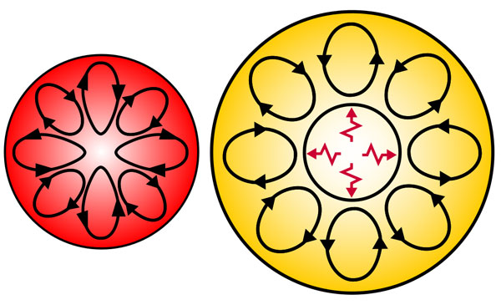

Magnetism of M dwarfs: why do we care?
Physical properties of M dwarfs
Magnetic field generation in fully convective stars
$$M≳0.35 M_{⊙}$$
Effects on exoplanets

Slide 3
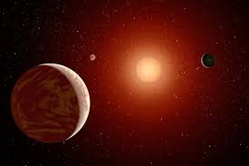

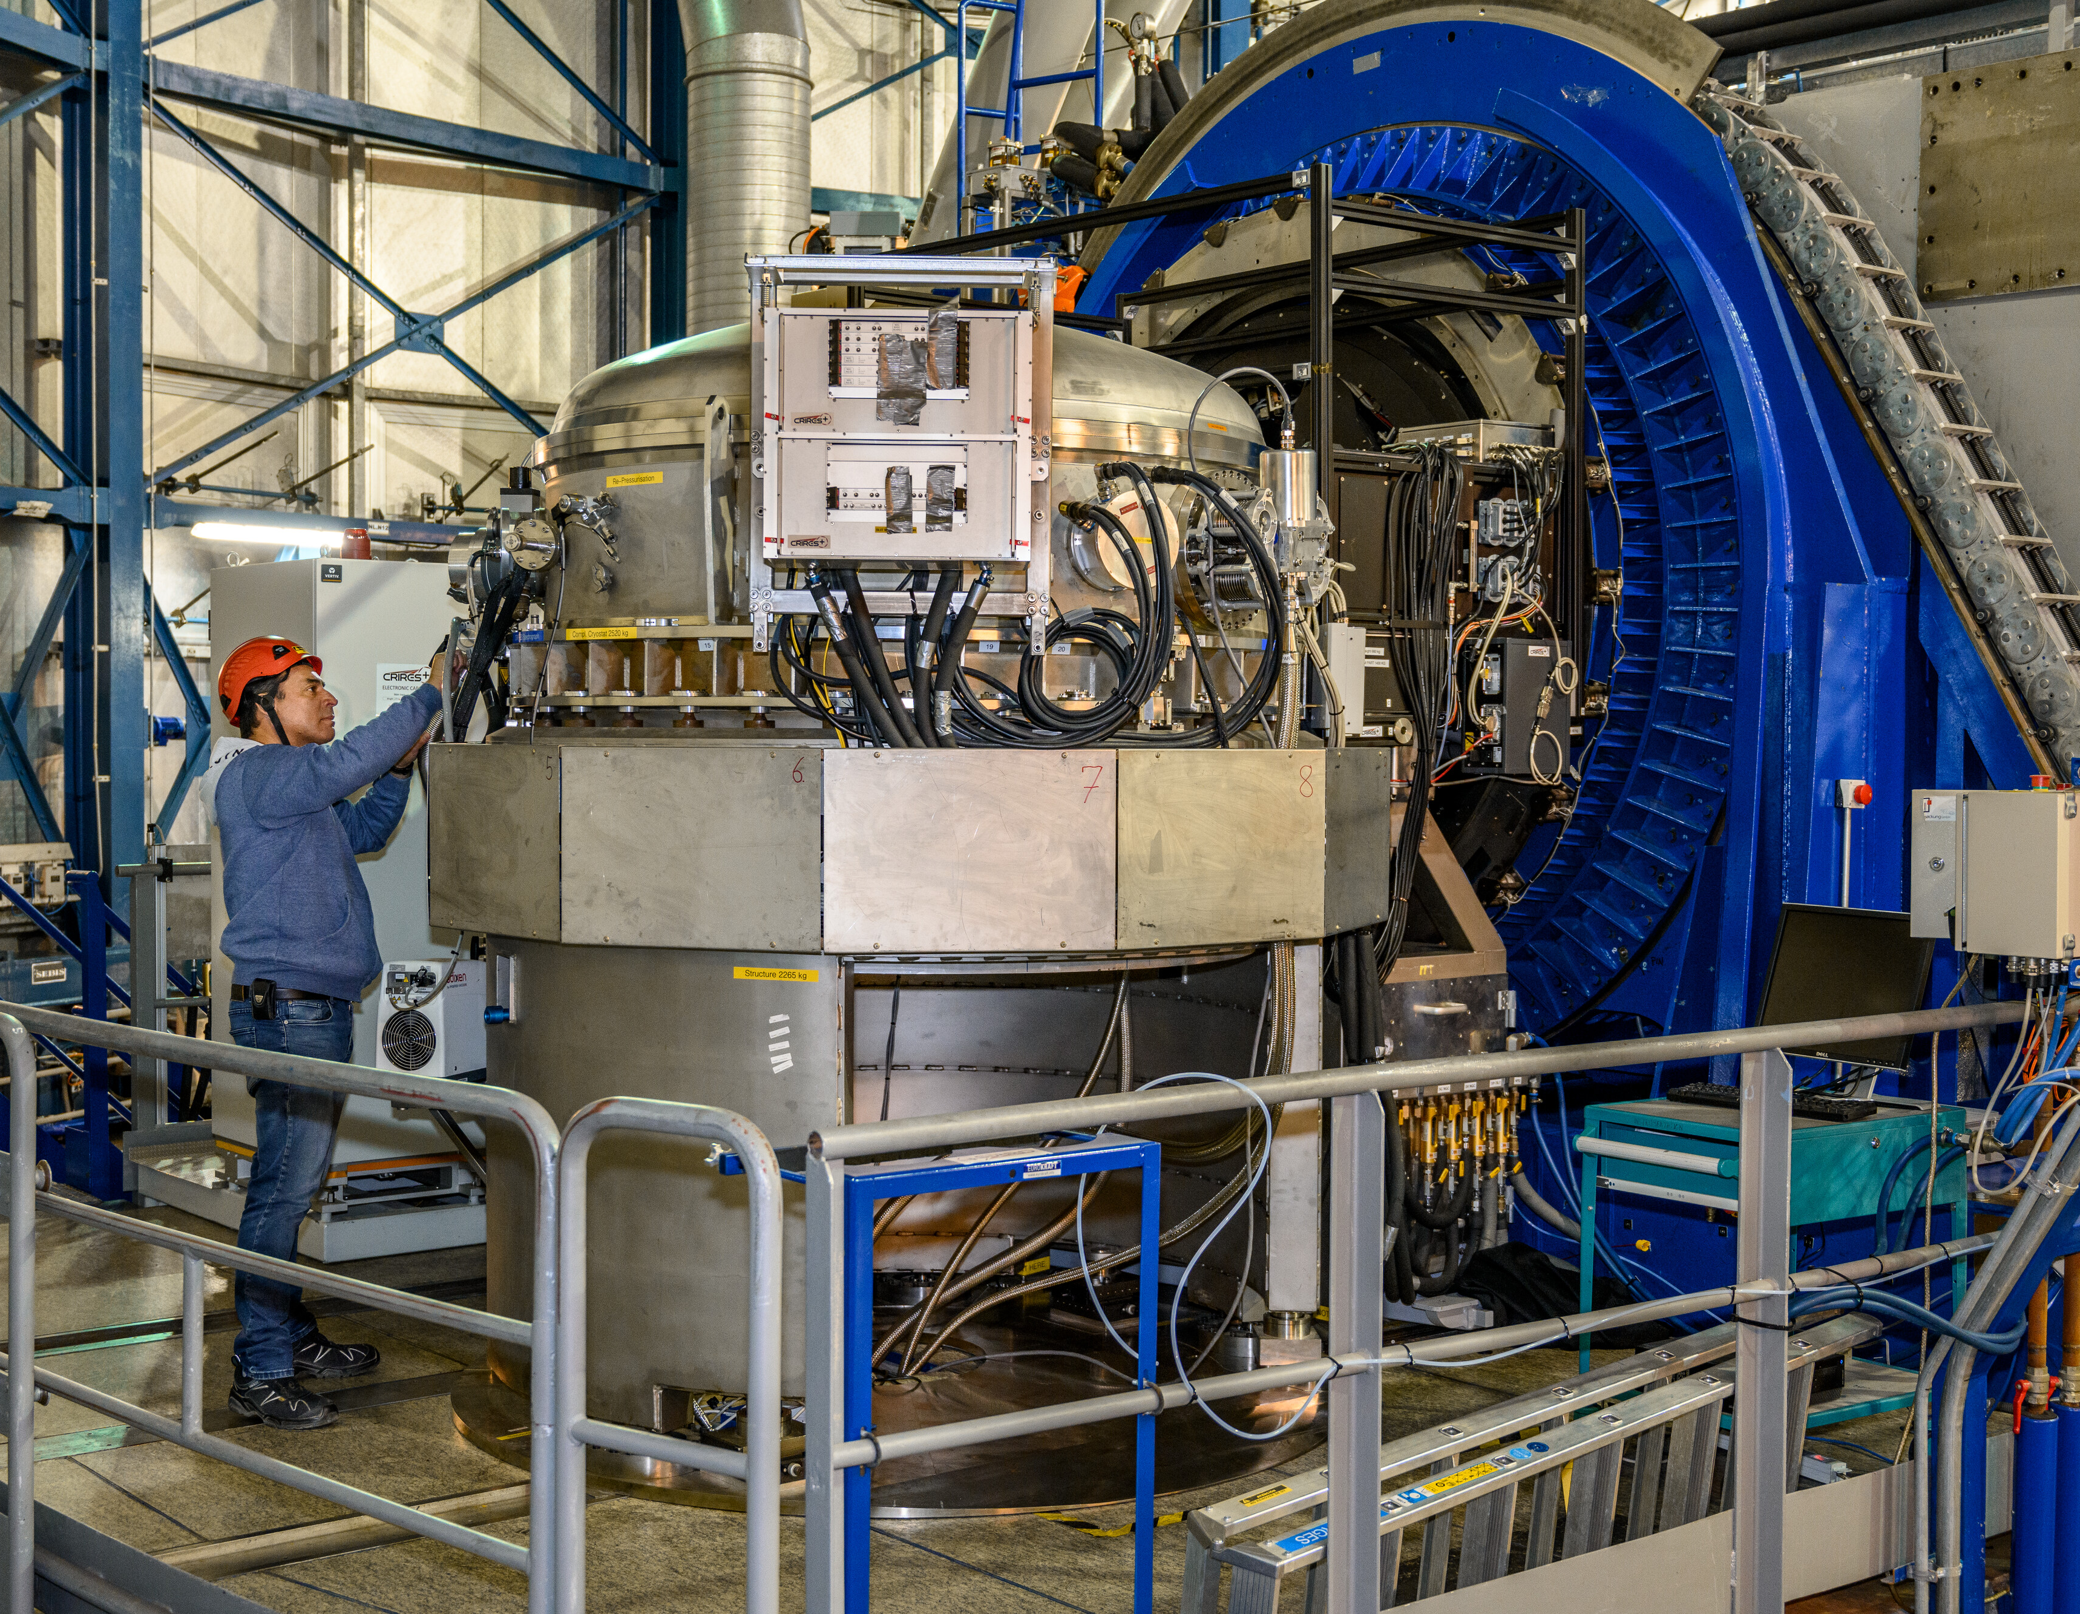
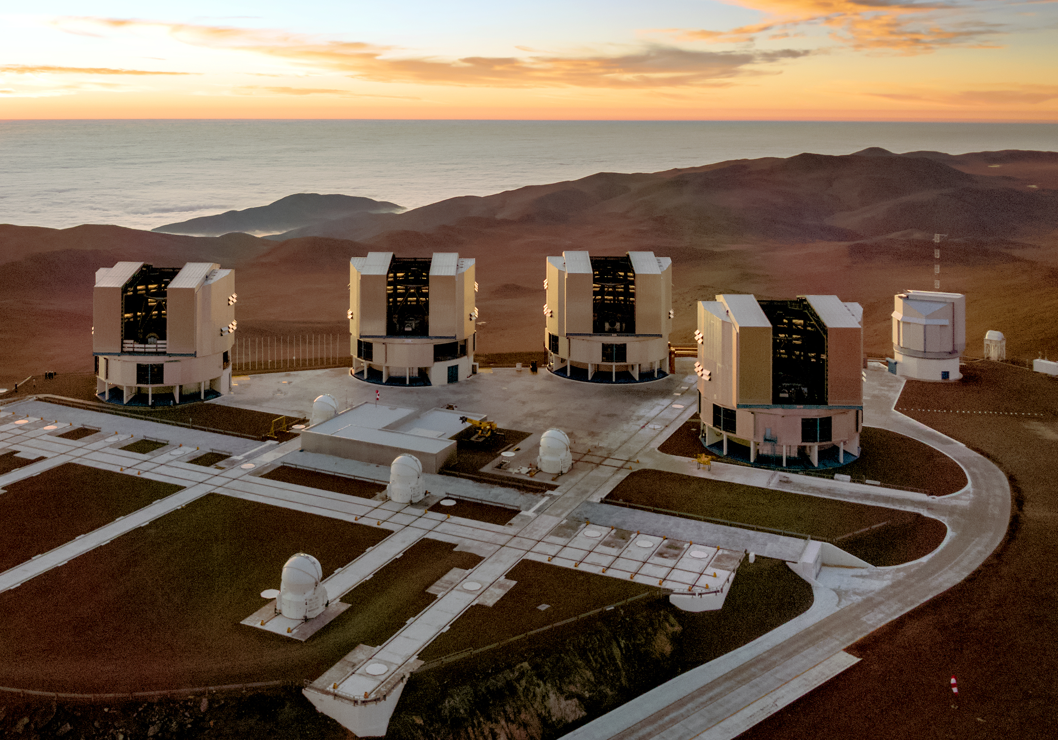
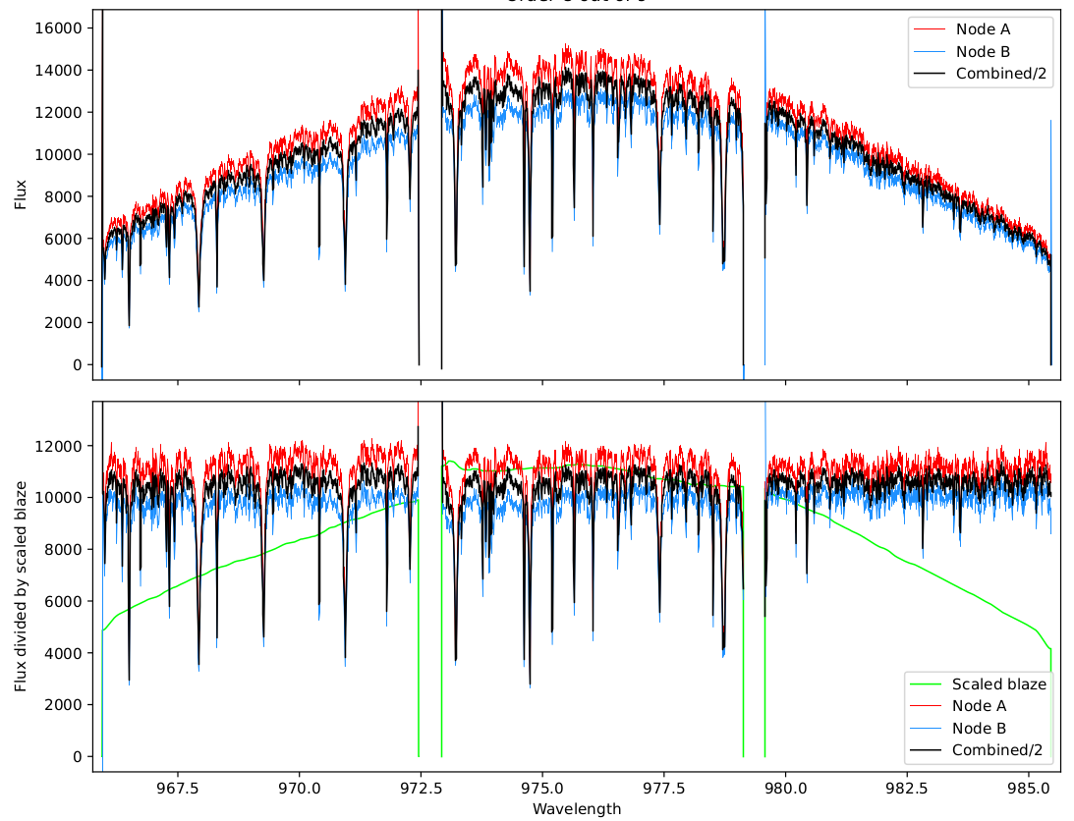

M dwarfs as exoplanets hosts
Small stars $→$easier exoplanet detection
Effects on planetary atmosphere?
CRIRES⁺ : high resolution IR spectrograph at VLT
YZ Ceti from CRIRES+

Slide 4
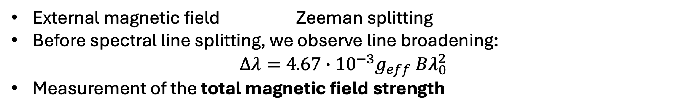
Zeeman Broadening
External magnetic field Zeeman splitting
Before spectral line splitting, we observe line broadening:
$$Δλ=4.67∙{10}^{−3}g_{eff} Bλ_{0}^{2}$$
Measurement of the total magnetic field strength
Shulyak et al. (2019)
Notes:
Fig: Ti lines of J15218+209, spectra from CARMENES

Slide 5
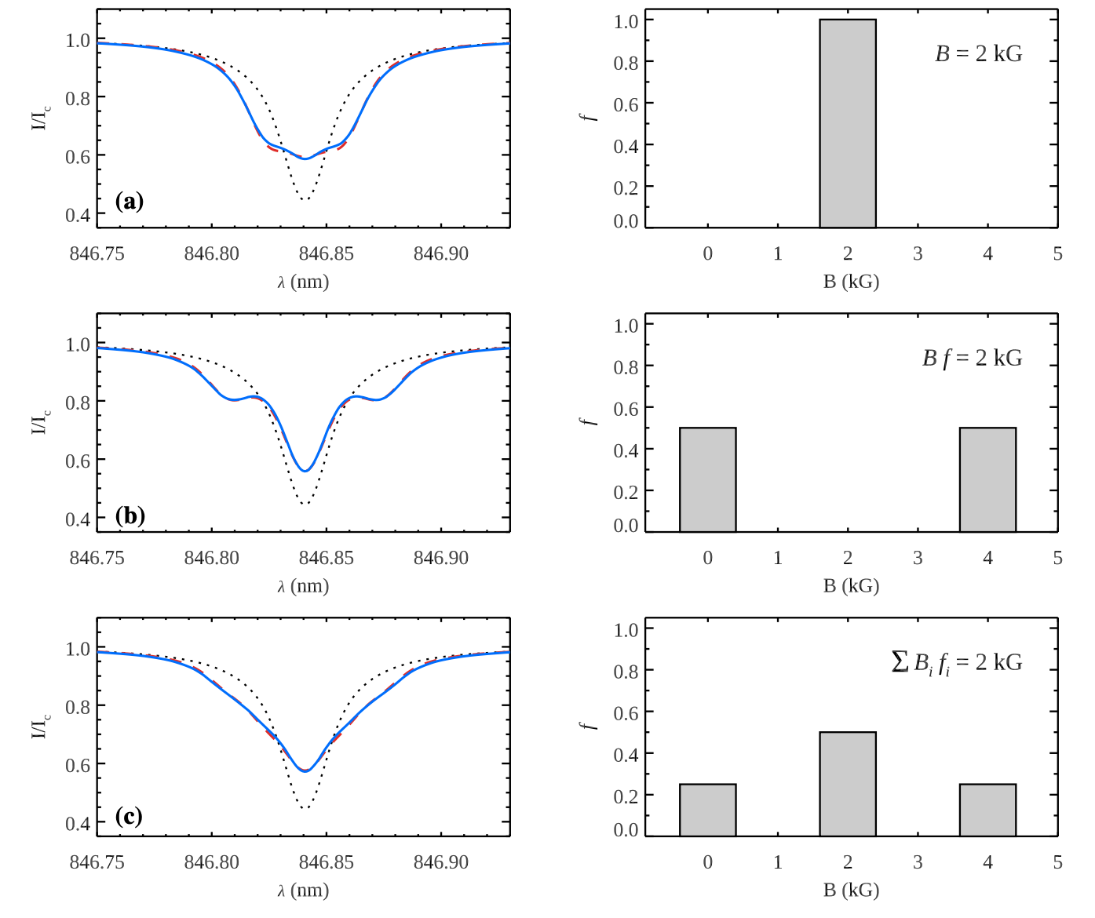
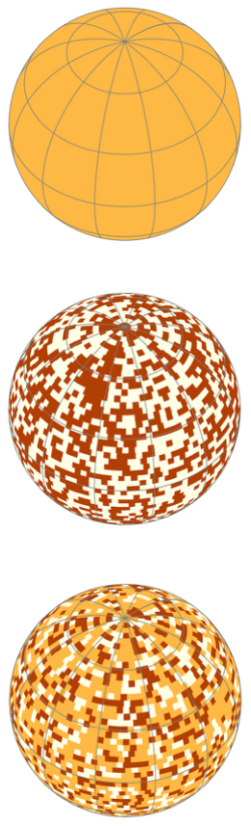

Magnetic field distribution
Non uniform surface magnetic field
Filling factors $f_{i}$ : fraction of the stellar surface covered with a magnetic field of a certain strength $B_{i}$
$\sum_{i}{f_{i}=1}$
The magnetic distribution affects the line profile
Kochukhov (2021)
Notes:
Picture: Fe I line, uniform field and different distributions. Solid lines correspond to the theoretical spectra calculated for a uniform radial field, dashed lines show calculations assuming a horizontal field, and dotted lines illustrate non-magnetic profiles

Slide 6
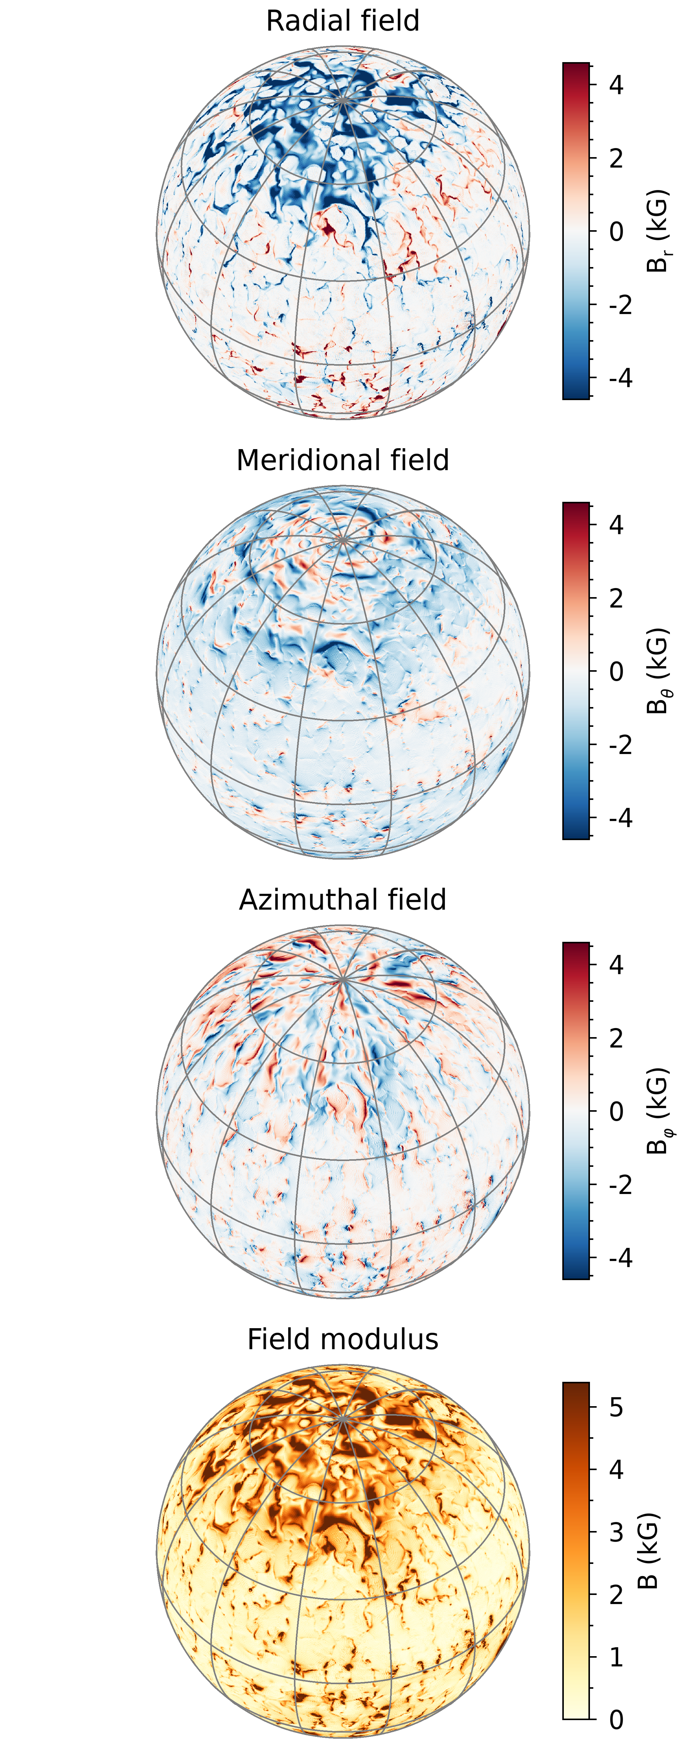

MHD Model
3D MHD numerical simulations from Yadav et al. (2015) of a fully convective M dwarf
Large-scale components + uniformly distributed small-scale fields
Surface average magnetic field strength of ${\left\langle B\right\rangle }_{s}≈1.6$kG
Scale to approximate stars with higher and lower activity
Notes:
Spherical map of the radial, meridional, azimutal field as well as the field modulus which is the total magnetic field strength

Slide 7
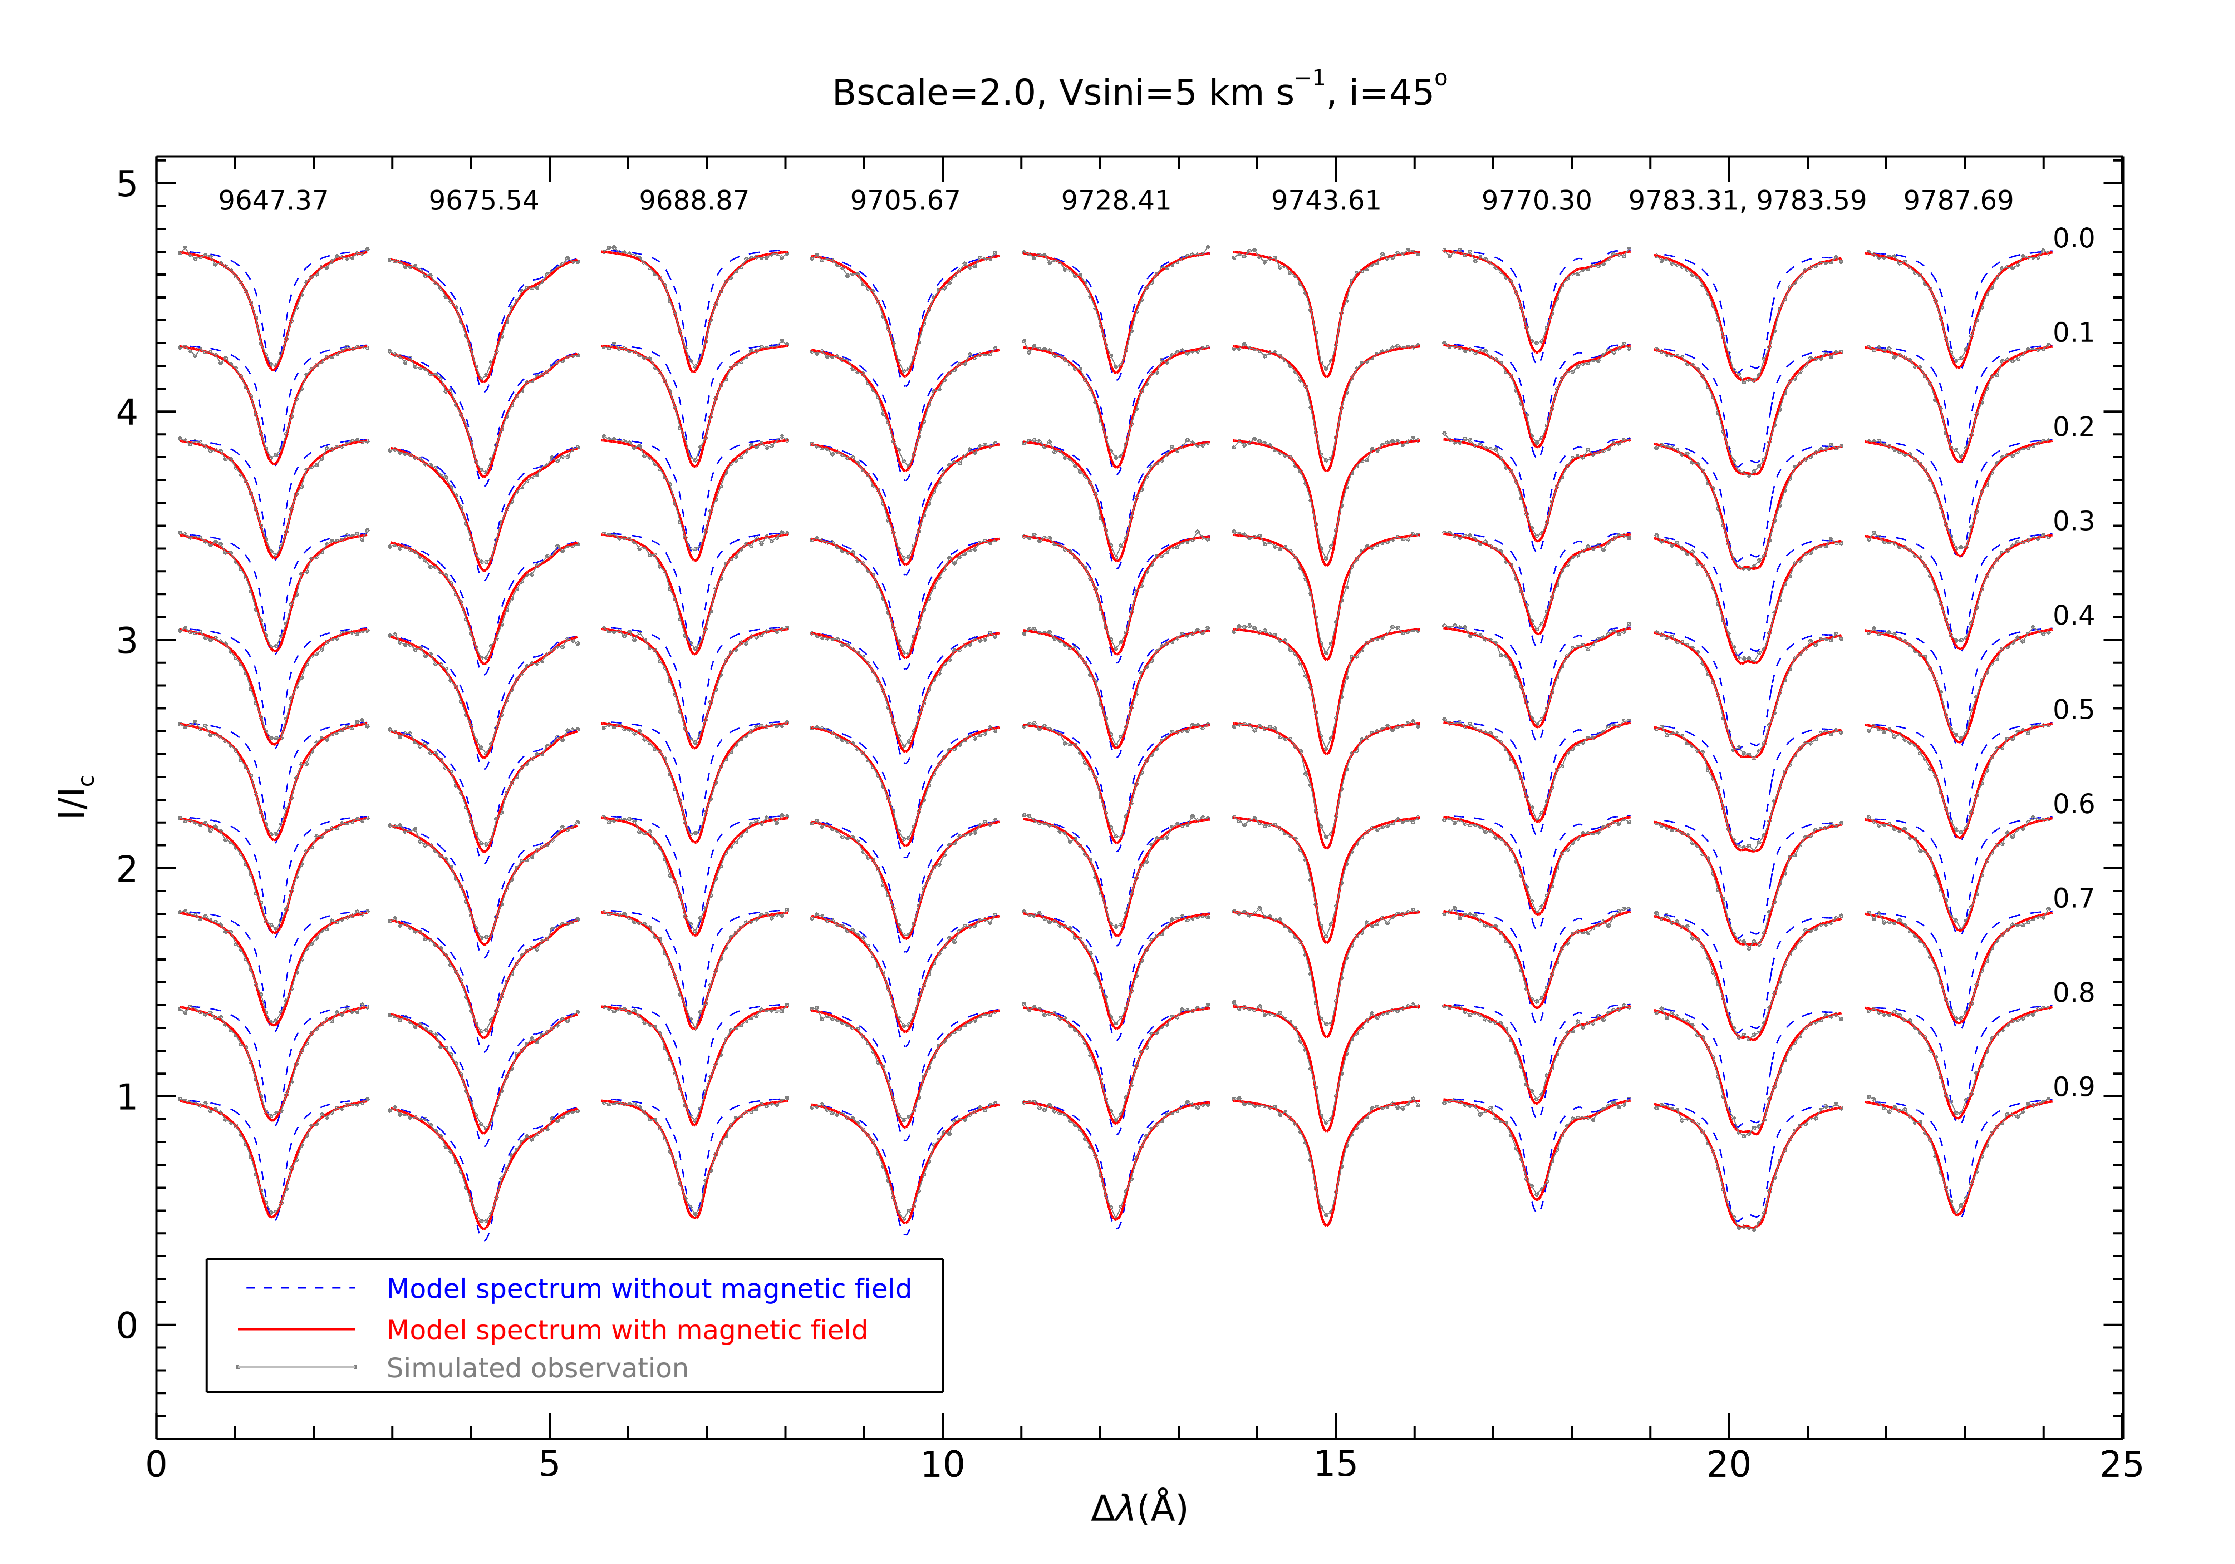

Simulated observations from MHD model
Ti I lines from the ${ a }^{5}F−{ z }^{5}F^{o}$multiplet at wavelengths 964.74-978.77 nm
Synthetic spectra using MARCS model atmospheres
Simulated observations with:
  Resolution $R=65000$
  $S/N=100$
  Diverse inputs in
    Magnetic activity
    Projected rotational velocity
    Inclination angle
Notes:
Why MARCS? MHD model doesn’t have realististic equation of state, detailed opacities, non-grey radiative trasfer. These are needed for realistic velocity fields and temperature-density profile.
Synmast: advanced magnetic spectrum synthesis code used for calculating four Stokes parameter stellar spectra. Synmast takes a MARCS model atmosphere as input and solves the polarized radiative transfer equation. It computes spectra in all four Stokes parameters (I, Q, U, V)
Velocity bin-size=2 km/s

Slide 8
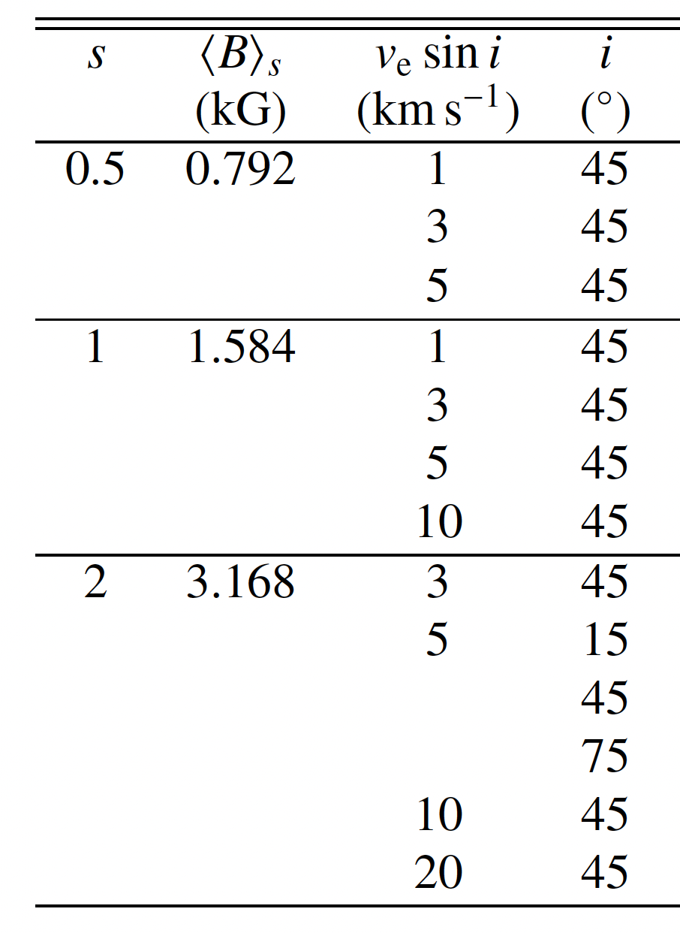

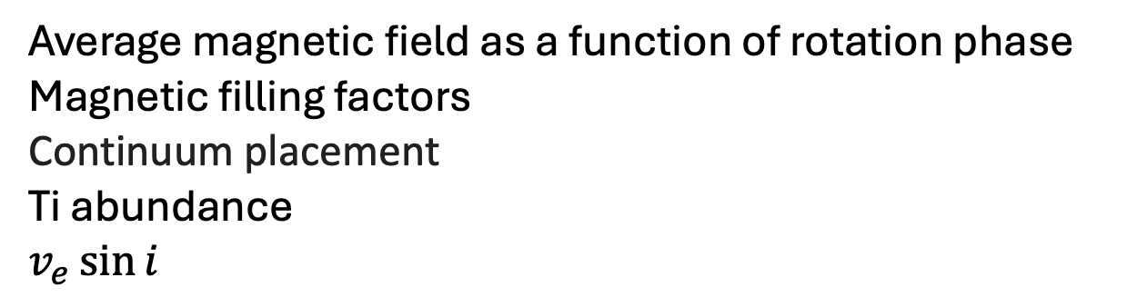
Magnetic field inference
Average magnetic field as a function of rotation phase
Magnetic filling factors
Continuum placement
Ti abundance
$$v_{e}\sin{i}$$
Inference of
Markov chain Monte Carlo (MCMC) sampling
$s=0.5, 1, 2$
Reconstruction for $v_{e}\sin{i=1, 3, 5, 10, 20 }$km/s
$i=15°,45°,75°$

Slide 9

Magnetic inference – example results
$s=2$, $v_{e}\sin{i=5 }$km/s, $i=45°$
Input spectra VS inferred spectra
Input distribution VS inferred distribution of filling factors
Input VS inferred hemispheric average magnetic field
Amateis et al. (2026)

Slide 10
Choice of number of magnetic components
Fixed number chosen a priori
Statistical criteria
BIC
AIC
WAIC

Slide 11
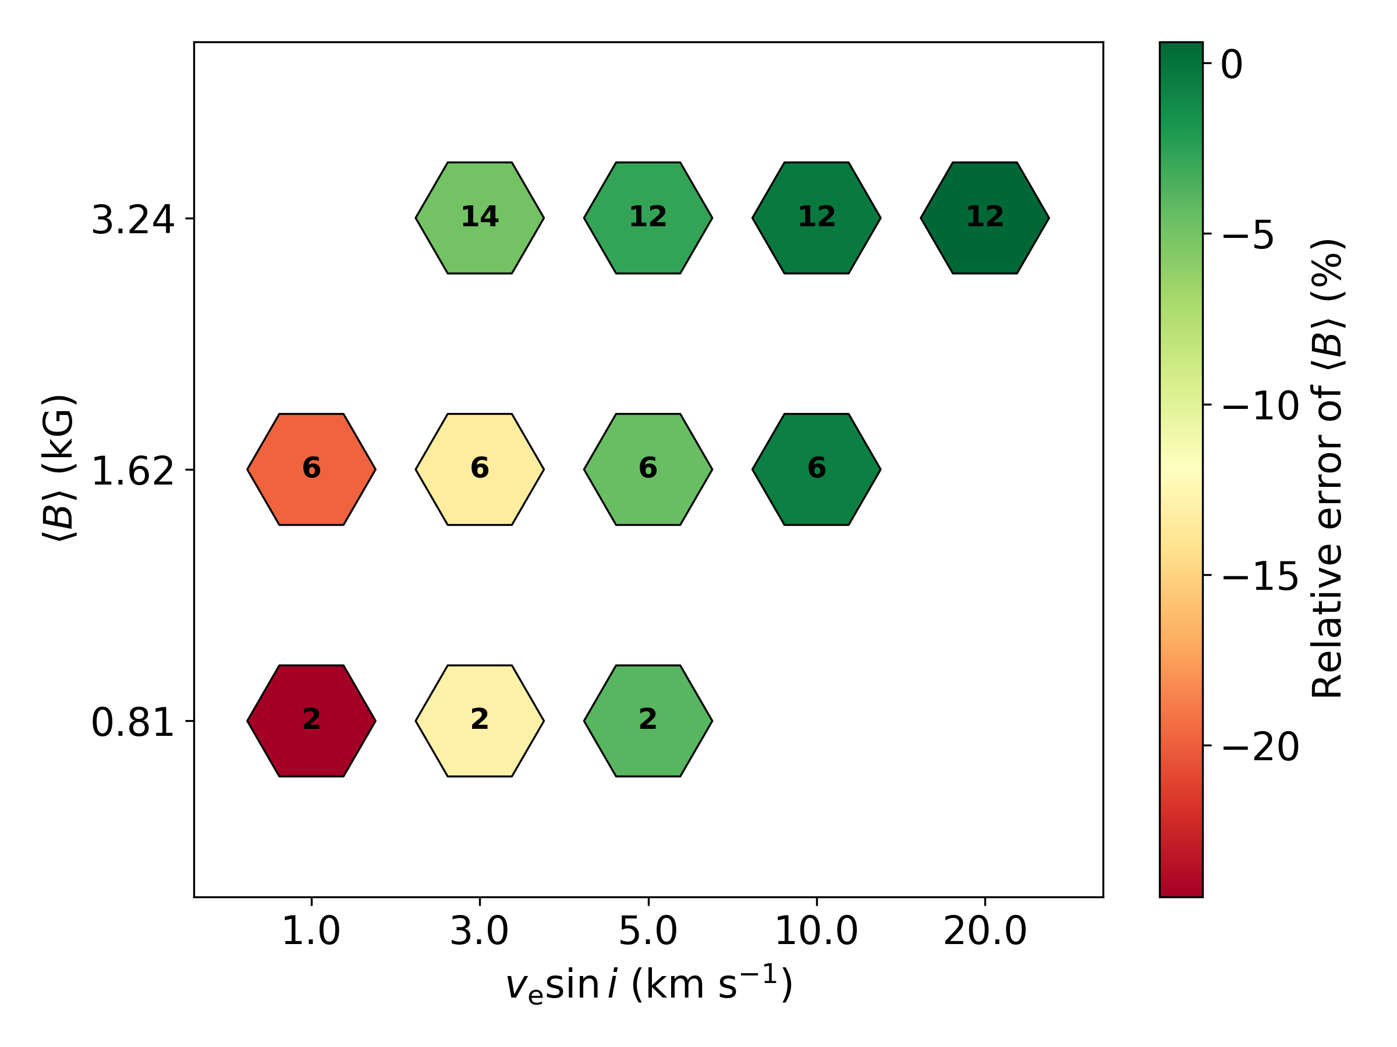
Accuracy of the magnetic field inference
Underestimation for slowly rotating and inactive stars of 13–24%
More active and fast rotating stars: more components and more accurate inference

Slide 12
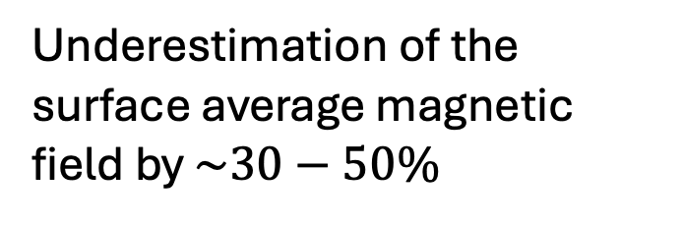
Alternative fitting strategy
Standard method: continuum of each spectral line and Ti abundance treated as free parameters
Reiners et al. (2022): continuum level and elemental abundances are fixed, while line-strength scaling factors are fitted
Underestimation of the surface average magnetic field by $\sim 30−50\%$
Amateis et al. (2026)
Notes:
Pixel step: 1.5 km/s

Slide 13

Conclusions
  More on: https://arxiv.org/abs/2605.18151
  Simulated observations from MHD model
  Inference of magnetic field for different $v_{e}\sin{i }$ and $i$
  Tested statistical criteria for choosing the number of magnetic components
  Tested different line fitting strategies
  Ti abundance and continuum as free parameters
  The future: Analysis of CRIRES+ spectra for benchmark and planet hosting M dwarfs

Slide 14
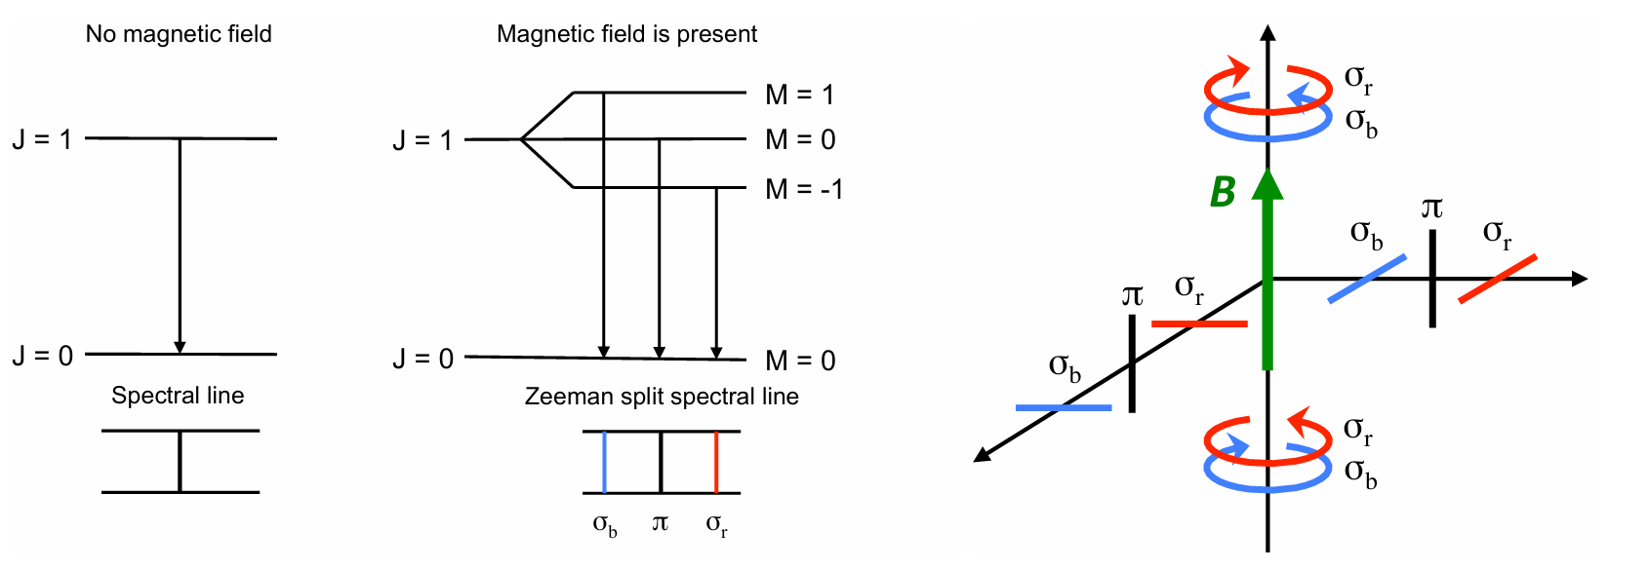

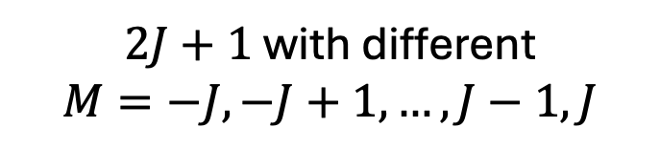
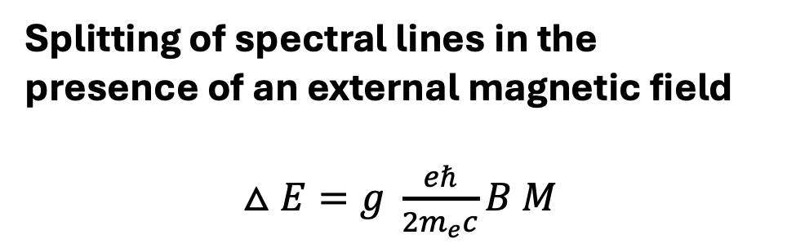
Backup: Zeeman Effect
Splitting of spectral lines in the presence of an external magnetic field
$△E=g \frac{eℏ}{2m_{e}c}B M$
$$J$$
$2J+1$with different
$$M=−J,−J+1,…,J−1,J$$
Kochukhov (2021)
Notes:
Picture: Fe I line, uniform field and different distributions. Solid lines correspond to the theoretical spectra calculated for a uniform radial field, dashed lines show calculations assuming a horizontal field, and dotted lines illustrate non-magnetic profiles

Slide 15
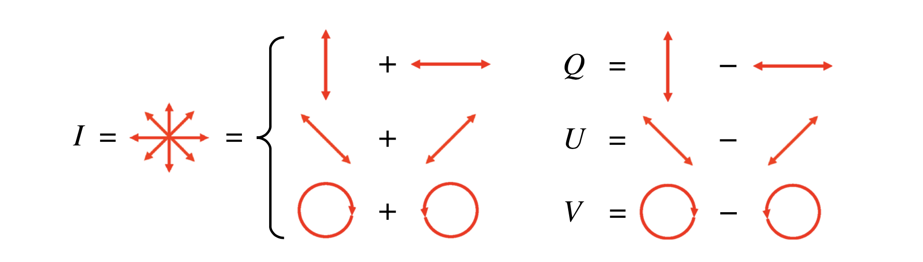
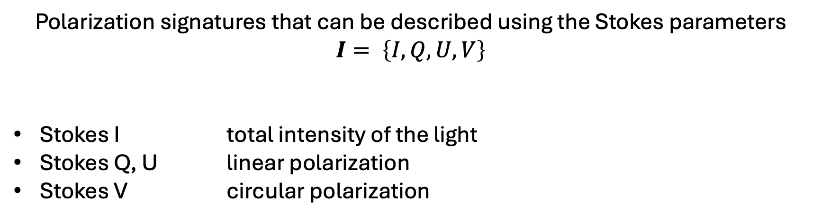
Backup: Stokes parameters
Polarization signatures that can be described using the Stokes parameters $I= \left\{I,Q,U,V\right\}$
Stokes I total intensity of the light
Stokes Q, U linear polarization
Stokes V circular polarization
Kochukhov (2021)

Slide 16
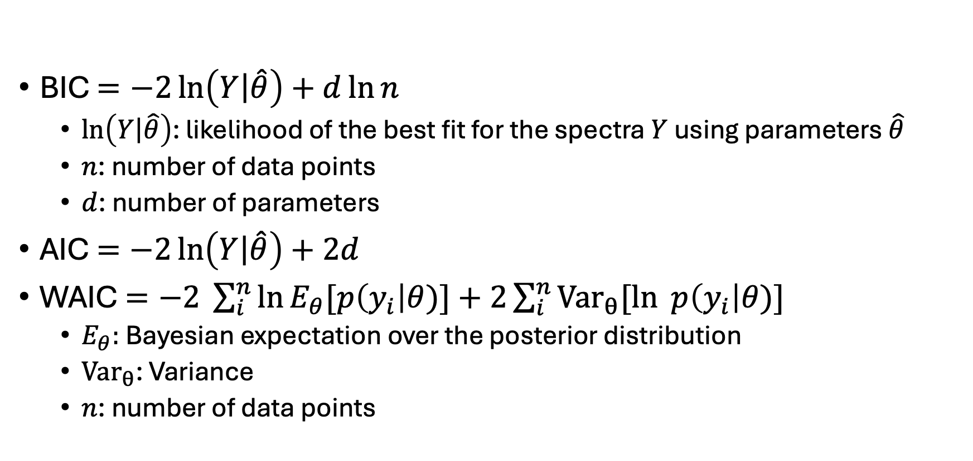
Backup: Statistical criteria
BIC $=−2\ln\left(\left.Y\right|\hat{θ}\right)+d\ln{n}$
  $\ln\left(\left.Y\right|\hat{θ}\right)$: likelihood of the best fit for the spectra $Y$ using parameters $\hat{θ}$
  $n$: number of data points
  $d$: number of parameters
AIC $=−2\ln\left(\left.Y\right|\hat{θ}\right)+2d$
WAIC $=−2 \sum_{i}^{n}{\ln{E_{θ}[p\left(y_{i}\right|θ)]+2\sum_{i}^{n}{{Var}_{θ}[ln{ p\left(y_{i}\right|θ)] }}}}$
  $E_{θ}:$Bayesian expectation over the posterior distribution
  ${Var}_{θ}$: Variance
  $n$: number of data points

Slide 17
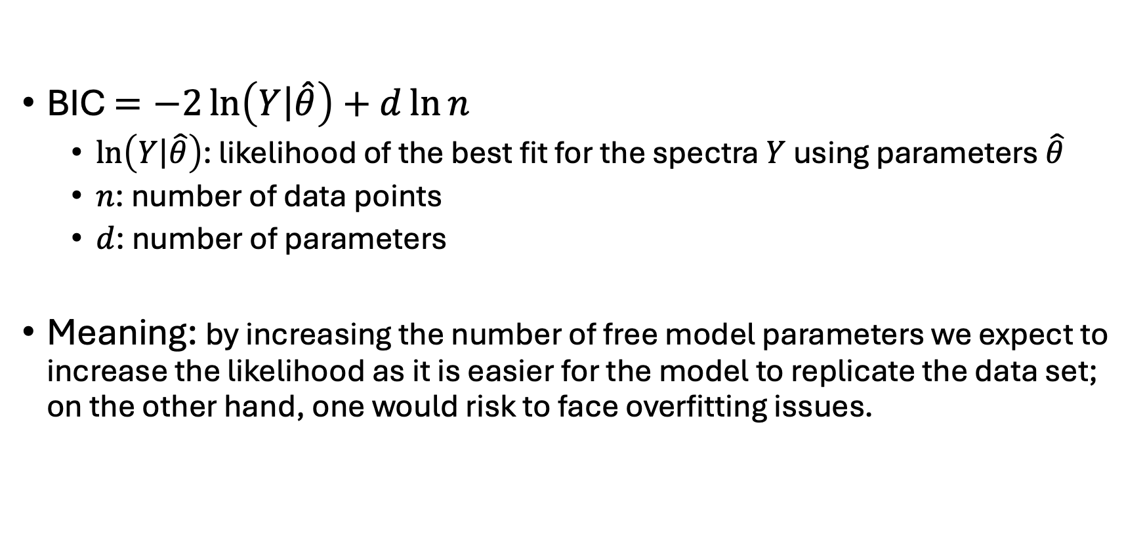
Backup: Bayesian Information Criterion
BIC $=−2\ln\left(\left.Y\right|\hat{θ}\right)+d\ln{n}$
  $\ln\left(\left.Y\right|\hat{θ}\right)$: likelihood of the best fit for the spectra $Y$ using parameters $\hat{θ}$
  $n$: number of data points
  $d$: number of parameters
Meaning: by increasing the number of free model parameters we expect to increase the likelihood as it is easier for the model to replicate the data set; on the other hand, one would risk to face overfitting issues.

Slide 18
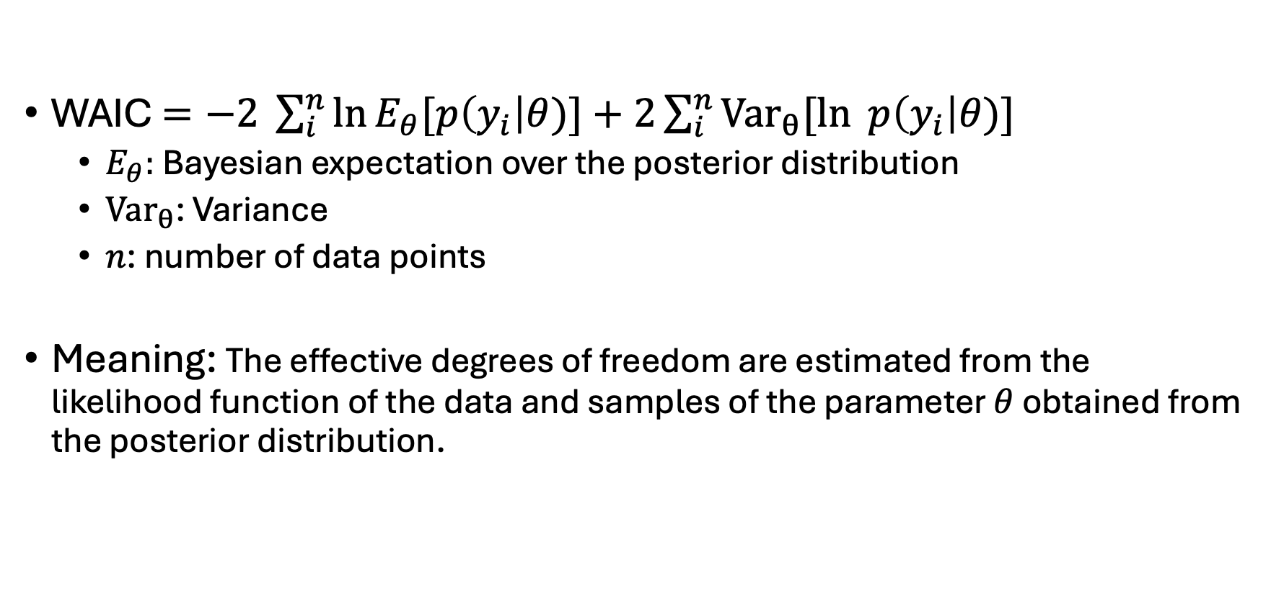
Backup: Watanabe-Akaike Information Criterion
WAIC $=−2 \sum_{i}^{n}{\ln{E_{θ}[p\left(y_{i}\right|θ)]+2\sum_{i}^{n}{{Var}_{θ}[ln{ p\left(y_{i}\right|θ)] }}}}$
  $E_{θ}:$Bayesian expectation over the posterior distribution
  ${Var}_{θ}$: Variance
  $n$: number of data points
Meaning: The effective degrees of freedom are estimated from the likelihood function of the data and samples of the parameter $θ$ obtained from the posterior distribution.

Slide 19
Back up: Simulated observations from MHD model
Model spectrum without and with noise and convolution with the instrumental profile

Slide 20
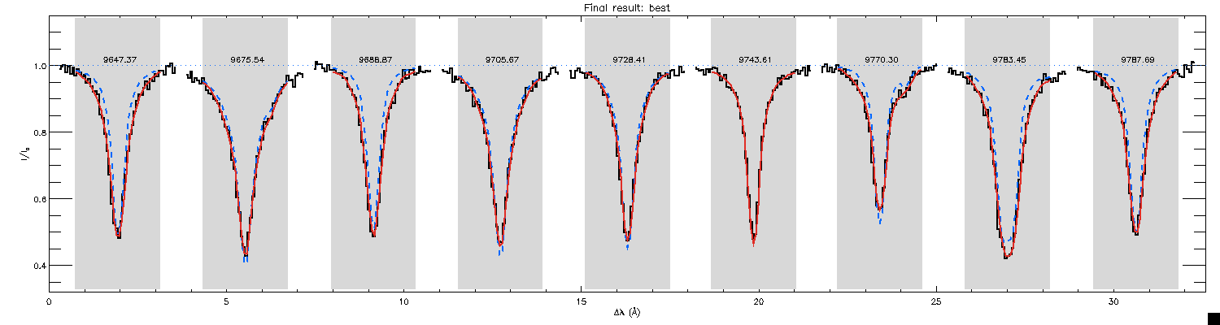

Backup: Results – line profiles
Input and fit line profile for $v_{e}\sin{i=5 }$km/s, $i=45°$and $p=0.0$
Amateis et al. (2026)

Slide 21
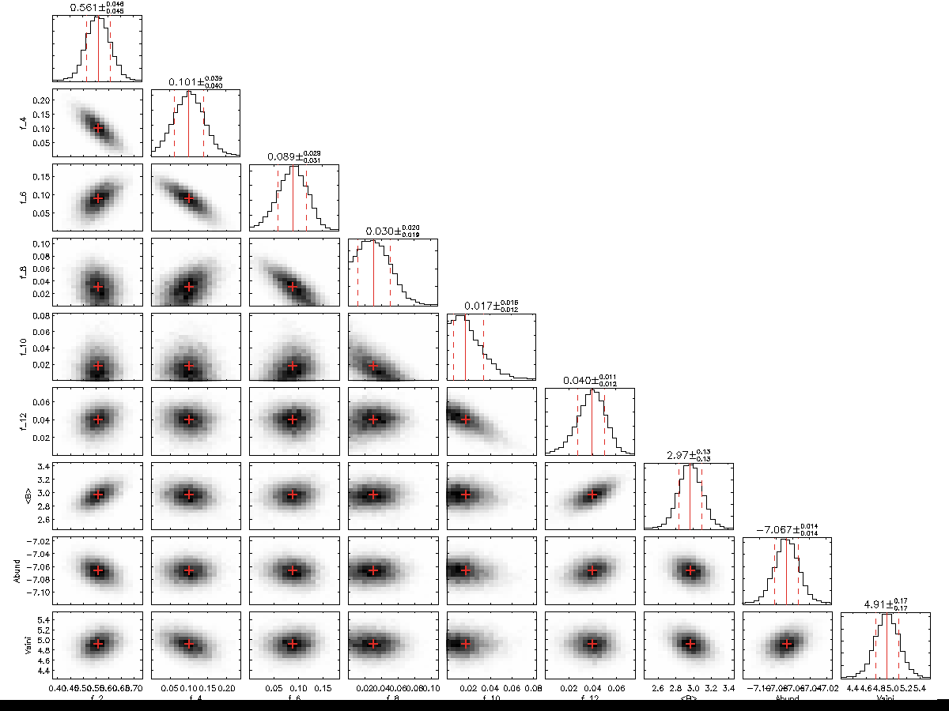
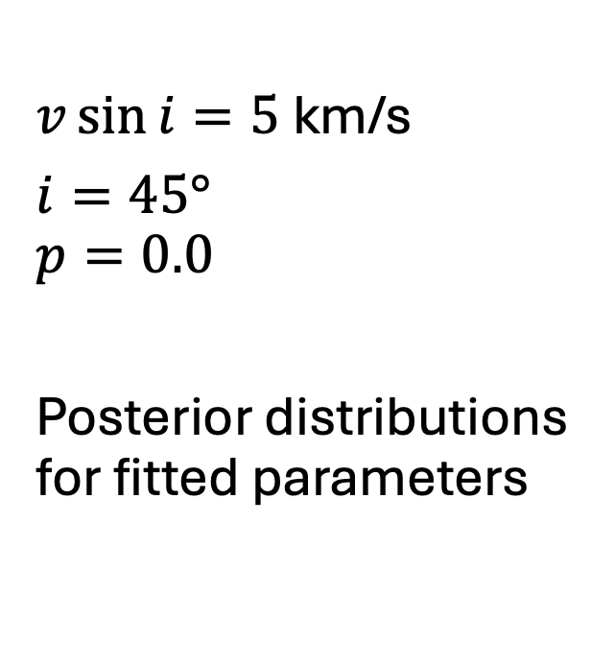
Backup: Results – posterior distributions
$v\sin{i=5 }$km/s
$i=45°$
$$p=0.0$$
Posterior distributions for fitted parameters

Slide 22

Backup: Results - Choice of maximum field strength
$$s=0.5$$
All criteria agreed on 2 components ($B_{max}=2$kG)
$$s=1$$
$v_{e}\sin{i}=1, 3, 5$km/s: all criteria agreed $B_{max}=6$kG
$v_{e}\sin{i}=10$km/s: WAIC favoured more components
Amateis et al. (2026)

Slide 23

Backup: Results - Choice of maximum field strength
$$s=2$$
Divergencies for fast rotors
$v_{e}\sin{i}=10, 20$km/s: WAIC favoured more components
Amateis et al. (2026)

Slide 24

Backup: Results – line profiles
Input distribution and reconstructed filling factors
$v\sin{i=5 }$km/s
$i=45°$
BIC: $B_{max}=12$kG
(7 components)

Slide 25

Backup: Results – line profiles
Input distribution and reconstructed filling factors
$v\sin{i=20 }$km/s
$i=45°$
BIC: $B_{max}=6$kG
(4 components)

Slide 26

Backup: Results – line profiles
Input distribution and reconstructed filling factors
$v\sin{i=20 }$km/s
$i=45°$
Test: $B_{max}=12$kG
(7 components)

Slide 27
Backup: Results – Inactive M dwarfs
Amateis et al. (2026)
2 kG
step
1 kG
step
Notes:
Top: R=64 000 (Espandos, Narval), S/N=100
Bottom: R = 80 400 (carmenes), S/N=300

Slide 28
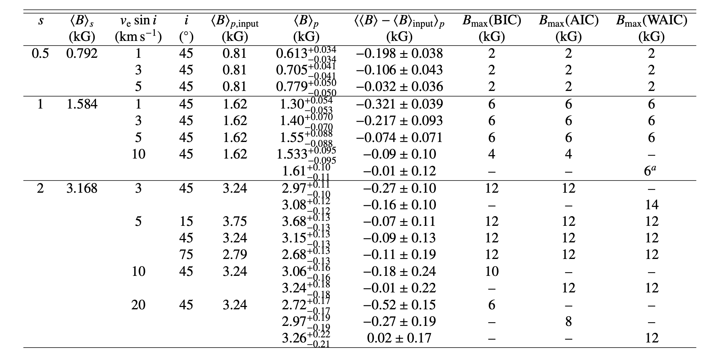
Backup: Summary of main results
Amateis et al. (2026)
Notes:
Top: R=64 000 (Espandos, Narval), S/N=100
Bottom: R = 80 400 (carmenes), S/N=300

