Slide 1
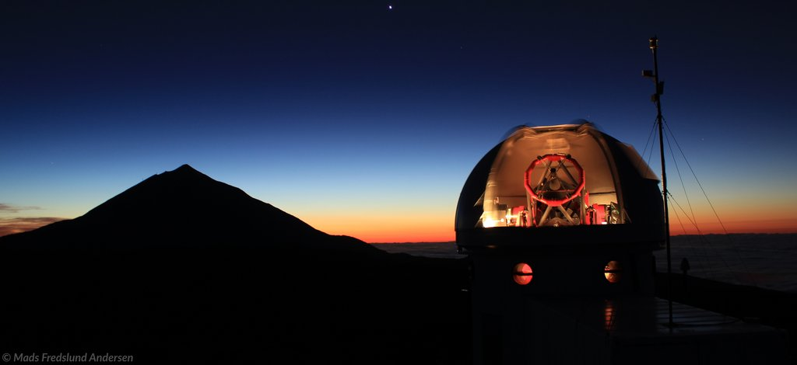
Looking inside stars:
Asteroseismology of solar-type stars
Hans Kjeldsen
Aarhus University, Denmark

Slide 2
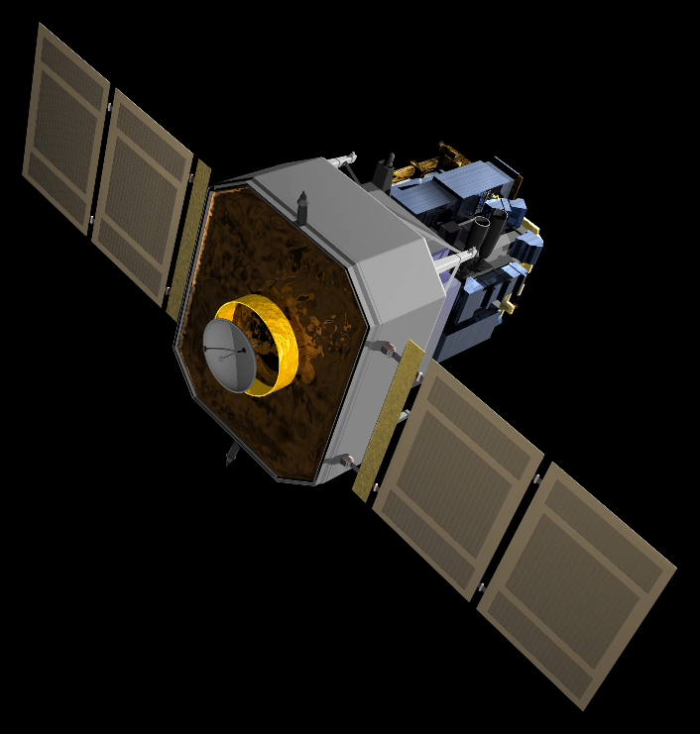
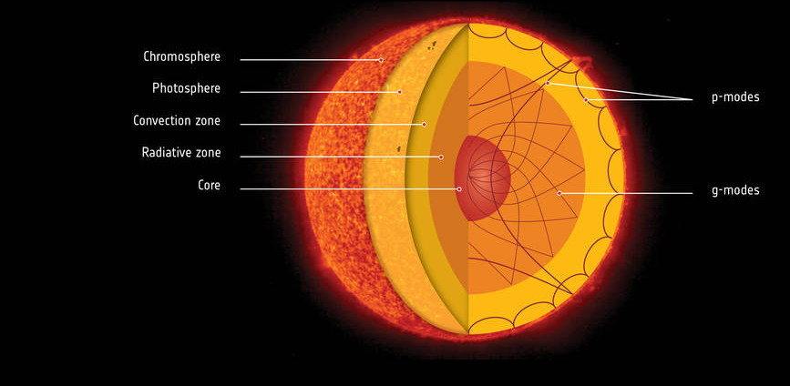
SoHO – GOLF – solar oscillations

Slide 3
SoHO – GOLF – solar oscillations

Slide 7
Mode degree
Radial modes
0 0 0
135 µHz
135 µHz
135 µHz
135 µHz

Slide 8
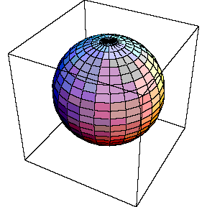
Mode degree
0 0 0
1 1 1 1

Slide 9
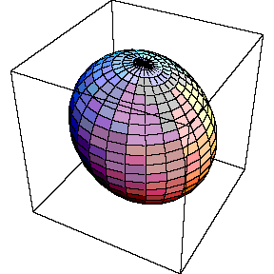
Mode degree
0 0 0
2 2 2
1 1 1 1

Slide 10
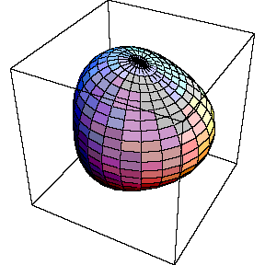
Mode degree
0 0 0
2 2 2
1 1 1 1
3 3 3 3

Slide 11
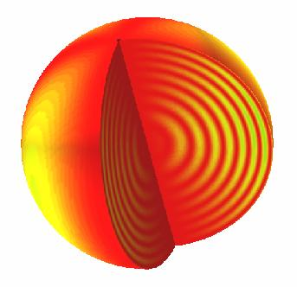
Radial order
17 18 19
2 2 2
135 µHz
135 µHz

Slide 12
Mode degree
2 0 3 1
26
24
22
20
18
16
14
Radial order
135 µHz
1.00 M(sun)
1.00 R(sun)
4.6 Gyr

Slide 13
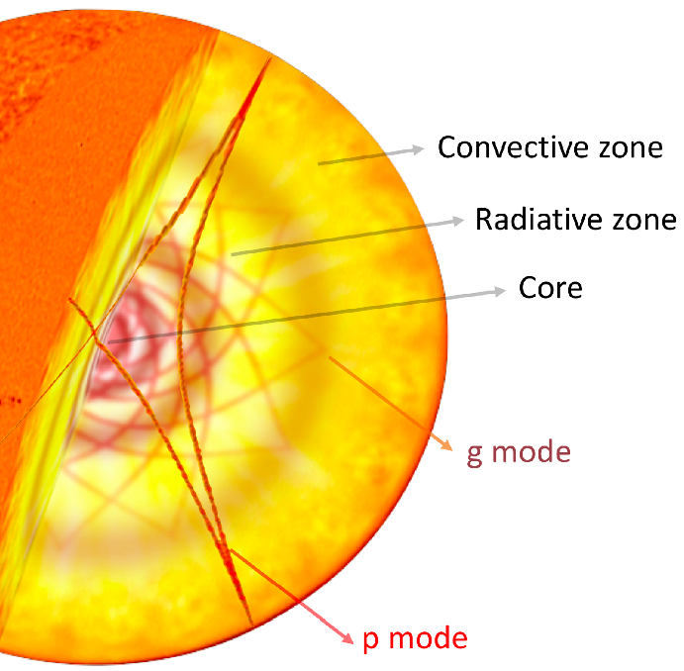
135 µHz
1.00 M(sun)
1.00 R(sun)

Slide 14
HeI → HeII
HeII → HeIII
Depth of convection zone
135 µHz
1.00 M(sun)
1.00 R(sun)

Slide 15
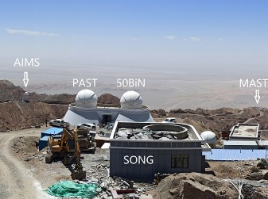
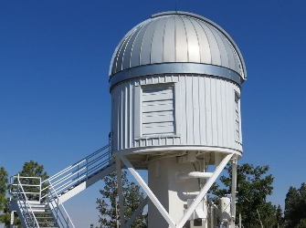
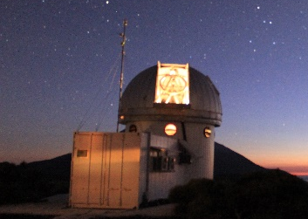
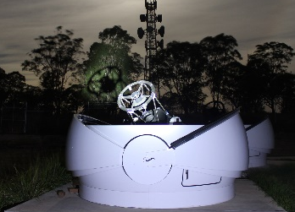
China USA Spain Australia
The primary aim of SONG (Stellar Observations Network Group)
is to collect high-precision RV measurements of oscillating stars

Slide 16
µ Herculis observed by SONG (Tenerife)

Slide 18
1 1 1 1 1
0 0 0 0 0 0
2 2 2 2 2 2
64.2 µHz
1.11 ± 0.01 M(sun)
1.72 ± 0.02 R(sun)
7.8 ± 0.4 Gyr

Slide 19
µ Her

Slide 20
µ Her
Mode degree
23
22
21
20
19
18
17
16
15
14
13
12
11
10
9
8
2 0 3 1
Radial order

Slide 21
µ Her

Slide 22
µ Her
HeI → HeII
HeII → HeIII
Depth of convection zone

Slide 23
µ Her
HeI → HeII
HeII → HeIII
Depth of convection zone

Slide 24
µ Her
HeI → HeII
HeII → HeIII
Depth of convection zone

Slide 25
µ Her
HeI → HeII
HeII → HeIII
Depth of convection zone
4H→He Shell source

Slide 26
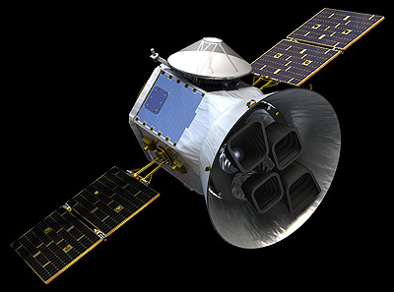
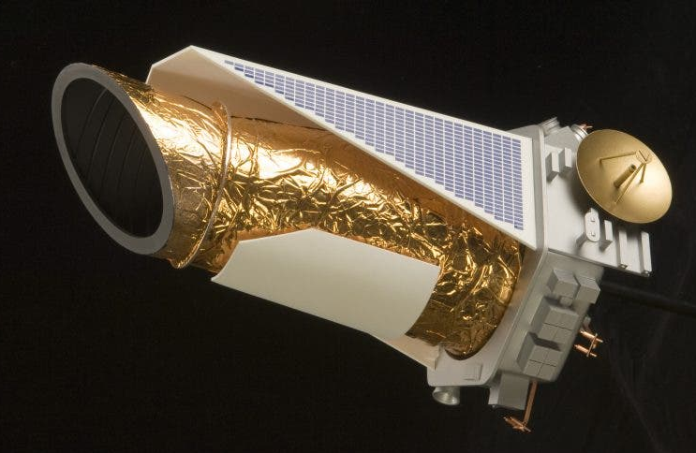
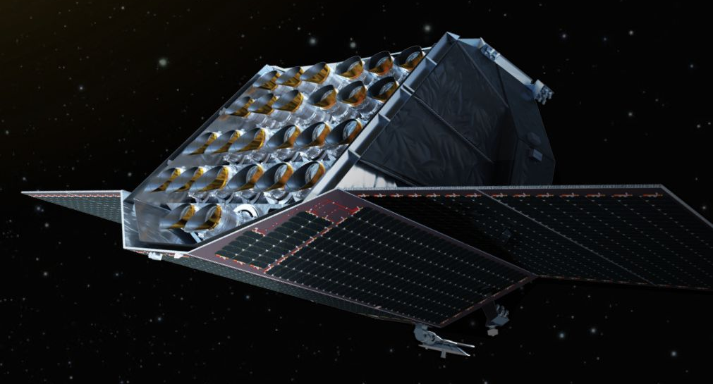
China USA Spain Australia
The primary aim of SONG (Stellar Observations Network Group)
is to collect high-precision RV measurements of oscillating stars
Kepler (NASA) TESS (NASA) Plato (ESA)

Slide 27

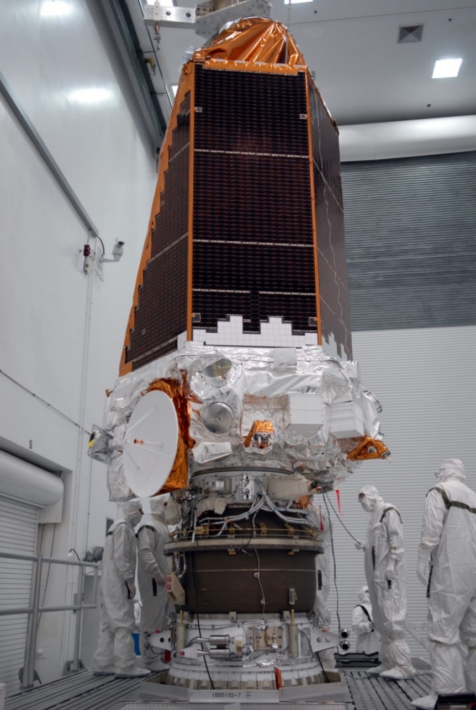
NASA’s space telescope Kepler revolutionized asteroseismology

Slide 28
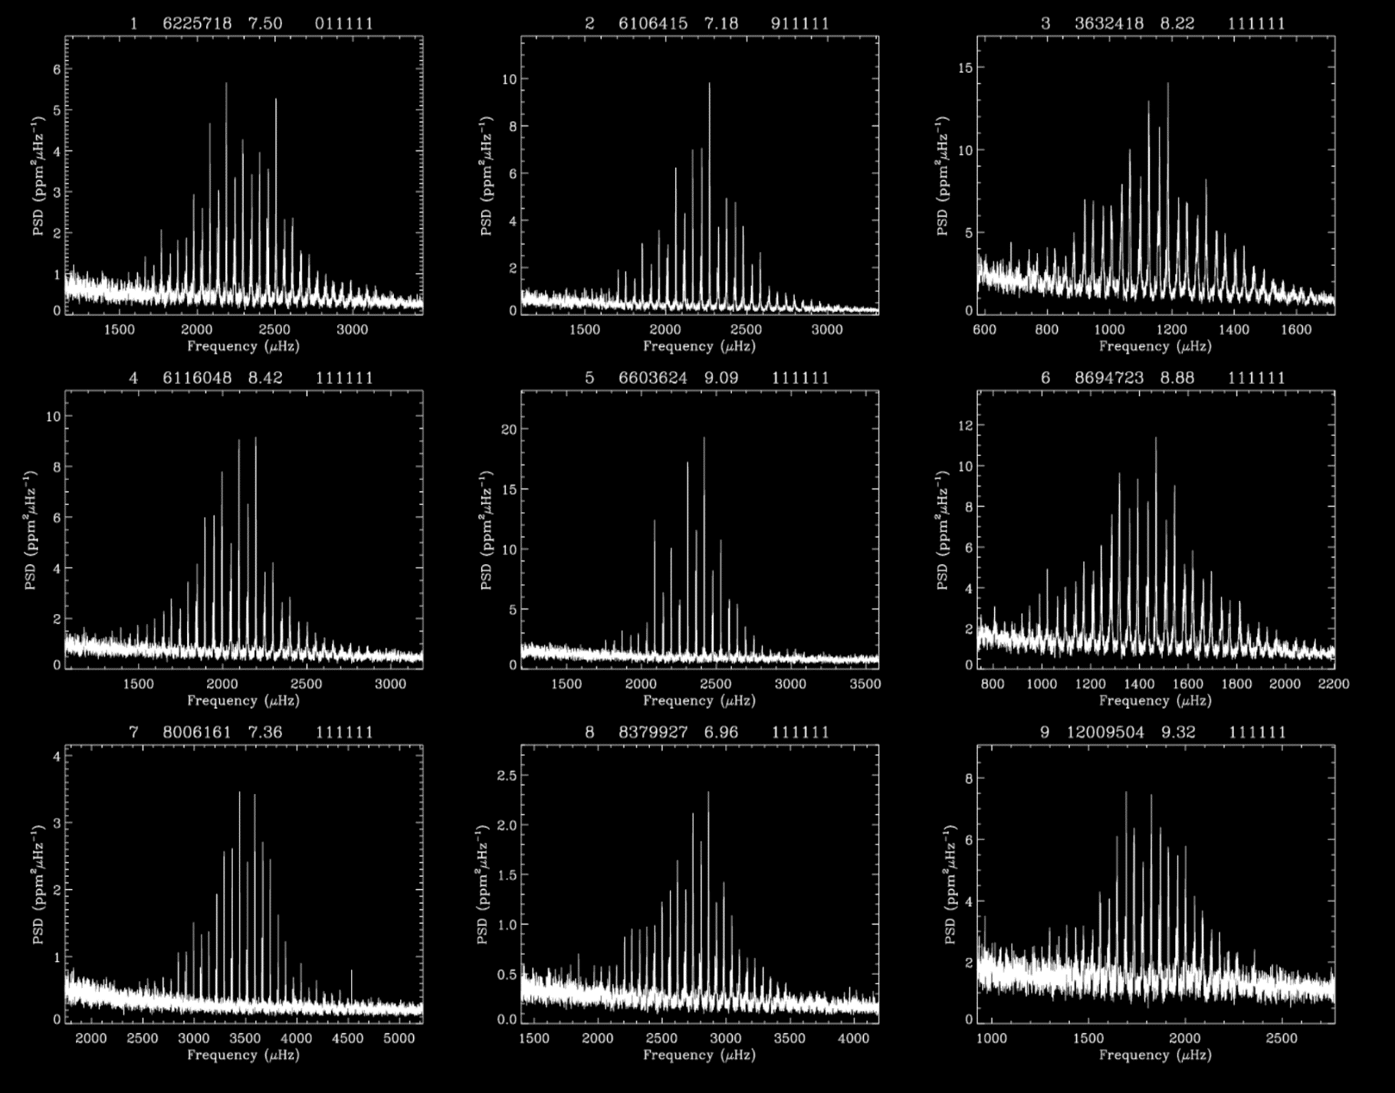
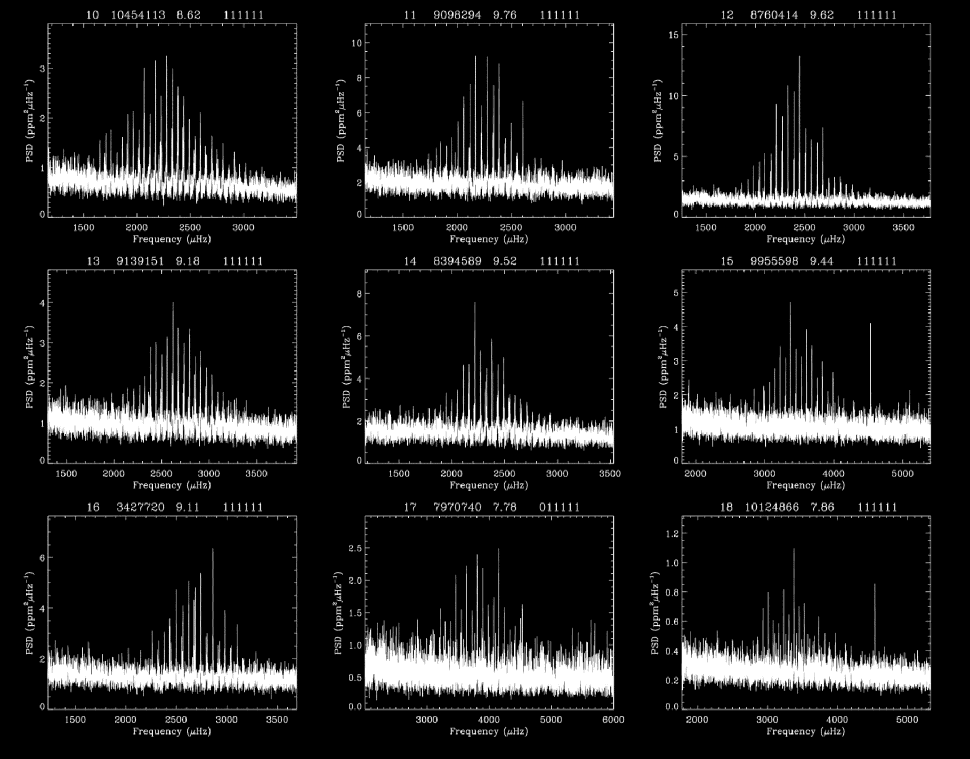
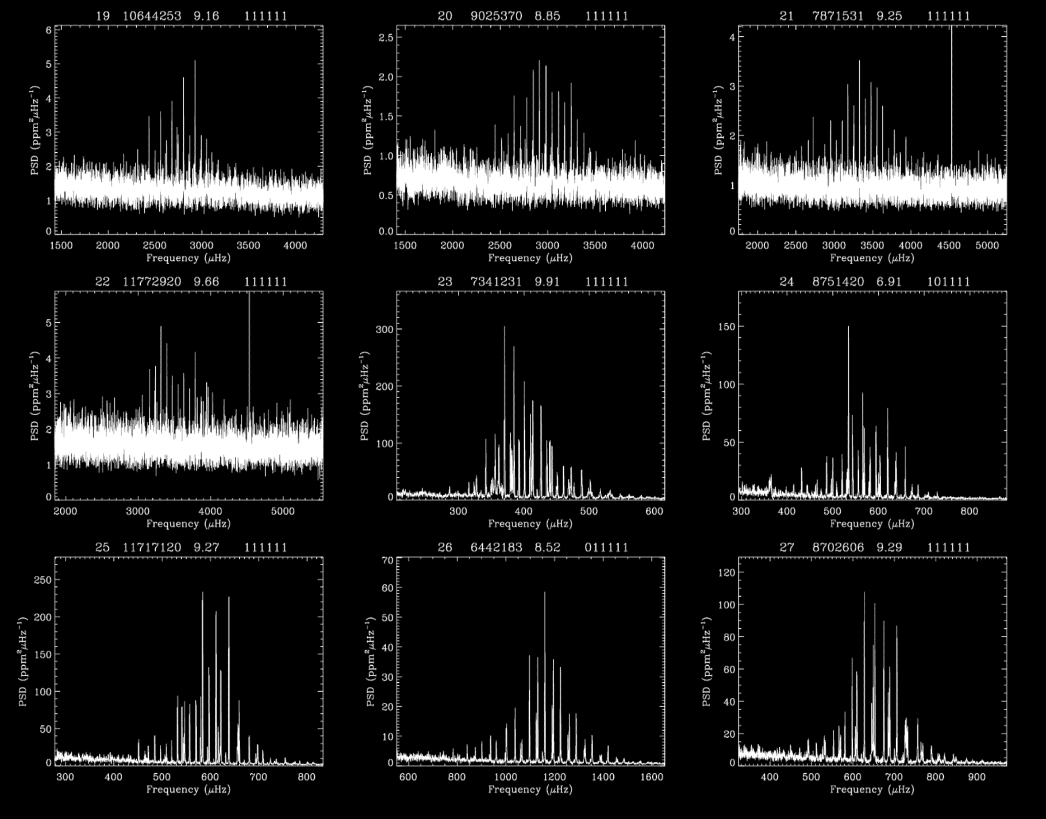
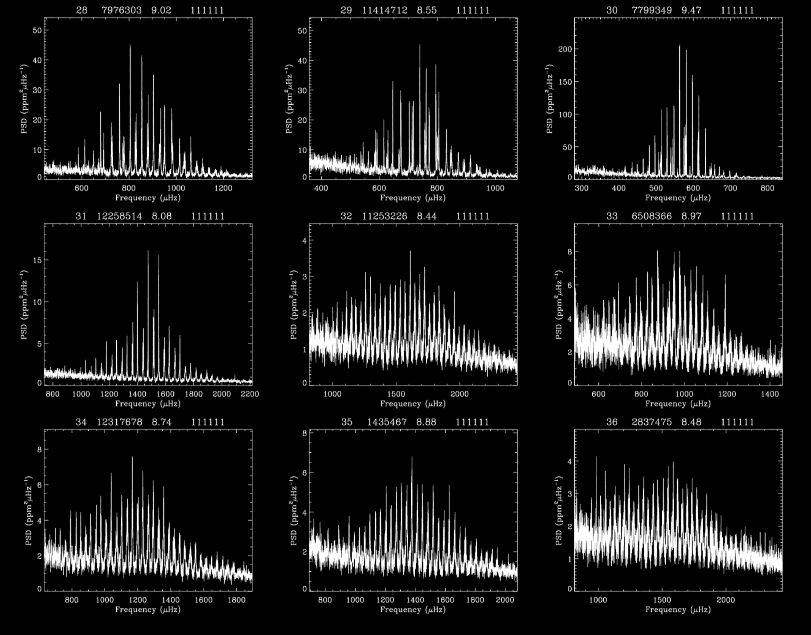
Kepler provided high quality oscillation spectra for several thousand stars in different stages of their evolution

Slide 29
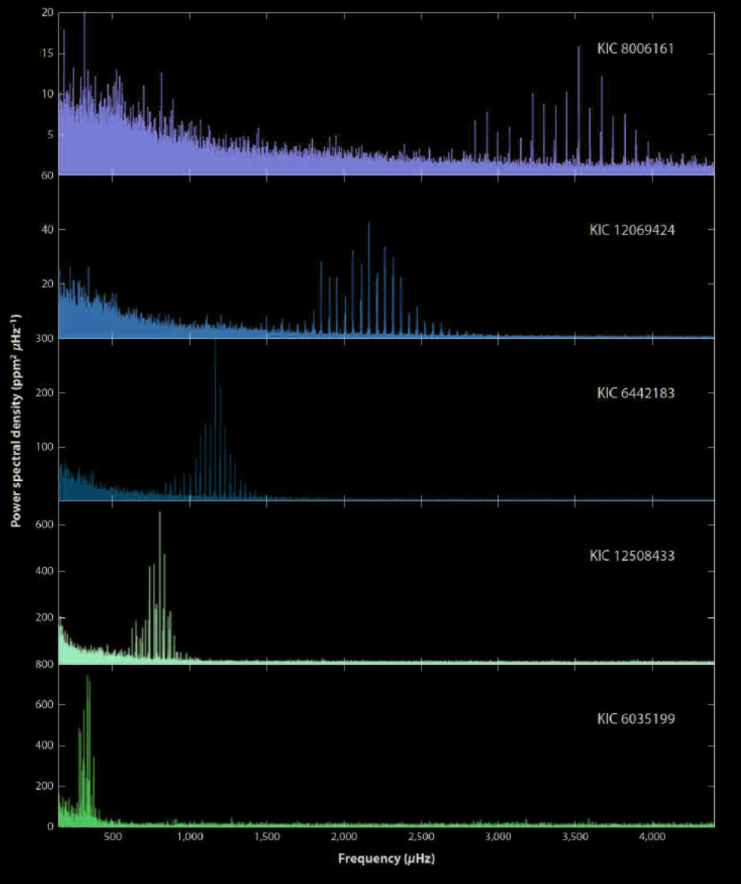
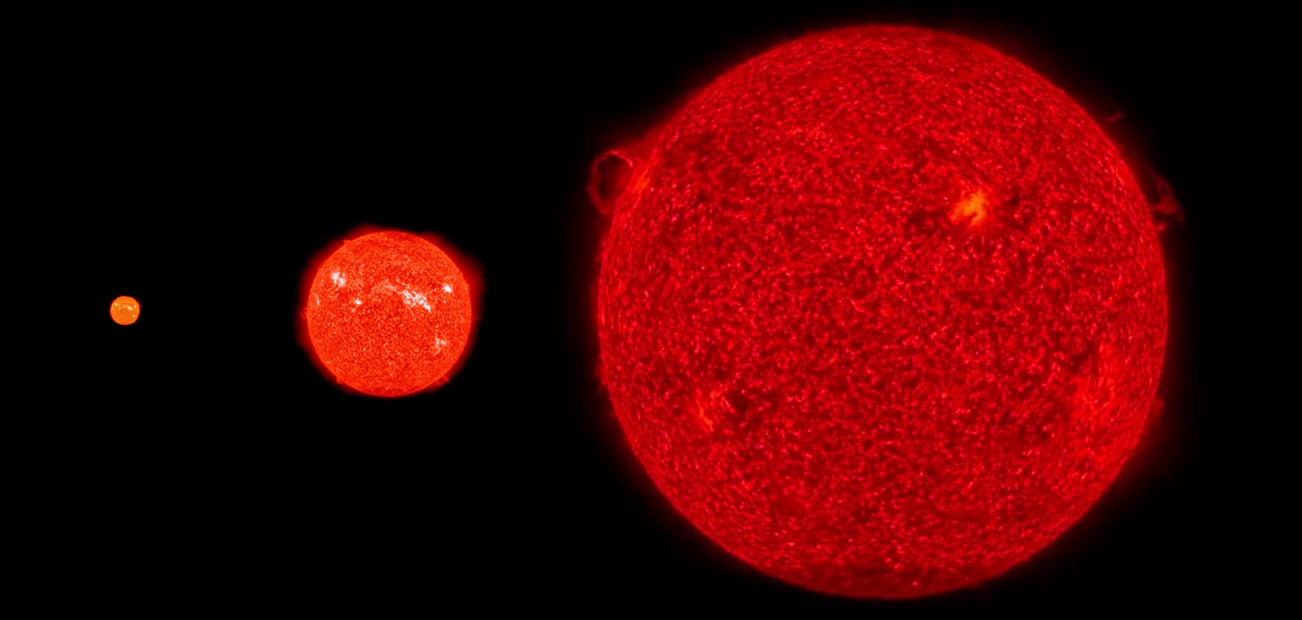
Stars evolve
KIC 8006161
KIC 12069424
KIC 6442183
Oscillation energy
KIC 12508433
KIC 6035199
Frequency (μHz)

Slide 30
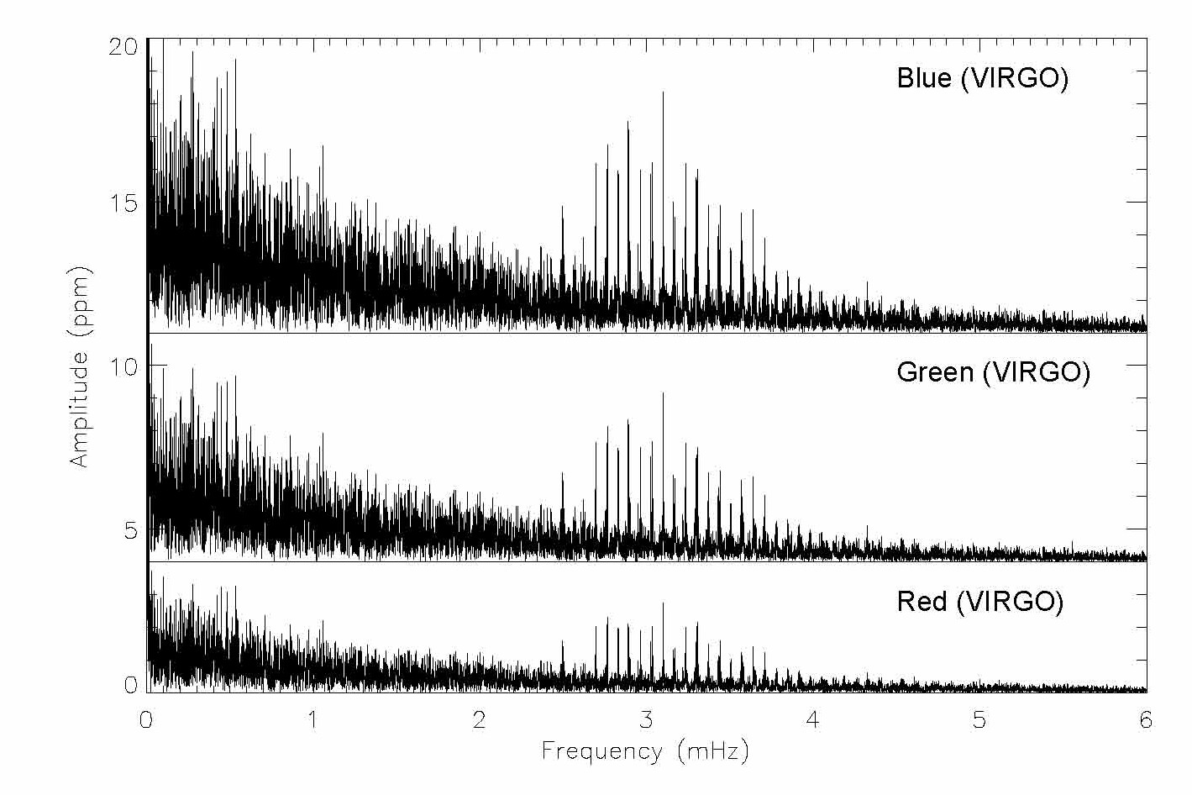
The Sun
10 d

Slide 31
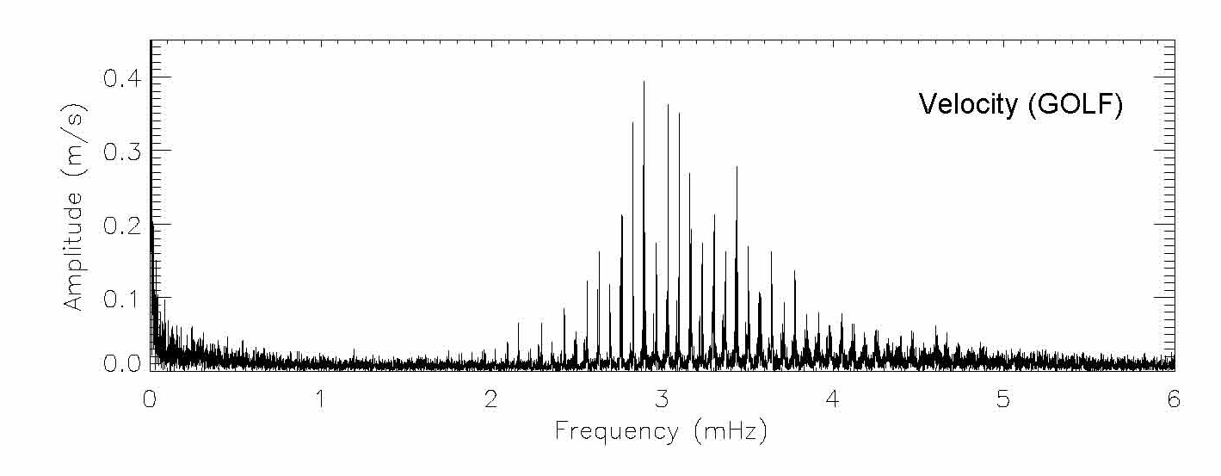
The Sun
10 d

Slide 32
10 d
RV: Dominated by oscillations
INT: Dominated by granulation

Slide 33
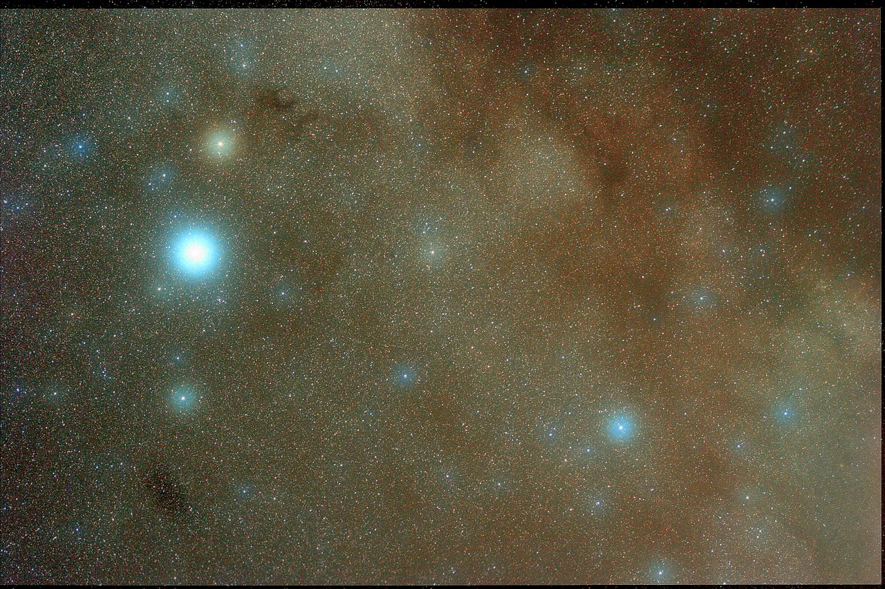
β Aquilae
An evolved star in the transition phase from a subgiant to a red giant branch (RGB) star.
γ
α
β
δ

Slide 34
β Aquilae

Slide 35
β Aquilae

Slide 36
β Aquilae

Slide 37
The photometry (bolometric)-to-velocity ratio for Aql at peak power is:
26.6 ± 3.1 ppm/(m/s)
The same ratio for the Sun and correcting to the Teff (5092 ± 50 K) for β Aql is:
22.1 ± 0.8 ppm/(m/s)
Difference 1.4σ
β Aquilae

Slide 38
We calculated the phase shift to be -113° ± 7°. In other words, the peak of the SONG oscillations (highest positive RV) occurs 31 per cent of an oscillation period before the peak of the TESS signal.
In the Sun, the corresponding phase shift can be measured using SOHO observations (Jiménez 2002). There are indications of the phase shift being sensitive to solar activity
β Aquilae

Slide 39
Key Opportunities with Simultaneous RV and Intensity Observations:
Plato (ESA) offers a unique, time-critical window for coordinated RV follow-up.
Photometry reveals the same oscillations but with lower SNR.
High-precision RV data improve frequency accuracy and mode identification.
Simultaneous RV observations enable studies of mode damping, amplitude ratios, and phase shifts… providing insight into magnetic activity and stellar surface phenomena.
Direct comparison with SoHO data.
Kepler (NASA) TESS (NASA) Plato (ESA)

