Slide 1
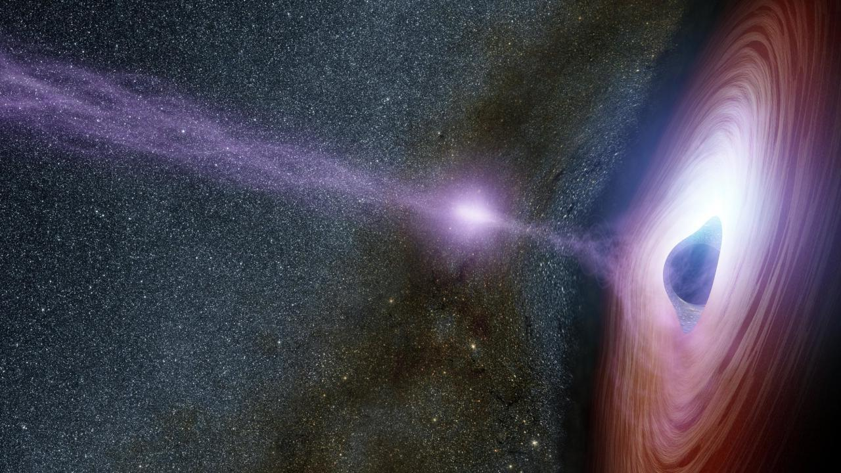



Echo Mapping of Accretion Flows around Supermassive Black Holes
Roberta Vieliute
University of St Andrews
Supervised by Keith Horne & Juan Hernández Santisteban
Nordic-Baltic Astronomy Days, 27th May 2026

Slide 2


AGN Component Scales
Dusty Torus
Broad Line Region
Electron corona
SMBH
Accretion Disc
*components not to scale
>10²-10³ LD
10¹-10² LD
1-10 LD
LD: Light-Day
Pc: Parsec (3.1✕10¹³ km)
R_{g}: Gravitational radii (R_{g} = GM/c²)
> 0.1-1 Pc
10⁻²-10⁻¹ Pc
10⁻³-10⁻² Pc
>10⁴-10⁵ R_{g}
10³-10⁴ R_{g}
100-1000 R_{g}
Current telescopes do not have sufficient resolving power to probe the compact inner regions of AGN directly
Use time-domain astronomy to resolve AGN structure with Reverberation (Echo) Mapping
1/15

Slide 3

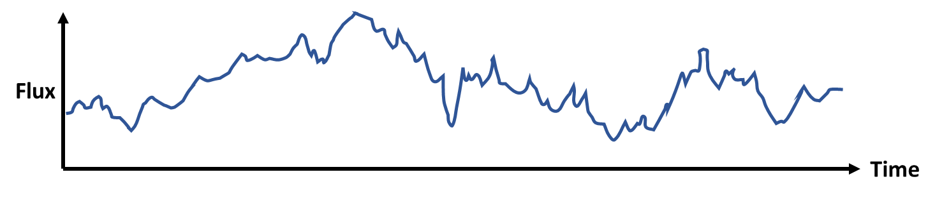
Reverberation Mapping
High energy emitting source
Driving Lightcurve
2/15

Slide 4

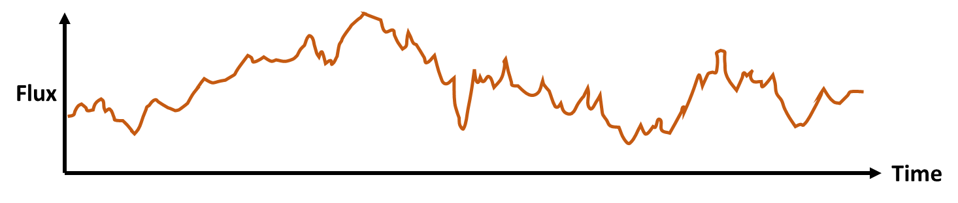
Reverberation Mapping
High energy emitting source
Reprocessing source
Driving Lightcurve
Reprocessed Lightcurve
2/15

Slide 5



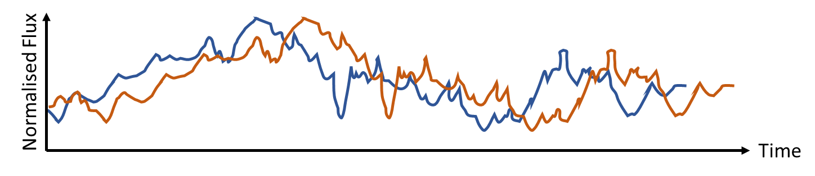

Reverberation Mapping
High energy emitting source
Reprocessing source
3/15

Slide 6

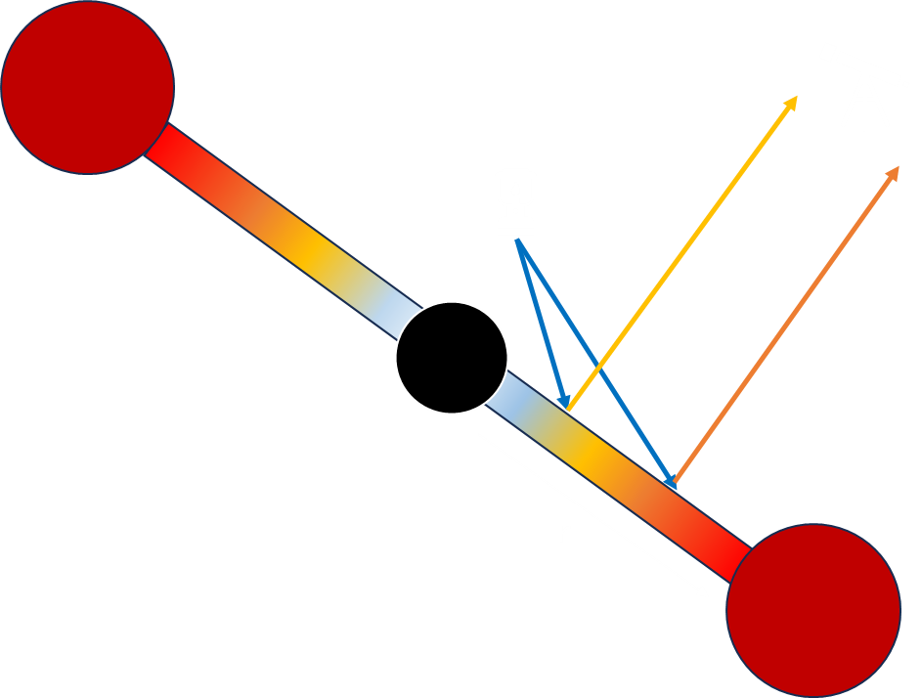
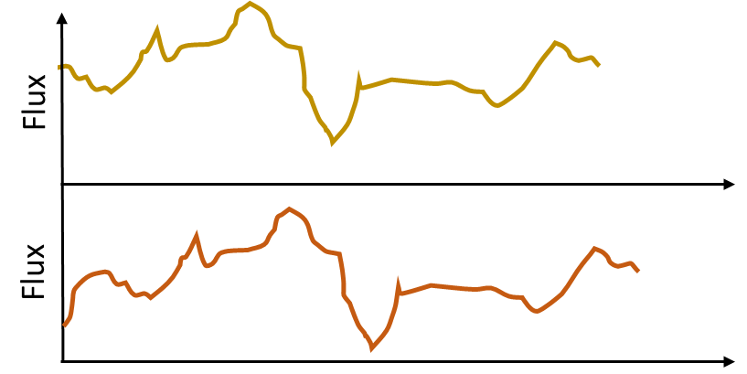

AGN Accretion Flow RM in a Nutshell
<
λ₁
λ₂
λ₁
△t
λ₁
Flux
λ₂
‘Standard’ Shakura & Sunyaev (SS; 1973) disc model
λ₂
Time
T(R₁)
Flux
T(R₂)
X-rays reprocessed as thermal emission with λ dependent on local temperature of disc (∑Blackbodies)
Time
d (λ₁,λ₂) ≈ cΔt
4/15

Slide 7
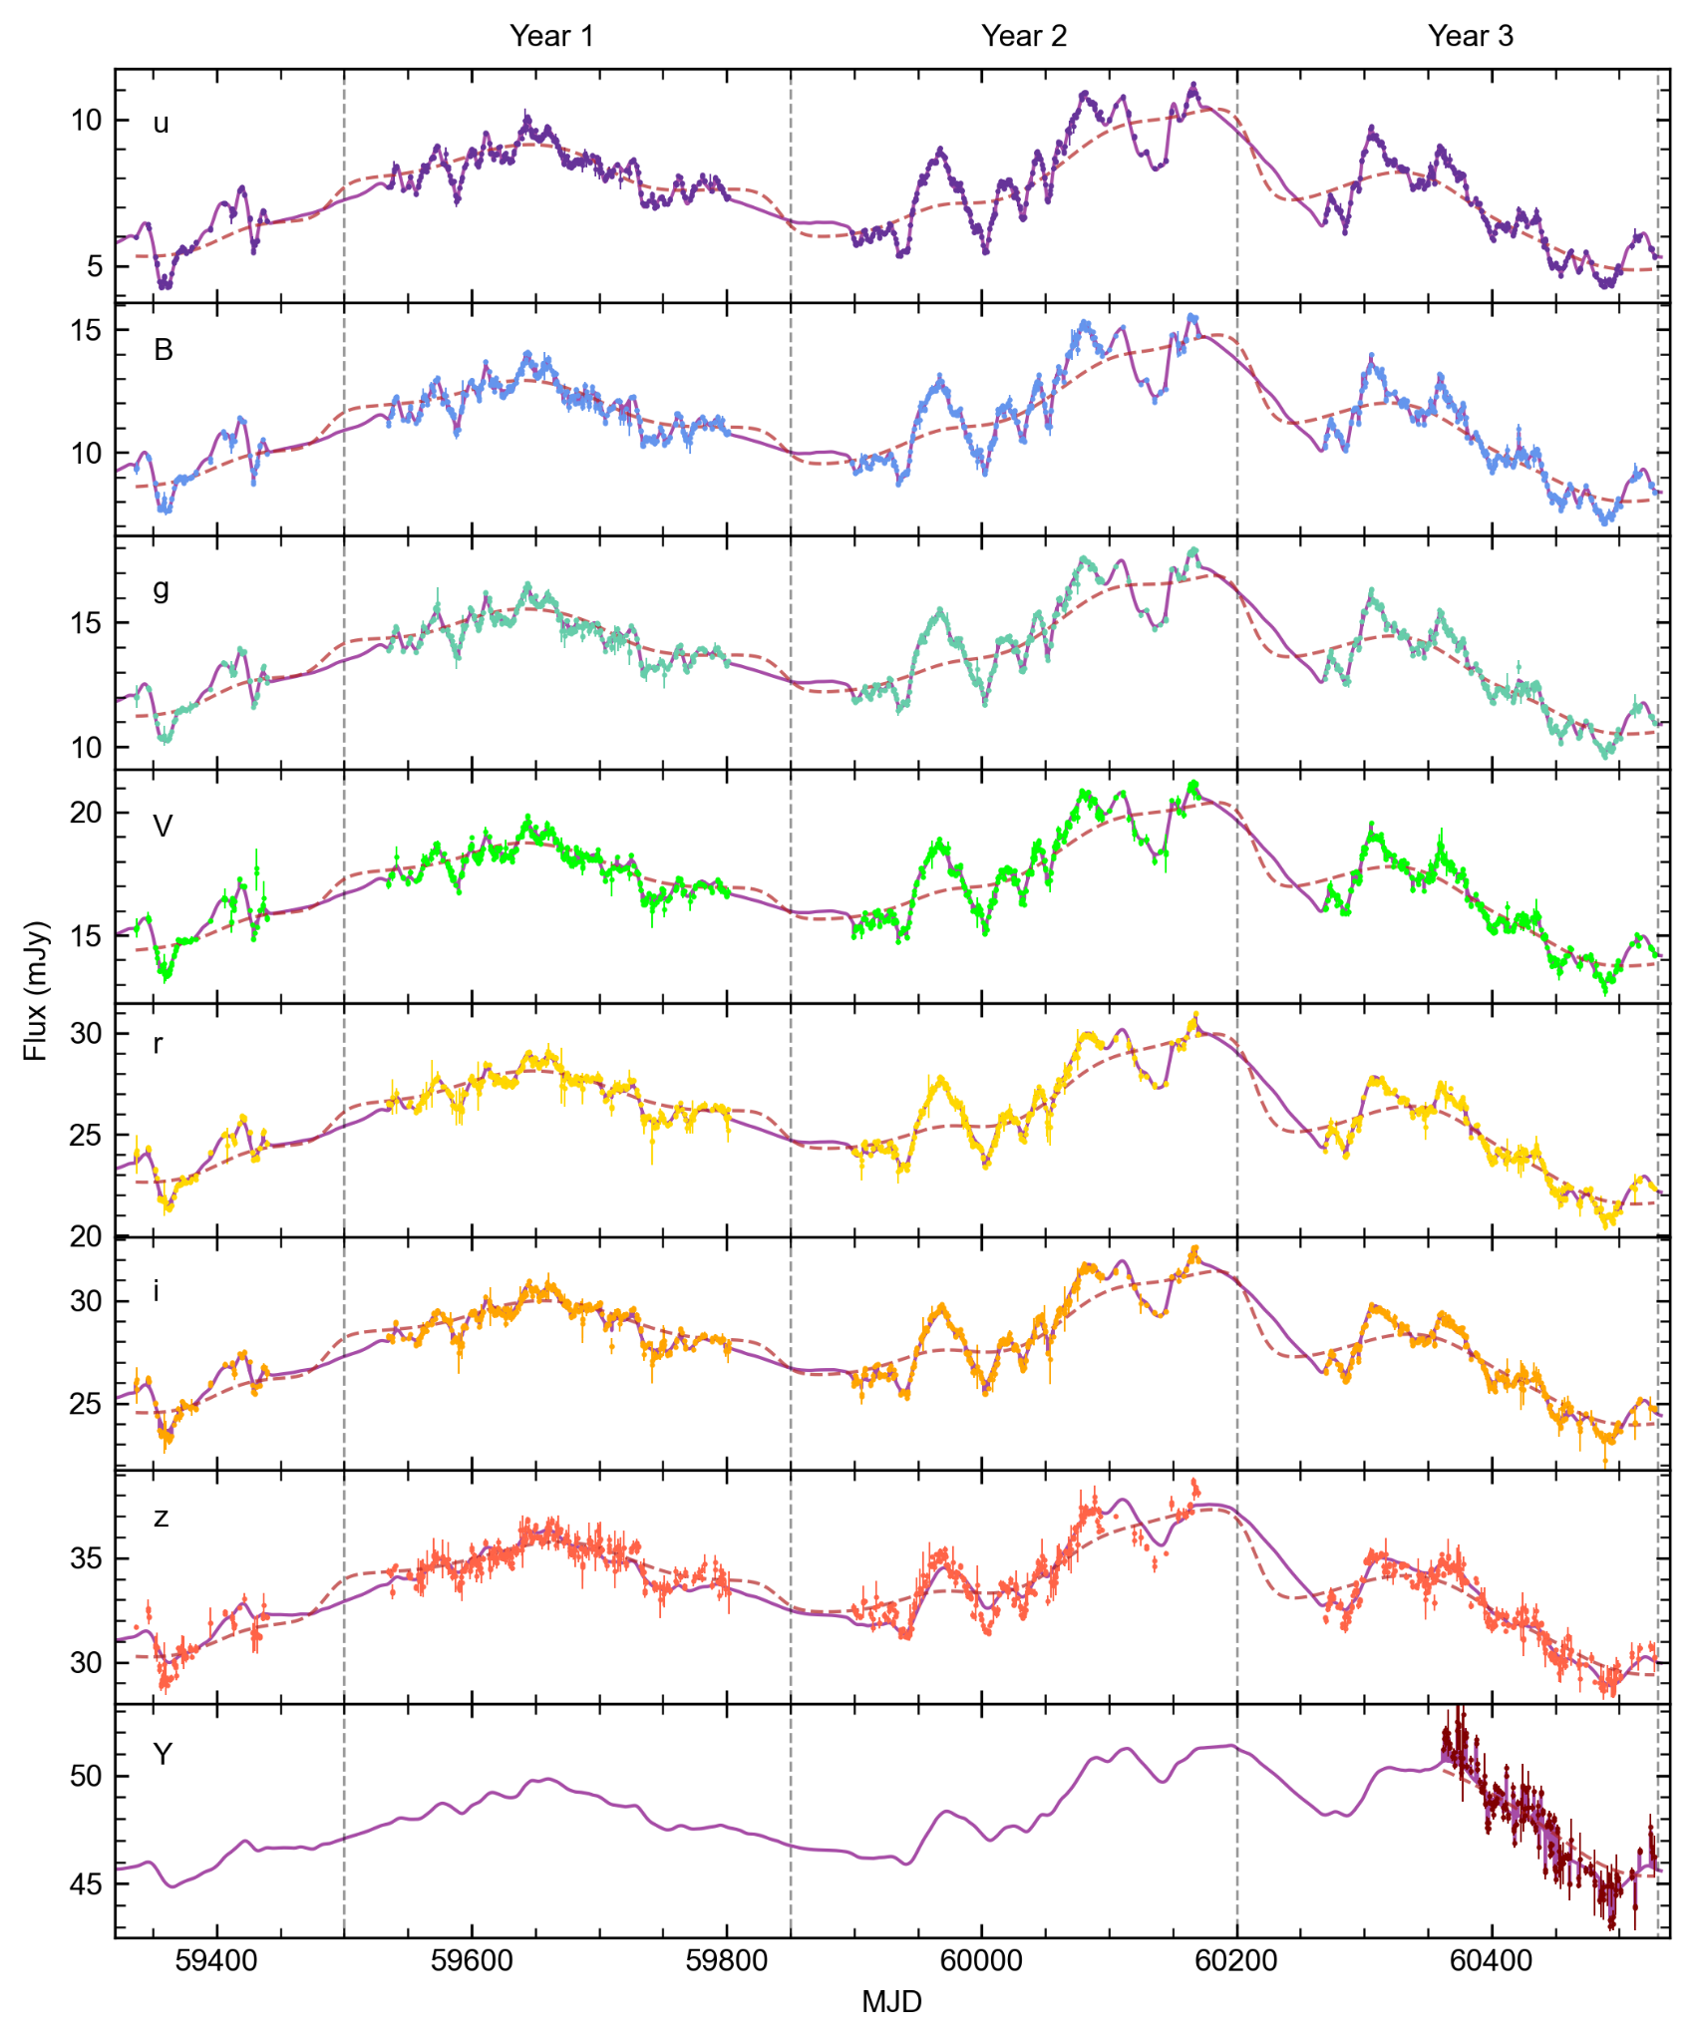
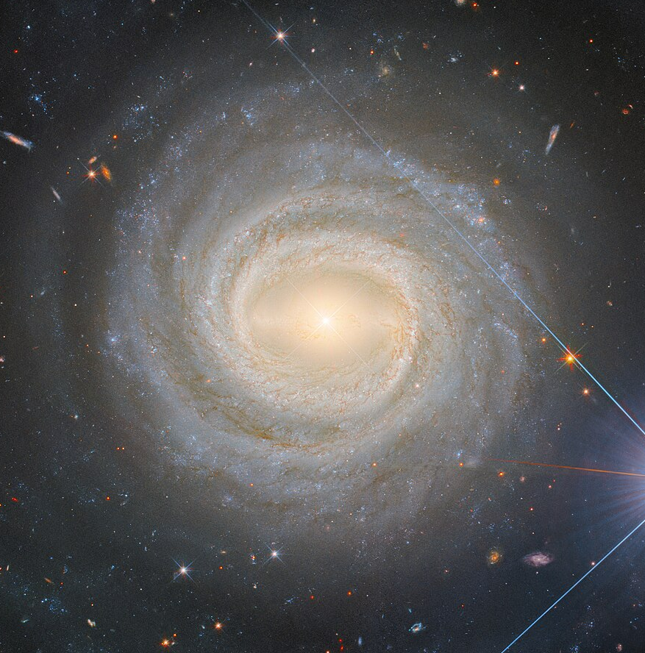
Vieliute et al. in prep.
NGC 3783
212,800 Light Years
< 10 Light Years
NGC 3783 imaged by the Hubble Space Telescope
3 years of sub-daily observations with the Las Cumbres Observatory across 8 optical bands
5/15

Slide 8
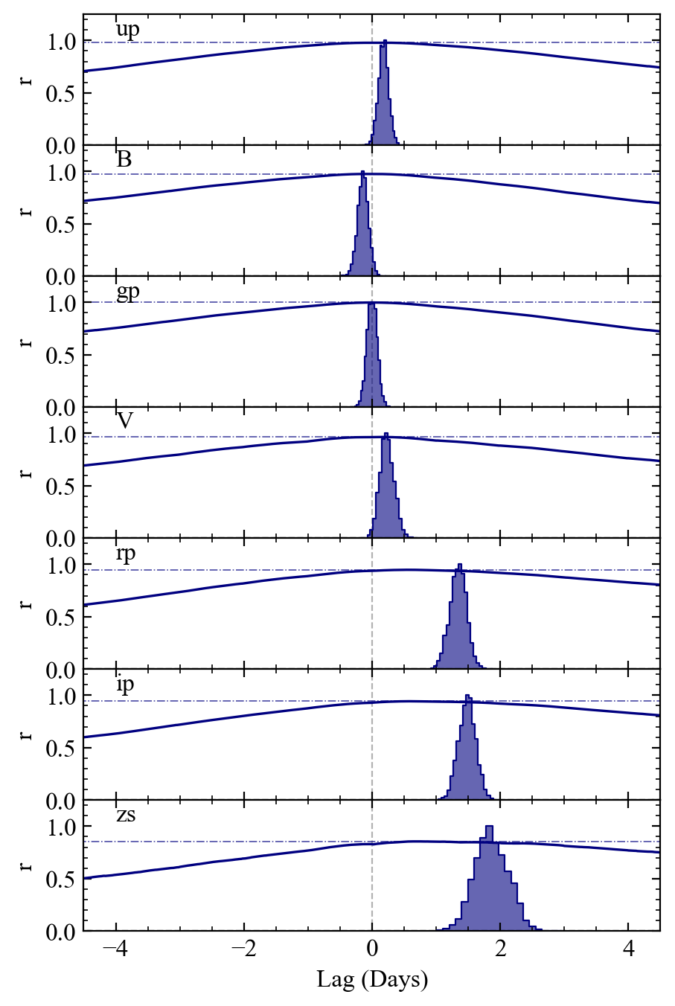
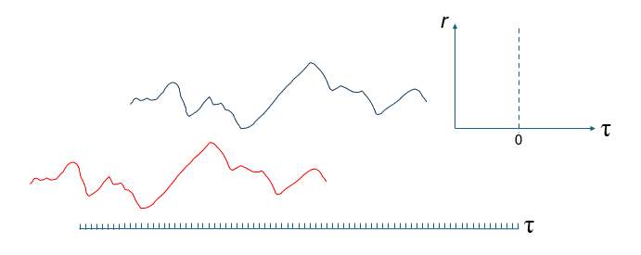
Vieliute et al. in prep.
Cross-Correlation Function
3580Å
Measure time delays using the Cross-Correlation Function (CCF)
quantifies the similarity of two time-series signals as a function of relative shifts in time
4392Å
4770Å
5468Å
6215Å
7545Å
8700Å
6/15

Slide 9
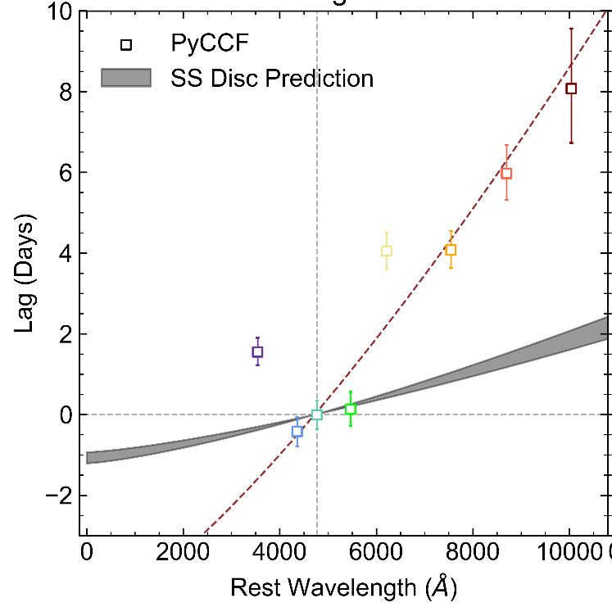
Results: Time Delay Spectrum
Vieliute et al. in prep.
A reverberation signal is detected
Lags increase with wavelength as expected from X-ray reprocessing
✓
7/15

Slide 10
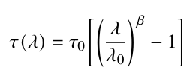
Results: Time Delay Spectrum
Vieliute et al. in prep.
A reverberation signal is detected
Lags increase with wavelength as expected from X-ray reprocessing
Slope consistent with SS disc prediction (β = 4/3)
✓
✓
7/15

Slide 11
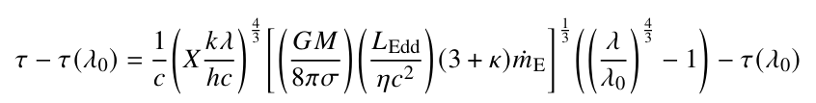
Results: Time Delay Spectrum
Vieliute et al. in prep.
A reverberation signal is detected
Lags increase with wavelength as expected from X-ray reprocessing
Slope consistent with SS disc prediction (β = 4/3)
The size of the disc >3 times greater than SS disc prediction
✓
✓
❌
7/15

Slide 12
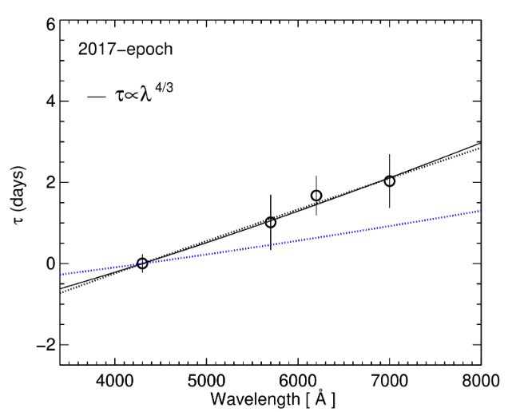
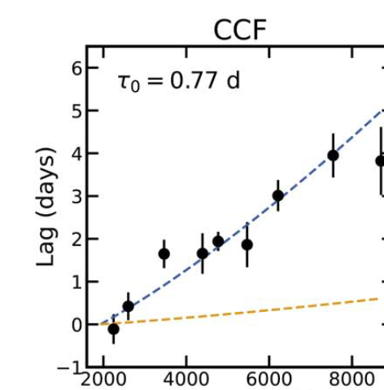
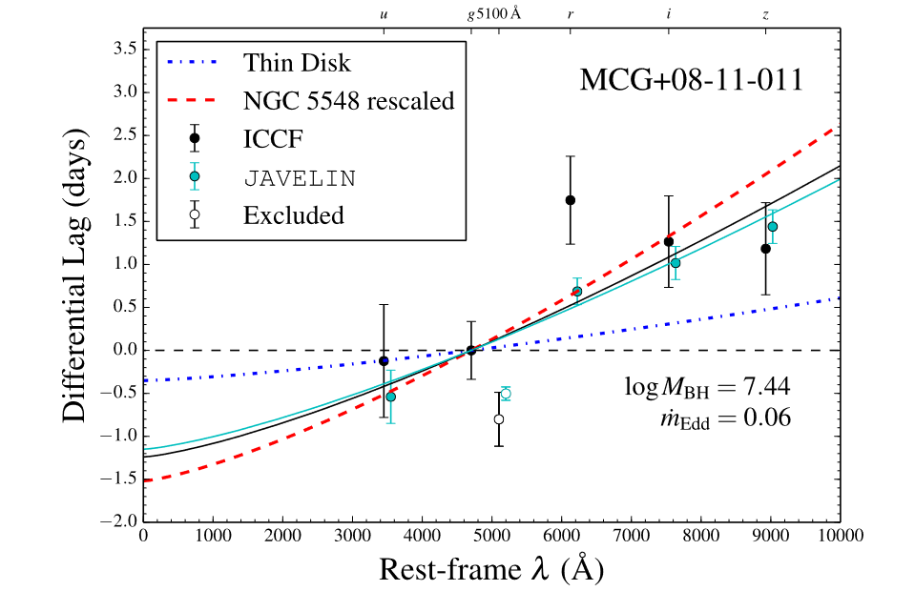
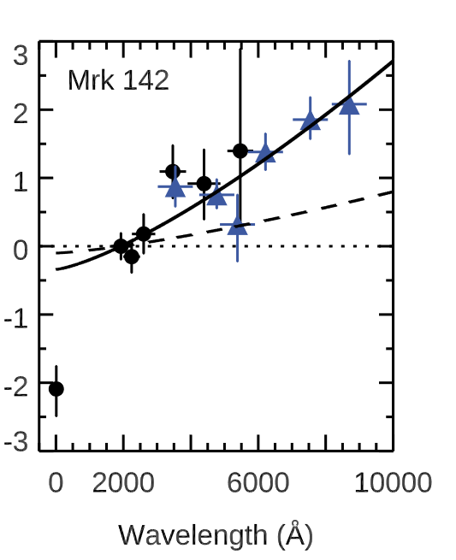
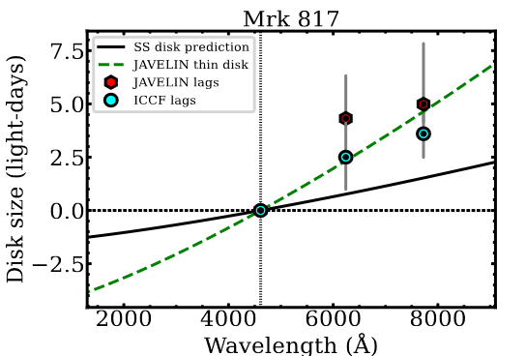
Time Delay Spectrum
Vieliute et al. in prep.
A reverberation signal is detected
Lags increase with wavelength as expected from X-ray reprocessing
Slope consistent with SS disc prediction (β = 4/3)
The size of the disc >3 times greater than SS disc prediction
✓
✓
Lewin et al. 2023
Nunez et al. 2019
Fausnaugh et al. 2016
Accretion Discs in AGN Are Too Big..?
❌
Jha et al. 2021
Cackett et al. 2020
8/15

Slide 13
Broad Line Region Diffuse Continuum Emission
𝝺
Thermal free-free and free-bound transitions in BLR clouds produce continuum emission in the same λ range as the disc
(e.g., Korista and Goad 2019)
Median radius of reprocessing region is shifted towards larger values
𝝺
Dusty Torus
Disc
Broad Line Region
Ψ
𝝺
〈τ(λ)_{disc}〉
〈τ(λ)_{disc + BLR}〉
Time Delay (r/c)
9/15

Slide 14
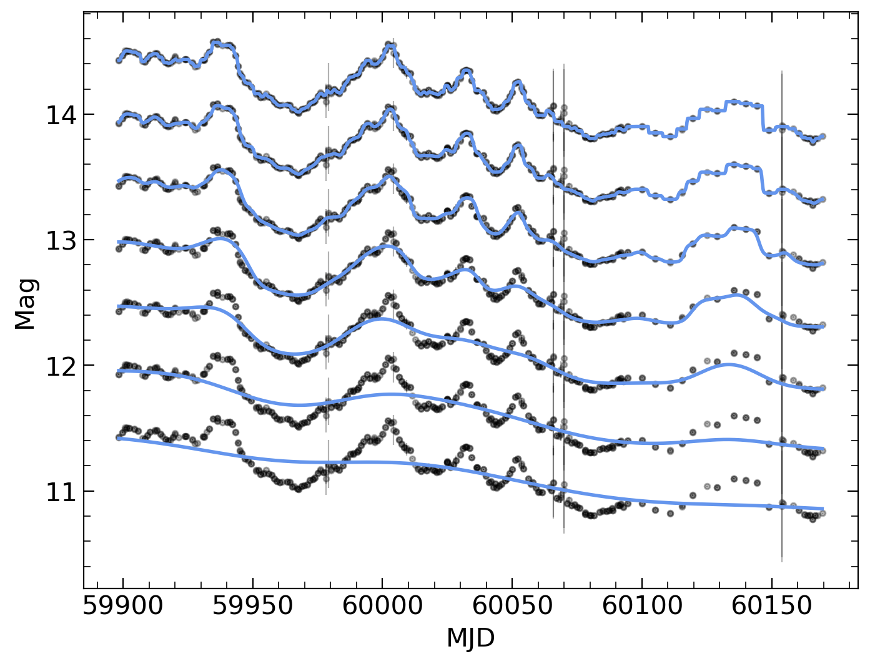
Why do we think there is DCE Contamination?
Long-timescale variations in optical lightcurves (greater response time), that show longer lags
𝝺
𝝺
Dusty Torus
Disc
Broad Line Region
10/15

Slide 15
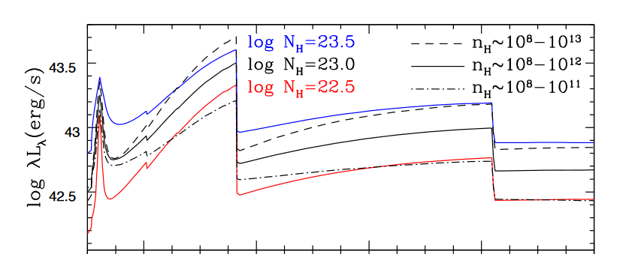

Why do we think there is DCE Contamination?
Vieliute et al. in prep.
Long-timescale variations in optical lightcurves (greater response time), that show longer lags
u-band excess in time delay spectrum
Korista & Goad 2019
11/15

Slide 16
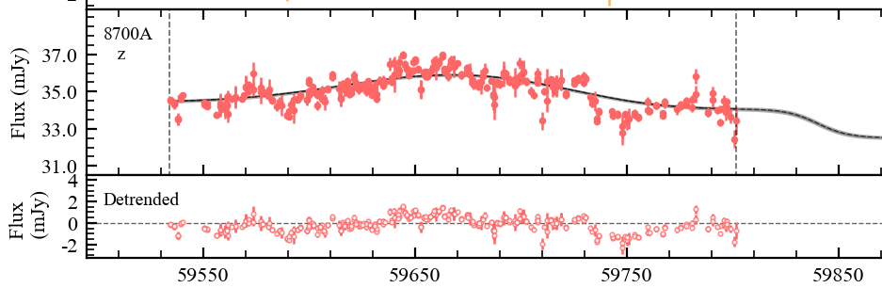
How can we isolate disc emission from the BLR?
De-trend the lightcurves (brute force)
Use alternative lag recovery software e.g., PyROA (Donnan et al. 2021)
Use Fourier-Resolved techniques
12/15

Slide 17
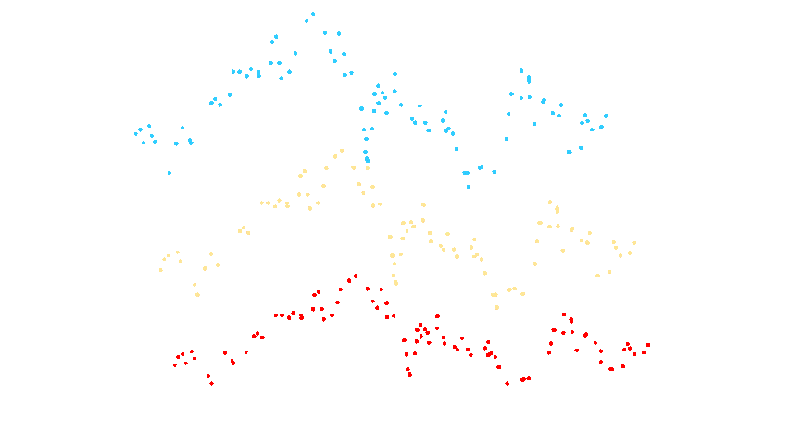

How can we isolate disc emission from the BLR?
De-trend the lightcurves (brute force)
Use alternative lag recovery software e.g., PyROA (Donnan et al. 2021)
Use Fourier-Resolved techniques
Dimensionless lightcurve model
Mean spectrum
rms spectrum
Lag spectrum
13/15

Slide 18
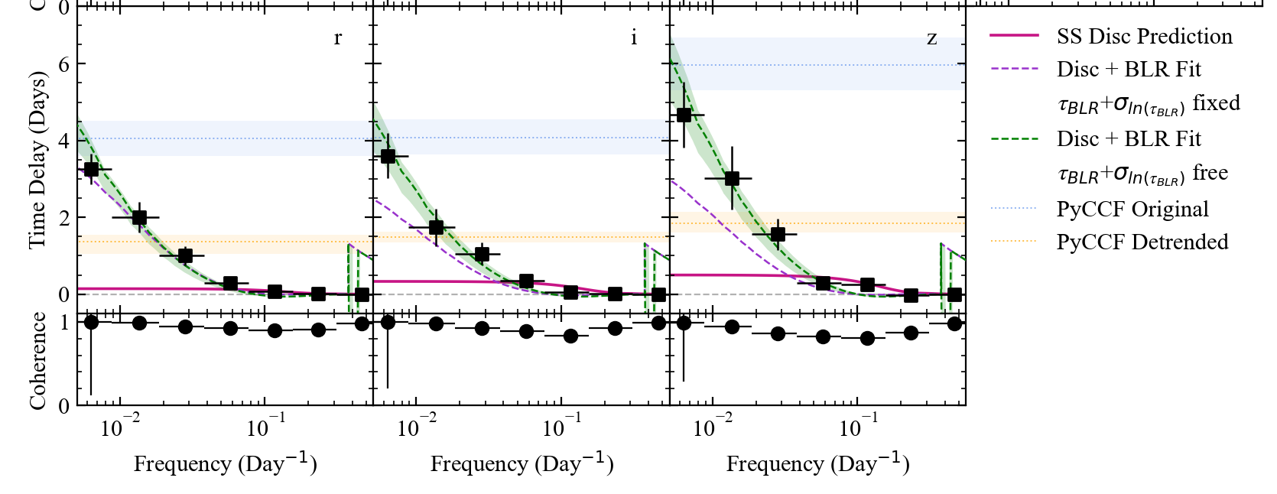
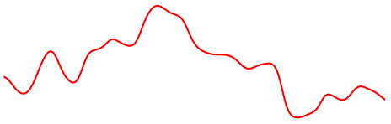
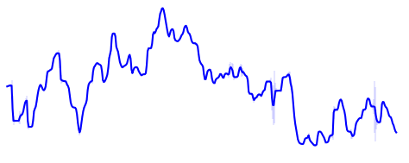
How can we isolate disc emission from the BLR?
De-trend the lightcurves (brute force)
Use alternative lag recovery software e.g., PyROA (Donnan et al. 2021)
Use Fourier-Resolved techniques
Vieliute et al. in prep.
14/15

Slide 19
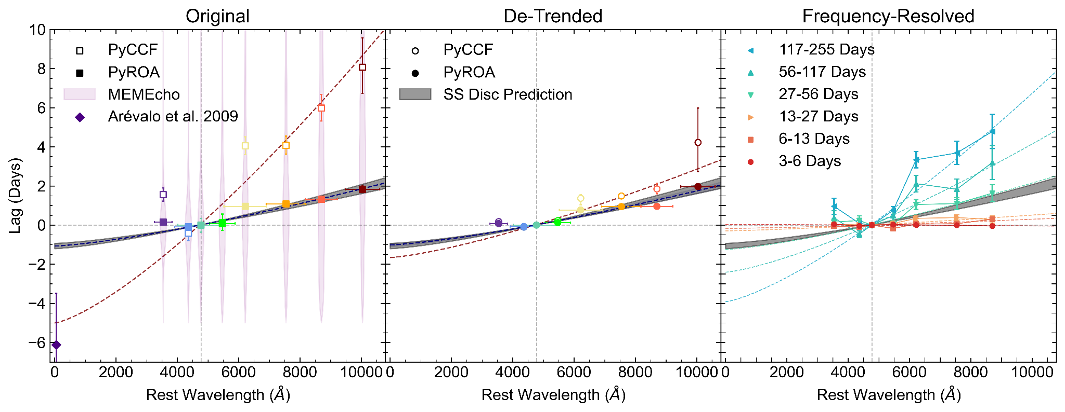
Diversity of time delays in NGC 3783
Vieliute et al. in prep.
Accretion Discs in AGN Are Too Big..?
Consider the variability timescales!
15/15

Slide 20
Summary & Key Takeaways
We can access the compact inner regions of AGN using Echo Mapping
Measure time delays between lightcurves in different photometric bands
Accretion discs of AGN across the Literature are found to be a few times greater than the standard disc prediction
Likely a consequence of DCE contamination from the BLR
It is crucial to consider variability timescales when inferring accretion disc properties from reverberation mapping
Thank You :)

Slide 21
Extra Slides

Slide 22
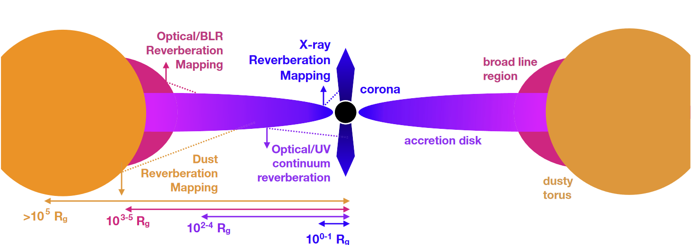
Beyond the Accretion Disc
Cackett, Bentz, and Kara 2021

Slide 23
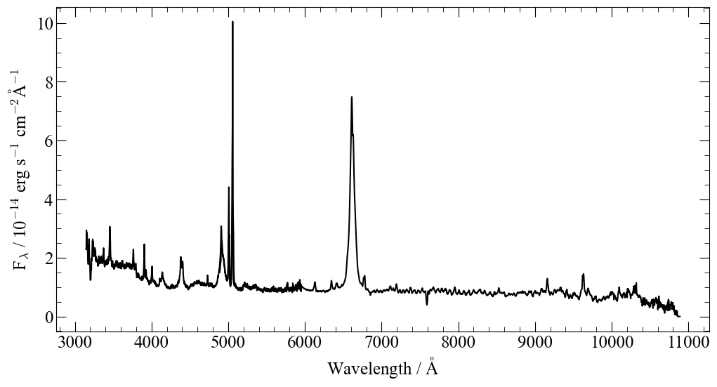
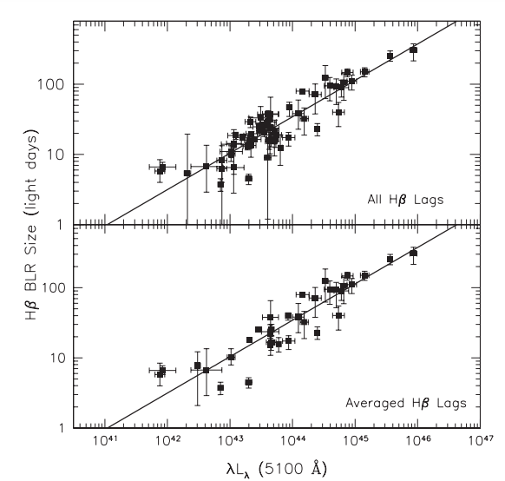

Beyond the Accretion Disc - Black Hole Masses
Lag-Luminosity Relation
Bentz et al. 2009
NGC 3783 single epoch LCO FLOYDS spectrum
Lag between continuum flux and line flux
BH Masses from single-epoch spectra!

Slide 24
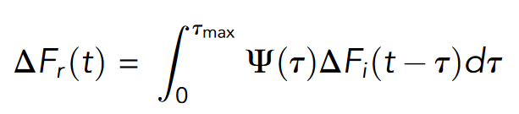
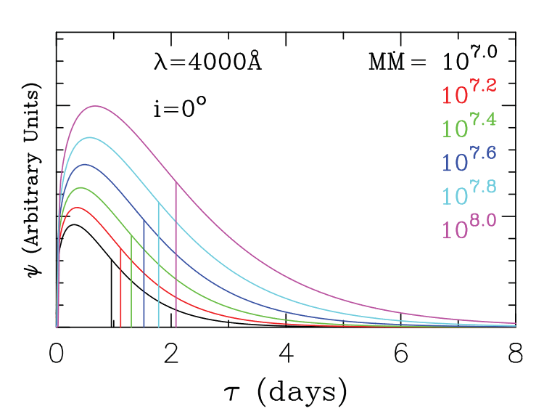
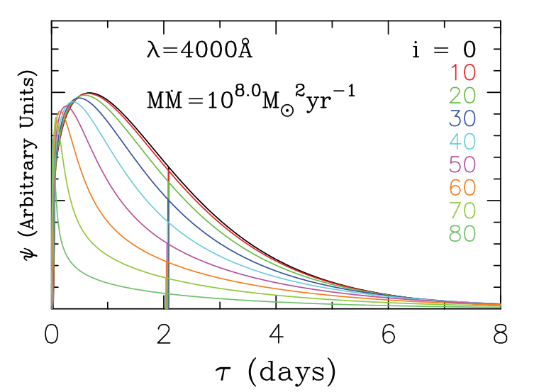
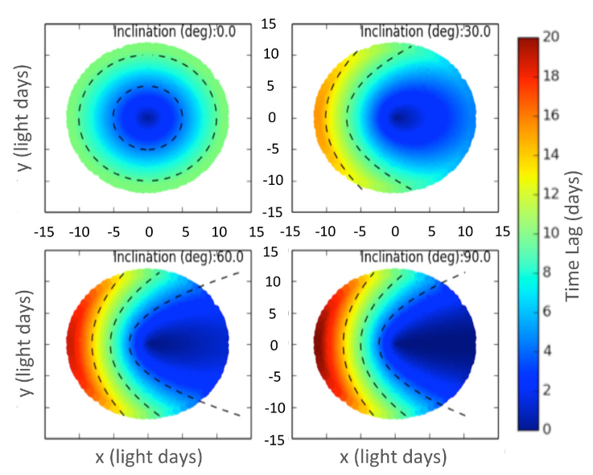
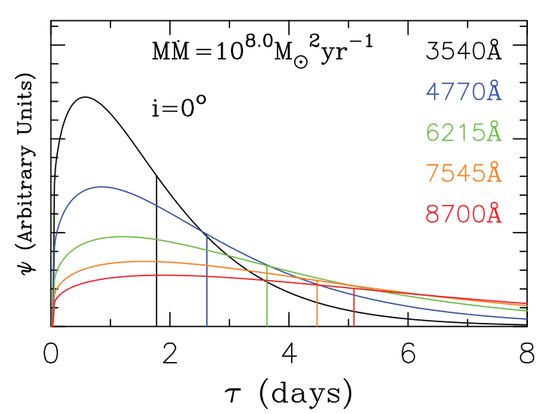
Transfer Functions
e.g Starkey, Horne, and Villforth 2016
d ≈ cΔt
Mean delay

Slide 25
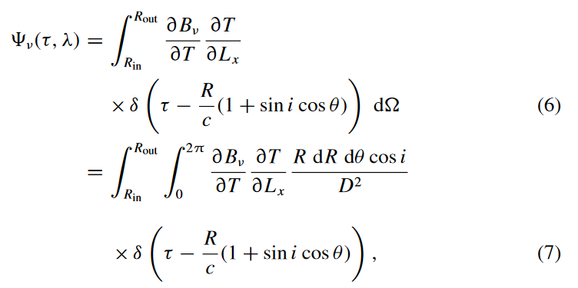
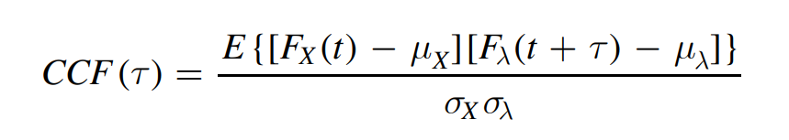
Equations
Cross-correlation function (e.g Panagiotou et al. 2022)
Accretion disc Transfer Function (Cackett et al. 2007)
SS disc + lamp-post time delay expectation (Fausnaugh et al. 2016)

