Slide 1

Quasar Tomography: Mapping the Broad Line Region
Vito Tuhtan
PhD student
Collaborators: M. Vestergaard, K.D. Horne, M. R. Goad, K. T. Korista, T. Berlok, S.I. Raimundo
Notes:
Hello everybody, my name is Vito and today I will present the work of my PhD. My phd is based in Copenhagen (DARK group) supervised by Marianne Vestergaard. This project is done as an international collaborative effort, and the collaborators are listed in the slide.
TRANSITION:
The goal of the project

Slide 2
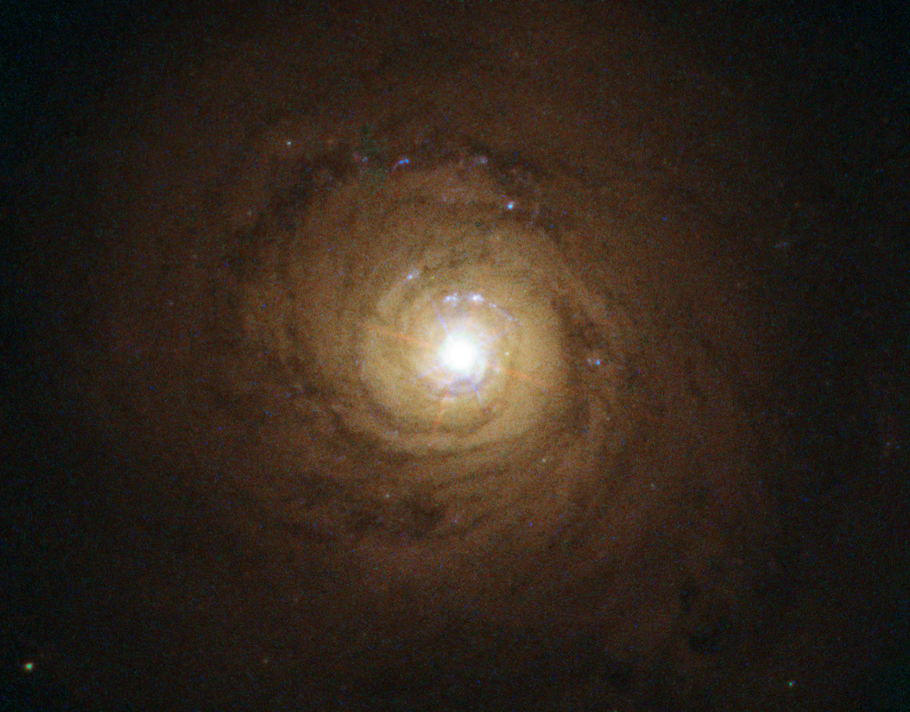
Anatomy of Active Galactic Nuclei
Image of the galaxy NGC 5548 hosting an active nucleus. Source: ESA/Hubble
Notes:
As most of you are aware of, some galaxies have a very bright center which we call the Active Galactic Nuclei. This center has never been resolved with direct imaging, but that doesn’t mean we don’t have an idea of what is going on there

Slide 3
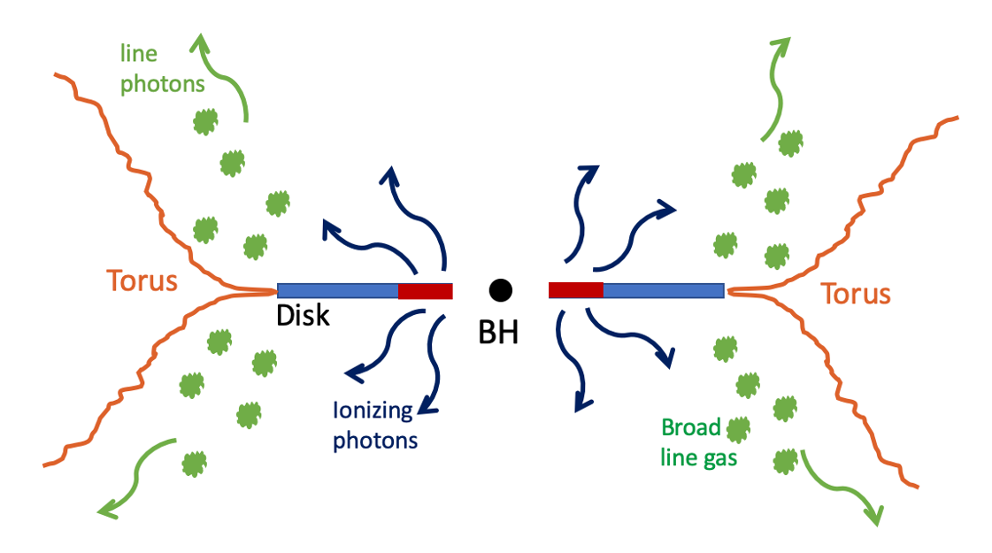
Anatomy of Active Galactic Nuclei
Image of the galaxy NGC 5548 hosting an active nucleus. Source: ESA/Hubble
AGN geometry model showing the BLR.
Source: Marianne Vestergaard
Notes:
The AGN produces ionizing radiation powered by accreting disk around a SMBH. When this radiation reaches the diffuse gas, it ionizes and subsequent recombination produces emission lines. Diffuse gas are affected by the gravity of the SMBH, which makes them travel very fast. This makes the observed emission lines broad, due to the Doppler effect. That’s why these gas clouds are collectively called the BROAD LINE REGION.

Slide 4
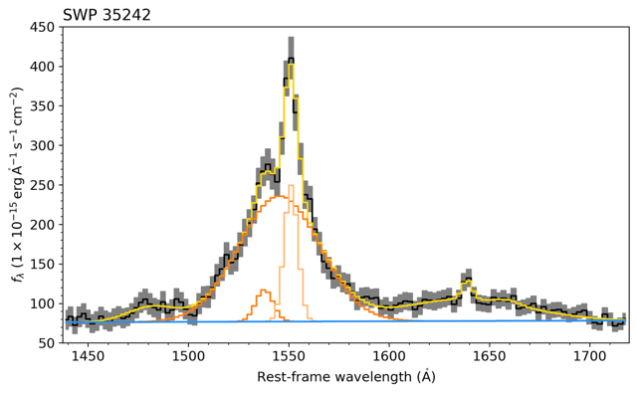
Ú
UV/Optical AGN spectra
Emission line
- BLR
Continuum
- Disk
NGC 5548 UV spectra taken with IUE space telescope (Clavel et al 1991)
Notes:
Here is the example of the UV spectra of the NGC5548 AGN collected in 1991 with the IUE space telescope. It shows the combination of the continuum (shown in blue) and emission line (in orange). Measuring the continuum strength tells you something about the disk and measuring emission line strength tells you something about the gas in the Broad Line Region.

Slide 5

Ú
UV/Optical AGN spectra
CHECK OUT THE POSTER
BY LIAM DE BÚRCA
Emission line
- BLR
Continuum
- Disk
NGC 5548 UV spectra taken with IUE space telescope (Clavel et al 1991)
Notes:
To learn more about the extraction process, please go check out the poster by Liam, who did a fantastic job in creating an automatic pipeline which identifies and extracts the emission line and continuum strengths

Slide 6
Reverberation Mapping
C IV 1550 Å
Continuum
Notes:
Once we know how to measure emission line and the continuum strength, we can measure how do they vary through time

Slide 7
Reverberation Mapping
C IV 1550 Å
Continuum
Notes:
An interesting pattern appears on the light curves:

Slide 8
Reverberation Mapping
Oscillations of the ionizing continuum are imprinted on the emission line oscillations:
Emission line light curves are smeared and time-shifted (echoed) continuum
→ it takes time for ionizing radiation to reach the BLR due to light travel time
→ time lags encode the spatial distribution of the BLR
C IV 1550 Å
Continuum
Notes:
Emission line light curves are smeared and time-shifted (echoed) continuum.
This is because it takes time for the radiation from the disk to reach the BLR.
The time lag in the oscillations encodes the geometry of the BLR.
The goal of Reverberation mapping is to infer the geometry and the physical state of the BLR.

Slide 9

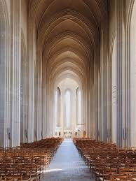

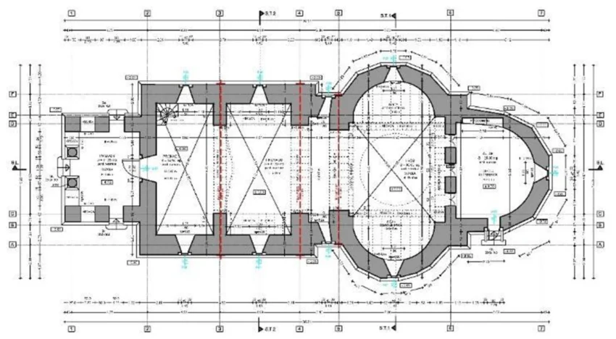

Reverberation Mapping – analogy
Oscillations of the ionizing continuum are imprinted on the emission line oscillations:
Emission line light curves are smeared and time-shifted (echoed) continuum
→ it takes time for ionizing radiation to reach the BLR due to light travel time
→ time lags encode the spatial distribution of the BLR
BLR
spatial
distribution
emission
lines
continuum
UV/Optical
spectrometer
Notes:
The way I think about reverberation mapping method is through an analogy. Imagine you are standing in front of the church, and through the open door you hear the choir sing. The sound you hear will be a combination of the choir, but also you hear the echo (reverb) coming from the walls of the church.
Reverberation mapping is like trying to figure out the blueprint of the church based on the echo of of the choir. In this context, the choir is the continuum and the BLR is church walls.
Reality is more complicated than the analogy I just mentioned. The BLR does not just reflect the light like a mirror: it absorbs radiation and reprocesses it into emission lines. That’s why it is important to consider photoionization processes to accurately model the BLR.

Slide 10
Photoionization model
Density
n_{H}
BLR - spatially extended population of clouds with a range of densities.
Gas cloud properties:
11
Notes:
We model the BLR as a spatially extended population with a range of densities

Slide 11
Photoionization model
Density
n_{H}
ionizing
radiation
accretion
BLR - spatially extended population of clouds with a range of densities.
Each cloud reacts to the ionizing radiation and reprocesses it into emission lines.
Gas cloud properties:
12
Notes:
Each cloud reacts to the ionizing radiation and reprocess it into emission lines

Slide 12
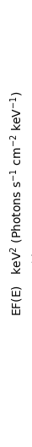
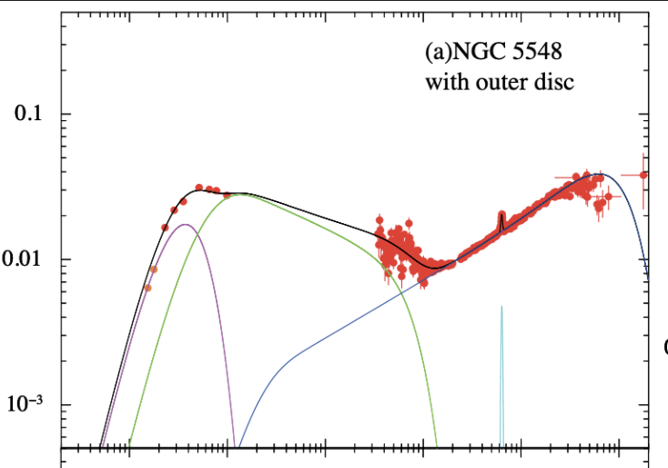

Photoionization model
accretion
BLR - spatially extended population of clouds with a range of densities.
Each cloud reacts to the ionizing radiation and reprocesses it into emission lines.
Source: Kubota & Done 2018
Gas cloud properties:
13
Notes:
As I mentioned before, this ionizing radiation comes from the accreting black hole. If you want to know more about the characteristics of the AGN ionizing continuum…

Slide 13
Photoionization model
accretion
BLR - spatially extended population of clouds with a range of densities.
Each cloud reacts to the ionizing radiation and reprocesses it into emission lines.
Source: Kubota & Done 2018
SEE SCOTT HAGEN’S
TALK TOMORROW!!
Gas cloud properties:
14
Notes:
… check out the talk by Scott Hagen tomorrow.

Slide 14
Photoionization model
Density
n_{H}
ionizing
radiation
accretion
BLR - spatially extended population of clouds with a range of densities.
Each cloud reacts to the ionizing radiation and reprocesses it into emission lines.
Cloud response to the ionizing radiation is evaluated using CLOUDY photoionization code:
Gas cloud properties:
15
Notes:
Cloud response to the ionizing radiation is evaluated using CLOUDY photoionization code for a grid of parameters

Slide 15
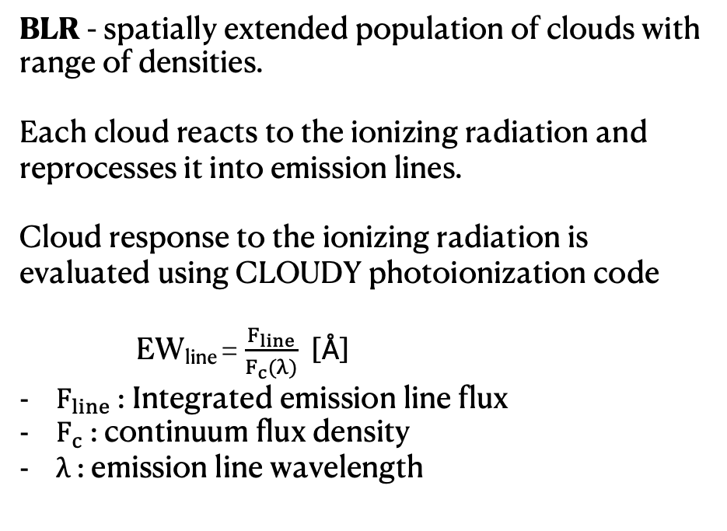
Photoionization model
Density
n_{H}
ionizing
radiation
accretion
BLR - spatially extended population of clouds with range of densities.
Each cloud reacts to the ionizing radiation and reprocesses it into emission lines.
Cloud response to the ionizing radiation is evaluated using CLOUDY photoionization code
EW_{line} = $\frac{F_{line}}{F_{c}(λ)}$ [Å]
$F_{line}$: Integrated emission line flux
$F_{c}$: continuum flux density
$λ$ : emission line wavelength
Gas cloud properties:
16
Notes:
Here is the example of the grid which shows the reprocessing efficiency of the continuum into the H Beta line.
Each of the points in this figure represents a cloud of certain parameters
The grid of parameters is density and incident photon flux, while the height of this plot shows the EW, which is a measure of reprocessing efficiency.
Incident photon flux can be thought of as the distance of the cloud to the source – the closer the cloud is to the source, the more photons are hitting the face of the cloud

Slide 16
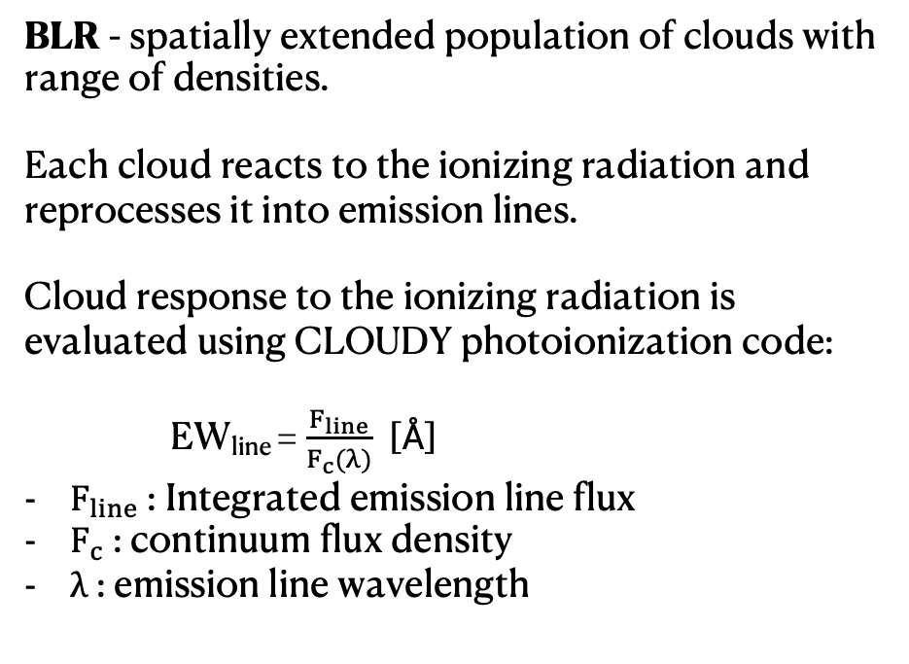
Photoionization model
BLR - spatially extended population of clouds with range of densities.
Each cloud reacts to the ionizing radiation and reprocesses it into emission lines.
Cloud response to the ionizing radiation is evaluated using CLOUDY photoionization code:
EW_{line} = $\frac{F_{line}}{F_{c}(λ)}$ [Å]
$F_{line}$: Integrated emission line flux
$F_{c}$: continuum flux density
$λ$ : emission line wavelength
Gas cloud properties:
17
Notes:
These grids are then created for for all the measured emission line light curves.
The goal is to use the clouds from the grids and find a spatial configuration which produces the observed light curves.

Slide 17
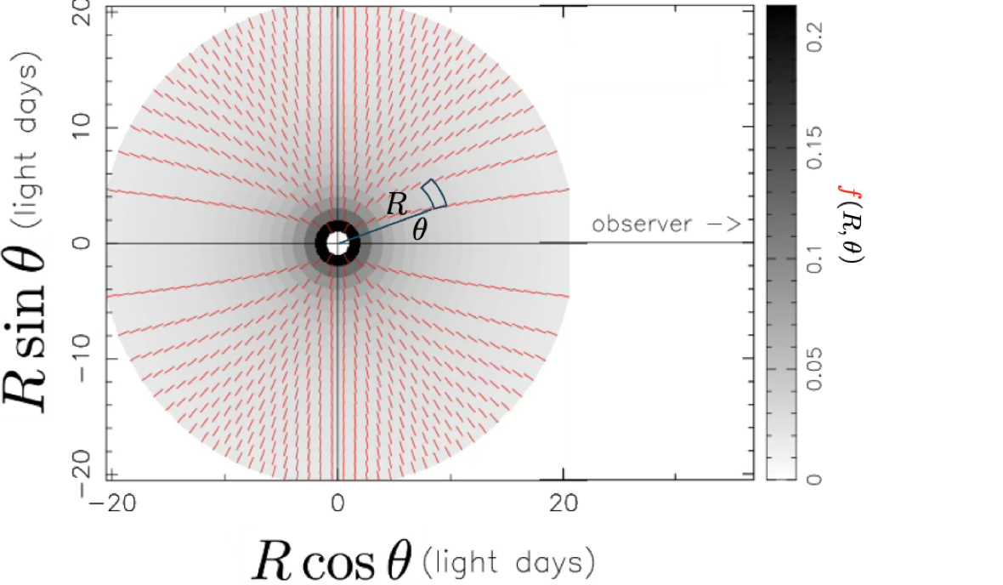
Geometrical model
Distribute clouds in space
Notes:
The recipe on how this can be done goes as follows:
1. Distribute clouds in space using 2D spherical coordinate system

Slide 18
Geometrical model
Distribute clouds in space
Evaluate cloud response to
the continuum time variations
Notes:
2. Evaluate the cloud response to the continuum variations based on CLOUDY grids

Slide 19
Geometrical (inverse) model
Distribute clouds in space
Iterate until minimum χ²/N and regularization are achieved
Evaluate cloud response to
the continuum time variations
Compare with observed light curves
Notes:
3. Compare with observed light curves
4. Iterate until minimum chi2 and regularization are achieved
The regularization is achieved by using the Maximum Entropy Method, and please ask me about it if you are interested in inverse modeling.

Slide 20
Geometry of the BLR
Recovered geometrical distribution of clouds in the BLR of NGC 5548 AGN.
Fits to the NGC 5548 light curves taken with IUE space telescope (Clavel et al 1991)
Notes:
On the right you can see the recovered geometry, and on the left you see how do the modeled emission line light curves compare to the data

Slide 21
Geometry of the BLR
Recovered geometrical distribution of clouds in the BLR of NGC 5548 AGN.
Spatial distribution is filled sphere (~ 3 lt-days),
Thick disk (~ 6 lt-days),
and an extended ring (~ 20 lt-days)
Fits to the NGC 5548 light curves taken with IUE space telescope (Clavel et al 1991)
Notes:
Here is another representation of the BLR, where I show the geometry from two sides: the perspective from the observer, and a view from the side.
Spatial distribution of the clouds is a combination of the filled sphere, thick disk and an extended ring.

Slide 22
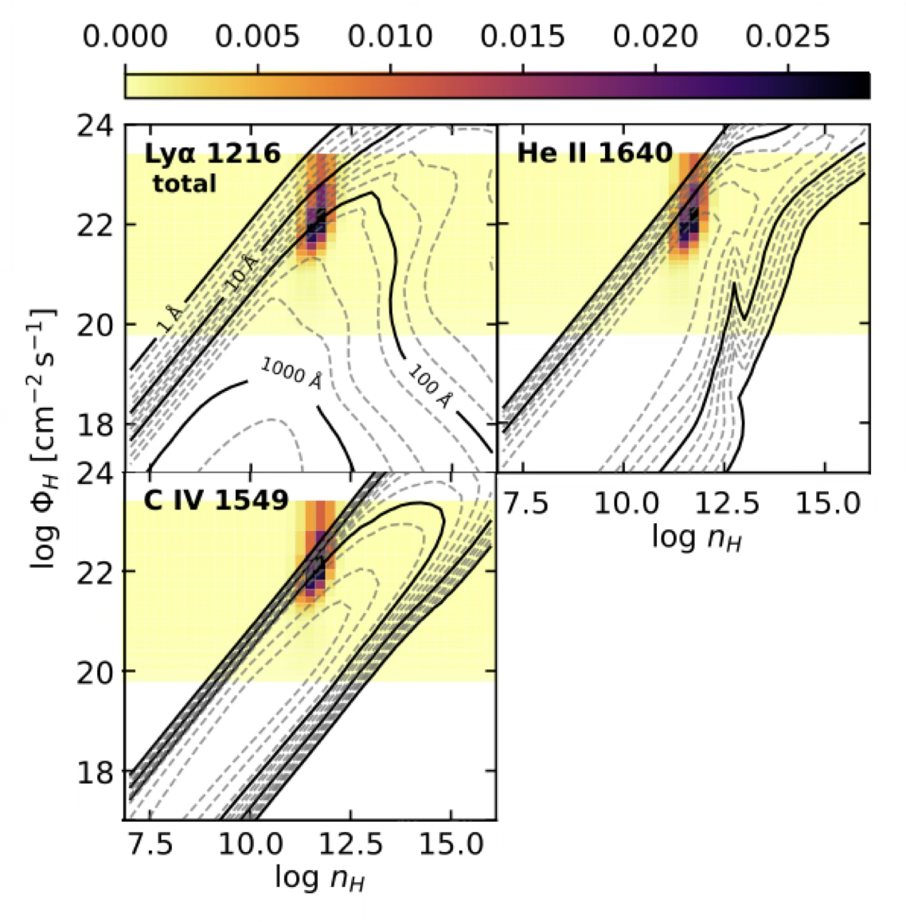

Physical state of the BLR
Recovered densities and incident photon flux of the NGC5548 BLR. The recovered density is:
~ 11
Notes:
A surprising result is that out of the whole considered range of densities, the recovered solution favors densities of 10^11 per cubic centimeter. I believe this is because on average, this is the density where the gas is mostly efficient in reprocessing continuum for the considered emission lines.

Slide 23
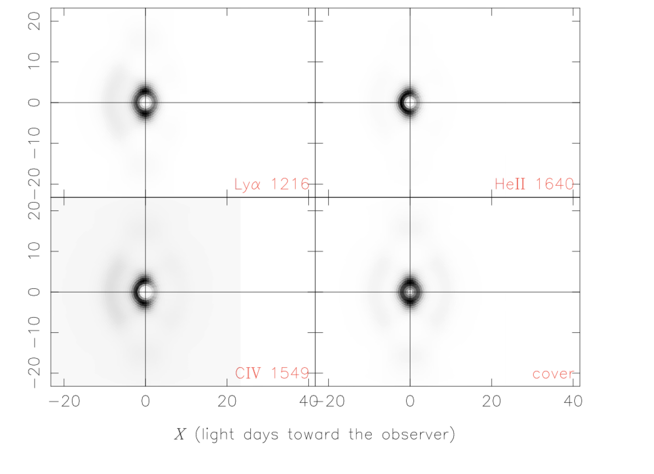
Physical state of the BLR
Ly⍺ 1216
He II 1640
Recovered densities and incident photon flux of the NGC5548 BLR. The recovered density is:
~ 11
C IV 1549
geometry
Top row and left panel: parts of the BLR responsible for production of emission line indicated by the legend Bottom right: Spatial distribution of BLR clouds
Notes:
Another cool thing that we can do is pinpoint where exactly does the emission from of each line comes from and this is shown on the plot on the left. Most of the observed emission comes from the clouds that are “reflecting” back towards the source. This is because the clouds that are facing the observer are more optically thick , so they re-absorb the emissionn

Slide 24
Conclusions and outlook
Emission line echo (reverberate) the ionizing continuum, based on the geometry of the Broad Line Region
Coupling photoionization models to reverberation mapping allows for determining the geometry of the BLR
Recovered geometry of NGC 5548 BLR is a filled sphere (~ 3 lt-days), thick disk (~ 6 lt-days), and an extended ring (~ 20 lt-days) The density of the BLR clouds is
Limitations and future work:
Currently we are only constraining the 2D geometry. Constraining 3D geometry would require using the velocity information of the measured emission lines
~ 11
Notes:
In the end I would like recap this talk and say that it is possible to infer geometry of the BLR using the photoionization models.
The biggest limitation of this method is that we are currently only able to resolve the 2D. Resolving the full 3D geometry requires would require adding the velocity information which would take into account the changes in line profile.
Thank you all for your attention, and please ask questions. If not now then around coffee or drinks ☺

Slide 25
EXTRA:
Combined optical and UV emission lines

