Slide 1

Understanding Jet Formation through Changing-Look Phenomena with VLBI
Gregory Walsh
DARK, Niels Bohr Institute, University of Copenhagen
Collaborators: Marianne Vestergaard, Sandra Raimundo, Daniel Lawther
Nordic-Baltic Astronomy Days 2026
Notes:
Check out Marianne’s poster on Mrk 590

Slide 2
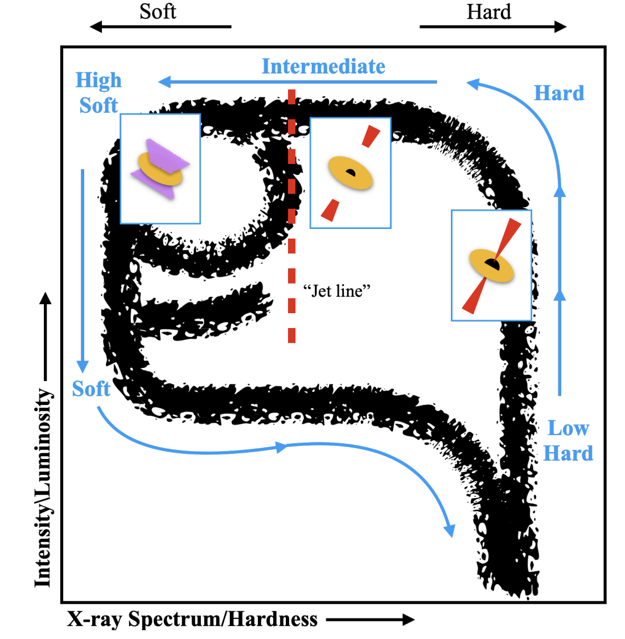
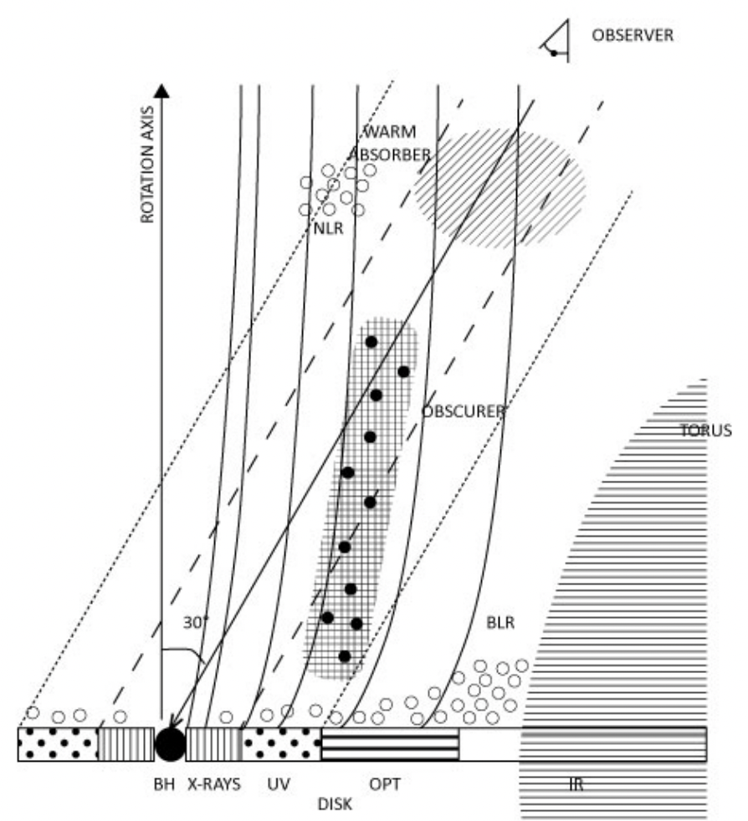
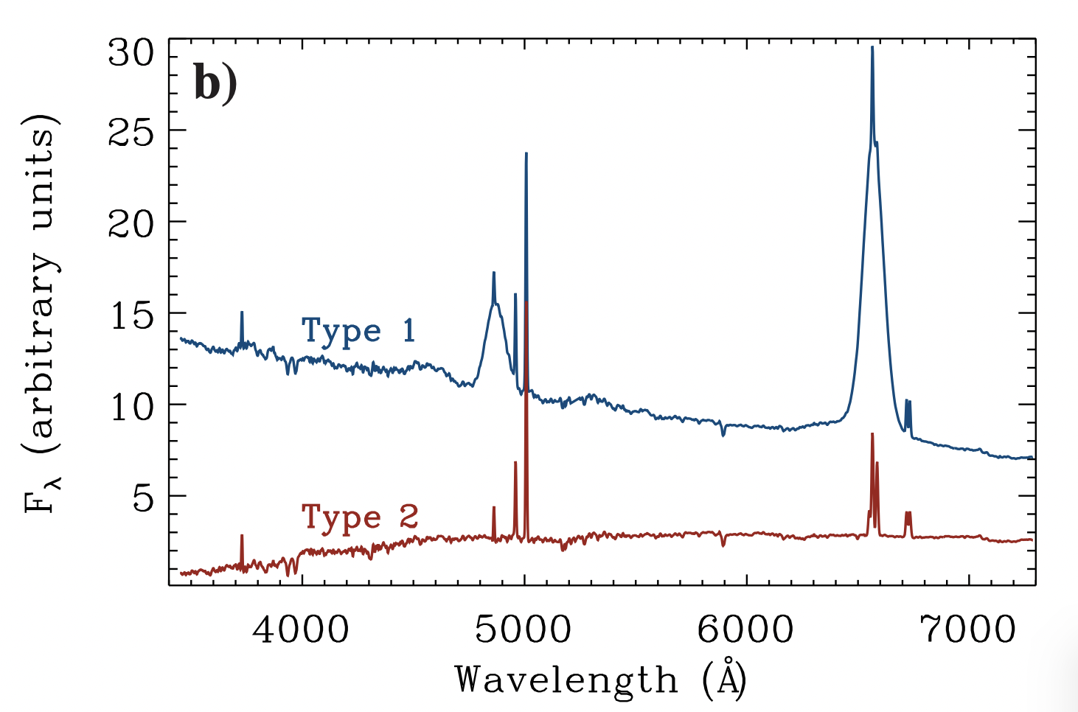
Variability in Accreting BH Systems
XRBs are ideal
laboratories to study
accretion physics
Large-area, multi-epoch surveys are serendipitously discovering AGN that show rapid, dramatic variability
Changing-obscuration (CO-AGN) and changing-state (CS-AGN)
Ricci and Trakhtenbrot+ (2023)
Moravec+ (2022)
Kaastra+ (2014)
Nordic-Baltic Astronomy Days 2026
1
Notes:
Variability over years. Not expected when scaling XRB timescales (should be over 10^6 years)
Rapid, dramatic variability on years-long timescales, even shorter
Talking about changing-state

Slide 3
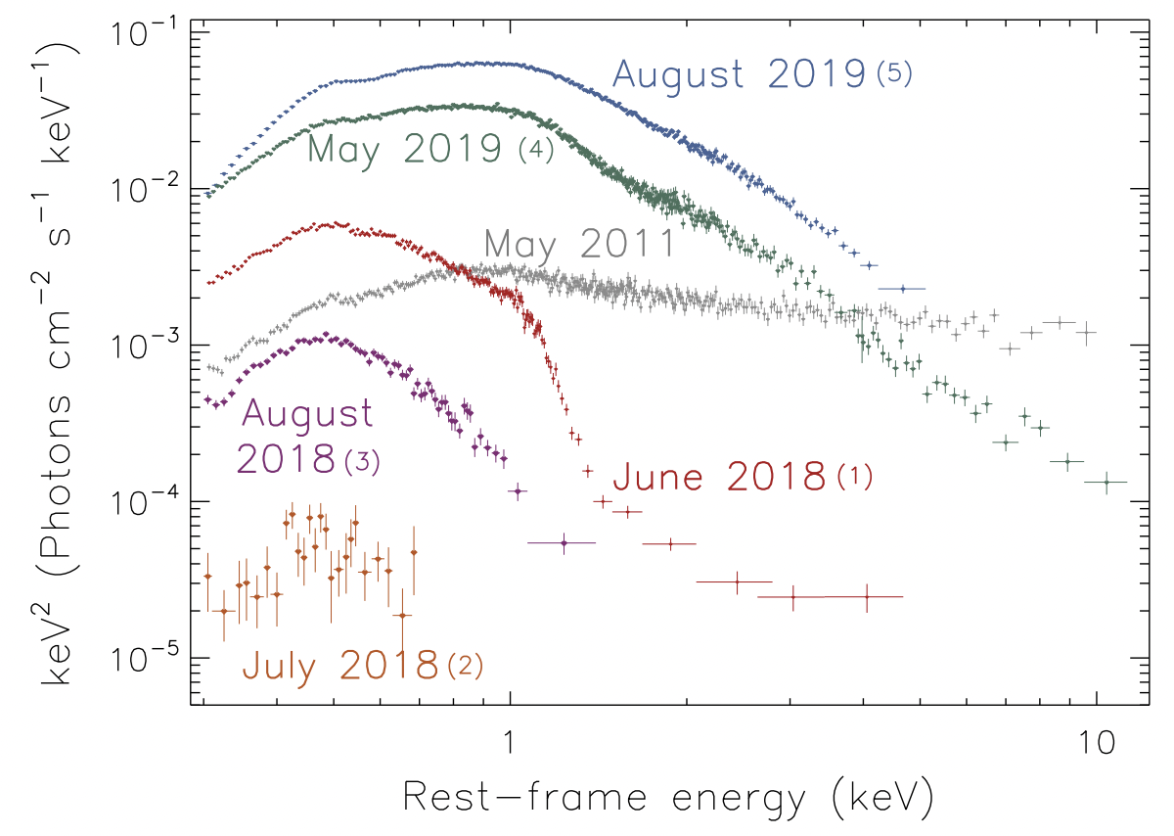
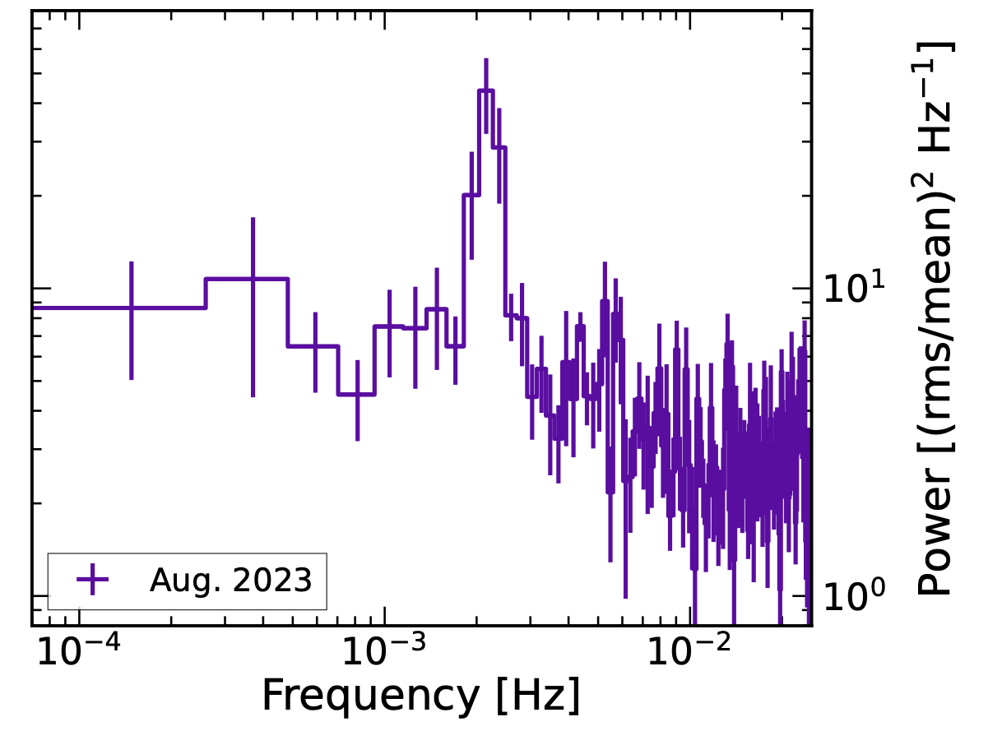
1ES 1927+654: Variable X-ray Corona
1ES 1927+654 lost and reformed its X-ray corona
  Correlated variability in optical, UV bands
Strong evidence for a QPO at late times
  CL event from a TDE in a pre-existing AGN disk?
Masterson+ (2025)
Ricci+ (2021)
Nordic-Baltic Astronomy Days 2026
2
Notes:
Over the course of a year, 1ES 1927 seems to have destroyed and reformed its X-ray corona
Late times, X-ray spectral timing shows an evolving QPO signature
CL event possibly driven by a TDE in a pre-existing AGN disk – mouthful and thus should be rare

Slide 4
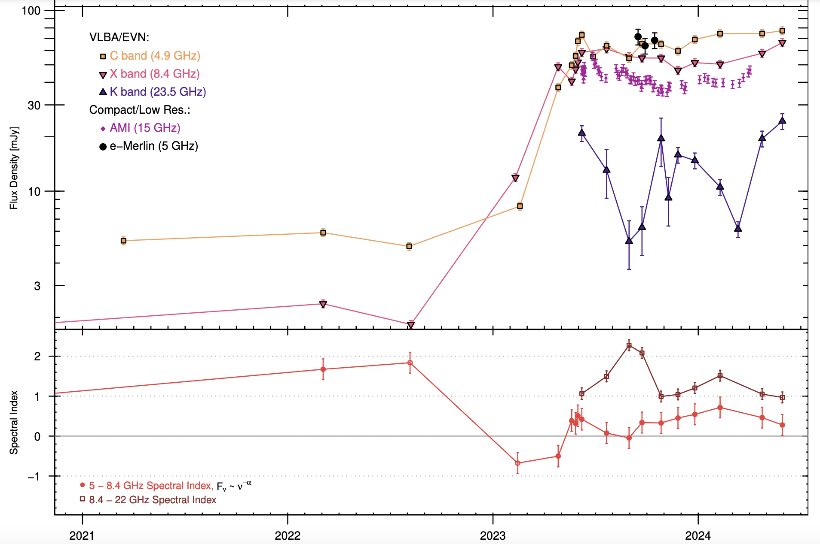
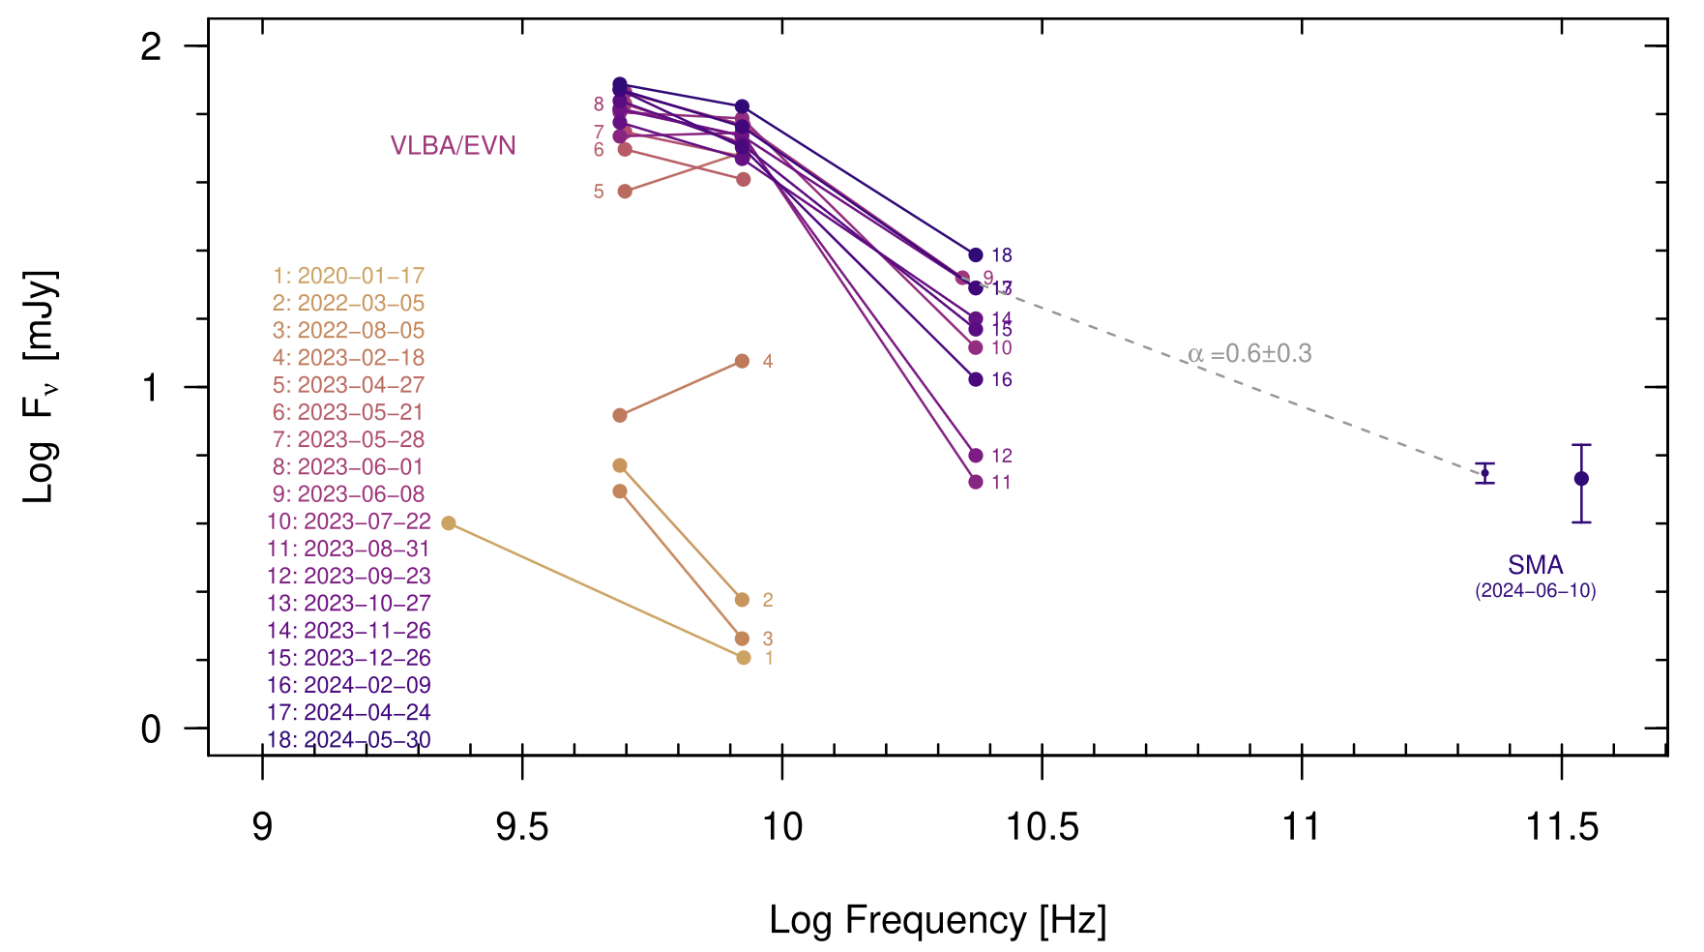
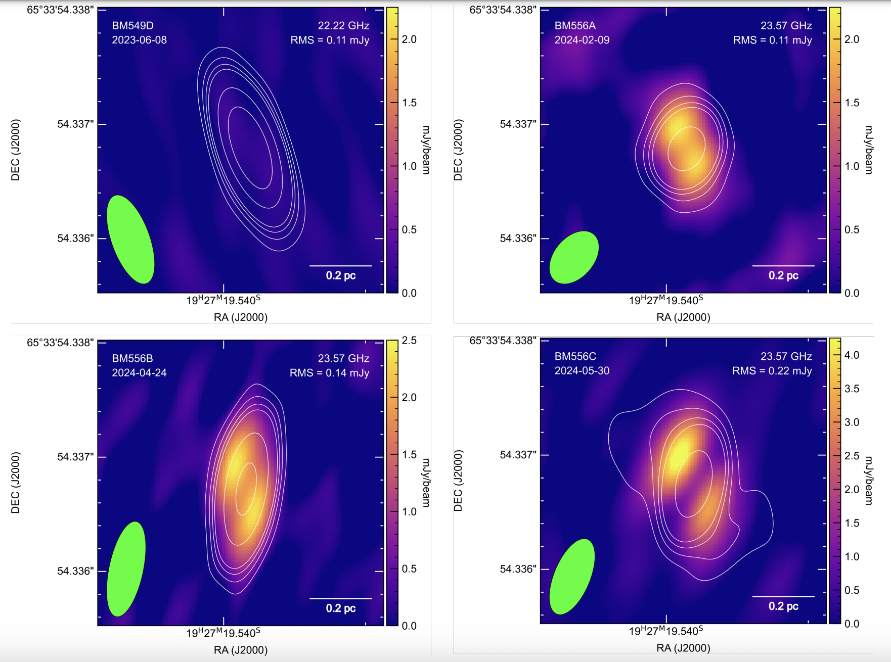
1ES 1927+654: Emerging Jet?
VLBA monitoring: significant, late-time brightening of the radio core
Correlated jet launching?
Suggests a dynamic magnetic field (topology and/or amplitude) close to the SMBH
Meyer+ (2025)
Nordic-Baltic Astronomy Days 2026
3
Notes:
Behavior of 1ES is analogous to the GPSs – hypothesized to be young radio AGN
Lacking coordinated MWB observations, which are needed to robustly assert that the radio variability is associated with any single CL event
Some(!) CLAGN show correlated variability across the EM from radio to X-ray wavebands. What about others? Is 1ES the archetype?

Slide 5
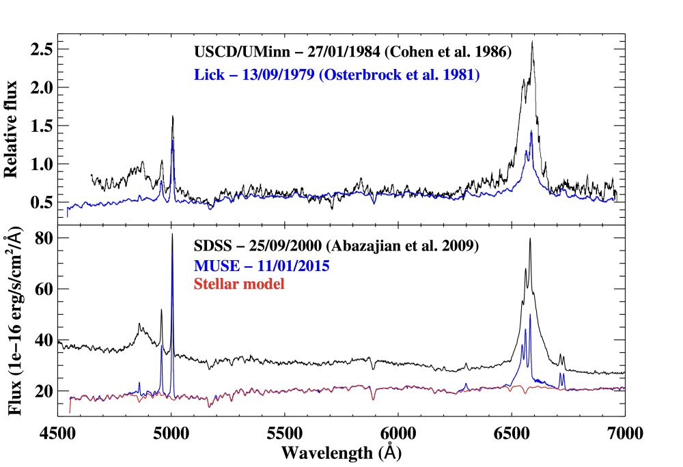
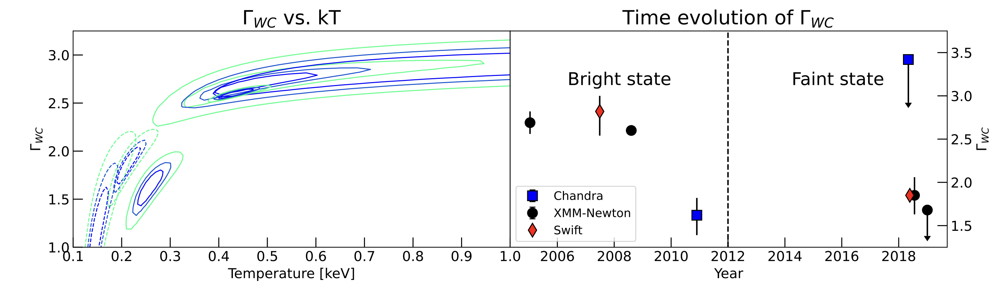
Mrk 1018: Optical/UV/X-ray Variability
Transitioned from Type 1.9 to Type 1 to Type 2 over ~30 years
Warm comptonization component cooled during Type 2 transition
  ... dynamic magnetic fields?
Veronese+ (2024)
McElroy+ (2016)
Nordic-Baltic Astronomy Days 2026
4
Notes:
Know this is not due to obscuration due to Balmer decrement
Second point is interpreted as a weakening of the magnetic field… should have direct consequences in the characteristics of the radio source, if there is one.

Slide 6
Mrk 1018: Correlated Radio Variability?
Compact, low luminosity (~10³⁸ erg/s) radio source (Walsh+ 2023; 2024)
Low significance proper motion (4.2𝜎)
Highly variable radio spectrum
Coincides with Mrk 1018’s transition back to Sy2 – CLAGN mechanism?
Walsh+ (2023)
Nordic-Baltic Astronomy Days 2026
5
Notes:
We were initially interested in Mrk 1018 as a recoiling SMBH candidate
Proper motion and variable spectrum fit into models invoking dynamic magnetic fields: flat spectrum core ejecting components as the magnetic field strength and/or topology changes

Slide 7
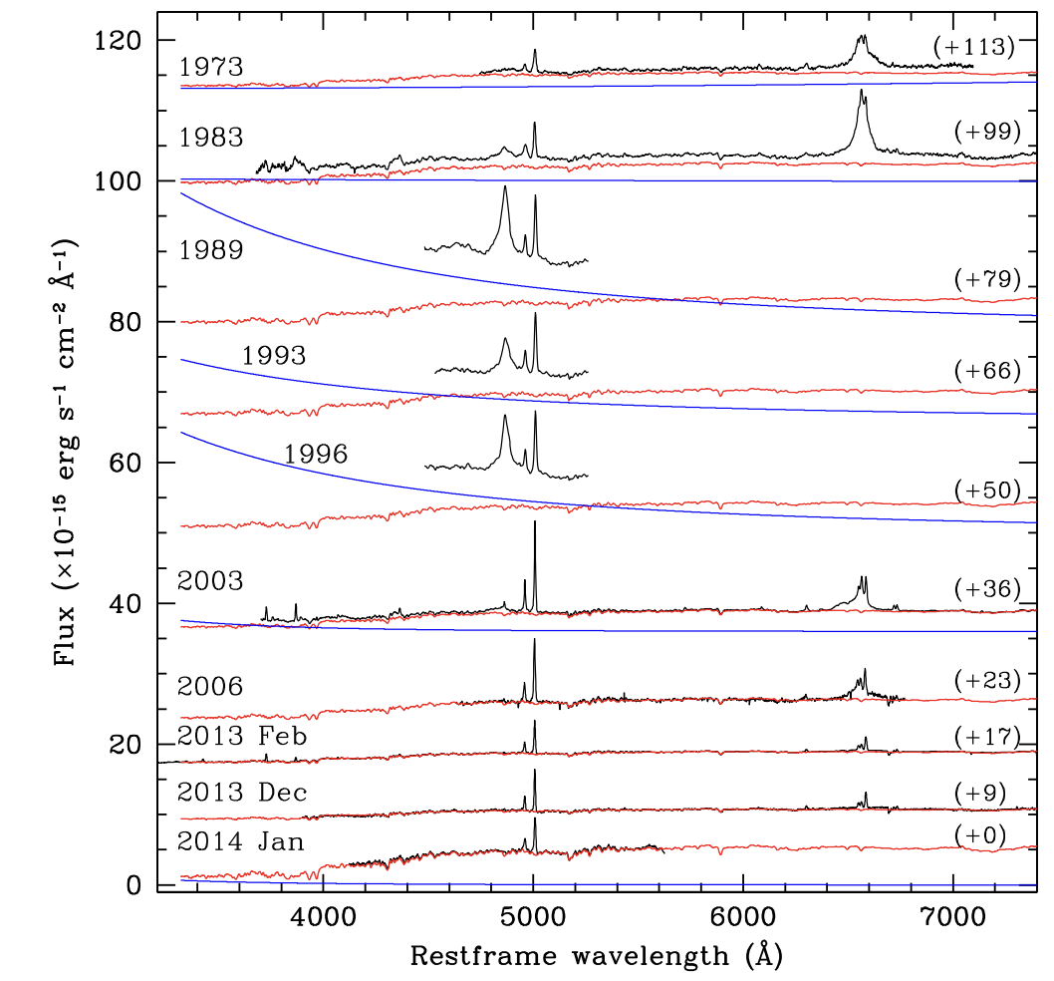
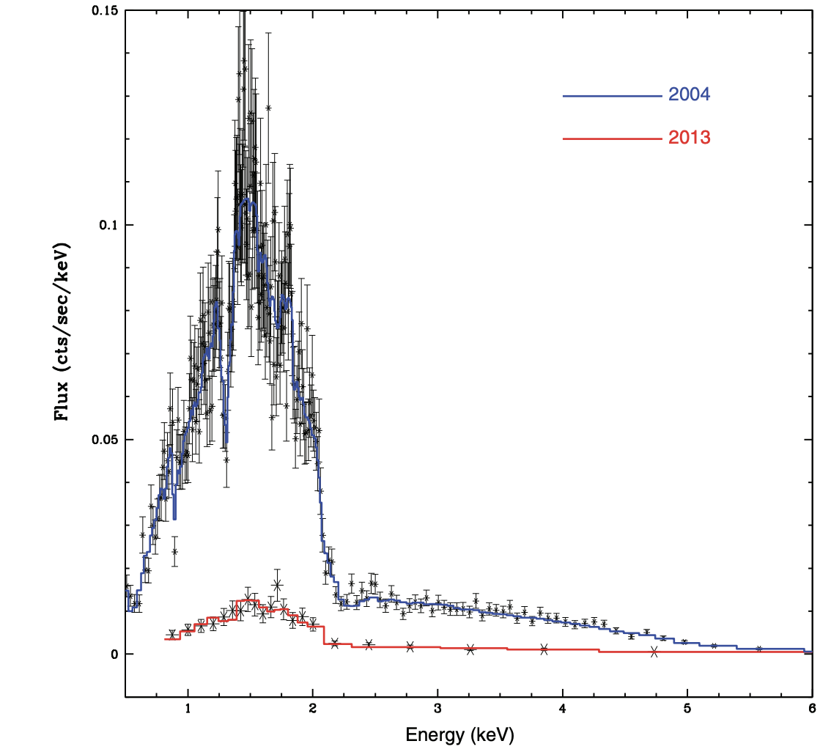
Mrk 590: A Dying AGN
Mrk 590 was a “classical” Sy1 before the mid-1990’s
Mid-90’s to 2014: broad lines disappeared, optical continuum decreased by over a factor of 100
Soft X-ray excess weakens dramatically
Denney+ (2014)
Nordic-Baltic Astronomy Days 2026
6
Notes:
X-ray spectral fitting determined no obscuration along the LOS during the fading period – CL event is accretion-driven

Slide 8
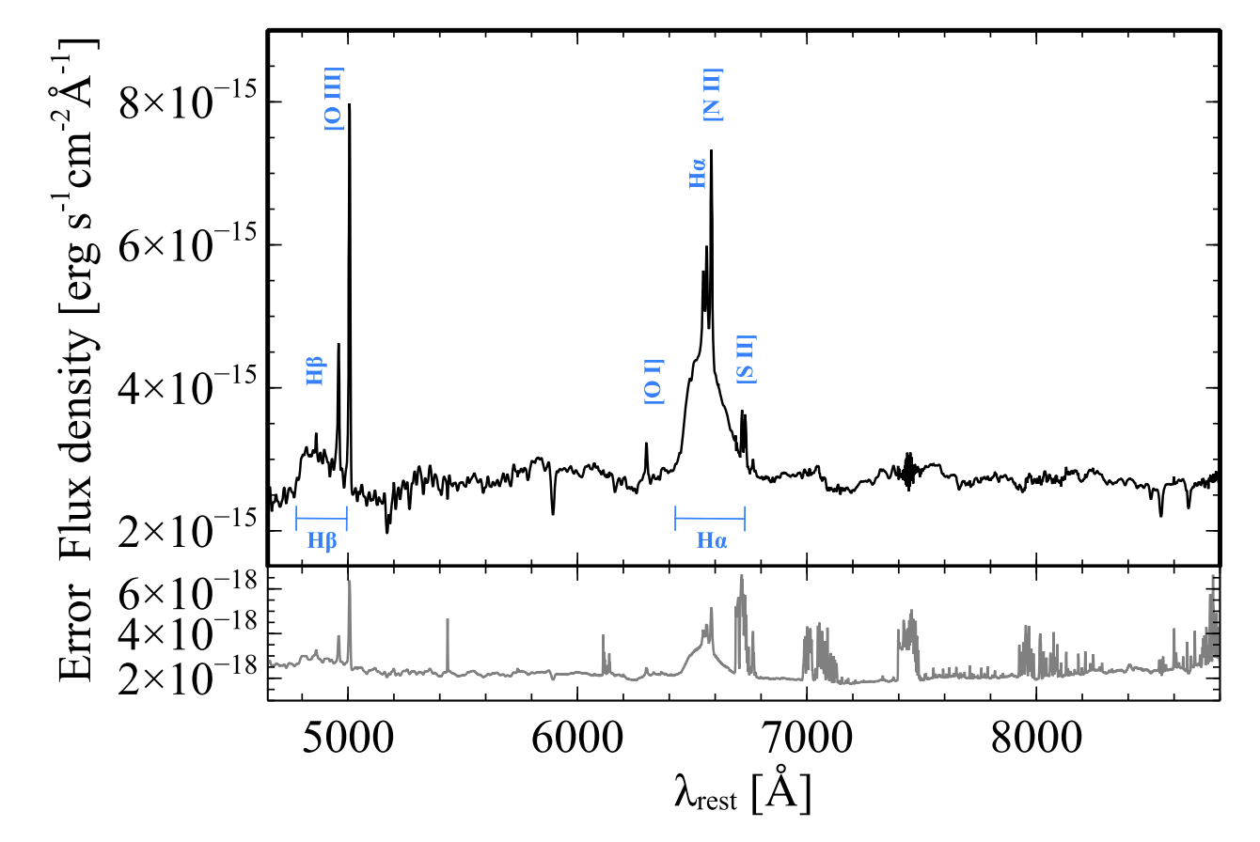
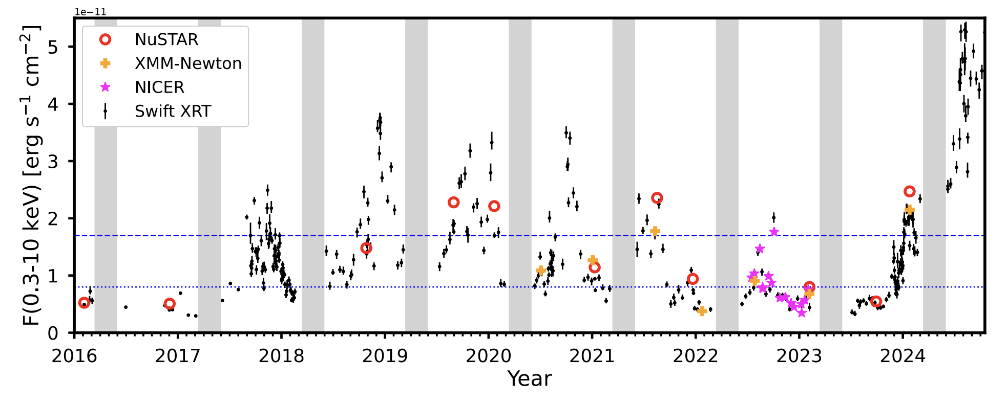
Mrk 590: Re-brightening and Flaring
By 2017 broad lines started returning
Continuum not close to original Sy1 level
Repeated X-ray flaring
Raimundo+ (2019)
Lawther+ (2025)
Nordic-Baltic Astronomy Days 2026
7
Notes:
X-ray variability not QPO when we look at the power spectrum

Slide 9
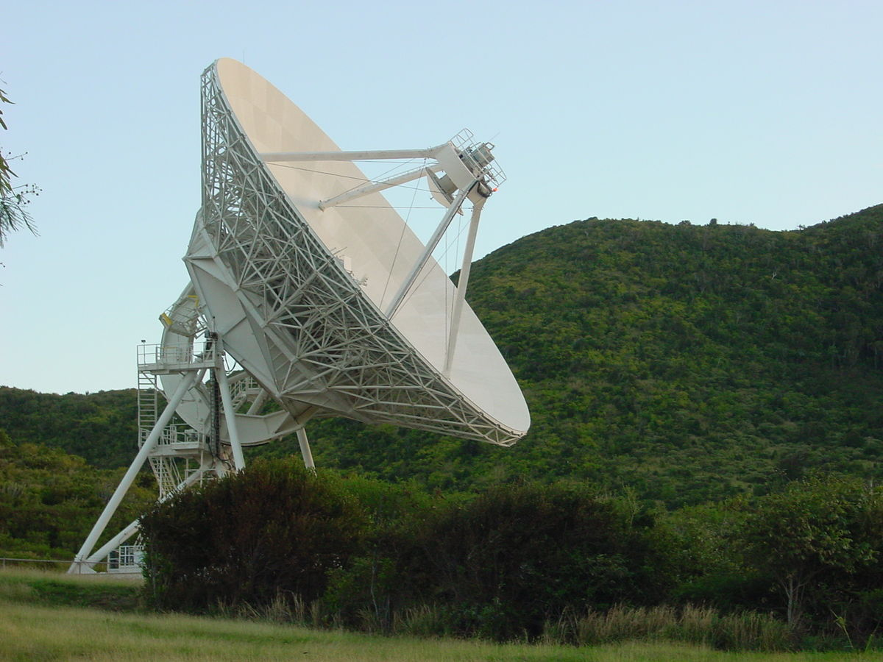
Mrk 590: 10-year VLBA Lightcurve
Extensively monitoring Mrk 590 with the VLBA for the past 8 years at L-band (1.6 GHz), C-band (5 GHz), X-band (8.4 GHz), Ku-band (15 GHz), and most recently K-band (22 GHz)
Nordic-Baltic Astronomy Days 2026
8

Slide 10
Mrk 590: 10-year VLBA Lightcurve
Extensively monitoring Mrk 590 with the VLBA for the past 8 years at L-band (1.6 GHz), C-band (5 GHz), X-band (8.4 GHz), Ku-band (15 GHz), and most recently K-band (22 GHz)
Walsh+ (in prep)
Walsh+ (in prep)
Nordic-Baltic Astronomy Days 2026
9
Notes:
Cadence ~7 weeks; covers the entire re-brightening and flaring phase
Although we have observed this unusual repeated flaring in the X-rays and UV, we see no correlated variability, at least at the eye-test level, in the radio.
Interesting, Mrk 590 seems to only be “burping”. No significant (>3-sigma), sustained flux variability, and the core remains more or less flat over this entire period.

Slide 11
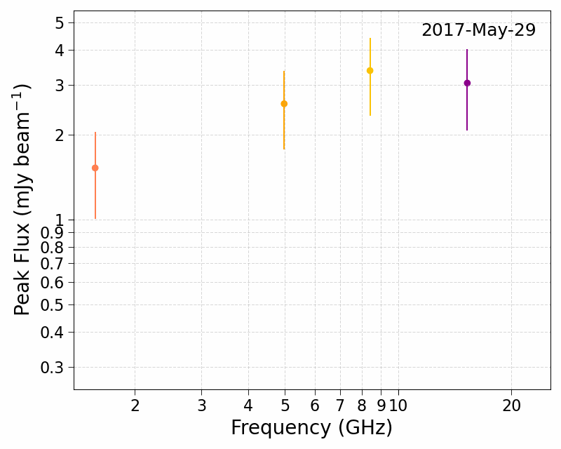
Mrk 590: A “Burping” VLBA Source
Mostly flat – “burps” similar to flat-spectrum flares
Radio color-color diagram reinforces the stability of the VLBA source
Driver of the optical/UV/X-ray variability does not appear to drive significant radio variability
Walsh+ (in prep)
Nordic-Baltic Astronomy Days 2026
10
Notes:
The spectra reinforce the ”burpiness” of Mrk 590, though some epochs show clear high-to-low frequency evolution.
Radio color-color diagram essentially confirms this: a few rising and peaked spectra, though there is no clear temporal evolution. Almost all spectra are classified as flat
… does not appear to drive significant radio variability, unlike the suggestive evidence of such in both 1ES and Mrk 1018

Slide 12

Future of CLAGNs with VLBI
Type 2
Type 1
Type 2
Type 2
VLBI informs us about the magnetic state of the accretion flow, with the capability to probe regions down to the EH scale
1ES 1927, Mrk 1018, Mrk 590 all hint at different CL mechanisms
Disk-jet connection in AGNs?
Walsh+ (2023)
Nordic-Baltic Astronomy Days 2026
11
Notes:
1ES 1927, Mrk 590 and Mrk 1018 demonstrate a complex scenario in which different CL mechanisms, at the accretion disk scale, have varying degrees of impact on the large-scale radio emission far from the accretion disk.

Slide 13
Extras
Nordic-Baltic Astronomy Days 2026
12

Slide 14
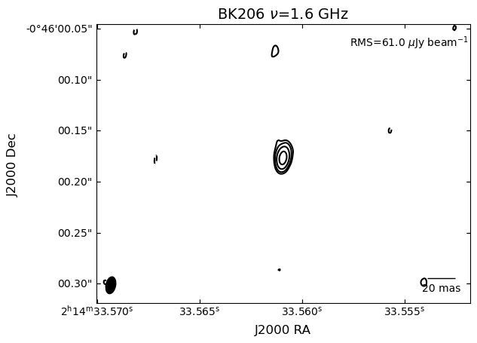
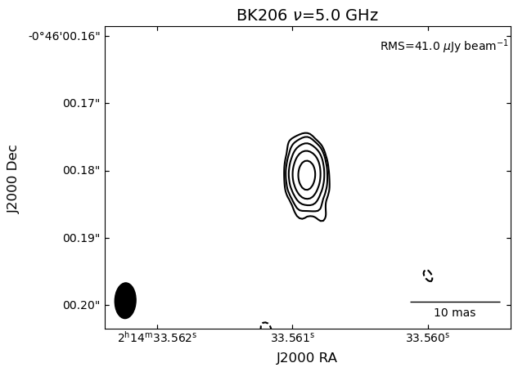
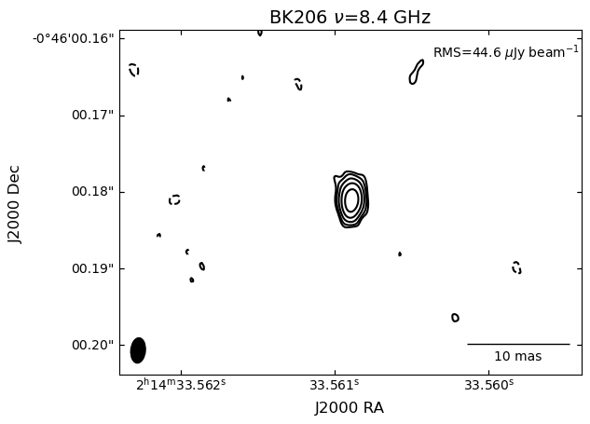
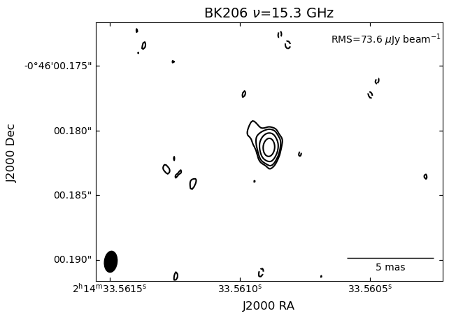
Mrk 590 Radio Morphology: BK206
Nordic-Baltic Astronomy Days 2026
13
Notes:
All AGN have narrow lines – but not all have broad lines
Is this an observational or astrophysical phenomenon? E.g., is this purely a function of viewing angle or is something source-intrinsic happening?

Slide 15
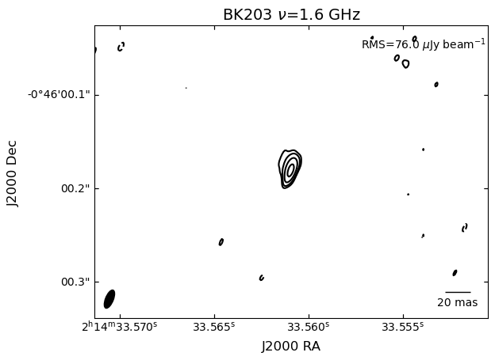
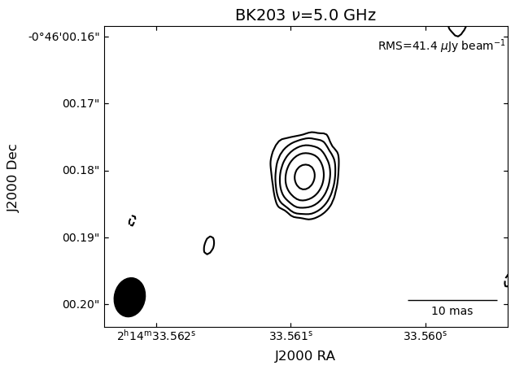
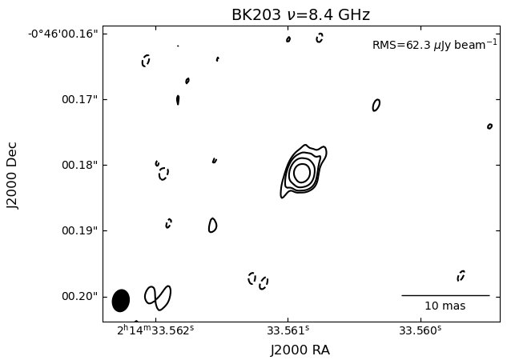
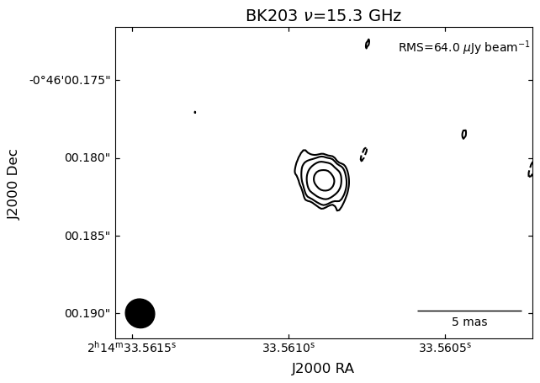
Mrk 590 Radio Morphology: BK203
Nordic-Baltic Astronomy Days 2026
14
Notes:
All AGN have narrow lines – but not all have broad lines
Is this an observational or astrophysical phenomenon? E.g., is this purely a function of viewing angle or is something source-intrinsic happening?

Slide 16
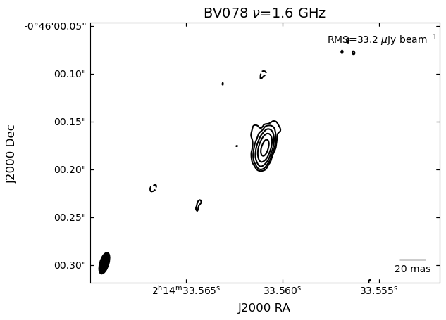
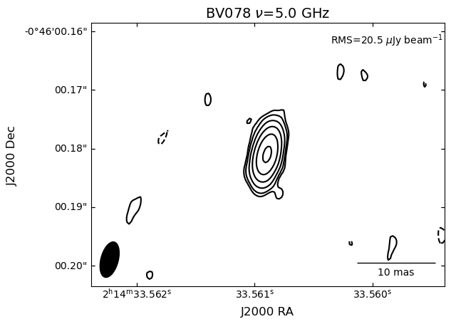
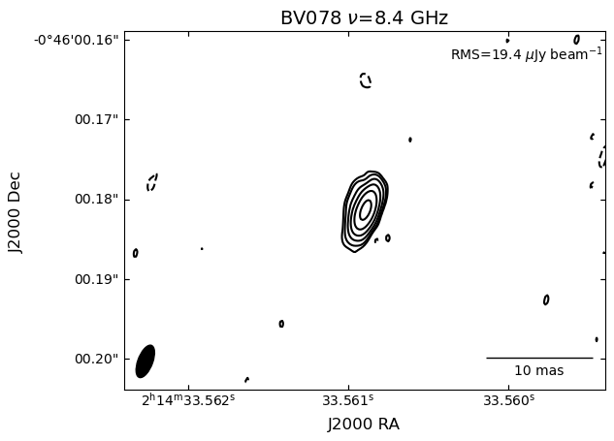
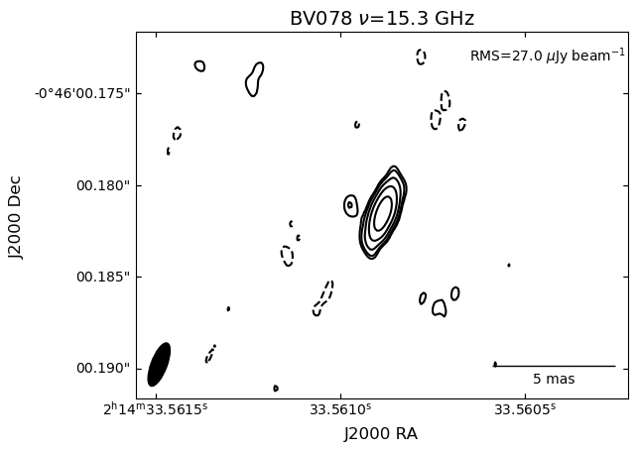
Mrk 590 Radio Morphology: BV078
Nordic-Baltic Astronomy Days 2026
15
Notes:
All AGN have narrow lines – but not all have broad lines
Is this an observational or astrophysical phenomenon? E.g., is this purely a function of viewing angle or is something source-intrinsic happening?

Slide 17
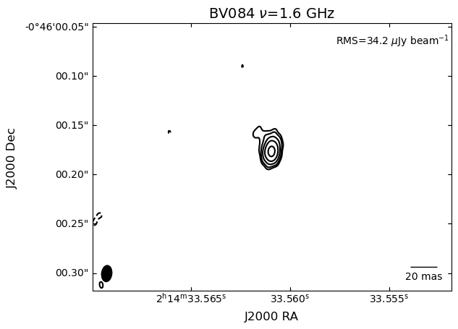
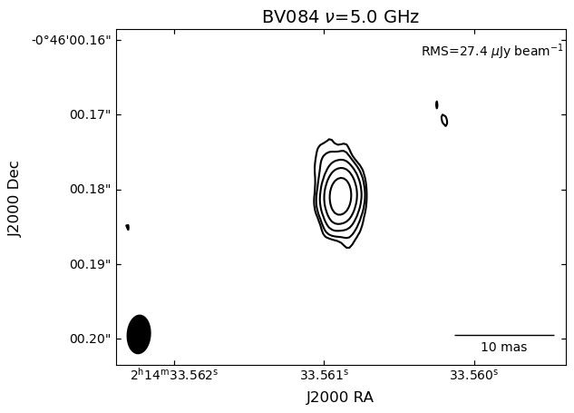
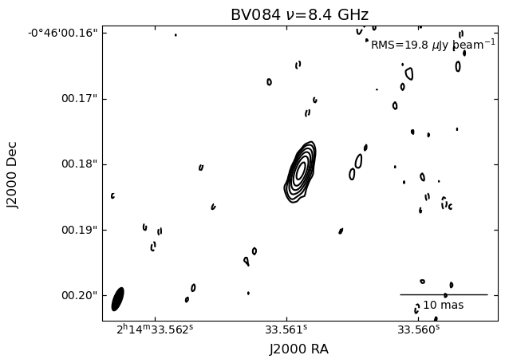
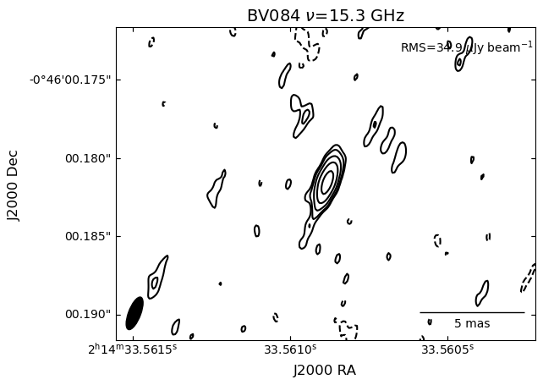
Mrk 590 Radio Morphology: BV084
Nordic-Baltic Astronomy Days 2026
16
Notes:
All AGN have narrow lines – but not all have broad lines
Is this an observational or astrophysical phenomenon? E.g., is this purely a function of viewing angle or is something source-intrinsic happening?

Slide 18

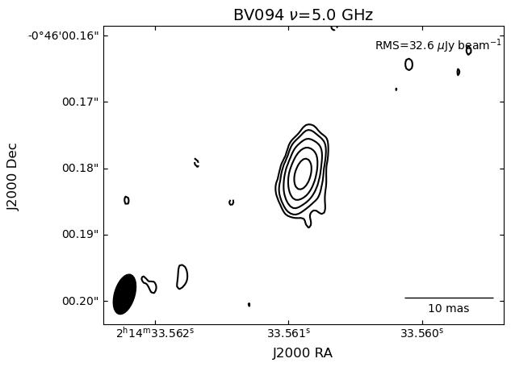
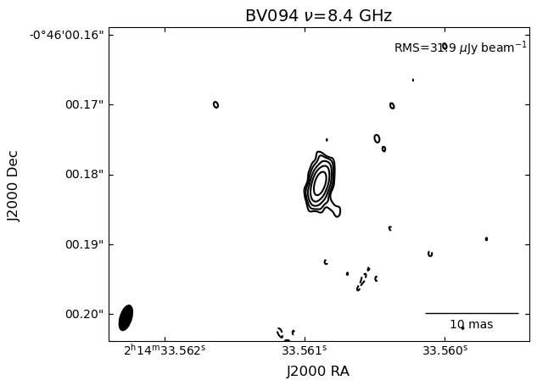
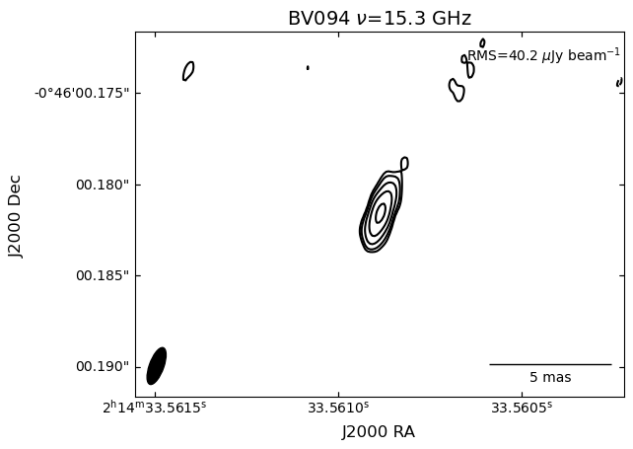
Mrk 590 Radio Morphology: BV094
Nordic-Baltic Astronomy Days 2026
17
Notes:
All AGN have narrow lines – but not all have broad lines
Is this an observational or astrophysical phenomenon? E.g., is this purely a function of viewing angle or is something source-intrinsic happening?

Slide 19
Mrk 590: Mysterious-ish Radio Source
Walsh+ (in prep)
Nordic-Baltic Astronomy Days 2026
18
Notes:
"Program-integrated" L-band images from 5 of our completed VLBA programs. Note the persistent feature to the northeast. PA is consistent with the EVN image of Yang+(21).
Evidence for newly ejected components is tenuous at best, but still more work to do. Still working towards discerning between an outflow (seen in the emission lines) or a jet
… honestly the more I look at this the more convinced I am that it’s a jet

Slide 20
Mrk 1018 Radio Morphology
Resolved?
Nordic-Baltic Astronomy Days 2026
19
Notes:
All AGN have narrow lines – but not all have broad lines
Is this an observational or astrophysical phenomenon? E.g., is this purely a function of viewing angle or is something source-intrinsic happening?

Slide 21

Changing-State AGNs
Type 1
Type 2
Nordic-Baltic Astronomy Days 2026
20
Notes:
The crux of the remainder of this talk focuses on these two models of the accretion flow – CLAGN transition between these two, essentially
Remember that the disk can change locally! Variations do not (and can’t) be global
Radiative efficiencies
Shakura-Sunyaev vs. Advection Dominated Accretion Flow
Geometrically thin, optically thick vs geometrically thick, optically thin

Slide 22
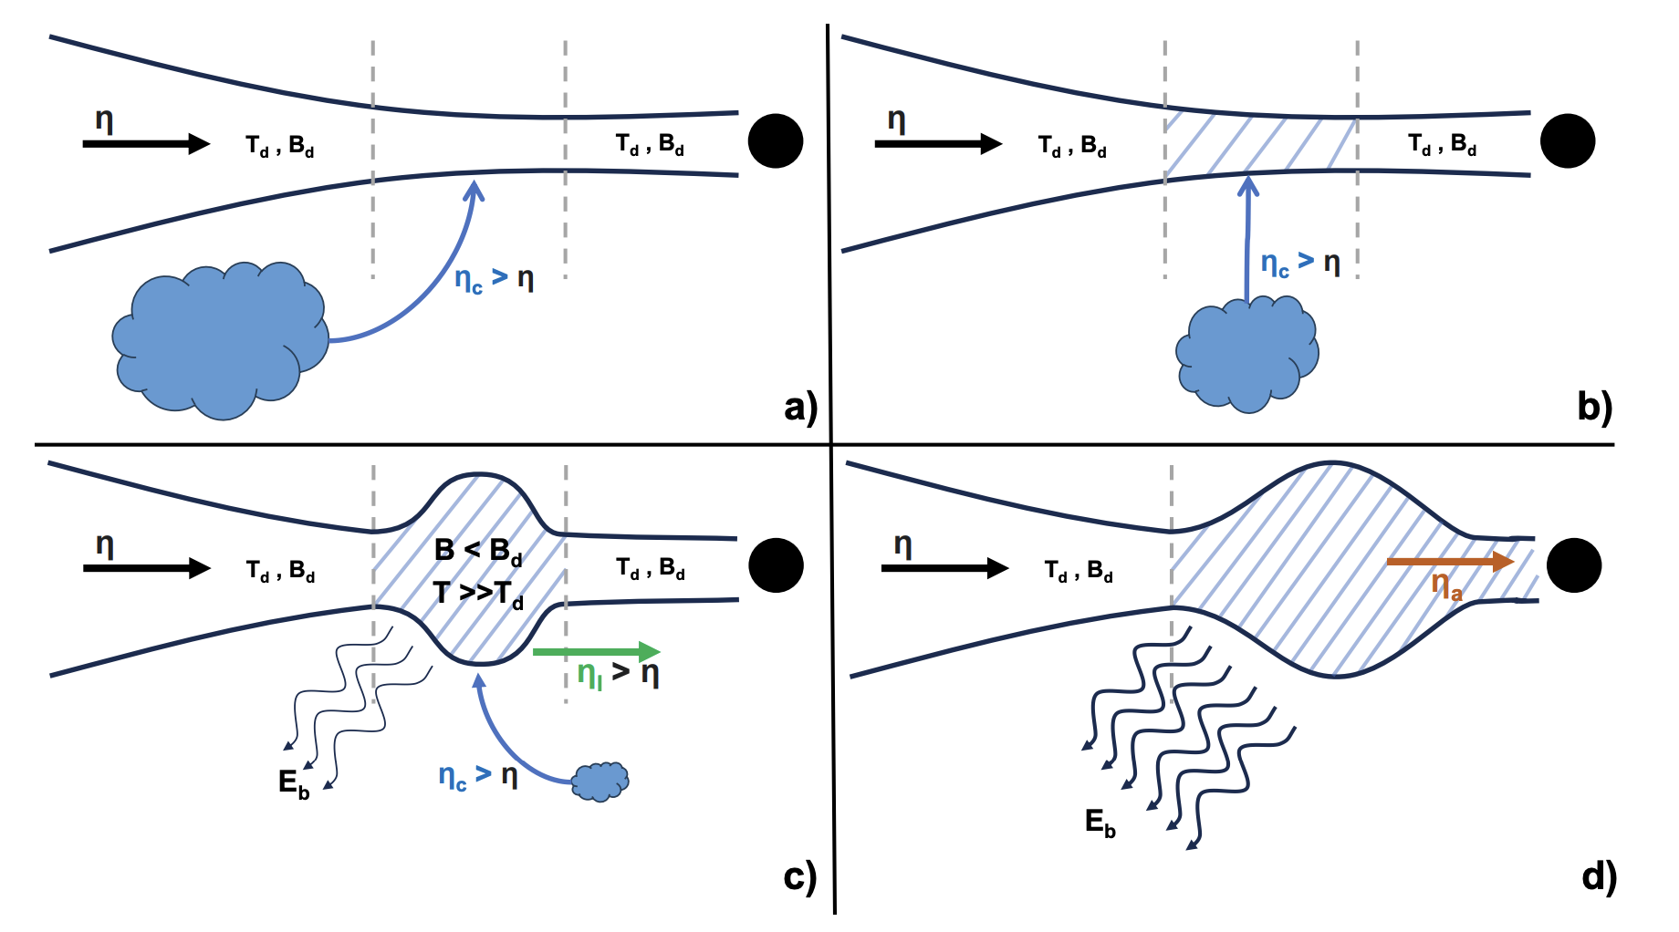

Slide 23
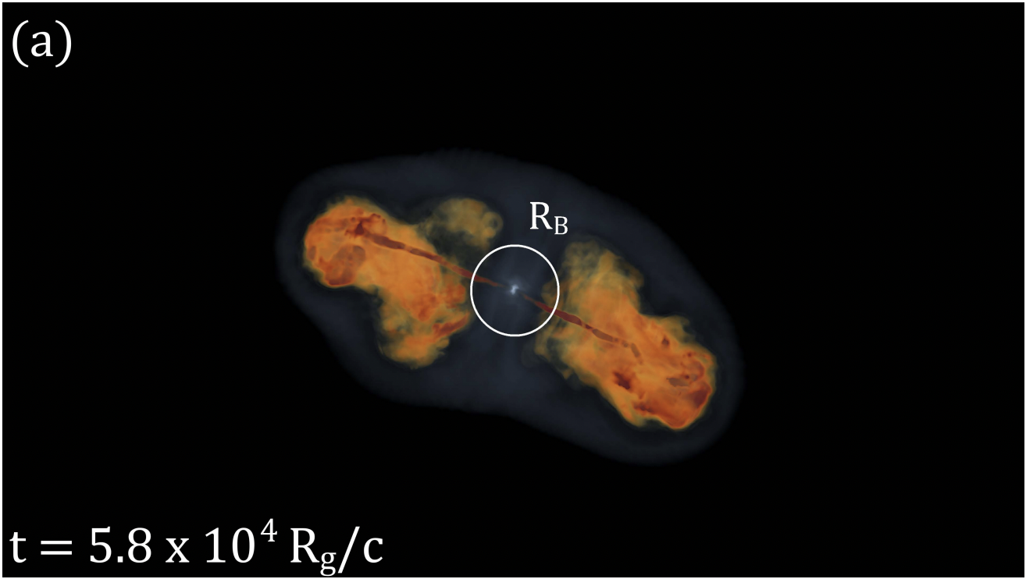
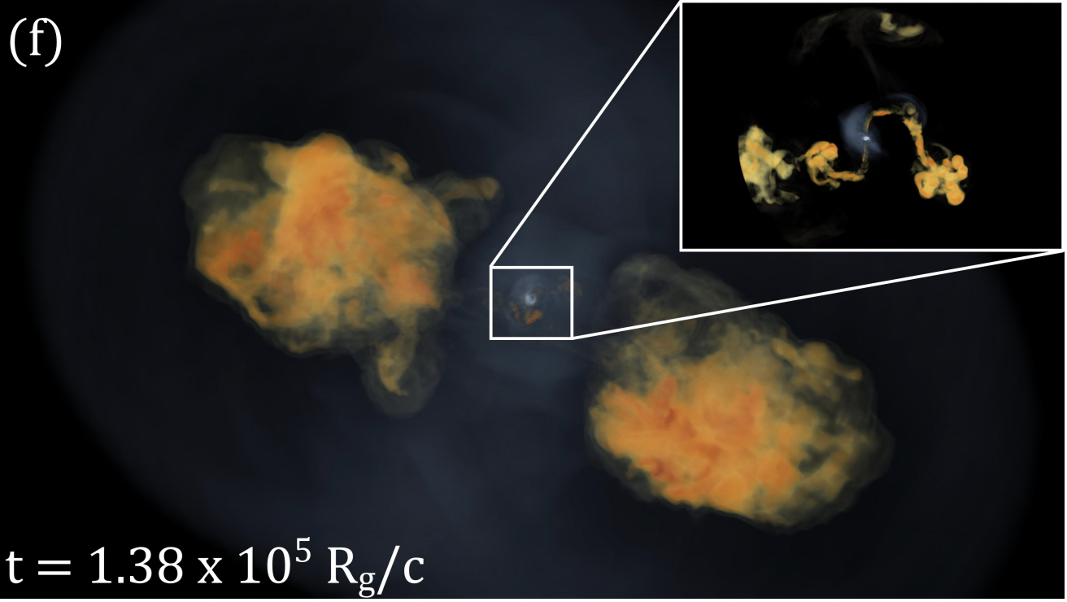
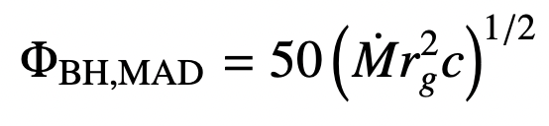
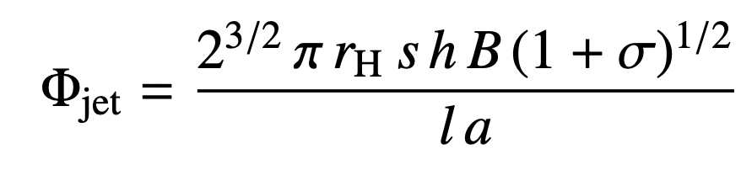
MAD States and Radio Jets
Type 1
Type 2
Thread the black hole with a magnetic flux of
Leads to a jet with a magnetic flux of
Lalakos+ (2023)
Nordic-Baltic Astronomy Days 2026
22
Notes:
MAD is magnetically arrested disk
Rg is the gravitational radius (GM/c^2)
Rh is the event horizon radius: rg(1+(1-a^2)^(1/2))
S is the Poynting flux? And always less than equal to 1
H is the distance along the jet in parsecs
L is the ratio of angular frequency of the field lines to the BH angular frequency
A is the spin
Simulations show that these MAD states may be transient – interactions with the ISM cause kink instabilities to propagate downstream and choke the nascent jet

Slide 24
MAD States and Mrk 1018?
Type 1
Type 2
Lalakos+ (2023)
Walsh+ (2023)
Nordic-Baltic Astronomy Days 2026
23
Notes:
Then, perhaps this kind of transient jet is exactly what we observed with Mrk 1018’s state transition and putative coherent radio variability?

Slide 25
Determining MADness
Type 1
Type 2
Type 2
Lalakos+ (2023)
Credit: H. J. B. Christensen
Nordic-Baltic Astronomy Days 2026
24
Notes:
The loss of soft X-rays (or destruction of the corona), evidence for new radio components points towards this kind of transient MAD state in CLAGN
These equations provide, in an abstract manner, the ingredients we need to actually test the MAD paradigm

Slide 26
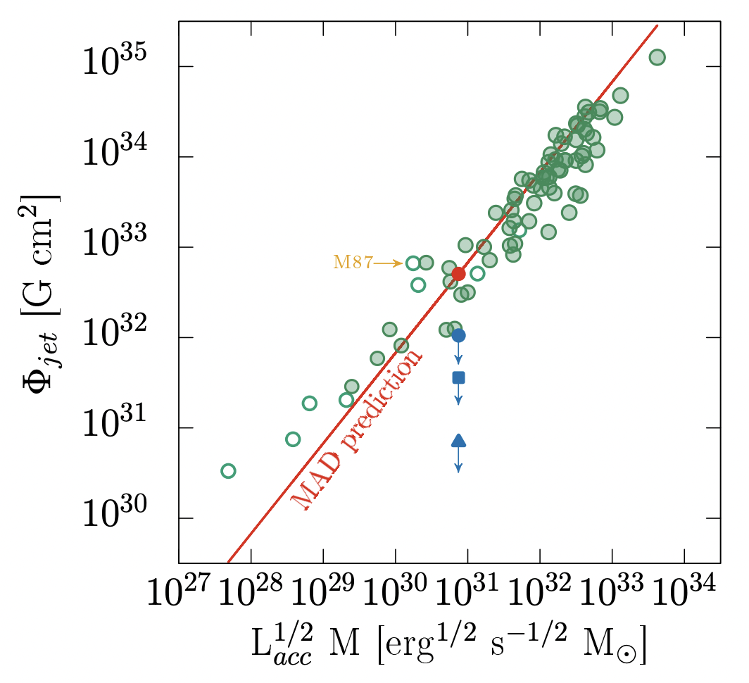
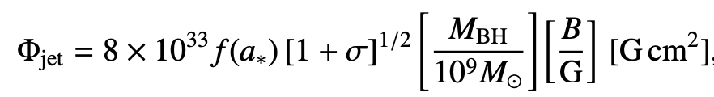
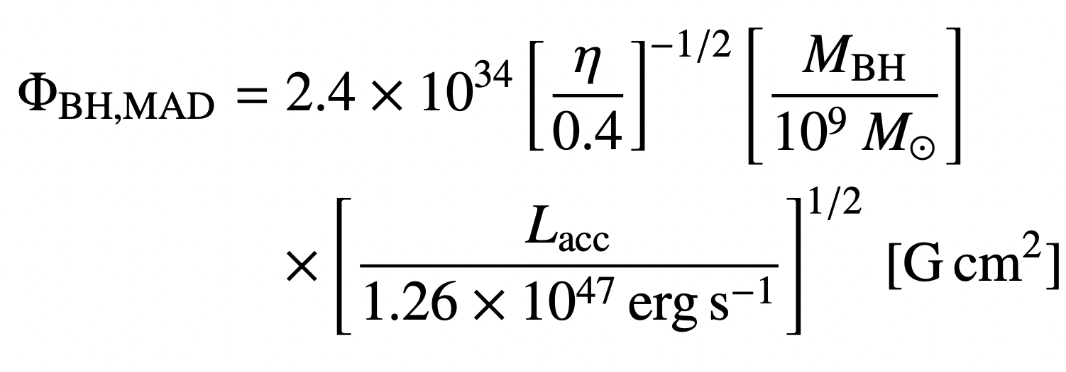
Determining MADness
Type 1
Type 2
Type 2
Rewrite Φ_{jet} and Φ_{BH}
Chamani+ (2021)
Nordic-Baltic Astronomy Days 2026
25
Notes:
Phi_jet depends on spin of BH, BH mass, and jet magnetization parameter (ratio of Poynting flux to kinetic energy) – just make some assumption
Phi_BH depends on a radiative efficiency factor, black hole mass, and accretion-powered luminosity (SED fitting)
May seem far-fetched, but indeed such studies have been carried out, even for statistical samples of radio galaxies
But how to get B? Remember that polarization is NOT the answer – polarization provides the ORDER of magnetic fields, not their strength

Slide 27
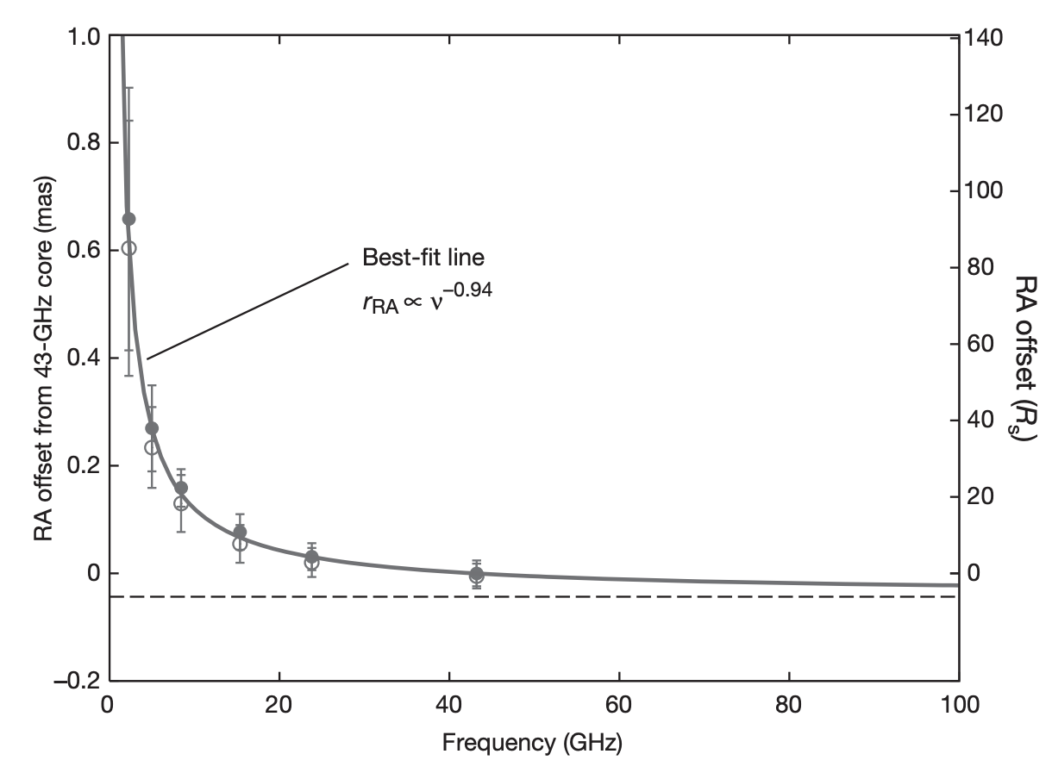
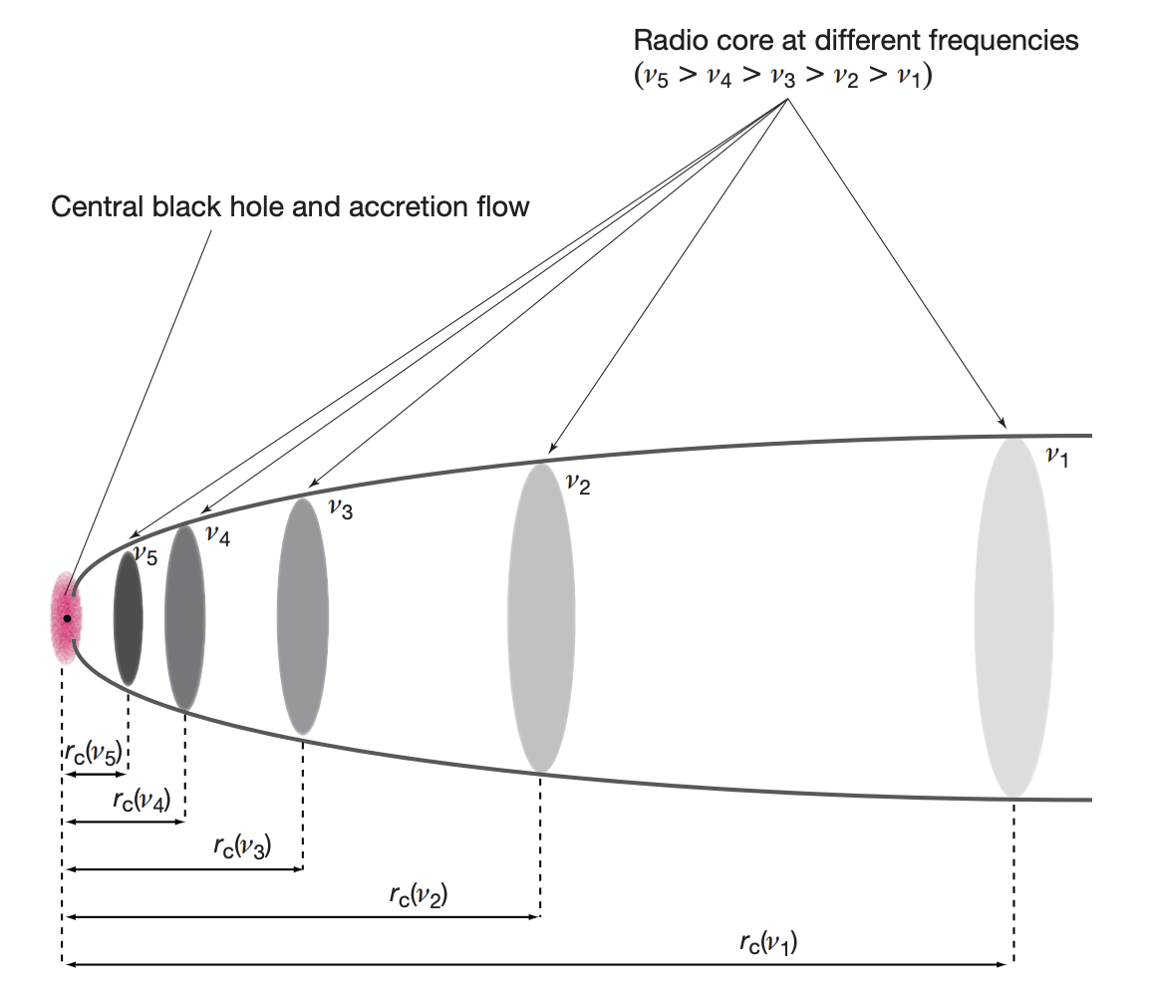
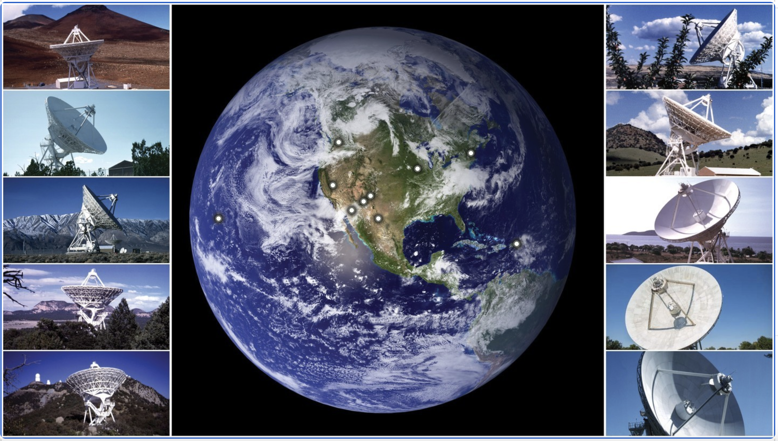
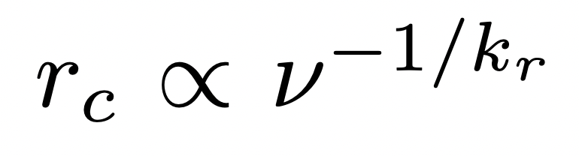
Determining MADness: Core Shift
Type 1
Type 2
Key parameter to determine is B
Core shift is the chromatic dependence of the radio core’s position
NRAO
Hada+ (2011)
Nordic-Baltic Astronomy Days 2026
26
Notes:
But how to get B? Remember that polarization is NOT the answer – polarization provides the ORDER of magnetic fields, not their strength
The unmatched angular resolution of VLBI observations provide a unique way to determine B
With some assumptions, the functional form of core shift is fairly straight forward

Slide 28
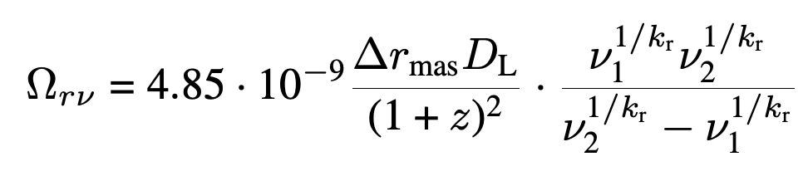
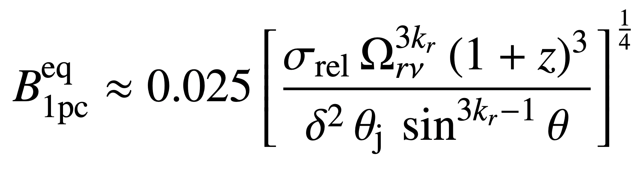
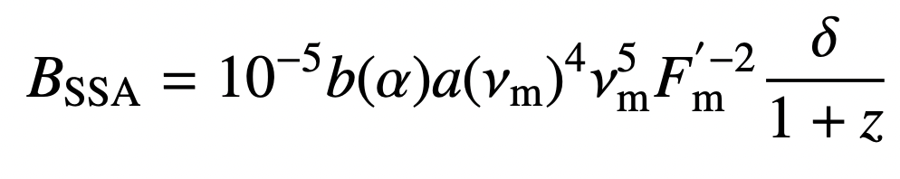
Determining MADness: Core Shift
Type 1
Type 2
Type 2
From r_{c}
Or
Hada+ (2011)
Nordic-Baltic Astronomy Days 2026
27
Notes:
Equipartition does not need to be an assumption; different functional form if not
Can also use SSA peak frequency for peaked sources
Want to compare the two magnetic flux values. Are CLAGN transitioning to and from MAD states? THIS HAS NEVER BEEN TESTED

Slide 29
Future: Constraining the Magnetic Fields
Type 1
Type 2
Astrometric VLBI observations can constrain B via measurement of core shift
(Accepted) Multi-epoch programs have the potential to reveal time-dependent magnetic fields threading the SMBH
Walsh+ (2023)
Hada+ (2011)
Nordic-Baltic Astronomy Days 2026
28
Notes:
B is a key driver of the SMBH’s ability to launch a (transient) jet
The unmatched angular resolution of VLBI observations provide a unique way to determine B

Slide 30


Future of CLAGNs with VLBI
Type 2
Type 1
Type 2
Astrometric VLBI programs of Mrk 590 and Mrk 1018 to robustly detect/measure core shift, constrain B
Understand the physical mechanisms driving the CLAGN phenomena
Disk-jet connection?
Type 2
Veronese+ (2024)
(a)
(b)
(c)
(d)
Walsh+ (2023)
Adapted from Cao+ (2023)
Nordic-Baltic Astronomy Days 2026
29
Notes:
The main takeaway is that we want to test the magnetic paradigm for state transitions in CLAGN by comparing core shift measurements from different epochs/accretion states
With constraints from MWB observations, test your favorite model for CL mechanisms
This is actually quite amazing. The PARSEC-SCALE JET will inform us about the innermost regions of the accretion flow itself. The nature of accretion directly affects the radio source in AGNs and will provide fundamental constraints on disk geometry, structure, and magnetic field information.
Importance of high resolution radio observations towards studies of CLAGN, though radio is overlooked.
We are only just scratching the surface of the critical information multi-epoch and astrometric radio observations can provide.
We know the disk and jet should be connected (e.g., BZ mechanism) but under what accretion disk manifestations does this happen and why?

