Slide 1
Characterization of White Dwarfs with Noisy Spectra
Sicheng Yu, Vitaly Neustroev
University of Oulu
Notes:
I’d prefer that you call me Tom for convenience, Im from University of Oulu and I will be reporting on our work of charactering white dwarfs with non-ideal spectra

Slide 2
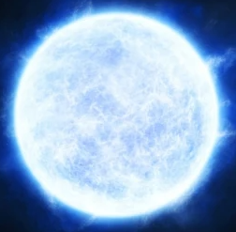
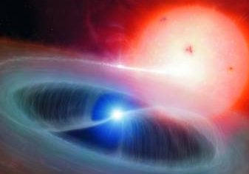
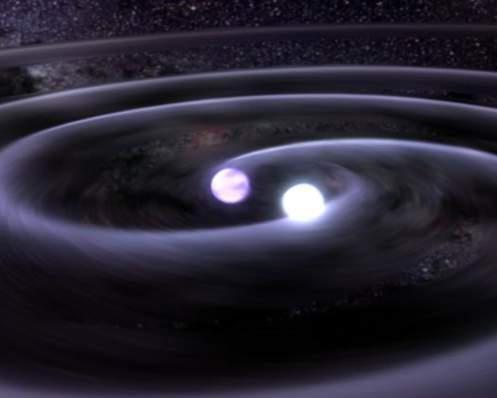
Background
White Dwarfs
Common fate for most stars in the universe
White Dwarf population:
Gaia EDR3: 1.3 million candidates (~360,000 high confidence)
Spectroscopic confirmation: ~50,000 (SDSS DR18: 35000)
Accurate atmospheric parameter measurements: ~1,000
Notes:
I’ll begin with a brief introduction on our research background.
[intro]
White dwarf represent the final evolutionary stage for the vast majority of stars in the universe. if a star is less than 8 time the mass of our sun, which is the situation for most of the stars in the universe, it’s gonna burn out its mass oneday and evolve into a white dwarf.
[background]
The gaia survey nowadays has widely enlarged our view of the universe, and up until its 3rd data release, 1.3 million white dwarf candidates were located, with 1 third of them being high-confidential candidates. With the advance of spectral surveys like Sloan digital sky survey, roughly 50 thousands white dwarfs were confirmed. Thats 15% of all confidential candidates from gaia, or less than 5% if we consider the entire candidate group.
If we then talk about measuring their atmospheric parameters, such as effective temperatures, surface gravities, we have even a smaller number, due to the limitation of observations.

Slide 3
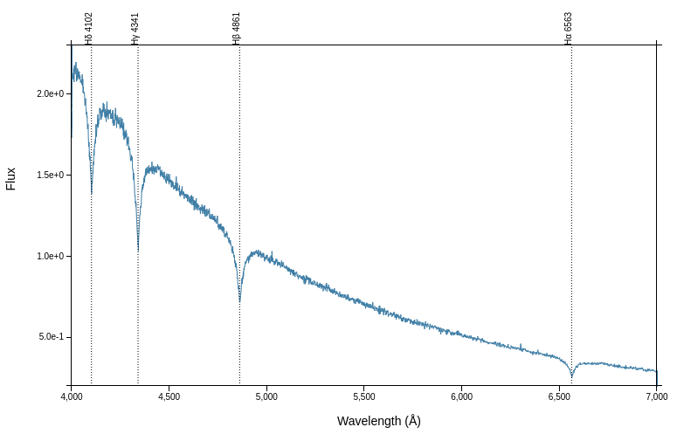
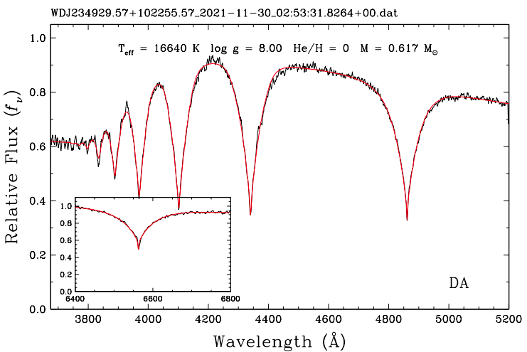
Open Problem
White Dwarf Atmospheric Parameters
Effective temperature (Teff)
Surface gravity (logg)
Conventional method: Chi-sq model fitting
Fitting of various template spectra
Best fit with least Chi-sq value
Quality-reliant
Notes:
Here on the top right we have typical spectrum of the most common type of white dwarf in the universe. a hydrogen rich DA white dwarf. It’s quite simple, It consists of a smooth continuum that is close to blackbody radiation, and a series of broad Hydrogen Balmer lines.
Right beneath it shows another DA WD spectrum which I found from a previous article. They trimed some part between H-alpha and H-beta because there is nothing there. And it shows you the most conventional way to measure atmospheric parameters on white dwarfs, or on any star actually: the template-fitting technique.
That means you try fitting your target spectrum with templates of different stellar types, you calculate the chi-square and find the fitting with a minimum chi-sq. This approach is rather robust and universal, and widely used throughout history. But meanwhile the accuracy of the outcome is dependent on the quality of the target spectrum.

Slide 4
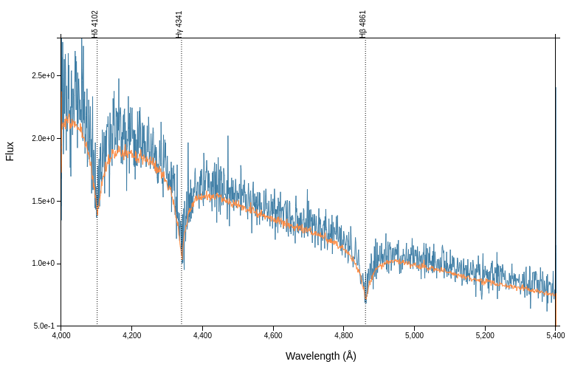
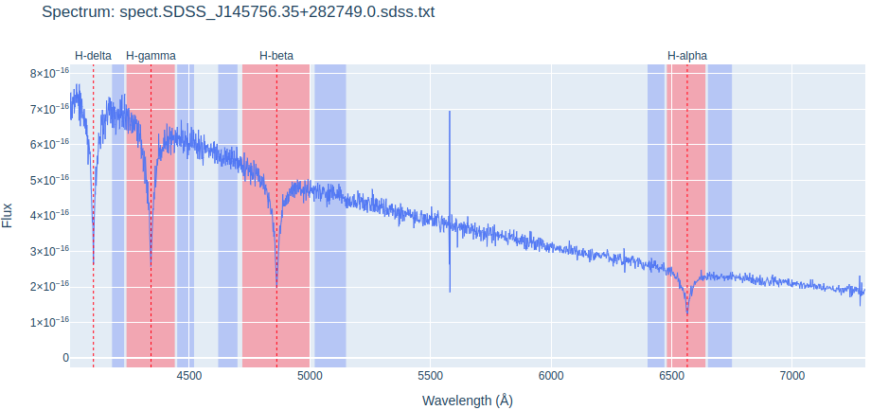
Goal and Justification
Pipeline
A spectral, but less quality-demanding estimation routine for WD atmospheric parameter estimation.
Justification:
Simplicity of DA WD spectra (continuum + Balmer lines)
The widths & depths dependence on Teff & logg
Equivalent width does not change drastically with noise level
Notes:
You see on the top right side two spectra of the same white dwarf, and you notice that the blue spectrum is significantly more noisy than the yellow one. While the yellow spectrum is quite good for template fitting technique, it’s going to be significantly more difficult to estimate atmospheric parameters using the blue spectrum, because the noise introduces random fluctuations across the entire wavelength range, you end up with a wide variety of different templates that yield nearly identical chi-sq values. And unfortunately, for most white dwarfs, especially the ones that are further away from us, their available spectra would be similar to the blue one or even worse.
This is what we wish to improve. We wish to develop a pipeline that make use of the simplicities of white dwarf spectra, to estimate white dwarf atmospheric parameters in a more specific but less quality demanding way. Instead of relying purely on a global fit, we focus heavily on the shapes of the Balmer lines by measuring their Equivalent Widths.
Why do we know this would work? Because first of all we talked about the simplicities of DA WD spectra; 2nd, the behaviour of a Balmer line depend on the WD’s temperature and surface gravity; but most importantly, the value of equivalent width would not be heavily influenced by noise level.

Slide 5
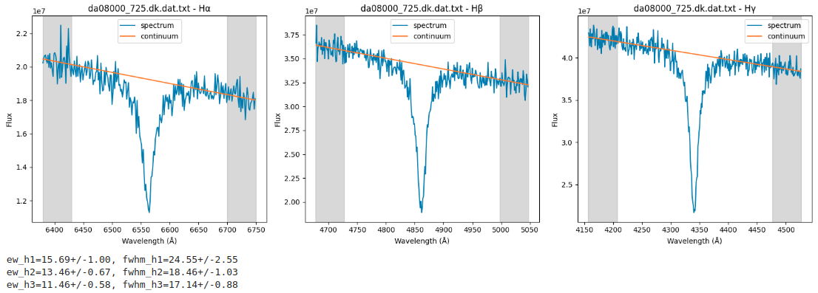
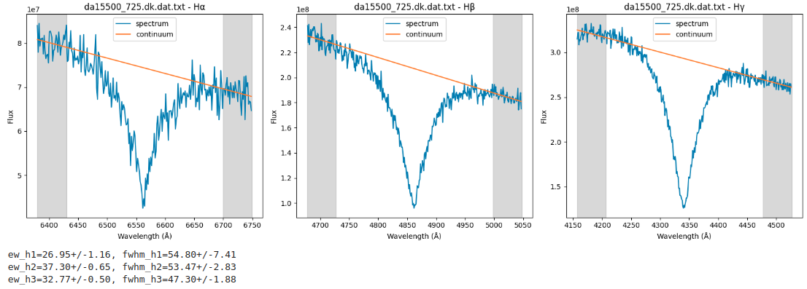
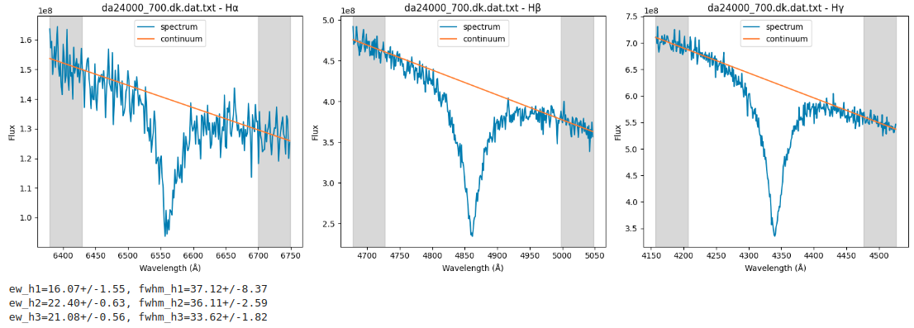
Methodology
Input
Koester WD Models (Koester, 2008)
WD spectra from various low-resolution spectral databases (SDSS, LAMOST, etc)
Processing
Convolution; interpolation; adding noise; selection of line and continuum ranges for normalization
EW measurements of Hɑ, Hβ & HƔ; monte carlo iteration for model spectra
Notes:
Now the practical part. Due to time limit I just explain briefly how the calculation works. We make use of Koester WD models, which is widely used as a template-fitting tool, we also collect real WD spectra of different qualities and from various sources, SDSS and LAMOST provides the richest low-resolution target pools. We built a pipeline that process these data with desired plan for uniformity, and measure the EW of Balmer lines for them. For model spectra we add poisson noise so it reaches the SNR similar to real targets, and we do monte carlo iterations to analyze the uncertainties.
Here on the right we have a few example models with added noise, a cold white dwarf 8000K on top, the middle is 15,000K and a hot WD of teff~24,000K in the bottom. Notice how these Balmer lines change as different parameters are introduced.

Slide 6
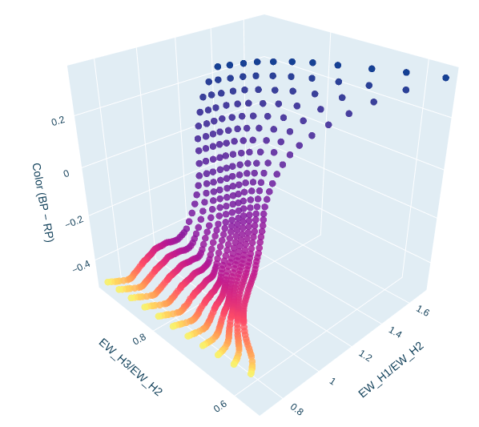
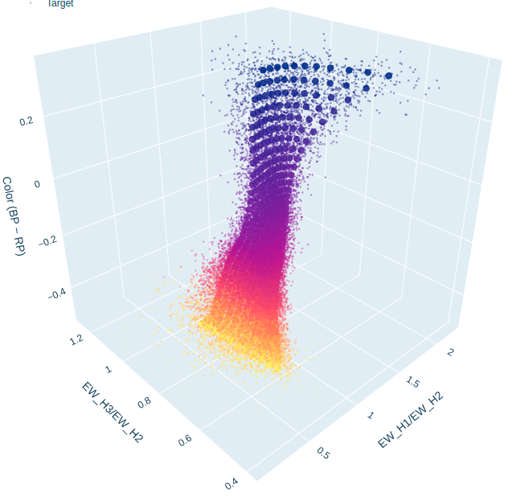
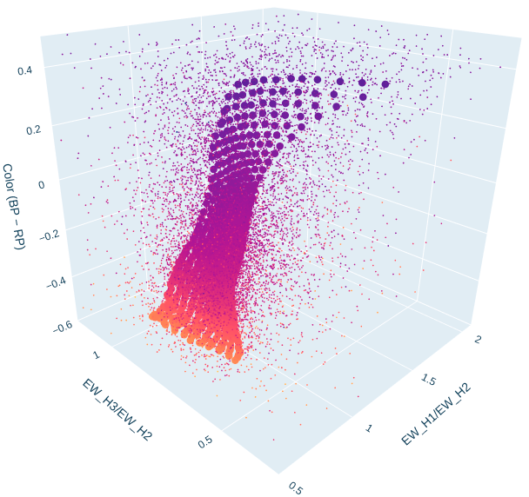
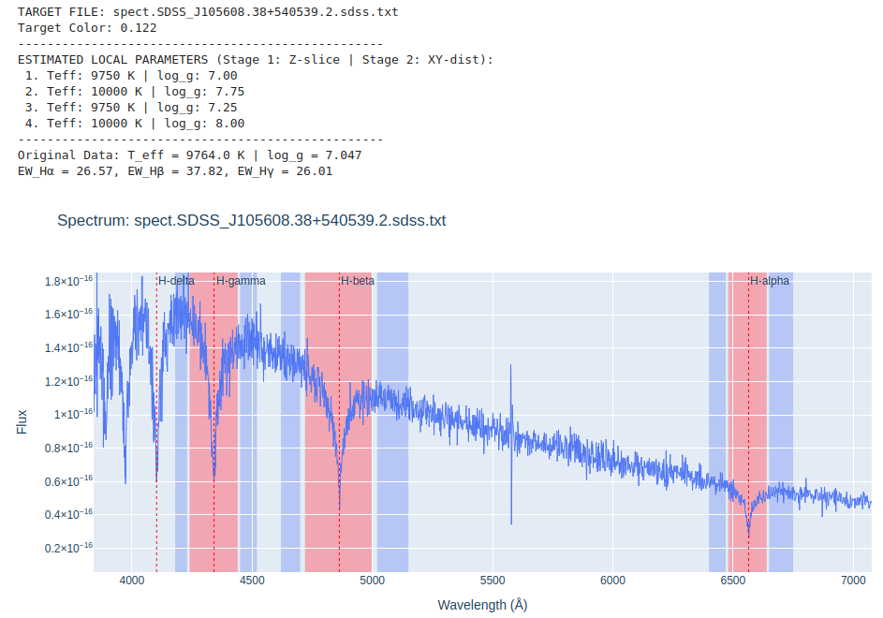
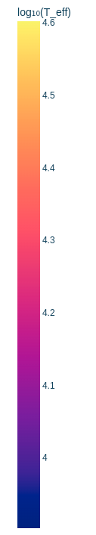
Outcome
3D plot
X-Y plane: EW ratios
Z axis: Color index (Bp-Rp magnitude)
For each of the scatter points:
locate the nearest model dots according to z-axis (color index for Teff )
Locate the nearest model dots according to x-y plane (logg)
Estimation of parameters (bottom right)
Notes:
here I present you the 3D plots, the x-y plane shows two different equivalent width ratio, and the z-axis gives color index (bp-rp magnitudes). On the top panel from lef tot right, we have the plot of perfect models; then in the middle one we add also these small scatter points of iterated noisy models which were used for target expectations, and the third one, we have models and real spectra.
We tested the reliability of our results by making the pipeline find the nearest model points for our targets, the pipeline will first locate 10 nearest points according to z-axis, the color dimension. As we said earlier the continuum of DA white dwarfs are remarkably clean and like ideal blackbodies, this photometric color provides a highly reliable first estimate of temperature. We then try to find out the nearest 4 points according to xy-plane, and compare the parameters of these 4 model points with the target’s recorded parameters from previous publications because many of our targets do have previously published outcomes. The bottom panel gives you an example of target scatter with recorded parameters, in comparion with our nearest models.

Slide 7
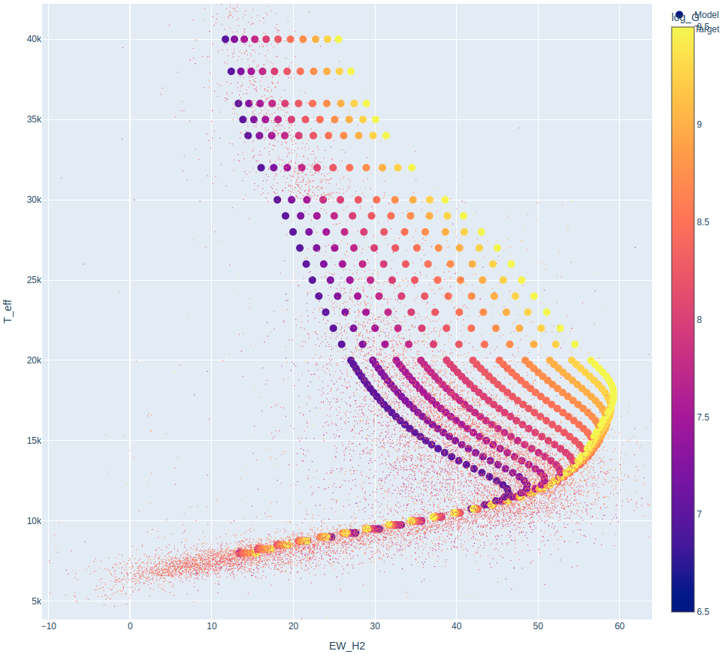
Outcome 2
2D plot for logg estimations
X-axis: equivalent width (Hβ)
Y-axis: Teff
Results:
Teff > 12,000K distinguishable
Lower temperature: some other day
Notes:
Here we have our second plot, assuming we have acquired temperature from the previous slide, now we try to make use of this parameter to find also surface gravity.
We plot equivalent width against effective temperature, and this is where things become more interesting.
We have 14000 target scatters who form up a cloud around model points,
At Above 12000 K, the separation between different surface gravities become significantly larger, and our estimation for surface gravities becomes possible.

Slide 8
Evaluation
Goal
A compromised approach to maximize the values of the vast amount of low-resolution, poor-quality survey spectra, for reliable & accurate estimations for WDs’ atmospheric parameters.
Challenges
Balmer lines behave differently, selection of wavelength ranges for normalization & measurements could be tricky if we wish to achieve uniformity for all WDs;
Unexpected contaminations: companions? Magnetic fields? Other elements, etc.
Future prospection
Generalize our approach to include not only DA WDs, but also Helium WDs, Carbon WDs, etc
A new way to find Accreting WDs?
Notes:
We are still evaluating the effectiveness of this approach, calibrating the input parameters and masking windows to figure out the most reliable and accurate way for our estimations, so no, we have not yet finalized the pipeline. But I think we are on the right track.
To close with, what you see in this presentation is a pragmatic approach to maximize the value of the millions of existing low-resolution, low-SNR ratio spectra, to do a population synthesis for DA WD to achieve reliability, accuracy and uniformity.
In a bigger picture, we’d also wish to turn this pipeline into a more general tool for population synthesis for a larger variety of stars.
Thank you very much for your time, and I am now happy to take questions.

