Slide 1
Search for stellar remnant candidates using microlensing events from Gaia
Uliana Pylypenko
FINCA / University of Turku
Nordic-Baltic Astronomy Days
27 May 2026

Slide 2
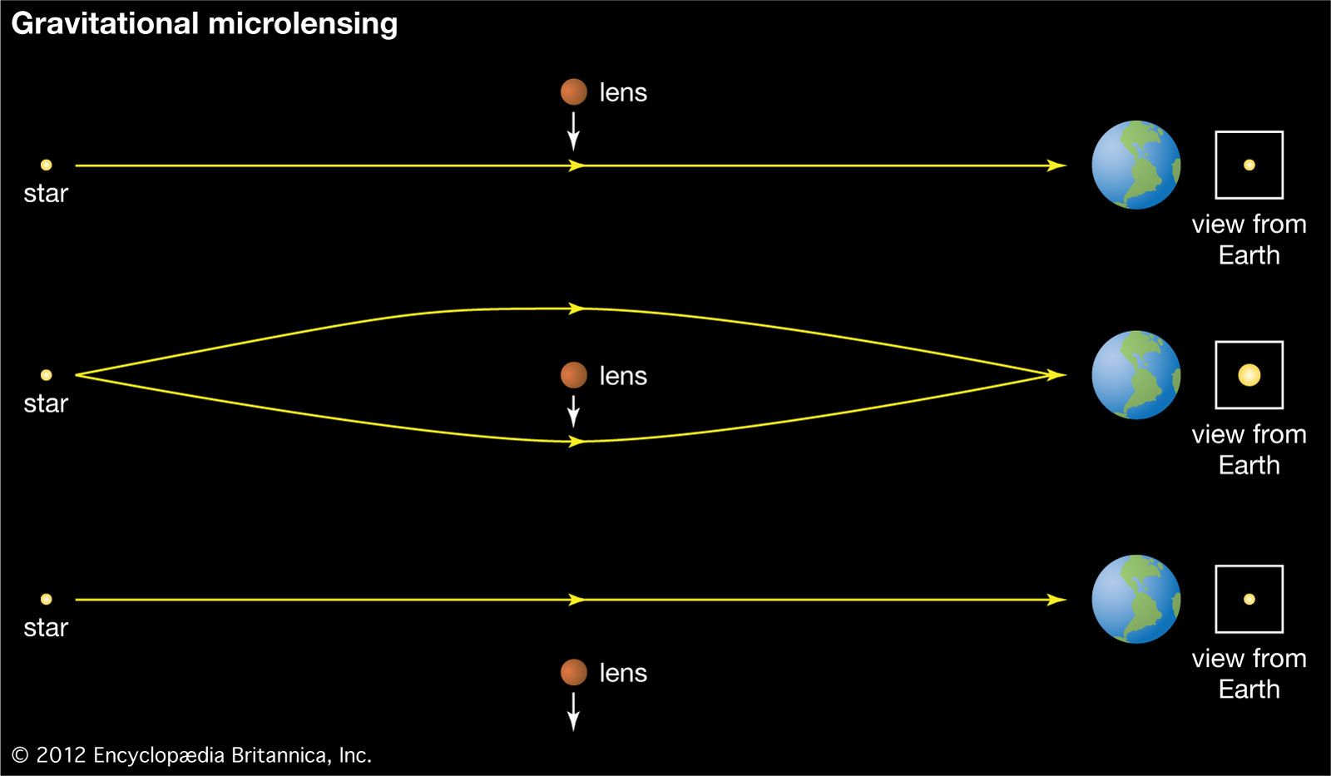
Microlensing
The lens may be dark!
lens
source
lens
source
source
lens
Notes:
say: the only technique for detecting dark and isolated objects → stellar remnants!
Gaia detected plenty of microlensing events

Slide 3
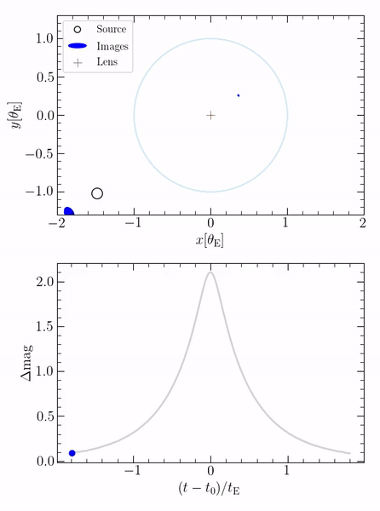
For most events we only have a light curve
Astrometric counterpart or additional effects needed to measure lens mass!
Paczyński+1986
Credit: Kris Rybicki

Slide 4
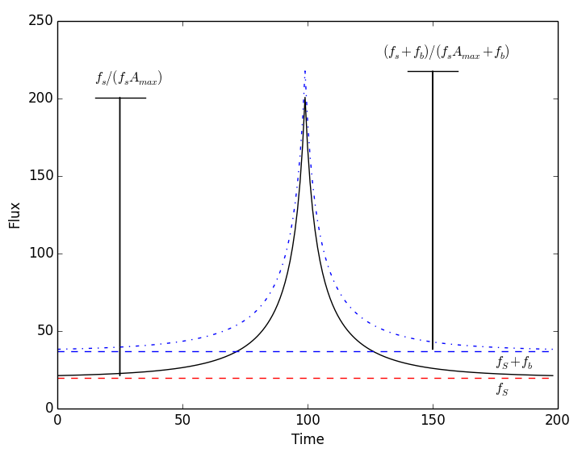
What can we measure using a light curve?
Blending (to determine whether the lens is dark)
with blending
no blending
Woźniak+1997
Credit: R.A. Street

Slide 5
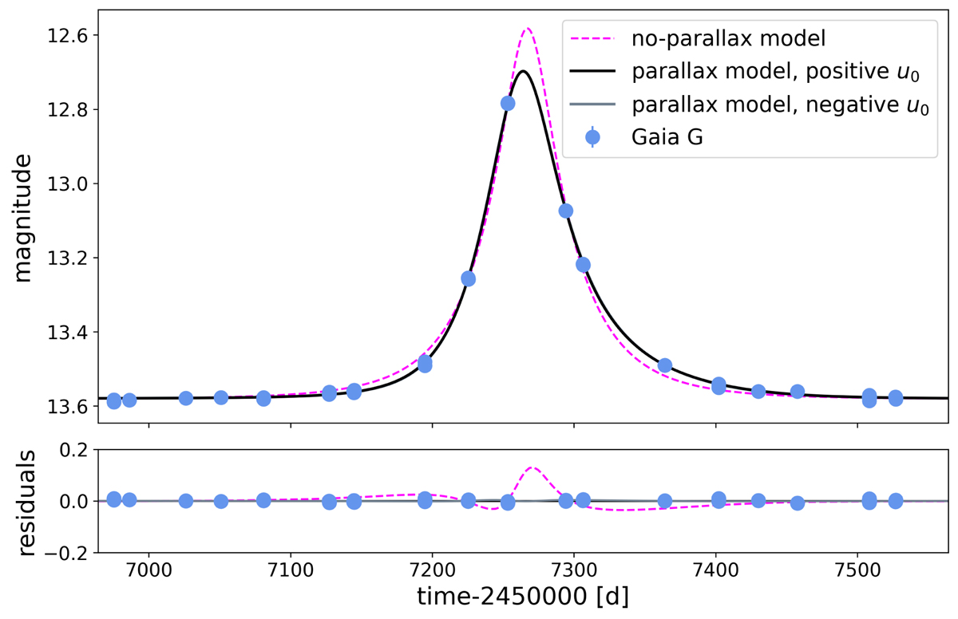
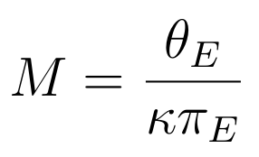
What can we measure using a light curve?
Blending (to determine whether the lens is dark)
Microlensing parallax 𝜋_{E} (lens mass)
Jabłońska+2022
Gould+2000

Slide 6
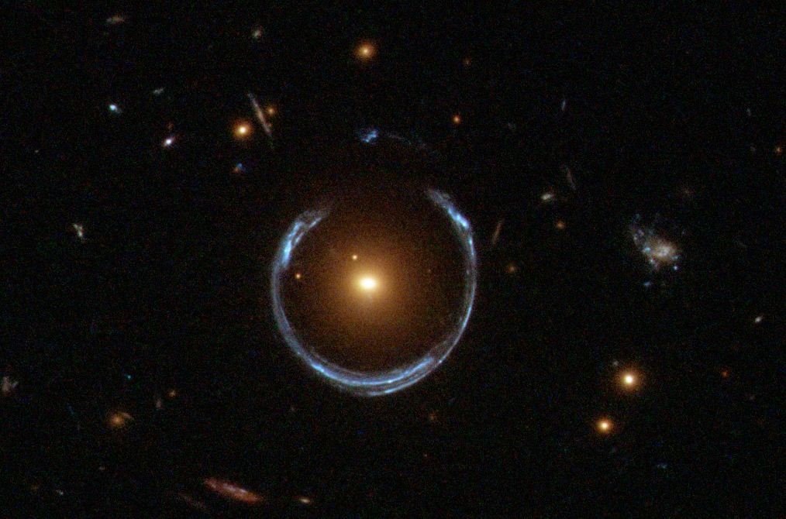
What can we measure using a light curve?
Blending (to determine whether the lens is dark)
Microlensing parallax 𝜋_{E} (lens mass)
Einstein radius θ_{E} – rarely! (lens mass)
Credit: ESA/Hubble & NASA
Gould+2000

Slide 7
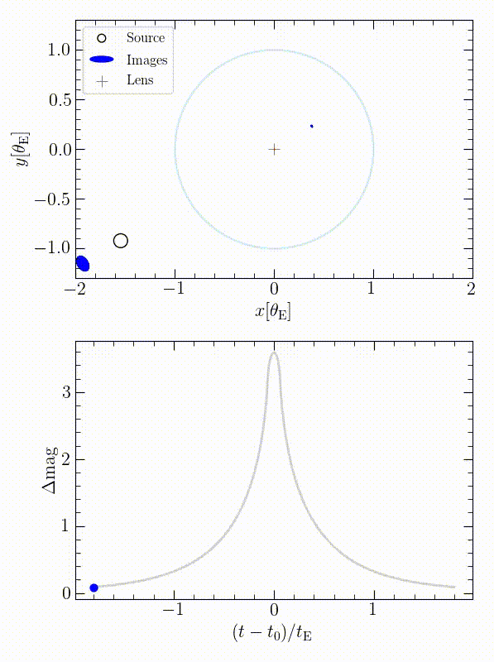
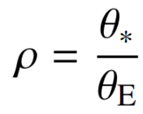
The finite source (FS) effect
source angular radius
“bump on the light curve peak”
Expected when source and the lens are exceptionally well aligned
In this case, the light curve is highly magnified
Witt & Mao 1994
Credit: Kris Rybicki

Slide 8
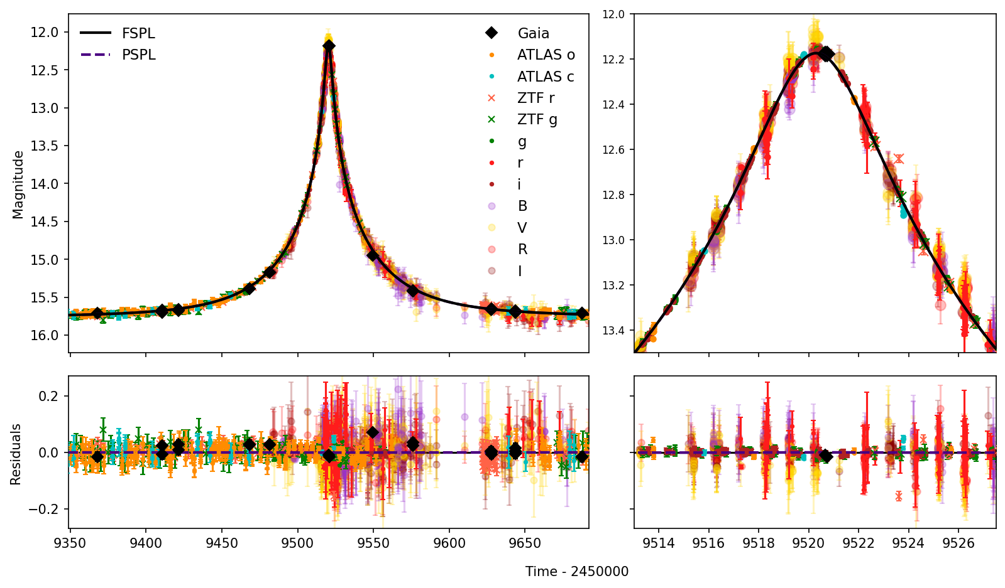
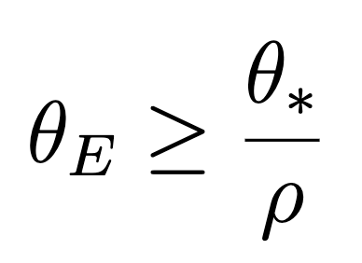
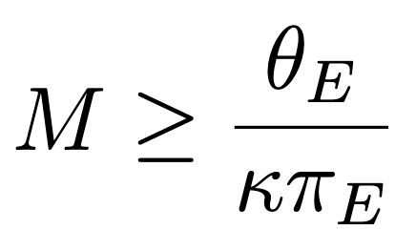
High magnification events without FS effect
~3 mag
May be caused by massive lenses
Upper limit for ⍴ → lower limits for θ_{E} and M_{L}

Slide 9
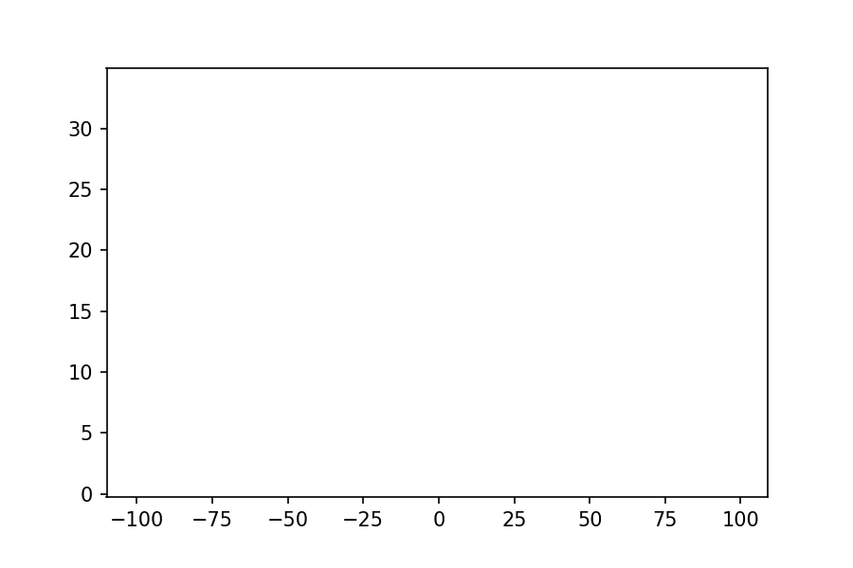
4 events studied
High magnification (Δm≥3 mag)
GaiaDR3-ULENS-067
Gaia21efs
Gaia21azb
Gaia21dpb
Small FS effect
Dark lens (from blending)

Slide 10



Data
Talk to
Marius Maskoliūnas
BHTOM2
bhtom.space
Gaia Alerts, Gaia DR3
Astrometric counterparts of microlensing events (not available for events analysed here yet)
Facilitating follow-up using multiple small telescopes
Notes:
another example of results from such a setup

Slide 11
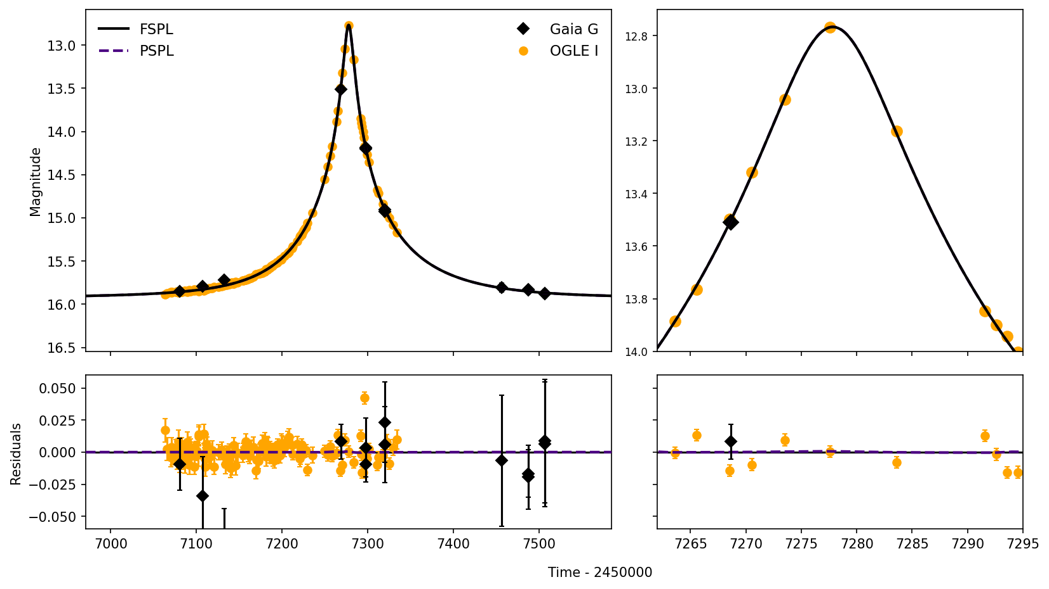
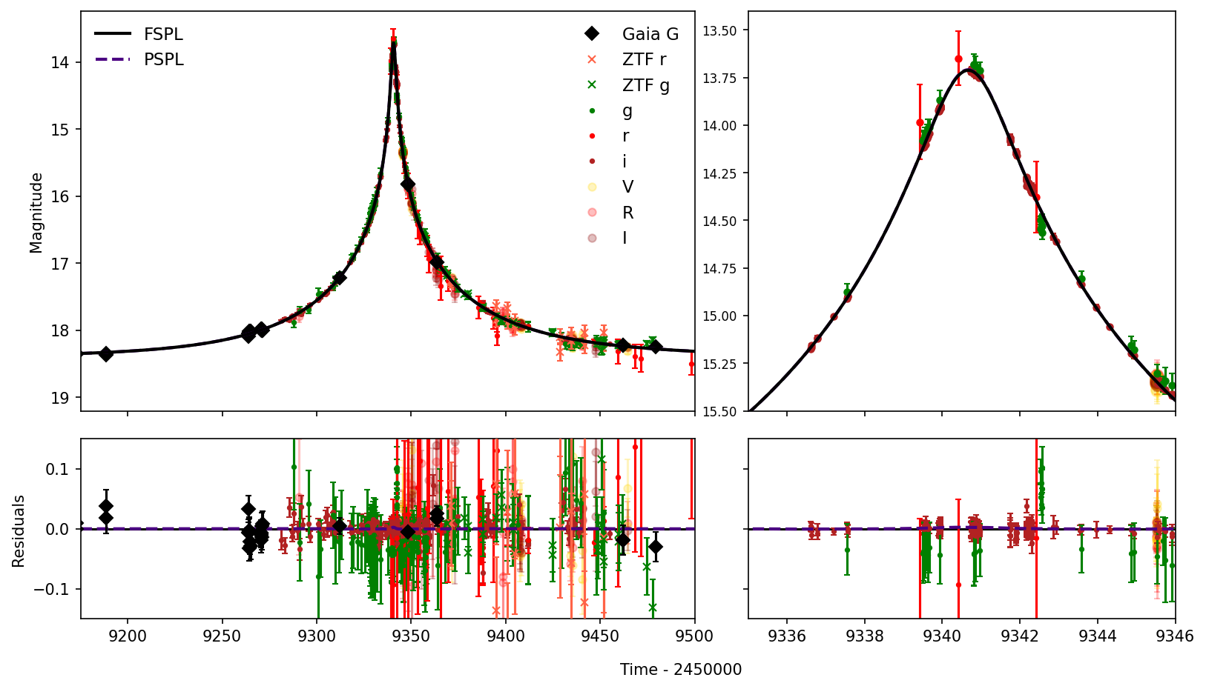
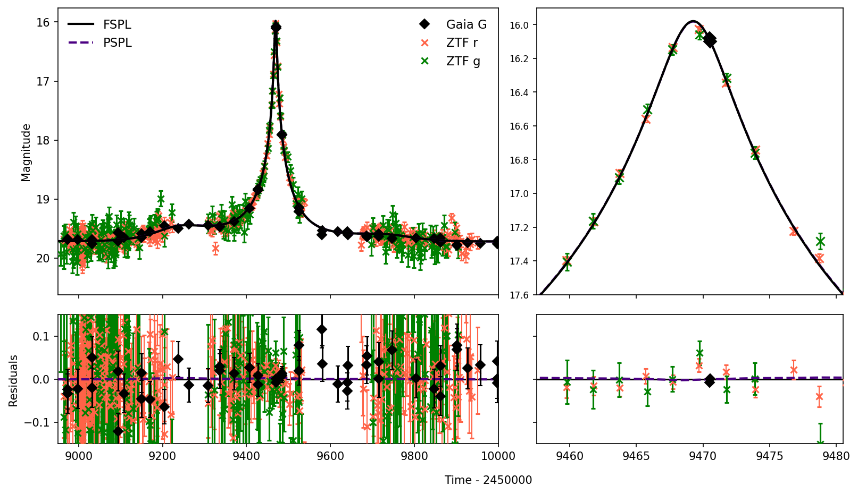
ULENS-067
Gaia21azb
Gaia21efs
Gaia21dpb

Slide 12
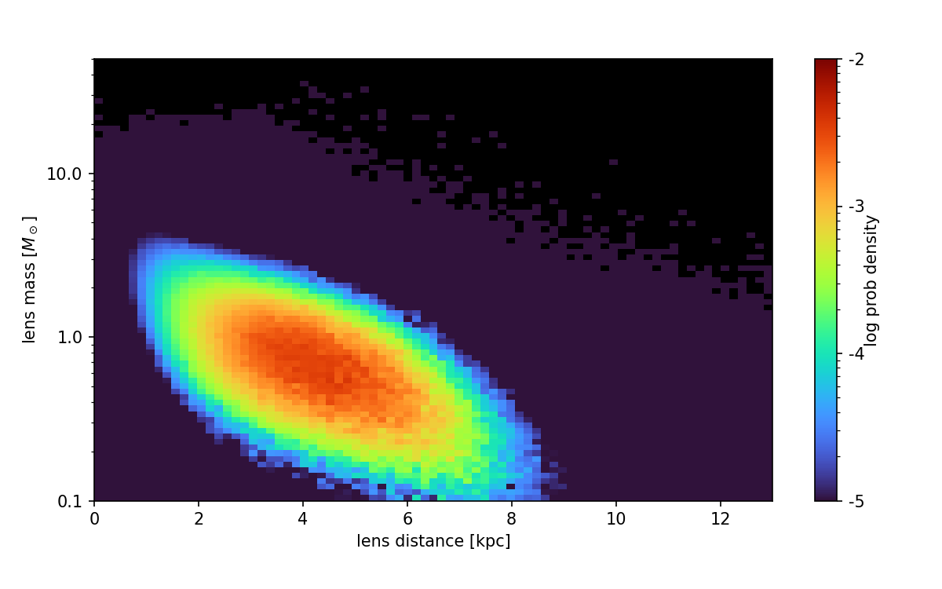
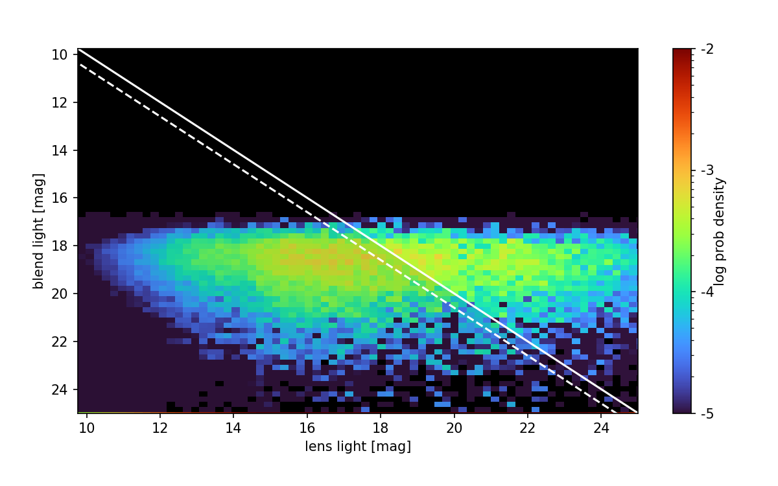
Dark lens code (DLC)
Lens mass, distance, transverse velocity, and brightness distributions
coordinates
light curve posterior distribution
source properties
extinction
Weights based on Galactic priors (relative proper motion, lens distance, lens mas)
Howil+2025

Slide 13
Results
M_{L} (FS effect) [M☉]
M_{L} (DLC) [M☉]
v_{⊥,L} (DLC) [km/s]
Type
GaiaDR3-ULENS-067
Gaia21efs
Gaia21azb
Gaia21dpb
>0.40
~1.4
~300
NS
>0.75
~1.0
~120
NS/WD
>0.50
~1.1
~190
NS/WD
>0.01
~0.4
~100
WD
Pylypenko+2025

Slide 14
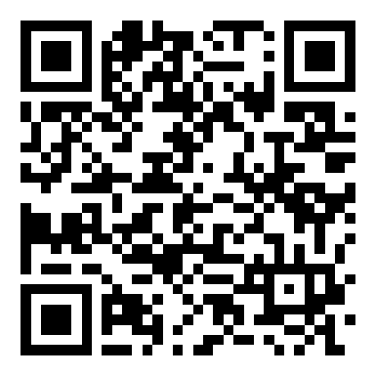
Summary
Thank you!
We got lens mass limits from light curves only!
1 NS candidate, 2 NS/WD candidates, 1 WD candidate found
They can be confirmed using astrometric counterparts from Gaia DR4 & DR5
Pylypenko+2025

Slide 16
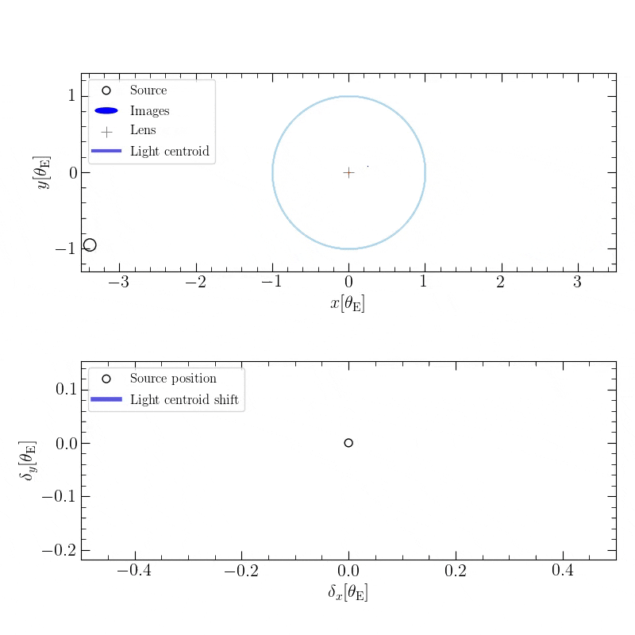
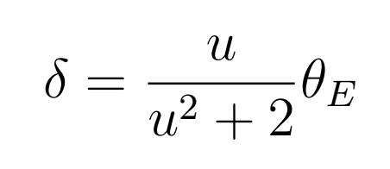
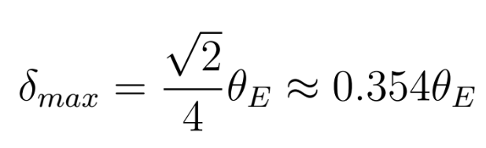
Astrometric microlensing
Dominik & Sahu 2000
Credit: Kris Rybicki

Slide 17
Method
Empirical colour-angular diameter relations
(Adams+2019)
Ө*
M_{L},D_{L}
Ө_{E}
Light curve
⍴_{lim}
DLC
Light curve
t₀, u₀, t_{E}, π_{EN,} π_{EE}

Slide 18
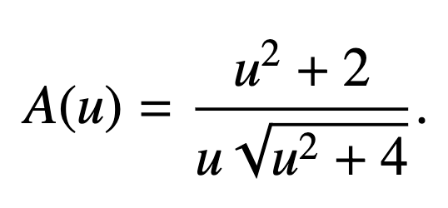
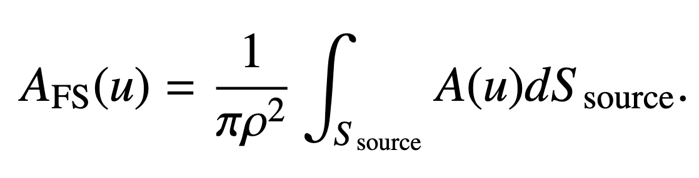
More on FS effect

Slide 19
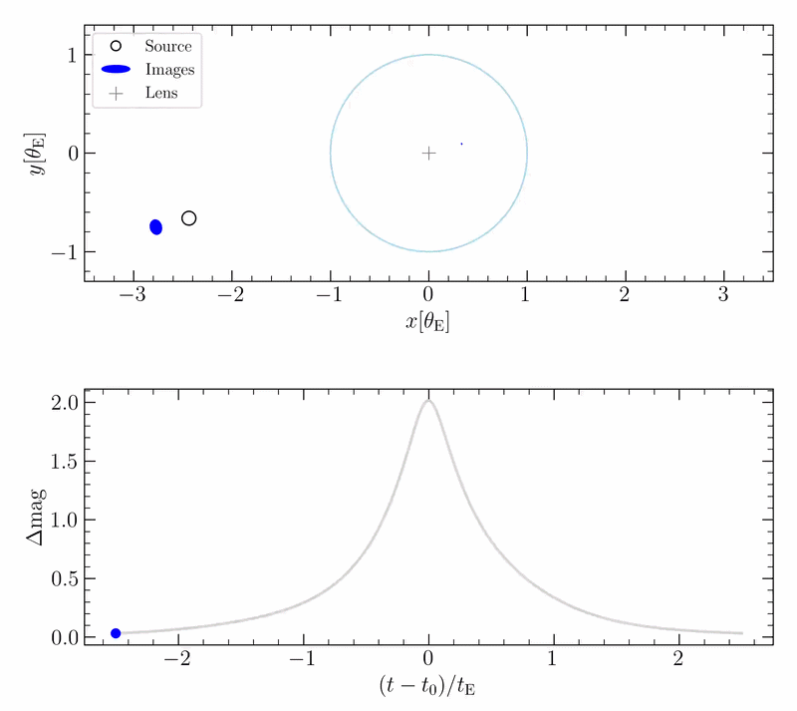
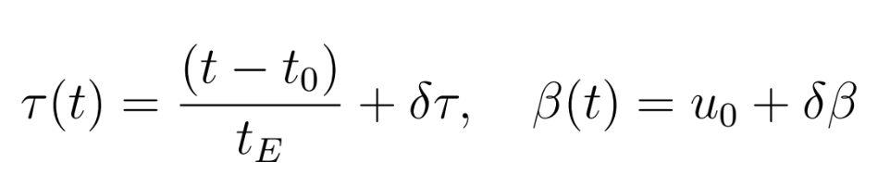
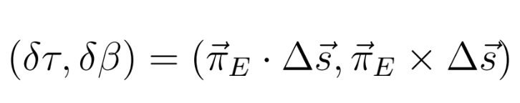
Microlensing parallax
Gould+2000
Credit: Kris Rybicki

Slide 20
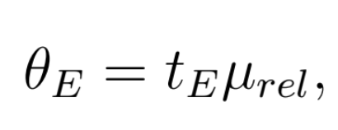
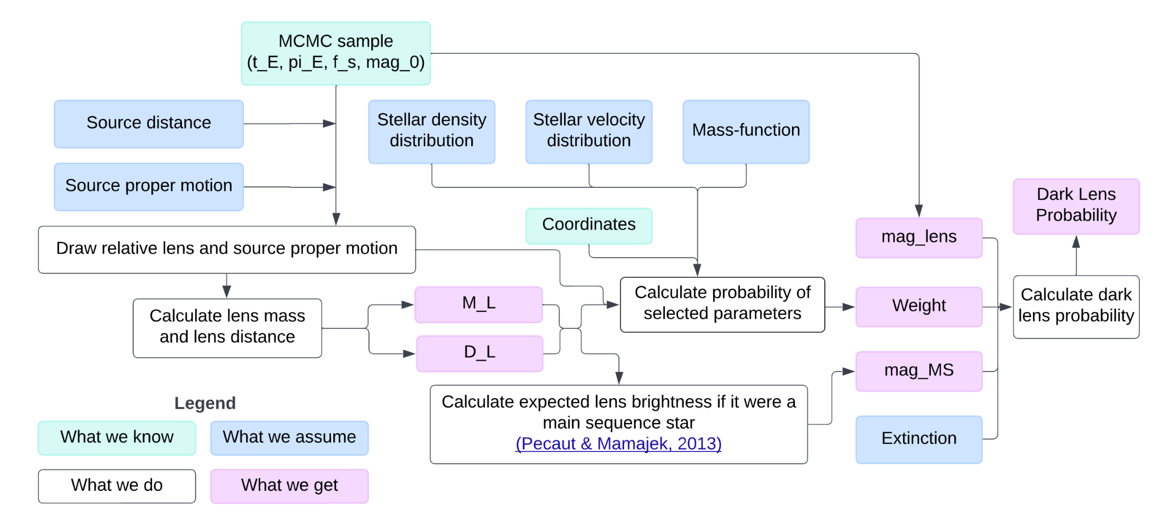
More on DLC
Howil+2025

Slide 21
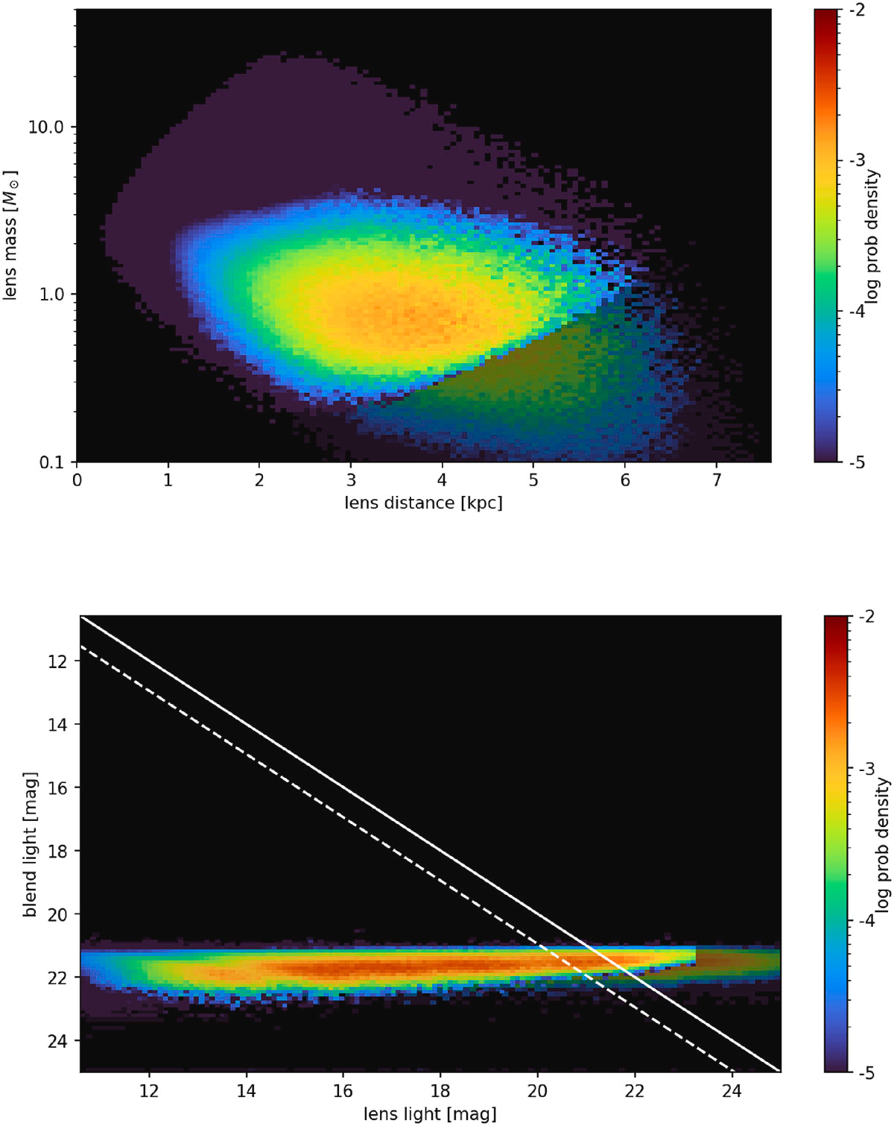
DLC — mass-distance plot
Distribution with Ө_{E} higher than the limit
Original distribution

Slide 22
DLC – blend-lens plot
A_{G}=max
A_{G}=0

Slide 23
Galactic priors
Distance: Han & Gould 2003, Batista+2011
Relative proper motion – two Gaussians:
  Source – Gaia
  Lens – kinematic relations from Reid+2009
Lens mass: Kroupa mass function
Howil+2025

Slide 24
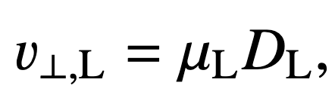
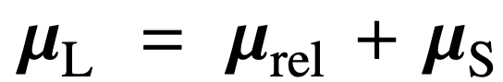
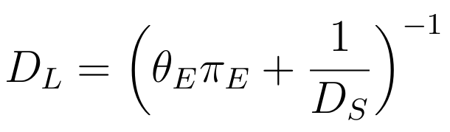
Lens transverse velocity
Gould+2000

Slide 25
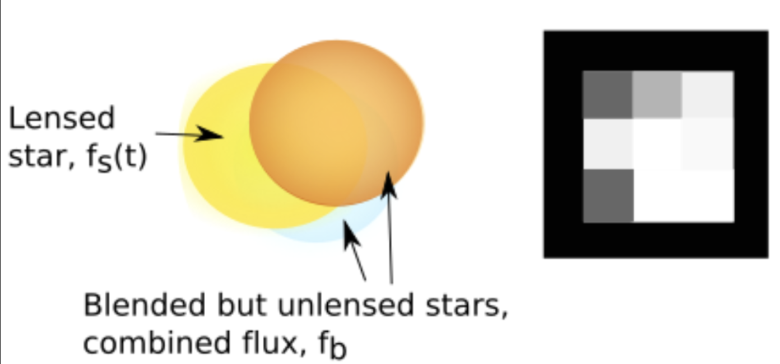
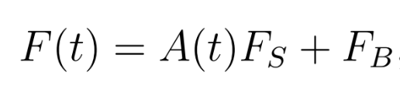
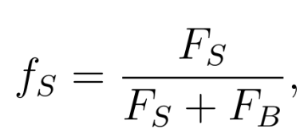
More on blending
fs~1 – dark lens
Credit: R.A. Street
Woźniak+1997

