Slide 1
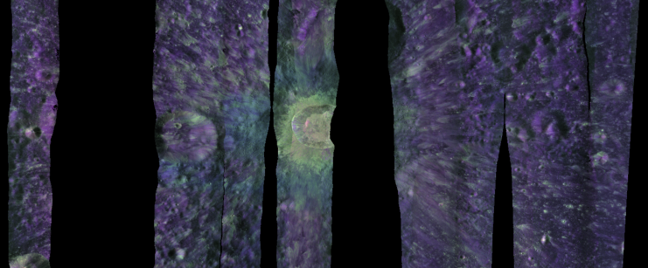
Polarimetric Radar Backscatter Roughness Metrics over the Lunar Surface
Image: A. Virkki
Anne Virkki¹,², Edgard G. Rivera-Valentín³, Caleb Fassett³, Tyler Powell³, Aino Huikari¹
¹ University of Helsinki, ² Finnish Geospatial Research Institute,
³ Johns Hopkins University Applied Physics Laboratory
Nordic-Baltic Astronomy Days, Turku, May 27, 2026

Slide 2
Context
There is a renewed interest in manned missions to the Moon
Rock abundance on the lunar surface is relevant for landing-site evaluation
Radar circular polarisation ratio has been used for decades to assess decimeter-scale surface roughness for planetary bodies, but only as a first-order estimate: low values for little roughness, high values for very rough (the definition of roughness has varied).
  The role of the illumination geometry is often omitted
We determine specific polarimetric values as a function of cm-to-m-scale rock abundance (Rivera-Valentin et al. 2026, PSJ, In press)

Slide 3
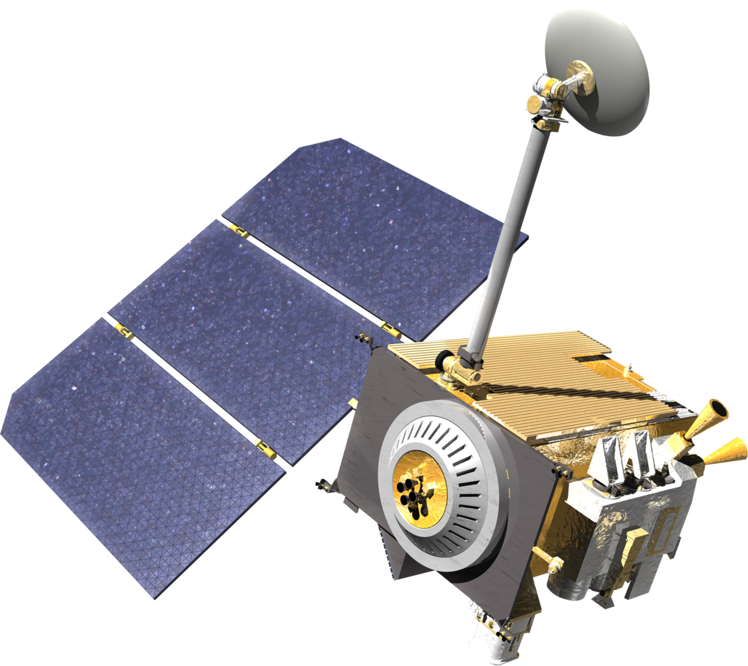
Mini-RF and Diviner
The Lunar Reconnaissance Orbiter (LRO) can determine
both the radar backscatter and the rock abundance
  The Mini-Radio Frequency instrument is a polarimetric synthetic-aperture radar
  The Diviner Lunar Radiometer Experiment infers meter-scale rock abundance from thermal measurements (large boulders retain heat longer than fine-grained regolith)
Mini-RF transmitted S-band (12.6 cm) radar signal in full circular polarization at a 50° incidence angle with respect to the mean normal of the observed area, and received the signal echo power in two orthogonal linear polarizations (“H” for horizontal and “V” for vertical), including the phase difference between them.
  The information is used to derive the four Stokes elements that describe the full polarimetric state of the received echo.

Slide 4
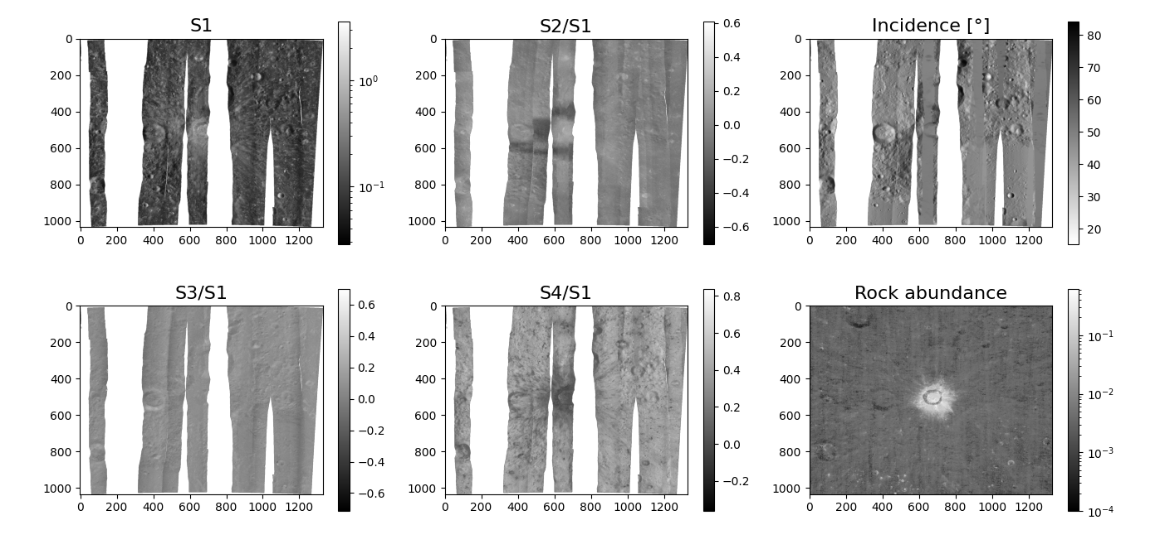
Stokes elements for Giordano Bruno crater
Note: The illuminating signal is circularly polarized, so the echo is also dominated by circularly polarized signal (different from optical measurements illuminated by unpolarized sunlight!)

Slide 5
Stokes elements for Giordano Bruno crater
There are striking bands visible in the S₂/S₁ data near bright craters. They are at least partially caused by a glitch in the signal compression algorithm.
The technical team is looking into instances where it can be corrected. Some instances will have a saturation-like effect where data were lost and cannot be corrected. For now, the bands should be excluded from any polarimetric analysis.

Slide 6
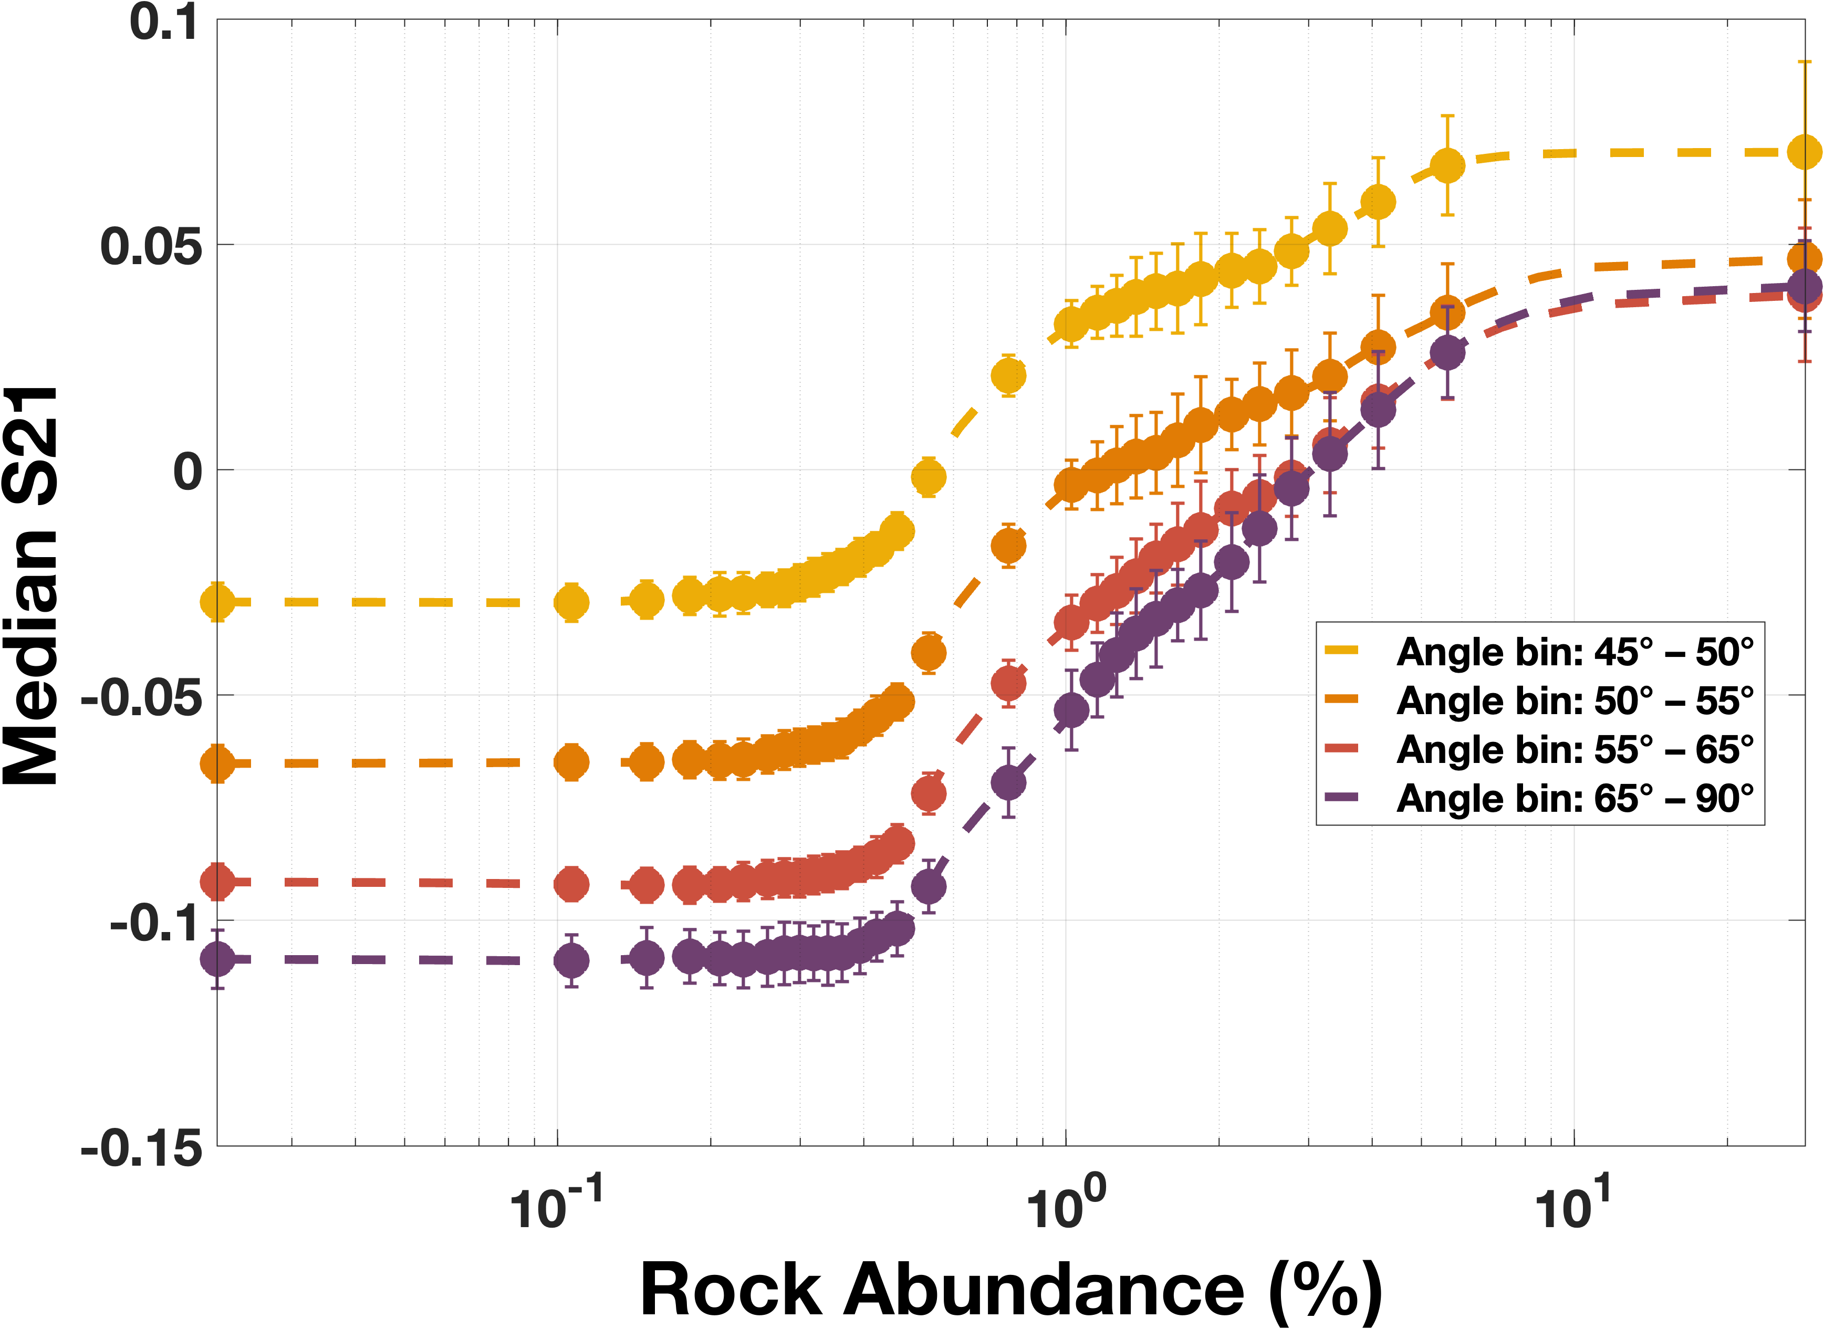
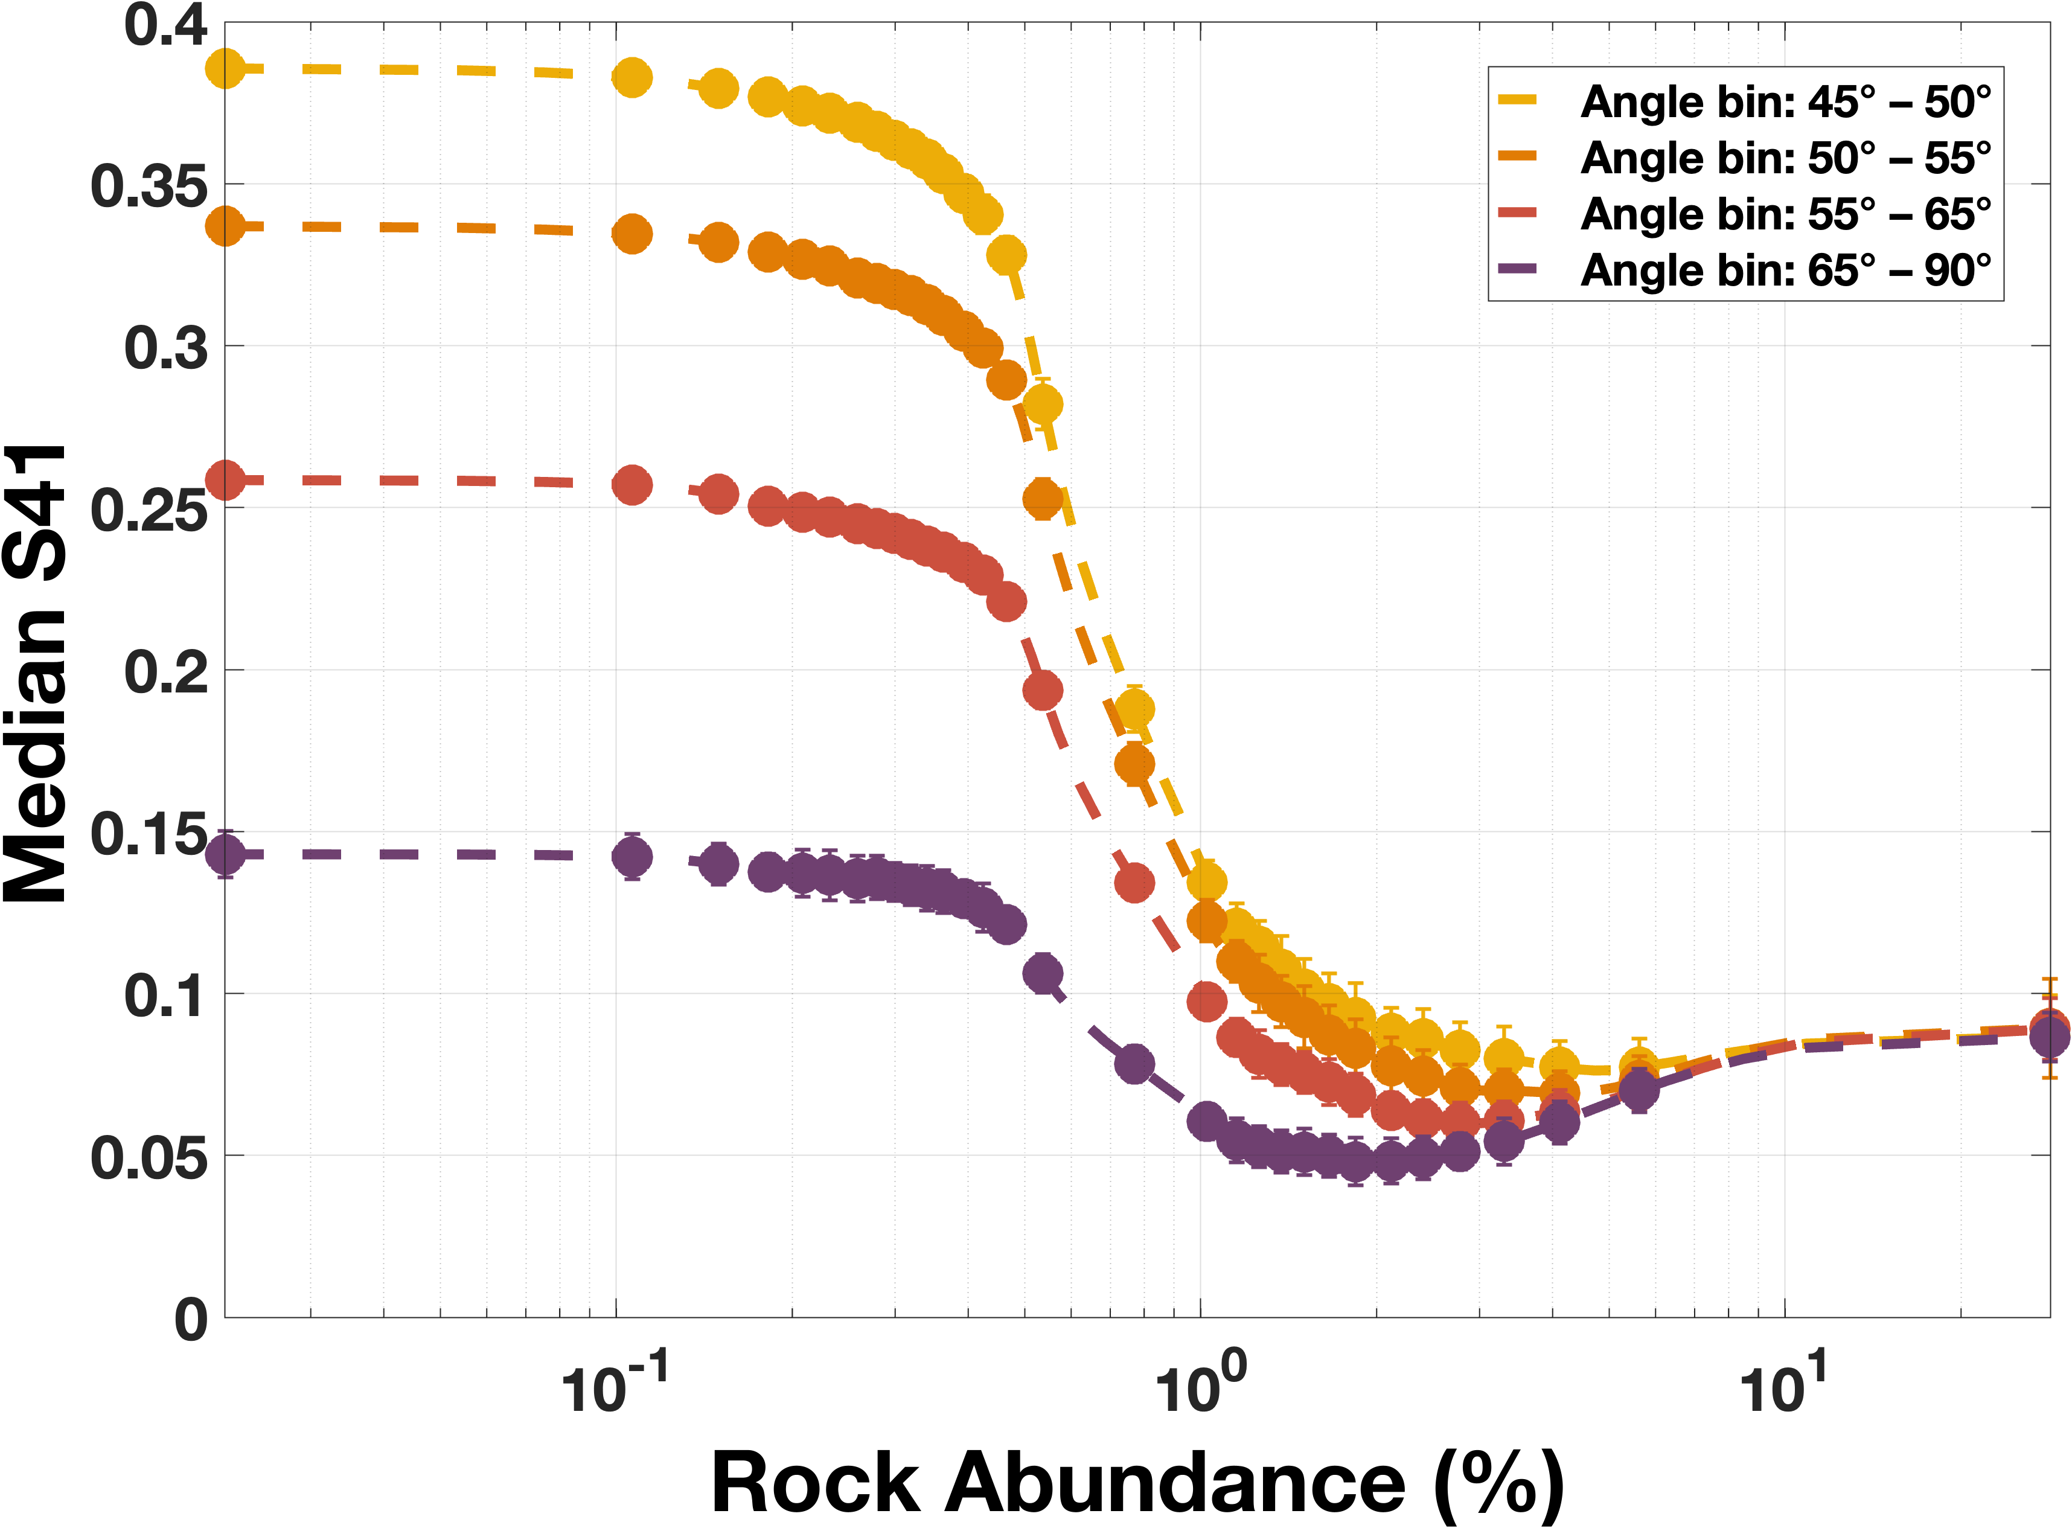
Stokes elements as a function of rock abundance
Median S₂/S₁
Median S₄/S₁
Data points were sampled from several regions, binned according to the incidence angle and rock abundance, and the median and the interquartile range were obtained for each subset of data. S₂ artifact bands were excluded.

Slide 7
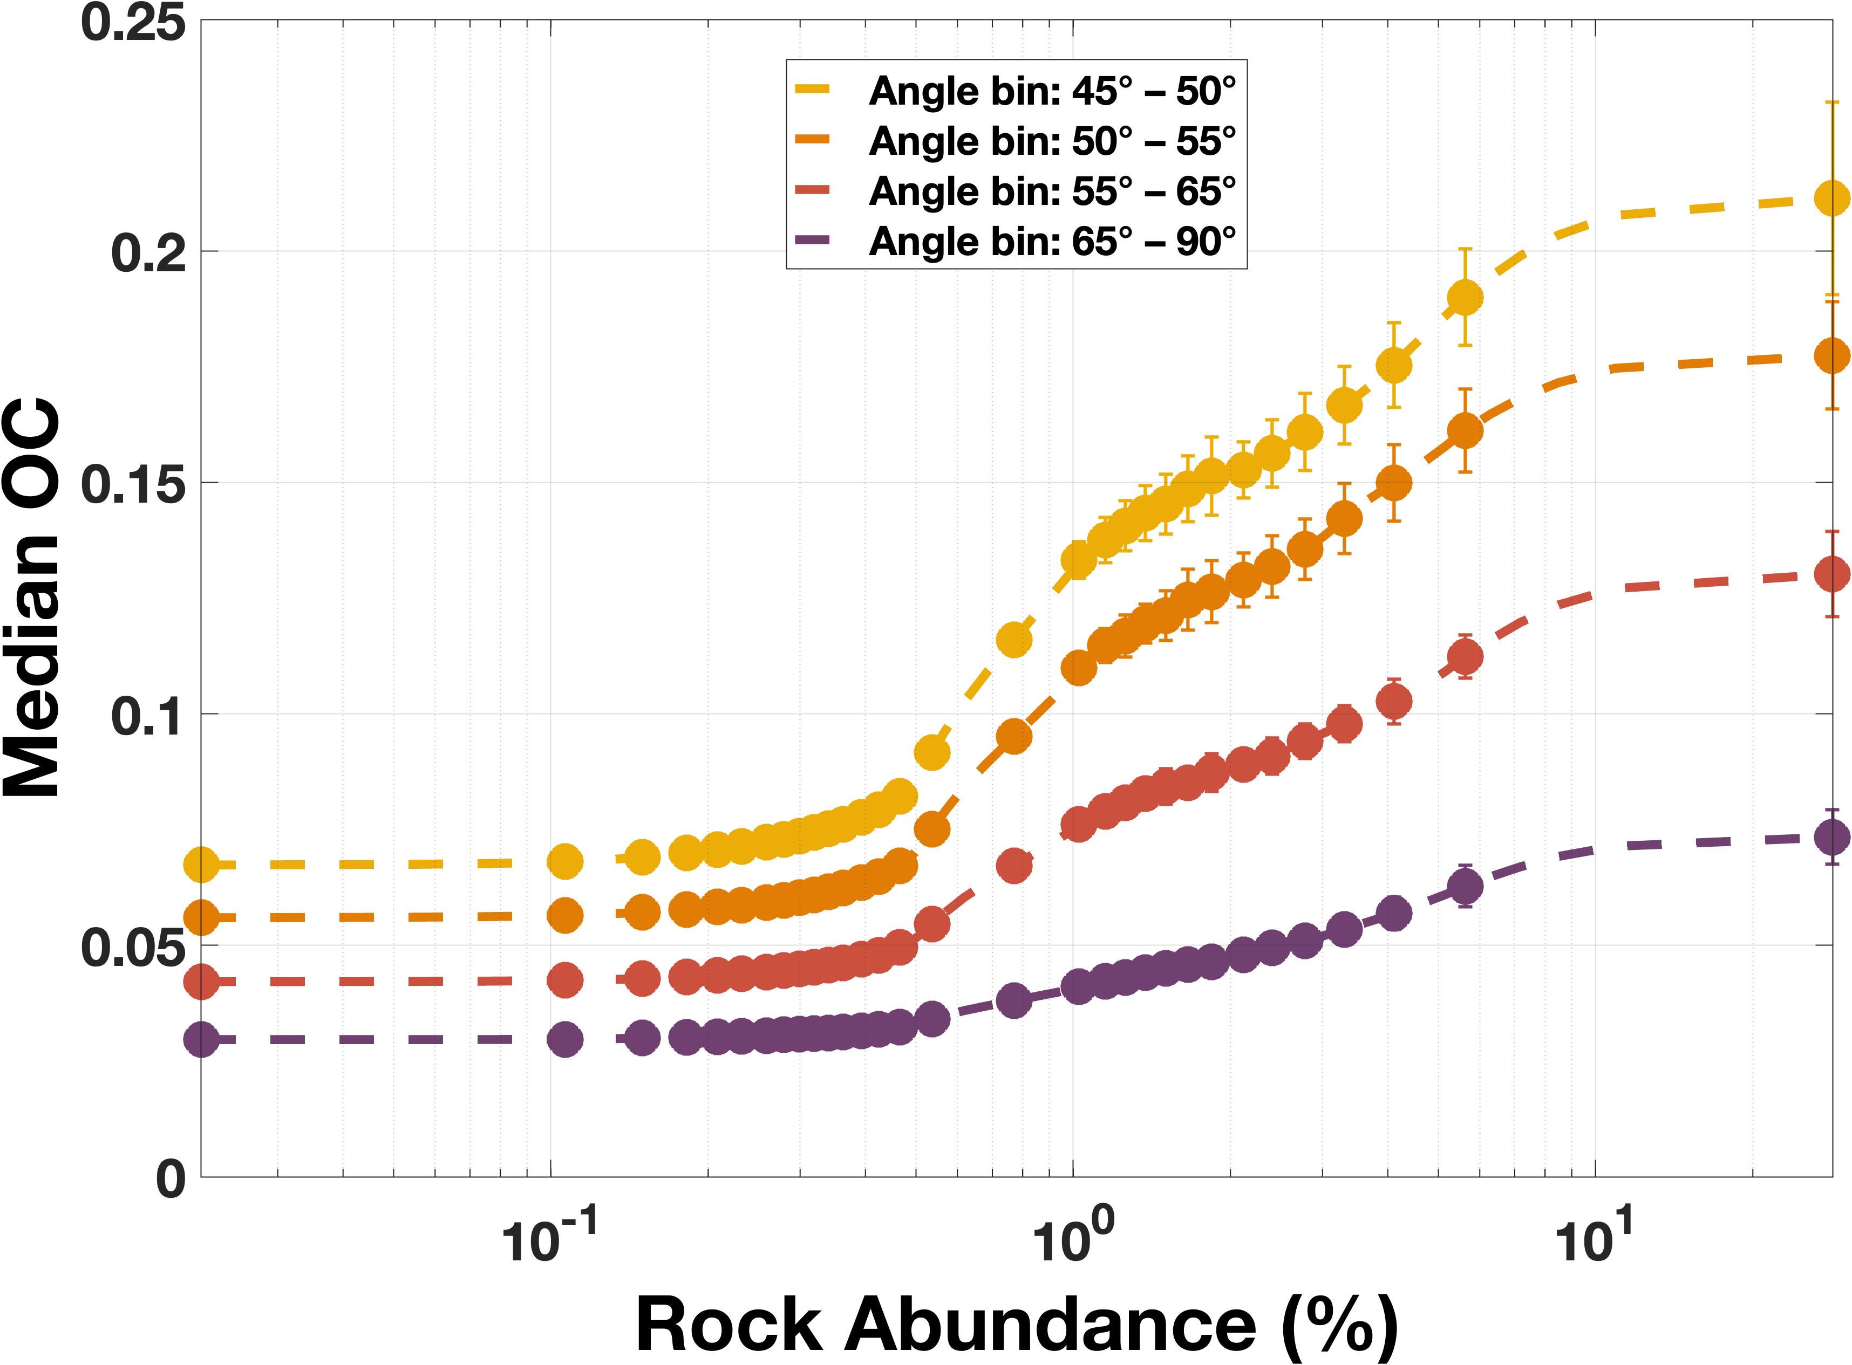
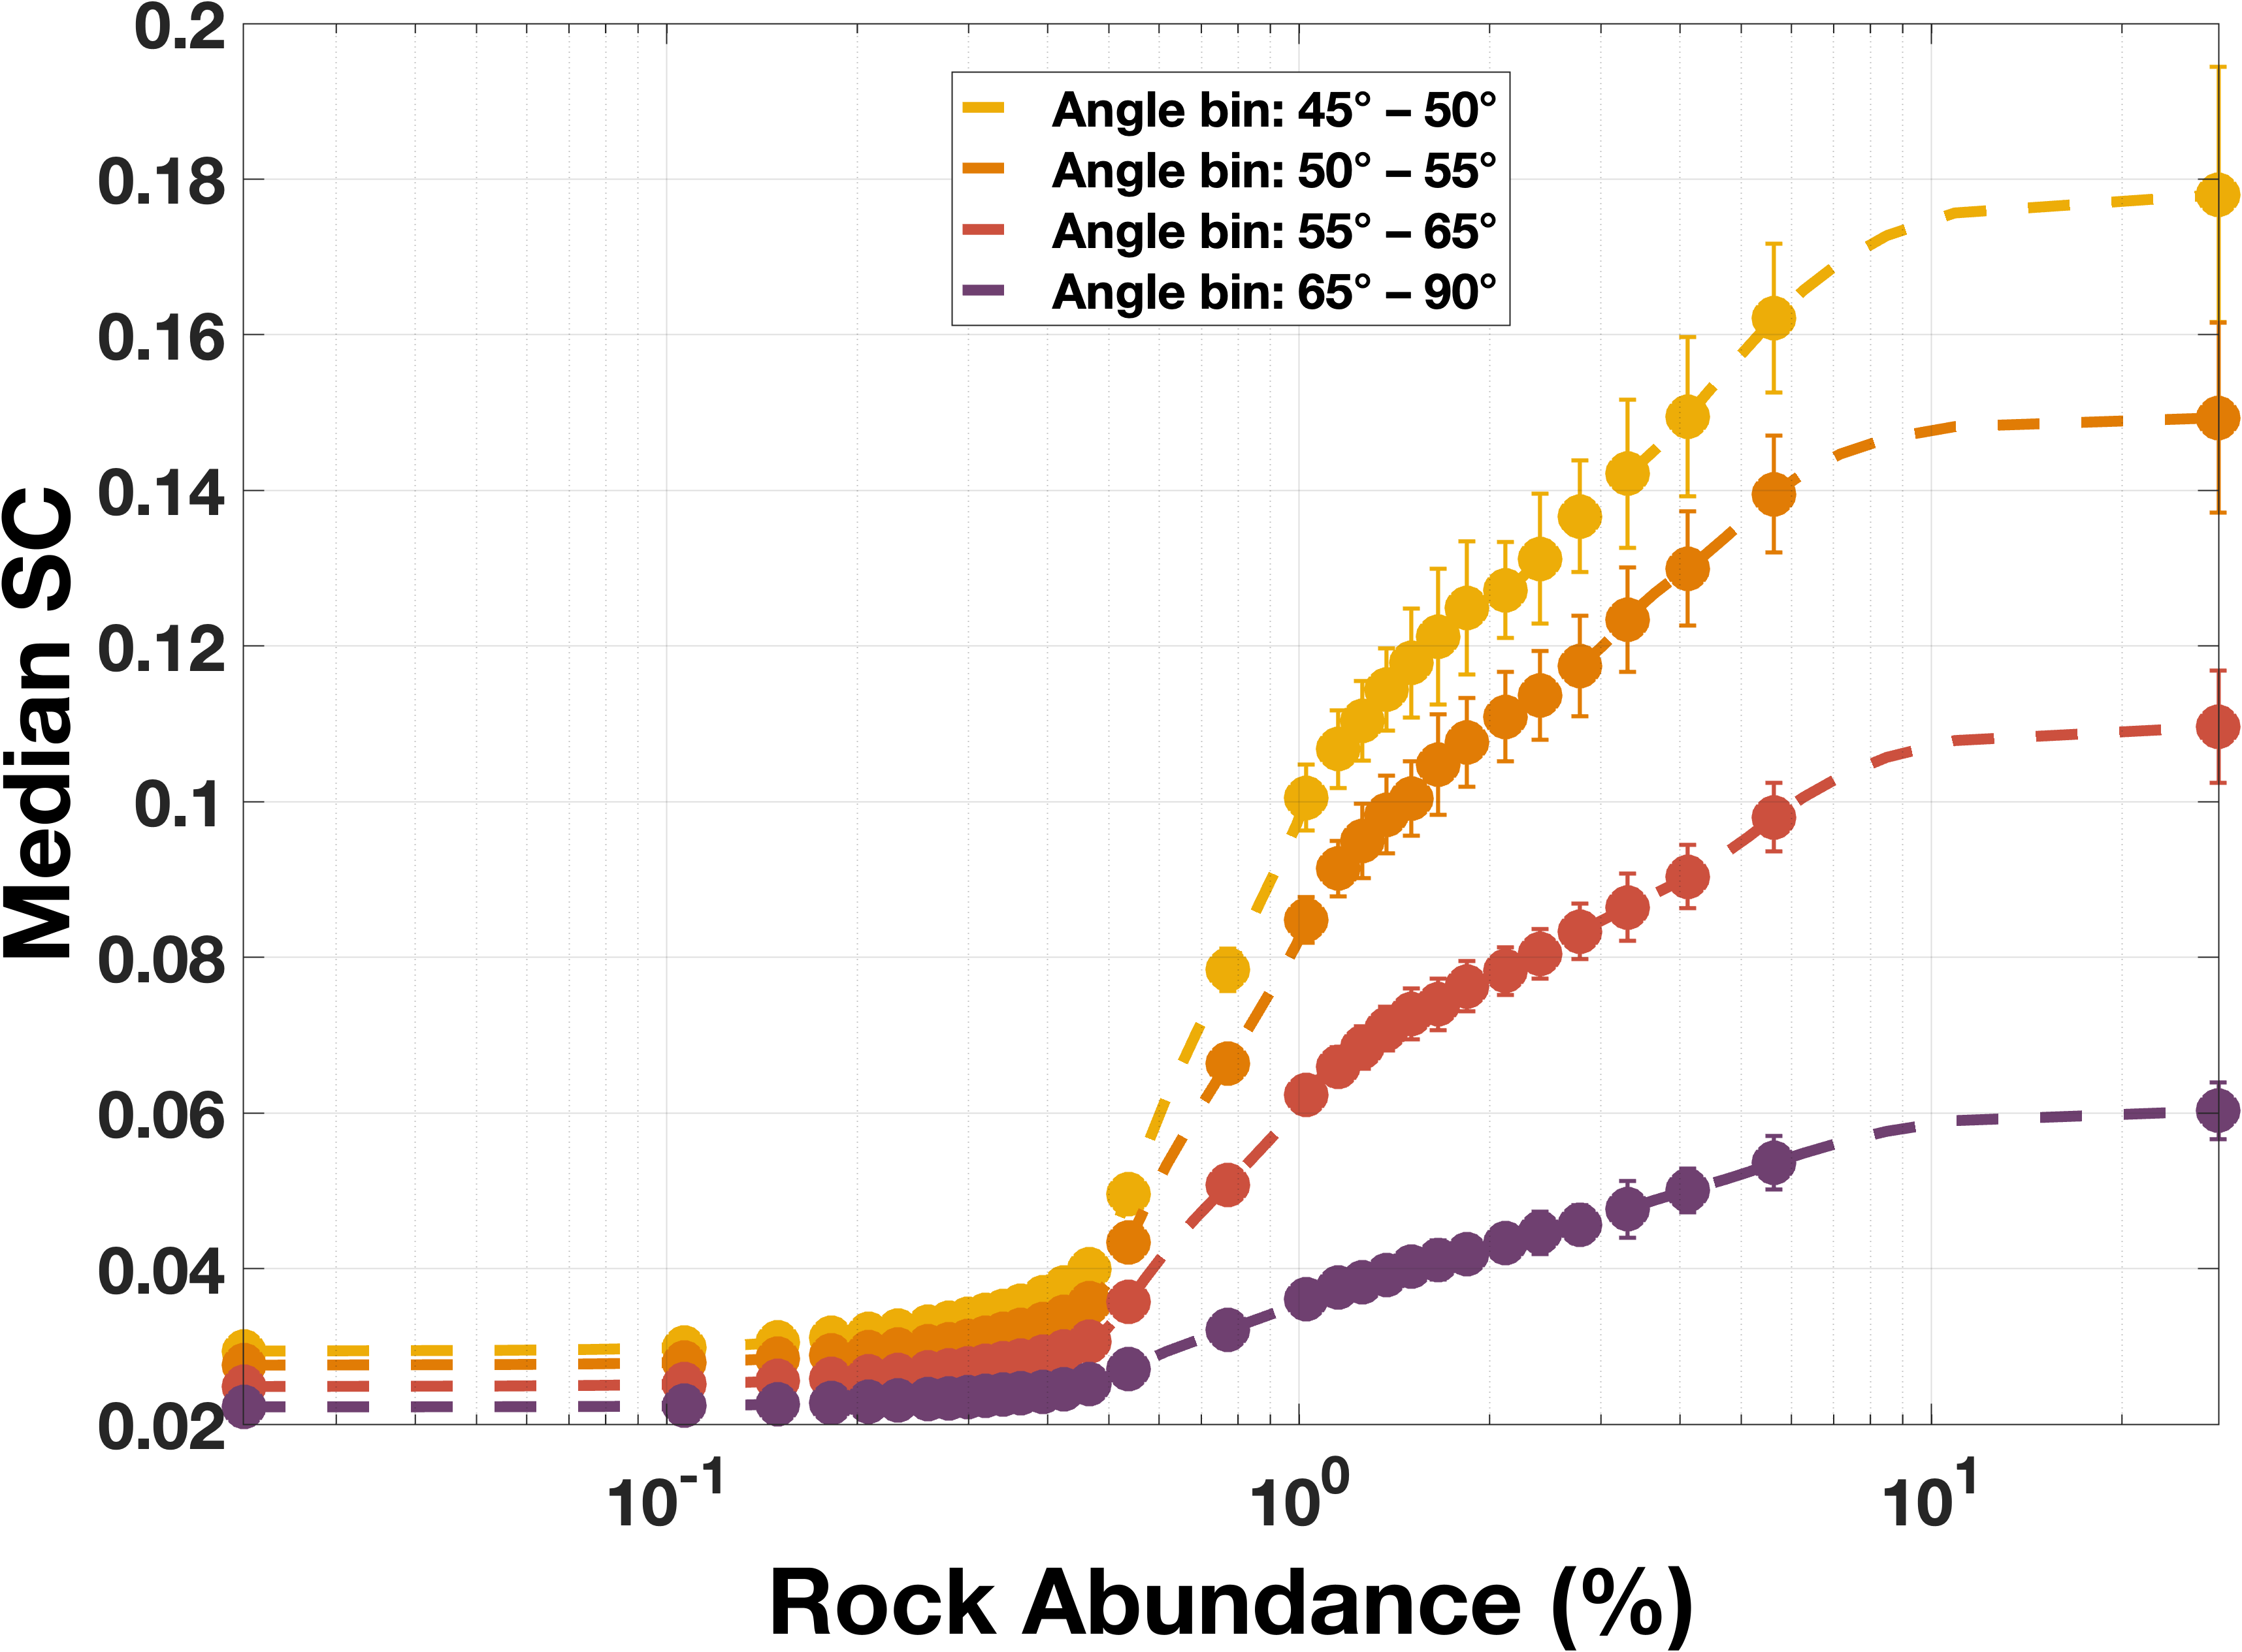
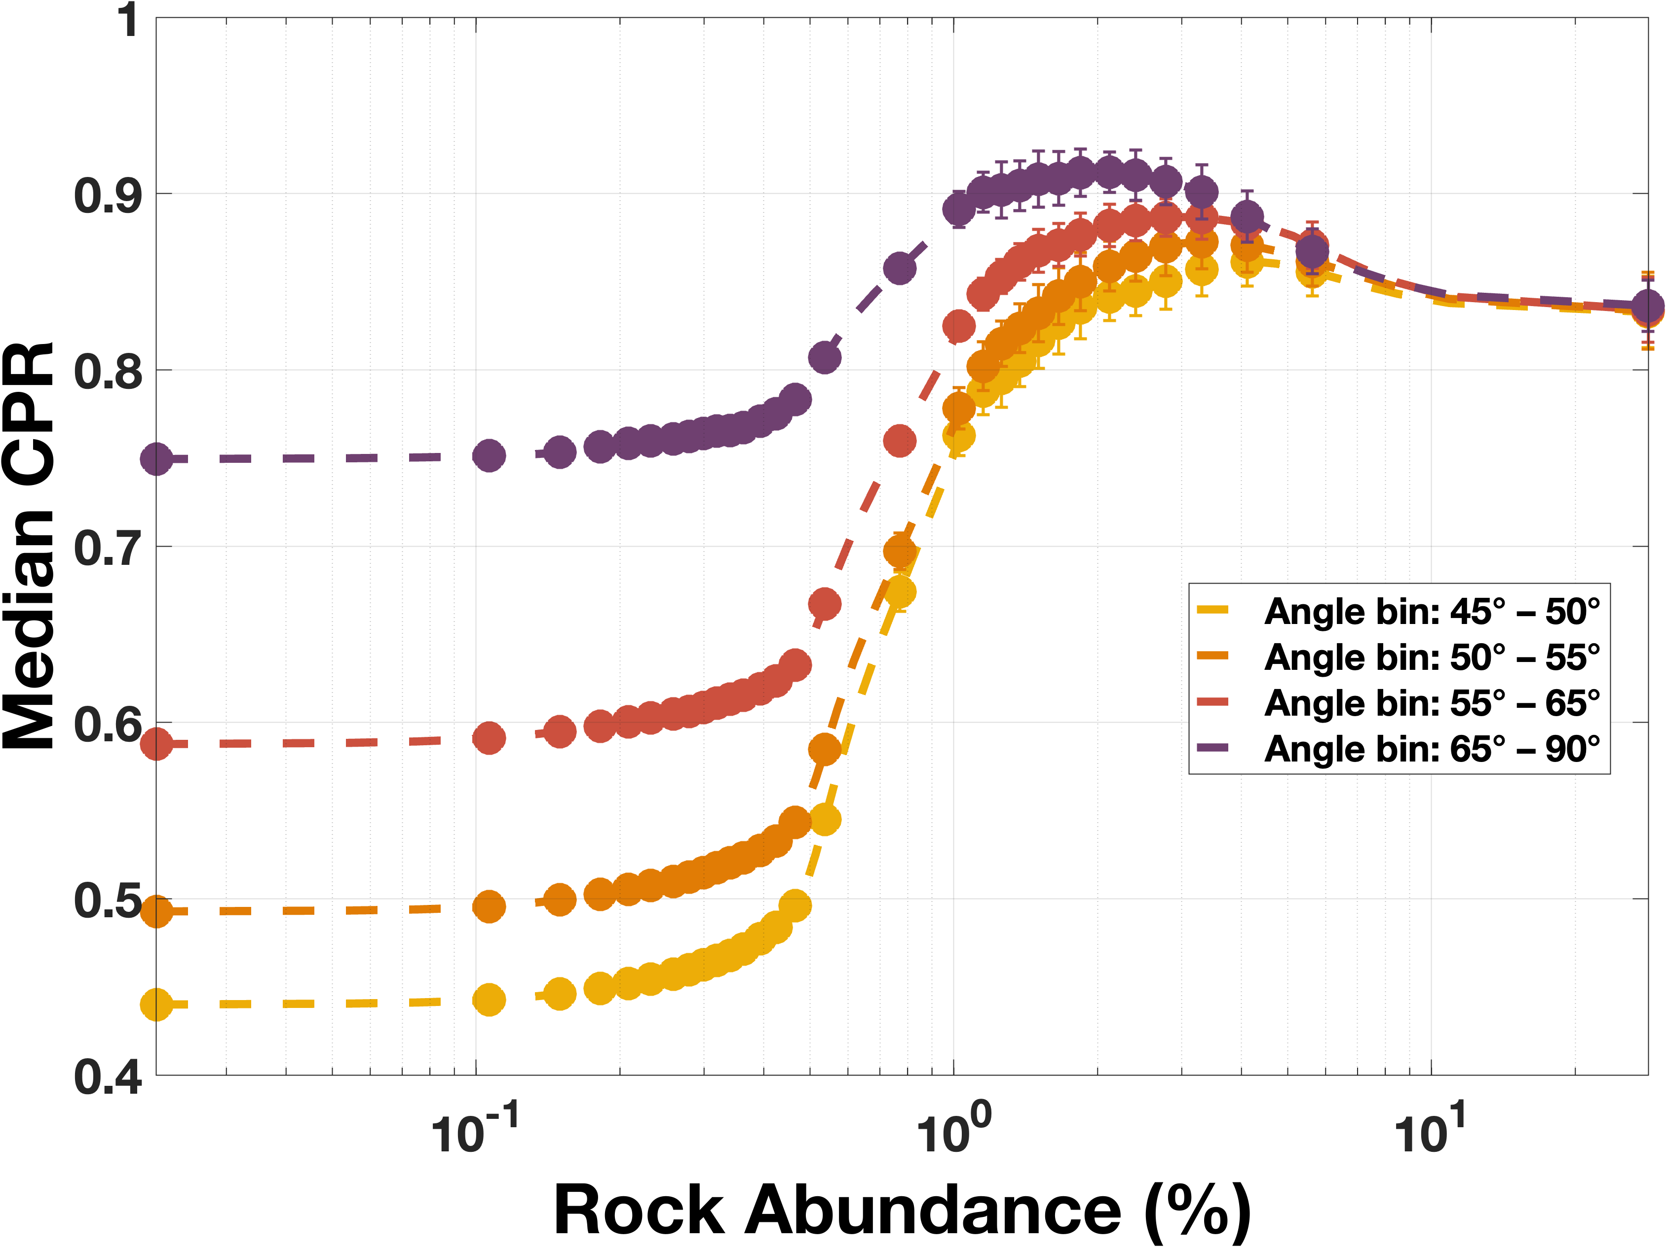
Circular polarization elements as functions of rock abundance
SC/OC (= CPR)
= (S₁ – S₄)/(S₁ + S₄)
= (1 – S₄/S₁)/(1 + S₄/S₁)
OC = (S₁ + S₄)/2 SC = (S₁ – S₄)/2
Normalized SC and OC cross sections are direct measures of rock abundance if incidence angle can be constrained (not always possible).
CPR is used often in the interpretation of roughness (= rock abundance) but it’s not an unambiguous measure.

Slide 8
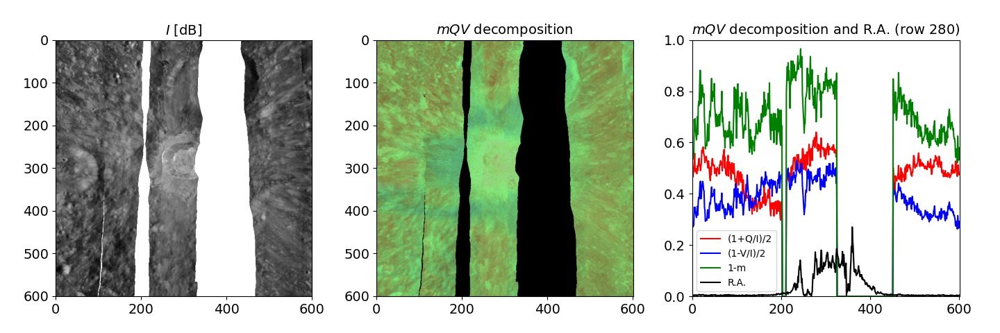

Polarization decomposition into an RGB map
The relative spatial variations of the polarimetric properties of an area become better visible by decomposing the polarimetric properties into color channels, where each color depicts one polarimetric parameter.
Here, we chose:
R: $(1+\text{S}\text{2}\text{/}\text{S}\text{1})/2$ (lin.)
G: $1−m$ (lin.+circ.)
B: $(1 –\text{S}\text{4}\text{/}\text{S}\text{1})/2$ (circ.)
where,
$m=\frac{\sqrt{S_{2}^{2}+S_{3}^{2}+S_{4}^{2}}}{S_{1}}$.
Both S₂ and S₄ are 0
at R,B = 0.5 (the figure
on the right)
Rock abund.
Note: The linear polarization component displays sharp variations depending on the distance from the crater. Artifacts are estimated at a few % but the negative S₂ features are very strong. A real feature?

Slide 9
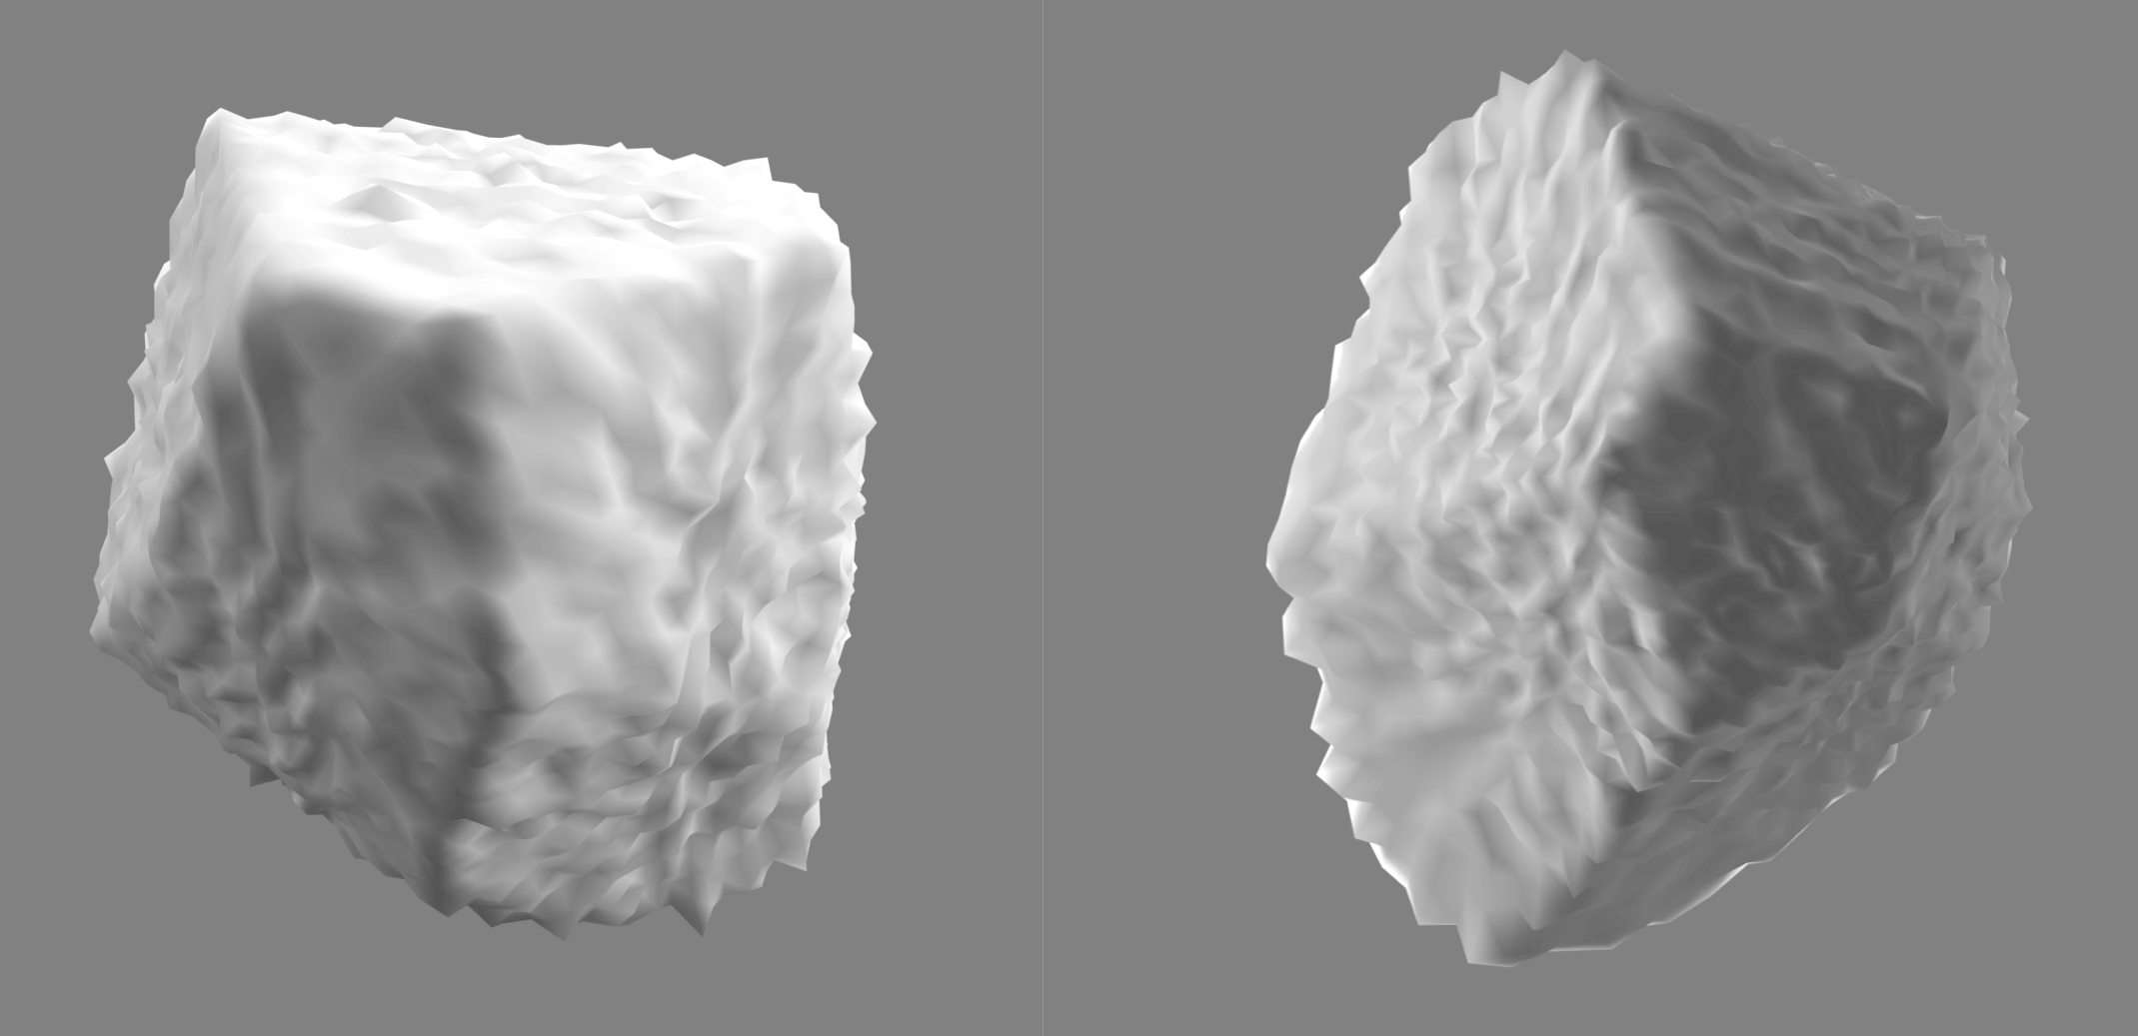
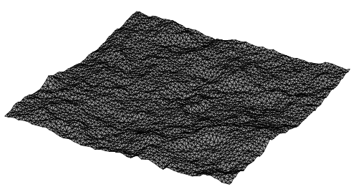

Simulating surface scattering by wavelength-scale particles
Future work
We used Advanced Discrete-Dipole Approximation (ADDA) code to simulate radar scattering by rocky particles on surfaces
Refractive indices determined based on laboratory-characterisation by Campbell et al. 1969: 2.17 + 0.004i for particles, 1.55 for the substrate
  Results not very sensitive to the refractive index in the range 2.1 – 2.8
Realistic asymmetric polyhedral particle shapes
Single-scattering cases
  Size parameters* up to x = 8 (D=32 cm)
  Incidence angles 0°–60°
Multiple-scattering cases
  Size parameters up to x = 7 (D=28 cm)
  Up to 10 particles per case
  Incidence angles 25°–85°
$$θ_{i}$$
*Size parameter: $x=\frac{2πr}{λ}=\frac{sphere−volume−equivalent circumference}{wavelength (here 12.6 cm)}$

Slide 10
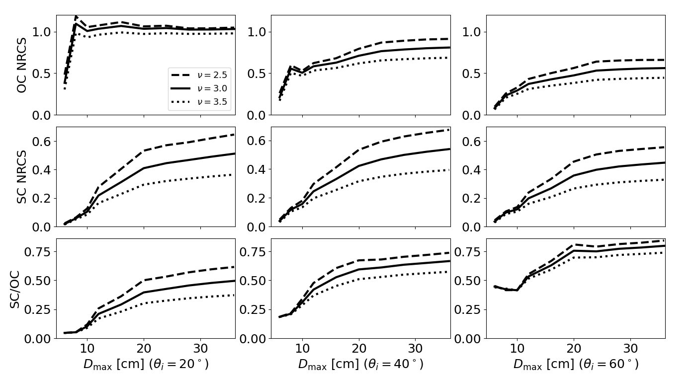
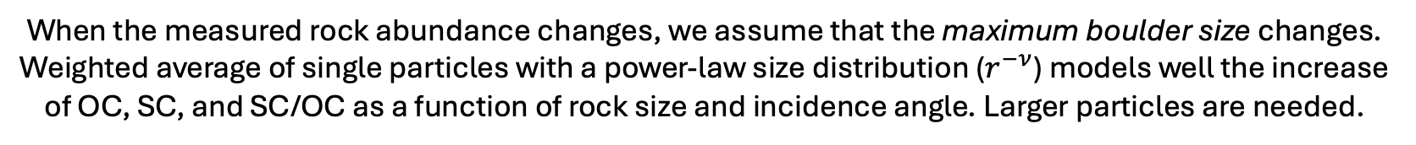
Single particles on a surface:
Circular polarization elements as a function of rock abundance
(incidence angles 20°, 40°, and 60°)
Future work
The number of particles scales OC and SC but not SC/OC.
Yellow lines on the right
Red lines on the right
When the measured rock abundance changes, we assume that the maximum boulder size changes. Weighted average of single particles with a power-law size distribution ($r^{−ν}$) models well the increase of OC, SC, and SC/OC as a function of rock size and incidence angle. Larger particles are needed.

Slide 11
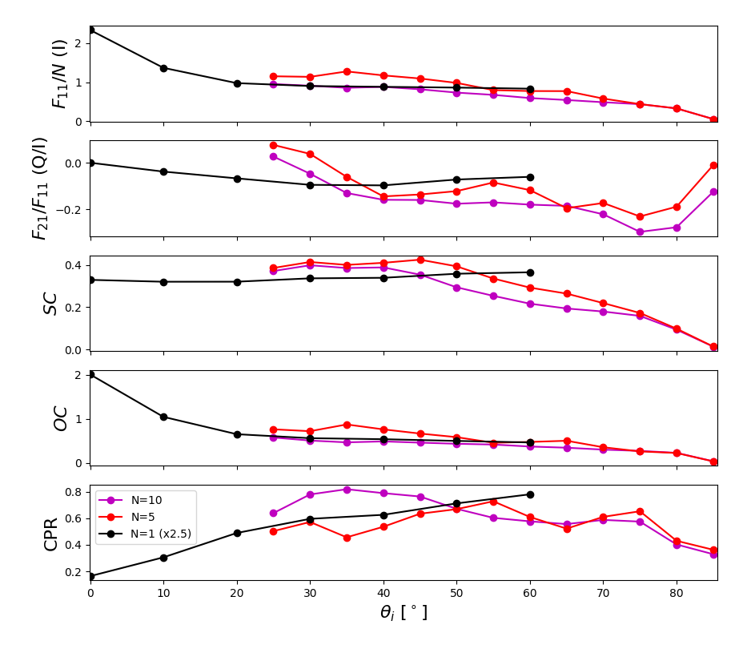
Multiparticle systems on a surface:
Surface-particle scattering as a function of incidence angle
Future work
Preliminary results for multi-particle systems on a surface: Comparing single particles to sets of 5 and 10 particles
  Number of realizations is still quite low for the multiparticle cases: further work is needed
Linear pol. deviates from 0 at non-zero incidence angles (primarily negative)
  In free space, F₁₂=F₂₁=0 at backscattering
Comparing to data: Rock abundance scales F₁₁ (∝ S₁) element vertically.
  Not directly comparable to the observed S₁ but shows the angular dependency due to the particles.
  A cosine coefficient was added to F₁₁, and SC and OC efficiencies to account for the illumination geometry.
  Contibutions of the particle-free surface and the subsurface volume scattering are not yet included.

Slide 12
Conclusions
We determine specific polarimetric values as a function of rock abundance (Rivera-Valentin et al. 2026, The Planetary Science Journal, In press).
  Rigorous quantification helps interpretation of radar polarimetry.
  For landing site evaluation and more generally crater ejecta characterisation
SC and OC increase directly proportional to the meter-scale rock abundance
  SC/OC ratio has been a commonly used metric for surface roughness, but it has a strong incidence angle ambiguity and is only valid when wavelength-scale particles dominate. High rock abundance means many large boulders.
  The ambiguities are smaller for SC and OC components individually due to the combined contribution of both S₁ and S₄ components.
Modeling work in progress: Are single particles sufficient or also multiparticle systems are needed? Role of volume scattering?

