Slide 1
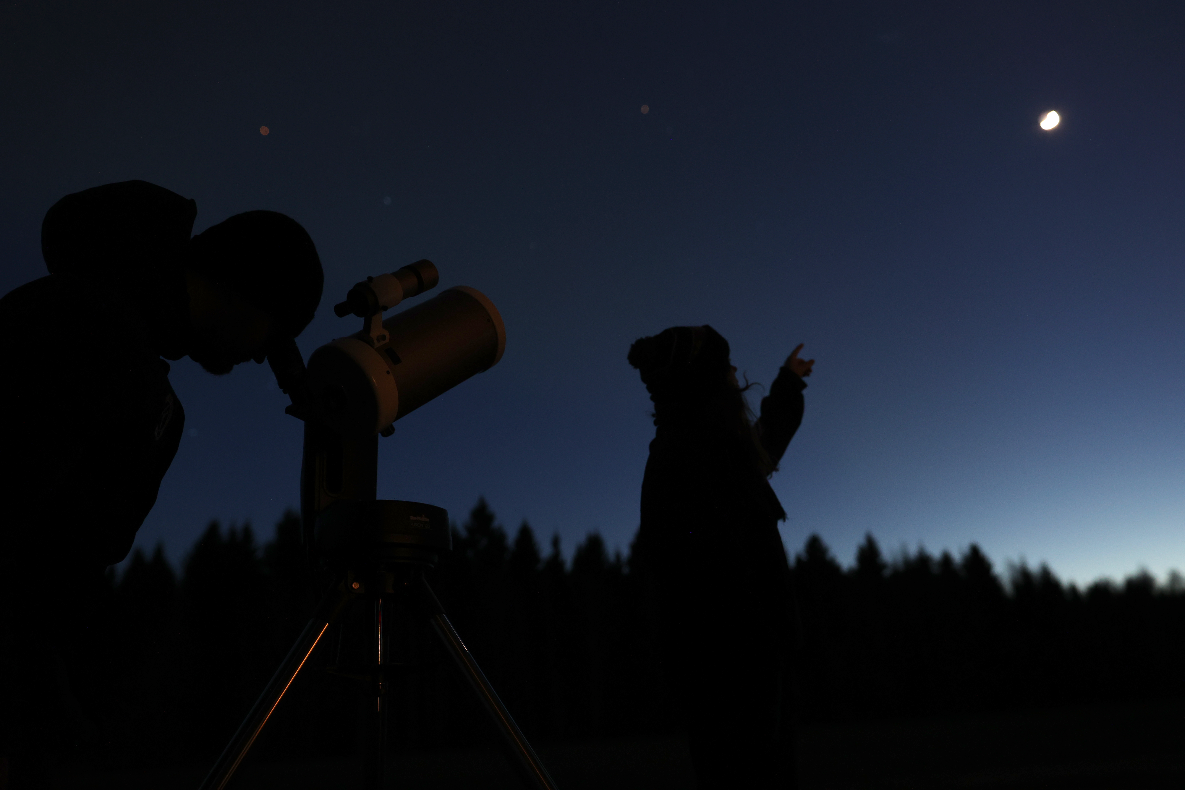


The Stars Belong to Everyone!
Communicating Astronomy in Finland
Anne Liljeström
Ursa Astronomical Association
Anne Liljeström | Ursa Astronomical Association | Nordic-Baltic Astronomy Days 2026

Slide 2
Astronomy outreach in Finland
(outside universities)
Astronomy associations
  Ursa Astronomy Association (”Ursa”), a national association
  Ca. 40 more or less active independent local astronomy associations
Science centres and museums
  Heureka Science Center, Vantaa
  Space Park Väisälä, Turku
  Tietomaa Science Center, Oulu
  Helsinki University Museum Flame, Helsinki
  Finnish Aviation Museum, Vantaa
  Kuopio Museum: ”Stardust – The Universe in You” exhibition
Some others
  Tiedetuubi, an online science publication
  Aikavaellus, history of the universe as walking tours
...Lots of visibility, diverse sources, plenty of interest – things are good!

Slide 3

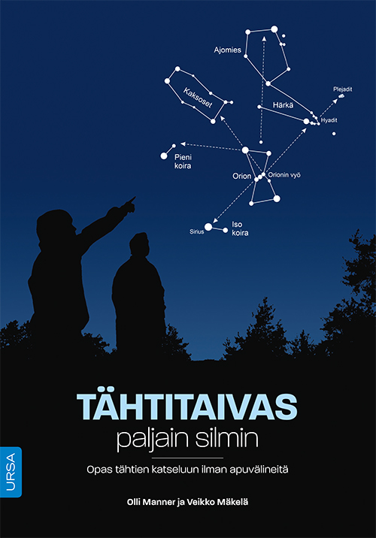

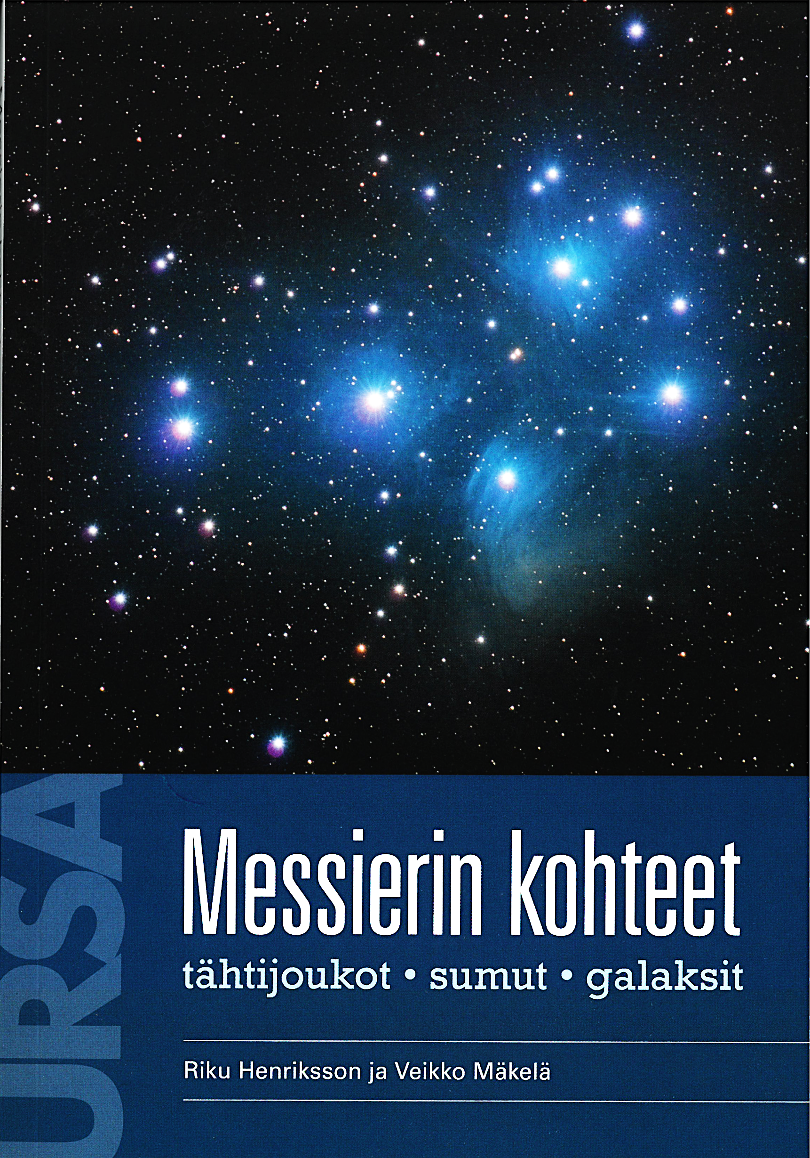
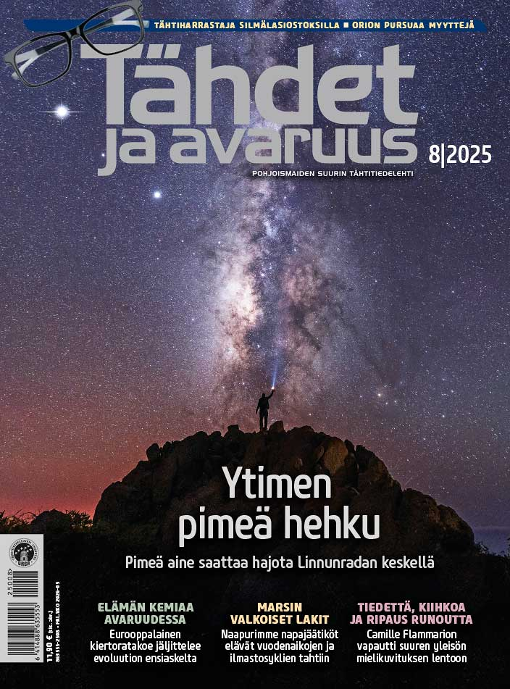
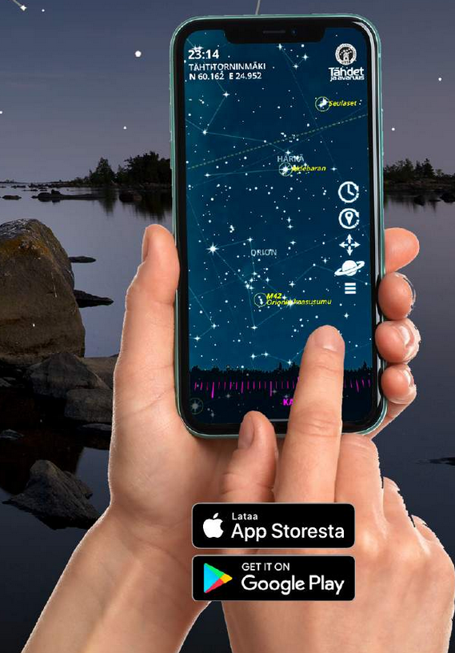
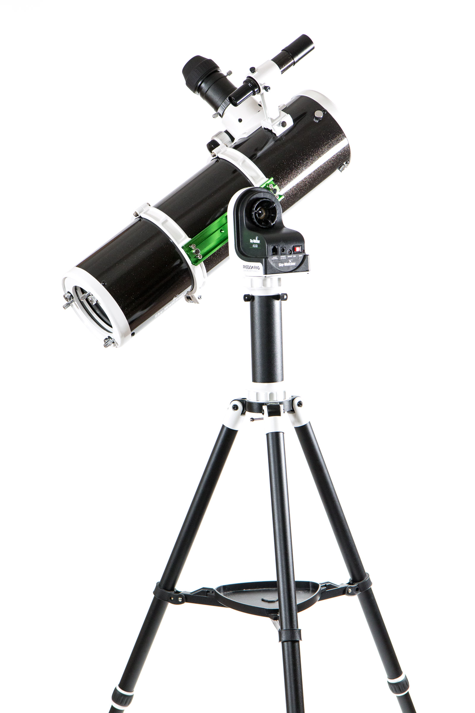
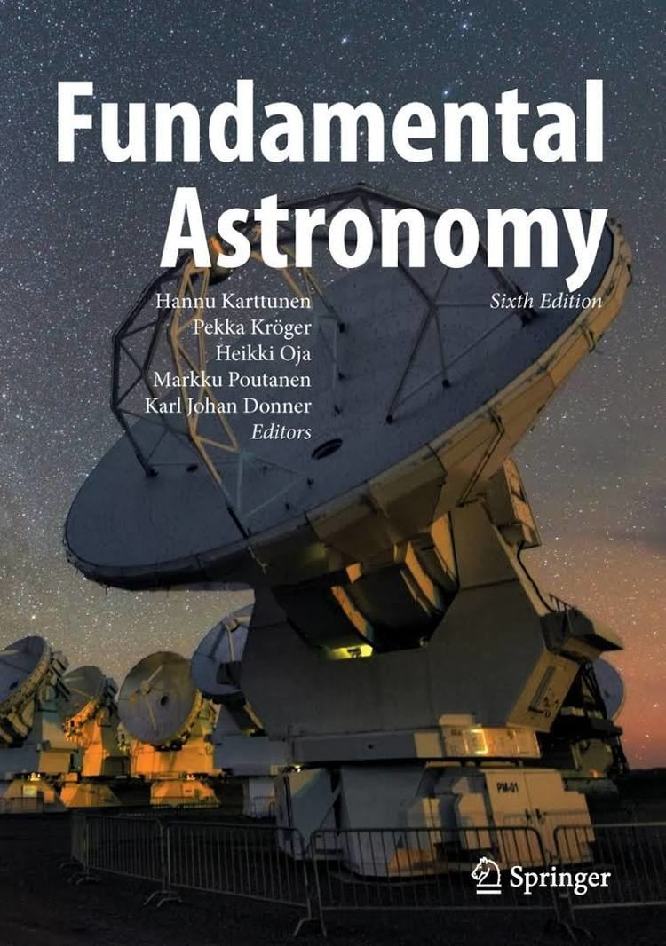
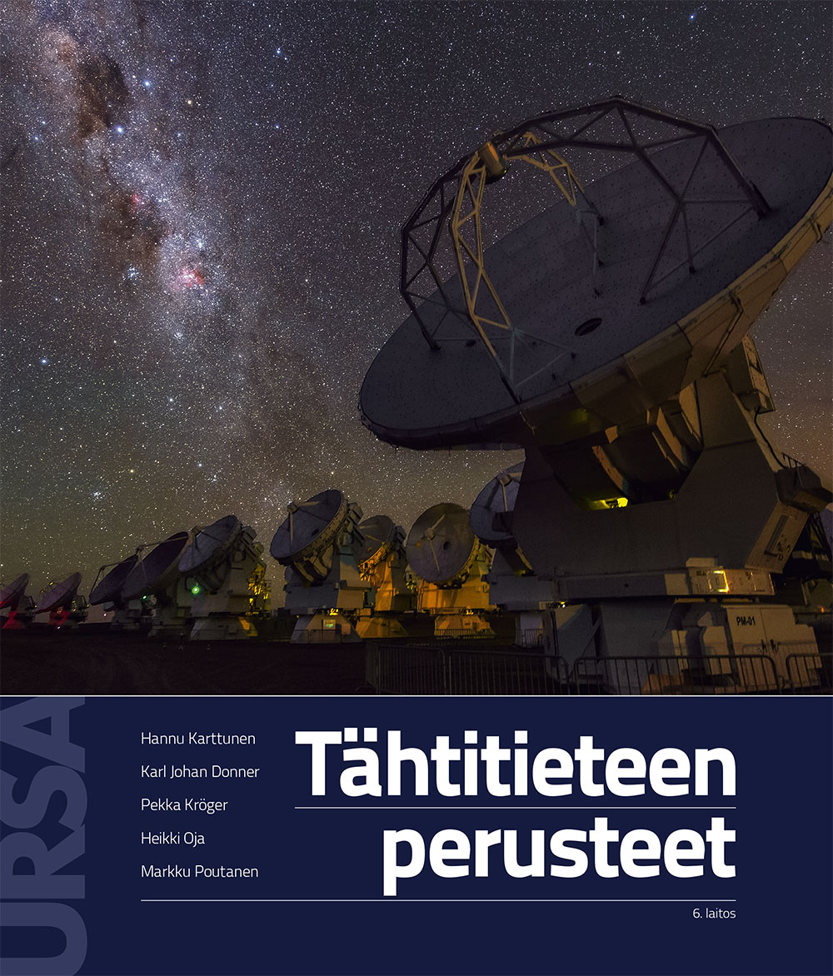
About Ursa
Est. 1921
Various activities and services,
not just for our members! in Finnish
Currently ~18 000 members

Slide 4
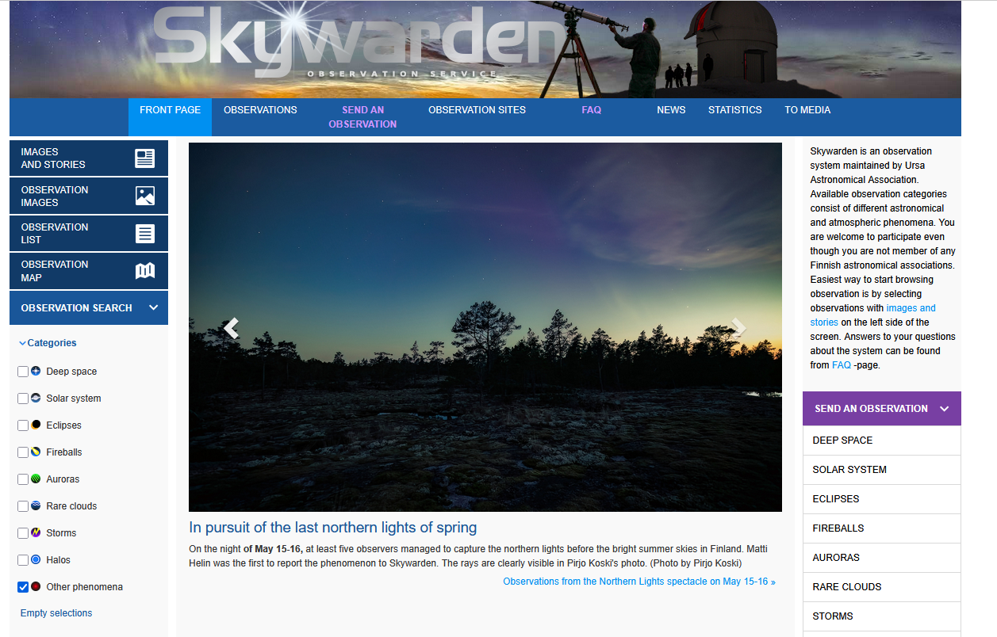
www.taivaanvahti.fi

Slide 5
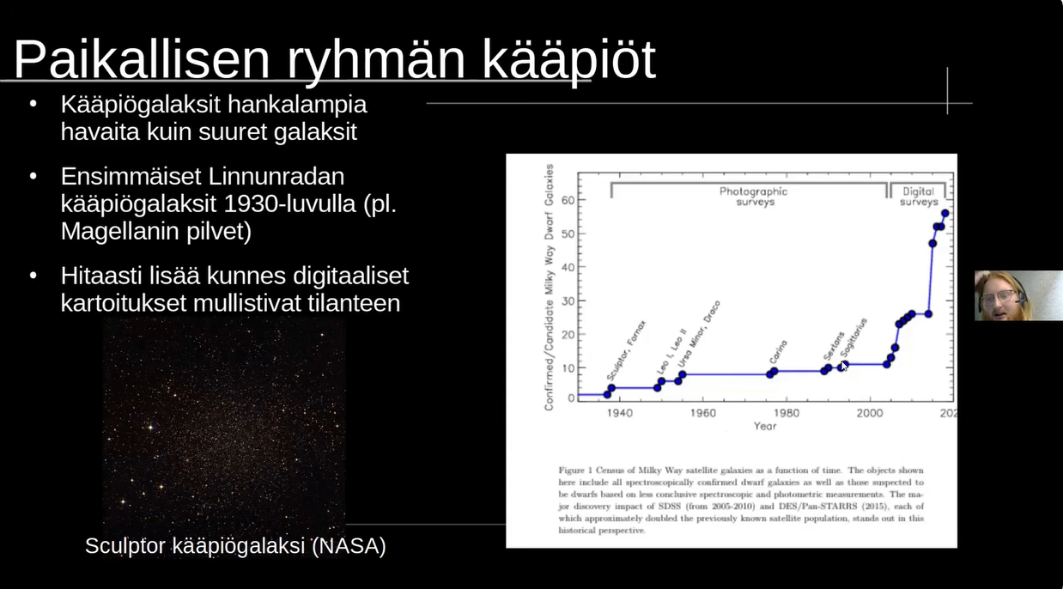
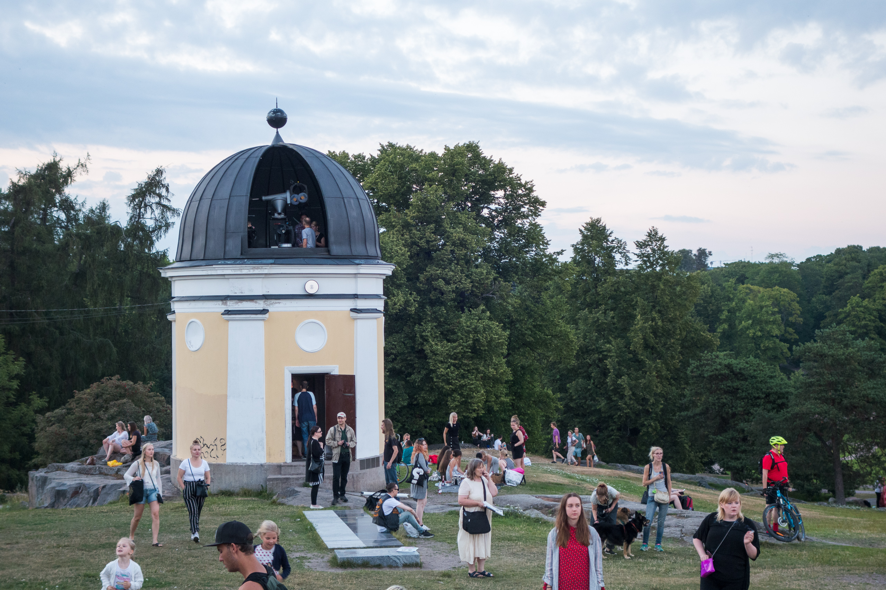
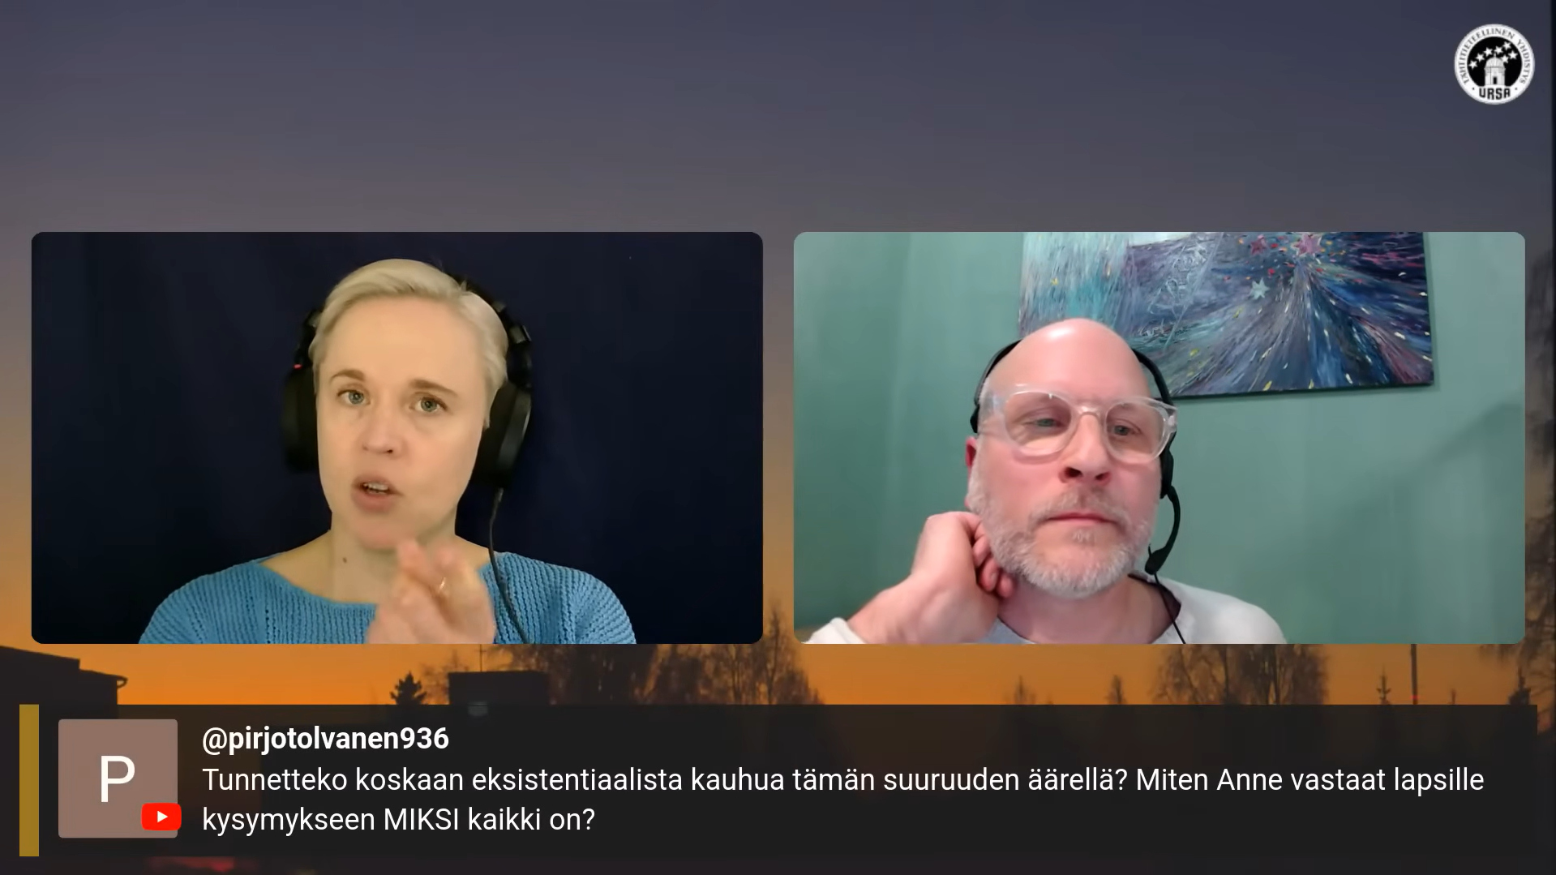
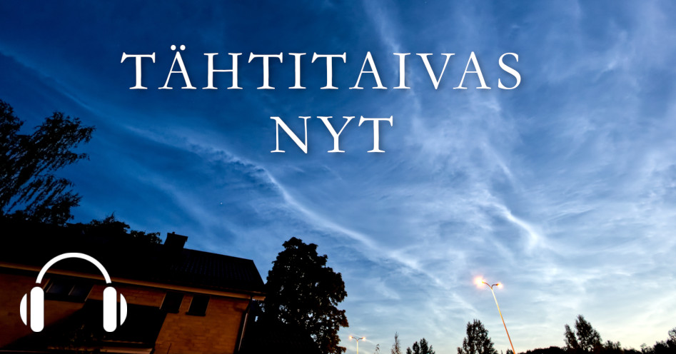
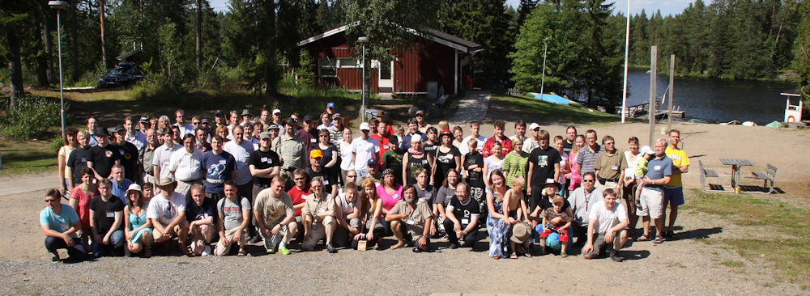
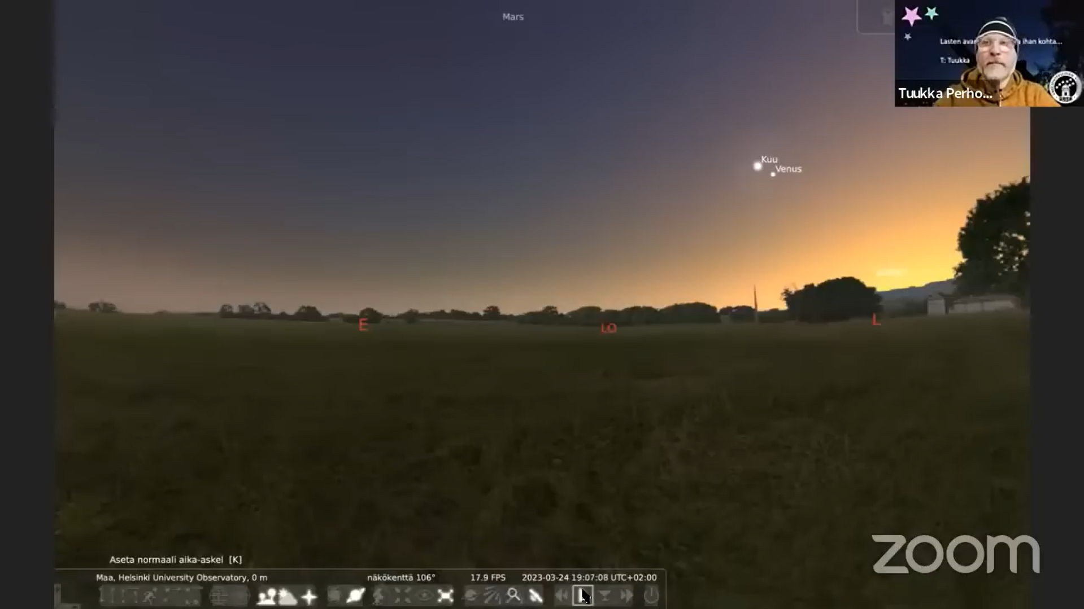
More Ursa
Photo: Toni Uuttu
Photo: Marko Myllyniemi

Slide 6
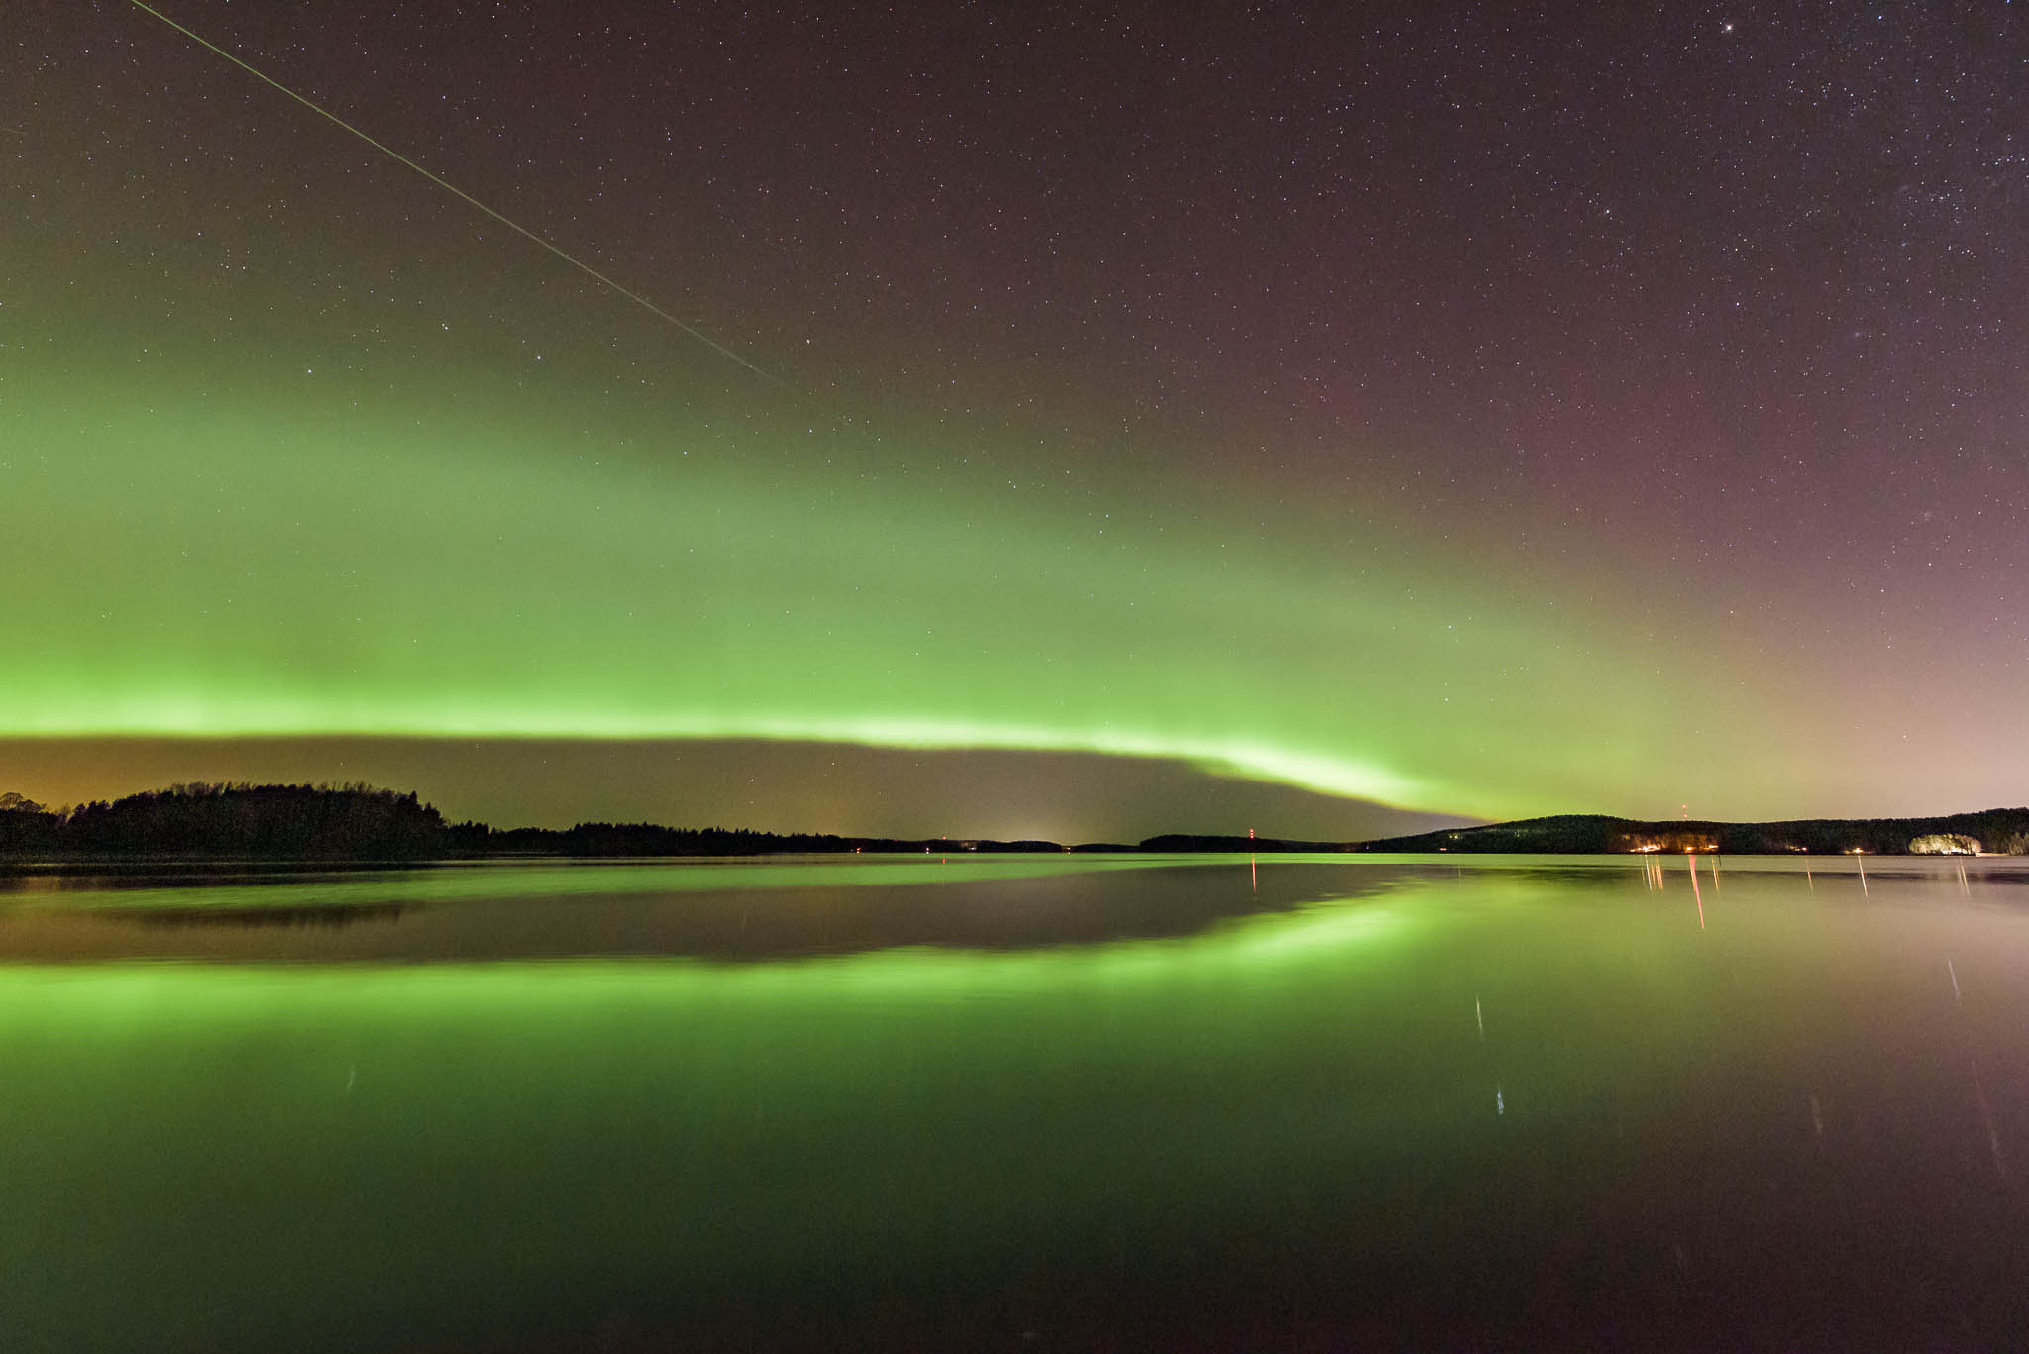
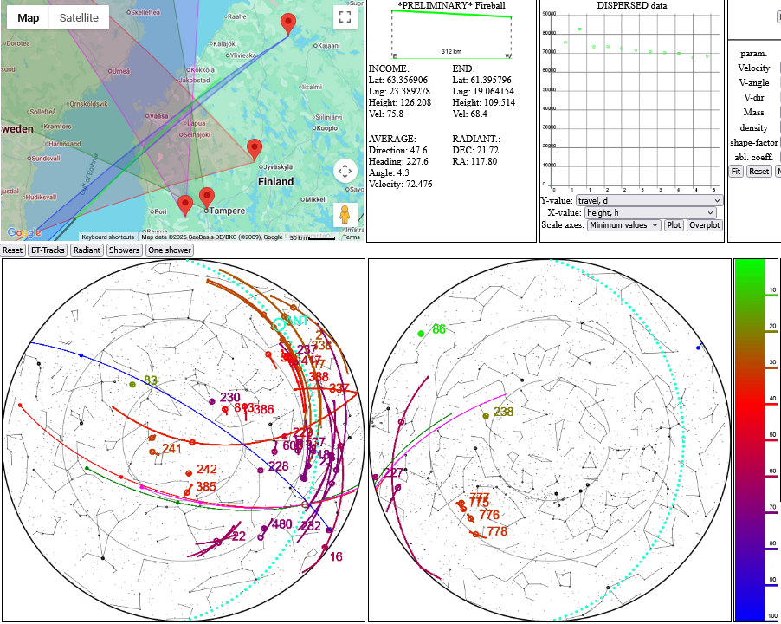
ProAm Activities and Collaborations
proam@ursa.fi
Peña-Asensio, E., Visuri J., Trigo-Rodríguez, J.M., Socas-Navarro H., Gritsevich M., Siljama M., and Rimola A. 2024. Oort cloud perturbations as a source of hyperbolic Earth impactors. Icarus, 408115844, https://doi.org/10.1016/j.icarus.2023.115844
Photo: Kari Haila, screenshots: The Finnish Fireball Network

Slide 7
Some highlights
Astronomy is very popular in Finland (and people here still trust science and universities)
  Rise of cosmology, images by Hubble+, Ursa, books by Esko Valtaoja
Amateur astronomy over here isn’t just about stargazing and telescopes
  Reading about astronomy is way more popular than observing!
  Atmospheric phenomena are included in our curriculum
Good collaboration between professional astronomers and astronomical associations

Slide 8
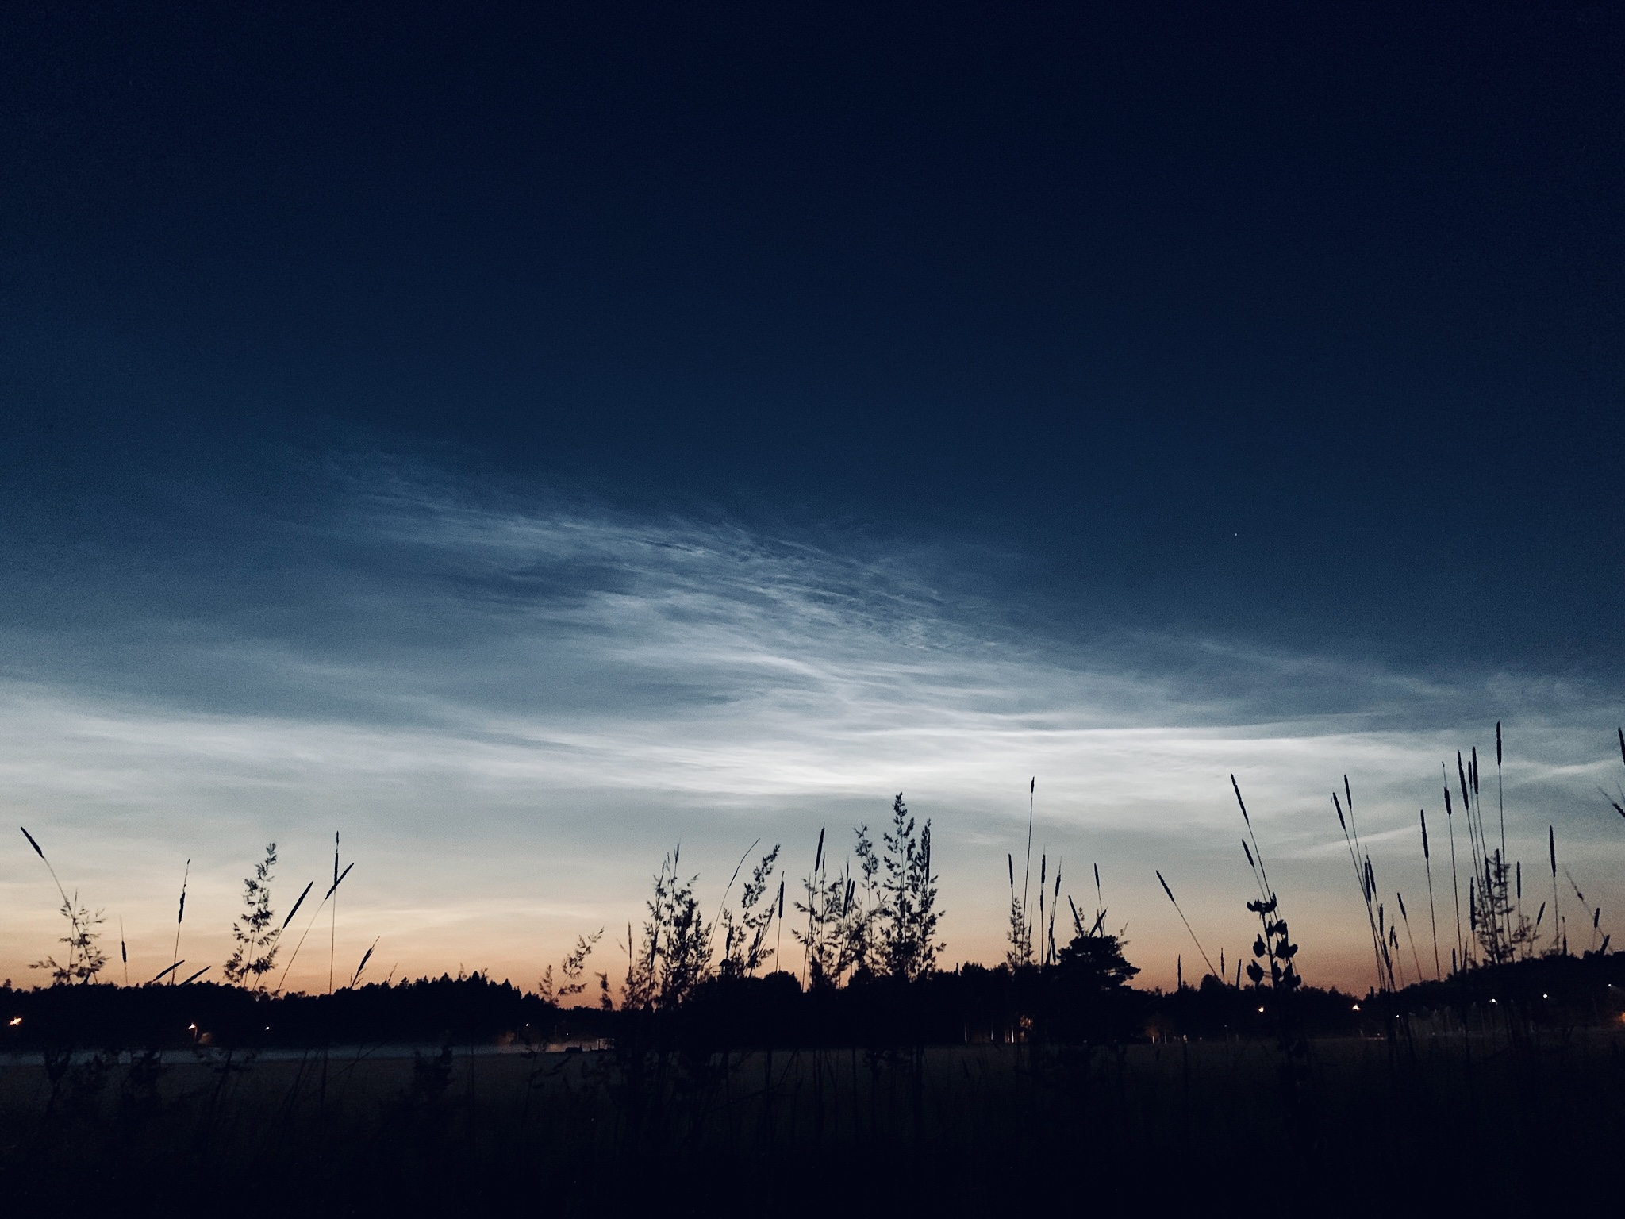
Thank you!
https://www.ursa.fi/ (https://www.ursa.fi/english.html)
You can reach me at
anne.liljestrom@ursa.fi

