Slide 1


J-PAS & FLAMINGO: Cosmic voids and void galaxies in the gravitational landscape of photometric surveys
J.A Mansour, B. McCarthy, L. J. Liivamägi, A. Tamm, R. van de Weygaert, J. Laur, M.Einasto, P. Heinämäki et al

Slide 2
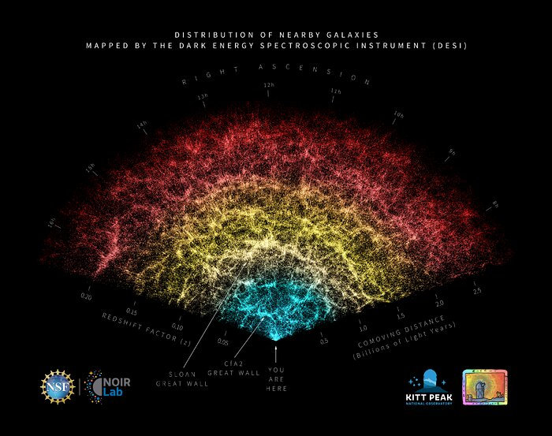
Cosmic voids and void galaxies
Cosmic voids: low density regions in the Cosmic Web
Occupy ~70-80% of the volume
Sizes 10-100 Mpc
Importance:
  Formation and evolution of galaxies
  Cosmology
  Neutrino mass
Void galaxies: galaxies located in cosmic voids.
From surveys and simulations, compared to denser regions:
  Bluer, later-type (spirals/irregulars)
  Lower stellar masses
  Star formation activity under debate (higher?)

Slide 3
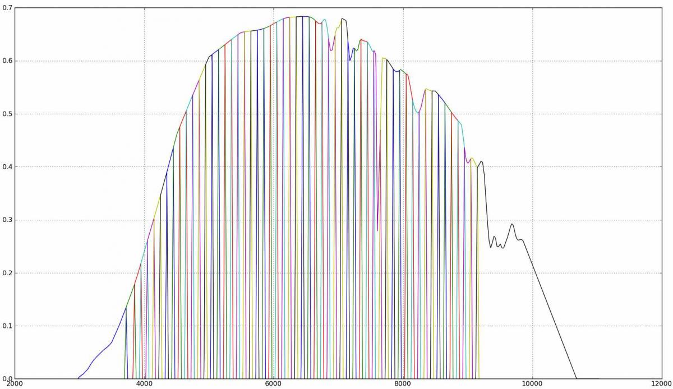
Javalambre Physics of the Accelerating Universe Astrophysical Survey (J-PAS)
Ongoing photometric survey
2.5 m telescope to cover an area of 8000 deg²
54 narrow-band and 2 broad-band filters.
Photometric survey: significant redshift errors.
Currently ongoing! Insufficient data to this date.
Notes:
JPAS is a photometric survey so, in comparison with a spectroscopic survey, it will have substantial redshift errors (and when I say redshift I want you to think of distance, so the distance to a galaxy that we measure will be rather uncertain). How uncertain? You can get a feeling of that by looking at the bottom plot picture. Where I show on the left the, using a simuation, the true galaxy distribution and on the right the galaxy disitribution by modeling the survey’s redshift errors. You can then understand how this makes identification of the cosmic web and in particular voids rather difficult. And second, the survey has not observed a large enough volume to allow identification of voids.

Slide 4
Main Goals
1. Identify dynamically relevant, robust voids in J-PAS galaxy mocks
2. Determine if expected trends exist within void galaxy properties
Notes:
Moving on to our main goals: we want to see how the identification of voids and void properties is affected by survey errors and if we can correctly identify voids in J-PAS. Furthermore, we want to see whether the J-PAS survey is able to capture expected trends in the void galaxies properties so for example if we can see that these galaxies have lower masses, are bluer and whether their star formation activity is different than galaxies in denser environments

Slide 5
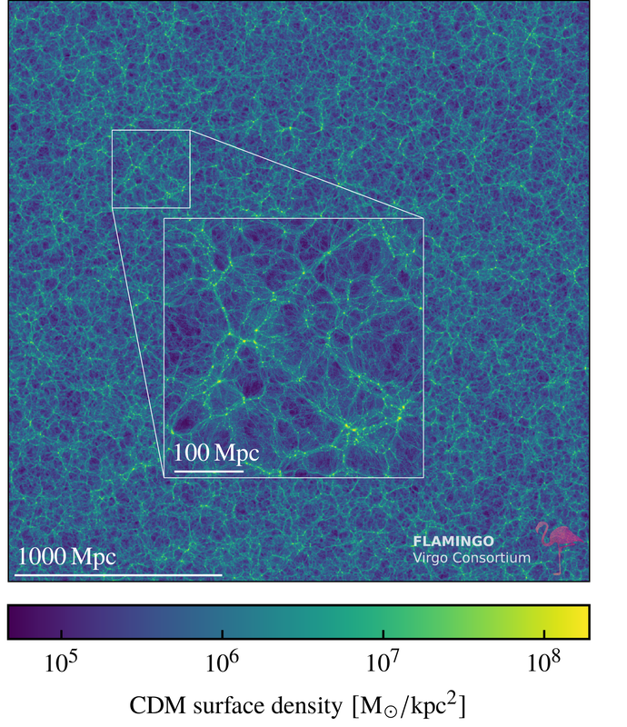
J-PAS mocks with FLAMINGO
Not enough data yet in J-PAS to study voids…
FLAMINGO: set of hydrodynamical simulations
1 Gpc³ volume, with baryonic particle mass 10⁸ M☉
Work with a snapshot z = 0.3 and m_{i} < 20
Limitation: FLAMINGO resolution does not give galaxy properties for subhalos <10¹⁰ M☉

Slide 6
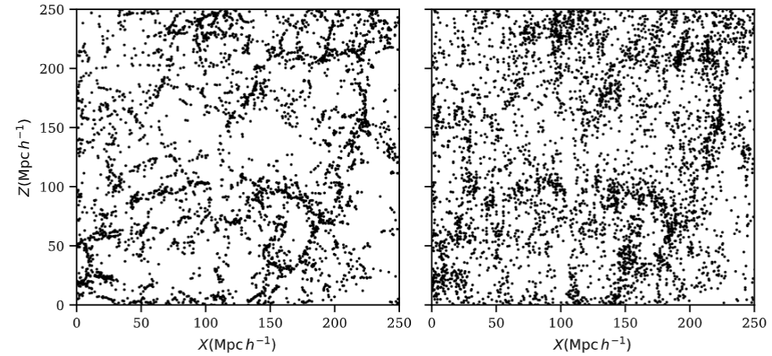

J-PAS mocks with FLAMINGO: Redshift error modelling
FBI
JP
Model photometric redshift errors based on J-PAS EDR (0.2 < z < 0.4) Photo-z and z_{err} obtained via TOPz¹
Two galaxy samples obtained:
  FLAMINGO BASED-IDEAL (FBI, no redshift errors)
  JP (with modeled redshift errors)
¹Laur et al 2022

Slide 7
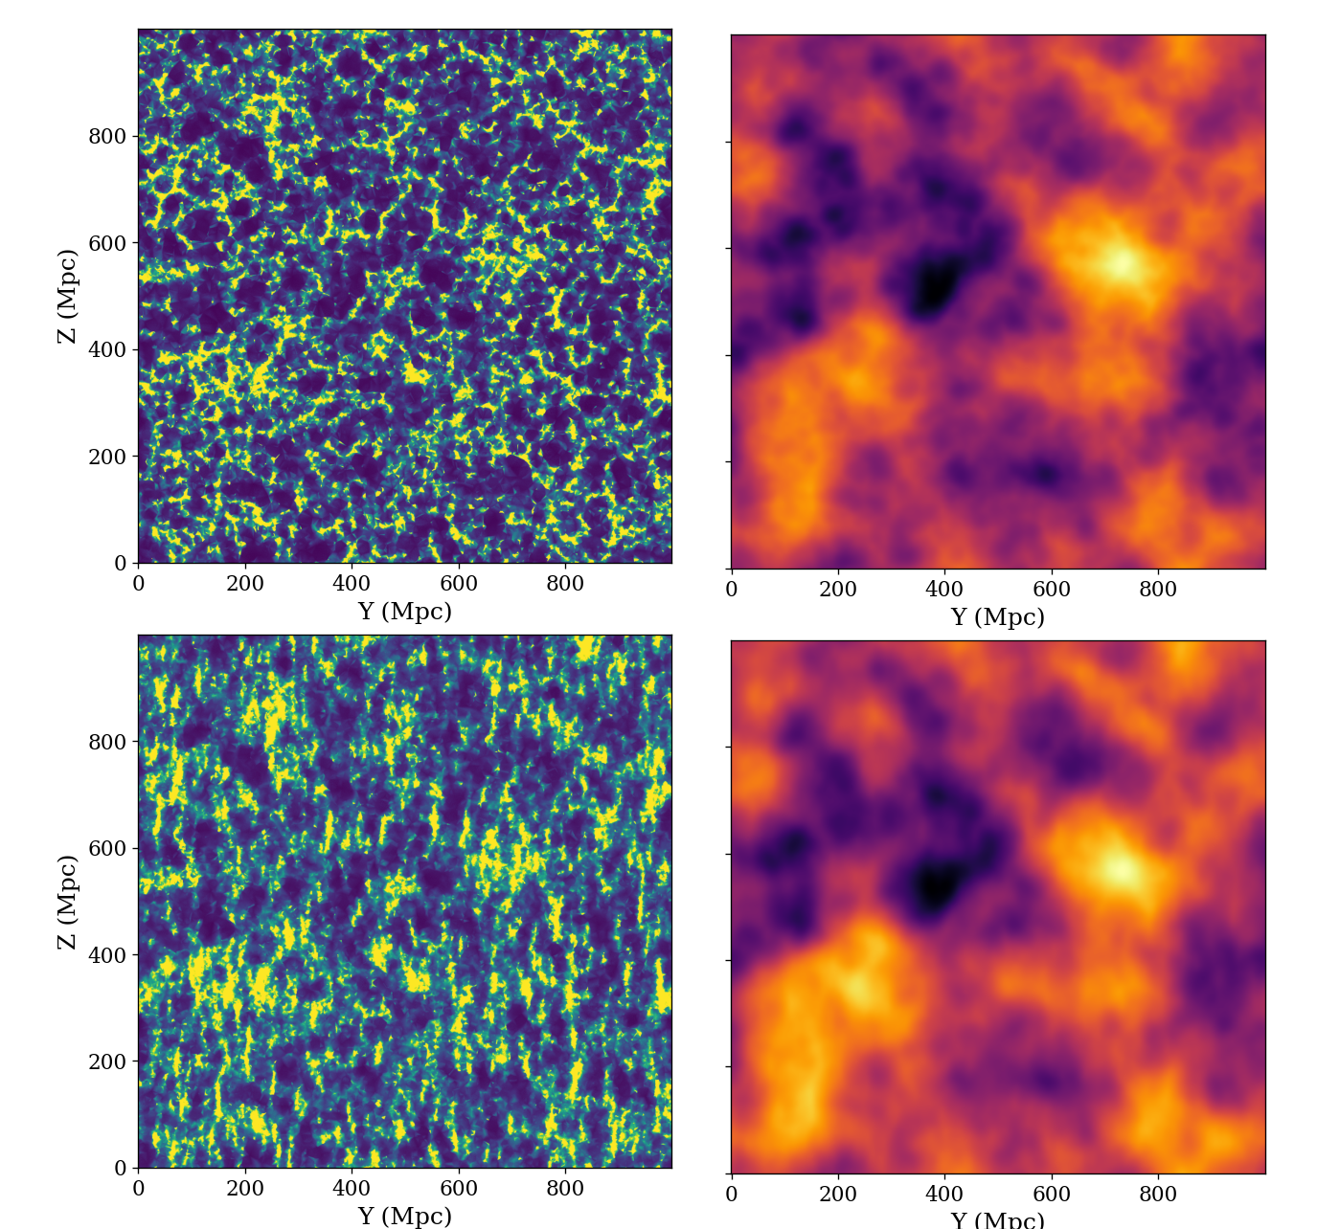
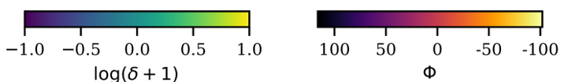
Density and gravitational potential fields
Density field
Quasi-potential field
FBI
Delaunay Tessellation Field Estimator (DTFE): reconstructs continuous density field from point distribution.
Gravitational potential field (Φ): physical way to smooth fluctuations => mitigates redshift errors.
Solve Poisson for a quasi gravitational potential using log(δ): range compressor
The quasi-potential field has the opposite profile to the density field:
  Voids: potential hills (Φ > 0) => matter outflow
  Clusters & filaments: potential wells (Φ < 0) => matter inflow
JP

Slide 8
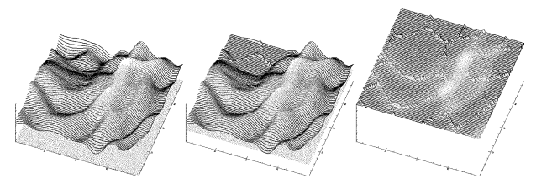
Watershed Voids
Voids identified in the quasi-potential field using a watershed algorithm
Quasi-potential threshold: don’t grow basins in regions with (Φ < 0):
  Preserve the expanding, large voids & remove voids-in-clouds
  ~50% of the simulation volume
Basins (voids)
Ridges (filaments)
Peaks (clusters)
Notes:
6:35 up to this point

Slide 9
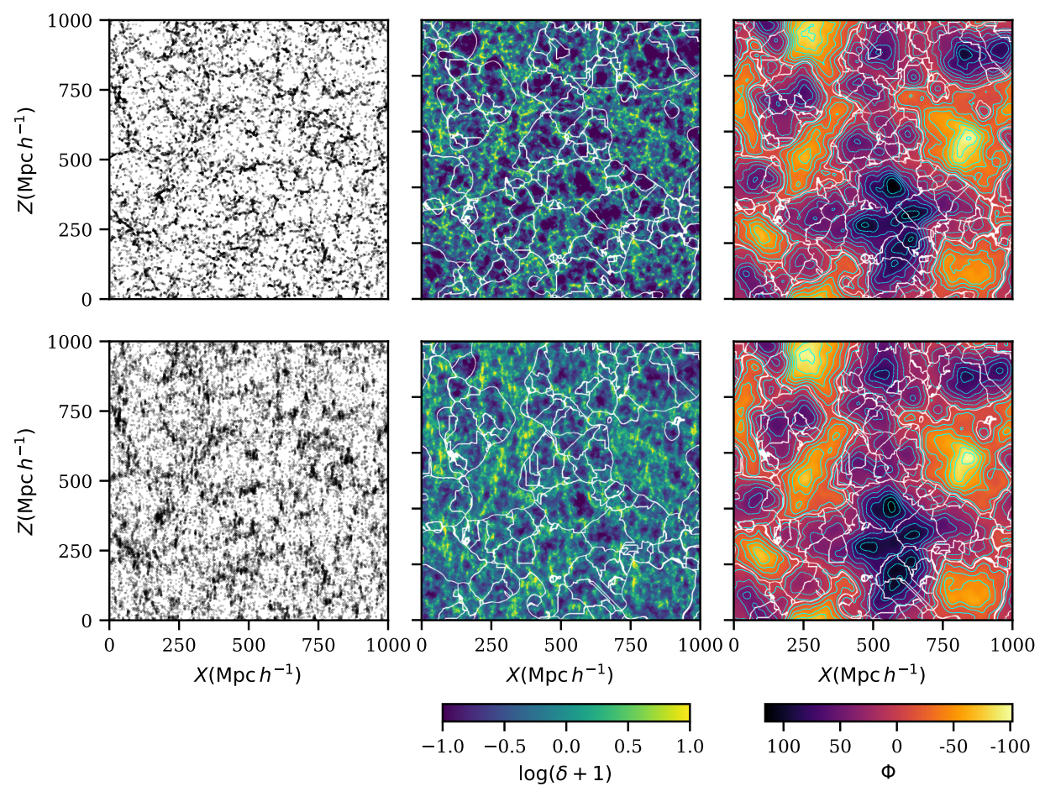
Results – Void populations in J-PAS Mocks
FBI
Galaxy distribution
Density field
Quasi-potential
Goal:
  Identify dynamically relevant, robust voids in J-PAS mock
Watershed voids: variety of shape and sizes.
Void maps visually similar.
Large voids due to smoothed out small-scale structures in quasi-potential field.
Void substructure present within the density field.
FBI sample: 1074 voids JP sample: 817 voids
FBI
JP
JP

Slide 10
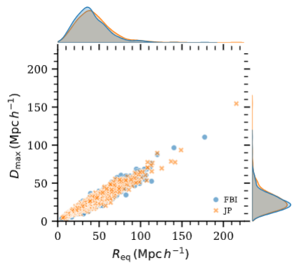
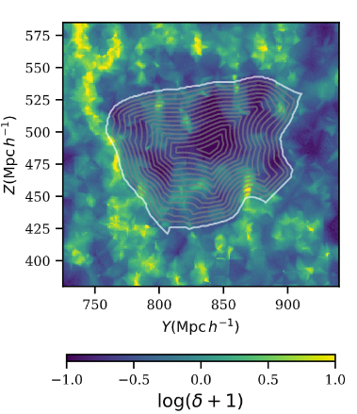
Results – Void sizes
Void size quantified via:
  Equivalent radius R_{eq} (spherical approximation)
  Maximum boundary distance²: D_{max}
R_{eq} overestimates void size: D_{max} more robust size quantifier for watershed voids.
Larger voids in the JP sample:
  R_{eq}: 43 Mpc/h vs 37 Mpc/h
  D_{max} 27 Mpc/h vs 23 Mpc/h
Good agreement between size distributions
Void boundary
²Cautun et al 2016
Notes:
How big are our voids exactly? Simplest way is to assume voids as spherical. But as we have seen, voids are not spherical, quite the contrary they have various shapes. So another way, is to measure the maximum distance from the void boundary, as illustrated in this figure here. Black line represent the void boundary and we measure the distance in boundary-like shells. If we plot the max boundary distance and the equivalent radius, then of course we should see a linear trend which we do. The spherical approximation overestimates the size of a void so the max bd distance is a better, more robust size quantifier. We found on larger voids in perturbed sample than in ideal gal distrib

Slide 11
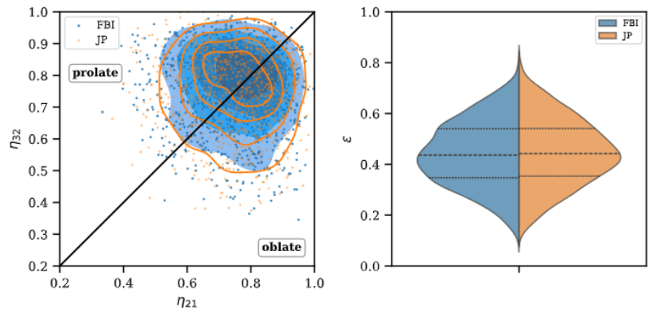
Results – Void shapes
Watershed produces non-spherical objects.
First order approximation for shape: fit voids with ellipsoids:
  Both FBI and JP sample voids slightly more prolate
  Similar ellipticity (ε) distributions
Notes:
Now we move on and quantify the shapes. One way to quantify this is by fitting elipsoids which of course is also a rough approximation, better than a sphere but still, not the best. At at least it is useful for it allows us to compare our results with literature
We found that both void populations in the ideal and perturbred sample are rathe elliptical and, slightly prolate. We also found a trend of shape with size which says that larger voids tend to be more spherical

Slide 12
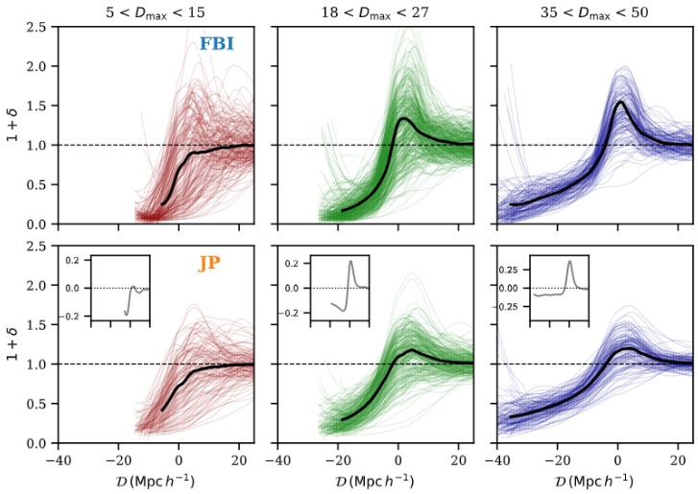
Results – Boundary density profiles
Far from the boundaries voids are underdense
Larger voids have denser boundaries
JP sample voids: lower density boundaries and higher density interiors
FBI
Void boundary
JP

Slide 13
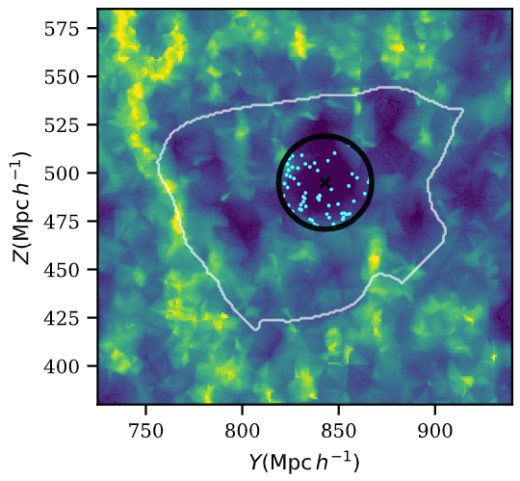
Results - Void galaxies in J-PAS mocks
Goal:
  Identify void galaxies and compare properties with the galaxies in high-density regions: can J-PAS find expected trends in galaxy properties?
  For FBI and JP samples we define:
    Void core galaxies: galaxies within a sphere that contains 50% of the average void density, centered on the void center
    Galaxies in high-density regions: δ > 3 δ_{mean}

Slide 14
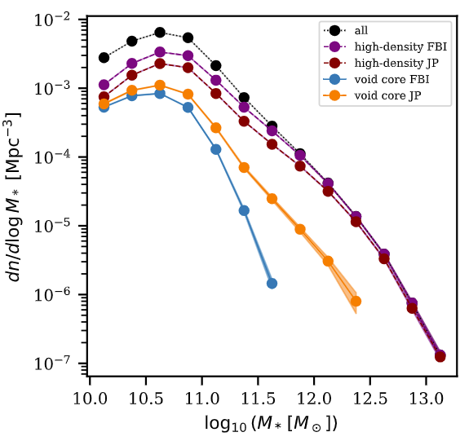
Results - Void galaxies (stellar mass function)
FBI shows fewer massive galaxies (M > 10¹¹ M☉) in voids.
Signal present in JP despite contamination with galaxies from over-dense regions
FLAMINGO limitation: no galaxies with M* < 10¹⁰ M☉.

Slide 15
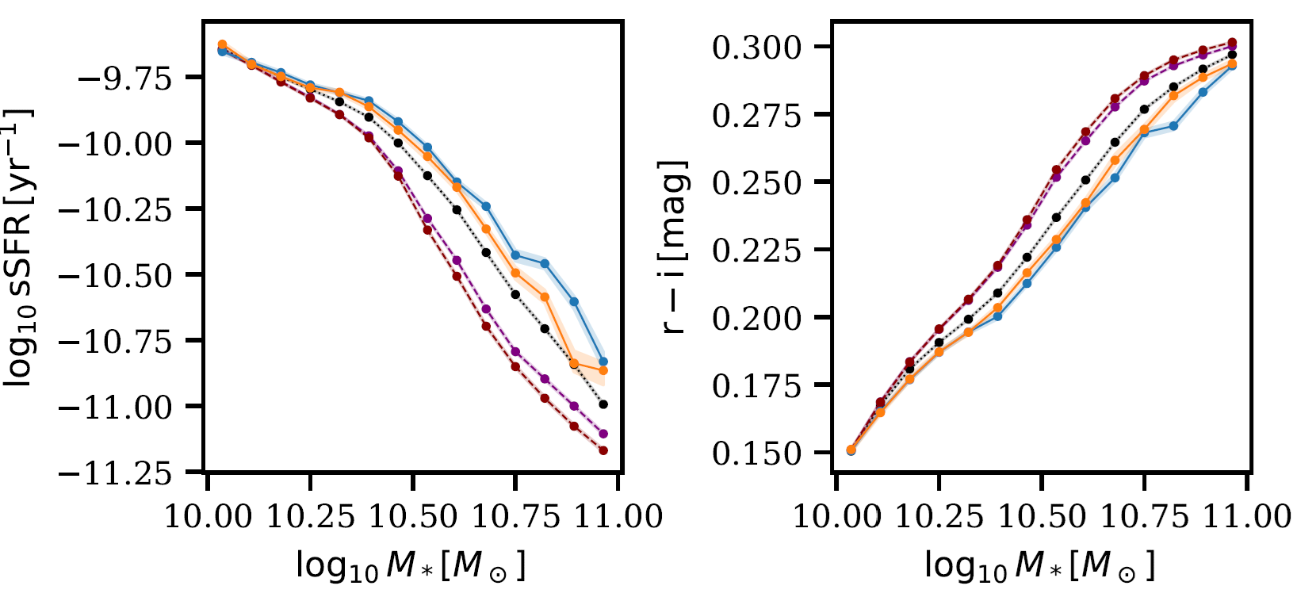
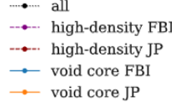
Results - Void galaxies (star formation activity and color)
Void core galaxies in FBI and JP, for fixed stellar masses:
  Higher sSFR
  Bluer
Signal detected in JP despite photometric redshift errors

Slide 16
Conclusions
Dynamically dominant voids identified in the gravitational potential field are robust to photometric redshift errors:
  Similar sizes and shapes between voids in FBI/JP samples
  Density profiles: underdense interiors but contamination from boundary due to errors present
Expected galaxy trends found in voids:
  Lower abundance of massive galaxies
  Bluer
  Higher star formation activity
Future work: test on upcoming photometric surveys (e.g Euclid)

Slide 17
BONUS SLIDES!!!!!!!!!!!!!!!!!!!!!!!!!!!

Slide 18
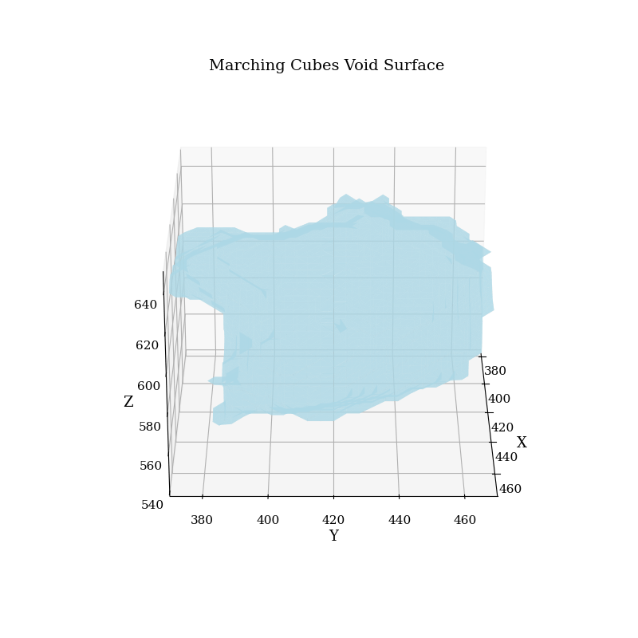
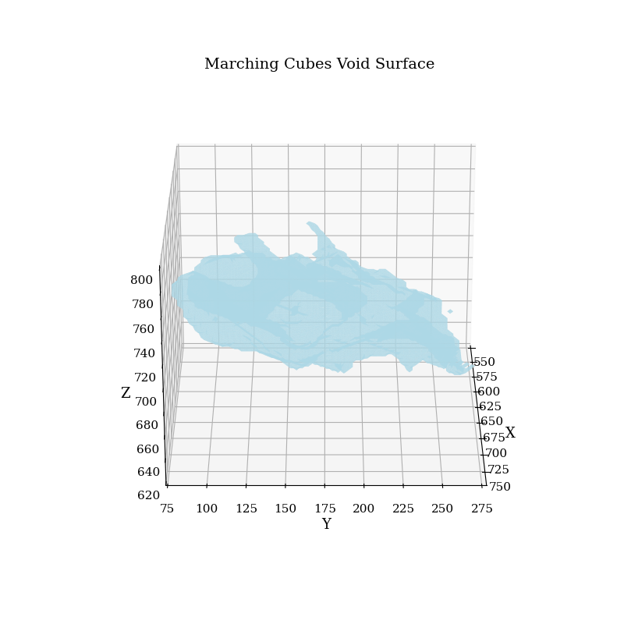
Example of voids

Slide 19
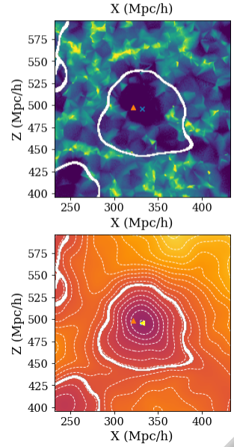
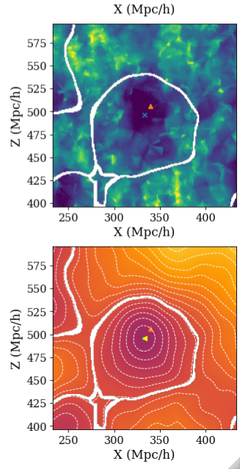
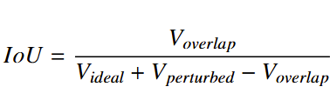
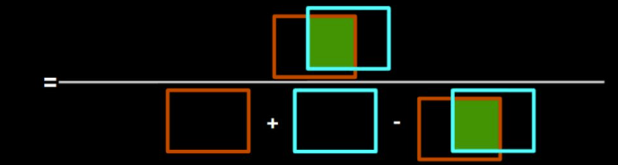
results – Void Recovery
Goal: improve the recovery of voids
A void in the Ideal sample is recovered in the Perturbed sample if IoU > 0.5
Ideal
Perturbed

Slide 20
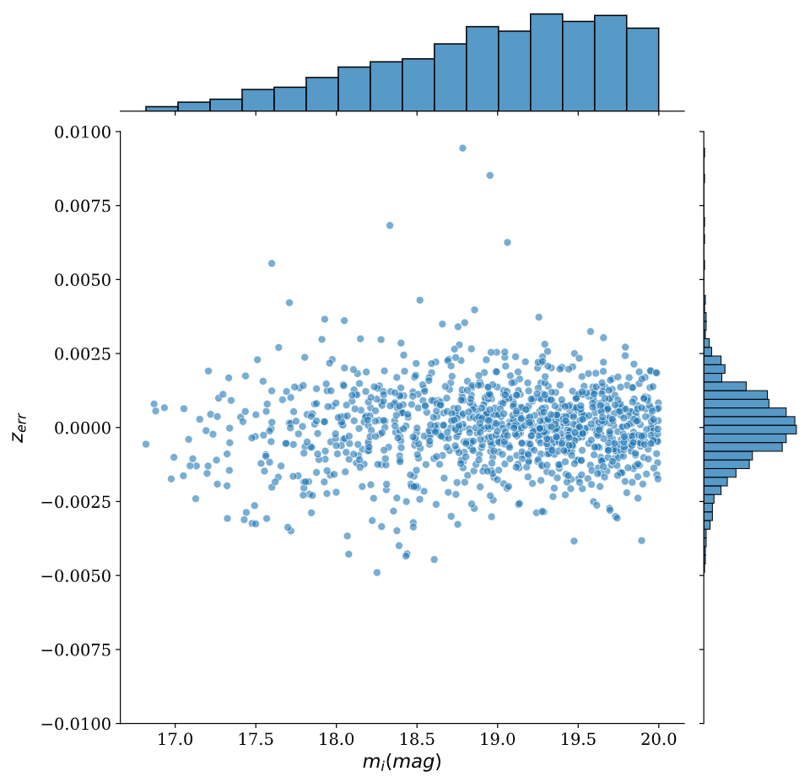
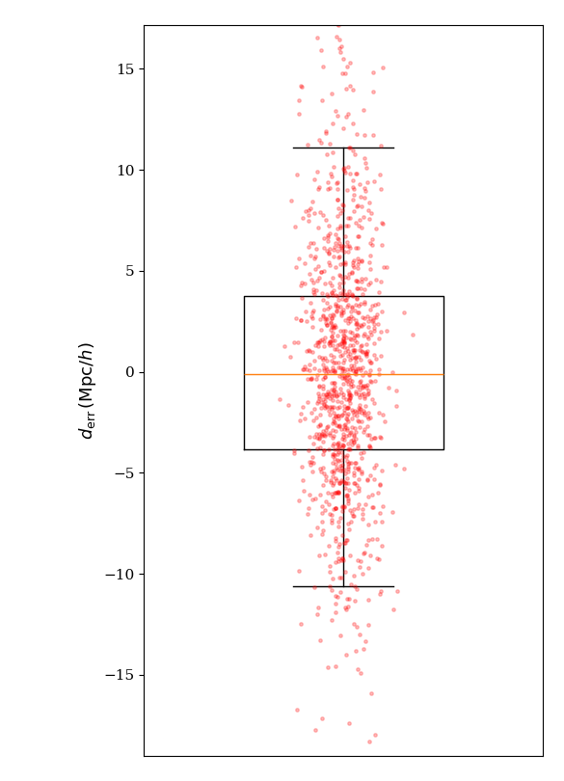

Methods – Redshift Error Modeling and J-PAS mocks creation
Model photometric redshift errors based on J-PAS IDR
Photo-z and z_{err} obtained via TOPz (Laur et al 2022)
How to apply the errors to FLAMINGO galaxies:
  Add J-PAS redshift errors to the FLAMINGO redshift z = 0.3: z_{pert}
  Convert z_{pert} to comoving distances: d_{pert}
  Obtain distance error distribution:
  Inverse transform sample d_{err}and add to the Z-coordinate of FLAMINGO galaxies
Two galaxy samples obtained:
  Ideal (no redshift errors)
  Perturbed (with modeled redshift errors)

Slide 21
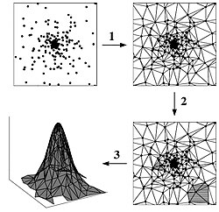
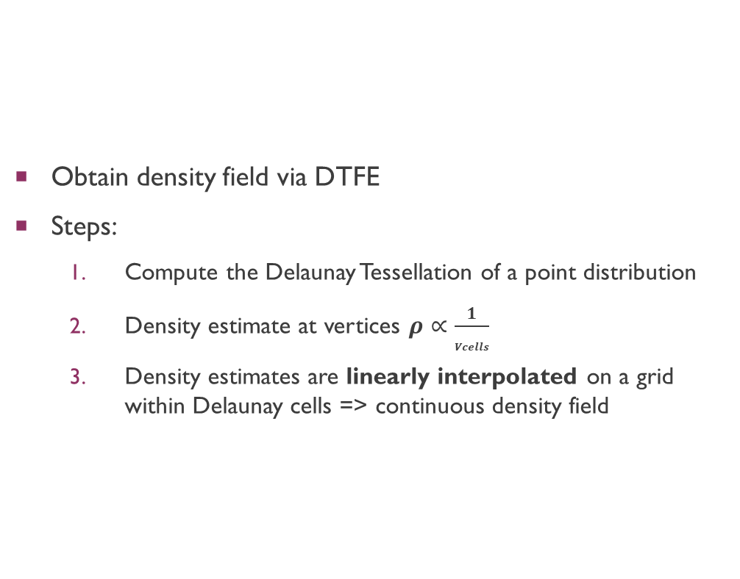
Methods - Delaunay Tessellation Field Estimator (DTFE)
Obtain density field via DTFE
Steps:
  Compute the Delaunay Tessellation of a point distribution
  Density estimate at vertices $ρ∝\frac{1}{Vcells}$
  Density estimates are linearly interpolated on a grid within Delaunay cells => continuous density field

Slide 22
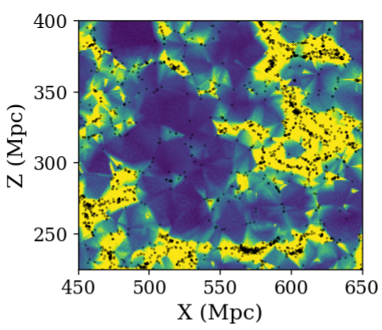
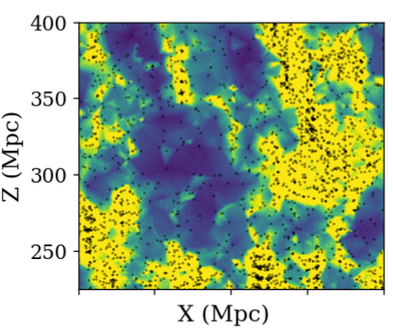
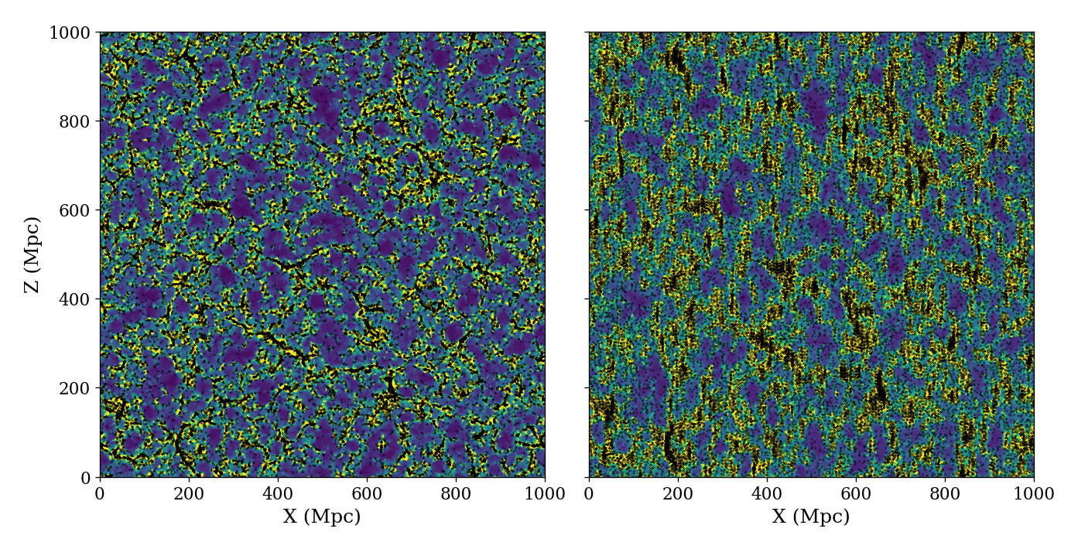
Methods - Delaunay Tessellation Field Estimator (DTFE)

