Slide 1
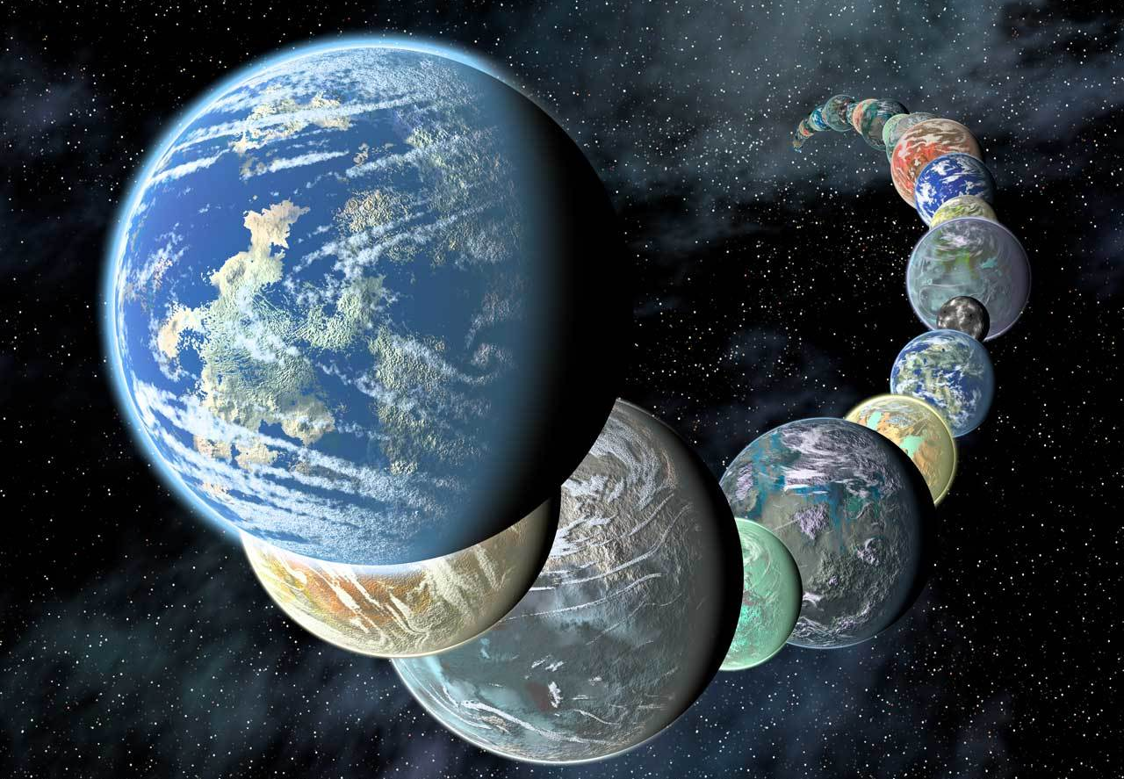
Searching for other Earths
Dainis Dravins
Lund Observatory, Division of Astrophysics, Department of Physics, Lund University
www.astro.lu.se/~dainis
ipac.caltech.edu

Slide 2
CONTEXT:
Many exoplanets found
… but …
not yet any “truly” Earth-like

Slide 3
How to find exoEarths?
Most exoplanets so far found from transit photometry

Slide 4
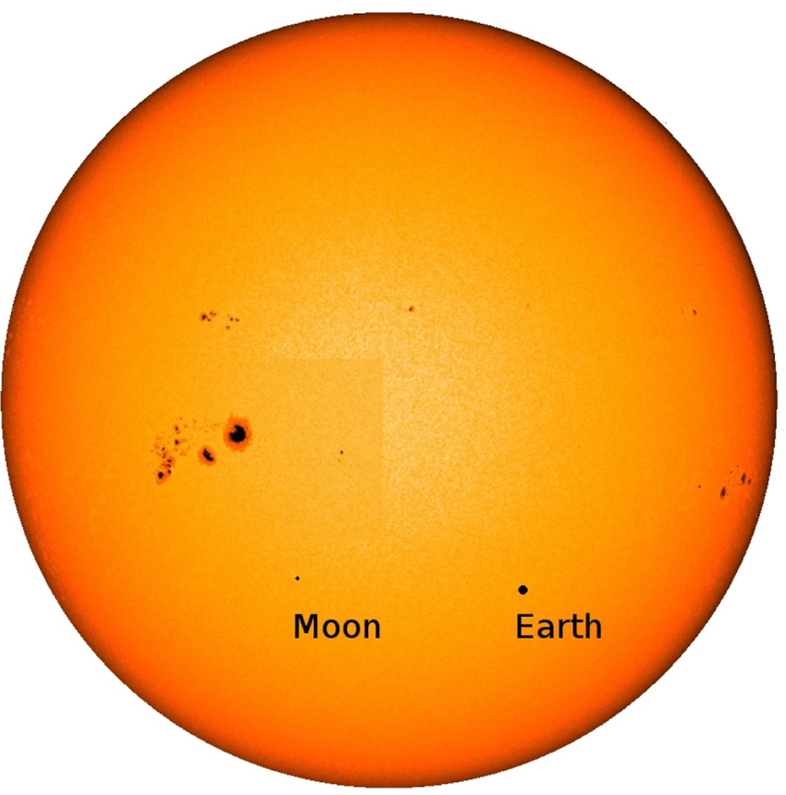
Earth transit
January 5, 2014
Composite image of the Earth transiting the Sun, as viewed from Jupiter
Earth diameter 4.2 arcsec
Sun 369 arcsec
Solar image: SDO/NASA
P.Molaro et al.: The Earth transiting the Sun as seen from Jupiter's moons: detection of an inverse Rossiter-McLaughlin effect produced by the opposition surge of the icy Europa
Mon.Not.Roy.Astron.Soc. 453, 1684 (2015)

Slide 5
Limitations in photometric
transit searches for exoEarths
* Earth covers only 10⁻⁴ of solar disk,
photometry overwhelmed by spots and other
* Lasts only some hours once a year, require
  24/7 monitoring from space for many years
* Transits visible only within very narrow angle,
very unlikely for samples of nearby stars

Slide 6
More promising: radial velocities

Slide 7
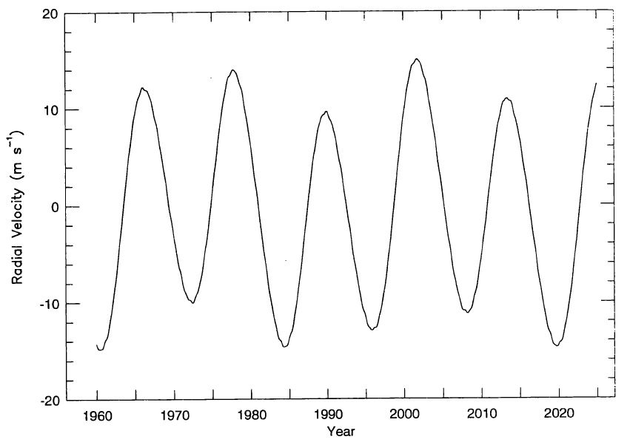
Detecting solar system planets by radial velocity
Radial velocity of the Sun relative to the solar system barycenter
(as viewed from the direction of the vernal equinox)
Main signature is the12-year modulation by Jupiter
Cochran & Hatzes, Astrophys.Space Sci. 241, 43

Slide 8
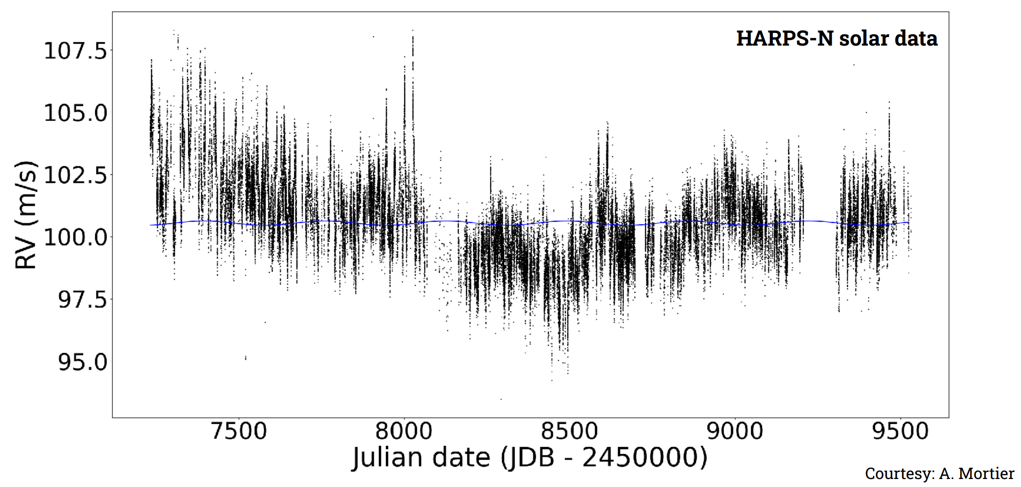
‘Radial velocity’ jittering of the Sun
EARTH - 0.09 m/s
Solar apparent radial velocity at 5-minute cadence, corrected for barycentric motion and differential extinction
Data release: X. Dumusque et al.: Three Years of HARPS-N High-Resolution Spectroscopy and Precise Radial Velocity Data for the Sun, Astron.Astrophys. 648, A103 (2021)

Slide 9
The basic problem?
Instrumentation is finally(!) precise enough to detect
also Earth-like planets around solar-type stars
But … the limitation is instead set by stellar variability, which overwhelms the tiny signal from any exoEarth

Slide 10
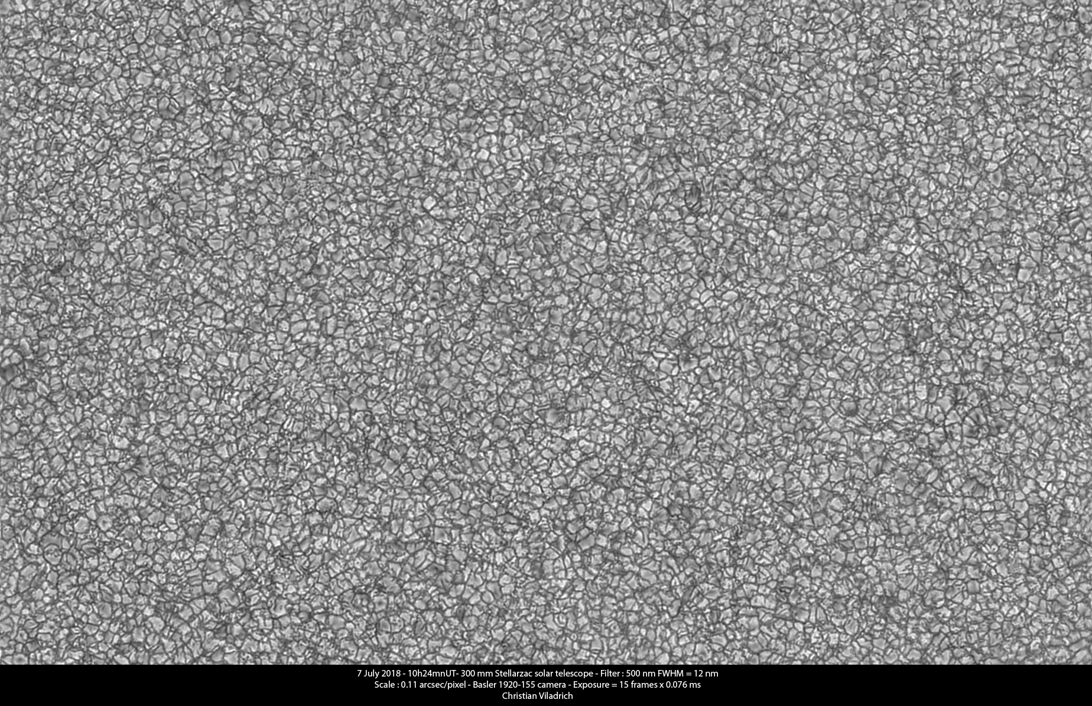
Solar surface image
Christian Viladrich, 300 mm Stellarzac solar telescope,
540/10 nm filter, https://www.cloudynights.com

Slide 11
Can we find planets around the Sun…
… if observing the
Sun-as-a-star?

Slide 12
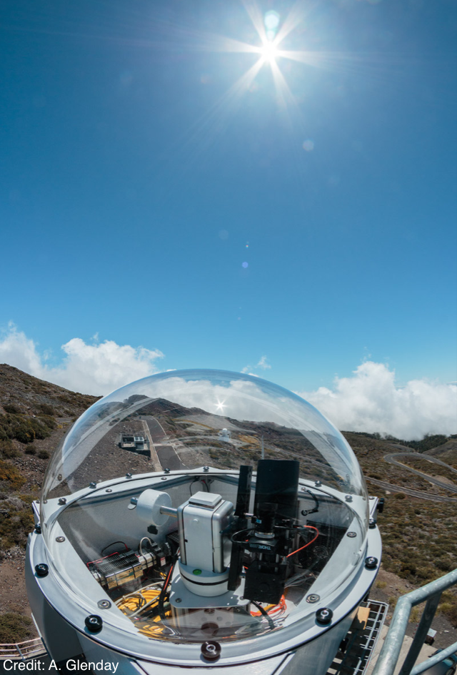
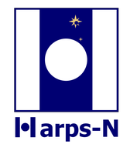
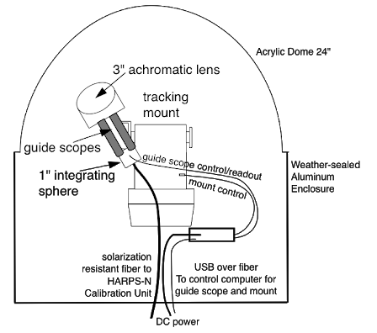
Sun-as-a-star
on La Palma
Solar telescope feeding sunlight
to HARPS-N

Slide 13
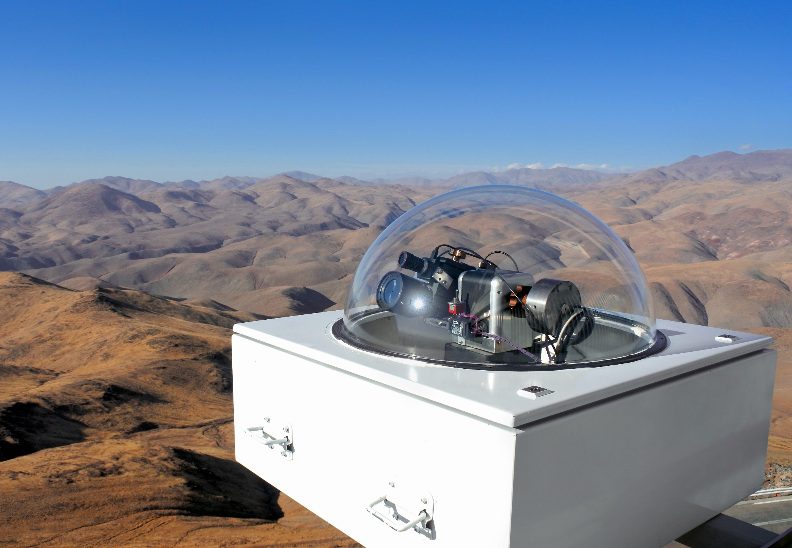
HELIOS solar telescope at ESO La Silla
(ESO / T.Pirson)

Slide 14
Effects of
magnetic fields

Slide 15
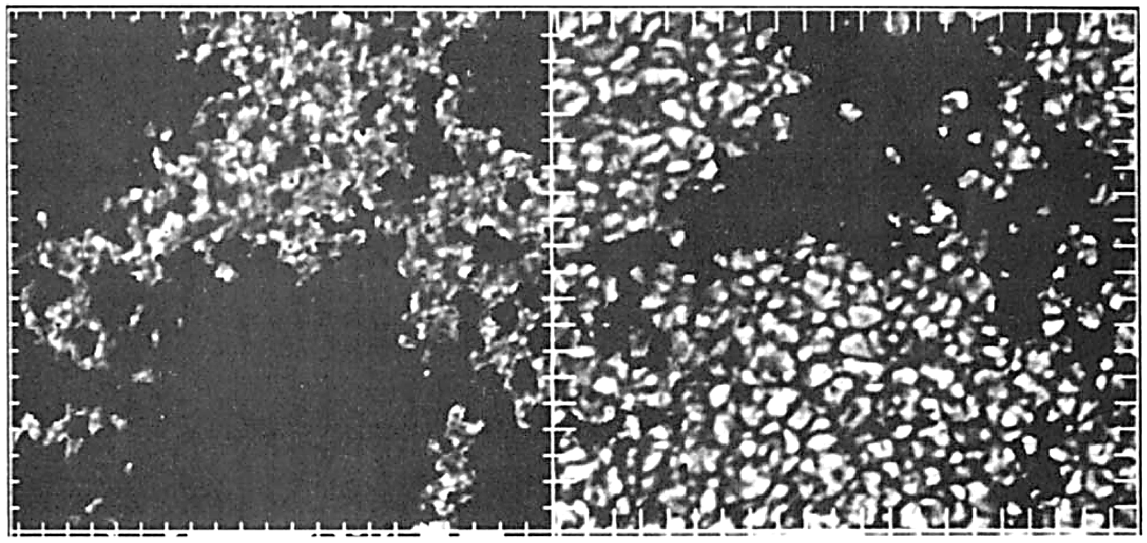
Magnetic & Non-magnetic
Solar granulation in magnetic and non-magnetic regions
Continuum images of the same area, blackened out (left) where the average field strength is <7.5 mT (75 G). and (right) where the field strength is >7.5 mT
(Swedish Solar Telescope, La Palma)
H.C.Spruit, Å.Nordlund, A.M.Title: Solar Convection, Ann.Rev.Astron.Astrophys. 28, 263

Slide 16
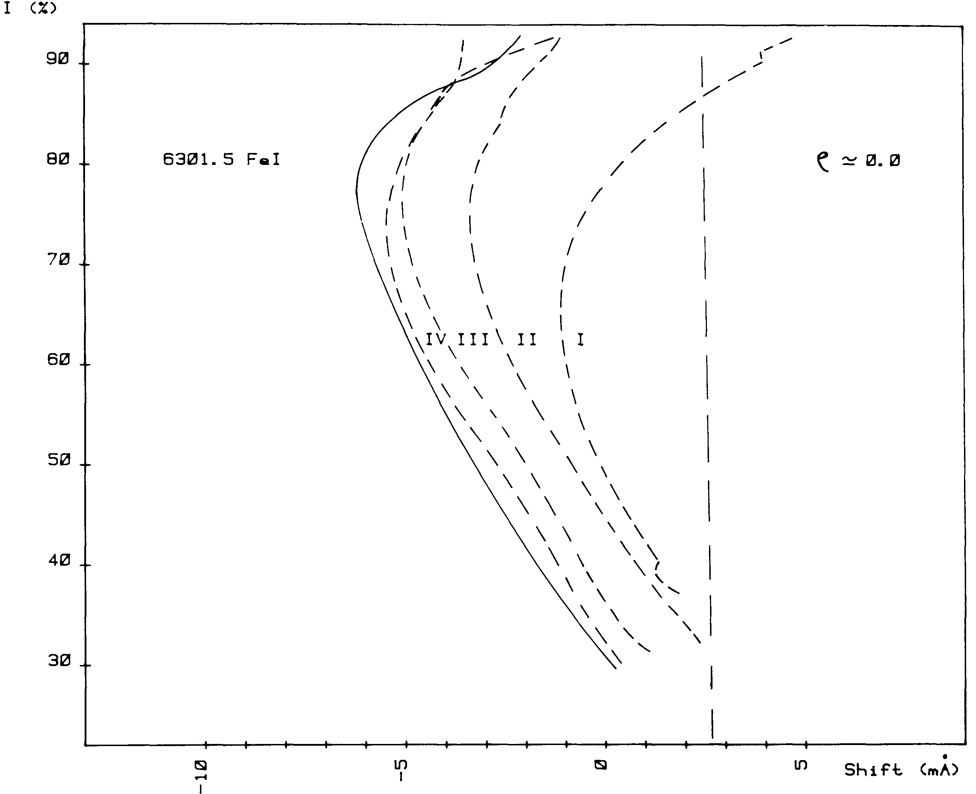
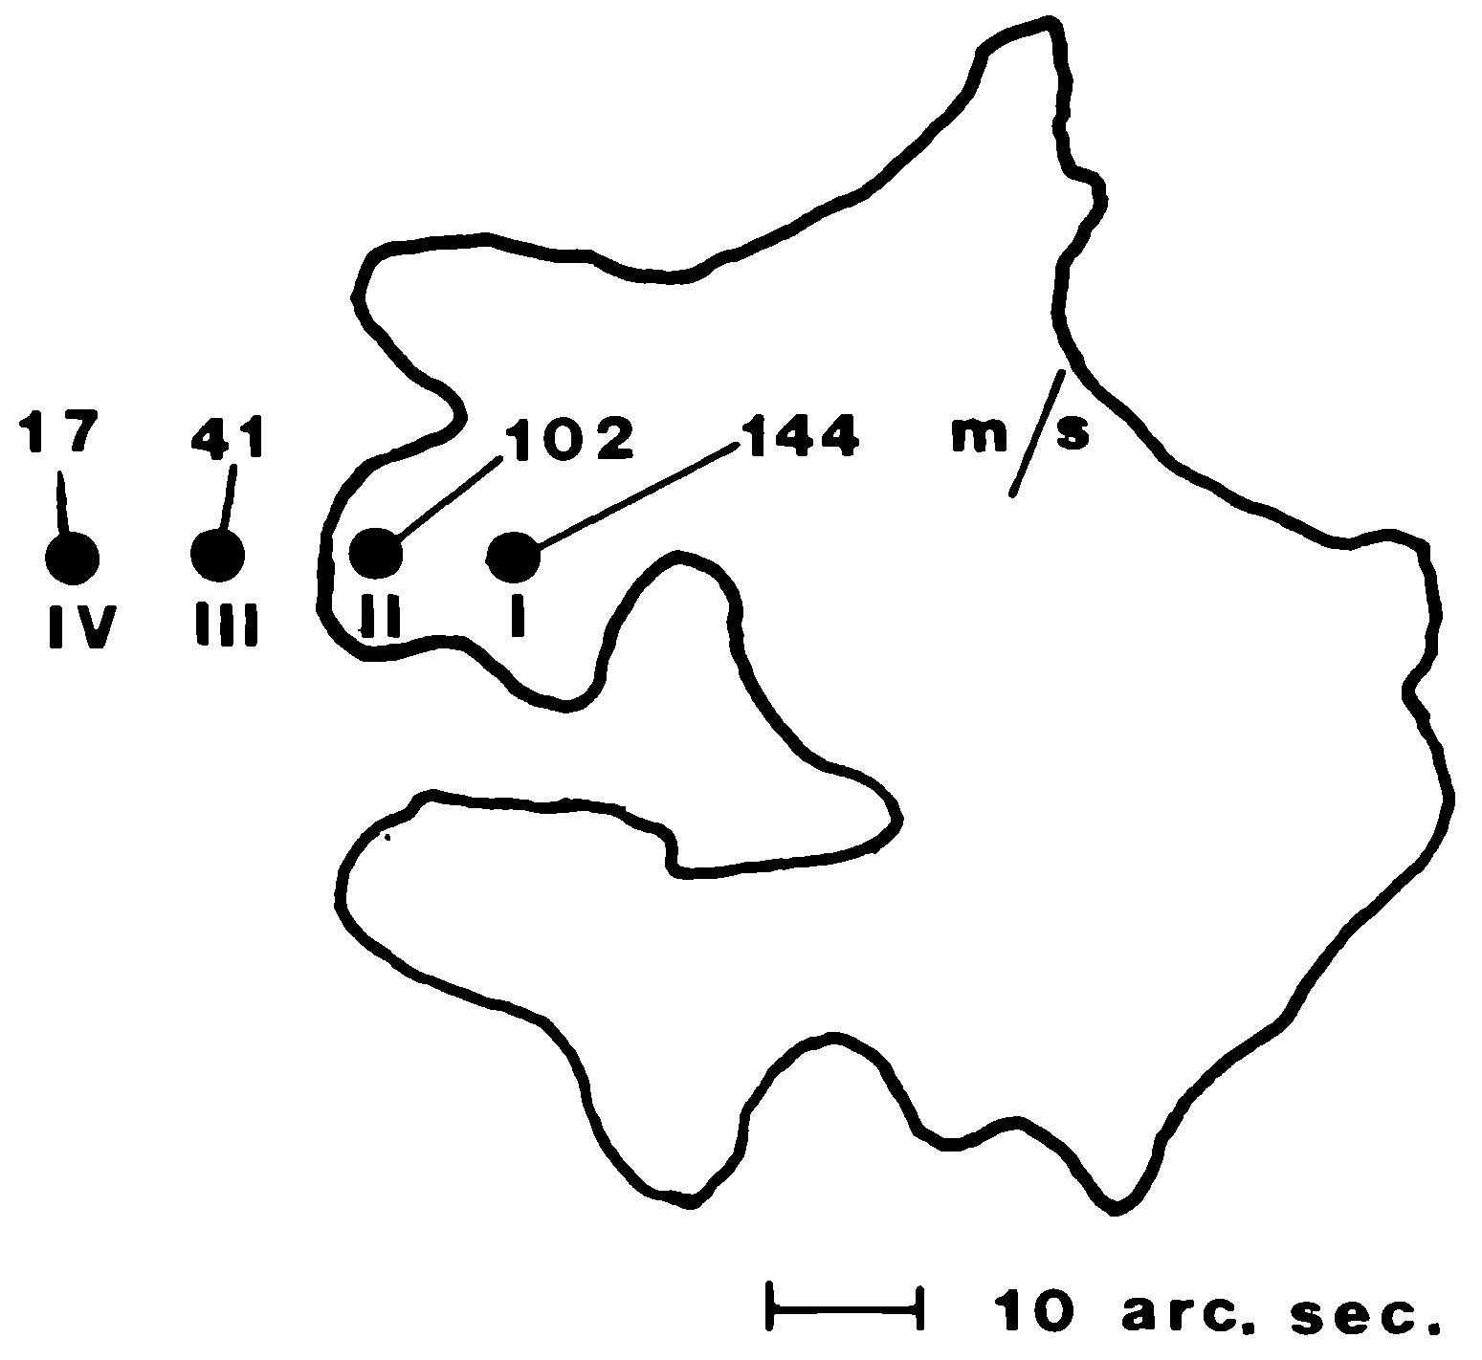
Magnetic & Non-magnetic granulation
Line bisectors gradually closer to an active region (dashed), compared to that of the quiet Sun.
Positions relative to the Ca II K plage are indicated.
F.Cavallini, G.Ceppatelli, A.Righini: Asymmetry and shift of three Fe I photospheric lines in solar active regions, Astron.Astrophys. 143, 116 (1985)

Slide 17
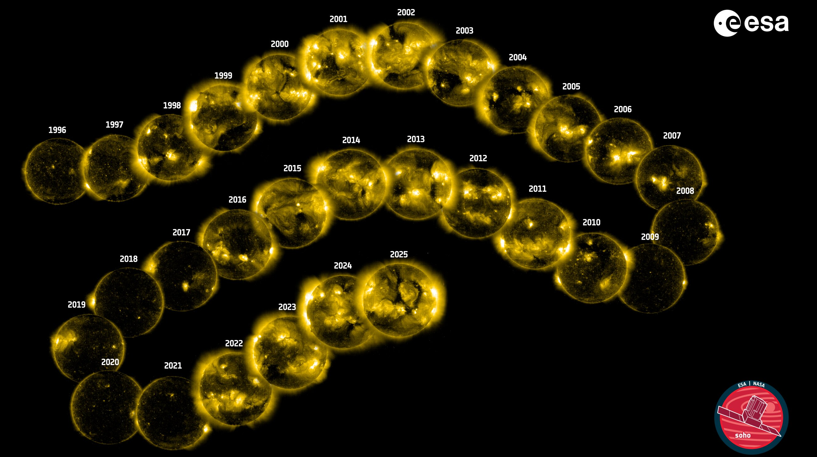
Solar activity cycle
ESA/NASA Solar and Heliospheric Observatory (SOHO) has monitored the Sun during three 11-year cycles.
Here: Fe XV 28.4 nm coronal line maps out temperatures around 2 million K.
(SOHO - ESA & NASA; F.Auchère & ATG Europe)

Slide 18
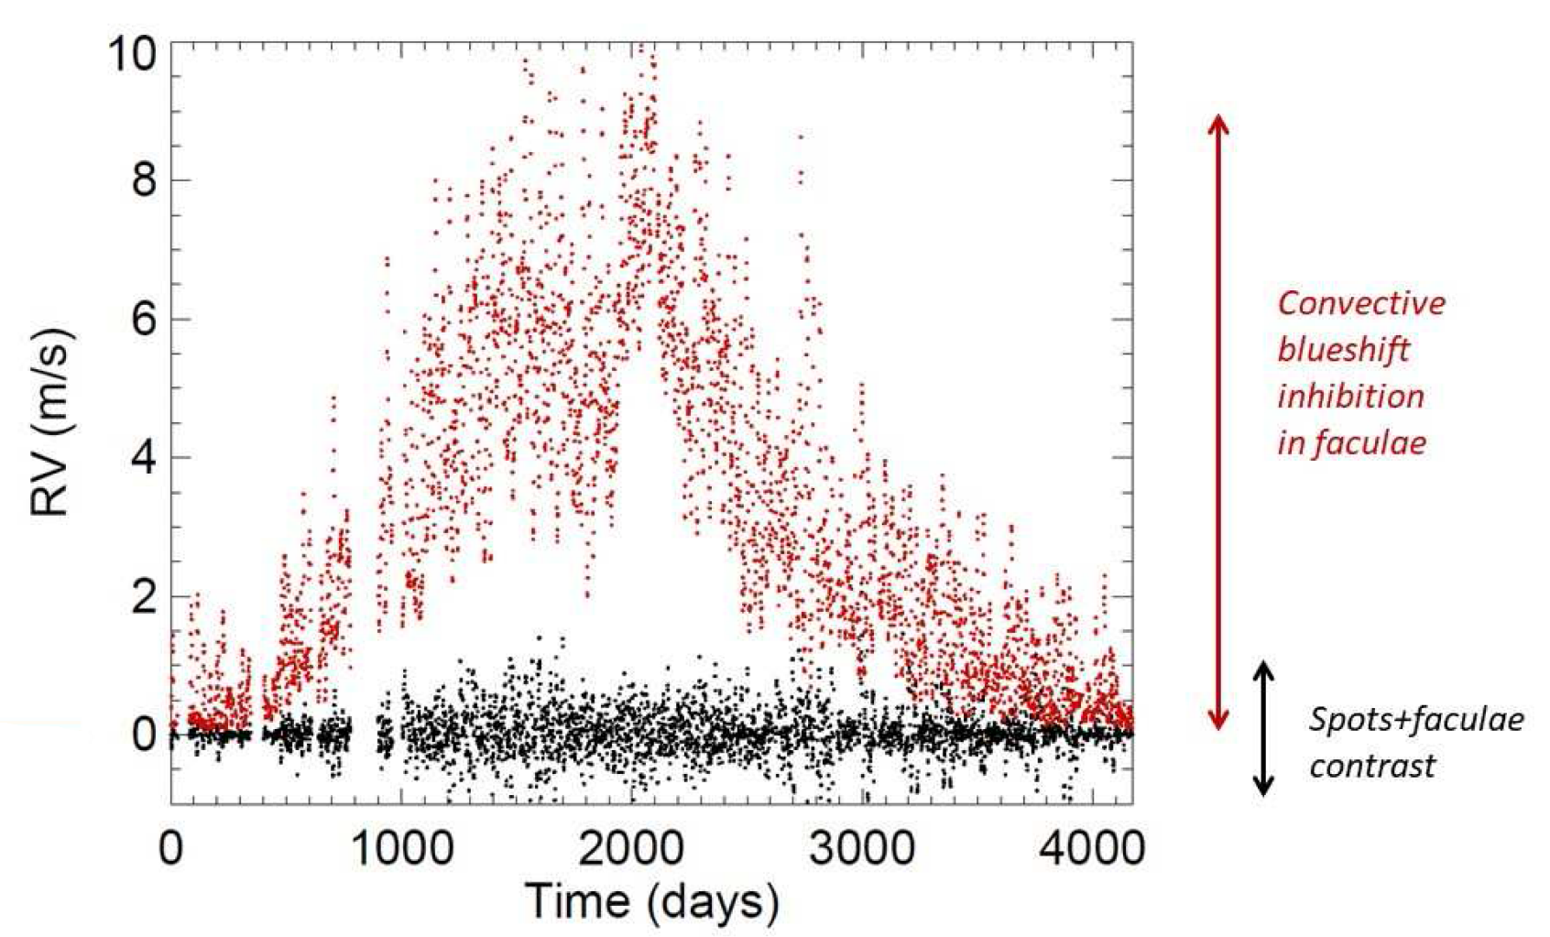
Solar ‘radial-velocity’ modulation
Main driver of solar
‘radial-velocity’ variations:
Modulated granulation
Reconstruction of the apparent radial velocity during an activity cycle, due to inhibition of
convective blueshift in magnetic plage regions (red) and due to the brightness contrast in sunspots and plages
N.Meunier: Stellar Variability in Radial Velocity, Proc. Evry Schatzman School "Interactions star-planet”, arXiv:2104.06072 (2021)

Slide 19
Photospheric proxies
for magnetic activity?

Slide 20
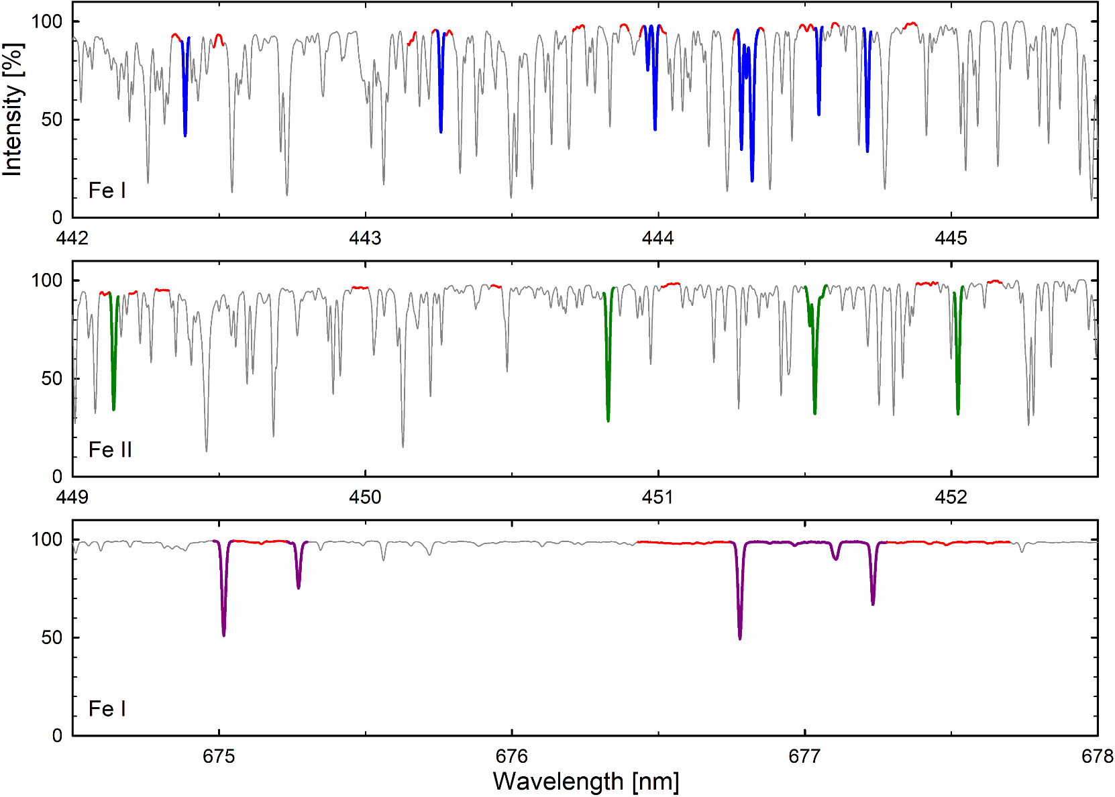
Fe I and Fe II lines @ HARPS-North
Selected Fe lines in different spectral regions
Red: Reference “continua”
Thin: 100-exposure average
D.Dravins, H.-G.Ludwig: Solar photospheric spectrum microvariability. II. Observed relations to magnetic activity and radial-velocity modulation, Astron.Astrophys. 687, A60 (2024)
Data from X.Dumusque et al.: Three Years of HARPS-N High-Resolution Spectroscopy and Precise Radial Velocity Data for the Sun Astron.Astrophys. 648, A103 (2021)

Slide 21
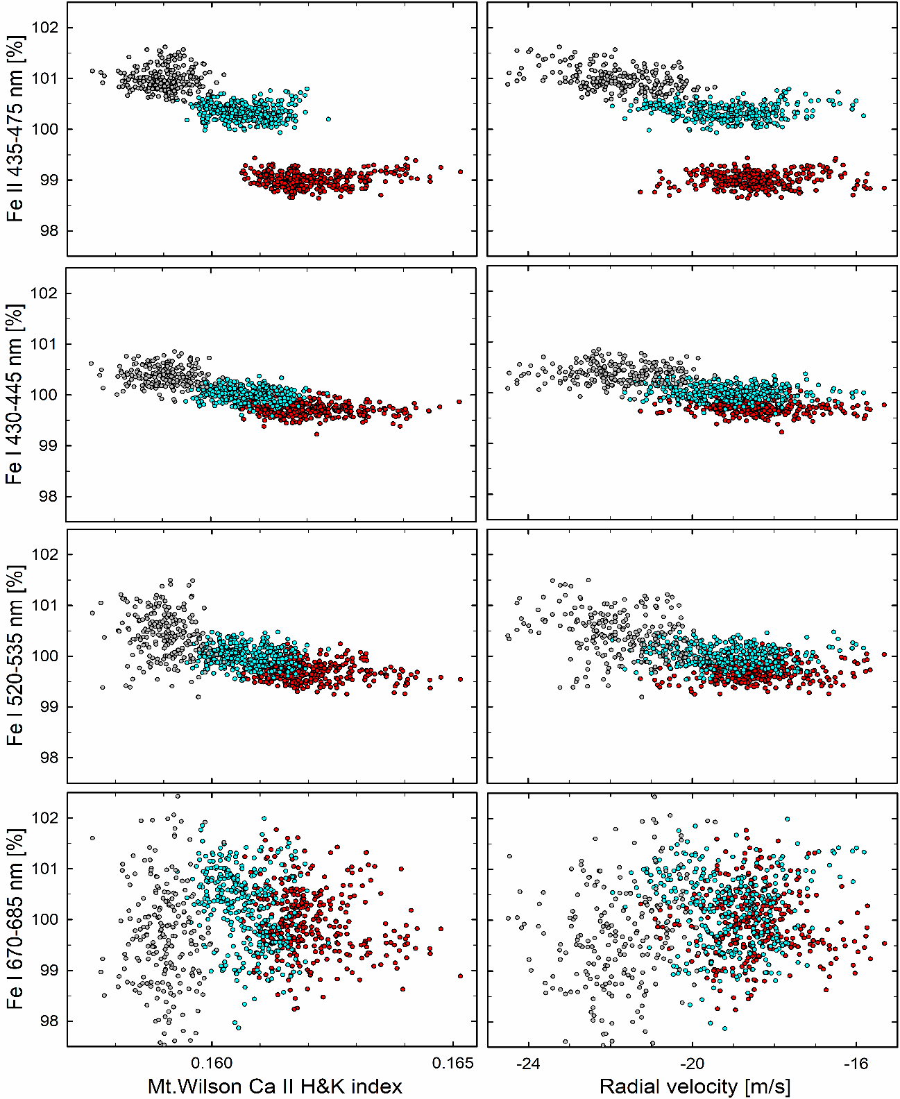
Ca II H & K →
RADIAL VELOCITY →
HARPS-N
observed solar Fe I & Fe II microvariability
Fe II
Fe I
EQUIVALENT WIDTH →
Relative equivalent widths for groups of Fe lines during summer seasons of 2016 (red), 2017 (cyan) and 2018 (gray).
Left: function of Ca II H & K activity index Right: function of apparent radial velocity
Fe I
Fe I
D.Dravins, H.-G.Ludwig: Solar photospheric spectrum microvariability.
II. Observed relations to magnetic activity and radial-velocity modulation, Astron.Astrophys. 687, A60 (2024)

Slide 22
3D hydrodynamics:
‘Movies’ of high-resolution
solar spectral atlases

Slide 23
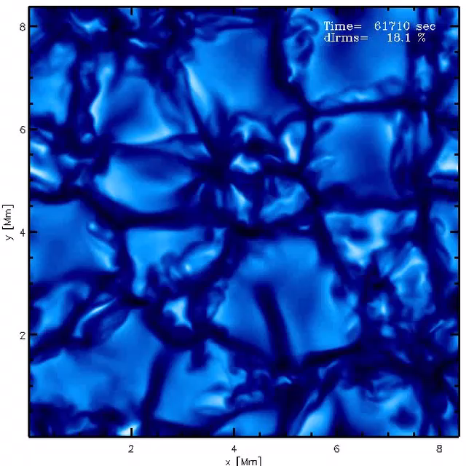
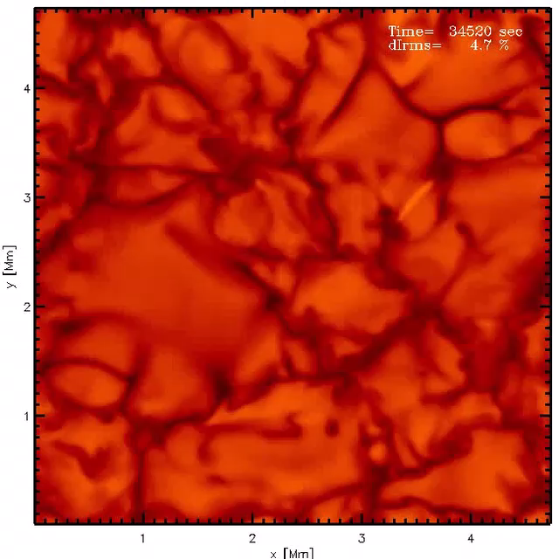
Hydrodynamic models of stellar surfaces
Stellar surfaces from above,
on same horizontal scale
Left: ‘F5 V’ model (T_{eff} = 6456 K),
log g = 4.5 [cgs]; ΔI_{rms} = 18.1%.
Right: ‘K8 V’ model (T_{eff} = 3964 K), log g = 4.5 [cgs]; ΔI_{rms} = 4.7%.
CO⁵BOLD models by H.-G. Ludwig, Heidelberg

Slide 24
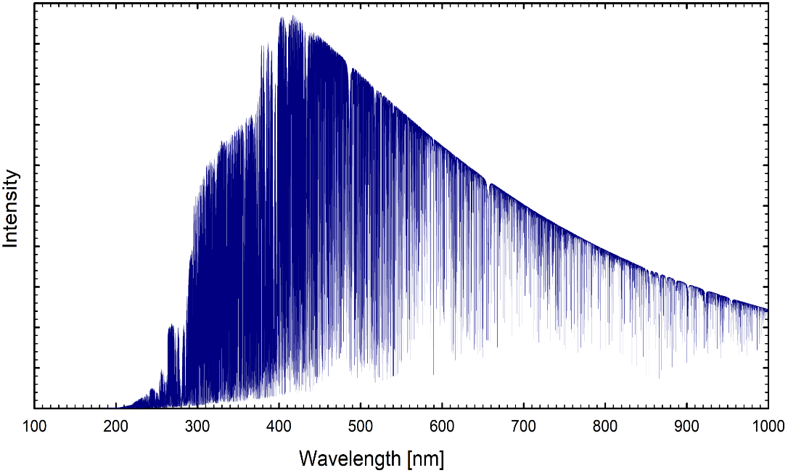
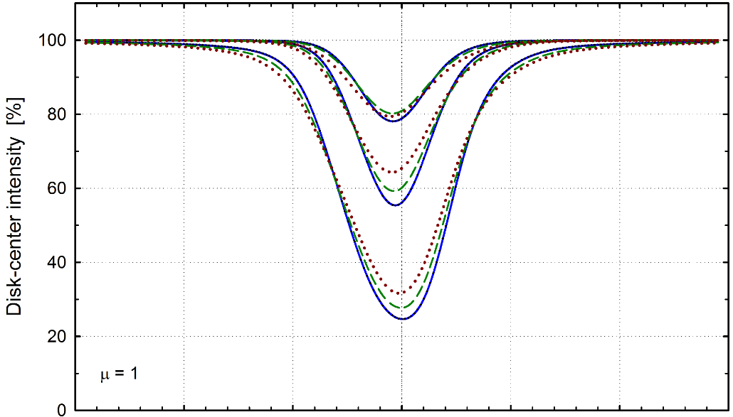
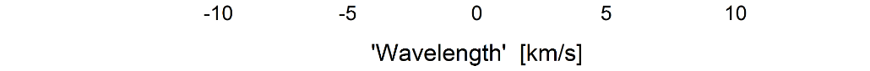
CO⁵BOLD Synthetic 3D Solar Spectra
Model 1: Complete spectrum
T_{eﬀ} = 5774 K , λ/Δλ ∼ 1,000,000
Model 2: Idealized spectral lines
T_{eﬀ} = 5782 K, λ/Δλ ∼ 2,000,000
µ = 1
Full spectrum synthesis
incorporating 636,837 lines
Fe I lines at λ 620 nm; varying strengths,
excitation potentials χ = 1, 3, 5 eV
D.Dravins, H.-G.Ludwig, E.Dahlén, H.Pazira:
Spatially resolved spectroscopy across stellar surfaces.
I. Using exoplanet transits to analyze 3D stellar atmospheres
Astron.Astrophys. 605, A90 (2017)
D.Dravins, H.-G.Ludwig: Solar photospheric spectrum microvariability. I.
Theoretical searches for proxies of radial-velocity jittering
Astron.Astrophys. 679, A3 (2023)

Slide 25
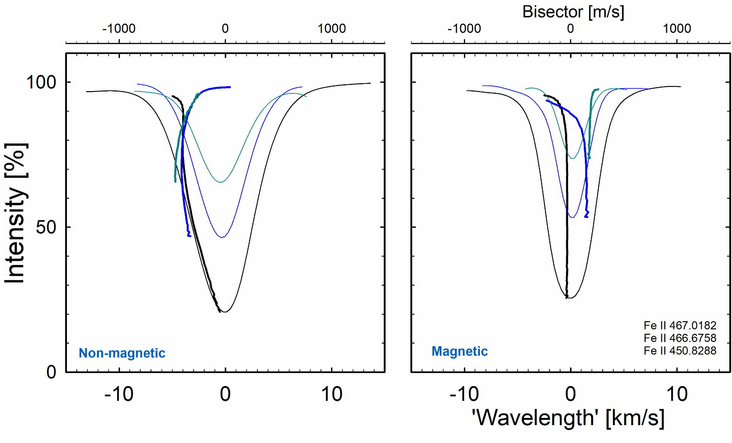
Non-magnetic vs. magnetic granulation
arXiv:2604.13166
arXiv:2604.13166
rXiv:2604.13166
Synthetic Fe II lines from non-magnetic and magnetic 240 mT (2400 G) simulations
Line profiles and bisectors for integrated sunlight
D.Dravins, H.-G.Ludwig, M.Steffen, C.Allende Prieto, L.Koesterke: Solar photospheric spectrum microvariability.
III. Radial velocities and line profiles in magnetic active-region granulation, Astron.Astrophys., in press (2026), arXiv:2604.13166

Slide 26
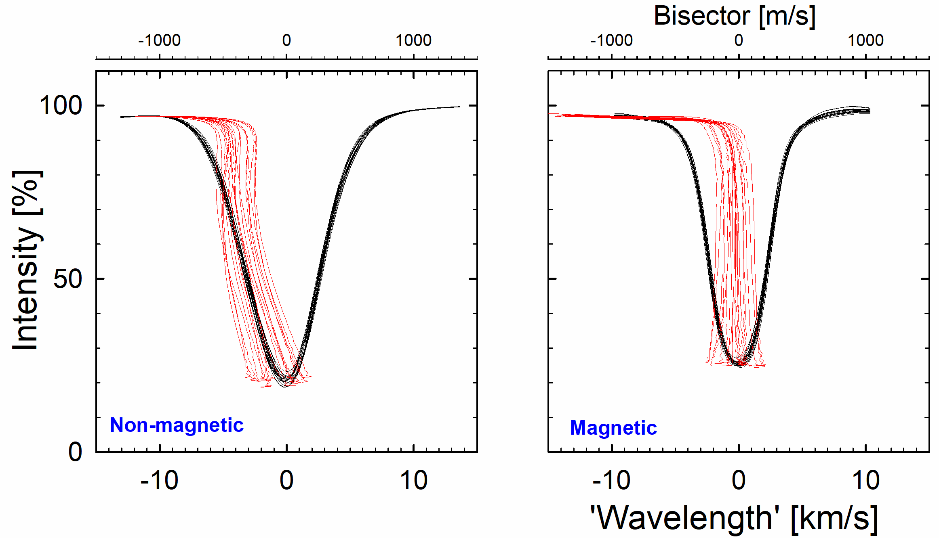
Spectral variability from 3D modeling
Line profile and bisector variability for a strong photospheric line in the solar flux spectrum (Fe II 450.8288 nm)
Profiles sampled at 20 times during 3D MHD simulations for non-magnetic and magnetic granulation
D.Dravins, H.-G.Ludwig, M.Steffen, C.Allende Prieto, L.Koesterke:
Solar photospheric spectrum microvariability. IV. Radial-velocity and line-profile fluctuations in (non-)magnetic granulation, in preparation

Slide 27
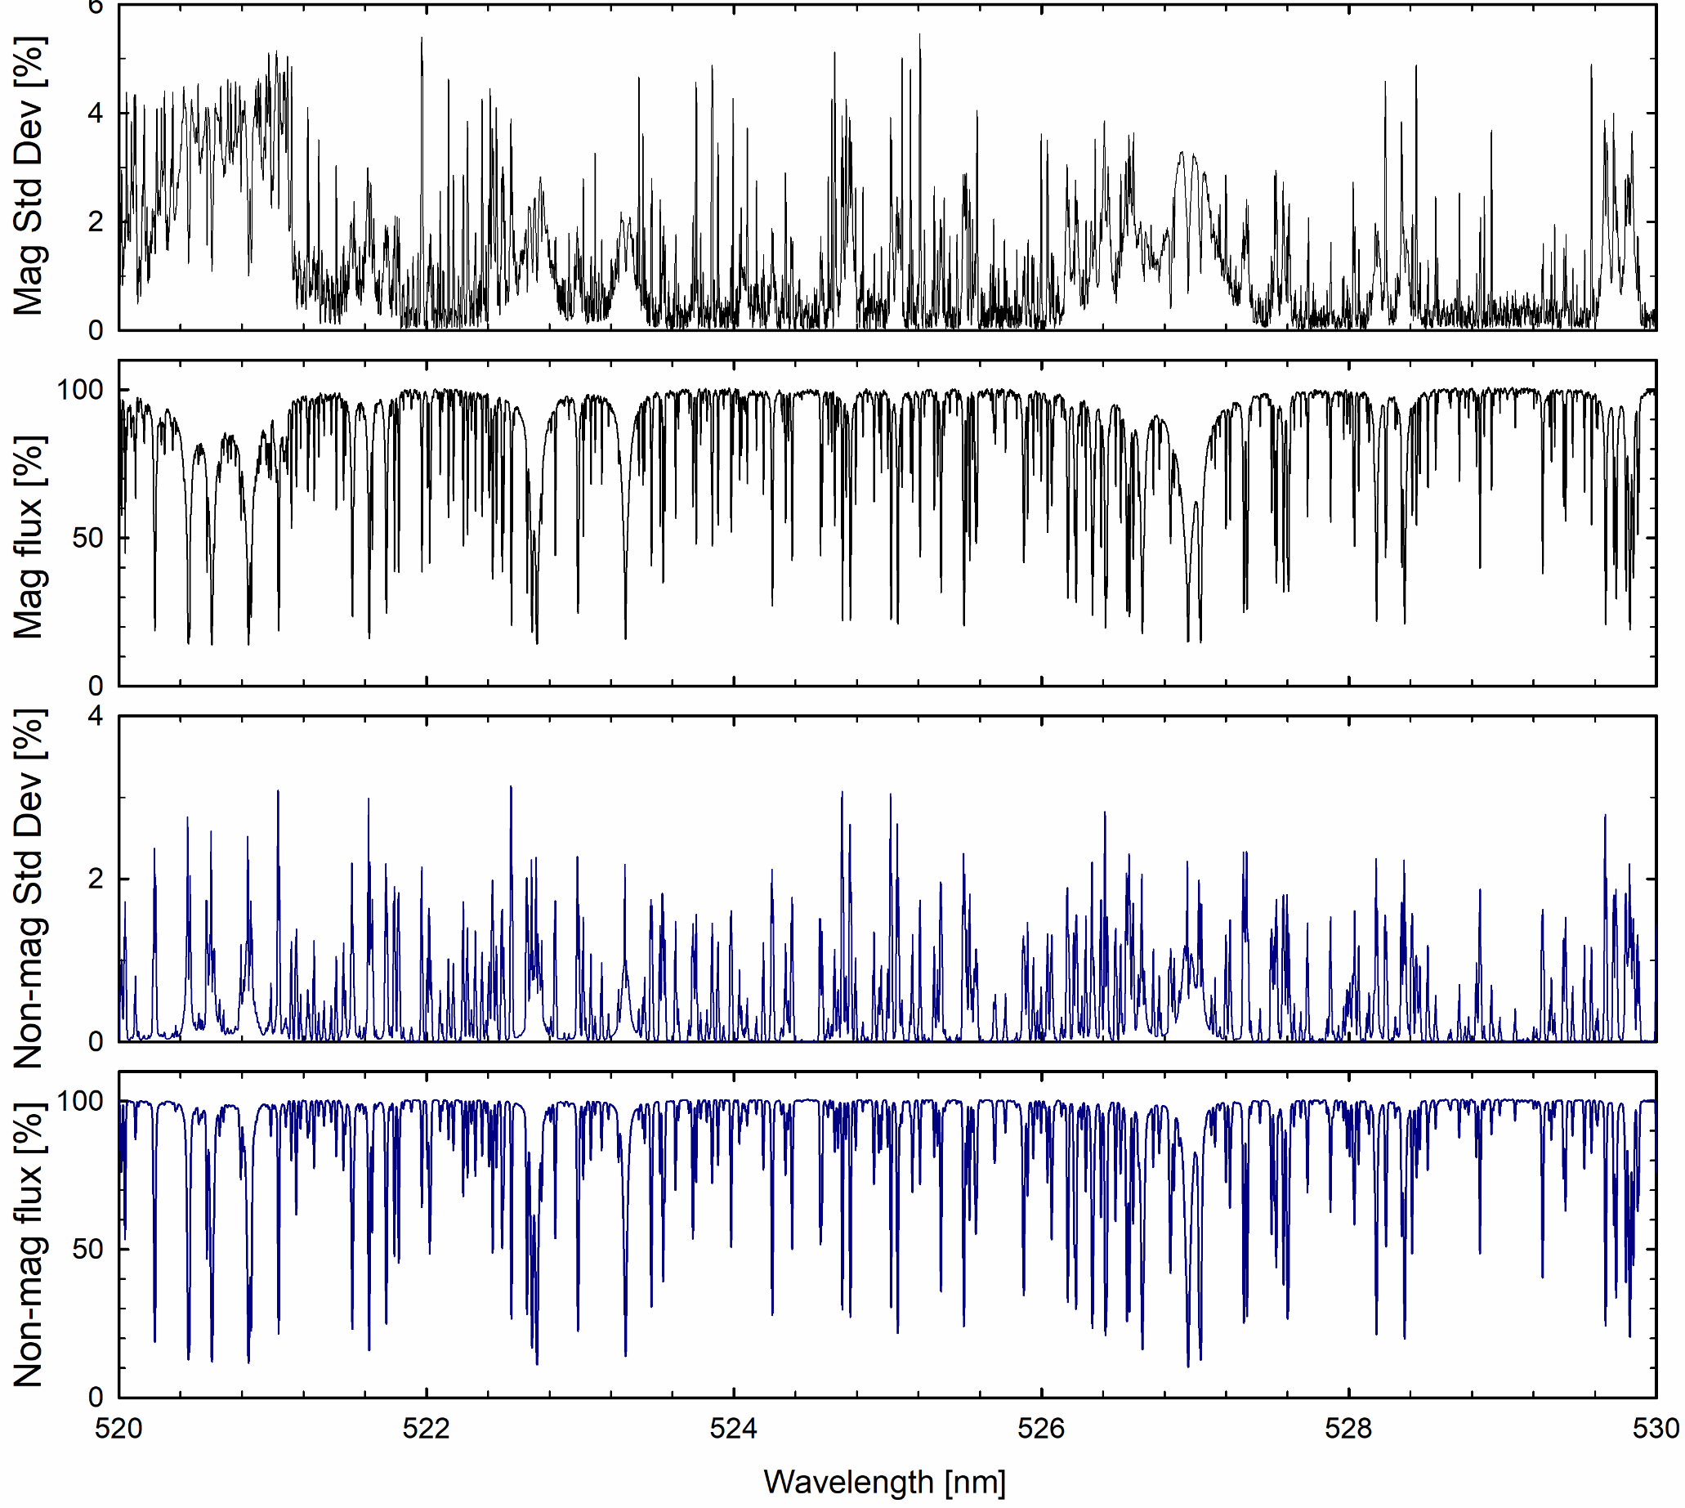
Spectral variability from 3D modeling
STANDARD DEVIATION
SYNTHETIC SPECTRUM
Synthetic spectrum and its temporal variability in a magnetic (240 mT = 2400 G) simulation
Data for integrated sunlight
D.Dravins, H.-G.Ludwig, M.Steffen, C.Allende Prieto, L.Koesterke:
Solar photospheric spectrum microvariability. IV. Radial-velocity and line-profile fluctuations in (non-)magnetic granulation, in preparation

Slide 28
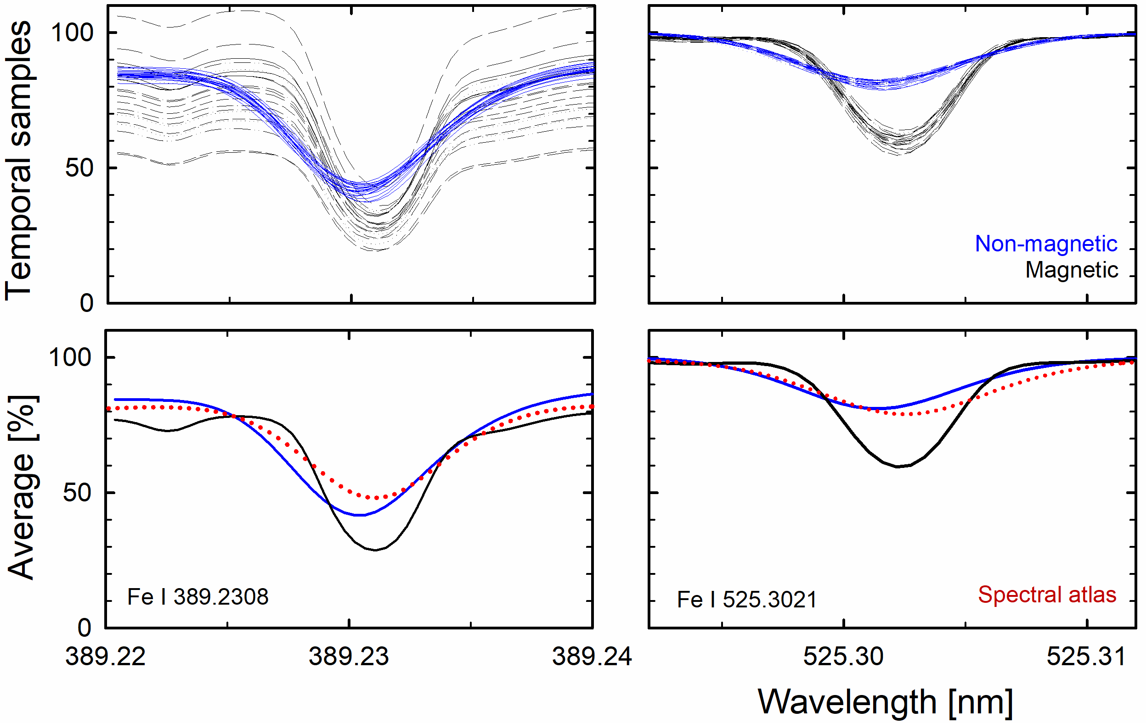
Spectral variability from 3D modeling
Variability in Fe I lines of different strengths in the violet and green spectral regions.
Profiles sampled at 20 times during 3D MHD simulations for non-magnetic and magnetic granulation
D.Dravins, H.-G.Ludwig, M.Steffen, C.Allende Prieto, L.Koesterke:
Solar photospheric spectrum microvariability. IV. Radial-velocity and line-profile fluctuations in (non-)magnetic granulation, in preparation

Slide 29

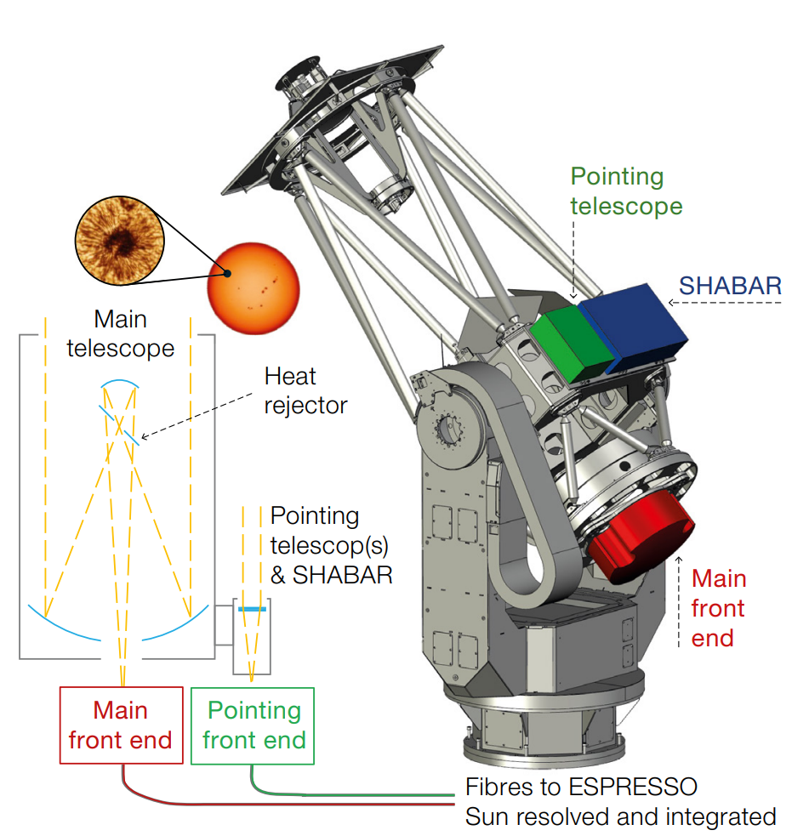
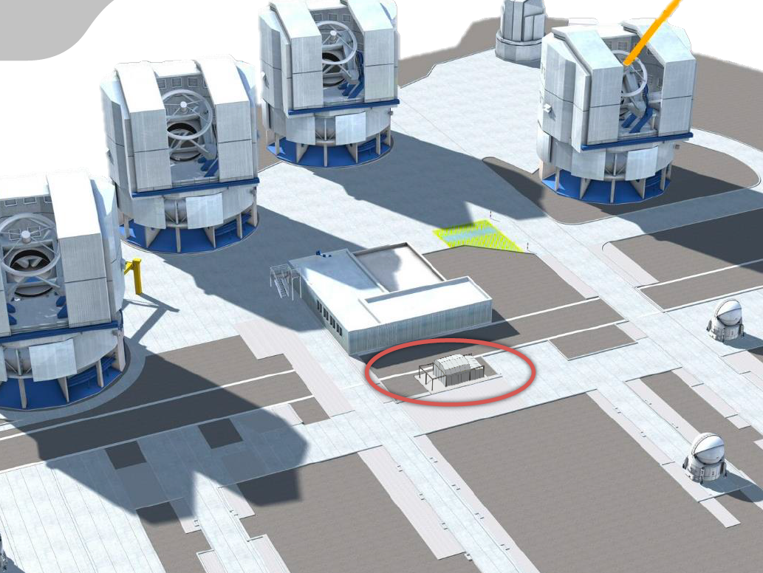
PoET: Paranal Solar ESPRESSO Telescope
N.C.Santos et al.: PoET: the Paranal solar ESPRESSO Telescope
ESO Messenger 194, 21 (2025)
PoET first light April 2026
P.I. - Nuno C. Santos https://poet.iastro.pt/

Slide 30
Once some exoEarths have been found…

Slide 31
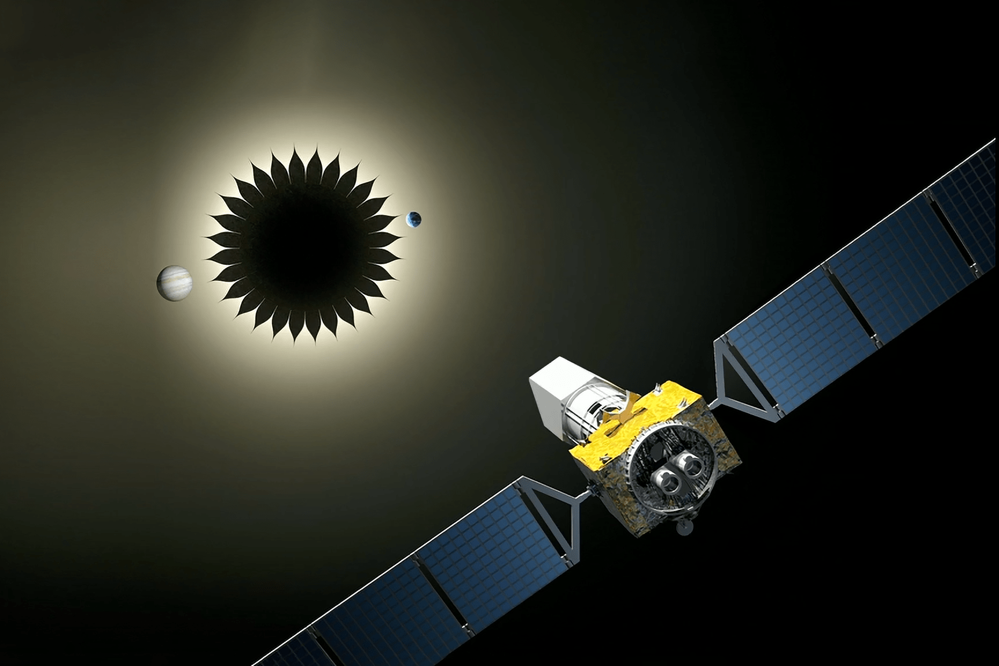

HWO concept with its starshade
https://www.robertsalazar.design/starshade/

Slide 32
And what could an
exoEarth look like?

Slide 33
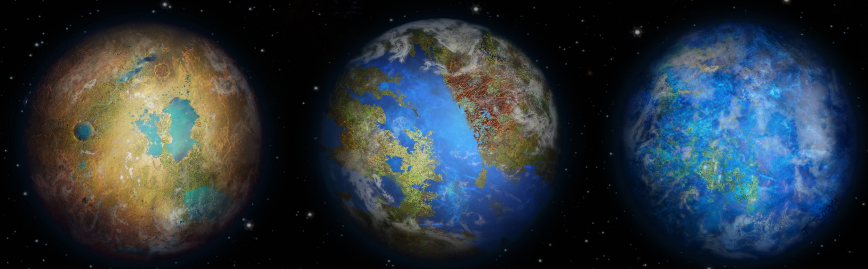
Different types of exoEarths?
Wide continents ̶ ̶ Land and seas ̶ ̶ Mostly oceans
T.Spohn & D.Hoening: Land/Ocean Surface Diversity on Earth-like (Exo)planets: Implications for Habitability
Europlanet Science Congress 2022 / T. Roger

Slide 34
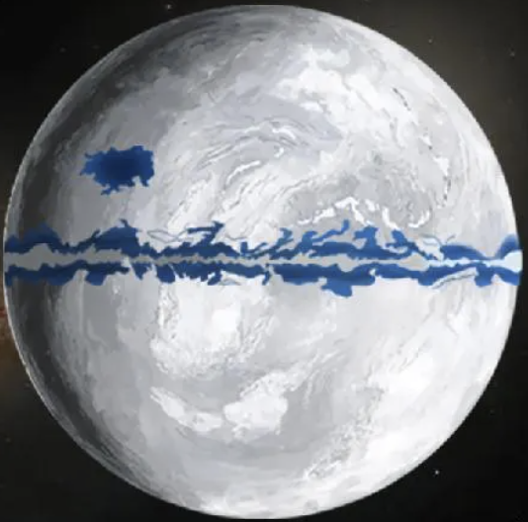
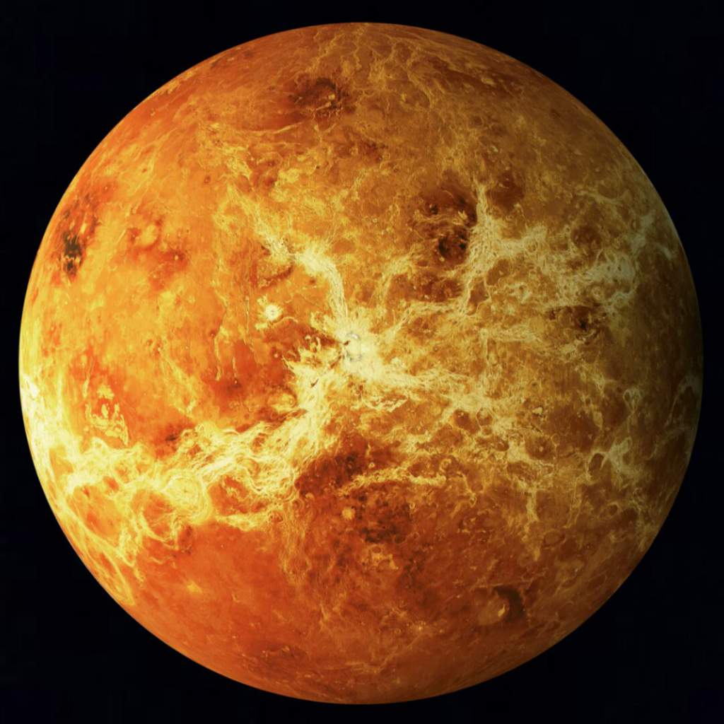
Different types of exoEarths?
Snowball planet ? ̶ ̶ Overheated ?
(liquid water only near equator) (like Venus)

Slide 35
Different types of exoEarths?
?
? ? ? ? ? ? ? ? ? ? ? ? ? ? ? ? ? ? ? ? ? ? ? ? ? ? ? ?
? ? ? ? ? ? ? ? ? ? ? ? ? ? ? ? ? ? ? ? ? ? ? ? ? ? ? ?
? ? ? ? ? ? ? ? ? ? ? ? ? ? ? ? ? ? ? ? ? ? ? ? ? ? ? ?
? ? ? ? ? ? ? ? ? ? ? ? ? ? ? ? ? ? ? ? ? ? ? ? ? ? ? ?
? ? ? ? ? ? ? ? ? ? ? ? ? ? ? ? ? ? ? ? ? ? ? ? ? ? ? ?
? ? ? ? ? ? ? ? ? ? ? ? ? ? ? ? ? ? ? ? ? ? ? ? ? ? ? ?
? ? ? ? ? ? ? ? ? ? ? ? ? ? ? ? ? ? ? ? ? ? ? ? ? ? ? ?
? ? ? ? ? ? ? ? ? ? ? ? ? ? ? ? ? ? ? ? ? ? ? ? ? ? ? ?
? ? ? ? ? ? ? ? ? ? ? ? ? ? ? ? ? ? ? ? ? ? ? ? ? ? ? ?
? ? ? ? ? ? ? ? ? ? ? ? ? ? ? ? ? ? ? ? ? ? ? ? ? ? ? ?
? ? ? ? ? ? ? ? ? ? ? ? ? ? ? ? ? ? ? ? ? ? ? ? ? ? ? ?
? ? ? ? ? ? ? ? ? ? ? ? ? ? ? ? ? ? ? ? ? ? ? ? ? ? ? ?
? ? ? ? ? ? ? ? ? ? ? ? ? ? ? ? ? ? ? ? ? ? ? ? ? ? ? ?
? ? ? ? ? ? ? ? ? ? ? ? ? ? ? ? ? ? ? ? ? ? ? ? ? ? ? ?

Slide 36
Thanks for listening!
Dainis Dravins
Lund Observatory, Division of Astrophysics, Department of Physics, Lund University
www.astro.lu.se/~dainis
ipac.caltech.edu

Slide 37
Thanks for listening!
ipac.caltech.edu

Slide 38


