Slide 1




Hard X-ray polarization results from the 2024 XL-Calibur flight: Crab and Cyg X-1
Varun, KTH
Notes:
Say about Crab and Cyg and XL-Calibur. Add pictures.
Add XL-Calibur launch picture.

Slide 2
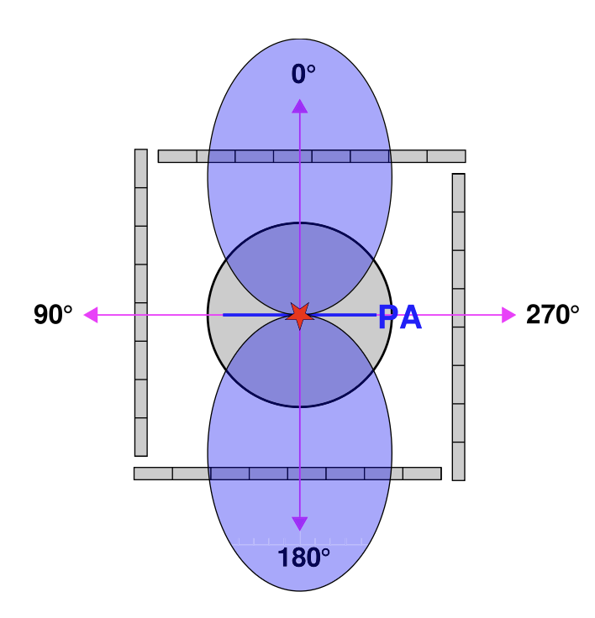
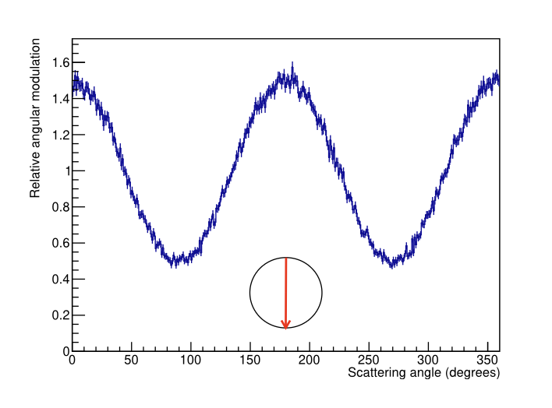
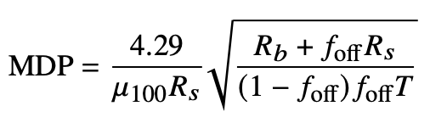
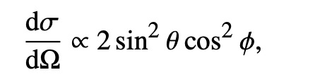
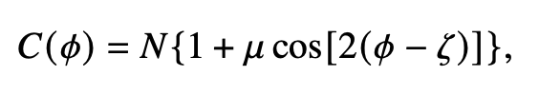

Hard X-ray Polarization measurements
Compton Scattering
Modulation curve
$μ$₁₀₀ : Modulation of 100%
polarized beam
R_{b} : Background rate
R_{S} : Source event rate
T : observation time
f_{off} : Fraction time
spent on the
off-source
Aoyagi et al. 2024
Notes:
Elaborate on left figure
Remove stokes and pol parameters

Slide 3
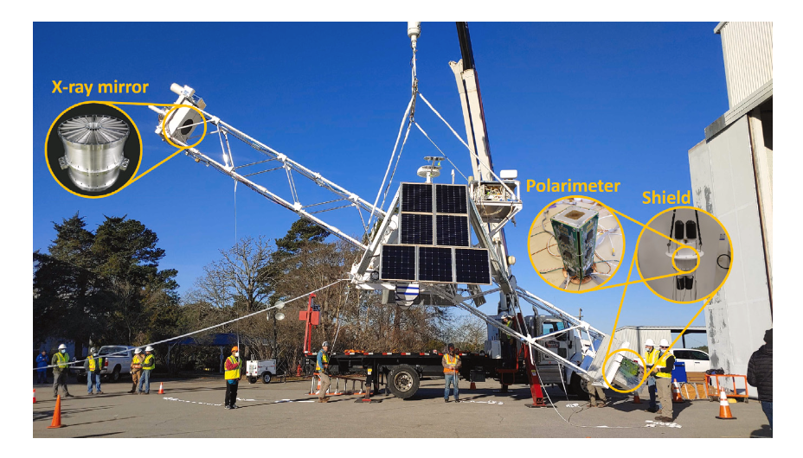
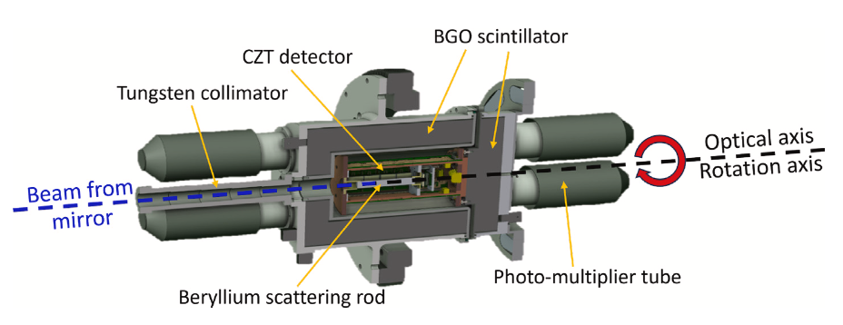
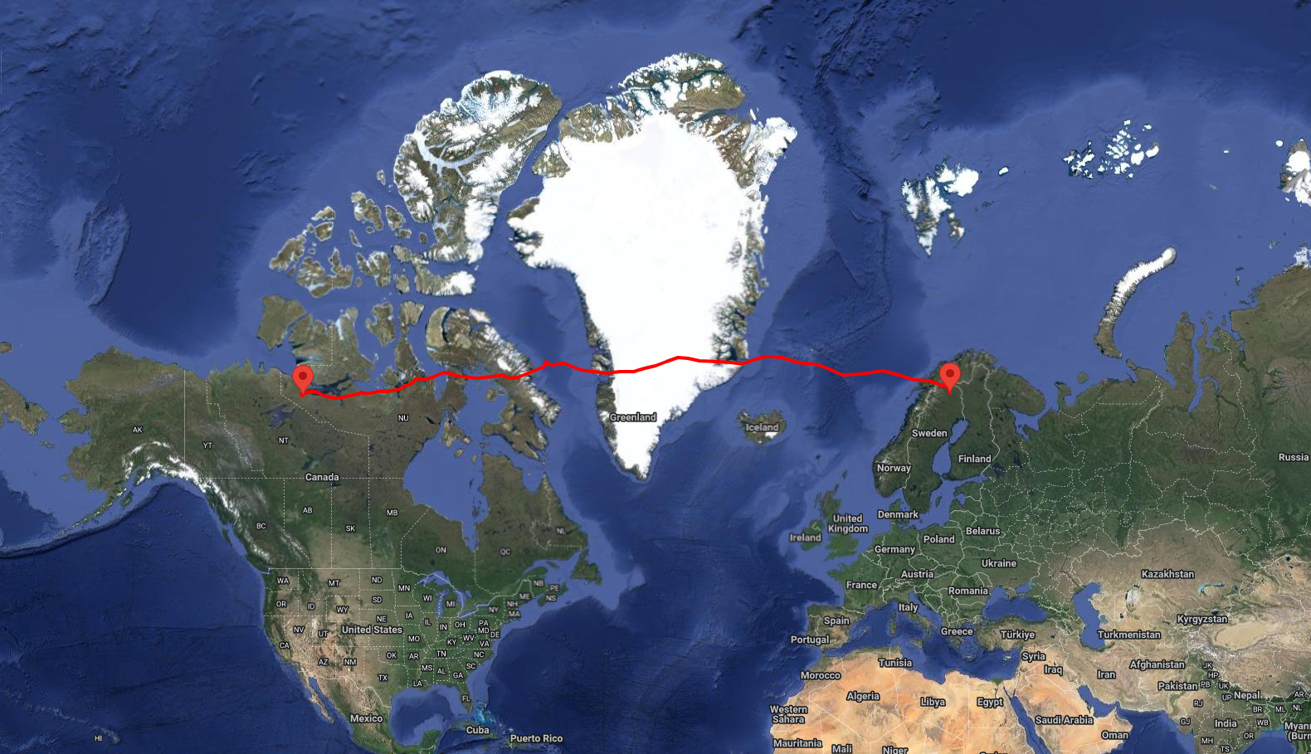

XL-Calibur Mission
Truss: 12 m optical bench
Anticoincidence Shield: 3.5 cm Bi₄Ge₃O₁₂ (BGO)
Mirror: 213 concentric Al shells coated with platinum-carbon multilayers
Polarimeter: 12 mm diameter, 80 mm long Be rod + cadmium zinc telluride detectors (CZT)
5 days 20 hours
July 14th
Kugluktuk,
Canada
July 9th
Esrange,
Sweden
$$μ100=42.4±0.1\%$$
Awaki et al. 2025a,b
Notes:
Elaborate on right figure, connect with previous figure

Slide 4
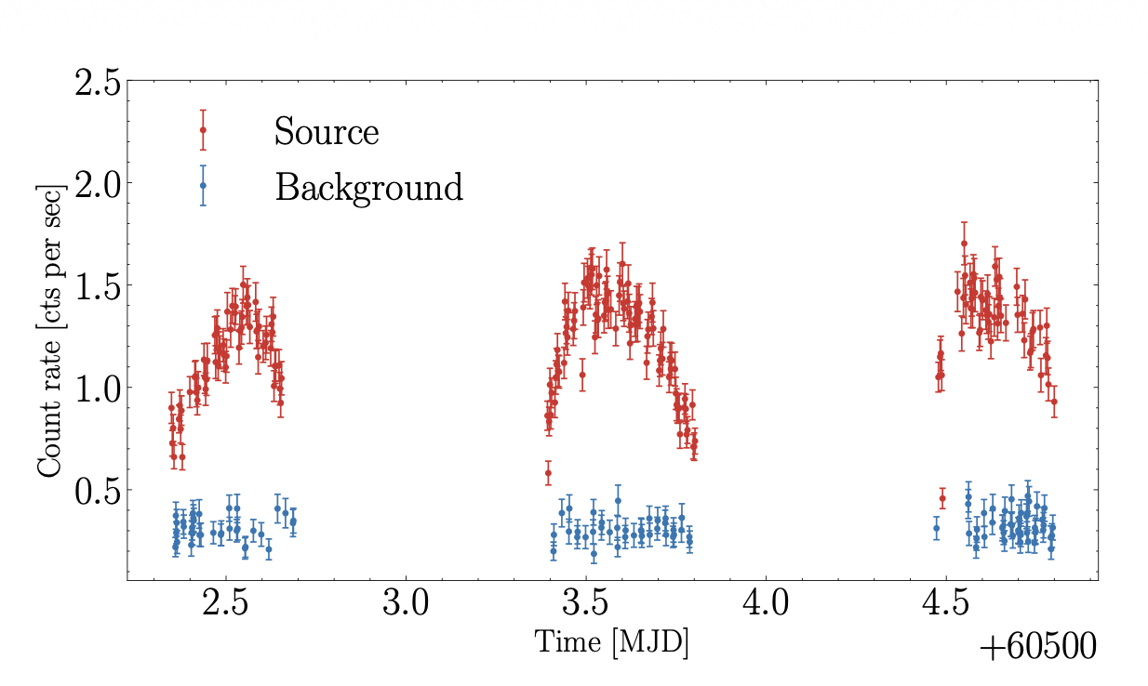

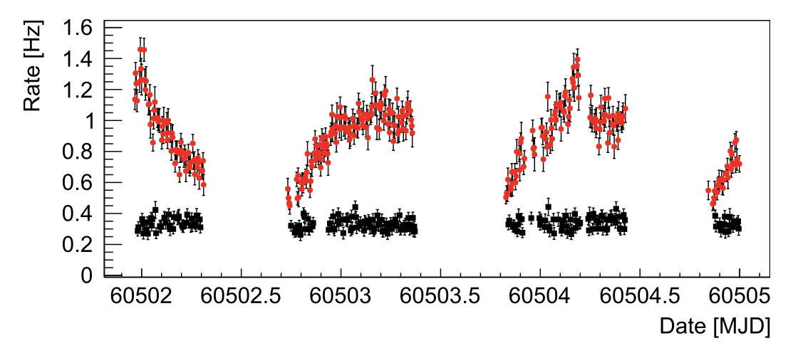
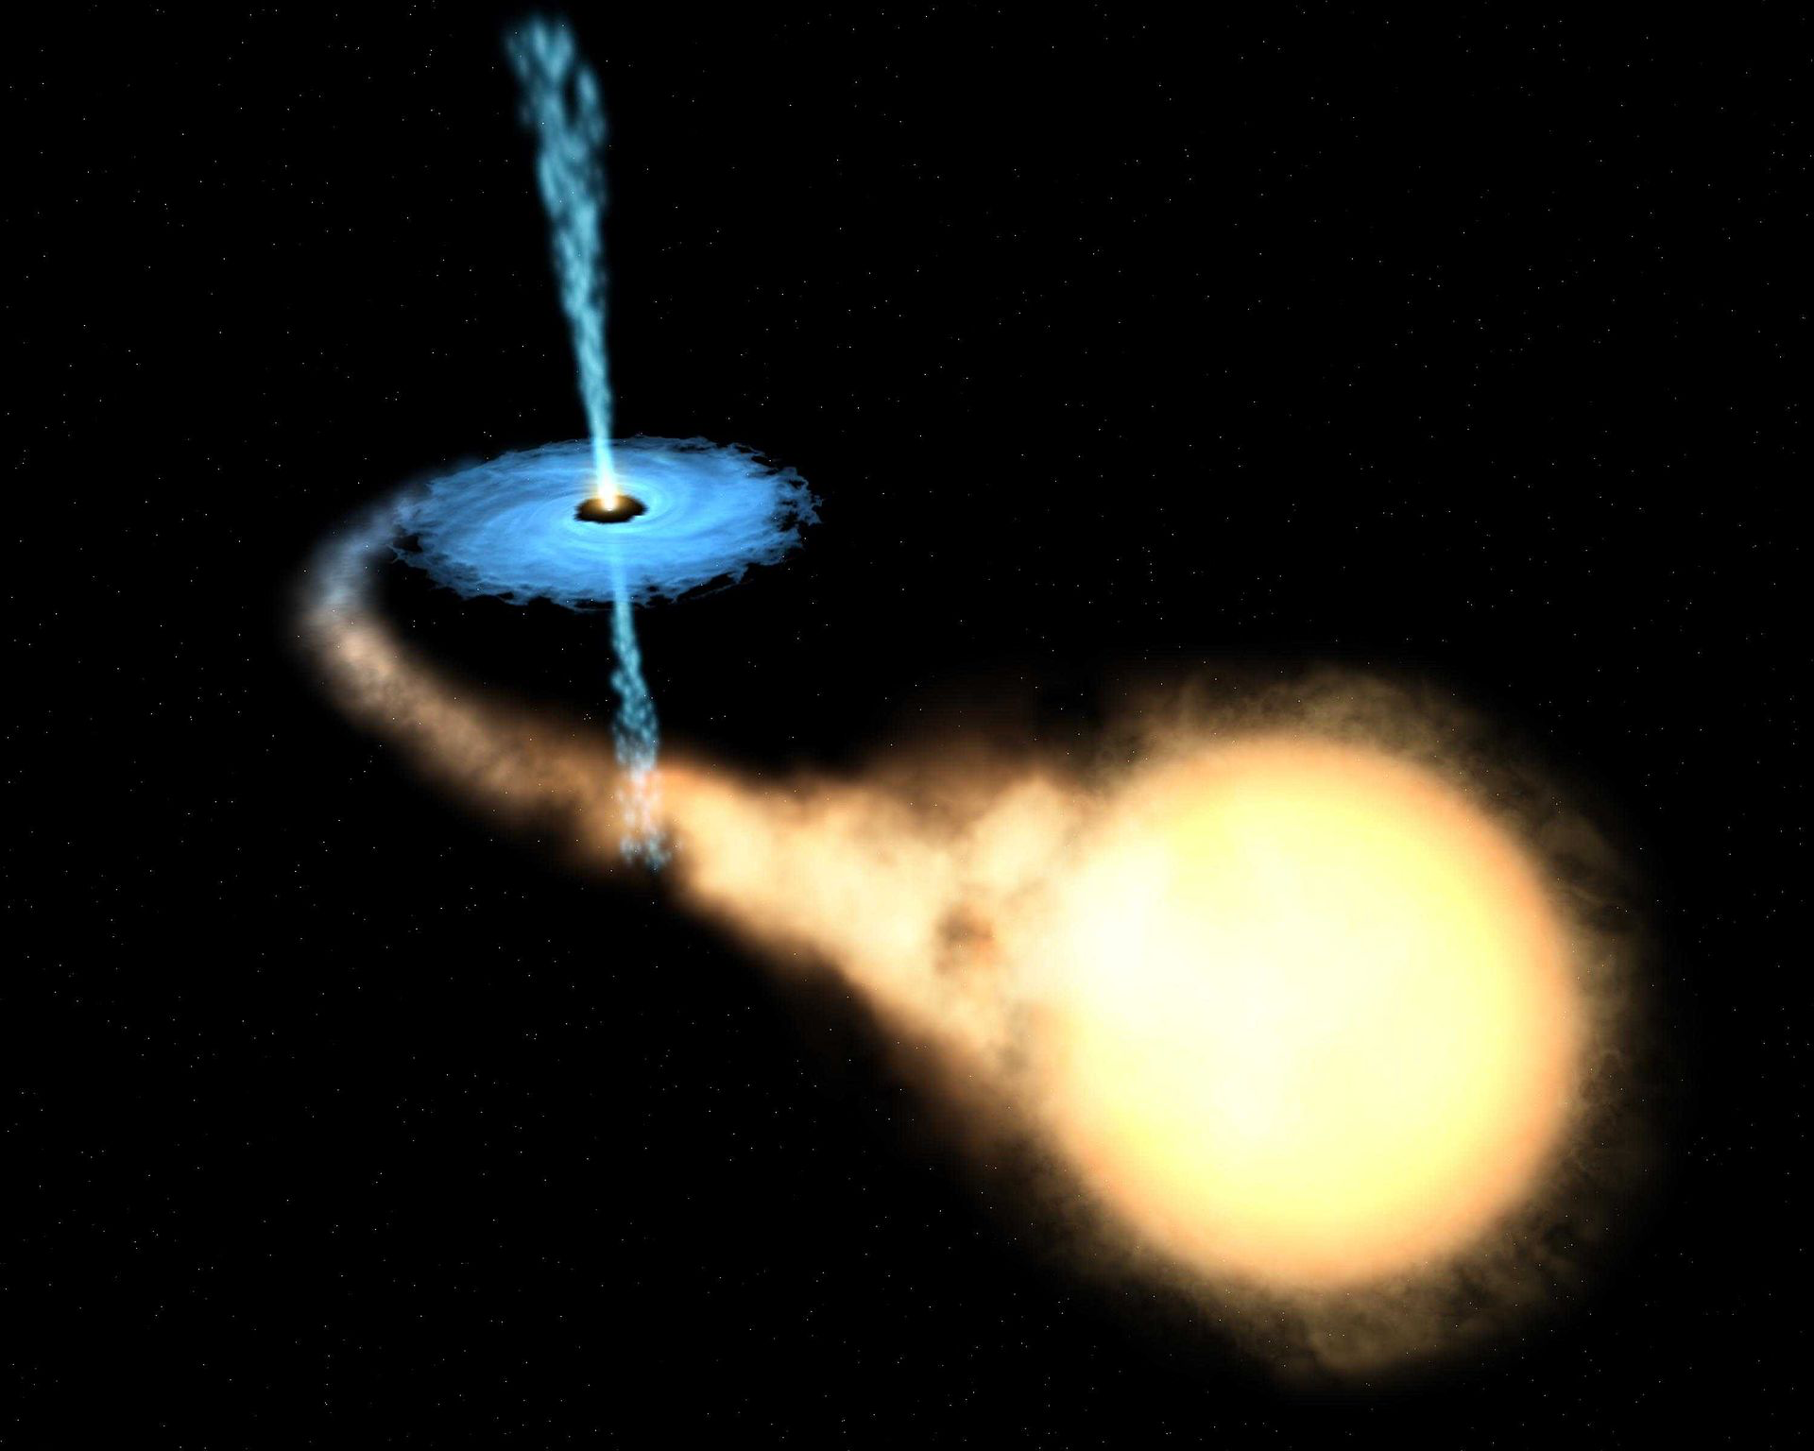


XL-Calibur Observations
Neutron Star as pulsar
Crab light curve
Baring et al. 2026
P_{spin} = 33 ms
B = $7.6×{10}^{12}$ G
Crab
Cyg X-1 light curve
Awaki et al. 2025b
Black hole
Relativistic jet
M_{BH} = $21.2 ±2.1 M_{⊙}$
M_{comp} = ${40.6}_{−7.1}^{+7.7}M_{⊙}$
P_{orb} ~ 5.6 days
Inclination = ${\left(27.1±0.8\right)}^{∘}$
Cyg X-1
Accretion disk
Visible companion star
20 times improvement in SNR compared to PoGO+
Notes:
Explain the modulation in the source rate

Slide 5
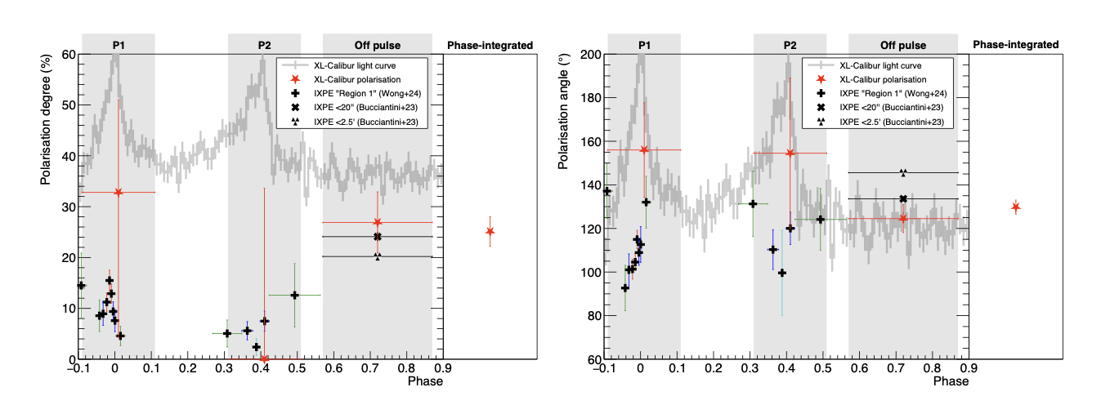


Crab Polarization results
Awaki et al 2025a
Off-pulse/Nebula emission
is strongly polarized
Pulse peaks are weakly
polarized
Phase integrated
PD = 25.1$±2.9$ %
PA = 129.8$°±3.2°$
MDP = 8.7%
Notes:
These results are in contradiction with inner magnetosphere emission model.
Outer Magnetosphere models like stripped wind mode (Petri et al 2013) and current sheets inside light cylinder (Cerutti et al. 2016)l have better agreement but requires more investigations with phase resolved measurements.
Be careful with the statement about the phase resolved results.

Slide 6
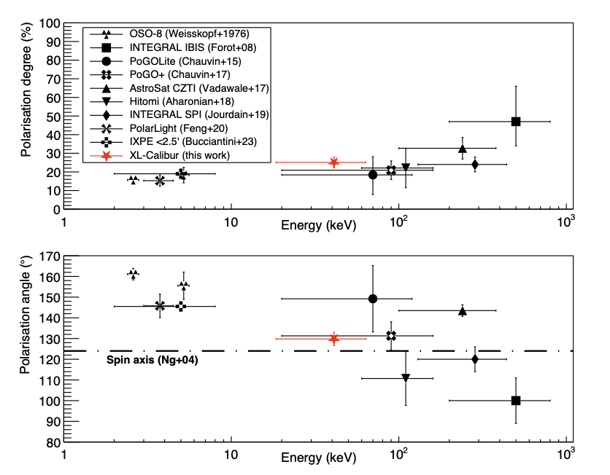
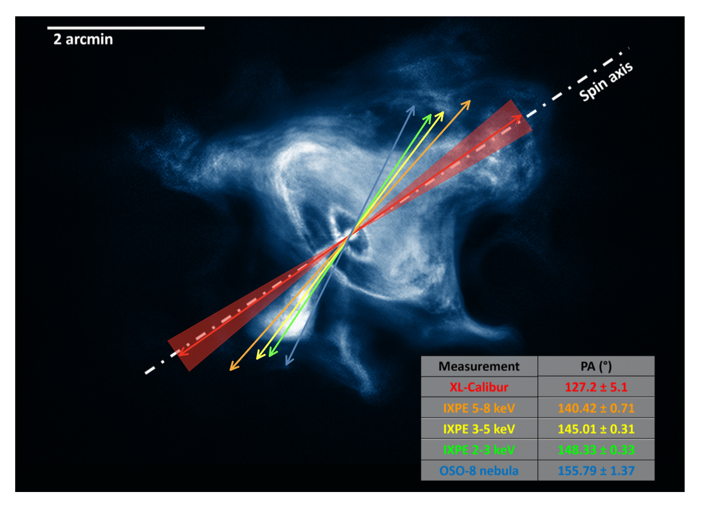

Crab polarization from soft X-ray to $γ$-ray
Energy
19-64 keV
2.6 keV
High energy emission originates closer to central toroidal regions of PWN
Awaki et al 2025a
Notes:
First use left figure then go to right figure as more clear picture of high energy emission.
Add energy ranges for XL-calibur and OSO-8.

Slide 7
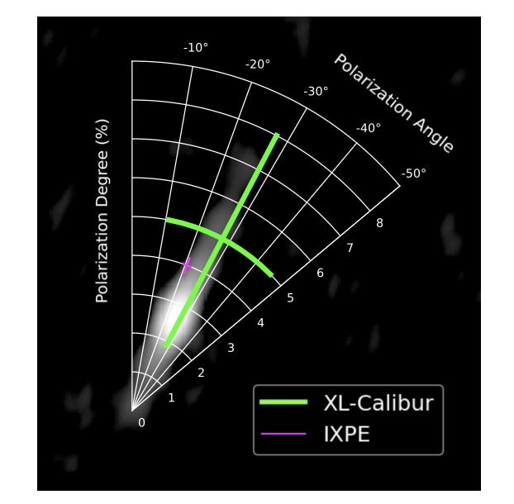
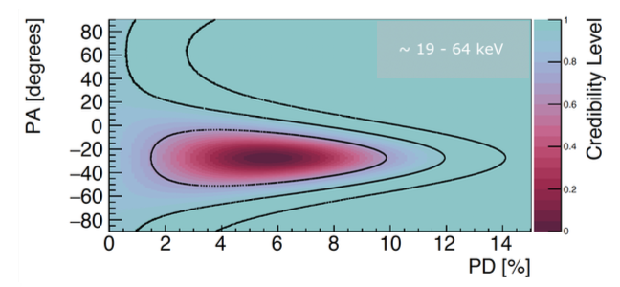


Cyg X-1 Polarization
Awaki et al 2025b
PD = ${5.0}_{−3.0}^{+2.7}\%$
PA = -28$°±17°$
Polarization is aligned with the Jet axis
Notes:
XL-Calibur results agrees with the previous best results by PoGO+ and provides a reduction in PD error by a factor of 2.
Remove PoGO+

Slide 8
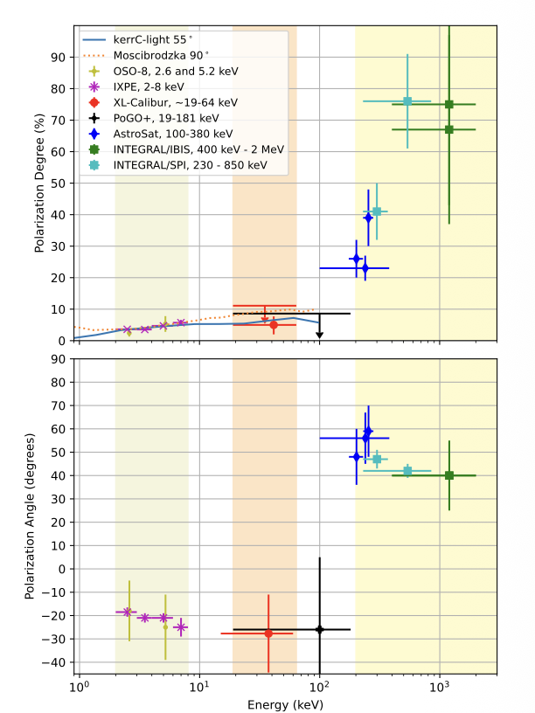
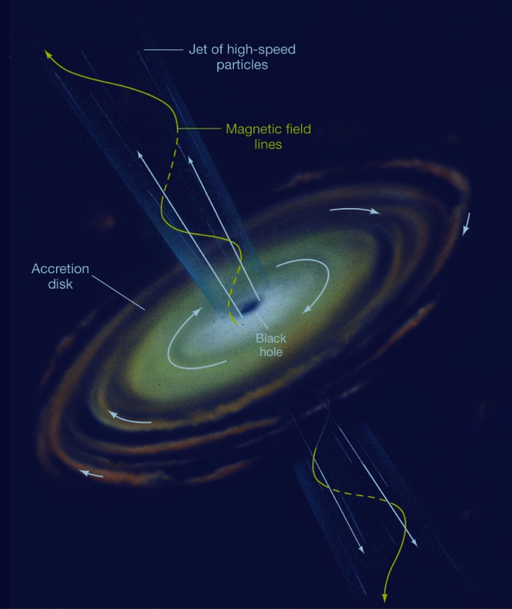


Cyg X-1 polarization from soft X-ray to $γ$-ray
Wedge shaped corona model infers high inclination (55$°$) to describe the polarization behavior.
In hard X-ray and $γ$-rays synchrotron significantly different polarization from Synchrotron emission in Jet.
Notes:
Low level of polarization from XL-Calibur and IXPE suggest that the emission in these energy bands comes from same physical mechanism.
The emission from Cyg X-1 in this band is dominated by comptonized emission from laterally extended corona, some of which reaches the observer after reflecting from the accretion disk.
At E> 100 keV the PD is significantly higher and PA swings by 90 deg.
Previous spectral study have indicated high energy transition from corona-dominated to Jet dominated.
Increase in polarization is due to high polarization of synchrotron emission and change in PA is due to emission from Jet than from the disk.
Howerver , E> 100 keV measurements are not done with dedicated polarimeters. The measurement have large systematic errors.
Kerr-C model PD modeling curve uses wedge shaped corona and 100 %-reflecting accretion disk. All other parameters are consistent with S3 of Krawczynski et al. 2022 with a few changes: 1) a = 0.94, 2) increased accretion rate 3) 55 deg disk inclinations.
In the alternate model like Moscibrodska 2024, the X-ray emission comes from the inverse Compton scattering of bremsstrahlung and synchrotron emission outflowing jet walls.

Slide 9


Summary and Conclusion
XL-Calibur provide most sensitive hard X-ray polarization measurements to date.
Recent XL-Calibur flight observed two most bright sources in X-ray astronomy.
Crab
  The nebular region of Crab is highly polarized ( ) whereas the pulsar peaks are weakly polarized.
  Investigation of pulse phase dependence of polarization for Crab requires an order of magnitude improvement in MDP.
Cyg X-1
  Cyg X-1 shows ${5.0}_{−3.0}^{+2.7}\%$ polarization during hard spectral state aligned with the radio jet.
  Polarization properties requires the high energy emission region to have much higher inclination
Next XL-Calibur flight (Dec 2027-Jan 2028) from south pole will help increase the number of sources and longer exposure for each targets
PD = 25.1$±2.9$ %
Notes:
Discuss that further improvement on phase variation is difficult: 1) background cannot be reduced 2) Source rate improvement requires an increase in concentric shells in mirror will be difficult due to mass limit of the payload.

Slide 10


















The XL-Calibur Collaboration
Guarino
Engineering
DGS Circuits
PI: Henric Krawczynksi, Washington University in St. Louis
Notes:
Remove Sweden funding agency

